Slide 1
1/11
Development of PID method in nuclear emulsion
Shinji KINBARA
Phys. Dept., Gifu Univ., JAPAN
Collaborators
Gifu Univ.
K.Nakazawa, J.Yoshida, M.K.Soe,
A.M.M.Theint, H.Itoh, H.Kobayashi, R. Murai
RIKEN
H.Ueno, Y.Ichikawa, T. Fujita, A. Takamine, K. Imamura
JAEA
S.H.Hwang, H.Ekawa, S. Hayakawa
Outline
1. Motivation
2. Experiment at RIKEN (NP1406 RRC-32-02)
3. Method for identification of decay daughter nuclei from double-Λ hypernuclei
3-1. Measurement of track width
4. Result
5. Summary

Slide 2
2/11
1. Motivation
To understand Λ-Λ interaction,
it is necessary for unique identification of many double-Λ hypernuclei.
“NAGARA” event (KEK E373)
ΛΛ⁶He was formed at point A, and sequential weak decay was observed point B and C.
ΛΛ⁶He
We expect to detect about one hundred double-Λ hypernuclei in J-PARC E07 experiment.
Ξ-

Slide 3
3/11
1. Motivation
If track #2 is known to be triton, the mode A is identified,
and the excitation energy of 2.8 MeV is confirmed.
B.
If track #3 is identified as He (³He, ⁴He or ⁶He )，
the mode A is identified.

Slide 4
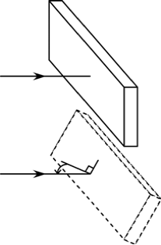
4/11
2. Experiment at RIKEN (NP1406 RRC-32-02)
(July.18~21, 2015)
■ 8 isotopes (¹H, ²H, ³H, ³He, ⁴He, ⁷Li, ⁹Be,¹¹B)
■ Several incident angles ( θ =0°, 25°, 50°, 75°)
A particle was exposed to an emulsion stack with several incident angels.
5mm
Emulsion stack
70mm
Beam
30mm
θ
Microscope images of Ξ-hyperons at 100 μm from stopping points, where double-Λ hypernuclei were produced.
We measure track width depending on the angles (θ) along light axis.
■ Reference ¹H for calibration
¹H was exposed horizontally(θ = 90°) to all emulsion stacks to calibrate width depending on development and optical condition.

Slide 5
5/11
3. Method for identification of decay daughter nuclei from double-Λ hypernuclei
H
He
Li
Be
B
C
N
O
We measure track width in the emulsion.
Track width reflect dE/dx.
「宇宙線」小田稔著，裳華房(1985)p.113
For the coming J-PARC E07 experiment, we try to recognize 8 isotopes.
(¹H⁺, ²H⁺, ³H⁺, ³He²⁺ ,⁴He²⁺ ,⁷Li³⁺, ⁹Be⁴⁺ and ¹¹B⁵⁺)
3.0
20
Esum(¹¹B) / Esum(¹H) = 17
Esum(⁹Be) / Esum(¹H) = 12
Esum(⁷Li) / Esum(¹H) = 8
Esum(⁴He) / Esum(¹H) = 4
2.5
15
2.0
-dE/dx [MeV/mg/cm²]
We expect to separate them well!!
1.5
10
Ratio of energy-loss sum to ¹H
1.0
0.5
5
Esum(⁴He) / Esum(³He) = 1.1
Esum(³H) / Esum(¹H) = 1.6
Esum(²H) / Esum(¹H) = 1.3
0
10⁰
0
10⁻¹
10¹
10²
10⁰
10¹
10²
Challenge!!
Range from stopping point [μm]
Range from stopping point [μm]

Slide 6
6/11
3．Method for identification of decay daughter nuclei from double-Λ hypernuclei
K.Nakazawa, et al., Ann. Rep. Tandem V.D.G.Lab. Kyoto Univ. 1996-1997 (1998) p.141
1996~1997, isotopes of ¹H⁺ , ⁴He²⁺ and ⁷Li³⁺ were exposed horizontally to the emulsion at Tandem V.D.G Lab. Kyoto Univ.
A superimposed image of
a track at focal planes.
Pick up edge of track with
image processing method.
We separated well ¹H⁺, ⁴He²⁺ and ⁷Li³⁺ in use of 60 μm.
Good recognition

Slide 7
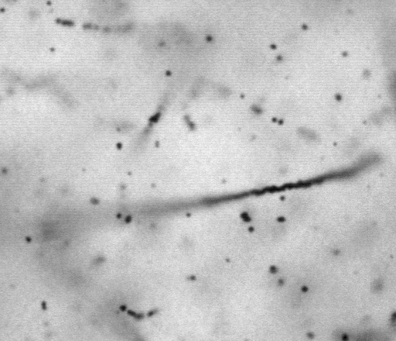
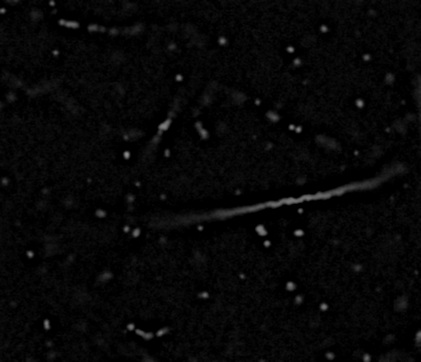
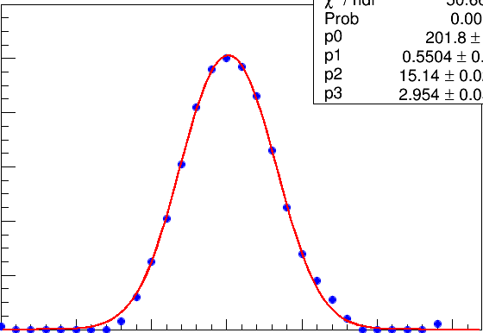
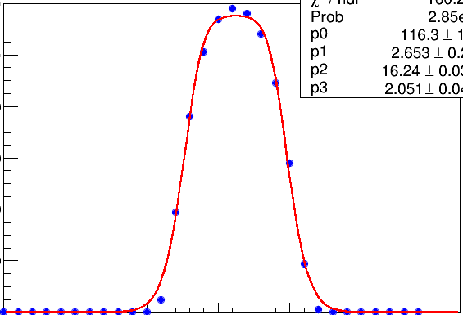
3-1. Measurement of track width
7/11
To uniform background
②ー①
① Raw image
② blurred image
F(x) = A*tanh(Gauss(x,μ,σ))
is applicable to fitting both tracks.
θ=0° (K-beam)
θ=90°(Proton)
120
120
100
100
80
brightness
brightness
80
60
60
40
Inflection points
40
Inflection points
20
20
0
0
0.4
0.8
1.2
1.6
2.0
2.4
[μm]
0
[μm]
0
0.4
0.8
1.2
1.6
2.0
2.4

Slide 8
4. Result
8/11
Ratio of volume of reference ¹H
Ratio of volume of reference ¹H
¹¹B,⁹Be
2.5
■：¹¹B ■：⁴He
■：⁹Be ■： ¹H
■：⁷Li
2.5
■：¹¹B ■：⁴He
■：⁹Be ■： ¹H
■：⁷Li
57MeV
2.0
2.0
1.5
1.5
⁴He,⁷Li
1.0
1.0
¹H,⁴He
0.5
0.5
0
10
20
30
40
50
60
70
80
90
100
0
10
20
30
40
50
60
70
80
90
100
Range from stopping point [μm]
Range from stopping point [μm]
¹H and ⁴He are separated at 60 μm in 3σ.
⁴He and ⁷Li are separated at 80 μm in 3σ.
¹¹B and ⁹Be are separated at 90 μm in 3σ.

Slide 9
4. Result
9/11
We compared our result with the data of the paper.
K.Nakazawa, et al., Ann. Rep. Tandem V.D.G.Lab. Kyoto Univ. 1996-1997 (1998) p.141
Ratio of volume of reference ¹H
2.0
■：⁷Li ■：⁴He ■：¹H
1.8
1.6
1.4
1.2
1.0
0.8
32
36
40
44
48
52
56
60
Range from stopping point [μm]
At the 60 μm,
Consistent
⁴He/¹H=1.28±0.08
⁷Li/¹H=1.58±0.19
⁴He/¹H=1.21±0.08
⁷Li/¹H=1.53±0.13

Slide 10
10/11
4. Result
We measured track width of ⁶He in emulsion and compared ⁴He with ⁶He.
Ratio of volume of reference ¹H
2.0
■：⁶He
■：⁴He
1.5
⁶He：1.50±0.15
⁴He：1.35±0.08
1.0
0.5
60
70
80
90
100
Range from stopping point [μm]
We try to separate ⁴He and ⁶He by taking a lot of statistics and using long range.

Slide 11
11/11
5. Summary
■ We develop PID method to identify daughter nucleus decayed from
double-Λ hypernuclei.
■ 8 isotopes were exposed to emulsion stacks with several angles and
¹H was exposed horizontally to all emulsion stacks to calibrate track width.
■ ¹H and ⁴He, ⁴He and ⁷Li, ¹¹B and ⁹Be are separated at range of 60 μm,
80 μm, 90 μm, respectively.
■ We will measure track width depend on angles(θ) along light axis.

Slide 13
10/11
4. Result
■：¹¹B
■：⁹Be
■：⁷Li
■ ：⁶He
■：⁴He
■：¹H
We measured track width of ⁶He in emulsion stack which ⁹Be was exposed.
Ratio of volume of reference ¹H
Ratio of volume of reference ¹H
2.5
2.5
2.0
2.0
1.5
1.5
1.0
1.0
0.5
0.5
0
10
20
30
40
50
60
70
80
90
100
0
10
20
30
40
50
60
70
80
90
100
Range from stopping point [μm]
Range from stopping point [μm]

Slide 14
Ratio of volume of reference ¹H
2.0
■：⁹Be ■：⁶He ■：⁴He
1.5
1.0
60
70
80
90
100
Range from stopping point [μm]

