Slide 1
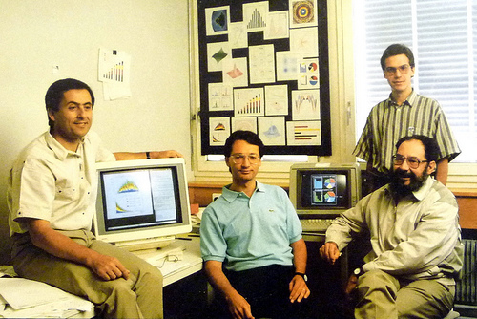
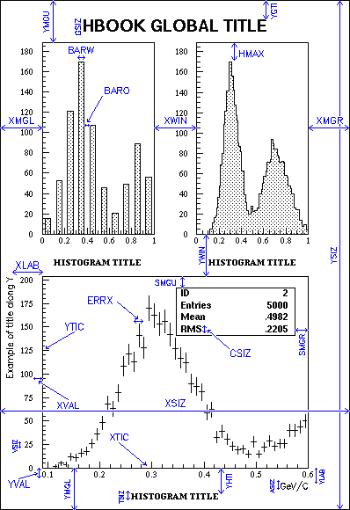

PAW to ROOT to …
a high energy vision

Slide 2

Front-End Electronics
&
Data Acquisition
RIKEN

Slide 3
Objective of the Meeting
GET is a relatively unique project in data capture for Nucl. Phys. because:-
  G : for Generic
  Multi national lab collaboration
  Multi project application:-
    ACTAR, AT-TPC, 2p-TPC, [SAMURAÏ-TPC], R3B-TPC GASPARD(Si), [S3(Si)]
  To inform you of what is the GET project.
  What are the different tasks?
  What are the schedules ?
Not a question of ‘selling’ the project but a question of your active participation as one of major Nucl. Phys. Lab. Internationally.

Slide 4




Multi-Lab Participation
4 men.years
AT-TPC
10 men.years
2p-TPC
9 men.years
S3 & R3B-TPC
ACTAR
8 men.years
S3 & ACTAR

Slide 5
An experiment for FEE & DAC
  Generic (Gas, Solid State, Scintillators …)
  Scalable (100 – 30,000 channels)
  Portable/Integrable ( GANIL, RIKEN, NSCL, GSI …)
  User Oriented Design
  Reliable/Future Proofing
    Archecture & Component Choices & Policy
  Numeric (Early) ➔ Energy/Time/Shape
  Dynamic range
  Fast Data Reduction & Collection
  Adaptive Live Control, Optimisation & Stabilisation.
  Modular (Electromechanical constrains)

Slide 6
Tasks GET
Electronics/DAC
Electronics
Electo-mechanical Int & Cabeling (ZAP) IRFU + *
Hardware
  AsAd – ASIC + on Front-end Board CENBG
  CoBo – Concentration Board & Cabeling NSCL
  MUTANT & BEM & µTCA – Trigger & Time Stamping GANIL
Firmware & Software
  Data stamping & reduction on CoBo NSCL, IRFU
  Slow Control on CoBo IRFU
  Data Acquisition System ➔PC farm GANIL
  Data Formating IRFU,GANIL, MSU
  Electronics Simulation IRFU
Calibration IRFU + *
System Security - Cooling & Power & Gas control CENBG
System control at a Distance *
Documentation IRFU+*
Managment *
Detector
A relatively
Complete
System
Develoment
Effort

Slide 7
Electro-mechanical constrains
Major consideraton in a design of an instrument
Electronics
Solid State devices (DSSSD, Planar Ge)
  Medium-to-Large number of channels (500-10,000)
  Vacuum⬅➔Air interfaces
  Very-FEE or FEE in Vacuum
  Self-contained detector+FEE(ADC+FPGA)
GAS devices
  Micro-pattern gas detectors
  Very large number of channels (10,000-…)
  Gas⬅➔Air interfaces
Scintillators
  Photodiodes (avalance, …)
  PMTs
Electronics
Detector

Slide 8

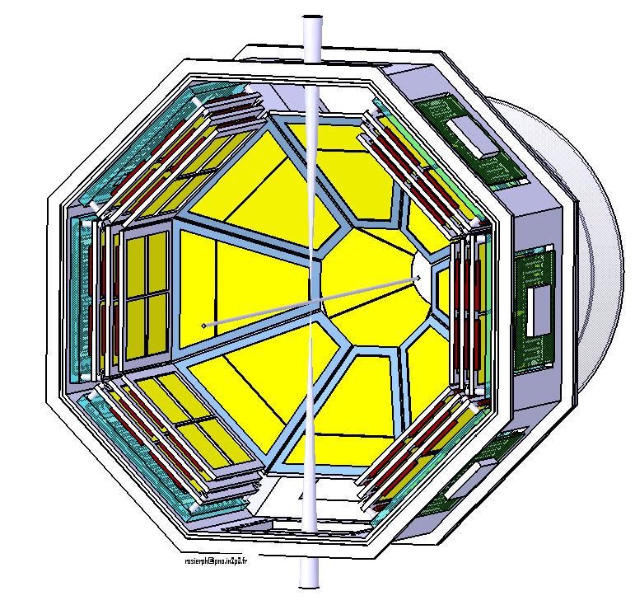
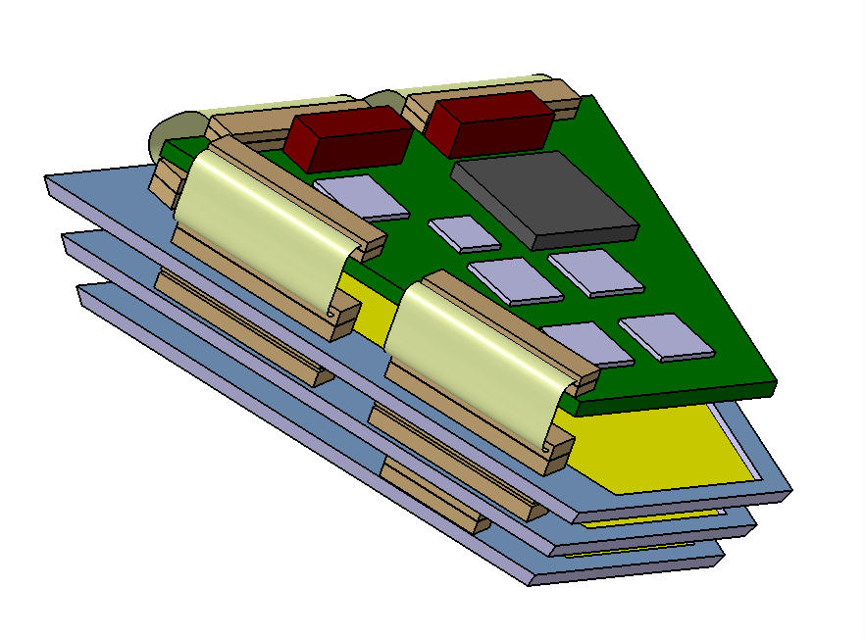
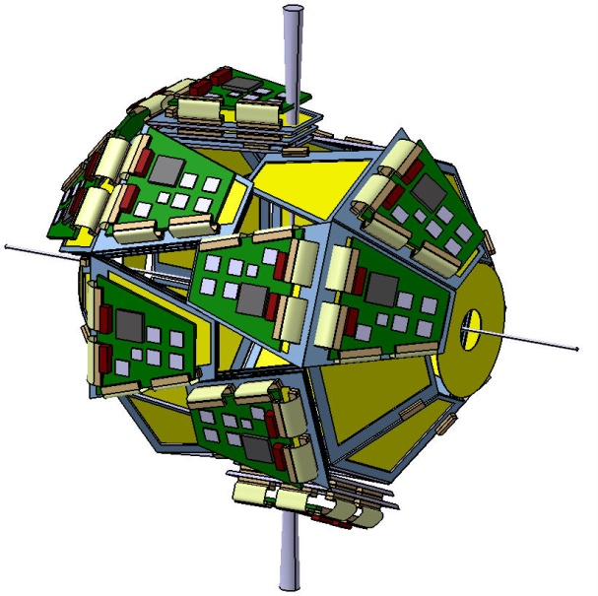
GASPARD
Beam and target
1 module
32 modules equipped
with 3 layers of silicon and electronics

Slide 9
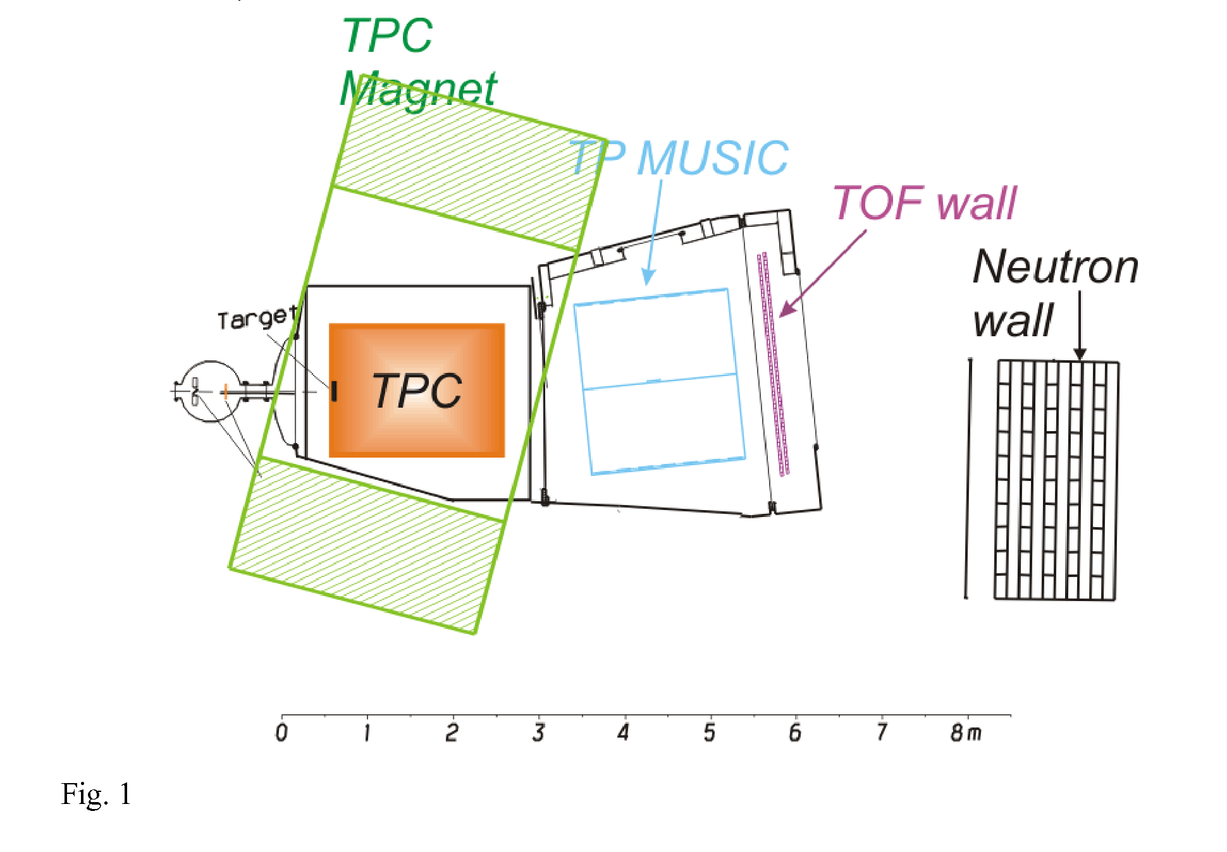
SAMURAI-TPC
SAMURAÏ
TPC
DAC
Maximising the magnetic volume
Phys:- EoS , GMR, …

Slide 10
An experimental approach towards FEE & DAC
  Generic (Gas, Solid State, Scintillators …) xxxxo
  Scalable (100 – 30,000 channels) xxxxo
  Portable/Integrable ( GANIL, RIKEN, NSCL, GSI …) xxxxo
  User Oriented Design
  Reliable/Future Proofing (under study) xxxoo
    Archecture & Component Choices & Policy
  Numeric (Early) ➔ Energy/Time/Shape xxxxo
  Dynamic range xxxxo
  Fast Data Reduction & Collection xxxxo
  Adaptive Live Control, Optimisation & Stabilisation.
  Modular (Electromechanical constrains) xxxoo

Slide 11
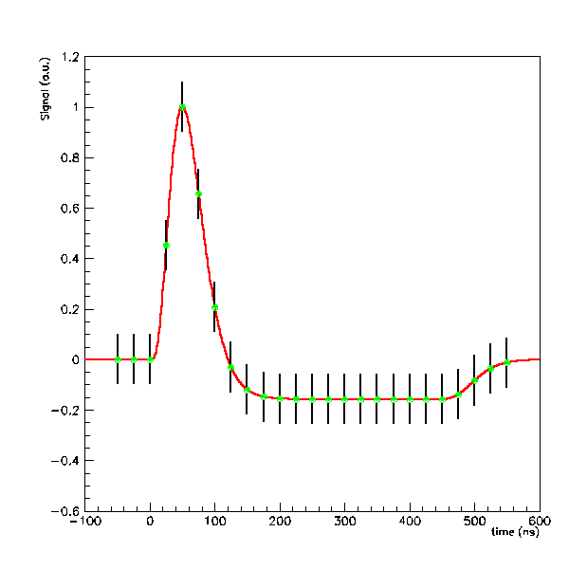
Generic Aspects for Nucl. Phys.
  Internal & External PAC & Slow Control
  Variable Sampling (1➔100MHz)
  Calibration facility & Low Power
  Good Resol^{n} & Dynamic Range
  Gain & Discriminator/ch
  Numeric Trigger Modes
  Channels/Asic = 64
aget
ASIC
for
GET
Based on the T2K
Program
AGET
DISC
Hit Patter
Multiplicity
DET
Filter

Trigger
DISC
DISC
DISC
DISC
DET
Filter
DISC
ADC
Pipe-Line
FPGA
Memory
DET
Filter
DET
Filter
DET
Filter
DET
Filter
Analog Memory Soln

Slide 12
Generic Aspects for Nucl. Phys.
  Internal & External PAC & Slow Control
  Variable Sampling (1➔100MHz)
  Calibration facility & Low Power
  Good Resol^{n} & Dynamic Range
  Gain & Discriminator/ch
  Numeric Trigger Modes
  Channels/Asic = 64
aget
ASIC
for
GET
Based on the T2K
Program
AGET
Ext PAC
DISC
Hit Patter
Multiplicity
DET
Filter

Filter
Trigger
DISC
DISC
DISC
DISC
DET
Filter
DISC
ADC
Pipe-Line
FPGA
Memory
DET
Filter
DET
Filter
DET
Filter
DET
Filter
Analog Memory Soln

Slide 13
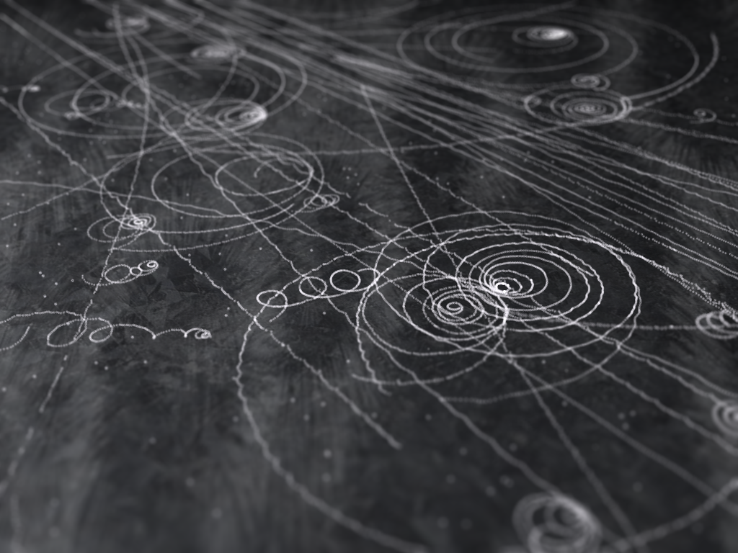
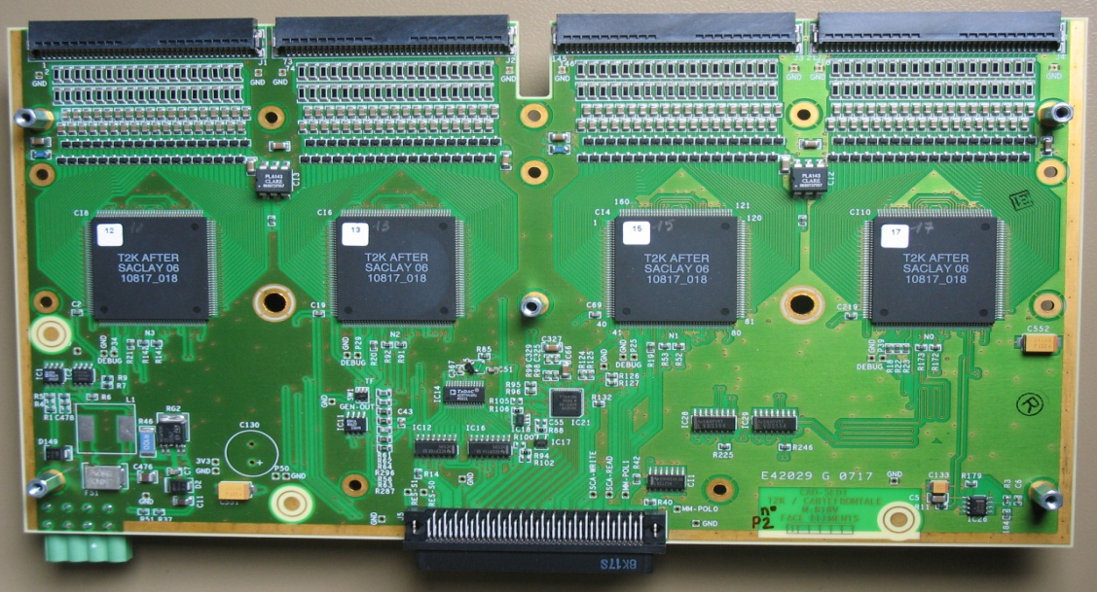
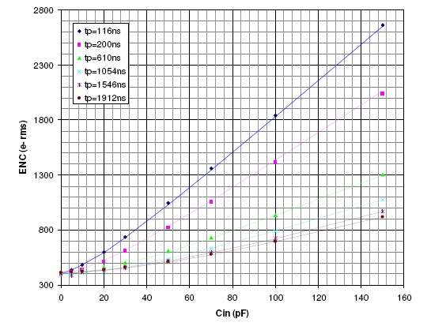
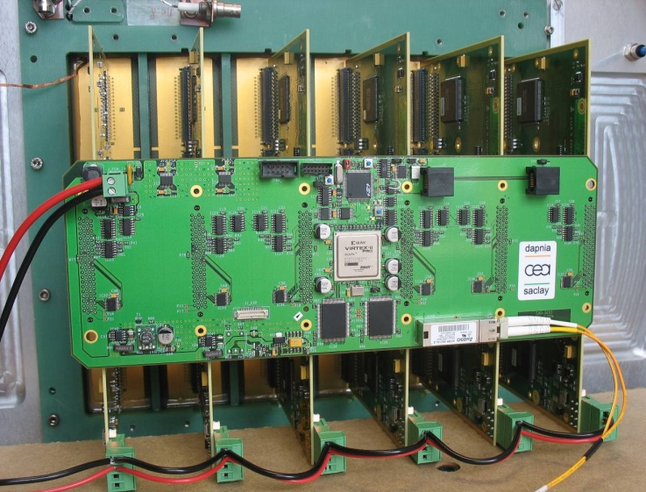
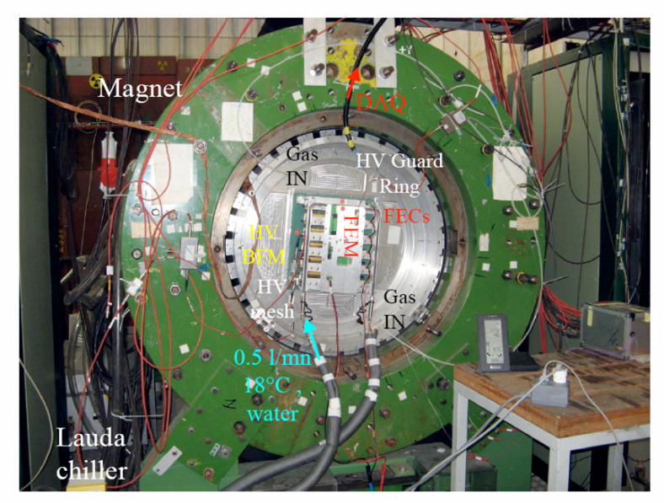
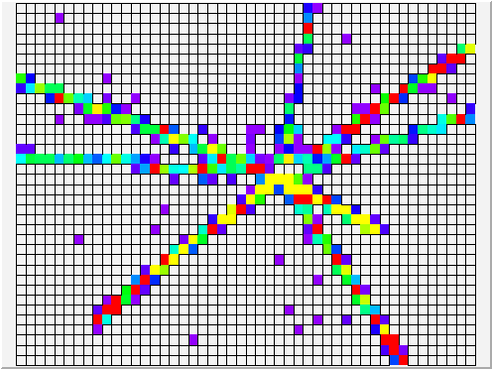

T2K
HARP test set-up at CERN (oct 07)
SEDI/IRFU
15 GeV/c p-Pb (# 20K events)
FE electronics
validated on 1728 channels

Slide 14


Concentration Board
TRIGGER
Numeric (LE Disc)
Level 0 - External
Level 1-Pad hits Multiplicity
Level 2 – Event Topology
Calculated read pattern
Sparse Channel Read
Selective Read of Capa Array
256 Pads
CoBo
Time Slice
PC Farm
AsAd
FPGA
PA-72
PA
ZAP- 
Mem
Time-Stamp
Zero Suppress
Base-Line
Ordering
Data Filtering
PA-72
Switch
4 X 25Mhz
-FADC – 12bits
ZAP 
PA
PA-72
Temp
ZAP- 
I/V
PA
Temp
LVDS
I/V
AGET
MUTANT

PA-72
PA
ZAP- 
FPGA
Pulser
BEM
Trigger
Selective/
Calculated
-Read out
FPGA
FPGA
Mem
BUTIS
Temp
Temp

I/V
I/V

Slide 15
2.5Gb/s

Slide 16


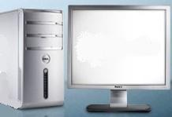


4
3
40
2
Up to 10240 channels = 160 ASICS
on 40 ASAD boards (4 asics/ASAD)
39
1
38
37
Aget
Aget
Counting Rate
Up to 1 KHz
Aget
TI ADS6422
Aget
ADC
ADC
Aget
Aget
Aget
LVDS readout signals @ 150Mbit/s
(ADC 12bits-25MHz) + slow control and
monitoring bus over 2 meters
ASAD
Aget
ASAD
GbE dual star carrier support
14 slot µTCA Crate
2 PM, 1 MCH, 10 CoBo AMC
+ 1 MUTANT AMC
P
M
MCH
P
M
MUTANT for
MUltiplicity
Trigger(s)
ANd
Time
FRU
Power supply
Power supply
10 GbE MCH uplink
Multiple fibbers in the same link
This module could be in
the acquisition room near
the pc and the scope or
inside the external trigger
system (with GMT,
CENTRUM, BUTIS…
BEM
PC farm
GbE network

Slide 17
Global architecture for the full version (3 crates)
Front End
Back End
P
M
MCH
P
M
PC farm
To 40 ASAD boards
Master
MUTANT
BEM
FRU
Power supply
Power supply
Ethernet Network
Up to 30720 channels
with 480 AGET (asics)
on 120 ASAD boards
Inter-MUTANT
Fast I/O link
Inter-MUTANT
Fast I/O link
10 GbE MCH uplink
P
M
MCH
P
M
P
M
MCH
P
M
To 40 ASAD boards
To 40 ASAD boards
FRU
FRU
Power supply
Power supply
Power supply
Power supply
Slave
MUTANT
Slave
MUTANT

Slide 18
Use of GET
GASPARD – external pac(IPNO)
S3 - Beam Tracking
S3 - Si (DSSSD) – external pac
2p-TPC, ACTAR, AT-TPC
SAMURAI-TPC

Slide 19
PAC: Ortec Standard vs ASIC
ATHED
  Noise with 60pF & i= namps
    30keV FWHM on 50MeV
    Threshold: Max Energy ➔1:850
GET
  Noise with 50pF
    87,500e FWHM on 62.5e6
    Threshold: Max Energy ➔1:550
    Sampling contribution ➔ 1:1500 (23keV in 50MeV)
Ortec 142A PAC
  Noise with 50pF
    4keV FWHM on 200MeV
    Threshold:Max Energy➔ 1:25000 (X30 better then ATHED)

Slide 20
Summary for GET - Hard
Generic
  External/Internal PA
  Adjustable Shaping Times & Gain, Sampling
  Dynamic Range - 1:550
  Scalable: 32 ch to 32,000 ch
  Disc/Numeric trigger
  FPGA based ➔ soft reconfugerable
Reasonable Through-Put
  1KHz large events (50% occupancy) 4Gb/s instant
Portable System
  BUTIS, CENTRUM … coupling with Spectrometer, Si …
Nuclear Physics Oriented
  High turn around time: Set-up➔Data Taking➔Analysis➔Set-up➔ …
  Slow Control Data Base, Calibration Policies, Data Filtering
  FEE & Backend – archecture - applicable to multi-use

