Slide 1
AT-TPC project at NSCL/MSU
June 30, 2010
NSCL, Daisuke Suzuki
on behalf of the AT-TPC collaboration

Slide 2
Introduction
Objective
Nuclear reaction studies using RI beams at ReA/FRIB - Nuclear structure & astrophysics; low-energy direct reactions
EOS; Heavy ion collisions
GMR measurements by (d,d’), (⁴He,⁴He’)
High resolution & high efficiency tracking
Large stopping power of low-energetic ions
Limit the target thickness
TPC as an active reaction target Tracking ‘inside’ the target
-> Increase the luminosity with a ‘thick’ target
-> 4 pi detection

Slide 3
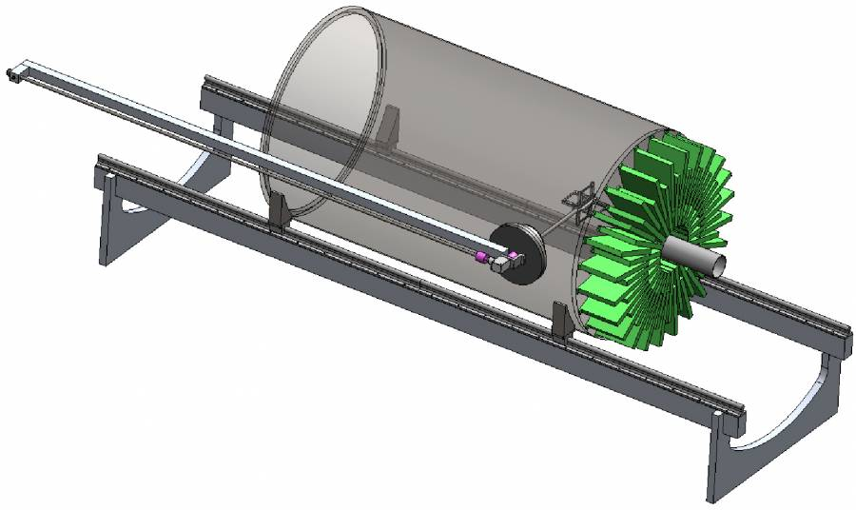
Concept
70 cm
274 cm
120 cm
105 cm
229 cm
Projection; along the beam axis
Electron amplifier; Mcromegas, GEM or wire
Anode pad; N~10,000, Mean area ~ 5 x 5 mm²
Particle confinement; TWIST solenoid (Max. field 2 T)
Gas (target); H, ⁴He, D, ³He, Ar; 0.2~1 atm

Slide 4
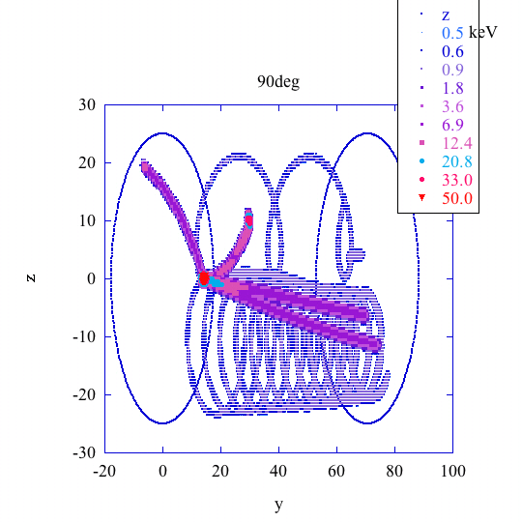
Challenges
TPC should work on versatile gases (targets)
drift velocity, sparking threshold -> gas dependent
Long projection length (1.2 m)
High cathode voltage (up to 120 kV)
By W. Mittig
Complex ion track - ‘Spiral staircase’
High sampling freq. flash ADC (z)
High segmentation (x-y)
-> Elaborated electronics
Y
Z

Slide 5
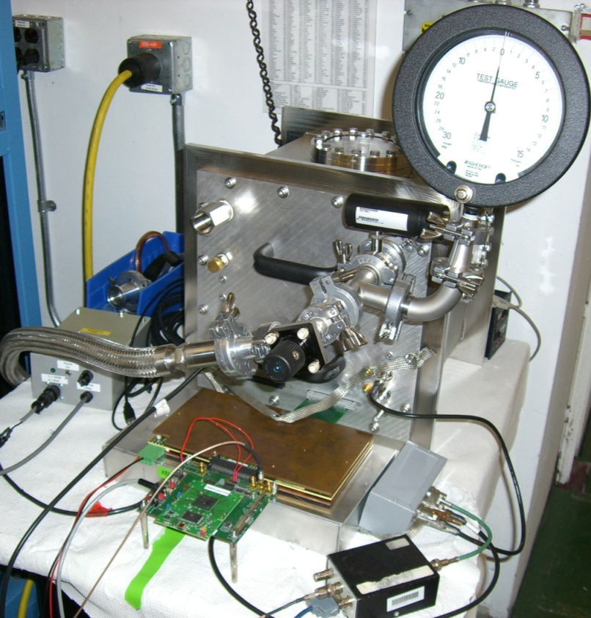
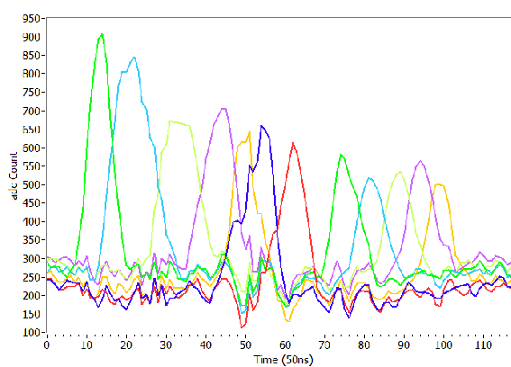
T2K electronics
4 ASIC with 72 inputs
511 switching capacitor array
Sampling freq. = 1~50 MHz
12-bit ADC
Limitations
No internal trigger
Trigger rate < 200 Hz -Bottleneck; SCA readout 25 MHz -USB2.0 -> Gigabit link
T. Lux for the T2K TPC groups,
J. Phys: Conf. Ser. 65, 012018 (2007).
²²⁸Th
dQ = 7%
ADC [ch]
Time (50 ns/ch)

