Slide 1
High Multiplicity Trigger Implementation to Silicon Tracker for sPHENIX
RIKEN/RBRC
Itaru Nakagawa

Slide 2
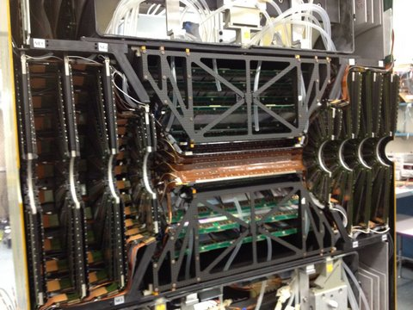
FVTX
4 Stations

Slide 3
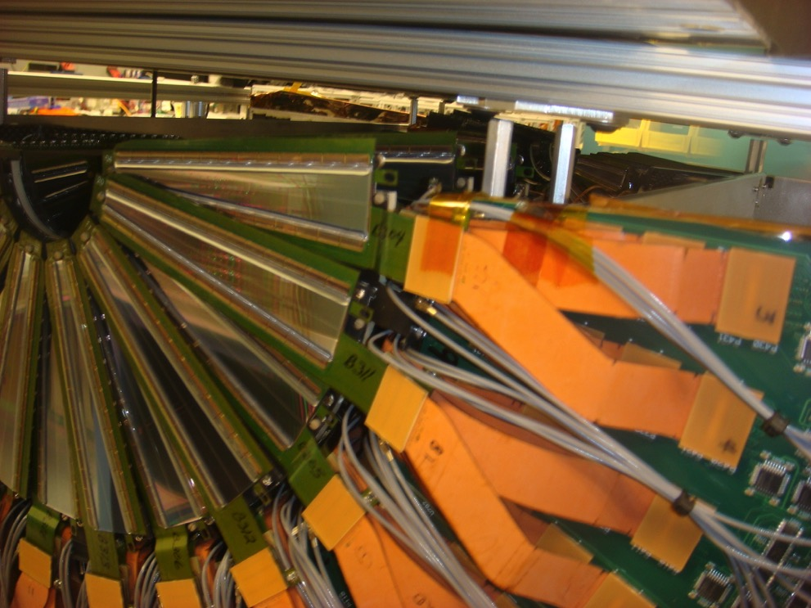
FVTX
Wedge

Slide 4
Multi-Track Counting in Online
Online Coarse Track
~ 3/4 active wedges
Trigger : #track > Threshold

Slide 5
FVTX Readout
FEM
Data
Collection
Module
FEM
FPGA
FPGA
FEM
FEM
FPG
Slow Control
FPGA
FEM-IB
FPGA
FVTX Tracker (4 layers)

Slide 6
FPGA Algorithm
FEM
Data
Collection
Module
１bit Serial Line
FEM
Online
Track?
# of FEM only goes up to 24
Online Track
FEM
FEM
Online Track?
1 bit serial line
Online Track ?
FEM-IB
Track Counter
GL1
FVTX Tracker (4 layers)
High Mult. Trigger

Slide 7
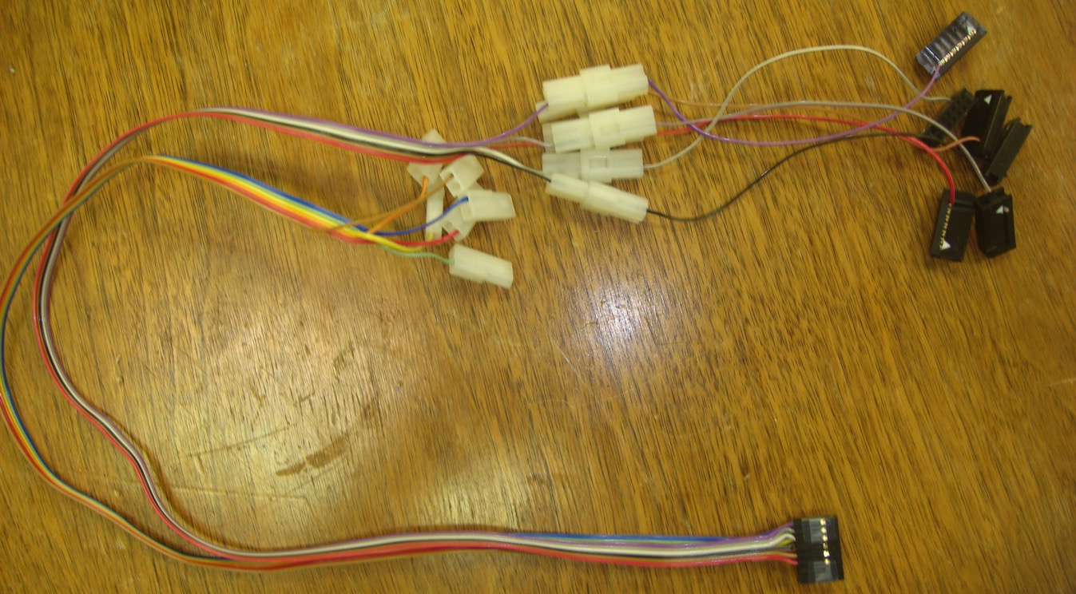
FEM -> FEM-IB Cable
FEM
FEM-IB
About 30 cm long.

Slide 8
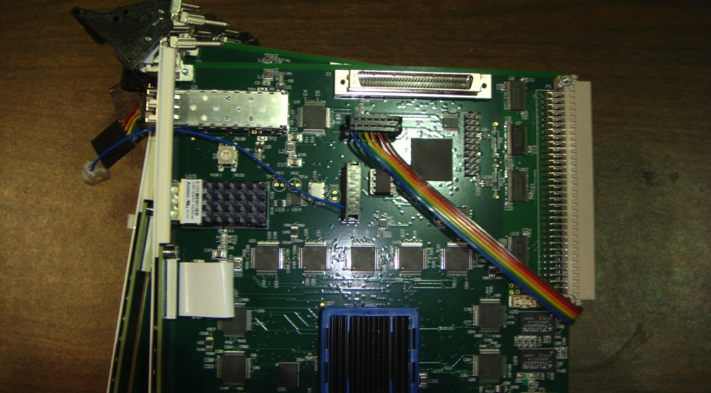
FEM Board
Serial Wire
To FEM-IB Test-Pin
Test Pin OUT

Slide 9
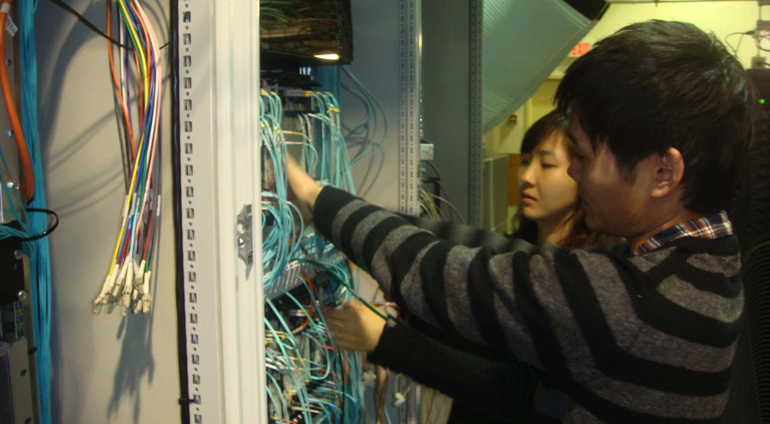
Commissioning FVTX Trigger

Slide 10
High Multiplicity Trigger vs MB
Au-going of pAu
Corresponds to CMS Multiplicity
Number of Triggers
MB Trigger
South FVTX Trigger
Reconstructed # of Tracks in FVTX per Arm

Slide 11
Trigger Efficiency Turn On
Ideal Trigger Turn On
Present Trigger Turn On
Trigger Efficiency
Reconstructed # of Tracks in FVTX per Arm

Slide 12
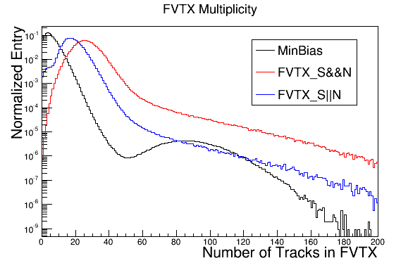
FVTX South OR North Trigger
FVTX South AND North Trigger
MB Trigger
Successful in collecting high multiplicity events in FVTX

Slide 13
Purity
pAu
 | pp (AND+OR) | pAu (South) | pAl (South)
# Trigger | 500M | 300M | 90M
Purity | 0.10 | 0.8 | 0.60
# of High Mult Event | 50M | 240M | 54M
pp
The trigger was prescaled by 2 ~ 10 during pp run

Slide 14
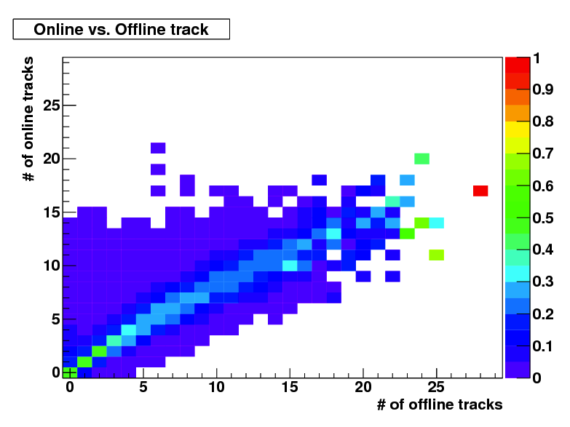
Upper Limit
Off Diagonal : Discrepancy between online offline track algorithm

Slide 15
FPGA Algorithm
FEM
Data
Collection
Module
１bit Serial Line
FEM
Online
Track?
# of FEM only goes up to 24
Online Track
FEM
FEM
Online Track?
1 bit serial line
Online Track ?
FEM-IB
Track Counter
GL1
FVTX Tracker (4 layers)
High Mult. Trigger

Slide 16
FPGA Algorithm + LUT
FEM
Data
Collection
Module
Multi-bit Serial Line
FEM
Online
Track?
# of FEM only goes up to 24
Online Track
FEM
FEM
Online Track?
MultiBit
Online Track ?
Strip#
FEM-IB
Track Counter
GL1
FVTX Tracker (4 layers)
High Mult. Trigger

Slide 17
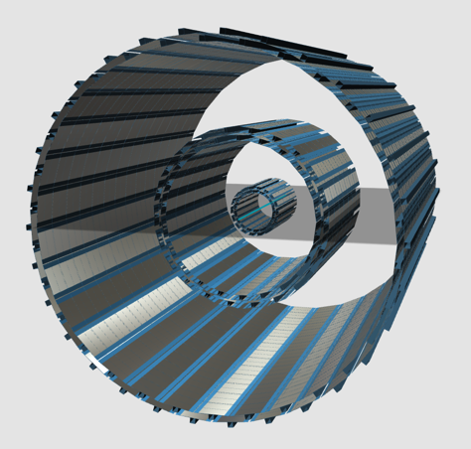
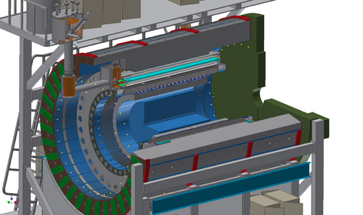
sPHENIX Silicon Tracker
Current Design Employs FPHX Chip
Readout to be very similar to FVTX
Silicon Tracker

Slide 18
Summary
The FVTX trigger has two major compromises
  Online Tracking : Coarse wedge based
  Upper limit in # of tracks counting
Above can overcome by
  More powerful FPGA to handle LUT in FEM
  Multi-bits communication between FEM and FEM-IB
Implement above improved version of the FVTX High Multiplicity Trigger to sPHENIX silicon tracker

Slide 19
Backup

Slide 20
各測定器のラピディティー範囲
CMS
南FVTX
北FVTX
sPHENIXシリコントラッカー
-3 -2 -1 0 1 2 3
ラピディティー η

Slide 21
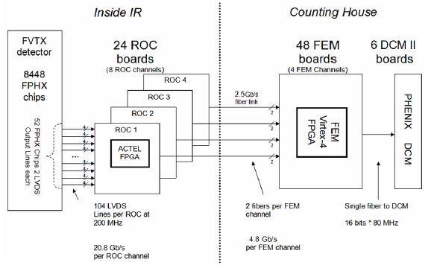
FVTX Readout
All hits are sent to FEM regardless of trigger request
FEM
Slow Control
FPGA
FEM-IB

Slide 22
FVTX Trigger Design
Raise a “track flag” if track like hit pattern is found.
FEM
Track flag
Slow Control
If the number of flagged FEMs are more than threshold, then issue a trigger
FPGA
TRIGGER
GL1
FEM-IB

