Slide 1
Introduction of IPA at RIKEN
RIKEN/RBRC
Itaru Nakagawa

Slide 2
What is RIKEN?
理 RI 리 Physic &
化 KA 카 Chemistry
学 GAKU 가쿠
研 KEN 켄 Research
究 KYU 큐
所 SYO 쇼 Institute
These days, also for life science (a lot).

Slide 3
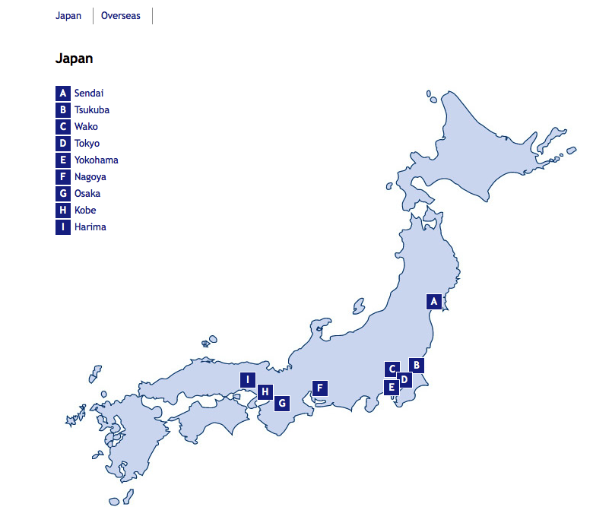
Location of RIKEN
Wako
Tokyo

Slide 4
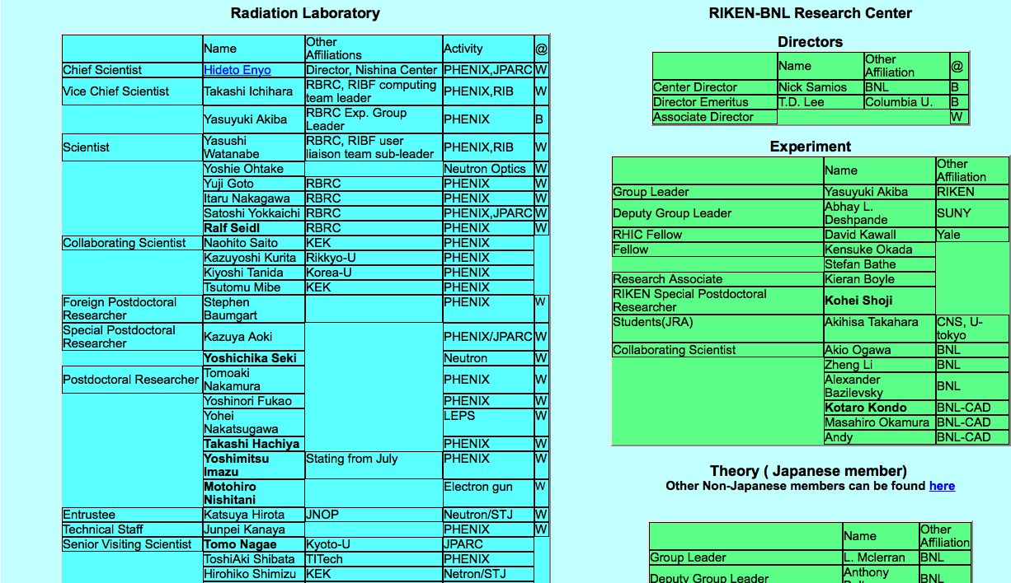
Radiation Laboratory

Slide 5





Radiation Laboratory

Slide 6
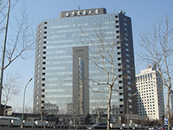
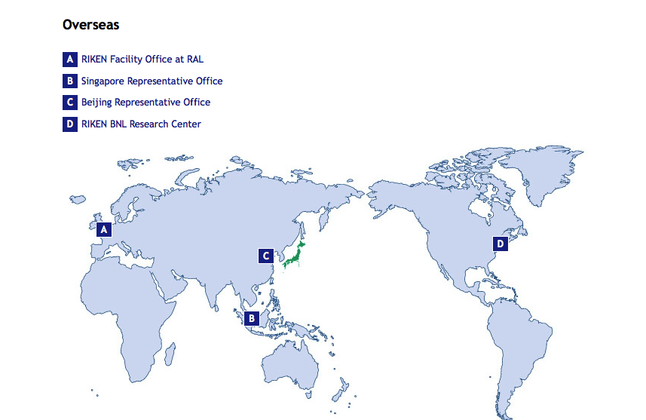
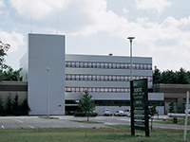
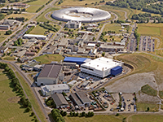
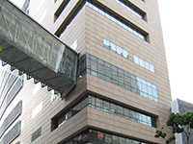
Overseas Branches

Slide 7


How PHENIX Research is Supported
RBRC

Slide 8
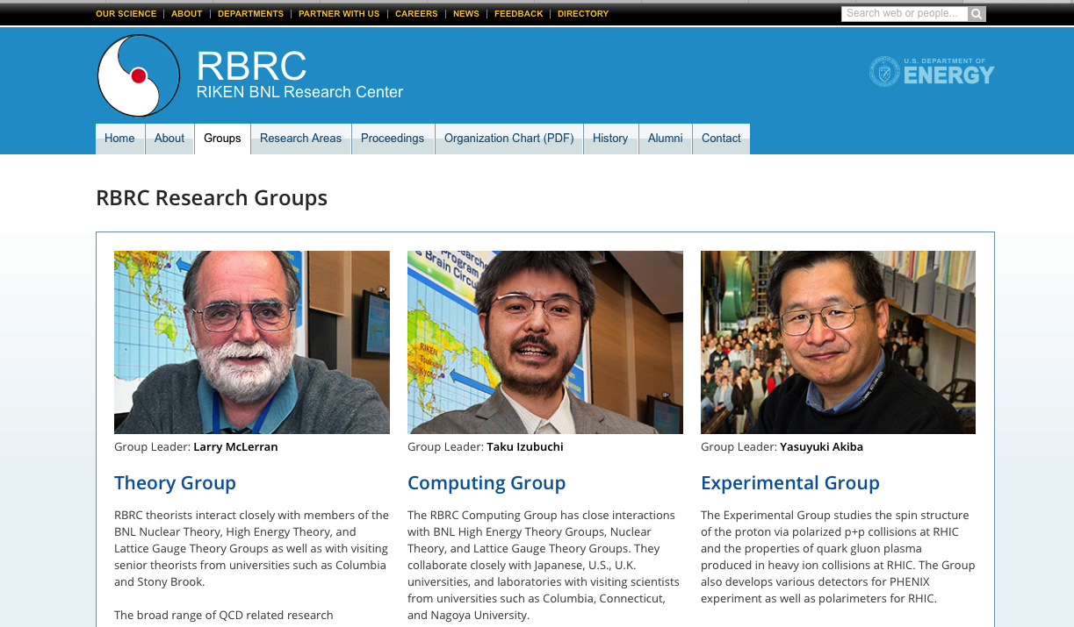
RIKEN BNL Research Center (RBRC)

Slide 9
RIKEN is Research Lab (not university),
but has a system to support students financially
You at | Under Grad | Master Student | Doctor Student | OD (yet to complete) | Postdoc | Comment
Government JSPS | none | none | DC fellow For Japanese | Non | PD fellow | also Foreigners PD program
University | Scholar ship | Scholar Ship Teaching Assistant Research Assistant |  |  | none | Not many posts available
RIKEN Lab. operation | Trainee | Trainee Student PT | Trainee Student PT | Research Assistant | PD Researcher | For anybody but cheep
RIKEN Fellow Program |  |  | Junior Research Associate | Special Doctoral Fellow |  | For Japanese
 |  |  | International Program Associates | Foreign Postdoctoral Fellow |  | For Non Japanese

Slide 10
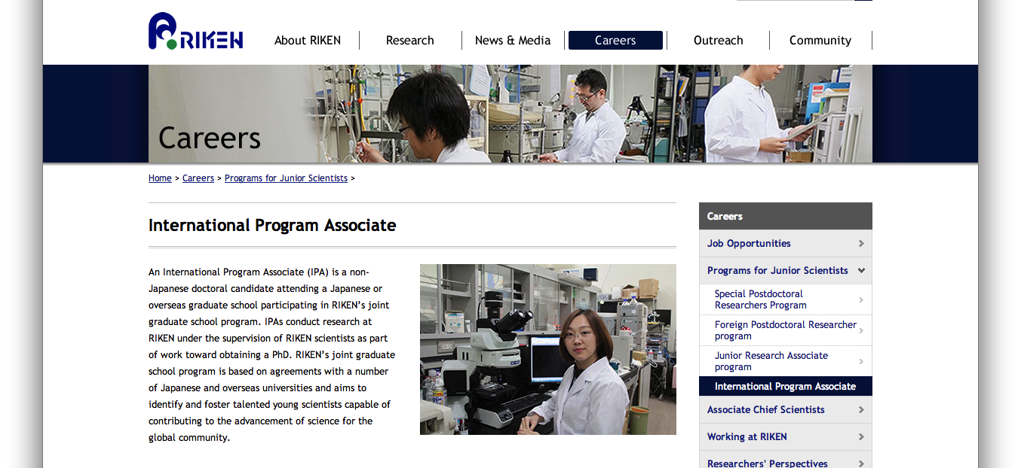

Slide 11
IPA : General Information
Applicants should be (or to be) in Ph.D course (not Master course).
Call for application issues twice a year (April and October).
Long term (3years) and Short term (1 year).

Slide 12
IPA : Compensation
(Financial Supports )
Airfare (1 round-trip ticket to Japan)
Living allowance (5,200 JPY/day ~ 150,000 JPY/month)
Free on-campus housing, or payment of actual amount of rent for off-campus apartment, up to a maximum of 70,000 JPY/month
Payment of accident insurance premium
100 JPY ~ 1050 W

Slide 13
IPA Students @ Radiation Lab.
Student | Research Topic | Mentor @ RIKEN
Sagnhwa Park (SNU) | Sea Quark Polarization thru Run13 W->mu Longitudinal Single Spin Asymmetry | Itaru Nakagawa
Inseok Yoon (SNU) | Gluon Polarization thru Run13/12/11 Central Arm pi0 Longitudinal Double Spin Asymmetry | Yuji Goto
Taebong Moon (Yonsei) | Gluon Polarization through Run13 Central π^{+/-} Longitudinal Double Spin Asymmetry | Yasuyuki Akiba
Chong Kim (KOREA) | Sea Quark Polarization thru Run13 W->mu Longitudinal Single Spin Asymmetry | Ralf Seidl
Minjung Kim (SNU) | Forward Neutron Asymmetry A_{N} for Run15 pA | Itaru Nakagawa
SeYoung Han (Ewha) | Search for mini-QGP in Small Colliding System using Run15 High Multiplicity Events | Itaru Nakagawa
JaeHee Yoo* (Korea) | Gain Matching Calibration for SMD | Itaru Nakagawa
* In preparation to apply for IPA

Slide 14
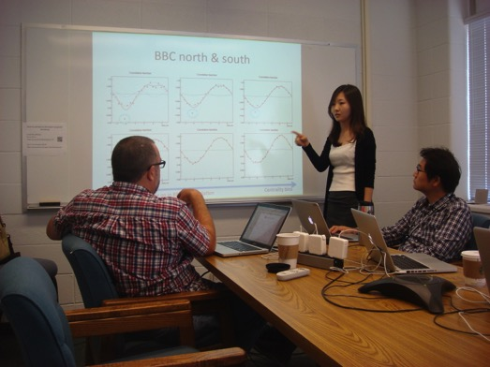
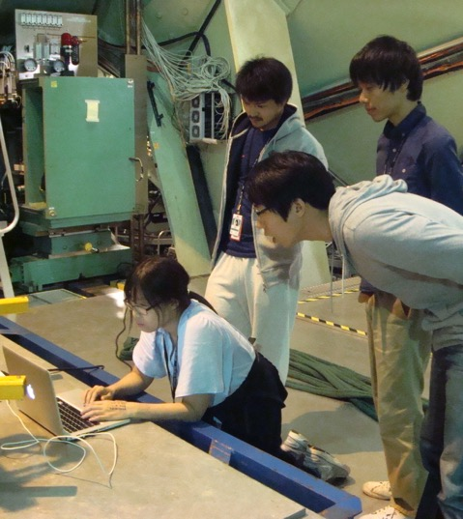
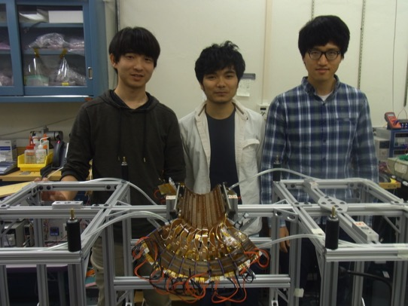
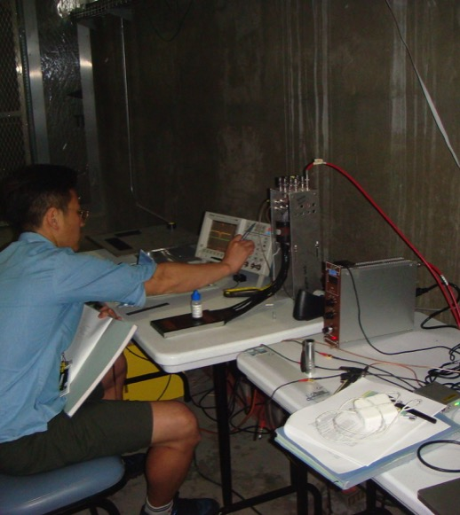
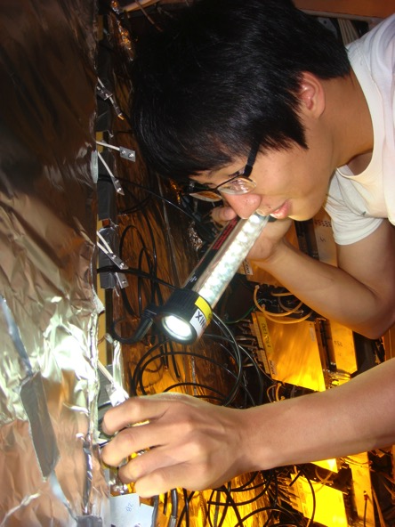
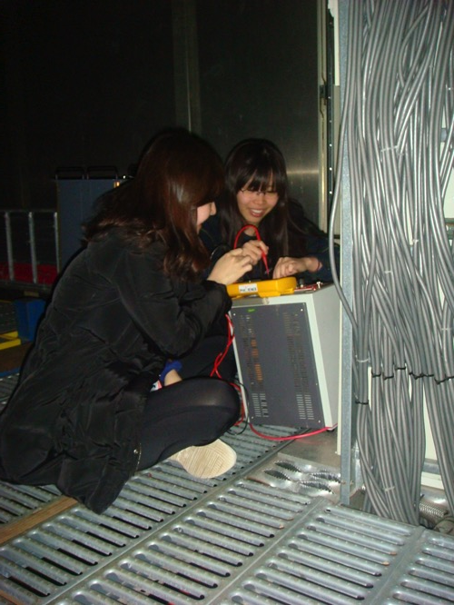
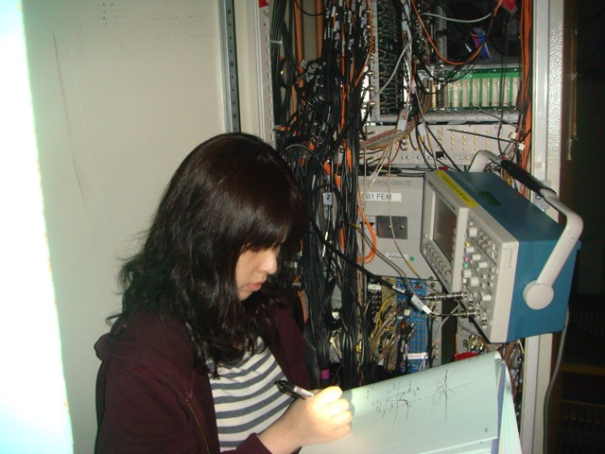

Slide 15
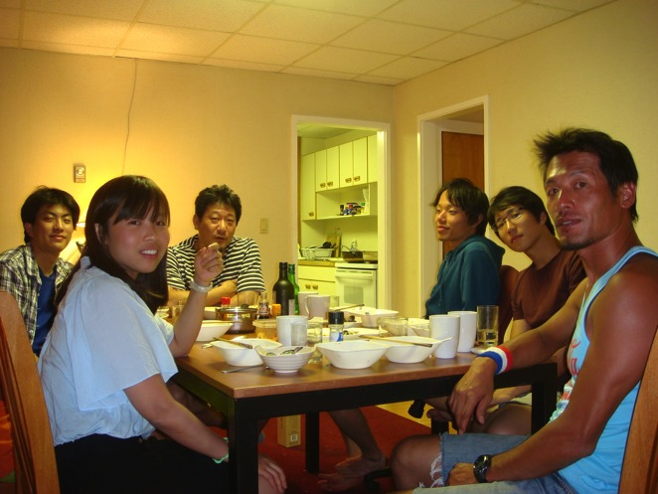
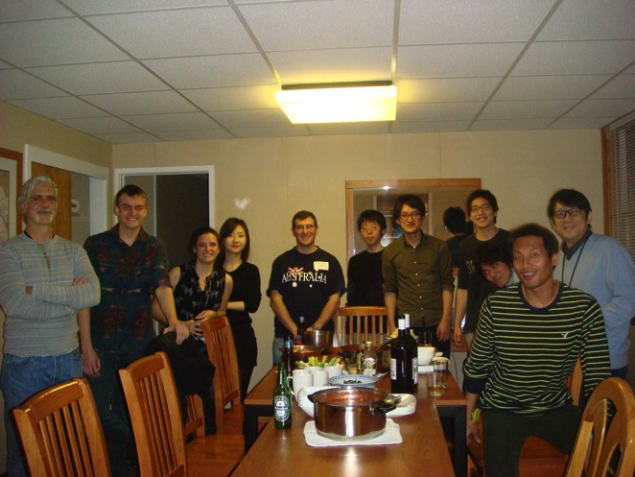
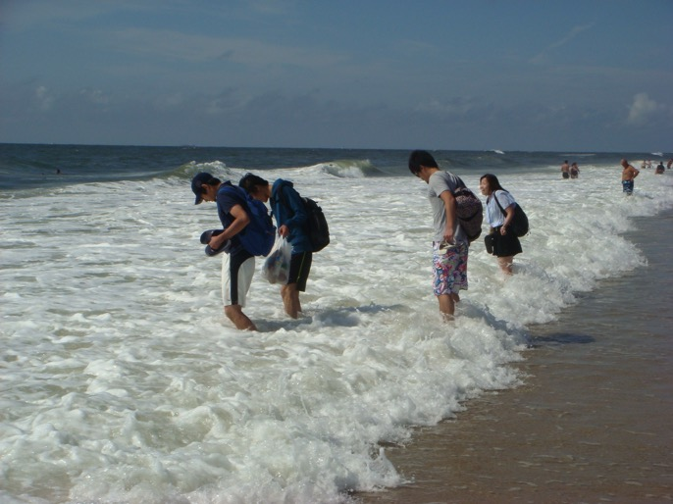
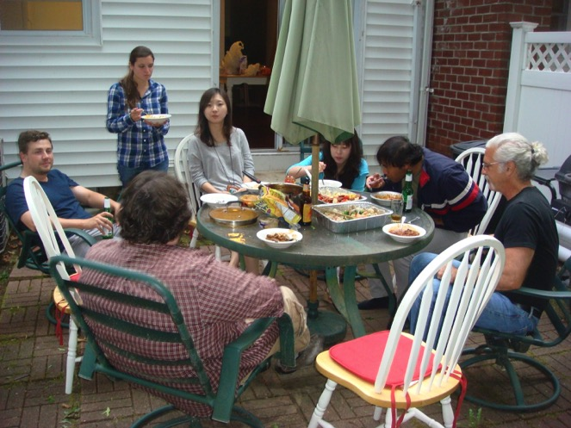

Slide 16
Present IPA Students @ Radiation Lab.
 | 2012 | 2013 | 2014 | 2015 | 2016 | 2017
Sagnhwa Park (SNU)
Inseok Yoon (SNU)
Taebong Moon (Yonsei)
Chong Kim (KOREA)
Minjung Kim (SNU)
SeYoung Han (Ewha)
JaeHee Yoo* (Korea)
Ph.D
Long Term
Long Term
Long Term
Hideto’s Retirement
Ph.D
Short Term
Long Term
Long Term
Short Term
Intern

Slide 17
What happen to RadLab beyond 2017?
2014 | 2015 | 2016 | 2017 | 2018 | 2019 | 2020 | 2021 | 2022 | 2023 | 2024 | 2025 | 2026 | 2027
PHENIX
 |  |  | sPHENIX + fsPHENIX
 |  |  |  |  |  |  |  |  |  |  | EIC

Slide 18
Carrier Path for IPA Students
 | 2012 | 2013 | 2014 | 2015 | 2016 | 2017
Sagnhwa Park (SNU)
Inseok Yoon (SNU)
Taebong Moon (Yonsei)
Chong Kim (KOREA)
Minjung Kim (SNU)
SeYoung Han (Ewha)
JaeHee Yoo* (Korea)
Ph.D
Long Term
FPR
Long Term
Long Term
Ph.D
Short Term
Postdoc @ UCR
Long Term
Long Term
Short Term
Intern

Slide 19
RIKEN is Research Lab (not university),
but has a system to support students financially
You at | Under Grad | Master Student | Doctor Student | OD (yet to complete) | Postdoc | Comment
Government JSPS | none | none | DC fellow For Japanese | Non | PD fellow | also Foreigners PD program
University | Scholar ship | Scholar Ship Teaching Assistant Research Assistant |  |  | none | Not many posts available
RIKEN Lab. operation | Trainee | Trainee Student PT | Trainee Student PT | Research Assistant | PD Researcher | For anybody but cheep
RIKEN Fellow Program |  |  | Junior Research Associate | Special Doctoral Fellow |  | For Japanese
 |  |  | International Program Associates | Foreign Postdoctoral Fellow |  | For Non Japanese

Slide 20
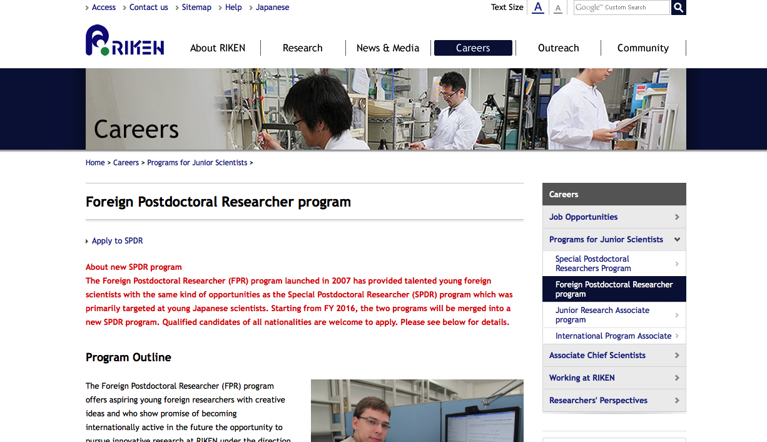
Foreign Postdoc Fellow
http://www.riken.jp/en/careers/programs/fpr/

Slide 21
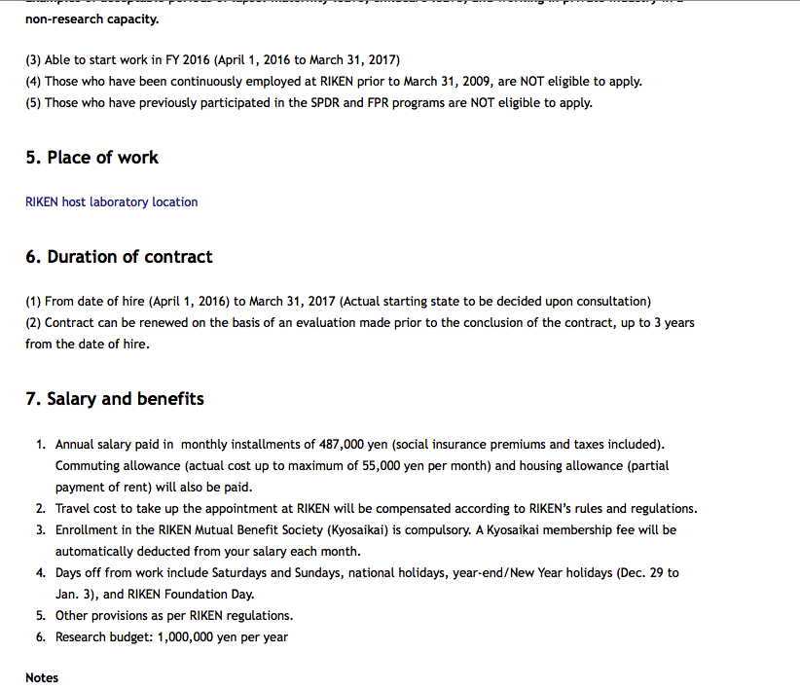
Consider as Postdoc++

Slide 22
Summary
RIKEN is world class research laboratory.
Let’s strengthen collaboration between Korea and Japan to be more productive in PHENIX/sPHENIX/fsPHENIX/EIC.
Students who shares the interest with us are welcome to join us. Let’s work together.

Slide 23
Summary
RIKEN
Univeristy
Students
collaboration
support
research
education
tuition

Slide 24
I am working not for RIKEN but for my thesis!
RIKEN’s
Business
(Research)
Your daily life
Your work in the collaboration

