Slide 1



The Origin of the r-Process
Timothy C. Beers
University of Notre Dame
SDSS

Slide 2
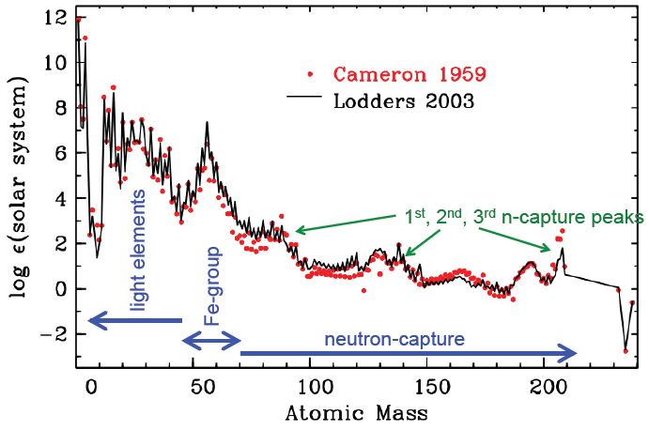
Ultimate Goal – Understanding the Solar and Cosmic Abundance Distribution

Slide 3
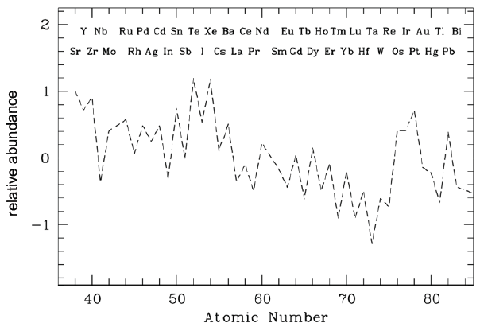
The r-Process Pattern

Slide 4
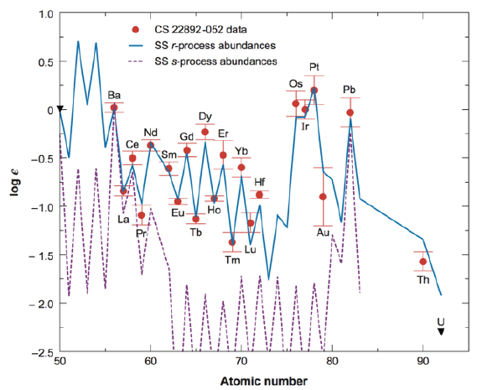
The First r-Process Enhanced Star in the Halo of the Galaxy – CS 22892-052
Distribution of heavy n-capture elements consistent with scaled SS results
[Fe/H] ~ -3.0
McWilliam / Sneden ~1995

Slide 5
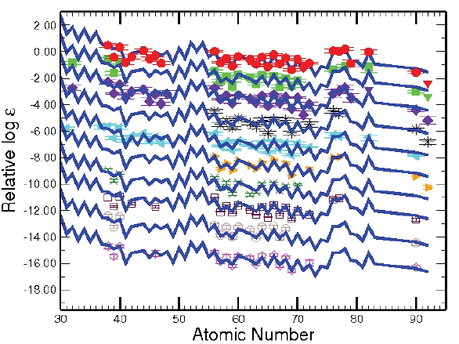
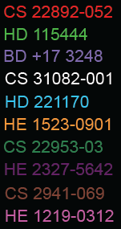
The Universality of the r-Process –
A Robust Production Site ?
Very little star-to-star variation in the pattern of r-process elements

Slide 6
The BIG Question(s)
What is the dominant astrophysical site of the r-process ?
  Core-collapse supernovae
  Neutron star mergers
  Others (e.g., magnetars ?)
What is the rate and yield of the event(s) ?
Does the dominant site change over time and is it
dependent on environment ?

Slide 7
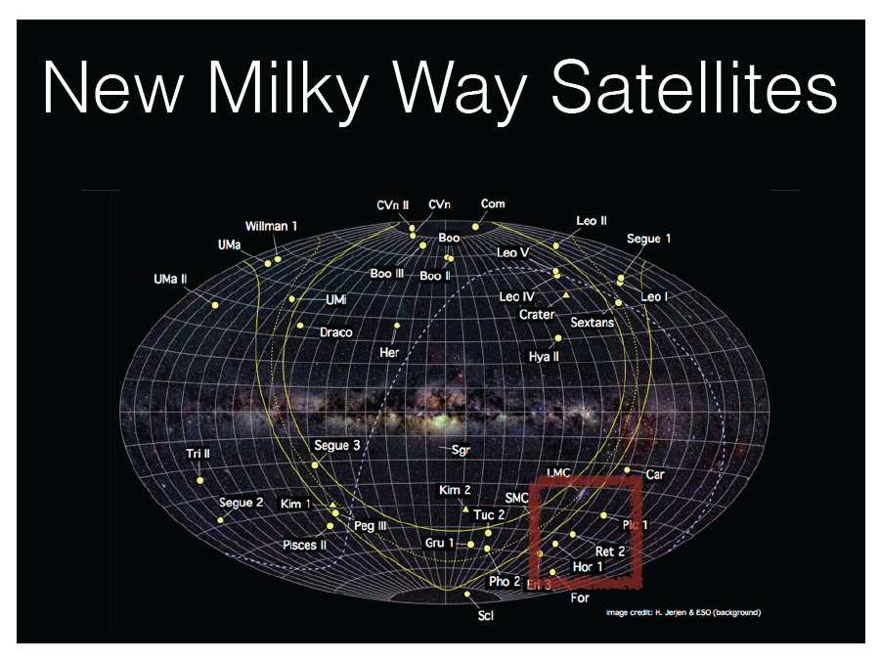
New Probes of the Origin of the r-Process

Slide 8
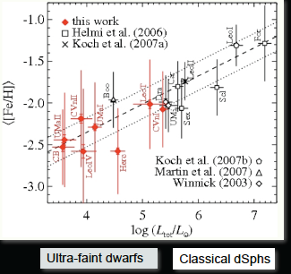
Ultra Faint Dwarf (UFD) Properties
Low luminosity
(300 – 3000 L_{sun})
Dark matter dominated (M/L > 100)
Very metal-poor
(mean [Fe/H] < -2.0)
Stars are old
(mean age ~13.3 Gyr)
Relatively inefficient star formation

Slide 9
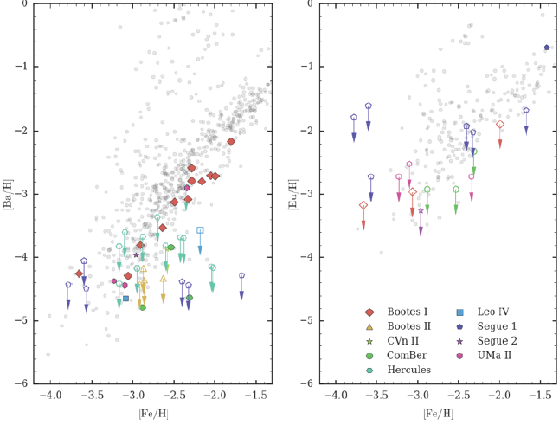
Stars in the First Nine UFDs with High-Resolution Spectroscopy had LOW n-capture Elements
Frebel and collaborators

Slide 10
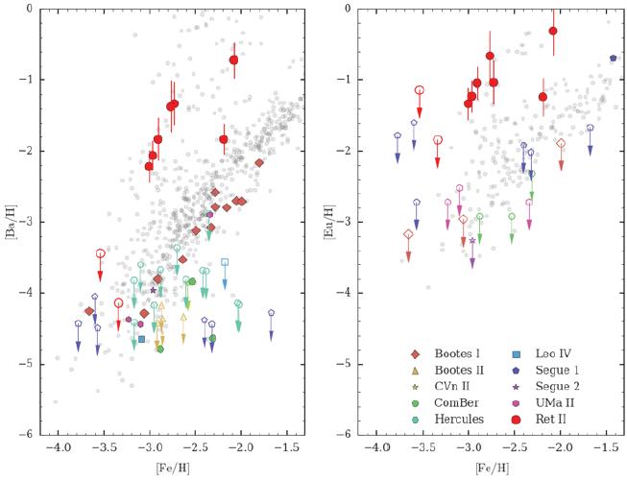
Along Comes Reticulum II -> 100 Times Higher n-capture Elements than Other UFDs
Frebel and collaborators

Slide 11
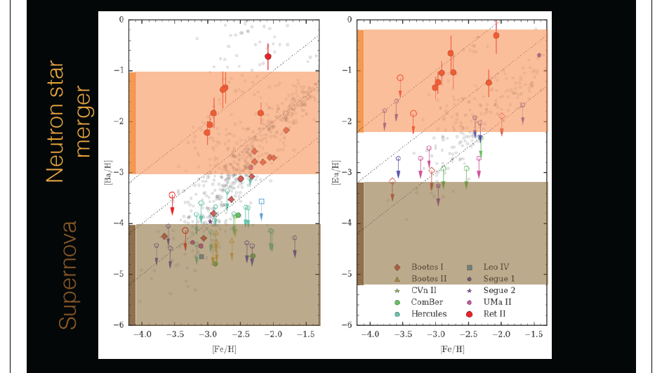
Reticulum II Abundances Consistent with Neutron Star Merger Origin
Winteler et al. (2012)

Slide 12
Reticulum II Enriched by a Rare, Prolific, and Possibly Delayed r-Process Event
A typical core-collapse supernova could not be
responsible for the Ret II r-process signature
  Increasing numbers of SNe wont help → 1000+ SNe
  would disrupt this low-mass system
  Need to be one/few massive events
Arent NSMs taking too long to enrich the system ?
    After the few (initial) SNe it takes time for
    the system to reassemble (~100 Myr)
    Minimum time scale for coalescence is
    similar (~100 Myr)

Slide 13
Basic Facts and Realities of the Problem
The halo population in the Galaxy contains small fractions of stars at very low metallicity, yet moderate to large enhancements of r-process elements relative to iron, compared to the Solar ratio (Beers & Christlieb 2005):
  r-II: [Eu/Fe] > +1.0 (factor of 10-100 enhancement)
  r-I: +0.3 < [Eu/Fe] < +1.0 (factor of 2-10 enhancement)
  CEMP-rII: As above but also [C/Fe] > +0.7
  CEMP-rI: As above but also [C/Fe] > +0.7
Recent detection of r-II stars in the Ultra Faint Dwarf (UFD) galaxy Reticulum II (Ji et al. 2016, Roederer et al. 2016) have refocused attention on the possible nucleosynthetic origin of such stars, and the astrophysical site of the r-process
One important consideration concerning the nature of the halo r-II stars has not received adequate attention …

Slide 14
Basic Facts and Realities of the Problem
THAT THEY EXIST AT ALL
Q. How do you create a simultaneously HIGH r-process-element abundance while maintaining a LOW iron abundance ?
A. You must limit the mixing process with large amounts of material lacking this abundance signature, and capable of diluting/erasing evidence for its presence
THIS HAS IMPLICATIONS . . .

Slide 15
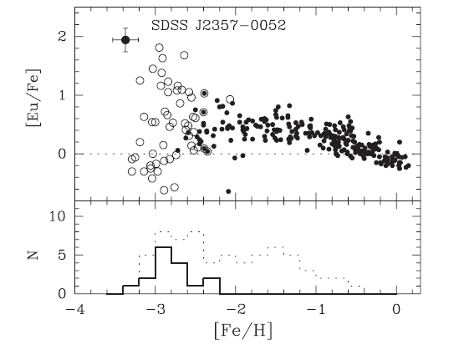
They are Found in ALL Stages of Stellar Evolution
Until recently, all of the r-II stars known were red giants, allowing for the possibility that some peculiar atmospheric effect was the cause for the apparent excess of r-process elements. This is now precluded by observation
  Aoki et al. (2010) – Discovery of r-II nature for a cool, main-sequence dwarf, SDSS J2357-0052 (Teff = 5000 K, [Fe/H] = -3.4, [Eu/Fe] = +1.9)
  Roederer et al. (2014) – Discovery of r-I and r-II stars in the subgiant and red horizontal-branch evolutionary stage

Slide 16
They are not (Required to be) Binaries
Although a number of authors (Wanajo and collaborators, Qian & Wasserberg, others) have considered the possibility of mass-transfer of r-process-enhanced material from a binary companion, this is now rejected based on long-term radial velocity monitoring of r-II (and r-I) stars
Hansen et al. (2015) – The binary fraction of such stars is only 18%, consistent with the observed binary fraction of other metal-poor halo stars, including two canonical examples, CS 22892-052 and CS 31082-001
Observations conducted over temporal window of 8-10 years, using the NOT 2.5m telescope and FIES spectrograph, with precision (and accuracy) on the order of 50-100 m/s

Slide 17
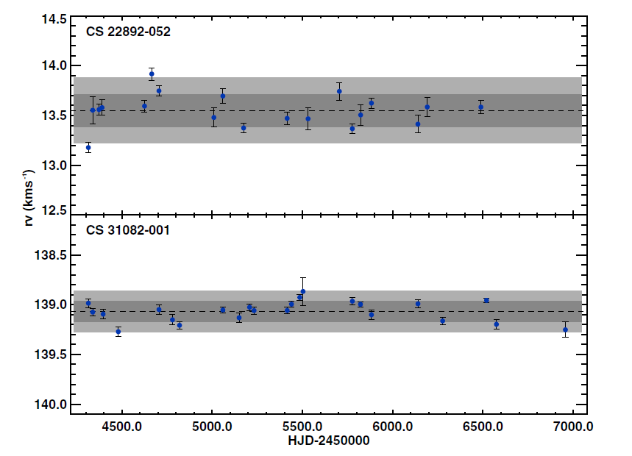
They are not (Required to be) Binaries
Hansen, T.T. et al. (2015, A&A 583, 49)

Slide 18
They are Exquisitely Rare but Display Surprisingly Uniform Heavy-Element Patterns
The r-II stars are the rarest of the rare among metal-poor stars in the halo of the Milky Way
  About 25 r-II stars have been found in the field over the past 25 years since their recognition
  Only 3% (at most 5%) of very metal-poor stars (VMP, [Fe/H] < -2) are r-II stars
  About 15% are r-I (5 times greater frequency)
This argues for their creation by relatively rare progenitors, compared to the progenitors of “normal” VMP stars
The “universality” of the r-process-element abundance pattern (identical to the Solar pattern) among 2nd and 3rd peak elements suggests a single progenitor population, rather than a collection of different progenitors mixed together

Slide 19
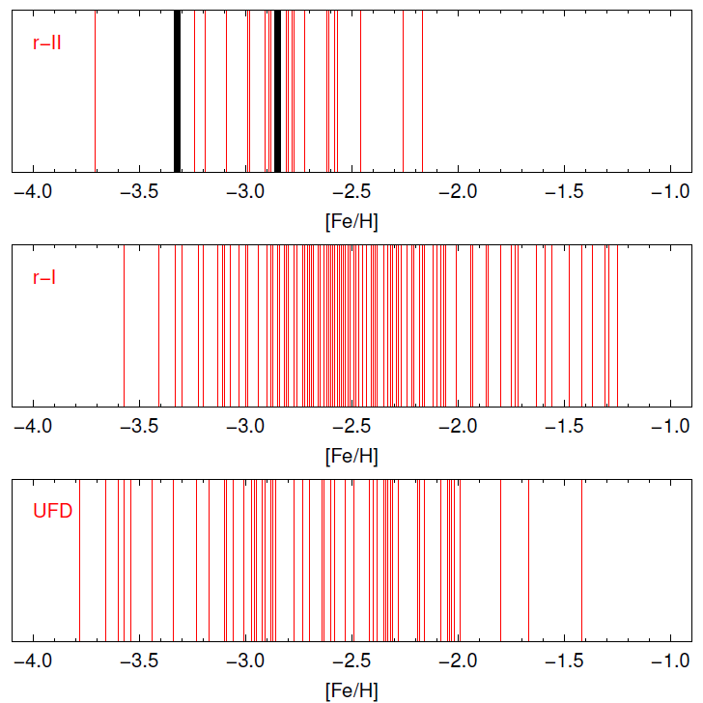
The r-II Stars and r-I Stars Exhibit Different Metallicity Distribution Functions (MDFs)
N = 24
N = 133
N = 55

Slide 20
Interpretation of the r-II MDF and Enhancement Range
The r-II stars preferentially occupy the metallicity range -3.5 < [Fe/H] < -2.0, the same range covered by the VMP and EMP stars found in the UFDs
The range of r-process-element enhancement among the halo stars matches that of the r-II stars found in the Ret-II UFD
This evidence strongly suggests that the UFD environment is their likely formation site, followed by accretion into the halo

Slide 21
Example High-Resolution Spectrum
CS 31082-001: [Fe/H] = -2.9 VLT/UVES Blue Spectrum
Uranium
Thorium

Slide 22
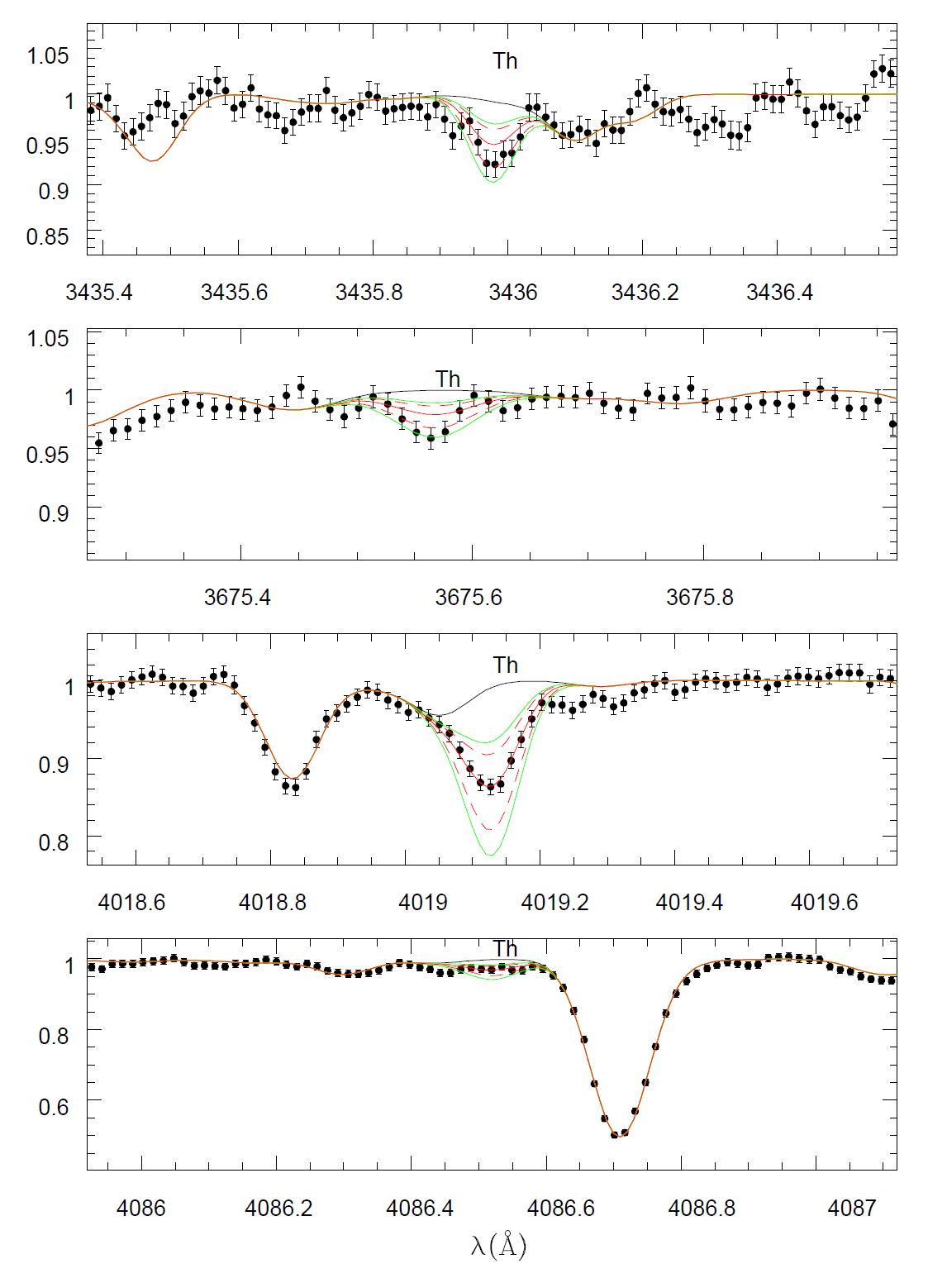
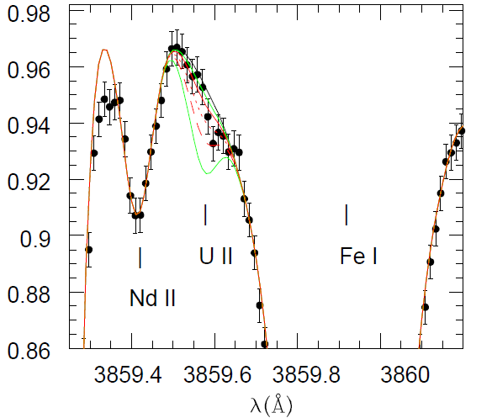
VLT Observations of a new r-II Star with Th and U – CS 29497-004
Teff = 5013 K
log g = 2.05
[Fe/H] = -2.85
[r/Fe] = +1.7
Hill et al. (2016, submitted)

Slide 23
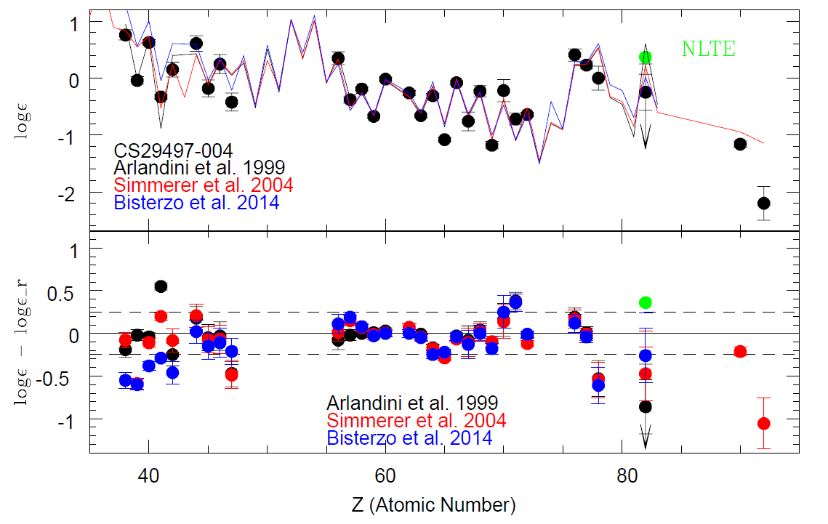
VLT Observations of a new r-II Star with Th and U – CS 29497-004
Hill et al. (2016, submitted)

Slide 24
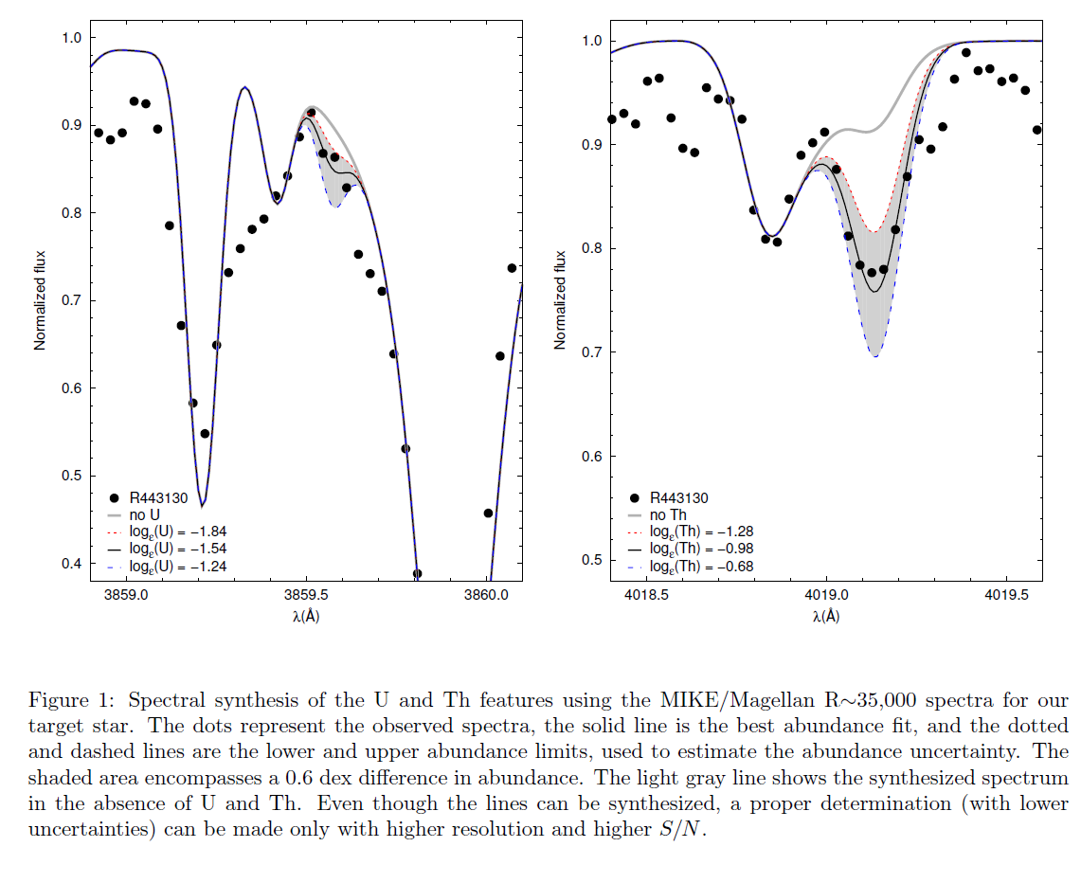
Magellan Observations of a new r-II Star with Th and U – RAVE 2038-0023
Teff = 4720 K
log g = 0.95
[Fe/H] = -3.32
[r/Fe] = +2.0
Placco et al. (in prep)

Slide 25
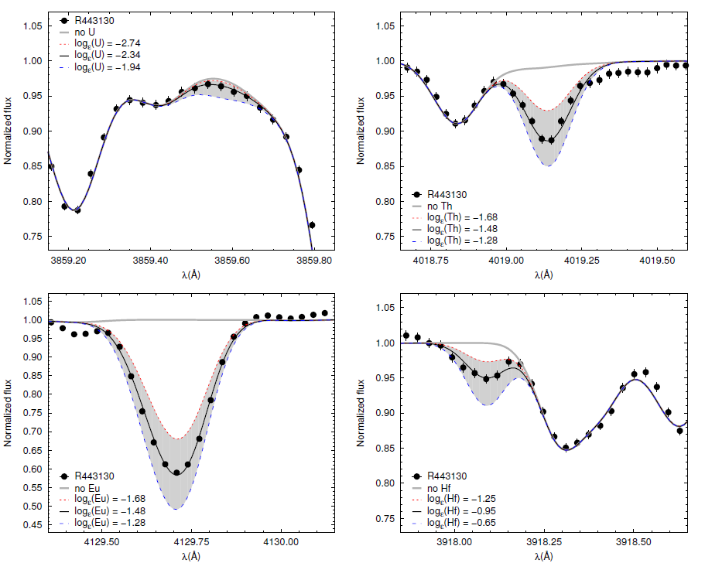
Magellan Observations of a new r-II Star with Th and U – RAVE 2038-0023
Placco et al. (in prep)

Slide 26
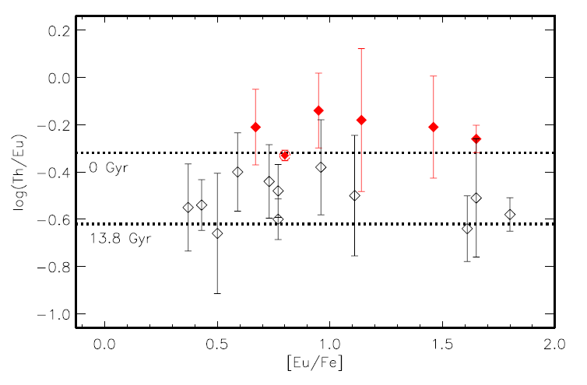
Presence of the Actinide Boost Among r-II Stars – What does it mean ?
Observed differences in the abundance patterns of actinides (Th, U) in r-II stars
  About 1/3rd of r-II stars exhibit an actinide boost
  Provides a hint that, if there is a single class of progenitors, there must be variations within that class
Mashonkina et al. (2014, A&A 569, 43)

Slide 27
Identification of the Astrophysical Site(s) of the r-Process
All of the above issues (and others) require a significant increase in the numbers of known r-II (and r-I) stars in the halo, enabling statistical studies of the frequencies of various abundance signatures that constrain models for their progenitors
  Goal is to triple/quadruple the number of known r-II stars, ~25 → ~75-100
  Numbers of known r-I stars will increase as well, ~125 → ~375-500
This effort has now begun, using a first-pass high-resolution spectroscopic survey of bright very metal-poor (VMP; [Fe/H] < -2) and extremely metal-poor (EMP; [Fe/H] < -3) stars identified by the medium-resolution survey efforts
Recall: r-II stars represent only about 3-5% of all VMP/EMP stars

Slide 28
The Future is Bright !
Having recognized many of the “players” involved with developing an understanding of the origin of the elements, based on large-scale spectroscopic survey efforts over the past ~25 years, future progress will be greatly accelerated by identification of the BRIGHTEST – most information rich – examples of various chemically peculiar stars
Multiple survey efforts underway to accomplish this:
  Medium-res spectroscopic follow-up of RAVE survey stars claimed to have [Fe/H] < -2.0, with 10 < V < 14 (ESO/NTT + SOAR + LNA + McDonald)
  Medium-res spectroscopic follow-up of “Best & Brightest” candidates using Gemini 8m bad weather time + ESO/NTT + SOAR, with 10 < V < 13.5
  Medium-res spectroscopic follow-up of bright SkyMapper (Australia) metal-poor candidates with -3.0 < [Fe/H] < -2.0 – release of `short-survey’ has just occured
  Anticipated follow-up of bright metal-poor candidates from S-PLUS (Brazil)
Collaborative effort with personnel from Univ. Sao Paulo (Brazil), PUC (Chile), Lick Observatory, Sydney & Canberra (Australia)

Slide 29
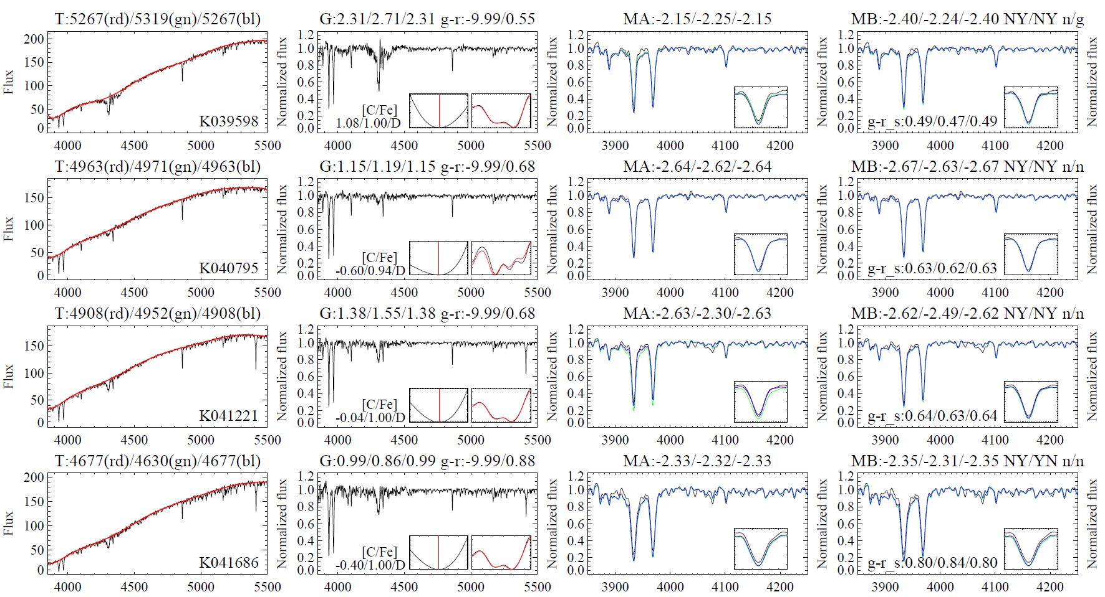

Example R ~ 2000 spectra of RAVE candidates with [Fe/H] < -2.0 – Suitable for identification of r-II, r-I, and CEMP stars for high-resolution follow-up observations
All have 10 < V < 14; ~ 2000 available, about 1700 of which are already observed

Slide 30
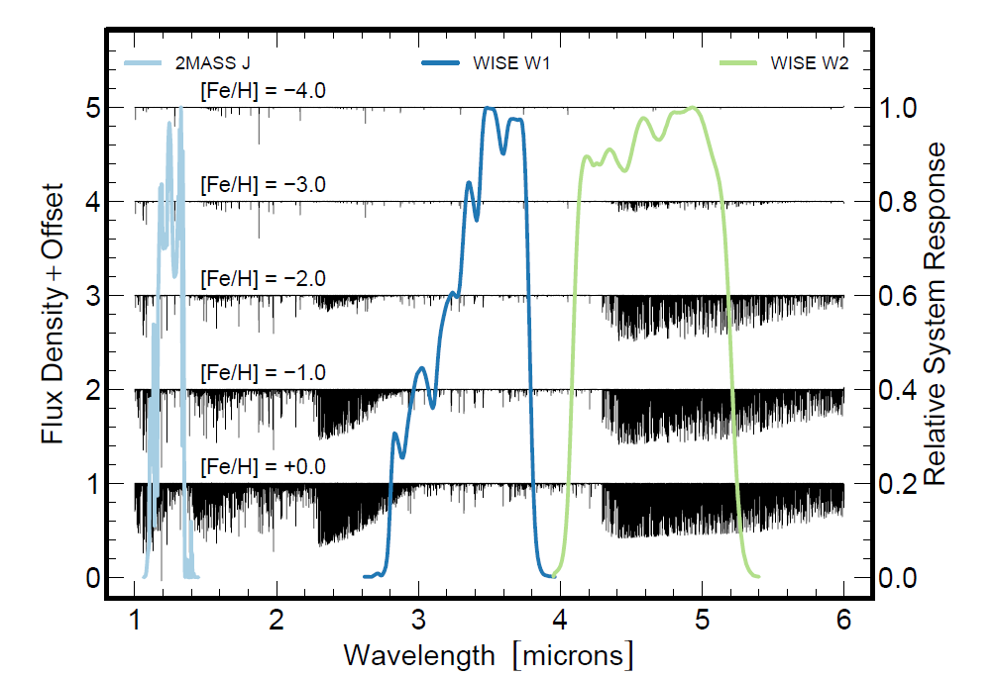
Best & Brightest candidates picked out by contrasting molecular line strengths –
~5000 candidates with [Fe/H] < -2.0 identified / expect ~ 1000 “hits”

Slide 31
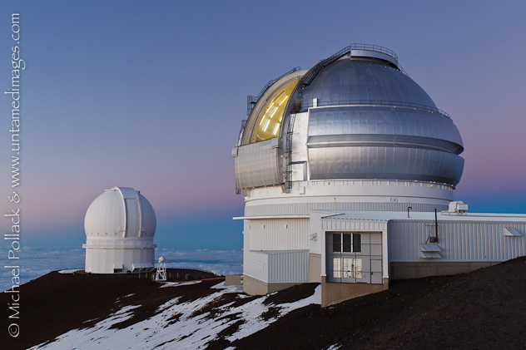
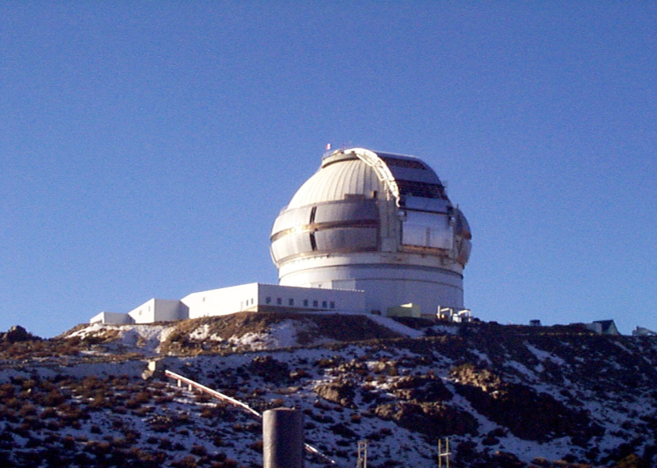
When the Weather Turns Bad ☺
The Importance of Metal-Poor Stars
One of the fundamental realizations of twentieth century astronomy was that not all stars in the Galaxy share the same chemical composition. This hard-won knowledge opened the door to numerous modern concepts, cutting across a wide swath of astrophysics. Today it is widely recognized that, in particular, stars with atmospheric abundances of the heavy elements (such as iron) that are substantially lower than the solar content provide fundamental constraints on numerous issues of contemporary interest. This long, and expanding, list includes:
The Nature of the Big Bang: Standard Big Bang cosmologies predict, with increasing precision, the amount of the light element lithium that was present in the Universe after the first minutes of creation. The measured abundance of Li in very metal-poor stars is thought to provide a direct estimate of the single free parameter in these models, the baryon-to-photon ratio. New measurements of the Li content in the most metal-deficient stars will make it possible to fully understand this link to the earliest periods in history of the Universe.
Gemini-N 8m Telescope (Hawaii)
Gemini-N 8m Telescope (Hawaii)
Gemini-S 8m Telescope (Chile)

Slide 32
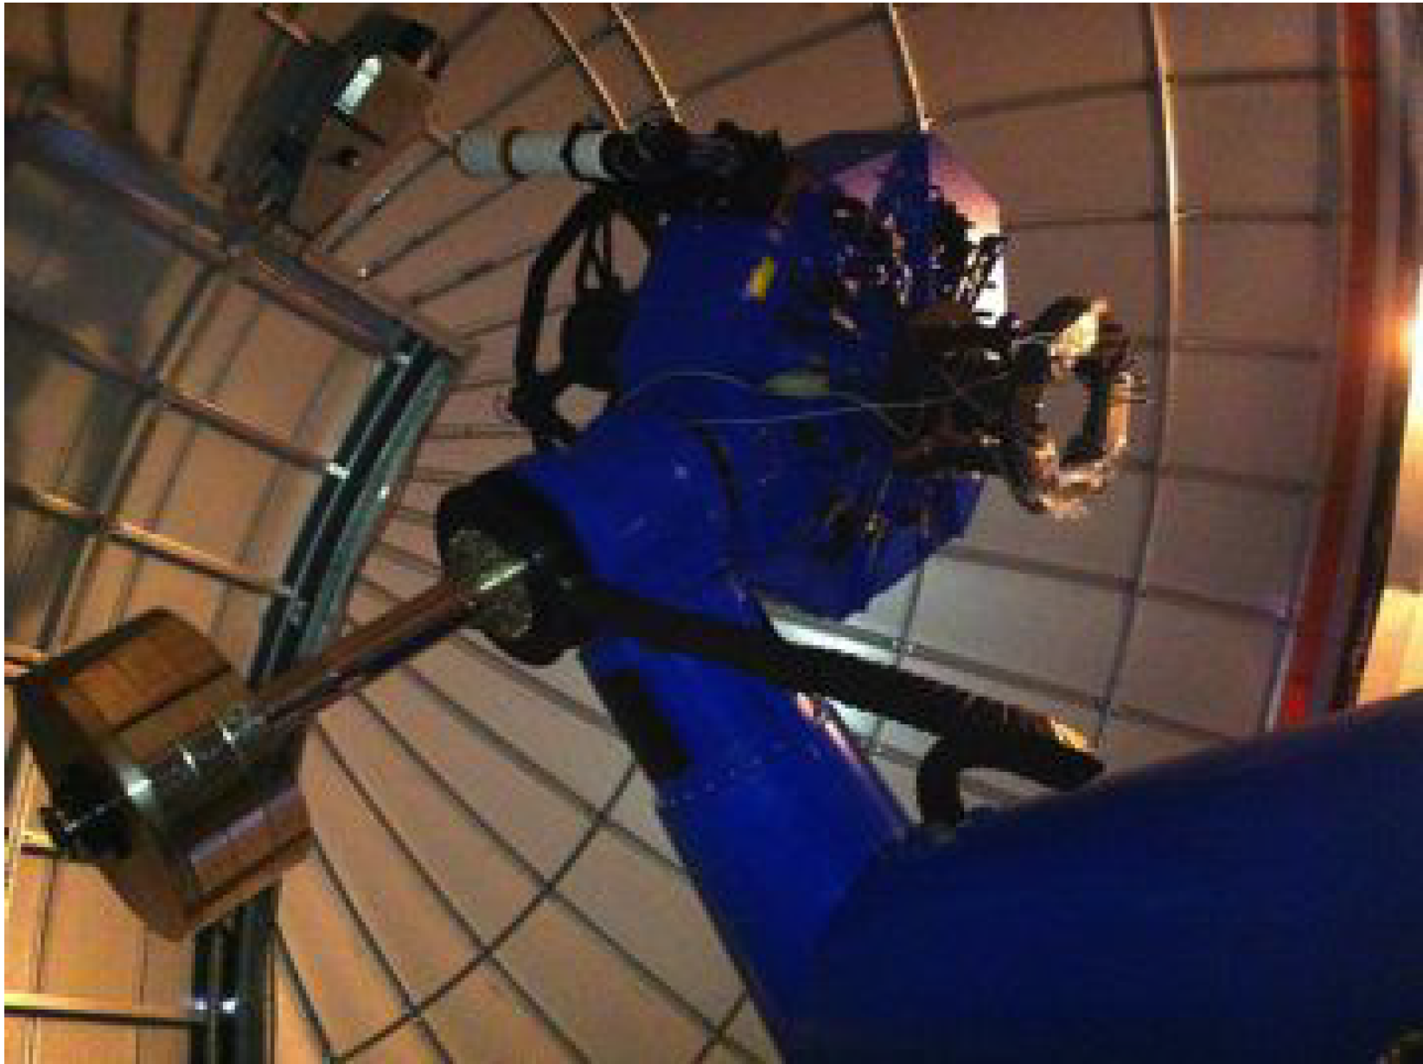
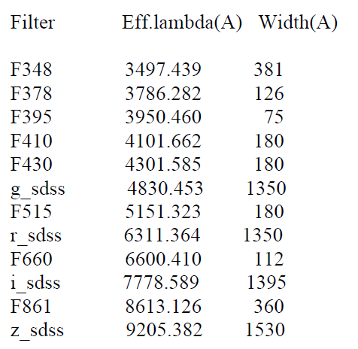
S-PLUS 0.8m Telescope at CTIO

Slide 33
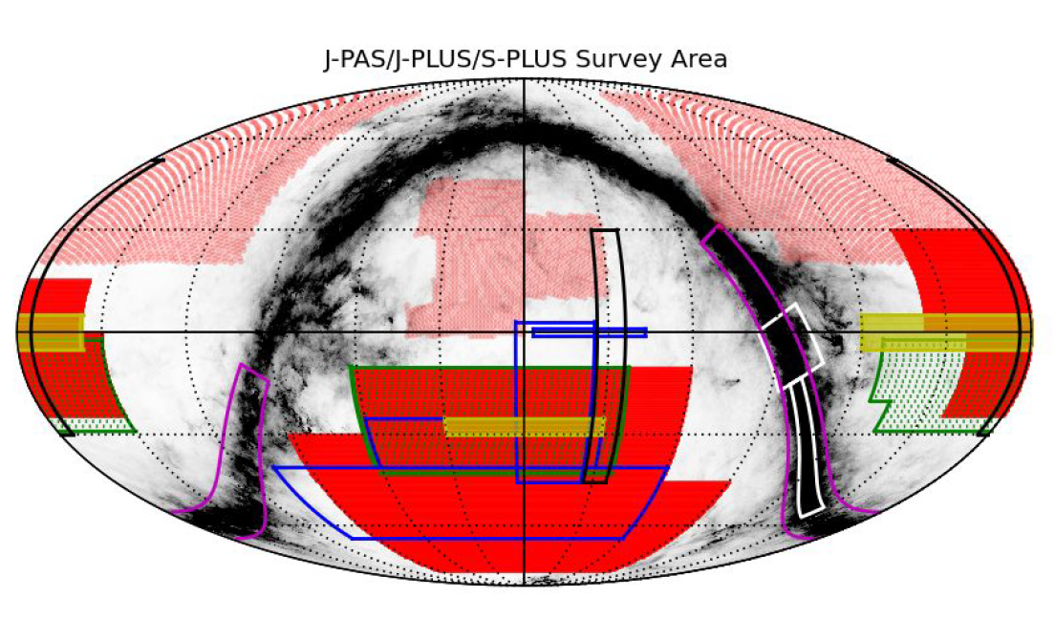
S-PLUS Sky Coverage Plan
S-PLUS SHOWN IN RED

Slide 34
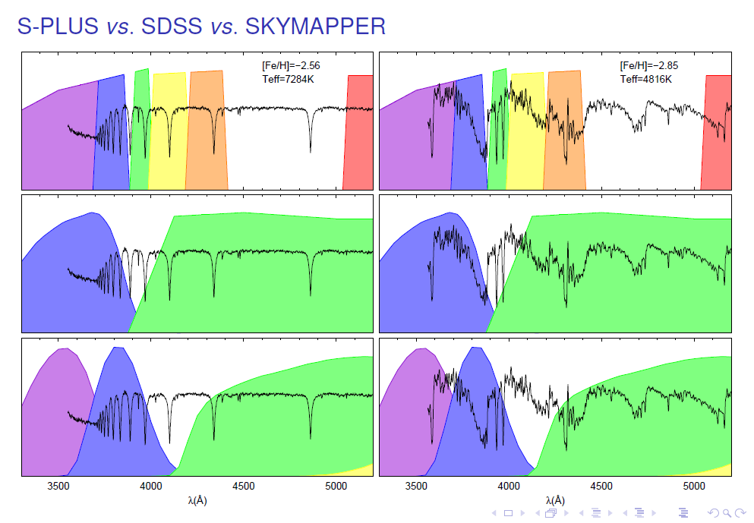

Slide 35
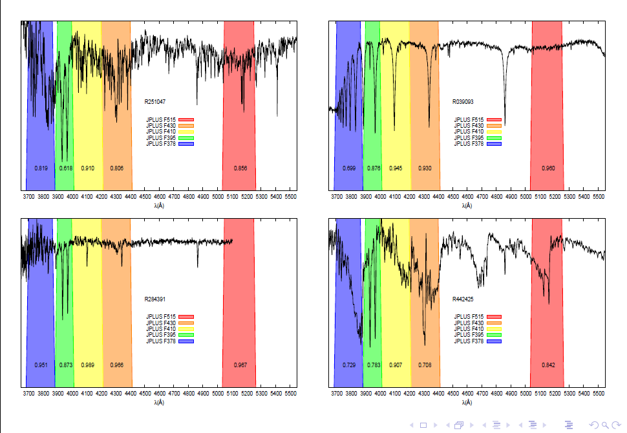

Slide 36
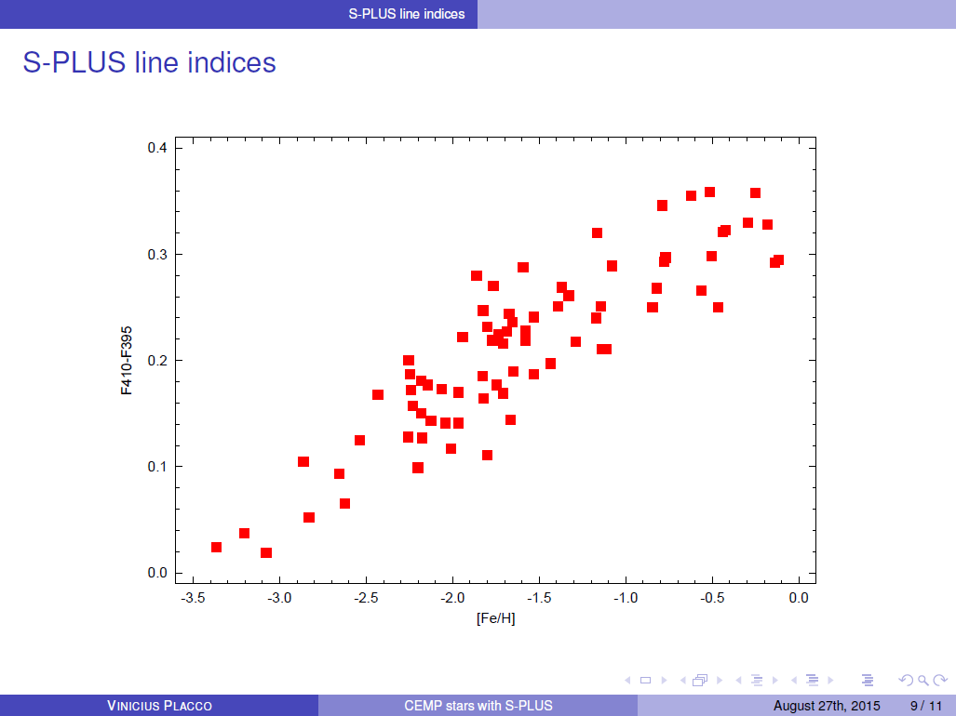

Slide 37
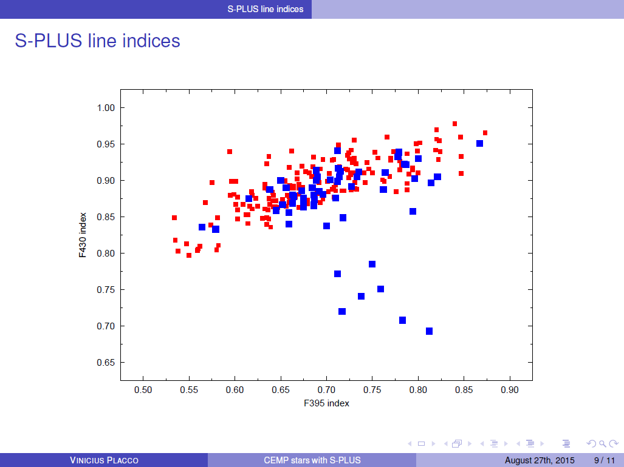

Slide 38
Identification of the Astrophysical Site(s) of the r-Process
Baseline plan is for “snapshot” high-resolution observations with the du Pont 2.5m telescope on Las Campanas (Chile), operated by the Carnegie Observatory
  Echelle spectrograph to be upgraded using Carnegie Observatory funds
  Pilot survey of ~200 candidates proposed for starting fall 2016
  Full survey of ~1500 candidates over next two years
Additional snapshot spectroscopy
  Magellan 6.5m (Chile, in collaboration with Frebel, Roederer)
  SALT 10m telescope (South Africa)
  SOAR 4.1m telescope (Chile) ← STELES just shipped !
Additional higher resolution, higher S/N observations to be taken of best r-II (and r-I) stars to be obtained with Magellan, Gemini/GHOST, VLT, etc., for measurement of precise Th and U abundances, among many others. HST a possibility if star is sufficiently bright.

Slide 39
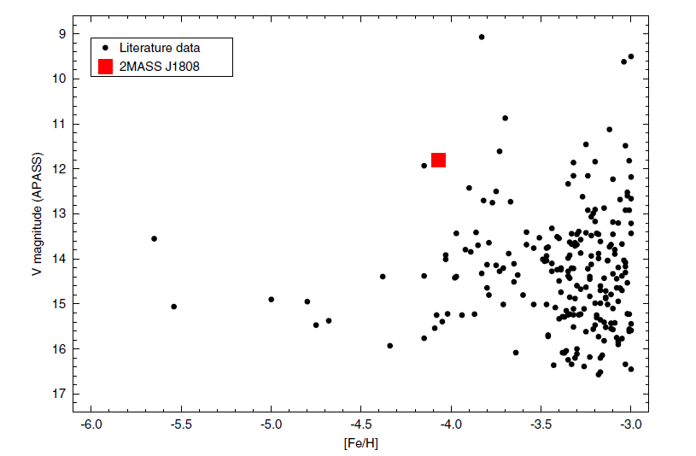
Known EMP and UMP Stars
MORE HERE PLEASE !
Melendez et al. (2016, A&A 585, L5)

Slide 40
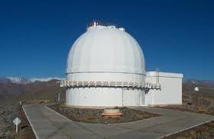
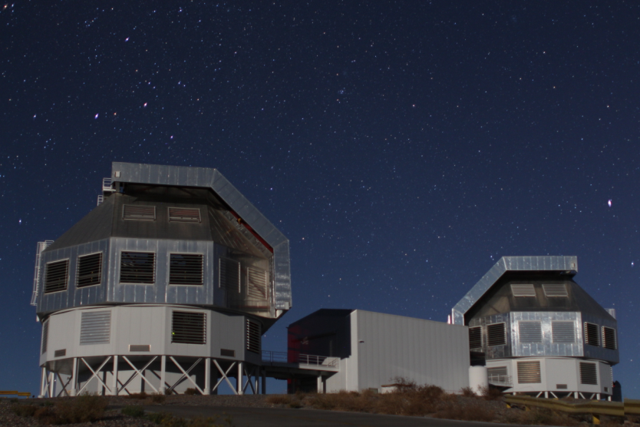
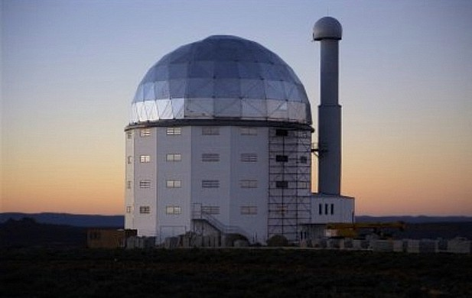
Snapshot High-Resolution Spectroscopy with Moderate to Large Telescopes
The Importance of Metal-Poor Stars
One of the fundamental realizations of twentieth century astronomy was that not all stars in the Galaxy share the same chemical composition. This hard-won knowledge opened the door to numerous modern concepts, cutting across a wide swath of astrophysics. Today it is widely recognized that, in particular, stars with atmospheric abundances of the heavy elements (such as iron) that are substantially lower than the solar content provide fundamental constraints on numerous issues of contemporary interest. This long, and expanding, list includes:
The Nature of the Big Bang: Standard Big Bang cosmologies predict, with increasing precision, the amount of the light element lithium that was present in the Universe after the first minutes of creation. The measured abundance of Li in very metal-poor stars is thought to provide a direct estimate of the single free parameter in these models, the baryon-to-photon ratio. New measurements of the Li content in the most metal-deficient stars will make it possible to fully understand this link to the earliest periods in history of the Universe.
Du Pont 2.5m (Chile)
Magellan 6.5m (Chile)
SALT (South Africa)

Slide 41
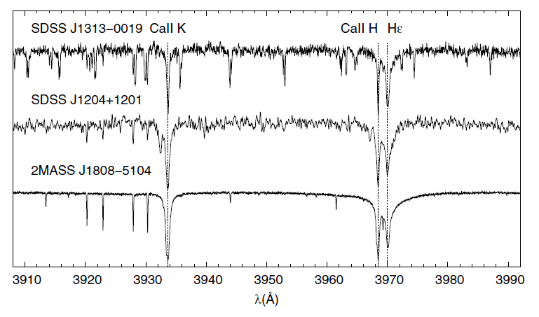
The Brightest Known UMP Star
[Fe/H] = -4.1 V = 11.9 [Proposed for HST]
Melendez et al. (2016, A&A 585, L5)

Slide 42
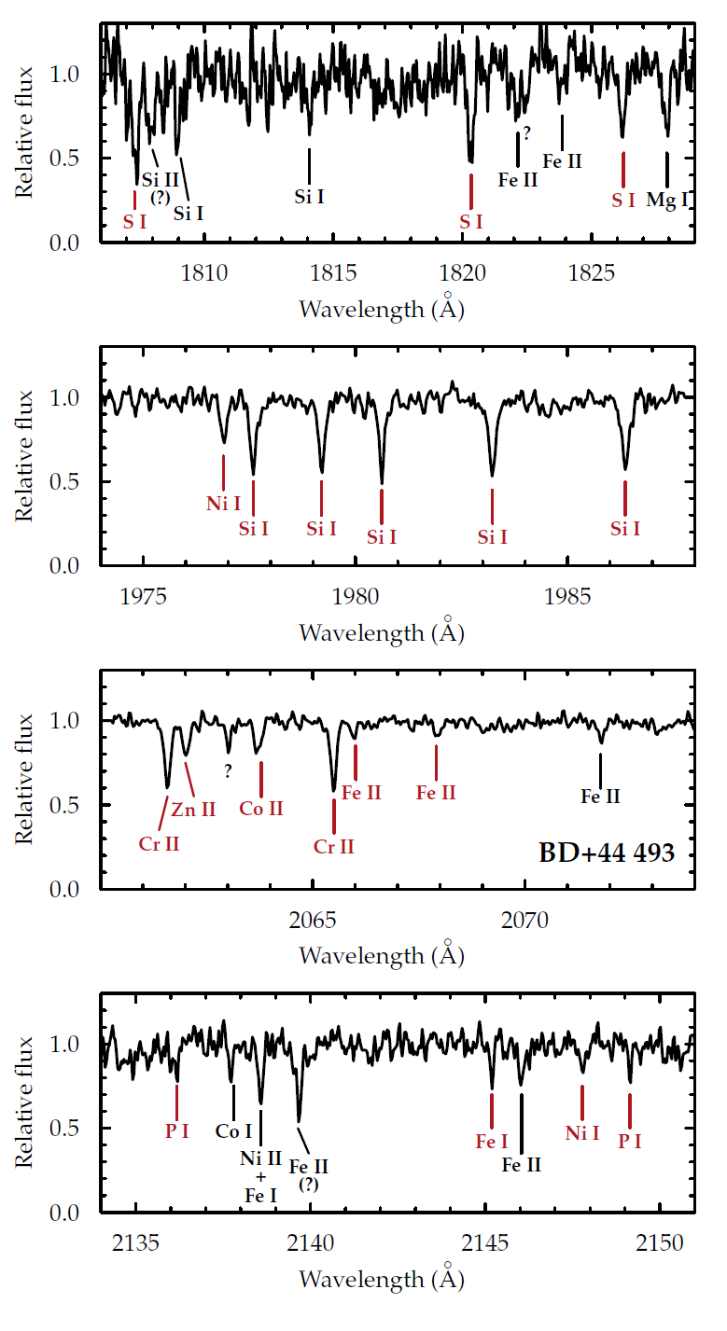
HST / STIS and COS Observations of BD+44:493 (V = 9.1, [Fe/H] = -3.9, CEMP-no)
First Detection of Phosphorus (P) and Sulphur (S) in any CEMP-no Star
Note accurate measurement of Si (difficult in the optical)
Roederer, Placco, & Beers, ApJ (in press)

Slide 43
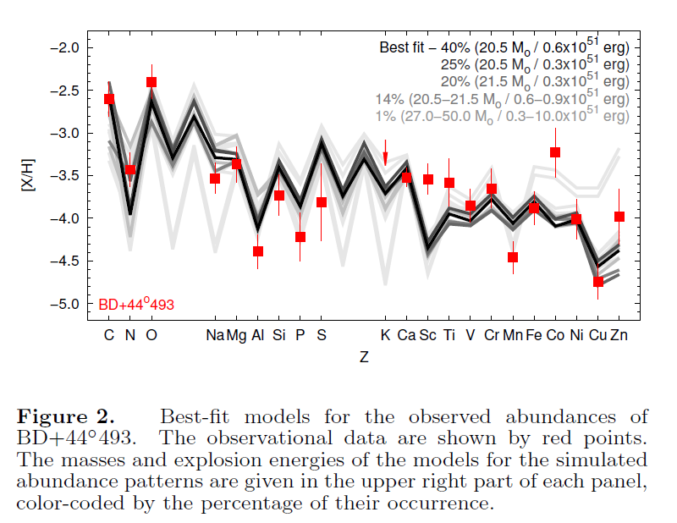
HST / STIS and COS Observations of BD+44:493 (V = 9.1, [Fe/H] = -3.9, CEMP-no)
Roederer, Placco, & Beers, ApJ (in press)

Slide 44
The Path Forward – Lets Solve this Problem !
There now exist a number of observational constraints on the nature of the r-process, based on halo r-II and r-I stars [including some not presented here] -- no extant progenitor model satisfies all of even the current constraints
These must be kept in mind as various progenitors for the r-process are developed and evaluated. It is possible to produce too many (!) as well as too few r-II stars
Ideally, progenitor models would predict testable abundance signatures that are uniquely associated with those sites, even if presently difficult to measure
Real progress demands a significant increase in the numbers of known r-II (and r-I) stars in the halo, enabling statistical studies of the frequencies of various abundance signatures that constrain models for their progenitors

