Slide 1
Asymptotic giant branch stars as drivers of cosmic chemistry
Maria Lugaro
Konkoly Observatory of the Hungarian
Academy of Sciences (Hungary)
and Monash University (Australia)

Slide 2

Asymptotic giant branch stars as drivers of cosmic chemistry
Maria Lugaro
Konkoly Observatory of the Hungarian
Academy of Sciences (Hungary)
and Monash University (Australia)
Amanda Karakas
Monash University (Australia) and University of Tokyo (Japan)
talk on Monday afternoon

Slide 3
Before we start
Some parts of the lectures are interactive: you will be asked to perform a tasks or answer a question
To do that you can work alone or in groups
Please make sure you have the following:
  Some pen and paper
  A set of the 4 colored bits of paper that are being distributed around (some to share)
  Download the nuclide chart on your laptop from http://indico2.riken.jp/indico/contributionDisplay.py?contribId=27&sessionId=19&confId=2103: go to the School website, “Contributions” link, and click on my contribution

Slide 4
Outline of the lectures
Introduction to asymptotic giant branch (AGB) stars
Why are AGB stars interesting?
Introduction to the slow neutron capture (s) process
The s process in AGB stars
The need for the intermediate neutron capture (i) process
Introduction to cosmochemistry

Slide 5
Outline of the lectures
Introduction to asymptotic giant branch (AGB) stars
Why are AGB stars interesting?
Introduction to the slow neutron capture (s) process
The s process in AGB stars
The need for the intermediate neutron capture (i) process
Introduction to cosmochemistry

Slide 6
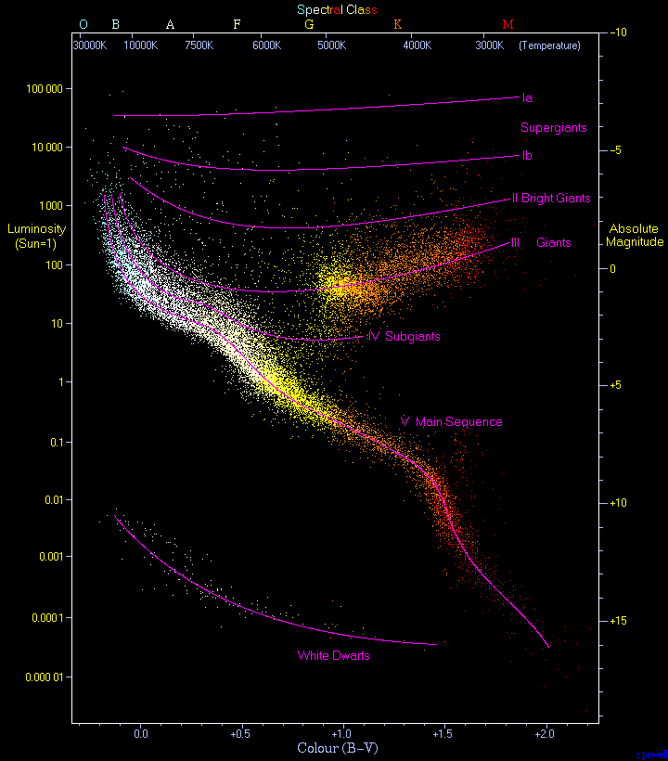

Slide 7
Core He exhaustion
Core H exhaustion
Core He burning starts
Schematic evolutionary track of the life of a star of 2 M

Slide 8
AGB phase
The end of the life of stars with initial mass <10 M
Stars that do not explode as core collapse supernovae
Core He exhaustion
Core H exhaustion
Core He burning starts
Schematic evolutionary track of the life of a star of 2 M

Slide 9
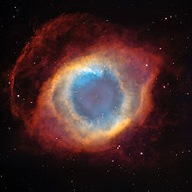
AGB phase
The end of the life of stars with initial mass <10 M
Stars that do not explode as core collapse supernovae
Post-AGB stars
Core He exhaustion
Core H exhaustion
Planetary nebulae
Core He burning starts
Schematic evolutionary track of the life of a star of 2 M

Slide 10
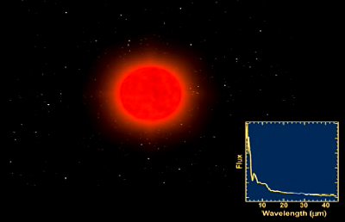
Artist impression.
Courtesy of Pedro Garcia-Lario, ESA and Anibal García-Hernandez, IAC

Slide 11
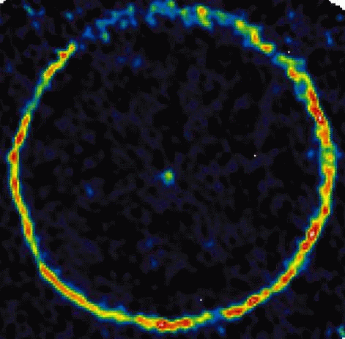
How a real AGB star looks like:
TT Cygni observed from the coordinated array of millimeter wavelength radio telescopes IRAM showing radio emission from carbon monoxide (CO) molecules.
The central emission is from material blown off the red giant over a few hundred years.
The thin ring, with a radius of about 1/4 light-year, represents a shell of gas expanding outward for 6,000 years.
Credit: H. Olofsson (Stockholm Observatory) et al. (2001)
Notes:
The AGB star TT Cygni: central emission from material blown off the red giant over a few hundred yr; thin ring is a shell of gas that has been expanding outward for 6,000 years (H. Olofsson).

Slide 12
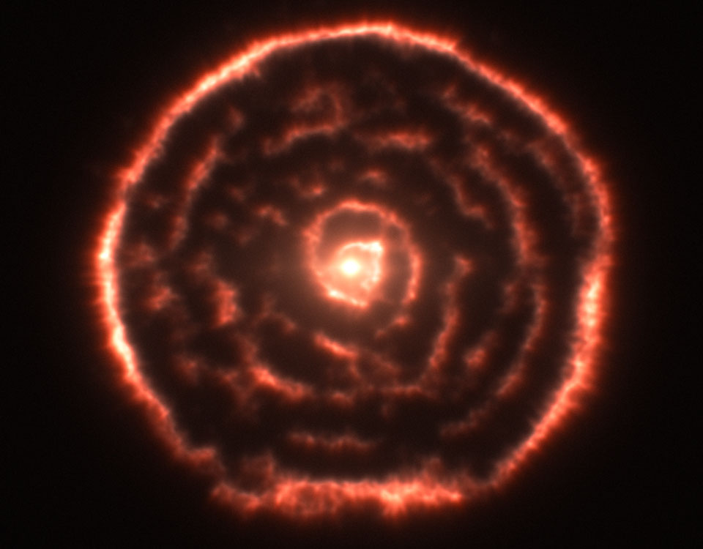
How a real AGB star looks like:
R Sculptoris, observed with the Atacama Large Millimeter/submillimeter Array ALMA, showed the unexpected spiral structure. The AGB star in R Sculptoris might be puffing gas toward an unseen binary companion star. Visualization Credit: ALMA Observatory (ESO/NAOJ/NRAO)
Notes:
The AGB star TT Cygni: central emission from material blown off the red giant over a few hundred yr; thin ring is a shell of gas that has been expanding outward for 6,000 years (H. Olofsson).

Slide 13
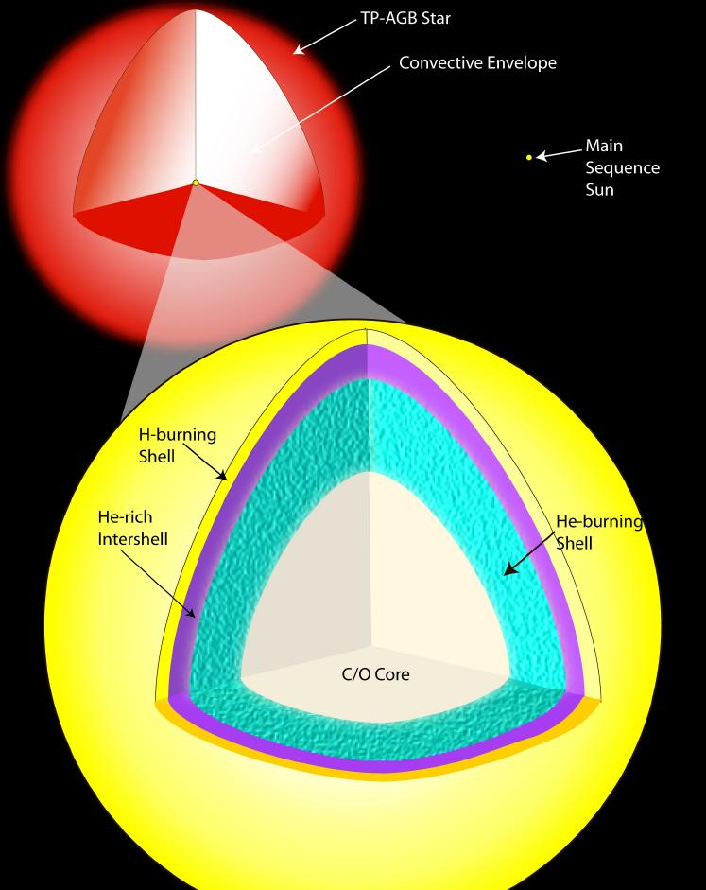
We are going deep inside AGB stars
Notes:
The AGB star TT Cygni: central emission from material blown off the red giant over a few hundred yr; thin ring is a shell of gas that has been expanding outward for 6,000 years (H. Olofsson).

Slide 14
Extended convective envelope
Compact core

Slide 15
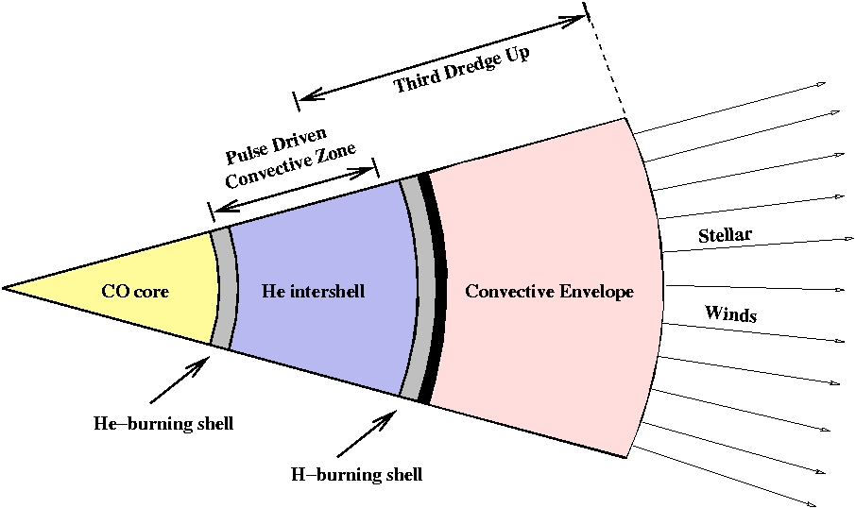
Extended convective envelope
Compact core
From 3D to 2D
Aaaaaa

Slide 16
Aaaaaa
aaa
H-burning shell
aaaa
He-burning shell

Slide 17
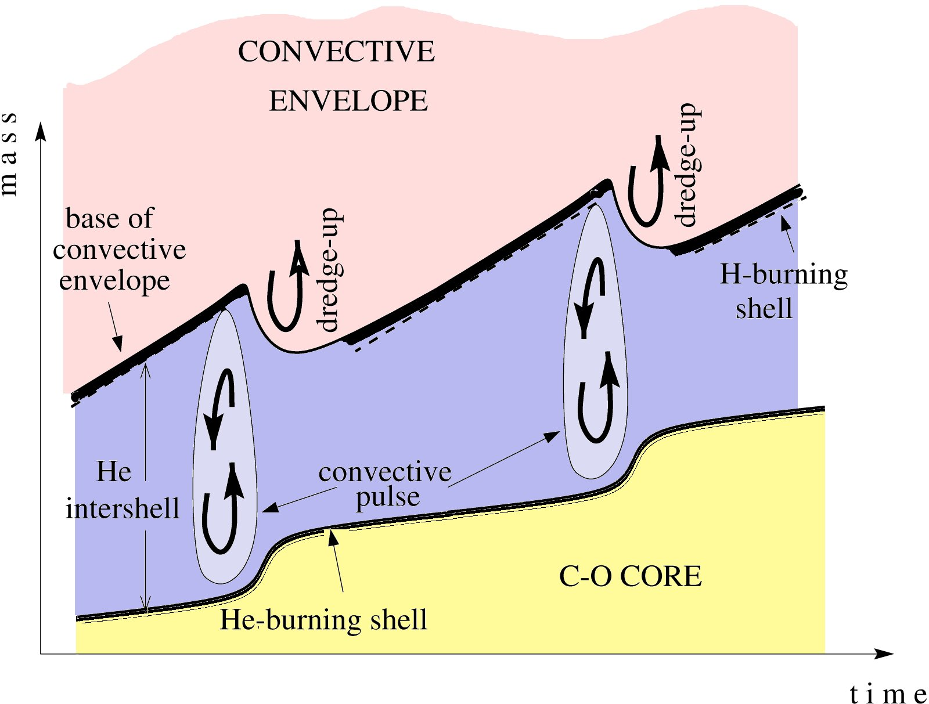
From 2D to 1D: the time evolution
Aaaaaa
aaa
H-burning shell
aaaa
He-burning shell

Slide 19
Draw your own AGB thermal pulses!
Suggestion: start by drawing the intershell convective regions.
Then draw the edges of the He-rich and the C-O core that connect the intershell convective regions.
Draw two pulses with TDU and two pulses without TDU
Shade the region representing the H-burning ashes

Slide 20
Outline of the lectures
Introduction to asymptotic giant branch (AGB) stars
Why are AGB stars interesting?
Introduction to the slow neutron capture (s) process
The s process in AGB stars
The need for the intermediate neutron capture (i) process
Introduction to cosmochemistry

Slide 21
Why AGB stars are so interesting
1. Partial He burning makes C, and not O

Slide 22
AGB stars can become C rich
= they have more C than O in their envelopes = C/O > 1
Karakas & Lugaro (2016)

Slide 23
AGB stars can become C rich
= they have more C than O in their envelopes = C/O > 1
Karakas & Lugaro (2016)
When C/O > 1 the chemistry in the outer layers changes: instead of oxides (HO, SiO, etc), C-rich molecules form: C₂, CH, CN, … the opacity, the luminosity, the mass loss change.
The spectra are so different that C stars were discovered already in 1860 by Angelo Secchi.

Slide 24


Why the C/O ratio is so crucial for chemistry?
O
C

Slide 25

Why the C/O ratio is so crucial for chemistry?
O
C
CO

Slide 26
Why the C/O ratio is so crucial for chemistry?
5O
5C
5CO

Slide 27

Why the C/O ratio is so crucial for chemistry?
6O
5C
HO
H
5CO

Slide 28
Why the C/O ratio is so crucial for chemistry?
5O
CH
6C
5CO

Slide 29
Why AGB stars are so interesting
2. The base of the envelope can be hot enough to drive proton captures from C to Al (hot bottom burning, HBB)
1. Partial He burning makes C, and not O

Slide 30
2. The most massive AGB stars can become N rich
C is converted to N via the CN cycle

Slide 31
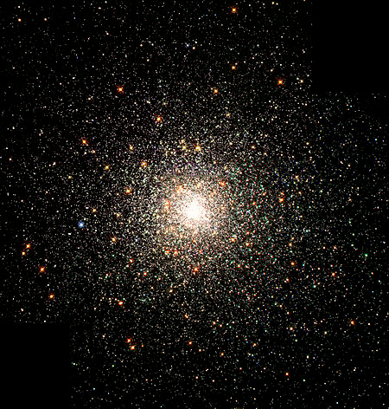
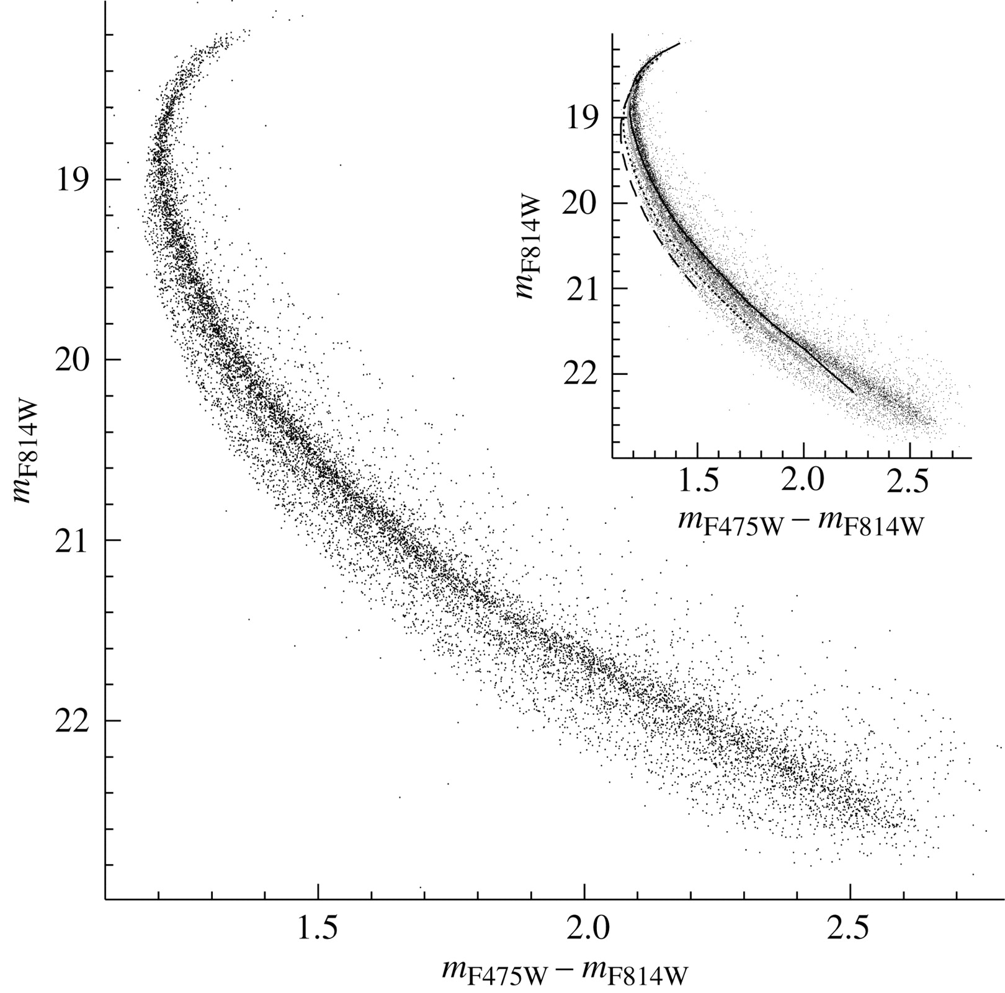
The mystery of Globular clusters
Multiple populations with different He abundances:

Slide 32
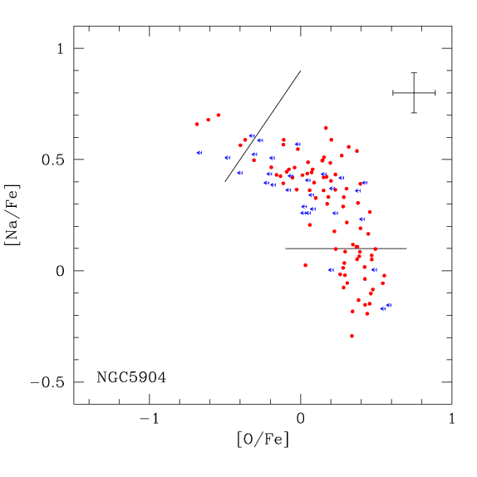
The mystery of Globular clusters
Multiple populations with different He abundances…
…and a famous Na-O anti-correlation
= clear signature of H-burning at high temperature
= HBB in massive AGB stars?
Carretta et al. (2009)

Slide 33
Why AGB stars are so interesting
2. The base of the envelope can be hot enough to drive proton captures from C to Al (hot bottom burning, HBB)
3. Ingestion of H-burning ashes in the thermal pulses produces ²²Ne and ¹⁹F (and ¹⁵N?)
1. Partial He burning makes C, and not O

Slide 34
3. Peculiar nucleosynthesis
Ingest H-burning ashes rich in ¹⁴N:
¹⁴N(α,γ)¹⁸F(β+)¹⁸O(α,γ)²²Ne
There is also some ¹³C:
¹³C(α,n)¹⁶O
¹⁴N(n,p)¹⁴C(α,γ)¹⁸O
¹⁸O(p,α)¹⁵N
¹⁵N(α,γ)¹⁹F
Abia et al. (2015)

Slide 35
Why AGB stars are so interesting
normal star
AGB star
normal star
AGB star
normal star
AGB star
Merrill 1952, Burbidge et al. 1957

Slide 36
Why AGB stars are so interesting
Why is technetium (Tc) so revolutionary?
Can you find it on the nuclide chart?
What does its name mean?
Merrill 1952, Burbidge et al. 1957

Slide 37
Outline of the lectures
Introduction to asymptotic giant branch (AGB) stars
Why are AGB stars interesting?
Introduction to the slow neutron capture (s) process
The s process in AGB stars
The need for the intermediate neutron capture (i) process
Introduction to cosmochemistry

Slide 38

The origin of the elements heavier than iron
Pb
H, He
Fe, Co, Ni
Au, Pt
Eu
C, N, O
Ba
Z
Sr, Y, Zr
U
N
Because of their high number of protons, elements heavier than Fe have a large Coulomb barrier and can be produced only by capturing neutrons.
Notes:
Is this first talk on neutron captures? YES! And K.-L. is just after me

Slide 39
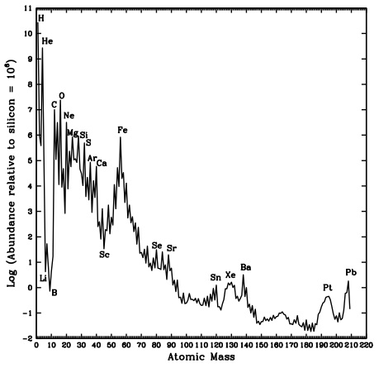
Solar System abundances

Slide 40
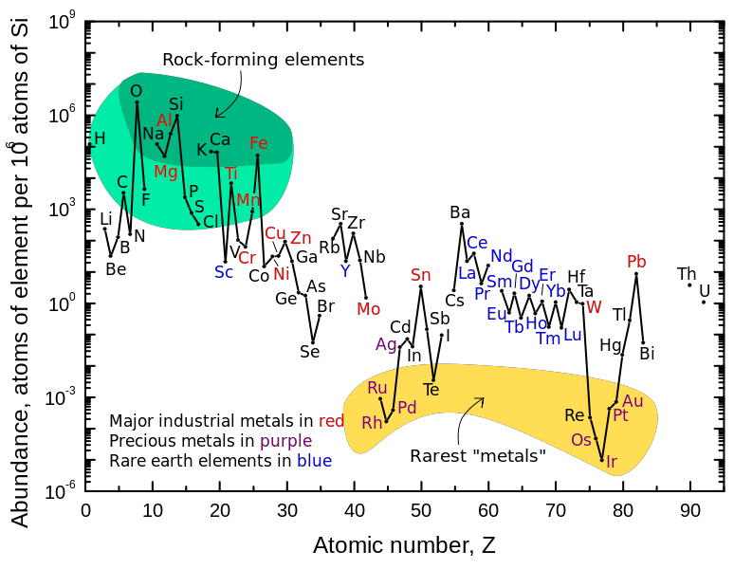
Earth’s crust abundances
The seeds of technology elements that make possible the high-tech world we live in today

Slide 41
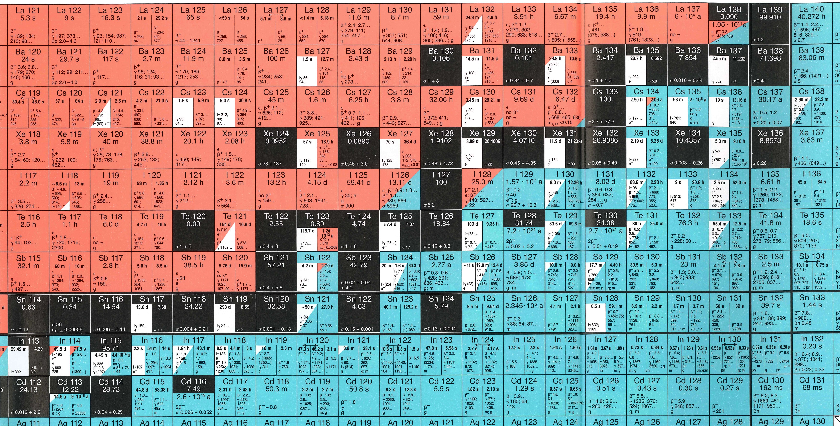
Slow and Rapid neutron captures
During the s process:
Time scale (n,γ) >> time scaleβdecay
N_{n} ~ 10⁸ n/cm³
During the r process:
Time scale (n,γ) << time scaleβdecay
N_{n} > 10²⁰ n/cm³

Slide 42
r-only s-only p-only

Slide 43
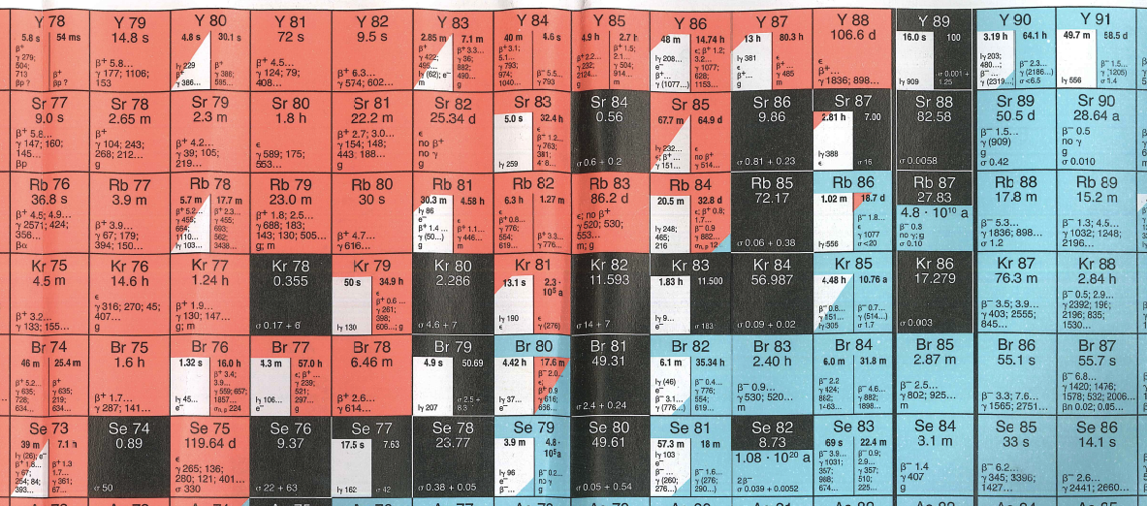
Which of this statements is wrong?
Kr has one p-only isotope
Sr has one s-only isotope
Sr has one p-only isotope
Kr has one s-only isotope

Slide 44
Track the s- and r-process path on the nuclide chart in the Tc region. Which processes produce the long-lived (T_{1/2} > 0.1 Myr) isotopes of Tc?
the p and the s processes
the p process
the r and the p process
the r, s, and p processes

Slide 45
Track the s- and r-process path on the nuclide chart in the Tc region. Which processes produce the long-lived (T_{1/2} > 0.1 Myr) isotopes of Tc?
the p and the s processes
the p process
the r and the p process
the r, s, and p processes

Slide 46
If the s process happens in AGB stars, which isotopes of Tc do we see in these stars?
97 and 98
99 only
99 and 100
98 only

Slide 47
If the s process happens in AGB stars, which isotopes of Tc do we see in these stars?
97 and 98
99 only
99 and 100
98 only

Slide 48
1. Neutron magic nuclei have low neutron capture cross sections σ and accumulate
The neutron exposure τ = total time-integrated neutron flux is the key quantity the defines the final s-process distribution
N=82
Notes:
Here draw on the board and explain the neutron exposure versus neutron density

Slide 49
Solar System abundances
The s-process peaks correspond to stable nuclei with Neutron Magic Numbers
N = 50, 82, 126
s-process peaks

Slide 50
2. In-between neutron magic nuclei abundances go to equilibrium: N ~ 1/σ
For example,
¹³¹Xe/¹³²Xe ≅ σ(¹³²Xe)/σ(¹³¹Xe)
N=82

Slide 51
3. Branching points can appear when half lives are greater than ~ a day
The neutron density N_{n} is the key quantity the defines the final abundances around branching points

Slide 52
Which of these statements is wrong?
The branching point at ⁸⁵Kr means that ⁸⁶Kr is not really an r-only isotope
There is a branching point at ⁸⁰Br
⁸⁶Rb is a branching point
⁸⁹Sr and ⁹⁰Sr are both branching points
Because it can decay both beta+ and beta-

Slide 53
Which of this statements is correct?
Its half life is so long we can consider it as stable during the s process
⁸¹Se is a branching point
⁸¹Kr is a not branching point
⁸⁵Kr is not a branching point
⁸⁶Rb is a branching point

Slide 54
Which of the nuclear data below are required to calculate s-process elemental abundances?
Neutron-capture rates of stable isotopes, including T dependence both direct and via population of excited states
Neutron-capture rates of unstable isotopes, including T dependence both direct and via population of excited states
β decay and e-capture rates, including their T and ρ dependence
Rates of the neutron source reactions

Slide 55
Which of the nuclear data below are required to calculate s-process elemental abundances?
Neutron-capture rates of stable isotopes, including T dependence both direct and via population of excited states
Neutron-capture rates of unstable isotopes, including T dependence both direct and via population of excited states
β decay and e-capture rates, including their T and ρ dependence
Rates of the neutron source reactions

Slide 56
Which of the nuclear data below are required to calculate s-process accurate isotopic abundances?
Neutron-capture rates of stable isotopes, including T dependence both direct and via population of excited states
Neutron-capture rates of unstable isotopes, including T dependence both direct and via population of excited states
β decay and e-capture rates, including their T and ρ dependence
Rates of the neutron source reactions
Notes:
There is one notable exception Rb discussed below

Slide 57
Which of the nuclear data below are required to calculate s-process accurate isotopic abundances?
Neutron-capture rates of stable isotopes, including T dependence both direct and via population of excited states
Neutron-capture rates of unstable isotopes, including T dependence both direct and via population of excited states
β decay and e-capture rates, including their T and ρ dependence
Rates of the neutron source reactions
Notes:
There is one notable exception Rb discussed below

Slide 58
Outline of the lectures
Introduction to asymptotic giant branch (AGB) stars
Why are AGB stars interesting?
Introduction to the slow neutron capture (s) process
The s process in AGB stars
The need for the intermediate neutron capture (i) process
Introduction to cosmochemistry

Slide 59
Free neutrons are needed: the ¹³C(α,n)¹⁶O reaction is the main source because it is active from 90 MK
Partial mixing of protons over a very thin layer make the ¹³C pocket
Gallino et al. 1998, Goriely & Mowlavi 2000, Lugaro et al. 2003, Cristallo et al. 2009
Assuming some mixing: ¹²C(p,γ)¹³N(β⁺)¹³C
¹³C(α,n)¹⁶O
Stellar mass ~1.5 - 4 M
Notes:
Mention here/reconnect to the exposure/density drawing

Slide 60
What is the effect of rotation?
¹³C(α,n)¹⁶O
Notes:
Main point is that the different neutron sources produce different elements. C13(a,n) produces Sr, Ba, Pb depending on Z. The ne22(a,n) source main produces elements at the first s-process peak.

Slide 61
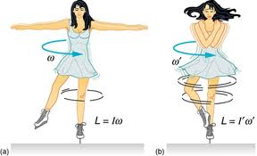
What is the effect of rotation?
aaaa
aaaa

Slide 62
What is the effect of rotation?
mixing of ¹⁴N inside the ¹³C pocket,
¹⁴N(n,p)¹⁴C is very efficient: it steals neutrons from the s process:
Rotation can dramatically reduce the number of free neutrons (Herwig, Langer & Lugaro 2003, Siess & Goriely 2004, Piersanti, Cristallo & Straniero 2013)
aaaa
aaaa

Slide 63

What is the effect of rotation?
mixing of ¹⁴N inside the ¹³C pocket,
¹⁴N(n,p) ¹⁴N is very efficient: it steals neutrons from the s process:
Rotation can dramatically reduce the number of free neutrons (Herwig, Langer, & Lugaro 2003, Siess & Goriely 2004, Piersanti, Cristallo & Straniero 2013)
aaaa
aaaa
Coupling of envelope and core can slow down the core

Slide 64
¹³C(α,n)¹⁶O
Extrapolations of direct measurements at energies > 270 keV, far from the Gamow window at 140 – 230 keV
Indirect measurements of the contribution of the sub-threshold resonance due to the 6.356 MeV state in ¹⁷O
JINA reaclib
Notes:
Guo et al China Institute of Atomic Energy

Slide 65
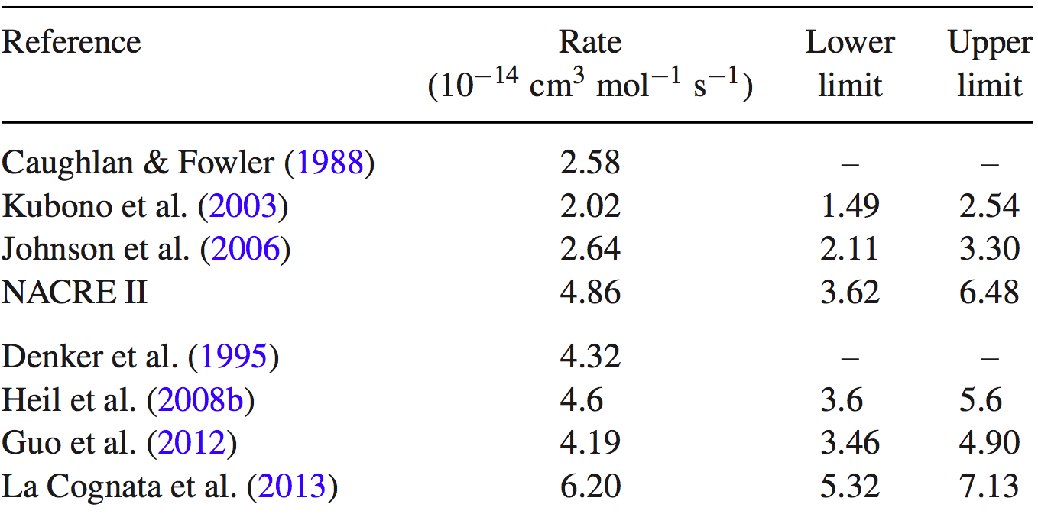
¹³C(α,n)¹⁶O
(Bisterzo et al. 2015)
T=100 MK
(100 MK)
Do the latest evaluations agree with each other?
No
Yes

Slide 66
Another neutron source in AGB stars of mass > 3 M
Lower neutron exposures but higher neutron densities than the ¹³C source
²²Ne(α,n)²⁵Mg
activated from 300 MK
Notes:
Mention here/reconnect to the exposure/density drawing

Slide 67
The lowest well studied resonance at 832 keV dominates the rate (Drotleff et al. 1993) and lies above the relevant astrophysical energies.
The influence of a possible resonance at 635 keV was ruled out based on parity (Longland et al. 2009).
Theoretical extrapolations may be affected by other unknown low-energy resonances.
²²Ne(α,n)²⁵Mg
JINA reaclib
Notes:
Longland et al. (2009) determined the energy and quantum numbers of excited states in 26Mg through a nuclear resonance fluorescence experiment and demonstrated that the corresponding level at an ex- citation energy of Ex = 11 154keV has unnatural parity Jπ = 1+, contrary to the previous spin-parity assignment. Because both 22Ne and 4He have Jπ = 0+, by angular momentum selection rules only natural-parity (0+, 1−, 2+, etc.) states in 26Mg can participate in the 22Ne(α, n)25Mg reaction, thus excluding the Jπ = 1+ reso- nance.

Slide 68
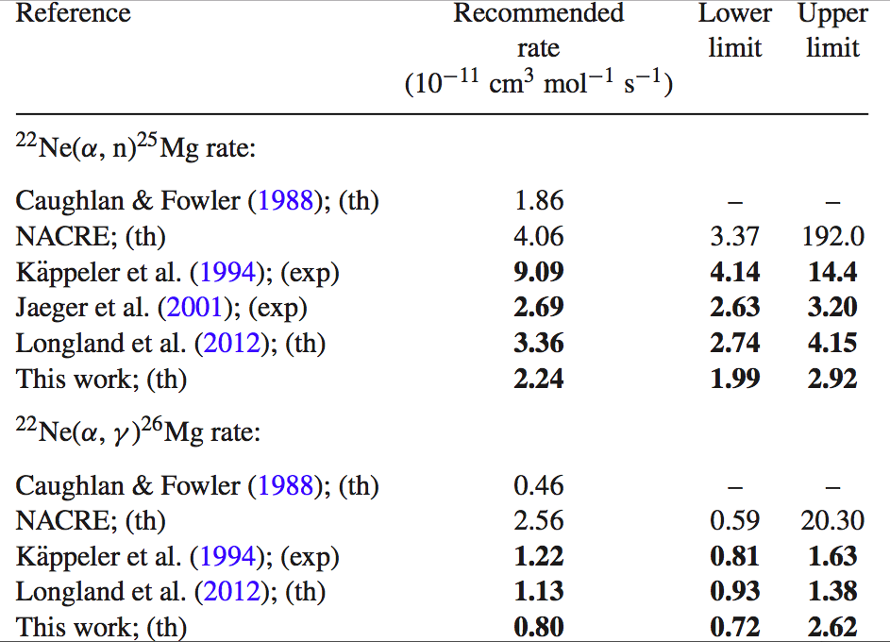
²²Ne(α,n)²⁵Mg
(Bisterzo et al. 2015)
T=300 MK
Iliadis et al. (2010), (th)
2.22
(Important only for AGB stars with mass > 5 M)
Iliadis et al. (2010); (th)
0.20

Slide 69
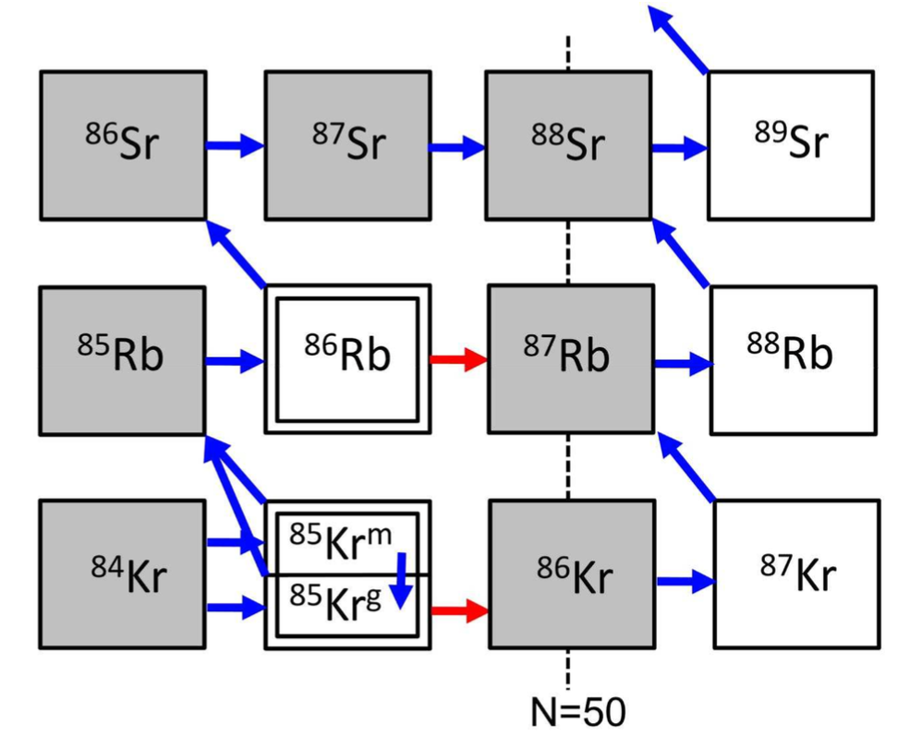
The branching point at ⁸⁶Rb is activated at N_{n} ~ 10¹⁰ cm⁻³
T_{1/2}=19 d
T_{1/2}=11 yr

Slide 70
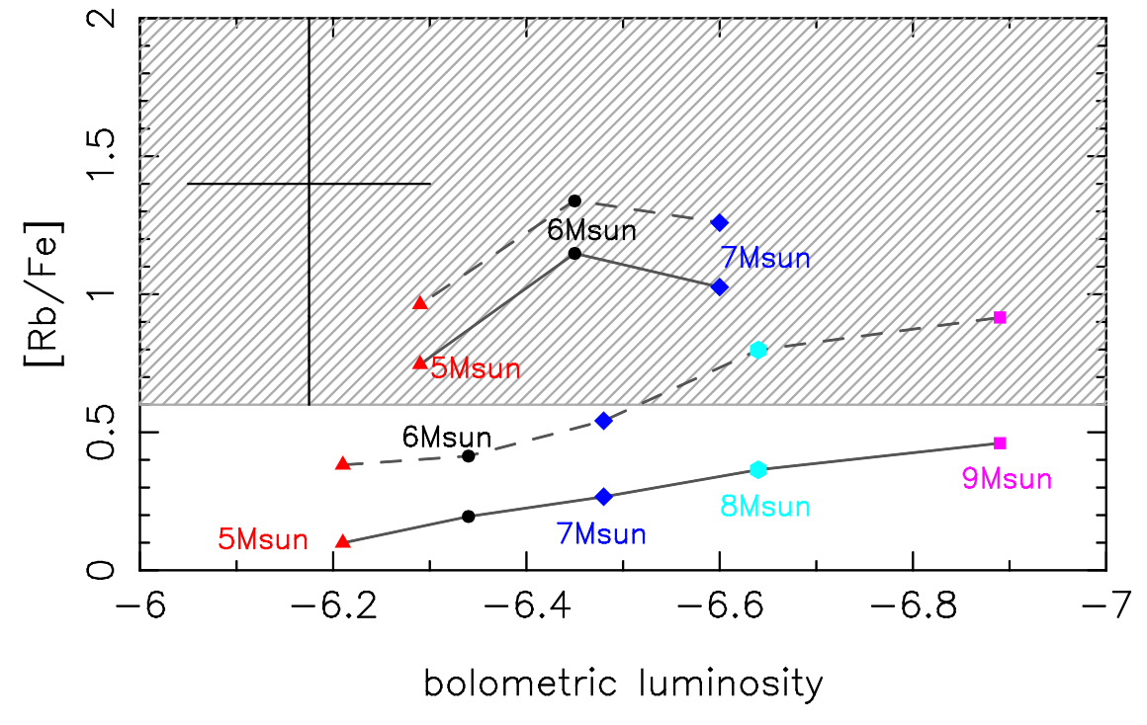
Observations of Rb in massive AGB stars
Garcia-Hernandez et al. (2006)
NACRE
Iliadis et al. (2010)
Karakas et al. (2006)
Karakas, Garcia-Hernandez, Lugaro 2012
Notes:
Add zamora

Slide 71
Zamora et al. 2014: on average 1 dex lower!
NACRE
Iliadis et al. (2010)
Karakas et al. (2006)
Karakas, Garcia-Hernandez, Lugaro 2012, ApJ
Notes:
Add zamora

Slide 72
Outline of the lectures
Introduction to asymptotic giant branch (AGB) stars
Why are AGB stars interesting?
Introduction to the slow neutron capture (s) process
The s process in AGB stars
The need for the intermediate neutron capture (i) process
Introduction to cosmochemistry

Slide 73
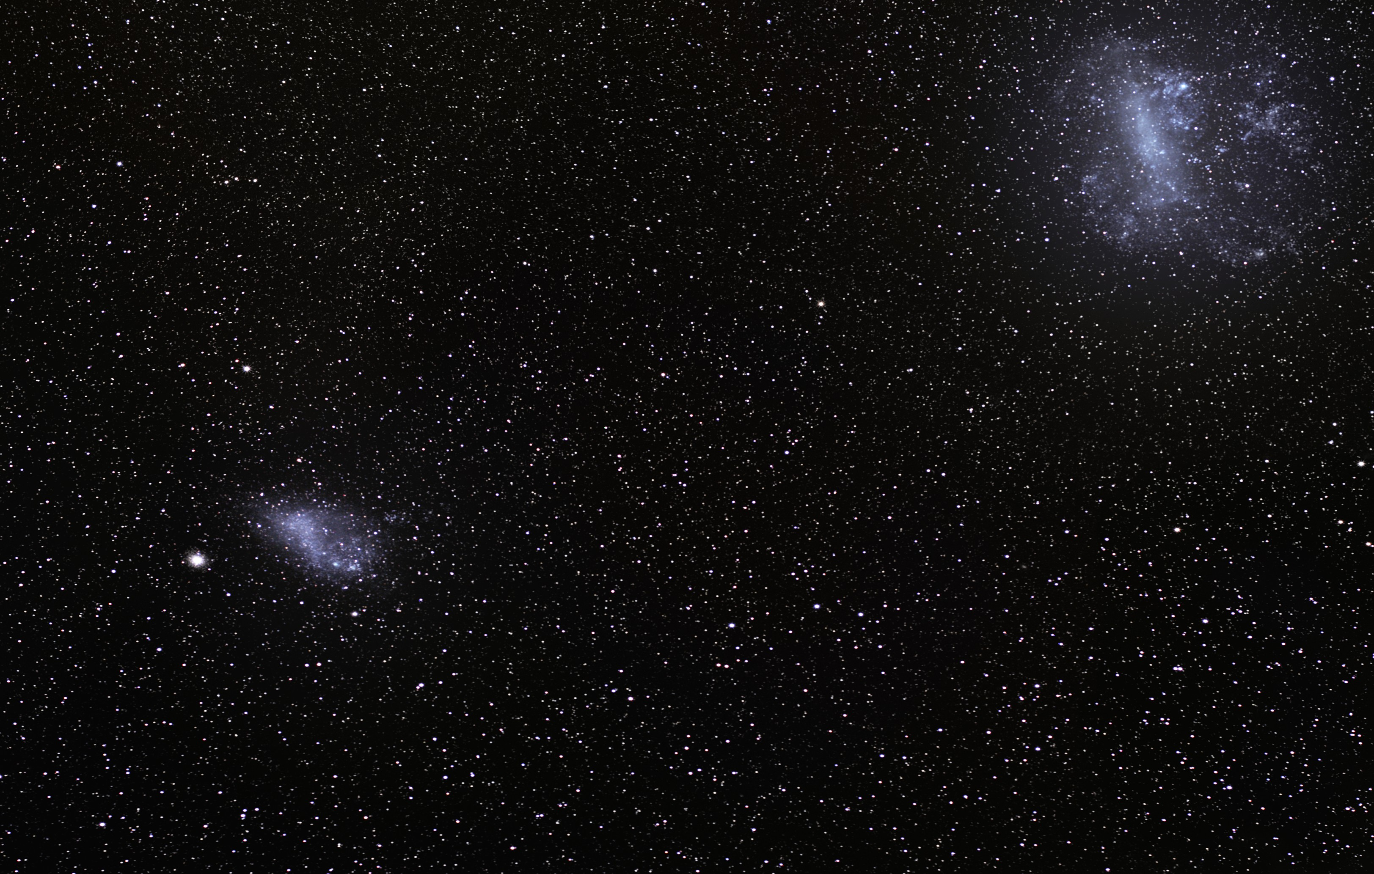
The Large and Small Magellanic Clouds (MCs)

Slide 74
The Large and Small Magellanic Clouds (MCs)
De Smedt et al. have derived the abundances of many neutron-capture elements from the spectra of post-AGB stars in the MCs
We know the distance of the MCs so we can derive the absolute luminosity of these stars.
Comparing to evolutionary models we can infer that their initial mass was 1 to 1.5 M.
No
Notes:
Another 2 in the LMC just published this month by De Smedt et al.

Slide 75
Standard ¹³C pocket
Too much lead!
Lugaro et al. 2015

Slide 76
Standard ¹³C pocket
Too much lead!
This is not an s process!
Lugaro et al. 2015

Slide 77
High Ba (magic) and low Pb (magic) but high abundances of the elements in-between
Which s-process Golden Rule is broken?
1 (bottlenecks)
2 (equilibrium)
3 (branching points)
1, 2 and 3

Slide 78
High Ba (magic) and low Pb (magic) but high abundances of the elements in-between
Which s process Golden Rule is broken?
1 (bottlenecks)
2 (equilibrium)
3 (branching points)
1, 2 and 3

Slide 79
We need an intermediate (i) neutron-capture process :
10¹³ < N_{n} < 10¹⁷
Cowan & Rose (1977) Herwig et al. (2011)
Hampel et al. (2016)
N_{n} = 10⁷
N_{n} = 10¹⁵

Slide 80
We need an intermediate (i) neutron-capture process :
10¹³ < N_{n} < 10¹⁷
Cowan & Rose (1977) Herwig et al. (2011)
Hampel et al. (2016)
N_{n} = 10⁷
N_{n} = 10¹⁵
¹³⁵I

Slide 81
We need an intermediate (i) neutron-capture process :
10¹³ < N_{n} < 10¹⁷
Cowan & Rose (1977) Herwig et al. (2011)
Hampel et al. (2016)
N_{n} = 10⁷
N_{n} = 10¹⁵
Similar problems with some old halo stars: the CEMP-s/r: see R. Stancliffe talk on Thursday morning
¹³⁵I

Slide 82
Low-mass AGB stars are an i-process site:
where can it happen?
Proton ingestions episodes:
need 3D hydrodynamics
¹³C(α,n)¹⁶O

Slide 83
Outline of the lectures
Introduction to asymptotic giant branch (AGB) stars
Why are AGB stars interesting?
Introduction to the slow neutron capture (s) process
The s process in AGB stars
The need for the intermediate neutron capture (i) process
Introduction to cosmochemistry

Slide 84
What is cosmochemistry?
Wikipedia: “The study of the chemical composition of matter in the universe and the processes that led to those compositions.”

Slide 85
What is cosmochemistry?
Wikipedia: “The study of the chemical composition of matter in the universe and the processes that led to those compositions.”
This is done primarily through the study of the chemical composition of meteorites and other physical samples. Given that the asteroid parent bodies of meteorites were some of the first solid material to condense from the early solar nebula, cosmochemists are generally concerned with the objects contained within the Solar System.

Slide 86
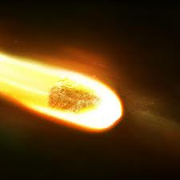
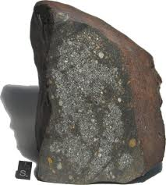
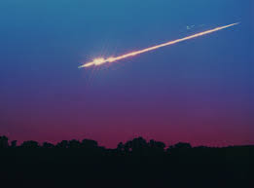
Meteor and meteorite
What is the difference?

Slide 87
Solar System abundances

Slide 88
Solar System abundances
In 1938, Victor Goldschmidt compiled the first list of "cosmic abundances" based on analysis of terrestrial and meteorite samples
In 1956, Harold Urey and Hans Suess, published the first table of cosmic abundances to include isotopes based on meteorite analysis

Slide 89
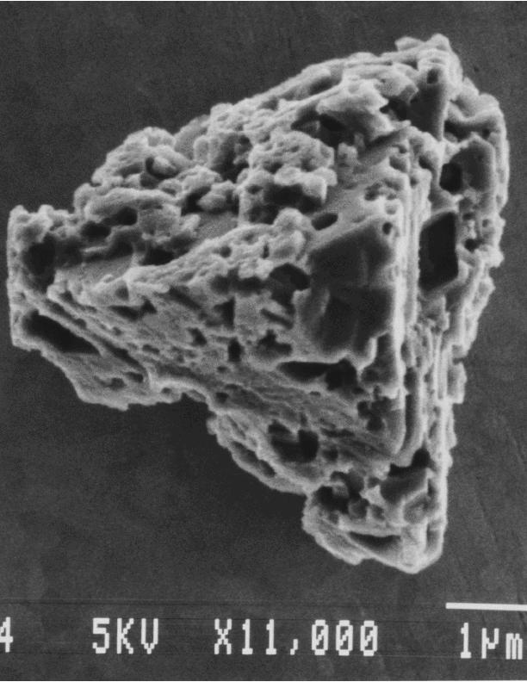
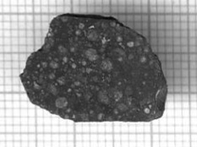
Can we investigate other stars with meteorites?
Microscopic stardust is found inside meteorites
Allende meteorite (Mexico, 1969)
Carbonaceous chondrite
Matrix: amalgam of amorphous material and crystals of very small dimensions
size ~ 1 μm
Chondrules
size ~ 1 mm
Stellar grains, very unusual compositions!

Slide 90
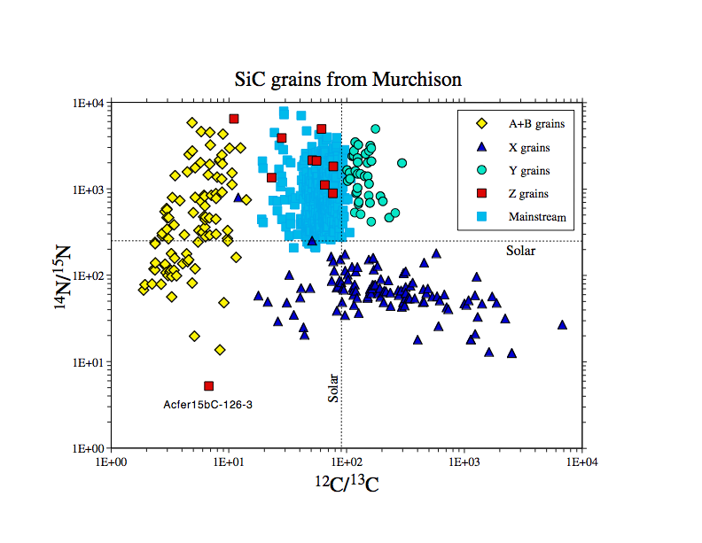
How do we know this grain came from a star?
In the Solar System ¹²C/¹³C=89 in this grain =50

Slide 91
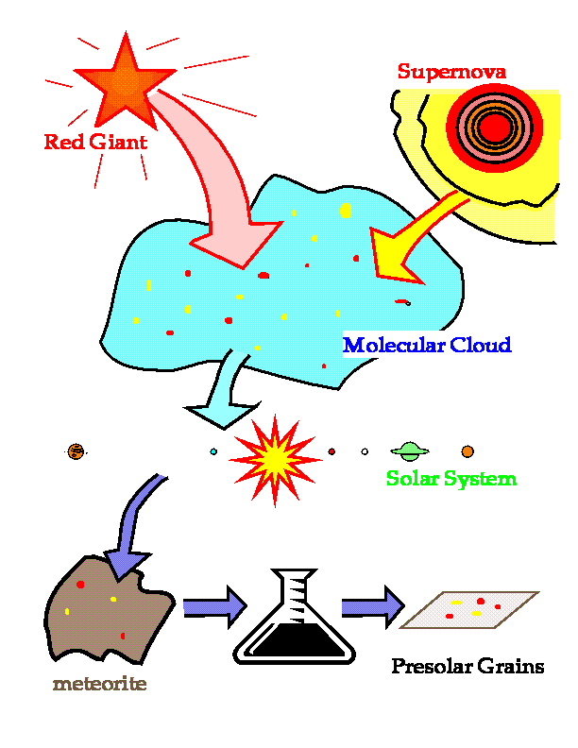
How did stardust travel to us?
Stellar grains were
born in circumstellar regions around ancient stars,
ejected into the interstellar medium,
preserved during the formation of the solar system, and
trapped inside primitive meteorites from where they are now extracted and analysed.

Slide 92
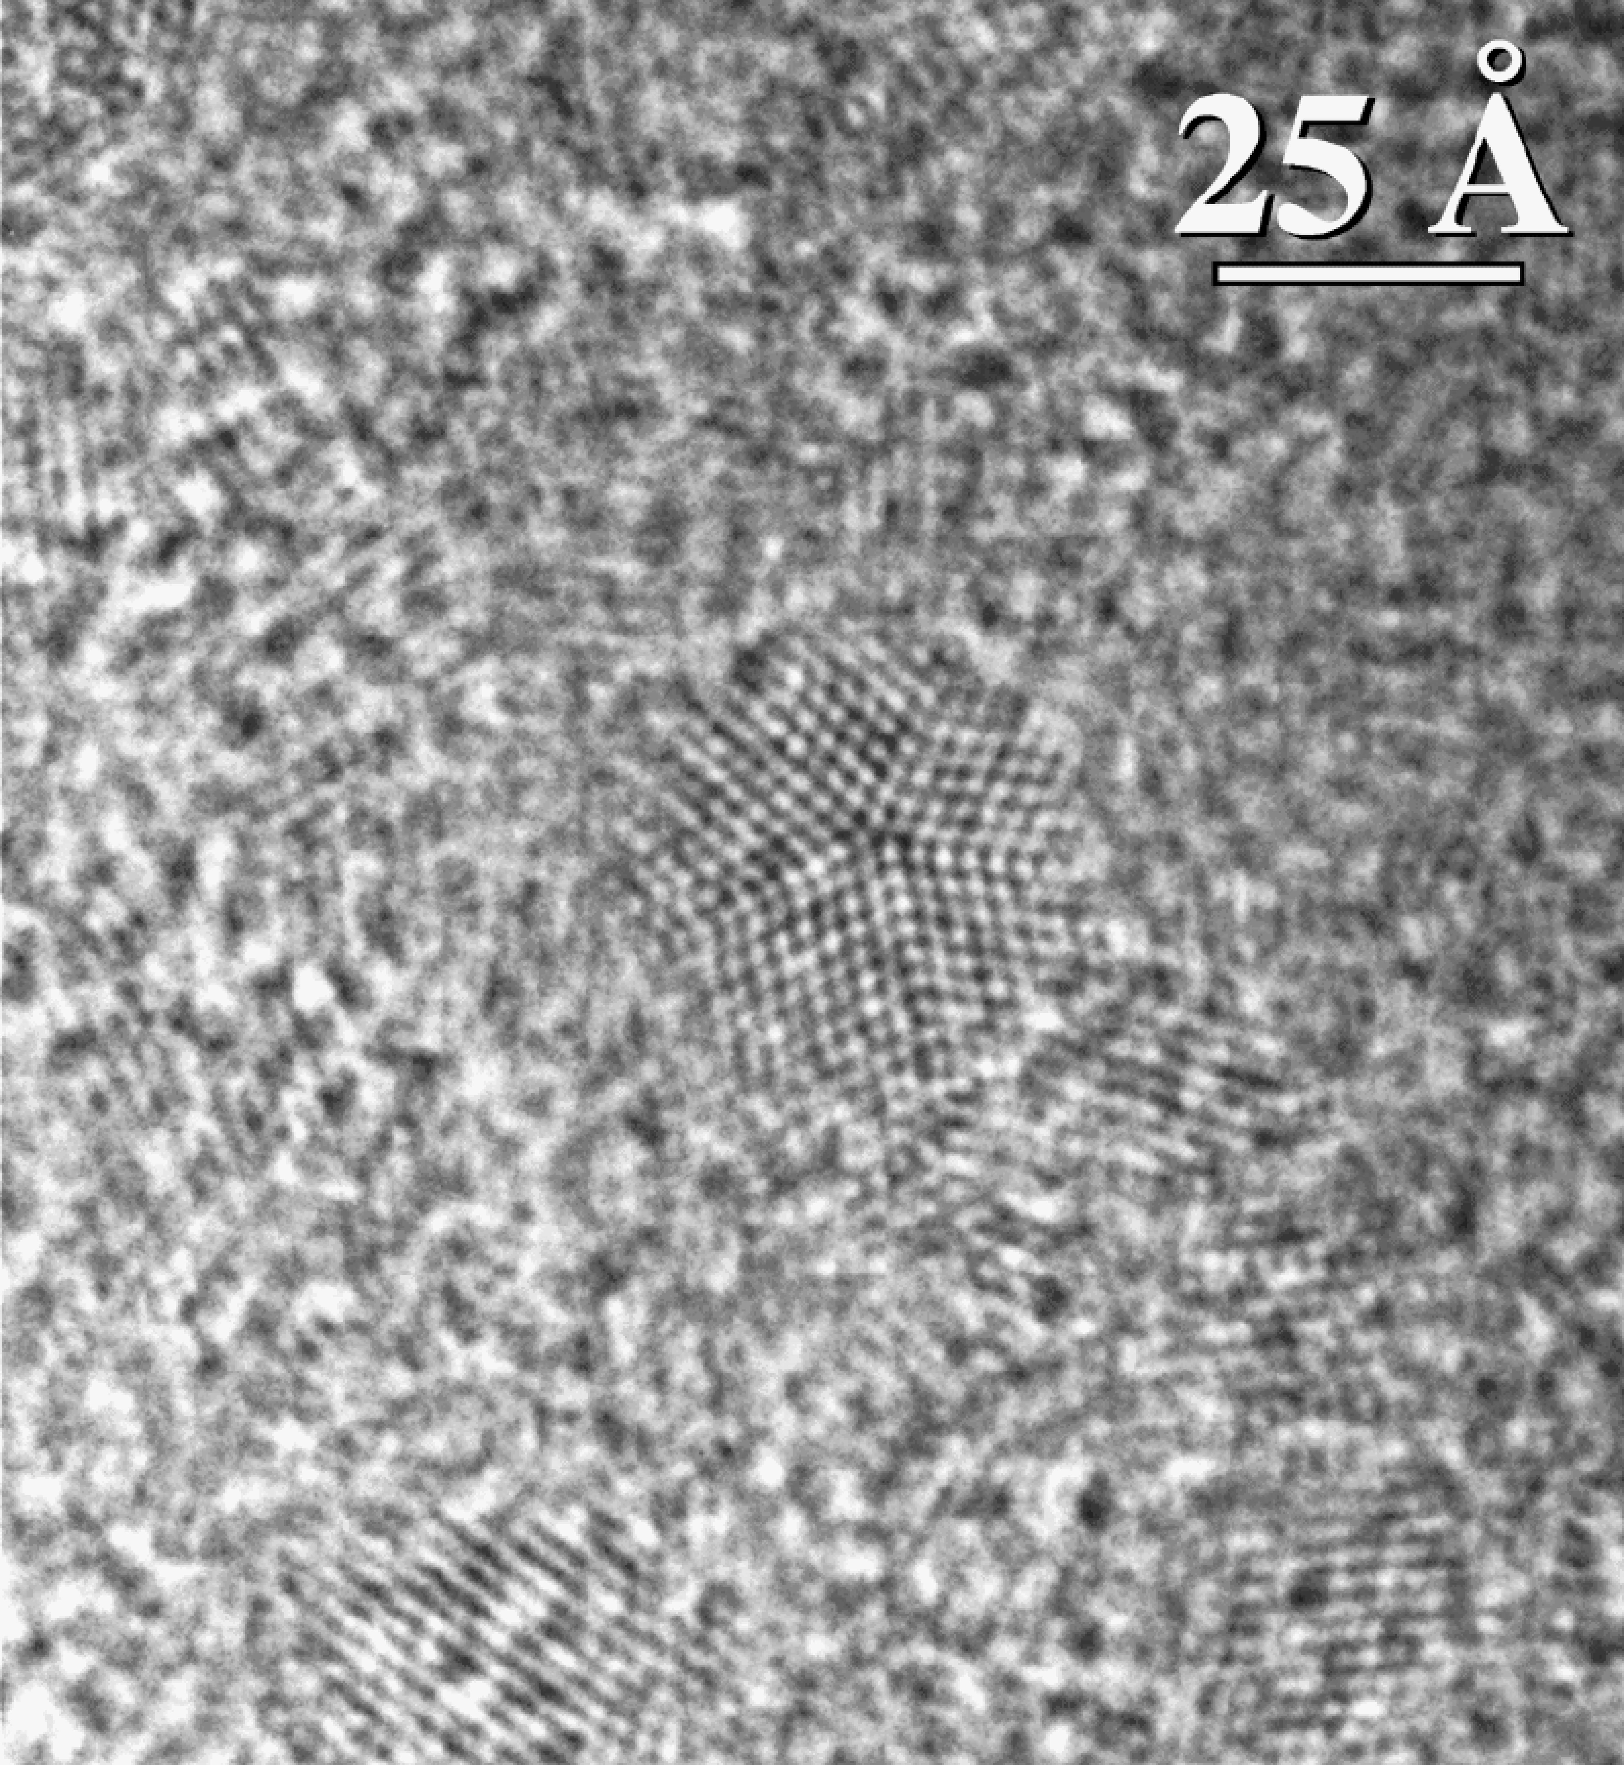

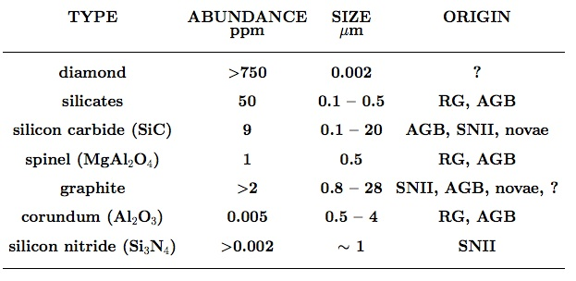


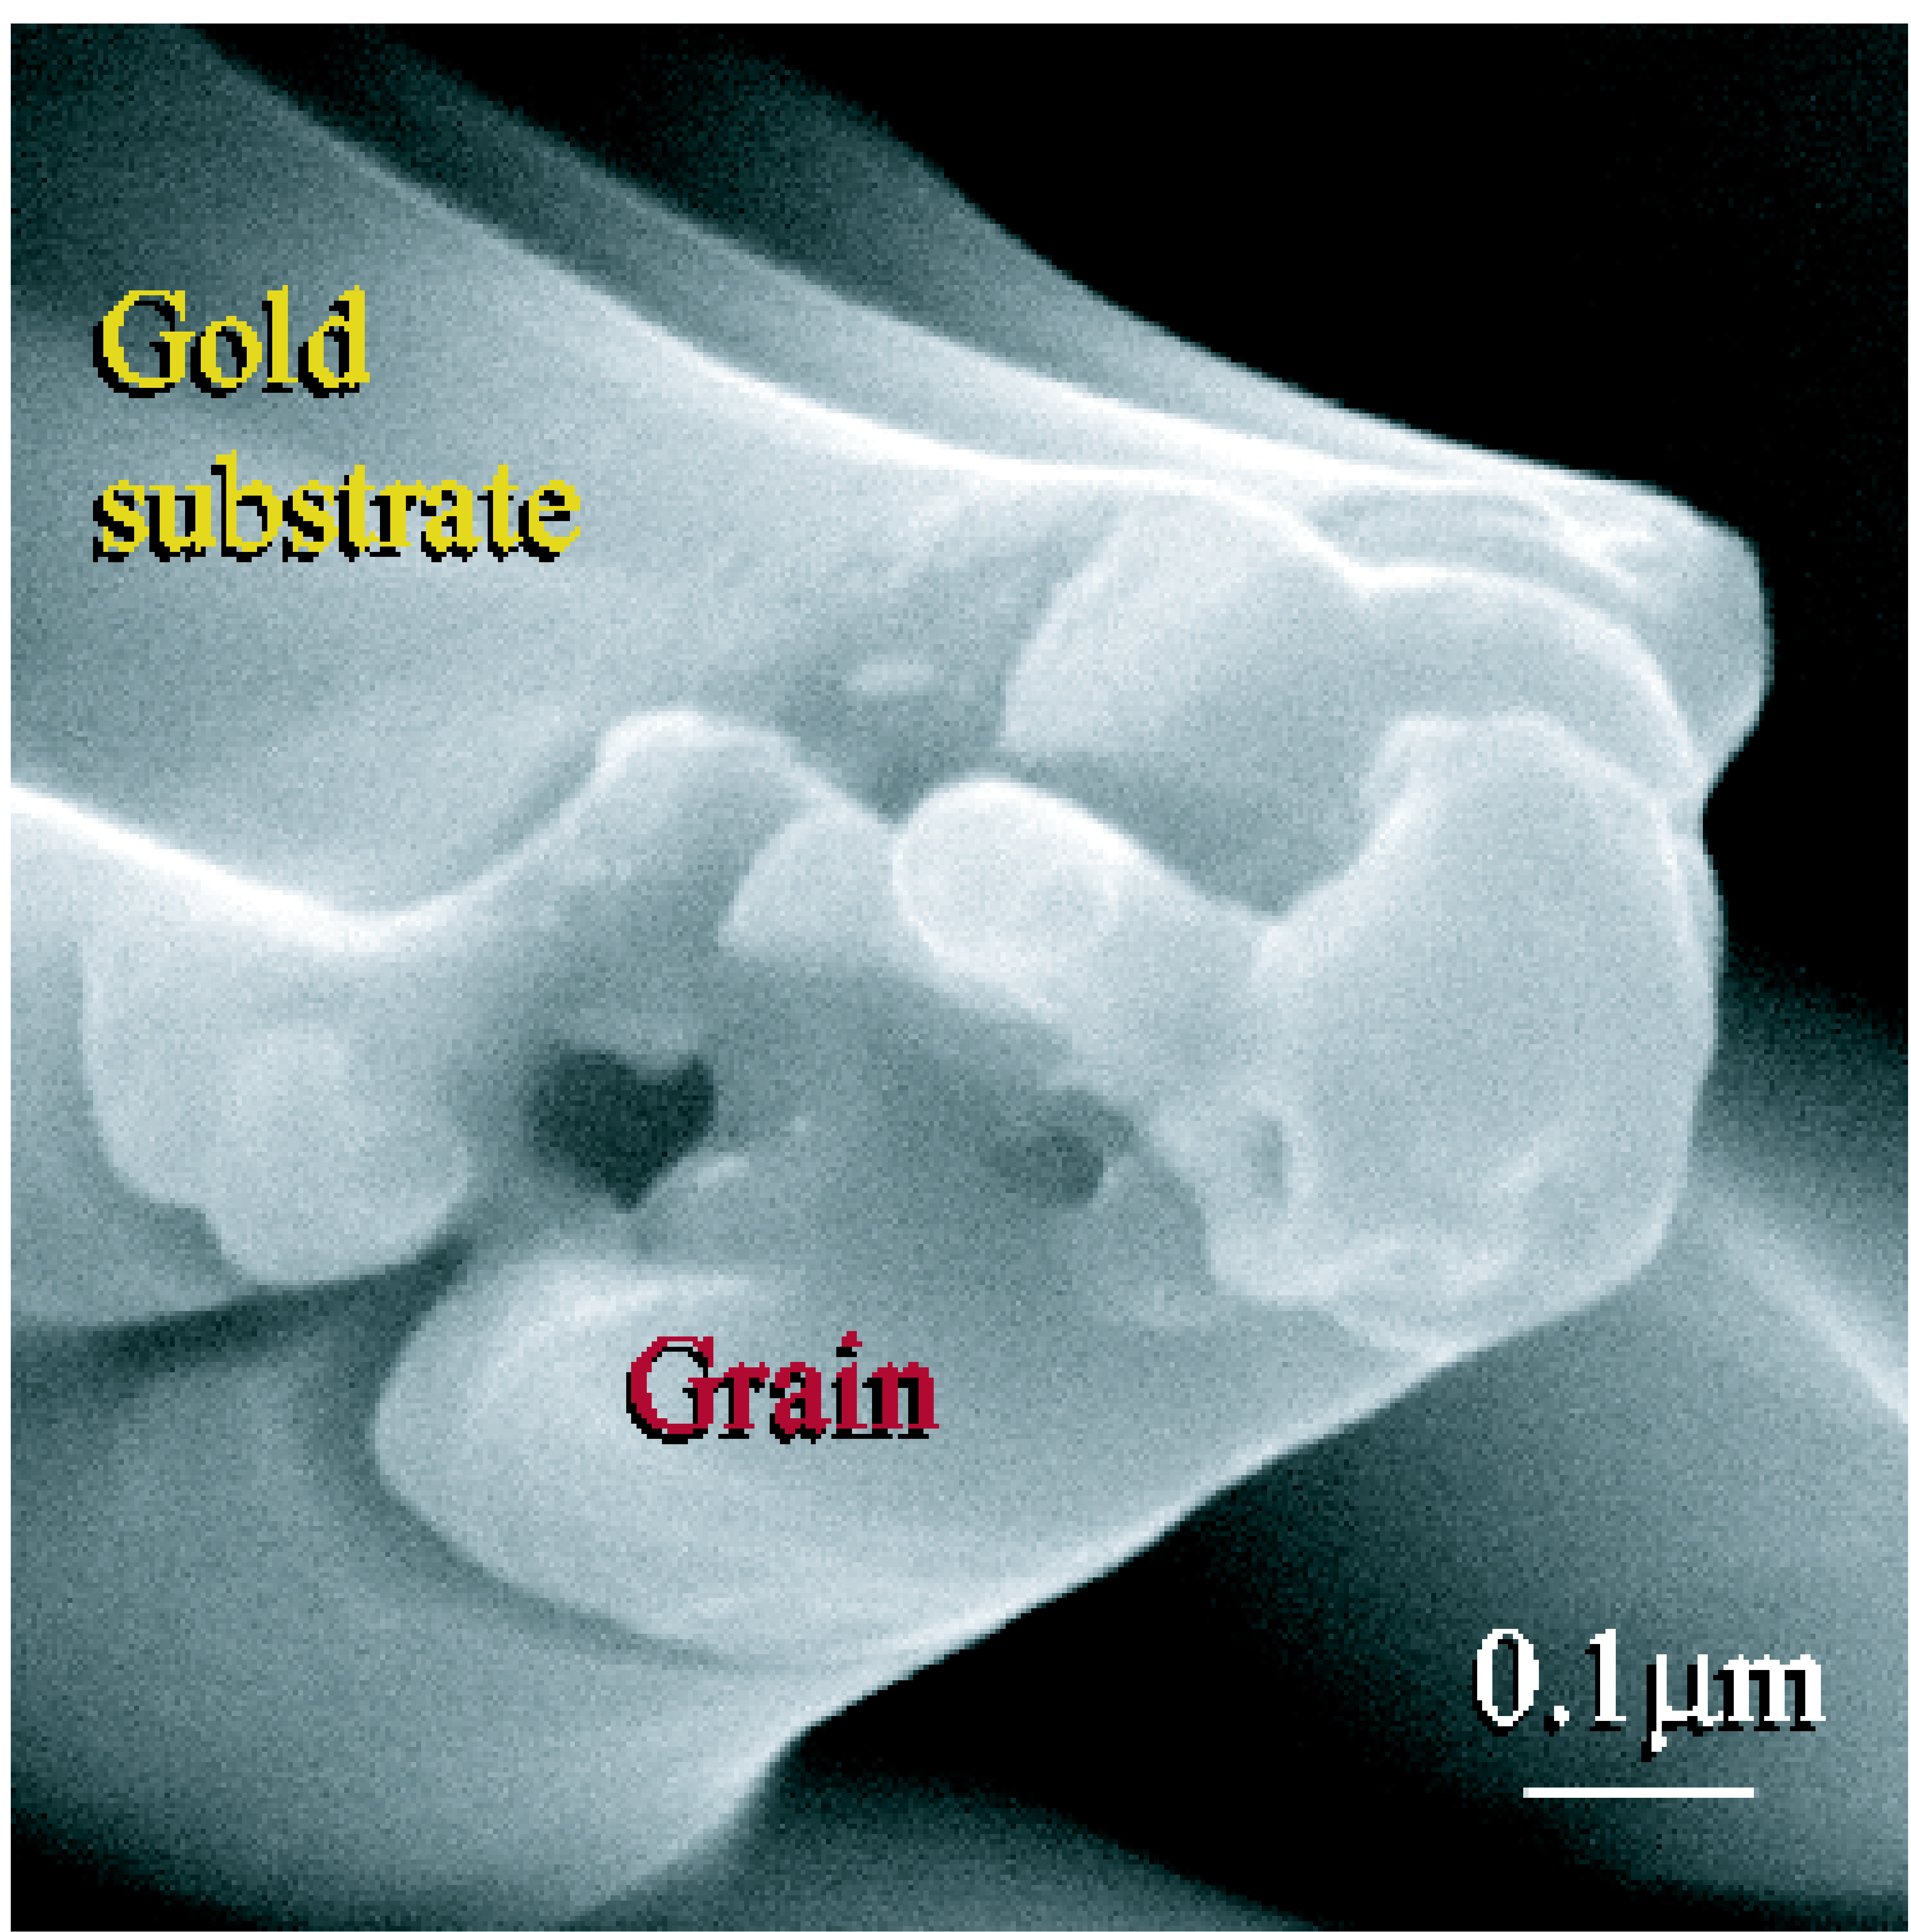

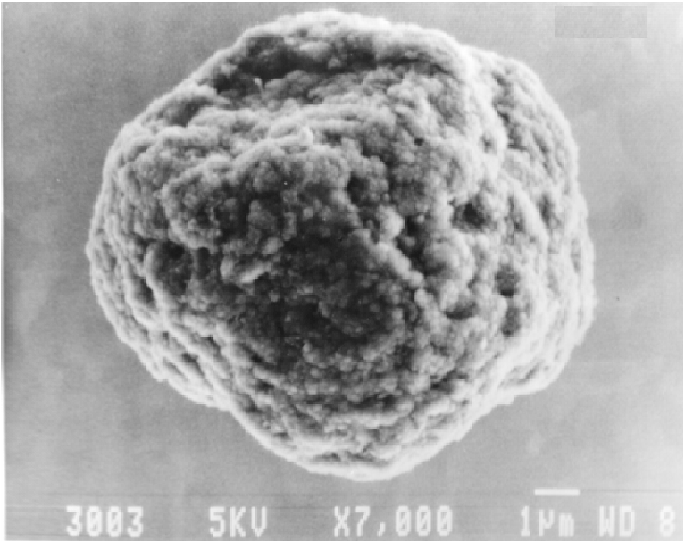
(SiO, SiO₂ etc)

Slide 93
(SiO, SiO₂ etc)
Which of these form when C>O and which when O>C?

Slide 94
Most of these grains come from AGB stars!
(SiO, SiO₂ etc)
Which of these form when C>O and which when O>C?

Slide 95
Artist impression.
Courtesy of Pedro Garcia-Lario, ESA and Anibal García-Hernandez, IAC

Slide 96
To speak the cosmochemist language
Talk mostly isotopic ratios!

Slide 97
To speak the cosmochemist language
Talk mostly isotopic ratios!
Data are usually presented as variations with respect to the Solar System and since often variations are small the following are used:
δ = per mil
ε = per ten thousand
μ = per million

Slide 98
In one stardust grain ²⁹Si/²⁸Si is 20% higher than in the Solar System.
Which of the following is correct:
δ(²⁹Si/²⁸Si) = 2000
ε(²⁹Si/²⁸Si) = 2000
μ(²⁹Si/²⁸Si) = 2000
μ(²⁹Si/²⁸Si) = 20000

Slide 99
In one stardust grain ²⁹Si/²⁸Si is 20% higher than in the Solar System.
Which of the following is correct:
δ(²⁹Si/²⁸Si) = 2000
ε(²⁹Si/²⁸Si) = 2000
μ(²⁹Si/²⁸Si) = 2000
μ(²⁹Si/²⁸Si) = 20000

Slide 100
In a meteorite ²⁹Si/²⁸Si is the same as in the Solar System.
Which of the following is correct:
ε(²⁹Si/²⁸Si) = 0
ε(²⁹Si/²⁸Si) = 1
ε(²⁹Si/²⁸Si) = 2
ε(²⁹Si/²⁸Si) = undefined

Slide 101
In a meteorite ²⁹Si/²⁸Si is the same as in the Solar System.
Which of the following is correct:
ε(²⁹Si/²⁸Si) = 0
ε(²⁹Si/²⁸Si) = 1
ε(²⁹Si/²⁸Si) = 2
ε(²⁹Si/²⁸Si) = undefined

Slide 102
To speak the cosmochemist language
Talk mostly isotopic ratios!
Data are usually presented as variations with respect to the Solar System and since often variations are small the following are used:
δ = per mil
ε = per ten thousand
μ = per million
Talk mixing lines between components

Slide 103
Which nucleosynthetic signatures are reflected in the plotted meteoritic compositions?
The s process
The r process
The p process
The s, r, and p processes
Dauphas et al. 2004
aaaaaaa
ε(¹⁰⁰Ru/¹⁰¹Ru)
aaaaaaa
ε(⁹²Mo/⁹⁶Mo)

Slide 104
Which nucleosynthetic signatures are reflected in the plotted meteoritic compositions?
The s process
The r process
The p process
The s, r, and p processes
Dauphas et al. 2004
aaaaaaa
s+r
ε(¹⁰⁰Ru/¹⁰¹Ru)
aaaaaaa
s-only
ε(⁹²Mo/⁹⁶Mo)
p-only

Slide 105
s-process component
Dauphas et al. 2004
aaaaaaa
s+r
mixing line
ε(¹⁰⁰Ru/¹⁰¹Ru)
aaaaaaa
p,r-process component
s-only
ε(⁹²Mo/⁹⁶Mo)
p-only

Slide 106

Ernst Zinner (1937-2015)
Zinner and his colleagues found minute amounts of stardust that originated outside the solar system.
Zinner was widely considered one of the leading authorities on secondary ion mass spectrometry (SIMS). He trained scientists worldwide in its use.
Zinner’s work led to the emergence of a new field of study, the laboratory analysis of stardust, which opened up new insights into the evolution of stars and nucleosynthesis of the elements.
Plenary session 15 on Friday morning

Slide 107
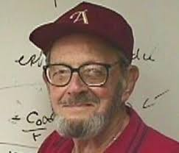
Gerald J. Wasserburg (1927-2016)
Wasserburg was deeply involved in the Apollo Program with the returned Lunar samples. He was a pioneer in the field of isotope geochemistry for which he received the Crafoord Prize in 1986 jointly with Claude Allègre.
With his invention of the first computer-controlled mass spectrometer, Lunatic I, and later sophisticated instruments,
Wasserburg’s lab was able to establish a time scale for the
development of the early solar system, including the end of the process of nucleosynthesis and the formation of solid objects such as planets, moons, and meteorites.

