Slide 1
Recent result of an exclusive measurement of ${}_{}^{3}{He}\left(K^{−},Λp\right)n$ reaction to search for $\overline{K}NN$ bound state at J-PARC
Notes:
I am Takumi Yamaga from RCNP of Osaka University.
We are searching for the K-pp bound state by using the inflight kaoin induced reaction at J-PARC.
Today, I’m going to show you the first preliminary results of E15-2nd data analysis focusing on an exclusive measurement of helium-3 K- going to Lambda p reaction.

Slide 2
Contents
Introduction of KNN bound state
Experimental Procedure
Analysis Method
Results
Summary
Notes:
These are contents of this talk.
Firstly, I will introduce about KbarNN bound state.
But, many of you may well know about the KbarNN bound state
Because previous speaker, Dote-san, and today’s plenary talking gave that.
So, I will only give a very brief introduction in this time.
And I’m going to show our experimental setup and analysis procedure before showing our preliminary results.

Slide 3
Introduction
Recent status of $\overline{K}NN$ bound state searching
Result of E15-1st
Notes:
The first is Introduction.
I will introduce about KbarNN bound state and a situation of that briefly.
And, I also show you the our result based on 1st data analysis at here.

Slide 4
Kaonic Nuclei and $\overline{K}NN$ bound state
Kaonic nuclei
What’s this?
Bound state of anti-kaon and nucleus
What’s interest?
$\overline{K}N$ interaction in the sub-threshold region
$\overline{K}NN$ bound state
The simplest kaonic nucleus
So-called $K^{−}pp$ bound state
Notes:
The interaction between anti-kaon and nucleus is know as attractive force in isospin equal 0 channel.
As a consequence of this attractive force, they would make a bound state.
That bound state is called as The kaonic nuclei.
To understand the kaonic nuclei has important roll to understand KbarN interaction in the sub-threshold region
,because we cannot measure the KbarN interaction directly in this energy region.
So, it has been studied long time.
The most simple system around the kaonic nuclei is KbarNN bound state, so-called K-pp bound state.
The studying for Kaonic nuclei has been done by both experiment and theoretical side by searching for this KbarNN bound state.

Slide 5
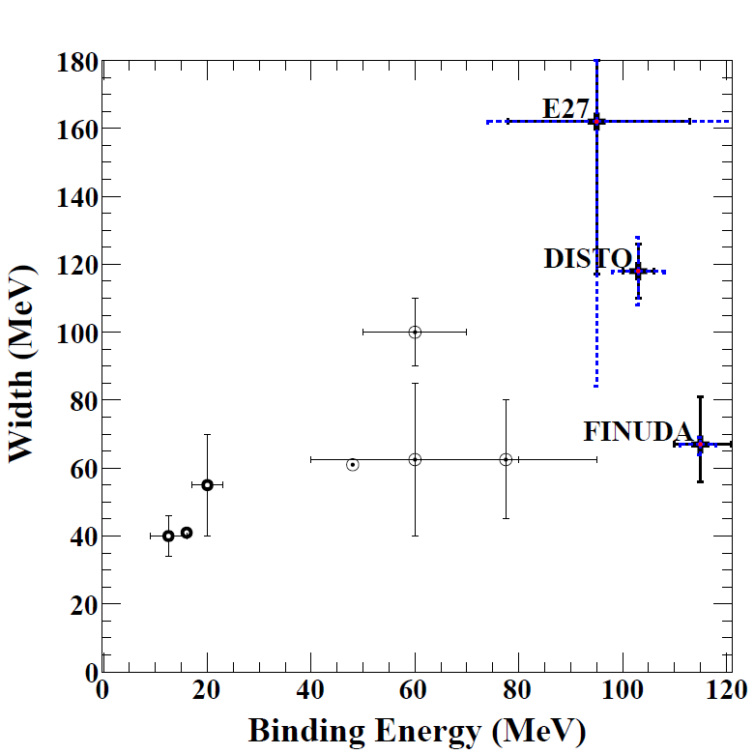
Recent status of $K^{−}pp$ bound state
Recent results
Theoretical calc.
Experiments
KbarN interaction model
E-dep. / E-indep.
Reports structure
/ NO structure
J-PARC E27
$d\left(π^{+}, K^{+}\right)X$
LEPS
$p\left(γ,π^{−}K^{+}\right)X$
DISTO
$pp→ΛpK^{+}$
HADES
$pp→ΛpK^{+}$
E-indep.
FINUDA
$(stopped K^{−},Λp)$
E-dep.
$K^{−}pp$ is still subject to refined experiments.
J-PARC E15
Using $(in‐flight K^{−}, n)$ reaction
Notes:
I summarize recent results on Kpp bound state in this page.
This figure shows reported binding energy and decay width of calculated or observed Kpp bound state.
The theoretical calculations can be divided roughly into two different types.
One is based on Energy dependent KbarN interaction model.
And the another one is based on energy independent model.
The decay width is not so change between two types of calculation.
But, the binding energy looks tend to be larger in the energy independent model than energy dependent model.
===
On the other hands, some experimental group reported the Kpp like structure which binding energy and width are plotted here.
All of them reported larger binding energy than that reported from theoretical calculations.
===
And at the same time, these experimental group claimed that there is no significant structure corresponds to Kpp bound state.
===
So, the situation of the Kpp sudying is still subject to refined experiments.
We, J-PARC E15 experiment has been searching for Kpp bound state by using inflight K-, n reaction.
This reaction can be produce the Kpp bound state with relatively simple reaction compare to other experiment.
And, momentum transfer is low, such as several hundred MeV/c , so that the production cross section of the Kpp bound state can be expected to be large.

Slide 6
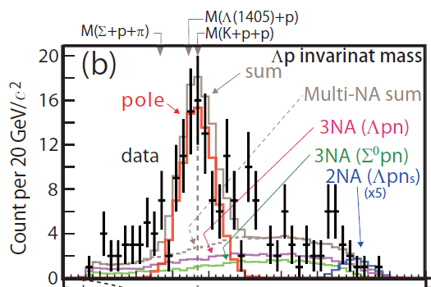
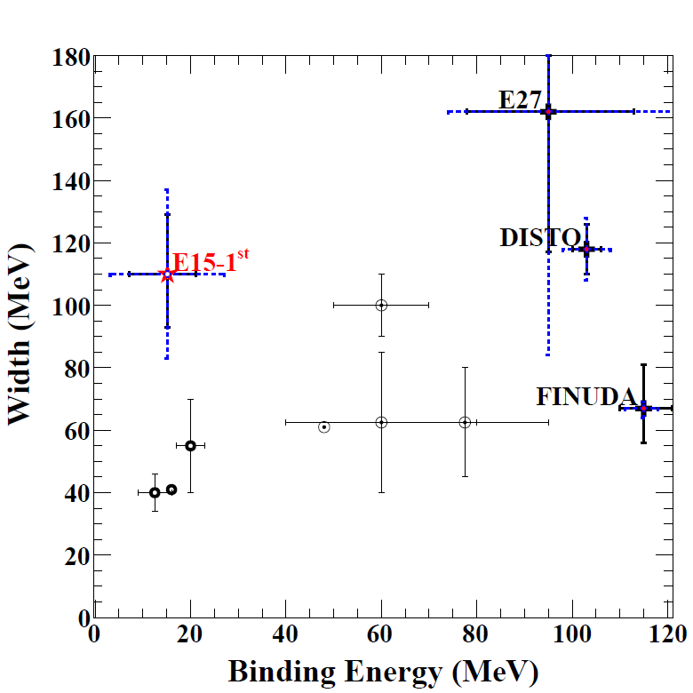
Recent status of $K^{−}pp$ bound state
Recent results including E15
Y. Sada, et al, Prog. Theor. Exp. Phys. (2016) 051D01
Mass ($MeV/c^{2}$) | Width ($MeV/c^{2}$)
${2355}_{−6}^{+8} {\left(stat.\right)}^{±12} (sys.)$ | $${110}_{−17}^{+19} {\left(stat.\right)}^{±27} (sys.)$$
E-indep.
E-dep.
E15-1st experiment
$Λp$ invariant mass analysis in ${}_{}^{3}{He(K^{−},Λp)"n"}$
Assuming simple Breit-Wigner
Notes:
In the beginning of this year, we published a paper based on our 1st physics data-taking performed in 2013.
In here, we measured lambda p invariant mass spectrum in the helium-three K- going to lambda p n final state.
A structure was observed just below the Kpp threshold like this.
And by assuming simple breit-wigner shape combined with s-wave form factor, we evaluated pole position and its width as these values.
Here is our reported value.
The decay width is not so changed from other experiment.
But, the binding energy is much lower than others which is almost consistent with theoretical calculation using energy dependent KbarN potential.

Slide 7
Recent status of $K^{−}pp$ bound state
Recent results including E15
Y. Sada, et al, Prog. Theor. Exp. Phys. (2016) 051D01
E15-1st experiment
Lack of statistics
Assuming 1-pole structure
Mass ($MeV/c^{2}$) | Width ($MeV/c^{2}$)
${2355}_{−6}^{+8} {\left(stat.\right)}^{±12} (sys.)$ | $${110}_{−17}^{+19} {\left(stat.\right)}^{±27} (sys.)$$
E-indep.
E15-2nd experiment
8-times more $K^{−}$-beam
Dedicated trigger condition
Statistics becomes larger.
E-dep.
More detail analysis can be performed.
Notes:
But, due to lack of statistics, we only assumed 1 pole structure with simple picture.
And we cannot detail analysis such as studying for angular dependence.
===
So, to do more detail analysis and confirm the origin of the structure,
We performed 2nd physics data-taking in the last year.
In that time, 8-times more kaon beam was irradiated onto the experimental target.
And dedicated trigger condition for focusing on this analysis is strongly help to increase the statistics.
Today, I will show the results based on this data.

Slide 8
Experimental procedure
Overview of the J-PARC E15 Experiment
Notes:
So, I will give you information about our experiment form here.

Slide 9
J-PARC E15 Experiment
Searching for $K^{−}pp$
$\left(K^{−}, n\right)$ reaction @ 1 GeV/c
Detector for decay particles
Detector for neutron
Detect!
$$p$$
Detect!
$$K^{−}$$
$${}_{}^{3}{He}$$
$$"K^{−}pp"$$
$$"K^{−}pp"$$
$$n$$
$$n$$
$$Λ$$
$$p$$
Detect!
$$π^{−}$$
Notes:
We are searching for the K-pp bound state by using (K-, n) reaction at J-PARC hadron experimental facility.
The reaction can be drawn as this very simple picture.
1 GeV/c kaon beam is irradiated onto the liquid helium-three target.
And the neutron is kicked out to forward direction, with bring large momentum.
Then, K-minus and 2 protons remain and would form the K-pp bound state.
The K-pp decays into lambda p pair which is one of the expected decay mode of the K-pp bound state.
===
We detect this proton and pi-p pair from charged decay of Lambda by decay particle counter.
Actually, we have a detector for kicked out neutron in the forward angle,
But it doesn’t matter in this talk, so I don’t touch this.

Slide 10
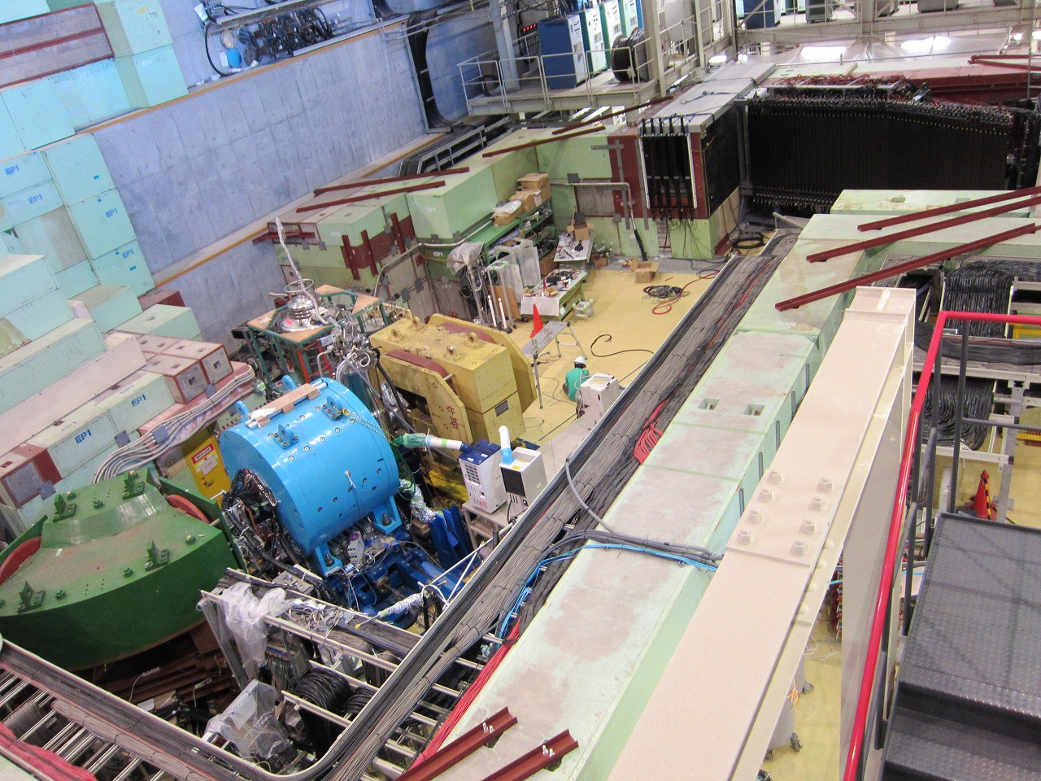
J-PARC E15 Experiment
Neutron counter
Flight length : 15 m
Beam sweeping magnet
CDS
CDS
Beam spectrometer
Notes:
This is overview picture of our experimental setup.
The intense kaon beam is provided form here,
And its momentum is measured by beam spectrometer system here.
The helium-three target is located in center of the cylindrical detector system here.
And there are forward counters in downstream.
===
In this talk, I focus on the analysis using only CDS.

Slide 11
Analysis method
Procedure of the exclusive ${}_{}^{3}{He}(K^{−}, Λp)"n“$ analysis
Notes:
I move to introduction of the analysis procedure of the exclusive 3He K- going to Lambda p n final state.

Slide 12
Analysis Overview
$Λp$ invariant mass spectroscopy in ${}_{}^{3}{He}\left(K^{−}, Λp\right)"n“$reaction
$$K^{−}$$
$${}_{}^{3}{He}$$
$$p$$
Missing neutron
$$Λ$$
$$p$$
$πpp$ event selection
$Λ$-Reconstruction
Missing neutron selection
$$π^{−}$$
Notes:
The analysis procedure is very simple and the event selection can be described three steps.
===
The first, we chose pipp events with CDS particle identification.
===
The second, we reconstruct the lambda form one of the pip pair.
===
The third, we identified missing neutron with missing mass of Lambda p pair.
That is all of our event selection. It is very simple.
Following, I will explain these selection again with some analyzed spectra.

Slide 13
CDS Configuration
Solenoid magnet
Tracker
Position Resolution : $<200 μm$
ToF counter
ToF Resolution : $∼150 ps$
Inv. Mass Resl. : $∼10 MeV/c^{2}$
ToF counter
Tracker
${}_{}^{3}{He}$ target
Notes:
In this analysis, the CDS is main part.
So I show the configuration of the CDS before showing the results.
The figure in here shows sectioned drawing of the CDS.
===
The is helium-three target at the center.
And tracking drift chamber, Tof Counter.
The solenoid magnet provide 0.7 T magnetic field.
===
The tracker has a position resolution better than 200 um.
It can measure the particle momentum and reaction vertex.
The TOF counter measure the particle velocity with ToF resolution of about 150 ps.
Then, we can calculate mass of the detected particles form these informations.
The invariant mass resoloution of the Labmda p pair is evaluated to be about 10 MeV/c.

Slide 14
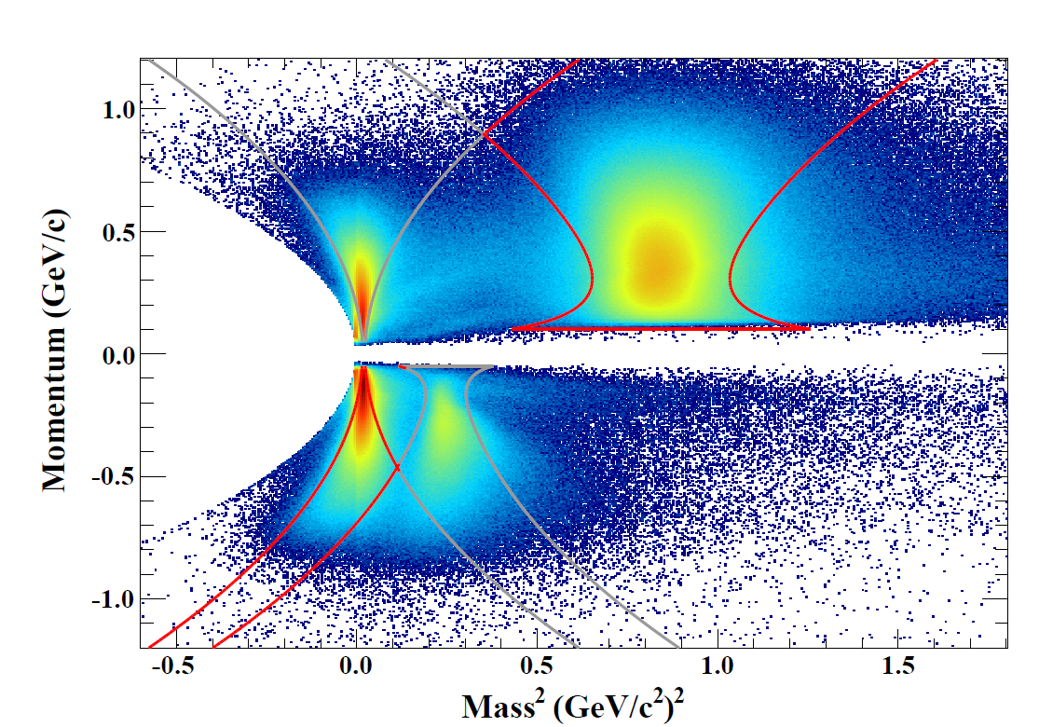
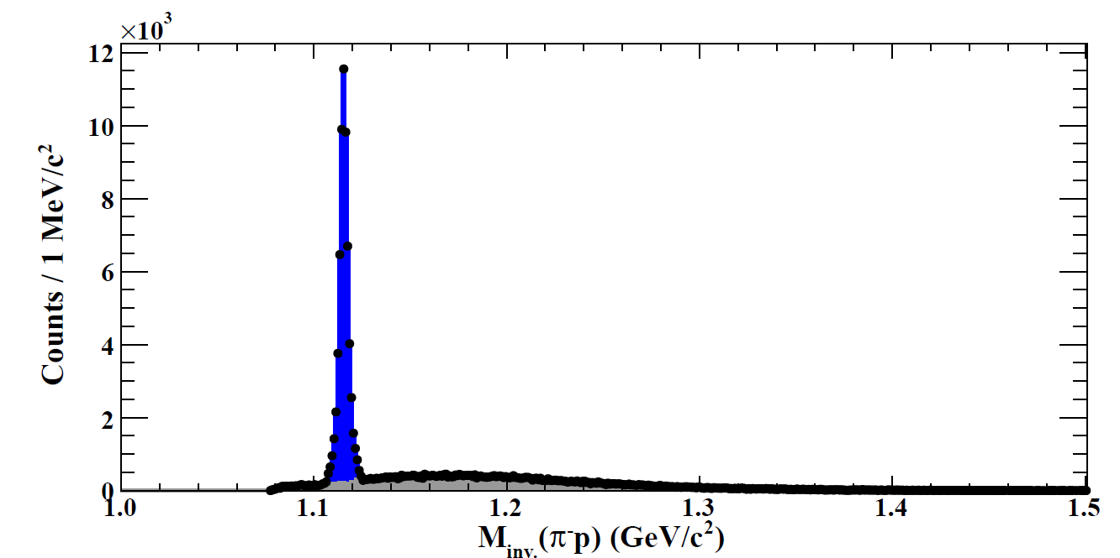
CDS Analysis
PID
$$p$$
Solenoid magnet
ToF counter
Tracker
$$π^{−}$$
$$p$$
Preliminary
${}_{}^{3}{He}$ target
$Λ$- Reconstruction
$$Λ$$
$πp$-pair from $Λ$-decay
Other $πp$-pair
$$π^{−}$$
$$p$$
Preliminary
Notes:
If we calculate particle mass by using measured momentum and velocity,
We can plot a PID plot like this.
We select the pi-minus and proton in the region indicated red line which is corresponding to 2.5 sigma region.
To avoid contaminations, we removed overlap regions.
===
Then, we try to reconstruct Lambda form two pi-p pair.
We use Log likelihood method to select correct pi p pair from Lambda decay.
And this figure shows invariant mass spectrum of pip pairs.
The blue events are selected as Lambda decay events, which is located around Lambda mass correctly.
The contamination from wrong pip pair is expected to be less than a few percent.

Slide 15
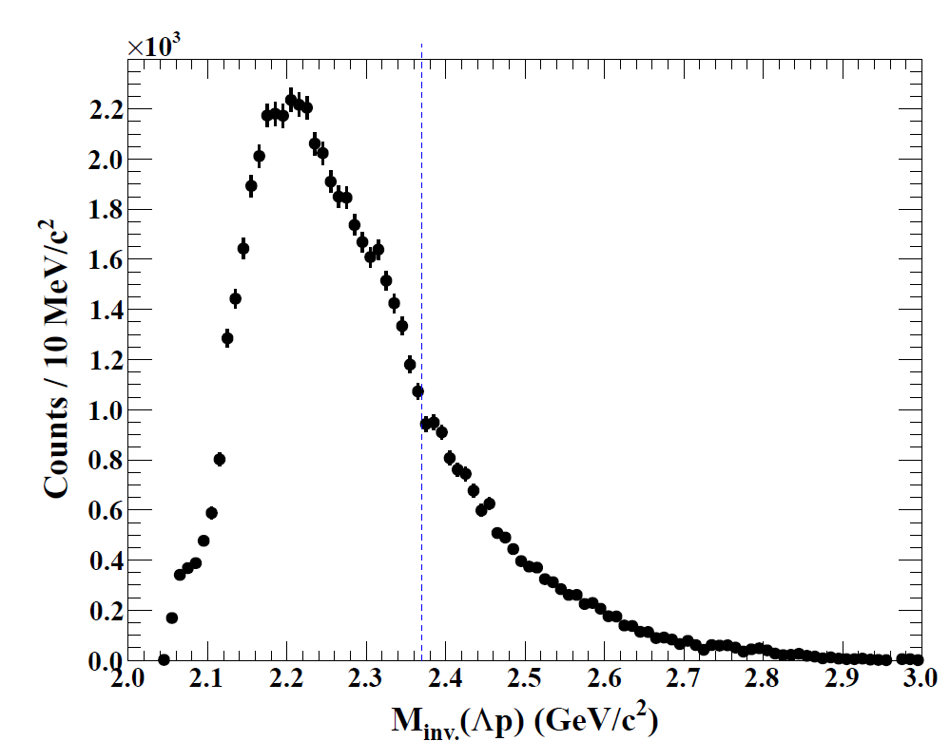
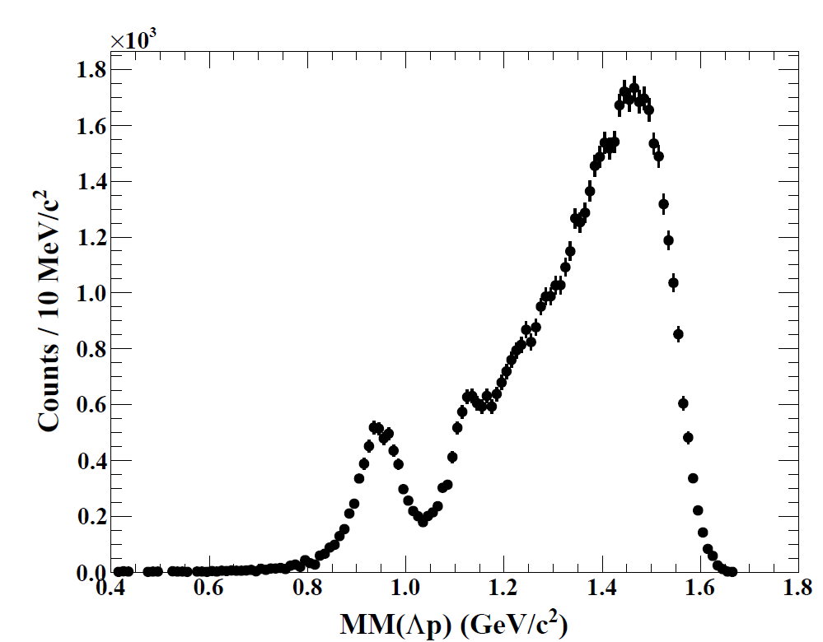
Analyzed Spectrum
$$K^{−}$$
$${}_{}^{3}{He}$$
$$p$$
Missing neutron
$$Λ$$
$$p$$
$Λp$ Invariant-mass
$$π^{−}$$
${}_{}^{3}{He}(K^{−}, Λp)"X"$ Missing-mass
Preliminary
Preliminary
$$"n"$$
$$M_{K^{−}pp}$$
Notes:
And, we measure the Lambda p invariant mass spectrum to study the produced state.
And Lambda p missing mass spectrum to select the Lambda p n final state.

Slide 16
results
Results based on E15-2nd physics data taking
About 30 times larger events than E15-1st
Notes:
So, let me move to show our preliminary results.
All of them are based on out new data.
The statistics is larger than that of our 1st results.

Slide 17
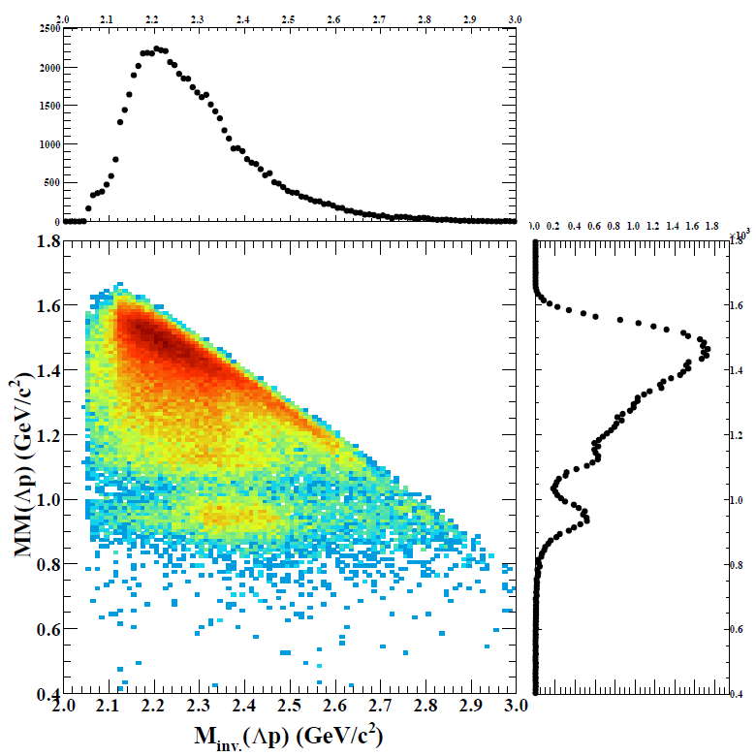
$Λp$ IM vs. MM Plot
Final state identification
Selecting $Λpn$ final state
Preliminary
$"n+π(π)“$/$"γn+π(π)“$
$$(Λ{/Σ}^{0}pn+π(π))$$
Selected neutron window
$$"γn“$$
$$(Σ^{0}pn)$$
$$"n“$$
$$(Λpn)$$
$n_{window}=0.85 −1.03 GeV/c^{2}$

Slide 18
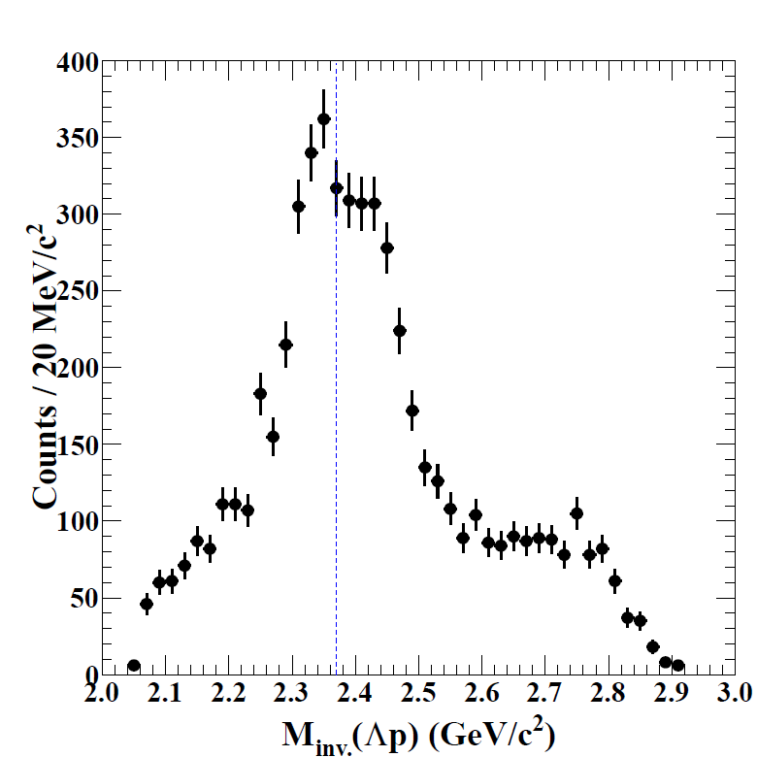
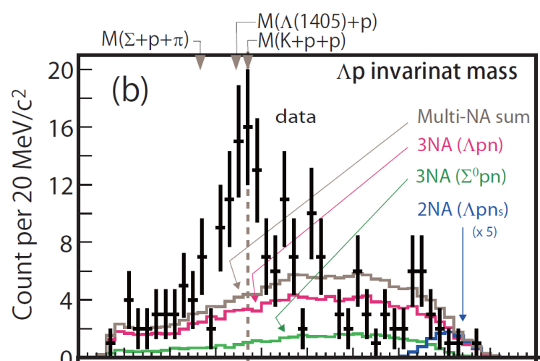
$IM\left(Λp\right)$ in $Λpn$ Final State
Y. Sada, et al, Prog. Theor. Exp. Phys. (2016) 051D01
E15-2nd
E15-1st
$n_{window}=0.85 −1.03 GeV/c^{2}$
Preliminary
Consistent with the E15-1st result
With in statistics
Structure around $M_{K^{−}pp}^{}$
$$M_{K^{−}pp}$$

Slide 19
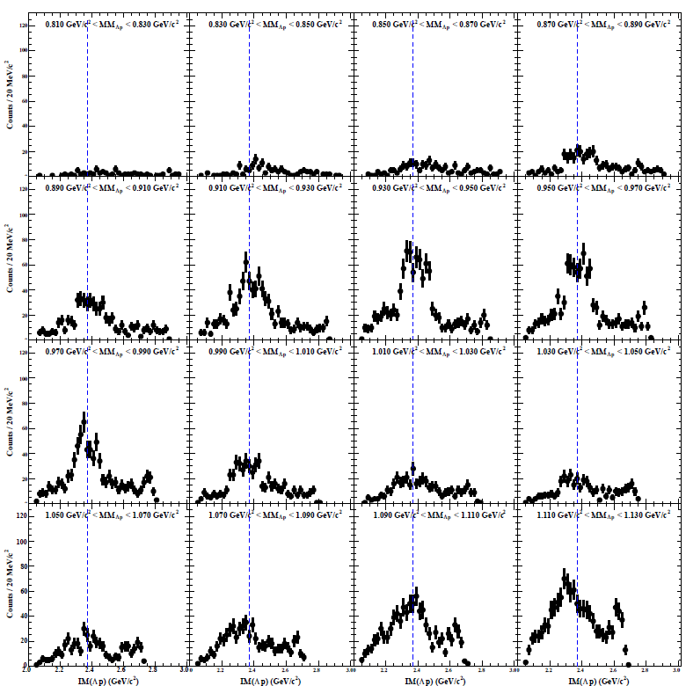
$MM\left(Λp\right)$ Slice around $"n"$ Region
Lower
Preliminary
*Sliced with $0.02 GeV/c^{2}$ bin
$$"n"(Λpn)$$
Selected neutron window
Structure around $M_{K^{−}pp}$
$0.9 – 1.0 GeV/c^{2}$
$$"γn"(Σ^{0}pn)$$

Slide 20
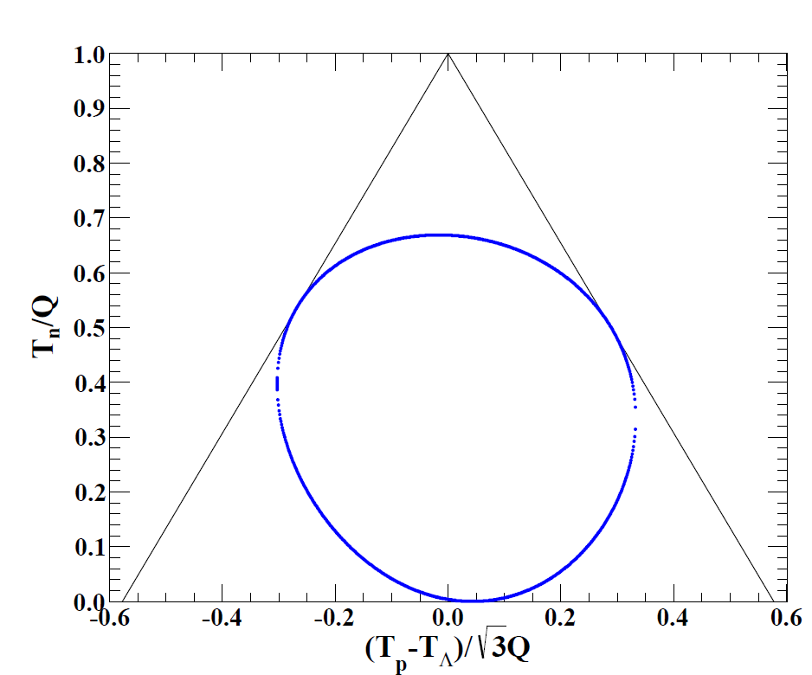
Dalitz Plot of $Λpn$
3NA process
$K^{−}pp$ formation
2NA process
One spectator
$n_{spec}$ / $p_{spec}$
2-step process
Out of acceptance
$$T_{p}$$
$$T_{Λ}$$
Out of acceptance
$$T_{n}$$
Kinematical Limit

Slide 21
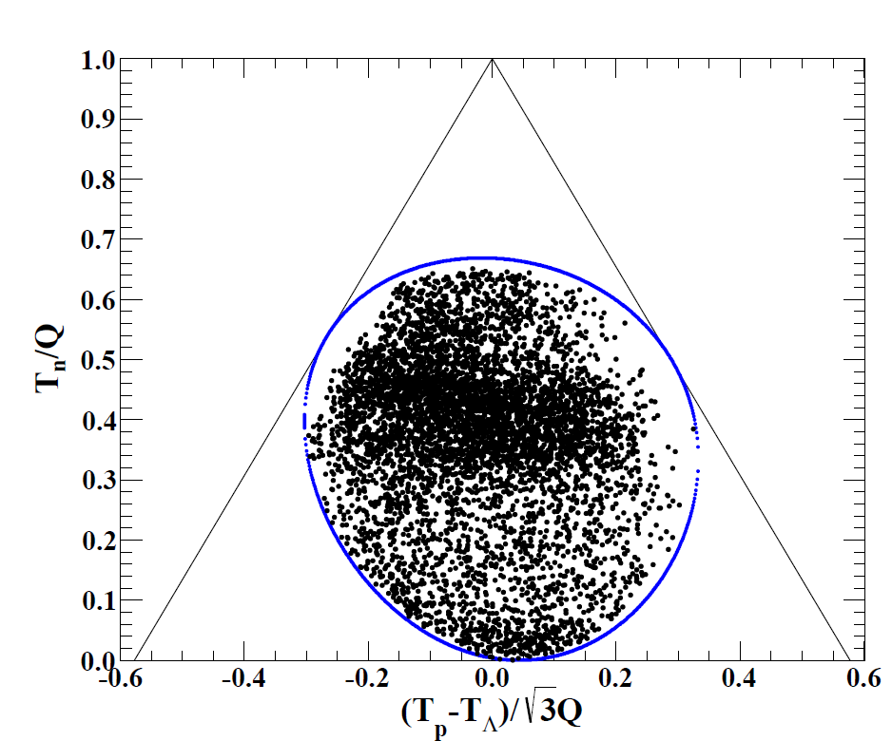
Dalitz Plot of $Λpn$
Preliminary
Preliminary
Structure
2NA
$$M_{K^{−}pp}$$

Slide 22
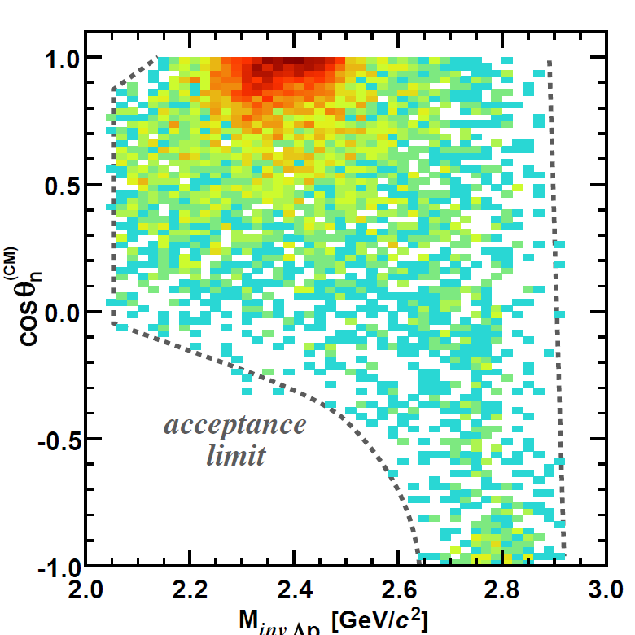
$IM\left(Λp\right)$ vs. $\cos{{θ_{n}^{}}^{CM}}$ Plot
Structure
$$"n"$$
CM frame
$$θ_{n}^{CM}$$
$$Λ$$
Beam
$$p$$
2NA process
Preliminary

Slide 23
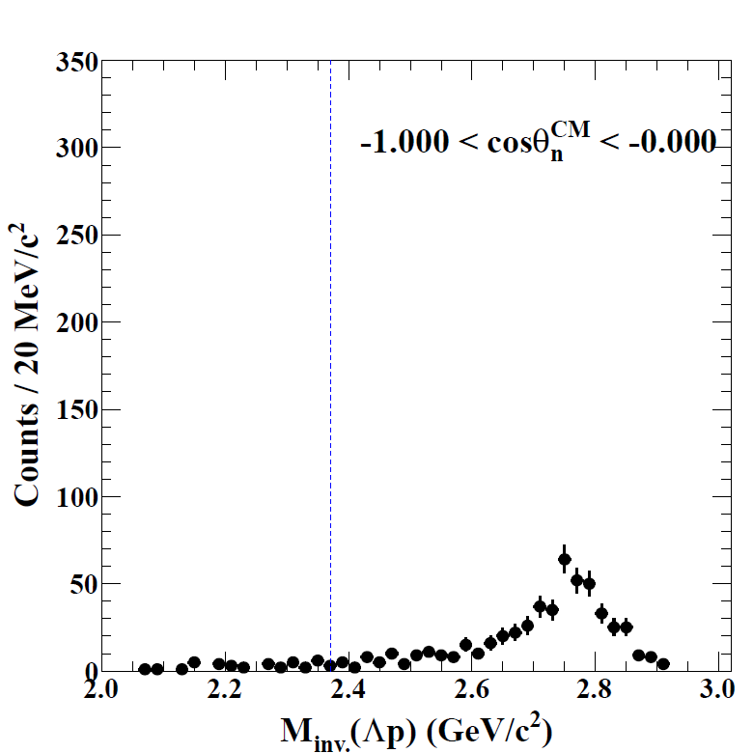
$\cos{{θ_{n}^{}}^{CM}}$ Sliced $IM\left(Λp\right)$
$−1.0<\cos{θ_{n}^{CM}}<0.0$
2NA process
Preliminary
Preliminary
$$M_{K^{−}pp}$$

Slide 24
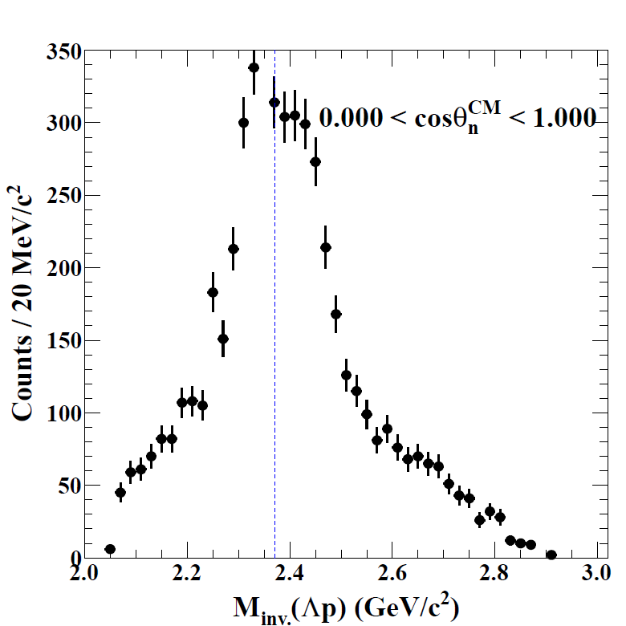
$\cos{{θ_{n}^{}}^{CM}}$ Sliced $IM\left(Λp\right)$
$0.0<\cos{θ_{n}^{CM}}<1.0$
Structure around $M_{K^{−}pp}$
Preliminary
Preliminary
$$M_{K^{−}pp}$$
To be sliced

Slide 25
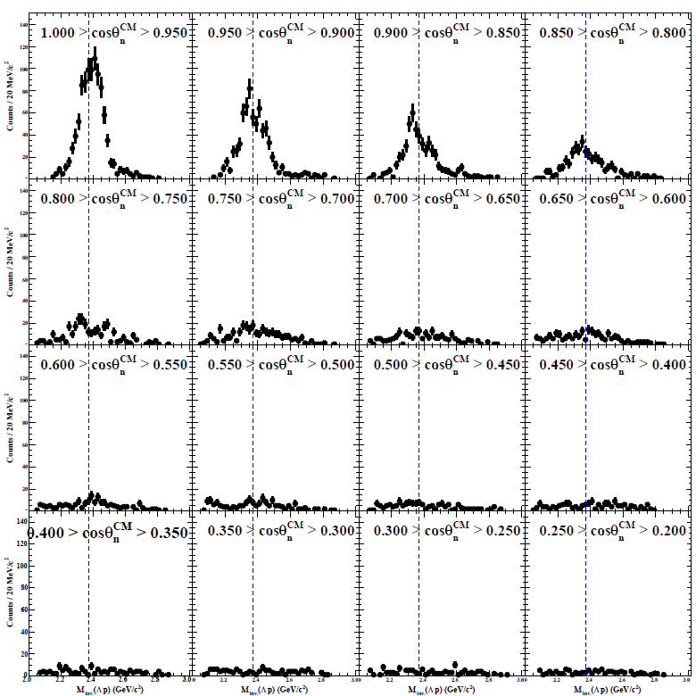
$\cos{{θ_{n}^{}}^{CM}}$ Sliced $IM\left(Λp\right)$
Higher
Preliminary
*Sliced with $0.05$ bin
Sliced
Preliminary
Lower

Slide 26
$\cos{{θ_{n}^{}}^{CM}}$ Sliced $IM\left(Λp\right)$
Preliminary
*Sliced with $0.05$ bin
Decreasing
Higher Opening angle
0.75 – 1.0
Structure observed
Lower O.A.
0 – 0.75
No structure
Small event

Slide 27
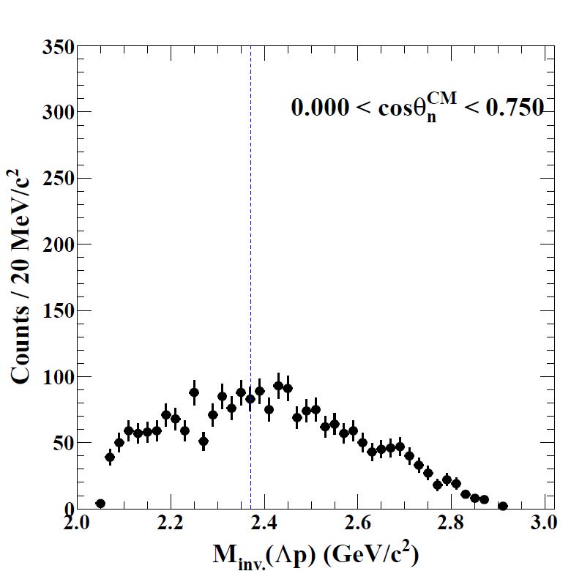
$\cos{{θ_{n}^{}}^{CM}}$ Sliced $IM\left(Λp\right)$
$0.0<\cos{θ_{n}^{CM}}<0.75$
3NA
Preliminary
$$M_{K^{−}pp}$$
Preliminary
No Structure

Slide 28
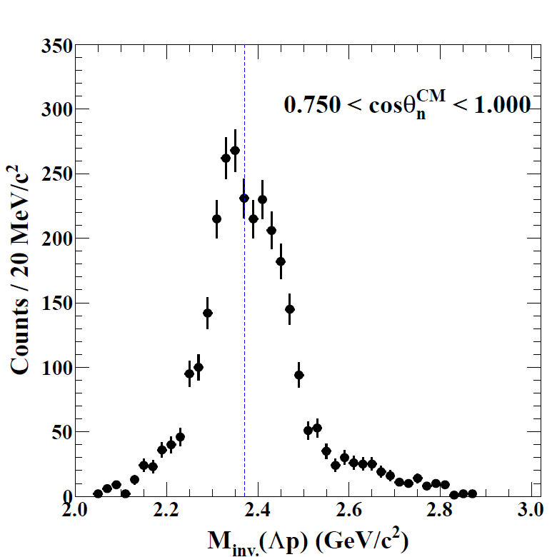
$\cos{{θ_{n}^{}}^{CM}}$ Sliced $IM\left(Λp\right)$
$0.75<\cos{θ_{n}^{CM}}<1.0$
Structure + 3NA
Preliminary
Preliminary
Structure enhanced
$$M_{K^{−}pp}$$

Slide 29
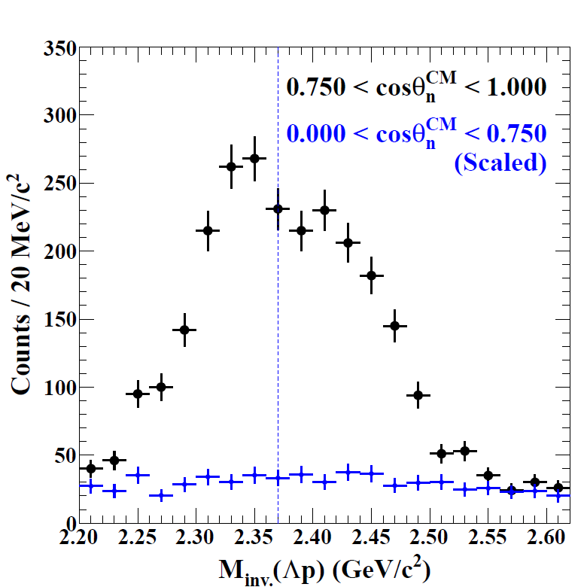
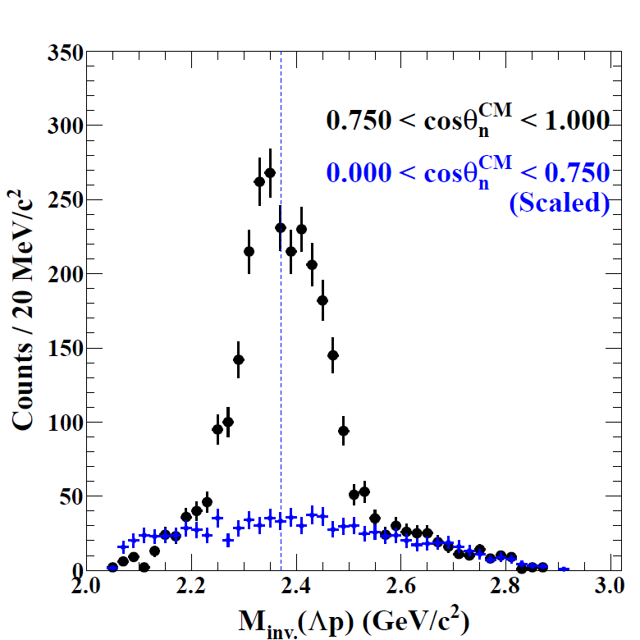
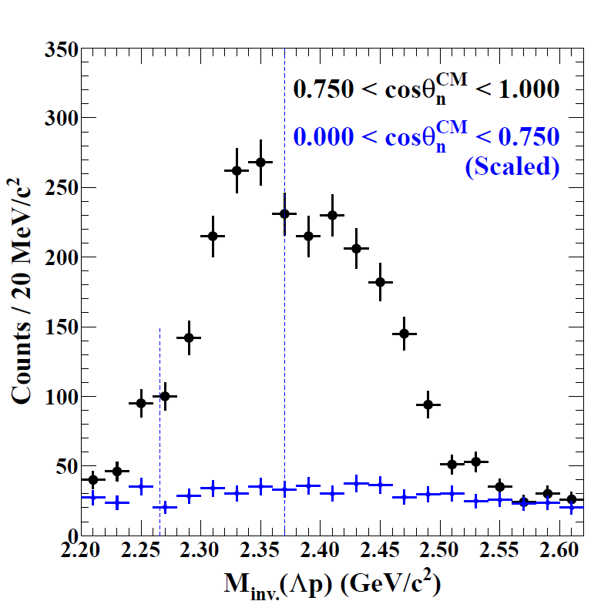
$\cos{{θ_{n}^{}}^{CM}}$ Sliced $IM\left(Λp\right)$
E-indep.
E-indep.
*Acceptance NOT Corrected
*Acceptance NOT Corrected
*Acceptance NOT Corrected
*Acceptance NOT Corrected
Preliminary
Preliminary
Preliminary
Preliminary
Preliminary
E-dep.
E-dep.
Out of acceptance
$K^{−}pp$? / Other?
Careful study is ongoing.
E-indep.
E-indep.
E-dep.
E-dep.
E27
FINUDA
DISTO
E27
FINUDA
DISTO
$$M_{πΣp}$$
$$M_{K^{−}pp}$$
E15-1st
E15-1st
Preliminary
$$M_{K^{−}pp}$$
$$M_{K^{−}pp}$$

Slide 30
Summary
First preliminary results are presented based on high statistic data of the E15-2nd run.
Totally consistent with the results obtained from the E15-1st run
Structures below and above the $K^{−}pp$ mass threshold are observed.
Located in the region of $\cos{θ_{n}^{CM}>0.75}$
Is it the $K^{−}pp$ state?

Slide 31
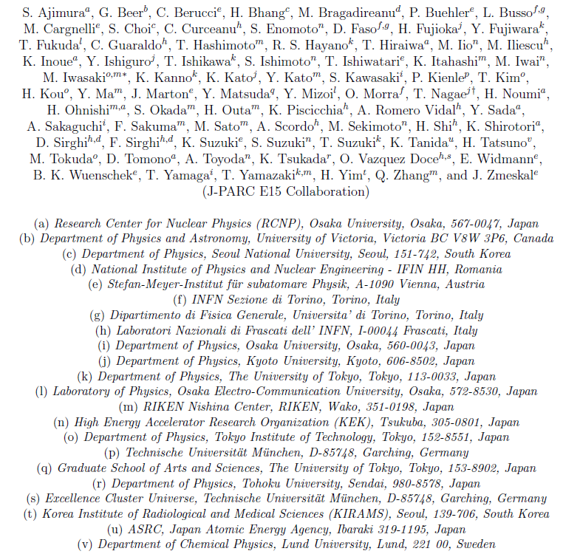
Thank you for your attention
$∼$ The E15 collaboration $∼$

Slide 33
$\cos{{θ_{n}^{}}^{CM}}$ Sliced $IM\left(Λp\right)$
Structure
$−1.0<\cos{θ_{n}^{CM}}<0.0$
2NA process
Preliminary
$$M_{K^{−}pp}$$
Preliminary

Slide 34
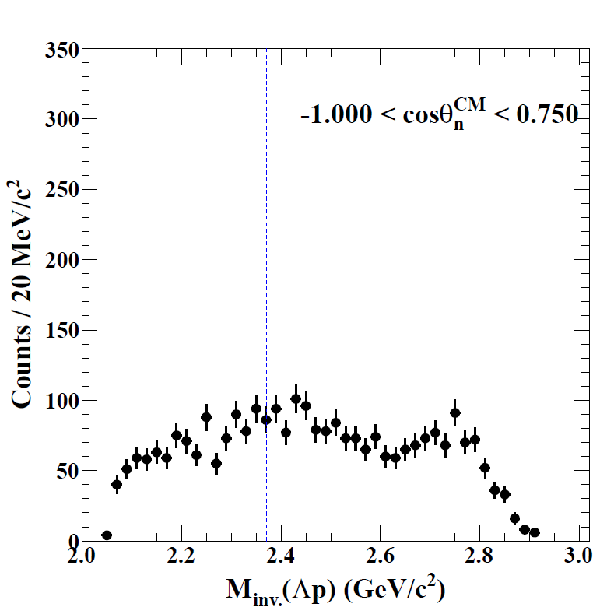
$\cos{{θ_{n}^{}}^{CM}}$ Sliced $IM\left(Λp\right)$
$−1.0<\cos{θ_{n}^{CM}}<0.75$
3NA + 2NA
Preliminary
$$M_{K^{−}pp}$$
Preliminary
No Structure

Slide 35
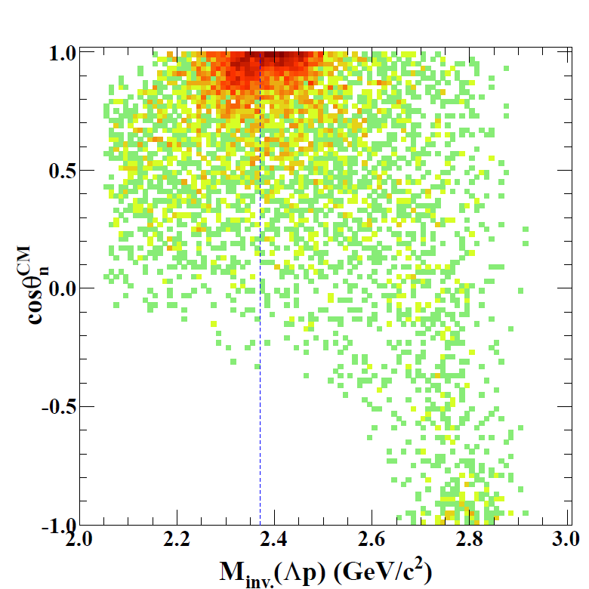

Slide 36
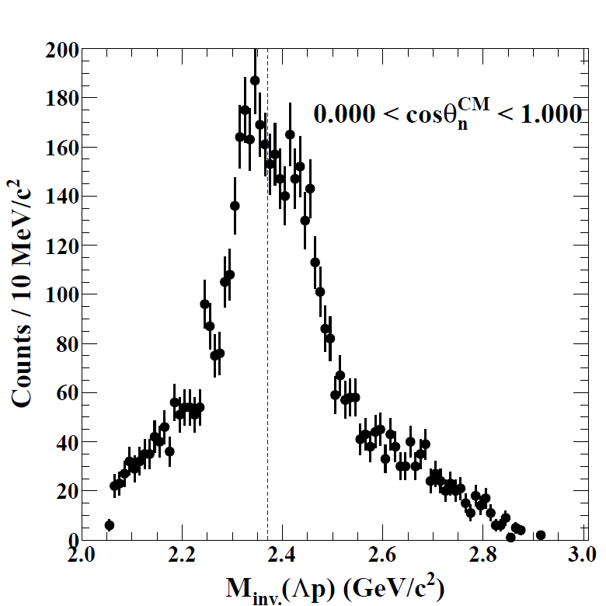

Slide 37
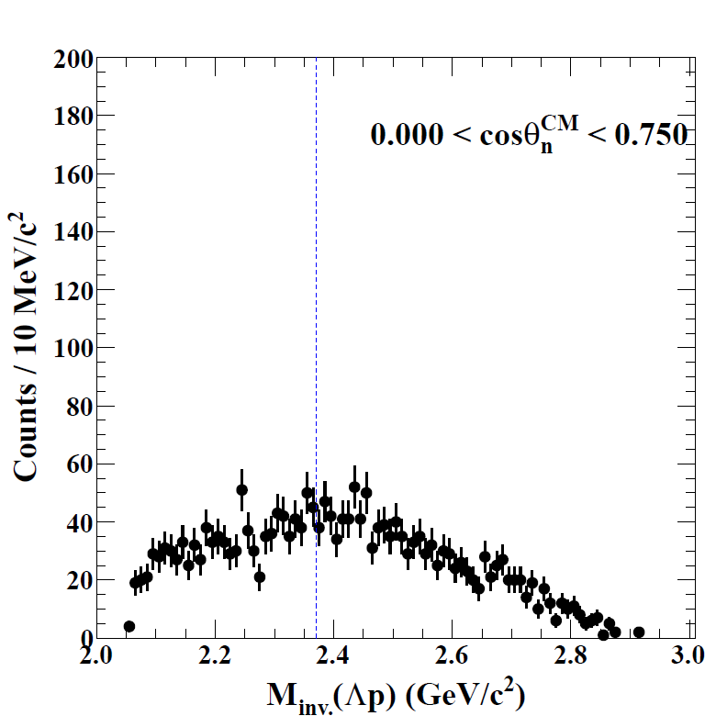

Slide 38
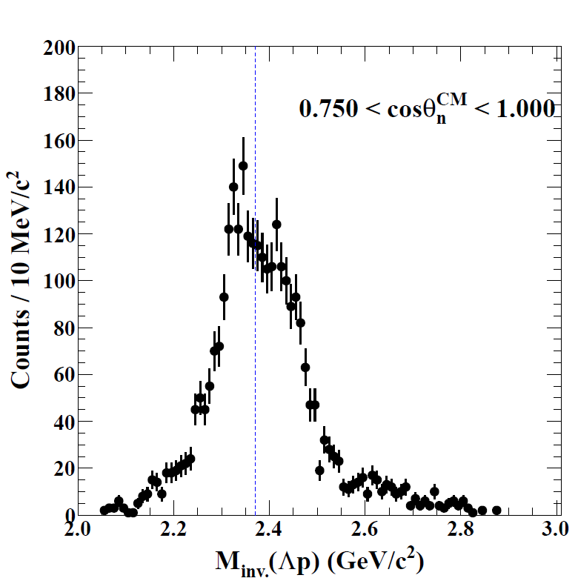

Slide 39
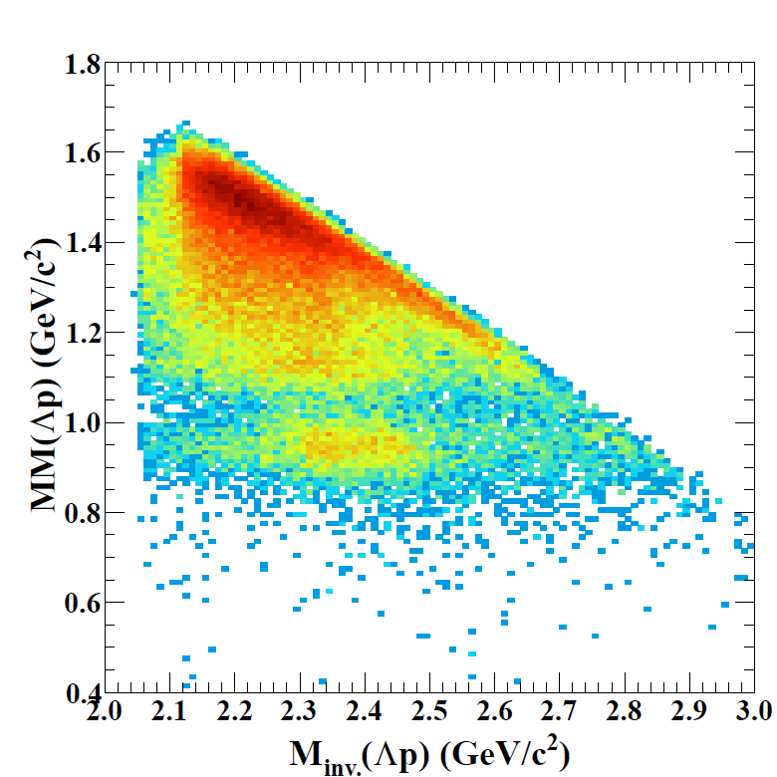
Neutron Window for $Λpn$ Selection
Preliminary
Lower
Higher
Preliminary
Selected neutron window
$n_{window}=0.85 −1.03 GeV/c^{2}$

Slide 40
$Λp$ IM vs. MM Plot
Final state identification
Selecting $Λpn$ final state
Preliminary
$"n+π(π)“$/$"γn+π(π)“$
$$(Λ{/Σ}^{0}pn+π(π))$$
$$"γn“$$
$$(Σ^{0}pn)$$
$$"n“$$
$$(Λpn)$$

Slide 41
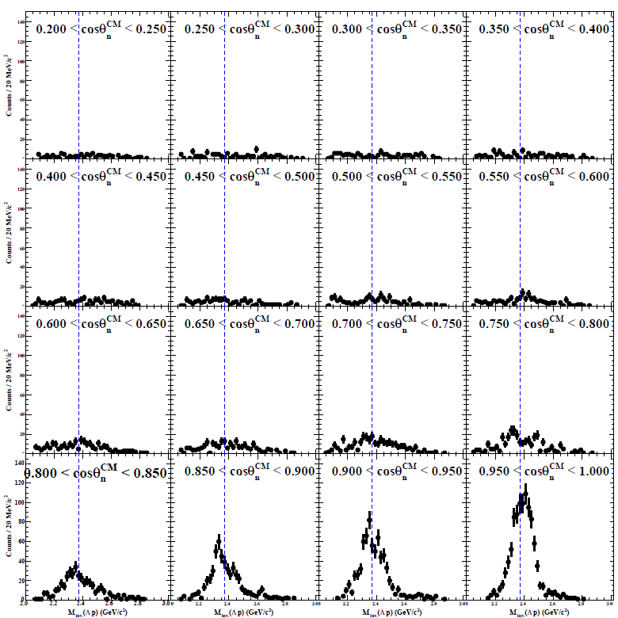
$\cos{{θ_{n}^{}}^{CM}}$ Sliced $IM\left(Λp\right)$
*Sliced with $0.05$ bin
Lower
Preliminary
Sliced
Preliminary
Higher

Slide 42
$\cos{{θ_{n}^{}}^{CM}}$ Sliced $IM\left(Λp\right)$
Lower
Preliminary
*Sliced with $0.05$ bin
Lower Opening Angle
0 – 0.75
No structure
Small event
Higher O.A.
0.75 – 1.0
Structure observed
Decreasing
Higher

Slide 43
$MM\left(Λp\right)$ Slice around $"n"$ Region
Lower
Preliminary
$$"n"(Λpn)$$
Preliminary
Sliced
$$"γn"(Σ^{0}pn)$$
Higher

