Slide 1
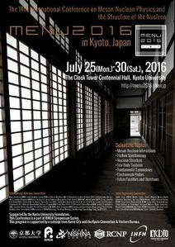
Welcome to MENU2016
The 14th International Conference on
Meson-Nucleon Physics and
the Structure of the Nucleon
Karlsruhe (1983), Los Alamos (1987), Gatchina/Leningrad (1989),
Bad Honnef (1991), Boulder (1993), Blaubeuren (1995), Vancouver (1997), Zuoz (1999), Washington DC (2001), Beijing (2004), Juelich (2007),
Virginia (2010) and Rome (2013)

Slide 2
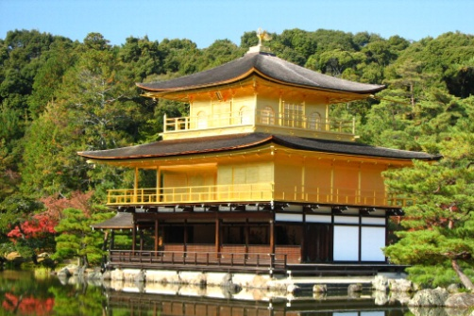
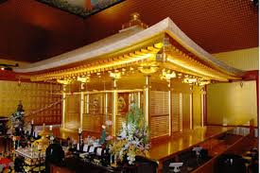
Welcome to Nihon
日本
Japan is written with two Chinese characters which mean "the land of rising sun" .
They are read as “Nihon” or “Nippon”. “Japan” is a European dialect to pronounce Nippon. These are like Genève, Geneva or Genf, all of them are from the same verbal origin and officially allowed in Switzerland (or Swiss !).
Our supporters of football, volleyball etc, often scream "Nippon cha cha cha", so the name of Nippon became more famous than Nihon.

Slide 3
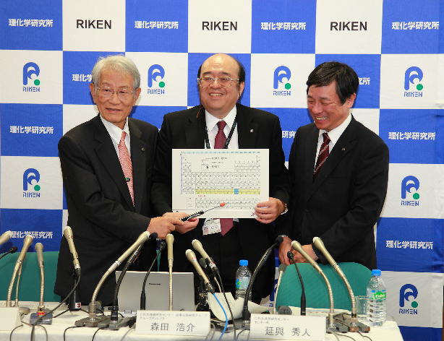
At last, we earned the naming rights to element 113
Nihonium, Nh
Public review until November 8
December 31, 2015
3
Notes:
December 31st, very morning.
Morita received the call from IUPAC.
At last we earned the naming rights to element 113.
New years morning, all, no exception, Morita’s face was on the front page of news papers.
After 6 months of public review, the periodic table will be officially modified. With Nihonium.

Slide 4
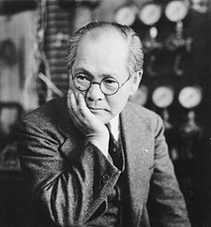
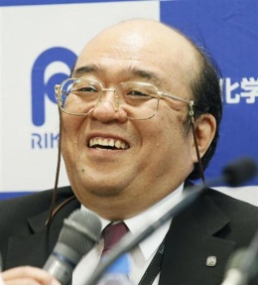
¹¹³Nh, Nihonium trivia
In 1910, Ogawa discovered element 43, and named it "nipponium "(Np), which showed up in ancient periodic tables. But, he was wrong. Tc-43 is unstable, and actually he discovered Re-75 (in the same family). Realized but too late.
In 1940 Nishina discovered element 93, but unable to do purified isolation. Then element 93 was named Neptunium (Np!!!) by McMillan. These stories can be found Japanese-Wiki. Not in English Wiki.
They chose Nihonium, by paying
their homage to the predecessors.
name |  |  | symbol
1 | Japonium | ○ | Jp | ○
2 | Nipponium | × | Np | ×
3 | Nihonium | ○ | Nh | ○
4
Notes:
Let me spend a minutes for Nihonium trivia.
Nihonium’ ash is a wrong choice for our distinguished french chair man.
//read

Slide 5
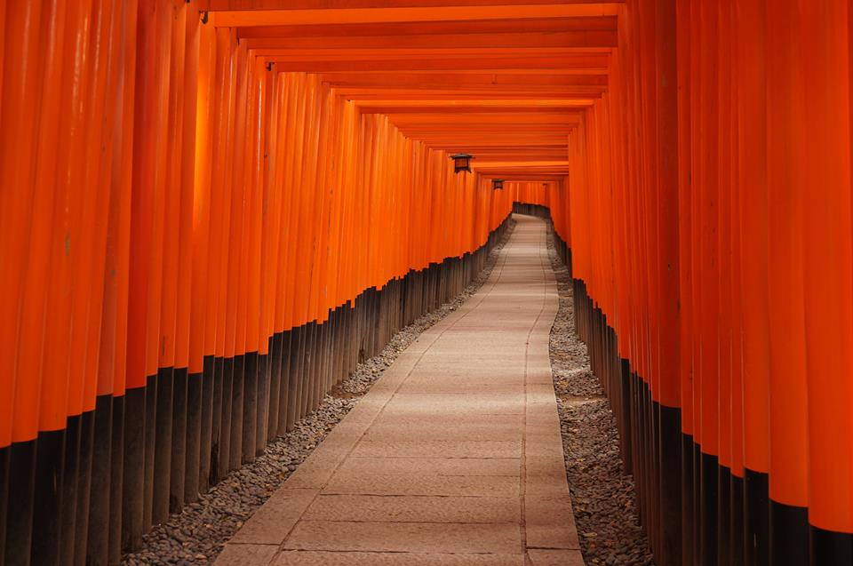
Welcome to Kyoto the place of legend
Fushimi
Inari
伏見稲荷大社
The Birth place of
pions and heavy quarks

