Slide 1
Review on recent results from RHIC polarized collider; unexpected forward neutron asymmetry
Itaru NAKAGAWA
on behalf of RHIC Spin Collaboration
RIKEN/RBRC

Slide 2
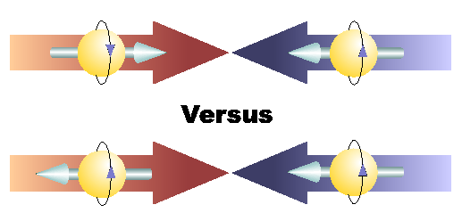
Outline
RHIC
  Polarized Proton
  STAR & PHENIX
Transverse
  Soft Process (very forward n)
  Hard Process (forward π)
Longitudinal
  Gluon Spin
  Sea Quark Spin
p
p
p

Slide 3
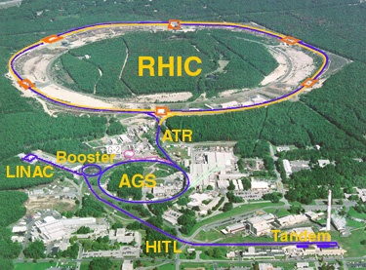
The Relativistic Heavy Ion Collider
accelerator complex
at Brookhaven National Laboratory
Brahms
pp2pp
PHENIX
STAR

Slide 4

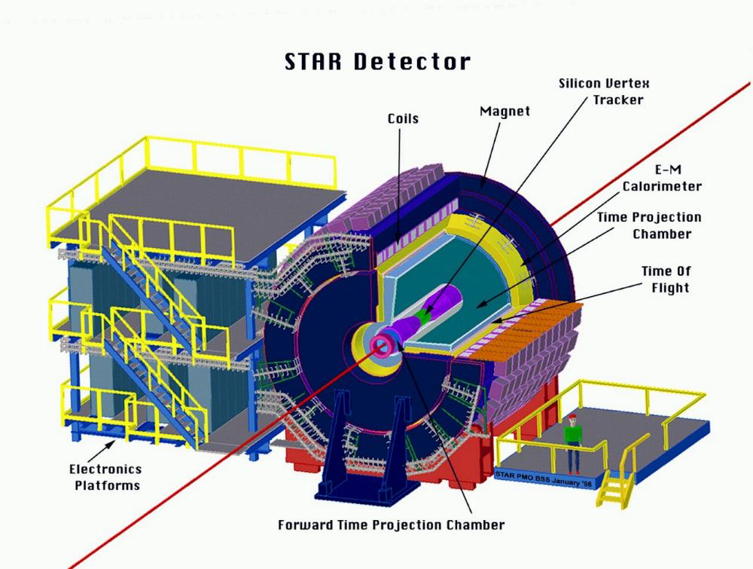
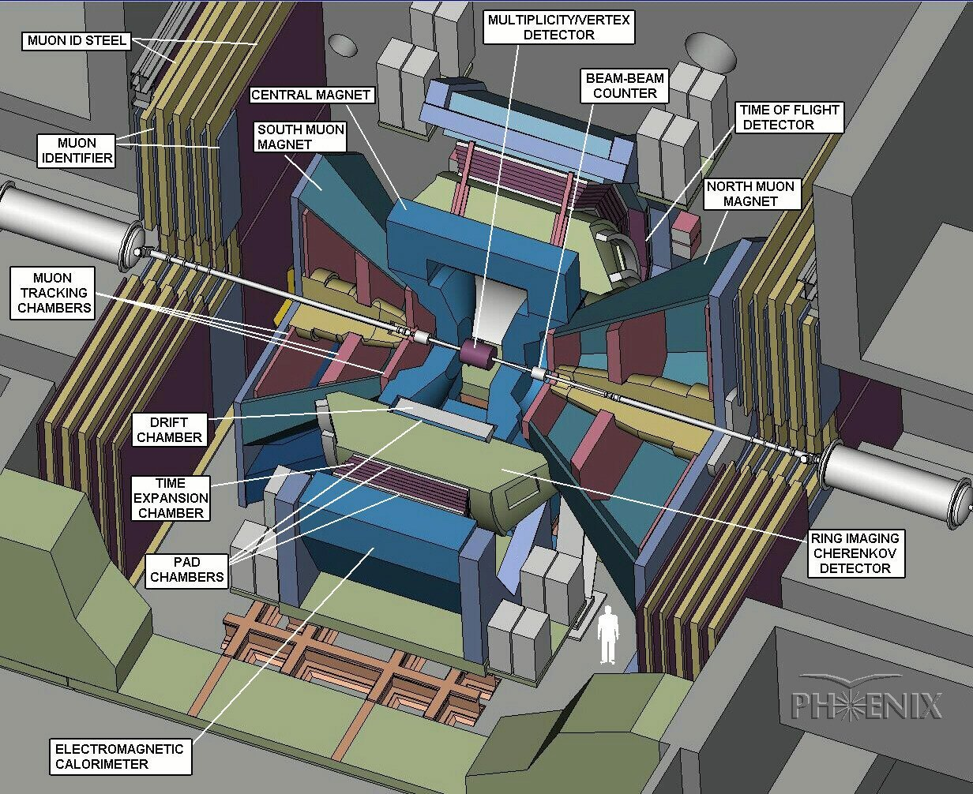

Brahms
pp2pp
PHENIX
STAR
Collision Energy : 62 ~ 510 GeV
Polarization : 50 – 60 %
Luminosity : 10 pb⁻¹/week

Slide 5
 | PHENIX | STAR
Advantage | High resolution and rates | Large acceptance and low mass
Central arm | |η|<0.35, Δφ∼π | |η|<1, Δφ∼2π
Target observables | γ, π⁰ and η | Jet and correlation
Forward arm | 1.2<|η|<2.4 | 2<|η|<4
Target observables | μ | π⁰ and η

Slide 6
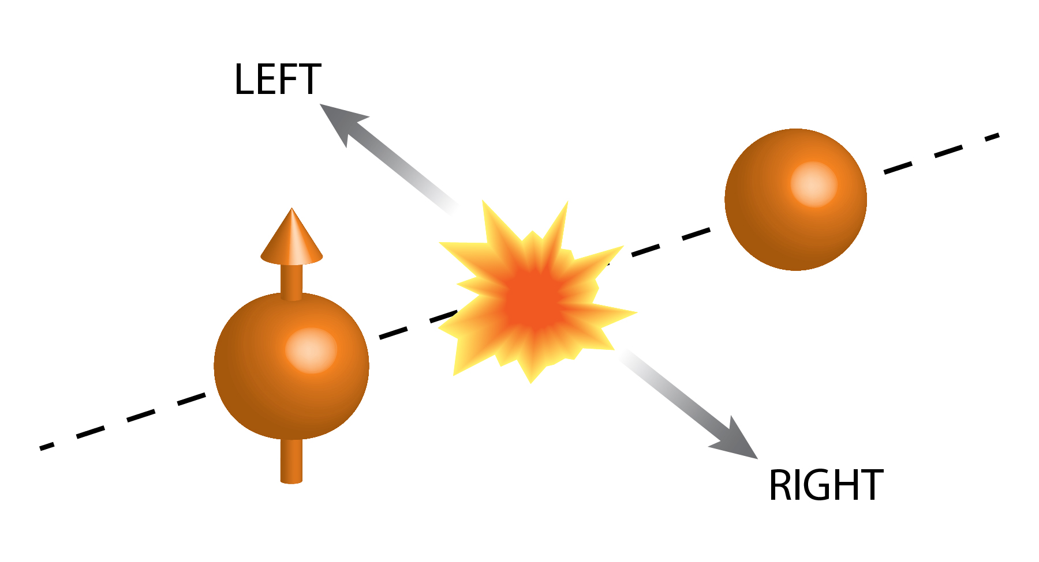
Transverse Single Spin Asymmetry
Forward π⁰ and very forward neutron

Slide 7
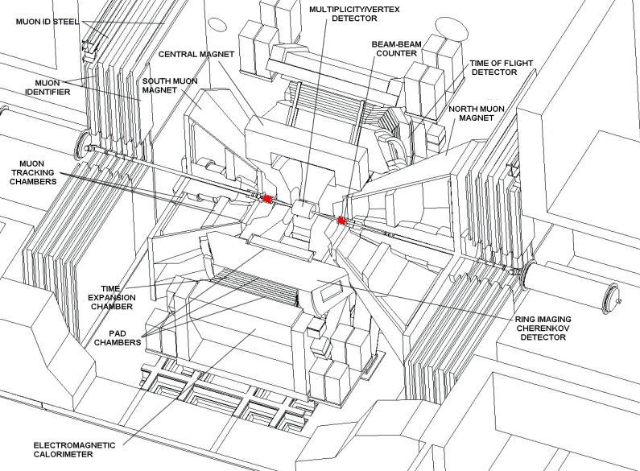

Transverse Asymmetry Observables
100GeV
Soft Process
(mesonic)
very forward n
(6<|η|<8)
forward π
(2<|η|<4)
ZDC
Hard Process
(partonic)

Slide 8
Production Mechanism of Forward Neutron
Cross Section
PRD88,032006
p
Cross Section
π⁺
< 2mrad
p
n
Neutron Energy／Proton Energy
Momentum Transfer ~ 100MeV
Well Explained by One-Pion Exchange

Slide 9
p↑+p Forward Neutron A_{N}
Spin non-flip
Spin flip
Neutron
Neutron
proton
proton
proton
proton
δ : phase shift
Unpolarized Cross Section

Slide 10
p↑+p Forward Neutron A_{N}
Spin non-flip
Spin flip
Neutron
Neutron
proton
a₁
proton
π⁺
proton
proton
δ : phase shift

Slide 11
p↑+p Forward Neutron A_{N}
PRD84,114012(2011)
p
p
π⁺,a₁
p
↑
n
Neutron P_{T} (GeV/c)
Data are well reproduced by the interference between π and a₁ Reggeon

Slide 12
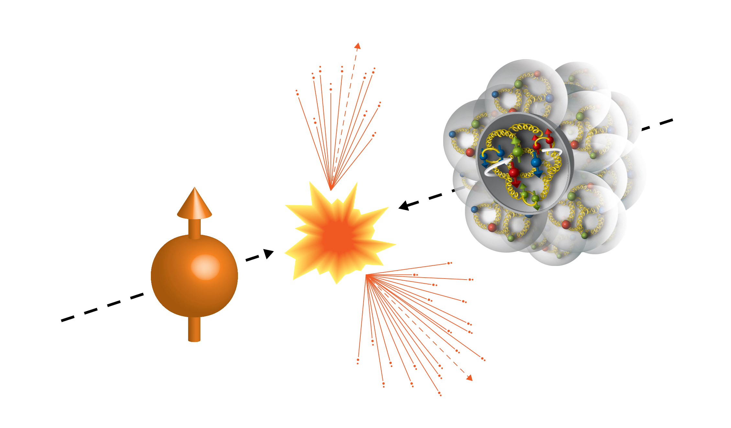
The First Time Ever
High Energy Collisions
Run15 (2015)
100GeV/nucleon
100GeV
Au, Al
Porarized Proton

Slide 13
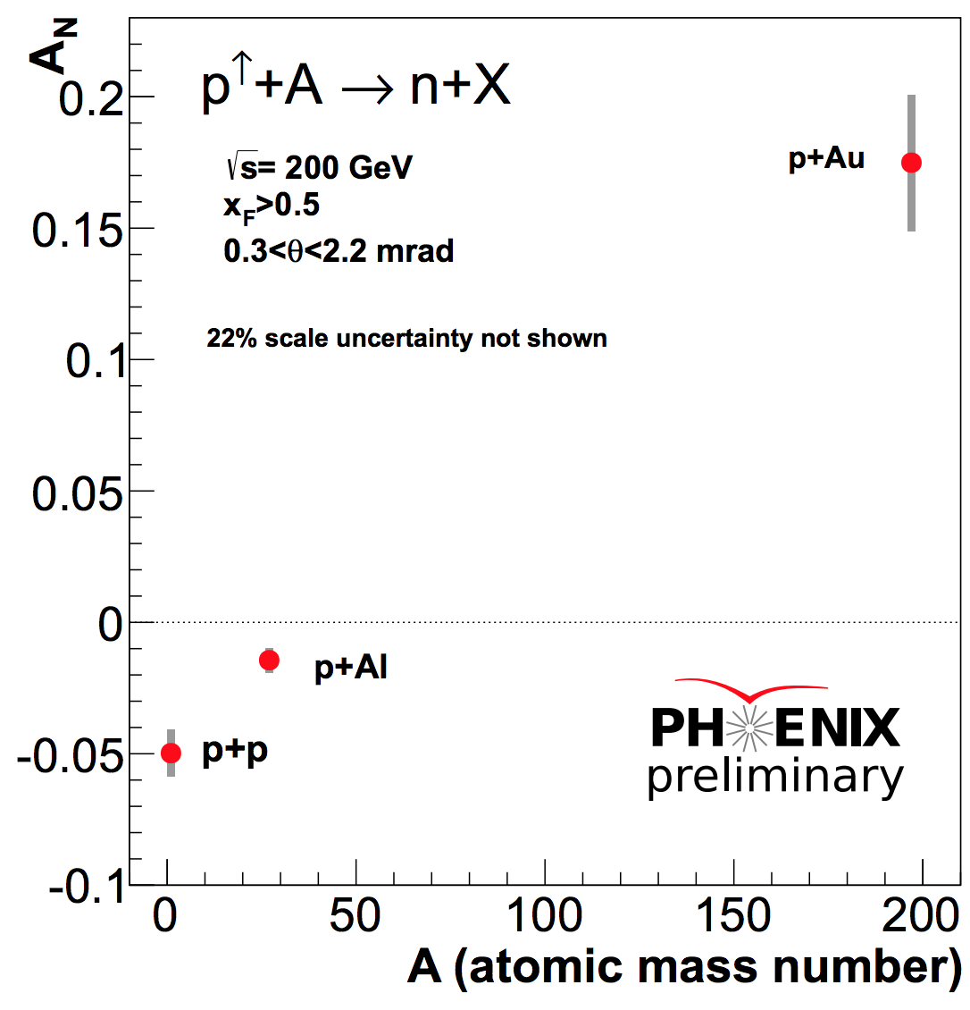
A-Dependent A_{N} (inclusive)
Present Frame Work

Slide 14

A-Dependent A_{N} (inclusive)
!
Absolutely Unexpected!
Analysis by
Minjung Kim (SNU/RIKEN)

Slide 15
What is going on ?
 | # of proton | # of neutron
p | 1 | 0
Al | 13 | 14
Au | 79 | 118
Isospin Symmetry
Surface Structure of Nucleus
QED Process
Gluon Saturation
Else…

Slide 16
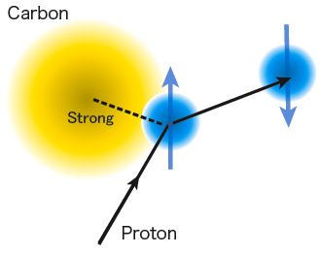
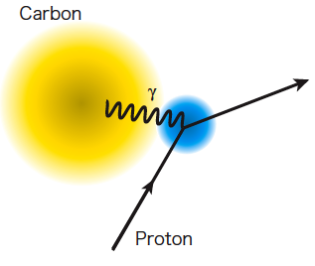
Primakoff Effect
Electro-Magnetic
neutron
A
A
EM-field
t → 0
α
α_{ΕΜ}
A
A
γ∗
π⁺
↑
p
n
p
↑
n

Slide 17
Primakoff Effect
(Electro-Magnetic)
neutron
A
A
Primakoff
In pAu case
t → 0
α
α_{ΕΜ}
A
A
γ∗
π⁺
π⁺
↑
p
n
p
↑
n
Δ

Slide 18
Full Description of A_{N}
d_{1~4} : relative phase of amplitudes
(For pp)
large
-t
small

Slide 19
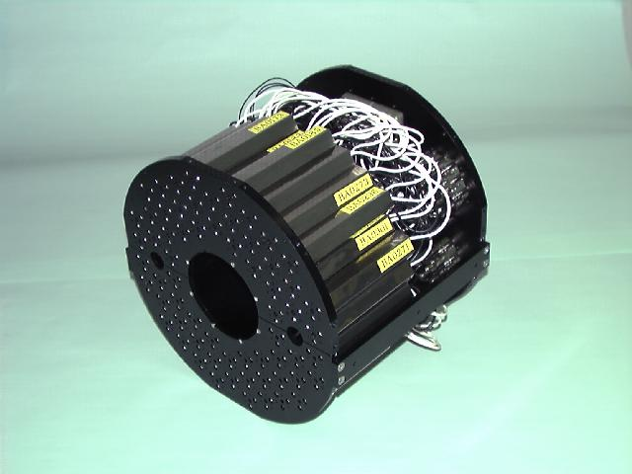
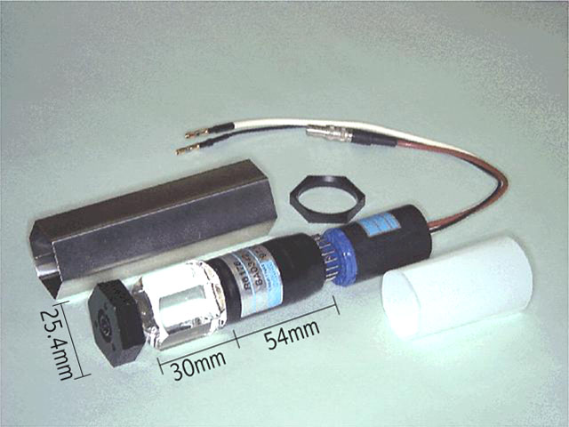
Beam-Beam Counter
PHENIX Detector
Dipole Bending Magnet
ZDC
BBC
Quartz Cherenkov radiator

Slide 20
Can we identify Primakoff events?
Semi-Inclusive
+
Dipole
π
+
π
6%
Δ
BBC
n
ZDC
94%
Primakoff MC : SOPHIA
G. Mitsuka, Eur. Phys. J.C. (2015) 75:614
BBC | tag | veto
Primakoff | Small | Large

Slide 21
BBC Tagging and Vetoing
Inclusive

Slide 22
BBC Tagging and Vetoing
A
BBC
?
Non-diffractive
↑
p
n
BBC
BBC Tagging
EM surpressed

Slide 23
BBC Tagging and Vetoing
BBC Vetoing
A
γ*
Diffractive
π⁺
p
↑
n
EM enhanced

Slide 24
Coulomb-Nuclear Interference in Forward Neutron Production
π⁺
π⁺
Same Final State
t → 0
A
A
A
A
P
π⁺
γ∗
π⁺
p
n
p
n
Δ
Diffractive Process Required?
Notes:
This is 5 times smaller than OPE, but can interfere with UPC

Slide 25
Non-Diffractive Events
π⁺
π⁺
Little chance to be same final state
t → 0
A
X
A
X
P
π⁺
γ∗
π⁺
p
n
p
n
Δ
Suppressed?
Notes:
This is 5 times smaller than OPE, but can interfere with UPC

Slide 26
Transverse Asymmetry Observables
100GeV
Soft Process
(mesonic)
very forward n
(6<|η|<8)
forward π
(2<|η|<4)
ZDC
Hard Process
(partonic)

Slide 27
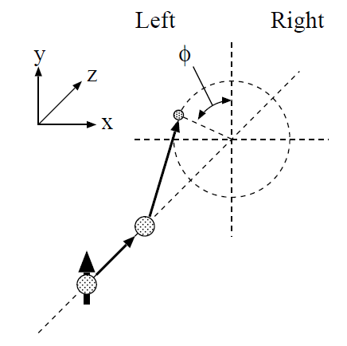
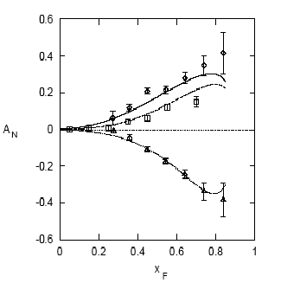
Single Transverse Spin Asymmetries
p
E704: Left-right asymmetries
p
π⁺
Theory Expectation:
Small asymmetries at high energies
(Kane, Pumplin, Repko, PRL 41, 1689–1692 (1978) )
π⁰
A_{N}
A_{N} O(10⁻⁴) Theory
Experiment:
(E704, Fermi National Laboratory, 1991)
π⁻
A_{N} O(10⁻¹) Measured

Slide 28
Energy Dependence of A_{N}
RHIC
E704 200GeV beam
Asymmetry still persists even in high energy!
Non-perturbative
Perturbative

Slide 29
What Could be the Cause?
Collins Effect +higher twist
Sivers Effect +higher twist
correlation between transversely-polarized nucleon and transversely polarized partons inside
Collins fragmentation function
transverse-momentum dependence of partons inside the transversely-polarized nucleon

Slide 30
Activities around π⁰
The more isolated π⁰, the larger the A_{N}.
Smaller A_{N} for jet-like events?

Slide 31
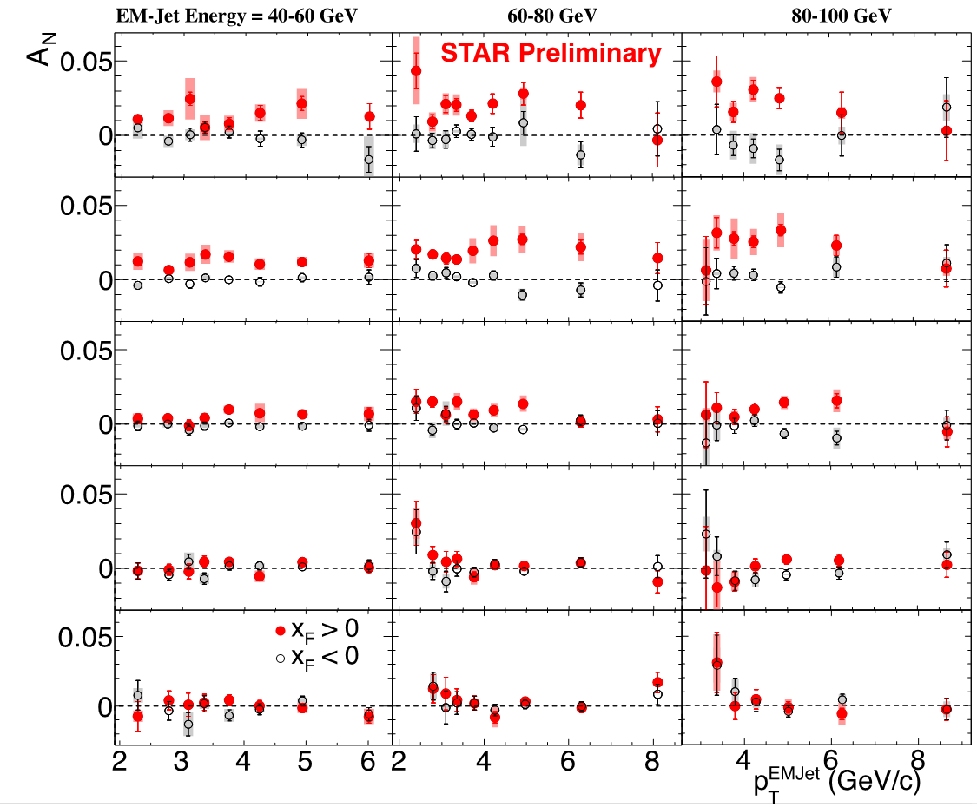
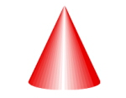






Event Topology: Forward TSSAs
E_{jet}=40_60 GeV
60_80 GeV
80_100 GeV
Diffractive
(soft)
1γ
2γ
3γ
4γ
5γ
γ
γ
(π⁰)
Jet
(hard)

Slide 32
Event Topology: Forward TSSAs
E_{jet}=40_60 GeV
60_80 GeV
80_100 GeV
Diffractive
(soft)
1γ
2γ
3γ
4γ
5γ
γ
γ
(π⁰)
Collins fragmentation or/and
diffractiveness in charge of finite A_{N}?
Jet
(hard)

Slide 33
Transverse Summary
Very drastic and unexpected A-dependence was observed in very forward neutron A_{N}.
According to MC study, EM process likely to be in charge of the large positive asymmetry in large A.
A-dependence in strong interaction is likely to be moderate as existing model predicts.
Forward π has been studied in pQCD framework, but recent data indicate possibility of soft process may be (partially) playing a role.
So far, “diffractiveness” can be the common key word of both asymmetries.

Slide 34
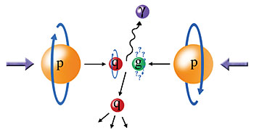
Longitudinal Program
ΔG, Polarization

Slide 35
Proton Spin Decomposition
Proton spin =
Longitudinal Spin Sum Rule
~30%
?
??
Quark Spin
Sea quark
Gluon Spin

Slide 36
Longitudinal Spin Structure
Longitudinally Polarized proton-proton
Hadron
Asymmetry
Fragmentation Function
Double Helicity Asymmetry A_{LL}

Slide 37
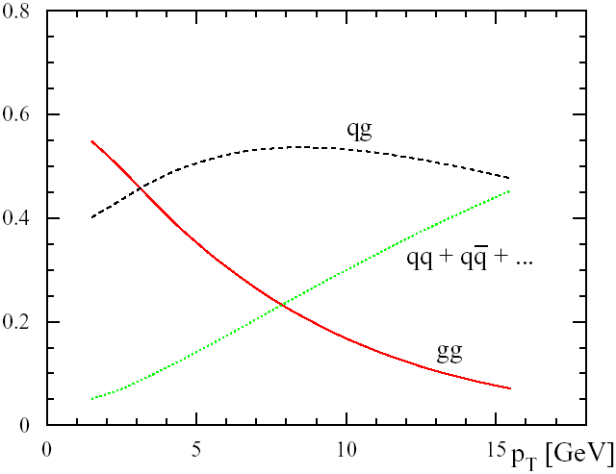
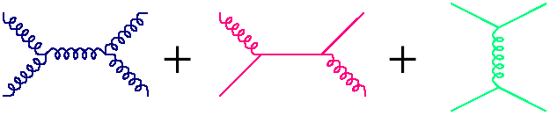
Subprocess of pp
ex) π⁰ production
|η|<0.35
Fraction of Subprocess
<- small x
g
g
q
g
q
q

Slide 38
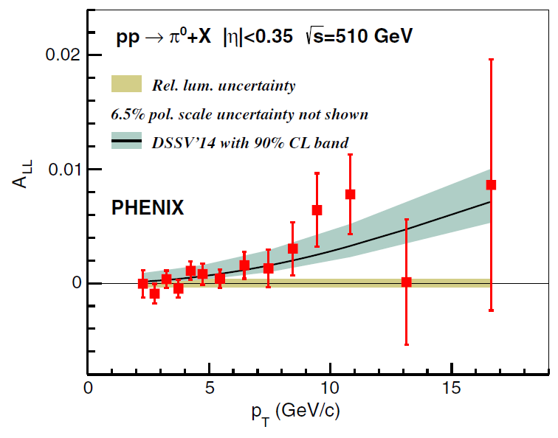
Latest A_{LL} Results
PRD 93, 011501R (2016)
PRL115, 092002 (2015)

Slide 39
Δg(x) extraction : Global Fit
arXiv:1602.03922
pp
DIS
SIDIS
Δq(x), Δq(x), Δg(x)
Global Fit

Slide 40
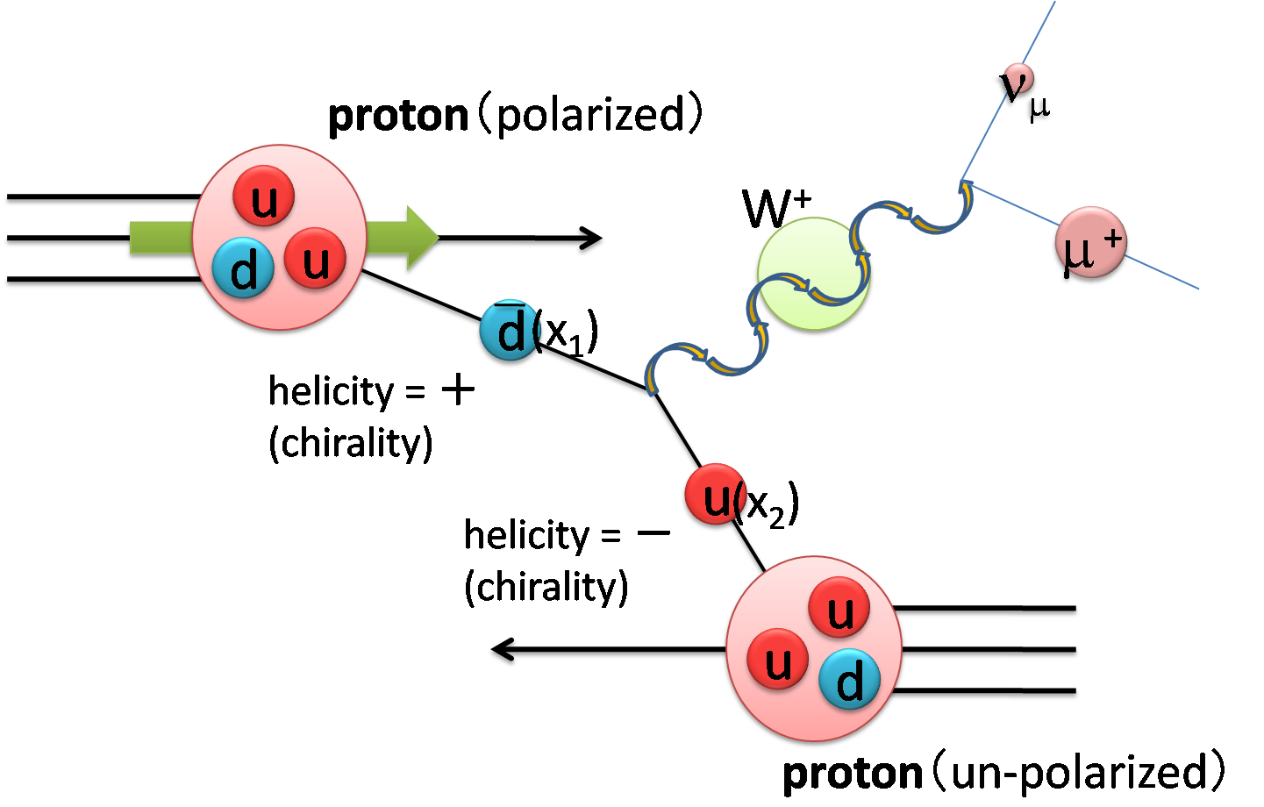
Sea Quark Polarization

Slide 41
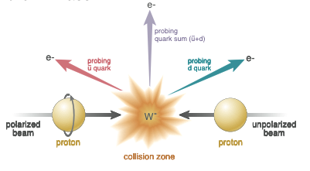
Single Lepton Measurement
μ⁻
μ⁻

Slide 42
Energy
Spectra
Backgrounds
(M_{W} = 80GeV)

Slide 43
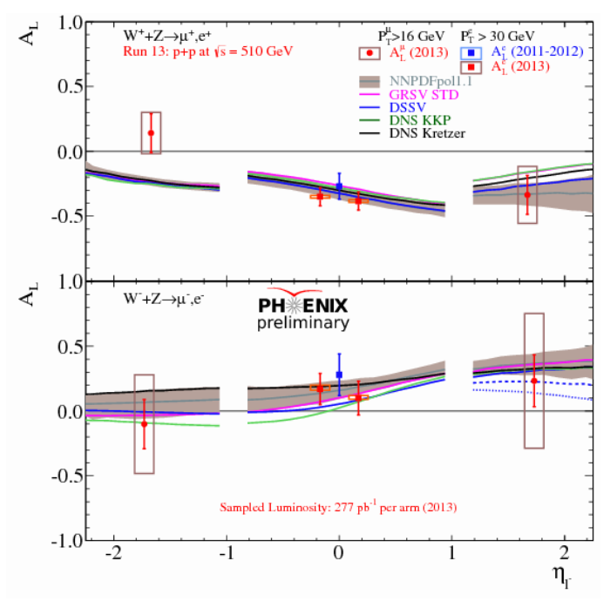
Single Lepton Asymmetry A_{L}
PRD93, 051103(R) 2016

Slide 44
Summary
RHIC spin program has been providing new insights to spin structure of proton
Absolutely unexpected strong A-dependence in very forward neutron TSSA of p+A.
EM process likely to be taken into account.
More sophisticated measurements on forward π TSSA to disentangle competing effects (ISI or FSI).
Diffractiveness may connects between forward π and very forward n.
Latest data shows non-zero gluon spin fraction
Ongoing W analyses will improve precision of sea-quark polarized parton distribution
T
L

Slide 45
Backup slides

Slide 48
UPC Monte Carlo
Neutral Particle @ 200GeV
QCD(DPMJET)
ZDC
UPC
(SOPHIA)
Predicts comparable yields between QCD and UPC processes

Slide 49
Coulomb-Nuclear Interference
(CNI)
π⁺
π⁺
Notes:
This is 5 times smaller than OPE, but can interfere with UPC

Slide 50
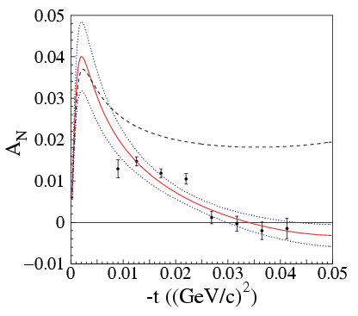
Elastic A_{N} at Coulomb Nuclear Interference
Pomeron
(High energy & small t limit)
pC Analyzing Power
EM
C
C
γ∗
zero hadronic
spin-flip
p
p
↑
With hadronic
spin-flip (E950)
had
C
C
P
p
↑
p
Phys.Rev.Lett.,89,052302(2002)
E_{beam} = 21.7GeV

Slide 51
Run15 Au,Al beam + p target
↑
Plot from Oleg Eyser (The 2015 PSTP workshop)
↑
p+p
↑
Al+p
±5%
↑
Au+p
Strong A-Dependence
Flips sign of A_{N} in Au+p
0.002 < -t < 0.014 (Gev/c)²
↑
Forward Neutron
0.02 < -t < 0.5 (Gev/c)²

Slide 52
Underlying Mechanism Comparison
Polarimeter
Forward n
A
A
A
X?
Pomeron
π⁺,a_{1, ..}
p
p
p
n
Elastic | Inelastic
√s = 14 GeV | √s = 200 GeV
0.002 < -t < 0.014 | 0.02 < -t < 0.5
ΔI =0 | ΔI =1

Slide 53
Interim Summary (CNI)
CNI is not necessarily new.
Elastic in much smaller –t than present neutron results observed similar behavior, but the asymmetry is in the order of 5% or less.
There are possible diagram to hadron and EM interfere for neutron production as well.

Slide 55
The origin of Asymmetry

Slide 56
Origin of the Asymmetry
A
A
A
A
γ∗
γ∗
π⁰
×
π⁰
p
p
p
p
Δ
Ν∗
Δ*(1232) P33
N*(1440) P11
Nπ (>99%)
Nπ (60∼70%)
Νππ (30∼40%)
Notes:
[Boris] In both diagrams the interfering gamma and pion cover the whole rapidity interval between the colliding p and A. The pion exchange is, as I said, strongly suppressed. However the OPE mechanism, responsible for neutron production, pion exchange cover only a small part of the rapidity interval. The main part in inelastic collision pi+P(A)=>X. The energy of this collision is very high s(1-z). When we square this inelastic amplitude, we get Pomeron.

Slide 57
Comparison between two
 | Fermi | PHENIX | STAR17
Beam Energy [GeV] | 185 | 100 | 255
√s [GeV] | 19.5 | 200 | 22
Target | Pb | Au | Al/Sn/Au
Observables | p + π⁰ | n ( + charged) | n ( + charged) π⁰ ?
t' | < 0.001 | 0.02 < -t < 0.5
M | 1.36 < M(π⁰p)<1.52 | ? | ?
A_{N} | - 0.57 ± (0.12)_{sta}+ 0.21 - 0.18 | + 0.27 ± 0.003 (BBC veto)

Slide 58
Origin of the Asymmetry
A
A
A
A
γ∗
γ∗
Fermi
π⁰
×
π⁰
p
p
p
p
Δ
Ν∗
A
A
A
A
γ∗
γ∗
RHIC
π⁺
×
π⁺
p
n
p
n
Δ
Ν∗
Notes:
[Boris] In both diagrams the interfering gamma and pion cover the whole rapidity interval between the colliding p and A. The pion exchange is, as I said, strongly suppressed. However the OPE mechanism, responsible for neutron production, pion exchange cover only a small part of the rapidity interval. The main part in inelastic collision pi+P(A)=>X. The energy of this collision is very high s(1-z). When we square this inelastic amplitude, we get Pomeron.

Slide 59
hadronic
CNI
Primakoff
A
A
A
A
×
P
π⁰
π⁰
π⁰
p
p
p
p
Δ
Ν∗
×
A
A
A
A
γ∗
×
γ∗
π⁰
π⁰
p
p
p
p
Δ
Ν∗
Fermi (p+π⁰ channel)
Notes:
[Boris] In both diagrams the interfering gamma and pion cover the whole rapidity interval between the colliding p and A. The pion exchange is, as I said, strongly suppressed. However the OPE mechanism, responsible for neutron production, pion exchange cover only a small part of the rapidity interval. The main part in inelastic collision pi+P(A)=>X. The energy of this collision is very high s(1-z). When we square this inelastic amplitude, we get Pomeron.

Slide 60
hadronic
CNI
Primakoff
A
A
A
A
×
P
π⁰
π⁺
π⁺
p
n
p
n
Δ
Ν∗
×
A
A
A
A
γ∗
×
γ∗
π⁺
π⁺
p
n
p
n
Δ
Ν∗
RHIC (n+π⁺ channel)
Notes:
[Boris] In both diagrams the interfering gamma and pion cover the whole rapidity interval between the colliding p and A. The pion exchange is, as I said, strongly suppressed. However the OPE mechanism, responsible for neutron production, pion exchange cover only a small part of the rapidity interval. The main part in inelastic collision pi+P(A)=>X. The energy of this collision is very high s(1-z). When we square this inelastic amplitude, we get Pomeron.

Slide 62
Future
arXiv:1602.03922

Slide 63
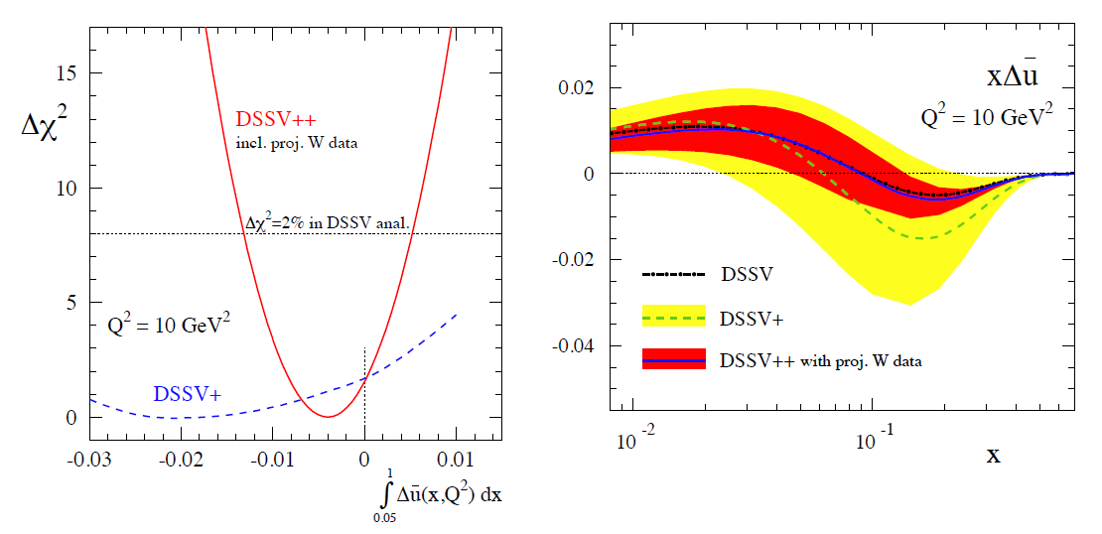
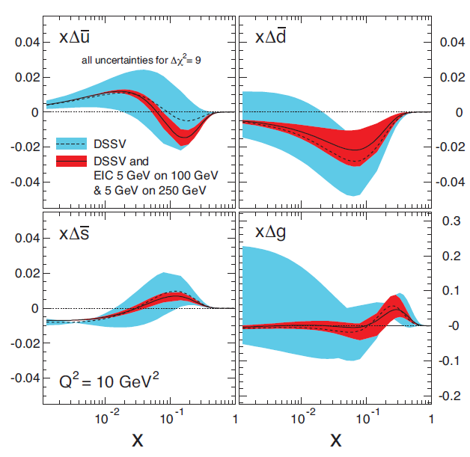
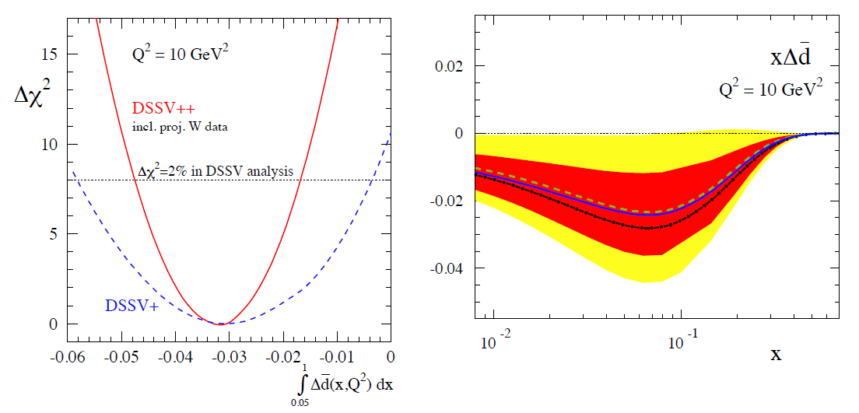
Present and Future
arXiv: 1501.01220
arXiv: 1212.1701

Slide 64
Transverse Summary
Very Forward n
EM/EM*strong
interference
Large + positive A_{N}
Diffractive?
Strong
Negative + Moderate
A-dependence
Forward p
Strong
Hard process?
Diffractive?

Slide 65
x_{F} and p_{T} Dependence

Slide 66
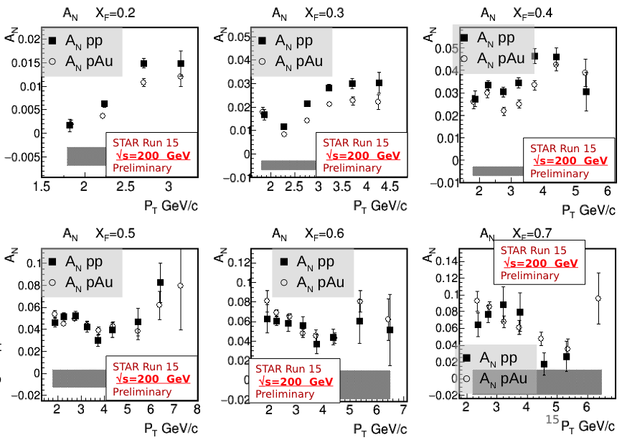
Forward π⁰ A_{N} in p+Au
Did not observe A-dependence unlike very forward neutron A_{N} in PHENIX

