Slide 1

Resent results
from WASA-at-COSY
mesons production
mesons decays
(10¹¹ π and 10⁹ η)
(Ankita Goswami,
Today 18:20, Hall II)
Paweł Moskal for the WASA-at-COSY Collaboration
Jagiellonian University, Cracow, Poland
-EE
MENU 2016
Kyoto University, Kyoto, 25-30 July, 2016
Notes:
1
1
Maria left me kindly a choise of the subjcet..
So I guess, you may easly imagine all the agonies
of having to make a choice which I experienced last week.
Here I have to mention that I will explain the meaning of WASA and COSY …
(WASA is the detector… and COSY is the proton Cooler Synchrotron)

Slide 2

Recent results from WASA-at-COSY
mesic nuclei
dibaryons
P.M., Acta Phys. Polon. B 47 (2016) 97
Notes:
contributing to the study of the muon
anomalous magnetic moment
Jakos to poskladac do kupy … dlaczego eta SM etc…
Polaczyc z nastepna strona i nawiazac podobnie as two years ago I will repeat since …than to Falsify the theory !!!
With Wasa at COSY we study both production and decays of the eta-meson but Today I will concentrate
of decays which is also a primordial aim of the experiment
In general we search for the phenomena which cannot be describe by the Standard Model…

Slide 3
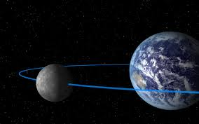
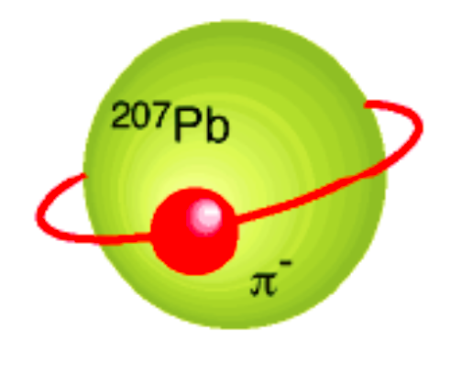
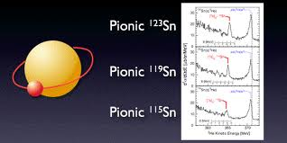
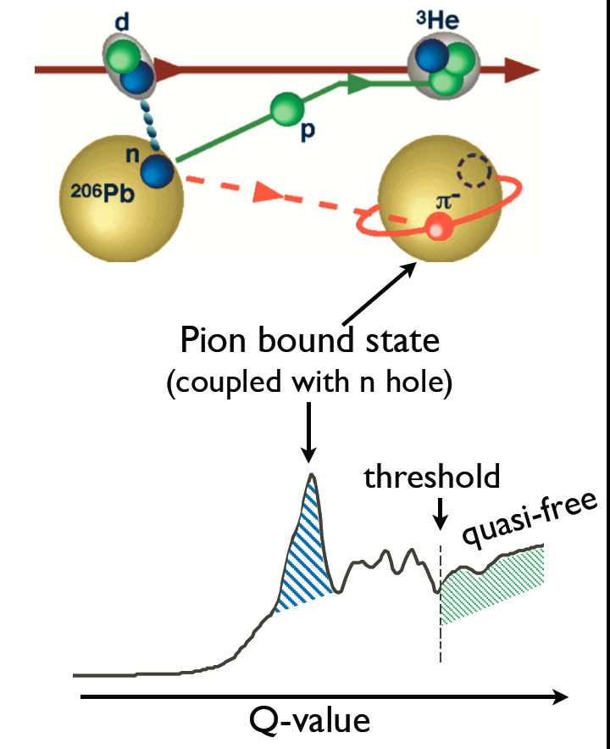
+
-
+
η
Kenta Itahashi, RIKEN
From talk at Symposium in Cracow 2013
Notes:
This is one of the systems Copernicus was interested in a bound state of moon and earth ...
Bound state bound by the strong interction of the object which exists (separately)
Not like a meson or baryon.. Here you we can not say that quark exists as a seperate object.....
Something similar to nucleus (But including a meson)…

Slide 4

Jagiellonian University
Student of astronomy in 1491-1495
+
-
+
η
Kenta Itahashi, RIKEN
From talk at Symposium in Cracow 2013
Notes:
This is one of the systems Copernicus was interested in a bound state of moon and earth ...
Bound state bound by the strong interction of the object which exists (separately)
Not like a meson or baryon.. Here you we can not say that quark exists as a seperate object.....
Something similar to nucleus (But including a meson)…
So I woould like to stress again… This what we are trying to find is a meson bound with nucleus solely by the strong intercation

Slide 5
THE ETA-MESIC NUCLEUS
η meson bound with nucleus via
STRONG INTERACTION
+
+
N*
π‾
+
η
N*
COSY, J-PARC, MAMI, GSI, LPI/JINR
Talk by Wojciech Krzemień at this conference …
G. A, Sokol et al., arXiv:nucl-ex/0106005

Slide 6
THE ETA-MESIC NUCLEUS
η meson bound with nucleus via
STRONG INTERACTION
γ
+
+
η
γ
COSY, J-PARC, MAMI, GSI, LPI/JINR
Talk by Wojciech Krzemień at this conference …
G. A, Sokol et al., arXiv:nucl-ex/0106005
Notes:
For the first time also this mechanisms …

Slide 7
Theoretical indications ...

Slide 8
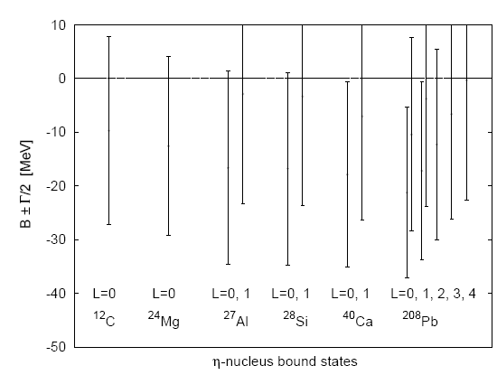
  Attractive interaction between η and N
  (R. Bhalerao and L. C. Liu, Phys. Lett. B54 (1985) 685 )‏
  possible existence of bound states
  of the η meson with nuclei for A>10
  (Q. Haider and L. C. Liu, Phys. Lett. B172 (1986) 257 )‏
  (C.Garcia-Recio, T. Inoue, J.Nieves,
  E. Oset, Phys. Lett. B550 (2002) 47).

Slide 9
  η bound state possible with the light nuclei
  C. Wilkin, Phys. Rev. C47 (1993) 938
³He-η ³H-η ⁴He-η
Supported by model calculations of:
- S. Wycech et al., Phys. Rev. C52(1995)544
(the multiple scattering theory)
…
…
…
η-nuclear bound states revisited
E. Friedman, A. Gal, J. Mares, Phys. Lett. B725 (2013) 334
N. Kelkar et al., Rept. Prog. Phys. 76 (2013) 066301

Slide 10
Experimental indications ...

Slide 11
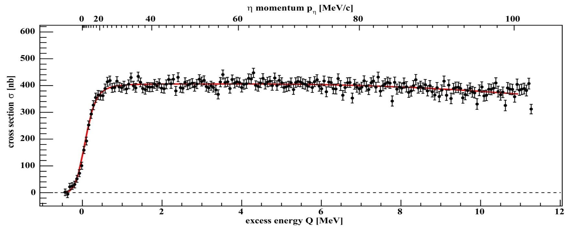
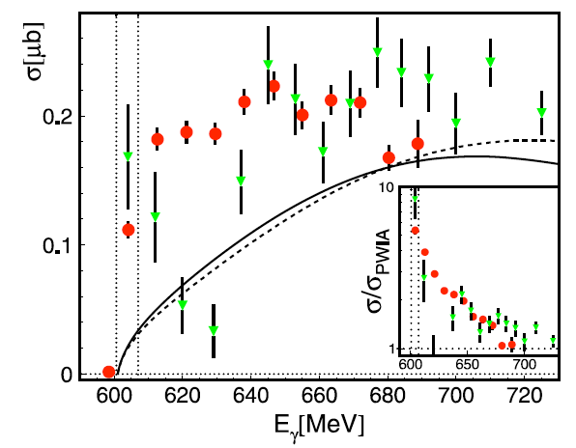
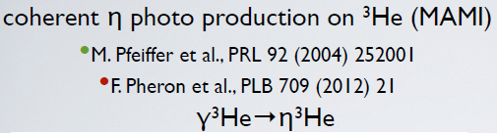
+
η - ³He
+
dp→ ³Heη γ ³He → ³Heη
COSY
MAMI
η
MAMI:
M. Pfeiffer et al., Phys. Rev. Lett. 92 252001 (2004)
F. Pheron et al., Phys. Lett. B709 21 (2012)
ANKE: T. Mersmann et al., Phys. Rev. Lett. 98 242301 (2007)
COSY-11: J. Smyrski et al., Phys. Lett B 649 258-262 (2007)
T. Mersmann et al., Phys. Rev. Lett. 98, 242301 (2007)
Notes:
Fusion of pd to 3He associated with the production of the eta meson.
SO its connected to the eta-3He system !!!
Is it production or interaction in the final state??? It has rather something to do with hel-eta because…

Slide 12
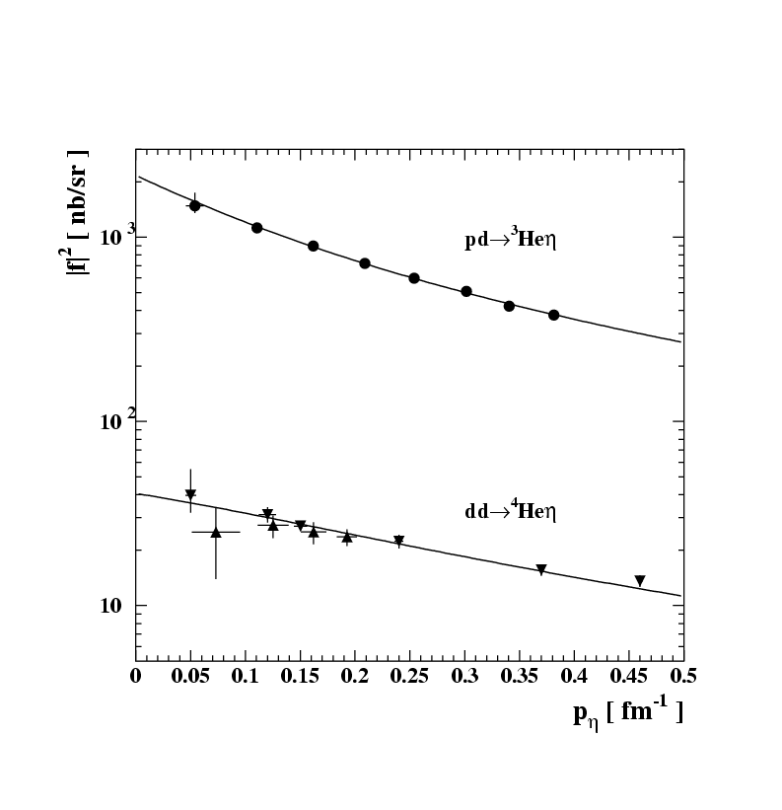
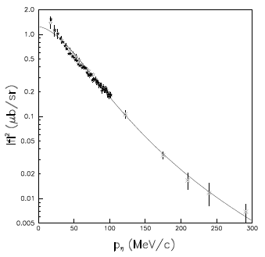
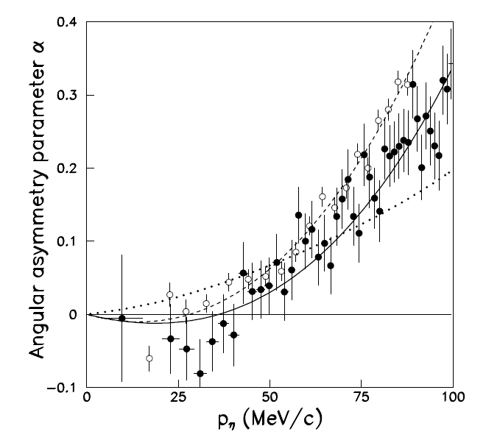

+
η - He
η
+
dp→ ³Heη
C.Wilkin et al., Phys. Lett. B654 (2007) 92‏
|Re(a)| > Im(a)
σ_{tot} = p_{cm}/p^{cm}_{beam} |f_{B}/(1-ip_{cm}a)|²
|Re(a)| = 2.9 ± 0.6 fm
Im(a) = 3.2 ± 0.4 fm
+
η
COSY-11 , COSY-ANKE
and also MAMI …
+
ANKE: T. Mersmann et al., Phys. Rev. Lett. 98 242301 (2007)
COSY-11: J. Smyrski et al., Phys. Lett B 649 258-262 (2007)
Notes:
Differences in steep are perhaps better seen directly at excitation function (see next page)

Slide 13
Expected signature ...

Slide 14
THE ETA-MESIC NUCLEUS
η meson bound with nucleus via
STRONG INTERACTION
+
+
+
N*
π‾
+
η
N*
+
COSY, J-PARC, MAMI, GSI, LPI/JINR
Talk by Wojciech Krzemień at this conference …
G. A, Sokol et al., arXiv:nucl-ex/0106005

Slide 15
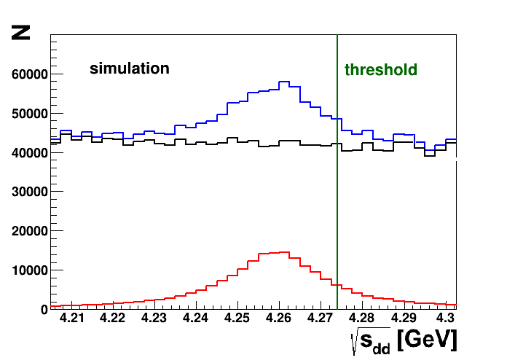
d+d → (⁴He-η)_{bound}→ ³He + p + π⁻
d+d → ³He + p + π⁻
SIMULATIONS
Notes:
G=30 a Bs=15 MeV

Slide 16
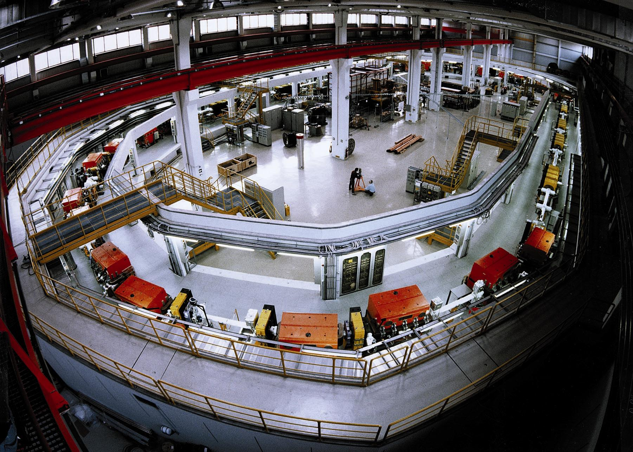
spolaryzowana lub niespolaryzowana
wiązka protonów i deuteronów
polarised and unpolarised proton
and deuteron beams
chłodzenie stochasyczne i elektronowe
stochastic and electron cooling
zakres pędu: 600 – 3700 MeV/c
momentum range: 600 – 3700 MeV/c
produkcja mezonów do φ(1020) włącznie
meson production up to φ(1020)‏
COoler SYnchrotron COSY
Notes:
16
16

Slide 17
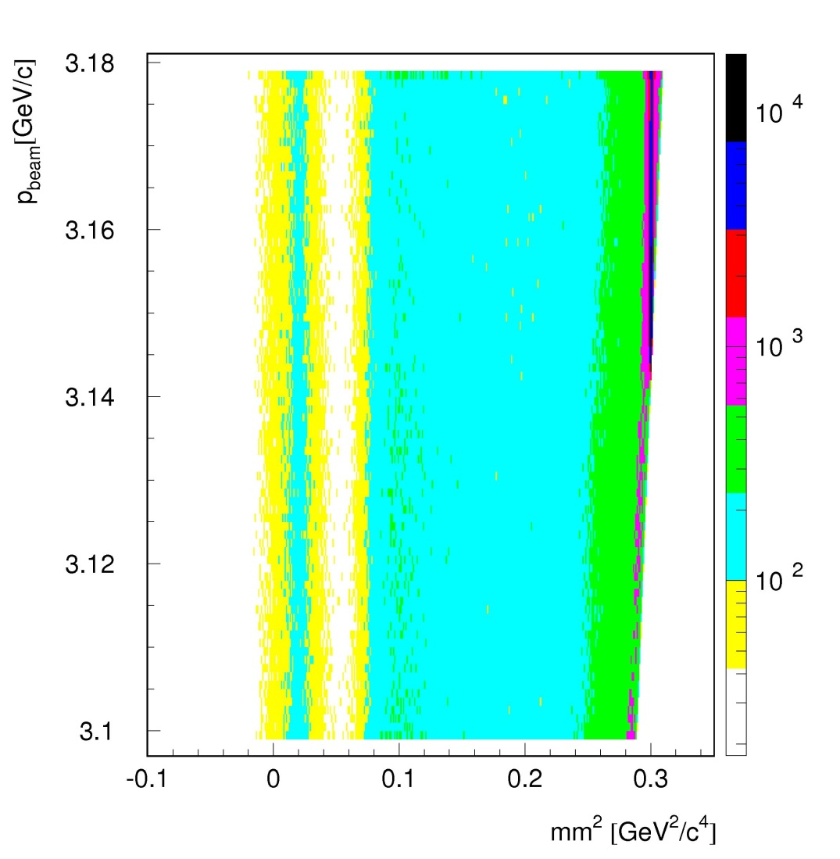
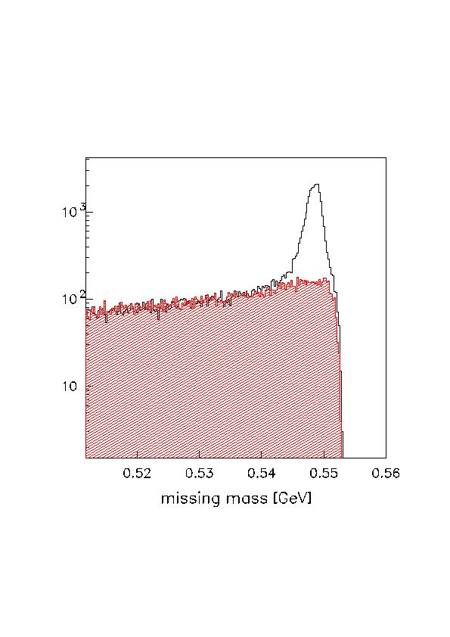
dp → ³He X
+
π
η
+
η

Slide 18
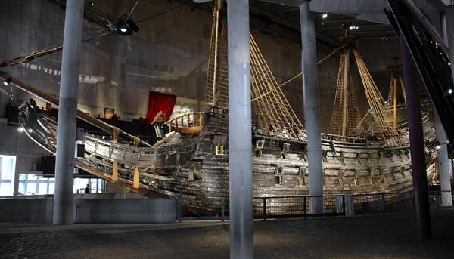
WASA
WASA
A WARSHIP built for the war with Poland
which sank in 1628 in the middle of Stockholm harbour
after sailing barely 1300 meters
Notes:
at the turn of 16th and 17th century Swedish Colleagues have made two mistakes ….
1596… przeniósł stolice do Warszawy ….
1628 … Statek WASA poszedł na dno…
Traditionally, the home of the Emperor was considered the capital. From 794 through 1868, the Emperor lived in Kyoto.^{[1]} After 1868, the seat of the Government of Japan and the location of the Emperor's home was Tokyo.^{[2]}
In 1941, the Ministry of Education published the "designation of Tokyo as capital.
Nara period Heijō-kyō (Heijō Palace), 710–740^{[44]} in the reigns of Empress Genmei,^{[45]} Empress Gensho,^{[46]} and Emperor Shomu^{[46]}
Kuni-kyō (Kuni Palace), 740–744^{[47]} in the reign of Shomu^{[48]}
Naniwa-kyō (Naniwa Palace), 744^{[36]}
Naniwa-kyō, Shigaraki Palace, 744–745^{[36]}
Heijō-kyō (Heijō Palace), 745–784^{[44]}
Nagaoka-kyō (Nagaoka Palace), 784–794^{[49]} in the reign of Emperor Kammu^{[50]}
Heian period Heian-kyō (Heian Palace), 794–1180^{[51]} in the reign of Kammu^{[50]} and others
Fukuhara Palace, 1180^{[52]} in the reign of Emperor Antoku^{[53]}
Heian-kyō/Kyoto (Heian Palace), 1180–1868^{[51]}
To-kyō (Kōkyo), 1868–present^{[2]}

Slide 19
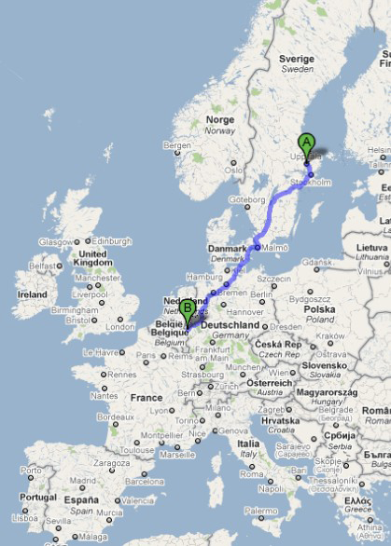
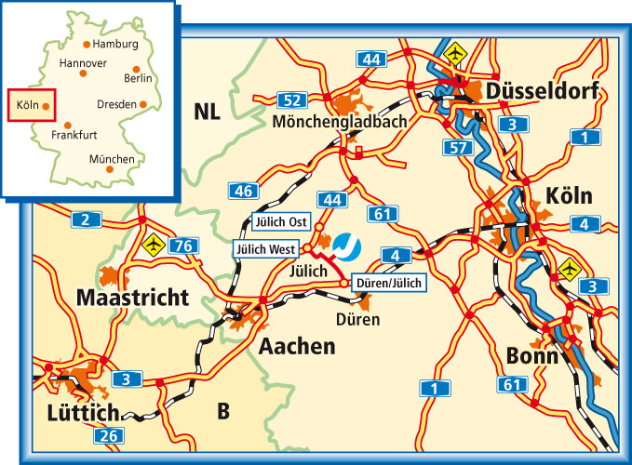

Slide 20
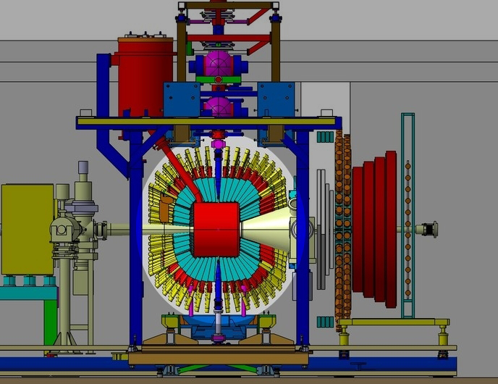
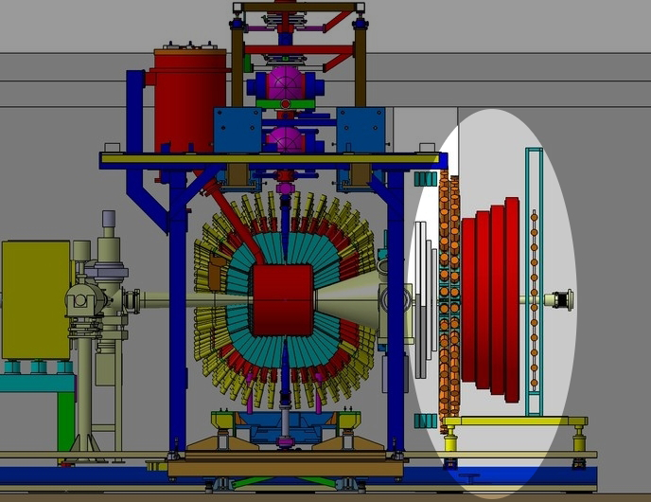
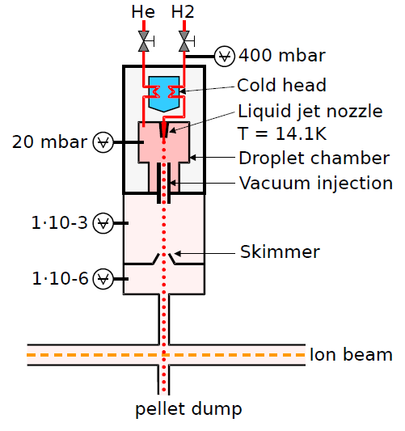
WASA-at-COSY
pp → pp η pd → ³He η

Slide 21
WASA-at-COSY
pp → pp η pd → ³He η

Slide 22
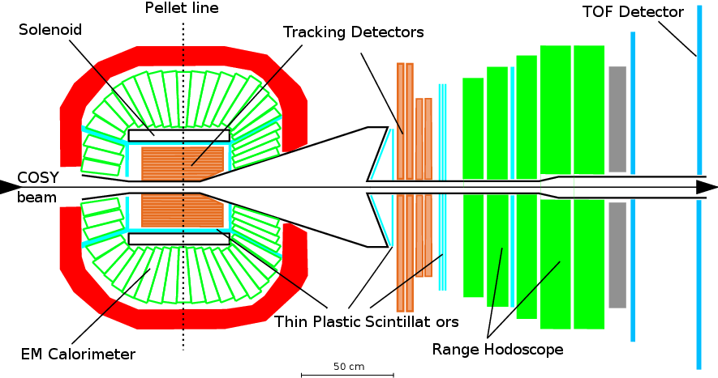
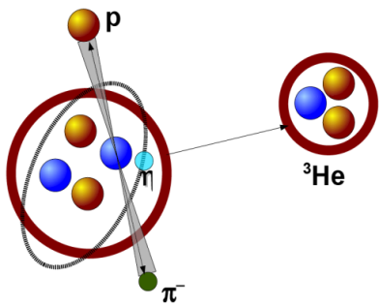
WASA-at-COSY
→
Notes:
Tu wpsomniec o Pelletach … ( a może ktos ma szkic albo zdjęcie ..)
TU PRZYDAŁOBY SIĘ WIDMO POKAZUJACE IDENTYFIKACJE …
Magdalena ??
Polaryzacj at Q=15 and at Q=72…

Slide 23
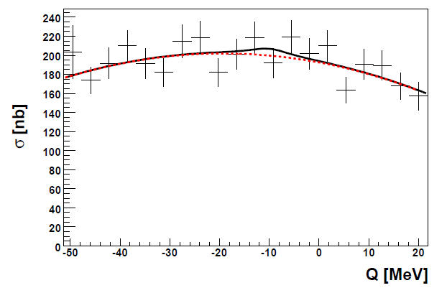
d+d → (⁴He-η)_{bound}→ ³He + p + π⁻
d+d → ³He + p + π⁻
SIMULATIONS
EXPERIMENT
Upper limit of about 25 nb
WASA-at-COSY: Phys. Rev. C87 (2013) 035204
Notes:
G=30 a Bs=15 MeV

Slide 24
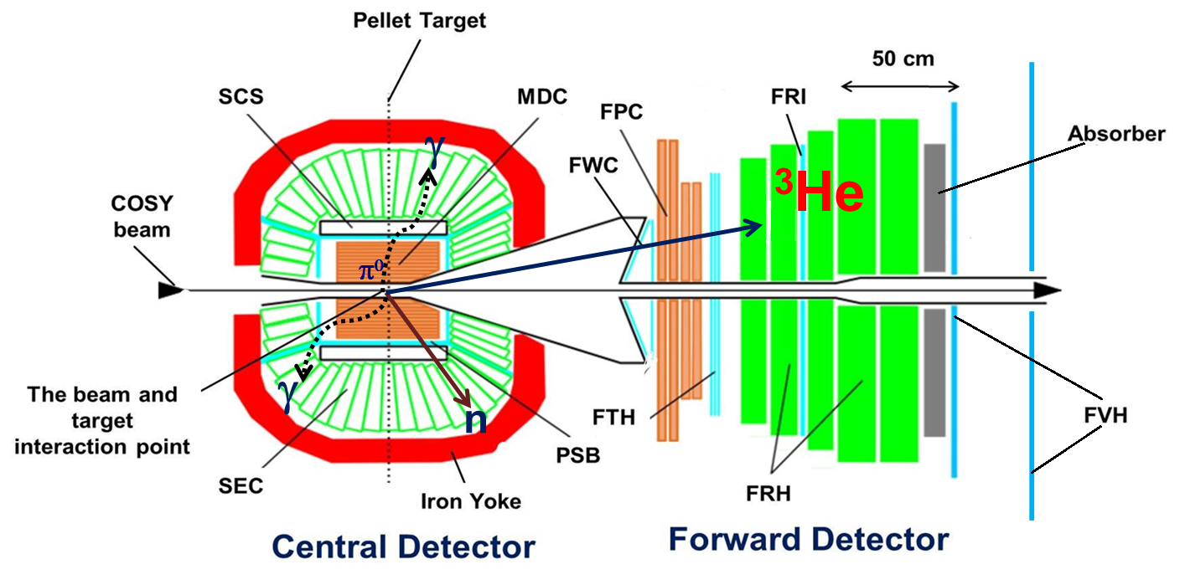
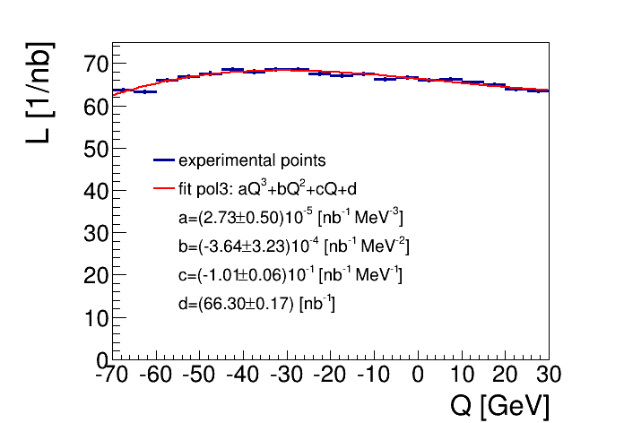
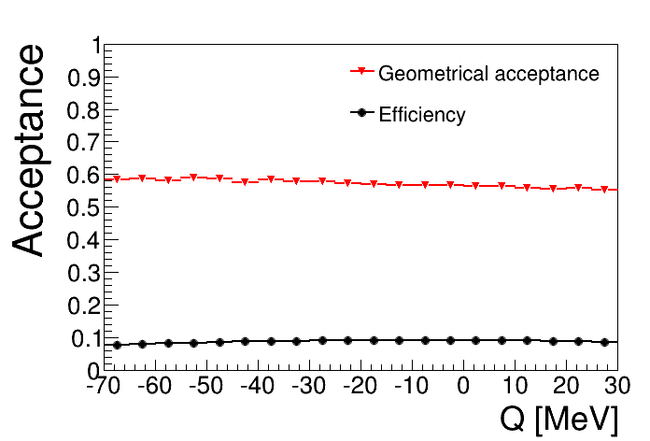

Slide 25
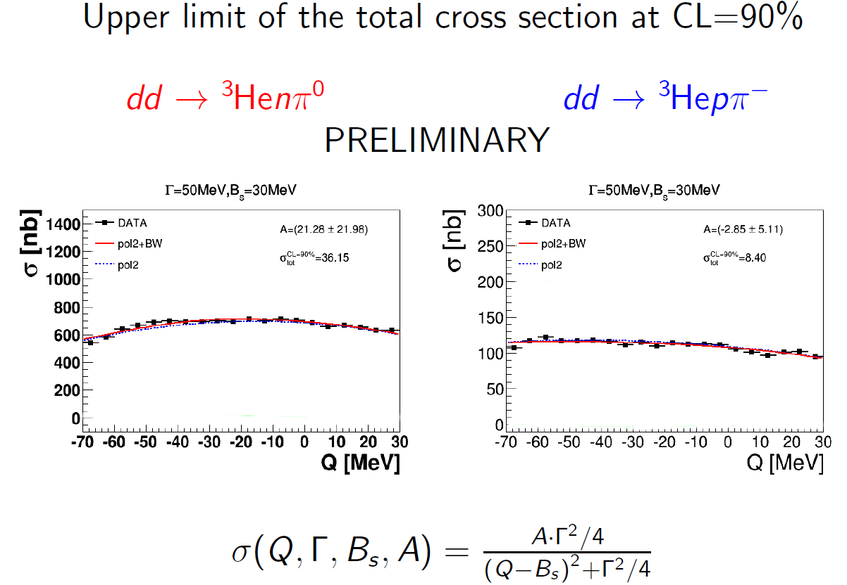

Slide 26
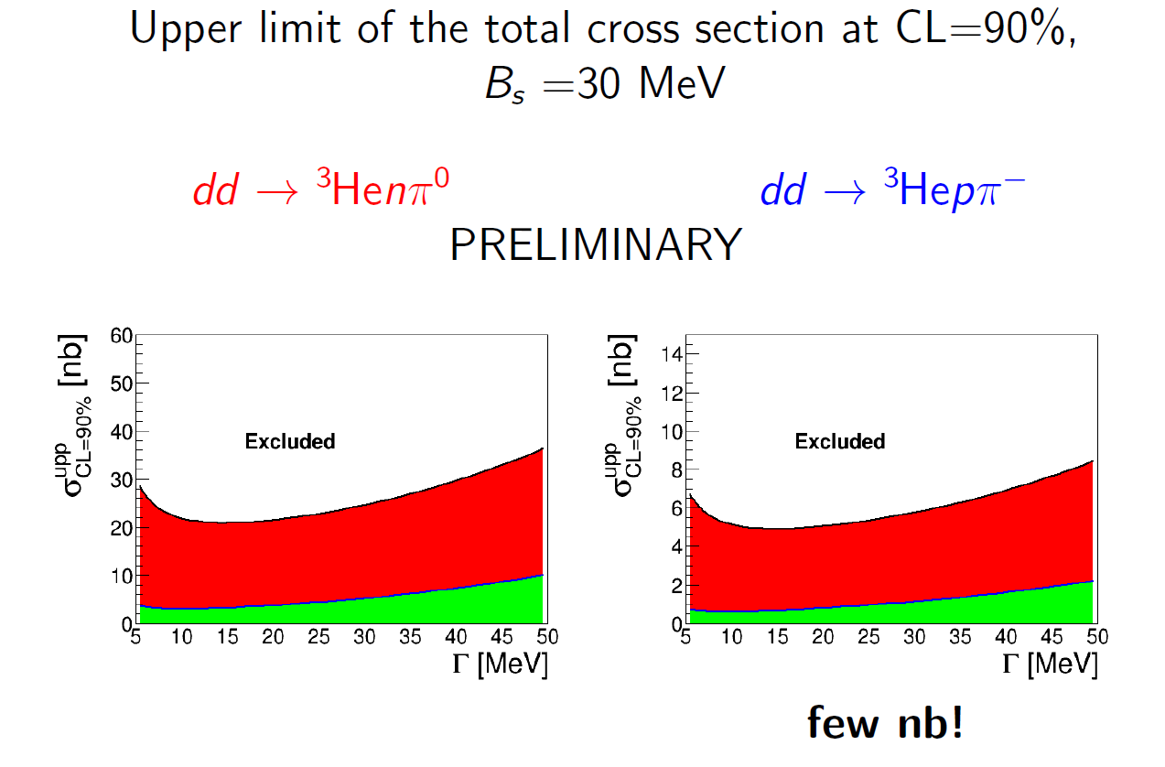
Acta Phys. Polon. B 47 (2016)

Slide 27
η - ⁴He
~ 6 nb -- Present preliminary experimental upper limit .
~ 4 nb -- Theoretical estimation .
S. Wycech, W. Krzemien , Acta. Phys. Pol. B45 (2014) 745 .
η - ³He
~270 nb -- Present experimental upper limit pppπ⁻
COSY-11: Acta Phys. Pol B41 (2010) 21
~80 nb -- Theoretical estimation .
C. Wilkin, Acta. Phys. Pol. B45 (2014) 603
~ 10nb -- expected from New WASA-at-COSY data
collected in May 2014

Slide 28
Eulochio Oset et al., (priv. com. 2016)
Chiral unitary approach
Generates the 3He-eta amplitude from the eta-3He potential
fitted to the data. With this optical potential solve the BSE
for the η 3He system and find an η bound state around 0.3 MeV
and a width around 3 MeV,
Notes:
Bethe-Salpeter equation (BSE),

Slide 29
decay via N*
p+d → (³He-η)_{bound} → p + p + p+ π⁻
p+d → (³He-η)_{bound} → d + p + π⁰
p+d → (³He-η)_{bound} → p + p + n + π⁰
p+d → (³He-η)_{bound} → d + n + π⁺
decay while orbiting
p+d → (³He-η)_{bound} → ³He 6γ
p+d → (³He-η)_{bound} → ³He γγ
(H. Nagahiro, S. Hirenzaki)

Slide 30
Experimental search for the exotic matter
mesic nuclei
dibaryons
Notes:
contributing to the study of the muon
anomalous magnetic moment
Jakos to poskladac do kupy … dlaczego eta SM etc…
Polaczyc z nastepna strona i nawiazac podobnie as two years ago I will repeat since …than to Falsify the theory !!!
With Wasa at COSY we study both production and decays of the eta-meson but Today I will concentrate
of decays which is also a primordial aim of the experiment
In general we search for the phenomena which cannot be describe by the Standard Model…

Slide 31
MATTER
Meson
Baryon
1947 Powell in Cracow
Powell <-- Nobel Prize
~1960 Quark Model
COSY, J-PARC, MAMI, GSI, LPI/JINR
G. A, Sokol et al., arXiv:nucl-ex/0106005
Notes:
For the first time also this mechanisms …
Powell in cracow ...-> Nobel → so please come to Cracow

Slide 32
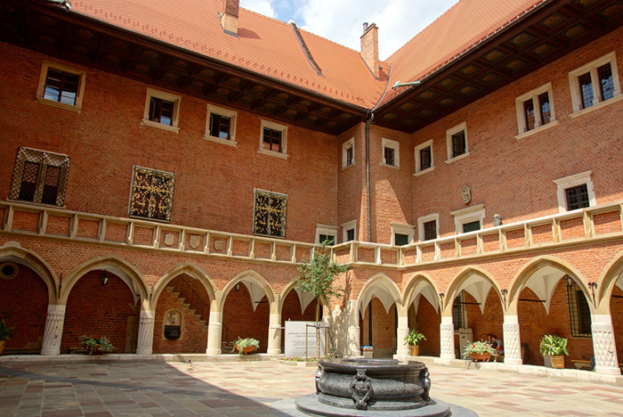
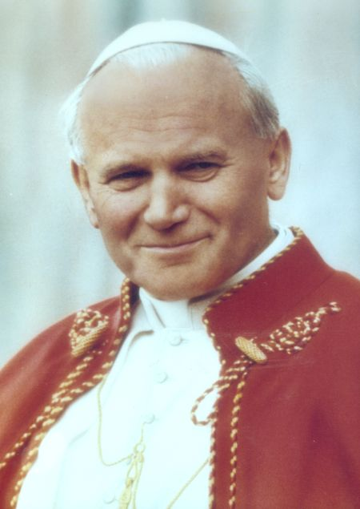
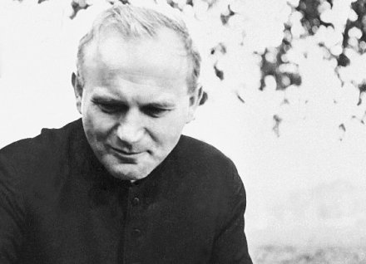
Jagiellonian University
1364
Jagiellonian Symposium, Collegium Maius, 4-11 June 2017 http://koza.if.uj.edu.pl/conferences/
Collegium Maius at the University since 1400
historical entanglement
Notes:
Most famous student and most famous professor ☺

Slide 33
MATTER
Meson
Baryon
1947 Powell in Cracow
Powell <-- Nobel Prize
~1960 Quark Model
COSY, J-PARC, MAMI, GSI, LPI/JINR
G. A, Sokol et al., arXiv:nucl-ex/0106005
Notes:
For the first time also this mechanisms …
Powell in cracow ...-> Nobel → so please come to Cracow

Slide 34
MATTER
Meson
Baryon
Pentaquark
Dibaryon
Tetraquark
?
?
?
COSY, J-PARC, MAMI, GSI, LPI/JINR
G. A, Sokol et al., arXiv:nucl-ex/0106005
Notes:
For the first time also this mechanisms …

Slide 35
MATTER
Meson
Baryon
Pentaquark
Dibaryon
Tetraquark
?
Belle 2003; LHCb 2014; LHCb 2015;
COSY, J-PARC, MAMI, GSI, LPI/JINR
G. A, Sokol et al., arXiv:nucl-ex/0106005
Notes:
For the first time also this mechanisms … c anty-c d anty-u a maximum in invariant mass of pi+ psi’ z rozpadu B -> K pi+ psi’
BELLE , KEK , e+e- -> B anty-B -> ... (1.2 MeV width)
LHCb PENTAquark -> J/psi p (40 MeV width)
„The exotic resonances observed by Belle and BESIII cannot be standard mesons which are constructed from a quark and an antiquark. This is because they decay to a heavy quark -antiquark pair and a charged pion. A heavy quark-antiquark pair in the decay products of a narrow resonance means that the heavy pair must have been there in the first place. It could not have been produced as a result of a quantum fluctuation of a highly excited regular meson containing only light quarks, because such a meson would have been very wide, having plenty of other open decay channels. Having a positively charged pion in the final state means that the minimal quark content of the original resonance must have included a u quark and a d antiquark. This is because quantum fluctuations cannot create a quark-antiquark pair with a net electric charge. The upshot is that the minimum quark content of these exotic resonances includes a heavy quark, a heavy antiquark and a light quark-antiquark pair with a net electric charge.
The question whether these resonances are "genuine" tetraquarks or "molecules" of two heavy mesons is much more difficult and does not have a sharply defined answer. This is because "genuine" tetraquarks and "molecules" can mix, although the mixing is expected to be small. We have several indications from the data that the currently discussed resonances are close to being molecules.
The evidence for this is discussed in the talk writeup that Tommaso refers to. Mark Karliner???”
„Proposed assignments for these states have included: multiquark states, either of the
(c̄q,
̄cq) “molecular” type [10] or [cq,
̄c
̄q
] diquark-antidiquark type [11] (here c represents a charmed quark and q either a
u-,d- or s-quark); hybrid c̄c-gluon mesons [12]; or other missing charmonium states where the masses predicted
by potential models are drastically modified by nearby D(∗)̄D(∗)thresholds [13, 14]. A characteristic that clearly distinguishes multiquark
states from hybrids or charmonia is the possibility to have c harmonium-like mesons with non-zero charge (e.g.
[cu
̄c
̄d]), strangeness ([cd
̄c
̄s]) or both ([cu
̄c
̄s
]) [15]. These considerations
motivated a search for charmonium-like mesons with non-zer
o electric charge.

Slide 36
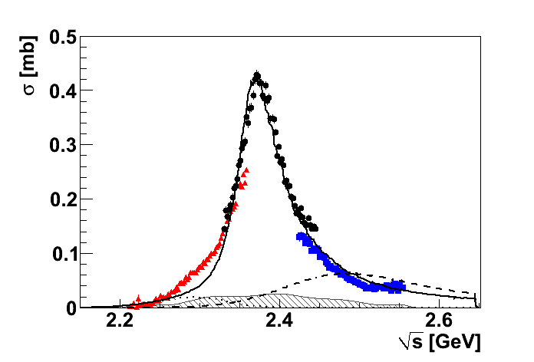
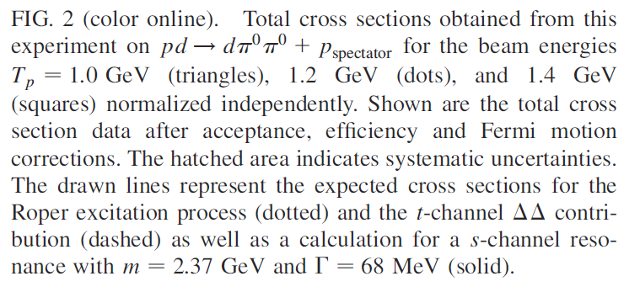
Double pionic fusion - a new resonance?
Cross section for pn → dπ⁰π⁰
WASA-at-COSY: Phys. Rev. Lett. 106 (2011) 242302
Notes:
ISOSCALAR d pi0 pi0 I=0 , J^P = 3+
What might be the discrepancy on the left side ?

Slide 37

Double pionic fusion - a new resonance
Cross section for pn → dπ⁰π⁰
$$Γ_{d^{∗}}=70 MeV≪Γ_{ΔΔ}=240 MeV$$
Γ∼70 MeV
ΔΔ
NN*(1440)
WASA-at-COSY: Phys. Rev. Lett. 106 (2011) 242302
pn → ΔΔ → dπ⁰π⁰ ; pn → ΝΝ∗ → dπ⁰π⁰
pn → dibaryon → ΔΔ → dπ⁰π⁰
Notes:
ISOSCALAR d pi0 pi0 I=0 , J^P = 3+
What might be the discrepancy on the left side ?

Slide 38
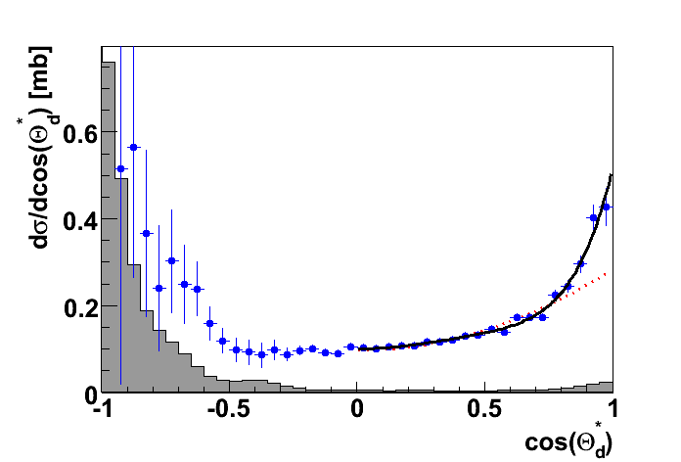
Double pionic fusion - a new resonance?
Cross section for pn → dπ⁰π⁰
Γ∼70 MeV
J=3
NN*(1440)
J=1
ΔΔ
WASA-at-COSY: Phys. Rev. Lett. 106 (2011) 242302
I = 0; J^{P} = 3⁺
Notes:
I = 0 ponieważ clebsh-gordan do 1,0; 1,0 -> 1,0 jest równy zeru
ISOSCALAR d pi0 pi0 I=0 , J^P = 3+
What might be the discrepancy on the left side ?

Slide 39
Double pionic fusion - a new resonance
Cross section for pn → dπ⁰π⁰
$$Γ_{d^{∗}}=70 MeV≪Γ_{ΔΔ}=240 MeV$$
Γ∼70 MeV
ΔΔ
NN*(1440)
WASA-at-COSY: Phys. Rev. Lett. 106 (2011) 242302
I = 0; J^{P} = 3⁺
Notes:
ISOSCALAR d pi0 pi0 I=0 , J^P = 3+
What might be the discrepancy on the left side ?

Slide 40
The decay modes of the dibaryon
Channel | Publications
d π⁰π⁰ | P. Adlarson et al., Phys. Rev. Lett. 106 (2011) 242302 P. Adlarson et al., Phys. Lett. B721 (2013) 229-236 P. Adlarson et al., Eur. Phys. J. A52 (2016) 147
d π⁺π⁻ d π⁺π⁰ | P. Adlarson et al., Phys. Lett. B721 (2013) 229-236
ppπ⁰π⁻ | P. Adlarson et al., Phys. Rev. C 88 (2013) 055208
npπ⁰π⁰ | P. Adlarson et al., Phys. Lett. B743 (2015) 325-332
np | P. Adlarson et al., Phys. Rev. Lett. 112 (2014) 202301 P. Adlarson et al., Phys. Rev. C90 (2014) 035204
³He ππ | P. Adlarson et al., Phys. Rev. C91 (2015) 015201
⁴He ππ | P. Adlarson et al., Phys. Rev. C86 (2012) 032201
 | ....

Slide 41




I=1
Total cross section pN → dππ
$$σ\left[pn→dπ^{+}π^{−}\right]=\frac{1}{2}σ\left[pp→dπ^{+}π^{0}\right] \\ +2σ\left[pn→dπ^{0}π^{0}\right]$$
I=0
$$dπ^{+}π^{−}$$
$$\frac{1}{2}∙dπ^{+}π^{0}$$
$$2∙dπ^{0}π^{0}$$
WASA-at-COSY: Phys. Lett. B721 (2013) 229

Slide 42
pn → pnπ⁰π⁰
P. Adlarson et al., Phys.Lett. B743 (2015) 325-332

Slide 43
The decay modes of the dibaryon
Channel | Publications
d π⁰π⁰ | P. Adlarson et. al Phys. Rev. Lett. 106 (2011) 242302 P. Adlarson et. al Phys. Lett. B721 (2013) 229-236
d π⁺π⁻ d π⁺π⁰ | P. Adlarson et. al Phys. Lett. B721 (2013) 229-236
ppπ⁰π⁻ | P. Adlarson et. al Phys. Rev. C 88 (2013) 055208
npπ⁰π⁰ | P. Adlarson et al., Phys. Lett. B743 (2015) 325-332
np | P. Adlarson et al. Phys. Rev. Lett. 112 (2014) 202301 P. Adlarson et al. Phys. Rev. C90 (2014) 035204
³He ππ | P. Adlarson et al., Phys. Rev. C91 (2015) 015201
⁴He ππ | P. Adlarson et. al. Phys. Rev. C86 (2012) 032201
 | ....

Slide 44
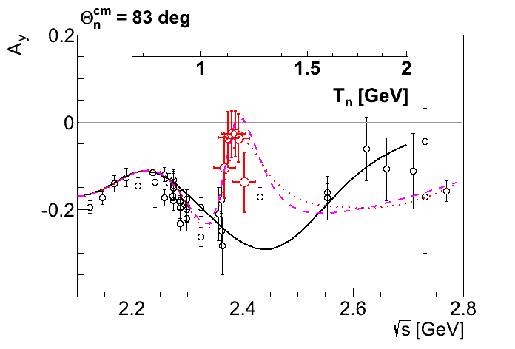
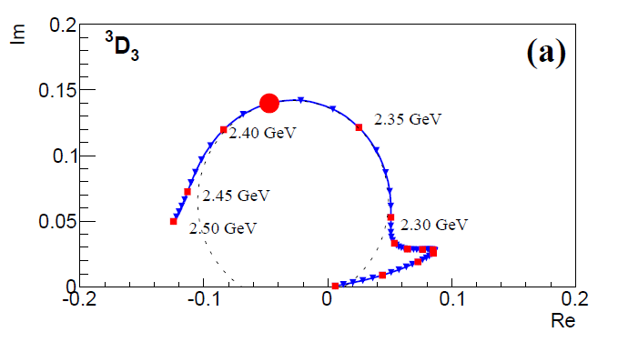
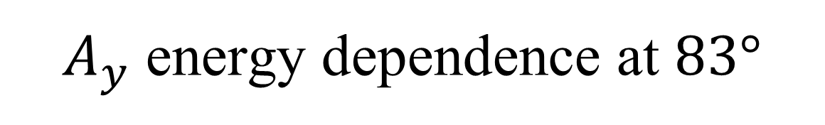
$A_{y}$ energy dependence at $83°$
p
p
n
n
SAID
New SAID
solutions
WASA-at-COSY: Phys. Rev. Lett. 112 (2014) 202301
Notes:
J^P = 3+; ISOSCALAR dpi0pi0 !!
R. L. Workman,27 W. J. Briscoe,27 and I. I. Strakovsky27
(SAID Data Analysis Center)
Data Analysis Center at the Institute for Nuclear Studies, Department of Physics, The George Washington University,
Washington, D.C. 20052, USA

Slide 45
Deuteron to Deltaron
I(J^{p}) = 0(1⁺)
I(J^{p}) = 0(3⁺)
u
u
u
d
d
d
u
u
u
d
d
d
Threshold
2.2 MeV
p
n
80 MeV
Δ
Δ
deuteron
d*
M. Bashkanov, Jagiellonian Symposium, 2015

Slide 46




Deltaron vs Hexaquark
L=0
$$≈33\%$$
Δ
Δ
0.9 fm
0.9 fm
0.7 fm
$$≈66\%$$
1.2 fm
Δ
Δ
L=2
$$?$$
$$≈5\% of ΔΔ configuration$$
F. Huang et al, arXiv:1408.0458
M. Bashkanov, Jagiellonian Symposium, 2015

Slide 47
MATTER
Meson
Baryon
Tetraquark
Pentaquark
Dibaryon
Belle 2003: Phys. Rev. Lett. 91 (2003) 262001
LHCb 2014: Phys. Rev. Lett. 112 (2014) 222002
LHCb 2015: Phys. Rev. Lett. 115 (2015) 072001
WASA-at-COSY
Phys. Rev. Lett.
112 (2014) 202311
COSY, J-PARC, MAMI, GSI, LPI/JINR
G. A, Sokol et al., arXiv:nucl-ex/0106005
Notes:
BELLE: Phys. Rev. Lett. 100 (2008) 142001
LHCb: Phys. Rev. Lett. 112 (2014) 222002
WASA-at-COSY: Phys. Rev. Lett. 112 (2014) 202311
For the first time also this mechanisms …

Slide 48
Recent results
from WASA-at-COSY
mesic-nuclei
discovery of dibaryons
+
η
+
Notes:
contributing to the study of the muon
anomalous magnetic moment
Jakos to poskladac do kupy … dlaczego eta SM etc…
Polaczyc z nastepna strona i nawiazac podobnie as two years ago I will repeat since …than to Falsify the theory !!!
With Wasa at COSY we study both production and decays of the eta-meson but Today I will concentrate
of decays which is also a primordial aim of the experiment
In general we search for the phenomena which cannot be describe by the Standard Model…

Slide 49
THANK YOU
FOR YOUR ATTENTION

