Slide 1
Searches for Lepton Number Violation and resonances in the K±→$π$µµ decays by NA48/2 at CERN
Andrey Zinchenko – Joint Institute for Nuclear Research
on behalf of the NA48/2 Collaboration
(email: Andrei.Zinchenko@cern.ch)
Outline:
● The NA48/2 experiment
● Theoretical Motivations
● Search for LNV K± → π∓µ±µ± decay – Majorana neutrinos
● Search for resonances in K± → π±µ⁺µ– decays
● Prospects for the NA62 experiment
The 14th International Conference on Meson-Nucleon Physics and the Structure of the Nucleon
July 25-30, 2016 in Kyoto, Japan

Slide 2
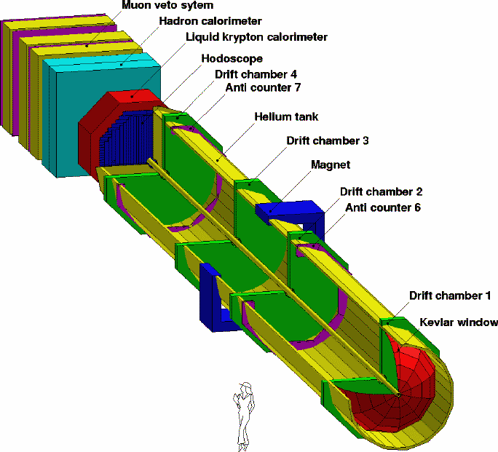
Introduction – The NA48/2 experiment
The NA48/2 detector
Narrow momentum band K± beams:
P_{K} = 60 GeV/c, δP_{K}/P_{K} ̴4% (rms)
Nominal K± decay rate: ̴100 kHz
Main triggers: 3-track vertex K± → π±π⁺π⁻
Simultaneous K+/K– beams
Principal sub-detectors:
● Spectrometer (4 DCHs)
σ_{p}/p = 1.02% ⊕ 0.044% p(GeV/c)
4 views/DCH: redundancy → efficiency
● Scintillator Hodoscope
Fast trigger, time measurement σ_{t} ̴ 150 ps
● LKr EM calorimeter
High-granularity, quasi-homogeneous
σ_{E}/E = 3.2%/√E(GeV)⊕9%/E(GeV) ⊕ 0.42%
σ_{x} = σ_{y} = 4.2mm/√E(GeV) ⊕ 0.6mm (1.5mm @ 10 GeV)
● MUV:
consisted of three 2:7 x 2:7 m² planes of plastic scintillator strips, each preceded by a 80 cm thick iron wall.
26/07/2016
Andrey Zinchenko – MENU 2016 – Kyoto

Slide 3
Theoretical Motivations
Majorana Neutrinos
AsakaShaposhnikov model (νMSM) [Asaka and Shaposhnikov, PLB 620 (2005) 17]:
Dark Matter + Baryon Asymmetry of the Universe (BAU) + low mass of SM ν can be explained by adding three sterile Majorana neutrinos N_{i} to the SM
● N1 is the lightest O(keV) → Dark Matter candidate
● N2, N3 are nearly degenerate (100 MeV to few GeV) to tune CPV-phases and extra-CKM sources of baryon asymmetry. N2, N3 produce standard neutrino masses through seesaw with a Yukawa coupling of ~ 10⁻⁸
Activesterile neutrino mixing (U-matrix):
Effective vertices involving the sterile neutrinos N_{i}, the W±, Z bosons and SM leptons
BR(K± → µ±N₄) x BR(N₄ → π∓µ±) ~ |U_{µ4}|⁴
Inflatons
Shaposhnikov-Tkachev model [Shaposhnikov and Tkachev, PLB 639 (2006) 414]:
νMSM + a real scalar field (inflaton χ) with scale-invariant couplings
Explains Universe homogeneity and isotropy on large scales/structures on smaller scales
● χ-Higgs mixing with mixing angle θ
● χ-Higgs coupling → Universe reheating
● χ-is unstable: τ ~ (10⁻⁸-10⁻¹²) s
χ in Kaon decays [m_{χ} < 354 MeV/c2]
26/07/2016
Andrey Zinchenko – MENU 2016 – Kyoto

Slide 4
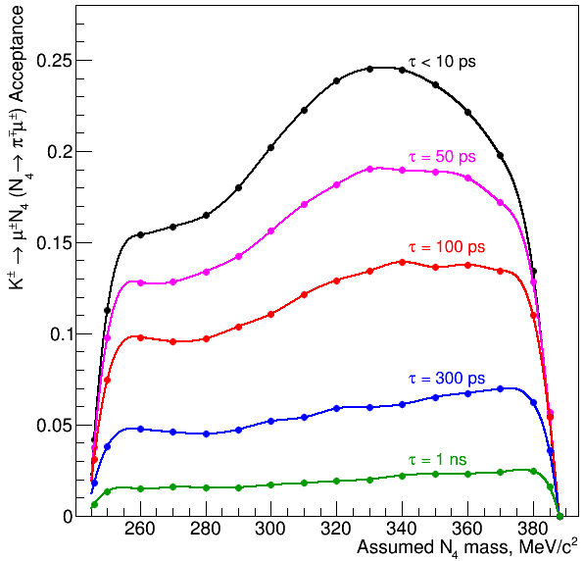
Search for resonances in K → πµµ decays – Same-sign muons sample
The NA48/2 same-sign muons sample (LNV)
Basic principles of the searches:
● Fully reconstructed final states, 3-track vertex topology
● Similar topology to normalisation channel K± → π±π⁺π ‒
→ First-order cancellation of systematic effects (trigger inefficiency, etc)
● Method: exclusive search for the K± → π∓µ±µ± decay
● Main background: K± → π±π⁺π^{­-} with 2 π± → µ±ν decays (one within the Spectrometer)
● Sensitivity: UL on BR(K± → π∓µ±µ±)
UL on BR(K± → µ±N₄)xBR(N₄ → π∓µ±)
K± decays in the fiducial volume: N_{K} ̴2x10¹¹
(from reconstructed K± → π±π⁺π ‒ decays)
Mass and lifetime dependence of the
signal acceptance from dedicated MC
simulation of the signal
26/07/2016
Andrey Zinchenko – MENU 2016 – Kyoto

Slide 5
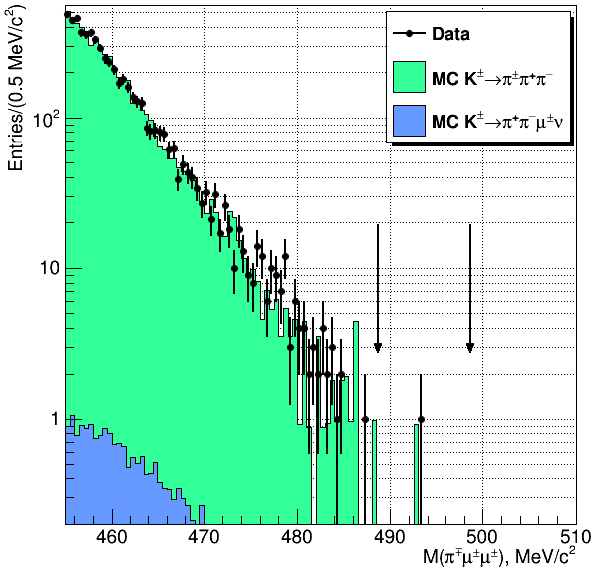
Search for resonances in K → πµµ decays – Same-sign muons sample
The same-sign muons selection (LNV)
● Blind analysis: K± → π∓µ±µ± selection based on
o K± → π∓µ±µ± MC simulation
− Uniform phasespace (|M_{fi}|2 = 1)
− Resonant Majorana neutrino model
o K± → π±π⁺π⁻ MC simulation (10¹⁰ events)
o Control Region: M(π∓µ±µ±) < 480 MeV/c2
● Event selection:
o One wellreconstructed 3-track vertex
o 2 same-sign muons, 1 odd-sign pion
o Total P_{T} consistent with zero
o Signal Region: |M(π∓µ±µ±) – M_{K}| < 5 MeV/c2
● Expected background: Additional K± → π±π⁺π‒
MC sample (10¹⁰ events) used to evaluate number
of expected K± → π±π⁺π‒ events in Signal Region
Events in Signal Region observed after finalising K± → π∓µ±µ± selection → N_{obs} = 1
Expected background (from MC simulation): N_{exp} =1.163±0.867_{stat}±0.021_{ext}±0.116_{syst}
Rolke-Lopez statistical treatment to get UL(N_{sig})→
BR(K → π∓µ±µ± ) < 8.6 x 10⁻¹¹ @ 90% CL
26/07/2016
Andrey Zinchenko – MENU 2016 – Kyoto

Slide 6
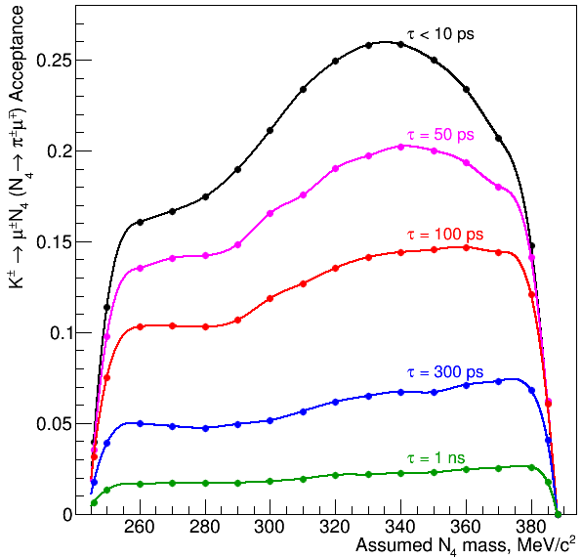
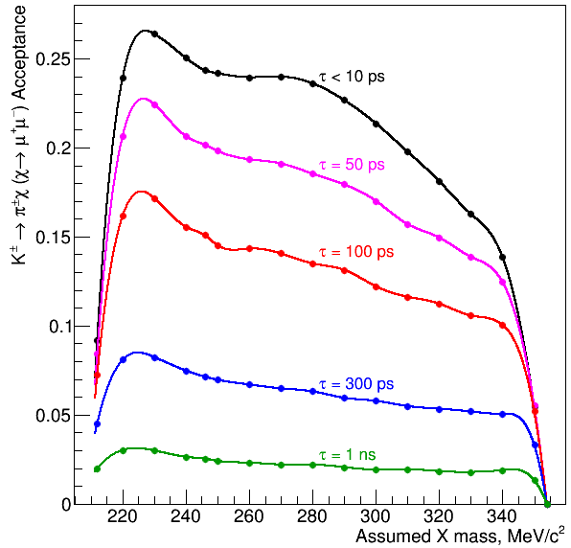
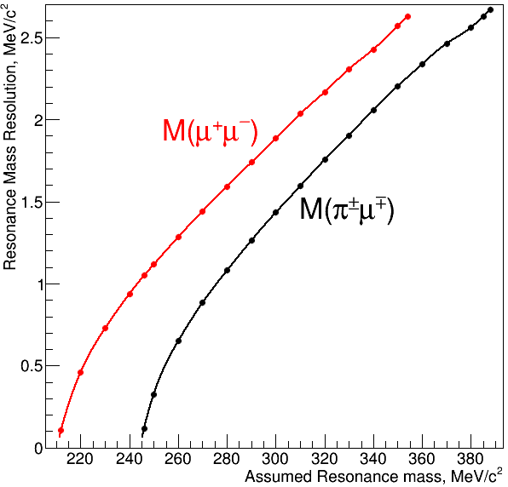
Search for resonances in K → πµµ decays – Opposite-sign muons sample
The NA48/2 opposite-sign muons sample (LNC)
Basic principles of the searches:
● Fully reconstructed final states, 3-track vertex topology
● Similar topology to normalisation channel K± → π±π⁺π ‒
→ Firstorder cancellation of systematic effects (trigger inefficiency, etc)
Search for resonances in K± → π±µ⁺µ‒ – decays
● Method: exclusive search for the decay chains K± → µ±N₄(N₄ → π± µ ∓), K± → π±X(X → µ⁺µ‒)
● Main background: K± → π±µ⁺µ‒ – (irreducible) → Limited sensitivity
● Sensitivity: UL on BR(K± → µ±N₄) x BR(N₄ → π± µ ∓)
UL on BR(K± → π±X) x BR(X → µ⁺µ‒)
26/07/2016
Andrey Zinchenko – MENU 2016 – Kyoto

Slide 7
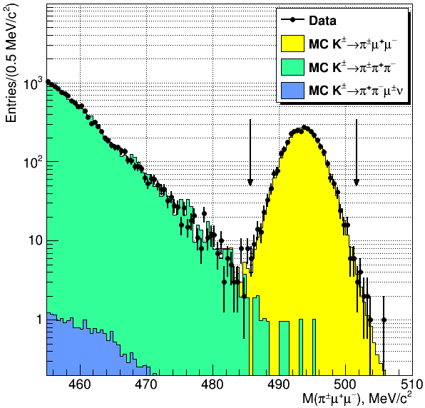
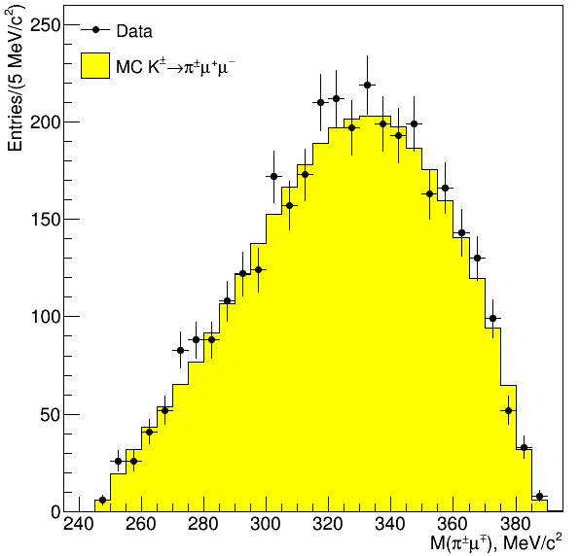
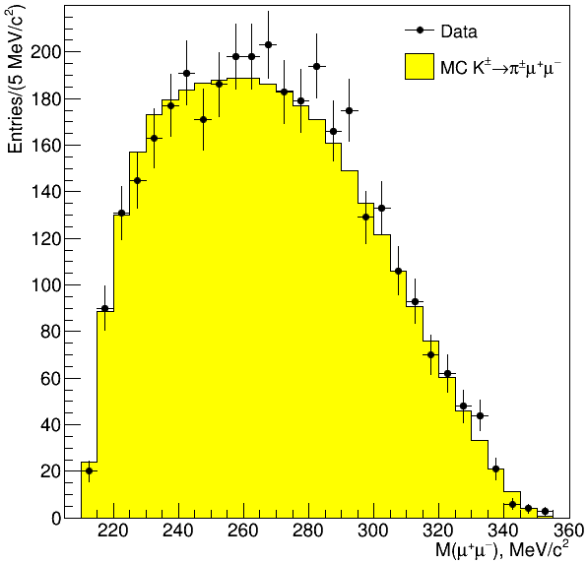
Search for resonances in K → πµµ decays – Opposite-sign muons sample
The opposite sign muons selection (LNC)
● Event selection:
o Minimal changes with respect to same-sign
o One well-reconstructed 3-track vertex
o 2 opposite-sign muons, 1 pion
o Total P_{T} consistent with zero
o Signal Region: |M(π±µ⁺µ‒) – MK| < 8 MeV/c2
To be scanned searching for
peaks in M(π± µ ∓) and M(µ⁺µ‒)
invariant masses
3489 K± → π±µ⁺µ‒ candidates in Signal Region
K± → π±π⁺π ‒ background: (0.36 ± 0.10)%
Improved selection with respect to previous NA48/2 K± → π±µ⁺µ‒ analysis [PLB 697 (2011) 107]
26/07/2016
Andrey Zinchenko – MENU 2016 – Kyoto

Slide 8
Search for resonances in K → πµµ decays – Mass scan framework
The mass scan framework
Basic principles:
● Based on selected K± → π±µµ candidates. Variable step = 0.5σ(M_{res}) and window = ± 2σ(M_{res})
● For each M_{res}: Observed events in data (N_{obs}) vs Expected events from MC (N_{exp}) → UL(N_{sig})
● Rolke-Lopez statistical treatment used in each mass hypothesis M_{res} to get UL(N_{sig})
Search for Lepton Number Violation – Majorana neutrinos
● 284 mass hypotheses M_{res} tested
● 2 possibilities in building M(π∓ µ ±) [same-sign µs]: closest invariant mass to M_{res} considered
Search for resonances in K± → π±µ⁺µ‒ – decays
● The distributions of both invariant masses M(π± µ ∓) and M(µ⁺µ‒) are probed
● 267 hypotheses for M(π± µ ∓)
● 280 hypotheses for M(µ⁺µ‒)
● K± → π±µ⁺µ‒ – MC simulation
uses form factors extracted from
the selected data sample to
obtain best data/MC agreement
26/07/2016
Andrey Zinchenko – MENU 2016 – Kyoto

Slide 9
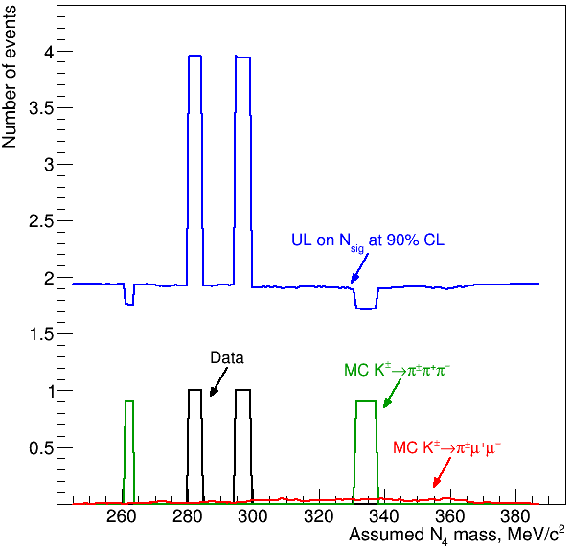
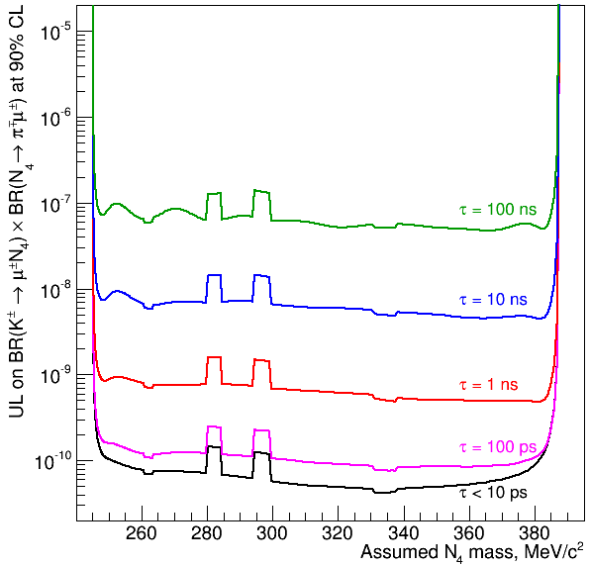
Search for resonances in K → πµµ decays – Final results
Search for K± → µ±N₄(N₄ → π∓ µ±) decays
Same-sign muons sample (LNV)
UL(BR(K±→μ± N₄)BR(N₄→π∓μ±))=
Statistical significance
never exceeds +3σ: no signal observed
26/07/2016
Andrey Zinchenko – MENU 2016 – Kyoto

Slide 10
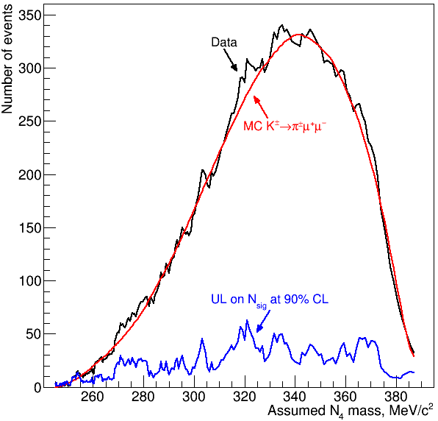
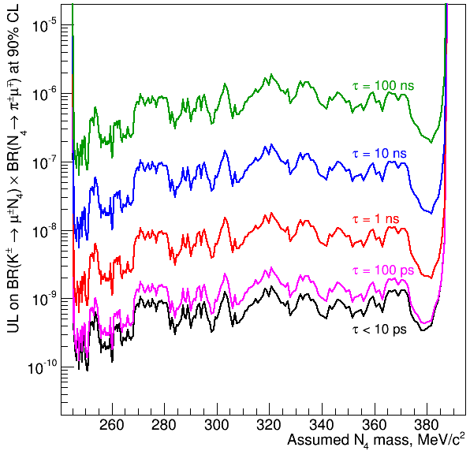
Search for resonances in K → πµµ decays – Final results
Search for K± → µ±N₄(N₄ → π± µ ∓) decays
UL(BR(K±→μ± N4)BR(N4→π±μ∓))=
Statistical significance
never exceeds +3σ: no signal observed
26/07/2016
Andrey Zinchenko – MENU 2016 – Kyoto

Slide 11
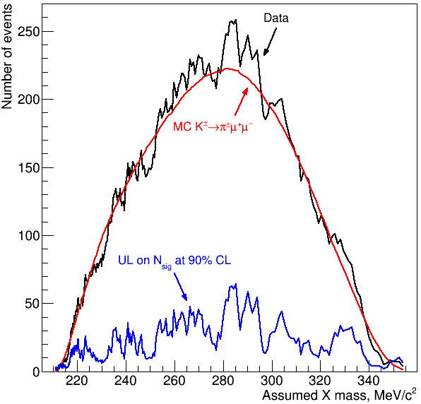
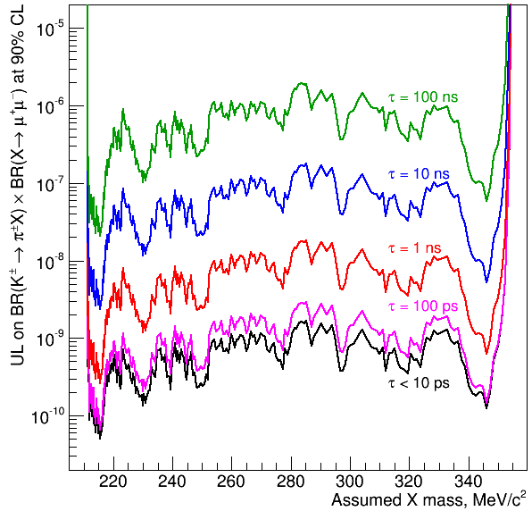
Search for resonances in K → πµµ decays – Final results
Search for K± → π±X(X → µ⁺µ‒) decays
Oppositesign muons sample (LNC)
UL(BR(K±→π± X)BR(X→μ⁺μ–))=
Statistical significance
never exceeds +3σ: no signal observed
26/07/2016
Andrey Zinchenko – MENU 2016 – Kyoto

Slide 12
The NA62 experiment – Prospects
Prospects for the new NA62 experiment
NA62 will collect the world-largest K+ decay sample: ~ 10¹³ decays in 3 years of data taking (~ 50 times more than NA48/2)
Kaon and π⁰ LNFV decays
Mode | UL at 90% CL | Experiment | NA62 acceptance*
K⁺→π⁺µ⁺e⁻ | 1.3 × 10⁻¹¹ | BNL 777/865 | ~ 10%
K⁺→π⁺µ⁻e⁺ | 5.2 × 10⁻¹⁰ | BNL 865 | ~ 10%
K⁺→π⁻µ⁺e⁺ | 5.0 × 10⁻¹⁰ | BNL 865 | ~ 10%
K⁺→π⁻e⁺e⁺ | 6.4 × 10⁻¹⁰ | BNL 865 | ~ 5%
K⁺→π⁻µ⁺µ⁺ | 8.6 × 10⁻¹¹ | NA48/2 | ~ 20%
K⁺→µ⁻νe⁺e⁺ | 2.0 × 10⁻⁸ | Geneva Saclay | ~ 2%
K⁺→e⁻νµ⁺µ⁺ | no data |  | ~ 10%
π⁰→µ⁺e‒ | 3.6 × 10⁻⁶ | KTeV | ~2%
π⁰→µ‒e⁺
* From fast MC with flat
phase-space distribution.
Single-event sensitivity:
NA62 Sensitivities:
~10⁻¹² for K⁺ decays
~10⁻¹¹ for π⁰ decays
26/07/2016
Andrey Zinchenko – MENU 2016 – Kyoto

Slide 13
Conclusions
Conclusions
The NA48/2 experiment at CERN was exposed to ̴2x10¹¹ K± decays in 2003-2004
● New NA48/2 results presented for the first time today:
− Search for LNV K± → π∓µ±µ± decay:
● BR(K± → π∓µ±µ± ) < 8.6 x 10⁻¹¹ @ 90% CL [World Best Limit]
● Factor of 10 improvement with respect to previous best limit [1.1 x 10⁻⁹ @ 90% CL]
− Search for K± → µ±N₄(N₄ → π∓ µ±) decays [Majorana neutrinos]
● Limits on BR products of the order of 10⁻¹⁰ for neutrino lifetimes < 100 ps
− Search for K± → µ±N₄(N₄ → π± µ ∓) decays [LNC heavy neutrinos]
● Limits on BR products of the order of 10⁻⁹ for neutrino lifetimes < 100 ps
− Search for K± → π±X(X → µ⁺µ‒) decays [Inflatons, …]
● Limits on BR products of the order of 10⁻⁹ for resonance lifetimes < 100 ps
● Prospects for the new NA62 experiment:
● Major beam and detector upgrades for K⁺ → π⁺νν̅: improved performances
● NA62 will collect the world-largest K⁺ decay sample ( ̴10¹³) in 3 years of data taking
● Potential sensitivities ~ 10⁻¹² for K decays, ~ 10⁻¹¹ for π⁰ decays
26/07/2016
Andrey Zinchenko – MENU 2016 – Kyoto

