Slide 1
Nucleon spin decomposition
Yoshitaka Hatta
(Yukawa institute, Kyoto U.)

Slide 2
The proton spin problem
The proton has spin ½.
The proton is not an elementary particle.
Quarks’ helicity
Orbital angular
Momentum (OAM)
Gluons’ helicity
In the quark model,
with relativistic effects,

Slide 3
from polarized DIS
Longitudinal double spin asymmetry in polarized DIS

Slide 4
`Spin crisis’
In 1987, EMC (European Muon Collaboration) announced a very small value
of the quark helicity contribution
!?
Recent value from NLO QCD global analysis

Slide 5
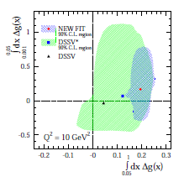
Gluon polarization
Result from the NLO global analysis
after the RHIC 200 GeV pp data
DeFlorian, Sassot, Stratmann, Vogelsang (2014)
Note that the uncertainty from
the small-x region is huge!

Slide 6


QCD angular momentum tensor
QCD Lagrangian → Lorentz invariant
→ Noether current
QCD angular momentum tensor
quark helicity gluon helicity
canonical energy momentum tensor
→ Quark OAM → Gluon OAM

Slide 7
Jaffe-Manohar decomposition (1990)
Based on the canonical energy momentum tensor
Operators NOT gauge invariant.
Partonic interpretation in the light-cone gauge

Slide 8
Ji decomposition (1997)
Improved (Belinfante) energy momentum tensor
← One can add a total derivative.
Further decomposition in the quark part (but not in the gluon part)

Slide 9
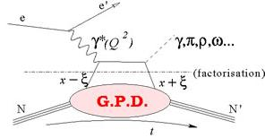
Generalized parton distributions (GPD)
Non-forward proton matrix element
Twist-two GPDs, accessible in
Deeply Virtual Compton Scattering (DVCS)

Slide 10
Lattice test of spin sum rule
Alexandrou et al. (2013)
Deka et al. (2015)
`Disconnected insertions’ included

Slide 11
Two spin communities divided
measured by PHENIX, STAR, COMPASS, HERMES
Jaffe-Manohar
Nonexistent in Ji’s scheme…
common and
well-known
not measured yet
not even well-defined?
Ji
Define rigorously.
Must be related to GPD!
accessible from GPD measured at JLab, COMPASS, HERMES, J-PARC
also calculable in lattice QCD

Slide 12
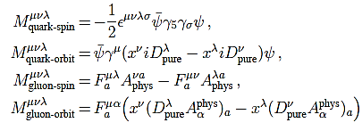
Complete decomposition
Chen, Lu, Sun, Wang, Goldman (2008)
Wakamatsu (2010)
Y.H. (2011)
where
(my choice)
Gauge invariant completion of Jaffe-Manohar

Slide 13
OAM from the Wigner distribution
Wigner distribution in QCD
Belitsky, Ji, Yuan (2003)
Need a Wilson line !
Define
Lorce, Pasquini (2011)
Which OAM is this??

Slide 14
Canonical OAM from the light-cone Wilson line
YH (2011)
Ji’s OAM from the straight Wilson line
Ji, Xiong, Yuan (2012)
`Potential’ OAM
Torque acting on a quark
Burkardt (2012)

Slide 15
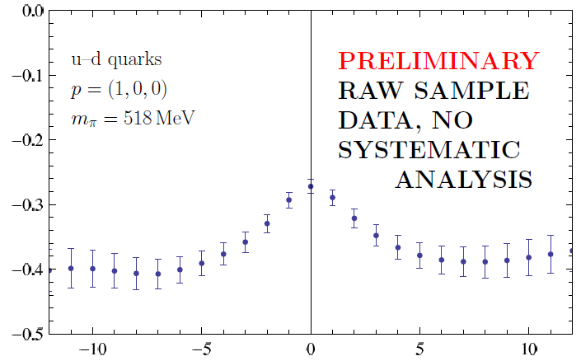
vs. on a lattice
Engelhardt, talk at POETIC VI (2015)
Ji
Jaffe-Manohar
staple length

Slide 16
Density of OAM
Understand this relation at the density level
??

Slide 17
Deconstructing OAM
Ji’s OAM canonical OAM `potential OAM’
``F-type”
For a 3-body operator, it is natural to define the double density.
``D-type”

Slide 18
The D-type and F-type correlators are related.
Eguchi, Koike, Tanaka (2006)
doubly-unintegrate
Canonical OAM density
The gluon has zero energy
→ partonic interpretation!
YH. Yoshida (2012)

Slide 19
Relation to twist-three GPD
YH. Yoshida (2012)
twist-2
twist-3
Penttinen, Polyakov, Shuvaev,
Strikman (2000)
integrate

Slide 20
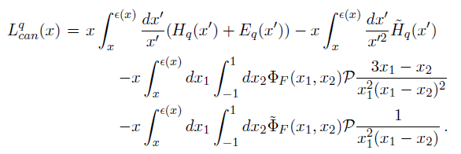

Quark canonical OAM density
Wandzura-Wilczek part
genuine
twist-three
First moment:
The bridge between JM and Ji

Slide 21
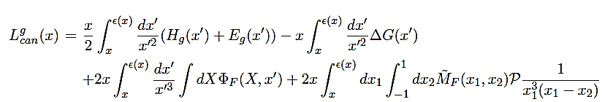


Gluon canonical OAM density
twist-three gluon GPD
WW part
genuine
twist-three
first moment:

Slide 22


Transverse spin decomposition
Use the Pauli-Lubanski vector
instead of the angular momentum tensor .
Ji (1996)
Ji, Xiong, Yuan (2012)
YH, Tanaka, Yoshida (2012)
Leader (2012)
Frame dependent!

Slide 23
Complete transverse spin decomposition?
Longitudinal
Transverse
YH, Tanaka, Yoshida (2012)
same!
cannot be separated in a
frame-independent way

Slide 24
Computing on a lattice?
Consider the usual quark distribution function
Nonlocal operator along the light-cone → Real-time problem
Becomes local after taking the x-moment.
nonlocal even though it is a moment. Local only in the light-cone gauge.

Slide 25
Compute the naïve gluon helicity in some gauge
…gauge dependent, frame dependent.
Boost it to large momentum and do the matching
Ji, Zhang, Zhao (2013)
The limits and do not commute
Not all gauges are allowed. The allowed gauges form a universality class.
YH, Ji, Zhao (2013)
Preliminary lattice study by xQCD collaboration
Even the parton densities (PDF, , etc.) can be directly calculable? Ji (2013)

Slide 26

Conclusions
Complete gauge invariant decomposition of nucleon spin now available in QCD, even at the density level
Relation between Jaffe-Manohar vs Ji fully understood in terms of twist and GPD.
Can we measure in experiment?
Hint: Wigner distribution measurable
YH, Xiao, Yuan (2016)

