Slide 1
Gluon fragmentation functions in the Nambu-Jona-Lasinio model
Dong-Jing Yang (NTNU)
In collaboration with Hsiang-nan Li (Academia Sinica)
This talk is based on: arXiv:1606.04213

Slide 2
Outline
Introduction & Motivation
Gluon fragmentation functions
Comparison with data
Summary

Slide 3
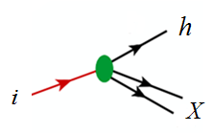
Fragmentation functions
Fragmentation functions $D_{i}^{h}(z)$mean the probability to ﬁnd the hadron h from a parton i=u, d, s,...,g with the energy fraction z.
one needs fragmentation functions for the analysis of $e^{+}e^{−} annihilation$into hadrons, $Semi inclusive deep inelastic scattering$, and so on.

Slide 4
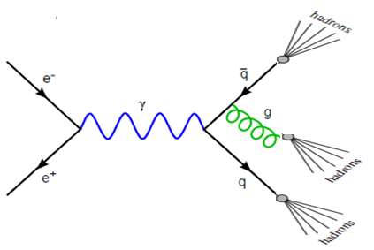
$$e^{+}e^{−} annihilation: e^{+}+e^{−}→h+x$$
LO: $σ^{e^{+}e^{−}→hx}=\sum_{q}{σ^{e^{+}e^{−}→q\overline{q}}⨂{(D}_{q}^{h}+D_{\overline{q}}^{h})} (LO)$
NLO: $σ^{e^{+}e^{−}→hx}=\sum_{q}{σ^{e^{+}e^{−}→gq\overline{q}}⨂{(D}_{q}^{h}+D_{\overline{q}}^{h}{+D}_{g}^{h})} (NLO)$
FFs

Slide 5
NJL model
Nambu and Jona-Lasinio model (1961)
Effective Lagrangian:
Low energy chiral effective model of QCD.
Gluon d.o.f. is integrated out in the low energy limit.
Non-renormalizable theory, we need to apply a cut-off.
NJL model does not include confinement.

Slide 6
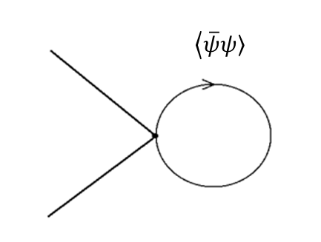
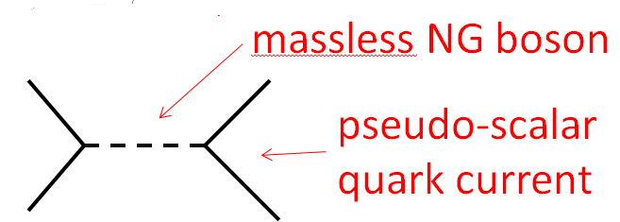
NJL model
NJL model is a low-energy effective theory like BCS theory to demonstrate chiral symmetry breaking and appearance of NG boson.
Chiral condensate $\left\langle \overline{ψ}\right.\left.ψ\right\rangle ≠0$ as $G>G_{crit}$
Spontaneous chiral symmetry breaking gives rise to dynamical quark mass from gap equation and generates massless NG bosons
Explicit chiral symmetry breaking (Add bare mass term) gives pion mass.

Slide 7
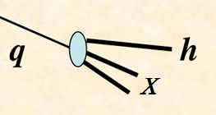
Qaurk FFs & Elementary qaurk FFs
Fragmentation function :${ D}_{q}^{h}(z)$
It is difficult to calculate.
R. D. Field and R. P. Feynman, Nucl.Phys. B136 (1978) 1-76
One step process : $q(k)→Q(k−p)+h(p)$
$${ d}_{q}^{h}(z)$$
$$h_{1}=h(q\overline{Q})$$
$$h_{2}$$
$$h_{3}$$
$$d_{q}^{h}\left(z\right)$$
In this talk, we only consider pion and kaon.

Slide 8
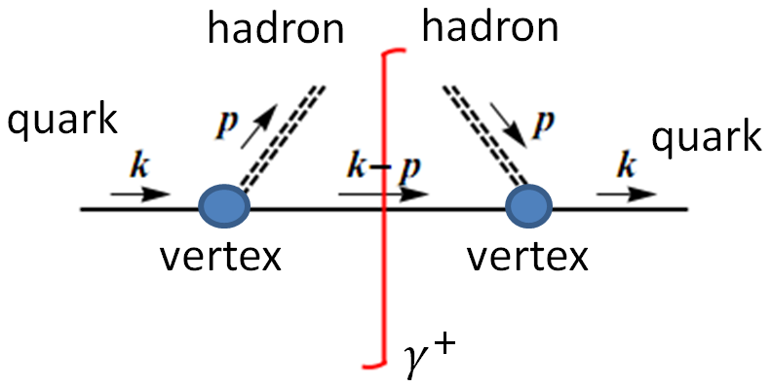
Qaurk FFs & Elementary qaurk FFs
Elementary fragmentation function :${ d}_{q}^{h}(z)$
(T. Ito, W. Bentz, I. C. Cloet, A. W. Thomas, and K. Yazaki, Phys. Rev. D80, 074008 (2009) )
meson mass
M1
M2

Slide 9
Qaurk FFs & Elementary qaurk FFs
Solve evolution equation
Iteration gives
$D_{q}^{h}\left(z\right)=d_{q}^{h}\left(z\right)$+$\sum_{Q}{\int_{z}^{1}{\frac{ⅆy}{y}}}$ $d_{q}^{Q}\left(y\right)D_{Q}^{h}\left(\frac{z}{y}\right)$
With $d_{q}^{Q}(y)$=$d_{q}^{h^{′}}(1−y)$
$$h_{1}$$
$$h_{2}$$
$$h_{3}$$

Slide 10
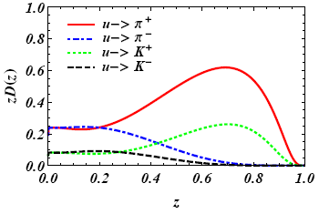
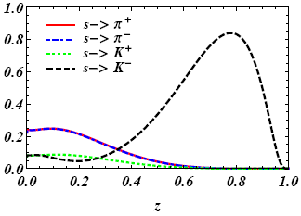
Quark FFs at model scale
Favor FFs: ${{ D}_{q}^{h}\left(z\right) with d}_{q}^{h}(z)≠0$, example:${ D}_{u}^{π^{+}}\left(z\right)$
Unfavor FFs: ${{ D}_{q}^{h}\left(z\right) with d}_{q}^{h}\left(z\right)=0$ , example:${ D}_{u}^{π^{−}}\left(z\right)$

Slide 11
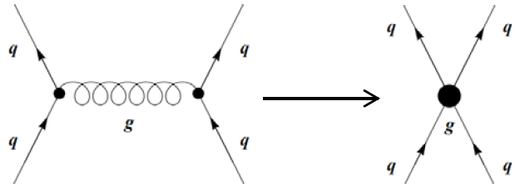
Gluon fragmentation functions
Gluon fragmentation functions are assumed to be null at a model scale, due to the absence of gluonic degrees of freedom in the corresponding Lagrangians.
A gluon can certainly fragment into hadrons at a low energy scale, just like a quark does.

Slide 12
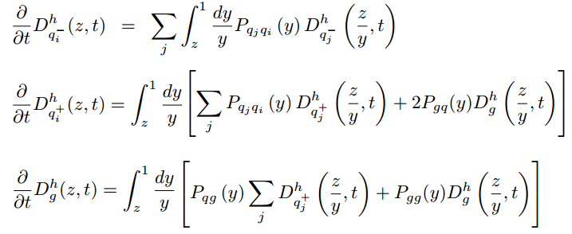
Gluon fragmentation functions
Without the gluon fragmentation functions at model scale, QCD evolution eﬀects cannot be complete.
$$t=\log{Q^{2}}$$

Slide 13
idea
Treat a gluon as a color dipole, formed by fictitious quark and anti-quark pair (color octet)
Fictitious quark then radiates hadrons according to NJL model.
=
mirror symmetry
maintains flavor
singlet

Slide 14
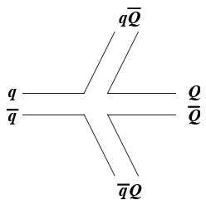
Scheme 1
Quark shares gluon momentum according to splitting function
Taken care of by quark FFs afterwards
Corresponding diagram
Fix flavor of quark pair after emitting
Similar to Lund model
(B. Andersson, G. Gustafson, G. Ingelman, and T. Sjostrand, Phys. Rept. 97, 31 (1983) )

Slide 15
Results at model scale
$${ zD}_{g}^{Lπ^{0}}\left(z\right)={ zD}_{g}^{Lπ^{+}}\left(z\right)={ zD}_{g}^{Lπ^{−}}\left(z\right)$$
$${ zD}_{g}^{LK^{+}}\left(z\right)={ zD}_{g}^{LK^{−}}\left(z\right)={ zD}_{g}^{LK^{0}}\left(z\right)={ zD}_{g}^{L\overline{K^{0}}}(z)$$

Slide 16
Annihilation
The quark pair is fictitious pair. It is not necessary to fix flavor after emitting hadrons.
Color flow for quark mixing via annihilation
Missing in scheme 1
If included, quark flavor conservation can be relaxed
‘
‘

Slide 17
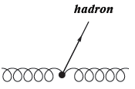
Scheme 2
Define elementary gluon FF
Annihilation included
Solve evolution equation

Slide 18
Results at model scale
$${ zD}_{g}^{π^{0}}\left(z\right)={ zD}_{g}^{π^{+}}\left(z\right)={ zD}_{g}^{π^{−}}\left(z\right)$$
$${ zD}_{g}^{K^{+}}\left(z\right)={ zD}_{g}^{K^{−}}\left(z\right)={ zD}_{g}^{K^{0}}\left(z\right)={ zD}_{g}^{\overline{K^{0}}}(z)$$

Slide 19
Multi-dipole
The gluonic dynamics is more complicated than discussed above definitely.
For example, $g→g+g$
The fictitious quark pair can split into two or more fictitious quark pairs at any stage of meson emissions.

Slide 20
Scheme 3
Define elementary gluon FF
Multi-dipole
Solve evolution equation
$D_{g}^{Mm}\left(z\right)={\hat{d}}_{g}^{Mm}\left(z\right)$+$\sum_{m^{′}}{\int_{z}^{1}{\frac{ⅆy}{y}}}$ ${\hat{d}}_{g}^{{Mm}^{′}}\left(1−y\right)D_{g}^{Mm}\left(\frac{z}{y}\right)$

Slide 21
Results at model scale
$${ zD}_{g}^{Mπ^{0}}\left(z\right)={ zD}_{g}^{Mπ^{+}}\left(z\right)={ zD}_{g}^{Mπ^{−}}\left(z\right)$$
$${ zD}_{g}^{MK^{+}}\left(z\right)={ zD}_{g}^{MK^{−}}\left(z\right)={ zD}_{g}^{MK^{0}}\left(z\right)={ zD}_{g}^{M\overline{K^{0}}}(z)$$

Slide 22
Comparison of three schemes
We employ QCDNUM-17-00/07 ( released on February 26, 2016) code to evolve $Q^{2}$ in NLO.
(M. Botje, Comput. Phys. Commun. 182, 490 (2011))
$$model scale$$
$$Q^{2}=4GeV^{2}$$
$$Q^{2}=4GeV^{2}$$
After QCD evolution, the difference of three schemes is only at very small z.
Results are insensitive to choices of splitting function.

Slide 23
Comparison at $Q^{2}=4GeV^{2}$
data fitting
HKNS: M. Hirai, S. Kumano, T. H. Nagai, and K. Sudoh, Phys. Rev. D 75, 094009 (2007).
DSS: D. de Florian, R. Sassot, and M. Stratmann, Phys. Rev. D 75, 114010 (2007).

Slide 24
Comparison at $Q^{2}=M_{z}^{2}$

Slide 25
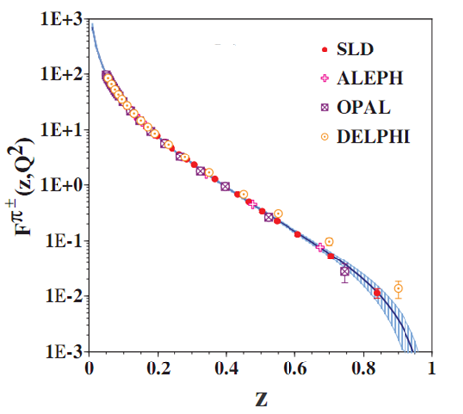
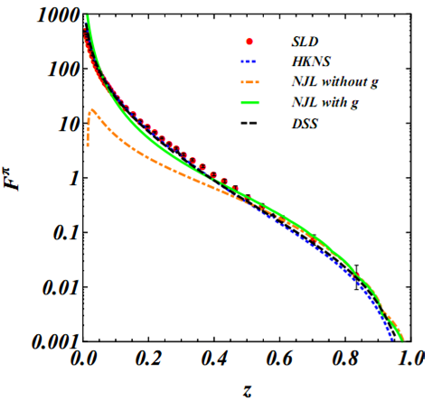
Comparison with data at $Q^{2}=M_{z}^{2}$
improve consistency
SLD Collaboration: Stanford Linear Accelerator Center, 2003
OPAL collaboration: CERN Large Electron-Positron collider, 1994 (stands for Omni-Purpose Apparatus for LEP.)
ALEPH collaboration: CERN Large Electron-Positron collider,1 998 (stands for Apparatus for LEP PHysics)
DELPHI collaboration: CERN Large Electron-Positron collider, 1995&1998 (standing for "Detector with Lepton, Photon and Hadron Identification")
$$h=π=π^{+}+π^{−}$$
The figure is from HKNS paper.
K. Abe et al. (SLD Collaboration), Phys. Rev. D69, 072003 (2004)

Slide 26
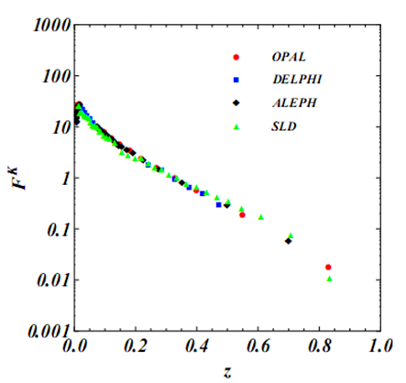
Comparison with data at $Q^{2}=M_{z}^{2}$
$$h=K=K^{+}+K^{−}$$

Slide 27
Sensitivity of model scale $Q_{0}^{2}$
Quark FFs versus Gluon FFs
$$Q^{2}=4GeV^{2}$$
$$Q^{2}=4GeV^{2}$$
Quark FFs are more sensitive to model scale than the gluon FFs.
Gluon FFs contribute in small z region after QCD evolution.
$e^{+}+e^{−}→h+x$ diﬀerential cross section at high z strongly depends on model scale due to quark FFs, but at small z it weakly depends on model scale.

Slide 28
Summary
NJL model can produce quark fragmentation functions, but it can not directly provide gluon fragmentation functions because of no gluon d.o.f..
Without gluon fragmentation functions at model scale, QCD evolution cannot be complete.
We treat a gluon as a fictitious quark and anti-quark pair to calculate gluon fragmentation functions.
Gluon FFs improve consistency with pion data.
$e^{+}+e^{−}→h+x$ diﬀerential cross section at high z depends on model scale, but at small z it does not.
Results of gluon FFs are insensitive to model parameters, like quark masses and model scales.

Slide 29
$$Semi inclusive deep inelastic scattering \\ e+P→e^{′}+h+x$$

Slide 30
$$Semi inclusive deep inelastic scattering \\ e+P→e^{′}+h+x$$
LO:
NLO:
FFs
: coefﬁcient functions
: PDFs

