Slide 1


The “K⁻pp” system investigated with a coupled-channel Complex Scaling Method
Akinobu Doté
(KEK Theory Center, IPNS / J-PARC branch)
Introduction
Current situation of theoretical studies of “K⁻pp”
“K⁻pp” investigated with ccCSM+Feshbach method
  Outline of the methodology
  Result with SIDDHARTA constraint for K⁻p scattering length
  Double pole of “K⁻pp”?
Fully coupled-channel CSM study (On-going)
Summary, future plans and remarks
Takashi Inoue
(Nihon univ.)
Takayuki Myo
(Osaka Inst. Tech.)
The 14th International Conference on Meson-Nucleon Physics and the Structure of the Nucleon (MENU2016)
26. July, ’16 @ Kyoto University Clock Tower Centennial Hall, Kyoto, Japan

Slide 2
1. Introduction

Slide 3
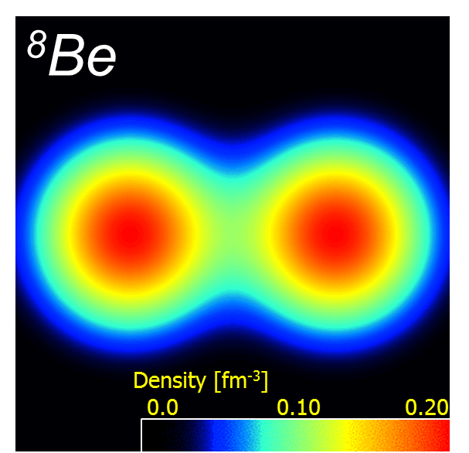
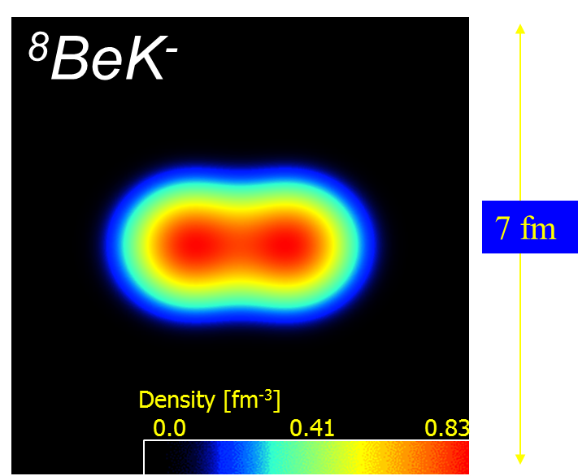
K⁻
K^{bar}N two-body system
-->> Mr. Y. Kamiya’s talk
Low energy scattering data, 1s level shift of kaonic hydrogen atom
Hard to describe Λ(1405) with Quark Model as a 3-quark state
Success of Chiral Unitary Model with a meson-baryon picture
Proton
Excited hyperon Λ(1405) = K⁻ proton quasi-bound state
Strongly attractive K^{bar}N potential
† A. D., H. Horiuchi, Y. Akaishi and T. Yamazaki, PRC70, 044313 (2004)

Slide 4
K⁻
K^{bar}N two-body system
-->> Mr. Y. Kamiya’s talk
Low energy scattering data, 1s level shift of kaonic hydrogen atom
Hard to describe Λ(1405) with Quark Model as a 3-quark state
Success of Chiral Unitary Model with a meson-baryon picture
Proton
Excited hyperon Λ(1405) = K⁻ proton quasi-bound state
Strongly attractive K^{bar}N potential
Doorway to dense matter†
→ Chiral symmetry restoration in dense matter
Interesting structure†
Neutron star
Kaonic nuclei
³HeK⁻, pppK⁻,
⁴HeK⁻, pppnK⁻,
…, ⁸BeK⁻,…
† A. D., H. Horiuchi, Y. Akaishi and T. Yamazaki, PRC70, 044313 (2004)

Slide 5
K⁻
K^{bar}N two-body system = Λ(1405)
Proton
P
K⁻
P
Prototype system = K⁻ pp
Kaonic nuclei
= Nuclear many-body system with antikaons

Slide 6
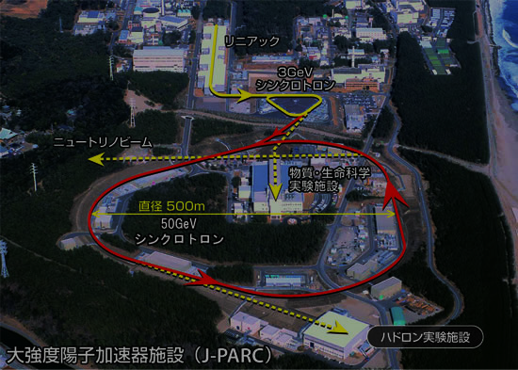
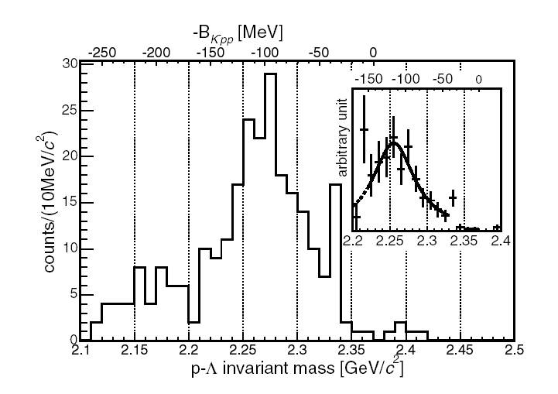
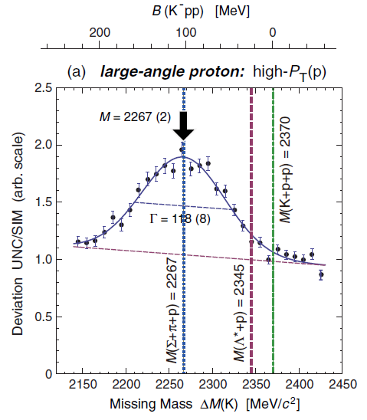
Experiments of K⁻pp search
Kaonic nuclei
FINUDA
DISTO
K⁻ pp???
B. E.= 115 +6+3/-5-4 MeV
Γ = 67 +14+2/-11-3 MeV
PRL 94, 212303 (2005)
P
K⁻
P
K⁻ pp???
B. E. = 103 ±3 ±5 MeV
Γ = 118 ±8 ±10 MeV
PRL104, 132502 (2010)
J-PARC E15
J-PARC E27
SPring8/LEPS
Prototype system = K⁻ pp
Attraction in K⁻pp subthreshold region
PTEP 061D01 (2015)
ΣN cusp, Y* shift
PTEP 101D03 (2014)
at J-PARC
No evidence of K⁻pp bound state
PLB 728, 616 (2014)

Slide 7
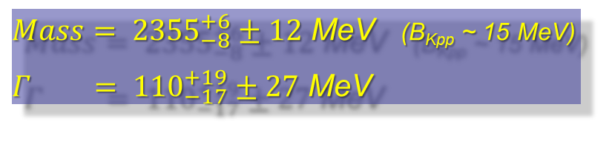
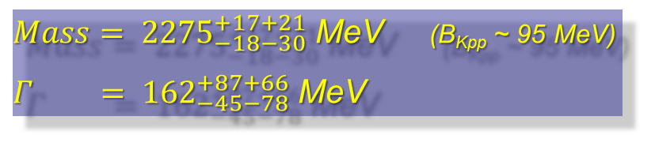
K⁻pp at J-PARC
J-PARC E27
d(π⁺, K⁺) P_{π}=1.7GeV/c
$Mass= {2275}_{−18−30}^{+17+21}$ MeV (B_{Kpp} ~ 95 MeV)
$Γ = {162}_{−45−78}^{+87+66}$ MeV
Y. Ichkawa et al. PTEP 2015, 021D01
-->> Dr. Y. Ichikawa’s talk
on a different reaction
J-PARC E15 (1st run)
³He(inflight K⁻, Λp)n_{missing} P_{K}=1.0GeV/c
$Mass= {2355}_{−8}^{+6}±12$ MeV (B_{Kpp} ~ 15 MeV)
$Γ = {110}_{−17}^{+19}±27$ MeV
Y. Sada et al. PTEP 2016, 051D01
-->> Mr. T. Yamaga’s talk

Slide 8
2. Current situation of
theoretical studies
P
K⁻
P
“K⁻pp” =
K^{bar}NN – πΣN – πΛN (J^{π} = 0⁻, T=1/2)

Slide 9
Theoretical studies of “K⁻pp”
Variational / Faddeev-AGS approaches
Chiral / Phenomenological potentials
 | Dote-Hyodo-Weise | Barnea-Gal-Liverts | Akaishi-Yamazaki | Ikeda-Kamano-Sato | Shevchenko-Gal-Mares
 | PRC79, 014003 (2009) | PLB712, 132 (2012) | PRC76, 045201 (2007) | PTP124, 533 (2010) | PRC76, 044004 (2007)
B(K⁻pp) | 20±3 | 16 | 47 | 9 ～ 16 | 50 ～ 70
Γ | 40 ～ 70 | 41 | 61 | 34 ～ 46 | 90 ～ 110
Method | Variational (Gauss) | Variational (H. H.) | Variational (Gauss) | Faddeev-AGS | Faddeev-AGS
Potential | Chiral (E-dep.) | Chiral (E-dep.) | Pheno. | Chiral (E-dep.) | Pheno.
* Latest progress
Systematic study of kaonic clusters (A+1≦ 7) with Stochastic Variational Method
-->> Dr. S. Ohnishi’s talk
Study of kaonic clusters (A+1, A+2≦ 4) with Hyperspherical Harmonics approach
in momentum-space (R. Y. Kezerashvili, et al., arXiv:1510.00478)

Slide 10
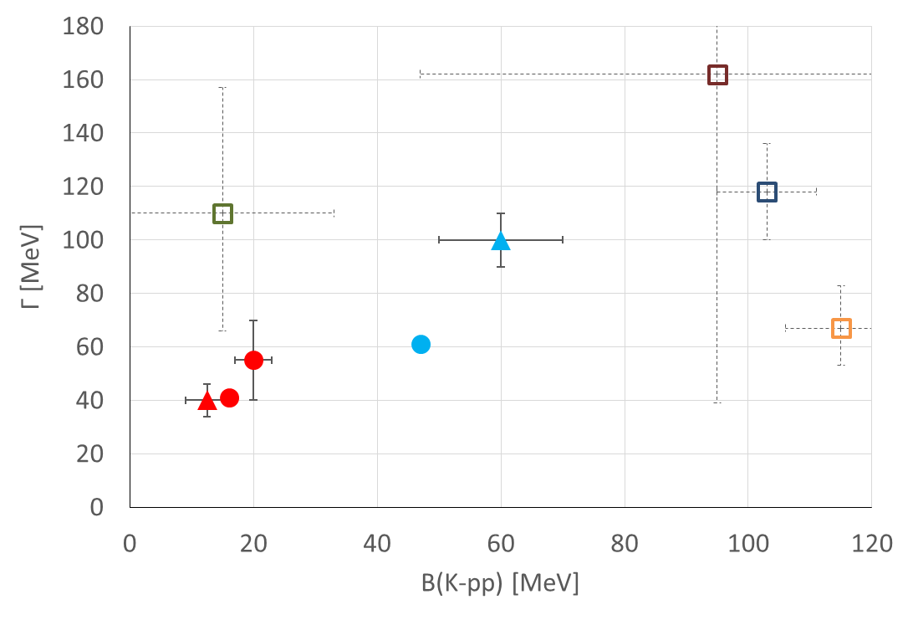
Theoretical studies of “K⁻pp”
J-PARC E27
DISTO
J-PARC E15
Faddeev-AGS
Pheno. pot. (E-indep.)
Variational (Gauss)
Pheno. pot. (E-indep.)
FINUDA
Variational (Gauss)
Chial. pot. (E-dep.)
Faddeev-AGS
Chiral pot. (E-dep.)

Slide 11
Theoretical studies of “K⁻pp”
J-PARC E27
B(K⁻pp) < 100 MeV
K⁻pp should be a resonance between K^{bar}NN and πΣN thresholds.
DISTO
J-PARC E15
Faddeev-AGS
Pheno. pot. (E-indep.)
Variational (Gauss)
Pheno. pot. (E-indep.)
FINUDA
Variational (Gauss)
Chial. pot. (E-dep.)
Faddeev-AGS
Chiral pot. (E-dep.)

Slide 12
Theoretical studies of “K⁻pp”
J-PARC E27
B(K⁻pp) < 100 MeV
K⁻pp should be a resonance between K^{bar}NN and πΣN thresholds.
DISTO
J-PARC E15
Faddeev-AGS
Pheno. pot. (E-indep.)
Variational (Gauss)
Pheno. pot. (E-indep.)
FINUDA
Variational (Gauss)
Chial. pot. (E-dep.)
Faddeev-AGS
Chiral pot. (E-dep.)
Chiral pot. (E-dep.) → Small B. E.
… Λ(1405) ~ 1420 MeV (B. E. ~ 15 MeV)
Pheno. pot. (E-indep.) → Large B. E.
… Λ(1405) = 1405 MeV (B. E. = 30 MeV)

Slide 13
3. “K⁻pp” investigated with
ccCSM+Feshbach method
P
K⁻
P
“K⁻pp” =
K^{bar}NN – πΣN – πΛN (J^{π} = 0⁻, T=1/2)

Slide 14
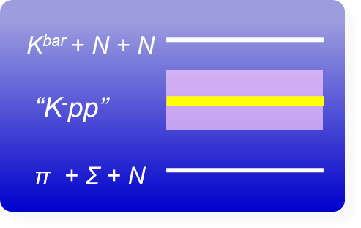
Λ(1405) = Resonant state & K^{bar}N coupled with πΣ
“K⁻pp” … Resonant state of
K^{bar}NN-πYN coupled-channel system
Doté, Hyodo, Weise, PRC79, 014003(2009). Akaishi, Yamazaki, PRC76, 045201(2007)
Ikeda, Sato, PRC76, 035203(2007). Shevchenko, Gal, Mares, PRC76, 044004(2007)
Barnea, Gal, Liverts, PLB712, 132(2012)
Resonant state
Coupled-channel
system
⇒ “coupled-channel
Complex Scaling Method”

Slide 15
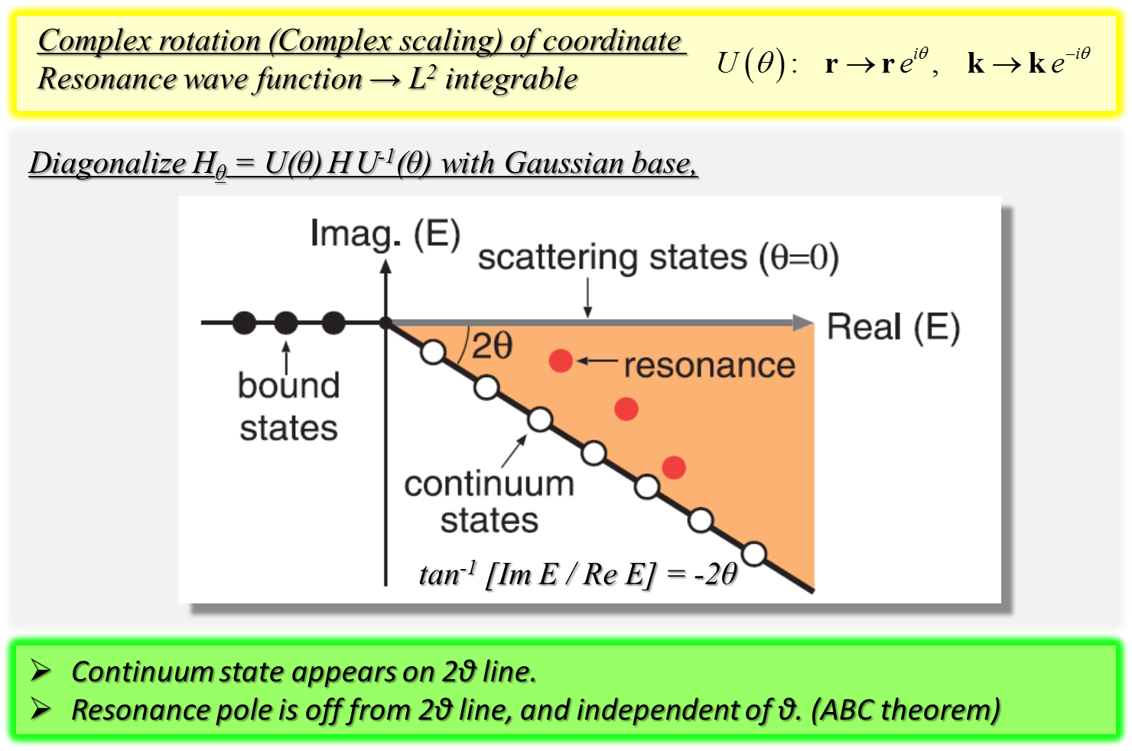
S. Aoyama, T. Myo, K. Kato, K. Ikeda, PTP116, 1 (2006)
T. Myo, Y. Kikuchi, H. Masui, K. Kato, PPNP79, 1 (2014)
Complex Scaling Method
… Powerful tool for resonance study of many-body system

Slide 16
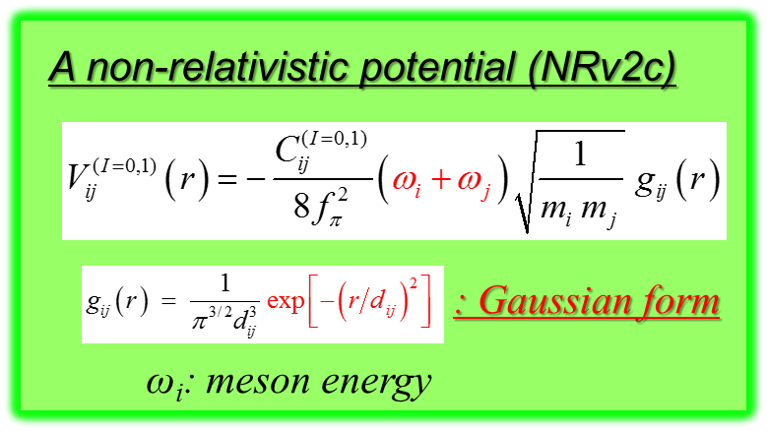
Chiral SU(3) potential with a Gaussian form
A. D., T. Inoue, T. Myo, Nucl. Phys. A 912, 66 (2013)
Anti-kaon = Nambu-Goldstone boson
⇒ Chiral SU(3)-based K^{bar}N potential
Weinberg-Tomozawa term
of effective chiral Lagrangian
Gaussian form in r-space
Semi-rela. / Non-rela.
Based on Chiral SU(3) theory
→ Energy dependence
Constrained by K^{bar}N scattering length
Old analysis by Martin
a_{KN(I=0)} = -1.70 + i0.67 fm, a_{KN(I=1)} = 0.37 + i0.60 fm A. D. Martin, NPB179, 33(1979)
Analysis of SIDDHARTA K⁻p data with a coupled-channel chiral dynamics
a_{K-p} = -0.65 + i0.81 fm, a_{K-n} = 0.57 + i0.72 fm Y. Ikeda, T. Hyodo and W. Weise,
NPA 881, 98 (2012)

Slide 17
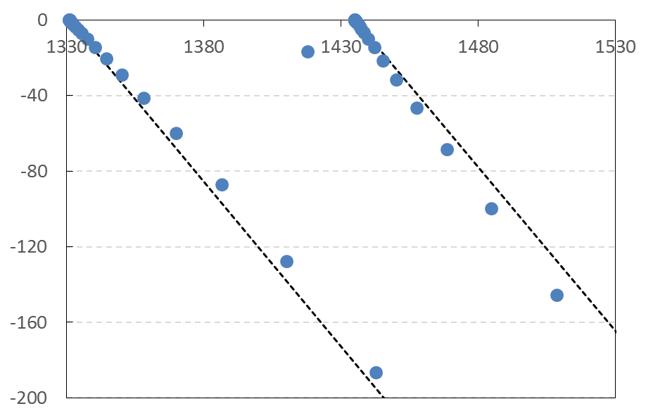
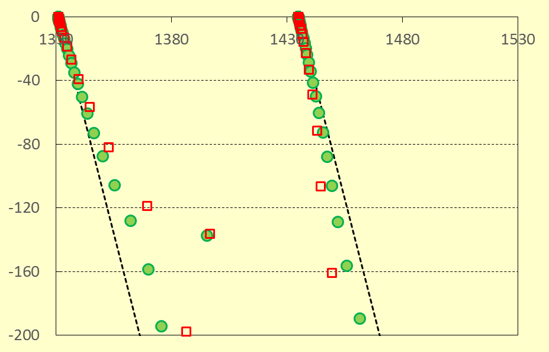
Λ(1405) on coupled-channel Complex Scaling Method
M [MeV]
K^{bar}N potential:
a chiral SU(3) potential
(NRv2, f_{π}=110,
Martin constraint)
Λ*
Higher pole
A. D., T. Myo,
Nucl. Phys. A 930, 86 (2014)
“Complex-range
Gaussian basis”
-Γ/2 [MeV]
K^{bar}N continuum
πΣ continuum
θ=30°
A. D., T. Inoue, T. Myo,
Nucl. Phys. A 912, 66 (2013)
Lower pole
πΣ
K^{bar}N
θ=40°
Double-pole structure of Λ(1405)
D. Jido, J.A. Oller, E. Oset, A. Ramos, U.-G. Meißner, Nucl. Phys. A 725 (2003) 181

Slide 18
Outline: ccCSM+Feshbach calc. of “K⁻pp”
  A. D., T. Inoue, T. Myo, PTEP 2015, 043D02 (2015)
“K⁻pp” =
K^{bar}NN – πΣN – πΛN (J^{π} = 0⁻, T=1/2)

Slide 19
Outline: ccCSM+Feshbach calc. of “K⁻pp”
  A. D., T. Inoue, T. Myo, PTEP 2015, 043D02 (2015)
“K⁻pp” =
K^{bar}NN – πΣN – πΛN (J^{π} = 0⁻, T=1/2)
K^{bar}NN single-channel three-body problem
with an effective K^{bar}N potential

Slide 20
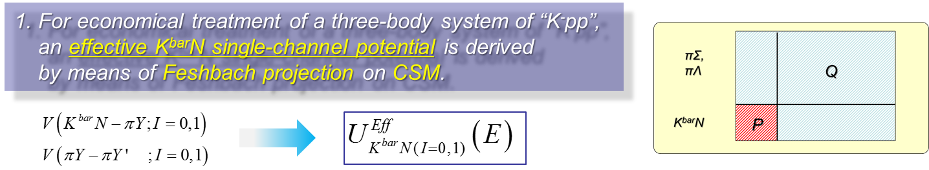
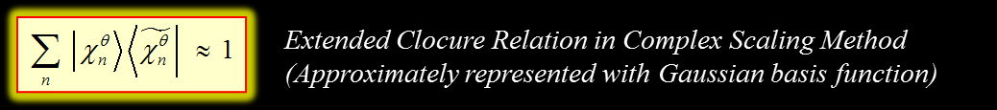
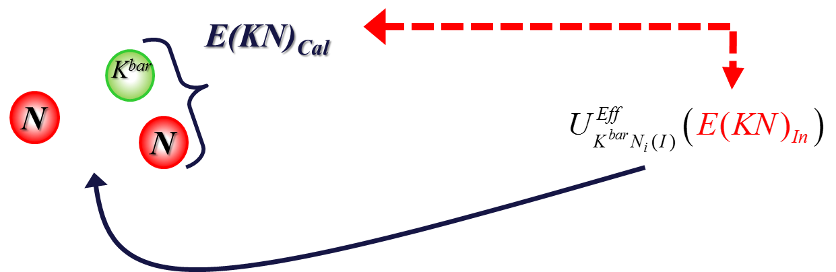
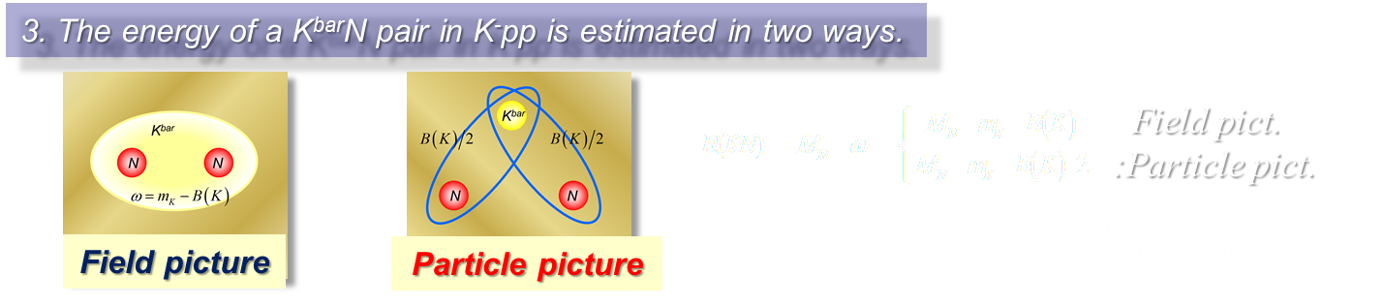
Outline: ccCSM+Feshbach calc. of “K⁻pp”
2. Self-consistency for complex K^{bar}N energy is taken into account.
E(KN)_{In} : assumed in the K^{bar}N potential
E(KN)_{Cal} : calculated with the obtained K⁻pp
E(KN)_{In}= E(KN)_{Cal}

Slide 21
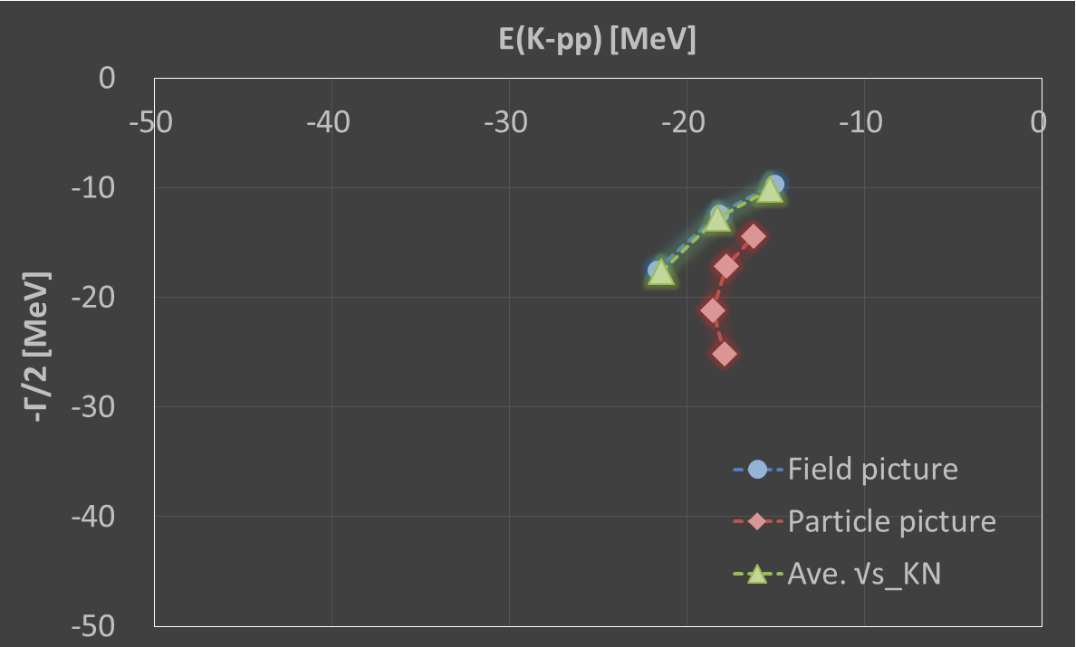
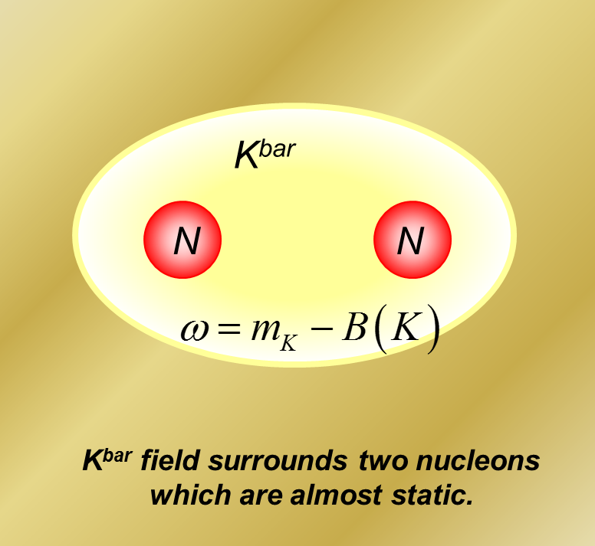
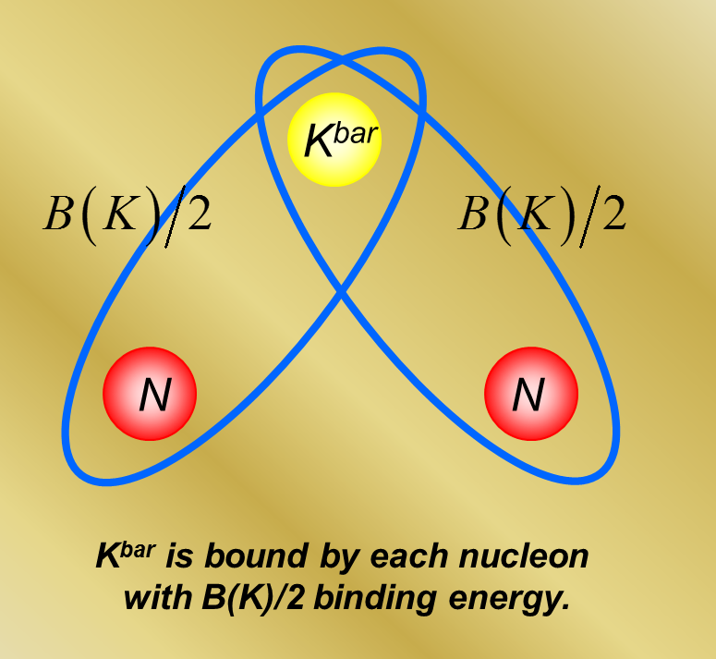
“K⁻pp” with SIDDHARTA value
NN pot. : Av18 (Central)
K^{bar}N pot. : NRv2a-IHW pot.
(f_{π}=90 - 120MeV)
a_{KN}(I=0) = -1.97 + i1.05 fm
a_{KN}(I=1) = 0.57 + i0.73 fm
Field picture and BGL ansatz
(B, Γ/2) = (15~22, 10~18)
120
110
120
Particle picture
(B, Γ/2) = (16~19, 14~25)
f_{π} = 100
110
100
Averaged K^{bar}N energy in many-body system
f_{π} = 90
E(KN) = -B(K)
E(KN) = -B(K)/2
Field picture
Particle picture
E(KN) = -B(K)/2 - Δ
Barnea, Gal, Liverts, PLB 712, 132 (2012)

Slide 22
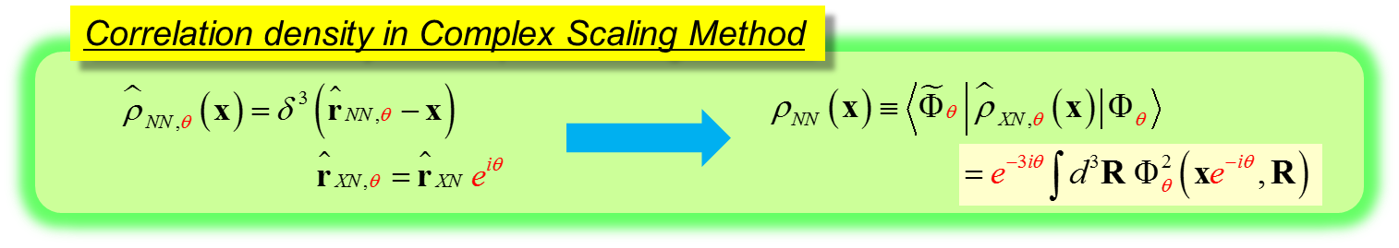
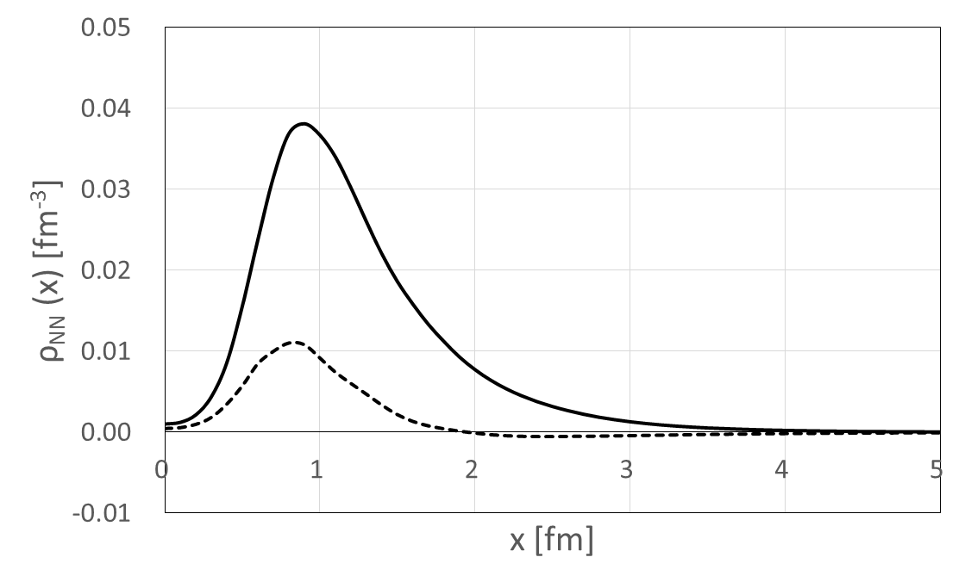
NN correlation density
NN pot. : Av18 (Central)
K^{bar}N pot. : NRv2c potential
f_{π}=110, Particle pict.
NN repulsive core
K^{bar}
Re ρ_{NN}
N
N
Im ρ_{NN}
NN distance = 2.1 - i 0.3 fm
~ Mean distance of 2N in nuclear matter at normal density!

Slide 23
3. “K⁻pp” investigated with
ccCSM+Feshbach method
P
K⁻
P
Double pole of “K⁻pp”?

Slide 24
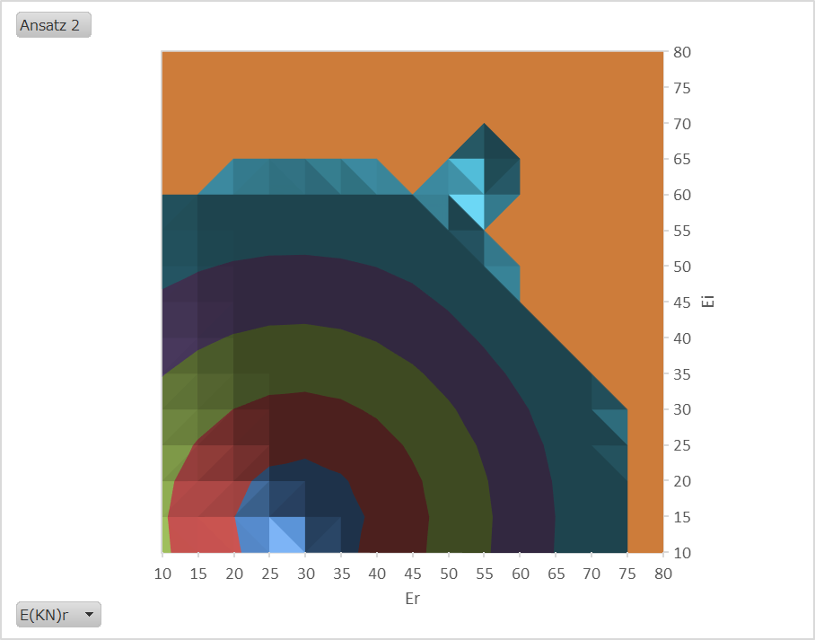
Double pole of “K⁻pp”?
Chiral pot.
(f_{π}=110 MeV, Martin)
Particle picture
?
Indicator of self-consistency
Δ=|E(KN)_{Cal} – E(KN)_{In}|
Δ=10 at E(KN)=(58, 64)
Nearly self-consistent solution:
B(KNN) = 79
Γ/2 = 98 MeV
Im E(KN)_{In}
Δ=0 at E(KN)=(29, 14)
Self-consistent solution:
B(KNN) = 27.3
Γ/2 = 18.9 MeV
Lower pole??
“Candidate” of self-consistent solution:
(B_{KNN}, Γ/2) = (62～79, 74～104) MeV
for f_{π}=90～120 MeV (Martin const.)
only with Particle picture
★
Higher pole?
Re E(KN)_{In}

Slide 25
Comparison of Theor. and Exp. results
DISTO
B = 103 ±3 ±5 MeV
Γ = 118 ±8 ±10 MeV
J-PARC E27
B ~ 95 MeV
Γ ~ 162 MeV
J-PARC E15
B ~ 16 MeV
Γ ~ 110 MeV
(Preliminary?)
-103
πΣN thr.
0 [MeV]
K^{bar}NN thr.
Double pole with a chiral potential (E-dep.)
B = 15~22
Γ = 20~50
SIDDHARTA
ccCSM+Feshbach
B = 60~80
Γ = 150~210
B = 21~32
Γ = 18~64
Martin
Faddeev-AGS
Y. Ikeda, H. Kamano, T. Sato,
PTP 124, 533 (2010)
B = 67~89
Γ = 244~320
B = 9~16
Γ = 34~66
Enhancement of K^{bar}N interaction (E-indep.)
Partial restoration of chiral symmetry?
B = 102
V_{KN}× 1.17
B = 52
S. Maeda, Y. Akaishi, T. Yamazaki,
Proc. Jpn. Acad., Ser. B 89, 418 (2013)
pion-assisted dibaryon
“ πΛN–πΣN system (J^{π} = 2⁺, T = 3/2)”
B_{πΣN} = 12~20
Γ = 5~8
H. Garcilazo, A. Gal, NPA 897, 167 (2013)

Slide 26
4. Fully coupled-channel
CSM study (On-going)

Slide 27
Just diagonalize
the Hamiltonian matrix!
K^{bar}NN
- K^{bar}NN
K^{bar}NN
- πΣN
_{θ}
K^{bar}NN
- πΛN
H_{ij}
πΣN
- πΣN
πΣN
- πΛN
＊
πΛN
- πΛN
＊
＊
No channel elimination!!

Slide 28
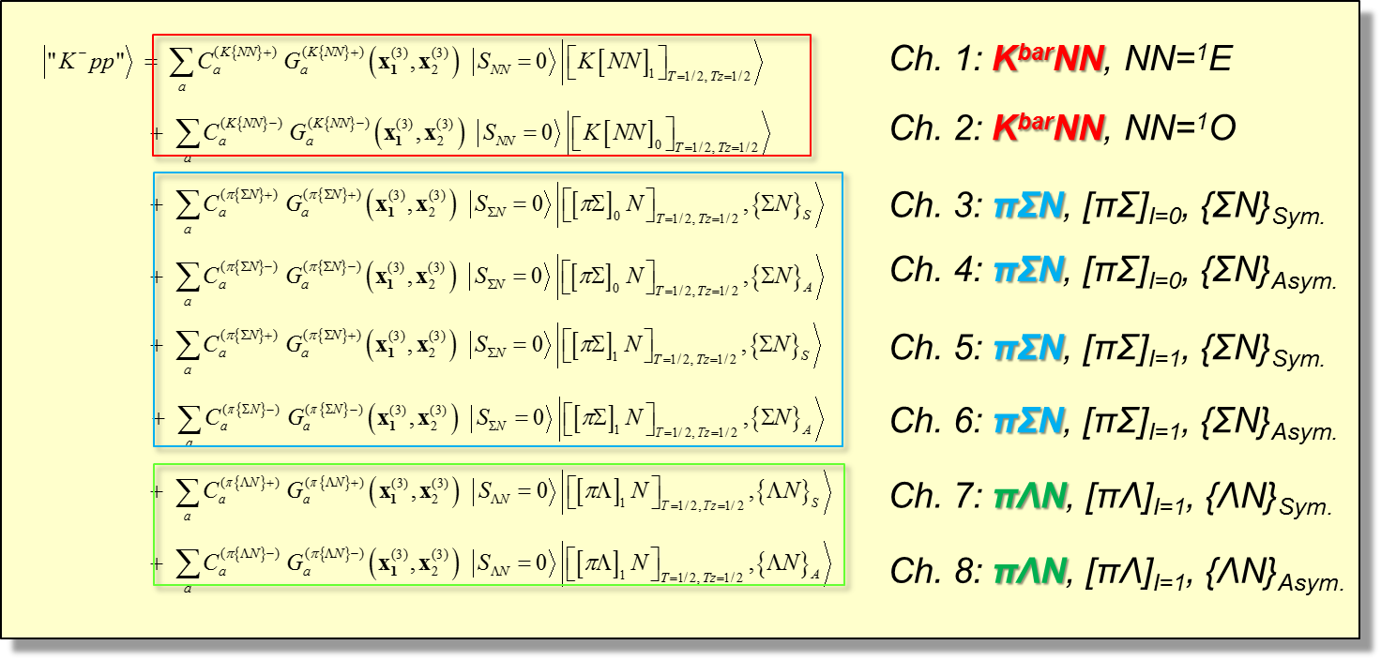
Hamiltonian
Wave function
Spatial part: Correlated Gaussian projected onto a parity eigenstate of B₁B₂,
including 3 types of Jacobi coordinates

Slide 29
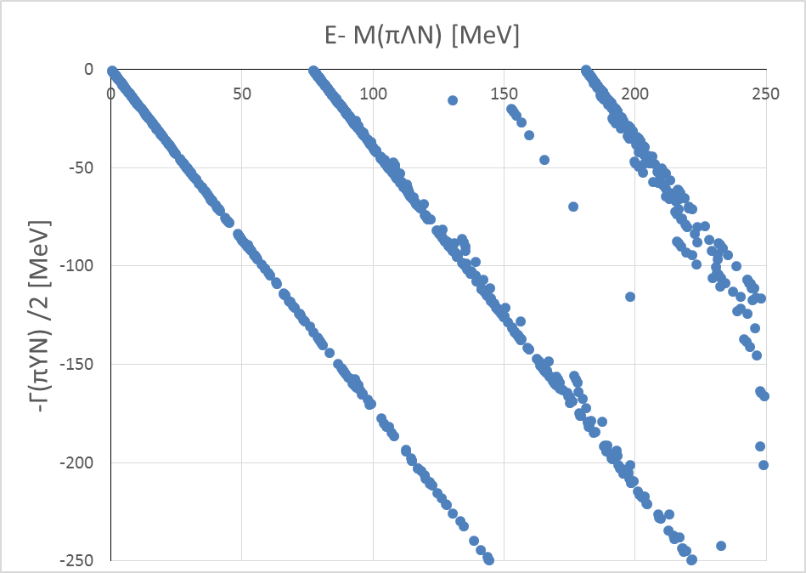
Complex eigenvalue distribution
NN: Av18 pot.
K^{bar}N-πY: AY pot.
Λ* pole
B_{KN} = 28 MeV, Γ_{πΣ} /2 = 20 MeV
The “K⁻pp” pole of AY potential :
B_{KNN} = 51 MeV, Γ_{πYN} /2 = 16 MeV
K^{bar}NN cont.
Λ*N cont.
Scaling angle θ=30°
Dimension = 6400
πΛN cont.
πΣN cont.

Slide 30
5. Summary, future plans
and remarks

Slide 31
5. Summary
A prototype of K^{bar} nuclei “K⁻pp” = Resonance state of K^{bar}NN-πYN coupled system
“K⁻pp” is theoretically investigated in various ways:
Chiral SU(3)-based potential (E-dep.) → Shallow binding … B(K⁻pp) = 10~25 MeV
Phenomenological potential (E-indep.) → Deep binding … B(K⁻pp) = 50~90 MeV
All theoretical studies predict B(K⁻pp) < 100 MeV.
K⁻pp studied with “coupled-channel Complex Scaling Method + Feshbach projection”
Used a Chiral SU(3)-based potential (Gaussian form in r-space)
Self-consistency for K^{bar}N complex energy (Field and Particle pictures)
K⁻pp (J^{π}=0⁻, T=1/2) … (B, Γ/2) = (20~30, 10~30) MeV (Martin constraint)
(15~22, 10~25) MeV (SIDDHATA constraint)
A candidate of self-consistent solution with Particle picture
… Deeper binding and larger decay width
K⁻pp (J^{π}=0⁻, T=1/2) …. (B, Γ/2) = (60~80, 75~105) MeV (Martin constraint)
“K⁻pp” has a double-pole structure similarly to Λ(1405)?
Relation to the K⁻pp search experiments
The signal observed in J-PARC E27 is considered to correspond to the lower pole of “K⁻pp”??
J-PARC E15 may pick up the higher pole of “K⁻pp”???

Slide 32
5. Future plans and remarks
Future plans:
  Fully coupled-channel calculation of K⁻pp (on-going)
  … E-dep. Chiral SU(3) pot. case, Detail study for the double pole structure, etc
  Application to resonances of other hadronic systems
Remarks (to be considered):
Need specrum calculations taking into reaction mechanism,
for the comparison with experimental result
Earlier works on ³He(in-flight K⁻, n) reaction:
T. Koike and T. Harada, PRC80, 055208 (2009)
J. Yamagata-Sekihara, D. Jido, H. Nagahiro and S. Hirenzaki, Phys. Rev. C 80, 045204 (2009)
Non-mesic decay of “K⁻pp” (two nucleon absorption, “K⁻pp” --> YN)?
All theoretical calculations of the “K⁻pp” pole position consider only mesic-decay mode,
not non-mesic decay mode. Need to be careful when comparing with experimental results.
Nature of Λ(1405) and K^{bar}N interaction
How strongly attractive is the K^{bar}N interaction? “Λ(1405) vs Λ(1420)”
-->> Latest work: Dr. T. Sekihara’s talk
The poles obtained in theoretical study = on the complex energy plane
Observables measured in experiments = on the real energy axis

Slide 33
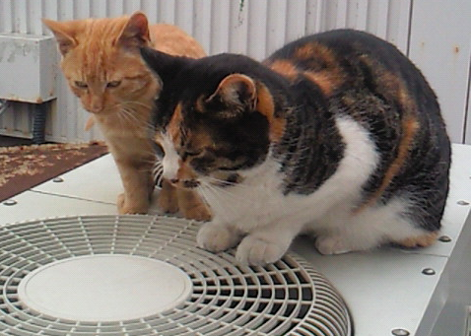
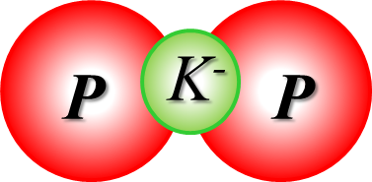
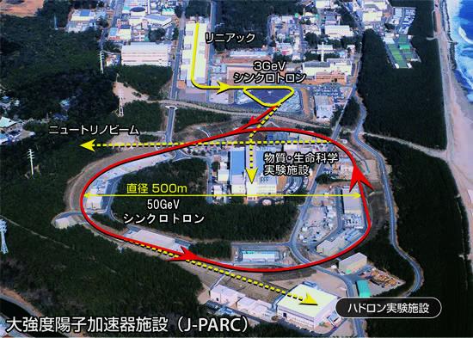
Thank you for your attention!
References:
  A. D., T. Inoue, T. Myo,
  NPA 912, 66 (2013)
  A. D., T. Myo, NPA 930, 86 (2014)
  A. D., T. Inoue, T. Myo,
  PTEP 2015, 043D02 (2015)
  A. D., T. Inoue, T. Myo,
  JPS Conf. Proc. (Proc. of HYP2015) (to be appeared )
Cats in KEK

