Slide 1
Baryon Spectroscopy : Recent Results from ELSA
R. Beck
University Bonn
MENU 2016 , Kyoto July 25th – 30th 2016
Introduction
Some Highlights from ELSA
Impact of the new Polarization Data
Summary and Outlook
supported by the DFG within the SFB/TR16

Slide 2
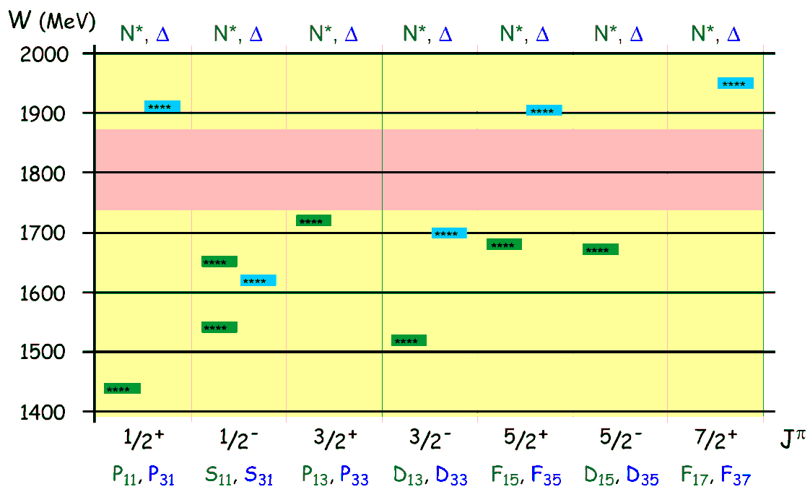
Introduction
Experiments at ELSA: focus on baryon spectroscopy
Excitation spectra: information about interaction and dynamics between constituents
Nucleon Excitation Spectrum
only 7 N* and 5 Δ* well established in the mass region 1400 MeV < W < 2000 MeV
Energy pattern for the dominant states
Various nucleon models predict many more states
- constituent Quark Models
- weak coupling to πN final state
- Dynamic Models , Lattice QCD
- incomplete data base

Slide 3
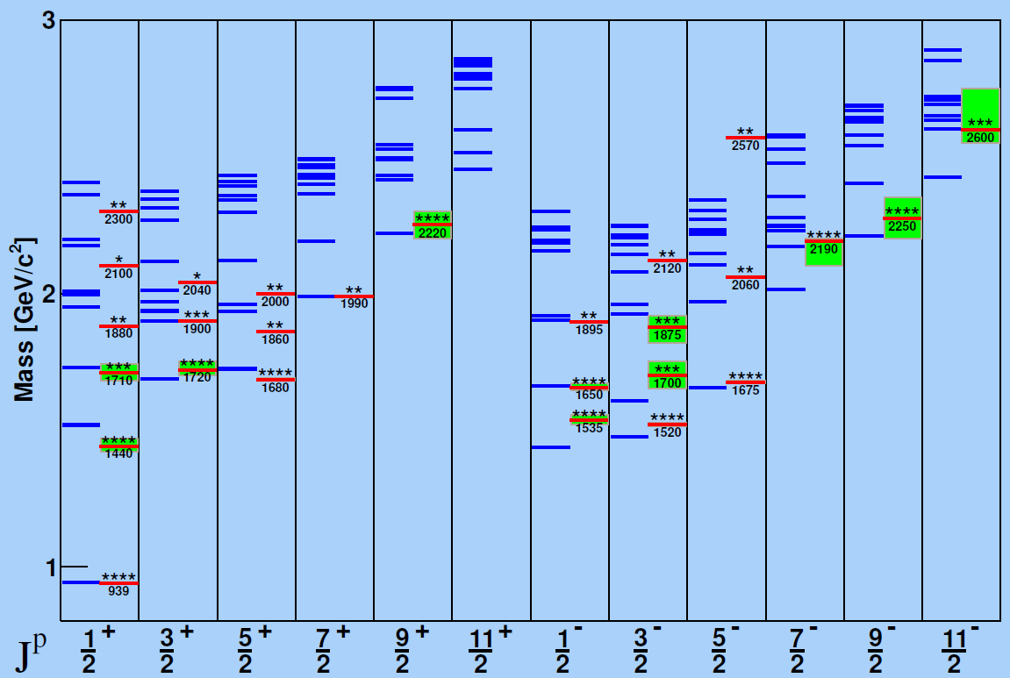
Introduction
Status on nucleon-resonances (PDG 2010) :
(Isospin I = 1/2)
____ PDG value
Nucleon Resonances
____ Quark Model prediction
Quark models
Many more states predicted

Slide 4
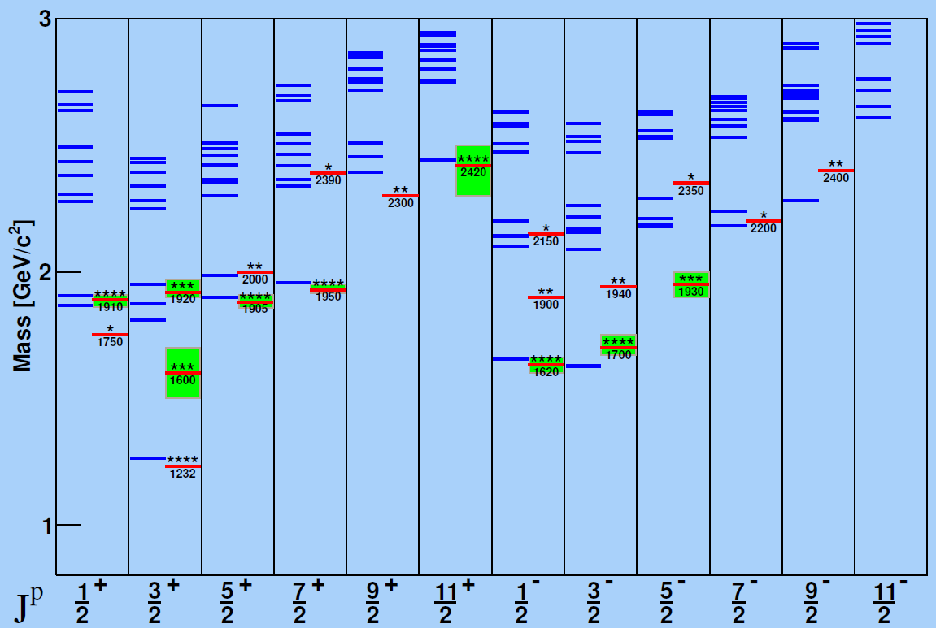
Introduction
Status on Delta-resonances (PDG2010) :
(Isospin I = 3/2)
____ PDG value
Delta Resonances
____ Quark Model prediction
Find missing states
Sufficient data base and
unique PWA necessary
Example P₃₃ - wave
Resonances with J^{P} = 3/2

Slide 5
Problem with a Unique PWA Solution
8 well chosen observables have to be measured to determine the production amplitudes (F₁,F₂,F₃ and F₄)
π- threshold until Δ⁺(1232)- region
additional constraints:
(a) s- and p- wave approximation truncated PWA
(b) Fermi- Watson theorem
same I, J in the final state
same scattering phase δ_{IJ}
two observables sufficient for “complete data base”
differential cross section : dσ/dΩ
beam asymmetry : Σ

Slide 6
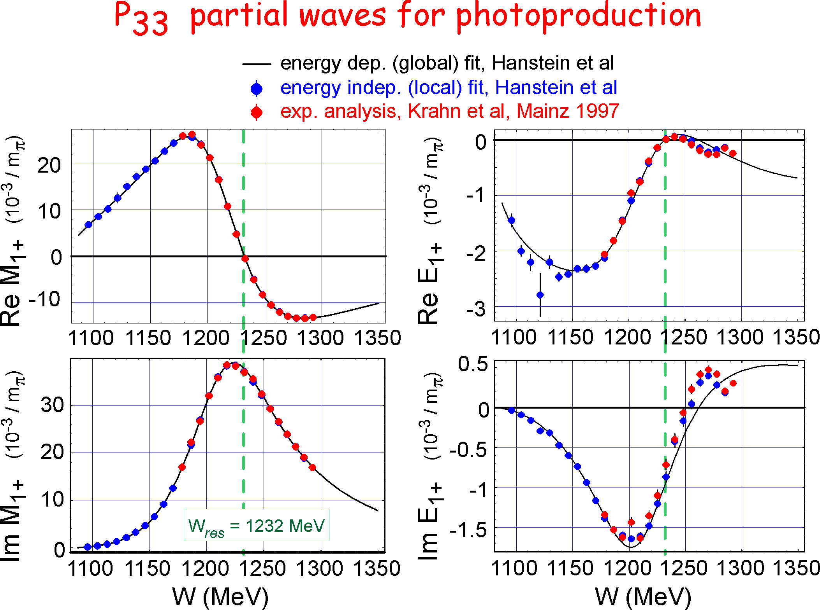
Partial waves for the P₃₃(1232)

Slide 7
Resonance Parameter for the P₃₃(1232)
electromagnetic transition moments and E2/M1 ratio at W = 1232 MeV
pole position and residues at Wpole = M_{R} – i/2 Γ_{R}
LEGS:
G. Blanpied. and A. Sandorfi PRL 79, 4337 (1997)
MAMI:
O. Hanstein, D. Drechsel, and L. Tiator PL. B 385, 45 (1996)
R.B. and H.P. Krahn PRL 78, 606 (1997)

Slide 8
Problem with a Unique PWA Solution
8 well chosen observables have to be measured to determine the production amplitudes (F₁,F₂,F₃ and F₄)
π- threshold until Δ⁺(1232)- region
additional constraints:
(a) s- and p- wave approximation truncated PWA
(b) Fermi- Watson theorem
same I, J in the final state
same scattering phase δ_{IJ}
two observables sufficient for “complete data base”
differential cross section : dσ/dΩ
beam asymmetry : Σ
above ππ- threshold
- Fermi- Watson theorem not valid any more
- More observable needed to get a unique partial wave solution
- Different final states are important -> coupled PWA are essential

Slide 9
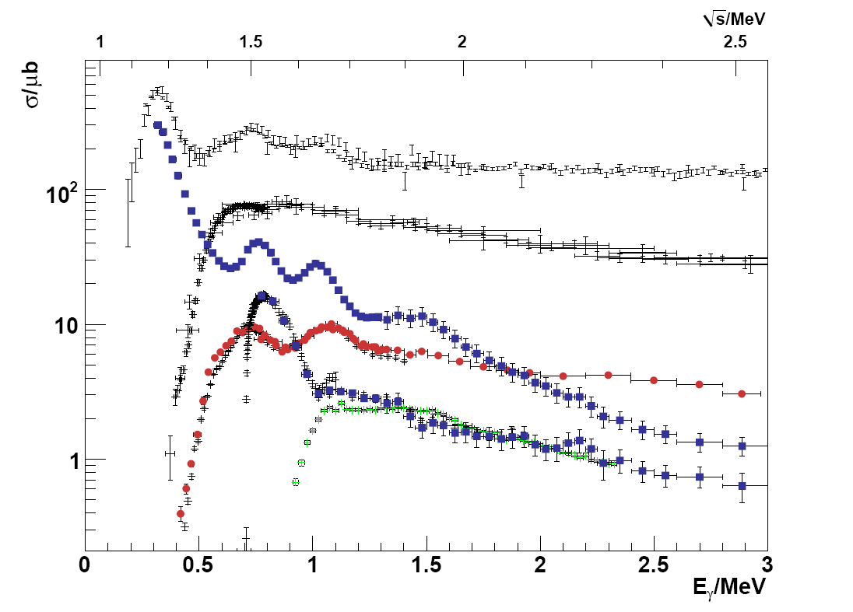
Experimental program for N*
Common effort at ELSA, JLab and MAMI
Precision data for different final states (pπ⁰, nπ⁺, pη , K⁺Λ, pπ⁰π⁰....)
Polarization experiments (beam, target and recoil)
“complete data base”
To constrain PWA −> unique PWA solution
γ + p −> p + π⁻ + π⁺
γ + p −> p + π⁰ + π⁰
γ + p −> p + π⁰
γ + p −> K⁺ + Λ
γ + p −> p + η

Slide 10
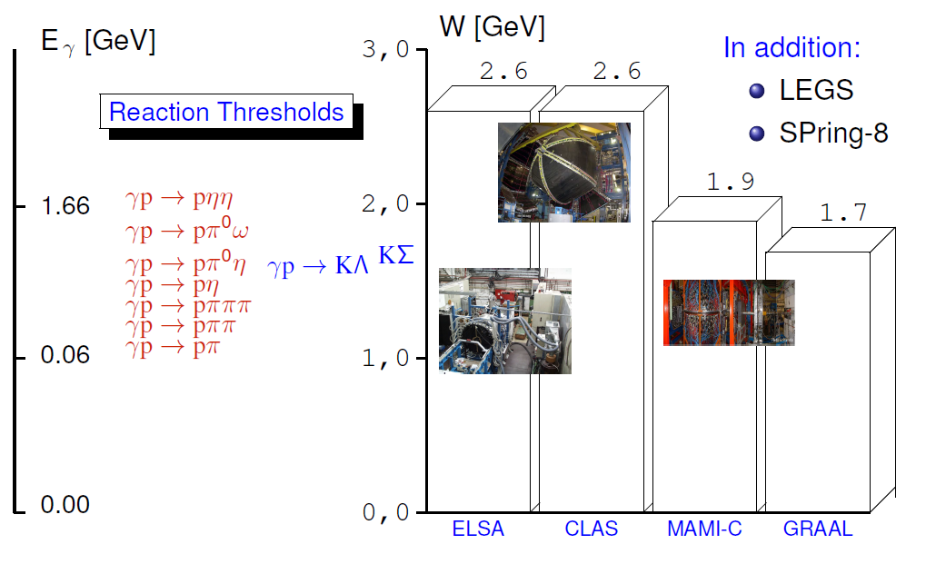
Experimental Program for N*
CLAS: talk by R. Schumacher, R. Gothe
MAMI: talk by V. Kashevarov
Spring-8: talk by T. Nakano
courtesy of V. Crede

Slide 11
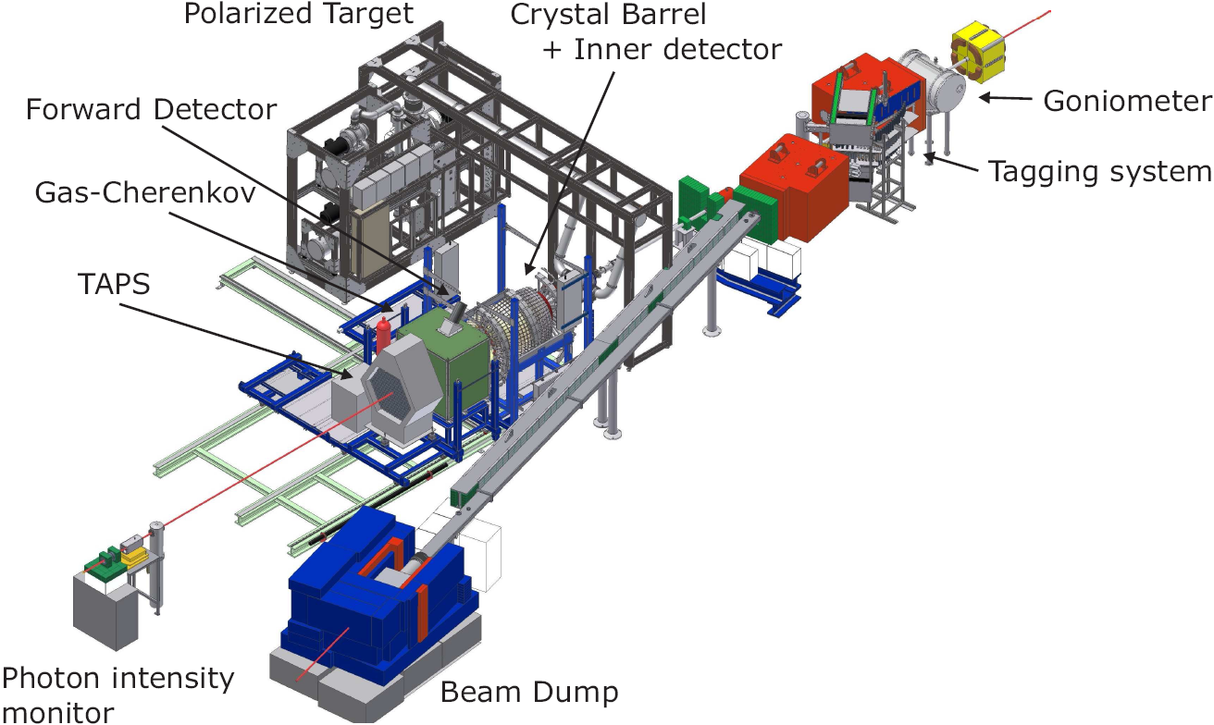
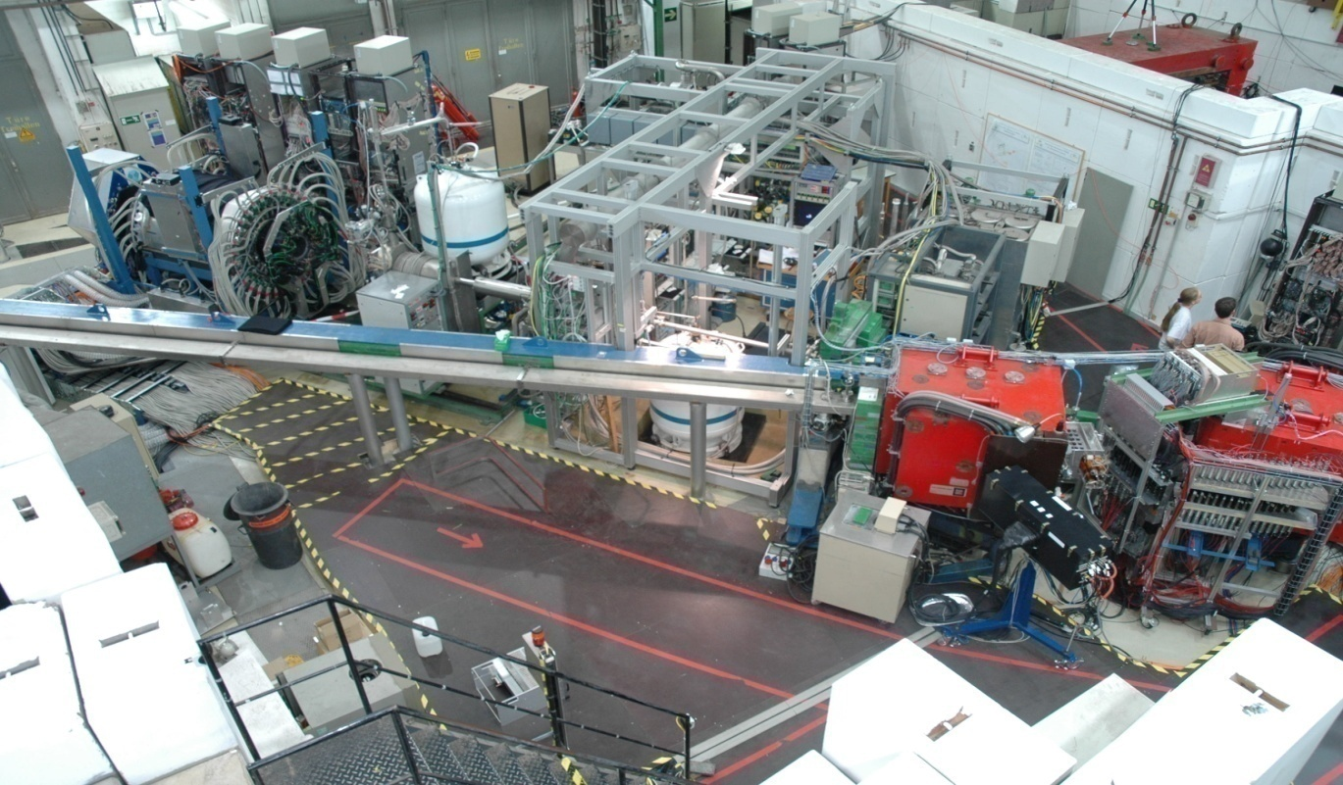
CBELSA/TAPS Experiment at ELSA
Important:
Polarized beam from ELSA
Polarized targets
4π detector setup

Slide 12
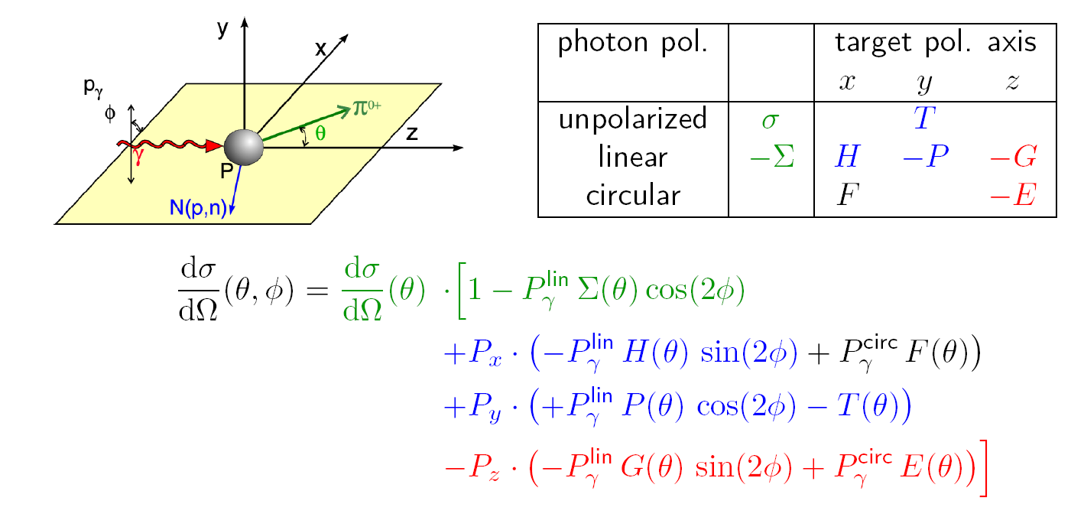
Beam-Target Polarization Observables
photoproduction of pseudoscalar mesons with polarized beam and target :
all three single polarization observables Σ, P , T and cross section σ
4 double polarization observables G , E , F and H
can be measured
ELSA- Experiments:
Data on all three single pol. observables Σ, P , T and diff. cross section σ
and on four double polarization observables G , E and H and (F)
for and

Slide 13
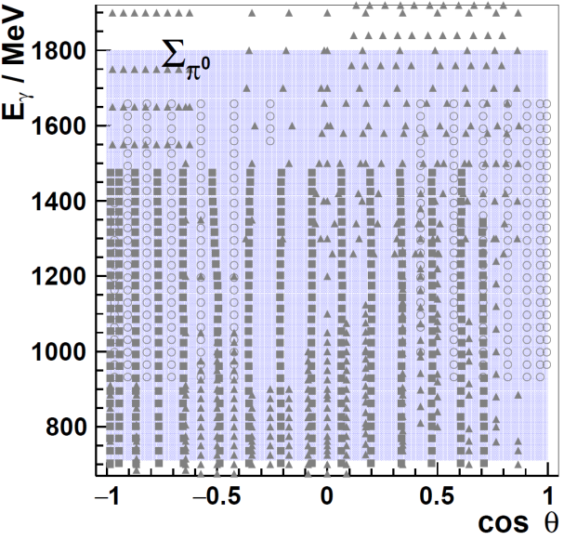
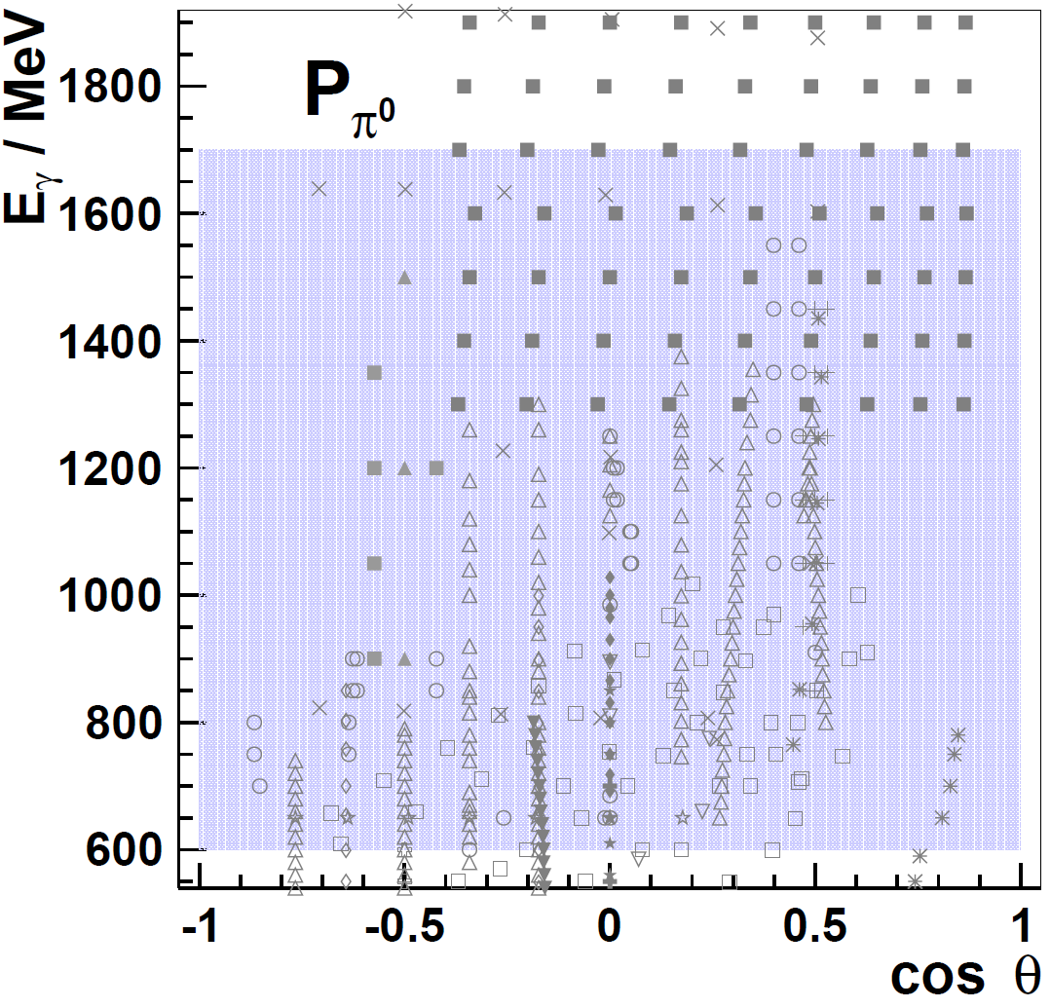
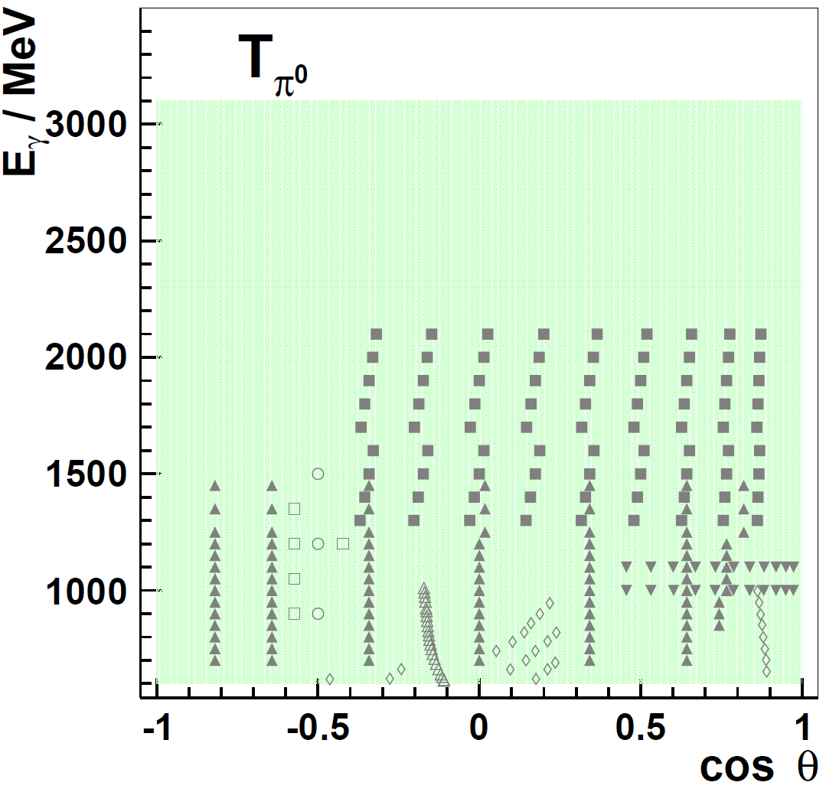
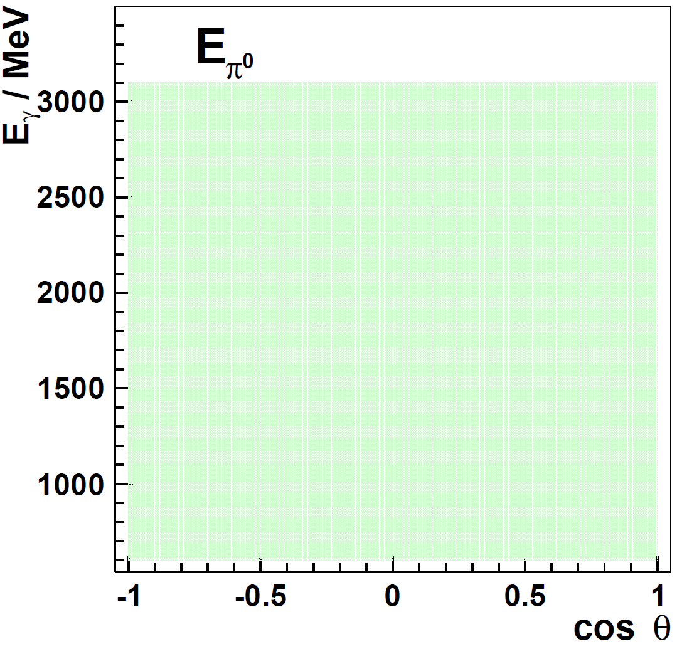
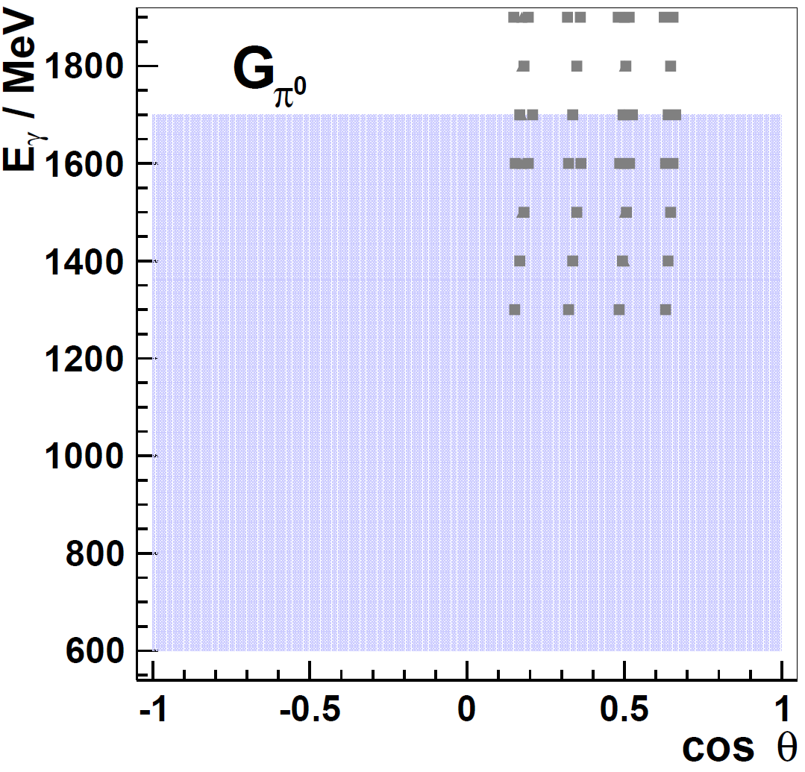
Results CBELSA/TAPS- Experiment
data base before
CBELSA/TAPS

Slide 14
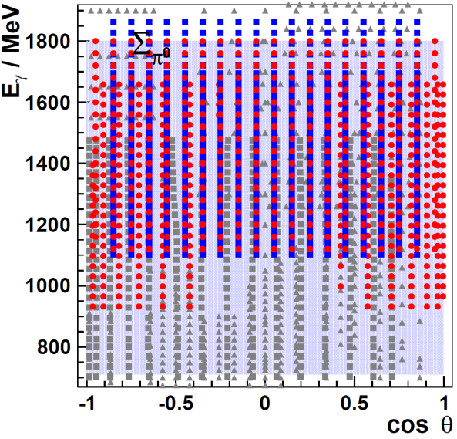
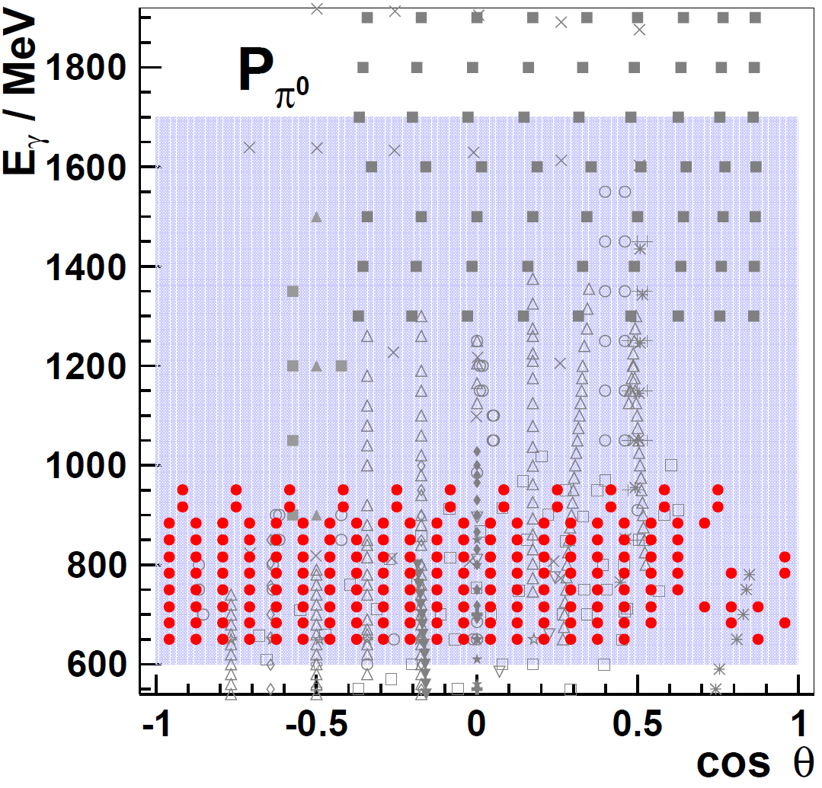
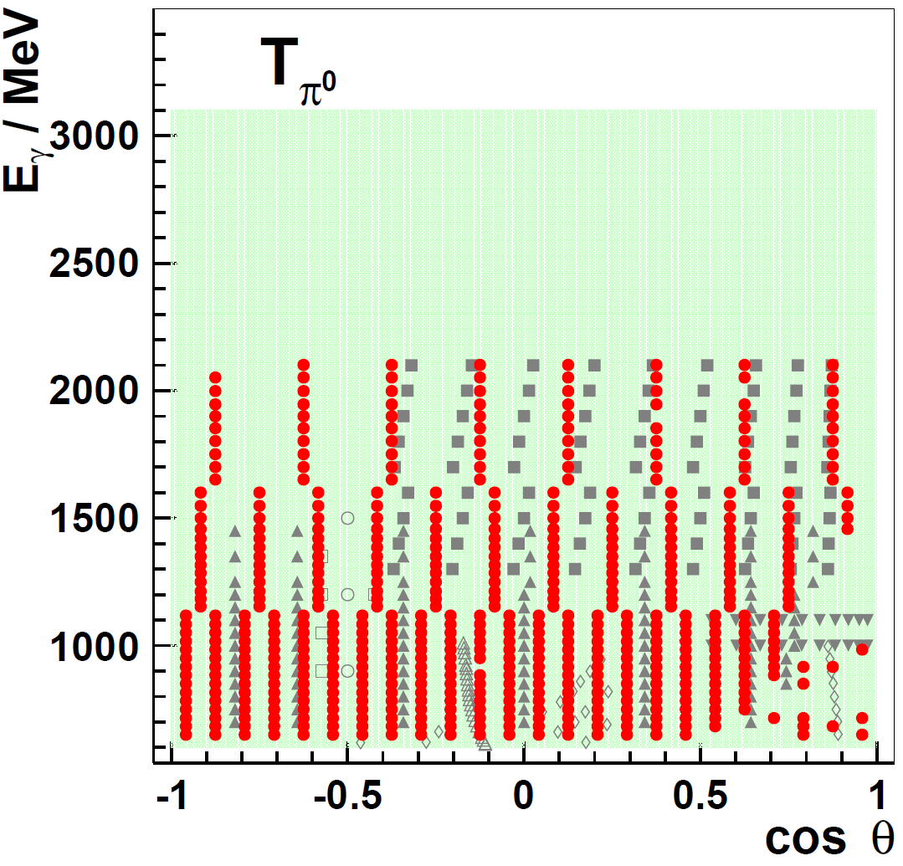
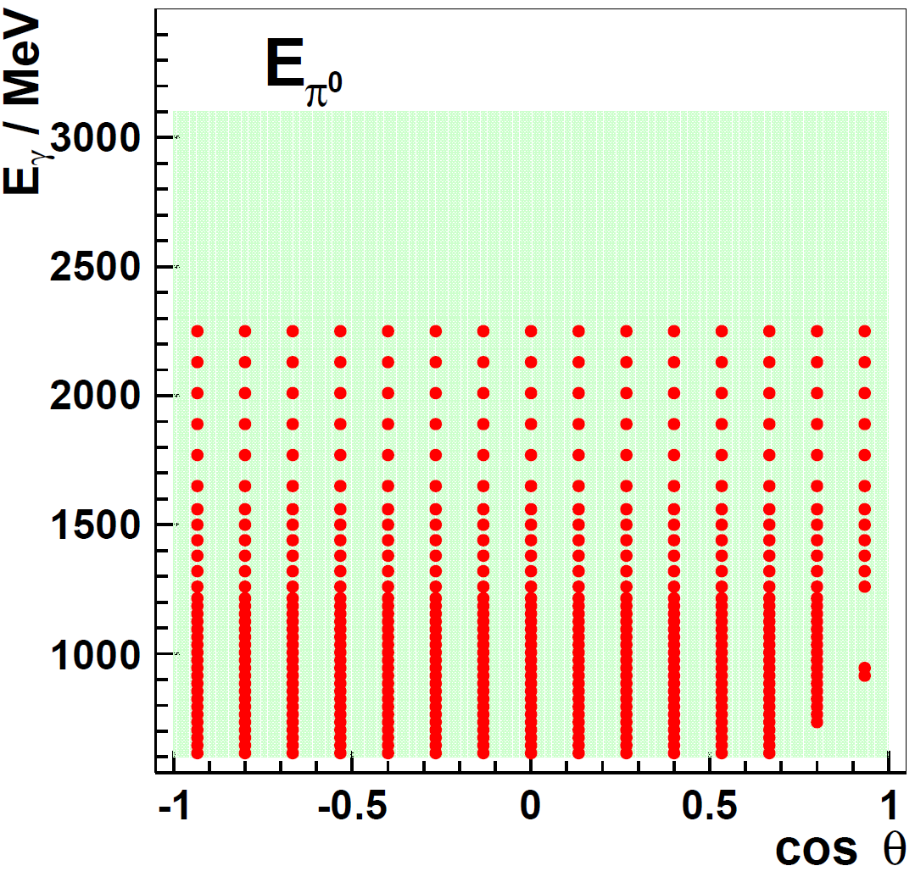
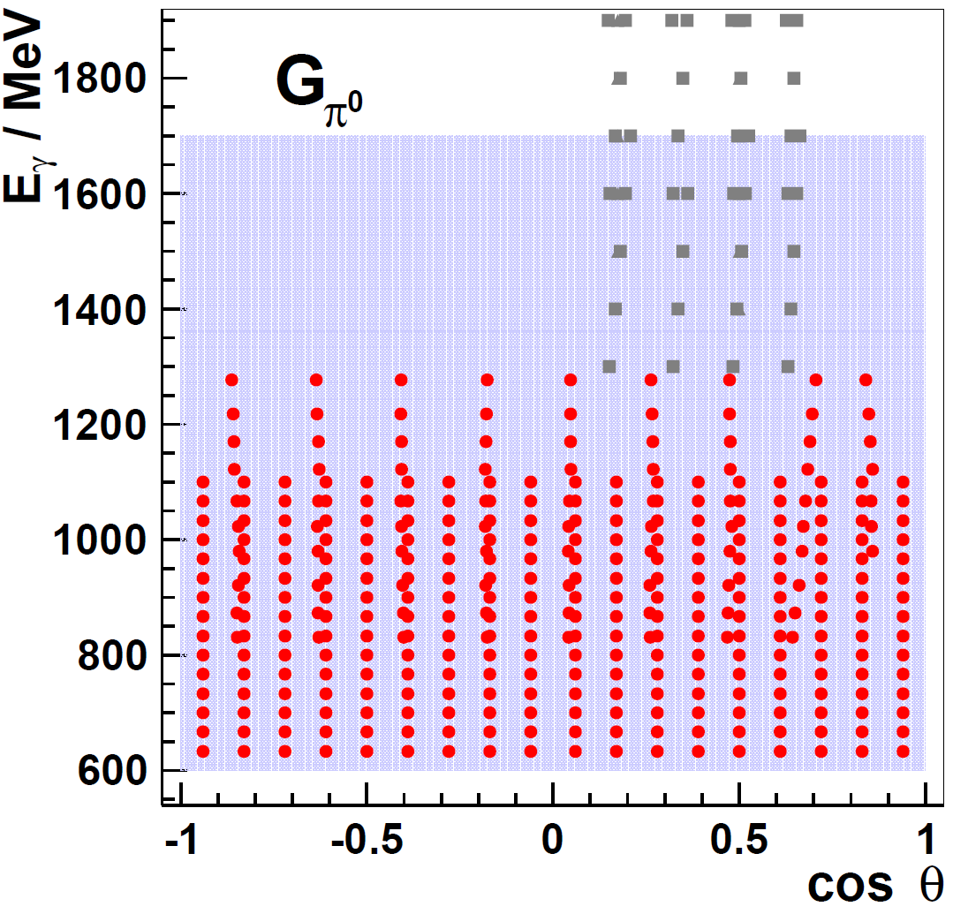
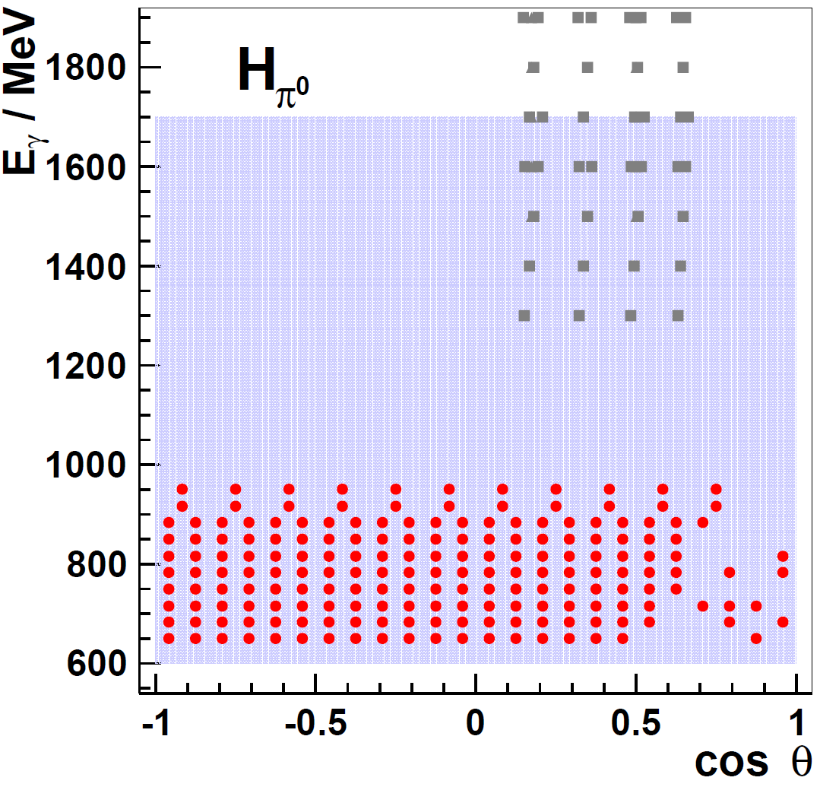
Results CBELSA/TAPS- Experiment
data base after
CBELSA/TAPS
CLAS

Slide 15
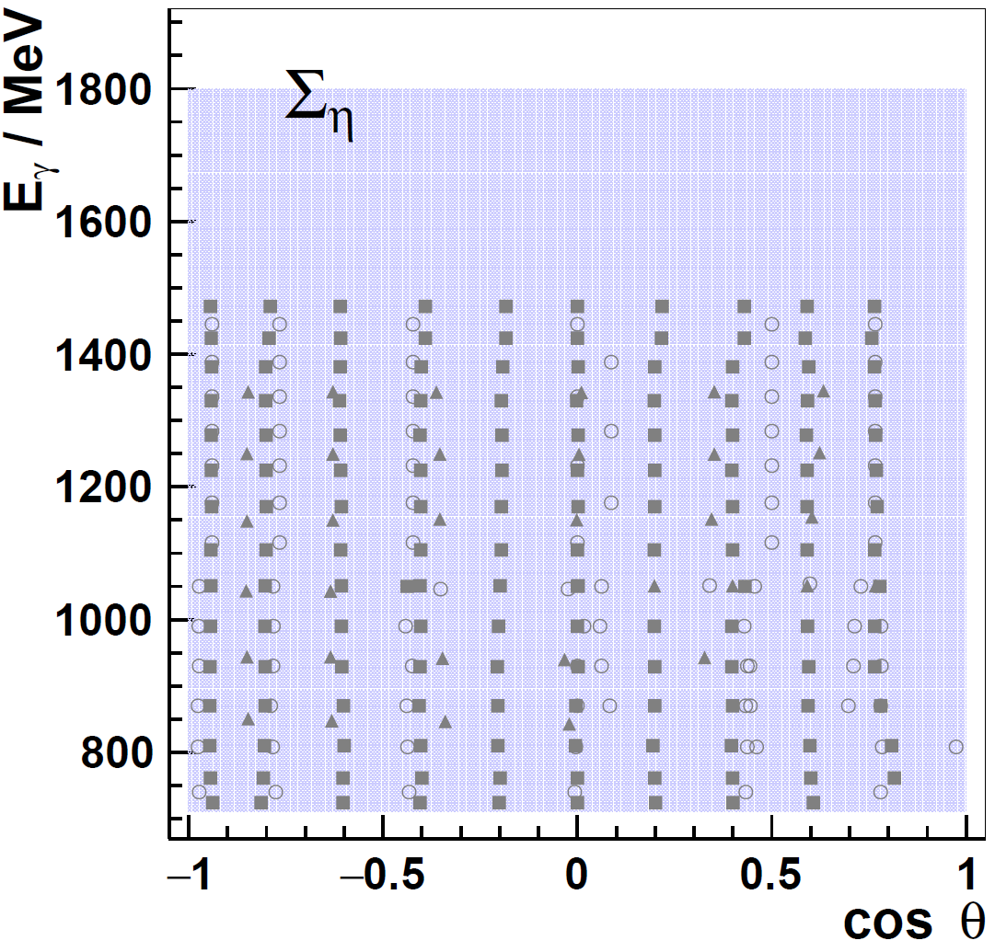
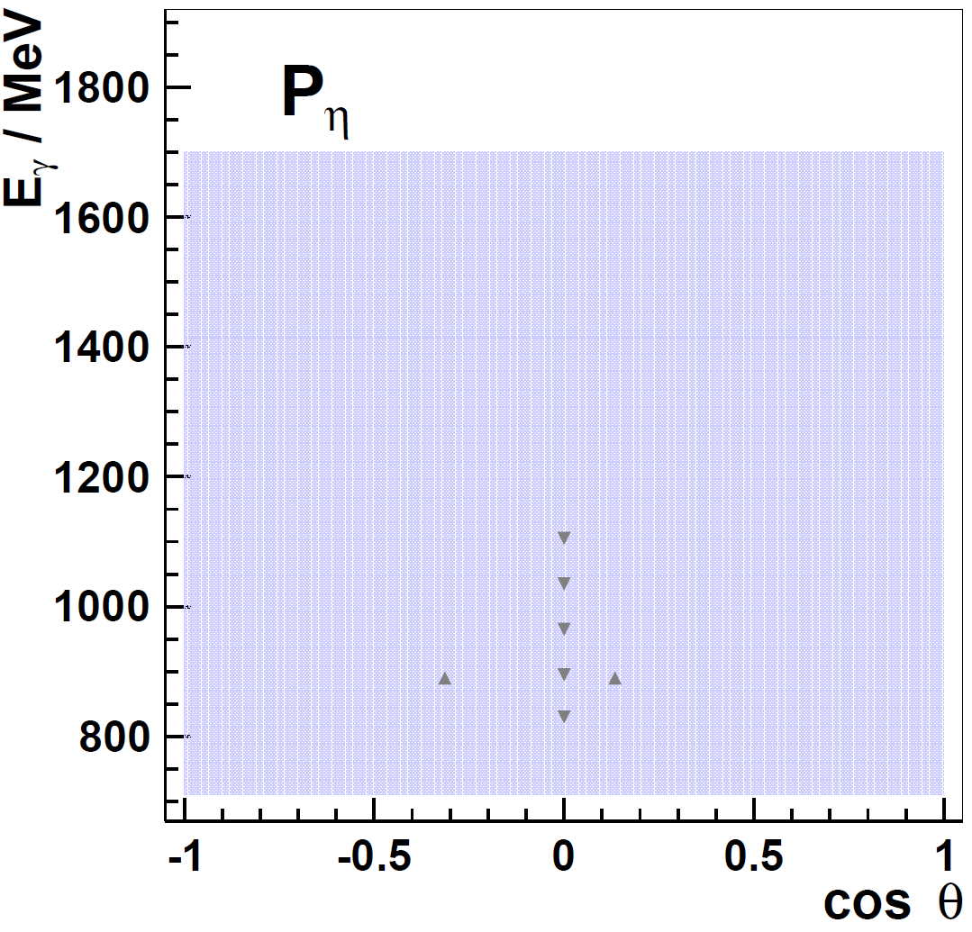
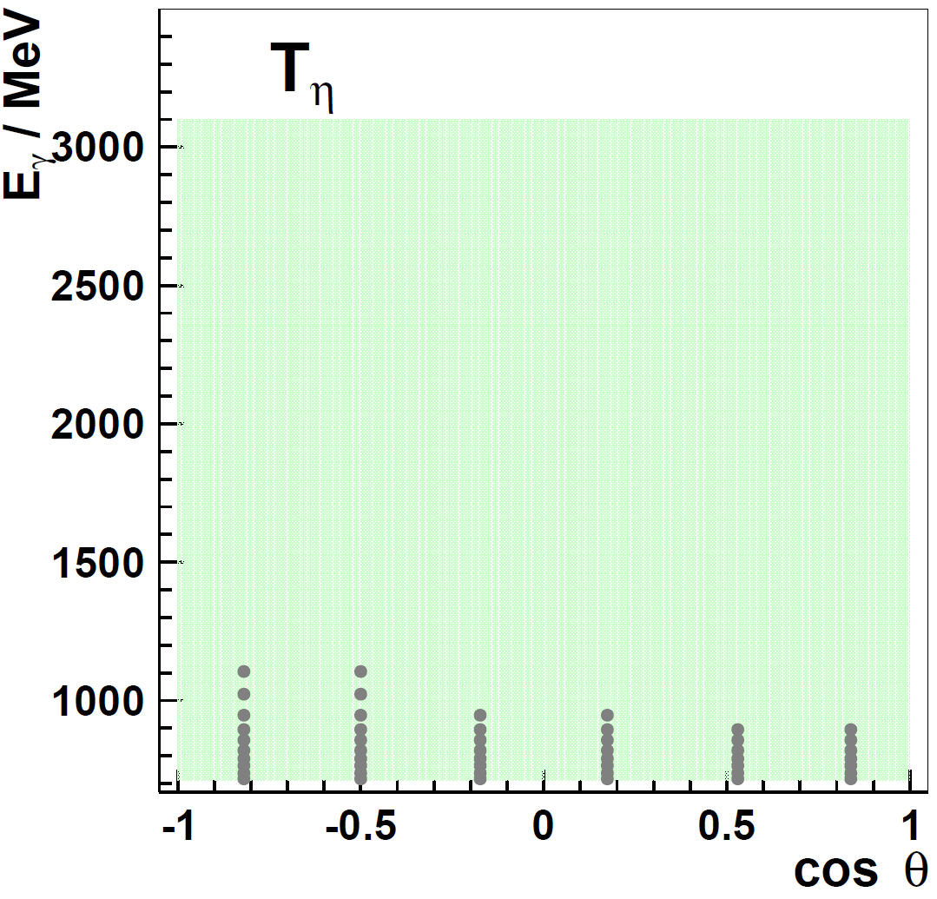
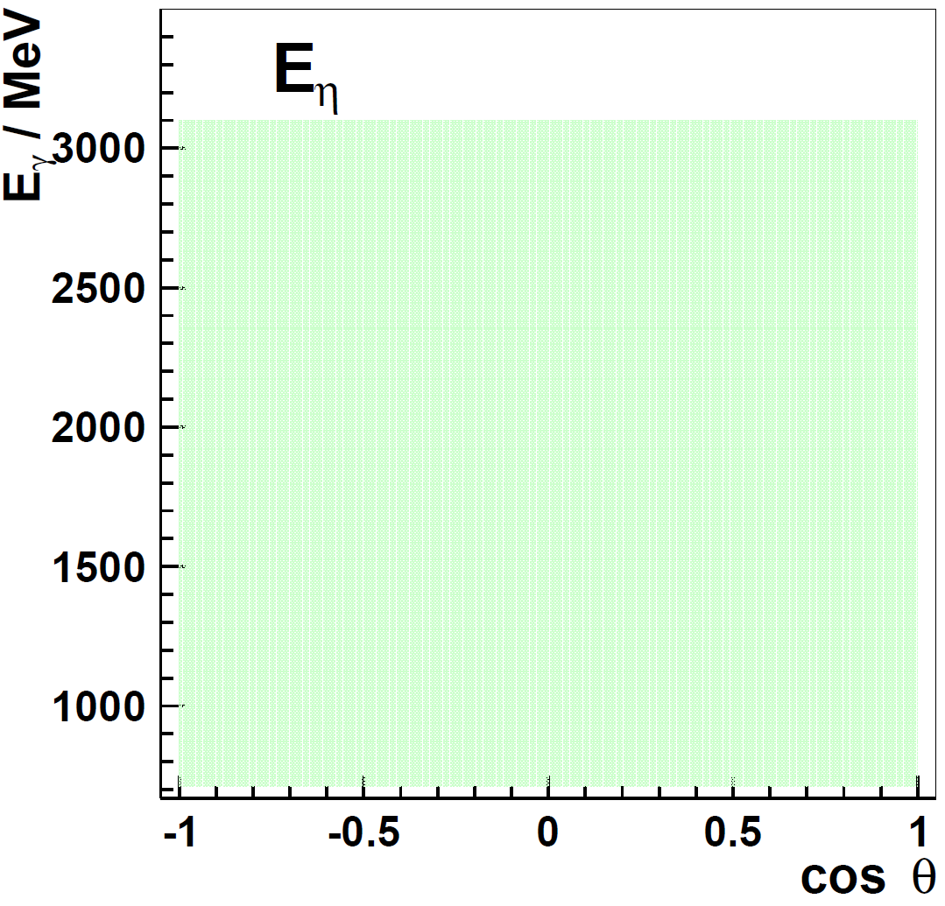
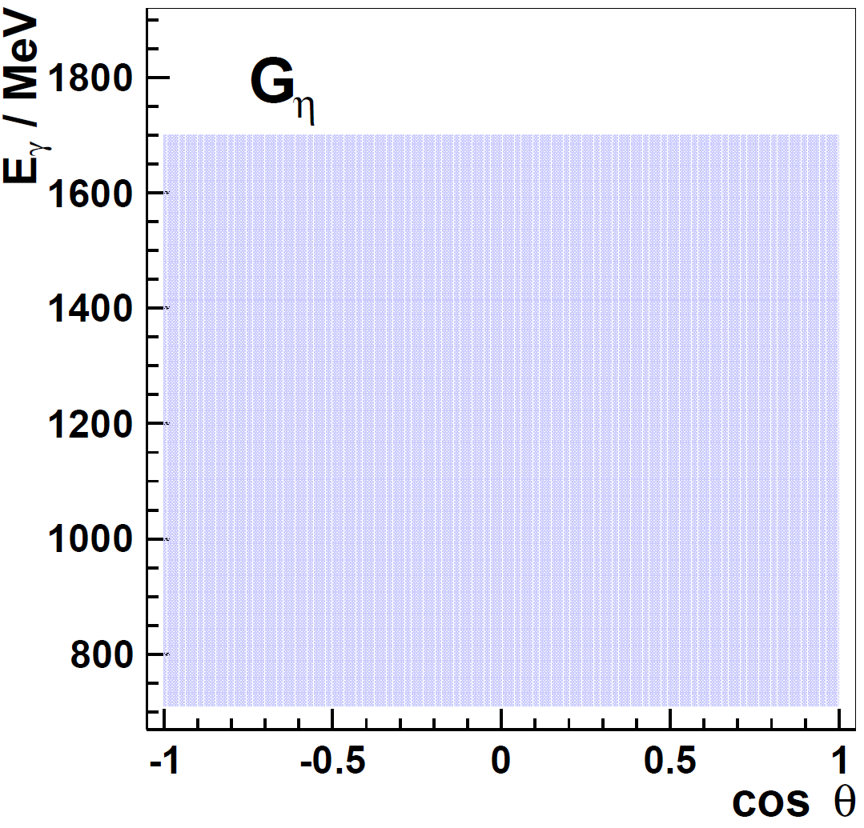
Results CBELSA/TAPS- Experiment
data base before
CBELSA/TAPS

Slide 16
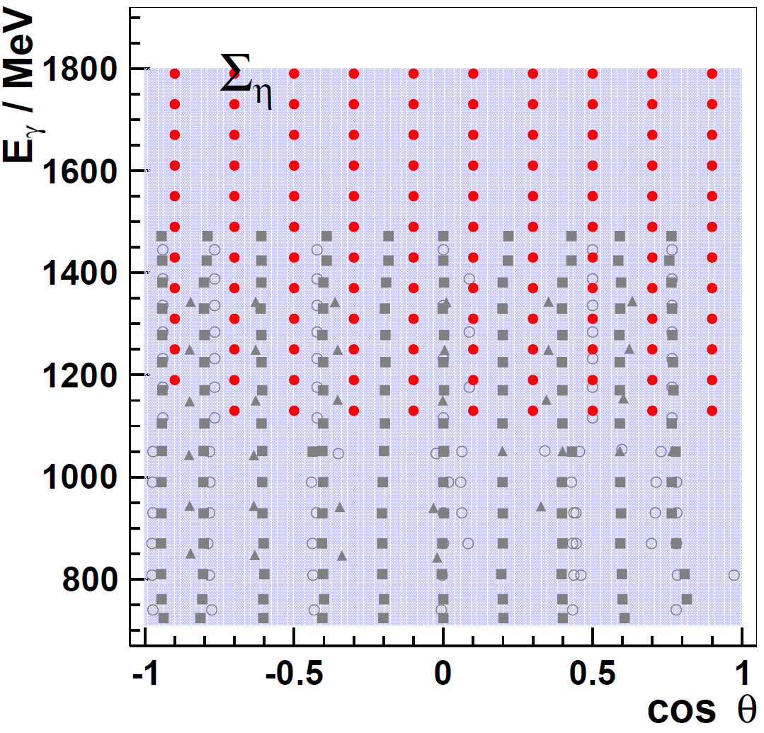
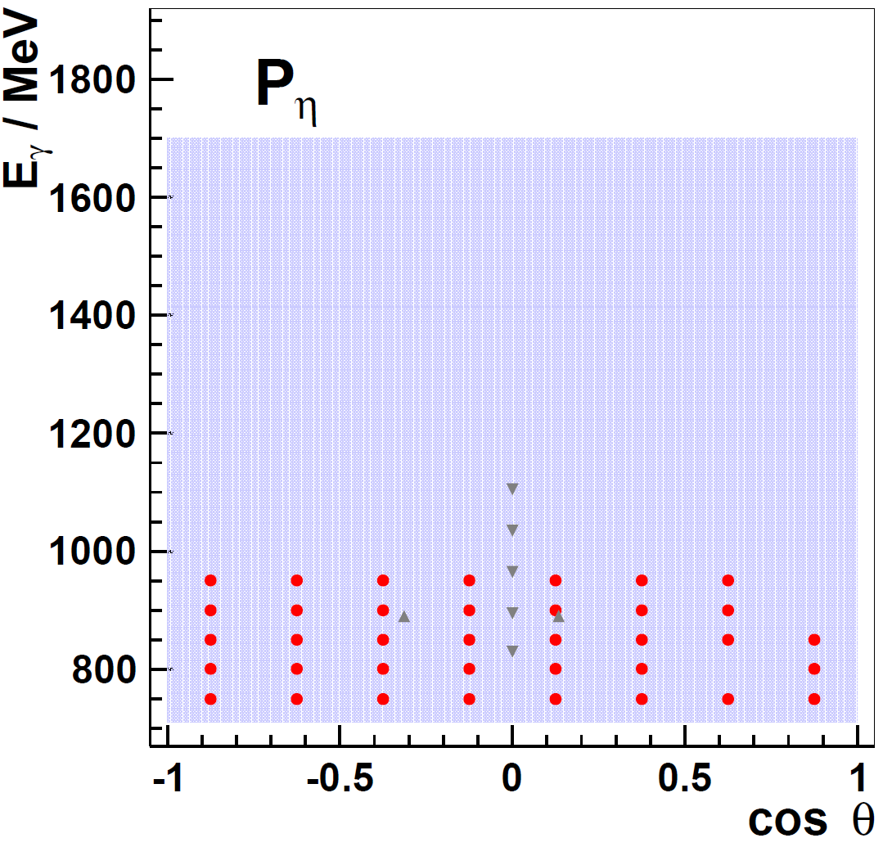
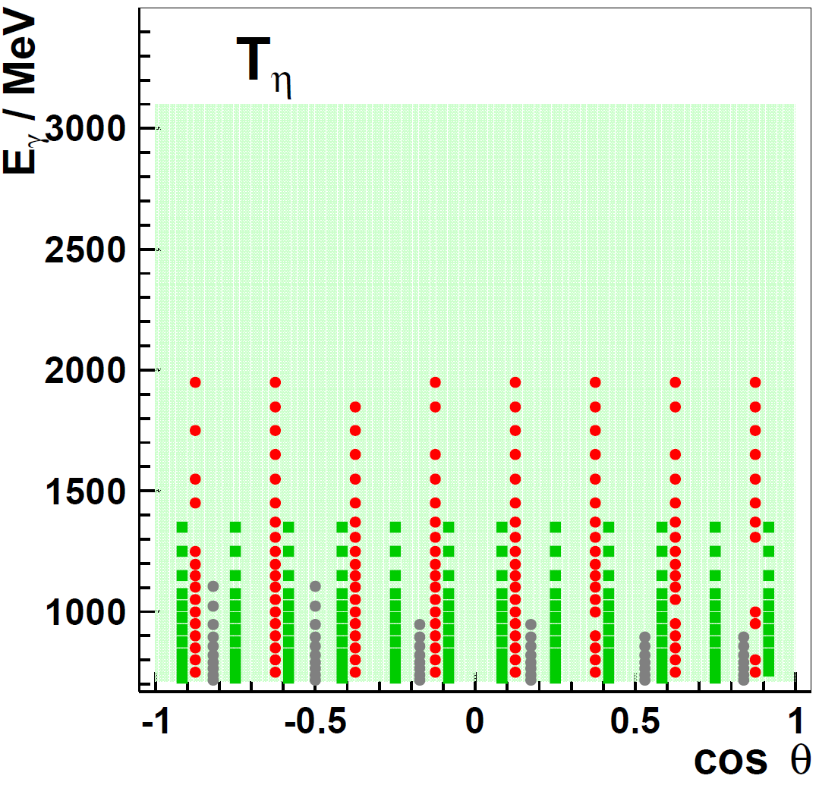
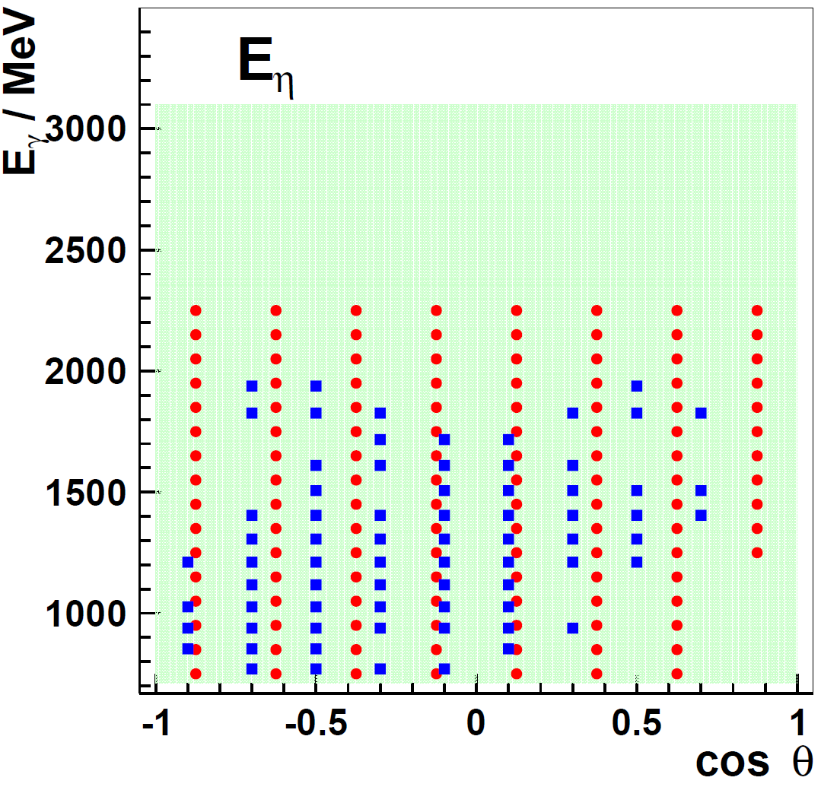
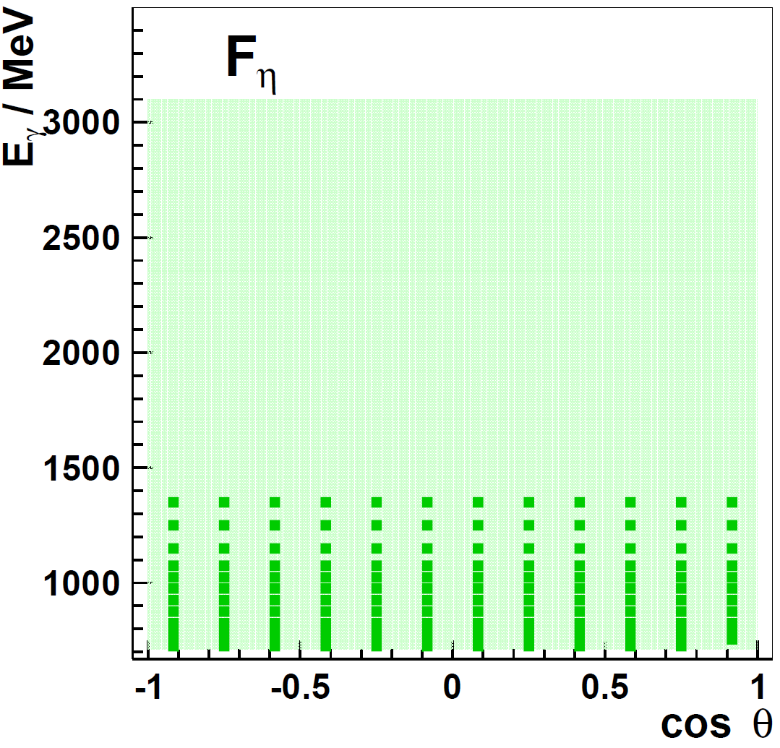
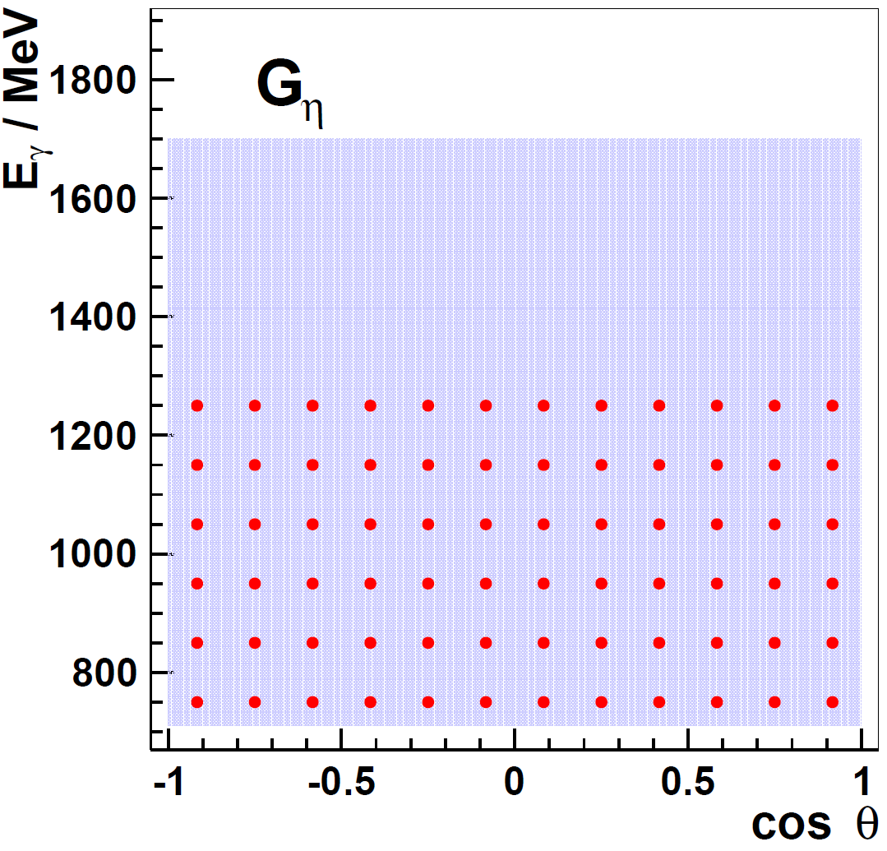
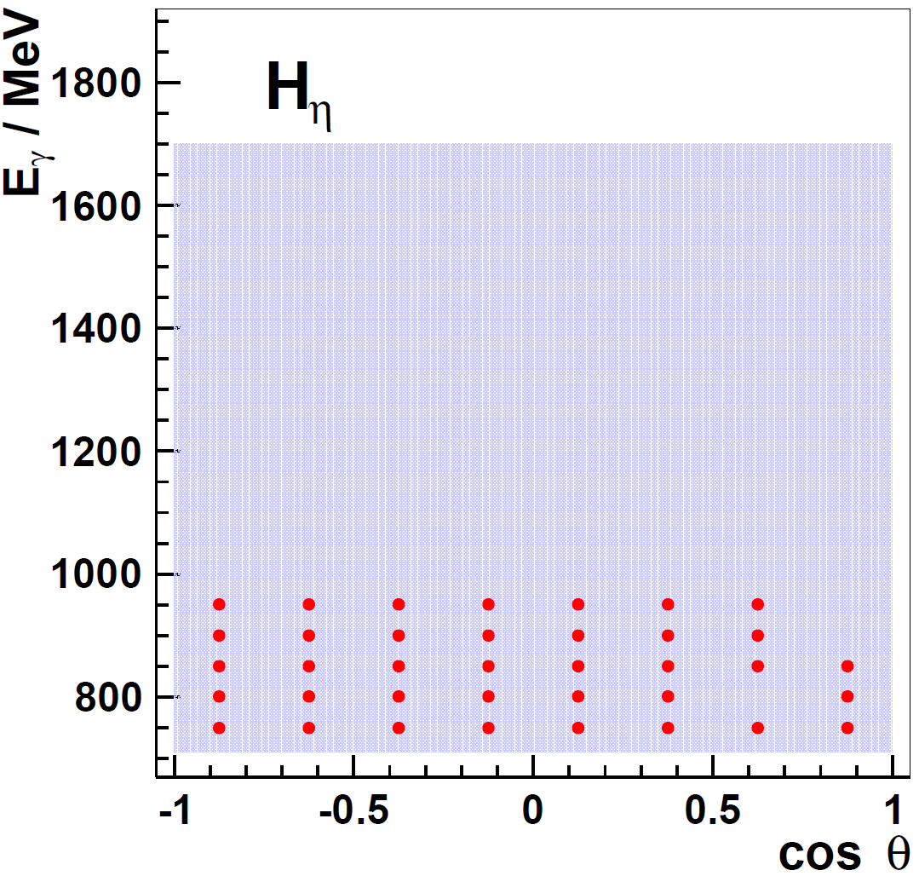
Results CBELSA/TAPS- Experiment
data base after
CBELSA/TAPS
JLab
MAMI

Slide 17
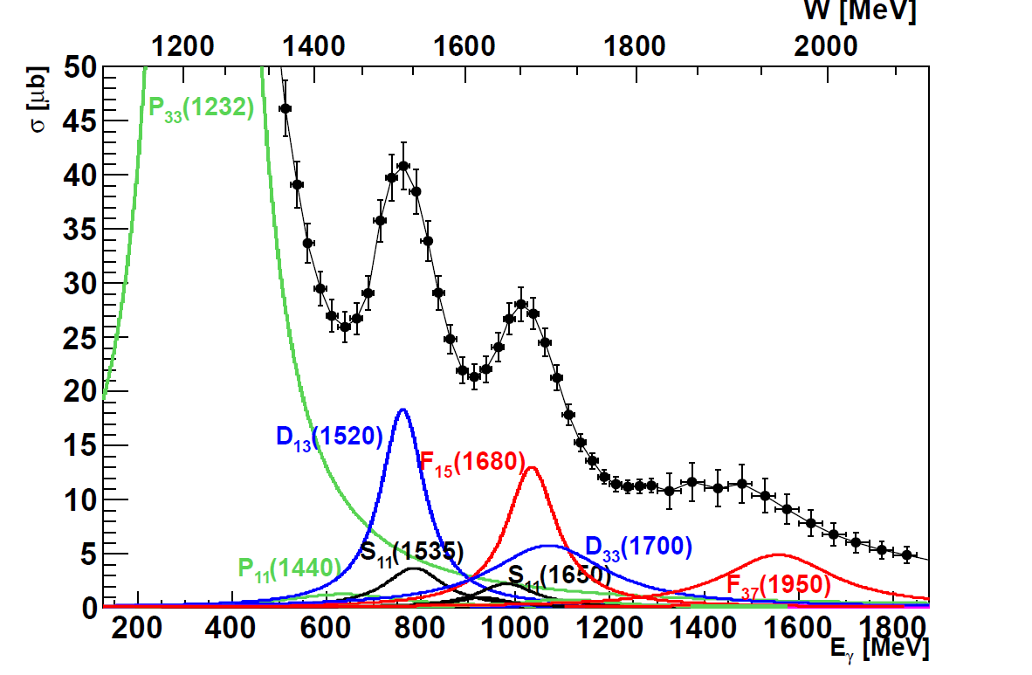
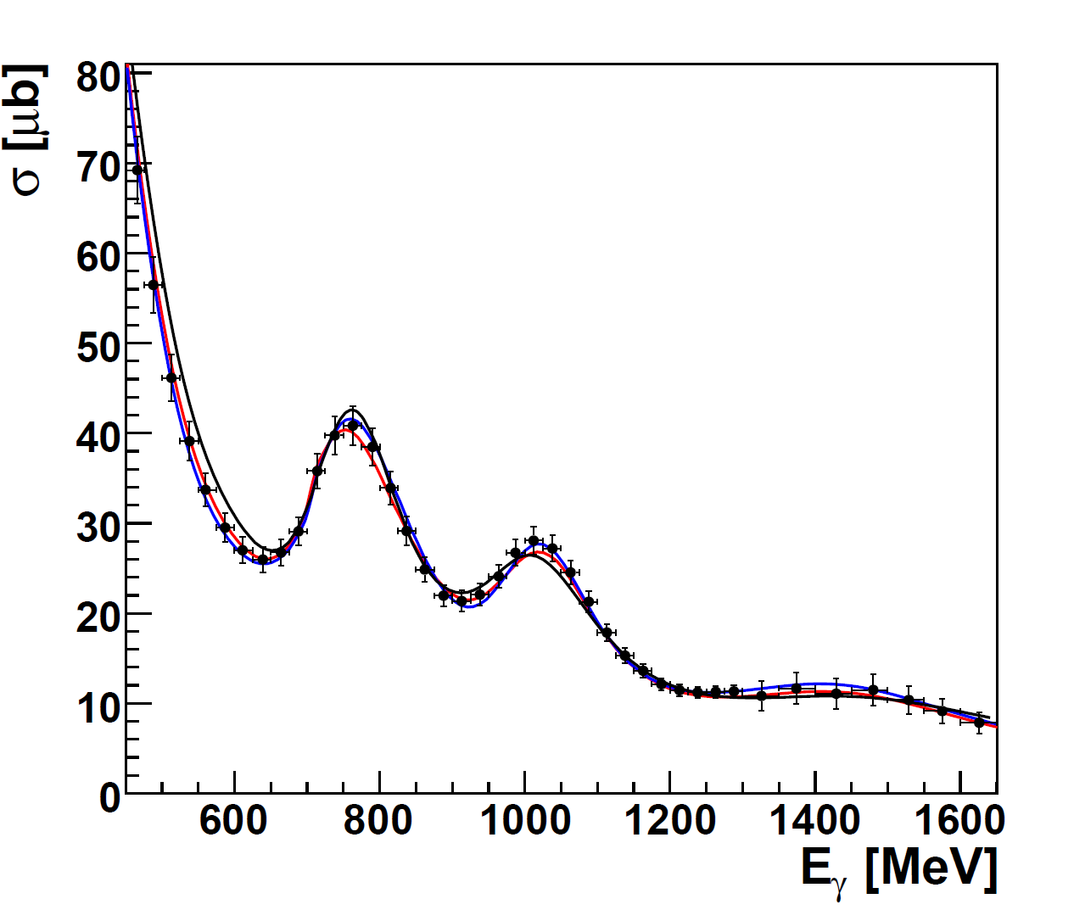
Problem with a Unique PWA Solution
2. resonance region
3. resonance region
Total cross section:
Partial wave analysis:
__ BnGa Bonn-Gatchina group
__ SAID Washington group
__ MAID Mainz group
Total cross section:
σ_{tot} ~ |A(P₃₃)|² + |A(D₁₃)|² + |A(F₁₅)|² + …..
no interferences between resonances

Slide 18
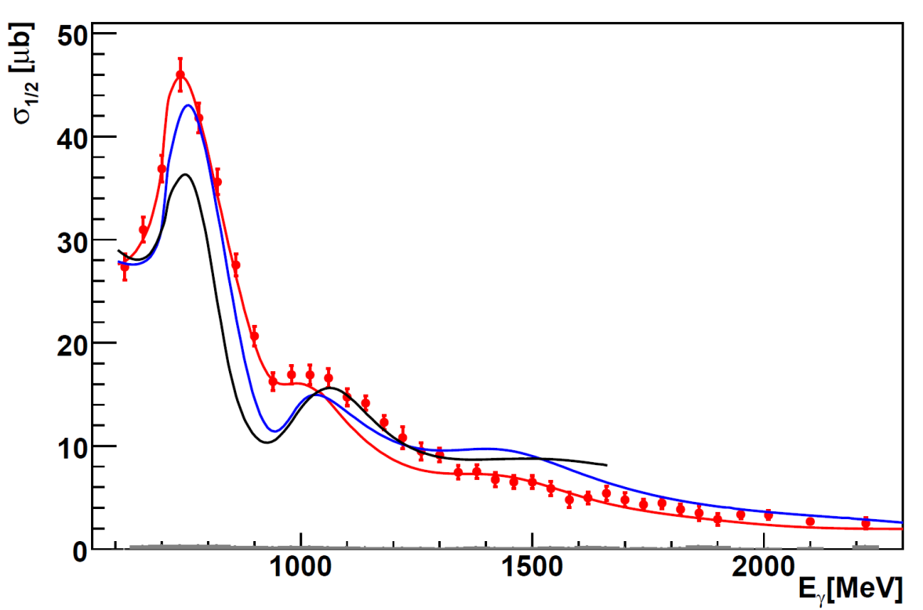
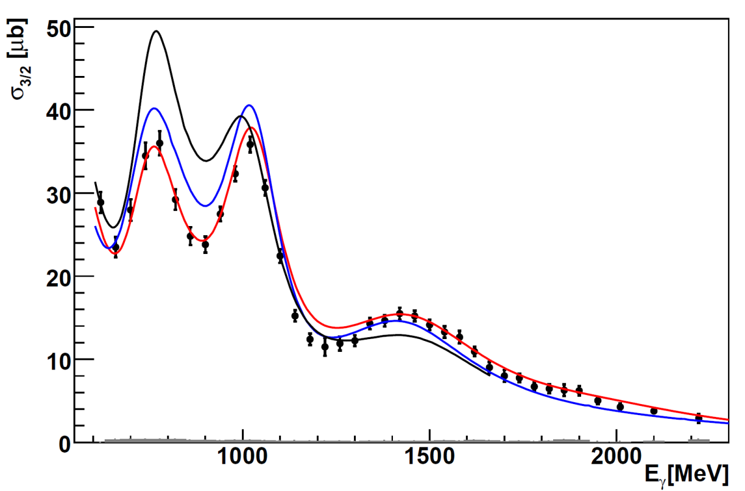
Helicity Dependent Cross Section for pπ⁰
reaction:
circularly polarized photons
longitudinally polarized proton
CBELSA/TAPS , M. Gottschall, PRL 112 (2014), 012003
σ_{1/2}
2. resonance region
σ_{3/2}
2. resonance region
3. resonance region
3. resonance region
4. resonance region
Helicity dependent cross section
σ_{1/2} ~ |A(P₃₃)|² + |A(D₁₃)|² + |A(F₁₅)|² + …..
+ Interference terms with same Lπ
like E₁₊ M₁₊ for P₃₃ or E₂₋ M₂₋ for D₁₃
4. resonance region
Partial wave analysis predictions :
__ BnGa
__ SAID
__ MAID

Slide 19
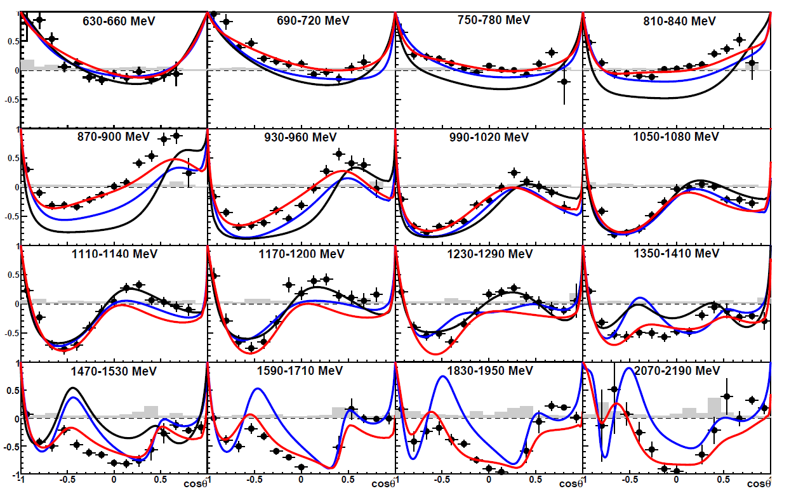
CBELSA/TAPS: Helicity Asymmetry E for pπ⁰
reaction:
CBELSA/TAPS, M. Gottschall, PRL 112 (2014), 012003
σ_{1/2} - σ_{3/2}
E =
σ_{1/2} + σ_{3/2}
Angular distributions
Sensitive to interference terms with different Lπ
Highest sensitivity to small resonance contributions
Partial wave analysis
prediction:
__ BnGa
__ SAID
__ MAID

Slide 20
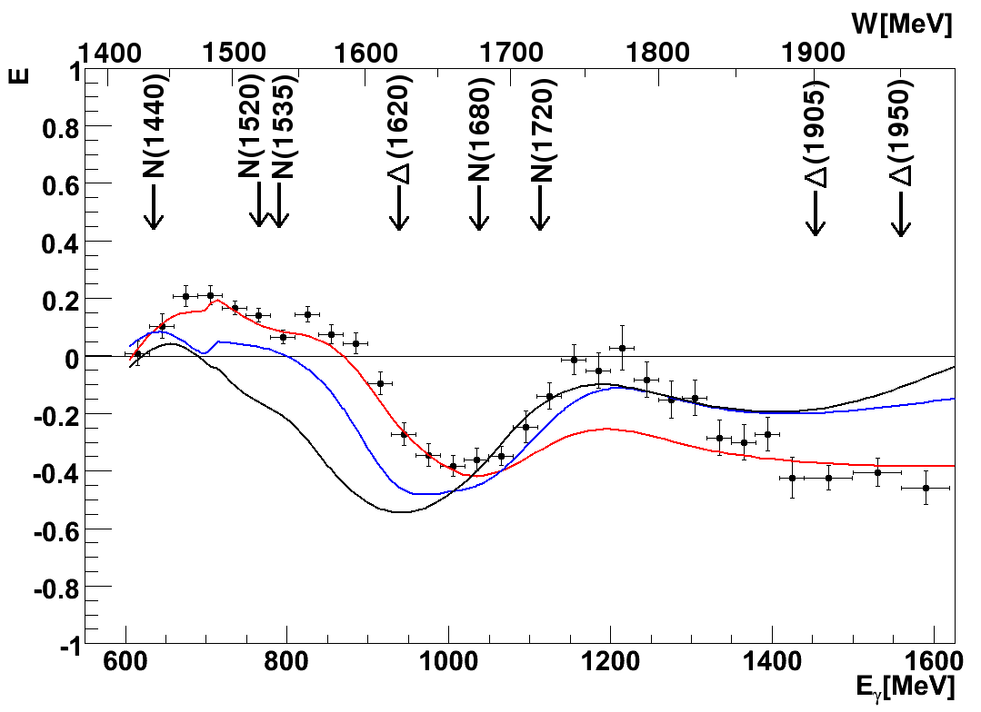
CBELSA/TAPS: Helicity Asymmetry E for pπ⁰
reaction:
σ_{1/2} - σ_{3/2}
E =
σ_{1/2} + σ_{3/2}
Partial wave analysis
prediction:
__ BnGa
__ SAID
__ MAID
PWA predictions fail already
in 2. resonance region

Slide 21
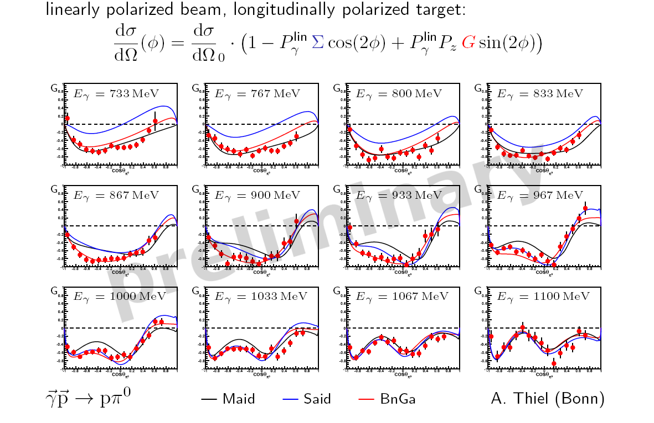
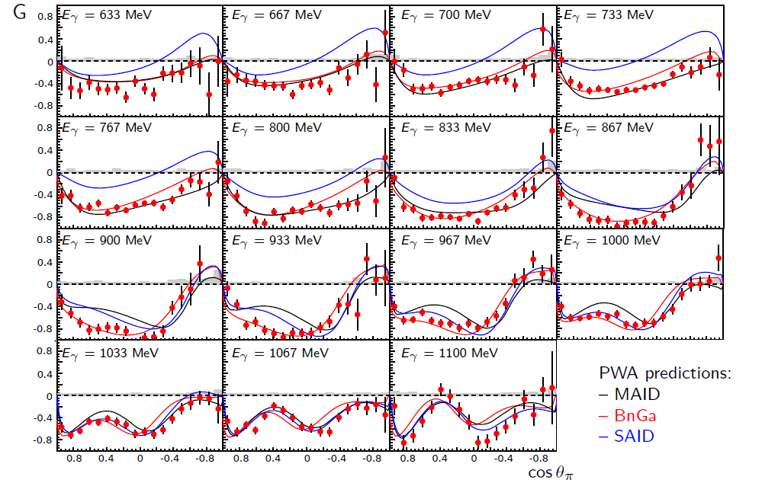
CBELSA/TAPS: Asymmetry G for pπ⁰
CBELSA/TAPS, A. Thiel, PRL 109 (2012), 102001

Slide 22
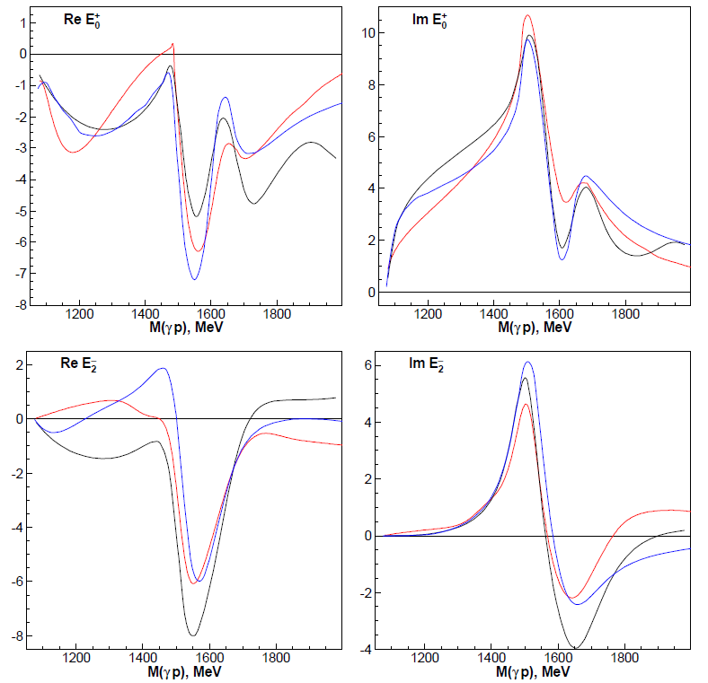
E₀₊ and E₂₋ Multipoles
Partial wave analysis:
____ BnGa
____ SAID
____ MAID
E₀₊ Multipole, S- wave
S₁₁(1535), S₁₁(1650) and S₃₁(1620)
E₂₋ Multipole, D- wave
D₁₃(1520) and D₃₃ (1700)
Polarization Observables necessary !
1.) Constrain energy dependence of multipoles
2.) Reliable extraction of resonance parameter
resonance + background contributions

Slide 23
Impact of the new polarization data
2. resonance region
3. resonance region
Which L_{max} is seen in the new polarization data ? −> Truncated partial wave analysis possible
L_{max} = 0 , S-wave , resonances in S-wave: S₁₁(1535) , S₁₁(1650) , S₃₁(1620)
L_{max} = 1 , P-wave , resonances in P-wave: P₁₁(1440) , P₁₃(1710) , P₃₃(1232) , P₃₁(?) ,
L_{max} = 2 , D-wave , resonances in D-wave: D₁₃(1520), D₁₅(1680), D₃₃(1700) , D₃₅(?),
L_{max} = 3 , F-wave , resonances in F-wave: F₁₅(1680) , F₁₇(?) , F₃₅(?) , F₃₇(1950)
L_{max} = 4 , G-wave , resonances in G-wave: G₁₇(?) , G₁₉(?) , G₁₇(?) , G₃₉(?)

Slide 24
L_{max} Interpretation of T- Asymmetry
for L ≤ 1 : only s- and p- waves
= $\frac{T · \frac{dσ}{dΩ}}{\sin^{1}{(θ)}}$ = A₀ + A₁$·cos{(θ)}$
for L ≤ 2 : only s-, p- and d- waves
= $\frac{T · \frac{dσ}{dΩ}}{\sin^{1}{(θ)}}$ = A₀ + A₁$·cos{(θ)}+A2{ ·cos}^{2}\left(θ\right)+$
A₃${ ·cos}^{3}\left(θ\right)$
for L ≤ 3 : only s-, p-, d- and f- waves
= $\frac{T · \frac{dσ}{dΩ}}{\sin^{1}{(θ)}}$ = A₀ + A₁$·cos{(θ)}+A2{ ·cos}^{2}\left(θ\right)+$
A₃${ ·cos}^{3}\left(θ\right)+\text{A}\text{4}{ ·cos}^{4}\left(θ\right)$ $+ A5·cos5{(θ)}$

Slide 25
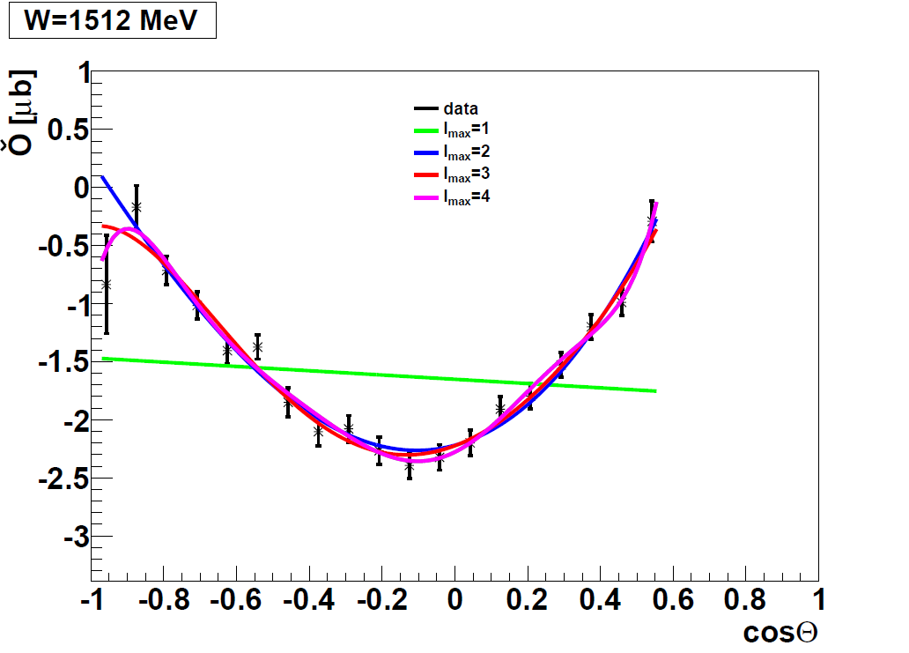
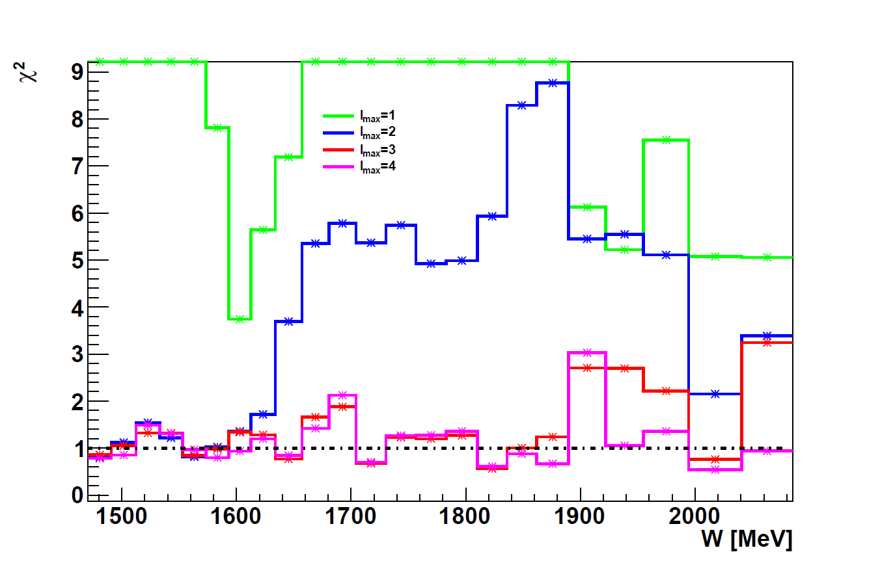
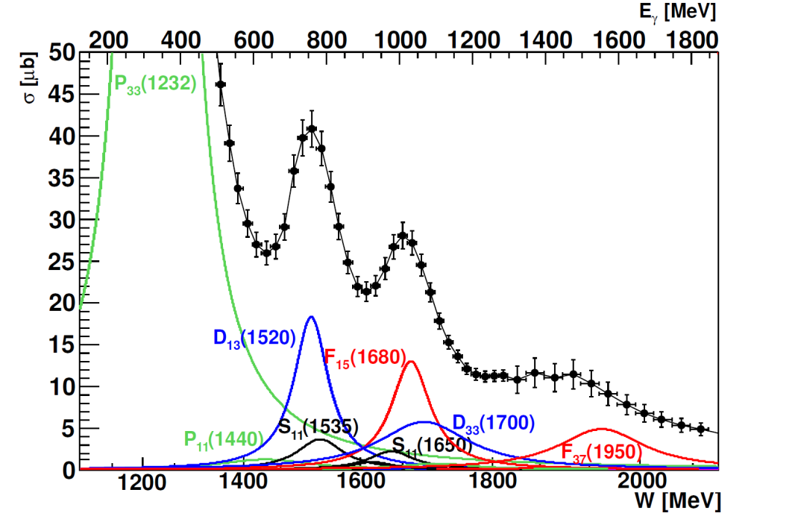
L_{max} Interpretation of T- Asymmetry
CBELSA/ELSA
Significant L = 3 signal seen
above W = 1500 MeV
Below L ≤ 2 seems to be sufficient
Some indication for L = 4 signal
above W = 1850 MeV
___ L_{max} = 1
___ L_{max} = 2
___ L_{max} = 3
___ L_{max} = 4

Slide 26
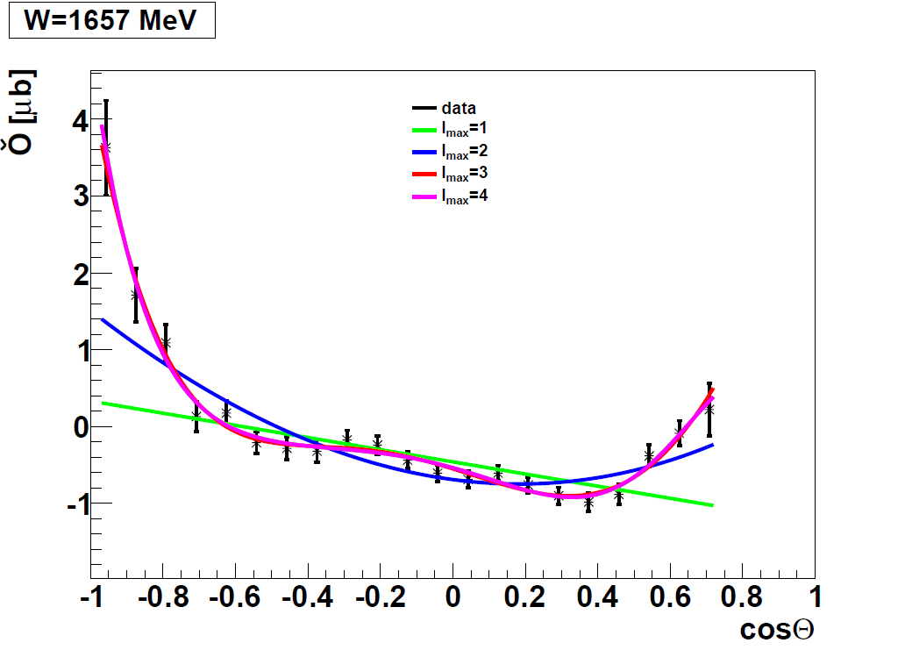
L_{max} Interpretation of T- Asymmetry
CBELSA/ELSA
Significant L = 3 signal seen
above W = 1500 MeV
Below L ≤ 2 seems to be sufficient
Some indication for L = 4 signal
above W = 1850 MeV
___ L_{max} = 1
___ L_{max} = 2
___ L_{max} = 3
___ L_{max} = 4

Slide 27
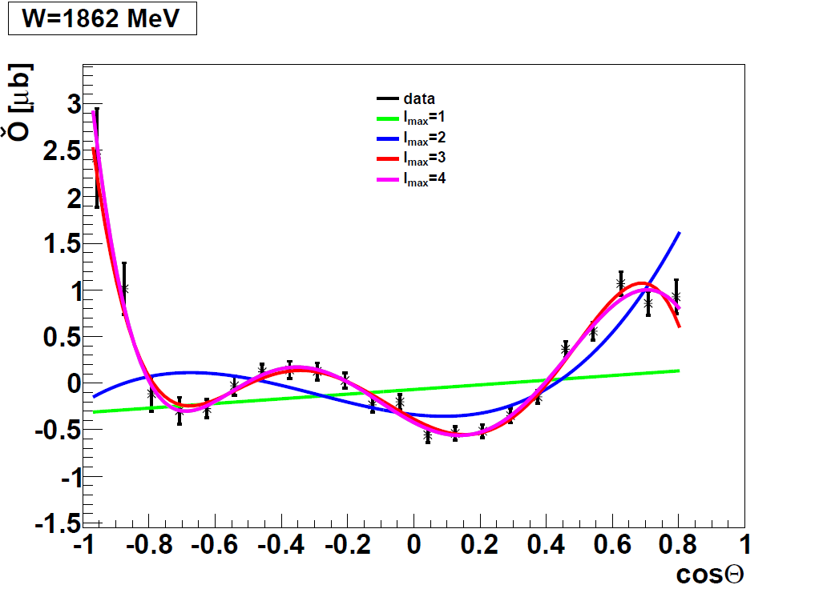
L_{max} Interpretation of T- Asymmetry
CBELSA/ELSA
Significant L = 3 signal seen
above W = 1500 MeV
Below L ≤ 2 seems to be sufficient
Some indication for L = 4 signal
above W = 1850 MeV
___ L_{max} = 1
___ L_{max} = 2
___ L_{max} = 3
___ L_{max} = 4

Slide 28
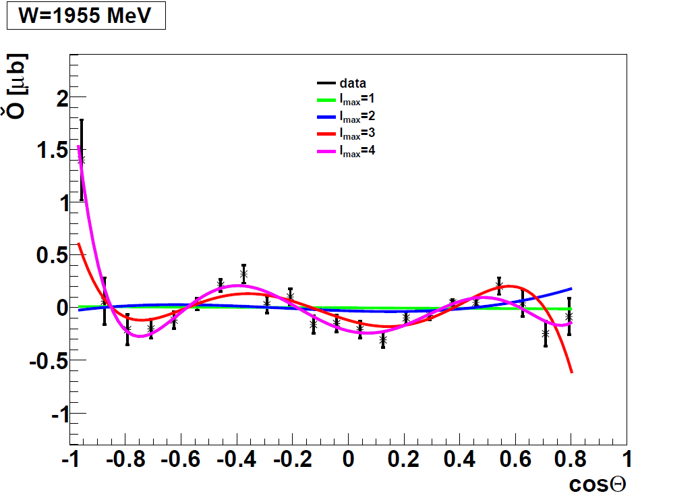
L_{max} Interpretation of T- Asymmetry
CBELSA/ELSA
Significant L = 3 signal seen
above W = 1500 MeV
Below L ≤ 2 seems to be sufficient
Some indication for L = 4 signal
above W = 1850 MeV
___ L_{max} = 1
___ L_{max} = 2
___ L_{max} = 3
___ L_{max} = 4

Slide 29
L_{max} Interpretation of T- Asymmetry
CBELSA/TAPS, J. Hartmann, PRL 113 (2014), 062001
CBELSA data
Precision data are necessary
- to be sensitive to large L contributions
- data sets with full angular coverage
- good angular resolution
___ L_{max} = 1
___ L_{max} = 2
___ L_{max} = 3
___ L_{max} = 4

Slide 30
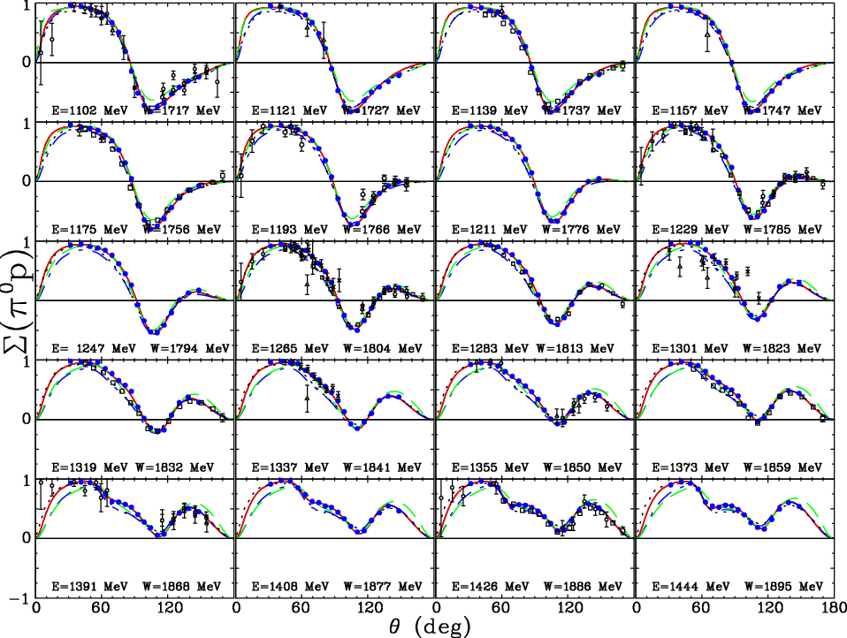
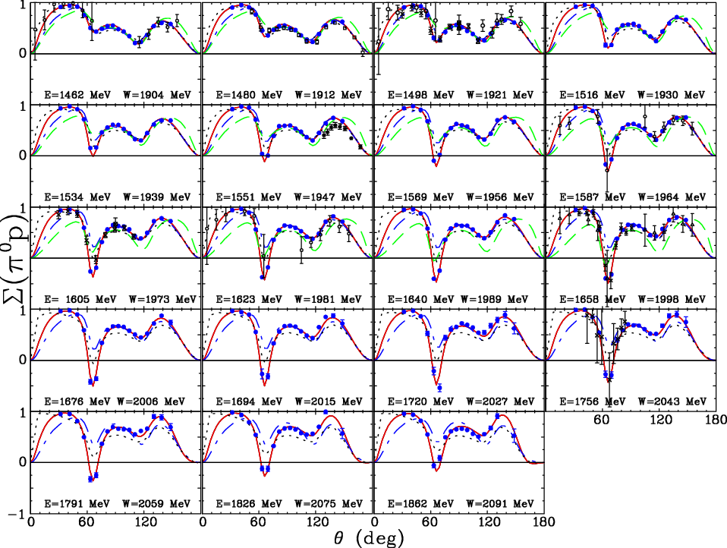
Σ-Asymmetry γ p −> p π⁰
DU12
CM12
MAID
BnGa
M. Dugger et al. Phys. Rev. C 88, 065203 (2013)

Slide 31
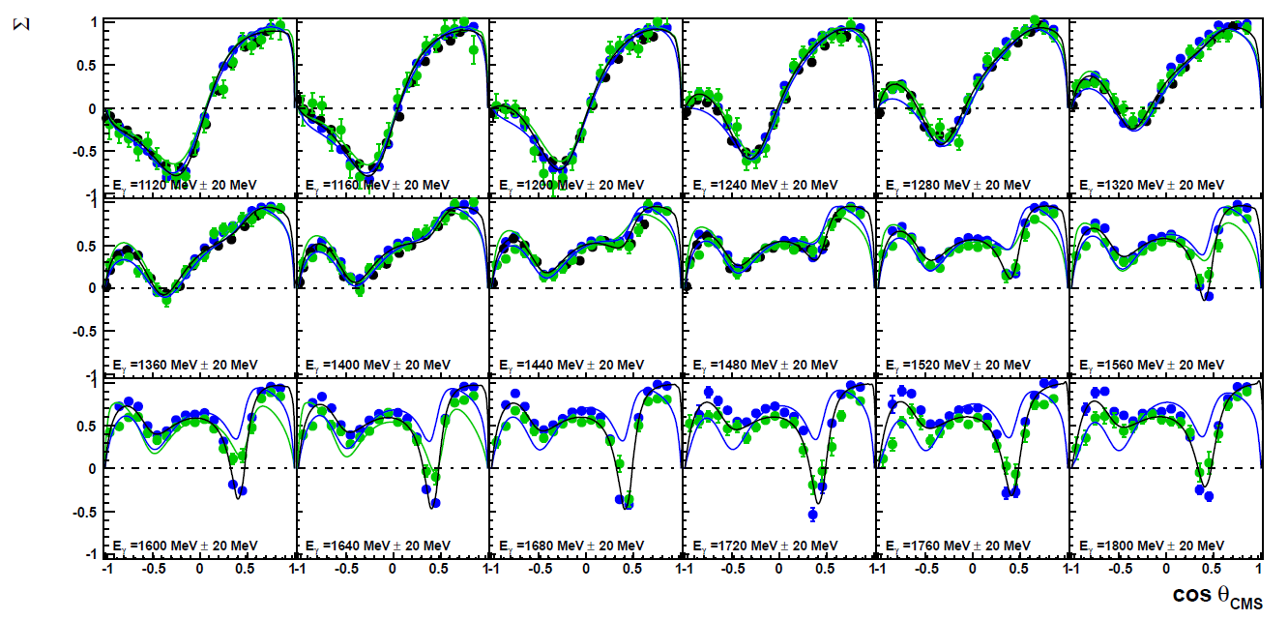
Σ-Asymmetry γ p −> p π⁰
DU12
CM12
MAID
BnGa
GRAAL : O. Bartallini et al. EPJ A 26, 399 (2005)
CLAS : M. Dugger et al. Phys. Rev. C 88, 065203 (2013)
CBELSA/TAPS (preliminary) : F. Afzal et al.
2013 hydrogen data with linearly polarized photons

Slide 32
L_{max} Interpretation of Σ- Asymmetry
Significant L = 3 signal seen
above W = 1500 MeV
Below L ≤ 2 seems to be sufficient
Some indication L = 4 signal
above W = 1750 MeV
GRAAL data
___ L_{max} = 1
___ L_{max} = 2
___ L_{max} = 3
___ L_{max} = 4

Slide 33
L_{max} Interpretation of Σ- Asymmetry
___ L_{max} = 1
Significant L = 3 signal seen
above W = 1500 MeV
Below L ≤ 2 seems to be sufficient
L = 4 signal above W = 1750 MeV
GRAAL data
___ L_{max} = 2
___ L_{max} = 3
___ L_{max} = 4

Slide 34
L_{max} Interpretation of Σ- Asymmetry
___ L_{max} = 1
GRAAL data
Significant L = 3 signal seen
above W = 1500 MeV
Below L ≤ 2 seems to be sufficient
L = 4 signal above W = 1750 MeV
___ L_{max} = 2
___ L_{max} = 3
___ L_{max} = 4

Slide 35
L_{max} Interpretation of Σ- Asymmetry
Significant L = 3 signal seen
above W = 1500 MeV
Below L ≤ 2 seems to be sufficient
L = 4 signal above W = 1750 MeV
GRAAL data
___ L_{max} = 1
___ L_{max} = 2
___ L_{max} = 3
___ L_{max} = 4

Slide 36
L_{max} Interpretation of Σ- Asymmetry
CBELSA/TAPS
CLAS
Significant L = 3 signal seen
above W = 1500 MeV
Below L ≤ 2 seems to be sufficient
L = 4 signal above W = 1700 MeV
___ L_{max} = 1
___ L_{max} = 2
___ L_{max} = 3
___ L_{max} = 4
High precision data for Σ from
CBELSA/TAPS
and CLAS

Slide 37
L_{max} Interpretation of Σ- Asymmetry
CBELSA/TAPS
CLAS
Significant L = 3 signal seen
above W = 1500 MeV
Below L ≤ 2 seems to be sufficient
L = 4 signal above W = 1700 MeV
___ L_{max} = 1
___ L_{max} = 2
___ L_{max} = 3
___ L_{max} = 4
___ L_{max} = 5
High precision data for Σ from
CBELSA/TAPS
CLAS

Slide 38
L_{max} Interpretation of Σ- Asymmetry
CBELSA/TAPS
CLAS
___ L_{max} = 1
Precision data are required
- for large L contributions
- full angular coverage and good angular resolution
- small systematic error in angular dependence
___ L_{max} = 2
___ L_{max} = 3
___ L_{max} = 4
___ L_{max} = 5

Slide 39
Impact of the new Polarization Data
New BnGa energy dependent multipole solution, impact of our new data in the full data base
____ BnGa_2011
- prediction
____ BnGa_2014
- with the new
polarization data
- new fit solution
BnGa_2014
Clear convergence seen !

Slide 40
Impact of the new Polarization Data
New BnGa energy dependent multipole solution, impact of our new data in the full data base
____ BnGa_2011
____ BnGa_2014
____ MAID
_ _ _ SAID_SN11
____ SAID_CM12
____ JüBn_2014
____ BnGa_2014
- with the new
polarization data

Slide 41
Impact of the new Polarization Data
____ BnGa_2011
____ BnGa_2014
____ MAID
_ _ _ SAID_SN11
____ SAID_CM12
____ JüBn_2014
New BnGa energy dependent multipole solution
including the new polarization data G,E,T,P and H
M1+ Multipole
M₁₊ Multipole
P₃₃(1232), P₃₃(1620) and P₁₃(1720)

Slide 42
Impact of the new Polarization Data
____ BnGa_2011
____ BnGa_2014
____ MAID
_ _ _ SAID_SN11
____ SAID_CM12
____ JüBn_2014
New BnGa energy dependent multipole solution
including the new polarization data G,E,T,P and H
E2+ Multipole
E₂₊ Multipole
D₁₅(1675)

Slide 43
Impact of the new Polarization Data
New polarization data G,E,T,P and H
included in the data base
Independent PWA- fits by BnGa, JüBo and SAID
Clear convergence between different PWA’s
Work together with:
JüBo: D. Rönchen, M. Döring
SAID: R. Workmann
BnGa: A. Sarantsev
Sum over 16 (complex) multipoles M up to L = 4
of their squared difference

Slide 44
Impact of the new Polarization Data
Independent PWA- fits
by BnGa, JüBo and SAID
Clear convergence between
different PWA’s
Work together with:
JüBo: D. Rönchen, M. Döring
SAID: R. Workmann
BnGa: A. Sarantsev
EPJA- publication accepted

Slide 45
Impact of the new Polarization Data
Multi-channel partial wave analysis, including data from
CLAS at Jlab, CB at ELSA, CB at MAMI and other labs
- confirm known resonances
- allow to search for new resonances
Results from meson- photoproduction do now enter the PDG
and determine the properties of baryon resonances
State | PDG 2010 | BnGa PWA | PDG 2014 | SAID PWA
N(1860) 5/2+ N(1875) 3/2- N(1880) 1/2+ N(1895) 1/2- N(1900) 3/2+ N(2060) 5/2- N(2150) 3/2- Δ(1940) 3/2- | ** * | * *** ** ** *** *** ** * | ** *** ** ** *** ** ** ** | no evidence no evidence

Slide 46
Impact of the new Polarization Data
____ PDG 2010
Status on nucleon-resonances (PDG 2014) :
(Isospin I = 1/2)
____ PDG 2014
New states have
been found

Slide 47
Summary
Precise double polarization data are coming out now from ELSA, Jlab and MAMI
- polarization observables are essential to get unique PWA- solution
- full angular coverage and precision is important to find high spin states
- different final states are important
Impact of the new polarization data, for example
- the new polarization data constrain the possible multipole solutions
- truncated partial wave analysis are possible
In the high W-mass region the final states
p η , p η‘ and K⁺ Λ , K⁺ Σ⁰ will be important
- the necessary precision in the data is still missing
New polarization data have to be analyzed by the different PWA groups
- better agreement in the energy dependence of the partial waves
- reduce systematic error and model dependence of resonance parameter extraction

Slide 48
Thank you for your attention

Slide 49
Experiments at ELSA
CBELSA/TAPS Set-Up
BGO-OD Set-Up
Talk: H. Schmieden B1 Project

