Slide 1
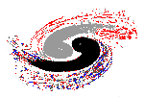



Institute of High Energy Physics
Threshold and kinematic effects for the exotic resonance-like structures
Qiang Zhao
Institute of High Energy Physics, CAS
and Theoretical Physics Center for Science Facilities (TPCSF), CAS
zhaoq@ihep.ac.cn
The 14th International Conference on Meson-Nucleon Physics and the Structure of the Nucleon, July 25-30, 2016, Kyoto, Japan

Slide 2
Outline
General features about the threshold phenomena in hadron spectra?
Definition of anomalous triangle singularity (ATS)
Recognition of ATS in physical processes in the study of exotic threshold structures
Summary

Slide 3
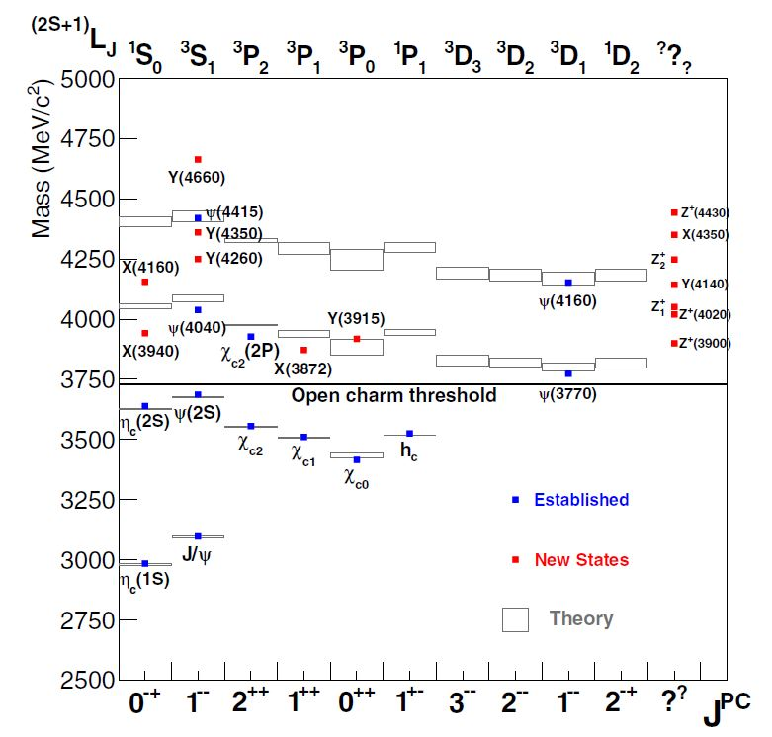
Charmonium Spectrum
S=0,1
c
‾c
L
J=L+S
New charmonium-like states, i.e. “XYZ” states, are observed in experiment

Slide 4
Charmonium Spectrum
Expected & Unexpected:
States below open-flavor thres. are well established.
A large number of excited states, i.e. XYZ states, cannot be accommodated by the conventional QM!
Full LQCD simulations are unavailable.

Slide 5
Some urgent questions:
Do we have indisputable evidence for exotic hadrons?
Do we have efficient and sufficient criteria for identifying exotic hadrons?
-- e.g. genuine states vs. kinematic effects ?
Where to look for exotic hadrons?
… …

Slide 6
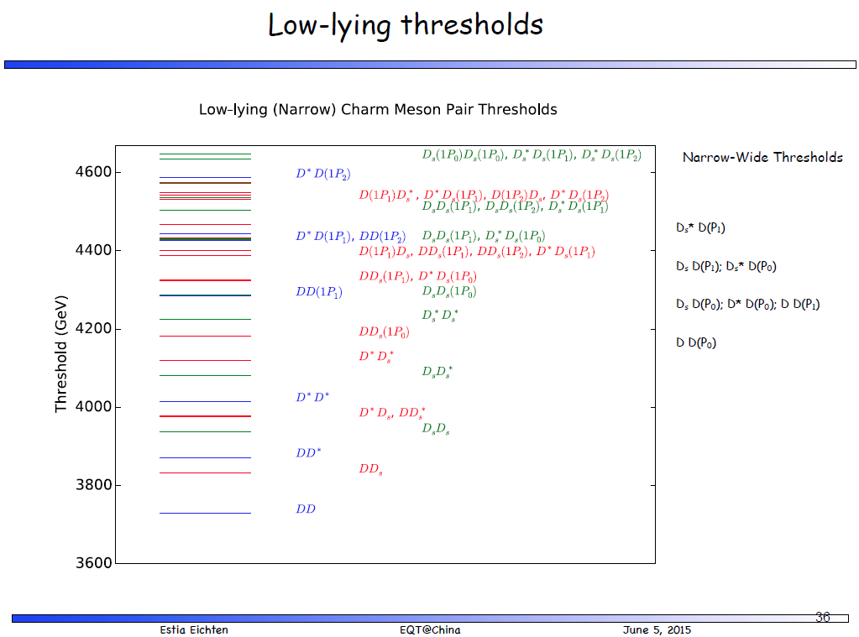

Slide 7
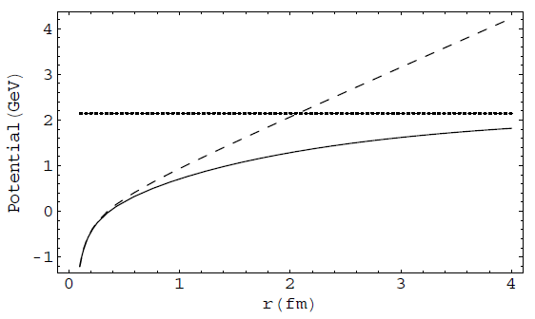
How the potential QM is broken down
V(r) = −κ/r + σ r
Linear conf.
‾qq creation
Coulomb
Color screening effects? String breaking effects?
The effect of vacuum polarization due to dynamical quark pair creation may be manifested by the strong coupling to open thresholds and compensated by that of the hadron loops, i.e. coupled-channel effects.
E. Eichten et al., PRD17, 3090 (1987)
B.-Q. Li and K.-T. Chao, Phys. Rev. D79, 094004 (2009);
T. Barnes and E. Swanson, Phys.Rev. C77, 055206 (2008)

Slide 8




Typical processes where the open threshold coupled channels can play a role
Y.J. Zhang et al, PRL(2009);
X. Liu, B. Zhang, X.Q. Li, PLB(2009)
Q. Wang et al. PRD(2012), PLB(2012)
“ρπ puzzle”
X.-H. Liu et al, PRD81, 014017(2010);
X. Liu et al, PRD81, 074006(2010)
Q. Wang et al, PRD2012
G. Li and Q. Zhao, PRD(2011)074005
F.K. Guo, C. Hanhart, G. Li, U.-G. Meissner and Q. Zhao, PRD82, 034025 (2010); PRD83, 034013 (2011)
F.K. Guo and Ulf-G Meissner, PRL108(2012)112002
The mass shift in charmonia and charmed mesons, E.Eichten et al., PRD17(1987)3090
X.-G. Wu and Q. Zhao, PRD85, 034040 (2012)

Slide 9
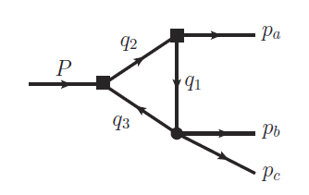
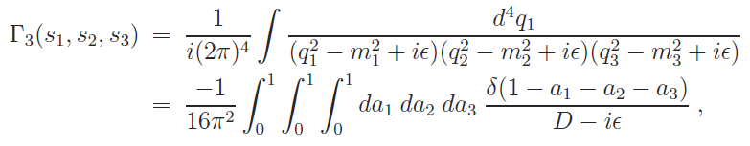



Special kinematic effects from anomalous triangle singularity (ATS)
The ATS occurs when all the three internal particles can be simultaneously on shell. It corresponds to
for all j=1,2,3.
L. D. Landau, Nucl. Phys. 13, 181 (1959).
G. Bonnevay, I. J. R. Aitchison and J. S. Dowker, Nuovo Cim. 21, 3569 (1961).
R.F. Peierls, Phys. Rev. Lett. 6 (1961) 641.
S. Coleman, R.E. Norton, Nuovo Cimento 38 (1965) 438.
P. Landshoff, S. Treiman, Phys. Rev. 127 (1962) 649.
C. Schmid, Phys. Rev. 154 (1967) 1363.

Slide 10



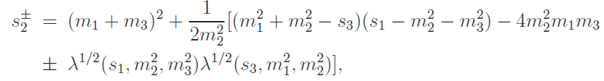
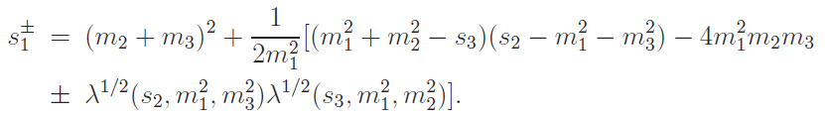

Kinematics :
The ATS condition for fixed s₁, m_{j}, and s₃ is:
Or for fixed s₂, m_{j}, and s₃ :
X.-H. Liu, M. Oka and Q. Zhao, PLB753, 297(2016); arXiv:1507.01674 [hep-ph]

Slide 11
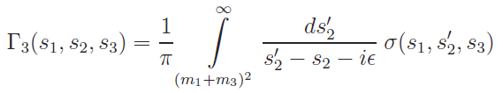

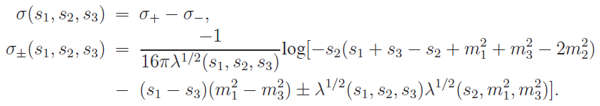
Single dispersion relation in s₂ in the complex plane of s₂′:
The spectral function σ(s₁, s₂, s₃) can be obtained by means of the Cutkosky’s rules (absorptive part of the loop amplitude):
which reads

Slide 12


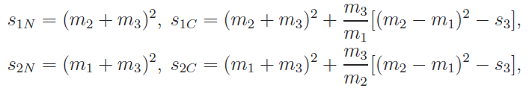
For fixed s₁, s₃ and m_{i}, the spectral function σ(s₁, s₂, s₃) has logarithmic branch points s±₂ , which correspond to the anomalous thresholds by solving the Landau equation.
How the logarithmic branch points s±₂ move as s₁ increases from the threshold of (m₂ + m₃)², with s₃ and m_{i} fixed?
Substituting s₁→s₁+iε, s±₂ in the s′-plane are then located at
With
the normal and critical thresholds for s₁ and s₂ can be determined:

Slide 13
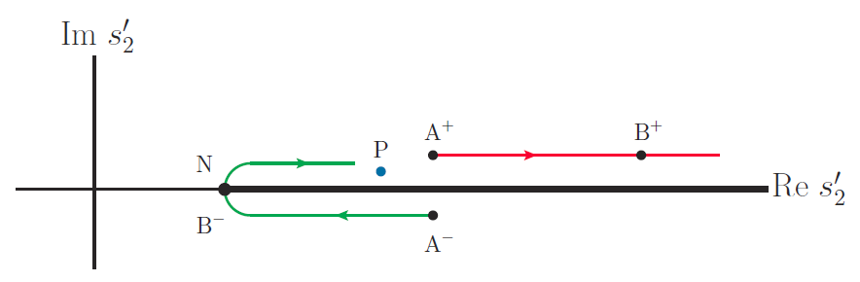
Trajectories of s±₂ in the complex s′₂-plane with
s₁ increasing from s_{1N} → ∞:
A⁺ :(s₁=s_{1N}, s₂⁺=s_{2C} +iε) → B⁺ :(s₁=s_{1C}, s₂⁺=s_{2N}+m₃ λ(s₃,m₁²,m₂²)/(m₁m₂)+iε)
A⁻ :(s₁=s_{1N}, s₂⁻=s_{2C} −iε) → B⁻ :(s₁=s_{1C}, s₂⁻=s_{2N})
s₂
P :

Slide 14
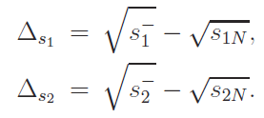
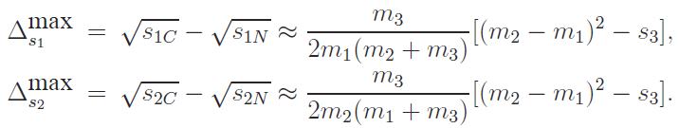
The difference between the normal and anomalous thresholds decides the kinematic range of the ATS effects:
When s₂=s_{2N} (s₁=s_{1N}), we will obtain the maximum value of Δs₁ (Δs₂ ),
Larger values of Δ_{s}^{max} means more significant effects from the ATS mechanism!

Slide 15
Physical cases for recognizing the ATS
(I) S-wave open flavor threshold in vector channel
Parallel talk by Si-Run Xue: B-2/26-M-1, July 26, 2016

Slide 16
Zc(3900) production in Y(4260) decays
e⁺
π
Y(4260)
π
ψ(4415)
e⁻
Y(4360)
D*‾D₁
Zc(3900)
J/ψ
Charmonium spectrum
Y(4260)
D‾D₁
At least 4 quarks !
ψ(4160)
π
ψ(4040)
Zc(3900)
D‾D*
ψ(3770)
D‾D
ψ′(3686)
π
J/ψ
J^{PC} = 1⁻⁻

Slide 17
Y(4260) could be a hadronic molecule made of DD₁(2420)
“threshold state”
D₁(2420)
Y(4260), 1⁻⁻
Y(4260)
DD*π
Y(4260)
DD₁(2420)
W= 4020 MeV
W= 4289 MeV
‾D(1868)
D1
π
D*
D
π
J/ψ (hc)
Zc(3900) can be dynamically generated.
The peak can also obtain contributions from the ATS mechanism.
Test of Schmid theorem?
Q. Wang, C. Hanhart, Q.Z., PRL111, 132003 (2013); PLB(2013)
W. Qin, S.R. Xue, Q.Z., arXiv:1605.02407[hep-ph]

Slide 18
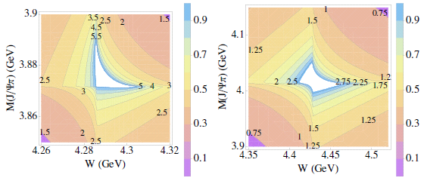
Singularity kinematics in e⁺e⁻→Y(4260) → J/ψππ
D1
π
D*
π
D
π
π
Zc
J/ψ
J/ψ
Γ(D₁(2420) )= 27 MeV
Γ(D^{*0}) = 190 keV
Q. Wang, C. Hanhart, Q. Zhao, PLB2013; arXiv: 1305.1997[hep-ph];
Liu, Oka, and Q. Zhao, PLB2016; arXiv: 1507.01674[hep-ph]

Slide 19
Singularity kinematics in e⁺e⁻→ Υ(nS) ππ
Two singularity regions by the BB* and B*B* thresholds can appear in the same c.m. energy in the Υ(6S) decays. Two peaks are expected!
Q. Wang, C. Hanhart, Q. Zhao, PLB2013; arXiv: 1305.1997[hep-ph]

Slide 20
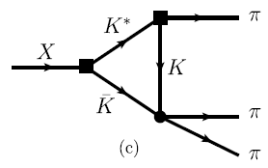
(II) The η(1405)/η(1475) puzzle, and f₁(1420)/a₁(1420) problem
Parallel talk by Si-Run Xue: B-2/26-M-1, July 26, 2016

Slide 21
The nonet structure repeats itself in the radial excitations in the ‾qq meson scenario.
S
K⁰
K⁺ (1460)
The abundance of 0⁻⁺ (I=0) states implies a glueball candidate?
Positive: Flux tube model favors M_{G}≅ 1.4 GeV
Caveat: LQCD (quenched) favors M_{G}≅ 2.4 GeV
More problems arising from 3 η scenario!
+1
1st radial excitation
I₃
–1
+1
π–
π⁰, η(1295), η(1475)
π⁺(1300)
−1
K⁻(1460)
‾K⁰(1460)

Slide 22
Isospin-violating decay of J/ψ → γπππ
γ
π
J/ψ
π
η(1405/1475)
f0(980)
π
BES-III Collaboration, Phys. Rev. Lett. 108, 182001 (2012)
See also plenary talk by S.S. Fang

Slide 23
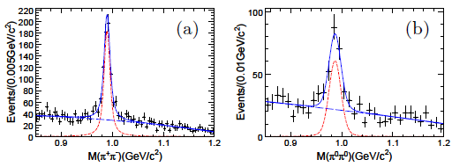
K⁺ K⁻
K⁰‾K⁰
f₀(980) is extremely narrow: Γ ≅ 10 MeV !
PDG: Γ ≅ 40~100 MeV.
Anomalously large isospin violation!
≅

Slide 24
“a₀(980)-f₀(980) mixing”gives only 1% isospin violation effects！
π
K⁰ (K⁺)
π
η(1405)
g(a₀K⁺K⁻) g(f₀K⁺K⁻)
= −g(a₀K⁰‾K⁰) g(f₀K⁰‾K⁰)
M(K⁰)−M(K±) = m_{d}−m_{u}
a₀(980)
f₀(980)
π
I=1
‾K⁰ (K⁻)
I=0
“Triangle singularity”
Internal‾KK*(K) approach the on-shell condition simultaneously!
f₀(980)
K*
π
K⁺ K⁻
K⁰‾K⁰
η(1405/1475)
K
π
‾K
f₀(980)
π
A novel isospin breaking mechanism!

Slide 25
Triangle loop amplitudes:
Absorptive amplitudes
Dispersive amplitudes

Slide 26
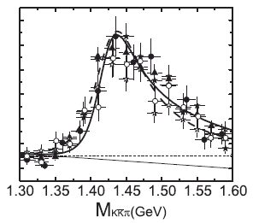
η(1440) → K‾K π decay mechanism:
Data from Mark III, BES-I, and DM2
J.J. Wu, X.H. Liu, Q.Z. and B.S. Zou, PRL(2012)

Slide 27
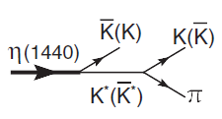
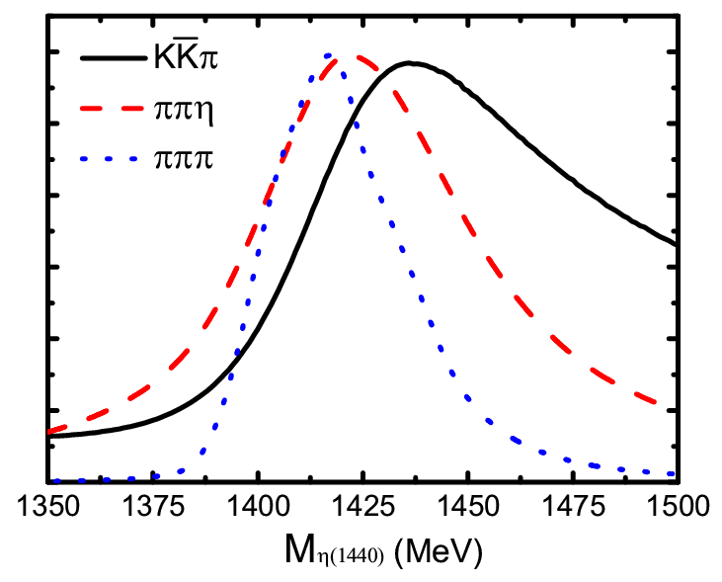
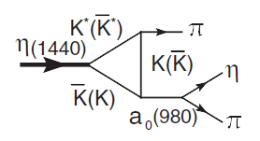
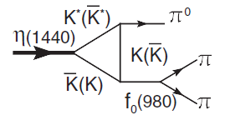
So far, BESIII do not see two peak signals in any exclusive process.
The same state has different peak positions and lineshapes in different decay channels.
η(1405) and η(1475) are likely to be the same state.

Slide 28

Where to look for pseudoscalar glueball candidate?
Pure gauge LQCD: M_{G}≅ 2.4 GeV

Slide 29
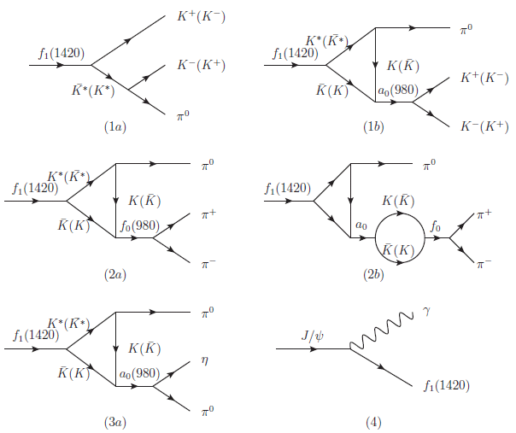
The puzzle of f₁(1420) and a₁(1420)
Relative S wave

Slide 30
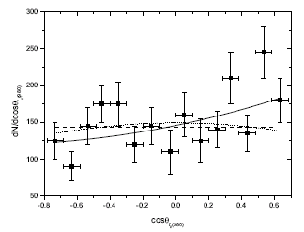
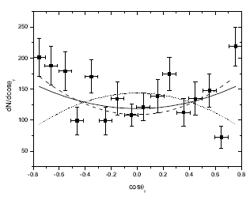
Partial wave analysis of J/ψ → γ η(1405)/f₁(1420) → γ πππ
Dashed: eta(1440)
Dotted: f1(1420)
Solid: eta(1440) + f1
BESIII results:

Slide 31
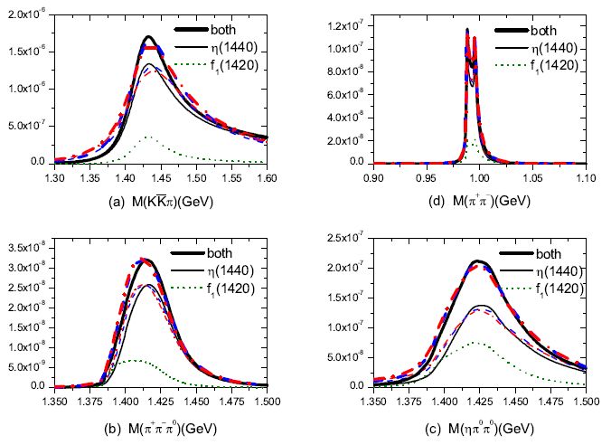

Slide 32
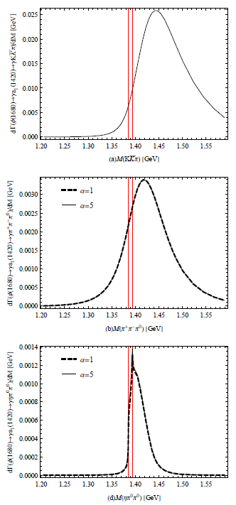
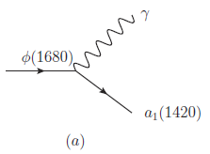
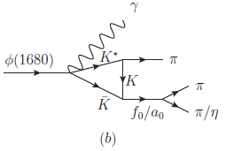
Implication of existence of a₁(1420) in isospin 1 channel
Due to the “triangle singularity”, the same “state” produces different resonance-like lineshapes in different channels!

Slide 33

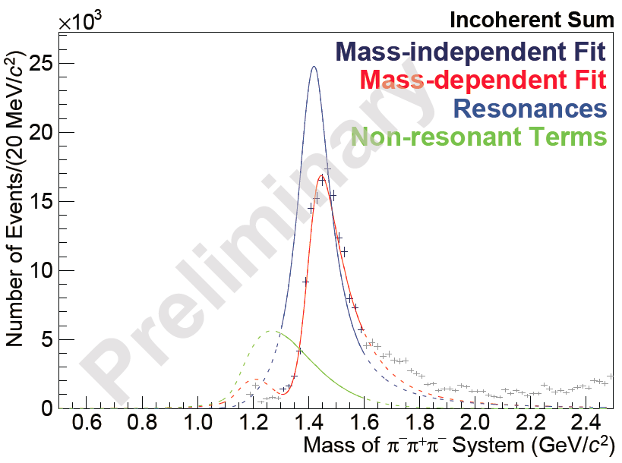
Observation of a new state a₁(1420) at COMPASS

Slide 34
(III) The heavy pentaquark Pc(4380) and Pc(4450) production
Parallel talks by Feng-Kun Guo: C-4/27-PQ-2,
and Xiao-Hai Liu in the same session, July 27, 2016

Slide 35
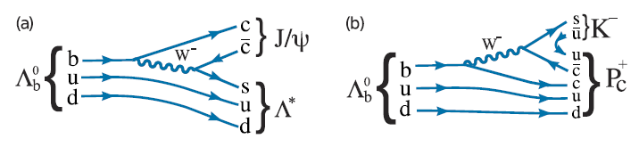

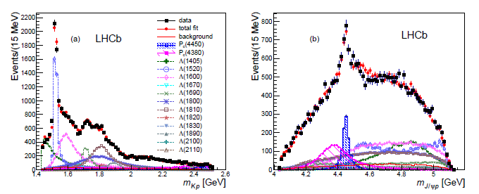
Exp. evidence for heavy pentaquarks with hidden charm
M[Pc⁺(4380)] = (4380±8±29) MeV, Γ= (205±18±86) MeV
M[Pc⁺(4450)] = (4449.8±1.7±2.5) MeV, Γ=(39±5±19) MeV
J^{P} = (3/2⁻, 5/2⁺) or (3/2⁺, 5/2⁻)

Slide 36
Some early studies:
J. J. Wu, R. Molina, E. Oset and B. S. Zou, Phys. Rev. Lett. 105, 232001 (2010) [arXiv:1007.0573 [nucl-th]].
J. J. Wu, R. Molina, E. Oset and B. S. Zou, Phys. Rev. C 84, 015202 (2011) [arXiv:1011.2399 [nucl-th]].
J. J. Wu, T.-S. H. Lee and B. S. Zou, Phys. Rev. C 85, 044002 (2012) [arXiv:1202.1036 [nucl-th]].
Z. C. Yang, Z. F. Sun, J. He, X. Liu and S. L. Zhu, Chin. Phys. C 36, 6 (2012) [arXiv:1105.2901 [hep-ph]].
See also plenary talk by B.S. Zou on July 28, and talks in parallel session A-3/26-PQ-1 by E. Oset, E. Santopinto, S. Takeuchi.
Alternative solutions? Or some further concerns?
Threshold enhancement produced by anomalous triangle singularity:
F.-K. Guo, U.-G. Meissner, W. Wang, and Z. Yang, arXiv:1507.04950 [hep-ph]
X.-H. Liu, Q. Wang, and Q. Zhao, arXiv:1507.05359 [hep-ph]
M. Mikhasenko, arXiv:1507.06552v1 [hep-ph]

Slide 37
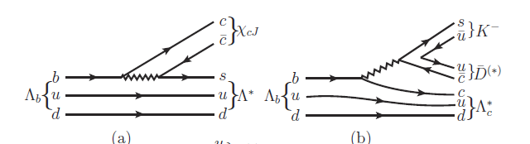
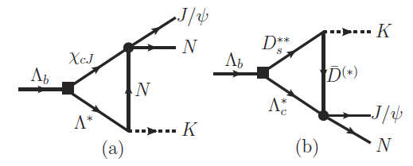
Production mechanism in Λ_{b} decay
Rescattering via triangle diagrams
Parallel talks by Feng-Kun Guo: C-4/27-PQ-2,
and Xiao-Hai Liu in the same session, July 27, 2016

Slide 38
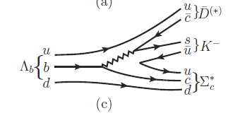

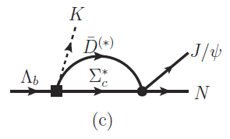
A new leading order mechanism
Rescattering to generate a pole?
Favored by the molecular picture
X.-H. Liu, Q. Wang, and Q. Zhao, PLB(2016); arXiv:1507.05359 [hep-ph]

Slide 39
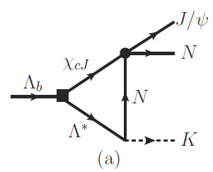

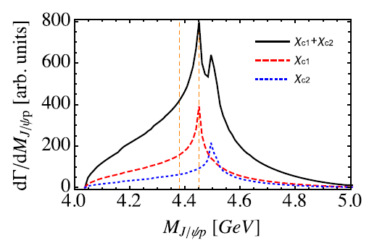
Thresholds for χ_{cJ} p
X.-H. Liu, Q. Wang, and Q. Zhao, arXiv:1507.05359 [hep-ph]

Slide 40
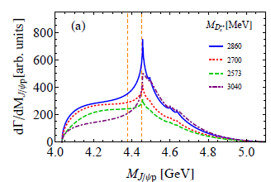
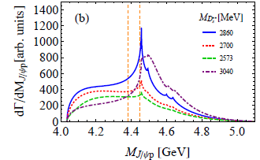
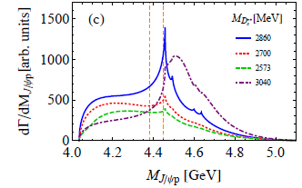
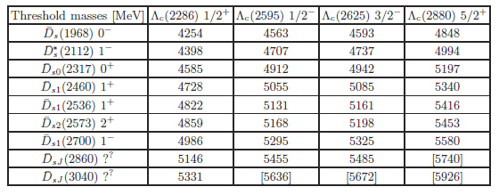
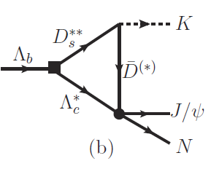
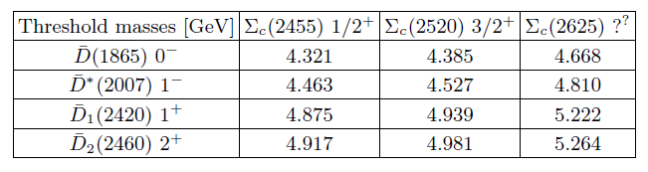

Slide 41
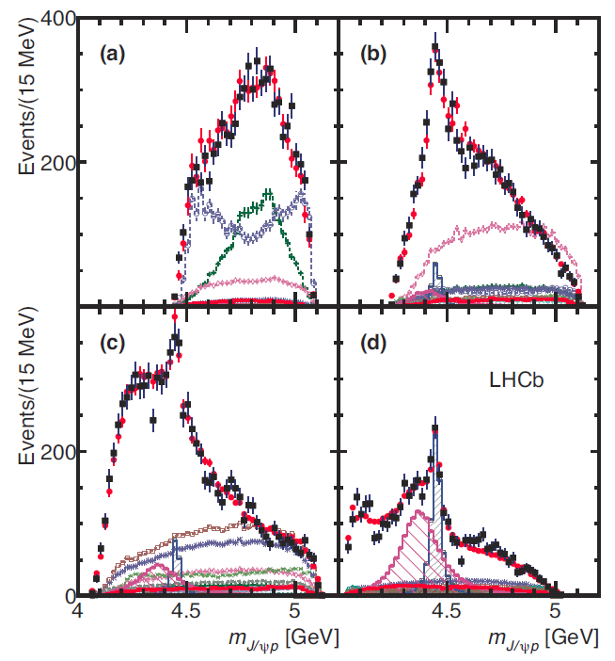
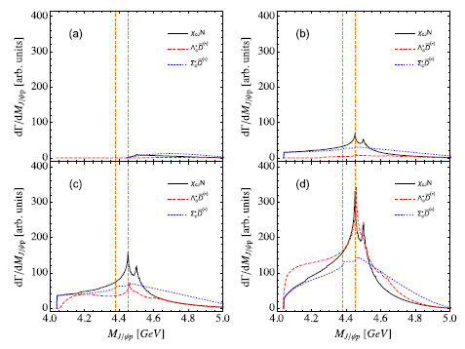
Invariant mass distribution of J/ψ p with different K⁻p momentum cuts

Slide 42
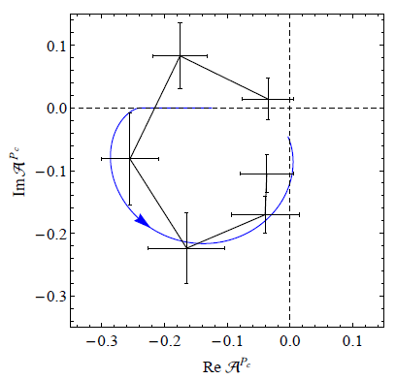
The ATS can mimic a resonance behavior in certain cases
F.-K. Guo, U.-G. Meissner, W. Wang, and Z. Yang, arXiv:1507.04950 [hep-ph]
See also talk by F.-K. Guo

Slide 43
Kinematic features of the production mechanism
Forward angle peaking is predominant due to the diffractive process, i.e. Pomeron exchanges.
S-channel resonance excitations contribute to the cross sections at middle and backward angles.
U-channel contributes to backward angles.
dσ/dΩ
t-channel:
Pomeron exchange
s-channel
u-channel
Interferences from different transition mechanisms
0
90
180
Scattering angle

Slide 44
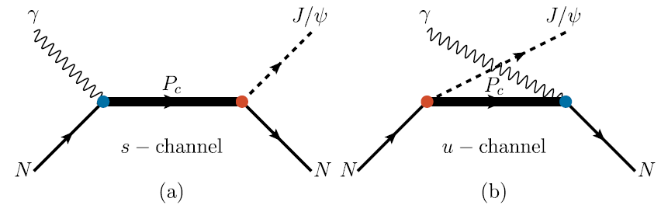
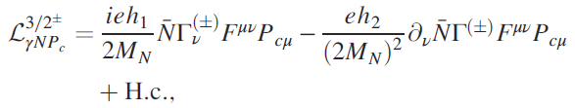
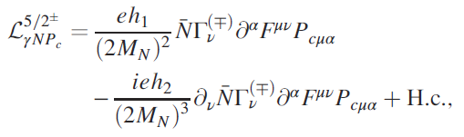

s and u-channel pentaquark production
Coupling vertices for γNP_{c}:
S. H. Kim, S. i. Nam, Y. Oh and H. C. Kim, PRD 84, 114023 (2011)
Q. Wang, X.-H. Liu, and Q. Zhao, arXiv:1508.00339 [hep-ph]

Slide 45




Coupling vertices for J/ψNP_{c}:
Leading transition matrix elements:
Rarita-Schwinger spin projections:
with

Slide 46



Vector meson dominance
γ
γ
eh₁
J/ψ
J/ψ
g₁
J/ψ
P_{c}
P_{c}
p
p
p
p
J/ψ
e⁺
e⁻
By assuming that the J/ψ p saturate the decay widths of the Pc states, we have
A form factor is included:

Slide 47


Total cross sections predicted:
Full width prediction
Prediction with 5% of b.r. to J/ψ p:

Slide 48

Predicted differential cross sections at different energies:
W= 4.15 GeV
W= 4.38 GeV
W= 4.45 GeV
W= 4.50 GeV

Slide 49

Predicted differential cross sections at different energies:
W= 4.15 GeV
W= 4.38 GeV
W= 4.45 GeV
W= 4.50 GeV

Slide 50
Summary
The ATS is strongly correlated with threshold phenomena and can produce observable effects when the condition is fulfilled in the physical regime.
The ATS may mix with the threshold pole structure if a genuine state does exist. So energy-dependence of the threshold peak should be studied.
An enhancement in elastic channel “almost” implies the existence of a genuine state.
More criteria for judging the ATS effects and genuine states should be pursued.

Slide 51
Institute of High Energy Physics
Recent developments on this relevant issue:
J.-J. Wu, X.-H. Liu, and Q. Zhao, B.-S. Zou, PRL108, 081003 (2012)
X.-G. Wu, J.-J. Wu, Q. Zhao, B.-S. Zou, PRD 87, 014023 (2013)
Q. Wang, C. Hanhart, Q. Zhao, PRL111, 132003 (2013)
Q. Wang, C. Hanhart, Q. Zhao, PLB725, 106 (2013)
X.-H. Liu, M. Oka, Q. Zhao, PLB753, 297(2016); arXiv:1507.01674 [hep-ph]
F.-K. Guo, U.-G. Meissner, W. Wang, and Z. Yang, PRD(2015); arXiv:1507.04950 [hep-ph]
X.-H. Liu, Q. Wang, and Q. Zhao, PLB(2016); arXiv:1507.05359 [hep-ph]
X.-H. Liu and M. Oka, NPA 954 (2016) 352; arXiv:1512.05474[hep-ph]
A. P. Szczepaniak, PLB747, 410 (2015) [arXiv:1501.01691 [hep-ph]]
Thanks for your attention!

Slide 52

(IV) Ds1(2460) or Ds1(2536) decays into Ds pipi can go through the ATS process.
D*
D_{s1}(2460), 1⁺
D_{s1}(2536), 1⁺
D_{s1}(2460) or D_{s1}(2536) are mixture of 3P₁ and 1P₁.
K

Slide 53


The ATS peaks appear at different energies

Slide 54
References:
J.-J. Wu, X.-H. Liu, and Q. Zhao, B.-S. Zou, PRL108, 081003 (2012)
X.-G. Wu, J.-J. Wu, Q. Zhao, B.-S. Zou, PRD 87, 014023 (2013)
Q. Wang, C. Hanhart, Q. Zhao, PRL111, 132003 (2013)
Q. Wang, C. Hanhart, Q. Zhao, PLB725, 106 (2013)
X.-H. Liu, M. Oka, Q. Zhao, PLB753, 297(2016); arXiv:1507.01674 [hep-ph]
F.-K. Guo, U.-G. Meissner, W. Wang, and Z. Yang, PRD(2015); arXiv:1507.04950 [hep-ph]
X.-H. Liu, Q. Wang, and Q. Zhao, PLB(2016); arXiv:1507.05359 [hep-ph]
X.-H. Liu and M. Oka, arXiv:1512.05474[hep-ph]
A. P. Szczepaniak, PLB747, 410 (2015) [arXiv:1501.01691 [hep-ph]]

Slide 55







Lagrangians in the NREFT
Y(4260)D₁D coupling:
Zc(3900)DD* coupling:
D1D*pi coupling:
Q. Wang, C. Hanhart, QZ, PRL111, 132003 (2013); PLB(2013)

Slide 56


π⁺
θ_{π}⁺
e⁺
e⁻
D
θ_{πD}
D*
Q. Wang, C. Hanhart, Q.Z., PRL111, 132003 (2013); PLB(2013)
W. Qin, S.R. Xue, Q.Z., arXiv:1605.02407[hep-ph]
See talk by Si-Run Xue in Parallel Section: B-2/26-M-1, July 26, 2016

Slide 57



Invariant mass spectra for Dπ, D*π, and ‾DD*
Signature for D₁(2420) via the tree diagram.
The Zc(3900) could have a pole below the DD* threshold.

Slide 58





How a D wave can be present?
π⁺
θ_{π}⁺
e⁺
e⁻
D
θ_{πD}
D*

Slide 59

Non-BW lineshape around the Y(4260) mass region as an evidence for the molecular feature of Y(4260):

Slide 60



DD₁
DD₁
Where is the peak position and pole position of Y(4260)?
Is the J/psi pipi the dominant decay channel for Y(4260)?
How to understand the non-trivial lineshape of the hc pipi channel?
Could the exclusive channel cross section lineshape provide more information about the nature of Y(4260)?
……
M. Cleven, Q. Wang, C. Hanhart, U.-G. Meissner, and Q. Zhao, 1310.2190; PRD90, 074039 (2014)

Slide 61

Slide from C.Z. Yuan

Slide 62


Angular distribution analysis
π⁺
θ_{π}⁺
e⁺
e⁻
D
θ_{πD}
D*
Updated data from BESIII, PRD 92 (2015) 092006

Slide 63





The asymmetry of events between
0.0 S wave
0.11 D wave
0.05 S+D
A =
Forward–backward asymmetry for the DD* peak:
0.0 S wave
0.37 D wave
0.16 S+D
=

