Slide 1
Spectroscopic experiment of Λ(1405) via in-flight d(K-,n) reaction at J-PARC K1.8BR
Shingo Kawasaki for the J-PARC E31 collaboration
RCNP, Osaka University
Notes:
I’m shingo Kawasaki from RCNP, Osaka University, Japan.
I would like to talk about spectroscopic experiment of Λ(1405) via in-flight d(K-,n) reaction @J-PARC K1.8BR

Slide 2
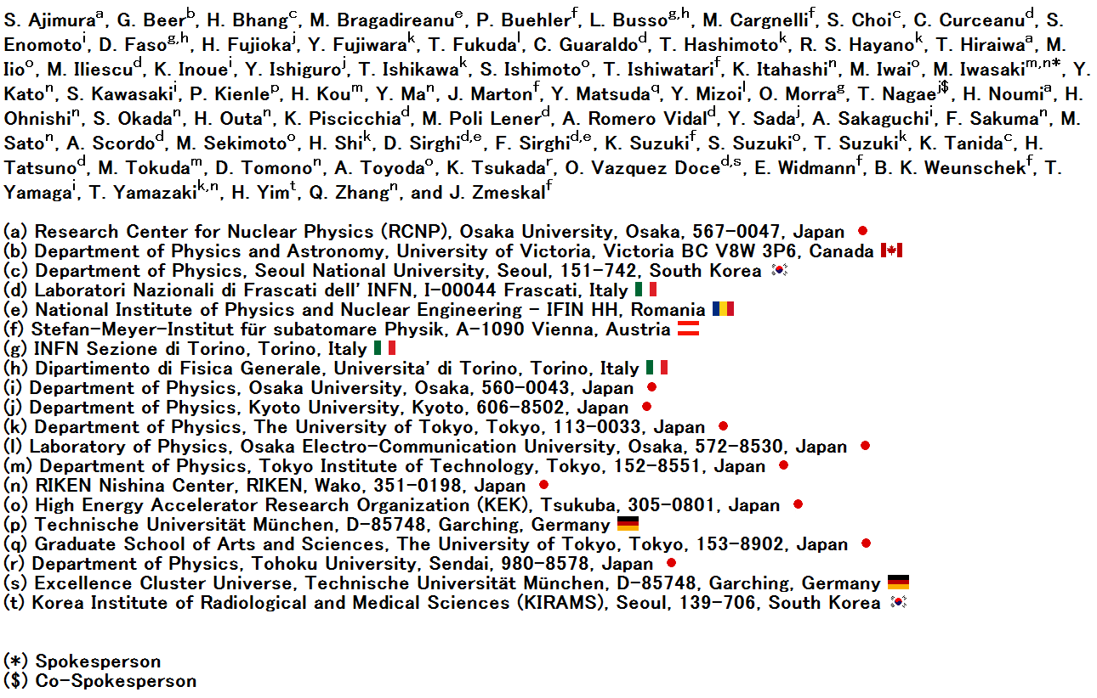
J-PARC E31 collaboration
Notes:
This is the collaborations of J-PARC E31 experiments

Slide 3
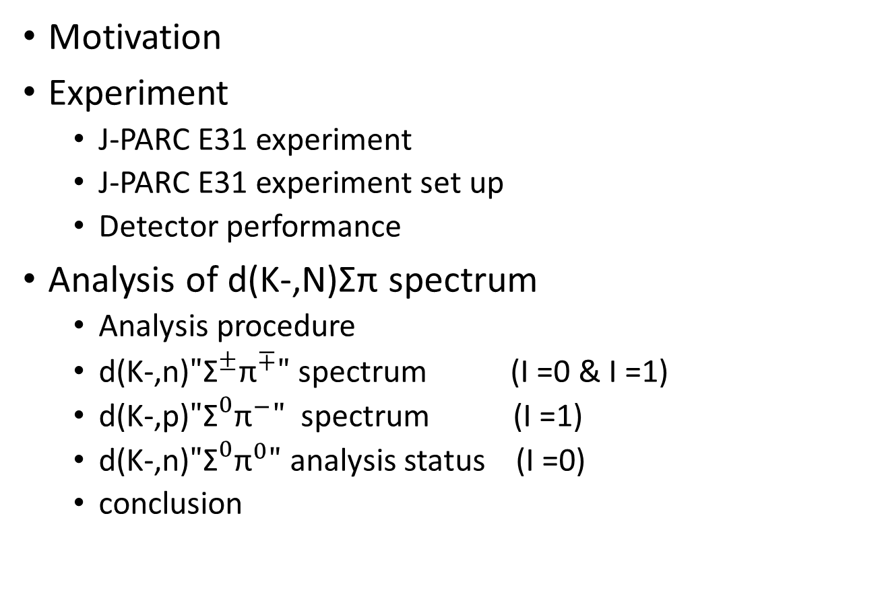
Contents
Motivation
Experiment
  J-PARC E31 experiment
  J-PARC E31 experiment set up
  Detector performance
Analysis of d(K-,N)Σπ spectrum
  Analysis procedure
  d(K-,n)$"{\text{Σ}}^{±}{\text{π}}^{∓}"$ spectrum (I =0 & I =1)
  d(K-,p)$"{\text{Σ}}^{0}{\text{π}}^{−}"$ spectrum (I =1)
  d(K-,n)$"{\text{Σ}}^{0}{\text{π}}^{0}"$ analysis status (I =0)
  conclusion
Notes:
The contents of my talk are as follows. First I will talk about the motivation of our experiment and the overview of the J-PARC E31 experiment. Then I will talk about the analysis of d(K-,n)Σπ spectrum.

Slide 4
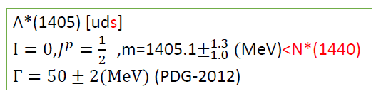
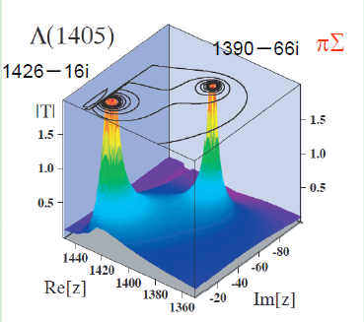
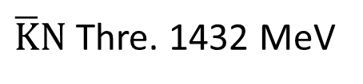
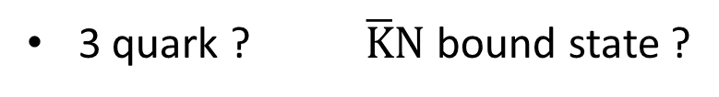
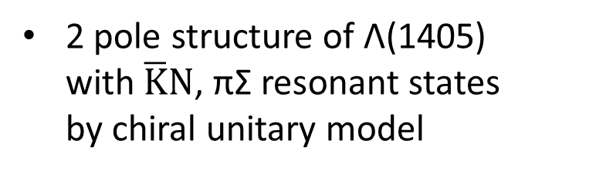


Motivation
Investigation of Λ(1405)
3 quark ? $\overline{K}N$ bound state ?
$\overline{K}N$ Thre. 1432 MeV
27 MeV
Λ(1405)
$$\overline{K}N$$
$$πΣ$$
2 pole structure of Λ(1405)
with $\overline{K}N$, πΣ resonant states
by chiral unitary model
T.Hyodo and W.Weise,
Phys.RevC77,035204(2008)
Notes:
Λ(1405) have the lightest mass in negative parity baryons. The mass cannot be explained by the simple quark model, so there are longstanding argument about the structure. In this situation, chiral unitary model claim 2 pole structure with KbarN and πΣ resonance states.

Slide 5
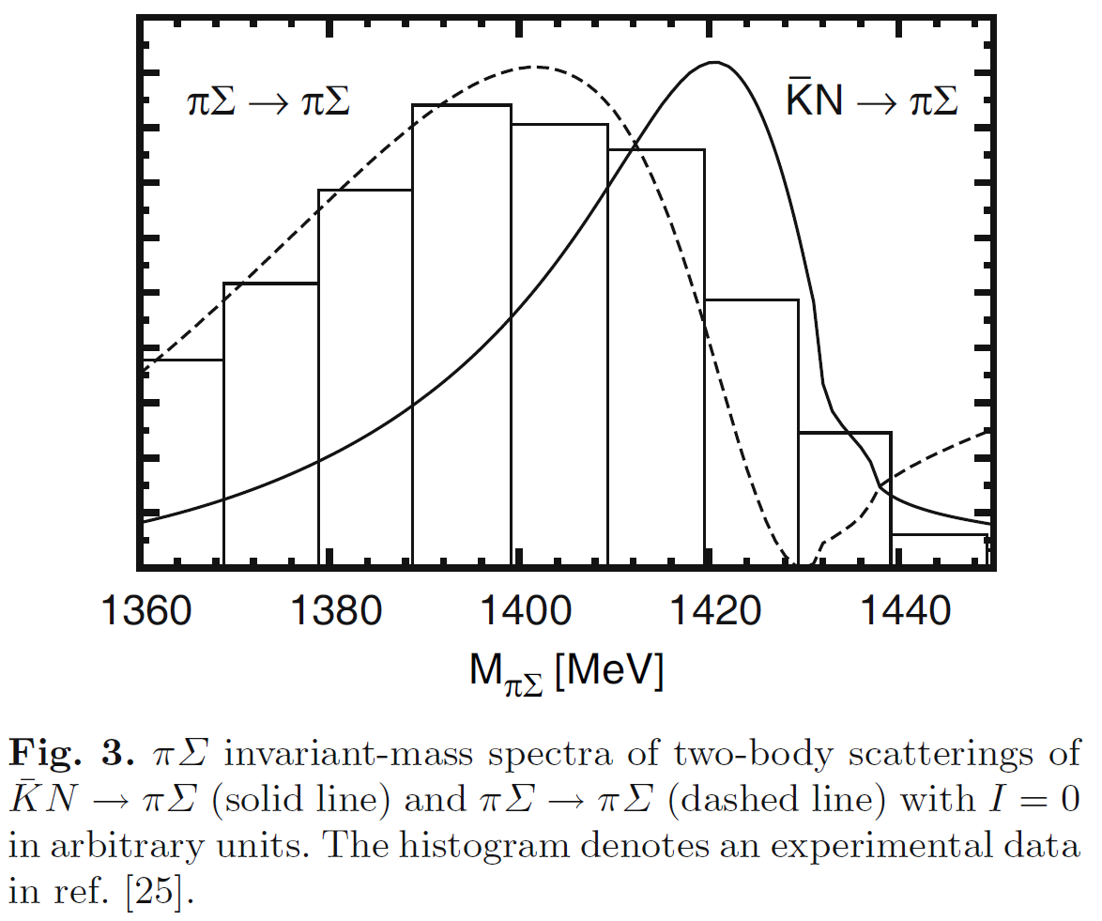
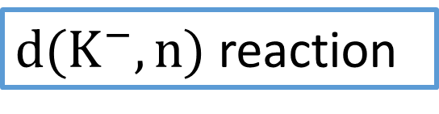
Investigation of Λ(1405) spectrum shape in $\overline{K}N→πΣ$
The reaction cannot occur
in free space
$d(K^{−},n)$ reaction
Eur. Phys. J. A42(’09)257
The reaction is expected to enhance the scattering
Notes:
So, we investigate Λ(1405) spectrum shape in KbarN → πΣ scattering channel. Λ(1405) mass is smaller than the threshold of KbarN, so we use the reaction of d(K-,n) reaction. In this reaction Λ(1405) is directly generated from KbarN. This reaction is expected to enhance the scattering distribution depending on the chiral unitary model.

Slide 6





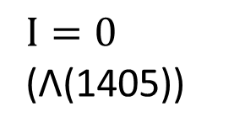
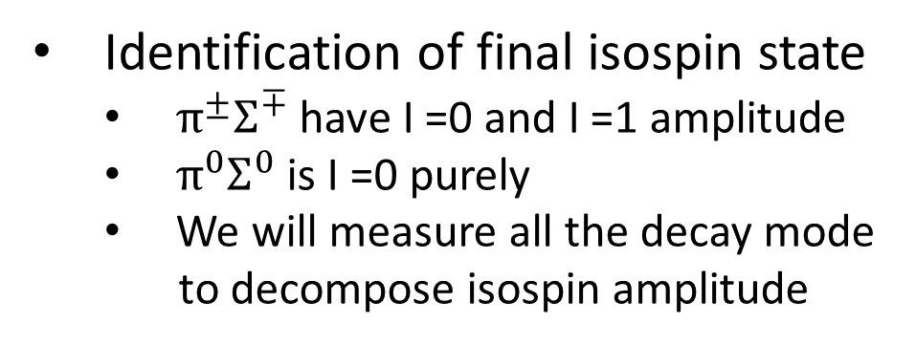
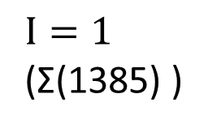
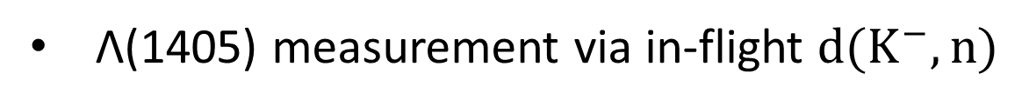
J-PARC E31 experiment
Λ(1405) measurement via in-flight $d(K^{−},n)$
Bound state
q ~200MeV/c
p
n
reaction
forward
scattered
neutron
$$K^{−}$$
n
p
$$K^{−}$$
1.0 GeV/c
$$D_{2}$$
1.2~1.3 GeV/c
Identification of final isospin state
  $π^{±}Σ^{∓}$ have I =0 and I =1 amplitude
  $π^{0}Σ^{0}$ is I =0 purely
  We will measure all the decay mode
  to decompose isospin amplitude
$I=0$
(Λ(1405))
$$X → π^{0}Σ^{0}$$
$→ π^{+}Σ^{−}$
$→ π^{−}Σ^{+}$
$→ π^{0}Λ$
$I=1$
(Σ(1385) )
$＊I=1$ is also measured
by d(K-,p) reaction
Notes:
Next I will talk about the J-PARC E31 experiment. Λ(1405) is measured via in-flight d(K-,n) reaction. In this measurement, the Kaon is irradiated on the deuteron, and the Kaon knock out a neutron out of the deuteron in a forward angle. The Kaon is slow down to form K-p bound state. The $π^{±}Σ^{∓}$ have I =0 and I =1 amplitude. The $π^{0}Σ^{0}$ is I =0 purely. we will measure all the decay mode to decompose isospin amplitude.

Slide 7
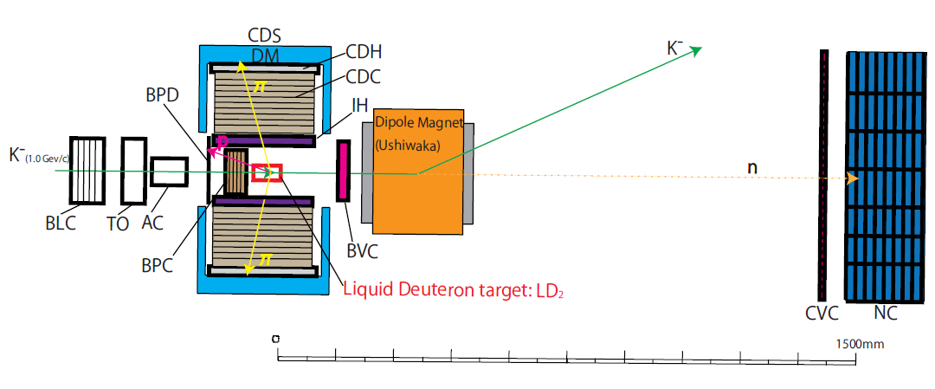
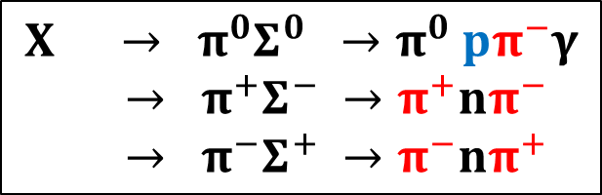







J-PARC E31 experiment set up
$$π$$
$$p$$
$$K^{−}$$
$$n$$
1 Gev/c
$$π$$
$$p$$
d(K-,n)”X”
PC
$$X → π^{0}Σ^{0} →π^{0} pπ^{−}γ$$
$→ π^{+}Σ^{−} →π^{+}nπ^{−}$
$→ π^{−}Σ^{+} →π^{−}nπ^{+}$
d(K-,p)”X-”
$$X− → π^{−}Σ^{0} →π^{−} pπ^{−}γ$$
Notes:
Next we show the J-PARC E31 experiment set up. This is the schematic view of the experiment set up @J-PARC HD K1.8BR
We measure the formation by missing mass of d(K-,n) and d(K-,p). The scattered neutron and proton is detected by counters about 15m away from the target. The liquid deuteron target is surrounded by the cylindrical detector system(CDS). The decay chagred particles are detected by CDS for the identification of the decay mode.

Slide 8
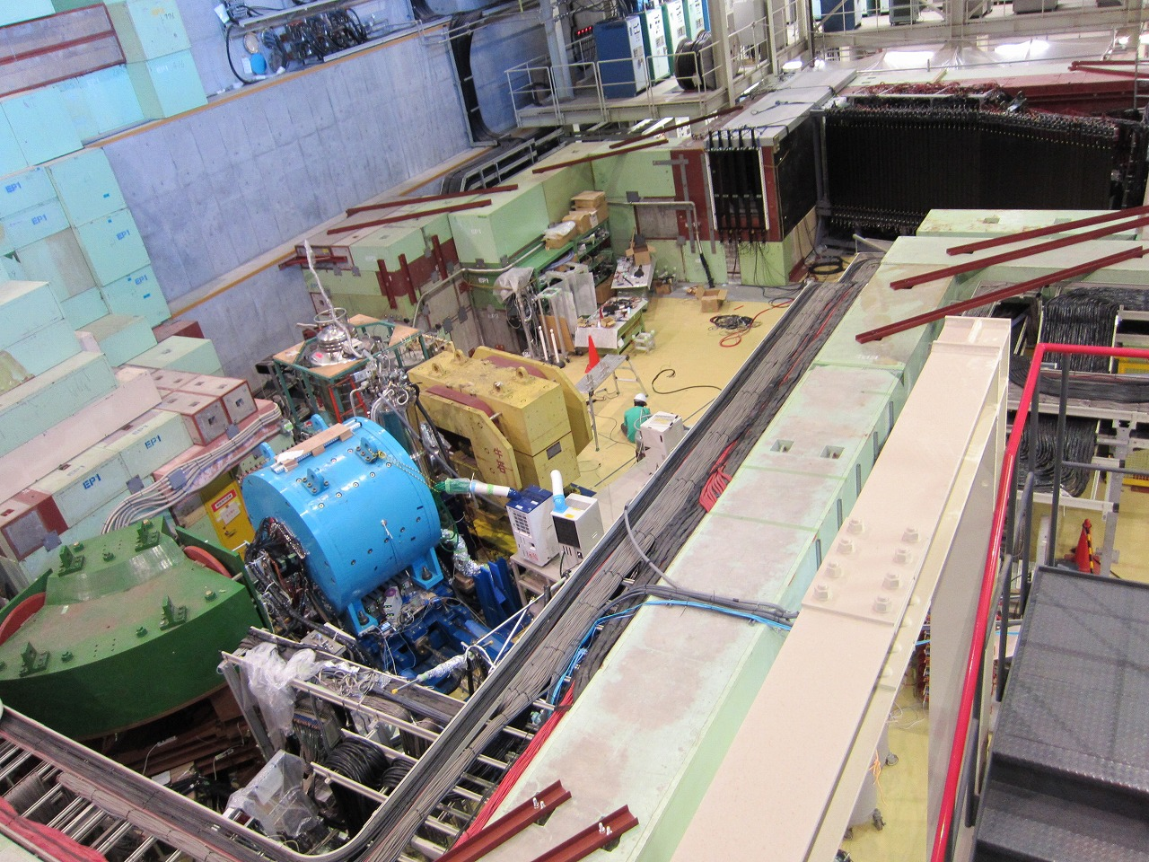

K1.8BR spectrometer
beam dump
beam sweeping
magnet
~15m
liquid $D2$-target
system
Proton Counter
Neutron
Proton Counter
CDS
We have taken the data successfully !
beam line
spectrometer
Notes:
This is the picture of the J-PARC K1.8BR spectrometer. This green one is the beam line spectrometer. This blue one is the cylindrical detector system(CDS). The liquid deuteron target is placed in the center of it. This black ones are the forward neutron counter and proton counter. This yellow one is the vending magnet for the forward scattered proton. We have successfully taken the E31 1st physics run data last May and June. In this presentation, we talk about the preliminary result of this data analysis.

Slide 9
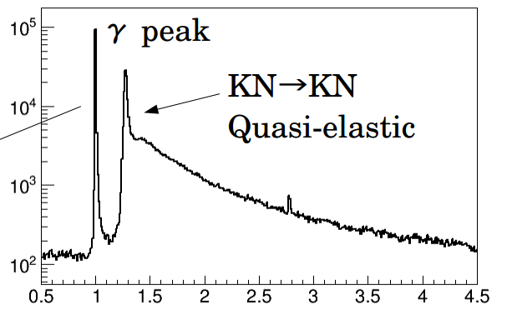
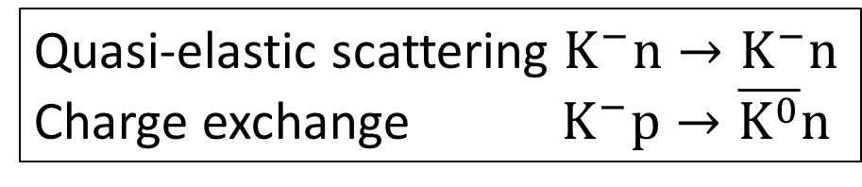
  Detector performance
Neutron Counter
Quasi-elastic scattering $K^{−}n→K^{−}n$
Charge exchange $K^{−}p→\overline{K^{0}}n$
accidental background
1/β
Notes:
Before analysis result, we talk about the detector performance of E31 1st physics run. We present the performance of NC. This figure is inverse beta of hit events @NC. γ events are separated clearly from neutron events. In neutron events, QF and charge exchange reaction peak can be seen clearly. A green dot line represents the accidental BG. The BG level is vey low. The signal to noise ratio @QF peak is about 100. The time resolution is about 150ps @γ peak, which corresponds to about 10MeV missing mass resolution.

Slide 10
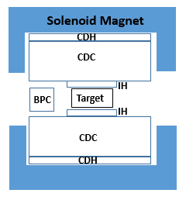
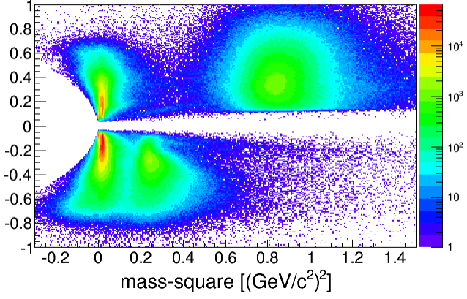
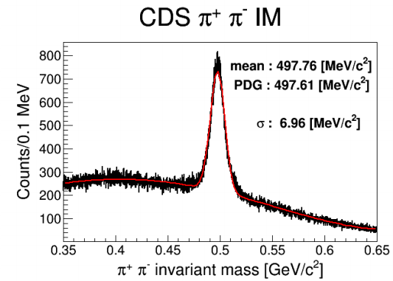
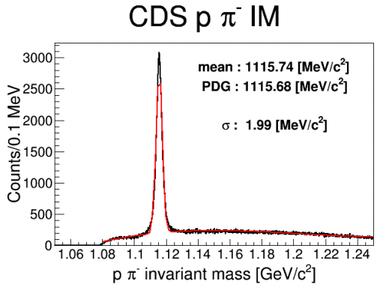
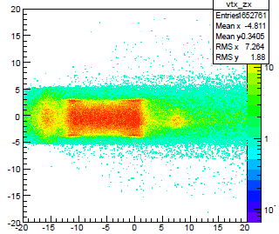
Cylindrical detector system (CDS)
CDS
Particle identification
p, π±,K⁻
π +
p
beam
Momentum [GeV/c]
π ⁻
K⁻
K⁰s reconstruction
Λ reconstruction
Vertex position
Notes:
Next, I talk about the performance of cylindrical detector system(CDS). CDS measures and identifies charged particles decayed from the production. Left –up figure shows mass square and momentum plots of detected charged particles in CDS. Proton , pion and Kaon are separated clearly. Right-up figure shows vertex position by trackings of beam and decay particle. The target cell figure can be seen clearly, so good vertex resolution. All detectors performances are good.

Slide 11


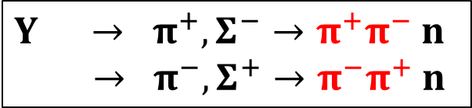
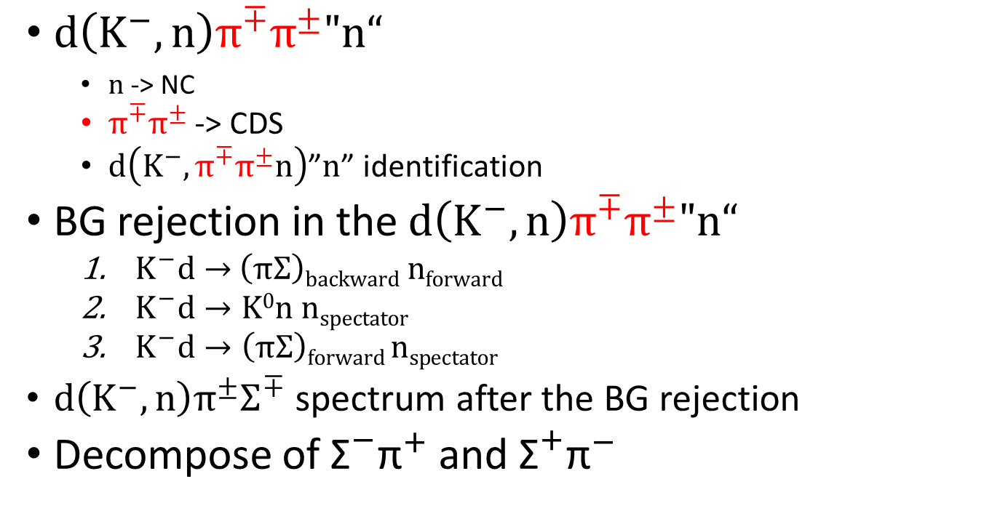
  Analysis of $d\left(K^{−},n\right)π^{±}Σ^{∓}$ spectrum
$Y → π^{+},Σ^{−}→π^{+}π^{−}$ $n$
$→ π^{−},Σ^{+}→π^{−}π^{+}$ $n$
Analysis procedure
  $d\left(K^{−},n\right)π^{∓}π^{±}"n“$
    $n$ -> NC
  $π^{∓}π^{±}$ -> CDS
  $d\left(K^{−},π^{∓}π^{±}n\right)$”$n$” identification
BG rejection in the $d\left(K^{−},n\right)π^{∓}π^{±}"n“$
  $K^{−}d→$ $\left(πΣ\right)backward nforward$
  $K^{−}d→K0n nspectator$
  $K^{−}d→\left(πΣ\right)forward nspectator$
$d\left(K^{−},n\right)π^{±}Σ^{∓}$ spectrum after the BG rejection
Decompose of ${\text{Σ}}^{−}{\text{π}}^{+}$ and ${\text{Σ}}^{+}{\text{π}}^{−}$
→ Signal
→ $K0$ production (BG)
→ Forward Σ production (BG)
Notes:
Next, we present the analysis of d(K-,n)πΣ spectrum. πΣ final state of ππn could be identified by n detected by NC and 2 charged pions detected by CDS. The remaining n is identified by d(K-,ππn)”X” missing mass. There are 2 BGs in the reaction of d(K-,n)ππn reaction which is can be identified. K-d going to recoiled backward πΣ and forward neutron reaction is our investigating reaction. 1st BG is K-d going to K0n with one neutron spectator, which is charge exchange reaction. 2nd is k-d going to forward scattered (πΣ) and one neutron spectator. After the rejection of the 2BGs we show the d(K-,n)πΣ spectrum. In the last we decompose this spectrum into Σ-π+ and Σ+π-

Slide 12
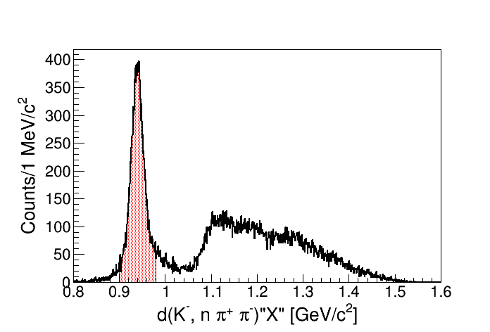

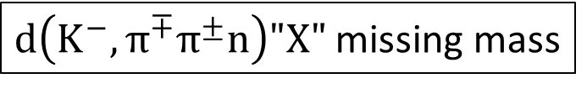


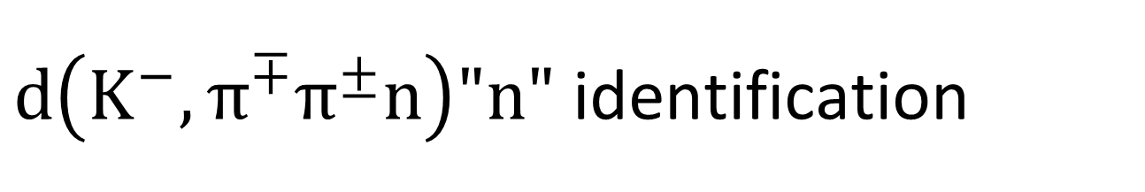

  $d\left(K^{−},π^{∓}π^{±}n\right)"n"$ identification
π
detect
$d\left(K^{−},π^{∓}π^{±}n\right)"X"$ missing mass
K-
$$n$$
$$"n"$$
detect
CDS
π
detect
preliminary
Selection of $"n"$ in this region
0.9 ~ 0.98 $GeV/C^{2}$
Notes:
First, we identify the d(K-n)ππn reaction. 2charged pions are detected by CDS and one n is detected by NC. The remaining n is identified by d(K-,ππn)”X” missing mass. This figure is the missing mass. So neutron peak can be seen clearly. We. select “n” in the region from 0.9 to 0.98 GeV

Slide 13
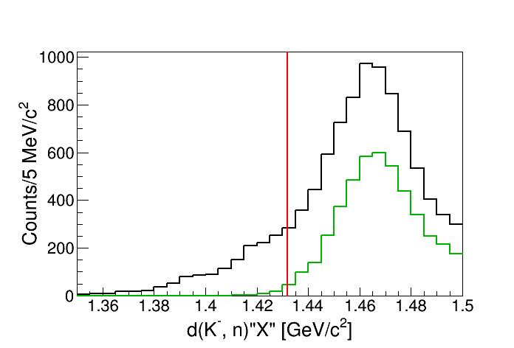
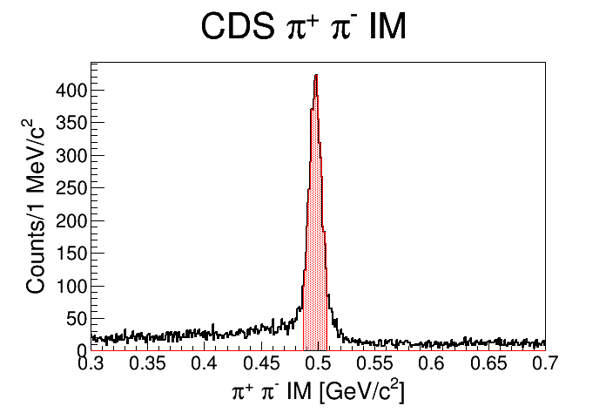




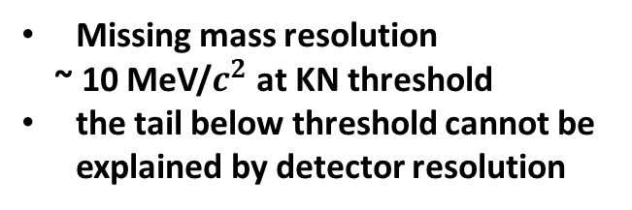
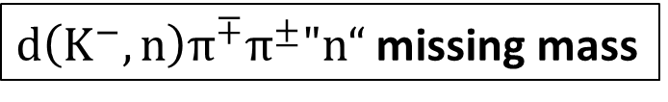
BG :$K^{−}d→K0n nspectator$
Charge exchange : $K^{−}p→\overline{K^{0}}n$
$d\left(K^{−}, n\right)π^{∓}π^{±}"n“$ missing mass
π
detect
K-
$$n$$
K0
detect
CDS
π
detect
preliminary
Invariant mass ($π^{−}π^{+}$)
Missing mass resolution
~ 10 MeV/$c^{2}$ at KN threshold
the tail below threshold cannot be explained by detector resolution
K0 event is reconstructed
Notes:
Next, we identify the 2BG process in the d(K-n) ππn reaction. 1st is K0n reaction. This reaction is identified by reconstruction of K0 by 2 charged pions. Left-down figure shows the invariant mass of the 2 charged pions The K0 reconstruction seems to be succeeded. Then the right figure shows the d(K-n) missing mass spectrum with ππn. Then the green line shows the spectrum with K0 identified. From this figure, It’s confirmed that There are almost no leakage to below the threshold by the detector resolution which is about 10MeV @threshold .

Slide 14
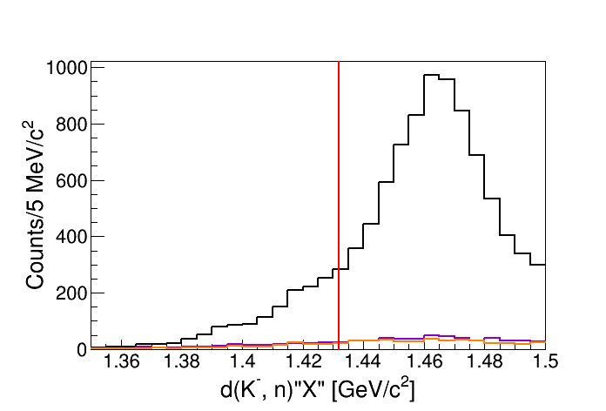
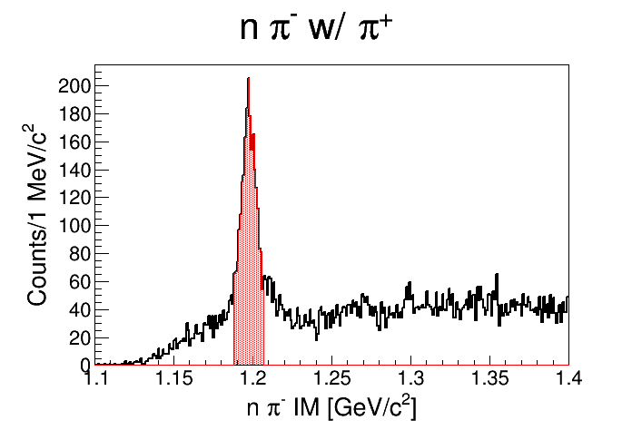
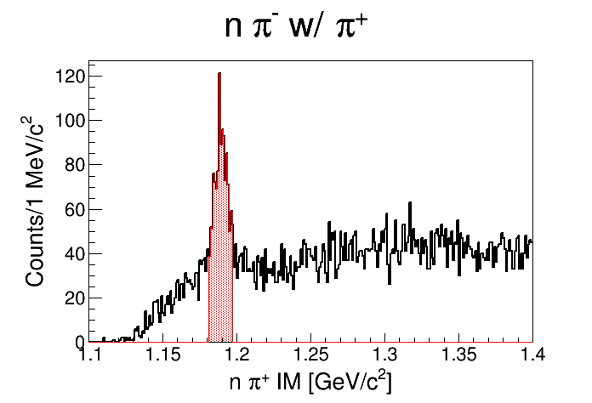





BG :$K^{−}d→πΣ nspectator$
$d\left(K^{−}, n\right)π^{∓}π^{±}"n“$ missing mass
π
detect
preliminary
K-
$$n$$
detect
Σ
CDS
π
detect
Invariant mass ($π^{−}n$)
Invariant mass ($π^{+}n$)
Neutron from Σ event is reconstructed
The contribution of this reaction is small
Notes:
The 2nd BG is the forward Σ reaction. This reaction is also identified by reconstruction of Σ down figures show the invariant mass of forward neutron and charged pion. The Σ+- reconstruction seems to be succeeded. Then the right-up figure shows the d(K-,n) missing mass spectrum again. The purple and orange lines shows the spectrum with Σ identified. From this figure, the contribution of this BG seems very small.

Slide 15
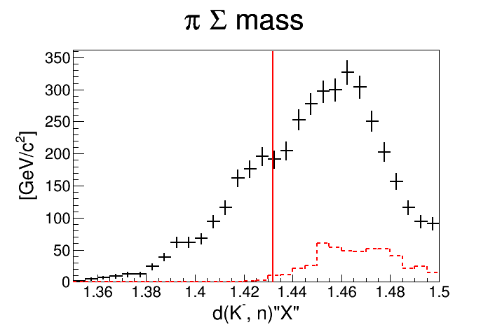


$d\left(K^{−},n\right)π^{±}Σ^{∓}$ spectrum
preliminary
The structures below and above the threshold
Notes:
So, we have obtained d(K-,n)πΣ spectrum by rejection of the 2BG from d(K-,n)ππn reaction.
The spectrum have some structures both below and above the threshold.

Slide 16
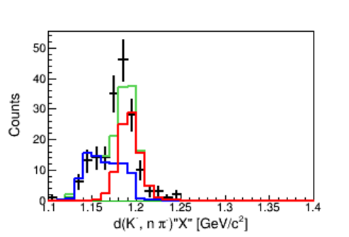
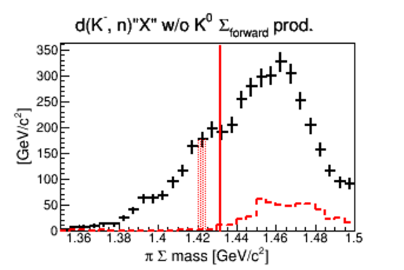
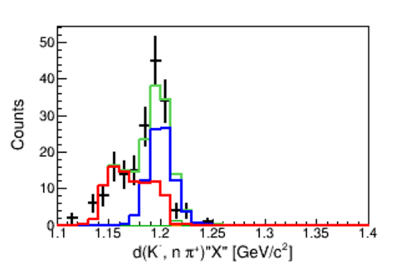
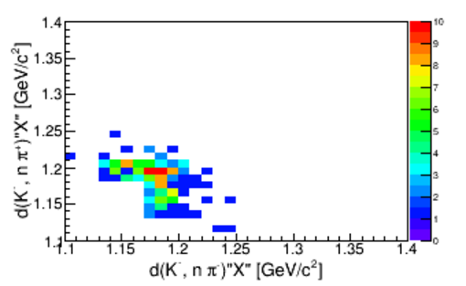



Decomposition into ${\text{Σ}}^{−}{\text{π}}^{+}$ and ${\text{Σ}}^{+}{\text{π}}^{−}$
  The d(K-,nπ)”X” distribution’s are fitted with the distribution of Σ+ and Σ- estimated by MC SIM (Template fitting)
    Fitted bin by bin of the d(K-,n)”X”
Σ+
d(K-,n$\text{π}$-)”X”
preliminary
Σ-
d(K-,n$\text{π}\text{+}$)”X”
Notes:
Next, we have tried to decompose the πΣ spectrum into Σ-π+ and Σ+π- by fitting the d(K-, nπ)”X” missing mass spectrum with the distribution of Σ+ and Σ- estimated by MC SIM. Then the fitting is done bin by bin of the d(K-n) “X” missing mass.
Left figure shows the same d(K-,n)πΣ spectrum as shown before page. Then we select 5 MeV region in this spectrum. Left-down figure shows the d(K-nπ-)”X” missing mass and d(K-,nπ+)”X” missing mass plots of the 5 MeV region events. Up and left figures are the projection histogrum of this plots each axis. So We have detected 2 pions (π+ and π- ). In the d(K-,nπ-) missing mass, Σ+ mode appear as peak, and Σ- mode appear as BG distribution. The same thing can be said in d(K-,nπ+)”X” missing mass. so, we fit Σ+ peak and Σ- BG distribution in d(K-,nπ-) missing mass
spectrum and Σ- peak and Σ+ distribution in d(K-,nπ+) simultaneously. Then we have done the same operation to all segment of d(K-,n)”X”

Slide 17
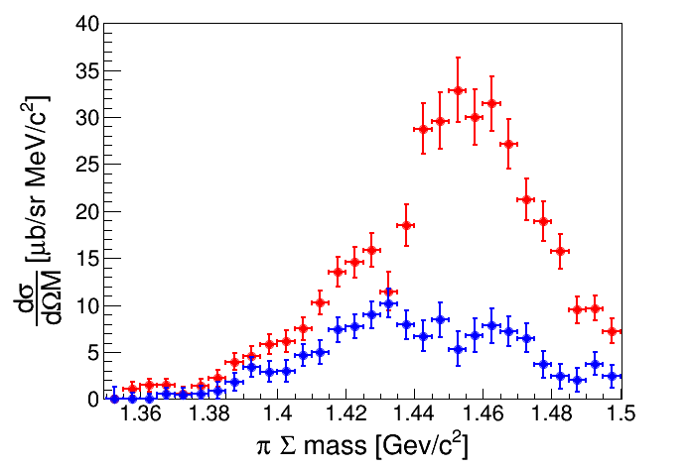


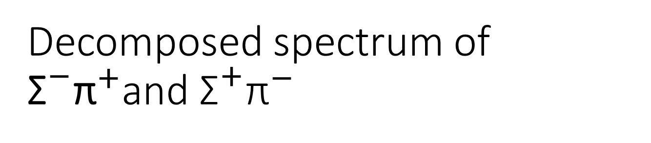
Decomposed spectrum of
${\text{Σ}}^{−}{\text{π}}^{+}$and ${\text{Σ}}^{+}{\text{π}}^{−}$
w/ acceptance correction
$${\text{Σ}}^{+}{\text{π}}^{−}$$
$${\text{Σ}}^{−}{\text{π}}^{+}$$
Very preliminary
  The difference between two mode is due to the interference term of I =0 and I =1
Notes:
The result of the decomposition are shown in this figure with acceptance correction for each mode.
The red dot is Σ+ and blue dot is Σ-
The difference between two mode can be seen which is due to the interference term of I=0 and I=1.

Slide 18
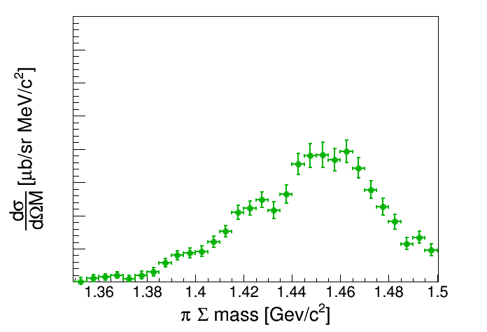

Average of ${\text{Σ}}^{−}{\text{π}}^{+}$ and ${\text{Σ}}^{+}{\text{π}}^{−}$ spectra
Very preliminary
The interference term is expected to be canceled
Notes:
We calculate the average of the 2 spectrum for the comparison with I=1 mode
The interference term is expected to be canceled in this spectrum.

Slide 19
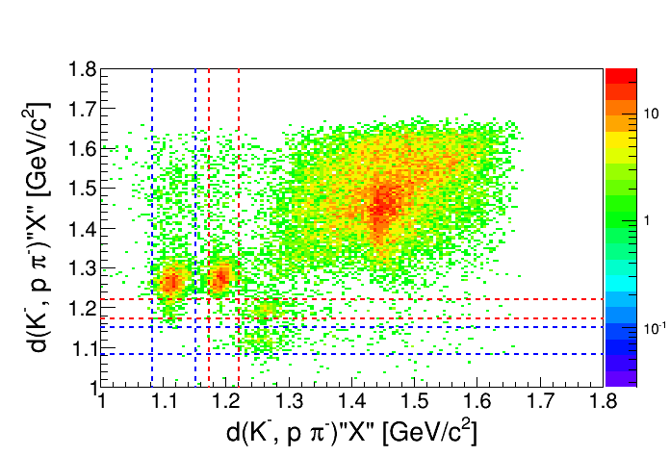
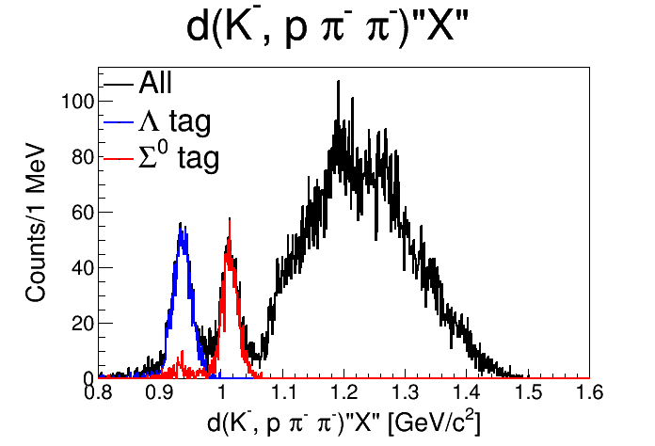

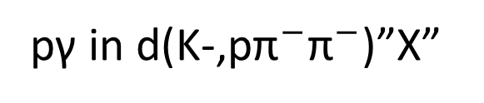
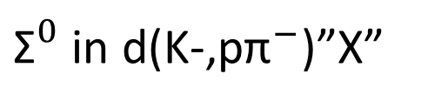



d(K-,p)$"{\text{Σ}}^{0}{\text{π}}^{−}"$
π-
detect
CDS
K-
$$π^{−}Σ^{0} →π^{−} pπ^{−}γ$$
$$p$$
detect
$${\text{Σ}}^{0}$$
Λ
π-
detect
${\text{Σ}}^{0}$ in d(K-,p${\text{π}}^{−}$)”X”
pγ in d(K-,p${\text{π}}^{−}{\text{π}}^{−}$)”X”
Selection of “pγ” in this region
Very preliminary
Notes:
Next, We investigate d(K-,p) reaction for the comparison of I=0 analysis with I=1.
First I talk about the identification of d(K-,p)Σ0π- reaction.
Left figure shows the d(K-,pπ-) and d(K-,pπ-) plots with 2 pi- detected by CDS then Σ0 events are selected by red dot lines.
Then, the right figure shows the d(K-pπ-π-)”X” missing mass. pγ events are selected by peach dot lines

Slide 20


d(K-,p)$"{\text{Σ}}^{0}{\text{π}}^{−}"$ missing mass
  I =1 mode
Very preliminary
Suppression of I =0 below the threshold relatively
Notes:
This is the d(K-,pπ)Σ0π- spectrum
The events below the threshold seems to be suppressed reratively.

Slide 21




Suppression of I =1
The average of d(K-,n)$"{\text{Σ}}^{−}{\text{π}}^{+}"$ and d(K-,n)$"{\text{Σ}}^{+}{\text{π}}^{−}"$
d(K-,p)$“{\text{Σ}}^{0}{\text{π}}^{−}”$ x 0.5
$$\frac{1}{2}×\left(π^{+}Σ^{−}+π^{−}Σ^{+}\right)$$
$$\sim \frac{1}{3}{\left|f_{I=0}\right|}^{2}+{\frac{1}{2}\left|f_{I=1}\right|}^{2}$$
Very preliminary
$$\frac{1}{2}×\left({π^{−}Σ}^{0}\right)$$
$$\sim \frac{1}{2}{\left|f_{I=1}\right|}^{2}$$
Assuming the similarity of d(K-,n) and d(K-,p),
the amplitude of I =1 in the d(K-,n) reaction is expected to be suppressed → the measurement of I =0 is waited for strongly
Notes:
Now I compare the d(K-,p)Σ0π- I=1 and the average of d(K-,n)Σ+π- and Σ-π+ . To match the amplitude of I=1, d(K-,p)Σ0π- is halved.
The Suppression of I=1 can be seen clearly. Assuming the similarity of d(K-,n) and d(K-,p) the amplitude of I=1 in the d(K-,n) reaction is expected to be suppressed. The measurement of I=0 is waited for the confirmation of it.

Slide 22







  d(K-,n)$"{\text{Σ}}^{0}{\text{π}}^{0}"$ analysis status
$$π^{0}Σ^{0} →π^{0} pπ^{−}γ$$
Λ(1405) is recoiled backward
the decay proton emitted backward is detected by backward detectors
Solenoid Magnet
$$p$$
Λ
Λ(1405)
$$n$$
$$π^{−}$$
K-
Analysis procedure
Reconstruction of Λ from p $π^{−}$
Separation of Λ $π^{0}$γ by$d\left(K^{−},\text{n} \text{Λ}\right)“X”$ missing mass from Λ$π^{0}$or Λ$π^{0}π^{0}$
Notes:
I will present the d(K-,n)Σ0π0 analysis status. This mode is more difficult to measure than charged mode due to “non-charged”.
Λ(1405) is recoiled backward, so the decay proton emitted backward is detected by backward detectors. The Identification of this mode is done by the reconstruction of the Λ. Then Λπ0γ event are separated from Λπ0 and Λ(ππ) by d(K-, nΛ)”X” missing mass

Slide 23







Backward Lambda reconstruction
$$π^{−}$$
NC
BPD
BPC
Λ
$$p$$
$$n$$
Backward
detectors
CDS
Invariant mass ($π^{−}p$)
Sigma = 0.0037 $(GeV/C^{2})$
Very preliminary
$$GeV/C^{2}$$
Lambda is reconstructed as designed
Notes:
Here we show the backward lambda reconstruction. Figure shows the invariant mass of backward proton and decay charged pion- detected by CDS. The reconstruction seems to be succeedded.

Slide 24







d(K-,nΛ)”X” missing mass
$π^{0}\text{Λ}$ (I =1)
$π^{0}Σ^{0}$ -> $π^{0}$γ Λ (I =0)
$π^{0}π^{0}\text{Λ}$
$${\text{π}}^{0}$$
${\text{π}}^{0}$γ
$$({π\text{π})}^{0}$$
Very preliminary
$$GeV/C^{2}$$
Events in the region of ${\text{π}}^{0}$γ is confirmed
Events in the region of ${\text{π}}^{0}$ (I =1) is suppressed
However we need more data for the d(K-,n)$"{\text{Σ}}^{0}{\text{π}}^{0}"$ spectrum
Notes:
Then π0γΛ is separated from π0Λ I=1 mode and (ππ)Λ
The figure shows the d(K-,nΛ)”X” missing mass
The events in the region of π0γ is confirmed. The events in the region of π0(I=1) is suppressed which is consistent with the d(K-,p)Σ0π- reaction analysis. Analysis of this data and the measurement of this mode is ongoing for the d(K-,n)Σ0π0 spectrum

Slide 25

conclusion
The preliminary result of the E31 1st physics run is presented
  The d(K-,n)$"{\text{Σ}}^{−}{\text{π}}^{+}"$ and $"{\text{Σ}}^{+}{\text{π}}^{−}"$ spectra are observed.
    The difference of two spectrum is clearly seen which is due to the interference term
  The d(K-,p)$"{\text{Σ}}^{0}{\text{π}}^{−}"$ spectrum (I = 1) is observed.
    This mode is suppressed especially below the threshold .
  → The I = 0 amplitude is dominant below the KbarN threshold in the d(K-,n)$"{\text{Σ}}^{−}{\text{π}}^{+}"$ and $"{\text{Σ}}^{+}{\text{π}}^{−}"$ spectra
The d(K-,n)$"{\text{Σ}}^{0}{\text{π}}^{0}"$ spectrum (I = 0) is to be measured
    Identification of this mode is succeeded.
    We will take 2nd run data for the ${\text{Σ}}^{0}{\text{π}}^{0}$ (I=0) spectrum (in the next spr. ?).

Slide 26
BACK UP

Slide 27






  Decompose of signal and BG
Fitting of invariant ($π^{−}π^{+}$), (n $π^{+}$) and (n $π^{−}$) by SIM
Invariant mass ($π^{−}π^{+}$)
Invariant mass ($π^{−}n$)
Invariant mass ($π^{+}n$)
K⁻ d→π⁺ Σ⁻ n_{Forward}
K⁻ d→π⁻ Σ⁺ n_{Forward}
K⁻ d→K⁰ n n_{Spec}
K⁻ d→Σ⁻ π⁺ n_{Spec}
K⁻ d→Σ⁺ π⁻ n_{Spec}
preliminary
preliminary
preliminary
SIM seem to reproduce the data well

Slide 28



  $d\left(K^{−}, n\right)π^{∓}π^{±}"n"$ spectrum
preliminary
Charge exchange peak around 1.47 $GeV/C^{2}$
Significant yield below the $\overline{K}N$ threshold.
Removal of BG →

Slide 29








$d(K^{−},n)"X"$spectrum
$π^{−}π^{+}$ is detected in CDS
$d(K^{−},n)"X"$ w/$π^{−}π^{+}$ missing mass
$$π$$
detect
K-
$$n$$
detect
Σ
CDS
$$n$$
$$π$$
detect
Charge exchange peak around 1.47 $GeV/C^{2}$
In this spectra, $d\left(K^{−}, n\right)π^{∓}π^{±}"n“$ is abstracted →

