Slide 1
Estimate on spin asymmetry for Drell-Yan process at Fermilab with tensor-polarized deuteron
Qin-Tao Song
High Energy Accelerator Research Organization (KEK)
Graduate University for Advanced Studies (Sokendai)
Reference:Shunzo Kumano and Qin-Tao Song, arXiv:1606.03149 [hep-ph].

Slide 2
Contents
◆ Motivation
◆Theoretical and experimental status
◆Results

Slide 3
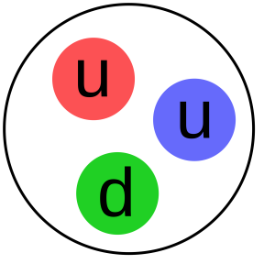
Spin Puzzle the proton
In Quark Model
The proton is S-wave
In patron picture, proton spin composites
proton in quark model
However, recent research shows

Slide 4
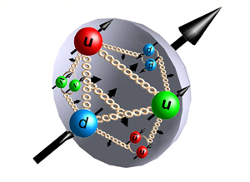
The quarks only contribute 20-30% of the spin, the rest should come from gluons and orbital angular momentum
In order to solve the spin puzzle of the proton, it is necessary to investigate the proton structure function to know the gluon-spin and orbital angular momentum contribution in the proton.
Generalized Parton Distributions (GPD) provide a way to study the proton puzzle

Slide 5
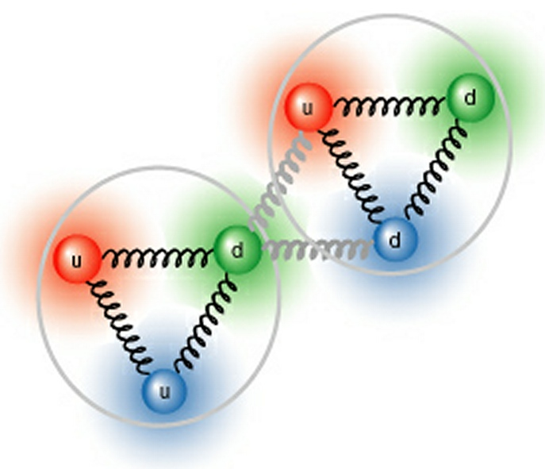
The puzzle of tensor-polarized structure in deuteron
The deuteron was originally considered as proton and neutron in S-wave.
Experimental magnetic moment of deuteron is consistent with the S-wave proposal, while the existence of electric quadrupole moment indicates that the deuteron should also contain D-wave.
Where q^{m} is patron distribution function in hadron spin-m state.

Slide 6
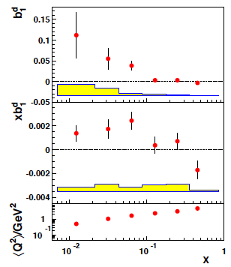
Hermes data show that b₁ is not as small as the prediction for the S-D mixture proposal.
A. Airapetian et al. (HERMES), PRL 95 (2005) 242001.
Standard S-D mixture proposal can not explain the experimental data

Slide 7
Possible explanations for the unexpected b₁ of the deuteron:
Six quarks configuration of the deuteron
Shadowing effects of the nucleus
Effects ofπexchange between proton and neutron
G. A. Miller, PRC 89 (2014) 045203
N. N. Nikolaev and W. Schafer, PLB 398 (1997) 245
J. Edelmann, G. Piller, and W. Weise, Z. Phys. A 357, 129 (1997)
K. Bora and R. L. Jaffe, PRD 57 (1998), 6906
The structure of the deuteron is not well understood！

Slide 8
An introduction to hadron tensor of deuteron: theory and experiment
Two ways to investigate the structure of deuteron are Deep Inelastic Scattering and Drell-Yan Process

Slide 9
Deuteron Structure Function in DIS
P. Hoodbhoy, R. L. Jaffe, and A. Manohar, NP B312 (1989) 571
L. L. Frankfurt and M. I. Strikman, NP A405 (1983) 557.
DIS for deuteron
F₁, F₂ ,g₁ and g₂ exist in spin-1/2 hadron, while b₁, b₂,b₁ and b₄ are new quantities for spin-1 hadron. In total,there are 8 structure functions for deuteron.

Slide 10
In Parton Model
Where q^{m} is patron distribution function in hadron spin-m state, and index i is the quark flavor. The tensor –polarized distributions will disappear if the deuteron is S-wave.
F. E. Close and S. Kumano, PRD 42 (1990) 2377.

Slide 11
Experiment Status: the measurement of b₁
The derivation from 0 of the integration will indicate the existence of tensor –polarized distributions for antiquark(sea) quarks
A. Airapetian et al. (HERMES), PRL 95 (2005) 242001.

Slide 12
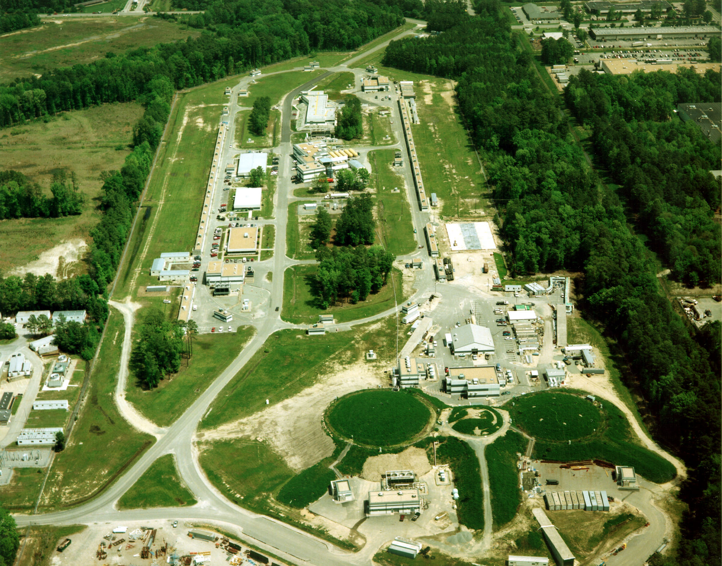
There is an approved experiment to measure b₁ at JLab (Thomas Jefferson National Accelerator Facility)，and this will help us to understand the tensor structure of deuteron.

Slide 13
Drell-Yan process for proton and deuteron

Slide 14
There are 108 structure functions for the hadron tensor of unpolarized proton- polarized deuteron Drell-Yan Process, and the quadrupole asymmetry A_{UQ0} is measured with the Q₀-type tensor polarized deuteron .
S. Hino and S. Kumano, PRD 59 (1999) 094026
S. Hino and S. Kumano, PRD 60 (1999) 054018
In Parton Model

Slide 15
The spin asymmetry A_{UQ0} will indicate that existence of tensor –polarized distributions and ，which are only available in D-wave deuteron. In experiment, the tensor –polarized distributions have been observed by Hermes measurements for b₁ of electron-deuteron DIS.
Large x_{F}=x₁-x₂
If the tensor –polarized distributions of the quarks are neglected.

Slide 16
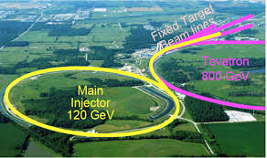
The asymmetry A_{UQ0} at large x_{F} reflects antiquark tensor-polarized distribution, and it is easier to get the antiquark tensor-polarized distribution from the measurement of the asymmetry A_{UQ0}.
The asymmetry could be measured by Fermilab E-906 experiment through proton-deuteron Drell-Yan Process. The beam is unpolaried proton(120 GeV, Fermilab Main-Injector) and the target is (tensor) polarized deuteron.
Fermilab E-906

Slide 17
Results:
Estimate on tensor-polarized asymmetry for the proton-deuteron Drell-Yan Process
Where p₁ and p₂ are the momenta of proton and deuteron, respectively.

Slide 18
In order to get A_{UQ}(x1,x2), we need unpolarized distributions of proton and and tensor-polarized distributions of deuteron.
The unpolarized distributions of proton and deuteron q(x, Q²) can be obtained by MSTW. We use the functional form of parameterizations for the initial tensor-polarized distributions of deuteron (Q²=2.5GeV²) based on Hermes data.
A.D. Martin et al EPJC 63 (2009) 189
S. Kumano, PRD 82 (2010) 017501

Slide 19
Parameterizations for initial tensor-polarized distributions of deuteron

Slide 20
Set 1 results of xb₁ can not explain the Hermes data at small x (x<0.1)
Set 2 results can fit the data well enough.
It is better to consider the antiquark tensor-polarized distributions at Q²=2.5 GeV²
A. Airapetian et al. (HERMES), PRL 95 (2005) 242001
S. Kumano, PRD 82(2010) 017501
Finite antiquark tensor-polarized distributions are necessary

Slide 21
Tensor-Polarized distributions at Q²=2.5 GeV², the set-2 antiquark tensor-polarized distribution is dominant at small x region (x<0.02). There is a node at x₀=0.229 for set 1 and x₀=0.221 for set 2, and this node is also predicted by standard S-D mixture proposal for deuteron.
P. Hoodbhoy, R. L. Jaffe, and A. Manohar, NPB 312 (1989) 571
H. Khan and P. Hoodbhoy, PRC 44 (1991) 1219

Slide 22
The tensor-polarized distributions at other energy scale
The tensor-polarized distributions can be obtained by evolving initial tensor-polarized distributions to any energy scale Q². The gluon tensor-polarized distribution is set to be 0 at Q²=2.5 GeV².
DGLAP evolution
P. Hoodbhoy et al,NPB 312 (1989) 571

Slide 23
The set-1 tensor-polarized distributions at Q²=2.5 GeV² and Q²=30 GeV² . There also exists the tensor-polarized distribution for gluon, even though it is set to be zero at the initial energy scale Q²=2.5 GeV² .Because there are no antiquark tensor-polarized distributions at Q²=2.5 GeV² ,so the symmetry for antiquarks will hold for any energy scale (leading order).

Slide 25
In the figure, tensor-polarizes asymmetry A_{Q} is shown at typical values of x₁=0.2, 0.4 and 0.6
The values of set-1 and set-2 are both a few percent.
The set-1 results are so different from those of set-2 at small region of x₂, and this is because that antiquark tensor-polarized distributions are more important when x₂ is small.
The set-2 should be more reliable, since the tensor-polarized distributions can also explain the Hermes data well.

Slide 26
Summary
The new structure function b₁ (DIS) and spin asymmetry A_{Q} (Drell-Yan) of deuteron reflect the tensor-polarized distributions, which have a close relationship with the orbital angular momentum in spin-1 hadrons. In this talk, we give the theoretical estimate of the spin asymmetry A_{Q}, and it is of the order of a few percent. In the future, those quantities could be measured by Jlab (b₁) and Fermilab (A_{Q}), which may reveal the puzzle of deuteron.

Slide 27
Thank you very much

