Slide 1

Shell structure: retrospective, perspective
Daisuke Suzuki
Riken Nishina Center
daisuke.suzuki@ribf.riken.jp
+81-(0)48-467-4958
Nuclear Physics Long Range Plan
April 27, 2016 RCNP, Osaka

Slide 2
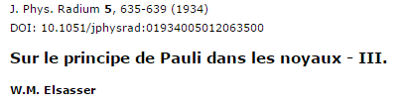
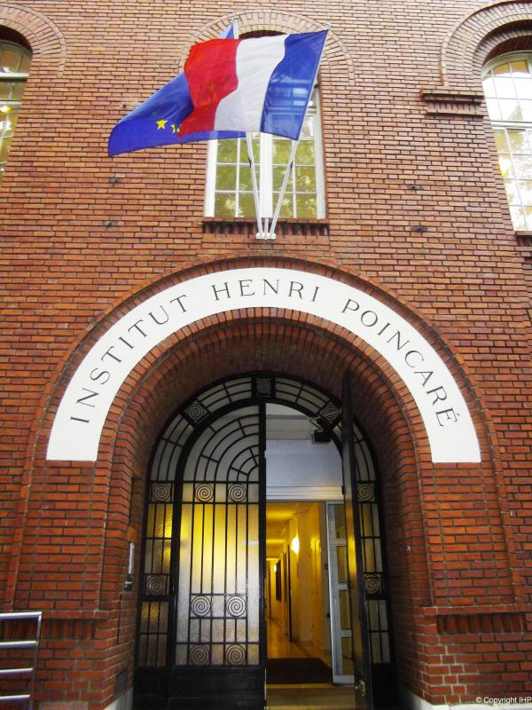
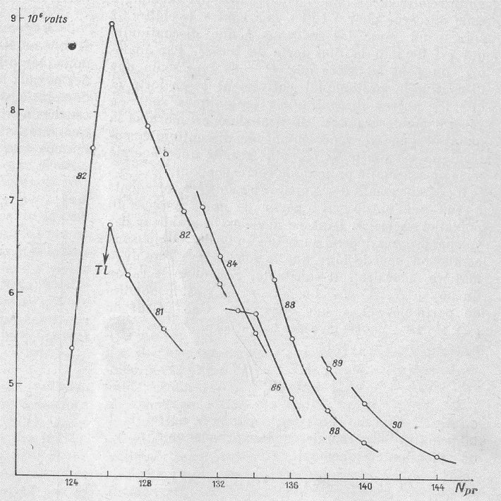
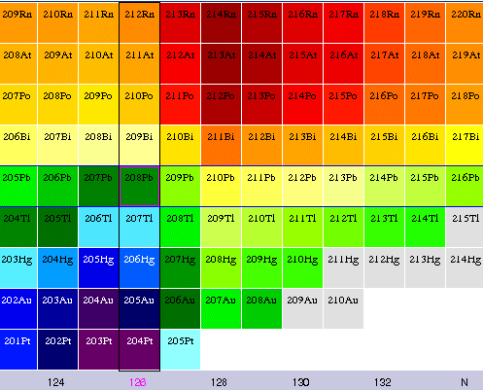
First insight
²¹²Po → ²⁰⁸Pb
Q_{α} [MeV]
Po → Pb
Bi → Tl
Neutron numbers

Slide 3

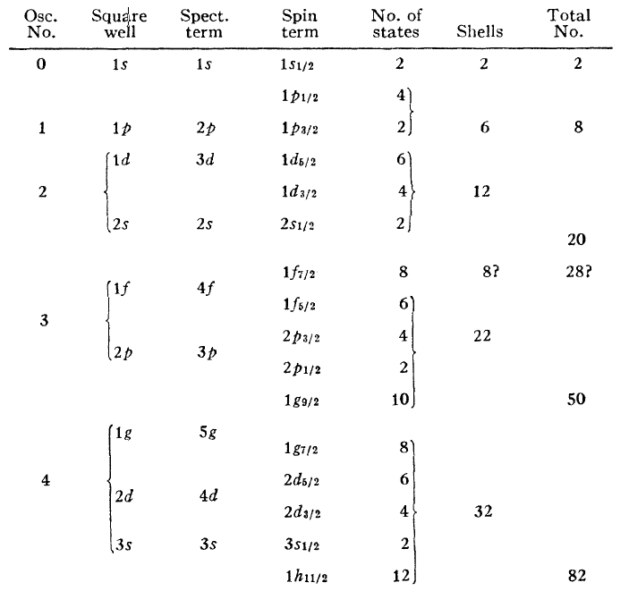
Question 1: How?
Or which term(s) of the nuclear force rule?
M.G. Mayer, Phys. Rev. 75, 1969 (’49)

Slide 4
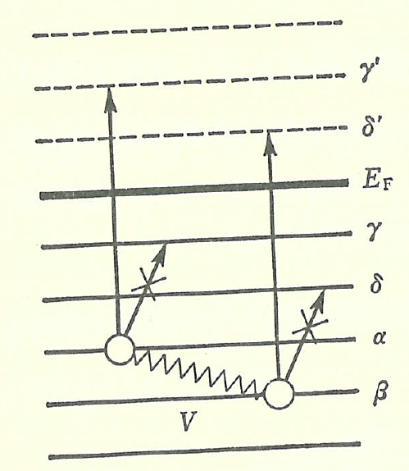
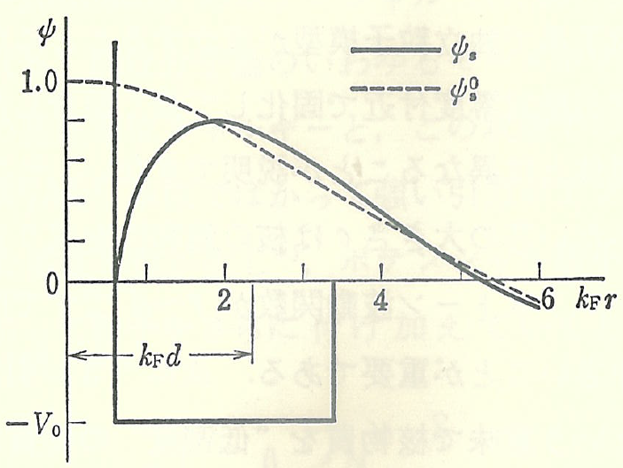
Question 2: Why?
Pauli principle
Saturation density
K.A. Brueckner, C.A. Levinson, H.M. Mahmoud,
Phys. Rev. 95, 217 (’54)
Figures taken from the textbook by K. Yagi

Slide 5
Modern questions
Who rules many-body correlations?
  Central/ LS/ tensor
  3N force
  Monopole (J independent)
  Quadrupole
Beyond saturation density
  Halo, bubble, clustering ... etc
  Density under saturation
  Non-uniformity
  Pauli blocking effects?

Slide 6
Today’s slides
Tensor interactions
N = 28: Power balance of interactions
Outside N = 28

Slide 7
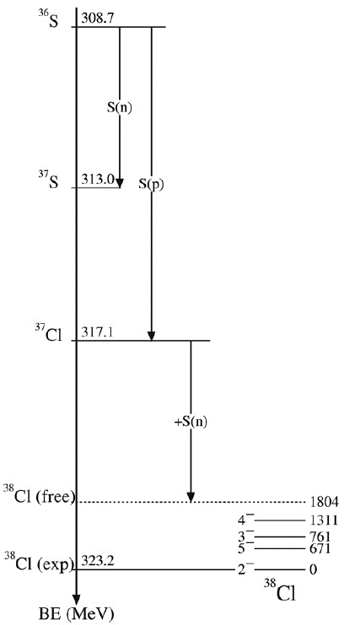
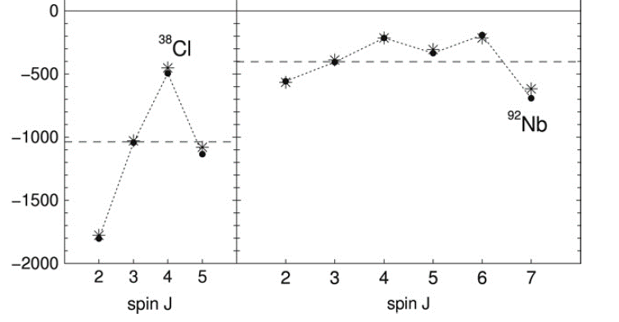

Monopole interactions
1f_{7/2}
2d_{5/2}
1d_{3/2}
1g_{9/2}
Z = 17, N = 21
Z = 41, N = 51
Interaction energy [keV]
O. Sorlin, M-G. Porquet, Phys. Scr. T152, 014003 (’13)

Slide 8
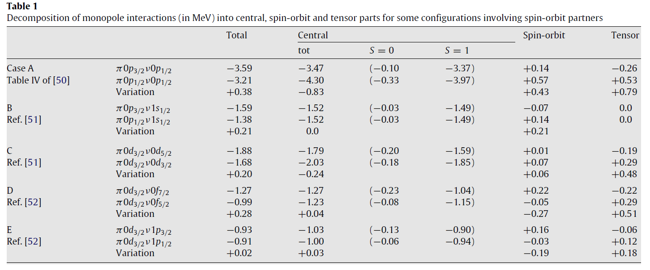
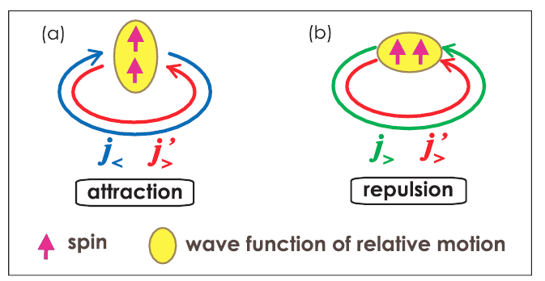
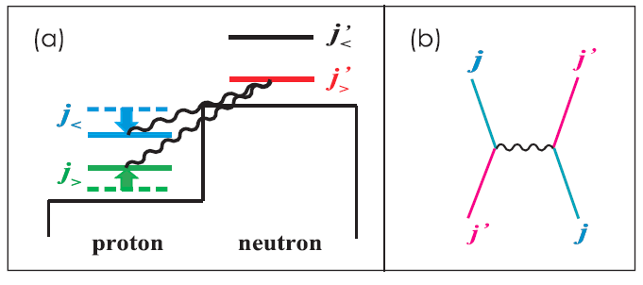
pn-tensor term reigns
O. Sorlin, M-G. Porquet, Phys. Scr. T152, 014003 (’13)
N = 8
N = 16
N = 28
N = 34
[50] A. Umeya, K. Muto, Phys. Rev. C69, 024306 (’04).
[51] A. Umeya, K. Muto, Phys. Rev. C74, 034330 (’06) and private communication (July ’07).
[52] J. Millener, private communication, August ’06.
T. Otsuka et al., Phys. Rev. Lett. 95, 232502 (’05)

Slide 9
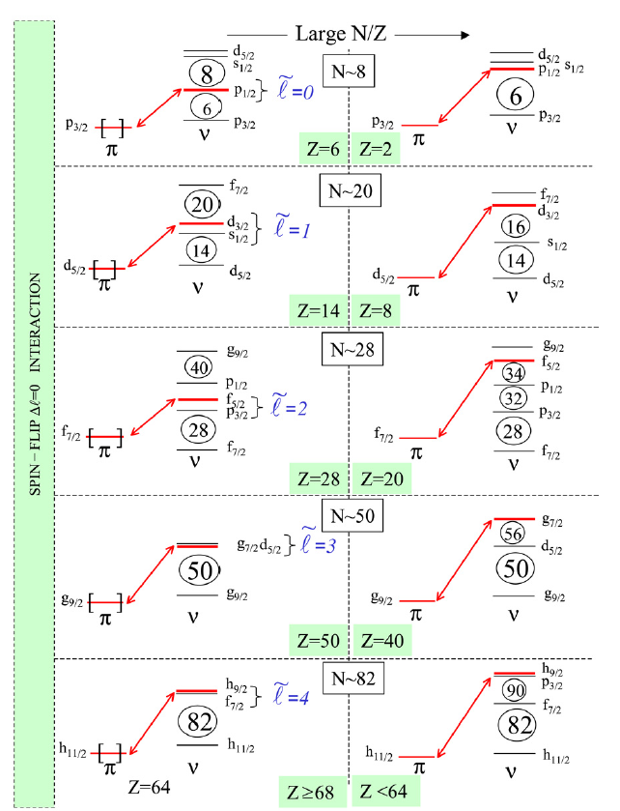
Magic numbers migrate
Classical magic numbers expire
N = 8
D.E. Alburger et al., Phys. Rev. C 17, 1525 (’78).
H. Iwasaki et al., Phys. Lett. B 481, 7 (’00).
H. Iwasaki et al., Phys. Lett. B 491, 8 (’00).
A. Navin et al., Phys. Rev. Lett. 85, 266 (’00).
N = 20
D. Guillemaud-Mueller et al., Nucl. Phys. A 426, 37 (’84).
T. Motobayashi et al., Phys. Lett. B 346, 9 (’95).
N = 28
B. Bastin et al., Phys. Rev. Lett. 99, 022503 (’07).
O. Sorlin, M-G. Porquet, Phys. Scr. T152, 014003 (’13)

Slide 10
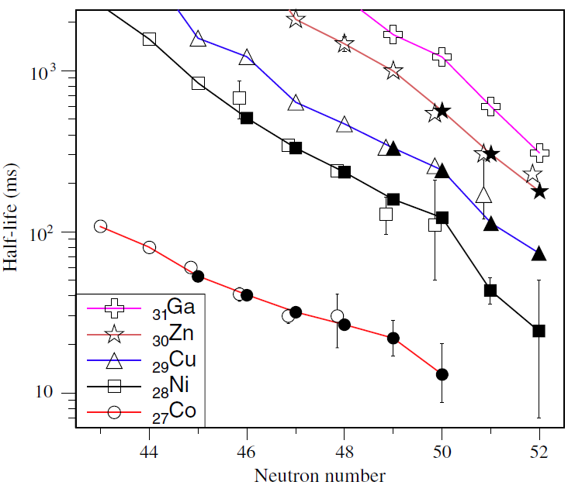
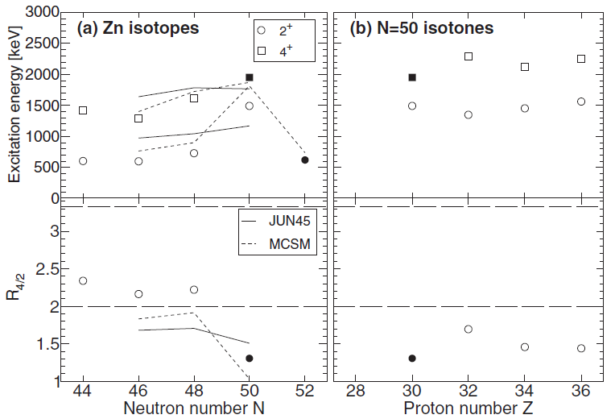
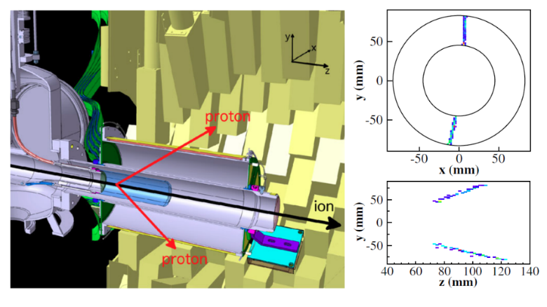
Magic number 50 is (likely) robust
β-decay halflives @RIBF/Eurica
2₁⁺, 4₁⁺ states of ^{80,82}Zn @RIBF/ZDS/DALI2
⁷⁸Ni
Z.Y. Xu et al., Phys. Rev. Lett. 113, 032505 (’14)
Y. Shiga et al., Phys. Rev. C 93, 024320 (’16)
Excited states of ⁷⁸Ni @RIBF/Minos/DALI2
Minos drawings from C. Santamaria et al., Phys. Rev. Lett. 115, 192501 (’15)

Slide 11
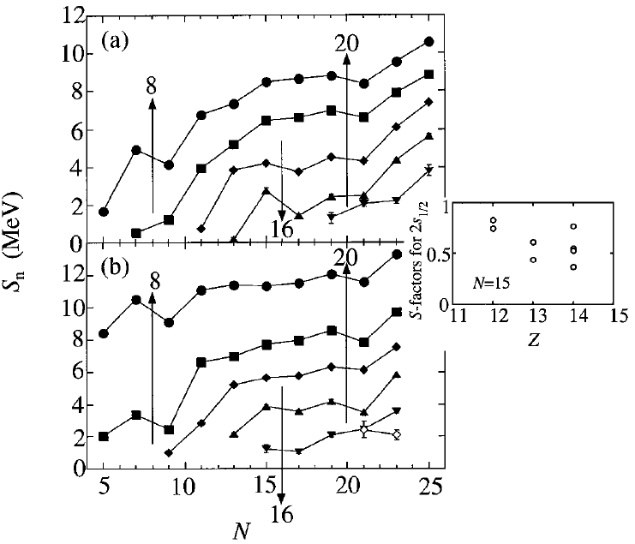
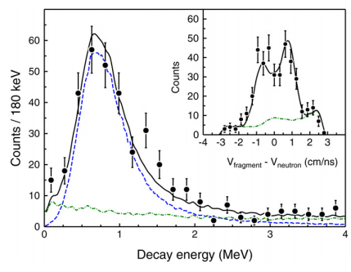
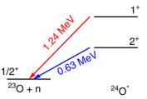
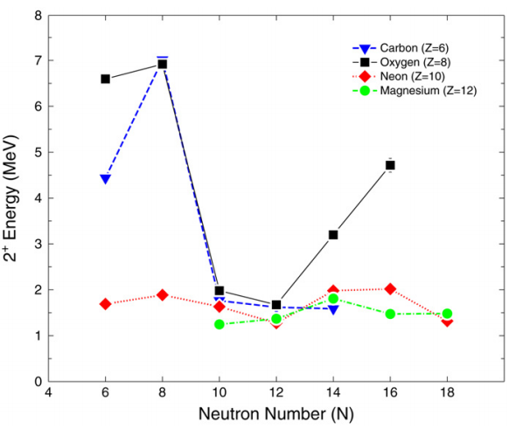
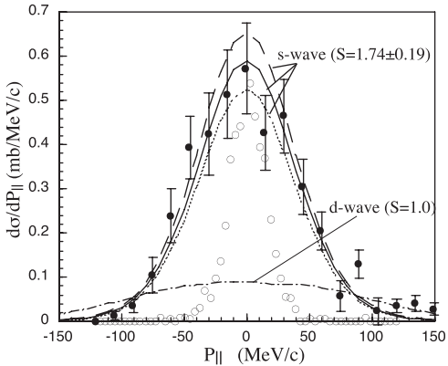
New magic number 16
Systematics of 1n separation energy
²⁴O 2₁⁺ state via ²⁶F + ⁹Be → ²⁴O* → ²³O + n @NSCL/MoNA (plastic telescope)
Odd N, even Z
Odd N, odd Z
A. Ozawa et al., Phys. Rev. Lett. 84, 5493 (’00)
1n removal of ²⁴O @GSI/FRS
²⁴O
ν1d_{3/2}
16
ν2s_{1/2}
R. Kanungo et al., Phys. Rev. Lett. 102, 152501 (’09)
C.R. Hoffman et al., Phys. Lett. B 672, 17 (’09)

Slide 12
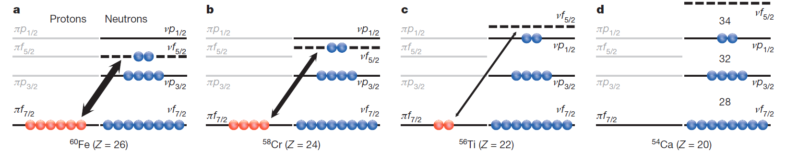
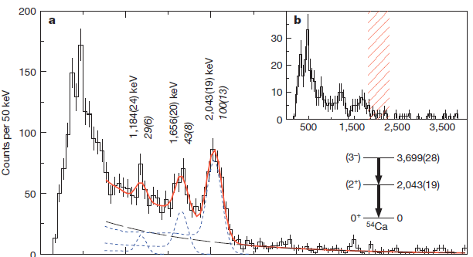
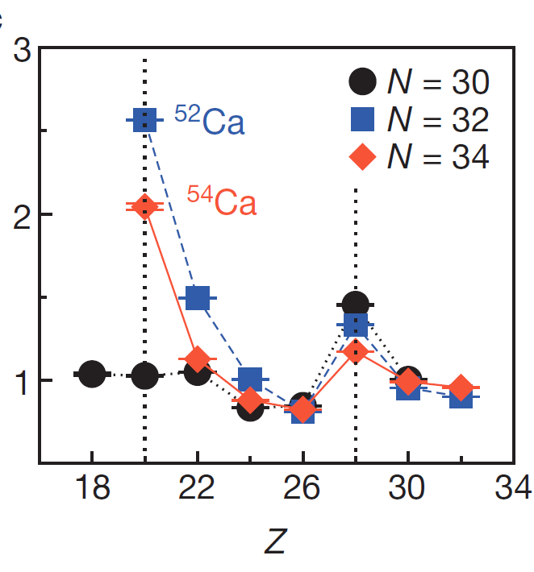
New magic numbers 32 and 34
⁵⁵Sc/⁵⁶Ti + ⁹Be → ⁵⁴Ca* → ⁵⁴Ca + γ @RIBF/DALI2/ZDS
E_{x} [MeV]
Gated by
2043-keV γ-ray
E_{gamma} [keV]
⁵²Ca 2₁⁺ energy
β-delayed γ-ray spectroscopy @ISOLDE
A. Huck et al., Phys. Rev. C31, 2226 (’85)
D. Steppenbeck et al., Nature 502, 207 (’13)

Slide 13
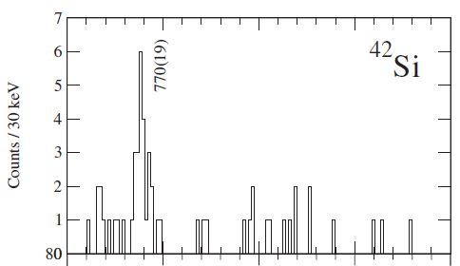
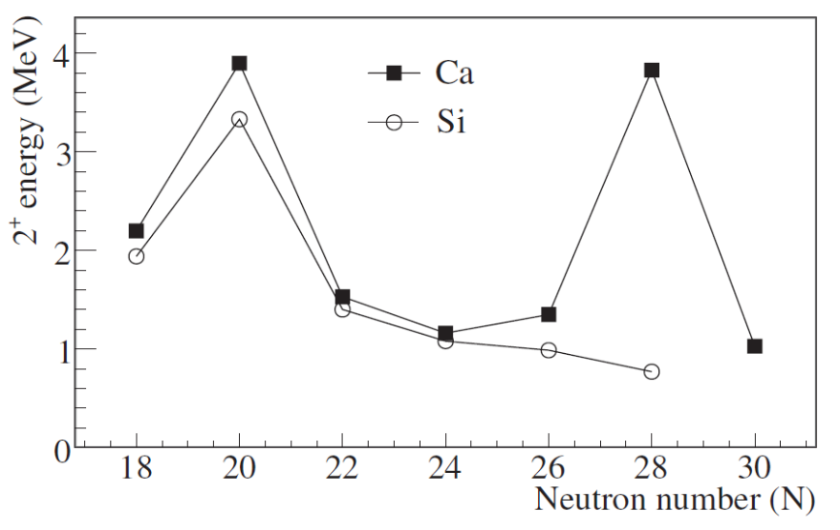

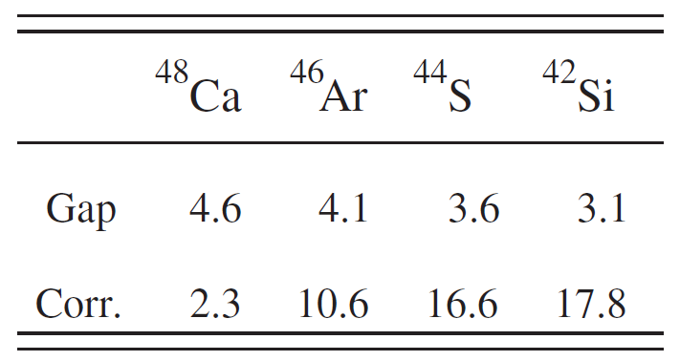
N = 28: diluting gap vs. quadrupole correlation
⁴²Si 2₁⁺ via 2p knockout of ⁴⁴S @GANIL/SPEG/BaF₂
B. Bastin et al., Phys. Rev. Lett. 99, 022503 (’07)
⁴⁸Ca
⁴²Si
Shell model (SDPF-U^{[1]})
in MeV
~70%
N = 28 gap
Multipole correlation
(pairing, L = 2, 3 ...)
× 8
C. Force et al., Phys. Rev. Lett. 105, 102501 (’10)
[1] F. Nowacki, A. Poves, Phys. Rev. C 79, 014310 (’09)

Slide 14
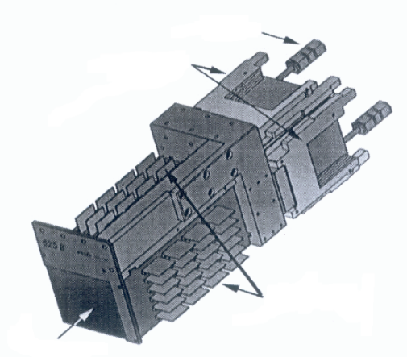
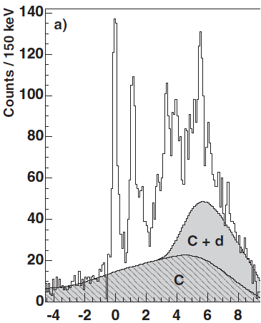
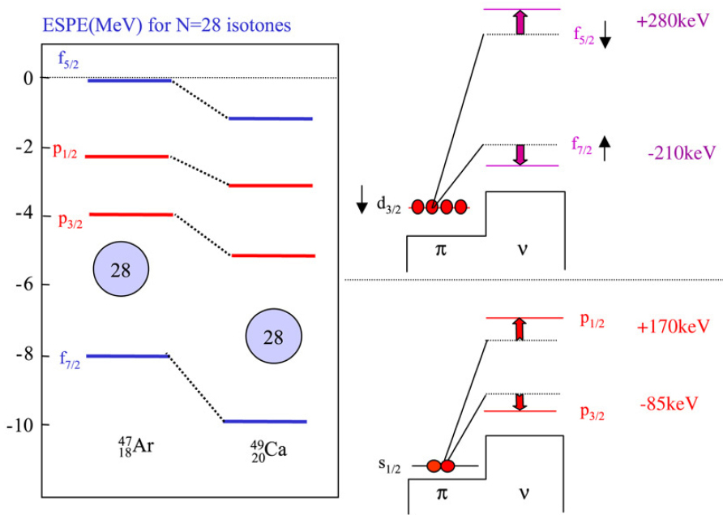
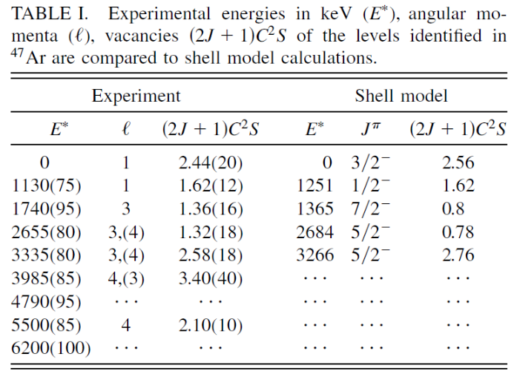
N = 28: non-tensor term
⁴⁶Ar(d,p)⁴⁷Ar @GANIL/Spiral/MUST
6×6 cm²
DSSD
Preamplifiers
Tensor
E_{x} [MeV]
Non-tensor
L. Gaudefroy et al., Phys. Rev. Lett. 97, 092501 (’06)

Slide 15
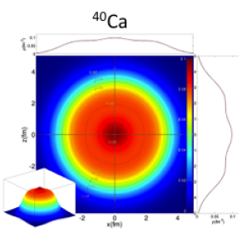
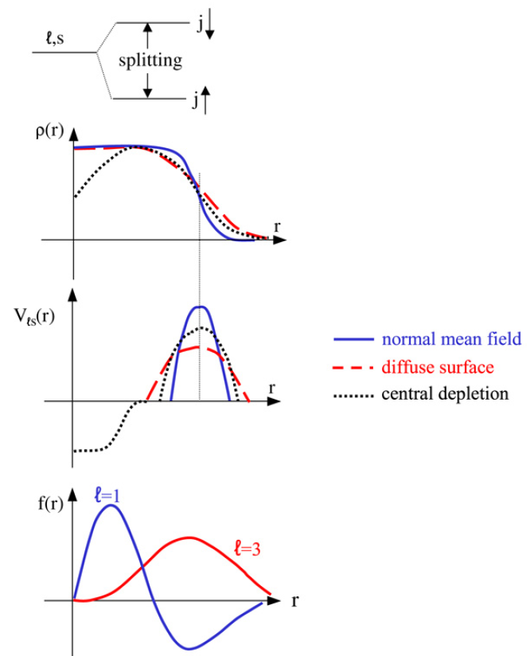
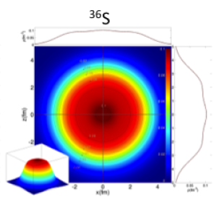
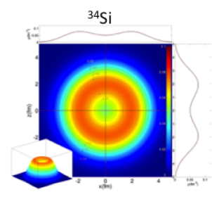
LS splitting with proton bubble
proton
π1d_{3/2}
π2s_{1/2}
π1d_{3/2}
π2s_{1/2}
π1d_{3/2}
π2s_{1/2}
RMF (J.P. Ebran)
O. Sorlin, M-G. Porquet, Prog. Part. Nucl. Phys. 61, 602 (’08)
O. Sorlin, M-G. Porquet, Phys. Scr. T152, 014003 (’13)

Slide 16
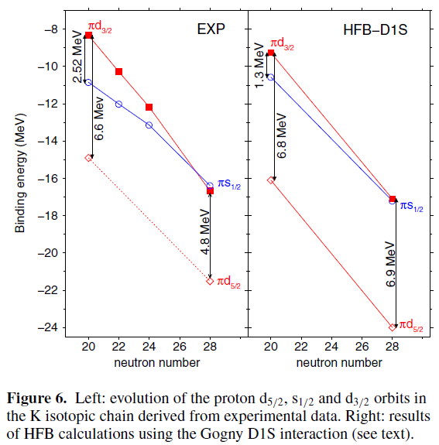
N = 28: LS and tensor interplay
Tensor
LS interactions
O. Sorlin, M-G. Porquet, Phys. Scr. T152, 014003 (’13)

Slide 17
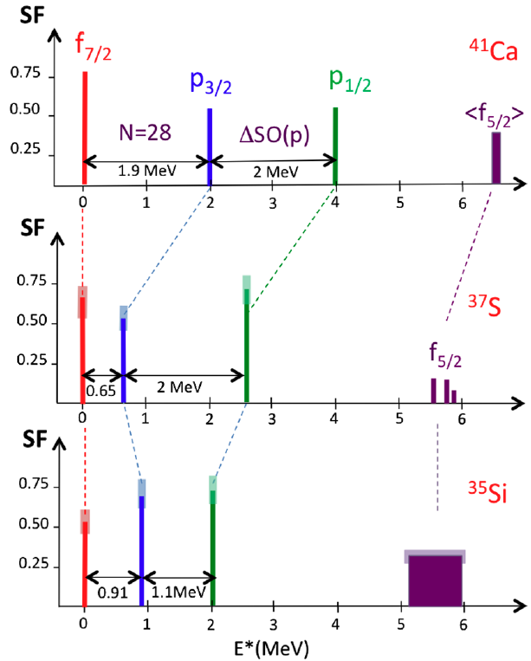
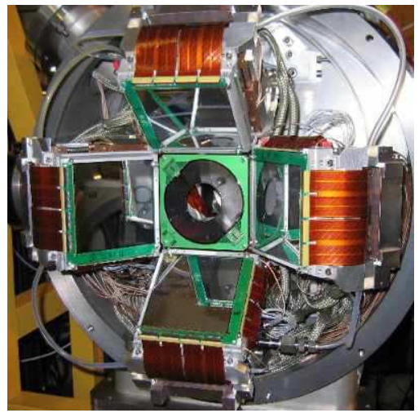
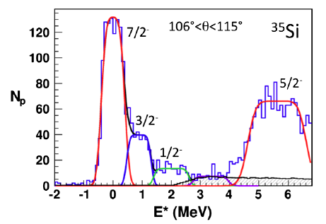
N = 20: isolate bubble-driven LS splitting
³⁴Si(d,p)³⁵Si @GANIL/LISE/MUST2
10×10 cm²
DSSD
G. Burgunder, O. Sorlin et al., Phys. Rev. Lett. 112, 042502 (’14)

Slide 18
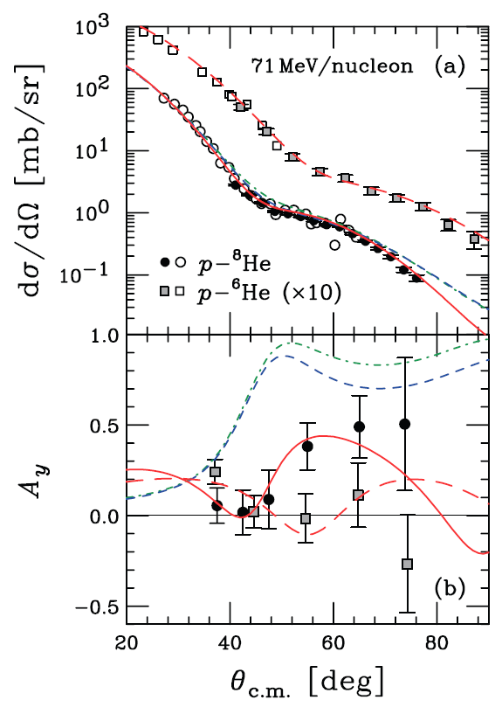
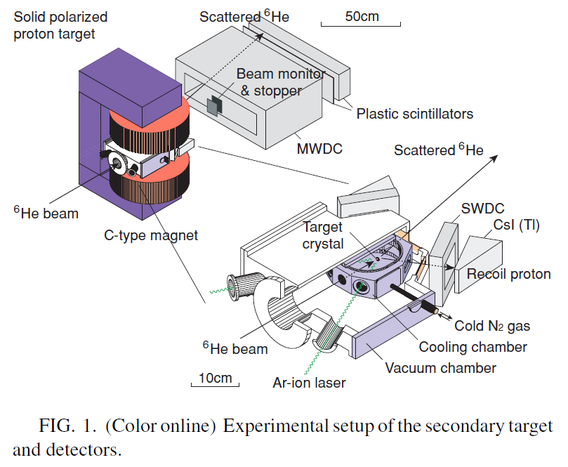
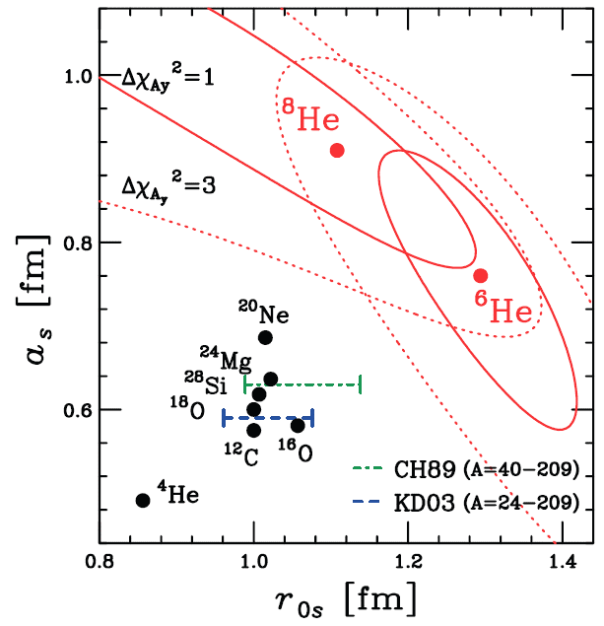
^{6,8}He: LS potential and diffuseness
^{6,8}He(pol p,p) @RIPS/Polarized proton target
T. Uesaka et al., Phys. Rev. C 82, 021602 (’10)
S. Sakaguchi et al., Phys. Rev. C 84, 024604 (’11)
S. Sakaguchi et al., Phys. Rev. C 87, 021601 (’13)

Slide 19
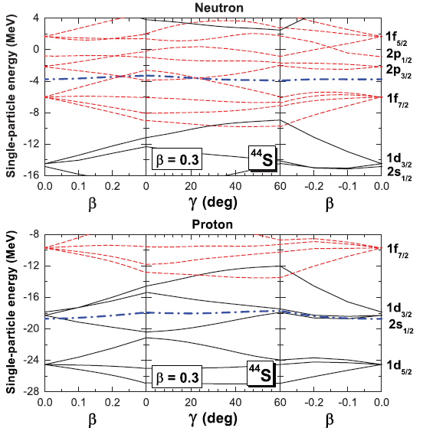
Proton shell vs. neutron shell in ⁴⁴S (Z = 16, N = 28)
Prolate
Oblate
Fermi surface
Fermi surface
Z.P. Li et al., Phys. Rev. C 84, 054304 (’11)

Slide 20
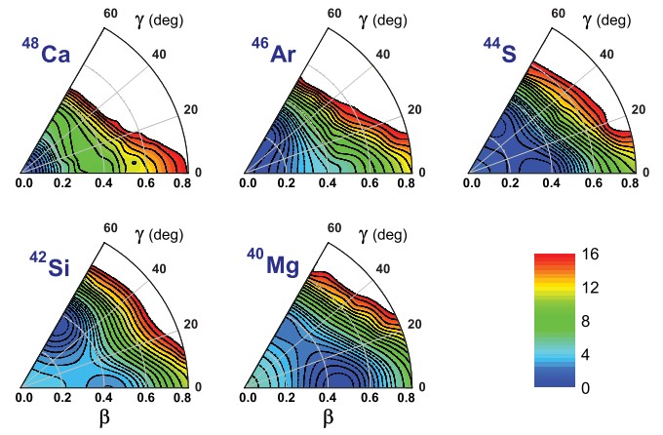
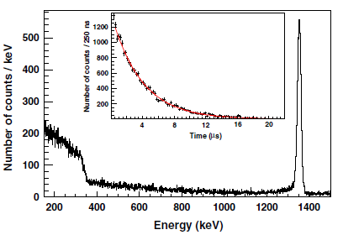
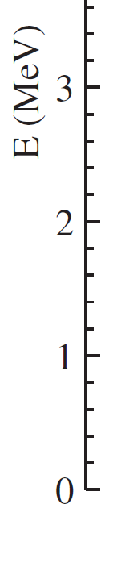
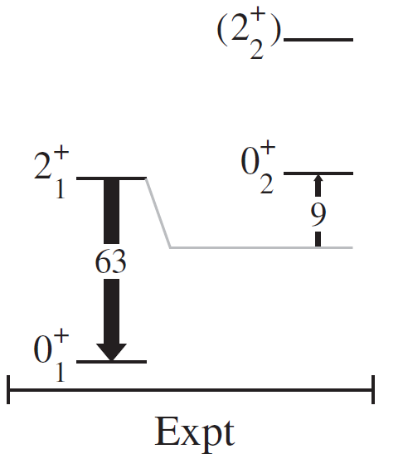
Shape frustration
Triaxial quadrupole constrained RHB
Z = 20
Z = 18
Z = 16
Z = 14
Z = 12
Spherical
γ-soft
prolate vs. oblate
oblate
prolate
Z.P. Li et al., Phys. Rev. C 84, 054304 (’11)
⁴⁴K β-decay → ⁴⁴S + γ/e⁻@GANIL/LISE/Si(Li)/Exogam
⁴⁴S
E_{x} [MeV]
C. Force et al., Phys. Rev. Lett. 105, 102501 (’10)

Slide 21
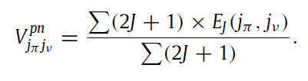
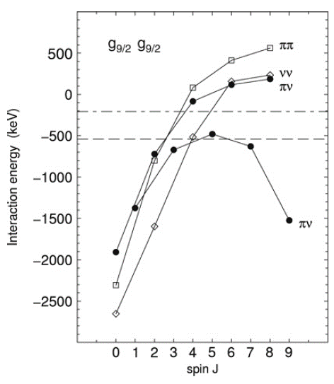
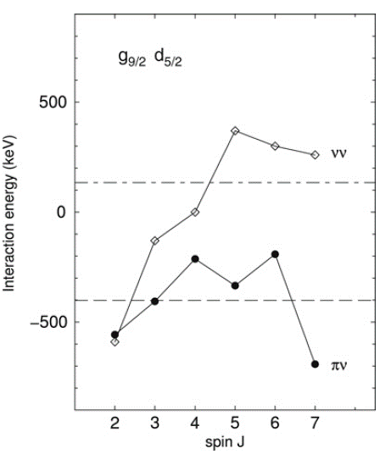
nn vs. pn interactions
⁹²₄₂Mo₅₀
T = 1
⁸⁸₄₀Zr₄₈
νν
⁹⁰₄₀Zr₅₀
T = 0
⁹⁰₄₁Nb₄₉
πν
⁹²₄₁Nb₅₁
O. Sorlin, M-G. Porquet, Phys. Scr. T152, 014003 (’13)
Weaker than pn monopole due to Pauli blocking
Except small J with strong pairing

Slide 22





Oxygen isotopes and 3N correlations
Systematics of binding energies
A. P. Zuker, Phys. Rev. Lett. 90, 042502 (’03)
T. Otsuka et al., Phys. Rev. Lett. 105, 032501 (’10)
²⁷F 1p removal → ²⁶O @RIBF/Samurai/Nebula
²⁹F 1p removal → ²⁸O
@RIBF/Minos/Samurai/Nebula + NeuLand
Y. Kondo et al., Phys. Rev. Lett. 116, 102503(’16)
From the RIBF seminar by Y. Kondo (April 19, ’16)

Slide 23




LS interactions vs. α clustering in ¹⁰Be
E_{x} [MeV]
⁶He + α resonant scattering @Twinsol/PAT-TPC
¹⁰Be
4⁺
Γ_{α} = 145 keV
θ_{α}² = 0.66 – 2.23
(R₀ = 1.8 – 1.4 fm)
σ type
RHB
Γ_{α} < 20 keV
J-P. Ebran et al.
Phys. Rev. C 90, 054329 (’14)
2⁺
0⁺
D. Suzuki et al.,
Phys. Rev. C 87, 054301 (’13)
ab-initio (ANL)
4⁺
α+α scattering analysis
⁸Be
S(4⁺) = 1.39
S(2⁺) = 1.46
0⁺
S(0⁺) = l.48
P. Mohr et al.
Z. Phys. A 349, 339 (’94)
R.B. Wiringa et al.,
Phys. Rev. C 62, 014001 (’00)

Slide 24


Effects of 1p_{1/2}-1p_{3/2} splitting
ν1p_{1/2}
ν1p_{1/2}
ν1p_{3/2}
ν1p_{3/2}
⁸Be
¹⁰Be
Molecular Orbital Model
M. Seya, M. Kohno, S. Nagata, PTEP 65, 204 (’81)
¹⁰Be
⁹Be
W/o spin-orbit
W/ spin-orbit

Slide 25
Retrospective of past 5 to 10 years
pn-tensor interaction is as important as LS interaction, conclusively(?)
  New magic numbers 16 and 34
Power balance – competition and cooperation
  Monopole vs. Quadrupole (N = 28)
  Proton shell vs. Neutron shell (⁴⁴S)
  LS vs. tensor (⁴⁷Ar, ¹⁰Be)
Isolate effects under shadow
  Density dependence of LS interaction (³⁵Si, ^{6,8}He)
  3N correlations (²⁴⁻²⁸O)

Slide 26



Retrospective of past 5 to 10 years
In-beam γ-ray specstoscopy
Missing mass specstoscopy
DALI2/Minos/ZDS or Samurai
MUST2/Tiara/Exogam/Vamos or LISE

Slide 27





Perspective toward next 5 years
Next flagships
  ⁵⁴Ca, ⁷⁸Ni are, or will soon be, over.
  ¹⁰⁰Sn (Z = 50, N = 50), ¹⁴⁰Sn (N = 90), else?
    nn-monopole and universality (c.f. ⁴⁸Ca)
    pairing
HF + Skyrme + Tensor
HFB + QRPA
Sn isotopes
Ca
Sn
2f_{7/2}
H. Shimoyama, M. Matsuo, Phys. Rev. C 84, 044317 (’11)
M. Anguiano et al., Phys. Rev. C 86, 054302 (’12)

Slide 28


Perspective toward next 5 years
Further insight into power balance
  LS vs. tensor (South of ²⁰⁸Pb, depletion due to π3s_{1/2})
  LS vs. monopole vs. α clustering (⁸Be-¹⁰Be-¹²Be...)
  Monopole vs. Quadrupole (single partice states near N = 20?)
  Else??
Normal (²⁰⁸Pb)
0₂⁺
Proton density [fm⁻³]
Bubble (²⁰⁶Hg)
0₁⁺
B.G. Todd-Rutel et al., Phys. Rev. C 69 (2004) 021301 (R).

Slide 29





GAmma SPectroscopy and PArticle Detection
4π Si array fully integrable in PARIS/AGATA/EXOGAM2
Collaboration: IPNO, INFN-Legnaro, UHU (Spain)., CEA Saclay, Surrey U., BARC (India)
“GASPARD-TRACE” design
Layers of Silicon
  300(500) μm DSSD pitch < 1mm
  1(or 2) x [1.5 mm DSSD pitch~1mm]
2 main shapes : square & trapezoid,
large area
Beam
Option:
Annular
detectors
AGATA
Design : Ph. Rosier (IPN)
Electronics :
GASPARD
~ 10000 channels (Digital)
high transparency to γ-rays
→ Big integration challenge

Slide 30
backup

Slide 31


Perspective toward next 5 years
Next flagships
  ⁵⁴Ca, ⁷⁸Ni are, or will soon be, over.
  ¹⁰⁰Sn (Z = 50, N = 50), ¹⁴⁰Sn (N = 90), else?
    nn-monopole (including 3N force)
    pairing
HFB + QRPA
Sn isotopes
2f_{7/2}
O. Sorlin, M-G. Porquet, Phys. Scr. T152, 014003 (’13)
H. Shimoyama, M. Matsuo, Phys. Rev. C 84, 044317 (’11)

Slide 32



Landscape of Si detectors @ P2IO Labs
1997
2007
2017
MUST
coll.: IPN,CEA-Saclay, DAM
detectors: IPN
electronics: IPN
6cm x 6cm CAMBERRA
60 X + 60 Y strips
PAC
MUST2
coll.: IPN,CEA-Saclay, GANIL
detectors: IPN
electronics:GANIL+Saclay+IPN
DAQ : GANIL
mother boards : IPN
10cm x 10cm MICRON
64X + 64Y
ASIC
GASPARD
coll.: IPN, INFN, BARC
Irfu,STFC,Surrey,GANIL
4π
square + trapezoid transparency to γ
Cooling
Connectors
Publications :
3 PRL, 2 PRC, 1 PLB
1 PRL submitted, 1 PRL in preparation
3 experiments under analysis this year
2 campaigns @ GANIL, 1 @ RIKEN
Preamplifiers
Detectors

Slide 33
GAmma SPectroscopy and PArticle Detection
4π Si array fully integrable in PARIS/AGATA/EXOGAM2
Collaboration: IPNO, INFN-Legnaro, UHU (Spain)., CEA Saclay, Surrey U., BARC (India)
“GASPARD-TRACE” design
Layers of Silicon
  300(500) μm DSSD pitch < 1mm
  1(or 2) x [1.5 mm DSSD pitch~1mm]
2 main shapes : square & trapezoid,
large area
Beam
Option:
Annular
detectors
AGATA
Design : Ph. Rosier (IPN)
Electronics :
GASPARD
~ 10000 channels (Digital)
high transparency to γ-rays
→ Big integration challenge

Slide 34
Perspective toward next 5 years
Players under shadow
  Density dependence of LS
    South of ²⁰⁸Pb
  nn monopole
    New magic number at N = 90 ¹⁴⁰Sn?
  nn pairing near continuum
    O, Ca, Sn(d,p)(p,d)
    O, Ca, Sn(p,t)

Slide 35

The earliest study
Isotopic abandance → magic numbers

Slide 36
Summary
Studying shell structure is to explore
  many-body correlations
  their origins in the nuclear force
Interactions | New findings | Future perspective
pn-tensor | New magic numbers at 16 and 34 N = 50 is most likely magic | Establish N = 50 New magic N = 90 (¹⁴⁰Sn)
LS | Sensitivity to central depletion Sensitivity to surface diffuseness Alpha cluster melting | South of ²⁰⁸Pb (new bubble)
3N | Oxygen binding energies | ²⁸O binding energy Ca isotopes
Quadrupole |  | → Niikura
Octupole |  | → Niikura

