Slide 1
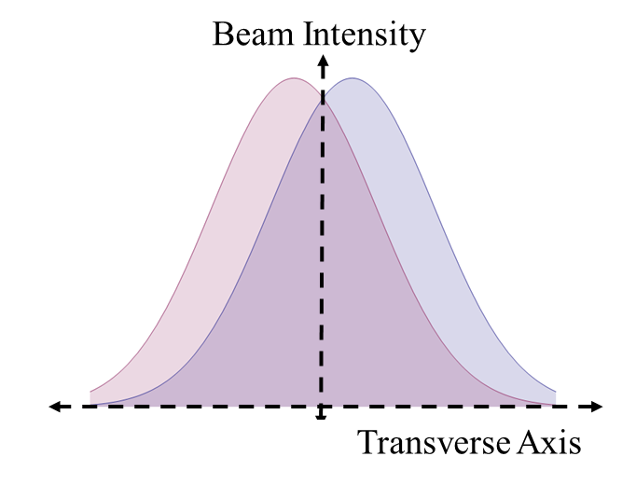
Vernier Analysis Tutorial
Spin Fest 2016
Mike Beaumier, PhD
University of California, Riverside

Slide 2
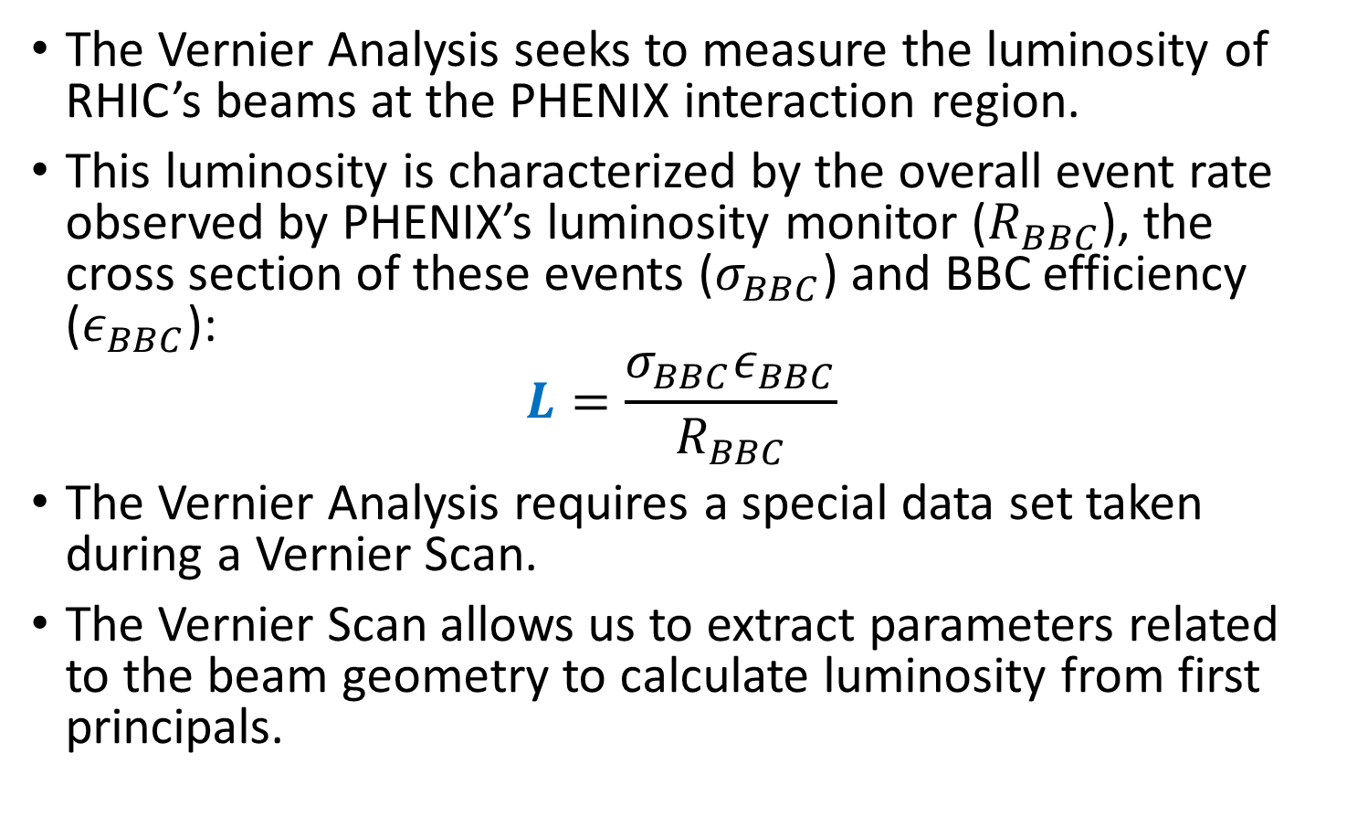
What is the Vernier Analysis?
The Vernier Analysis seeks to measure the luminosity of RHIC’s beams at the PHENIX interaction region.
This luminosity is characterized by the overall event rate observed by PHENIX’s luminosity monitor ($R_{BBC}$), the cross section of these events ($σ_{BBC}$) and BBC efficiency ($ε_{BBC}$):
$$L=\frac{σ_{BBC}ε_{BBC}}{R_{BBC}}$$
The Vernier Analysis requires a special data set taken during a Vernier Scan.
The Vernier Scan allows us to extract parameters related to the beam geometry to calculate luminosity from first principals.

Slide 3
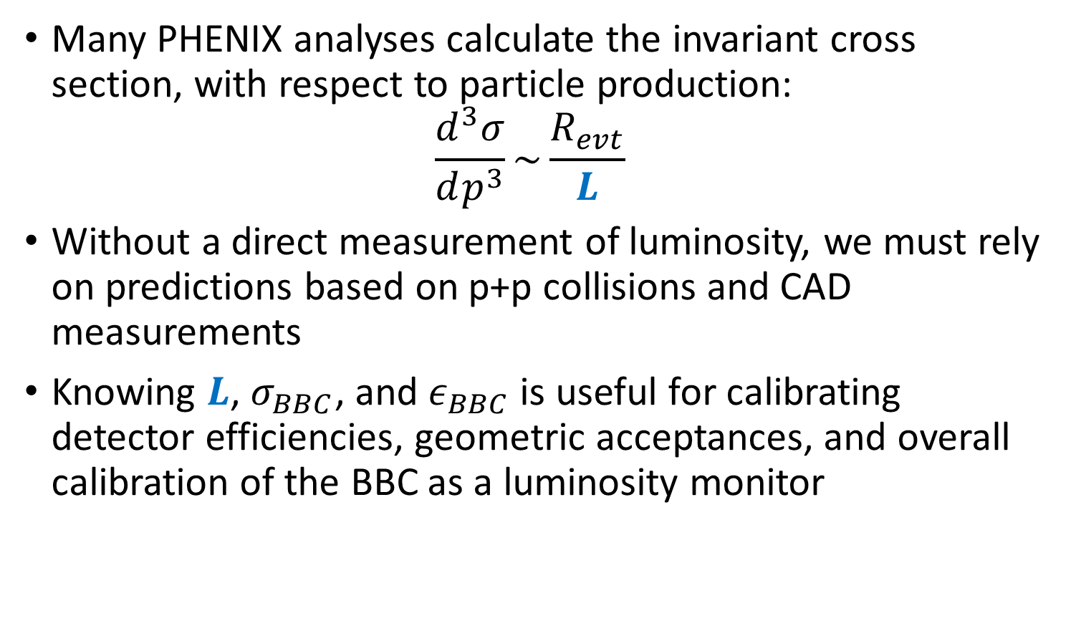

Why do we need to know $L$?
Many PHENIX analyses calculate the invariant cross section, with respect to particle production:
$$\frac{d^{3}σ}{dp^{3}}\sim \frac{R_{evt}}{L}$$
Without a direct measurement of luminosity, we must rely on predictions based on p+p collisions and CAD measurements
Knowing $L$, $σ_{BBC}$, and $ε_{BBC}$ is useful for calibrating detector efficiencies, geometric acceptances, and overall calibration of the BBC as a luminosity monitor

Slide 4
What is the Vernier Scan?
One beam is swept transversely across another. Correlating the displacement to the BBC rate produces the transverse beam profile.
BBC Rate
Beam Displacement
Blue Beam
Yellow Beam

Slide 5
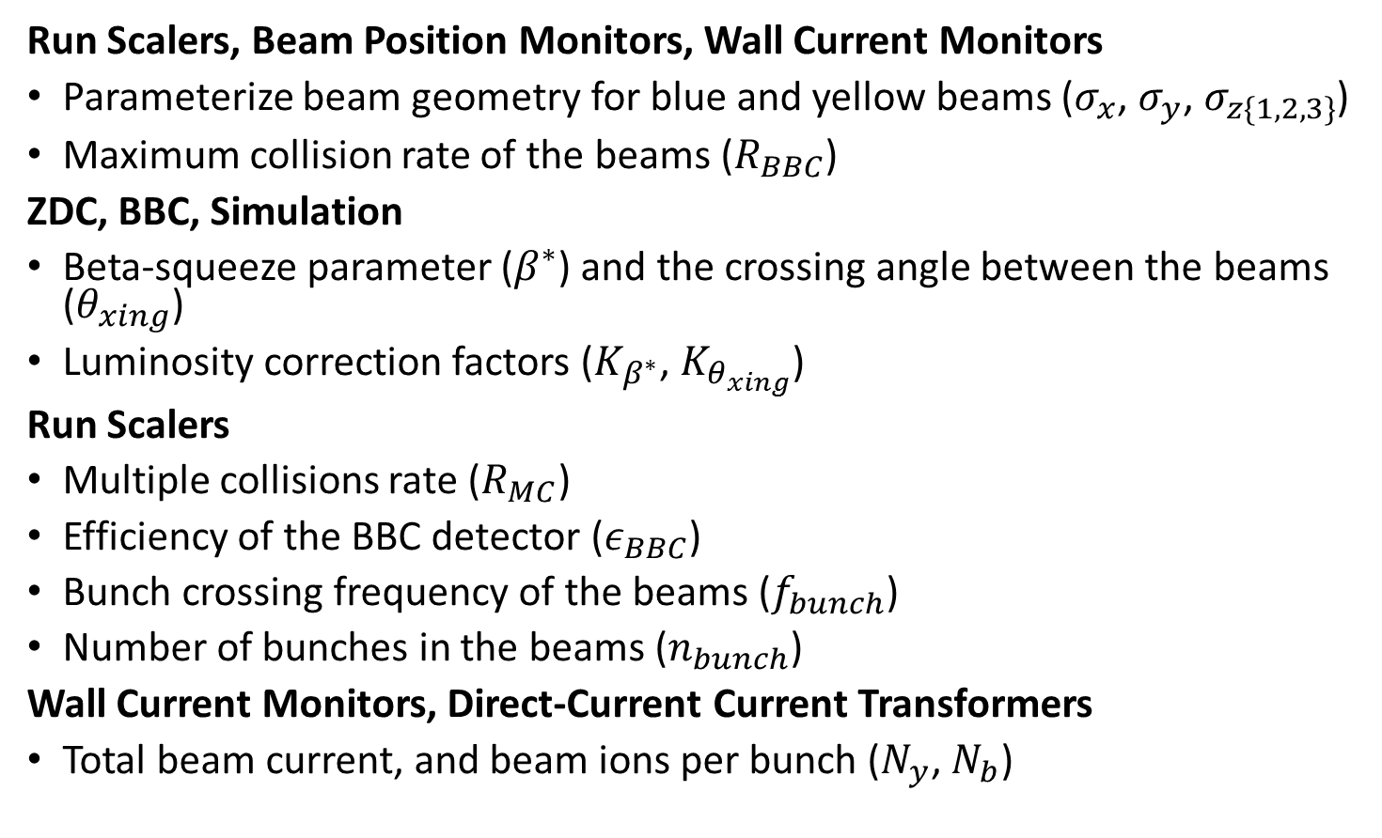
Parameters, Data Sources
Run Scalers, Beam Position Monitors, Wall Current Monitors
Parameterize beam geometry for blue and yellow beams ($σ_{x}$, $σ_{y}$, $σ_{z\{1,2,3\}}$)
Maximum collision rate of the beams ($R_{BBC}$)
ZDC, BBC, Simulation
Beta-squeeze parameter ($β^{∗}$) and the crossing angle between the beams ($θ_{xing}$)
Luminosity correction factors ($K_{β^{∗}}$, $K_{θ_{xing}}$)
Run Scalers
Multiple collisions rate ($R_{MC}$)
Efficiency of the BBC detector ($ε_{BBC}$)
Bunch crossing frequency of the beams ($f_{bunch}$)
Number of bunches in the beams ($n_{bunch}$)
Wall Current Monitors, Direct-Current Current Transformers
Total beam current, and beam ions per bunch ($N_{y}$, $N_{b}$)

Slide 6
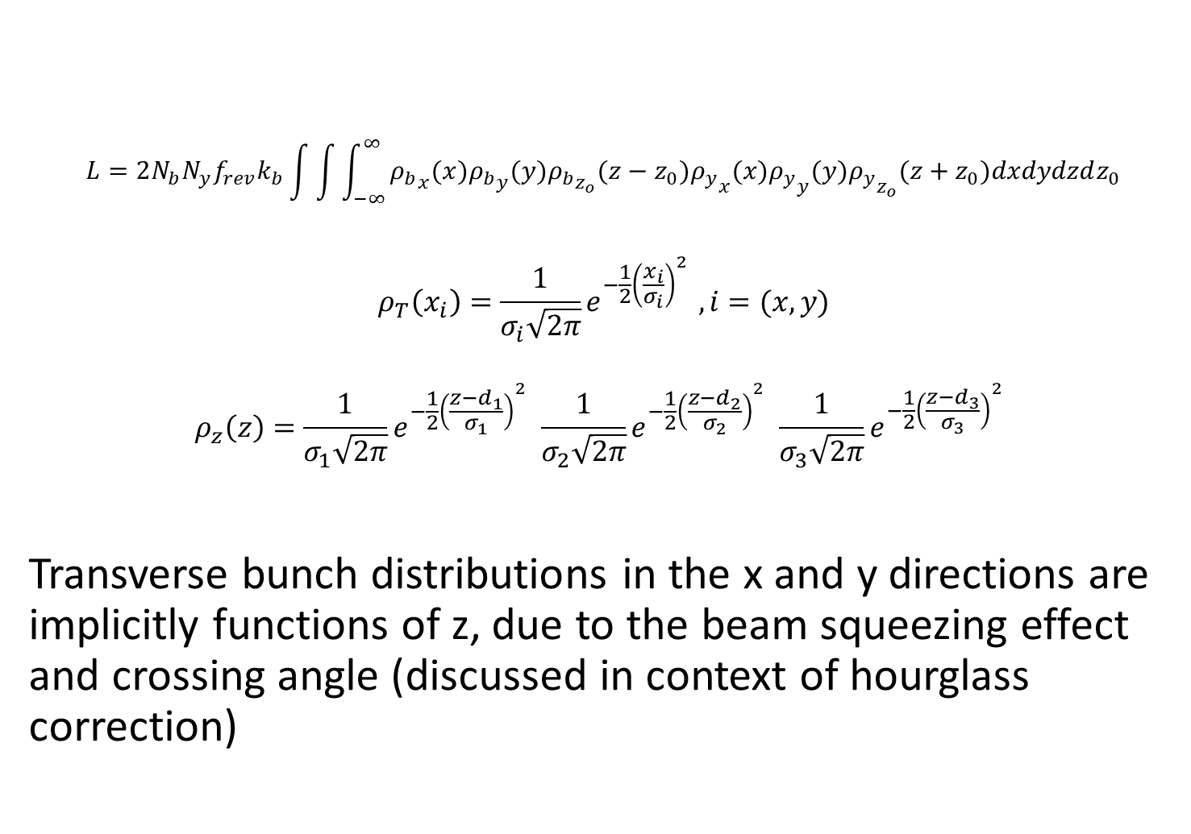
Calculating Luminosity
$$L=2N_{b}N_{y}f_{rev}k_{b}\int{\int{\int_{−∞}^{∞}{{ρ_{b}}_{x}(x){ρ_{b}}_{y}(y){ρ_{b}}_{z_{o}}(z−z_{0}){ρ_{y}}_{x}(x){ρ_{y}}_{y}(y){ρ_{y}}_{z_{o}}(z+z_{0})dxdydzdz_{0}}}}$$
$$ρ_{T}\left(x_{i}\right)=\frac{1}{σ_{i}\sqrt{2π}}e^{−\frac{1}{2}{\left(\frac{x_{i}}{σ_{i}}\right)}^{2} }, i=(x,y)$$
$$ρ_{z}\left(z\right)=\frac{1}{σ_{1}\sqrt{2π}}e^{−\frac{1}{2}{\left(\frac{z−d_{1}}{σ_{1}}\right)}^{2} }\frac{1}{σ_{2}\sqrt{2π}}e^{−\frac{1}{2}{\left(\frac{z−d_{2}}{σ_{2}}\right)}^{2} }\frac{1}{σ_{3}\sqrt{2π}}e^{−\frac{1}{2}{\left(\frac{z−d_{3}}{σ_{3}}\right)}^{2} }$$
Transverse bunch distributions in the x and y directions are implicitly functions of z, due to the beam squeezing effect and crossing angle (discussed in context of hourglass correction)

Slide 7
Extracting the Transverse Beam Profile

Slide 8
Run Scalers
Trigger Scaler | Description
“BBCLL1(>0 tubes) novertexcut” (BBC wide) | Fires any time there is a coincidence of the BBC North and South within a prescribed time window
“BBCLL1(>0 tubes)” (BBC narrow) | Same as novertex cut, but with an online vertex cut of approximately +/- 30 cm
“ZDCLL1wide” (ZDC wide) | Fires any time there is a coincidence of the ZDC north and South within a prescribed time window
“CLOCK” | Fires once every beam clock count (once per bunch crossing)
The GL1-1P scalers must be specially programmed into the GL1-1P boards. These scalers record the number of live triggers for each scaler, and sum them. The sum is read out each recorded event, and the counter resets

Slide 9
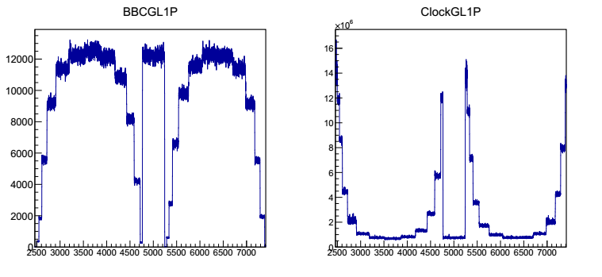
The BBC Rate
Events are ordered in time by summing every 1000 events. The BBC wide scaler is divided by the clock scaler for each bin to obtain the BBC rate

Slide 10
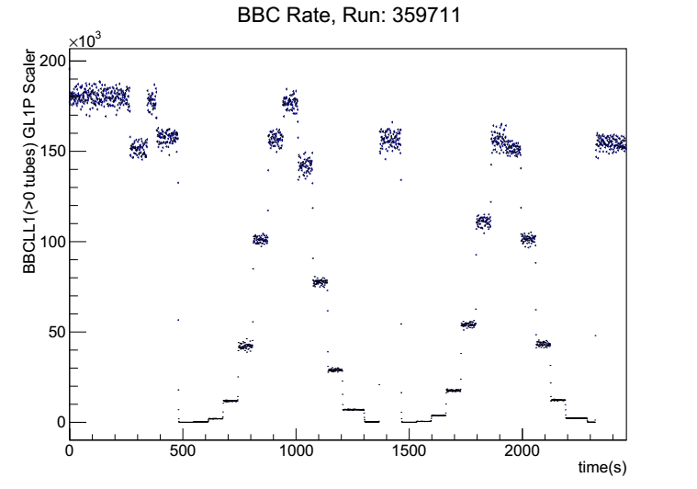
The BBC Rate
Note the obvious stepped distribution of the BBC rate. Each step corresponds to the BBC rate associated with a fixed beam displacement.

Slide 11
Obtaining Beam Positions
Use measurements at BPM7 and BPM8 to produce intersection point at IR plane of blue, yellow beams.
y
x
Blue beam
s
z
Yellow beam
Then, once intersection points are known, calculate distance between beams, s, at the IR plane.
BPM
Sector 7 Plane
BPM
Sector 8 Plane
PHENIX Interaction
Region, Coordinate System

Slide 12
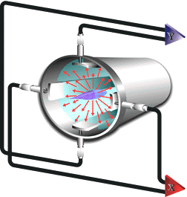
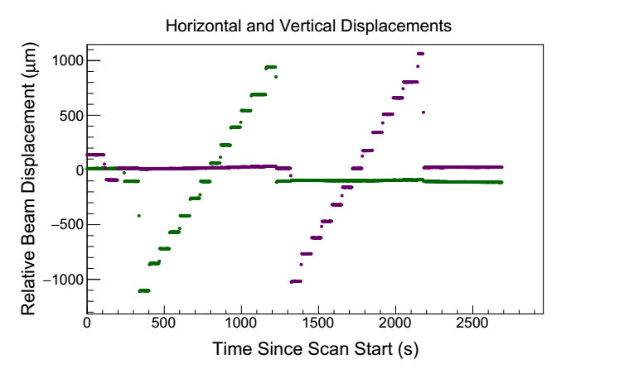
Monitoring Beam Position
Beam Position Monitor
While BPMs do not necessarily give an accurate position for each beam individually, they can be used to calculate the separation between the beams

Slide 13
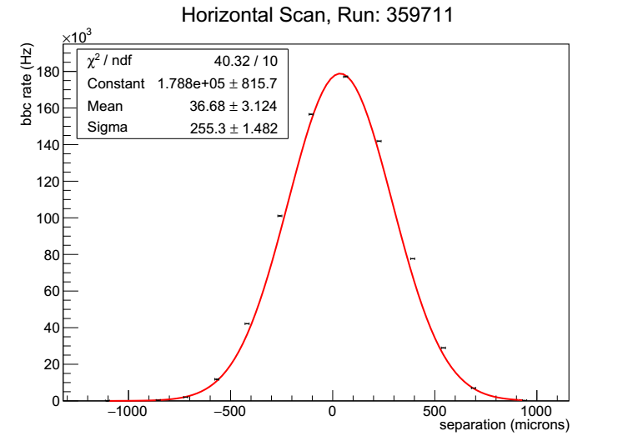
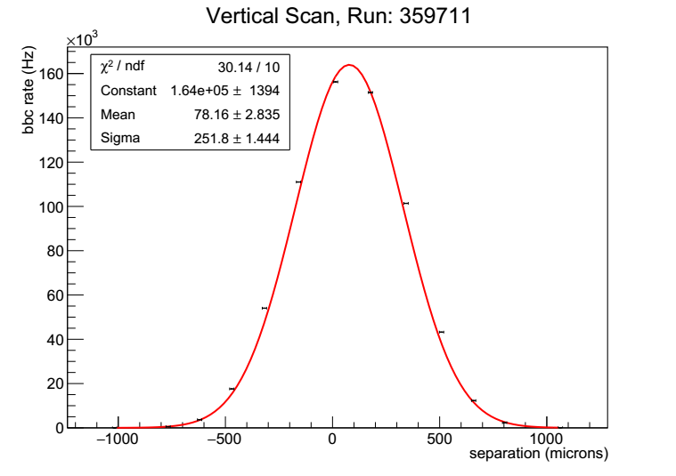
Beam Width Fit
The beam displacements are correlated to the related rates, and the distributions are fit with a Gaussian. The width of the Gaussian gives a measurement of the beam width for the horizontal and vertical dimensions of the beam.

Slide 14
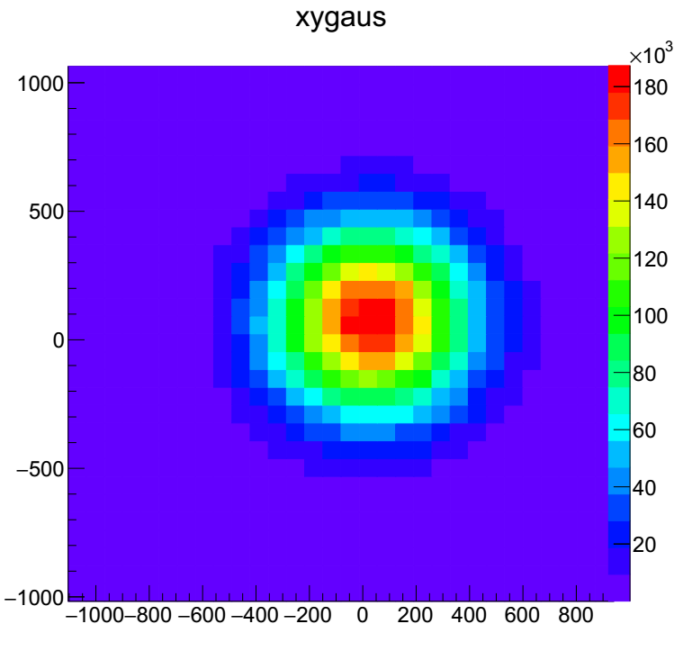
Beam Width Fit
Simultaneous Beam Width
A simultaneous Gaussian fit in x and y provides the ‘actual’ value for the beam width in the transverse directions.
Y Displacement
0.0251 mm
0.0254 mm
X Displacement

Slide 15
Beam Ion Population

Slide 16
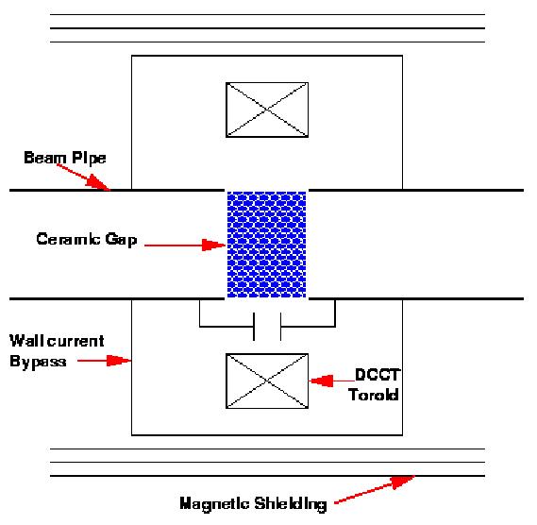
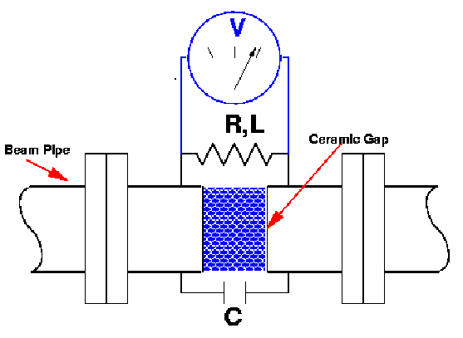
Wall Current Monitor
Direct-Current Current Transformer
The wall current monitor offers sub-beam clock current timing, and is sensitive to beam bunching, but is less accurate than the DCCT
The DCCT is sensitive to the overall beam population, and can be used to correct the readout of the WCM

Slide 17
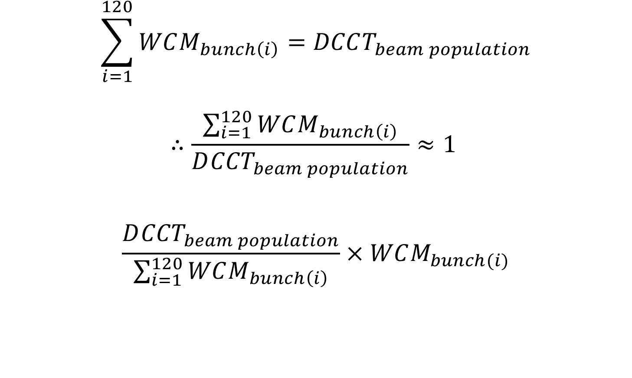
Calibrating the WCM with DCCT
$$\sum_{i=1}^{120}{WCM_{bunch\left(i\right)}}=DCCT_{beam population}$$
$$∴\frac{\sum_{i=1}^{120}{WCM_{bunch\left(i\right)}}}{D{CCT}_{beam population}}≈1$$
$$\frac{D{CCT}_{beam population}}{\sum_{i=1}^{120}{WCM_{bunch\left(i\right)}}}×WCM_{bunch(i)}$$

Slide 18
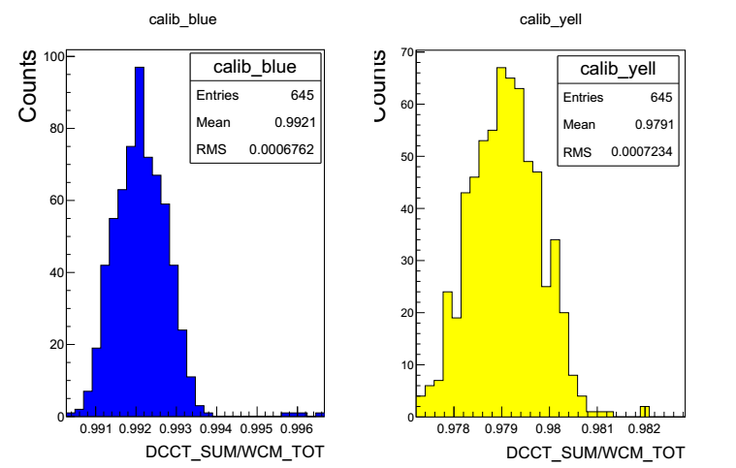
Calibrating the WCM with DCCT
The calibration may be done in ‘real time’
Calibration constant calculated, applied when DCCT + WCM data available simultaneously
Distribution of calibration can be studied
Blue Beam Calibration
Yellow Beam Calibration

Slide 19
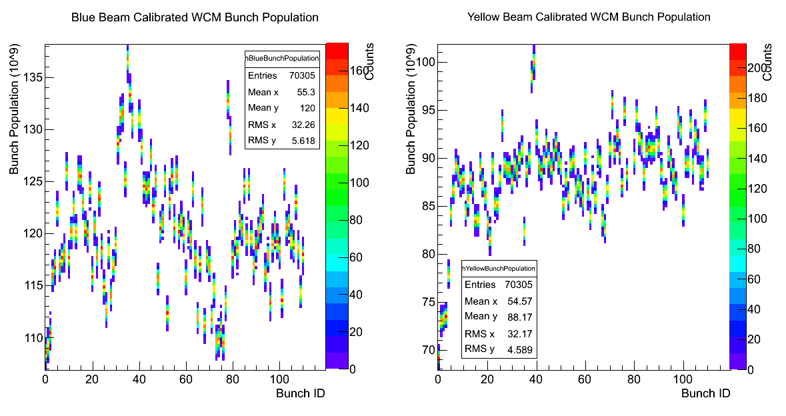
Beam Ion Population Per Bunch

Slide 20
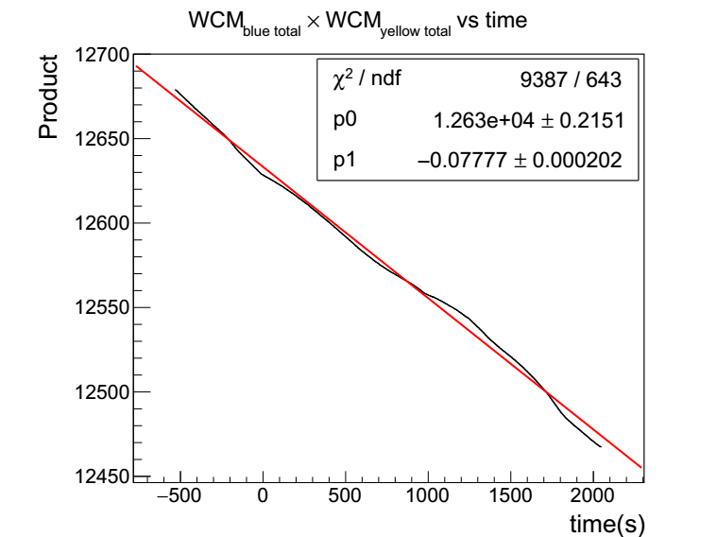
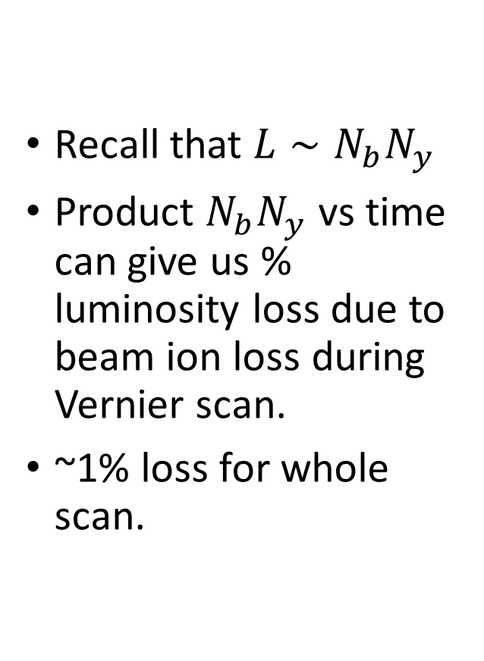
WCM and Luminosity Loss
Recall that $L∼N_{b}N_{y}$
Product $N_{b}N_{y}$ vs time can give us % luminosity loss due to beam ion loss during Vernier scan.
~1% loss for whole scan.

Slide 21
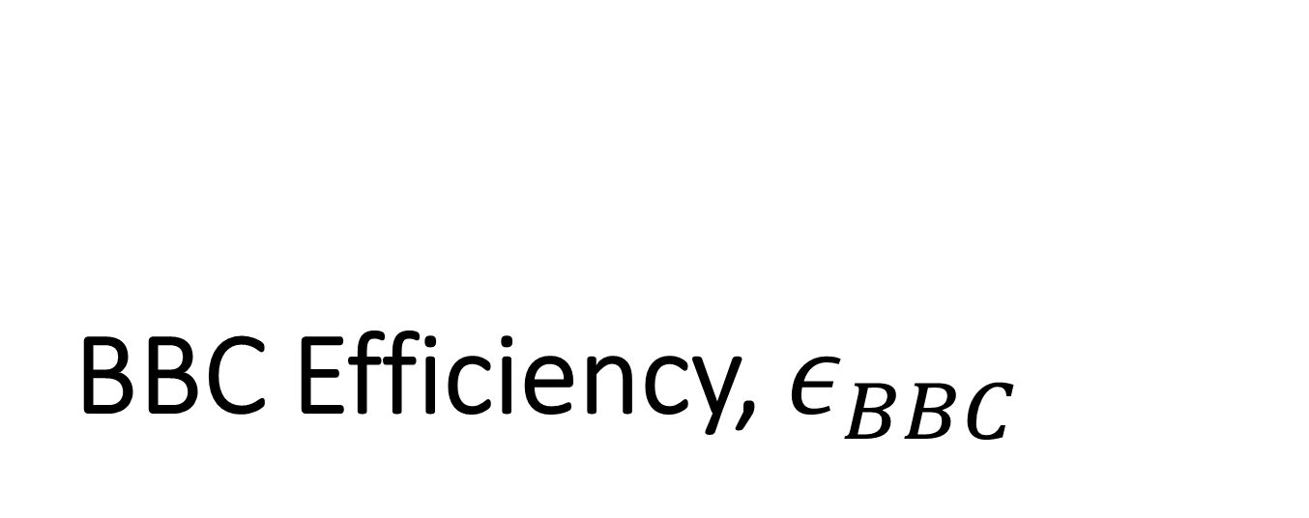
BBC Efficiency, $ε_{BBC}$

Slide 22






BBC Efficiency, $ε_{BBC}$
The BBCs are geometrically limited, and additionally have an associated trigger efficiency.
Beam collisions happen more frequently than the BBC’s recorded rate!
Geometric acceptance:
$$\frac{1}{4π}\left[\int_{θ_{1}}^{θ_{2}}{\sin\left(θ\right)dθ}\int_{0}^{2π}{dφ − \int_{θ_{3}}^{θ_{4}}{\sin\left(θ\right)dθ\int_{0}^{2π}{dφ}}}\right]$$
144.34 + d
144.34 - d
$$θ_{1}$$
$$θ_{4}$$
$$θ_{2}$$
$$θ_{3}$$
10 cm
BBC S
BBC N

Slide 23

Using the ZDC To Calculate $ε_{BBC}$
Solid angle of BBC plotted for all possible z-vertices for the BBC and ZDC
Relatively flat geometric acceptance of the ZDC over the range of the BBC allows us to use it to calculate the efficiency of the BBC
BBC
Solid Angle “As Seen From Vertex”
Z-Vertex
ZDC
Solid Angle “As Seen From Vertex”
Z-Vertex

Slide 24
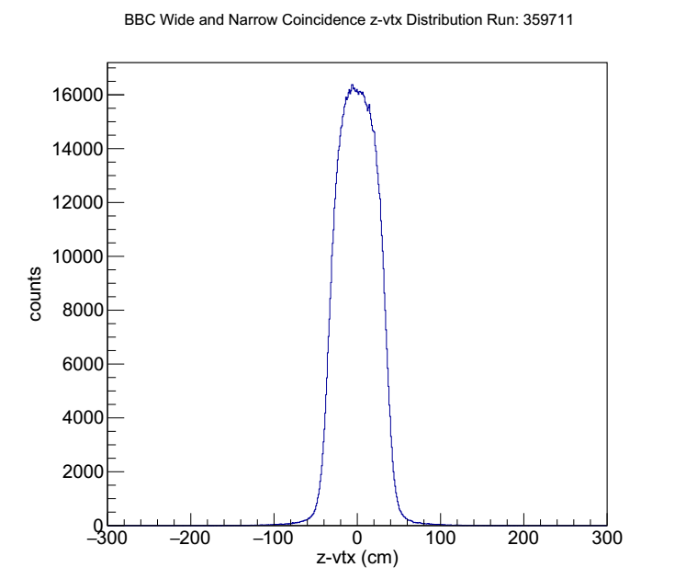
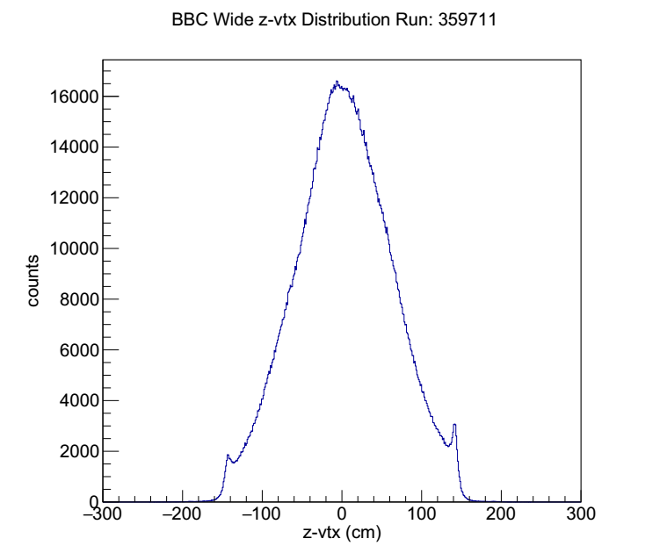
BBC Wide&Narrow vs BBC Wide
Events are binned in z-vertex for coincidences of the BBC wide AND BBC narrow triggers (left) vs BBC wide (right). Taking the bin-by-bin ratio of these distribution shows the trigger acceptance of the BBC narrow trigger.

Slide 25
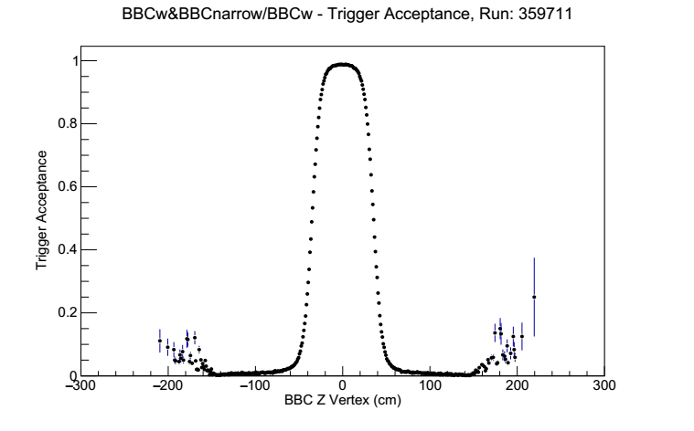
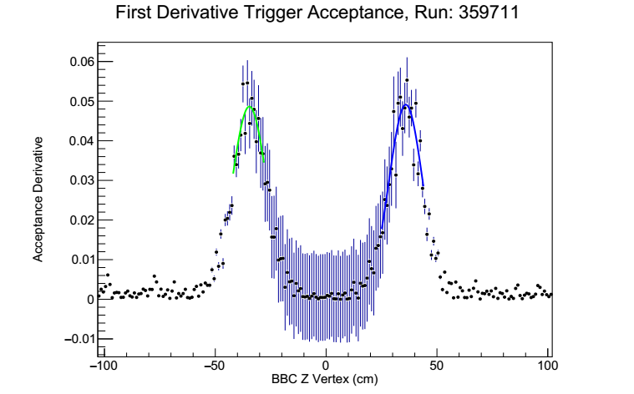
BBC Trigger Acceptance
Creating the trigger acceptance plot shows a clear turn on where there is maximum overlap between BBC wide and narrow triggered events. The absolute value of the derivative of the acceptance can be used to pinpoint the online vertex cut, in this case at -34.4 cm and +35.8 cm

Slide 26
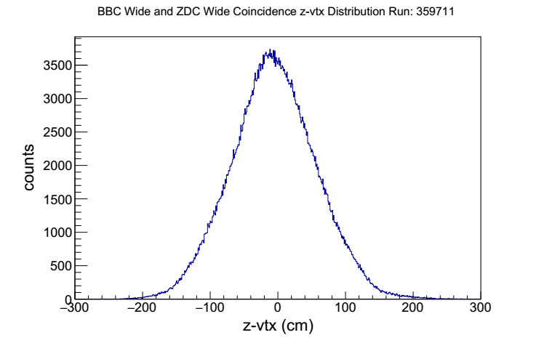
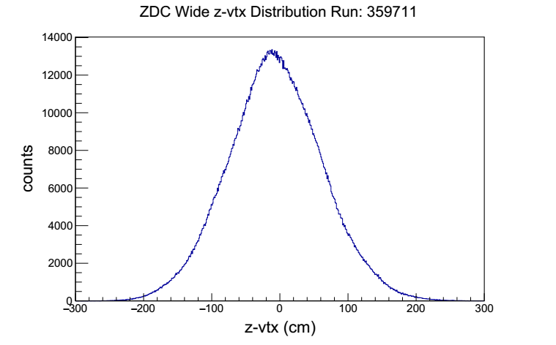
Correcting for z-Vertex Dependence
The BBC response has a z-dependence, more so than the ZDC. This is corrected for by creating a histogram in z-vertex for events firing the BBC wide and ZDC wide triggers, and events which fire the ZDC wide trigger. A bin-by-bin ratio is taken.

Slide 27
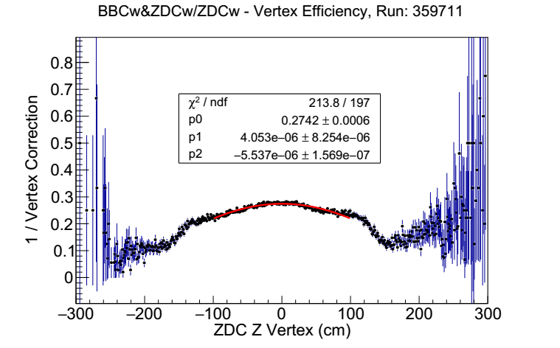
Correcting for z-Vertex Dependence
A quadratic function is fit to the resulting profile, which gives the z-vertex correction for the BBC. The BBC wide distribution is integrated over the nominal z-vertex cut region, and divided by the total yield. The z-vertex correction is applied bin-by-bin. The result is the efficiency, which for Run 359711 is about 0.43

Slide 28
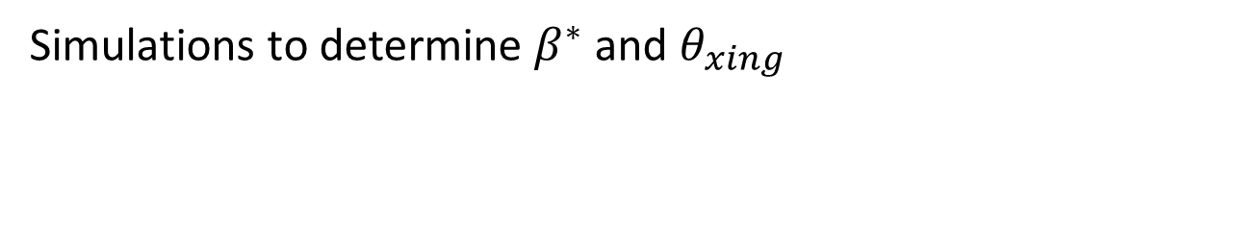
The Hourglass Effect
Simulations to determine $β^{∗}$ and $θ_{xing}$

Slide 29
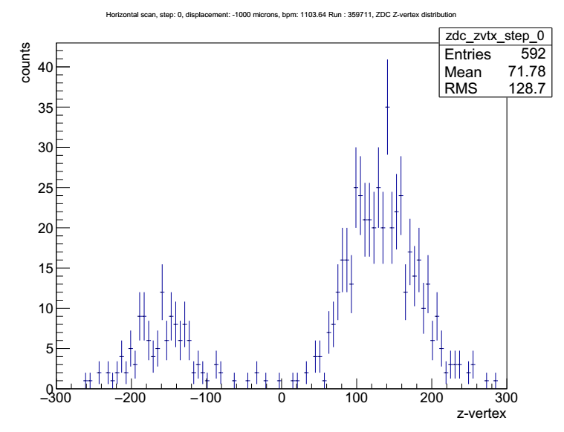
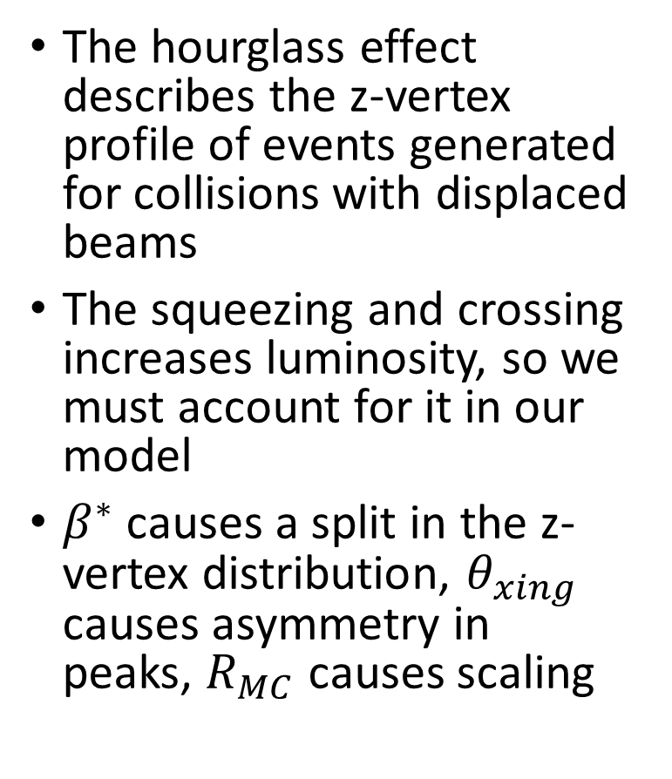
What is the Hourglass Effect?
The hourglass effect describes the z-vertex profile of events generated for collisions with displaced beams
The squeezing and crossing increases luminosity, so we must account for it in our model
$β^{∗}$ causes a split in the z-vertex distribution, $θ_{xing}$ causes asymmetry in peaks, $R_{MC}$ causes scaling

Slide 30
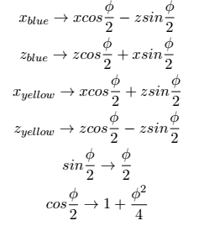
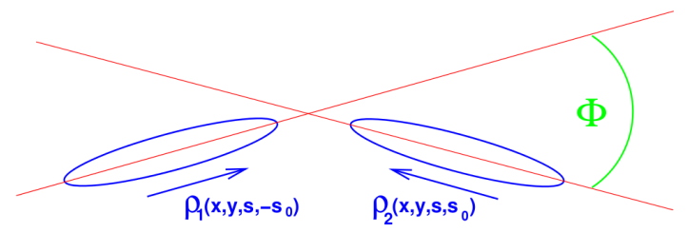
Crossing Angle Transformation

Slide 31
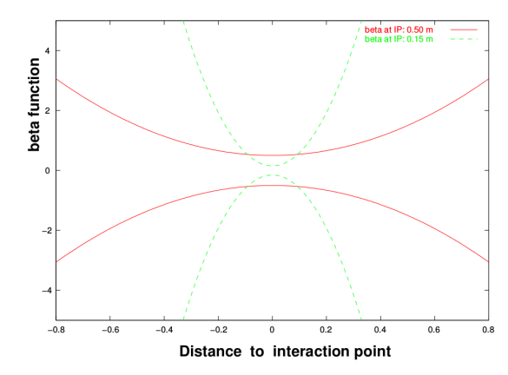
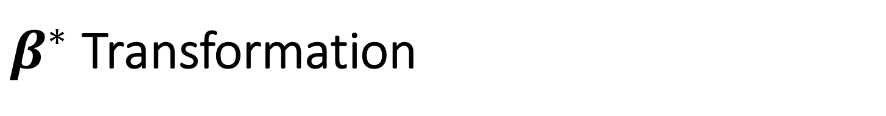

$β^{∗}$ Transformation
$${σ_{x}}_{i}\left(z\right)≡\sqrt{1+{\left(\frac{z}{β^{∗}}\right)}^{2}}$$

Slide 32
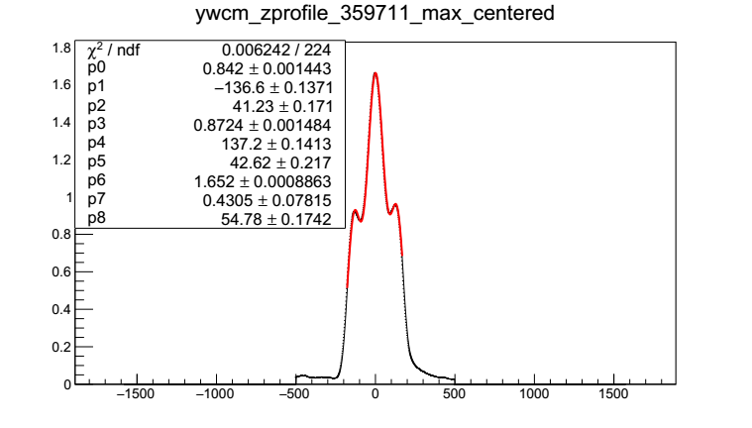
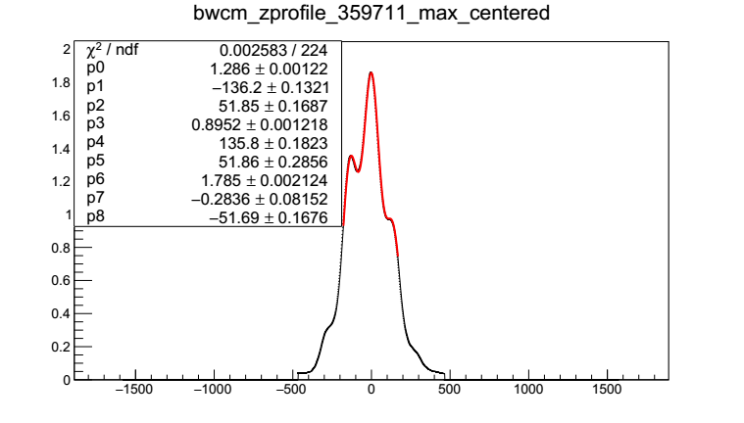
Real Beam Profiles
The blue and yellow z-distributions are recovered directly from the data
The distributions are fit with a triple-Gaussian.

Slide 33
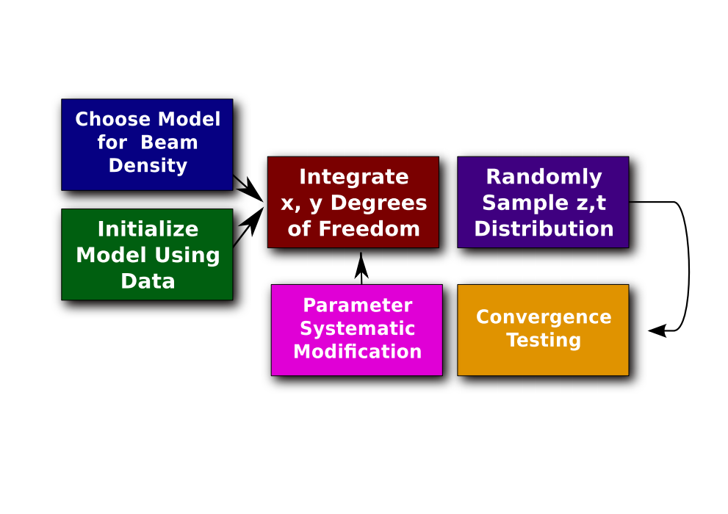
Simulating ZDC z-vertex Profile

Slide 34
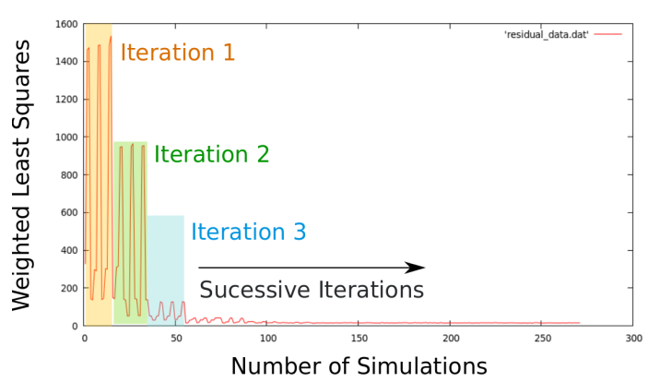
Convergence of Simulation

Slide 35
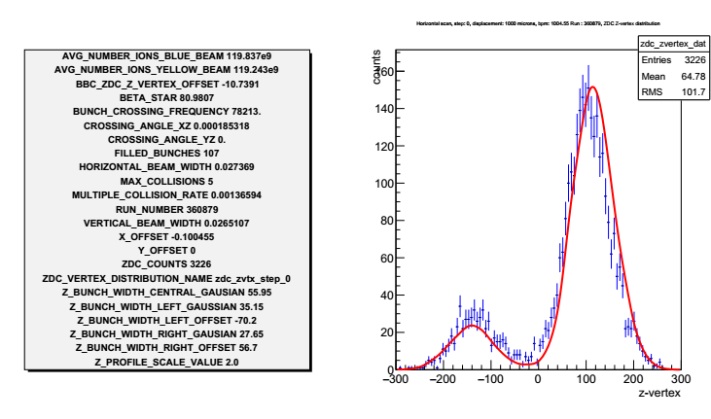
Simulation Results

Slide 36
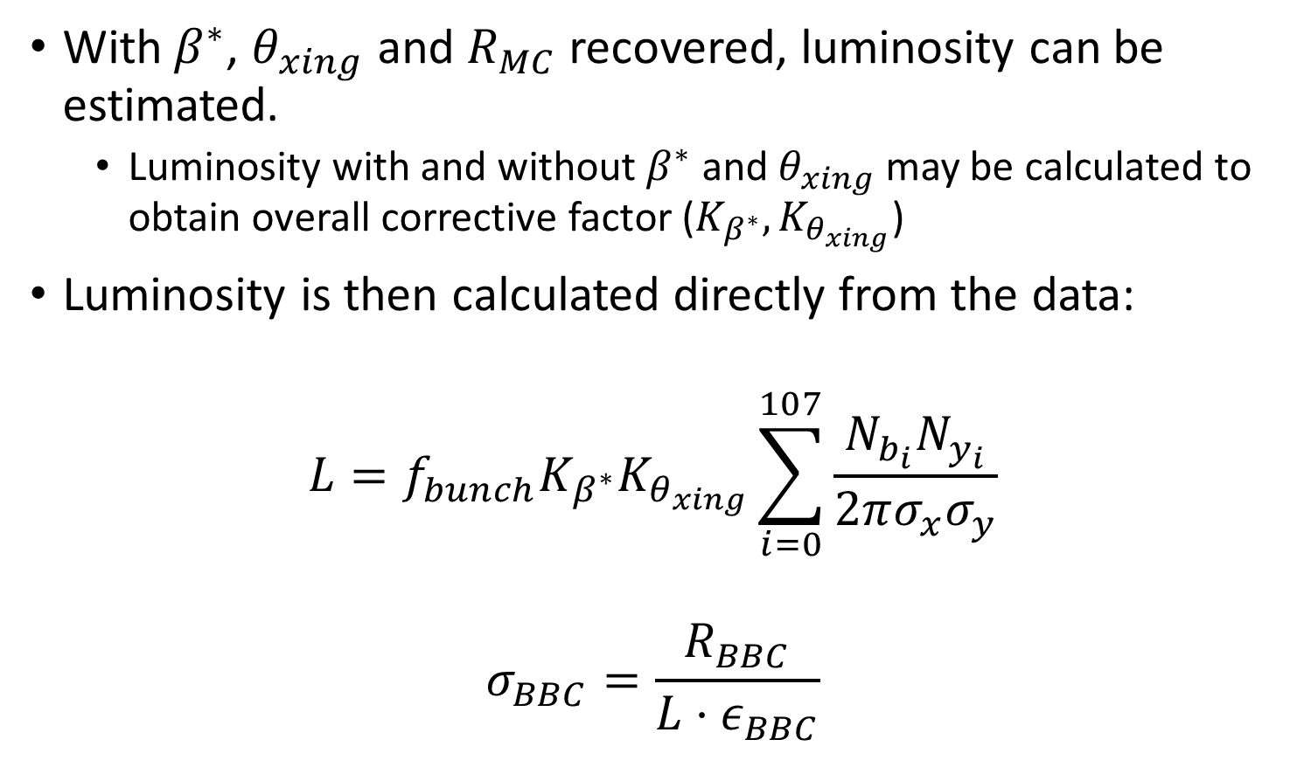
Putting it All Together
With$β^{∗}$, $θ_{xing}$ and $R_{MC}$ recovered, luminosity can be estimated.
  Luminosity with and without $β^{∗}$ and $θ_{xing}$ may be calculated to obtain overall corrective factor ($K_{β^{∗}}, K_{θ_{xing}}$)
Luminosity is then calculated directly from the data:
$$L=f_{bunch}K_{β^{∗}}K_{θ_{xing}}\sum_{i=0}^{107}{\frac{N_{b_{i}}N_{y_{i}}}{2πσ_{x}σ_{y}}}$$
$$σ_{BBC}=\frac{R_{BBC}}{L{⋅ε}_{BBC}}$$

Slide 37
Thank you!

