Slide 1
Introduction to pQCD and TMD physics
Spinfest 2016
University of California, Riverside
July 25 – 26, 2016

Slide 2
Outline
Lecture 1: perturbative QCD (I)
  QCD basics, collinear factorization, collinear PDFs and FFs
Lecture 2: perturbative QCD (II)
  Collinear factorization for jets, and jet substructure
Lecture 3: TMD physics (I)
  Basic ideas, TMD operator analysis
Lecture 4: TMD physics (II)
  TMD factorization, evolution, and phenomenology

Slide 3
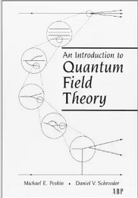
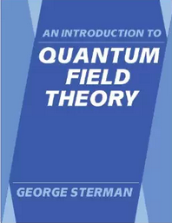
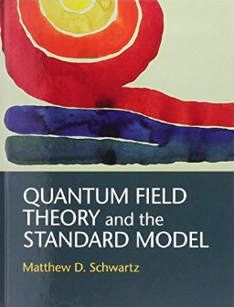

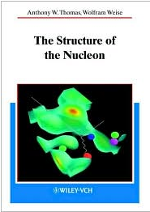
Selected references on QCD
Textbooks on QCD
  QCD and Collider Physics – Ellis, Stirling, Webber
  Foundations of Perturbative QCD: J. Collins
  Applications of Perturbative QCD: R. Field
Textbooks on Quantum Field Theory
  An Introduction to Quantum Field Theory: Peksin & Schroeder, as well as Sterman
  Quantum Field Theory and the Standard Model: M. Schwartz
  Quantum Field Theory in a Nutshell: A. Zee
The structure of the Nucleon: Thomas & Weise
CTEQ collaboration http://www.phys.psu.edu/~cteq
P. J. Mulders http://www.nat.vu.nl/~mulders/correlations-0new.pdf

Slide 4
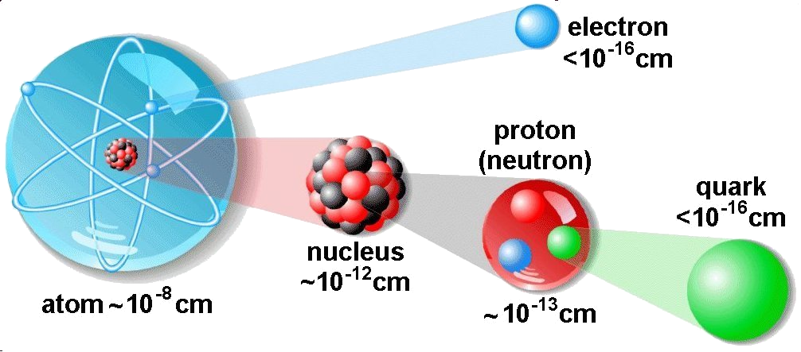
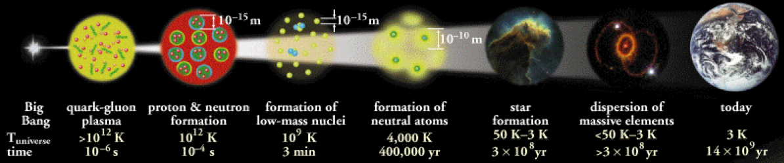
The structure of matter
The exploration on the structure of matter has a really long history
  Dalton 1803 (atom)
  Rutherford 1911 (nucleus)
  Chadwick 1932 (neutron)
  Gell-Mann and Zweig 1964 (quark model)
  Feynman 1969 (parton model), …
Central goal of nuclear science
  To discover, explore, and understand all forms of nuclear matter and the associated dynamics

Slide 5
Exploring the nucleon: fundamental importance in science

Slide 6
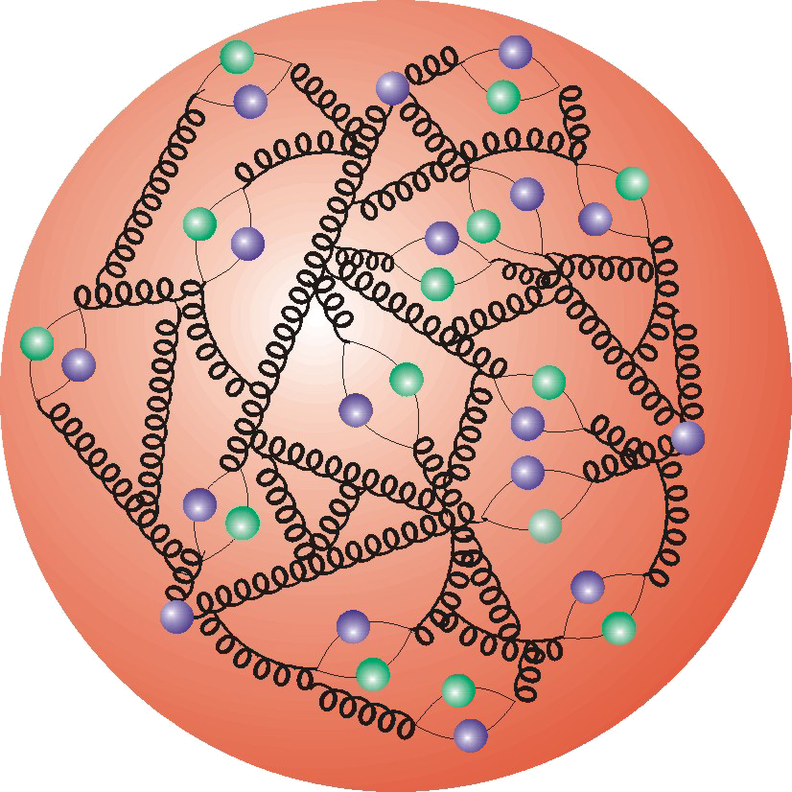

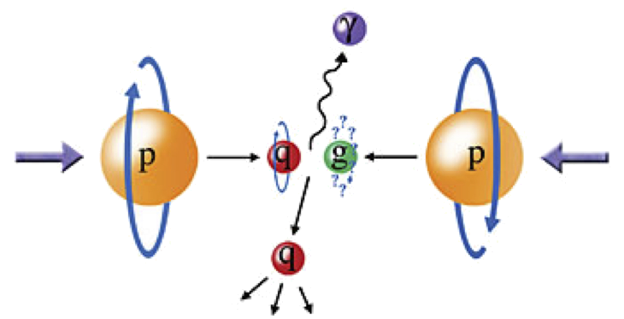
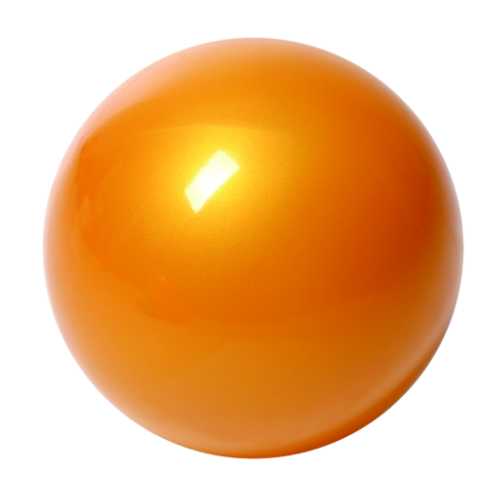
Hadron structure
Nucleon: quantum many-body system of quarks and gluons
High energy scattering: to extract information on the nucleon structure, we send in a probe and measure the outcome of the collisions
Rutherfold’s experiment
electron
p
Deep Inelastic Scattering (DIS)
Proton-Proton collisions

Slide 7
How to trace back?
Perturbative QCD paradigm: Asymptotic freedom + QCD factorization
2004
quark
Parton distribution function
measured
extracted
calculable
asymptotic freedom
perturbation theory for quarks and gluons
only hadrons are observed in experiments (confinement)

Slide 8
Lecture 1: perturbative QCD (I)
QCD basics, collinear factorization, DGLAP, PDFs, FFs

Slide 9
QED: the fundamental theory of electo-magnetic interaction
QED Lagrangian:
Feynman rule: photon has no charge, thus does not self-interact

Slide 10
QCD: the fundamental theory of the strong interaction
As the fundamental theory, QCD describes the interaction between quarks and gluons (not hadrons directly)
Feynman rules: gluon carries color, thus can self-interact

Slide 11
Experimental verification of the color
The color does exist: color of quarks Nc = 3 (low energy R=2/3 v.s. 2)

Slide 12
Understanding QCD: running coupling (asymptotic freedom)
Rough qualitative picture: due to gluon carrying color charges
  Value of the strong coupling α_{s} depends on the distance (i.e., energy)
Screening:
Anti-screening:

Slide 13
Why does the coupling constant run?
Leading order calculation is simple: tree diagrams – always finite
Study a higher order Feynman diagram: one-loop, the diagram is divergent as q → ∞
Make sense of the result: redefine the coupling constant to be physical

Slide 14



Renormalization (Redefine the coupling constant)
Renormalization
  UV divergence due to “high momentum” states
  Experiments cannot resolve the details of these states
Combine the “high momentum” states with leading order
Low momentum state
High momentum state
LO:
Renormalized coupling
NLO:
No UV divergence!

Slide 15
Simple study of Deep Inelastic Scattering (DIS): parton model
DIS has been used a lot in extracting hadron structure
Leptonic and hadronic tensor

Slide 16
Structure functions
Hadronic tensor: Lorentz decomposition + parity invariance (for photon case) + time-reversal invariance + gauge invariance
All the information about hadron structure is contained in the structure functions

Slide 17
The paradigm of perturbative QCD
The common wisdom: to trace back what’s inside the proton from the outcome of the collisions, we rely on QCD factorization
Hadron structure: encoded in PDFs
QCD dynamics at short-distance: partonic cross section, perturbatively calculable
Parton Distribution Functions (PDFs):
Probability density for finding a parton in a proton with momentum fraction x
Universal (measured)
calculable

Slide 18
Universality of PDFs: extraction from DIS
Universal (measured)
calculable

Slide 19
What about higher order?
pQCD calculations: understand and make sense of all kinds of divergences
  Ultraviolet (UV) divergence : renormalization (redefine coupling constant)
  Collinear divergence : redefine the PDFs and FFs
  Soft divergence : usually cancel between real and virtual diagrams for collinear PDFs/FFs; do not cancel for TMDs, leads to new evolution equations
Going beyond the leading order of the DIS, we face another divergence

Slide 20
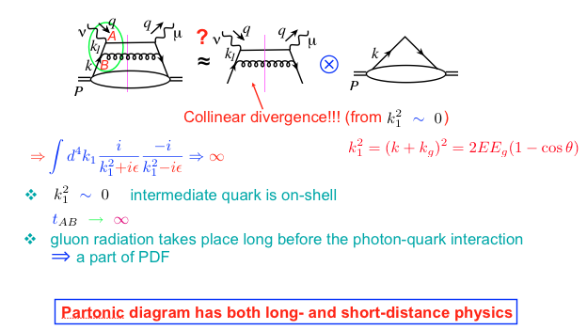
QCD dynamics beyond tree level
Going beyond leading order calculation

Slide 21
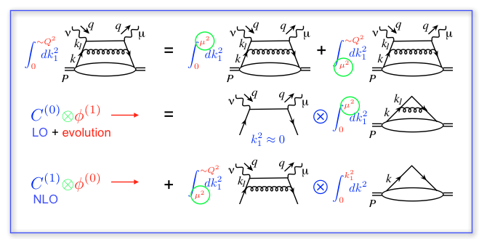
QCD factorization: beyond parton model
Systematic remove all the long-distance physics into PDFs

Slide 22
Scale-dependence of PDFs
Logarithmic contributions into parton distributions
Going to even higher orders: QCD resummation of single logs

Slide 23
DGLAP evolution = resummation of single logs
Evolution = Resum all the gluon radiation
By solving the evolution equation, one resums all the single logarithms of type

Slide 24
Evolutions of PDFs
Perturbative change:
Feynman diagrams for unpolarized PDFs

Slide 25
PDFs also depends on the scale of the probe
Increase the energy scale, one sees parton picture differently

Slide 26
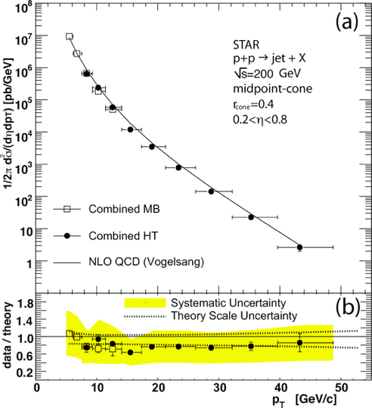
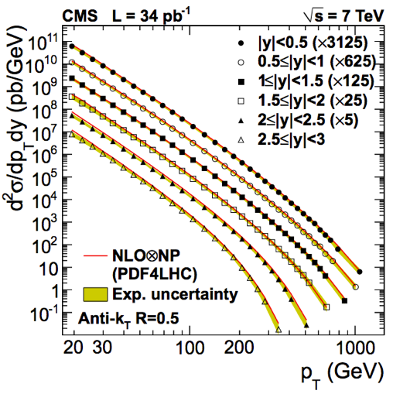
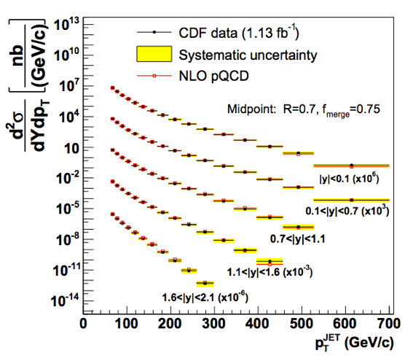
Success of QCD collinear factorization
PDFs are universal and evolve via DGLAP equations
LHC: p+p@7 TeV
DIS: e+p
Tevatron: p+pbar@1.96 TeV
RHIC: p+p@200 GeV

Slide 27
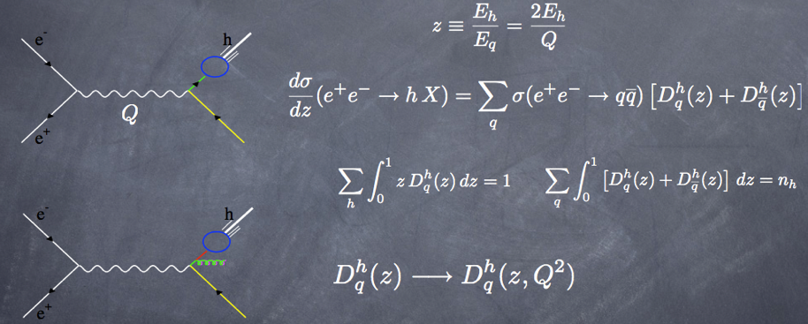
Same idea for hadron production
Fragmentation function: another probability
  Going to NLO, needs also to absorb the collinear divergence, and thus the scale dependence of the fragmentation function

Slide 28
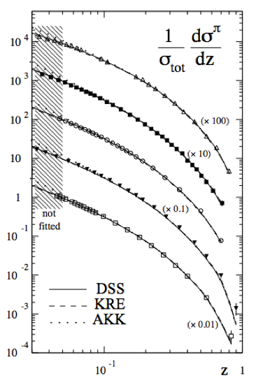
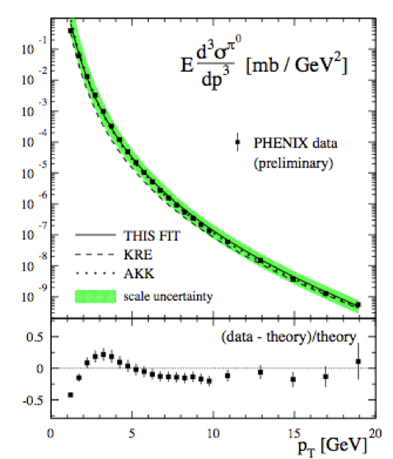
It also works well
DSS parameterizations for the fragmentation function

Slide 29
Summary
Asymptotic freedom: allow one to calculate partonic cross sections
Parton distribution functions and fragmentation functions
Renormalization scale and factorization scale

