Slide 1
Introduction to pQCD and TMD physics
Lecture 3: TMD physics (I)
Spinfest 2016
University of California, Riverside
July 25 – 26, 2016

Slide 2
The proton in QCD
Proton is made of
  2 up quarks + 1 down quarks
  + any number of quark-antiquark pairs
  + any number of gluons
Fundamental questions for proton structure (what is the internal landscape of the nucleons?)
  What are the momentum distributions of quarks, antiquarks, and gluons?
  How are quarks and gluons distributed spatially?
  How do partons carry the proton spin-1/2? (spin and orbital angular momentum)
  How are these quark and gluon distributions correlated with overall nucleon properties, such as spin direction?
Infinite many …
2007 nuclear physics long range plan
EIC white paper
Parton distribution functions (PDFs), Transverse momentum dependent distributions (TMDs), …

Slide 3
Collinear PDFs: one-dimensional picture
Universal (measured)
calculable

Slide 4


Recent advance in hadron structure
Hadron 3D structure: both longitudinal + transverse momentum dependent structure (confined motion in a nucleon)
Transversely polarized scattering provides new structure of proton
  Transverse Momentum Dependent parton distributions (TMDs)
Longitudinal motion only
Longitudinal + transverse motion

Slide 5
Parton’s transverse motion
Parton’s transverse momentum is usually smaller than the longitudinal component in the proton, which moves very fast in the longitudinal direction, how do we probe the parton’s transverse motion?
Use transverse spin as a probe: transverse-spin dependent observables are sensitive probes of the partons transverse momentum as they can correlate with each other
Transverse spin physics

Slide 6

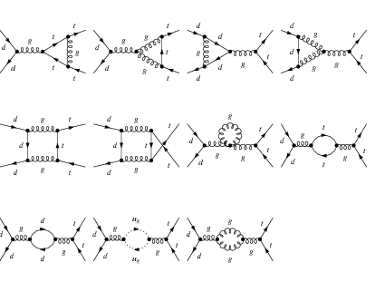
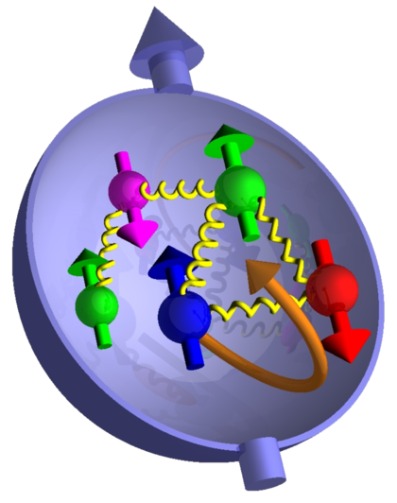
Spin physics: excellent laboratory for QCD
We are looking into both the partonic dynamics at the short distance, as well as the nucleon structure at long distance
QCD Factorization

Slide 7
Transverse spin physics: birth and growth
Remarkable development of this field
  From the sidelines in strong interaction physics
  To center stage in our efforts to figure out QCD
Numerous exciting new developments over recent years
  Differential citation grows exponentially as a function of time

Slide 8
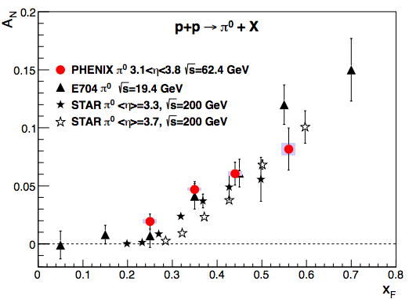
Example: experimental observable
Consider a transversely polarized proton scattering with an unpolarized proton or lepton
JLab Hall A

Slide 9
SSA vanishes with collinear momentum only
If one assumes partons are purely collinear
A_{N}≠0: result of parton’s transverse motion
A new window: much richer QCD dynamics
Kane-Pumplin-Repko, 1978

Slide 10
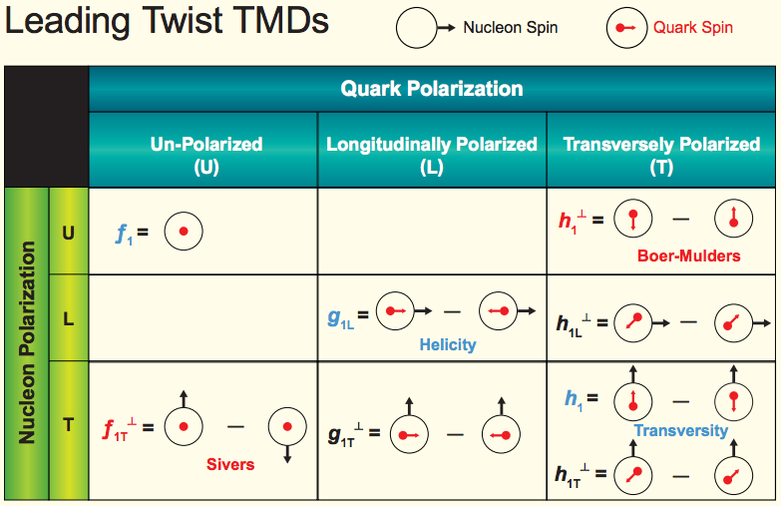
How many distributions are needed
In order to fully characterize the proton structure, how many parton distribution functions are actually needed
TMD parton distribution
Quark Polarization
U L T
TMD fragmentation function
Pion
Collins

Slide 11
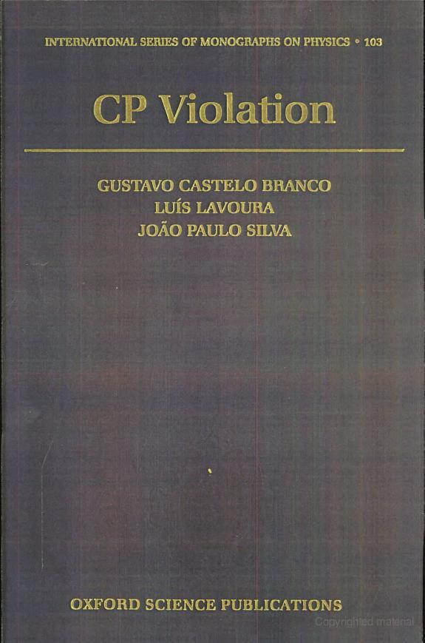
Good textbooks
Understand C, P, T discrete symmetry properties of the correlation function
  Most textbooks on quantum field theory will give discussion (somewhat limited) on this topic, such as Peskin, Sterman
  If you want extensive discussion, see this book

Slide 12
Operator analysis
Operator analysis to figure out how many distributions are needed to characterize the nucleon structure
I provide a detailed study for spin-0 particle
For details, see
  Mulders, Tangerman hep-ph/9403227
  Mulders, Tangerman hep-ph/9510301
  Mulders, http://www.nat.vu.nl/~mulders/correlations-0new.pdf
The next slide continues after I mentioned gauge link

Slide 13
Sivers function: non-universal
Sivers function: unpolarized quark distribution inside a transversely polarized proton
Spin-independent
Spin-dependent
Sivers effect
left-right asymmetry
Look closer
Naïve time-reversal-odd: recall momentum and spin change sign under T
Forbidden?: such kind of correlation is forbidden in T-invariant theory (QCD), unless there is a phase

Slide 14
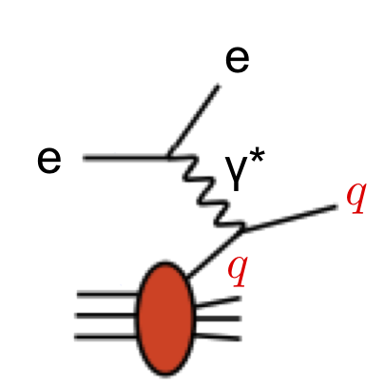
Where does the phase come from
Existence of the Sivers function relies on the interaction between the active parton and the remnant of the hadron
  DIS: final-state interaction
  Drell-Yan: initial-state interaction
σ=
+
+
+…
=
⊗
σ=
+
+
+…
=
⊗

Slide 15
Sivers function: sign change
Light-cone trajectory
Parity and time-reversal invariance
Different path in the phase different TMD distribution in DIS and DY
NSAC milestone: most important property of the Sivers function, need to be tested

Slide 16
Sivers effect: QCD version of Aharonov-Bohm effect
Pure quantum effect: different paths lead to interference
Physics today, September 2009

Slide 17
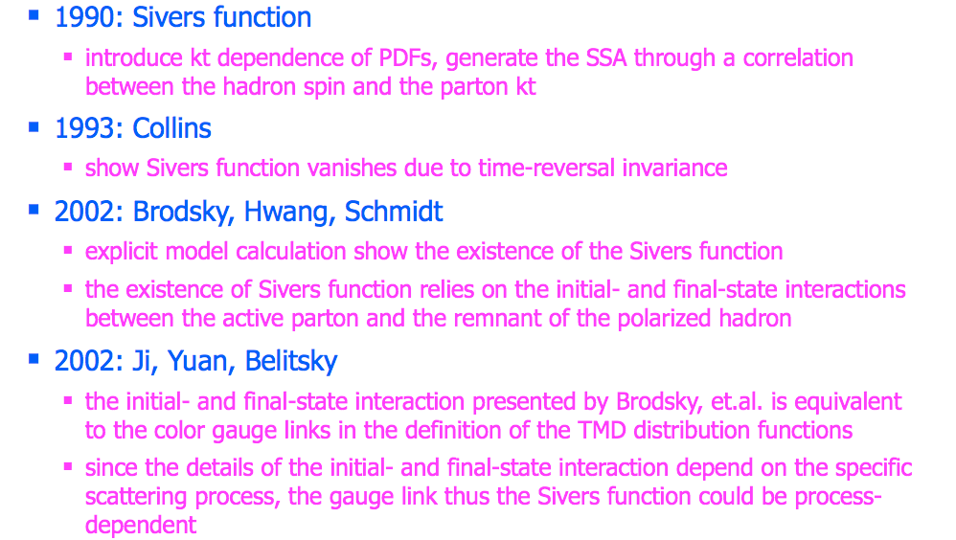
The history of Sivers function

