Slide 1
Introduction to pQCD and TMD physics
Lecture 2: perturbative QCD (II)
Spinfest 2016
University of California, Riverside
July 25 – 26, 2016

Slide 2
Jets and Jet substructure
One of the hottest topic at the LHC
It will for sure become one of the most important topics in the sPHENIX era

Slide 3
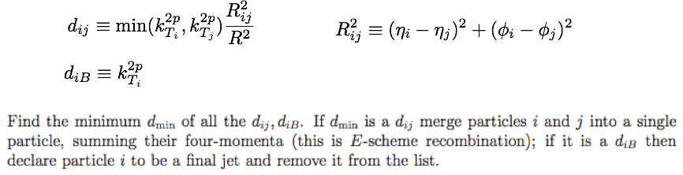
Jet: collimated spray of hadrons
How to define a jet?
Successive recombination algorithms
  Define a distance measure between particles i and j, also w.r.t beam
  Repeat the above procedure until no particles are left
  p = -1 anti-kt algorithm, most used

Slide 4
Can be easily simulated in Pythia
With a little piece of code, one can simulate jet cross section in Pythia
Inclusive jets
B-tagged jets

Slide 5
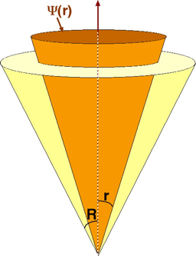
Internal structure of jets
People are very interested in studying the internal structure of jets, e.g., how energy are distributed inside the jet, or how hadrons are distributed inside the jets
jet
h
Jet shape
Jet fragmentation function

Slide 6
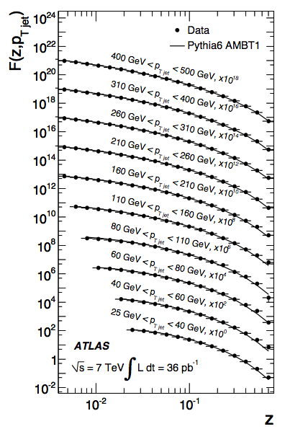
Test with Pythia
Jet fragmentation function
Differential jet shape

Slide 7
How to compute in pQCD?
Are these observables calculable from perturbative QCD?
  Yes, of course. They have been studied extensively in the past, and new insights have also been obtained in recent studies
Give two examples:
  Inclusive jet cross section
  Jet fragmentation function

Slide 8
Recall single hadron production
Illustration of single hadron production:
QCD factorization can be reviewed from the spirit of the effective field theory: physics at very different scales do not affect each other
  Hard collision happens at scale ~ pT
  Hadronization/fragmentation happens at a much lower scale ~ mh
  The interference between these two scales should be suppressed by mh/pT

Slide 9
Single jet production
The production of jets should be purely perturbative
  See recent calculations from Werner Vogelsang, et.al.
  Basic idea: produce partons in the final-state, and place kinematic constrains on these finite-number of partons, e.g., LO = 2 partons in the final state, NLO = 3 partons in the final-state
  Calculations are usually more complicated than the single hadron production

Slide 10
QCD factorization makes things simple
Think of QCD factorization using the spirit of effective field theory
  What are the relevant scales for single jet production?
  Two momenta: (1) hard collision: pT (2) jet radius can build one: pT*R
  In the small-R limit, one can actually factorizes the jet cross section into two steps, just like single hadron production
  Good thing: semi-inclusive jet function J_{q,g}(z, R, w) are purely perturbative
Kang, Ringer, Vitev, arXiv:1606.06732, Dai, Kim, Leibovich, 1606.07411, see also, Kaufmann, Mukherjee, Vogelsang, 1506.01415

Slide 11
Calculate semi-inclusive jet functions
At LO: only one parton becomes the jet
At NLO: e.g., for quark-initiated jets
Divergent: needs re normalization

Slide 12
Gluon-initiated jets
For gluon jets
Natural scale for quark/gluon jet functions
After renormalization, one will find: quark/gluon jets follow DGLAP evolution equation, just like hadron fragmentation functions
Kang, Ringer, Vitev, arXiv:1606.06732

Slide 13
Same factorization formalisms
Now single hadron and single jet share the same factorization formalisms
Same partonic cross sections, only replace FFs by semi-incusive jet functions
  FFs are non-perturbative, has to be fitted from experimental data
  Semi-inclusive jet functions are purely perturbative
, jet

Slide 14
Jet radius resummation: ln(R)
This investigation came from the search for a proper jet radius resummation for small jet radius
  Semi-inclusive jet functions are calculable, and have a natural scale pT*R
  Run DGLAP from pT*R to pT, one naturally resums
Could this affect A_{LL}?

Slide 15
Jet fragmentation function
First produce a jet, and then further look for a hadron inside the jet
Just like the single inclusive jet production, we have
  Semi-inclusive fragmenting jet function
jet
h
c
Kang, Ringer, Vitev, arXiv:1606.07063

Slide 16
Semi-inclusive fragmenting jet functions
Certainly, they cannot be purely perturbative any more, because we now observe a hadron inside the jet
  Good thing: they can be expanded in terms of the standard fragmentation functions, with calculable coefficients
  The perturbative calculations are still rather useful, since they will reveal how they evolve
At LO: simple
At NLO: more complicated but still manageable
  It determines the running of these new jet functions, as well as how they are related to the standard FFs

Slide 17
Evolution and relation to FFs
Again DGLAP evolution: evolution is for variable z
Relation to standard FFs: relevant to variable zh
With the above evolution and relation, one can thus perform resummation for jet radius R again for this new observable
Kang, Ringer, Vitev, arXiv:1606.07063

Slide 18
Some interesting phenomenology
Works pretty well in comparison with experimental data
Kang, Ringer, Vitev, arXiv:1606.07063

Slide 19
Comparison with fixed NLO results
The effect of radius R resummation is quite significant

Slide 20
Theoretical uncertainty
The theoretical uncertainty of the formalism

Slide 21
Summary
Inclusive jet production follows the same factorization formalism as the single inclusive hadron production, with the FFs replaced by semi-inclusive jet functions
These novel semi-inclusive jet functions are purely perturbative, and follow the usual DGLAP evolution equations
Jet substructure for inclusive jets can be computed similarly
Topics you might want to study:
  D meson, J/psi, photon inside the jet
  Hadron azimuthal distribution inside the jet (Collins effect)

