Slide 1
Introduction to QCD and TMD physics
Lecture 4: TMD factorization and phenomenology
Spinfest 2016
University of California, Riverside
July 25 – 26, 2016

Slide 2
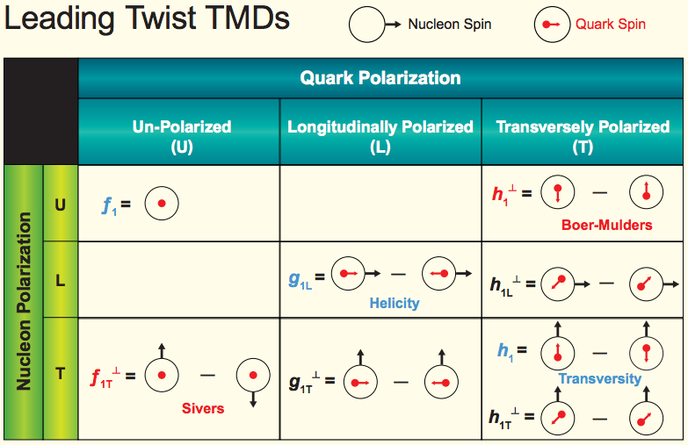


TMDs: rich quantum correlations
Quark Polarization
U L T
Pion
Collins

Slide 3
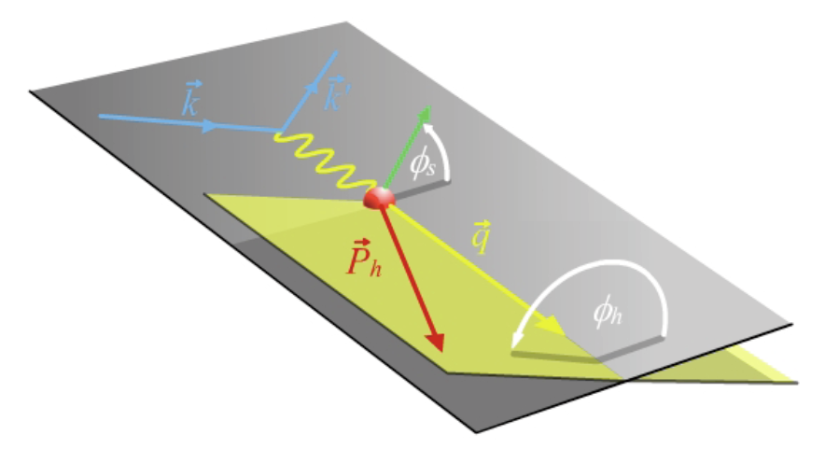
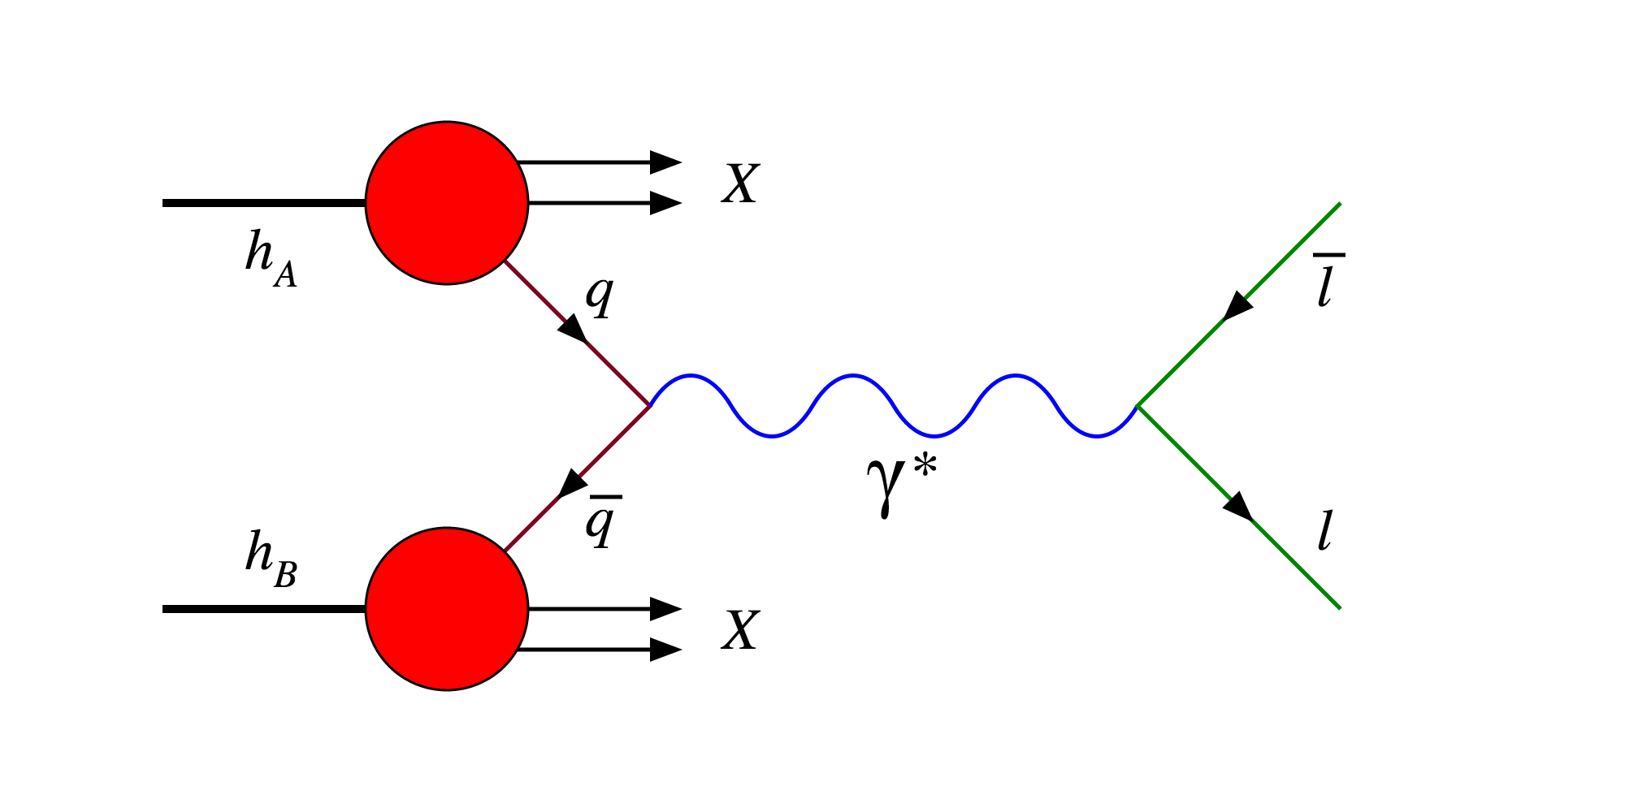
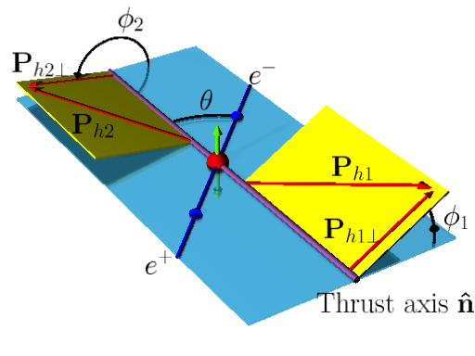
TMD work domain and experimental access
TMD factorization works in the domain where there are two observed momenta in the process, such as SIDIS, DY, e+e-
Q >> qt: Q is large to ensure the use of pQCD, qt is much smaller such that it is sensitive to parton’s transverse momentum
SIDIS
JLab 12, HERMES,
COMPASS
Drell-Yan
COMPASS, Fermilab, RHIC
e⁺+e⁻→h1+h2+X
Belle, BarBar

Slide 4
TMD factorization in a nut-shell
Drell-Yan:
Factorized form and mimic “parton model”
Factorization of regions:
(1) k//P₁, (2) k//P₂, (3) k soft, (4) k hard
mimic “parton model”

Slide 5
Access TMDs from SIDIS
Separation of different TMD contributions, e.g., Sivers vs Collins
Sivres effect (simple parton model): TMDs are independent of Q

Slide 6
Extraction of Sivers functions
Extraction of Sivers function from SIDIS: JLab, HERMES, COMPASS
Gamberg, Kang, Prokudin, PRL 2013
u
d

Slide 7
Understanding the outcome: d quark
Distortion from Sivers effect: positive = left preference
Unpolarized
Transversely polarized

Slide 8
Understanding the outcome: u quark
Distortion for u quark: negative = right preference
Unpolarized
Transversely polarized

Slide 9
Example prediction: Drell-Yan
Sivers effect: still need Drell-Yan to verify the sign change, thus fully understand the mechanism of the SSAs
Reverse the sign of Sivers function from SIDIS and make predictions for Drell-Yan production
Kang, Qiu, 2010
Q = Lepton pair with invariant mass 4 – 9 GeV

Slide 10
Energy dependence of TMDs
So far the predictions are based on leading order parton model
Experiments operate in very different kinematic ranges
  Typical hard scale Q is different: Q ~ 1 – 3 GeV in SIDIS, Q ~ 4 – 90 GeV in pp
  Also center-of-mass energy is different
Such energy dependence (evolution) has to be taken into account for any reliable QCD description/prediction
Both collinear PDFs and TMDs depend on the energy scale Q at which they are measured, such dependences are governed by QCD evolution equations
Collinear PDFs
TMDs

Slide 11
QCD evolution: meaning
Evolution = include important perturbative corrections
  DGLAP evolution of collinear PDFs: what it does is to resum the so-called single logarithms in the higher order perturbative calculations
TMD factorization works in the situation where there are two observed momenta in the process, Q>>qt: what it does is to resum the so-called double logarithms in the higher order perturbative corrections

Slide 12
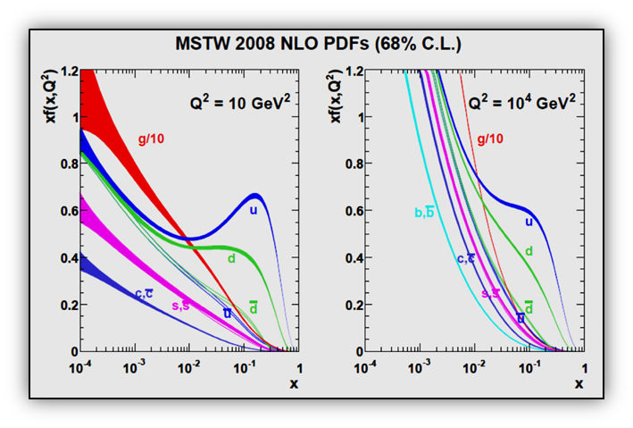
QCD evolution of collinear PDFs
Collinear parton distribution depends on the resolution scale: described very well by DGLAP evolution equations

Slide 13
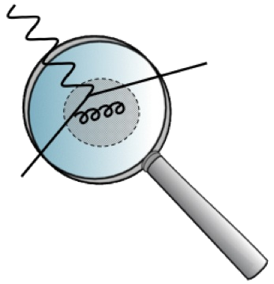
TMD evolves
Just like collinear PDFs, TMDs also depend on the scale of the probe = evolution
Collinear PDFs
TMDs
DGLAP evolution
Resum
Kernel: purely perturbative
Collins-Soper/rapidity evolution equation
Resum
Kernel: can be non-perturbative when

Slide 14
TMD evolution
We have a TMD above measured at a scale Q. It is easier to deal in the Fourier transformed space (convolution → product)
QCD evolution of TMDs
Evolution of longitudinal/collinear part
Non-perturbative part has to be fitted to experimental data
Evolution of transverse part

Slide 15
TMD global analysis
Outline of a TMD global analysis: numerically more heavy
Model ansatz for TMDs
with initial set of parameters
Model ansatz for non-perturbative evolution kernel
Evolve TMDs to relevant scale with TMD evolution
Fourier transform back to momentum space
adjust parameters
all data points
calculate the cross section/asymmetry as well as χ²
χ² minimum?
no
yes

Slide 16
TMD evolution works: multiplicity distribution in SIDIS
Comparison to COMPASS data
Echevarria, Idilbi, Kang, Vitev, 14

Slide 17
Drell-Yan and W/Z production
Comparison with DY, W/Z pt distribution
DY
W
Z
Works for SIDIS, DY, and W/Z in all the energy ranges
Note: same method works for Higgs production

Slide 18
Effect of QCD evolution
What evolution does
  Spread out the distribution to much larger kt
  At low kt, the distribution decreases due to this spread
Based on Echevarria, Idilbi, Kang, Vitev, 14

Slide 19
Sivers asymmetry from SIDIS
Sivers asymmetry has been measured in SIDIS process: HERMES, COMPASS, JLab
Sivers function

Slide 20
Sivers function with energy evolution
Example of the fit: JLab, HERMES, COMPASS
Echevarria, Idilbi, Kang, Vitev, 14

Slide 21
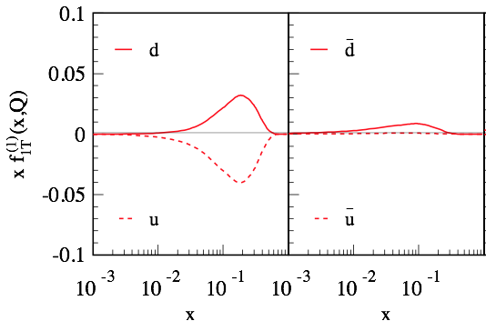
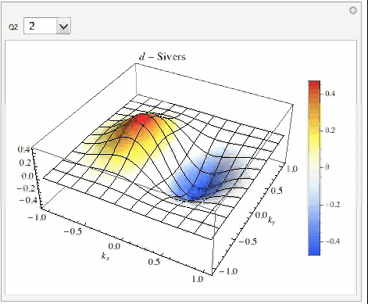
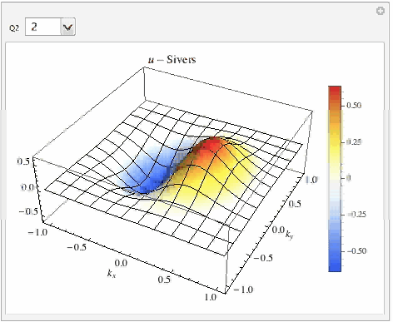
Extracted Sivers function and evolution
χ²/d.o.f. = 1.3, the collinear part is plotted: only u and d valence quark Sivers are constrained
  Visualization: positive = more quark moves to the left (Q²=2 – 100 GeV²)
D
U

Slide 22
DY Sivers asymmetry with energy evolution
Predictions for future DY experiments
COMPASS
Fermilab
RHIC

Slide 23
Sign change and predictions for W/Z
Sivers effect: still need DY/W/Z to verify the sign change, thus fully understand the mechanism of the SSAs
Reverse the sign of Sivers function from SIDIS, make predictions for W/Z at 510 GeV RHIC energy
  Note: sea quark Sivers functions are not constrained from the current data, so the backward rapidity region has large uncertainty
Kang, 15
Huang, Kang, Vitev, Xing, PRD 16

Slide 24
Experimental evidence of sign change
STAR measurements: the data favors sign change
Both theory and experiment has large uncertainty: hope to be improved in the near future (2017 run)
STAR, arXiv:1511.06003, PRL

Slide 25
Transverse W program
All the spin correlations in polarized p+p collisions
Huang, Kang, Xing, Vitev, PRD16
Sivers
Transversal helicity
up
down

Slide 26
Collins asymmetry from SIDIS and e+e-
SIDIS and e+e-: combined global analysis
transversity
Collins function
Collins function

Slide 27
Collins asymmetry in SIDIS
Fitting of SIDIS data
Kang, Prokudin, Sun, Yuan, PRD 15 & 16
HERMES
COMPASS
JLab

Slide 28
Collins asymmetry in e+e-
Fitting of e+e- data from BaBar and Belle
BaBar
Belle

Slide 29
Fitted TMDs
Fitted quark transversity and Collins function: x (z) -dependence
Collins function: pt-dependence

Slide 30
Collins asymmetry in p+p
Collins asymmetry can also be studied through the azimuthal distribution of hadrons inside a jet in p+p collisions
Such an asymmetry has been measured by STAR at RHIC
  Could be used to test the universality of the Collins functions
h
jet

Slide 31
Hadron azimuthal distribution in a jet
Indicate the universality of the Collins function in pp collisions
w/o TMD evolution
STAR preliminary data
Kang, Prokudin, Ringer, Sun, Yuan, 16, in preparation
Collins function from a Gaussian fit: Anselmino, et.al., arXiv: 1510.05389

Slide 32

Want to learn more
More opportunities

Slide 33

RHIC and EIC
Look forward to sPHENIX and fsPHENIX era
EIC: dedicated machine for QCD

Slide 34
Summary
QCD perturbation theory has been very successful in interpreting and predicting high energy scattering process
It provides a solid framework to extract information about hadron structure
RHIC produces important/interesting results, and hope this legacy continues; EIC is the highest recommendation for the new construction in nuclear physics – bright future

