Slide 1
Very Forward Neutron Asymmetry in Transversely Polarized p+A collision
Itaru Nakagawa
on behalf of PHENIX Collaboration

Slide 2
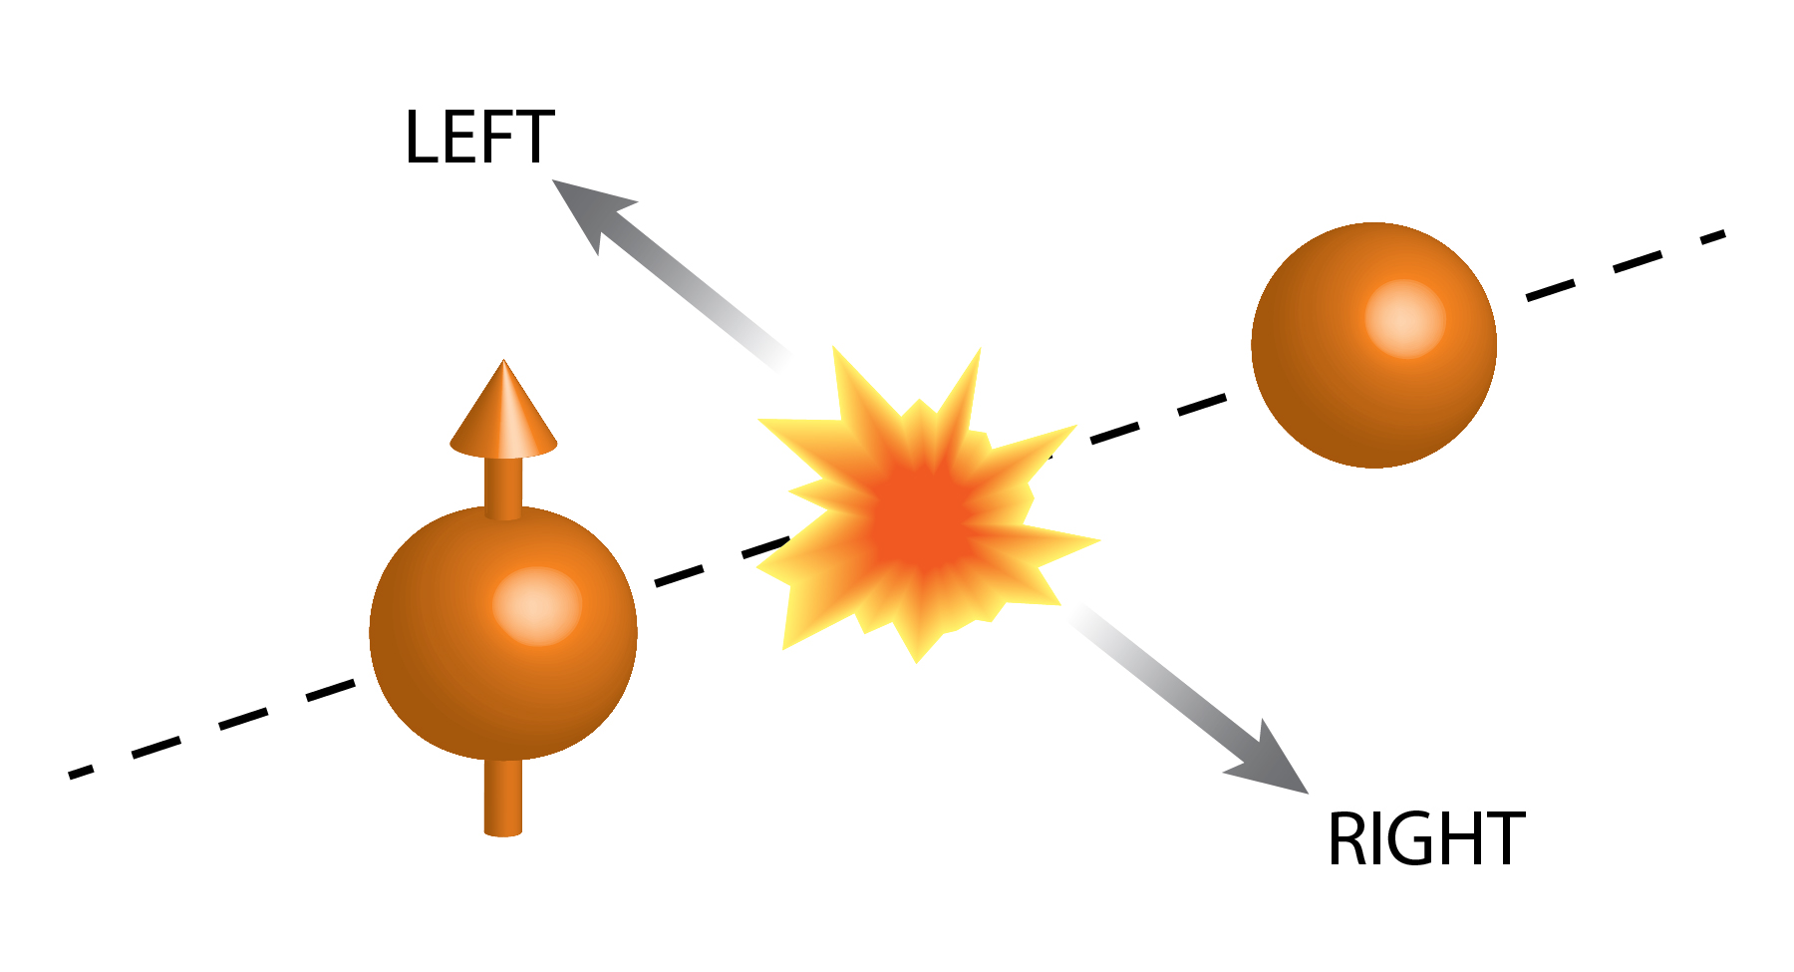
Transverse Single Spin Asymmetry
Forward π⁰ and very forward neutron

Slide 3
Production Mechanism of Forward Neutron
Cross Section
PRD88,032006
p
Cross Section
π⁺
< 2mrad
p
n
Neutron Energy／Proton Energy
Momentum Transfer ~ 100MeV
Well Explained by One-Pion Exchange

Slide 4
p↑+p Forward Neutron A_{N}
Spin non-flip
Spin flip
Neutron
Neutron
proton
proton
proton
proton
δ : phase shift
Unpolarized Cross Section

Slide 5
p↑+p Forward Neutron A_{N}
Spin non-flip
Spin flip
Neutron
Neutron
proton
a₁
proton
π⁺
proton
proton
δ : phase shift

Slide 6

p↑+p Forward Neutron A_{N}
PRD84,114012(2011)
p
p
π⁺,a₁
p
↑
n
Neutron P_{T} (GeV/c)
Data are well reproduced by the interference between π and a₁ Reggeon

Slide 7
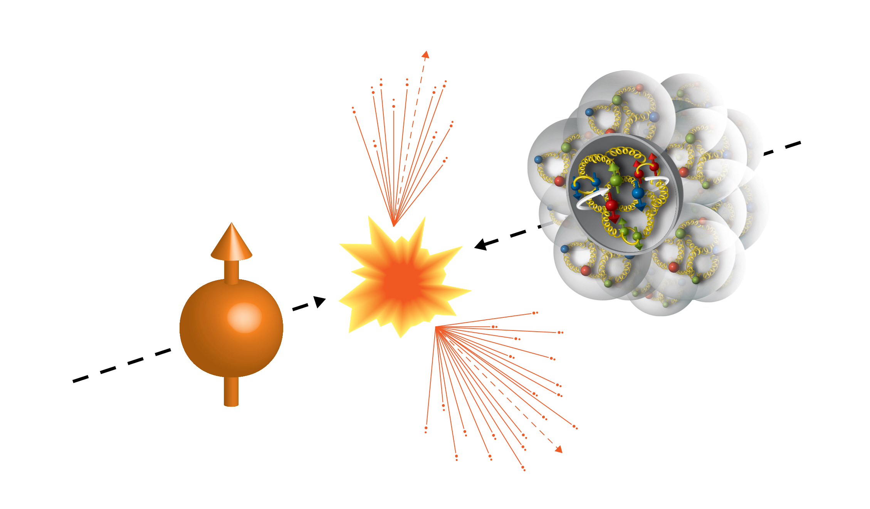
The First Time Ever
High Energy Collisions
Run15 (2015)
100GeV/nucleon
100GeV
Au, Al
Porarized Proton

Slide 8
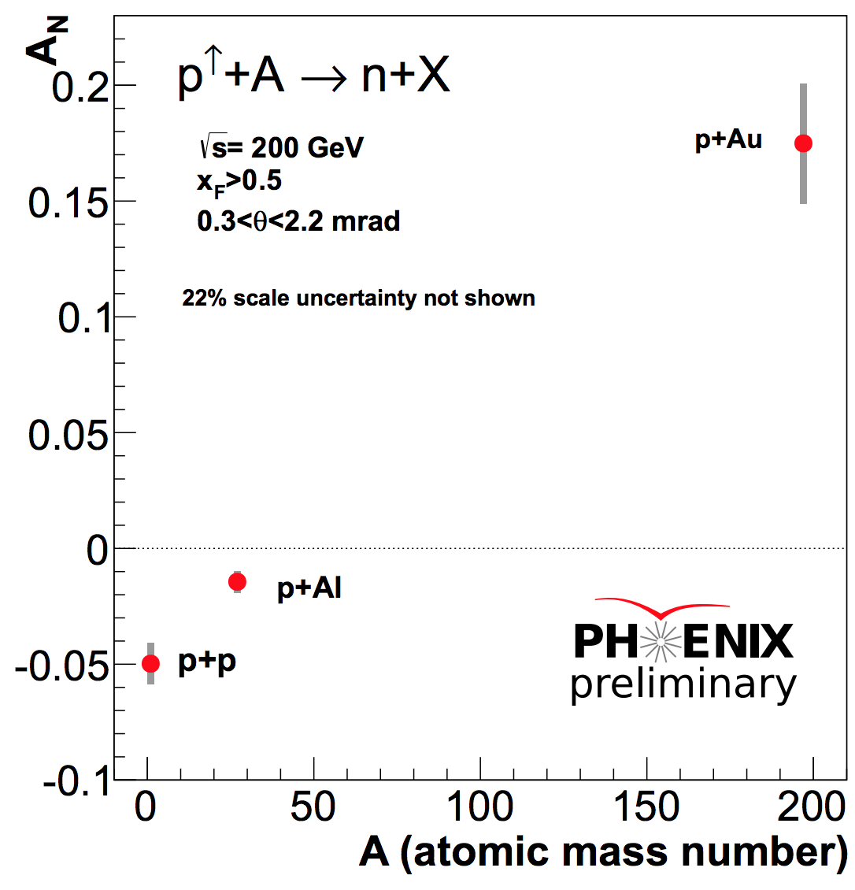
A-Dependent A_{N} (inclusive)
Present Frame Work

Slide 9
A-Dependent A_{N} (inclusive)
Analysis by
Minjung Kim (SNU/RIKEN)

Slide 10
What is going on ?
 | # of proton | # of neutron
p | 1 | 0
Al | 13 | 14
Au | 79 | 118
Isospin Symmetry
Surface Structure of Nucleus
QED Process
Gluon Saturation
Else…

Slide 11
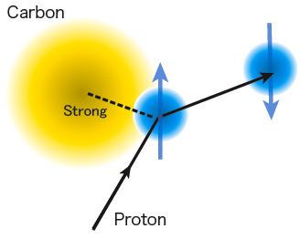
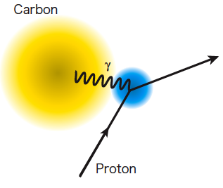
Primakoff Effect
Electro-Magnetic
neutron
A
A
EM-field
t → 0
α
α_{ΕΜ}
A
A
γ∗
π⁺
↑
p
n
p
↑
n

Slide 12
Primakoff Effect
(Electro-Magnetic)
neutron
A
A
Primakoff
In pAu case
t → 0
α
α_{ΕΜ}
A
A
γ∗
π⁺
π⁺
↑
p
n
p
↑
n
Δ

Slide 14
UPC Monte Carlo
Neutral Particle @ 200GeV
QCD(DPMJET)
ZDC
UPC
(SOPHIA)
Predicts comparable yields between QCD and UPC processes

Slide 15
Full Description of A_{N}
d_{1~4} : relative phase of amplitudes
(For pp)
large
-t
small

Slide 16
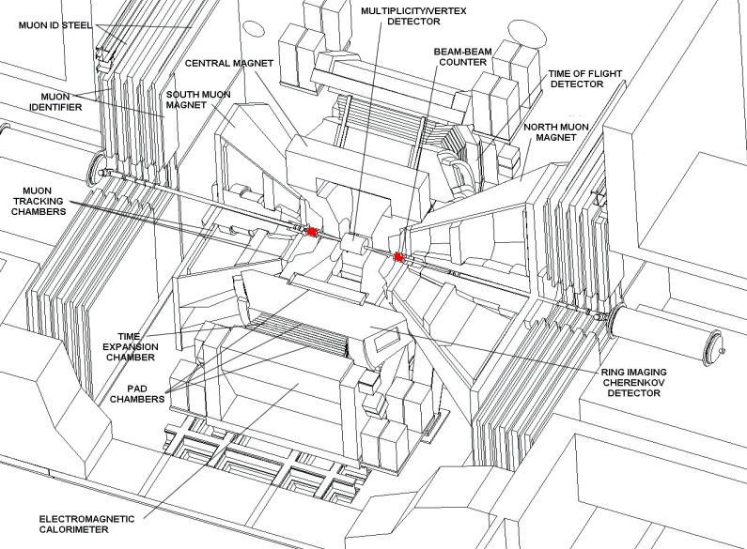
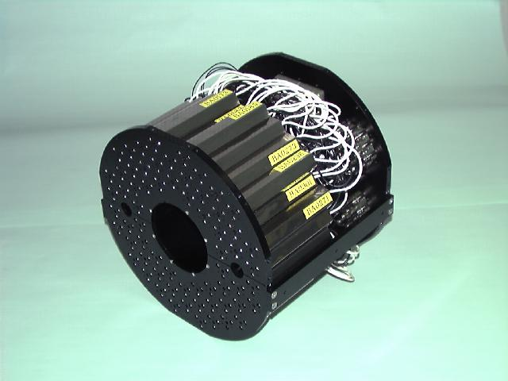
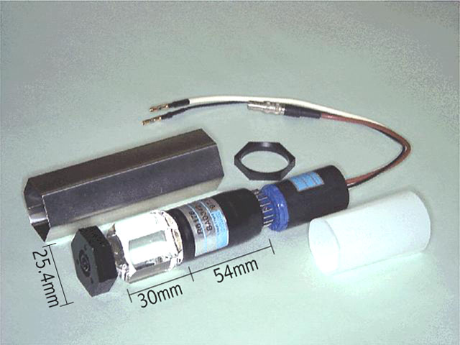
Beam-Beam Counter
PHENIX Detector
Dipole Bending Magnet
ZDC
BBC
Quartz Cherenkov radiator

Slide 17
Can we identify Primakoff events?
Semi-Inclusive
+
Dipole
π
+
π
6%
Δ
BBC
n
ZDC
94%
Primakoff MC : SOPHIA
G. Mitsuka, Eur. Phys. J.C. (2015) 75:614
BBC | tag | veto
Primakoff | Small | Large

Slide 18
BBC Tagging and Vetoing
Inclusive

Slide 19
BBC Tagging and Vetoing
A
BBC
?
Non-diffractive
↑
p
n
BBC
BBC Tagging
EM surpressed

Slide 20
BBC Tagging and Vetoing
BBC Vetoing
A
γ*
Diffractive
π⁺
p
↑
n
EM enhanced

Slide 21
Fractions
 | p+p | p+Al | p+Au
Inclusive | 36 % | 34 % | 13 %
BBC veto | 24 % | 31 % | 67 %
BBC tag | 36 % | 34 % | 13 %

Slide 22
Coulomb-Nuclear Interference
(CNI)
π⁺
π⁺
Notes:
This is 5 times smaller than OPE, but can interfere with UPC

Slide 23
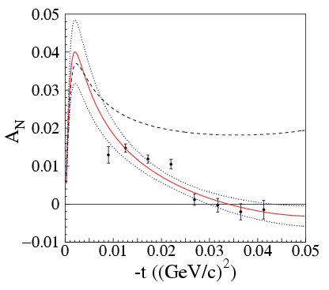
Elastic A_{N} at Coulomb Nuclear Interference
Pomeron
(High energy & small t limit)
pC Analyzing Power
EM
C
C
γ∗
zero hadronic
spin-flip
p
p
↑
With hadronic
spin-flip (E950)
had
C
C
P
p
↑
p
Phys.Rev.Lett.,89,052302(2002)
E_{beam} = 21.7GeV

Slide 24
Run15 Au,Al beam + p target
↑
Plot from Oleg Eyser (The 2015 PSTP workshop)
↑
p+p
↑
Al+p
±5%
↑
Au+p
Strong A-Dependence
Flips sign of A_{N} in Au+p
0.002 < -t < 0.014 (Gev/c)²
↑
Forward Neutron
0.02 < -t < 0.5 (Gev/c)²

Slide 25
Underlying Mechanism Comparison
Polarimeter
Forward n
A
A
A
X?
Pomeron
π⁺,a_{1, ..}
p
p
p
n
Elastic | Inelastic
√s = 14 GeV | √s = 200 GeV
0.002 < -t < 0.014 | 0.02 < -t < 0.5
ΔI =0 | ΔI =1

Slide 26
Coulomb-Nuclear Interference in Forward Neutron Production
π⁺
π⁺
Same Final State
t → 0
A
A
A
A
P
π⁺
γ∗
π⁺
p
n
p
n
Δ
Diffractive Process Required?
Notes:
This is 5 times smaller than OPE, but can interfere with UPC

Slide 27
Non-Diffractive Events
π⁺
π⁺
Little chance to be same final state
t → 0
A
X
A
X
P
π⁺
γ∗
π⁺
p
n
p
n
Δ
Suppressed?
Notes:
This is 5 times smaller than OPE, but can interfere with UPC

Slide 28
Summary
Observed large asymmetry in very forward neutron A_{N} in p+A collision.
Strong A-dependence in neutron + BBC vetoed events and flips the sign of A_{N} between p+p and p+Al.
Indication of EM from related experiments
  LHCf observed Primakoff Peak in p+Pb->n+X
  Primakoff MC indicates EM is relatively enhanced in BBC veto events where large positive A_{N} is observed.
  Elastic p+p, p+C at high energy also shows A_{N}<5% due to interference between EM and strong force.

Slide 29
Primakoff Effect
Itaru Nakagawa
RIKEN/RBRC

Slide 30
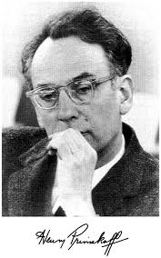
Primakoff Paper
Henry Primakoff, Phys. Rev. 81, 899 (1951).

Slide 31
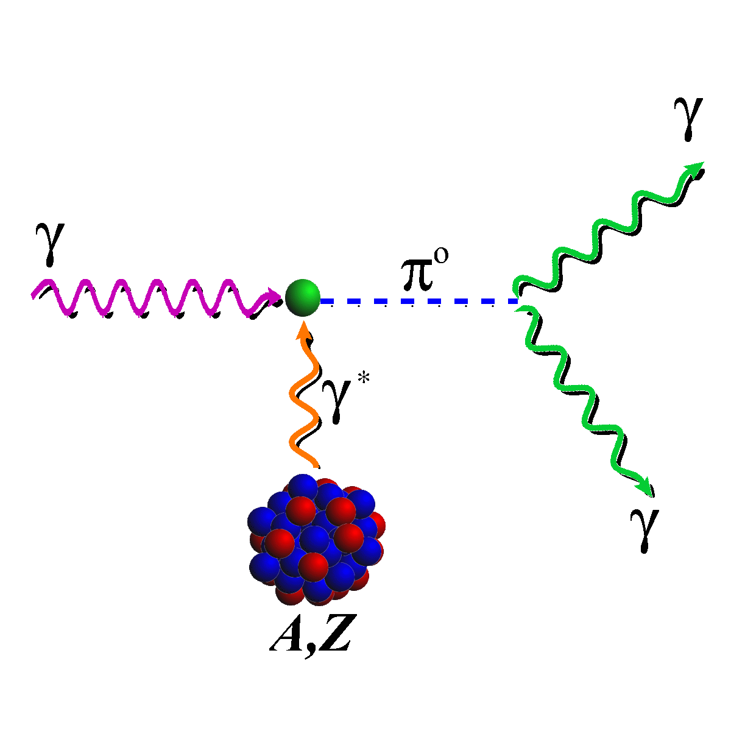
Primakoff Experiment (Hall-B, Jlab)
^{PRL 106, 162303 (2011)}

Slide 32
π⁰ angular distribution

Slide 33
Nuclear Electromagnetic Form Factor
Momentum p’
e⁻
Momentum p
γ∗
Virtual Photon
q: Momentum Transfer
Electromagnetic form factor

Slide 34
π⁰ angular distribution
Primakoff
Nucl. Incoherent
Nucl. Coherent

Slide 35
A(Z)-Dependence
Primakoff

Slide 36
Primakoff Summary
Photon pick up from the Coulomb
field of nucleus
Out-going products through Primakoff effect has strongly forward boosted.
Primakoff effect is suppressed rapidly as a function of emission angle or momentum transfers.
Primakoff effect gets stronger as a function of Z.

Slide 38
The origin of Asymmetry

Slide 39
Experiment

Slide 40
Invariant Mass Distribution

Slide 41
-t Distribution
M
 | < 1.36 [GeV] | 1.36 – 1.62 [GeV]
< 0.001 (GeV/c)² | ❌ | ⭕️
> 0.001 (GeV/c)² | ❌ | ❌
-t

Slide 42
Origin of the Asymmetry
Spin flip
Spin non-flip
A
A
A
A
γ∗
γ∗
π⁰
×
π⁰
p
p
p
p
Δ
Ν∗
Δ*(1232) P33
N*(1440 and higher) P11
Nπ (>99%)
Nπ (60∼70%)
Νππ (30∼40%)
Notes:
[Boris] In both diagrams the interfering gamma and pion cover the whole rapidity interval between the colliding p and A. The pion exchange is, as I said, strongly suppressed. However the OPE mechanism, responsible for neutron production, pion exchange cover only a small part of the rapidity interval. The main part in inelastic collision pi+P(A)=>X. The energy of this collision is very high s(1-z). When we square this inelastic amplitude, we get Pomeron.

Slide 43
Fermi Experiment Summary
Large asymmetry observed in Fermi forward pi0 production in pol(p)+Pb.
Large asymmetry is observed by selecting Primakoff kinematics (Small –t).
The asymmetry is known in photo pion production as a consequence of interference between Delta and N*.

Slide 44
Origin of the Asymmetry
A
A
A
A
γ∗
γ∗
Fermi
π⁰
×
π⁰
p
p
p
p
Δ
Ν∗
A
A
A
A
γ∗
γ∗
RHIC
π⁺
×
π⁺
p
n
p
n
Δ
Ν∗
Notes:
[Boris] In both diagrams the interfering gamma and pion cover the whole rapidity interval between the colliding p and A. The pion exchange is, as I said, strongly suppressed. However the OPE mechanism, responsible for neutron production, pion exchange cover only a small part of the rapidity interval. The main part in inelastic collision pi+P(A)=>X. The energy of this collision is very high s(1-z). When we square this inelastic amplitude, we get Pomeron.

Slide 45
hadronic
CNI
Primakoff
A
A
A
A
×
P
π⁰
π⁰
π⁰
p
p
p
p
Δ
Ν∗
×
A
A
A
A
γ∗
×
γ∗
π⁰
π⁰
p
p
p
p
Δ
Ν∗
Fermi (p+π⁰ channel)
Notes:
[Boris] In both diagrams the interfering gamma and pion cover the whole rapidity interval between the colliding p and A. The pion exchange is, as I said, strongly suppressed. However the OPE mechanism, responsible for neutron production, pion exchange cover only a small part of the rapidity interval. The main part in inelastic collision pi+P(A)=>X. The energy of this collision is very high s(1-z). When we square this inelastic amplitude, we get Pomeron.

Slide 46
hadronic
CNI
Primakoff
A
A
A
A
×
P
π⁰
π⁺
π⁺
p
n
p
n
Δ
Ν∗
×
A
A
A
A
γ∗
×
γ∗
π⁺
π⁺
p
n
p
n
Δ
Ν∗
RHIC (n+π⁺ channel)
Notes:
[Boris] In both diagrams the interfering gamma and pion cover the whole rapidity interval between the colliding p and A. The pion exchange is, as I said, strongly suppressed. However the OPE mechanism, responsible for neutron production, pion exchange cover only a small part of the rapidity interval. The main part in inelastic collision pi+P(A)=>X. The energy of this collision is very high s(1-z). When we square this inelastic amplitude, we get Pomeron.

Slide 47
Comparison between two
 | Fermi | BNL
Beam Energy [GeV] | 185 | 100
√s [GeV] | 19.5 | 200
Target | Pb | Au
Observables | p + π⁰ | n ( + charged)
t' | < 0.001 | 0.02 < -t < 0.5
M | 1.36 < M(π⁰p)<1.52 | ?
A_{N} | - 0.57 ± (0.12)_{sta}+ 0.21 - 0.18 | + 0.27 ± 0.003 (BBC veto)
If the asymmetry is induced at D or N* excitation, does the sign suppose to be the same?
-t
-t
p
p
π⁰
π⁺
Δ
p
Δ
n

Slide 48
Comparison between two
 | Fermi | BNL
Beam Energy [GeV] | 185 | 100
√s [GeV] | 19.5 | 200
Target | Pb | Au
Observables | p + π⁰ | n ( + charged)
t' | < 0.001 | 0.02 < -t < 0.5
M | 1.36 < M(π⁰p)<1.52 | ?
A_{N} | - 0.57 ± (0.12)_{sta}+ 0.21 - 0.18 | + 0.27 ± 0.003 (BBC veto)
If the asymmetry is induced at D or N* excitation, does the sign suppose to be the same?
p
π⁺
Δ
n
beam

Slide 49
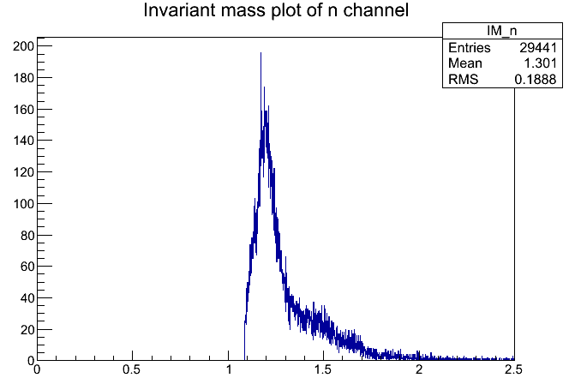
UPC MC
1232MeV
n+π⁺ Invariant Mass [GeV]
Plot made by Minho Kim

Slide 50
A_{N}~ 0 at CNI ?
-t<10⁻⁵
-t<10⁻³
CNI region
A_{N}
A_{N} ~ large
Average A_{N} ~ 0
0
-t

Slide 51
What we can learn from Fermi Exp.?
If we consider the difference between PHENIX neutron and p+pi0 as just a difference in the decay channels from Delta and N*, then both mechanisms are similar.
PHENIX –t is expected to be larger than Fermi, so CNI may be important in PHENIX.
  Although Fermi claims A_{N} is zero at CNI, it may be just because of accident?
  Not straight forward to perform kinematic decomposition in PHENIX data.
Sign of A_{N} are opposite between two experiments. Are we measuring the same A_{N}?

Slide 52
Backups

Slide 53
Comparison between two
 | Fermi | PHENIX | STAR17
Beam Energy [GeV] | 185 | 100 | 255
√s [GeV] | 19.5 | 200 | 22
Target | Pb | Au | Al/Sn/Au
Observables | p + π⁰ | n ( + charged) | n ( + charged) π⁰ ?
t' | < 0.001 | 0.02 < -t < 0.5
M | 1.36 < M(π⁰p)<1.52 | ? | ?
A_{N} | - 0.57 ± (0.12)_{sta}+ 0.21 - 0.18 | + 0.27 ± 0.003 (BBC veto)

Slide 54
Primakoff Diagrams
π⁰
γ
γ∗
θ
π⁰
A
A
π⁰
π⁰
γ
γ
A
A
A
X

Slide 55
Neuclear/Nucleon Photo-Excitation

