Slide 1
ISGMR and EOS
日本の核物理の将来像
不安定核WG
EOS勉強会
２０１６年１０月２７日
大田 晋輔
東大CNS

Slide 2
状態方程式
非対称核物質の飽和密度まわりで書き直す
Kτは新しい飽和密度における非対称核物質の非圧縮率を与える
=>中性子核物質で重要 => 中性子星の構造

Slide 3
状態方程式のパラメータ
（の例）
Bulk Parameter of EoS by J. Piecarewicz EPJA50 (2014) 25
いろいろあるけれど、びしっと決められる実験的な指標はないものか？
Notes:
Ktau から何が決定できるかをもう少し主張する。
左側の絵は必要ないか。。。

Slide 4

荷電非圧縮率 Ktau
実験的には
が決定できる。
理論計算は必ずこの値を再現できなければならない。
（挑戦） Ktauを精度よく（20MeV）決める。
K0, L, Ksymは他の方法から精度よく決められる。
＝＞密度の三次の項 Q0 が議論できる？

Slide 5
Correlation between J, L, Ksym and Kτ
Kτ
Kτ
J
L
Kτ
G. Colo, U. Garg, and H. Sagawa, EPJA50 (2014) 26
Kτ = 550 +- 100 MeV (Sn) Li et al.
Kτ = 555 +- 75 MeV (Cd) Patel et al.
Ksym

Slide 6
Symmetry term in EoS and ISGMR
Q: Is neutron matter soft or hard?
Symmetry term in Equation of State of nuclear matter is important to answer this question.
Kτ is one of the key values.
α=(N-Z)/A
Piekarewicz et al.,PRC79 (2009) 054311
Nuclear Incompressibility
Isoscalar Giant Monopole Resonance
The Kτ parameter can be directly obtained
through the measurement of ISGMR along the isotopic or isobaric chain.
Notes:
Is the neutron matter soft or hard? To answer this question, symmetry term in the equation of state of nuclear matter is important.
Ktau is one of the key values and consists of incompressibility of asymmetric matter, so-called slope parameter L, incompressibility of symmetric matter K0 and skewness parameter Q0 .
Ktau is a coefficient of asymmetric term in nuclear incompressibility.
The incompressibility is directly connected with the energy of ISGMR.
Then the Ktau parameter can be directly obtained through the measurement of ISGMR along the isotopic chain.
//
Is neutron matter soft or hard? To answer this question we need to study the symmetry term of the equation of state of nuclear matter.
The equation of state is an essential equation to describe the bulk property.
Ktau parameter has relationship with symmetric terms and can be measured directly as follows.
Ktau parameter is the coefficient of asymmetric term in the expansion of nuclear incompressibility.
Since the ambiguity in volume term and Coulomb term can be assumed to be small, we can deduce the Ktau parameter from the measurements of the nuclear incompressibility in isotopic chain.
The nuclear incompressibility and the energy of giant monopole resonance have a direct connection described like this.
We need to measure the Giant Monopole Resonance in unstable nuclei far from stability line.

Slide 7
Experimental Value of Kτ
(α,α’) measurement at RCNP
ignore the slight change of A^{-1/3}
fitting a + b (N-Z)²/A² : b = Kτ
Kτ = 500 MeV +- 100 MeV
G. Colo, U. Garg, and H. Saga, EPJA50 (2014) 26
Data:
D. Patel et al. PLB718 (2012) 447
T. Lie et al., PRC81 (2010) 034309
T. Li et al., PRL99 (2007) 162503
Kτ ~ 500-550 MeV +-100MeV
Notes:
N / Z の比を変えることにより Ktau を導出することができる

Slide 8
どうやって決めるか
Macroscopic scaling model
原子核の非圧縮率を展開
G. Colo, U. Garg, and H. Saga, EPJA50 (2014) 26
ignore the slight change of A^{-1/3} and c ~ 1.
fitting a + b (N-Z)²/A² : b = Kτ
Kτ = 500 MeV +- 100 MeV
Data:
D. Patel et al. PLB718 (2012) 447
T. Lie et al., PRC81 (2010) 034309
実験的には、同位体でKAを導出する。
Kτ ~ 500-550 MeV +-100MeV

Slide 9


原子核の非圧縮率
(α,α’) measurement at RCNP
Experiment
<r2> 原子核半径 （matter）<= もらってくる
EGMR:巨大単極共鳴のエネルギー<=決める
Scaling modelでは E3 を使うとよい。
（Li et al.のエネルギーは E1 なので、
矛盾している。By Stone et al.)
実験的には S(E) を決める。
=> アイソスカラー非弾性散乱の測定をする。
T. Li et al., PRL99 (2007) 162503

Slide 10
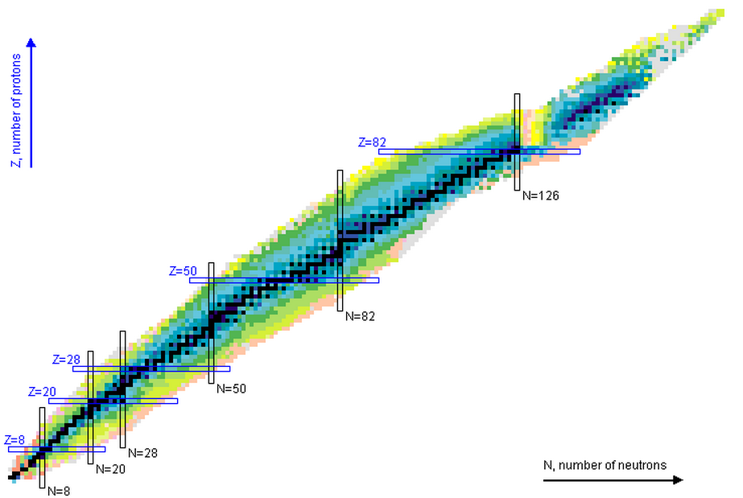
Previous works on ISGMR
204,206,208Pb
for example
144,148-154Sm
208Pb, 144,154Sm, 116Sn, 90Zr
D.H. Youngblood et al.
PRL82 (1999) 691
PRC69 (2004) 034315
C. Monrozeau et al., PRL100 (2008) 042501
116-124Sn
T. Lie et al.,
PRC81 (2010) 034309
116-124Sn
56Ni
144,148-152Sm
M.M. Sharma et al. PRC38 (1988) 2562
M. Itoh et al.,
PRC68, 064602 (2003)
106,110-116Cd
106,110-116Cd
D. Patel et al. PLB718 (2012) 447
90Zr
巨大単極共鳴 (IsoScalar Giant Monopole Resonance)
核物質の非圧縮率・非対称項の導出が行なわれてきた

Slide 11
Ktauの精度を上げるには
Relationship among the centroid (E_{GMR}), uncertainty of centroid and the value of K_{τ}.

Slide 12
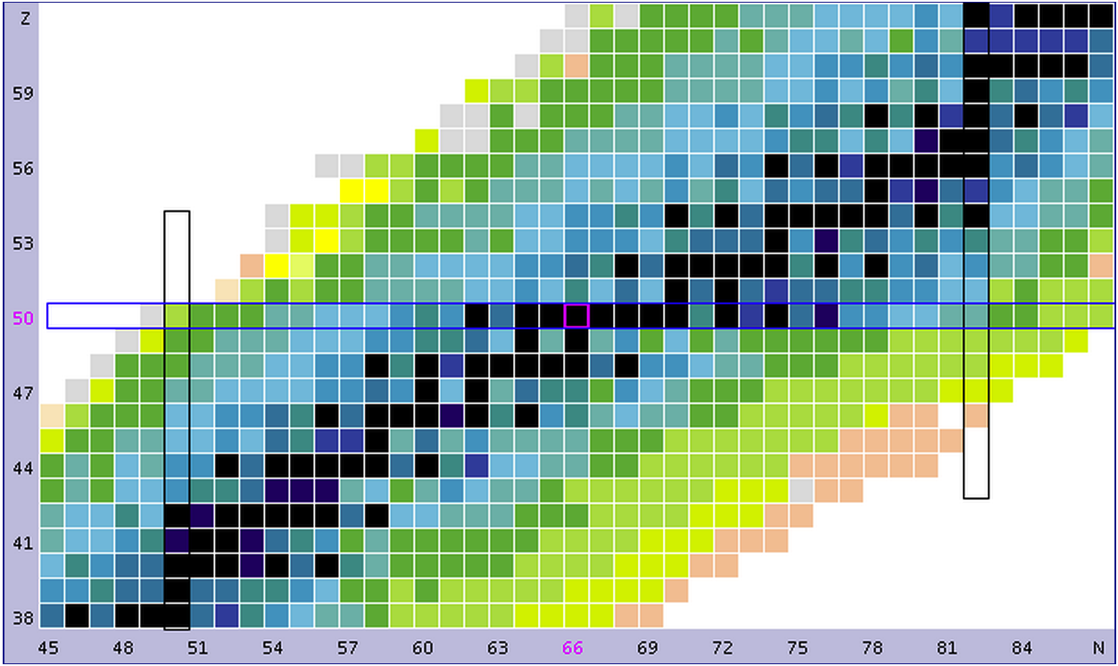
Field for ISGMR study
A=132体系
132Nd
(0.09)2
=0.008
@HIMAC
2014
132Xe
(0.212)
106Sn
(0.056)²
=0.003
112Sn
(0.107)²
=0.011
124Sn
(0.194)²
=0.038
132Sn
(0.242)²
=0.059
A=100体系
132Sn
(0.242
Sn アイソトープ
132Sn@RIBF
Approved
Doubly magic
Isotope
Isobar
Isotone
Notes:
132Sn を測定する。新しい!!
中性子と陽子の差があった場合にはアイソスカラーとはどう思えばよいのか?

Slide 13
Measurement of (d,d’) in inverse kinematics
¹³²Sn
detect recoiled deuteron
d
ROI
d
Ex = 15MeV
Missing mass
  Covers whole excitation energy region including ground state
  Excitation spectrum does not depend on the decay property
  θlab(d) : 0 – 90 deg
  TKE(d) : 0 – 5 MeV (θcm < 9 deg)
    low energy recoiled particle
Ex=30MeV
20
10
0
Kinematics of recoiled deuteron
θcm=5
θcm=0
Gas target + 3D tracker = Active Target
Notes:
We will perform (d,d’) measurement in inverse kinematics.
The 132Sn beam bombard the deuterium target and we measure the recoiled deuteron.
Missing mass spectroscopy in inverse kinematics can covers whole excitation energy region including ground state and
the measured excitation energy does not depend on the decay property.
However, the energy of recoiled deuteron is low in the region of interest.
Right up figure shows the angular distribution using spherical Bessel function for the simplicity.
To extract the monopole energy we need cover the forward angle.
Right down figure shows the kinematical curve of recoiled deuteron. Horizontal axis show the angle and vertical axis shows the total kinetic energy.
Vertical line around 90 degrees corresponds to the elastic scattering and curves perpendicular to this line indicate the scattering angle in the center-of-mass frame.
We need to measure the low energy recoiled particles below 0.5 MeV.
To measure such a low energy recoiled particle, we have developed an active target,
which provide two function of target and 3-D tracker at the same time.
//
I will explain the measurement of (d,d’) in inverse kinematics.
In this measurement the beam is 132Sn, and target is deuteron since we can not make 132Sn as a fixed target for now.
We perform missing mass spectroscopy. This has two advantages. We can measure whole excitation energy region including ground state.
And the measured excitation spectrum does not depend on the decay property.
However we need to measure very low energy recoil particles. Bottom figure shows the kinematical correlation of recoiled deuterons.
Horizontal axis shows the recoiling angle of deuteron in laboratory frame and vertical axis shows the total kinetic energy of deuteron.
The vertical line at 90 degree corresponds to the elastic scattering namely the excitation energy is zero.
The next line corresponds to 5 MeV excitation energy etc. The perpendicular curves displays the center of mass angle by 1 degree step.
The region on interest is hatched region and the lowest energy is around 0.3 MeV.
If we use the solid target such a low energy particle can not exit from the target.
We need to use gas target and put the tracking detector near the reaction point.
Active Target system provide these functions at the same time.

Slide 14
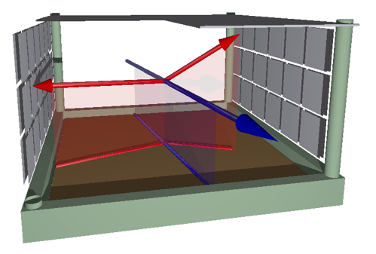
アクティブ標的
標的+検出器
= 核反応三次元カメラ
(イメージング)
反応粒子
霧箱
ビーム
時間投影型飛跡検出器(TPC) (+シリコン検出器 (固体検出器))
二次元の位置は画素
もう一次元は時間 (霧が地面に着く時間) を測って導出する
イベント識別能力の向上
逆運動学超前方測定や崩壊測定など従来困難であった測定を可能に.
ガスを交換することで、p,d,a標的などの実験が可能。

Slide 15
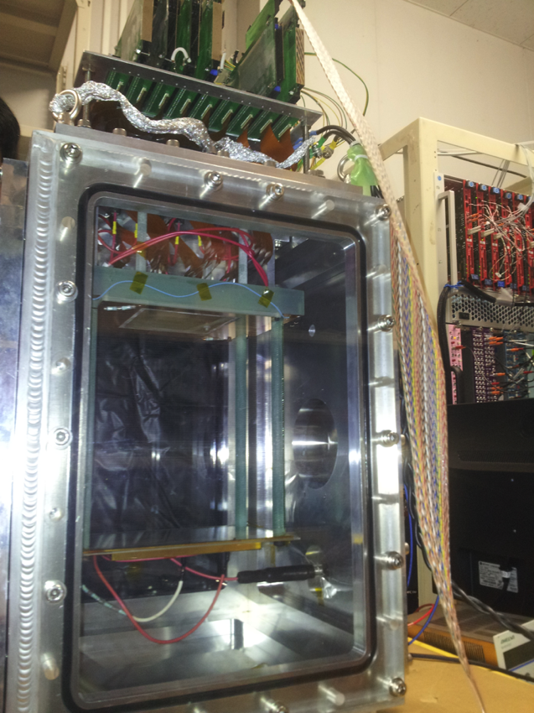
CNS Active Target
TPC and Si array
  0.4 atm. pure deuterium gas
  Gas Electron Multiplier (GEM) : required gain ~ 10⁴
  300 um resolution achieved
3D tracking of beam and recoiled particle
4-momenta of them.
(δElab ~ 10%, δθlab ~ 2 deg at θCM ~ 2 deg)
Converted to excitation energy and CM angle
(δEx ~ 1MeV, δθCM~0.5 deg are expected.)
9cm x 9cm, 0.5mm^{t}
25cm
10cm x 10cm
E~1kV/cm/atm
Notes:
We developed the CNS Active Target.
The Active Target system consists of Time projection chamber and Si array.
The TPC is used to measure the track and the range of low energy and Si array is used to measure the total energy of high energy particles.
TPC is like 3D camera and can track beam and recoiled particle at the same time.
We can measure the 4-mementa of them. The resolution of energy and angle is around 10% and 2 degrees respectively.
Then we can convert them to the excitation energy and scattering angle.
The expected resolutions of excitation energy and scattering angle are 1 MEV and 0.5 degrees.

Slide 16
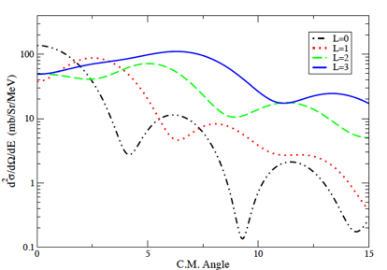
Acceptance of CAT
Efficiency
10
Scattering Angle (deg)
dσ/dΩ
0
0
CM Angle
10
30
Excitation energy (MeV)
CAT system has wide angular coverage
Notes:
In order to estimate the yield, I obtained the geometrical efficiency by using simple monte-calro simulation.
The left figure shows the efficiency in excitation energy and scattering angle plane.
You can see two parts. But the efficiency is almost uniform.
The angular coverage is shown in right figure at around 14 MeV excitation energy.
The black curve shows the angular distribution with L=0.
The CAT system covers wide angular region including the forward angle and dip around 4 degrees.

Slide 17
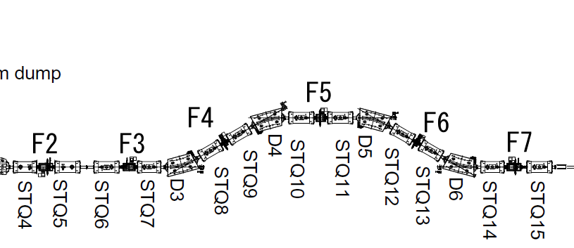
RIBF113 experiment
大強度に耐えうる検出器の導入
Diamond (0.2 mm)
MWDC
Plastic
MWDCs
Degrader
Diamond
MWDCs
132Sn
100 MeV/u
>100kcps
(total 数百kcps)
132Sn
100 MeV/u
>100kcps
(total ~ 1Mcps)
active
target
TOF-Bρ-Bρ
10⁶cps を越える大強度ビームを分離、識別し、かつアクティブ標的で使用可能にする
二次ビーム粒子識別: 応答の早い検出器システムを用いる (学会で発表予定)
アクティブ標的：ビームと反跳粒子に対して異なる電子増幅度を用いる工夫をした
ルミノシティ 10⁵ cps x 10²⁰cm⁻² ~ 0.01 mb⁻¹s⁻¹

Slide 18
Yield and Error Estimation
Expected strength distribution
Extraction of Kτ
10 days w/ 100kHz beam
δEx = 1 MeV ,δθ_{CM} = 0.5 deg
Total cross section is calculated using OM.
Only monopole / spherical Bessel
dE_{GMR} ~ 0.17 MeV
error of Kτ can be reduced to 50 MeV from 70 MeV.
0.5 MeV difference in E_{GMR} corresponds to 80 MeV difference in Kτ
Notes:
In the yield estimation, I assume the measurement for 10 days with the intensity of 100 kHz.
From the yields for each excitation energy, I extract the monopole strength by fitting the angular distribution with assumptions of errors.
The obtained strength distribution is shown in the right figure.
By fitting the lorentzian function, the estimated uncertainty of GMR energy is 0.17.
Right figure shows the extraction of Ktau value assuming various EGMRs.
With the expected uncertainty of EGMR, the error of Ktau can be reduced to 50 MeV from 70 MeV.
And the GMR energy difference of 0.5 MeV corresponds to 80 MeV difference in Ktau value.

Slide 19
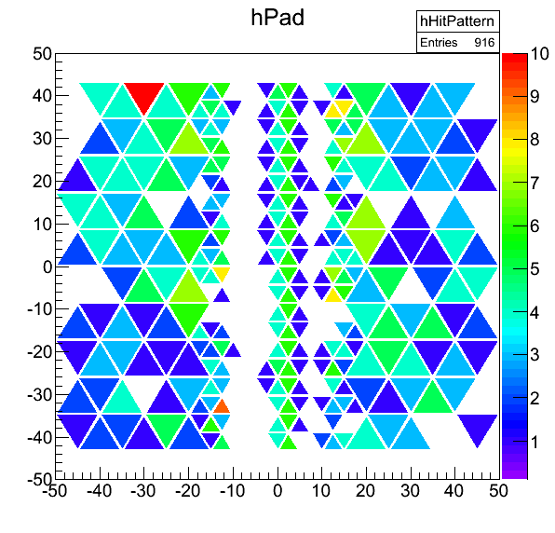
132Xe(d,d’) at HIMAC
HIMAC (28th Oct – 2nd Nov, 2013)
  132Xe
    100MeV/u
    500 kcps
  3 GEMs with 0.4-atm deuterium
  Recoiled particles were measured successfully
Notes:
We performed the pilot experiment using 132Xe at 100 MeV/u at HIMAC in Chiba.
We could operate a high intensity Xe beam of 100 kHz. This is same condition with the proposed experiment.
We use 3 GEMs with 0.4-atomospheric pressure pure deuterium.
Right figure shows the correlation between the pulse height and time in each readout pad.
In the blue circle the signals from beam particles are shown and in the red circle, the signal from recoiled particles are seen.
The other part may be delta-rays, which means our readout system is sensitive to such a low energy deposition.

Slide 20
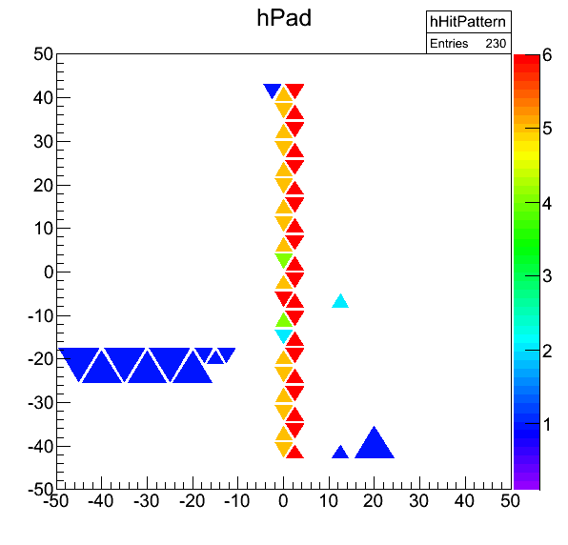
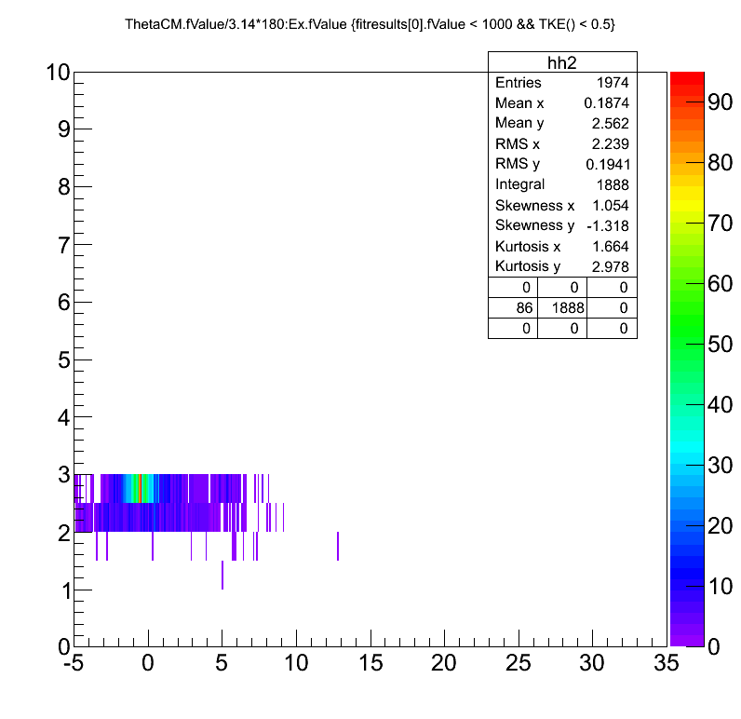
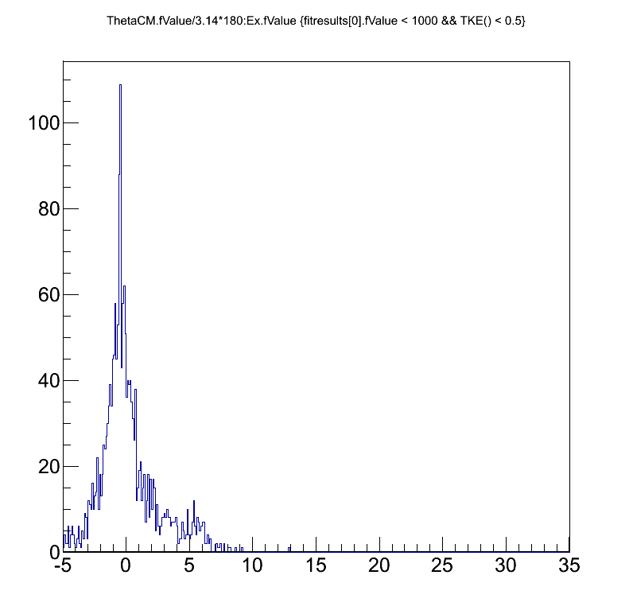
132Xe(d,d’) at HIMAC
HIMAC (28th Oct – 2nd Nov, 2013)
  132Xe
    100MeV/u
    500 kcps
  3 GEMs with 0.4-atm deuterium
  Recoiled particles were measured successfully
δEx ~ 2.5MeV(FWHM)
θcm
very preliminary
Ex(MeV)
Notes:
We performed the pilot experiment using 132Xe at 100 MeV/u at HIMAC in Chiba.
We could operate a high intensity Xe beam of 100 kHz. This is same condition with the proposed experiment.
We use 3 GEMs with 0.4-atomospheric pressure pure deuterium.
Right figure shows the correlation between the pulse height and time in each readout pad.
In the blue circle the signals from beam particles are shown and in the red circle, the signal from recoiled particles are seen.
The other part may be delta-rays, which means our readout system is sensitive to such a low energy deposition.

Slide 21
132Sn(d,d’) at RIBF
analysis in progress ...

Slide 22
Ktau の精度・確度改善策
Recall T. Li, U. Garg et al.
ignore the slight change of A^{-1/3} and c ~ 1.
fitting a + b (N-Z)²/A² : b = Kτ
Kτ = 500 MeV +- 100 MeV
C=1は仮定してよいのか？
質量依存性は取り入れられないものか？
質量を一定にすれば質量依存性は無視できる。
(Cも忘れられる。）
再解析
同重体での測定

Slide 23

同位体のKA => Ktau 再解析
J.R. Stone らによる再解析が行われた
  質量数依存性の取り扱いの変更
  原子核半径の修正 （荷電半径を使っていた）
  巨大共鳴エネルギーのE3への修正 （E1を使っていた）
  クーロン項の改善
C=-1

Slide 24
再解析の結果
(J.R. Stone et al.)
K0, Ktau free
K0 fix, Ktau free
Same as (i) but using charge radii

Slide 25
さらに踏み込んだ解析
K0, c もフィットで出してしまう。

Slide 26
もっと踏み込んだ解析

Slide 27
同重体を使うアイデア
Isotope: many stable nuclei are available => extend to the unstable nuclei region
Isobar: little dependence on A => new challenge
112Sn
(0.107)²
=0.011
124Sn
(0.194)²
=0.038
106Cd
(0.094)
116Cd
(0.172)
Isotope
Isobar
Isotone
Notes:
132Sn を測定する。新しい!!
中性子と陽子の差があった場合にはアイソスカラーとはどう思えばよいのか?

Slide 28
Field for ISGMR study
A=132体系
132Nd
(0.09)2
=0.008
@HIMAC
2014
132Xe
(0.212)
106Sn
(0.056)²
=0.003
112Sn
(0.107)²
=0.011
124Sn
(0.194)²
=0.038
132Sn
(0.242)²
=0.059
A=100体系
132Sn
(0.242
Sn アイソトープ
132Sn@RIBF
Approved
Doubly magic
Isotope
Isobar
Isotone
Notes:
132Sn を測定する。新しい!!
中性子と陽子の差があった場合にはアイソスカラーとはどう思えばよいのか?

Slide 29
魔法数核でのE_{ISGMR}
Pb isotope
204,206,208 Pb
E. Kahn PRC80, 057302 (2009)
D. Patel et al., PLB726, 178 (2013)
mutually enhanced magicity (MEM)
鉛 204, 206, 208 はほぼ同じエネルギー
132Sn は二重魔法数核
なにかしらの効果があるか

Slide 30
変形核での E_{ISGMR}
144,148-154Sm
M. Itoh et al., Phys. Rev. C68, 064602 (2003)
Y. Gupta et al., arXiv:1507.03639 [nucl-ex]
(to be published in PLB)
24Mg
疑問
Isobar => mid-shell => 変形
変形の効果により ISGMR の強度が分散する。
圧縮率を出したいと思ったら m₁/m₀ などを求めるやりかたで問題ないのか?

Slide 31
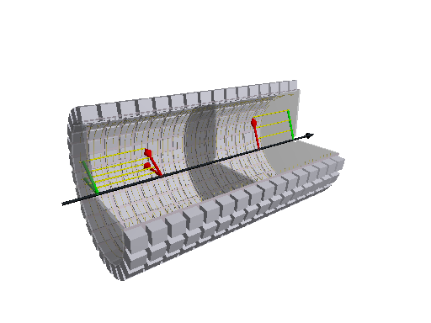
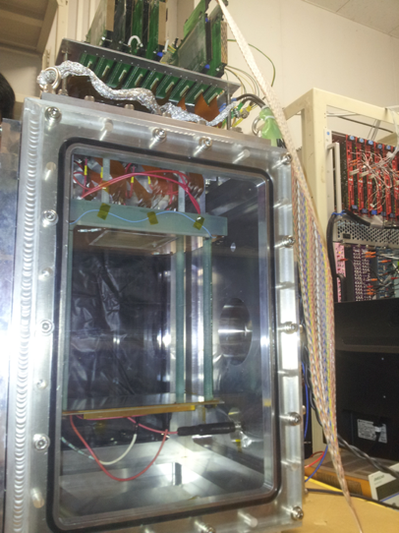
roadmap
~2021
(d,2p) w/ 100kcps・10day
(d,d’) w/ 10kcps・10day
(d,d’) w/ 100kcps・10day
~2018
2009-2016
反応粒子
Large Volume
+ Gamma
φ50cm x 2m
ビーム
CAT (phase II)
30cm x 30cm x 20 cm
Phase II key items
Large area GEM
High density readout
CAT (phase I)
10cm x 10cm x 25cm
Key feature achieved in Phase I
High intensity beam injection
100 MeV/u Sn region beam

Slide 33
まとめ
中性子核物質の非圧縮率の決定精度を向上させるため、逆運動学で非弾性散乱の測定をする
  錫同位体
    132Sn 測定予定
    106Sn 是非測定したい
  A=132 / A=100 同重体
    質量依存性をできるだけ排除して測定してみたい
    132Xe HIMACで測定済。解析中。
アクティブ標的を開発した
  100MeV/u 錫領域の100kcps 以上の大強度ビームで使用可能
  陽子、重陽子、ヘリウムの散乱実験が可能

Slide 34
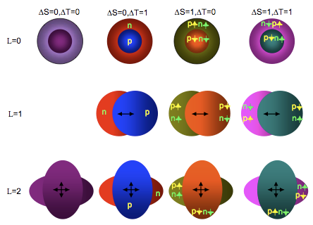
Giant Resonances
monopole
http://cyclotron.tamu.edu/structure.html

Slide 35
巨大共鳴と非圧縮率
理論計算との比較から対称核物質の非圧縮率を導出する
Knm ~ (Kvol) ~ 231 +- 5 MeV
D.H. Youngblood et al., PRL82, 691 (1999)

Slide 36
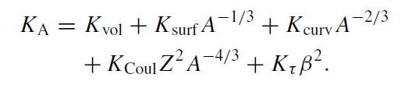

Recent treatment of ISGMRs

Slide 37
(d,d’) reaction study at 100 MeV/u
(d,d’) on 208Pb was measured at 100 MeV/u in normal kinematics at RCNP by D. Patel and U. Garg et al.
Optical potential parameter set was obtained by analyzing the elastic scattering data and it’s enough to reproduce the 3- state in 208Pb.
Notes:
The (d,d’) on 208Pb was measured recently at RCNP D. Patel and U. Garg et al.
They obtained good optical potential parameters.

Slide 38
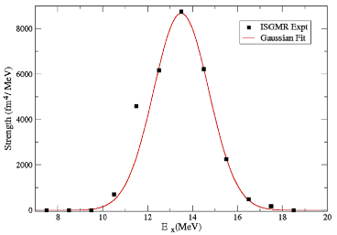
ISGMR in 208Pb via (d,d’)
Multipole decomposition analysis on 208Pb.
Ex = 13.5 MeV
Monopole strength in 208Pb deuced using (d,d’) reaction.
8
14
20
Ex (MeV)
(d,d’) can be used to effectively deduce the GMR!!
=> apply (d,d’) in inverse kinematics
We have also 116Sn(d,d’) data and OPM parameter was successfully obtained.
Notes:
They performed the multipole decomposition analysis using obtained optical model parameters.
An example of the decomposition shown in this figure.
Right figure shows the monopole strength in 208Pb deduced using (d,d’) reaction.
This result reveals that the (d,d’) reaction also can be used to effectively deduce the GMR.
// We have also 116Sn data and optical model parameter.

Slide 39
Future works on ISGMR
A=132体系
A=100体系
106Sn
132Sn (approved)
(大型アクティブターゲットの建設)
15O, 16O : low lying E0 strength
(BT at HIMAC 2015 proposed)

Slide 40
Contents
Why EOS?
What’s the EOS?
How to approach EOS? Ktau.
  Why ISGMR
  What’s the ISGMR
  How to approach the ISGMR?
    Why Active Target?
    What’s the Active Target?
    How to build the Active Target?
What’s the perspective?

Slide 41
References
[ST14] J. R. Stone, N. J. Stone and S. A Moszkowski, PRC 89, 044316 (2014)
[CO14] G. Colo, U. Garg, and H. Sagawa, EPJA50, 26 (2014)
[EB15] S. Ebata arXiv:1508.06407 (2015)

Slide 42
ISGMR => Ktau
E3 (scaling) vs E1 (constrained)
  Leptodermous expansion in powers of A-1/3
  Constrained
    Convergence is slow
    A2/3 term cannot be neglected
  Scaling
    Transition density clearly separates volume from surface region
    Convergence is fast
    Higher order terms are negligible
  K0 = 240 +- 20 MeV

Slide 44
Model
  Microscopic
  Macroscopic
Determination of EGMR
Experimental data analysis
  Method
  Sn and Cd data
  Extended data sets
  Estimation of Ktau,v and Ktau,s
Surface energy and diffuseness

Slide 45
ST14

Slide 46
E3

Slide 47
E1

Slide 48
CO14

