Slide 1
Reaction cross sections as a probe of
deformation and shell structures
Shin Watanabe
RIKEN Nishina center, Strangeness nuclear physics Lab.
K. Minomo², M. Shimada³, S. Tagami³, M. Kimura⁴,
M. Takechi⁵, M. Fukuda⁶, D. Nishimura⁷, T. Suzuki⁸,
T. Matsumoto³, Y. R. Shimizu³, and M. Yahiro³
¹RIKEN, ²RCNP, ³Kyushu Univ., ⁴Hokkaido Univ., ⁵Nigata Univ.,
⁶Osaka Univ., ⁷Tokyo Univ. of Sci., ⁸Saitama Univ.
6/Dec./2016
RIBF seminar (RIKEN)

Slide 2
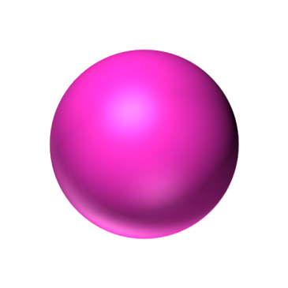
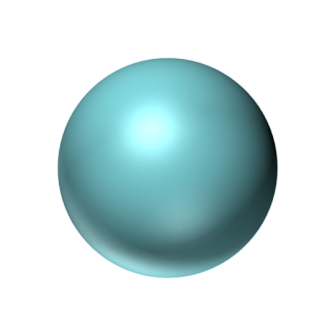
Reaction cross section (σ_{R})
$$σ_{R}≒π{\left(R_{P}+R_{T}\right)}^{2}$$
$$R_{P}$$
Projectile
$$R_{T}$$
The σ_{R} has been often used
as a probe of nuclear radii.
Target
(known)
Discovery of halo (¹¹Li)
The applications of σ_{R}
have been changing!
I. Tanihata et al., PRL 55, 24 (1985).

Slide 3
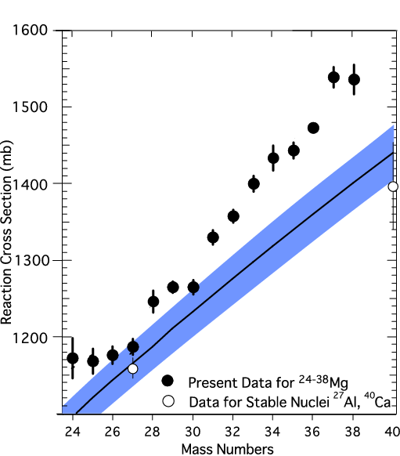
Experimental development (high quality)
GSI (1998) GSI (2011)
RIBF (2014)
T. Suzuki et al., NPA 630, 661 (1998).
R. Kanungo et al., PRC 83 021302(R) (2011).
M. Takechi et al., PRC 90 061305(R) (2014).
³⁸Mg
³⁵Mg
Total reaction cross section
²⁰⁻³⁵Mg+¹²C scattering
at 900 MeV/nucl.
²⁴⁻³⁸Mg+¹²C scattering
at 240 MeV/nucl.
Very high-quality data were measured
for very exotic nuclei at RIBF.

Slide 4
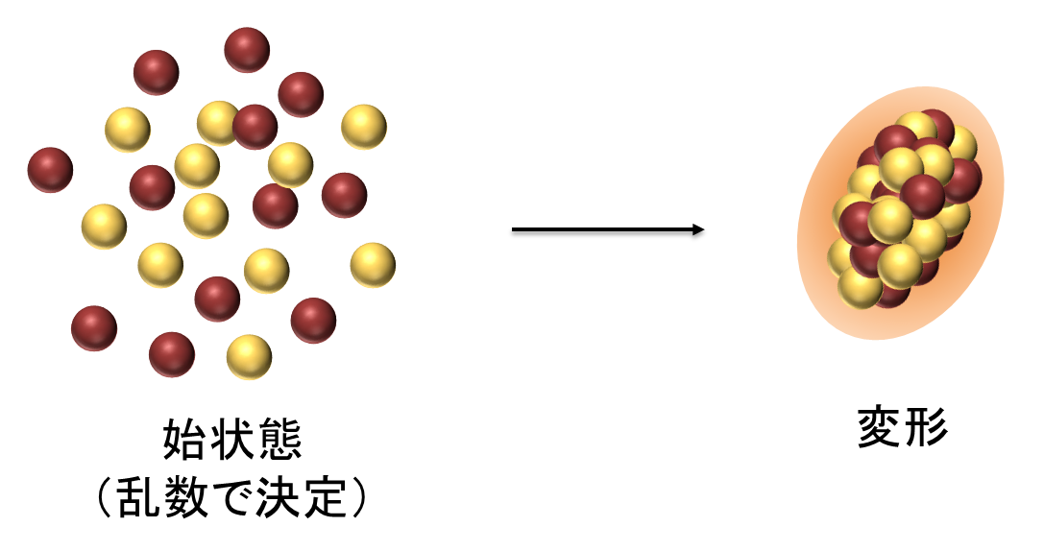
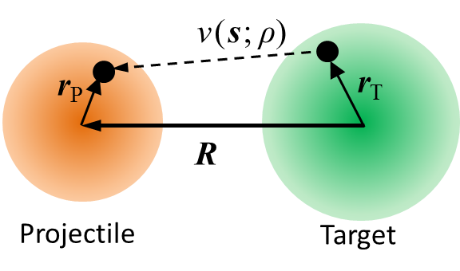
Theoretical development (microscopic approach)
Microscopic structure model
Microscopic reaction model
Energy
variation
Initial state
Deformed density
Projectile
Target
AMD
Hartree Fock
Folding model
Glauber model
・・・
・・・
We can calculate observables
through microscopic structure and reaction models
based on effective NN interactions.

Slide 5
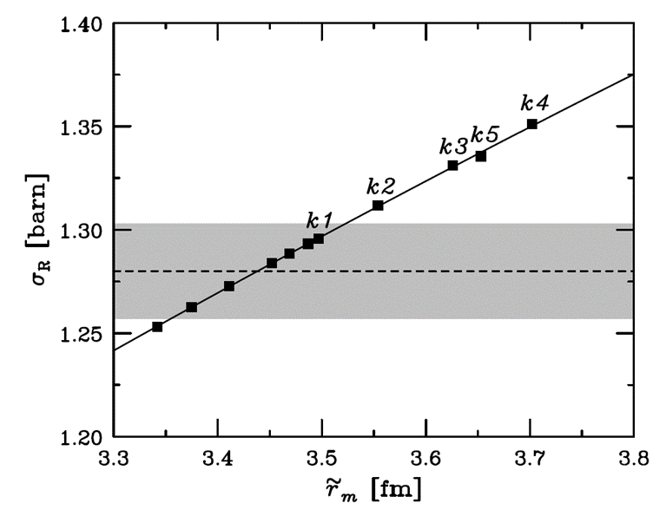
Thanks to the theoretical and experimental developments, …
Precise determination
Skin thickness
Togano, Nakamura, Kondo et al., PLB761, 412 (2016).
Horiuchi, Hatakeyama, Ebata et al., PRC93, 044611 (2016).
$$σ_{I}=1.280±0.023 b$$
$$a_{R}\left(N,Z,E\right)≈α\left(E\right)r_{m}\left(N,Z\right)$$
$$+β\left(E\right)δ\left(N,Z\right)+γ\left(E\right)$$
$$r_{m}=3.44±0.08 fm$$
²²C

Slide 6
Thanks to the theoretical and experimental developments, …
Precise experiment
Radius
Heavier Halo
Deformation
Skin
Halo parameter
Accurate
determination
Togano, Nakamura, Kondo et al., PLB761, 412 (2016).
Higher-order
quantities
Horiuchi, Hatakeyama, Ebata et al., PRC93, 044611 (2016).
Microscopic theories
→ New idea
Yahiro, SW, Toyokawa et al., PRC93, 064609 (2016).
・・・
The σ_{R} is utilized not only for radii and/or halo, but also deformation or skin structures.
We can also achieve a new idea.

Slide 7
Table of contents
Background and Motivation
Reaction cross sections as a probe of deformation
Island of inversion
Microscopic framework
Antisymmetrized Molecular Dynamics (AMD)
Double Folding Model (DFM)
Results
Ground-state properties of Mg isotopes
Overview of the island of inversion
Deformed halo of ³⁷Mg?
Summary

Slide 8
Table of contents
Background and Motivation
Reaction cross sections as a probe of deformation
Island of inversion
Microscopic framework
Antisymmetrized Molecular Dynamics (AMD)
Double Folding Model (DFM)
Results
Ground-state properties of Mg isotopes
Overview of the island of inversion
Deformed halo of ³⁷Mg?
Summary

Slide 9
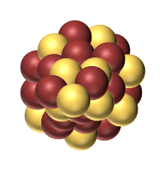
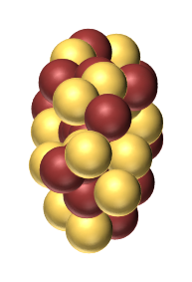
“Loss of magicity” and “Island of inversion”
N=20
magicity
N=28
magicity
⁴⁰ Ca
Magicity
Loss of Magicity
（Large gap at N=20）
（Inversion of shells）
f
N=20?
N=20 gap
d
Proton number Z
d
f
s
⁴⁰Ca: Spherical
s
³²Mg : Deformed
³² Mg
⁴⁰ Mg
Island of
Inversion
^{24 – 38} Mg
σ_{R} were measured
E.K. Warburton et al.,
Phys. Rev. C41, 1147 (1990).
Neutron number N
Exotic data have been accumulated at RI Beam Factory.
Now is the time to study the “IoI” again with experimental data.

Slide 10
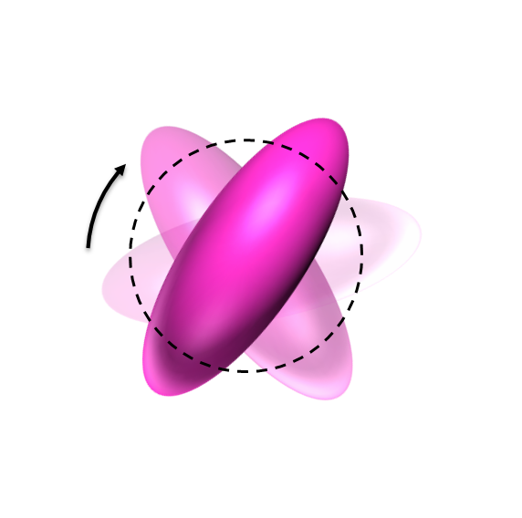
How to determine $β_{2}$?
Usually, the deformation parameter $\left|β_{2}\right|$ is determined from transition probabilities.
$$4_{1}^{+}$$
rotation
$$2_{1}^{+}$$
$$β_{2}∝\sqrt{B(E2)}$$
E2
$$0_{gs}^{+}$$
For unstable nuclei, measurements are not easy.
$E(2+)$
$E(4+)$
$R_{4/2}=E(4+)/E\left(2+\right)$

Slide 11
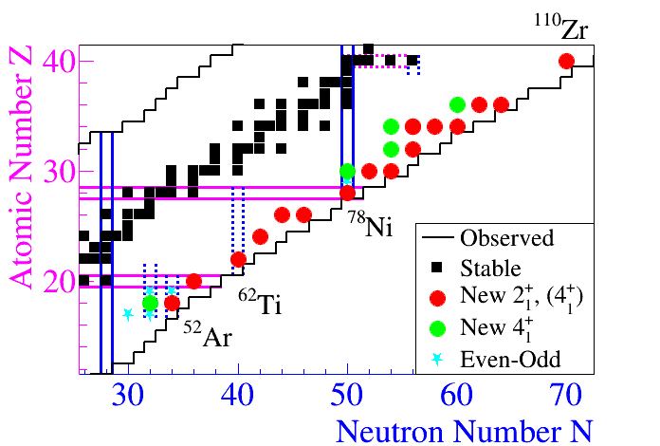
Systematic measurements
E(2+) and E(4+) were measured, for example, for Mg isotopes.
P. Doornenbal et al., PRL111, 212502 (2013).
Systematic measurements for E(2+) and E(4+) are quite important
to clarify the structure of unstable nuclei such as magicity.
for example
SEASTAR project
Shell Evolution And Search for Two-plus energies At RIBF
http://www.nishina.riken.jp/collaboration/SUNFLOWER/experiment/seastar/index.html
Systematic measurements of σ_{R} in addition to E(2+) and E(4+)

Slide 12
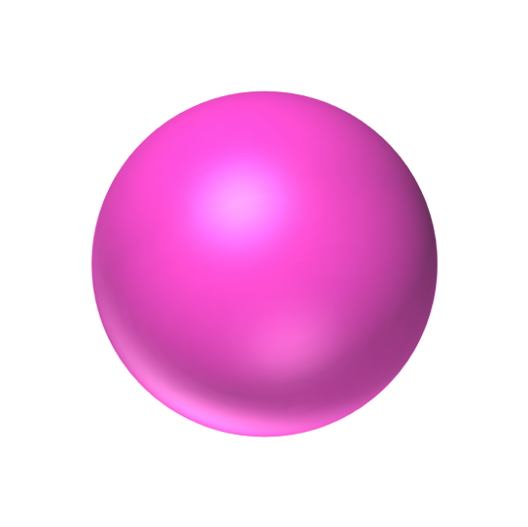
Deformation and σ_{R}
Nuclear deformation can be probed by σ_{R}.
cf. Angular Momentum Projection
$$σ_{R}≒π{\left(R_{P}+R_{T}\right)}^{2}$$
$$R_{P}$$
$$R_{T}$$
Projectile
（Spherical）
Projectile
(Deformed)
Target
Deformation enhances σ_{R}.

Slide 13
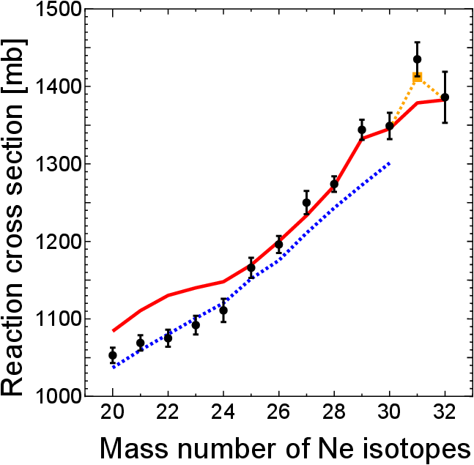
Previous studies on Ne (Z=10)
Experiment
σ_{I} for ²⁰⁻³²Ne were measured systematically.
Exp. M. Takechi et al., PLB 707, 357 (2012).
²⁰⁻³²Ne + ¹²C at 240MeV/nucleon
Theory
σ_{I} were analyzed theoretically.
AMD-RGM
AMD + Double Folding Model
island of inversion
K. Minomo et al., PRL 108, 052503 (2012).
AMD
Skyrme-HF + Glauber
W. Horiuchi et al., PRC 86, 024614 (2012).
Particle Rotor Model + Glauber
spherical-HF
Y. Urata et al., PRC 86, 044613 (2012).
$$β_{2}∼0.2$$
$$β_{2}∼0.4$$
²⁹⁻³²Ne: Large deformation
³¹Ne: Deformed halo

Slide 14
Motivation 1 (Experimental points)
We analyze ²⁴⁻⁴⁰Mg with the microscopic framework.
Since, in the isotopes, precise measurements were made not only for σ_{R} but also for E(2+) and E(4+).
M. Takechi et al., EPJ Web of Conferences 66, 02101 (2014).
P. Doornenbal et al., PRL111, 212502 (2013).
²⁴⁻³⁸Mg
N = 20 magicity?
N = 28 magicity?
²⁴ Mg
⁴⁰ Mg
Proton number Z
Island of
Inversion
Neutron number N

Slide 15
Motivation 2 (theoretical points)
Microscopic framework
AMD
Double Folding Model
Measurements
σ_{R}
E(2+) and E(4+)
N=20 magicity?
N=28 magicity?
²⁴⁻³⁸Mg
²⁴ Mg
⁴⁰ Mg
Proton number Z
Island of
Inversion
Neutron number N

Slide 16
Table of contents
Background and Motivation
Reaction cross sections as a probe of deformation
Island of inversion
Microscopic framework
Antisymmetrized Molecular Dynamics (AMD)
Double Folding Model (DFM)
Results
Ground-state properties of Mg isotopes
Overview of the island of inversion
Deformed halo of ³⁷Mg?
Summary

Slide 17
Microscopic framework
AMD
(Antisymmetrized Molecular Dynamics)
DFM
(Double Folding Model)
Energy
variation
Initial state
Deformed density
Projectile
Target
Projectile densities
Optical potentials
This framework allows us to calculate
various observables microscopically.

Slide 18
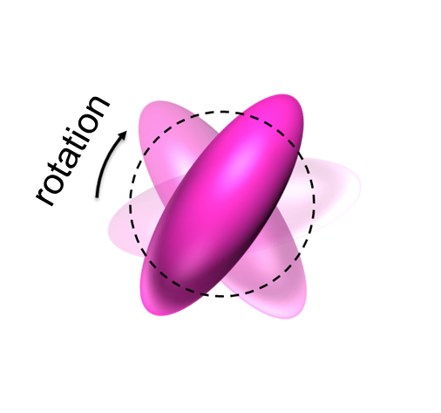
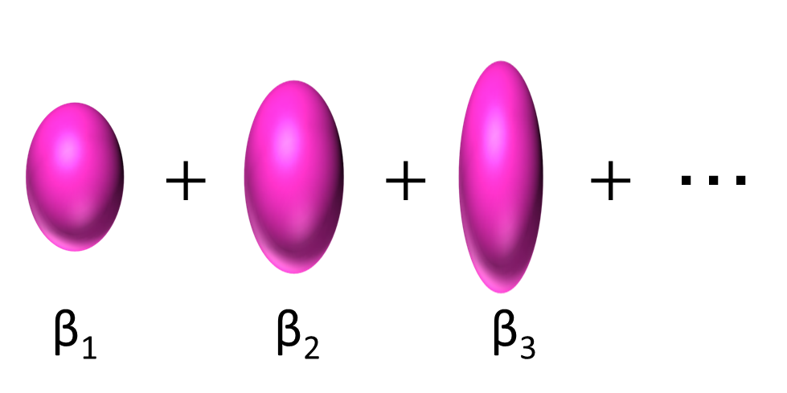
AMD Framework
Many-body Hamiltonian
$$H=\sum_{i=1}^{A}{t_{i}−T_{cm}}+\sum_{i<j}^{A}{v_{ij}},$$
$v_{ij}$: Gogny-D1S
$$φ^{π}(β)$$
Parity-projected Slater determinant
Energy
$$Φ_{mK}^{Iπ}(β)$$
$$E=\frac{\left\langle φ^{π} | H_{β} | Φ^{π}\right\rangle }{\left\langle Φ^{π} | Φ^{π}\right\rangle }$$
$$φ^{π}(β)=P^{π}𝒜\left\{φ_{1},φ_{2},⋯,φ_{A}\right\}$$
$$Ψ_{g.s.}^{Imπ}$$
Angular Momentum Projection
$$Φ_{mK}^{Iπ}(β)=\int{dΩD_{mK}^{I∗}\left(Ω\right)R\left(Ω\right)φ^{π}(β)}$$
Deformation (β)
AMP
Generator Coordinate Method
GCM
$$Ψ_{n}^{Imπ}=\sum_{K=−I}^{I}{\sum_{β}{c_{nK}\left(β\right)}}Φ_{mK}^{Iπ}(β)$$
from Hill-Wheeler eq.
Ground-state density
Superposing different deformation and configurations
$$ρ_{Im^{′}Im}\left(r\right)=\left\langle Ψ_{g.s.}^{Im^{′}π} | \sum_{i}{δ(r_{i}−r−X)} | Ψ_{g.s.}^{Imπ}\right\rangle$$
Restoring rotational symmetry

Slide 19
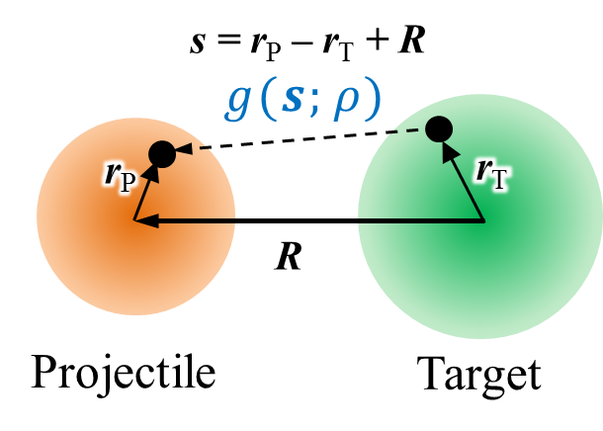
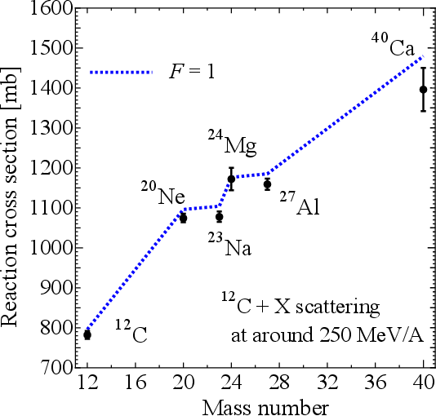
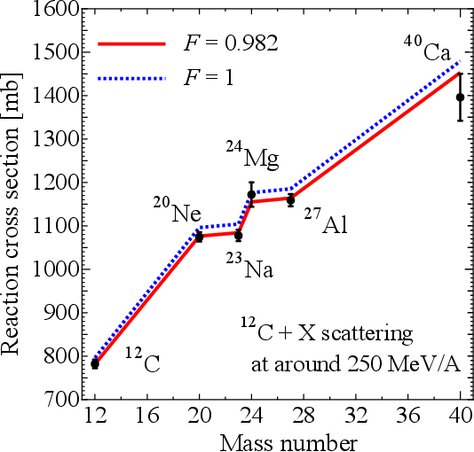
Double Folding Model
Schrödinger equation
$$\left(−\frac{ℏ^{2}}{2μ}∇^{2}+U\left(R\right)\right)χ(R)=Eχ(R)$$
$$U\left(R\right)=\int{ρ_{P}\left(r_{P}\right)ρ_{T}\left(r_{T}\right)g\text{(}\text{s}\text{;} ρ\text{)} {dr}_{P}{dr}_{T}}$$
Deformed density
(from AMD)
Melbourne
g-matrix interaction
Test calculation
The DFM calculation slightly overestimates experimental data.
We introduce 1.8% reduction.
Apply Mg isotopes.

Slide 20
Table of contents
Background and Motivation
Systematic measurements to probe deformation
Shell evolution around the island of inversion
Microscopic framework
Antisymmetrized Molecular Dynamics (AMD)
Double Folding Model (DFM)
Results
Reaction cross sections
Ground-state properties
Deformed halo of ³⁷Mg?
Summary

Slide 21
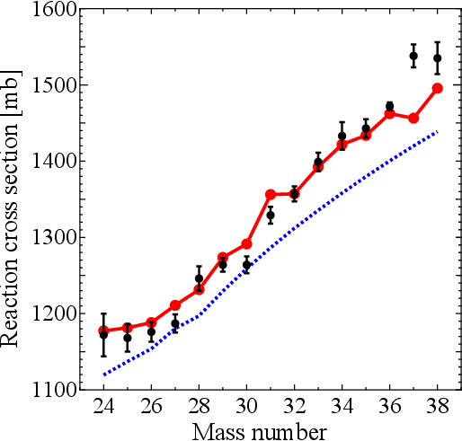
Results: σ_{R} for Mg (Z=12)
^{A}Mg+¹²C, E_{lab}=240MeV/nucleon
Deformation effect is significant for σ_{R}.
³⁷Mg?
due to
deformation
AMD well reproduces the measured σ_{R}.
AMD
(w/ deformation)
For ³⁷Mg, AMD underestimates the experimental data.
spherical-HF
(w/o deformation)
“Deformed halo”?
M. Takechi et al., PRC 90, 061305(R) (2014).
Exp. M. Takechi et al., PRC 90, 061305(R) (2014).

Slide 22
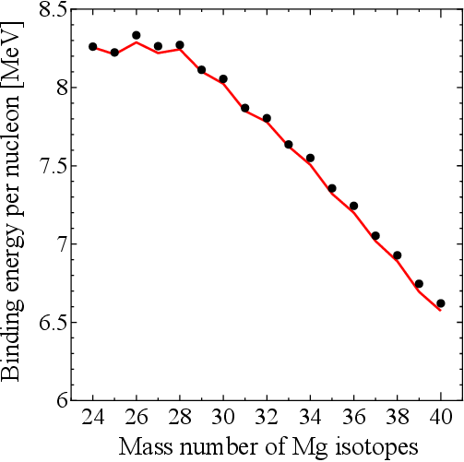
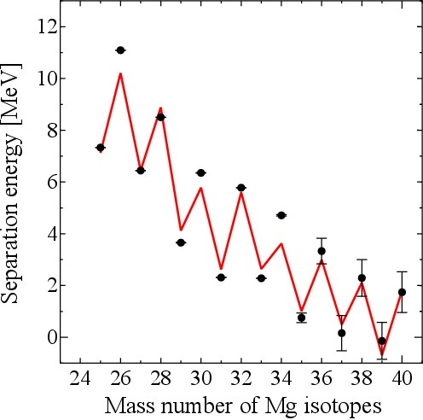
AMD results for Mg isotopes
AMD is applied to calculate B.E./nucleon, S_{n}, E(2+) and E(4+).
B.E./nucleon
Exp. P. Doornenbal et al., PRL111, 212502 (2013).
S_{n}
AMD is highly reliable!
Exp. G. Audi et al., Chin. Phys. C 36, 1157 (2012).

Slide 23
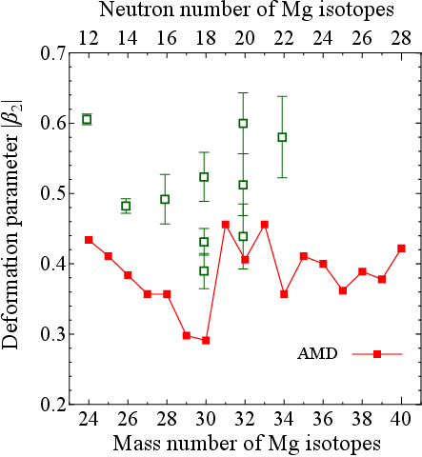
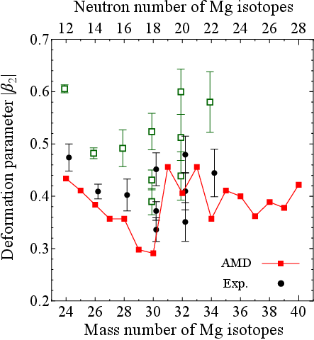
Deformation parameter β₂
Experimental data on B(E2) （β₂）
T. Motobayashi et al., Phys. Lett. B 346, 9 (1995).
B.V. Pritychenko et al., Phys. Lett. B 461, 322 (1999).
V. Chiste et al., Phys. Lett. B 514, 233 (2001).
S. Raman et al., At. Data Nucl. Data Tables 78, 1 (2001).
O. Niedermaier et al., Phys. Rev. Lett. 94, 172501 (2005).
H. Iwasaki et al., Phys. Lett. B 522, 227 (2001)
$$β_{2}^{(exp)}=\frac{4π}{3Ze^{2}R_{0}^{2}}\sqrt{B(E2;0_{gs}^{+}→2_{1}^{+})}$$
$R_{0}=1.2×A^{1/3}$ (Too small!)
$$β_{2}^{(exp)}=\frac{4π}{5Ze^{2}\left\langle r^{2}\right\rangle }\sqrt{B(E2;0_{gs}^{+}→2_{1}^{+})}$$
Transformation of the deformation parameter:
M. Shimada, SW, S. Tagami et al., PRC93, 064314 (2016).
They are consistent with AMD.
Simultaneous analysis of B(E2) and <r²> is important for estimating the deformation precisely.

Slide 24
We combine the result of Mg(Z=12) with that of Ne(Z=10),
and discuss the island of inversion.
N=20 magicity?
N=28 magicity?
²⁴⁻³⁸Mg
²⁰⁻³²Ne
Proton number Z
Island of
Inversion
Neutron number N
Previous studies on Ne isotopes
K. Minomo et al., PRL108, 052503 (2012).
T. Sumi et al., PRC85, 064613 (2012).

Slide 25
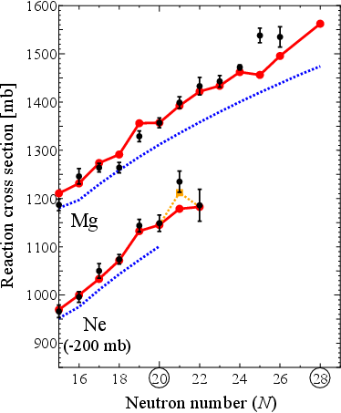
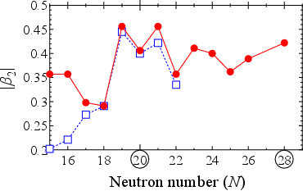
Simultaneous analysis of Mg and Ne
AMD
Big jump of σ_{R} from N=18 to 19
Originated from big jump of β₂
³¹Mg
sph-HF
Entrance of IoI is N=19
²⁹Ne
Deformation keeps large up to N=28
Consistent with E(4+)/E(2+)〜3.1
P. Doornenbal et al., PRL111, 212502 (2013).
N=20
N=28
“Peninsula of large deformation”
“the so-called island of inversion may not be an island but a peninsula reaching the drip line”
Mg
SW, K. Minomo, M. Shimada et al., Phys. Rev. C89, 044610 (2014).
Ne

Slide 26
Peninsula of large deformation
N=20 magicity?
N=28 magicity?
Peninsula of
large deformation
³¹ Mg
⁴⁰ Mg
Proton number Z
Island of
Inversion
²⁹ Ne
Neutron number N
This idea was reinforced by shell-model calculations.
“Long shore towards ⁴⁰Mg (N=28)”
“Big island of deformation”
N. Kobayashi et al., Phys. Lett. 112, 242501 (2014).
E. Caurier et al., Phys. Rev. C 90, 014302 (2014).

Slide 27
Brief summary
We have analyzed Mg isotopes in the microscopic framework.
S. Watanabe et al., Phys. Rev. C89, 044610 (2014).
As an experimental tool of probing the deformation strength, measurements of σ_{R} are also quite useful in addition to measurements of 2+ and 4+ excitation energies. ​
AMD calculations reproduce experimental data on σ_{R}, E(2+) and E(4+), B.E. and S_{n} systematically. Therefore, AMD is highly reliable except for ³⁷Mg and ³⁸Mg.
Deformed halo? → We will discuss from now.
AMD calculations show that the island of inversion starts with N=19 and there exists a “peninsula of large deformation” between N=19 to 28.

Slide 28
Table of contents
Background and Motivation
Reaction cross sections as a probe of deformation
Island of inversion
Microscopic framework
Antisymmetrized Molecular Dynamics (AMD)
Double Folding Model (DFM)
Results
Ground-state properties of Mg isotopes
Overview of the island of inversion
Deformed halo of ³⁷Mg?
Summary

Slide 29
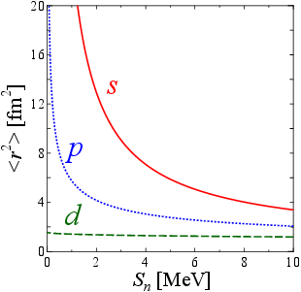
Divergence of mean square radii <r²>
The radii diverge for s or p wave
in the weak-binding limit $\left(S_{n}→0\right)$.
K. Riisager et al., NPA548, 393 (1992).
$$\left\langle r^{2}\right\rangle ∝\left\{\begin{matrix}1/S_{n} & s wave \\ 1/\sqrt{S_{n}} & p wave \\ const. & d wave\end{matrix}\right.$$
The last neutron should occupy the s or p orbital for the formation of halo.

Slide 30
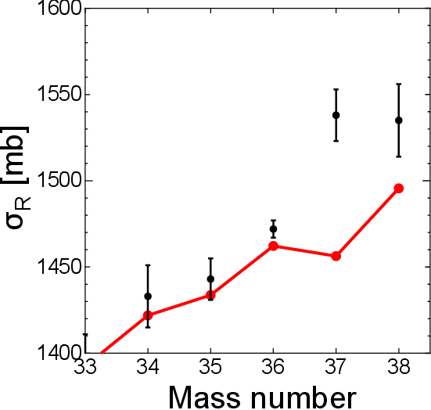
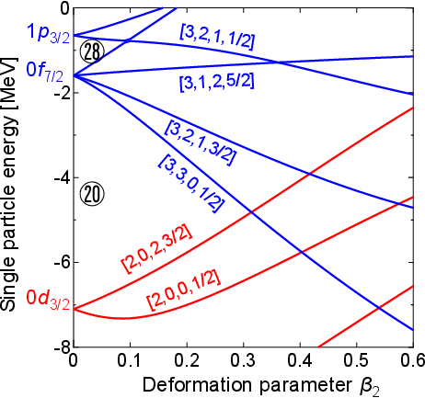
³⁷Mg (N=25): Deformed halo?
Halo structure cannot develop in ³⁷Mg?
Inversion of f- and p-origin orbitals occurs.
Mg+¹²C at 240MeV/nucleon
³⁷Mg
1p_{3/2}
㉘
N=25
0f_{7/2}
AMD
⑳
Large cross section
0d_{3/2}
Sn=0.16±0.68 MeV
（estimate value）
0s_{1/2}
0d_{5/2}
⑧
G. Audi et al., Chin. Phys. C 36, 1157 (2012).

Slide 31
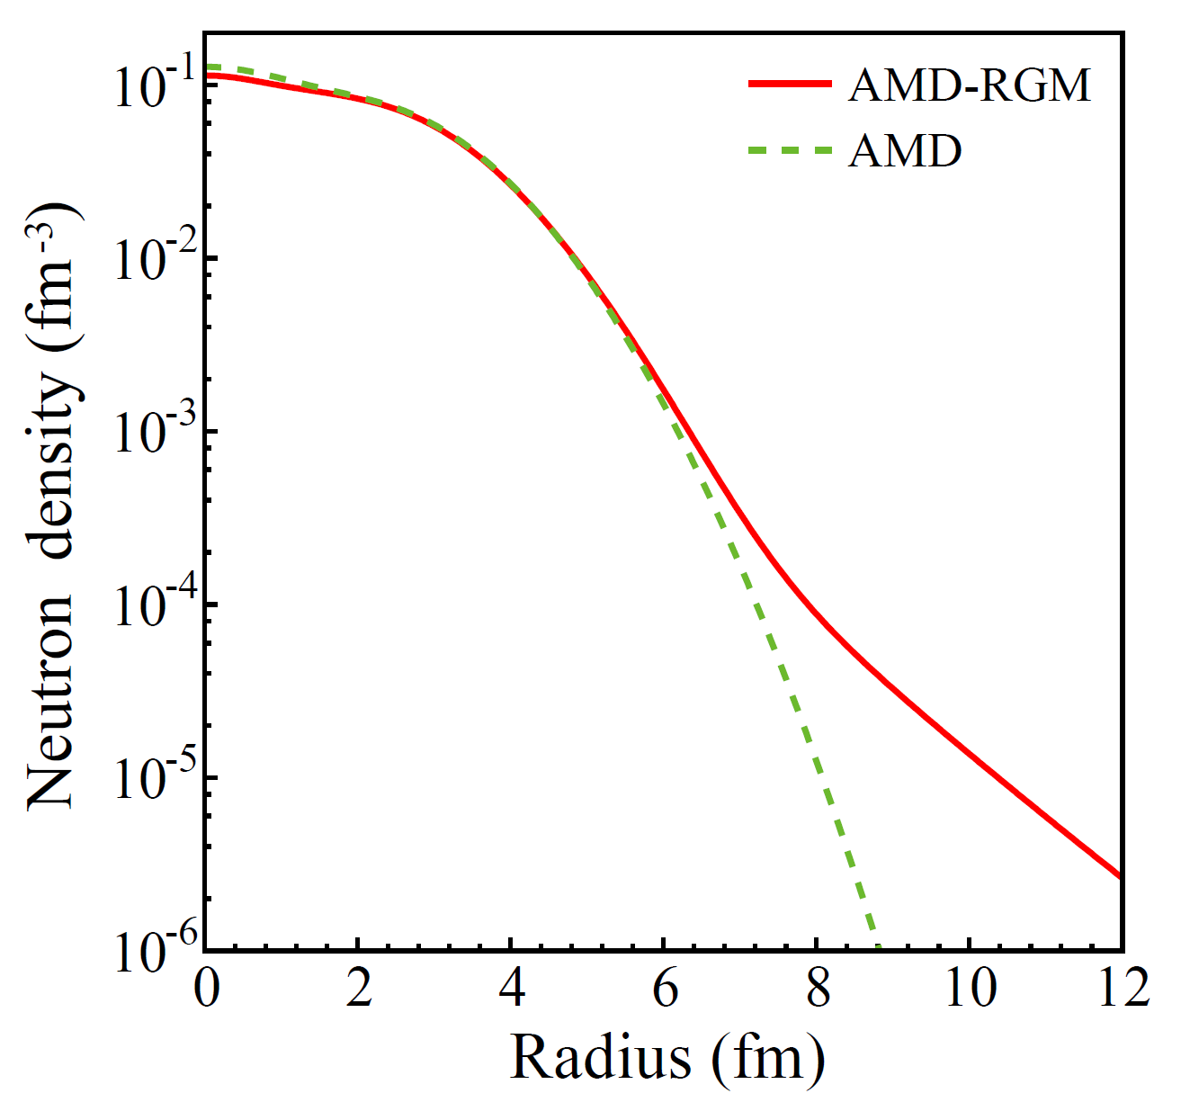
From “AMD” to “AMD-RGM”
☹ AMD densities may be inaccurate in its tail region.
Single wave packet → Gaussian
Successful example of AMD-RGM
$$φ_{i}\left(r\right)∝\prod_{σ=x,y,z}{\exp\left\{−ν_{σ}{\left(r_{σ}−\frac{Z_{iσ}}{\sqrt{ν_{σ}}}\right)}^{2}\right\}}$$
AMD-RGM
AMD-Resonating Group Method
AMD
(Tail correction to AMD)
Successful application to ³¹Ne
³¹Ne
Deformed halo
K. Minomo et al., PRL 108, 052503 (2012).
The tail part is drastically improved with AMD-RGM.

Slide 32
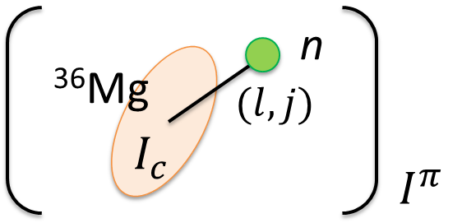
Results: AMD-RGM for ³⁷Mg(N=25)
We perform the AMD-RGM calculation as a tail correction.
$$Ψ\left({}_{}^{37}{Mg};I^{π}\right)=\sum_{l_{c}j_{c}}{c_{lj_{c}}𝒜{\left[Φ_{c}\left({}_{}^{36}{Mg};j_{c}\right)⊗{\left[χ_{l}⊗η_{1/2}\right]}_{j}\right]}_{I^{π}}}$$
Core by
AMD calc.
Relative motion
Mg+¹²C at 240MeV/nucleon
AMD-RGM CANNOT improve the σ_{R}.
³⁷Mg
AMD-RGM Calc.
AMD-RGM
$$I^{π}={5/2}^{−}$$
main component： f-wave
+5mb
Tail correction is not essential
AMD
In order to understand the origin of the discrepancy, we consider lowlying states in addition to g.s.

Slide 33
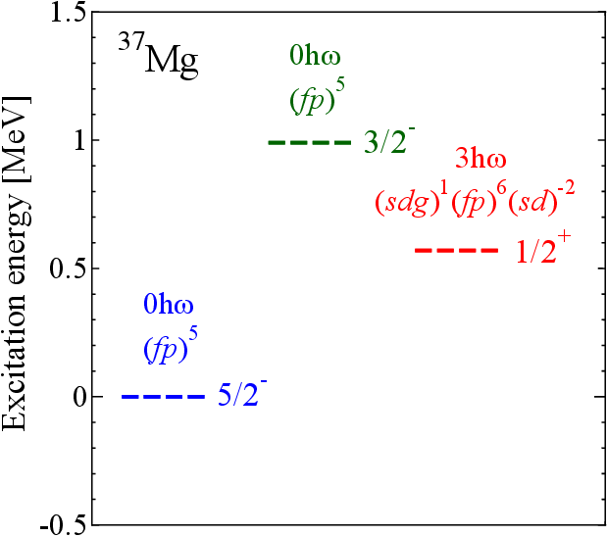
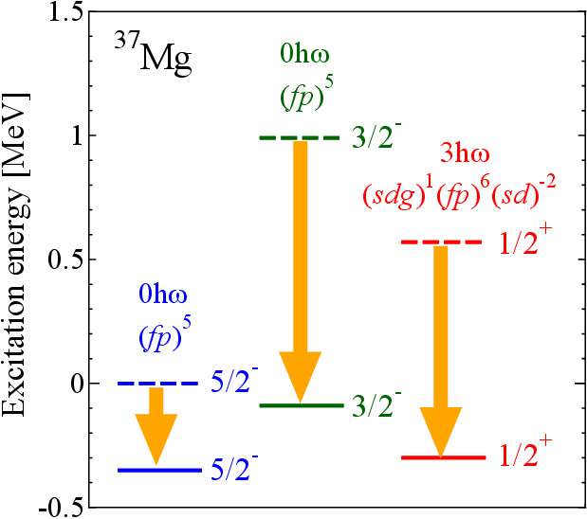
Candidates for g.s. instead of 5/2-
Candidates for g.s. instead of $I^{π}={5/2}^{−}$
3/2-：p-wave halo?
AMD
1/2+
(AMD-RGM)
☹ The result still underestimates.
Too strong core excitation?
～1700mb
1/2+：s-wave halo?
AMD-RGM
☹ The result largely overestimates.
Too small S_{n}?
³⁷Mg
3/2-
(AMD-RGM)
AMD-RGM calculations are not perfect for ³⁷Mg.
5/2-
(AMD-RGM)

Slide 34
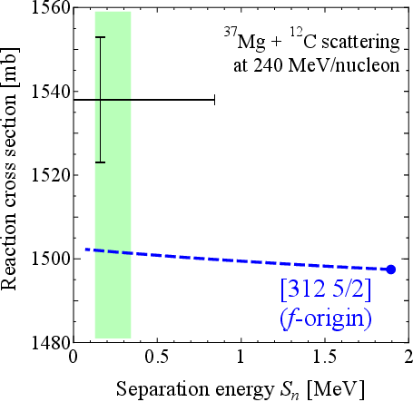
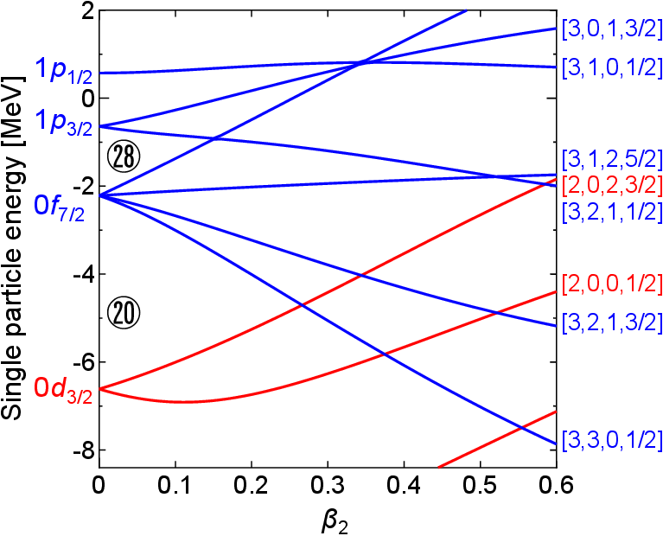
³⁷Mg (N=25): Weak-binding effect
We performed the deformed Woods-Saxon calculation.
Parameter set: from R. Wyss (T. Shoji et al., PTP121, 2 (2009).)
β₂(AMD)=0.36
25
N=20
$$J^{π}={5/2}^{−}$$
deformation parameter β₂
$$S_{n}=0.16±0.68 MeV$$
G. Audi et al., Chin. Phys. C 36, 1157 (2012).
$$S_{n}={0.22}_{−0.09}^{+0.12} MeV$$
N. Kobayashi et al., PRL 112, 242501 (2014).

Slide 35
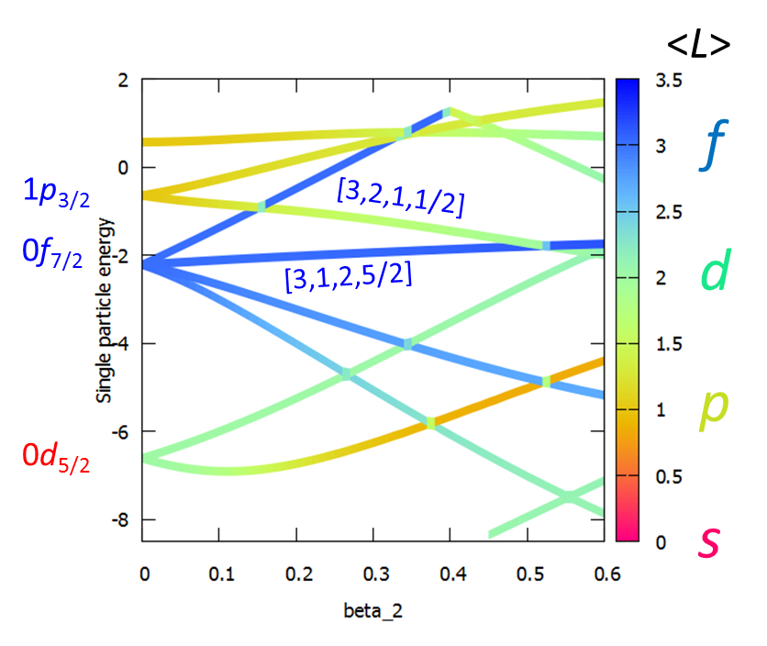
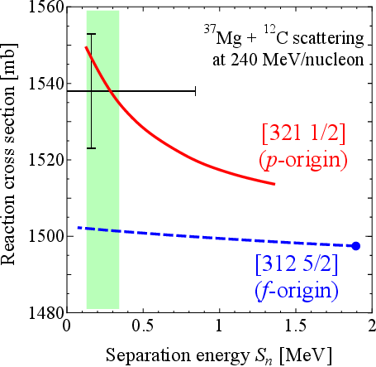
³⁷Mg (N=25): Weak-binding effect
We performed the deformed Woods-Saxon calculation.
Parameter set: from R. Wyss (T. Shoji et al., PTP121, 2 (2009).)
β₂(AMD)=0.36
p : 64.5%
f : 34.4%
h : 1.1%
$$J^{π}={3/2}^{−}$$
25
p : 0%
f : 97.9%
h : 2.0%
N=20
$$J^{π}={5/2}^{−}$$
0d_{3/2}
deformation parameter β₂
5/2- is excluded and 3/2- is possible.
M. Takechi et al., PRC 90, 061305(R) (2014).

Slide 36
Table of contents
Background and Motivation
Systematic measurements to probe deformation
Shell evolution around the island of inversion
Microscopic framework
Antisymmetrized Molecular Dynamics (AMD)
Double Folding Model (DFM)
Results
Reaction cross sections
Ground-state properties
Deformed halo of ³⁷Mg?
Summary

Slide 37
Summary
We have analyzed Mg isotopes in the microscopic framework.
S. Watanabe et al., Phys Rev C89, 044610 (2014).
As an experimental tool of probing the deformation strength, measurements of σ_{R} are also quite useful in addition to measurements of 2+ and 4+ excitation energies. ​
AMD calculations reproduce experimental data on σ_{R}, E(2+) and E(4+), B.E. and S_{n} systematically. Therefore, AMD is highly reliable except for ^{37,38}Mg.
AMD calculations show that the island of inversion starts with N=19 and there exists a “peninsula of large deformation” between N=19 to 28.
³⁷Mg as “deformed halo”
Even AMD-RGM calculations cannot reproduce the measured σ_{R}.
³⁷Mg may be a deformed halo nucleus. For the ground-state spin-parity, 5/2- is excluded and 3/2- is possible.

