Slide 1

Direct reaction mechanisms and fusion hindrance of light, weakly-bound nuclides
Direct Reactions with Exotic Beams 2018
Matsue, Japan
Ed Simpson
Department of Nuclear Physics
Australian National University

Slide 2
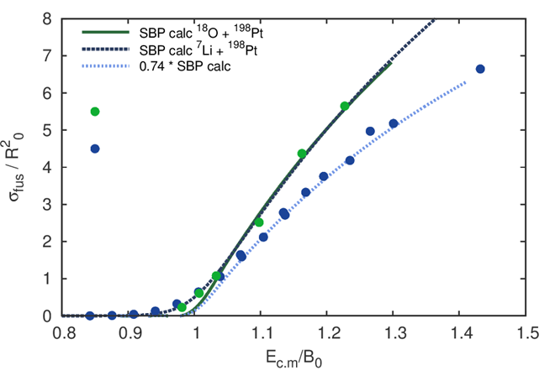
Complete Fusion Suppression
⁷Li+²⁰⁹Bi and ¹⁸O+¹⁹⁸Pt fusion
Fusion of weakly bound ⁷Li+²⁰⁹Bi suppressed relative to single-barrier calculation in contrast to ¹⁸O+¹⁹⁸Pt
0.8
0.7
0.6
0.5
0.4
0.3
0.2
0.1
0.0
¹⁸O + ¹⁹⁸Pt
⁷Li + ²⁰⁹Bi
σ_{fus}/R₀²
²¹⁶Rn
³H
⁴He
0.8 0.9 1 1.1 1.2 1.3 1.4 1.5
E_{cm}/V_{B} (MeV)
B. Wang et al., PRC 90, 034612 (2014); L. F. Canto et al., J. Phys. G 36, 015109 (2009)
Dasgupta et al., PRC 66, 041602(R) (2002); PRC 70, 024606 (2004); Wu et al., PRC 68 044605 (2004)

Slide 3
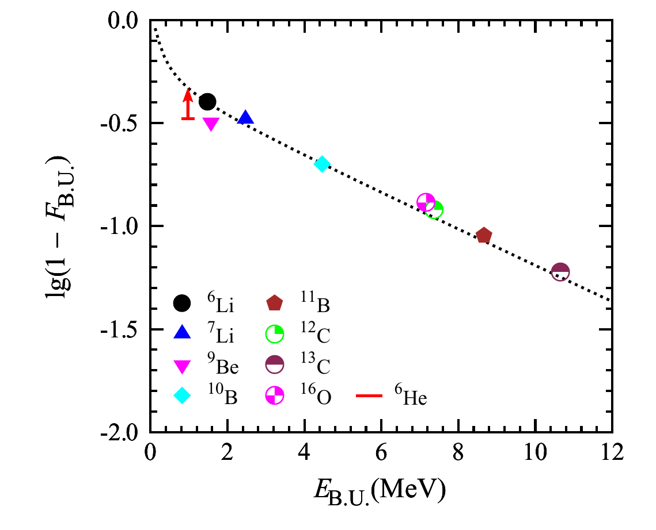
Complete Fusion Suppression
Suppression Systematics
Fusion of weakly bound ⁷Li+²⁰⁹Bi suppressed relative to single-barrier calculation in contrast to ¹⁸O+¹⁹⁸Pt
Degree of suppression
³H
⁴He
Breakup threshold
B. Wang et al., PRC 90, 034612 (2014); L. F. Canto et al., J. Phys. G 36, 015109 (2009)
Dasgupta et al., PRC 66, 041602(R) (2002); PRC 70, 024606 (2004); Wu et al., PRC 68 044605 (2004)

Slide 4
⁷Li+²⁰⁹Bi above barrier
²¹⁶Rn
Complete fusion
Which processes cause breakup?
How fast does breakup occur?
Do we have a consistent description of breakup and fusion?
Breakup followed by
partial fusion
^{X}Po, ^{X}At
Breakup
(no capture)

Slide 5
Mechanisms for ⁷Li Breakup
Bound
S_{x} < 2.5 MeV
⁸Be
⁹Be
Unbound
⁵Li
⁶Li
⁷Li
⁸Li
⁴He
⁵He
⁶He
⁷He
Luong et al., PLB 695, 105 (2011)
Luong et al., PRC 88, 034609 (2013)

Slide 6
Structure of ⁷Li neighbours
2⁺ +3.12
2⁺ +2.838
7/2⁻ +2.162
3/2⁻ +1.965
3⁺ +0.712
0⁺ +0.092
Breakup
Threshold
⁵Li
⁸Be
1⁺ -1.476
⁶Li
1/2⁻ -1.991
Classical Dynamical Models
Currently only way to calculate all relevant cross sections
Treat many key physical effects
3/2⁻ -2.468
⁷Li

Slide 7
Classical Dynamical Models
Stochastically sample impact parameters
Complete Fusion
²¹⁶Rn
⁷Li
²⁰⁹Bi

Slide 8

Classical Dynamical Models
Breakup suppresses complete fusion
Stochastically sample initial E_{x} and lifetime
Stochastically sample impact parameters
Sample initial orientations
α
Reaction
⁸Be
Decay
⁷Li
α
Reaction probability in a given time step:
²⁰⁸Pb
²⁰⁹Bi
$$P∝exp(−γR)$$
²¹²Po

Slide 9

Classical Dynamical Models
Reaction
Decay
⁷Li
⁸Be
α
α
²⁰⁹Bi
Reaction probability in a given time step:
²⁰⁸Pb
²¹⁶Rn
(complete fusion)
$$P∝exp(−γR)$$
Breakup occurs, but still leads to complete fusion
Experiment: Heavy Ion Accelerator Facility at ANU
3 above-barrier energies, singles angular distributions
Reactions: ⁷Li [α+t], ⁸Be [α+α], ⁵Li [α+p], ⁶Li [α+d]
Potentials: Coulomb + São Paulo

Slide 10
Structure of ⁷Li neighbours
Realistic Structure
Instant (τ → τ/1000)
2⁺ +3.12
7/2⁻ +2.162
0⁺ +0.092
Breakup
Threshold
⁸Be
One level, one channel R-matrix
Barker, Aust. J. Phys 41, 743 (1988)
Simpson et al., PRC 93, 024605 (2016)
Kalkal et al., PRC 93 044605 (2016)
Cook et al., PRC 93 064604 (2016)
Lane and Thomas, RMP 30, 257 (1958)
1/2⁻ -1.991
3/2⁻ -2.468
⁷Li

Slide 11
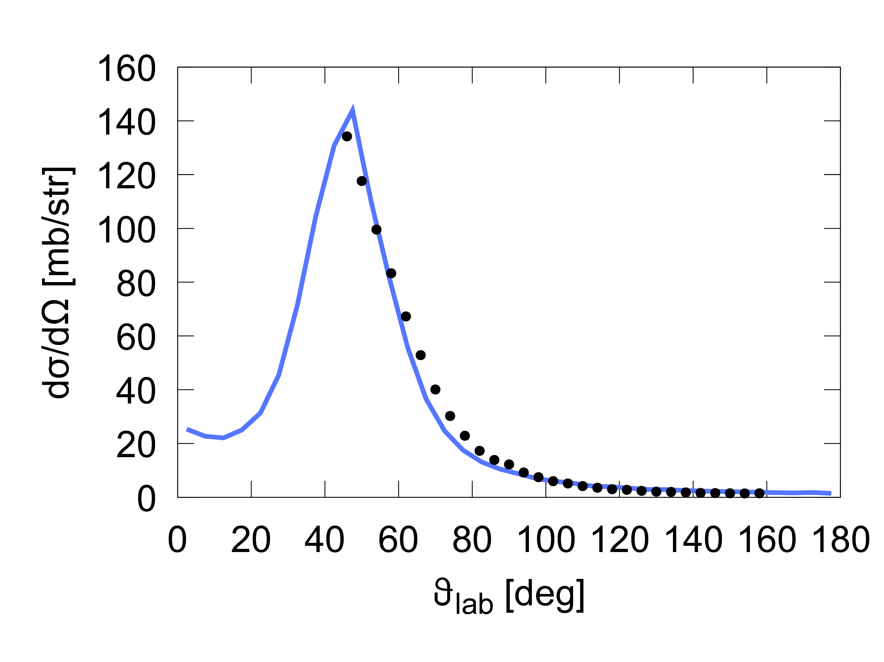
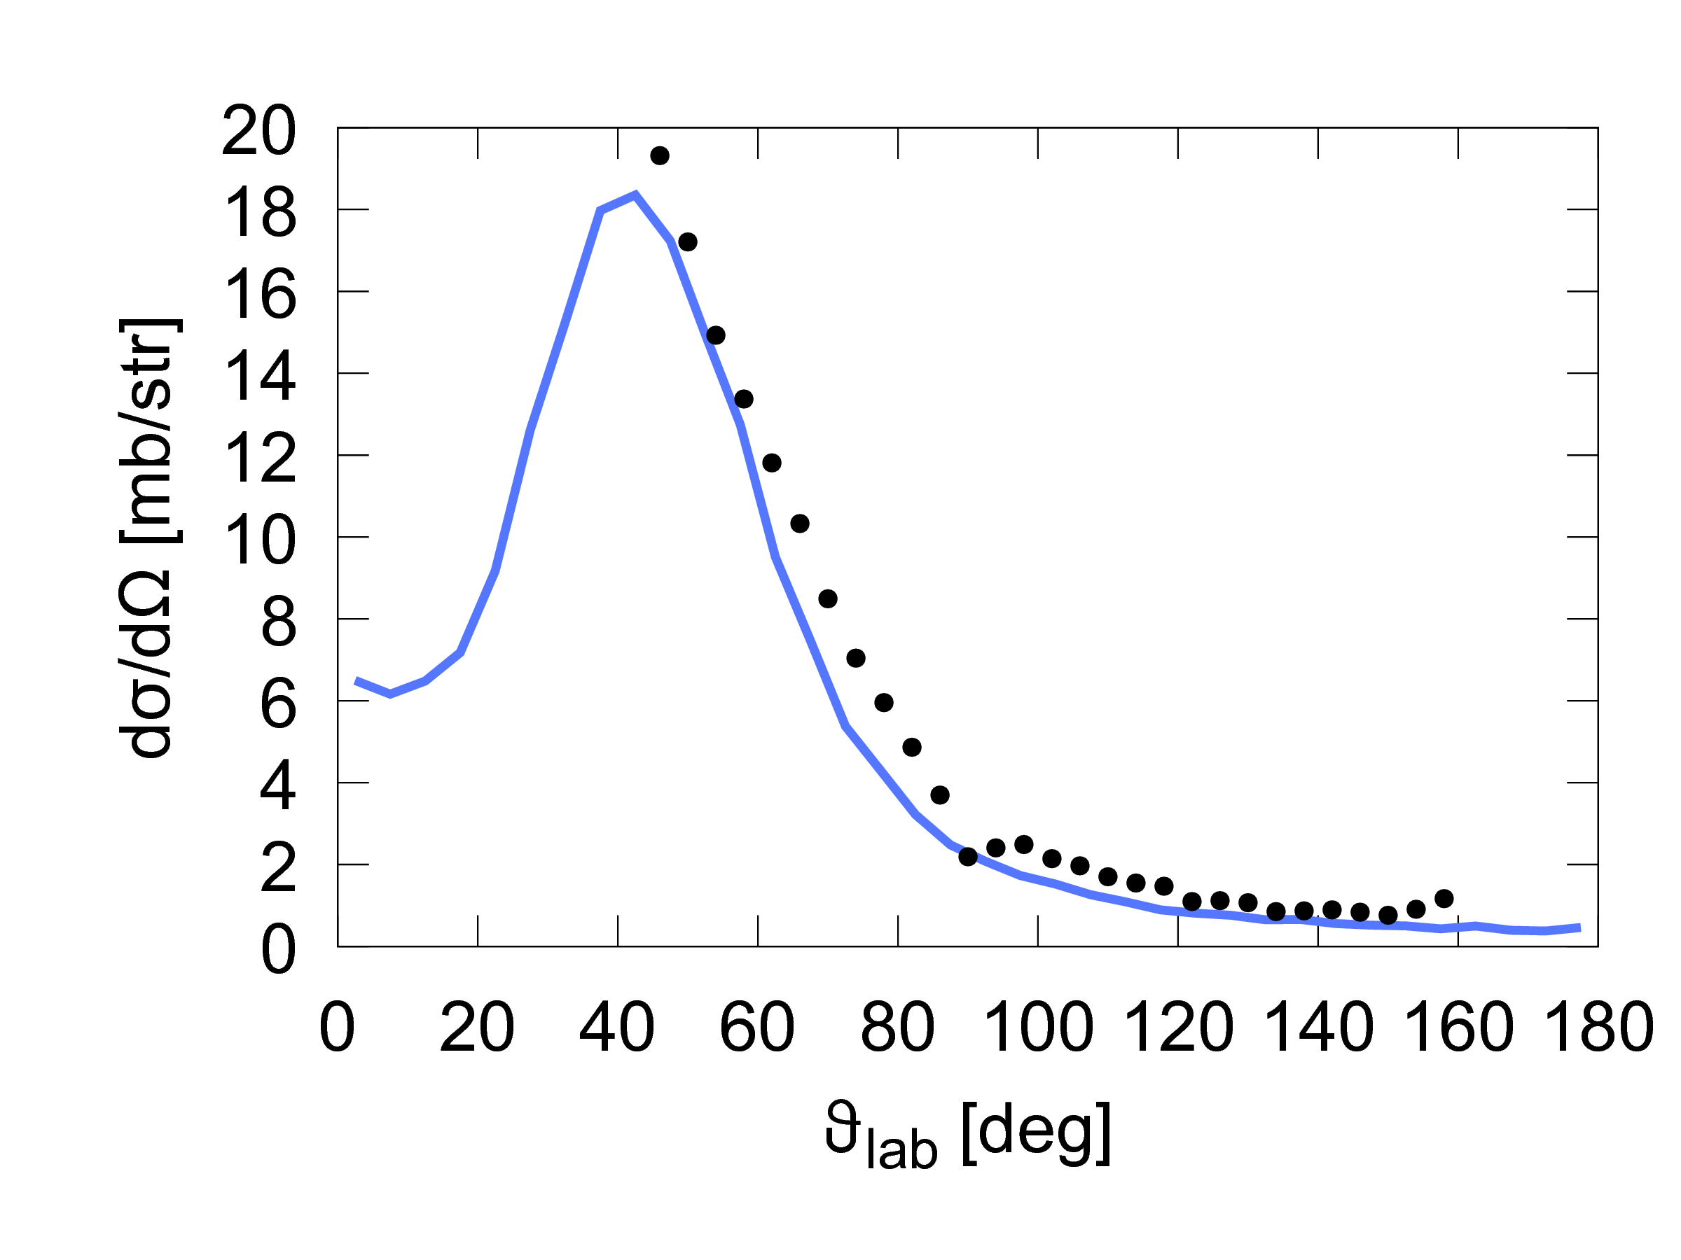
Angular distributions
Alpha
Triton
PRELIMINARY
PRELIMINARY
Realistic Structure
E_{lab} = 48.25 MeV

Slide 12
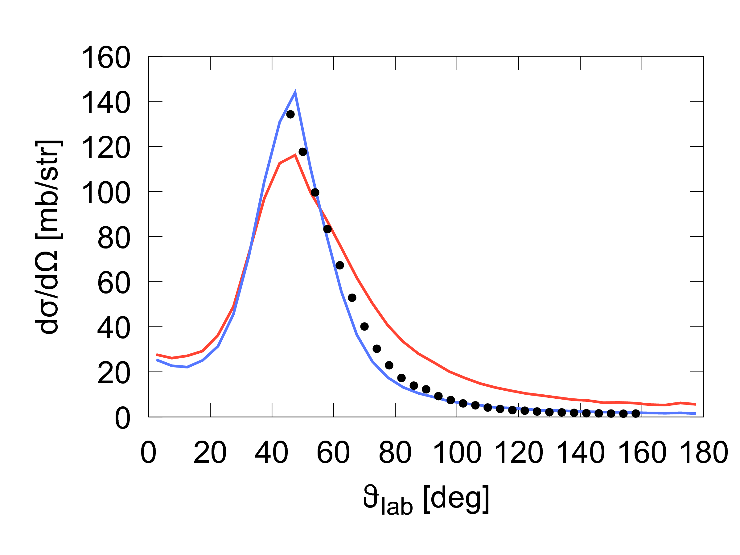
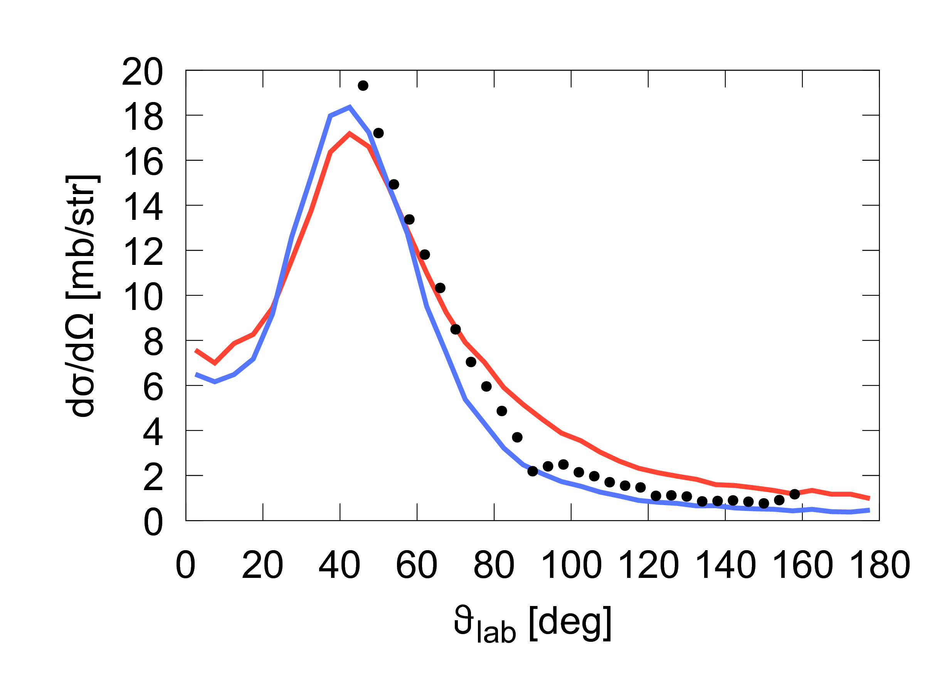
Angular distributions
Alpha
Triton
PRELIMINARY
PRELIMINARY
Realistic Structure
Instant (τ → τ/1000)
E_{lab} = 48.25 MeV

Slide 13
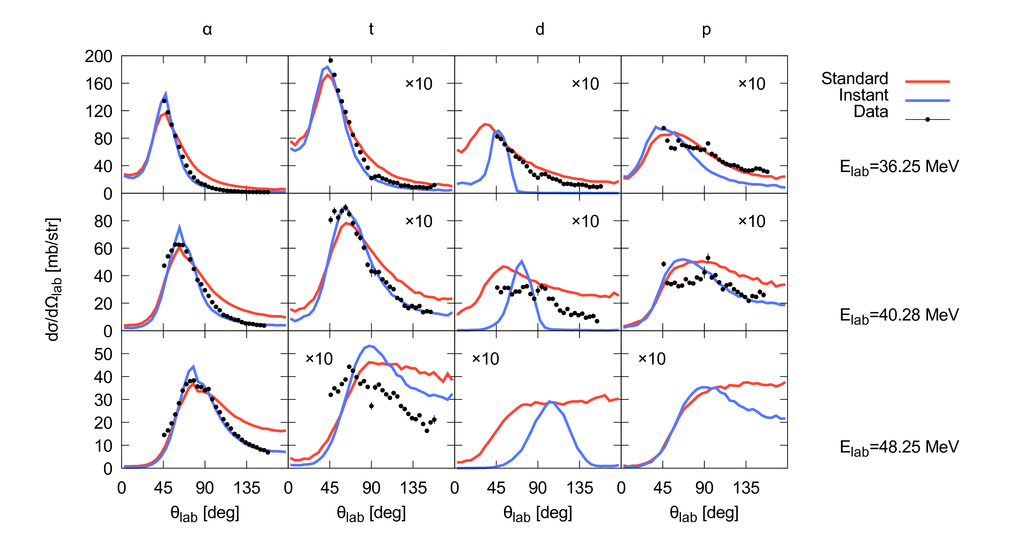
Angular distributions
Alpha Triton Deuteron Proton
Realistic Structure
Instant (τ → τ/1000)
E_{lab} = 48.25 MeV
E_{lab} = 40.28 MeV
E_{lab} = 36.25 MeV
PRELIMINARY

Slide 14
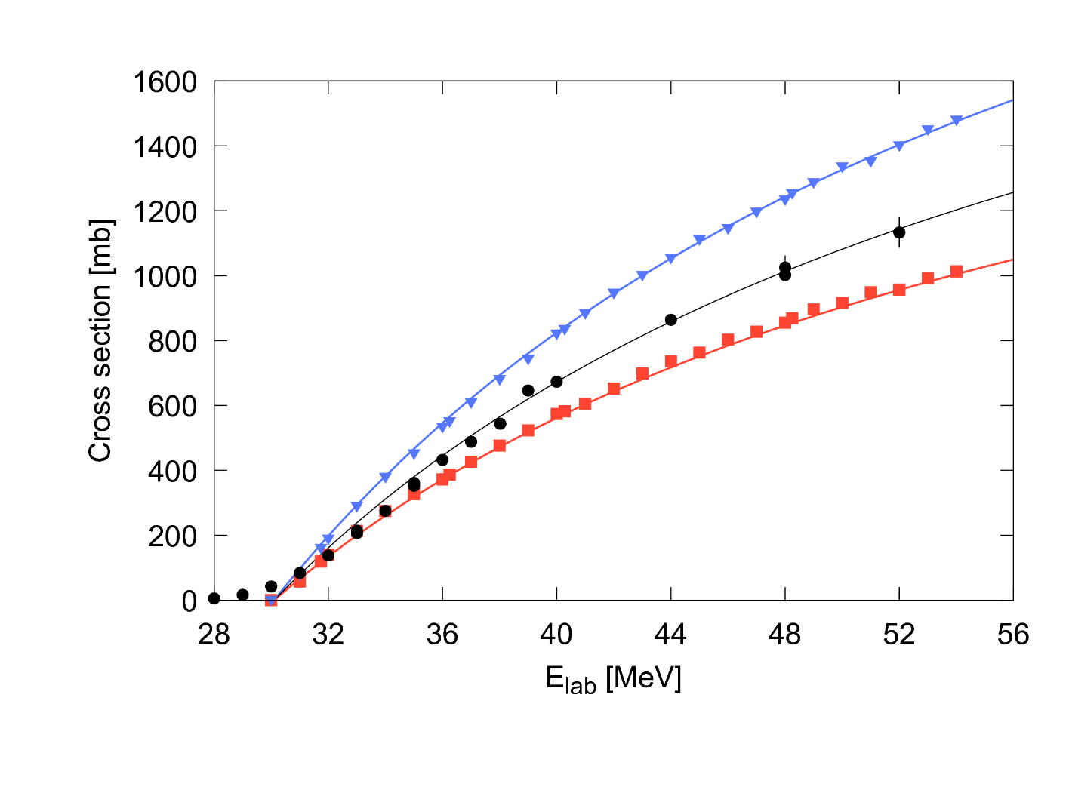
Complete Fusion
Realistic Structure
Data
Instant (τ → τ/1000)
Breakup suppresses complete fusion
Inconsistency between breakup and fusion
PRELIMINARY
Data: Dasgupta et al., PRC 70, 024606 (2004)

Slide 15
Summary
Classical dynamical models: breakup and fusion
Angular distributions well described by calculation including realistic estimates of lifetimes
Breakup suppresses fusion. How much depends sensitively on short timescale dynamics.
Open Questions
Is it possible to establish a consistent description of BU and fusion?
How precisely can we define the inputs to the model?
Is fusion suppressed for exotic nuclides?

Slide 16
Acknowledgements
K.J. Cook, M. Dasgupta, D. J. Hinde, Sunil Kalkal,
D. H. Luong, C. Sengupta, L. T. Bezzina, K. Banerjee

Slide 17
Backup Slides

Slide 18
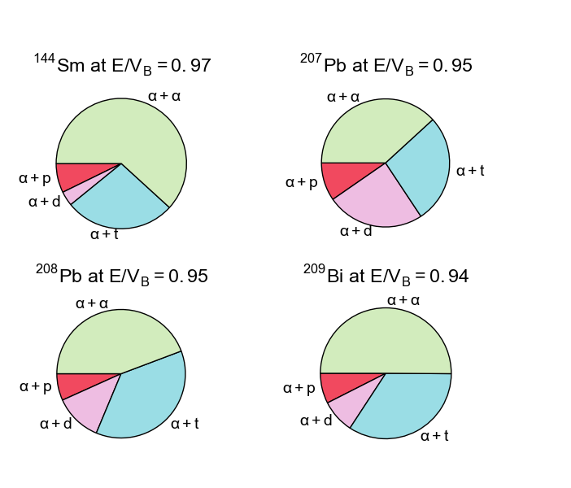
⁷Li breakup modes
Modes identified
Using ToF, ΔE-E, reconstructed Q-value
α+α
α+p
α+d
α+t
Transfer
Direct
Fast breakup only
Excludes narrow resonances, more on this next
Luong et al., PRC 88, 034609 (2013)

Slide 19
Angular distributions
Alpha Triton Deuteron Proton
Realistic Structure
Instant (τ → τ/1000)
E_{lab} = 48.25 MeV
E_{lab} = 40.28 MeV
E_{lab} = 36.25 MeV
PRELIMINARY

Slide 20
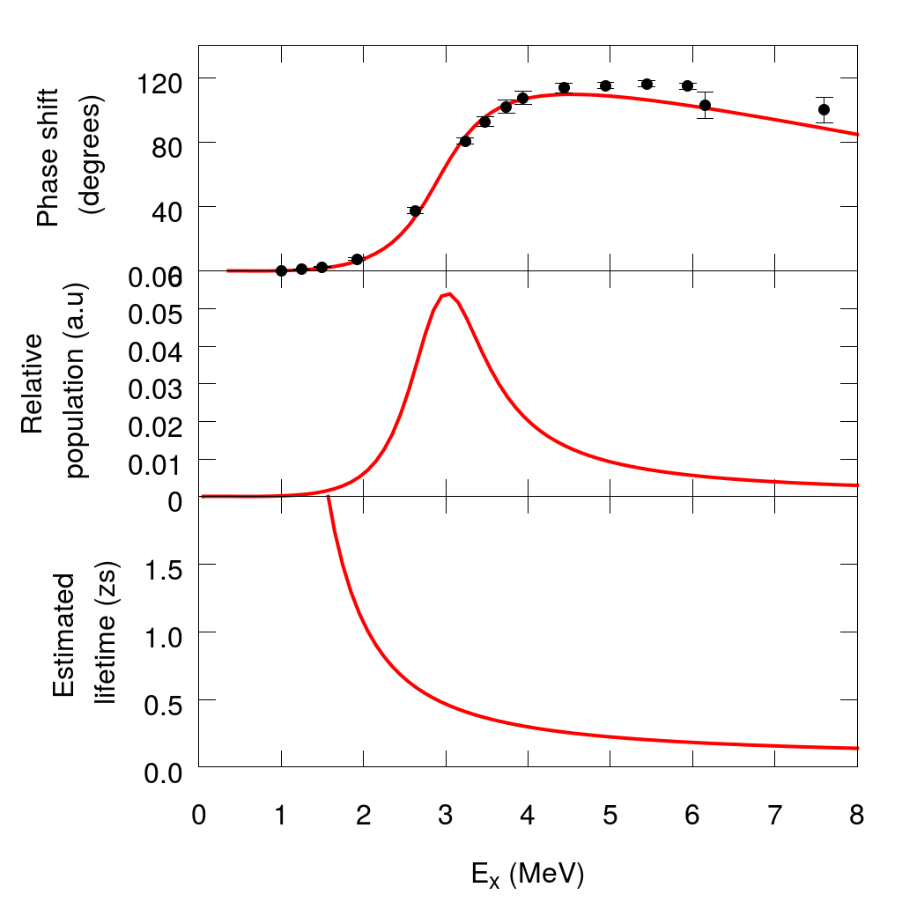
⁸Be 2⁺ resonance
Three sets of calculations
Standard
Instant (τ → τ/1000)
Fast (τ → τ/2)
Γ(E_{R})=1.5 MeV
τ(E_{R}) = ћ / Γ(E_{x}) = 0.4 zs
F. C. Barker, Aust. J. Phys 41, 743 (1988)
A. M. Lane and R. G. Thomas, Rev. Mod. Phys. 30, 257 (1958)

Slide 21
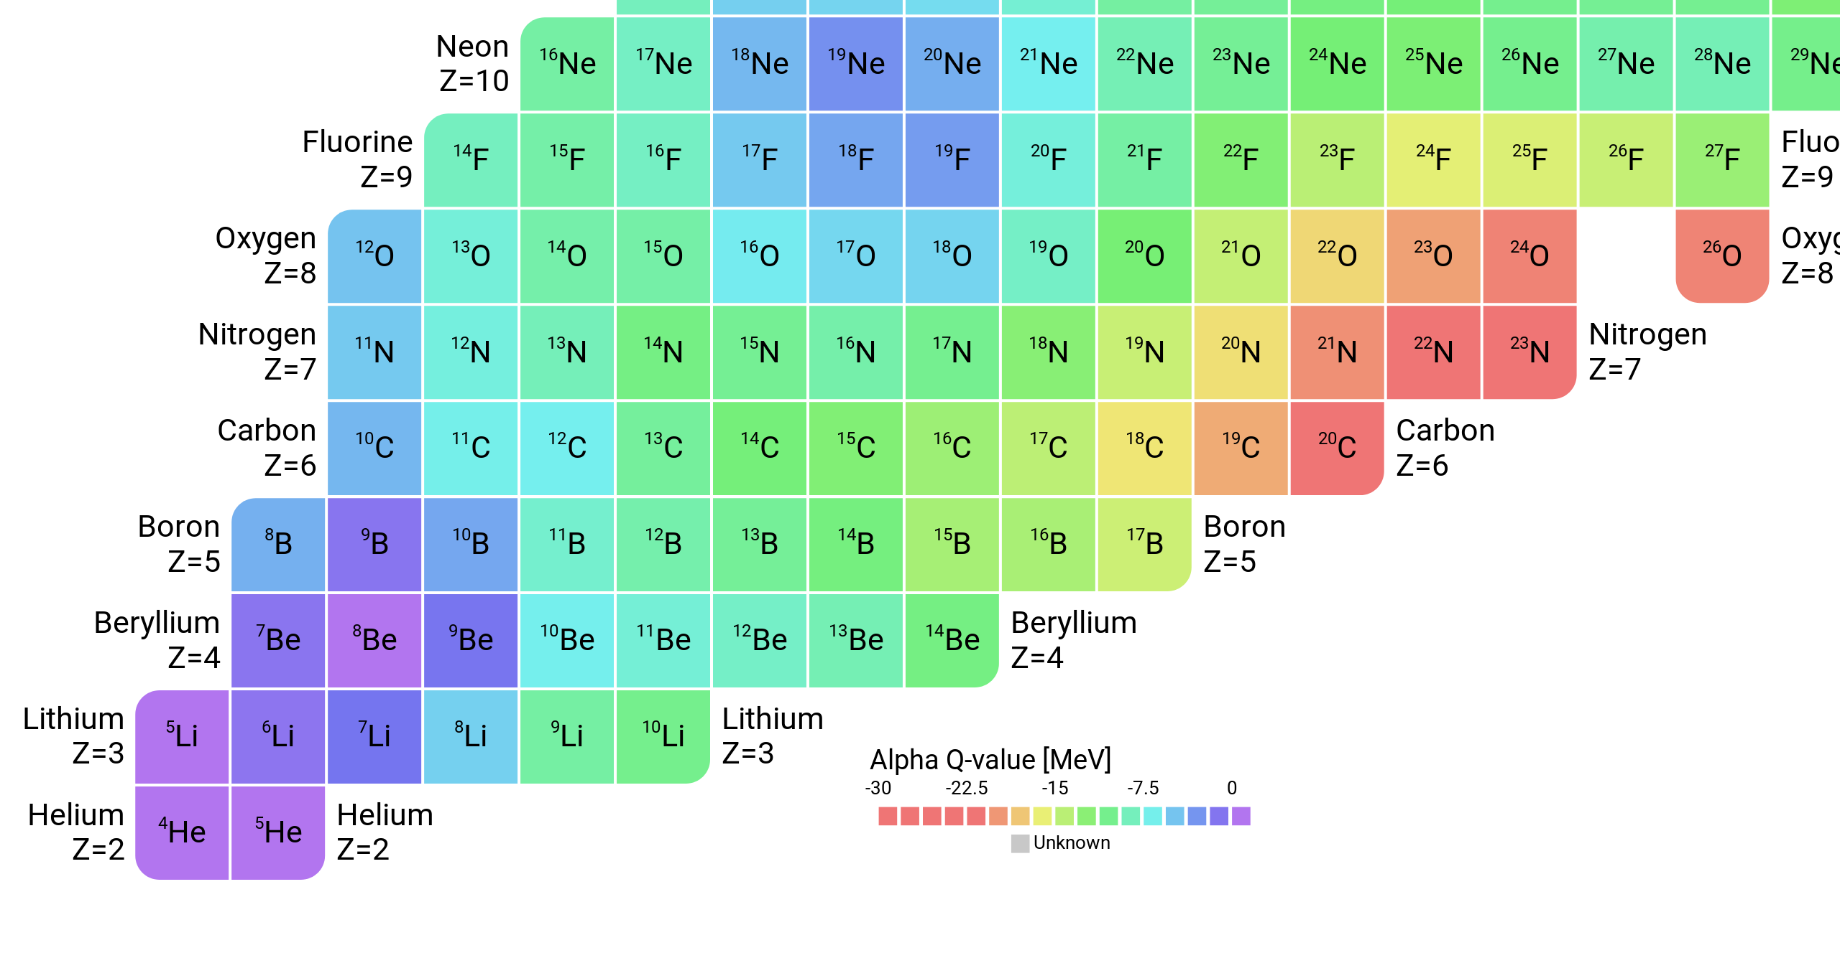
Fusion with Exotic Beams
Suppression due to
weak-binding or clustering?
AME2016, Chinese Physics C41, 030002 (2016)

Slide 22
Post breakup acceleration (I)
Suppose prompt breakup originates in the 2⁺ resonance, with well defined initial E_{x}:
Sensitivity to target proximity
Near target gives greater acceleration
Larger changes in final E_{rel} w.r.t E_{x}
Further from target, weaker acceleration
Final E_{rel} closer to of E_{x}

Slide 23
Post breakup acceleration (II)
Suppose prompt breakup originates in the 2⁺ resonance, with well defined initial E_{x}:
Sensitivity to orientation
Aligned perpendicular to the target field, leads to larger E_{rel}
Aligned parallel to the target field, acceleration tells to reduce the final relative energy E_{rel}

Slide 24
Post breakup acceleration (III)
Suppose prompt breakup originates in the 2⁺ resonance, with well defined initial E_{x}:
Sensitivity to approaching/receding
Approaching the target may lead to larger opening angles between the fragments; receding, smaller opening angles
General question:
How are the fragment correlations sensitive to these factors?

Slide 25
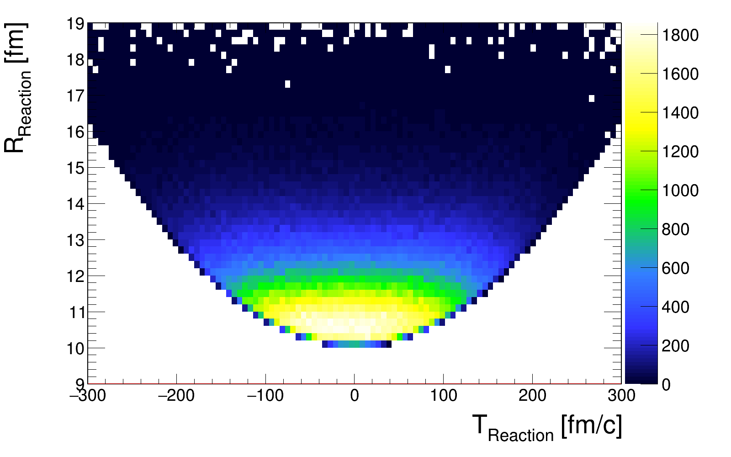
Reaction point

Slide 26
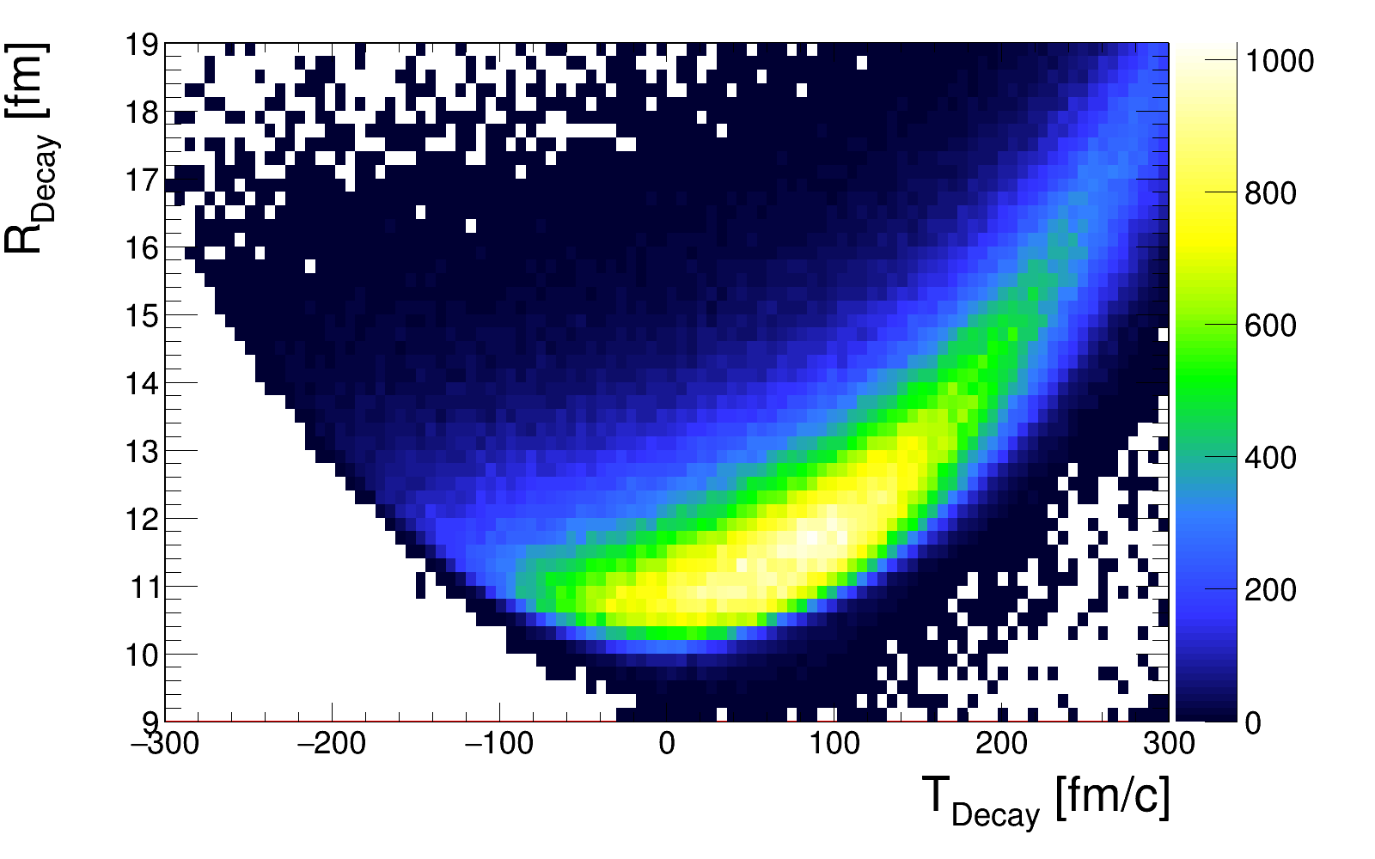
⁸Be decay point

Slide 27
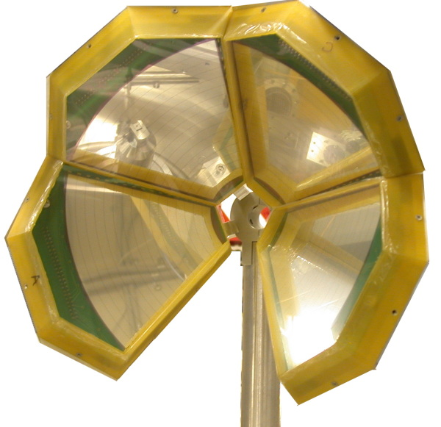
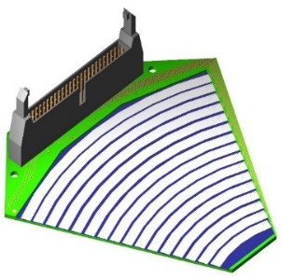
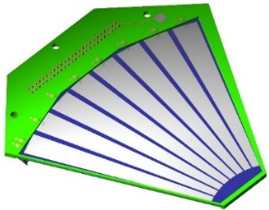
ANU Experiments
BALiN array
Double-Sided Silicon Strip Detectors
Target
Beam
Front
Back
In this “lampshade” configuration sensitive only to backward angles
115° < θ < 170°
30° < ϕ < 330°
See D. H. Luong, ANU PhD Thesis (2012)

Slide 28
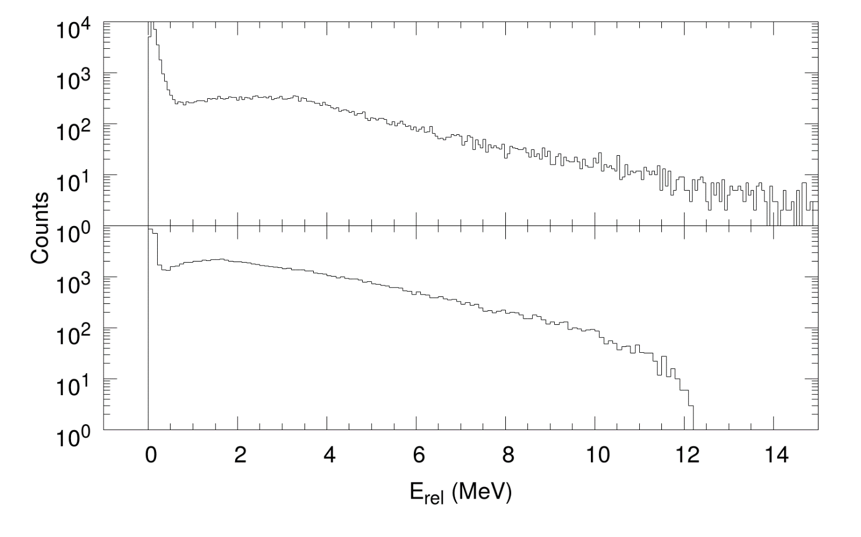

Relative energy distribution
⁷Li → ⁸Be → α + α
$$E_{rel}=\frac{1}{2}μv_{12}^{2}$$
Can we understand the prompt breakup component?
⁸Be ground state
²⁰⁸Pb
⁵⁸Ni
⁸Be 2⁺ state?
0⁺ 0.092 MeV Γ=6.6 eV
2⁺ 3.030 MeV Γ=1.5 MeV
Delayed
Prompt
2⁺ 3.030
0⁺ 0.092
⁸Be

Slide 29
When does breakup occur?
Above-barrier
Sub-barrier
f₂
Before R_{B}
→
Fusion
Suppression
After R_{B}
→
Cannot
prevent
fusion
Approaching
R₀
Receding
from R₀
f₂
T
T
R₀
P
f₁
P
f₁
R_{B}
f₂
f₁
f₂
T
P
T
f₁
R₀
P

Slide 30
⁶He cluster interconnections
Stable
⁸Be
⁹Be
Radioactive
Unbound
⁵Li
⁶Li
⁷Li
⁸Li
Transfer reactions
connect to different
cluster continua
⁴He
⁵He
⁶He
⁷He

Slide 31
Light nuclides
Stable
⁸Be
-0.092 MeV
⁹Be
1.665 MeV
Radioactive
Unbound
⁵Li
-1.965 MeV
⁶Li
1.474 MeV
⁷Li
2.468 MeV
⁸Li
2.468 MeV
⁴He
⁵He
-0.735 MeV
⁶He
0.975 MeV
⁷He
-0.410 MeV

Slide 32
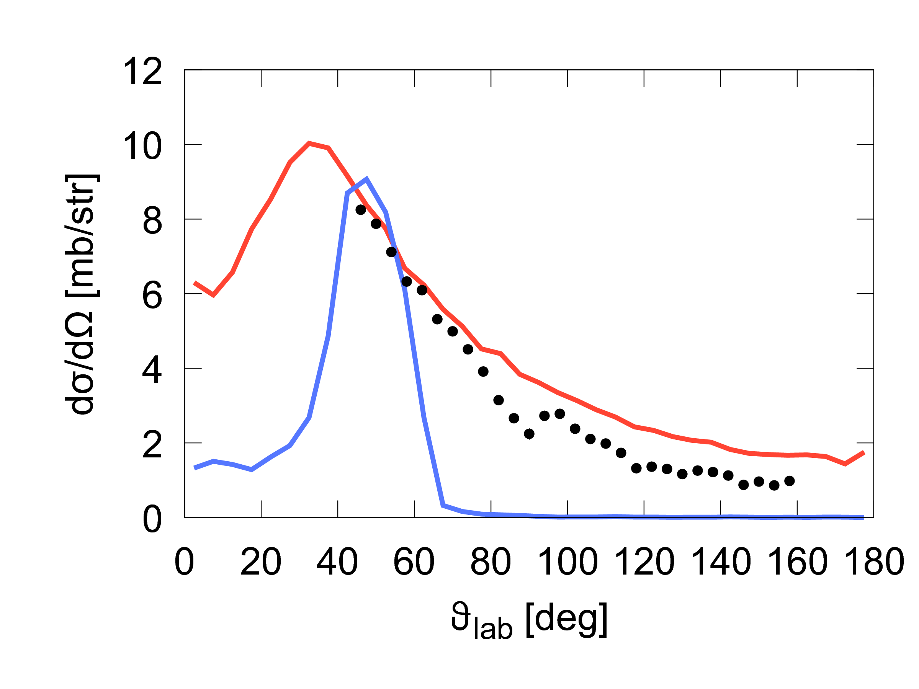
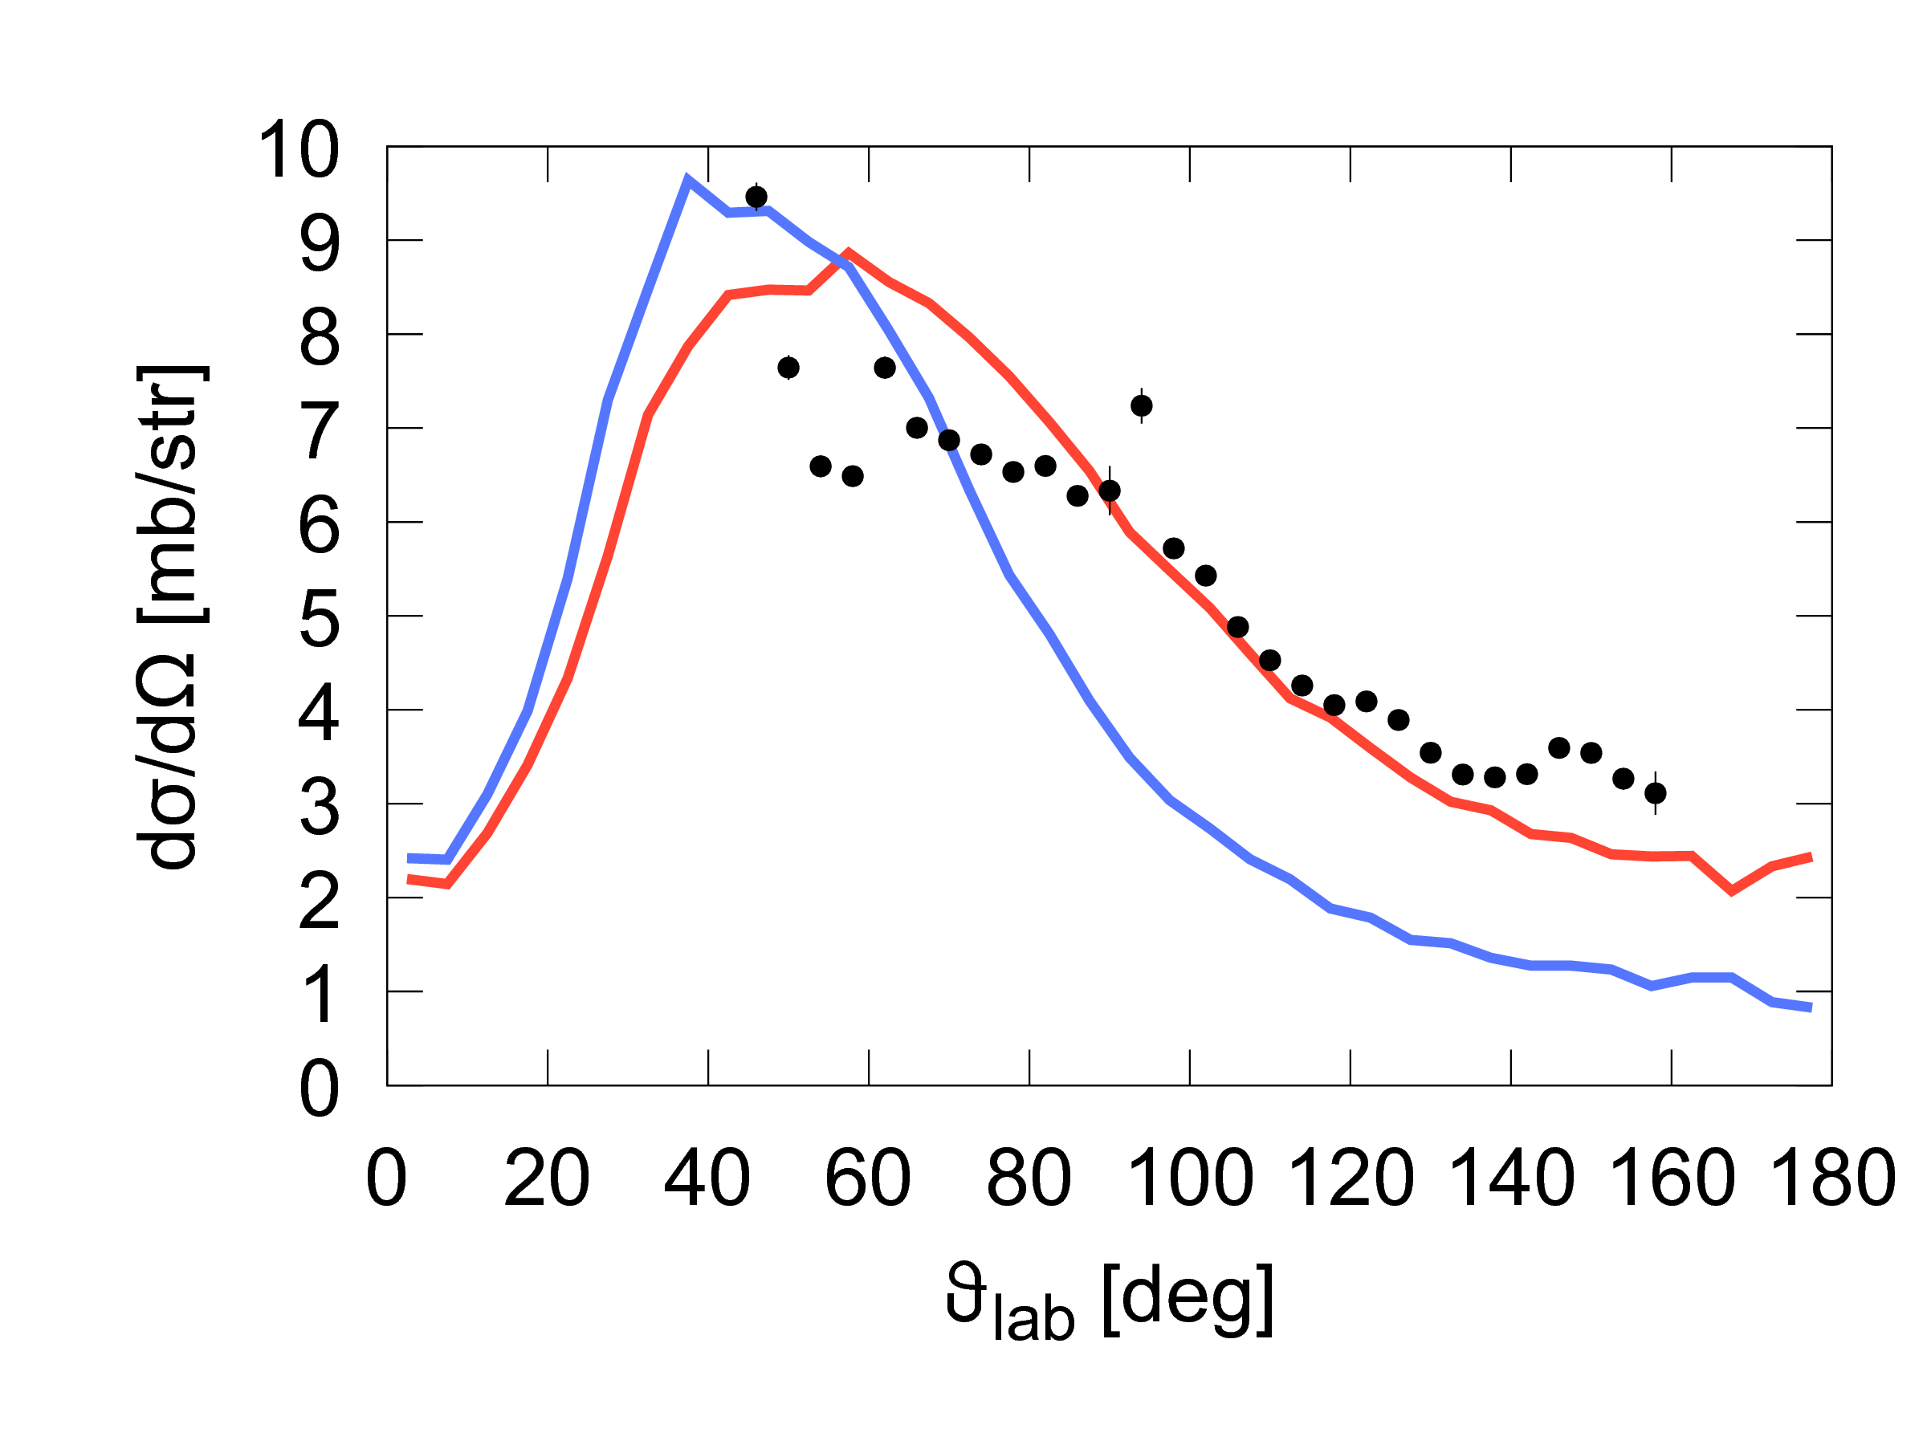
Angular distributions
Deuteron
Proton
PRELIMINARY
PRELIMINARY
Standard
Instant (τ → τ/1000)
Standard
Instant (τ → τ/1000)

Slide 33
When does breakup occur?
Above-barrier energies
Narrow, Long-lived states
Appear as peaks in relative energy distribution
Not expected to reduce fusion
Wide, short-lived states
….
…
f₂
Before R_{B}
→
Fusion
Suppression
After R_{B}
→
Cannot
prevent
fusion
T
P
f₁
R_{B}
f₂
T
P
f₁

Slide 34
Model Parameters
⁷Li → α+t (direct breakup)
  Assumed fast (L=0 [Kalkal et al., PRC (2016)]
⁷Li → ⁸Be → α+α (proton pickup)
  0⁺ and 2⁺ [Cook et al., PRC (2016)]
⁷Li → ⁶Li → α+d (neutron stripping)
  3⁺ [Kalkal et al., PRC (2016)]
⁷Li → ⁵Li → α+p (two-neutron stripping)
  3/2⁺ Γ=1.9 MeV [Tilley et al., XXXX]

Slide 35
What don’t we know?
What don’t we know is an important point…

Slide 36
Classical Dynamical Models
Decay
α
Stochastically sample impact parameters
p
⁵Li
Reaction
⁷Li
²⁰⁹Bi
Breakup occurs, but both fragments escape
²¹¹Bi

Slide 37
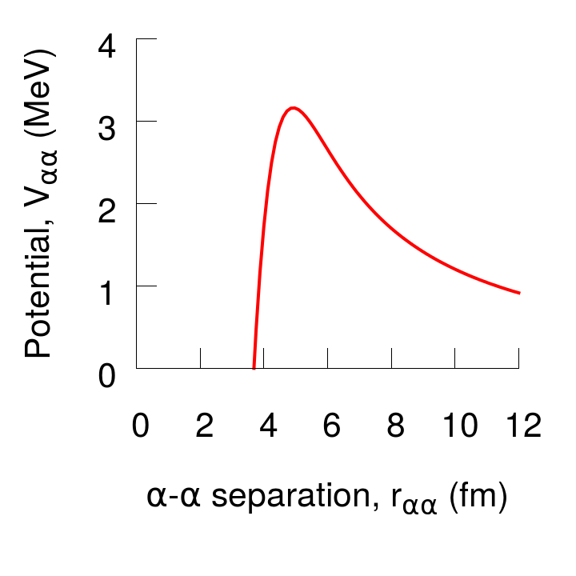
⁸Be 2⁺ resonance
L=2
Γ(E_{R})=1.5 MeV
τ(E_{R}) = ћ / Γ(E_{x}) = 0.4 zs
Standard
Instant (τ → τ/1000)
Fast (τ → τ/2)
F. C. Barker, Aust. J. Phys 41, 743 (1988)
A. M. Lane and R. G. Thomas, Rev. Mod. Phys. 30, 257 (1958)

Slide 38
Structure of ⁷Li neighbours
2⁺ +3.12
2⁺ +2.838
7/2⁻ +2.162
3/2⁻ +1.965
3⁺ +0.712
0⁺ +0.092
Breakup
Threshold
⁵Li
⁸Be
1⁺ -1.476
⁶Li
1/2⁻ -1.991
One level, one channel R-matrix
Barker, Aust. J. Phys 41, 743 (1988)
Simpson et al., PRC 93, 024605 (2016)
Kalkal et al., PRC 93 044605 (2016)
Cook et al., PRC 93 064604 (2016)
Lane and Thomas, RMP 30, 257 (1958)
3/2⁻ -2.468
Realistic Structure
Instant (τ → τ/1000)
⁷Li

