Slide 1

Measurement of ^{77,79}Se(d,p) reactions in inverse kinematics at OEDO
2018/June/7th
N. Imai (CNS, Univ. of Tokyo)
今井伸明

Slide 2
⁷⁹Se?
“stellar thermometer”
No experimental data about σ(n,γ)
E (MeV) | J^{p} | T1/2 | Decay modes
0.0 | 7/2⁺ | 3.2x10⁵ y | β⁻ 100%
0.0958 | ½- | 3.92m | IT:99.94% β⁻ 0.06%
Rep. of Prog. in Phys.52, (‘89) 945-1013
F. Kappler, H. Beer, and K. Wisshak

Slide 3
Nuclear transmutation of LLFPs
⁷⁹Se:Long-lived Fission Products
High level nuclear wastes
➔deep geological repository
https://www.numo.or.jp/en/publications/pdf/NUMO_En_Nov_2016.pdf
Proposal of the accelerator driven nuclear transmutation
⎝ σ of p/d/n induced reactions of LLFPs were evaluated.

Slide 4
Evaluation of ^{77,79}Se(n,γ)^{78,80}Se by ^{77,79}Se(d,p)^{78,80}Se
Fusion/pre- equilibrium reactions of ¹⁰⁷Pd, ⁹³Zr +p/d
#108 Proton- and deuteron-induced reactions on 107Pd and 93Zr at 20 - 30 MeV/u
M. Dozono et al.,
Don’t miss it
Energy degraded beam facility is needed
➔ OEDO

Slide 5
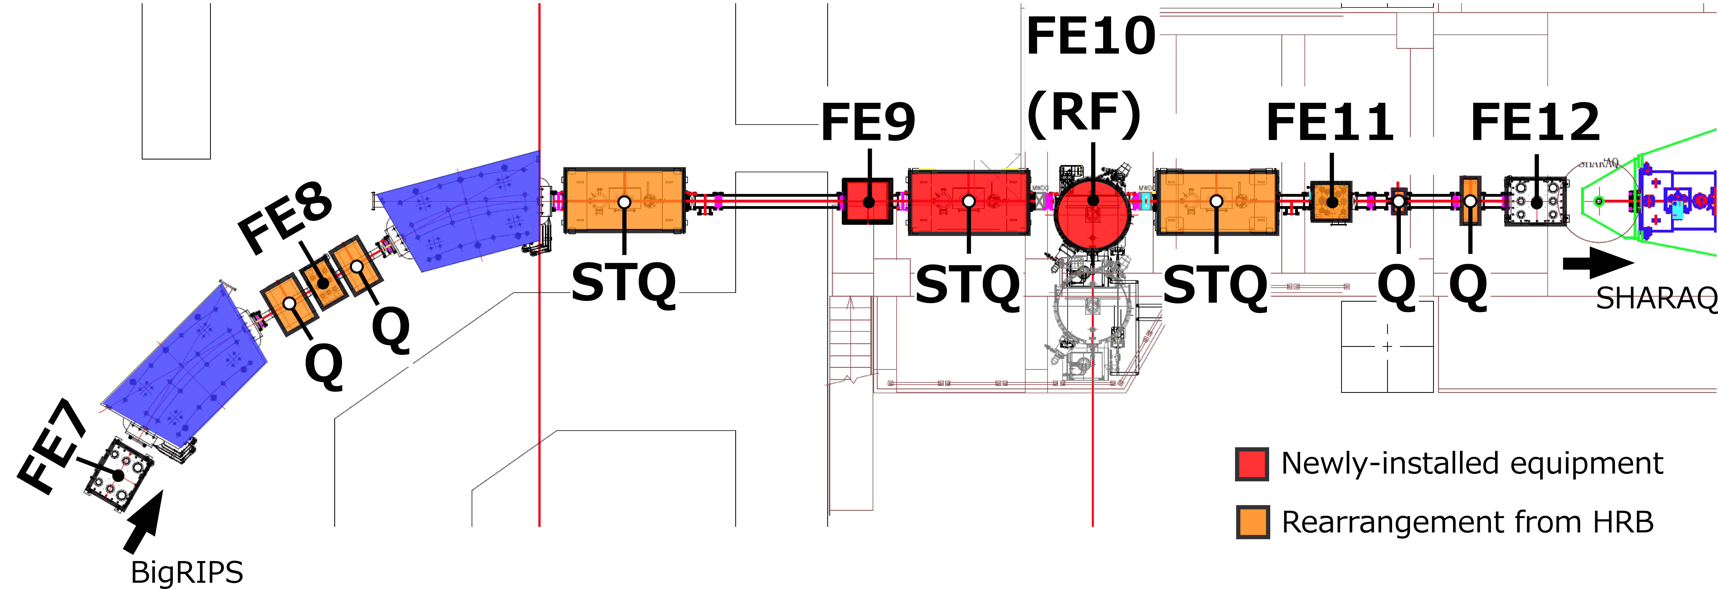
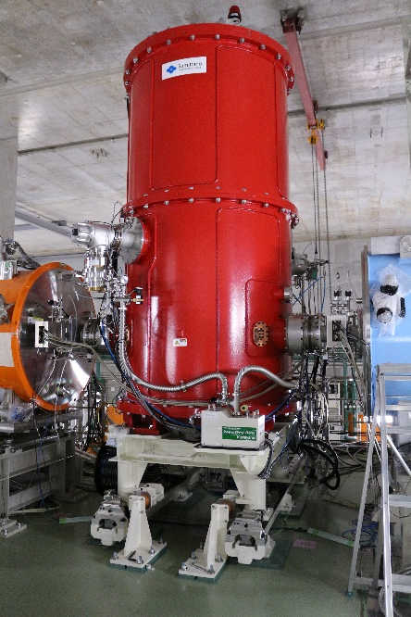
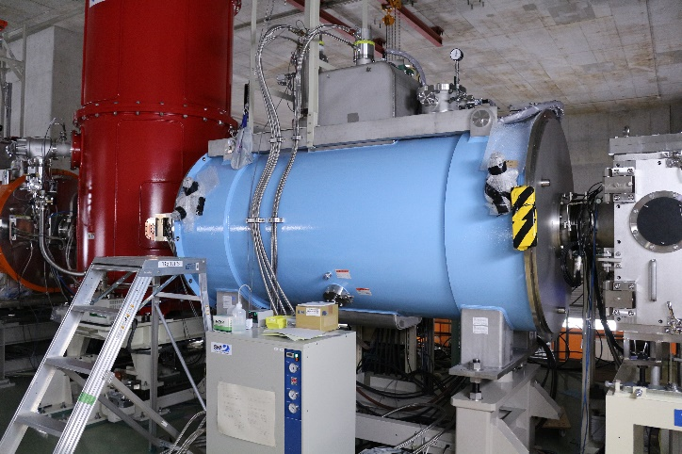
Optimized Energy Degrading Optics for RI beams
Degrader
OEDO
OEDO RFD
f_{RF} = 18.25 MHz
V_{max} = 350 kV
Gap(H) = 200 mm
L (Z) = 1200 mm
W(V) = 400 mm
Installed in Mar. 2017.

Slide 6
OEDO Beamline (Construction Site)
Construction was
completed in Mar 2017

Slide 7
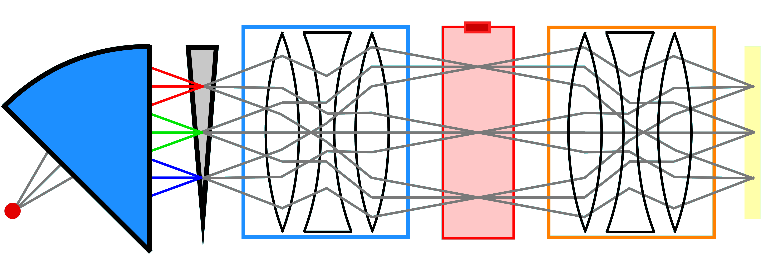
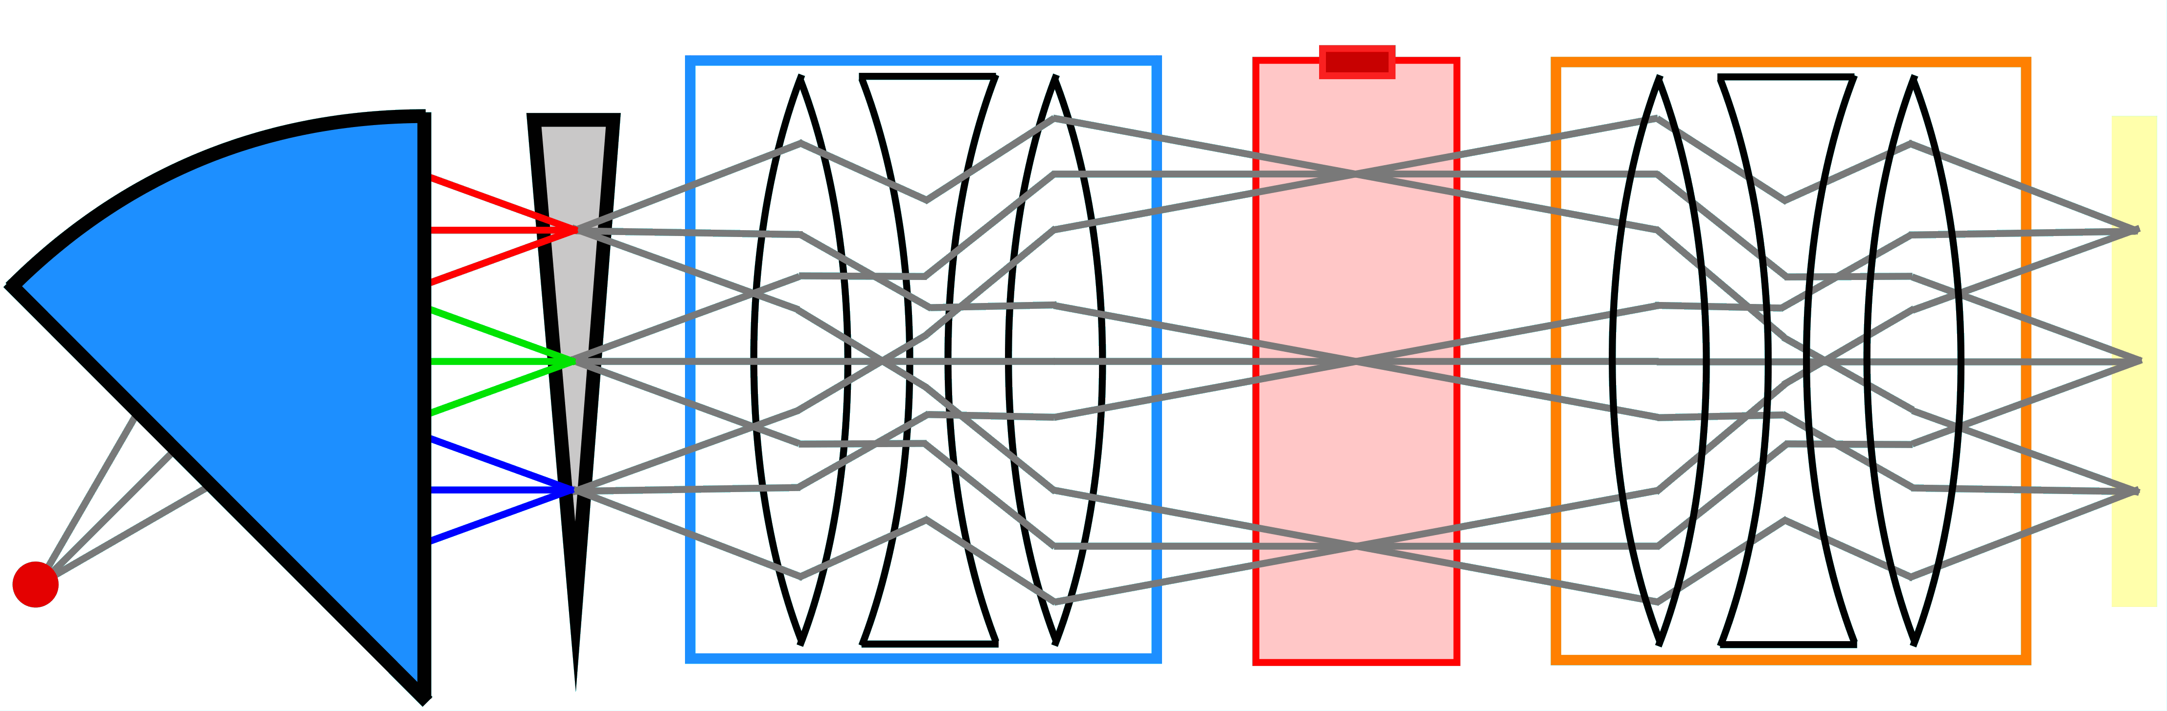
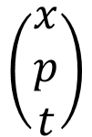









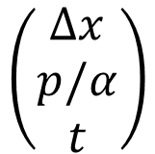


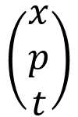
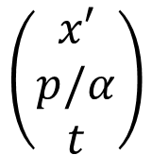
Principle of OEDO
$$p$$
$$t$$
RF
$$t$$
RF
Deflector
$$p$$
Energy degrader
#131 Study of performance of
OEDO beam line
J.W. Hwang et el.,
$$p/α$$
$$x$$
$$x$$
$$∆x$$
$$∆x$$
$$x′$$
$$x$$
Don’t miss it
RF on
$$\left(\begin{matrix}x′ \\ p/α \\ t\end{matrix}\right)$$
$$\left(\begin{matrix}x \\ p \\ t\end{matrix}\right)$$
RF off
$$\left(\begin{matrix}∆x \\ p/α \\ t\end{matrix}\right)$$
$$\left(\begin{matrix}x \\ p \\ t\end{matrix}\right)$$

Slide 8
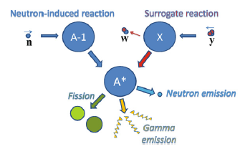
(n,γ) vs. (d,p)
⁷⁹Se+n
⁷⁹Se+d
Sn=9.91 MeV
Q=7.69 MeV
⁸⁰Se
⁸⁰Se+p
G. Boutoux et al., PLB 712, (2012) 319-325.
determined by
(d,p)
determined by
the optical model potential
Weisskopf-Ewing approximation
V. Weisskopf, DH. Ewing, Phys. Rev. 57, 472(‘40)

Slide 9

Surrogate reaction w/o γ-ray measurement
Typical setup for surrogate reaction exp.
= Recoil particle detectors
+ γ-ray detector array
Aha!
Gamma emission means
that the nucleus doesn’t
change N and Z number!
Pγ was determined by identifying
the outgoing residue nucleus.
¹⁷¹Yb(d,pγ) →¹⁷¹Yb(n,γ)
R. Hatarik et al.,
PRC81, 011602 (R) (2010)

Slide 10
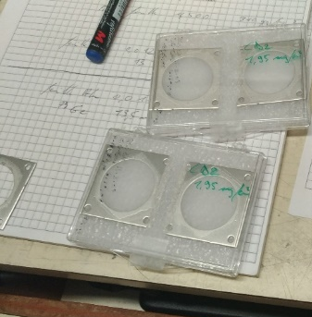
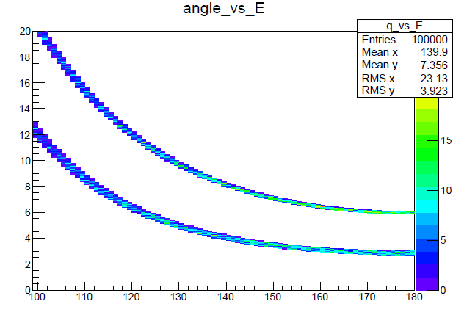
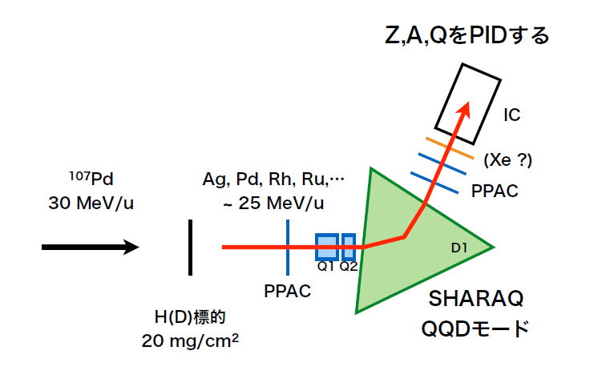
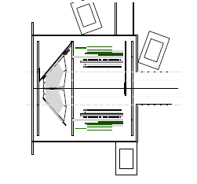
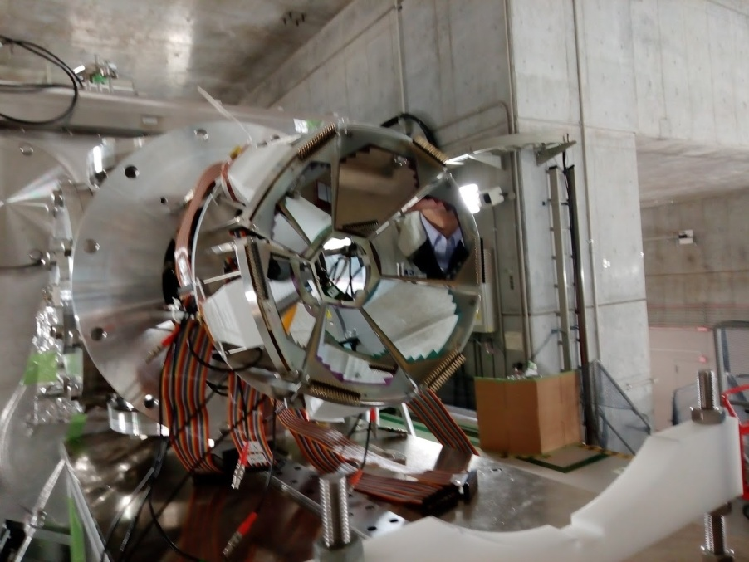
Experimental Setup at OEDO
Recoil particles: TiNA, SSD-CsI (CNS/RCNP/RIKEN)
reaction products: detectors at final focal plane
target: CD₂ 4mg/cm²
Beam int~ 10⁴ pps at on CD₂
# 77. TINA - a New Silicon
Tracker for Transfer Reactions
P. Schrock et al.,
Don’t miss it
⁸⁰Se
4mg/cm2 CD₂
⁸⁰Se g.s.
p
⁸⁰Se* 10 MeV
⁷⁹Se
SSD(16chx6)+
CsI
TiNA
coincidence measurement of
recoil particles + outgoing particles.

Slide 11
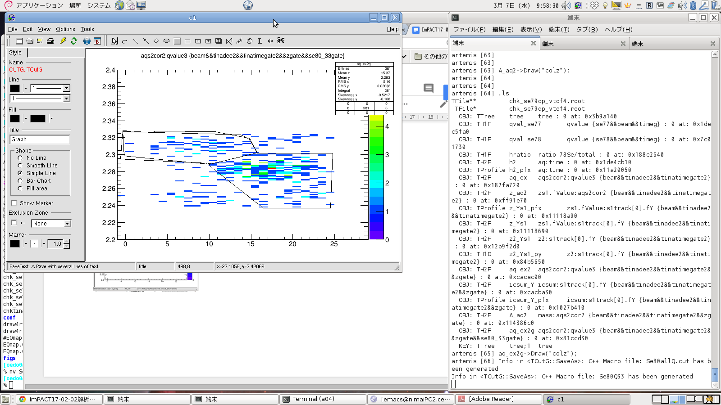
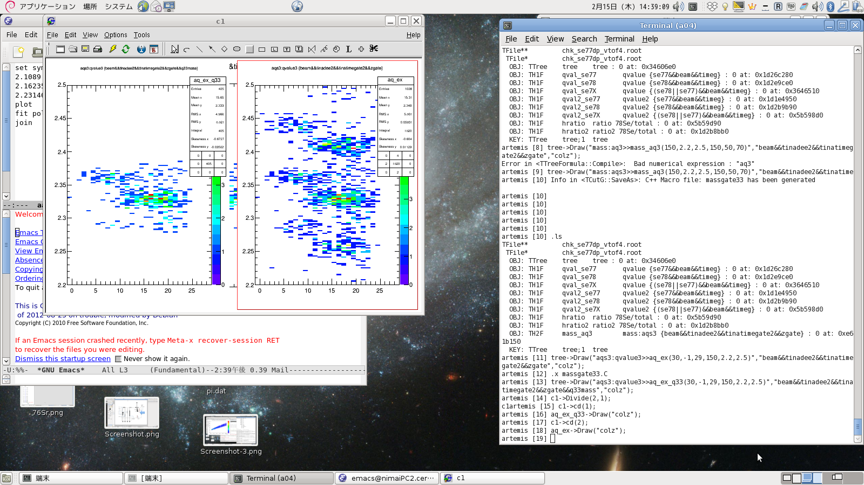
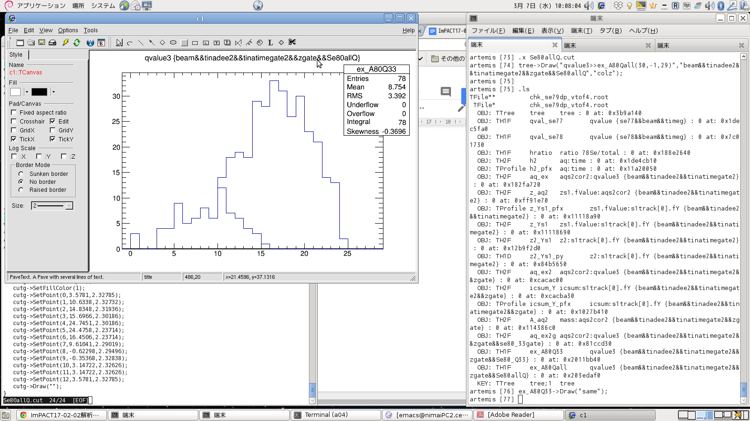
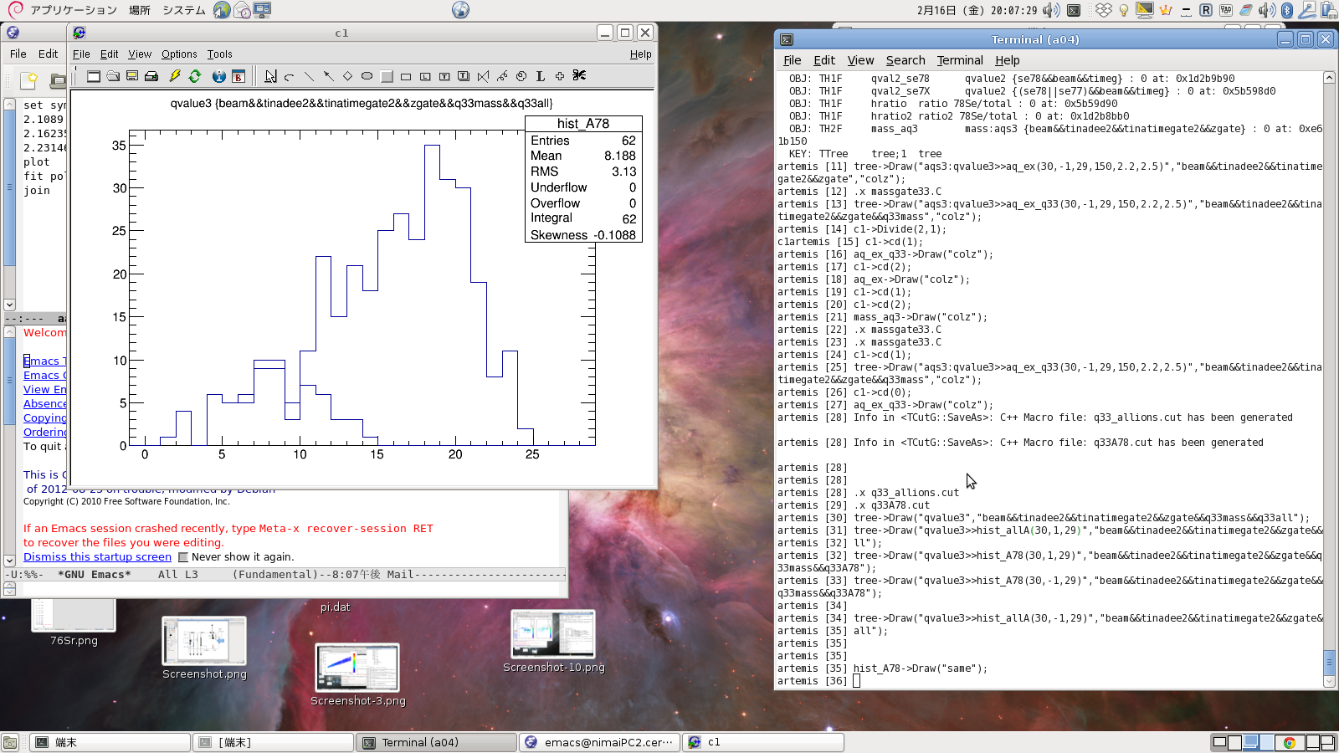
Experimental P_{γ}(E)
⁷⁷Se(d,p)⁷⁸Se
⁷⁹Se(d,p)⁸⁰Se
A/Q
A/Q
⁸⁰Se³³⁺
⁷⁸Se³³⁺
⁷⁹Se³³⁺
⁷⁷Se³³⁺
⁷⁶Se³³⁺
⁷⁸Se³³⁺
Ex (MeV)
Ex (MeV)
^{76,77,78}Se³³⁺
^{78,79,80}Se³³⁺
⁷⁸Se³³⁺
⁸⁰Se³³⁺
Ex (MeV)
Ex (MeV)

Slide 12
Preliminary σ(E) for ^{77,79}Se(n,γ)
TENDEL
JENDEL 3.3/4.0
ENDF/B-VII.1
⁷⁷Se(n,γ)⁷⁸Se
⁷⁹Se(n,γ)⁸⁰Se

Slide 13
Summary
⁷⁹Se(n,γ) is important sociologically and astrophysically.
A new energy degraded beam line named OEDO was installed at RIBF SHARAQ beam line.
^{77,79}Se(d,p)^{X}Se were measured successfully with a newly developed recoil particle tracker TiNA.
Surrogate reaction without γ-ray measurement was employed.
σ of ⁷⁷Se(n,γ)⁷⁸Se is in good agreement with the past experimental data and the evaluation.
σ of ⁷⁹Se(n,γ)⁸⁰Se were also determined at En<6 MeV for the first time.

Slide 14

Acknowledgement
This work was funded by ImPACT Program of Council for Science, Technology and Innovation (Cabinet Office, Government of Japan).

Slide 15
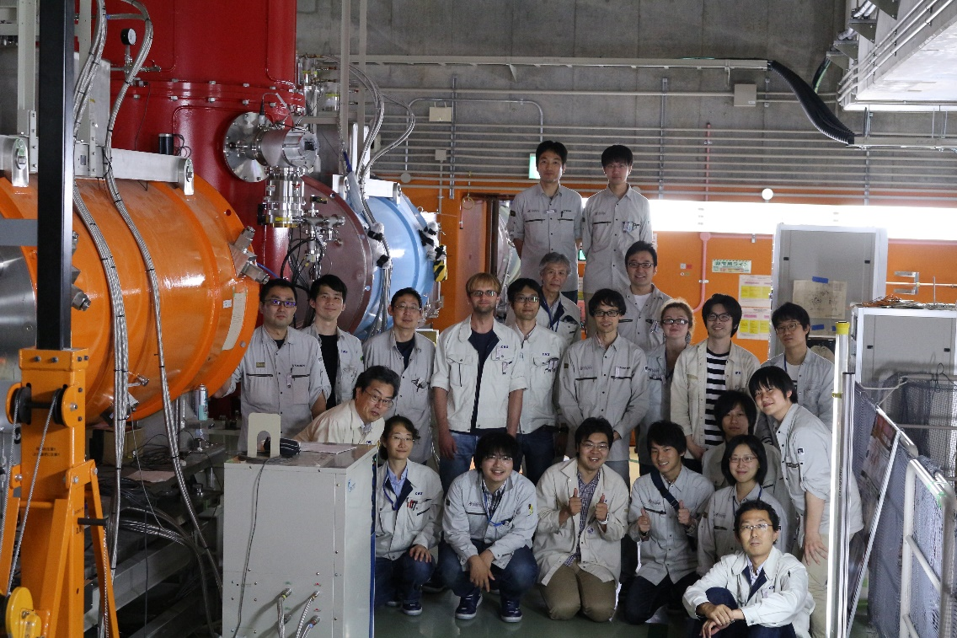




collaborators
N.Imai, S.Michimasa, M.Dozono, S.Ota, M.Takaki, J.Hwang, C.Iwamoto, S.Masuoka,
N.Kitamura, K.Kawata, H.Simizu, R. Tsunoda, S.Hayakawa, P.Schrock, O.Beliuskina,
L.Yei, H.Yamaguchi, K.Yako, K.Wimmer,
T.Sumikama, H.Otsu, H.Wang, S.Takeuchi, S.Kawase, N.Chiga, X.Sun,
S.Naimi, D.Nagae, S.Omika, K.Chikaato, T.Teranishi, K.Iribe, K.Yoshida,
E.Ideguchi, Y.Fan, Y.Watanabe, K.Nakano, H.Miyatake, Y.X.Watanabe, T.Nakamura,
K.Yoshida, N.Fukuda, Y.Shimizu,
H.Suzuki, H.Takeda, D.S.Ahn,
Y.Yanagisawa, K.Kusaka, T.Ohtake,
H.Sakurai, and S.Shimoura
Schrock
Dozono
Hwang

Slide 17
⁷⁹Se(d,p)⁸⁰Se*
high excited state of ⁸⁰Se will be populated by ⁷⁹Se(d,p)⁸⁰Se reaction.
branch of the γ decay from the compound nucleus will be determined.
determined by
the optical model potential
determined by
(d,p)
Assumption 1;
Assumption 2;
Weisskopf-Ewing approximation
V. Weisskopf, DH. Ewing, Phys. Rev. 57, 472(‘40)

Slide 18
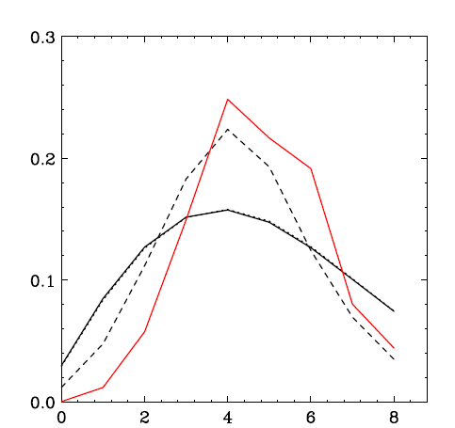
Problems of surrogate method
spin distribution of the transfer is different
⁷⁹Se(n,γ)⁸⁰Se@En=1MeV
F(E*=10MeV,J^{π})
⁷⁹Se(d,p)⁸⁰Se@Ed=5 MeV
⁷⁹Se(d,p)⁸⁰Se@Ed=40, 20 MeV
J
ΔL ~ 0 transfer for (n,γ)
G. Boutoux et al., PLB 712, (2012) 319-325.
The different population of J
Different probability
of emission of γ ?

