Slide 1






A new measurement of the intruder configuration in ¹²Be
J. L. Lou(楼建玲) , J. Chen and Y. L. Ye Peking University
Peking University, China
Chen Jie, Ye Yanlin, Li Zhihuan, Li Qite, Ge Yucheng, Jiang Dongxing, Hua Hui, Xu furong, Yang Zaihong, Sun Yelei, Tian zheng yang,Li Jing, Jiang Wei, Zang Hong Liang
Osaka University, Japan
Aoi, Ong Hooi Jin, Eiji Ideguchi, Tetsuya, Mana, Suzuki, Tran Trong
RIKEN, Japan
Jenny lee, Wu Jin, Liu Hongna, Wen Chao
Beihang University, China
Pang Danyang
Universidad de Sevilla, Spain
A.M.Moro
Sun Yat-Sen University, China
C.X.Yuan

Slide 2

Outline
1. Introduction
2. Experimental details and results
3. Shell model calculations(C. X. Yuan)
4. Discussion and Summary

Slide 3
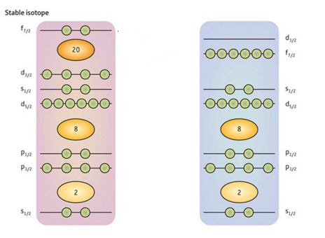
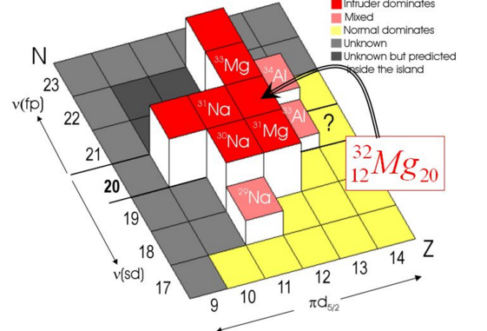
1. Intruder Configuration
“s d”Intruder into “p” orbital
Halo nuclei ¹¹Li, ¹¹Be,
Conventional magic number disappear, N=8 ¹²Be
“pf”Intruder into “sd” orbital
Inversion of island
³²Ne

Slide 4
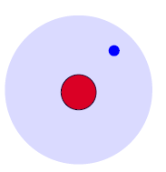
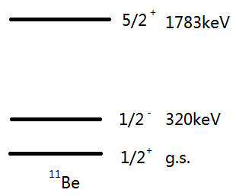
1. The halo nucleus ¹¹Be
Neutron loosely bound Sn=0.504 MeV
Larger radius rms= 2.91 fm
¹⁰Be core + 1 valance n
⑳
0 d3/2
¹¹Be_{gs}(1/2⁺)
inversion
1 s1/2
0 d5/2
0 p1/2
0 d5/2
⑧
1 s1/2
0 p1/2
0 p1/2
0 p3/2
¹⁰Be Core excited to 2⁺
0 s1/2
0⁺ × 1s_{1/2}
2⁺ × 0d_{5/2}
PRL 108, 192701 (2012),¹⁰Be(d,p)
PLB 461, 22-27 (1999) ¹¹Be(p,d)
S~16%
S~0.71(5)
PRL 84, 35(2000) ¹¹Be 1n removal
Reaction， momentum distribution
S~22%
s-wave intruder dominated in ¹¹Be_{g.s}

Slide 5
1. structure of nucleus ¹²Be(configurations)
disappearance of conventional magic number： N = 8
Isomeric state： 0₂⁺ 331(12) ns
Two decay modes:
E2 decay: 130 keV and 2.11 MeV gamma-rays 17(2)%
E0 decay: internal conversion: negligible
e+e- pair creation 511keV gamma 83(2)%
isomer
Physics Letters B 560 (2003) 31–36;
Physics Letters B 654 (2007) 87-91.
⑳
γ
VS
α
VS
β
0 d3/2
Normal
Intruder state
Intruder state
1 s1/2
¹²Be_{gs}(0⁺)
¹²Be_{gs}(0⁺)
¹²Be_{gs}(0⁺)
0 d5/2
⑧
0 p1/2
0 p1/2
1 s1/2
0 d5/2
0 p3/2
0 s1/2
(0s⁾⁴(0p)⁶(0p)² 0ћω
(0s⁾⁴(0p)⁶(1s)² 2ћω
(0s⁾⁴(0p)⁶(0d)² 2ћω

Slide 6
1. individual strength was Controversial
 | 0₁⁺ (Ground state) |  |  | 0₂⁺ (isomeric state) |  |  | Ref
 | α(% s^2) | β(% d^2) | γ(% p^2) | α(%s^2 ) | β(% d^2) | γ(% p^2)
Theory | 33 | 29 | 28 | 67 | 10 | 23 | JPG 2, L45, 1976
 | 31 | 42 | 27 |  |  |  | NPA 703, 593,2002
 | 23 | 48 | 29 |  |  |  | PRC 69,041302R, 2004
 | 53 | 15 | 32 | 25 | 7 | 68 | JPG 36, 038001,2009
 | 67~76 | 10~13 | 13~19 | 15~23 | 6~8 | 71~78 | PRC 77, 054313, 2008
 | 25 | 21 | 54 | 62 | 0 | 38 | PRC 82,034313, 2010
Experiment | 33 | 38 | 29 |  |  |  | PRL 85,266,2000 PRL 96, 032502, 2006
 |  |  | 25(5) |  |  | 59(5) | PRL 108, 122501, 2012
 | 19(7) | 57(7) |  | 39(2) | 2(2) |  | PLB 781,412-416,2018
1n knock-out
Charge-exchange
Transfer reaction
Without normalization, the Spectroscopic factors from two previous transfer reactions were not listed here.

Slide 7
1.1 Knock-out experiment (2ћω)
78 MeV/u ¹²Be+⁹Be(s p wave)
don’t distinguish (1s_{1/2})² and (0p_{1/2})² configurations ------gamma rays
not sensitive to the (0d_{5/2})² configuration--------¹⁰Be+n fragments
39 MeV/u ¹²Be+¹²C(s p d wave)
4 NaI detectors: detect the first excited state of ¹¹Be at 320keV(0p_{1/2})
Demon: detect n, n+¹⁰Be reconstruct the excited state of ¹¹Be at 1.78 MeV(0d_{5/2})
Phys.Rev.Lett 85,266,2000.
Phys.Rev.Lett 96,032502,2006.
Only for Ground state 0₁⁺,
Beam: 0₁⁺ may be mixed with 0₂⁺.
R. Kanungo et al.,Phys.Lett.B 682,391,2010.

Slide 8
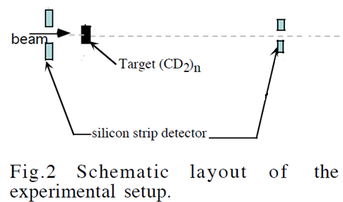
1.2 charge-exchange experiment and transfer reaction
¹²B(1⁺)(⁷Li, ⁷Be)¹²Be( 2ћω)
Gamow-Teller transition
Selected rules: Δ L=0, Δ S=1 , Select p-wave（normal）.
Clearly distinguish the first two 0⁺ states of ¹²Be.
p-Wave: 0₁+ 25（5)% 0₂+ 60(5)%
¹¹Be(d,p)¹²Be reaction(0ћω)
Select s-wave（abnormal）
Identify the excited states of ¹²Be
s-Wave: 0₁+ 0.28(0.07) 0₂+ 0.73(0.41)
Phys. Rev. Lett 108,122501,2012.
Phys. Lett. B 682,391,2010.

Slide 9
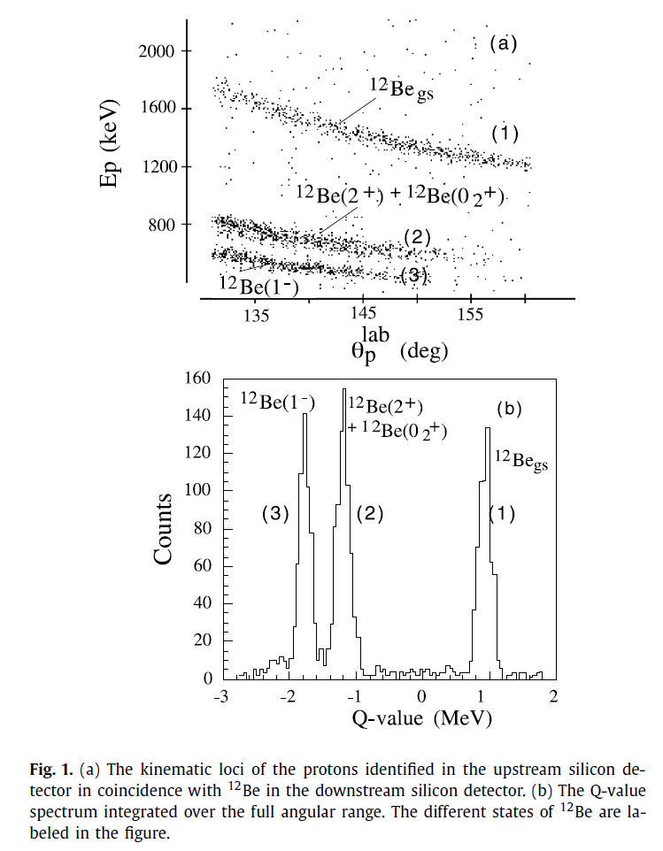
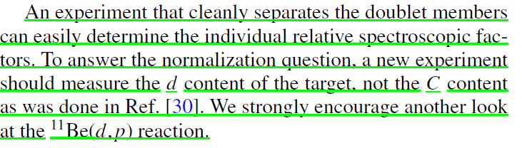
1. 3 Transfer reaction(2)----2.8 AMeV
Questioned by H.T.Fortune and R.Sherr.
0₁⁺ ： normalization factor for beam,
unsure deuterium content
0₂⁺ ： Mix with 2⁺ state.
separate them incorrectly
(larger s-wave SF and smaller d-wave SF)
Normalization factor for beam.
Phys.Rev.C 85,051303(R),2012.

Slide 10
1.3 Transfer reaction(2)---2.8 AMeV
Solve: doublet peak
Normalization factor of beam?
Deuterium content in CD2 target?
no data at smaller angles?
Difficulty to detect recoil proton at larger angles with lower incident energy
no elastic scattering data?
0₁⁺， SF = 0.15~0.25
0₂⁺ ， SF = 0.32~0.98.
J. G. Johansen et al., PRC 88, 044619, 2013

Slide 11
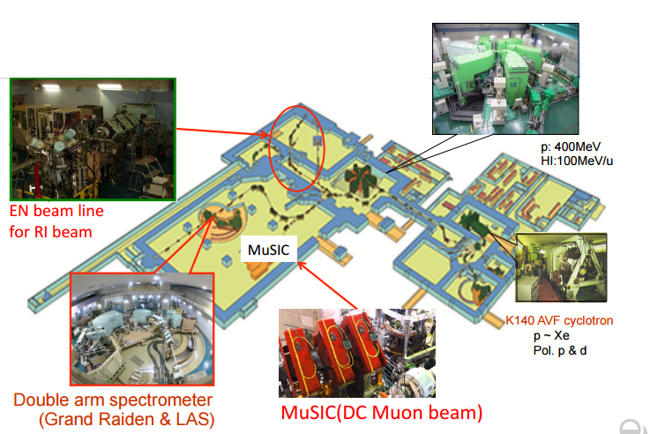
2.1 Experimental details: RCNP (En-course)
primary beam： 60 AMeV ¹³C
Secondary beam：26.9 AMeV 10⁴ pps, 95%
RCNP: En course

Slide 12
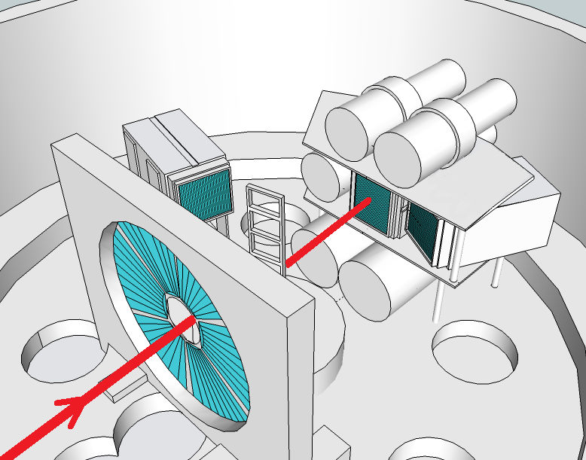
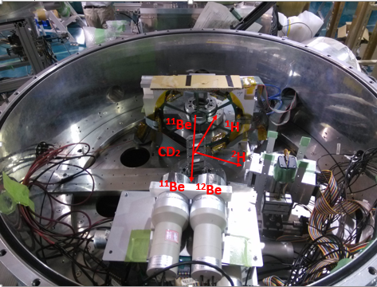
2.1 Experiment setup and implantation-decay method
NaI
¹²Be isomers (331 ns)
Implanted in Tele0
Decay 511 keV γ with Branching ratio of 83%
Tele1
Tele0
Annular DSSD
Tele2
Four targets:
CD2
CH2
C
Empty
Beam
J.L.Lou, Z.H. Li, Y.L. Ye et al., Phys. Rev. C 75, 057302 (2007).
Z.H. Li, J.L.Lou, Y.L. Ye et al., Phys. Rev. C 80, 054315 (2009).

Slide 13
2.2 ¹¹Be+p Elastic scattering data
Down-PPAC
Target
TELE1
Beam was monitored by Plastic scintillator
Detector.
beam
Up-PPAC
TELE0
Plastic scintillator
Annular silicon
PID using data taken by TELE0
Proton Energy verse Angles

Slide 14
2.2 OP for the ¹¹Be+p
Our data
Consistent with other data
Need normalization
Check data analysis process
Provide Op of entrance channel
for transfer reaction
J.Chen, J.L.Lou*, Y.L.Ye, PRC 93, 034623 (2016)
J. Chen,J.L.Lou*, D. Y. Pang et al, Sci. China-Phys. Mech. Astron 59, 632003 (2016).

Slide 15
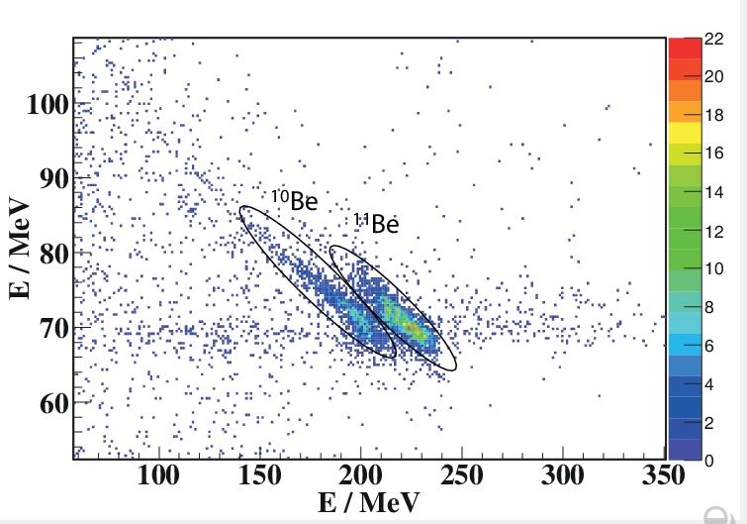
2.3 Proton contamination in CD₂ target 9.5(0.6)%
CD2 target
proton
CD2 – CH2 target
d
p
No proton

Slide 16
2. 3 Check deuterium content in CD2 target using ¹¹Be+d elastic scattering data
Small angles, nearly all the global OP can reasonably reproduce data .
Deuterium content in CD2 is checked
Developed Specifically global OP， DA1p, for the 1p-shell target nuclei
Reproduce Angular distributions well
A.M.Moro et al, include core excitation
P.Descouvemont, 4-body CDCC calculation
J.Chen, J.L.Lou*, Y.L.Ye, PRC94, 064620, 2016. Zhang, D.Y.Pang, J.L.Lou*, PRC94, 014619 (2016)

Slide 17
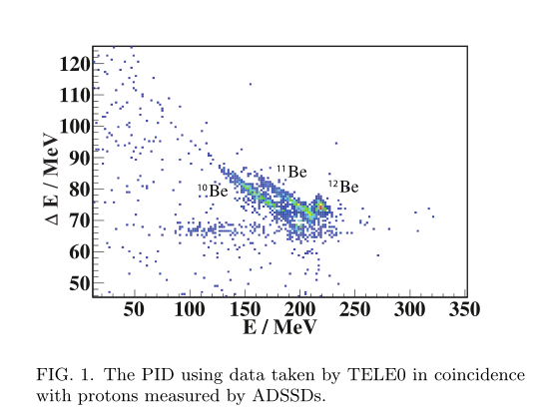
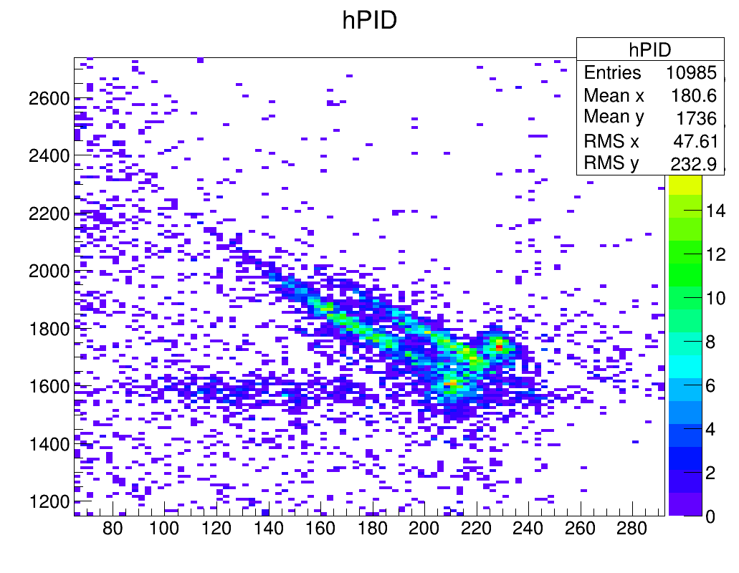
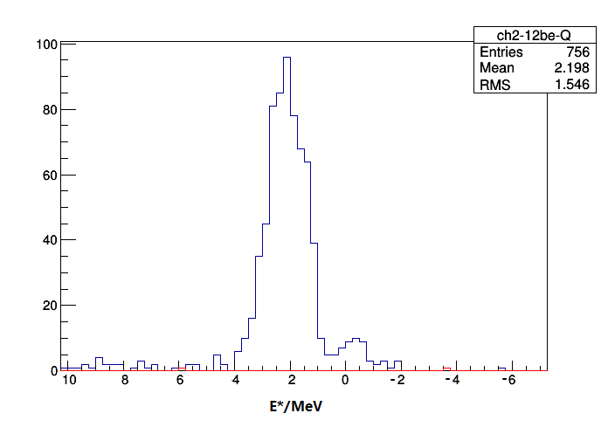
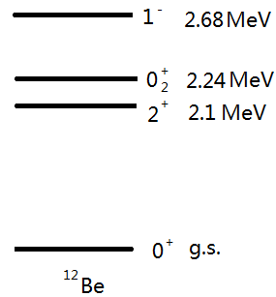
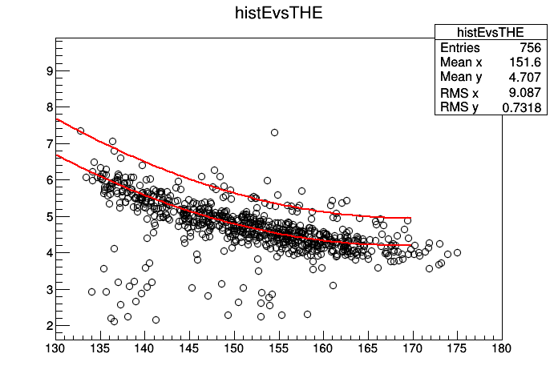
2.4 Experimental result of ¹¹Be(d, p)¹²Be
PID on the zero degree telescope
Energy spectrum for ¹²Be
ΔE
¹¹Be
¹²Be
¹⁰Be
ɵ_{lab}(deg)
Energy/MeV
g.s.
Kinematic loci for protons in coincidence with ¹²Be on Tele0
ex.s.
Notes:
在d弹散能量随角度的变化图中可以看到有一条带子，对应于质子能量随角度变化，说明CD2里面含有氢的杂质
通过比较重建出的激发态谱中质子的数目，并且用束流归一，可以得到CD2靶中的质子含量

Slide 18
Isomeric state(E0 decay was used)
2.4 Experimental result of ¹¹Be(d,p)¹²Be
NaI(Tl) + PMT
Tele0
E0: 83%
511 keV
T_{1/2} = 331 ns
e⁺e⁻ pair creation
E2: 17%
130 keV and 2100 keV
S. Shimoura et al., Physics Letters B 560 (2003) 31–36;
S. Shimoura et al., Physics Letters B 654 (2007) 87-91.

Slide 19
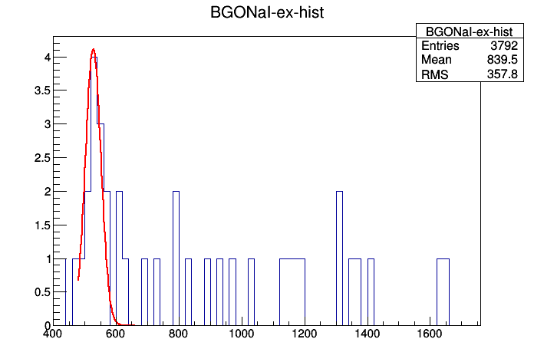
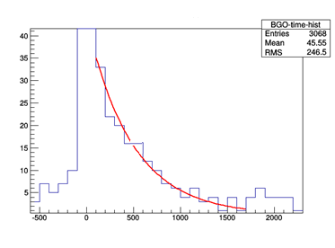
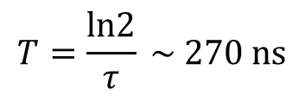
2.4 Decay gamma rays
γ spectrum gating on the e.x. states in q-value spectrum
511 keV γ-ray
Detection efficiency
23(1)%
Geant4 simulation
Energy/keV
$$T=\frac{ln2}{τ} \sim 270 ns$$
Time specturm gating on the 511keV γ-ray
Counts/100ns
T (ns)
Notes:
NaI探测器的放大倍数随时间会有明显的变化，因此选取特征峰对其进行修正。
在12be激发谱上选择12be的激发态，看gamma能谱，可以明显的看到511keV的gamma，将其选取出来，观察其计数随着时间的变化，拟合其半衰期，与331ns相近
此外，要详尽的计算gamma的效率来决定02+态的谱因子

Slide 20
2.4 Differential cross sections for ¹¹Be(d,p)¹²Be

Slide 21
2.5. two methods to extract SFs from (d,p) reaction
A(d, p)B
Provide by D.Y.Pang
DWBA
Distorted wave Born approximation
FR-ADWA
Finite-range adiabatic distorted wave approximation
Don’t include d-breakup
Ops of A+d and B+p
include d-breakup
Ops :A+p folding with A+n B+p (nucleonic potential)

Slide 22
2.5 SFs extracted from our data
Entrance channel :
¹¹Be+p: our data
¹¹Be + n: no data, global kd02 or CH89
Exit channel ¹²Be+p:
Data from reference
SFs extracted from ¹¹Be(d,p)¹²Be
 | 2.8 AMeV | 5 AMeV | 26.9 AMeV
0₁⁺ | 0.15(0.04) | 0.28(0.07) | 0.20(0.04)
0₂⁺ | 0.40(0.11) | 0.73(0.40) | 0.41(0.11)
2⁺ | 0.075(25) | 0.10(0.08) | 0.26(0.05)
1⁻ | 0.27(15) | (0.35) | 0.76(0.17)
Small s-wave SF in the 0₁⁺
Consistent with two previous experiment with error bar
2⁺ and 1⁻, SFs are larger, some recoil proton may be not detected due to the detection threshold of proton for previous experiments
Using CH89 systematic OP to refit the
Angular distributions to get the
exit channel OP
Physics Letters B 343 (1995) 53-58;

Slide 23
2.5. SF with different OPs
SFs for the 01+ and 02+ states are Sensitive to the OP (±27%)
Their ratio is Not sensitive to the OP(±7%)
The ratio Method was from ¹⁵C(d,p)¹⁶C
Phys. Rev. Lett 105, 132501 (2010);

Slide 24
2.6. intensities for the s- and d-wave in the 0+ states
Using the standard method proposed by Barker [12], the wave functions of the first two low-lying 0⁺ states can be written as
|0₁⁺> =a₁|1s_{1/2}²> + b₁|0d_{5/2}²> + c₁|0p_{1/2}²> ,
|0₂⁺> =a₂|1s_{1/2}²> + b₂|0d_{5/2}²> + c₂|0p_{1/2}²> ,
with the normalization relations [12]
a_{i}² + b_{i}² + c_{i}² =α_{i} + β_{i} + γ_{i} = 1, (i=1,2),
and the orthogonal requirement [12]
a_{1*}a₂ + b_{1*} b₂ + c_{1*} c₂ = 0.
From the present measurement we have
α₁/α₂ = 0.20/0.41 = 0.49+0.15-0.16.
Previously the 0p_{1/2}-wave strengths in the two 0⁺ states of ¹²Be were investigated via a charge-exchange reaction experiment ¹²B(⁷Li,⁷Be)¹²Be [28]. By applying the p-sd model space the p-wave intensities were determined for the 0₁⁺ and 0₂⁺ states as
γ₁ = 0.24±0.05, γ₂ = 0.59±0.05.
Then we have enough conditions to solve the above equations and the physically reasonable solutions for all 6 parameters are
α₁ = 0.19±0.07 (s-wave), β₁ = 0.57±0.07(d-wave), γ₁ = 0.24±0.05, 0₁⁺
α₂ = 0.39±0.02 (s-wave), β₁ = 0.02±0.02(d-wave), γ₁ = 0.59±0.05. 0₂⁺
The ratio method has been used
in the ¹⁵C(d,p)¹⁶C reaction
Phys. Rev. Lett 105, 132501 (2010);
J.Chen, J.L.Lou*, Y.L.Ye, Phys. Lett. B 781, 412,2018

Slide 25
2.6. intensities for the first two 0+ states
 | 0₁⁺ (Ground state) |  |  | 0₂⁺ (isomeric state) |  |  | Ref
 | α(% s^2) | β(% d^2) | γ(% p^2) | α(%s^2 ) | β(% d^2) | γ(% p^2)
Theory | 33 | 29 | 28 | 67 | 10 | 23 | JPG 2, L45, 1976
 | 31 | 42 | 27 |  |  |  | NPA 703, 593,2002
 | 23 | 48 | 29 |  |  |  | PRC 69,041302R, 2004
 | 53 | 15 | 32 | 25 | 7 | 68 | JPG 36, 038001,2009
 | 67~76 | 10~13 | 13~19 | 15~23 | 6~8 | 71~78 | PRC 77, 054313, 2008
 | 25 | 21 | 54 | 62 | 0 | 38 | PRC 82,034313, 2010
Experiment | 33 | 38 | 29 |  |  |  | PRL 85,266,2000 PRL 96, 032502, 2006
 |  |  | 25(5) |  |  | 59(5) | PRL 108, 122501, 2012
 | 19(7) | 57(7) |  | 39(2) | 2(2) |  | PLB 781,412-416,2018
small s-wave in 0₁⁺, 19% +small p-wave in 0₁⁺, 25% , we deduce larger d-wave in the 0₁⁺ of ¹²Be, which is different from ¹¹Be dominated by s-wave
Conflict with knock-out experiment, mixed ¹²Be isomers in beam

Slide 26
Consistent with our conclusion
Proton target
Not Carbon/Beryllium target

Slide 27
3. Shell model calculation(support our conclusion)
YSOX interaction
binding energy，B(E2) and properties of low-lying states of B,C,N, O isotopes
Full psd model space including
(0~3) hω excitation
YSOX interaction
apply to 12Be
Case1: unmodified YSOX interaction
wrong energy level order of low-lying excitation states
intensity are not in agreement with experimental values
Case2: modified YSOX interaction
d-orbital decrease 0.5 MeV
Support our experimental result
C.Yuan et al., Phys. Rev. C 85, 064324 (2012).
Cenxi.Yuan et al., Nucl. Phys. Rev, in press (2016).
Cenxi Yuan el al., http://arxiv.org/abs /1602.02957(2016).
J.Chen, J.L.Lou*, Y.L.Ye, Phys. Lett. B 781, 412,2018

Slide 28
4. Summary
Beam Energy: relatively higher
Deuterium content: deuterium content was carefully determined and proton contamination are subtracted
Doublet (0₂⁺ mixed with 2⁺): a new experimental technology
SF normalization: ratio method together with previously measured p-wave intensity
0₁⁺: S-wave SF is 0.21(0.03)
0₂⁺: S-wave SF is 0.41(0.11) without mixture
Deduce the intensity for the s and d-wave in the 12Beg.s.
¹²Be 0₁⁺: d-wave intruder dominate, different from ¹¹Be, s-wave larger

Slide 29
Thank you for your attention!
Welcome suggestions and commons

Slide 30
Shell model calculations with YSOX interaction can reproduce most
Observables of ¹¹Be and ¹²Be simultaneously.

