Slide 1
Jefferson Lab’s EIC Design
Speaker: V.S. Morozov (JLab)
on behalf of JLEIC Collaboration

Slide 2
JLEIC Collaboration
S. Benson, A. Bogacz, P. Brindza, A. Camsonne, E. Daly, Ya.S. Derbenev, M. Diefenthaler, D. Douglas,
R. Ent, Y. Furletova, D. Gaskell, R. Geng, J. Grames, J. Guo, F. Hanna, L. Harwood, T. Hiatt, Y. Huang,
A. Hutton, K. Jordan, G. Kalicy, A. Kimber, G. Krafft, R. Li, F. Lin, F. Marhauser, R. McKeown, T. Michalski,
V.S. Morozov, P. Nadel-Turonski, E. Nissen, H.K. Park, F. Pilat, M. Poelker, R. Rajput-Ghoshal, R. Rimmer,
Y. Roblin, T. Satogata, M. Spata, R. Suleiman, A. Sy, C. Tennant, H. Wang, S. Wang, G.H. Wei, C. Weiss,
M. Wiseman, R. Yoshida, H. Zhang, Y. Zhang - JLab, VA
D.P. Barber - DESY, Germany
Y. Cai, Y.M. Nosochkov, M. Sullivan - SLAC, CA
S. Manikonda, B. Mustapha, U. Wienands - Argonne National Laboratory, IL
P.N. Ostroumov, R.C. York - Michigan State University, MI
S. Abeyratne, B. Erdelyi - Northern Illinois University, IL
J. Delayen, H. Huang, C. Hyde, K. Park, S. De Silva, S. Sosa, B. Terzic - Old Dominion University, VA
P. Nadel-Turonski, SUNY, NY
Z. Zhao - Duke University, NC
A.M. Kondratenko, M. Kondratenko - Sci. & Tech. Laboratory Zaryad, Russia
Yu. Filatov - Moscow Institute of Physics and Technology, Russia
J. Gerity, T. Mann, P. McIntyre, N.J. Pogue, A. Sattarov - Texas A&M University, TX
V. Dudnikov, R.P. Johnson - Muons, Inc., IL
I. Pogorelov, G. Bell, J. Cary - Tech-X Corp., CO
D. Bruhwiler - Radiasoft, CO

Slide 3
Outline
Overall layout of JLEIC
Electron complex
  CEBAF as a full-energy injector
  Electron collider ring
  Electron polarization
Ion complex
  Ion injector complex: ion sources, linac, and booster
  Ion collider ring
  Ion polarization
  Crab crossing
  Electron cooling
Detector region
Conclusions

Slide 4

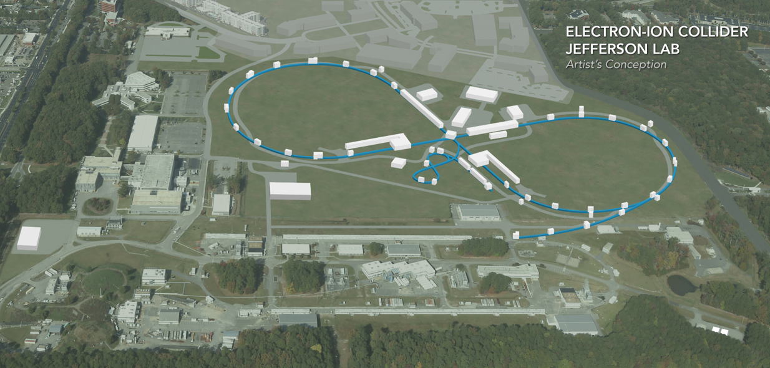
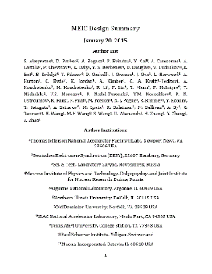
JLEIC Layout
Electron complex
  CEBAF
  Electron collider ring
Ion complex
  Ion source
  SRF linac
  (285 MeV/u for protons)
  Booster
  Ion collider ring
Up to two detectors at
minimum background
locations
8-100(400) GeV
3-12 GeV
8 GeV
SRF Linac &
2015
arXiv:1504.07961
May 17 update:
https://eic.jlab.org/wiki/index.php/Main_Page

Slide 5

Key Design Concepts
High luminosity: high collision rate of
short modest-charge low-emittance bunches
  Small beam size
    Small β* ⇒ Short bunch length ⇒
    Low bunch charge, high repetition rate
    Small emittance ⇒ Cooling
  Similar to lepton colliders such as
  KEK-B with L > 2×10³⁴ cm⁻²s⁻¹
$$L=f\frac{n_{1}n_{2}}{4πσ_{x}^{∗}σ_{y}^{∗}}\sim f\frac{n_{1}n_{2}}{εβ_{y}^{∗}}$$
High polarization: figure-8 ring design
  Net spin precession zero
  Spin easily controlled by small
  magnetic fields for any particle
  species
Full acceptance primary detector including far-forward acceptance
Beam Design
High repetition rate
Low bunch charge
Short bunch length
Small emittance
Damping
Synchrotron radiation
Electron cooling
IR Design
Small β*
Crab crossing

Slide 6
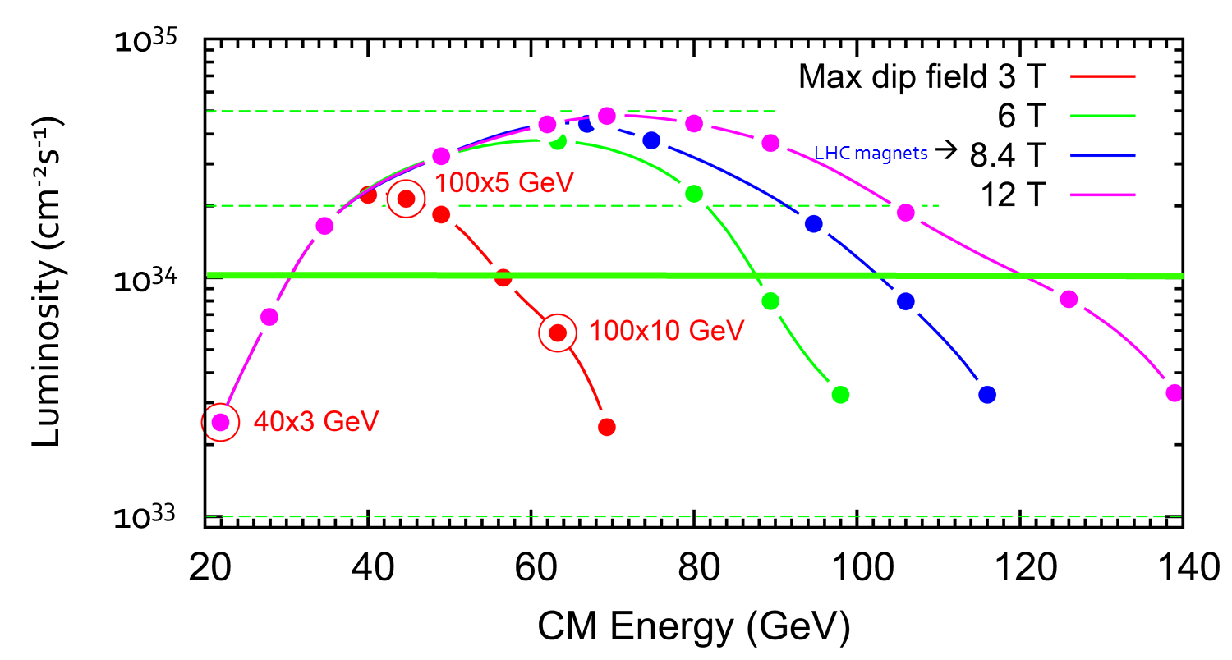
JLEIC Energy Reach and Luminosity
CM Energy (in each scenario) | Main luminosity limitation
low | space charge
medium | beam-beam
high | synchrotron radiation

Slide 7
JLEIC Parameters (3T option)
CM energy | GeV | 21.9 (low) |  | 44.7 (medium) |  | 63.3 (high)
 |  | p | e | p | e | p | e
Beam energy | GeV | 40 | 3 | 100 | 5 | 100 | 10
Collision frequency | MHz | 476 |  | 476 |  | 476/4=119
Particles per bunch | 10¹⁰ | 0.98 | 3.7 | 0.98 | 3.7 | 3.9 | 3.7
Beam current | A | 0.75 | 2.8 | 0.75 | 2.8 | 0.75 | 0.71
Polarization | % | 80% | 80% | 80% | 80% | 80% | 75%
Bunch length, RMS | cm | 3 | 1 | 1 | 1 | 2.2 | 1
Norm. emittance, hor / ver | μm | 0.3/0.3 | 24/24 | 0.5/0.1 | 54/10.8 | 0.9/0.18 | 432/86.4
Horizontal & vertical β* | cm | 8/8 | 13.5/13.5 | 6/1.2 | 5.1/1.0 | 10.5/2.1 | 4/0.8
Ver. beam-beam parameter |  | 0.015 | 0.092 | 0.015 | 0.068 | 0.008 | 0.034
Laslett tune-shift |  | 0.06 | 7x10⁻⁴ | 0.055 | 6x10⁻⁴ | 0.056 | 7x10⁻⁵
Detector space, up/down | m | 3.6/7 | 3.2/3 | 3.6/7 | 3.2/3 | 3.6/7 | 3.2/3
Hourglass(HG) reduction |  | 1 |  | 0.87 |  | 0.75
Luminosity/IP, w/HG, 10³³ | cm⁻²s⁻¹ | 2.5 |  | 21.4 |  | 5.9

Slide 8
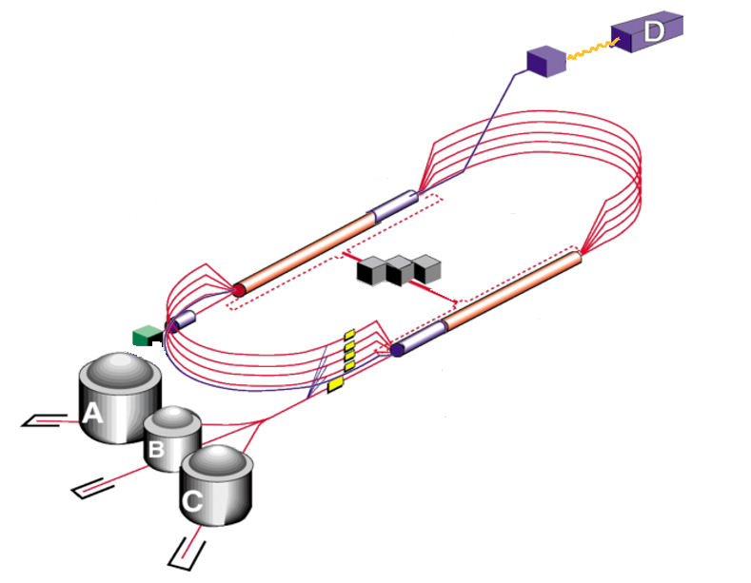
12 GeV CEBAF as Injector
Extensive fixed-target science program
  Fixed-target program compatible
  with concurrent JLEIC operations
JLEIC injector
  Fast fill of collider ring
  Full energy
  ~85% polarization
  Enables top-off
New operation mode
but no hardware
modifications
Up to 12 GeV
to JLEIC

Slide 9
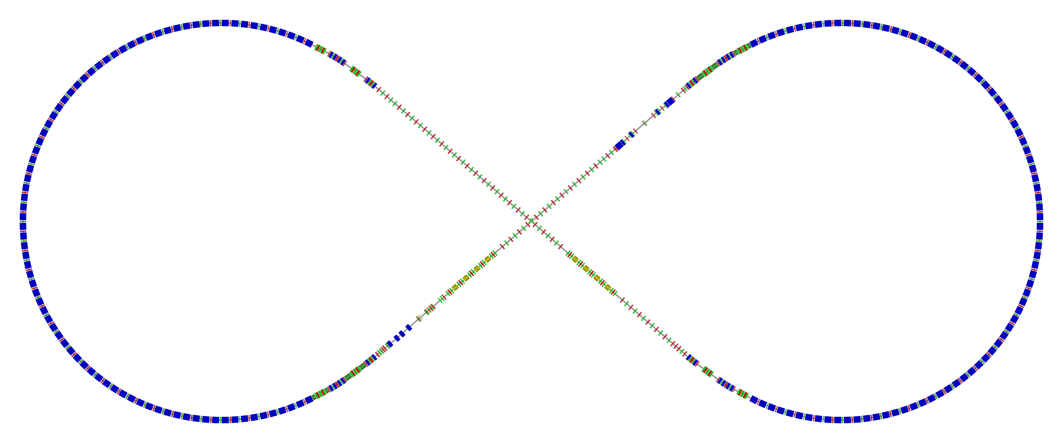
Electron Collider Ring Layout
Possible cost reduction by reusing PEP-II RF and vacuum pipe
Spin rotator
Spin rotator
CCB
Tune trombone & Straight FODOs
R=155m
81.7°
e⁻
Arc, 261.7°
Future 2nd IP
RF
RF
Spin rotator
IP
Spin rotator
Forward e⁻ detection and polarimetry

Slide 10
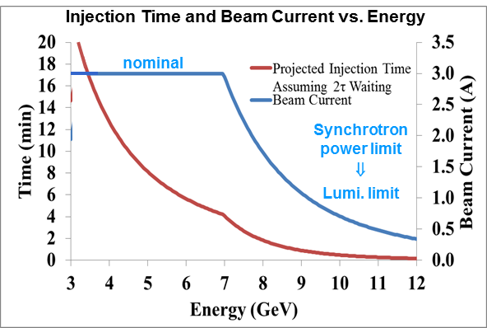
Electron Beam
Electron beam
  3 A at up to 7 GeV
  Normalized emittance
  54 µm @ 5 GeV
  Synchrotron power
  density < 10 kW/m
  Total power
  up to 10 MW

Slide 11
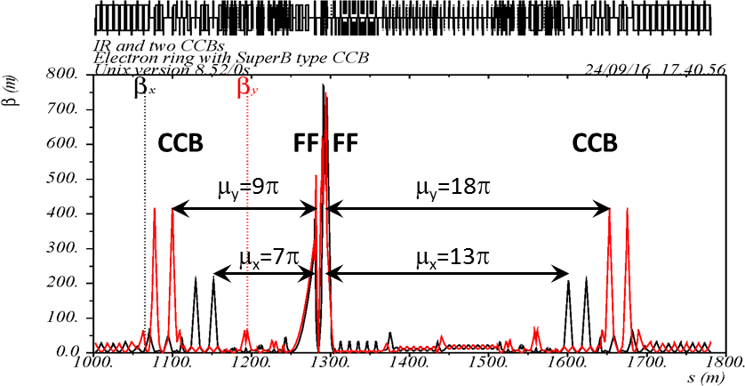
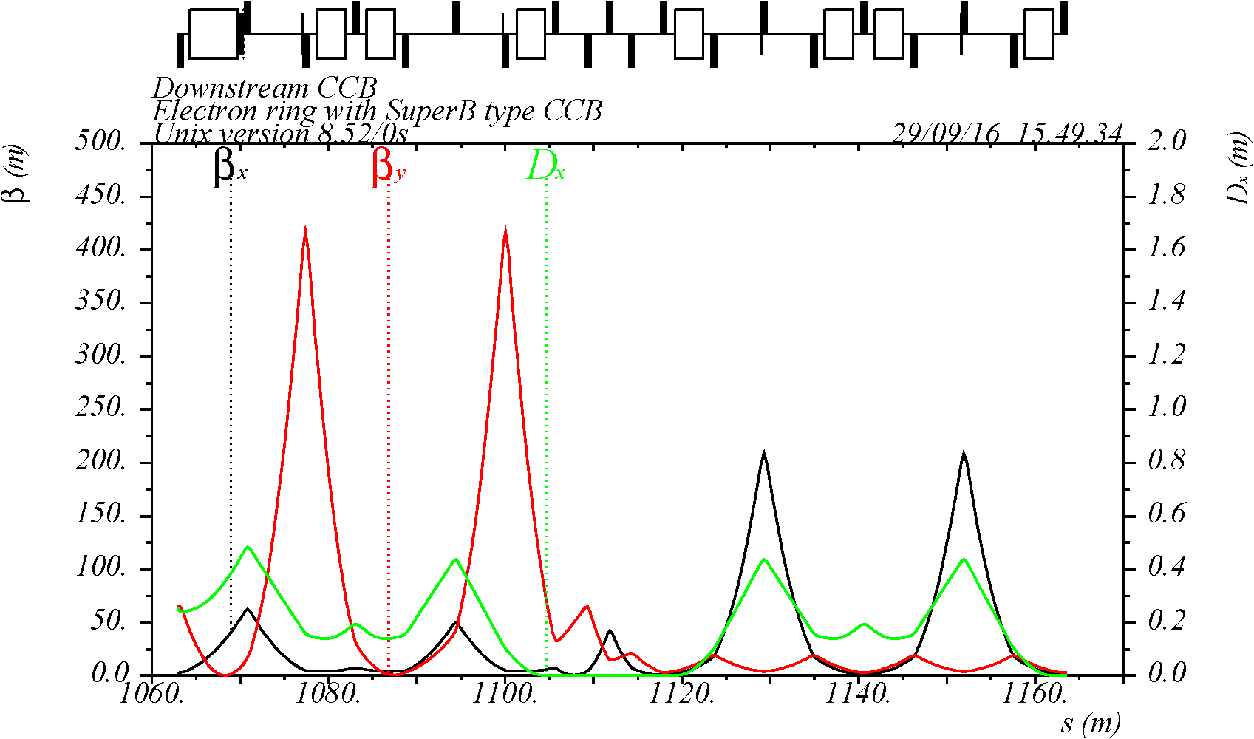
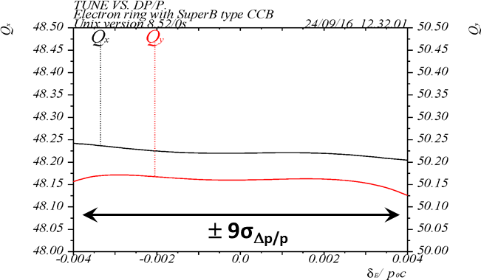
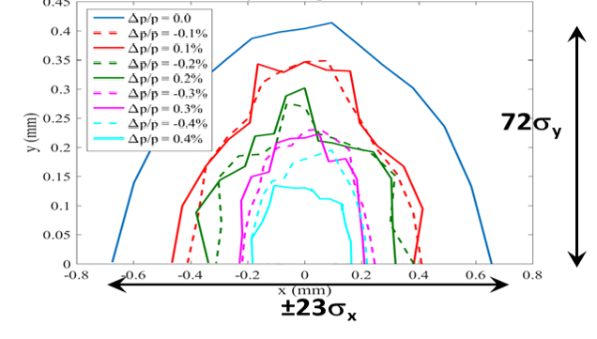
Electron Beam Dynamics
Linear optics
Momentum acceptance
Chromaticity compensation
Dynamic aperture
collaboration with SLAC

Slide 12
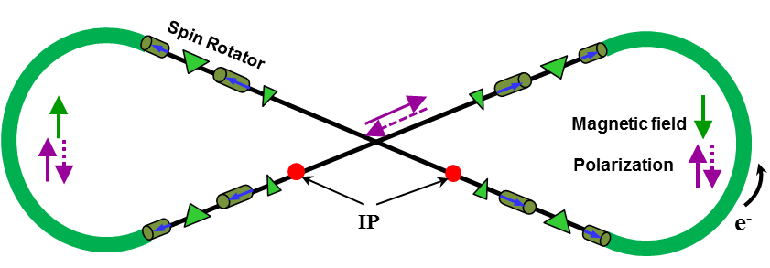
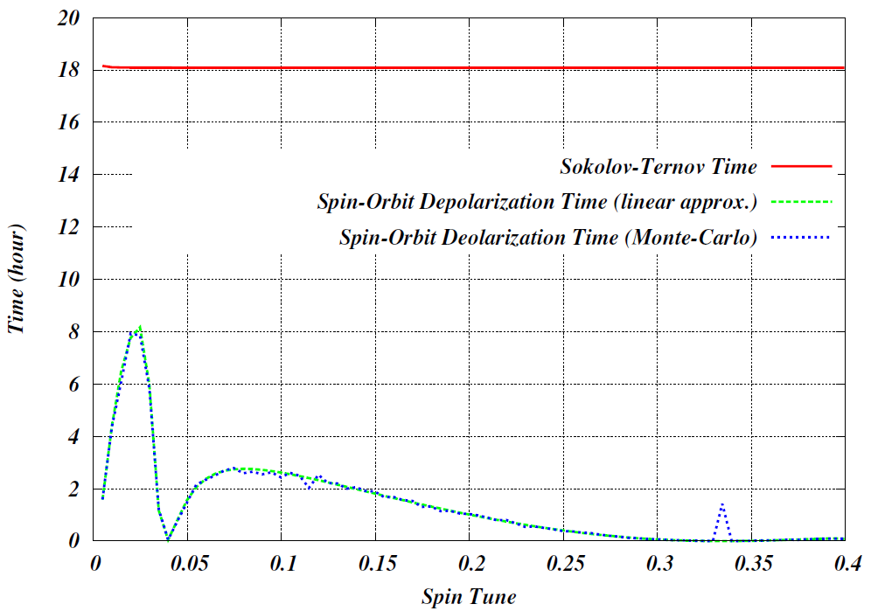
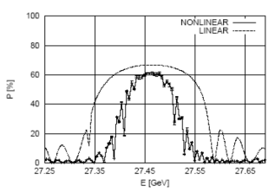
Electron Polarization
Two highly polarized bunch trains maintained by top-off
Universal spin rotator
  Sequence of solenoid
  and dipole sections
  Makes the spin
  longitudinal in the straights
  Basic spin match
  Lifetimes are the same for
  both states
Advantage of figure-8 geometry:
minimum depolarization
demonstrated by spin tracking
Optimum Spin Tune 0.0267 with a 3Tm solenoid
Energy (GeV) | 3 | 5 | 7 | 9 | 10
Lifetime (hours) | 66 | 8 | 2.2 | 0.9 | 0.3
Time (hours)
using SLICKTRACK
Spin tune

Slide 13
Ion Injector Complex Overview
Ion injector complex relies on demonstrated technologies for sources and injectors
  Atomic Beam Polarized Ion Source (ABPIS) for polarized or unpolarized light ions,
  Electron Beam Ion Source (EBIS) and/or Electron Cyclotron Resonance (ECR) ion source for unpolarized heavy ions
  Design for an SRF linac based on ANL design
  8 GeV Booster with imaginary transition energy
  Injection/extraction lines to/from Booster are designed

Slide 14
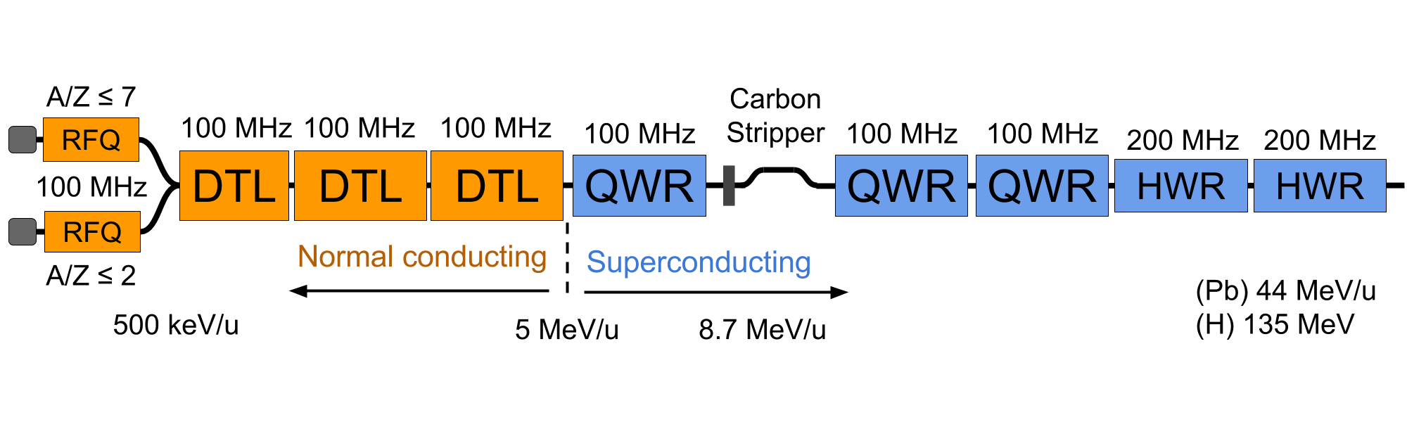

JLEIC Injector Linac Design
Two RFQs: One for light ions (A/q ~ 2) and one for heavy ions (A/q ~ 7)
  Different emittances and voltage requirements for polarized light ions and heavy ions
Separate LEBTs and MEBTs for light and heavy ions
RT Structure: IH-DTL with FODO Focusing Lattice
Stripper section for heavy-ions followed by an SRF section
Pulsed Linac: up to 10 Hz repetition rate and ~ 0.5 ms pulse length
+ 8 $×$ HWR
(Pb) 100 MeV/u
(H) 280 MeG

Slide 15

Booster
8 GeV/c Booster serves for
  Accumulation of ions injected from Linac
  Cooling
  Acceleration of ions
  Extraction and transfer of ions
  to the collider ring
Injection
  $H^{−}$ single pulse charge stripping at 285 MeV/u
  (0.22 – 0.25 ms long pulses ~180 turns)
  Phase-space painting combined with electron
  cooling for heavy ions
Design
  Circumference of 313 m
  No transition energy crossing
  Figure-8 shape for preserving
  ion polarization

Slide 16
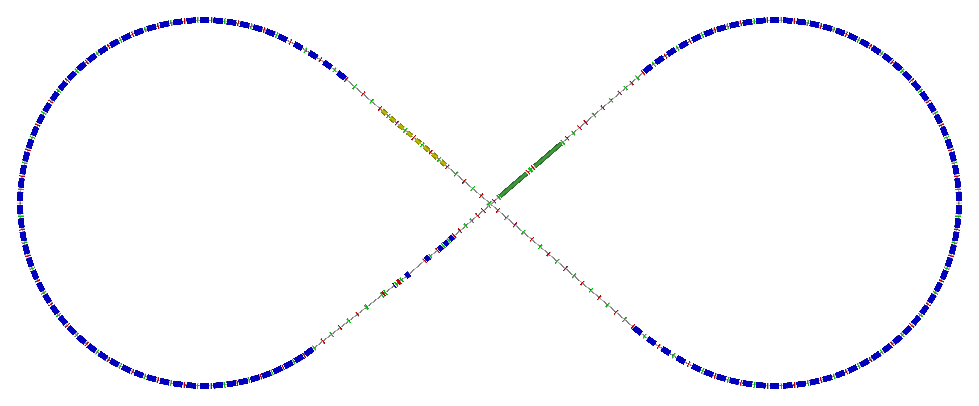

Ion Collider Ring Layout
Protons: 100 GeV/u (63 GeV/u in COM with 10 GeV e)
Lead: 40 GeV/u (40 GeV/u in COM with 10 GeV e)
Super-ferric magnets ($\cos{θ}$ under consideration as risk mitigation)
disp. supp./
geom. match #3
disp. supp./
geom. match #2
norm.+
SRF
Arc, 261.7°
elec. cool.
tune
tromb.+
match
81.7°
R = 155.5 m
future 2nd IP
Polarimeter
det. elem.
disp. supp.
ions
beam exp./
match
IP
disp. supp./
geom. match #3
disp. supp./
geom. match #1

Slide 17
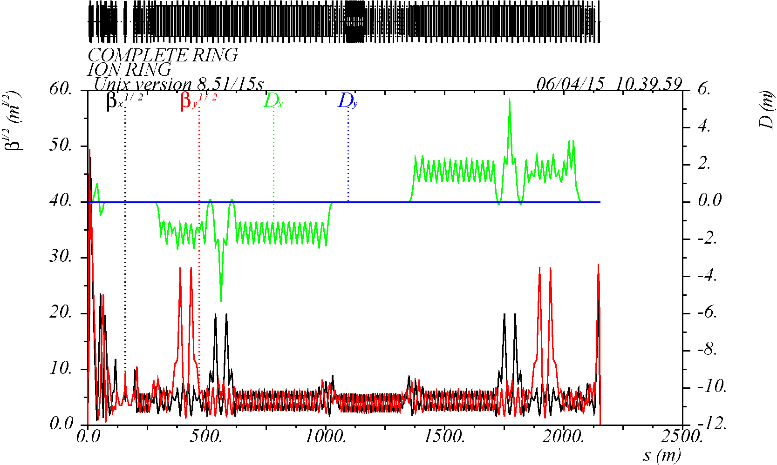
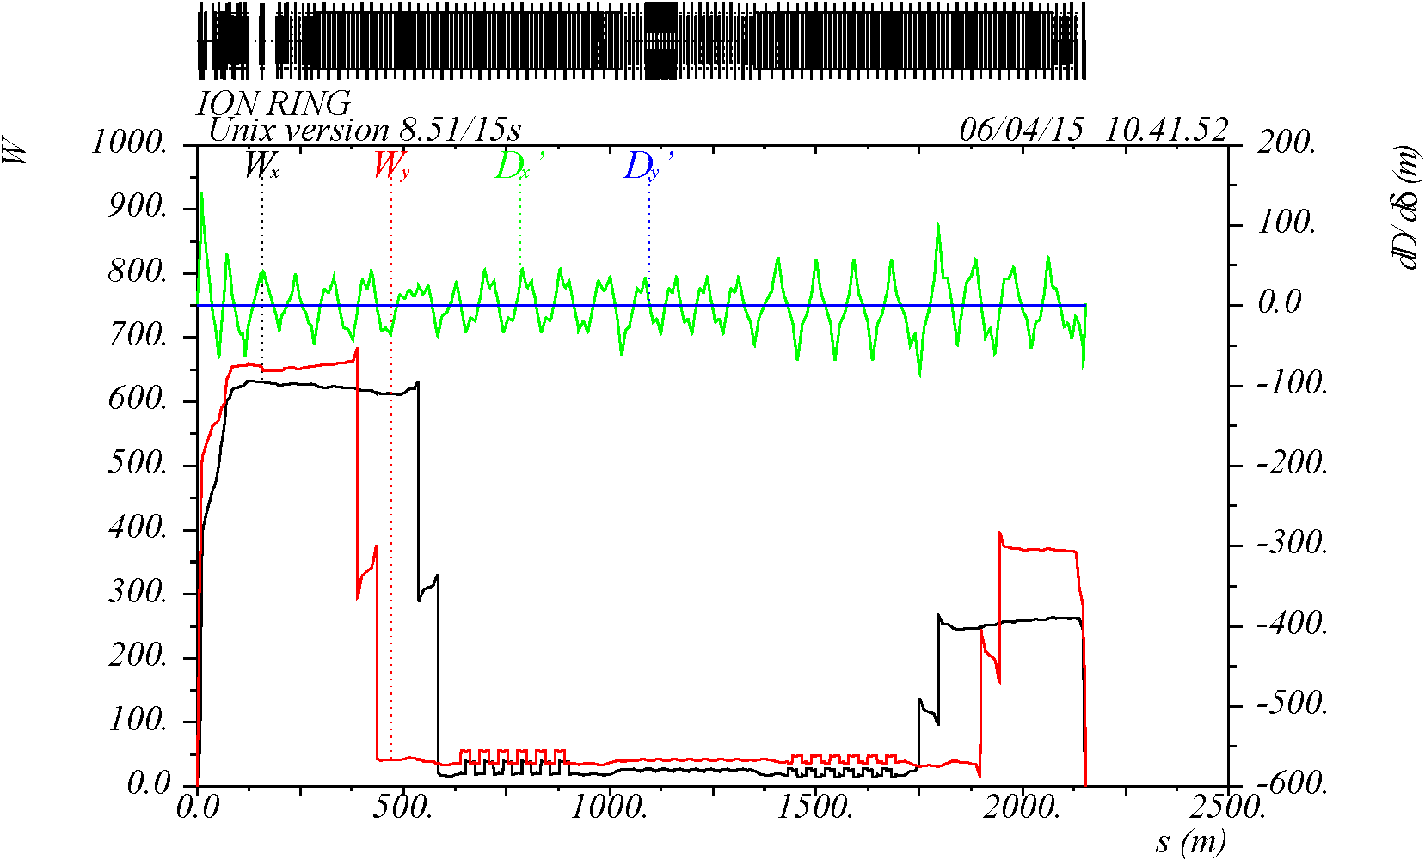
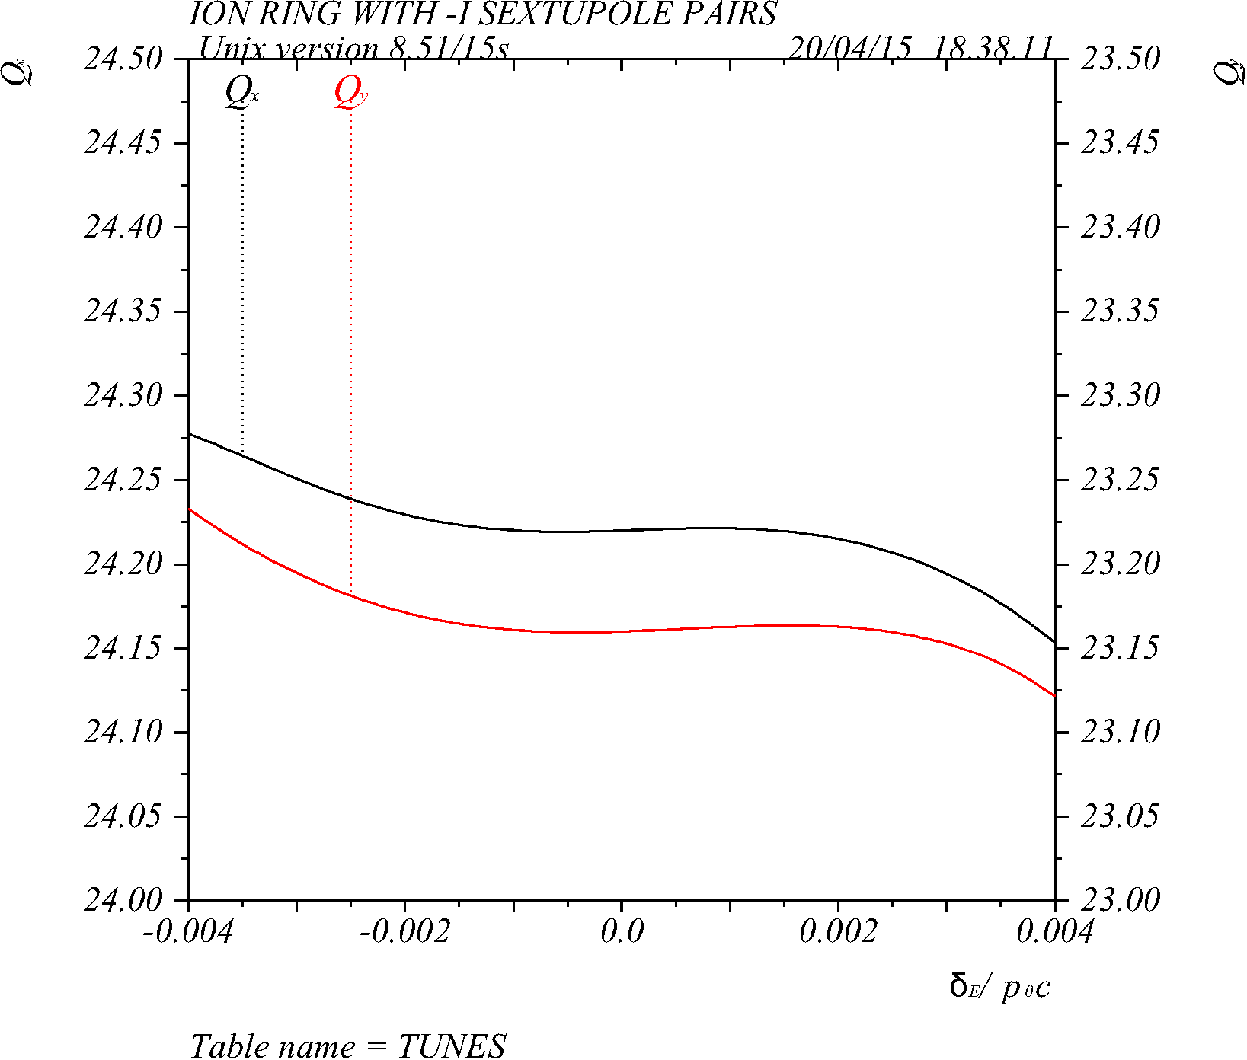
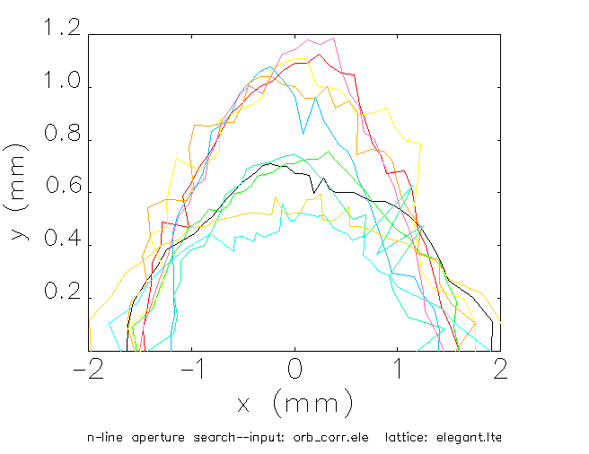
Ion Beam Dynamics
Linear optics
Momentum acceptance
Chromaticity compensation
Dynamic aperture
IP
with errors and correction
10 seeds
collaboration with SLAC
±50σ
-12 -6 0 6 12
σ_{Δp/p}

Slide 18
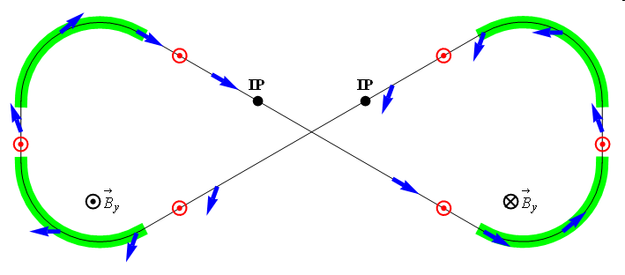
Ion Polarization
Figure-8 concept: Spin precession in one arc is exactly cancelled in the other
Spin stabilization by small fields: ~3 Tm vs. < 400 Tm for deuterons at 100 GeV
  Criterion: induced spin rotation >> spin rotation due to orbit errors
3D spin rotator: combination of small rotations about different axes provides
any polarization orientation at any point in the collider ring
No effect on the orbit
Polarized deuterons
Frequent adiabatic spin flips
ν = 0

Slide 19
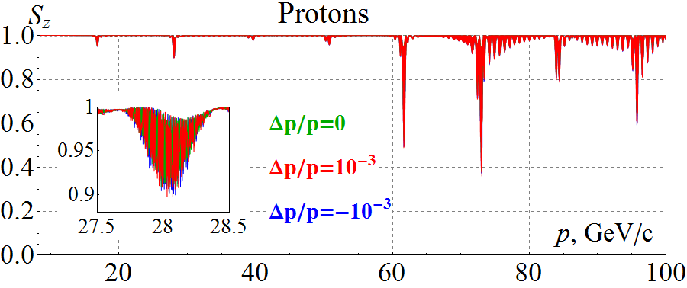
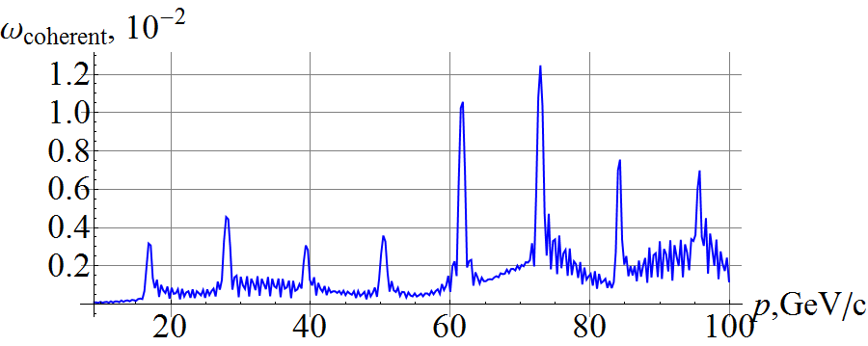
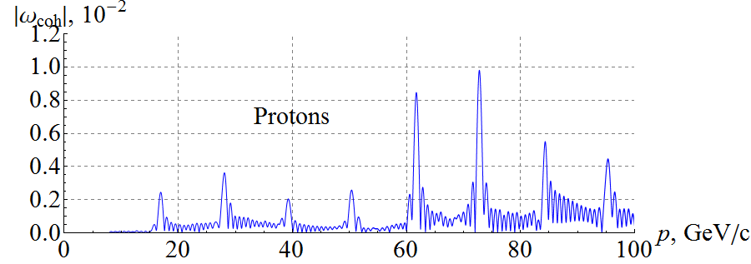
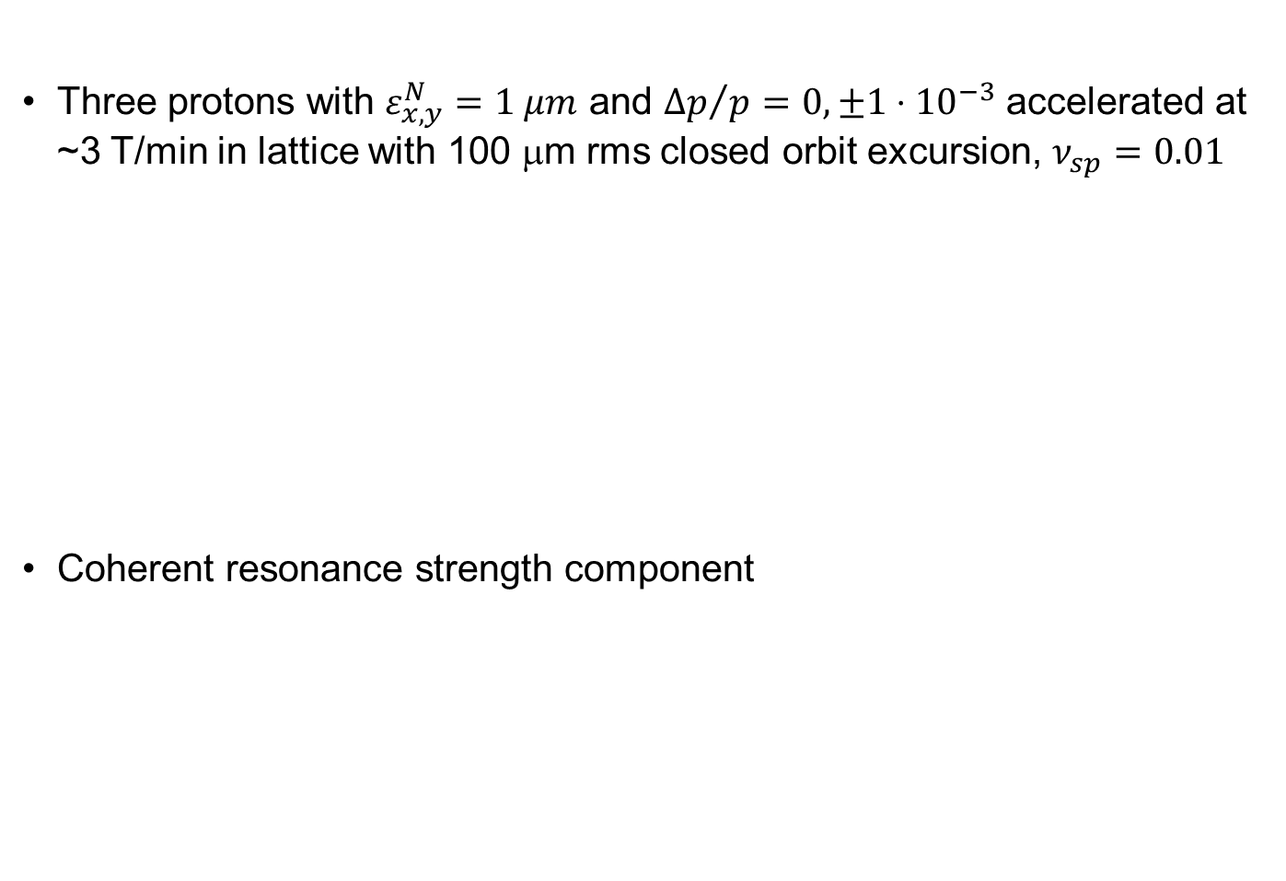
Start-to-End Proton Acceleration in Ion Collider Ring
Three protons with $ε_{x,y}^{N}=1 μm$ and ${Δp}/p=0, ±1⋅{10}^{−3}$ accelerated at
~3 T/min in lattice with 100 μm rms closed orbit excursion, $ν_{sp}=0.01$
Coherent resonance strength component
Zgoubi
simulation
Analytic prediction
Zgoubi simulation

Slide 20
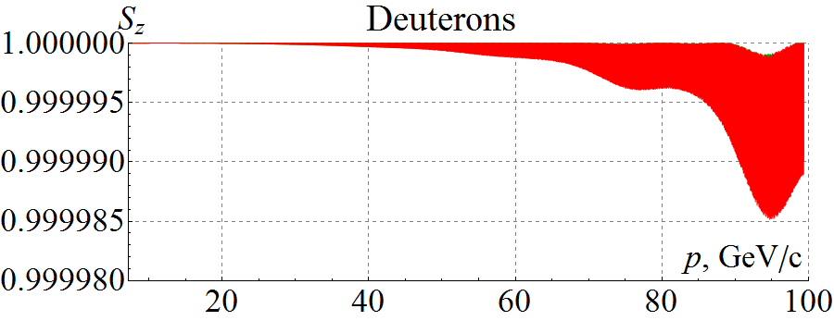
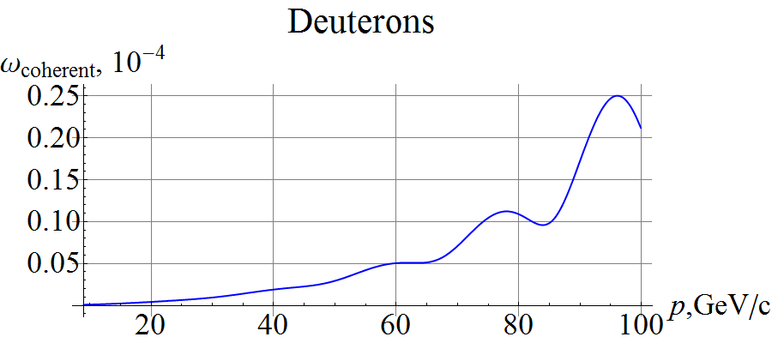
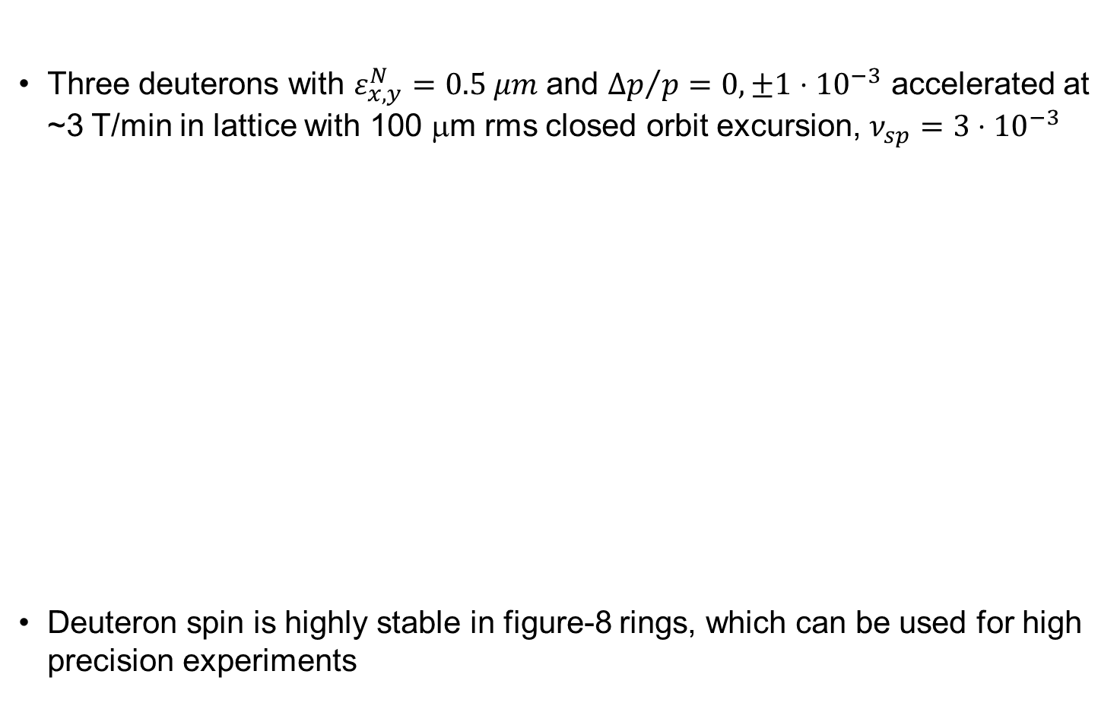
Start-to-End Deuteron Acceleration in Ion Collider Ring
Three deuterons with $ε_{x,y}^{N}=0.5 μm$ and ${Δp}/p=0, ±1⋅{10}^{−3}$ accelerated at ~3 T/min in lattice with 100 μm rms closed orbit excursion, $ν_{sp}=3⋅{10}^{−3}$
Deuteron spin is highly stable in figure-8 rings, which can be used for high precision experiments
(Zgoubi simulation)
Analytic prediction

Slide 21
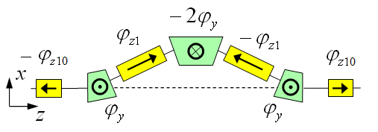
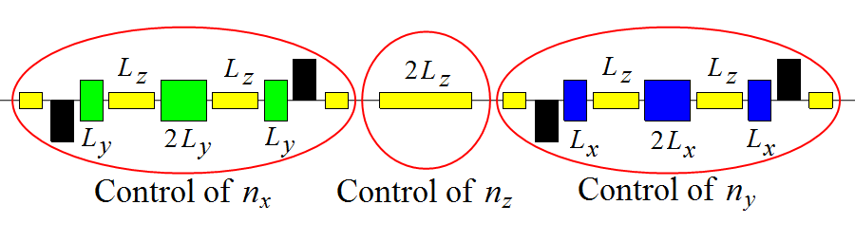
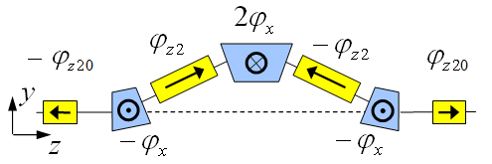
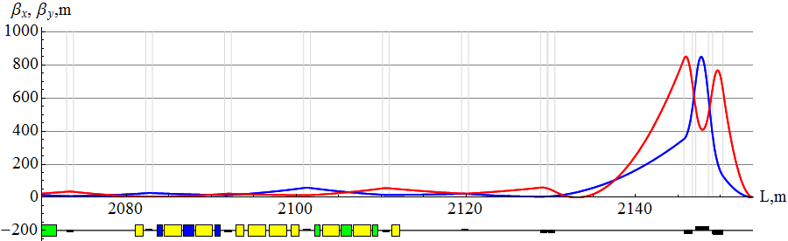

3D Spin Rotator in Ion Collider Ring
Provides control of the radial, vertical, and longitudinal spin components
Module for control of the radial component (fixed radial orbit bump)
Module for control of the vertical
component (fixed vertical orbit bump)
Module for control of the longitudinal
component
3D spin rotator
IP
ions

Slide 22
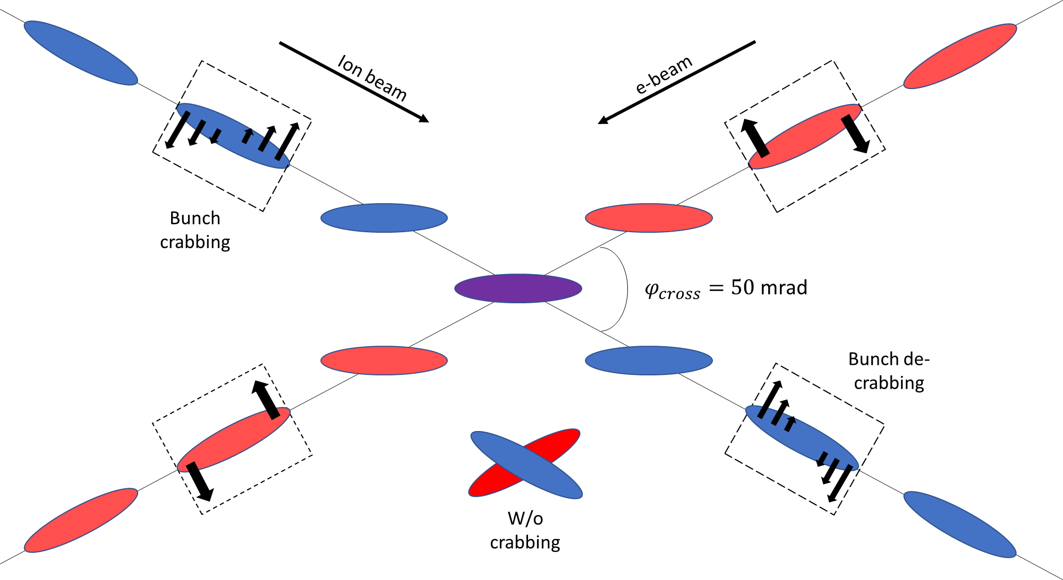
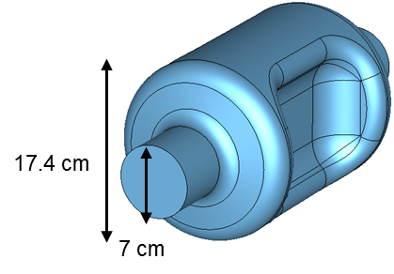
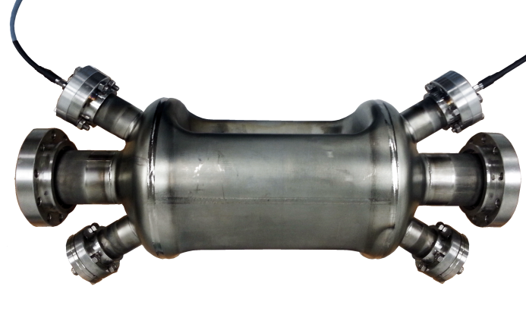
Crab Crossing
Electron and ion beams have to cross at an angle in an EIC
  Create space for independent electron and ion IR magnets
  Avoid parasitic collisions of shortly-spaces bunches
  Improves detections
  Improves detector background
Without compensation, geometric luminosity loss is about a factor of 12 and there is potential for dynamic instabilities
Crabbing restores effective head-on collisions
Local compensation scheme
  Set of crab cavities upstream and
  downstream of IP
Deflective crabbing
  Demonstrated at KEK-B
  Being tested with ions at LHC
  Prototype developed at ODU

Slide 23
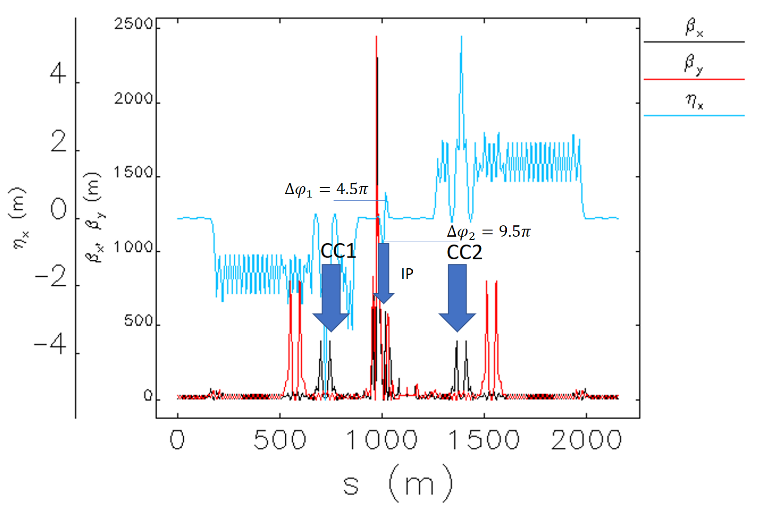
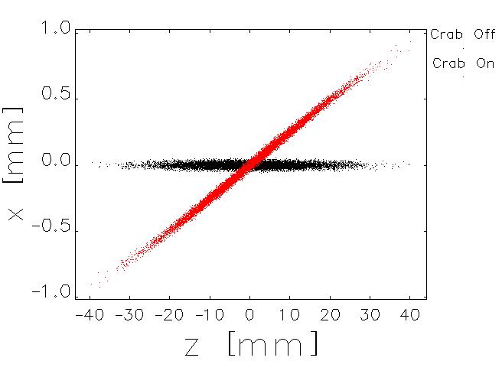
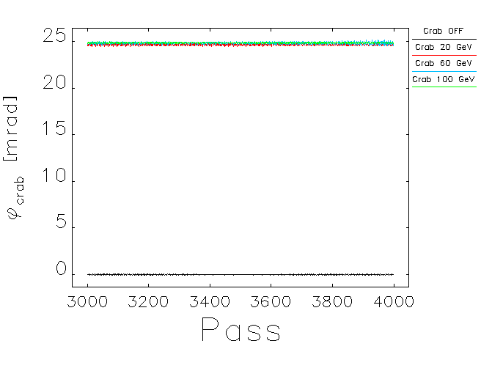

Crab Crossing Scheme of JLEIC
Locations of horizontal chromatic sextupoles are also adequate for crab cavities:
  Right phase advance
  High $β_{x}$ values
Found that sextupoles between crab cavities may lead to emittance increase, avoid them
Dispersion at the crab cavities satisfies the beam stability criterion
Parameter | Unit | Proton
Energy | GeV | 100
Frequency | MHz | 952.6
Crossing angle | mrad | 50
β* | cm | 10
β_{x} @ crab cavity location | m | 363
Crab voltage | MV | 20.8
Beam parameters
# of particles | 500
ε_{nx} | 0.35 μm
Δp/p | 3∙10⁻⁴
σ_{s} | 1 cm
Gaussian distribution 3σ

Slide 24
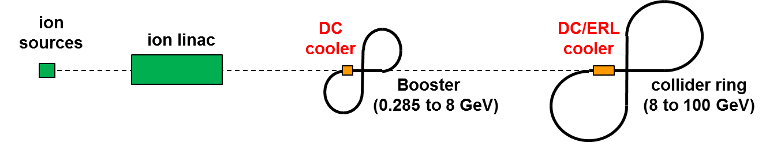
Multi-Step Cooling Scheme
Cooling of JLEIC proton/ion beams for
  Achieving small emittance (~10x reduction)
  Reaching short bunch length ~1 cm (with SRF)
  Suppressing IBS induced emittance degradation
Pre-cool when energy is low
Cool when emittance is small
(after pre-cool at low energy)
Ring | Functions | Kinetic energy (GeV / MeV) |  |  | Cooler type
 |  | Proton | Lead ion | Electron
booster ring | Accumulation of positive ions |  | 0.1 (injection) | 0.054 | DC
collider ring | Maintain emitt. during stacking | 7.9 (injection) | 2 (injection) | 4.3 (proton) 1.1 (lead) | DC
 | Pre-cooling for emitt. reduction | 7.9 (injection) | 7.9 (ramp to) | 4.3 | DC
 | Maintain emitt. during collision | Up to 100 | Up to 40 | Up to 54.5 | ERL
Can’t reduce emittance due to space charge limit
Pre-cooling both protons and lead ions
ERL cooler can’t reach energy below 20 MeV

Slide 25
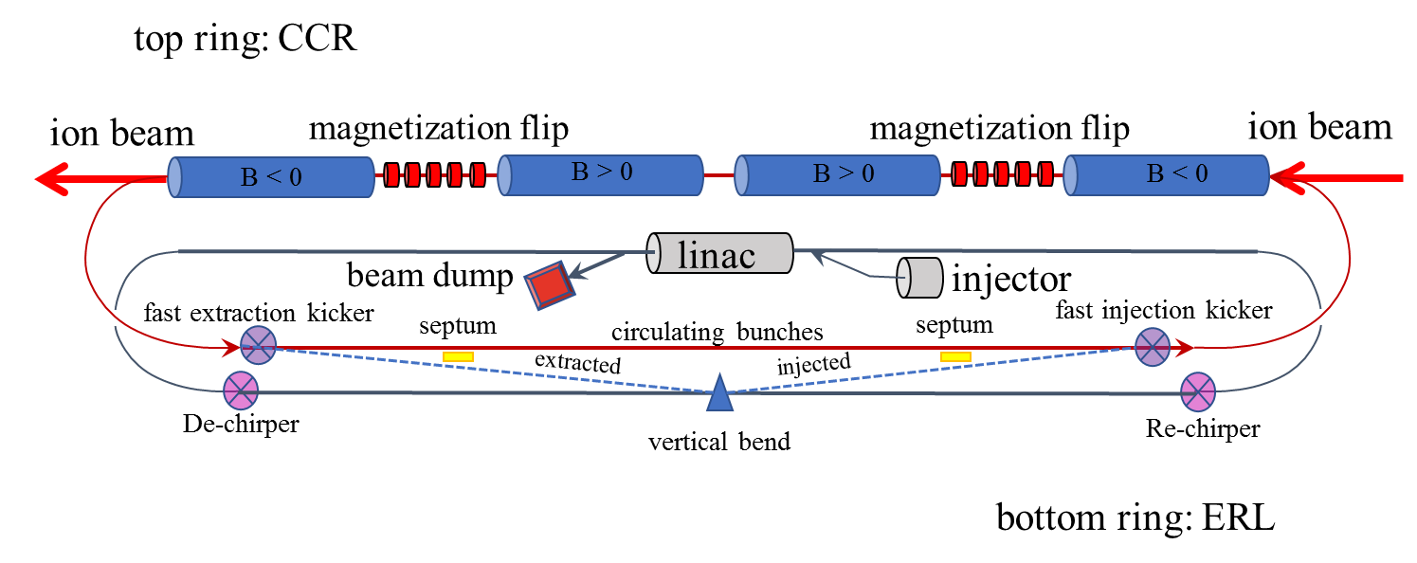
Cooling Ring Fed by ERL
Same-cell energy recovery in 952.6 MHz SRF cavities
Uses harmonic kicker to inject and extract from CCR (divide by 11)
Assumes high charge, low rep-rate injector (w/ subharmonic acceleration and bunching)
Use magnetization flips to compensate ion spin effects

Slide 26





Interaction Region Concept
Possible to get ~100% acceptance for the whole event
Central Detector/Solenoid
Ion beamline
Scattered Electron
Electron beamline
Dipole
Dipole
Forward (Ion) Detector
Particles Associated
with struck parton
Particles Associated
with Initial Ion

Slide 27
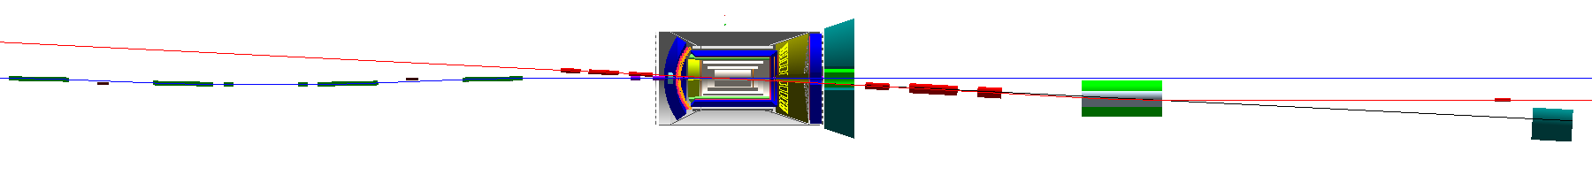
Detector Region
Integrated detector region design developed satisfying requirements of detection, beam dynamics and geometric match
GEANT4 detector model developed, simulations in progress
IP
e
Compton polarimetry
forward ion detection
ions
forward e detection
spectrometers
dispersion suppressor/
geometric match
p
(top view in GEANT4)
e
low-Q² electron detection
and Compton polarimeter
Forward hadron spectrometer
ZDC

Slide 28
Conclusion
JLEIC conceptual design is nearly complete
Key features:
  High luminosity
  High polarization
  Full-acceptance detection
Current work
  Key R&D
  Completion of consistent design
  Performance and cost optimization
  Evaluation of engineering challenges
  Completion of a pre-CDR

