Slide 1

eRHIC
BNL’s Electron Ion collider
E.C. Aschenauer
for the BNL EIC Design Team
Electron Ion Collider - eRHIC

Slide 2
Requirements from Physics
The Inner Secrets of Nucleons and Nuclei:
Increasing Energy
large kinematic coverage:
access to x and Q² over a wide range → √s: 20 – 140 GeV
polarized electron and hadron (p,d,He-3) beams:
access to spin structure of nucleons and nuclei
Spin vehicle to access the spatial and momentum structure of the nucleon in 3d
Full specification of initial and final states to probe q-g structure of NN and NNN
interaction in light nuclei
nuclear beams: D to U
accessing the highest gluon densities → saturation
high luminosity 10³³⁻³⁴ cm⁻²s⁻¹:
mapping the spatial and momentum structure of nucleons and nuclei in 3d
access to rare probes

Slide 3
eRHIC Design Concept
Design aims to meet the goals formulated in the EIC WHITE PAPER
eRHIC is based on the RHIC complex: Storage ring (Yellow Ring), injectors, ion sources, infrastructure, which need only relatively few modifications and upgrades
Todays RHIC beam parameters are close to what is required for eRHIC (except number of bunches and 40% higher beam current)
A (5-18) GeV electron storage ring & its injectors are added to the RHIC complex
→ E_{cm} = (29-141) GeV
Design is optimized under the assumption that each beam will have the parameters (in particular beam-beam tune shift) as has been demonstrated in collisions between equal species
The requirement to store electron beams with a variable spin pattern requires an on-energy, spin transparent injector.
Polarized electron source and 400 MeV injector linac: 10nC, 1 Hz
The total power of synchrotron radiation of the electron beam is assumed to be limited to 10 MW. This is a design choice.

Slide 4
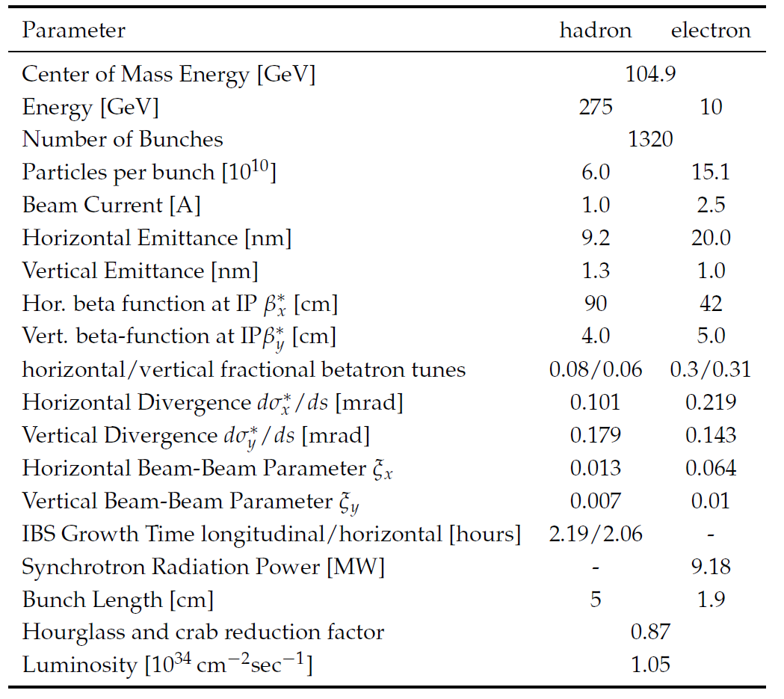
Maximum Luminosity Parameters
High beam currents
Many bunches
Large beam-beam tune-shift
Flat beams
Need strong hadron cooling
Short hadron bunches
22 mrad crossing angle with crab cavities
→ Large Luminosity

Slide 5
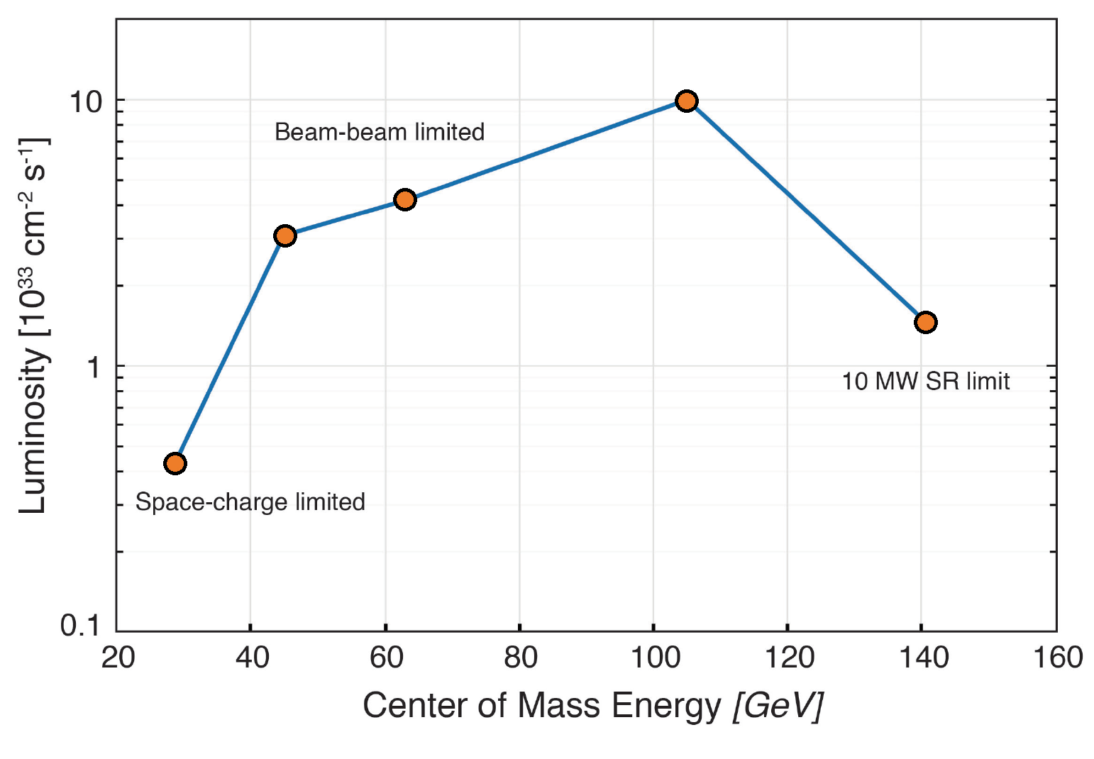
Luminosity versus Center of Mass Energy

Slide 6
Infra-Structure
6 snakes, polarimeter Feedback Diagnostics
eRF,
Cold p RF
Cooling
Beam dump
e-Injection
p-instrumentation
eRHIC Layout
h-warm RF,
h-injection
Detector
IR magnets
Crab Cav.
Spin rotators
Detector
IR magnets
Cab cavities
Spin rotators

Slide 7
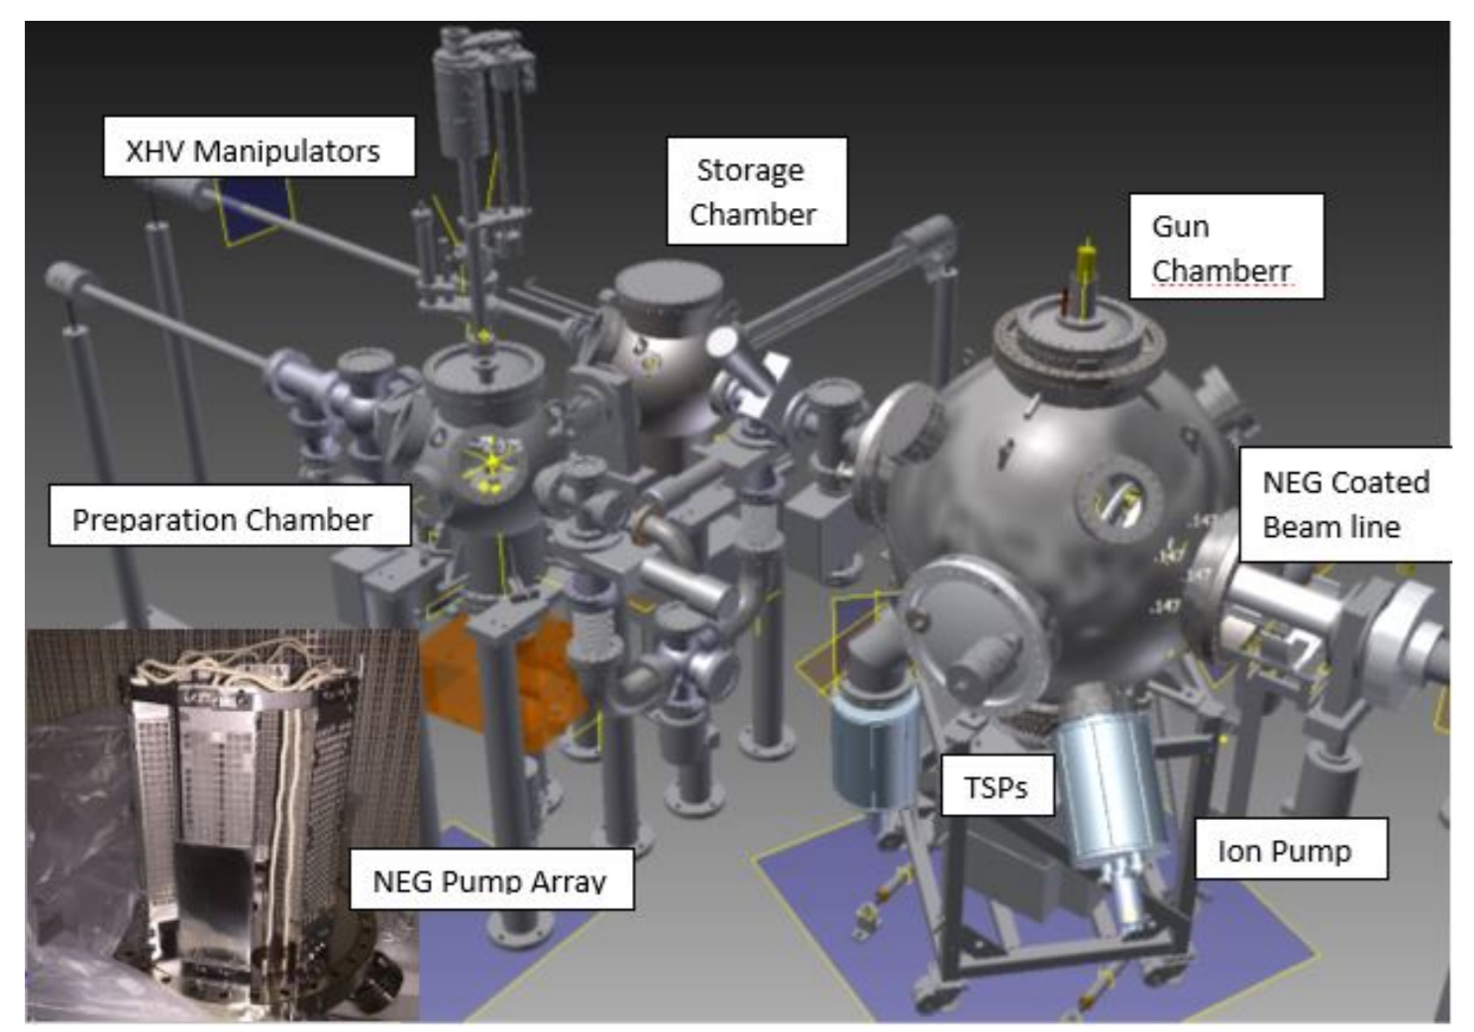
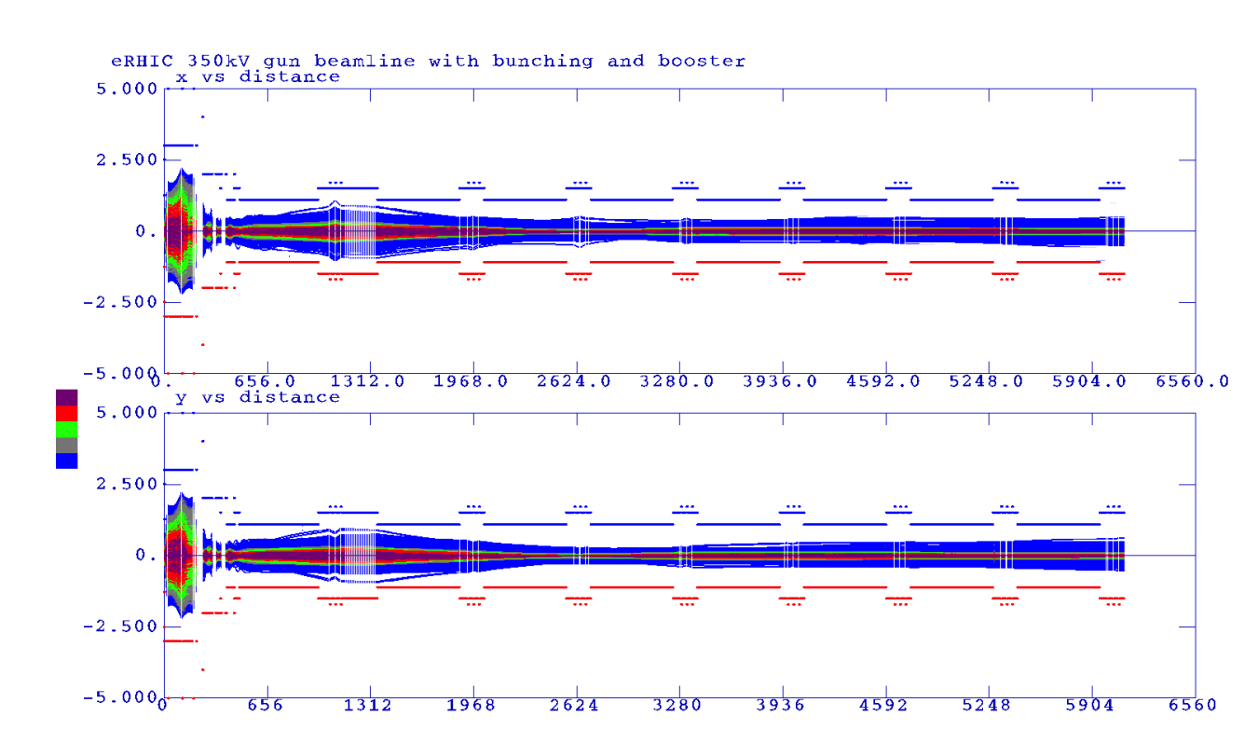
Polarized Electron Source
Need to provide 10 nC of polarized electrons/second
SLAC Gun with 16 nC 150 Hz operation is the existence proof
eRHIC polarized gun is based on the JLAB inverted gun
The gun, low energy beamline
Design and design verified by PIC beam dynamics simulations
400 MeV injector linac will be a SLAC type s-Band linac.
Beam transport simulated and found to be ok for eRHIC beams.
Wien filter, polarimeter design already in fairly large detail

Slide 8
High Electron Polarization and Injector Requirements
The accelerator technology to achieve high polarization at high energies includes:
fully polarized injector
highly efficient orbit correction
beam-based alignment of BPMs relative to quad centers
harmonic spin matching
well controlled betatron coupling
spin matching of spin rotator insertion
eRHIC
Beam polarization requirement calls for full energy injector :
Need to store bunches with 85% initial polarization with spin parallel ↑ ↑ and spin antiparallel ↑↓ to guide field in the arc.
Need to replace bunches with parallel spin ↑ ↑ with a rate of up to 1/(5 minutes) because of Sokolov-Ternov Depolarization (defines the injection chain)
Sokolov-Ternov self-polarization time vs. energy

Slide 9
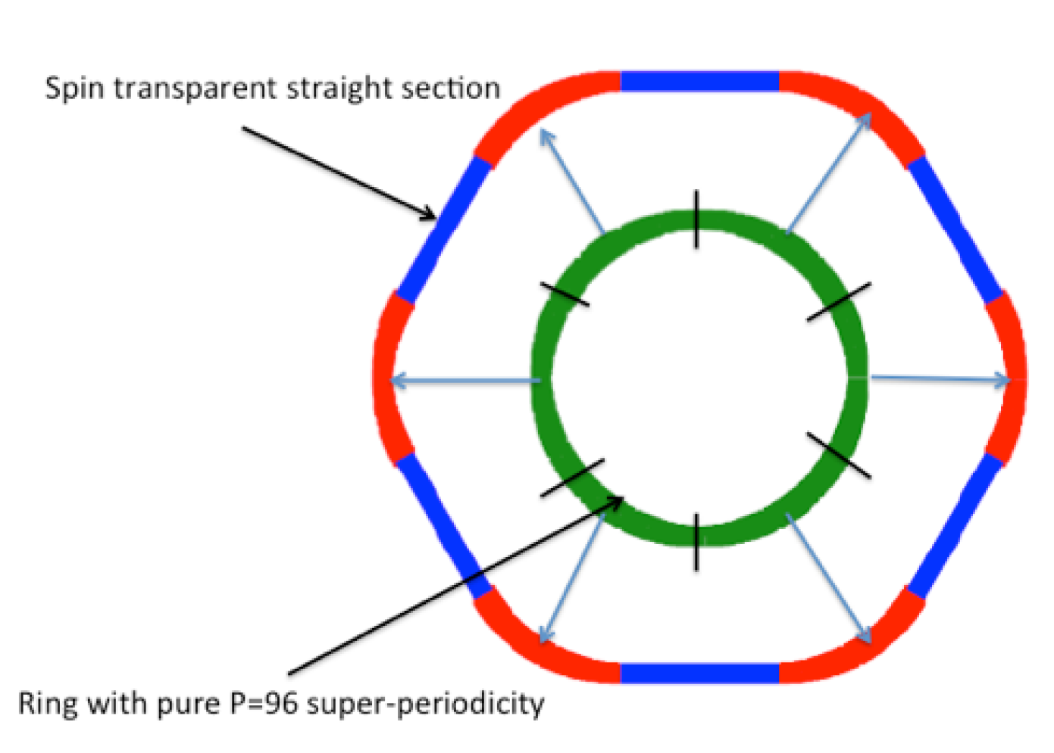
Rapid Cycling Synchrotron Polarization
Highly symmetric arcs (16 cells/sextant) connected by spin transparent straight sections (unity beam transport matrix) or detector bypasses
100 ms ramp from 400 MeV to 18 GeV; 1Hz ramp repetion rate
So far no problems for spin are seen for simula5ons using significant misalignment and magnet errors
v_{sp} (18 GeV) ~ 40.9; [Q_{y}] = 50, betatron tune (arcs only)
96-Q_{y} > ν_{sp} and Q_{y} > v_{sp} :
Strong spin resonances are eliminated.
Fast crossing of weak spin resonances.
Spin Transparency Simulation

Slide 10
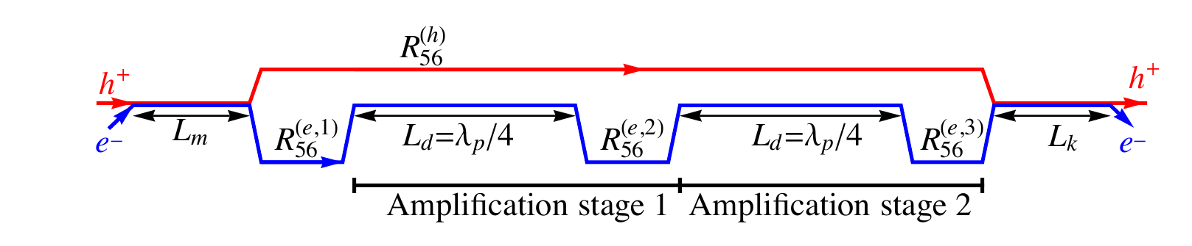
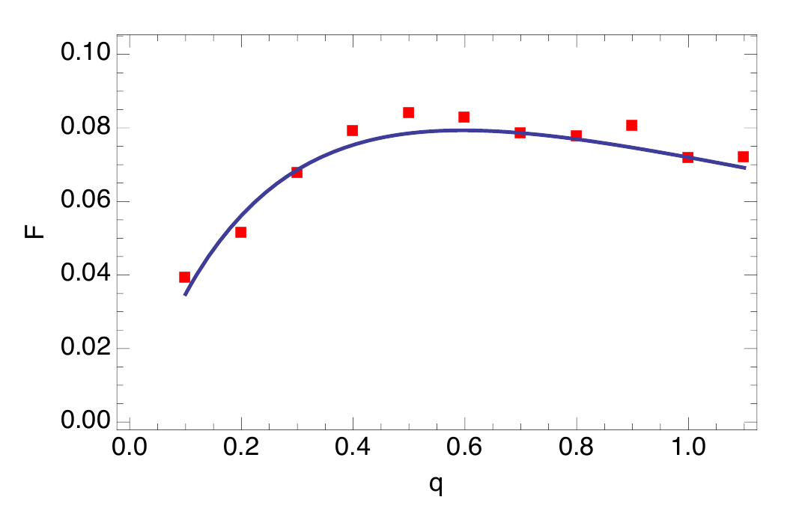
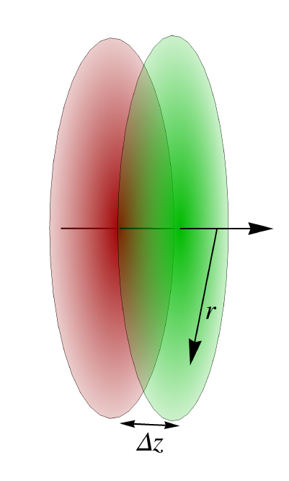
Strong Hadron Cooling
Several methods of strong hadron cooling have been studied.
The most promising approach up to this point is micro-bunched electron beam cooling with 2 plasma amplification stages.
Achievable cooling rates with 100 mA electron current and flat beams
are in the order of 1 h which would
be sufficient for eRHIC.
Analytical calculation of the
cooling rate agrees well with
simulations within the 1-D model.

Slide 11
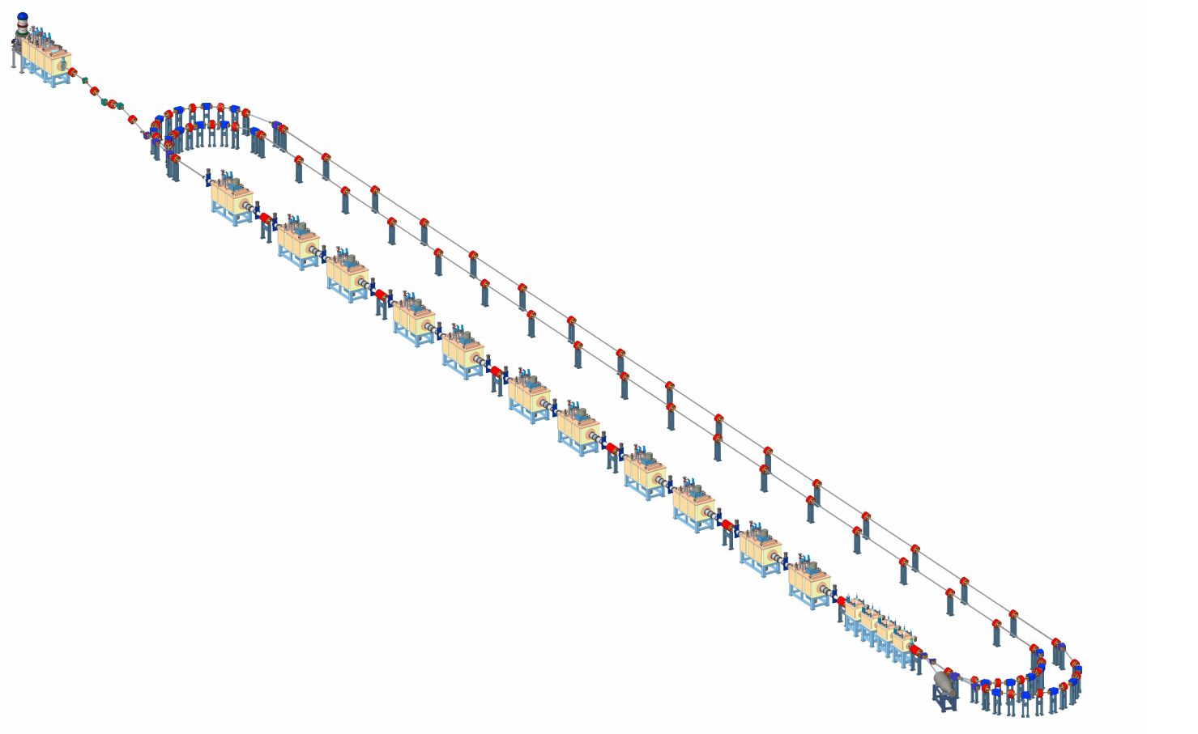
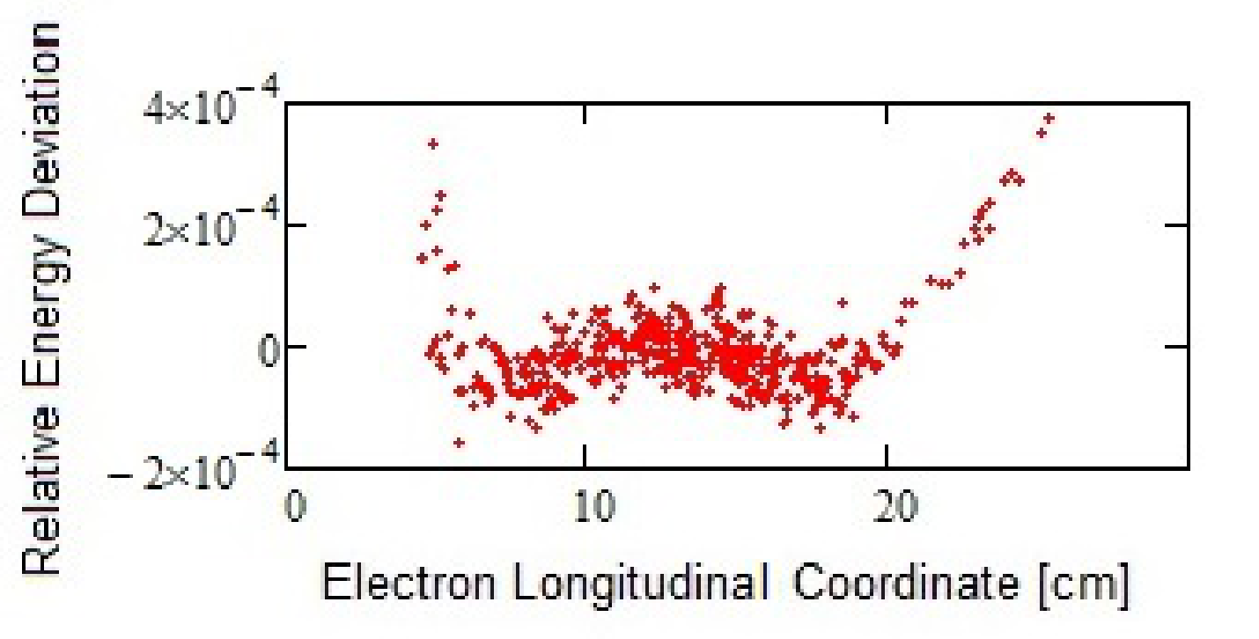
Hadron Cooling
A preliminary layout of the cooler facility, based on a 3-turn ERL with 567 MHz cavities

Slide 12
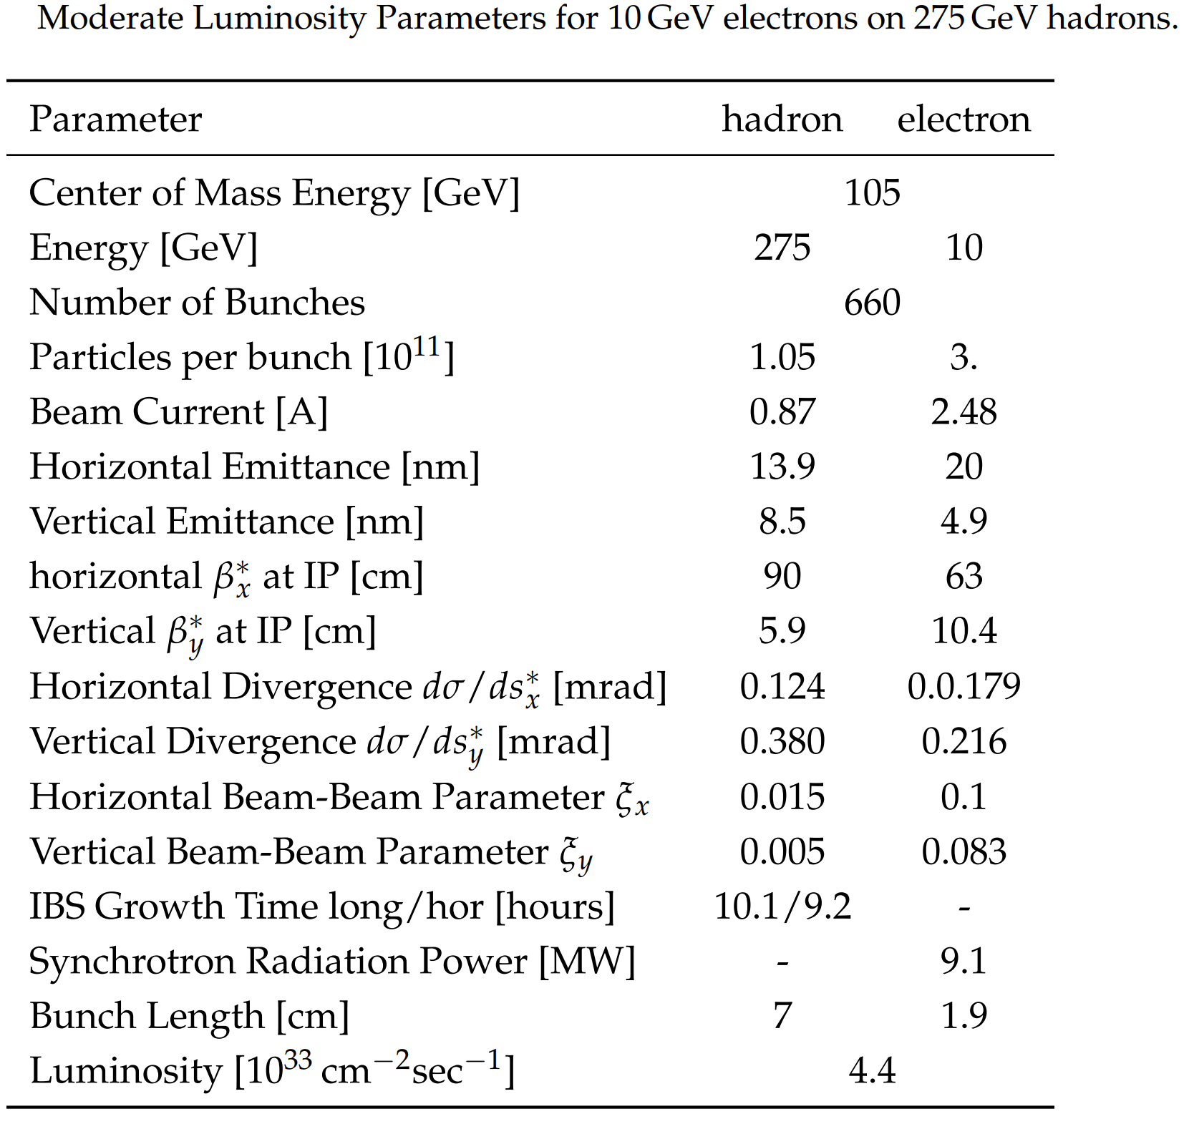
Mitigation of Strong Hadron Cooling Risk
Solution with L = 0.44·10³⁴cm⁻²s⁻¹ and hor., long IBS growth rates of 10,9 h

Slide 13


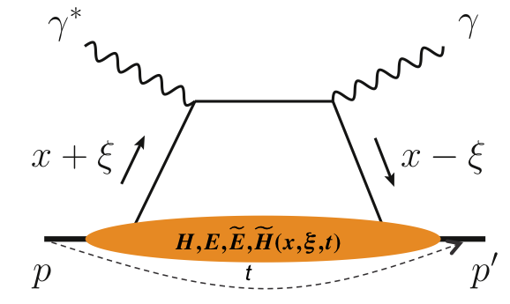
IR Requirements from Physics
inclusive DIS
critical to detect
scattered electron
with high precision
semi-inclusive DIS
detect the scattered
lepton and final state
exclusive processes
all particles in the
event need to be
measured
 | Hadron | Lepton
Machine element free region | +/- 4.5 m main detector beam elements < 1.5º in main detector volume
Beam pipe | Low mass material i.e. Beryllium
Low Q² tagger |  | Acceptance: Q² < 0.1 GeV
Zero Degree Calorimeter | 40 cm x 40 cm x 1m @30 m
scattered proton/neutron acc. all energies for ep | Proton: 0.18 GeV < p_{t} < 1.3 GeV Neutron: p_{t} < 1.3 GeV
scattered proton/neutron acc. all energies for eA | Proton and Neutron: Θ < 6 mrad (√s=50 GeV) Θ < 4 mrad (√s=100 GeV)
Integration of detectors | Local polarimeter
Luminosity | Relative Luminosity: R = L^{++/--}/L^{+-/-+} < 10⁻⁴
 |  | γ acceptance: +/- 1 mrad → δL/L < 1%

Slide 14
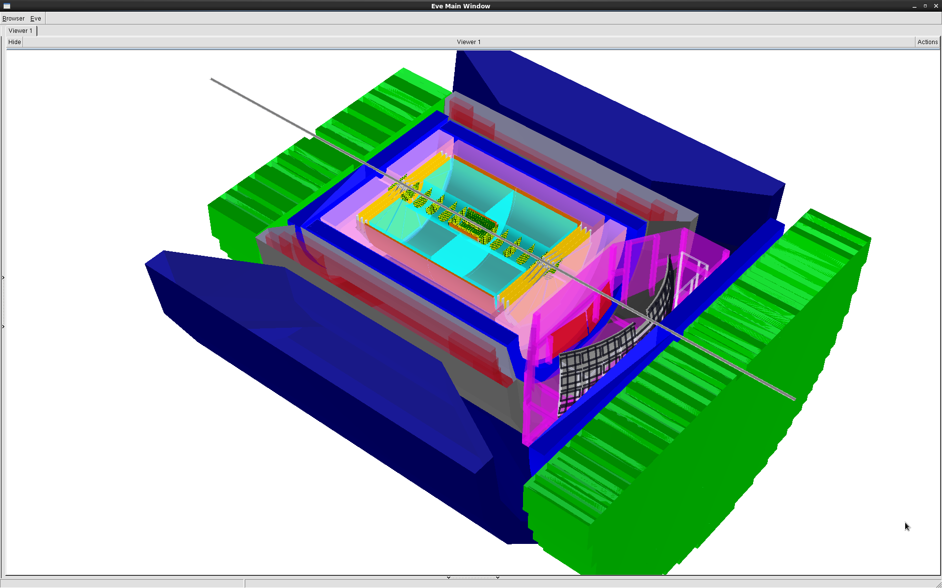
Beam Component free Region
-4<η<4: Tracking & e/m Calorimetry (hermetic coverage)
hadronic calorimeters
e/m calorimeters
RICH detectors
9.0m
Hadron PID:
-1<η<1: proximity focusing
RICH + TPC: dE/dx
1<η<3: Dual-radiator RICH
-1<η<-3: Aerogel RICH
Lepton-ID:
-3 <η< 3: e/p
1<|η|<3: in addition HCal response
& γ suppression via tracking
|η|>3: ECal+Hcal response &
γ suppression via tracking
-4<η<4: Tracking (TPC+GEM+MAPS)
A detector fully optimized for DIS needs at least +/- 4.5 m
A rapidity coverage: -4<η<4 → 2º < Θ < 178º
hadrons
electrons
silicon trackers
TPC
GEM trackers
3T solenoid coils
MAPS: CMOS Monolithic Active Pixel Sensors

Slide 15
Very forward scattered particles
Very forward scattered particles critical to detect for elastic/diffractive physics
Not detectable in main detector
Proton
Breakup Neutrons
Au
Requirement:
Need +/- 4 mrad beam element free
cone before the zero degree calorimeter
to detect the breakup neutrons from
heavy Ions
No nuclear dependence for heavy A
these neutrons are also critical to
reconstruct collisions geometry
peripheral to central arXiv:1407.8055
  precision neutron energy
  transv. size of ZDC
Note:
Main Detector: starts at 35 mrad
Full p_{T} coverage of proton critical for physics
p_{T} = p’_{L} sin(Θ) p’_{L} > 97% of p_{Beam}
0.65 < Θ (mrad) < 10 → 0.18 GeV < p_{t} < 1.3 GeV
small p_{T}-acceptance limited by
beam divergence and emittance
  rule of thumb keep 10σ between
  Roman Pot and beam
large p_{T}-acceptance limited by magnet
apertures

Slide 16
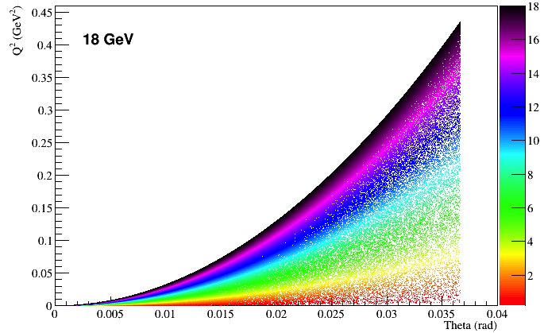
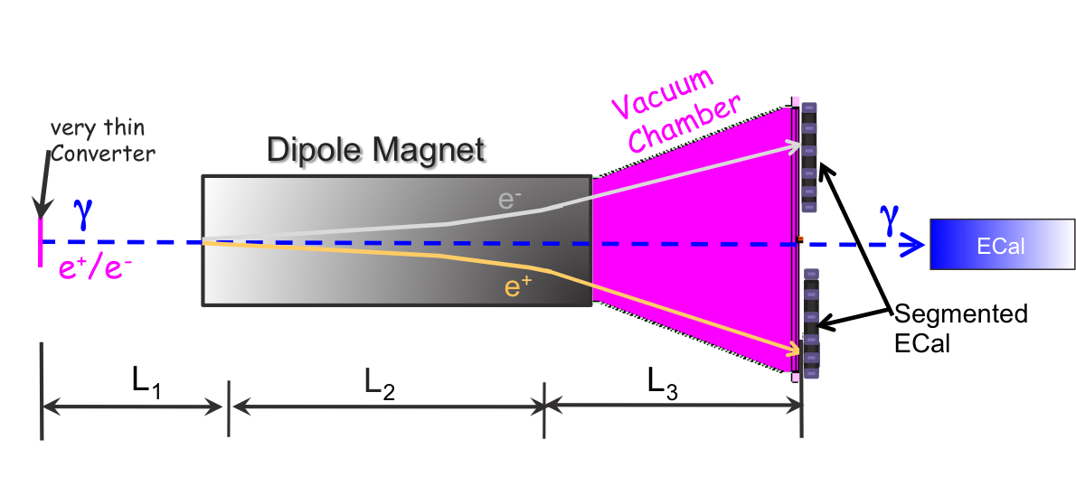
Requirements for Lepton Beam
Low Q² - Tagger
Luminosity Detector
There is very interesting physics requiring
Q² < 1 GeV → low Q² tagger
Concept:
Use Bremsstrahlung ep → epγ as reference cross section
different methods:
  Bethe Heitler, QED Compton, Pair Production
Hera: reached 1-2% systematic uncertainty
Goals for Luminosity Measurement:
Integrated luminosity with precision δL/L< 1%
Measurement of relative luminosity:
physics-asymmetry/10 → ~10⁻⁴ – 10⁻⁵
EIC challenges:
with 10³³ cm⁻²s⁻¹ one gets on average 23 bremsstrahlungs
photons/bunch for proton beam
→ A-beam Z²-dependence
Need more sophisticated solution
BH photon cone < 0.03 mrad
→ acceptance completely dominated by lepton beam size
Low Q2
tagger
Need to integrate:
Outgoing electron beam direction
Electromagnetic Calorimeter with Si-tracking planes
→ critical to minimize synchrotron radiation
pair spectrometer
low rate
High precision measurement for physics analysis
The calorimeters are outside of the primary synchrotron radiation fan
zero degree photon calorimeter
high rate
Fast feedback for machine tuning
measured energy proportional to # photons
subject to synchrotron radiation

Slide 17
IR Requirements from Machine Point of View
High luminosity:
Small beam spot and small β-functions at IP
  → focusing elements as close as possible to IP
  → but give space for experimental equipment
  Interleaved or dual-aperture magnets and single-aperture quadrupoles with minimized outer radii
    Magnet apertures: 10 σ for protons and 15 σ for electrons
Beam Separation:
give space for experimental equipment
  Crossing angle of 22 mrad
    Pro: no separator dipoles → reduced synchrotron radiation
    Con: need for crab cavities to compensate effects on luminosity and beam dynamics
    Multi-staged separation → separate beam from particles needed from physics
General Considerations
β*_{y} < β*_{x} → innermost quads vertically focusing
  β-fct: 1000m → limit contribution to chromaticity
Proton β_{x}-fct near crab-cavities 1200m → reduces U_{crab} to 14 MV
Same focusing scheme for electrons
Synchrotron Radiation background
  No bending magnet in lepton beam line up to 80 m upstream of IP
    This synchrotron radiation can be collimated
  SR source closest to IP: Quads
  Horizontal aperture: dominated by synchrotron radiation fan
  r_{SR}(s) = 6.75 10⁻³(s + 3.5 m) accommodates 13 σ ◊ SR dump at 23 m from IP
Very constraint systems, requires novel types of magnets in the IR

Slide 18
Overall IR Design
22 mrad total crossing angle

Slide 19
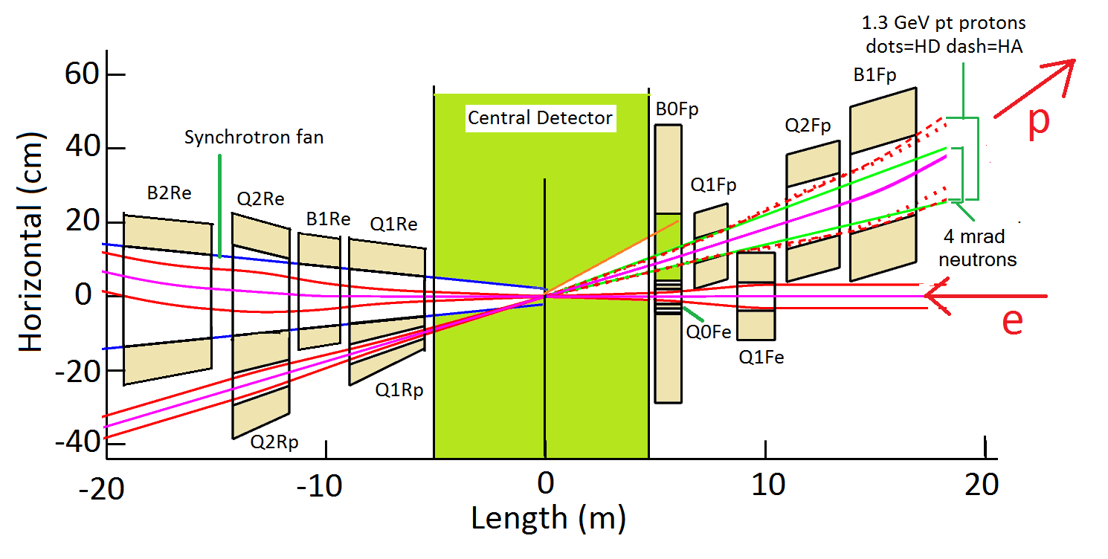
IR Design
main emphasis on integrating requirements for hadron beam direction
  B0Fp: Forward Spectrometer (5 - 20 mrad)
  Neutron Detector (0 to 4 mrad)
  Roman pots (Sensitive 1 to 5 mrad)
B1Re and B2Re: separate BH photons from beam, separate low Q² electrons from beam
and lepton beam from SR-fan
electron and hadron polarimetry at IP-12
need still to integrate a local IR hadron polarimeter to monitor degree of long. Polarisation

Slide 20
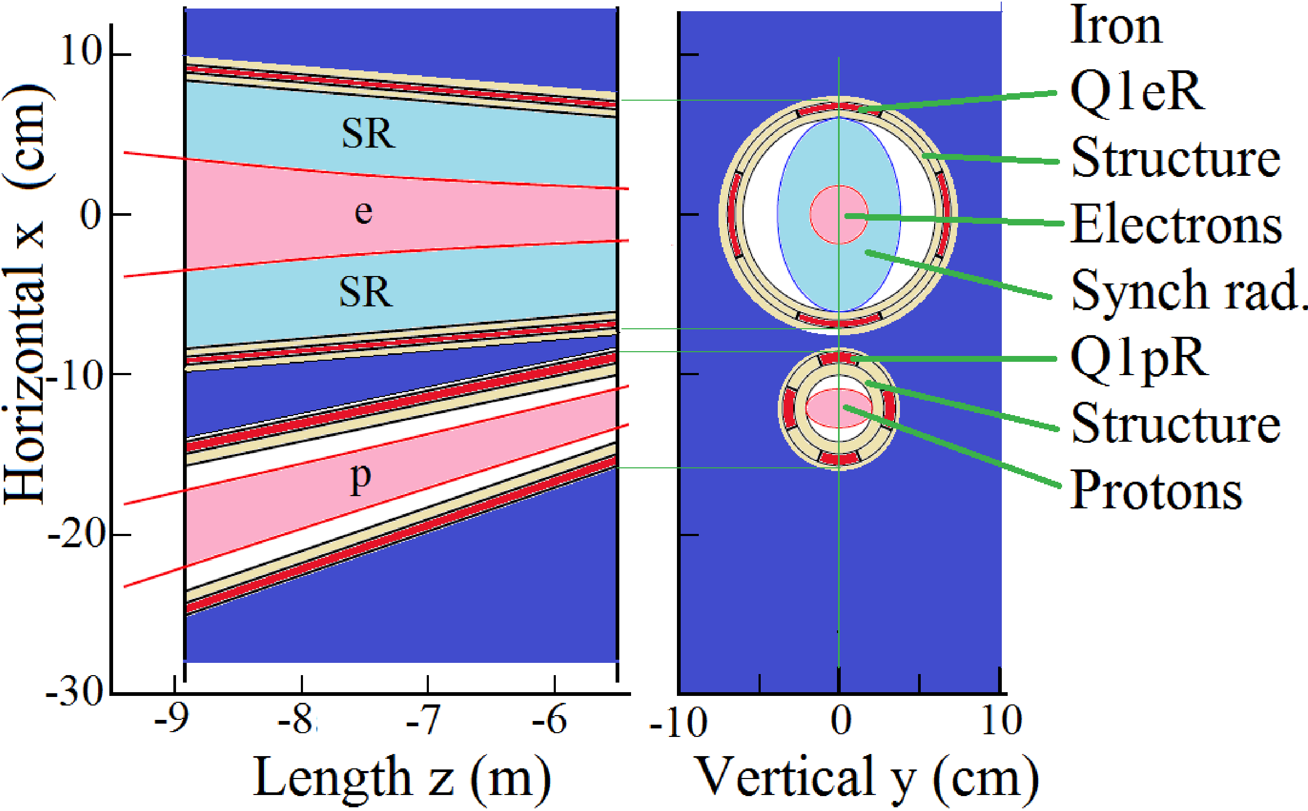
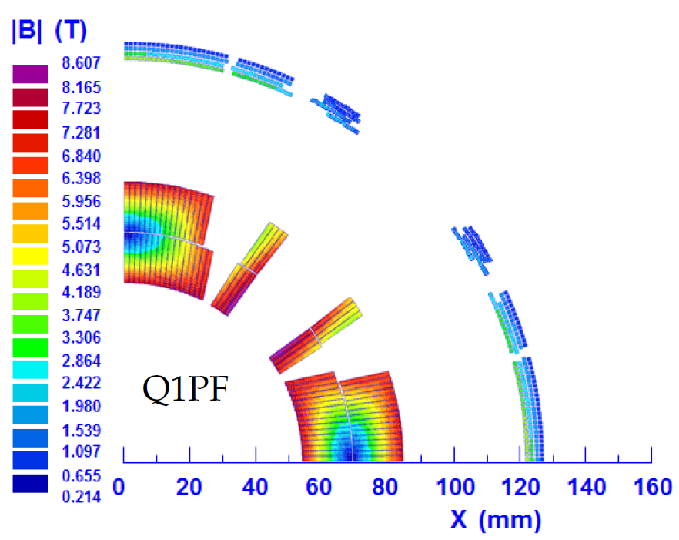
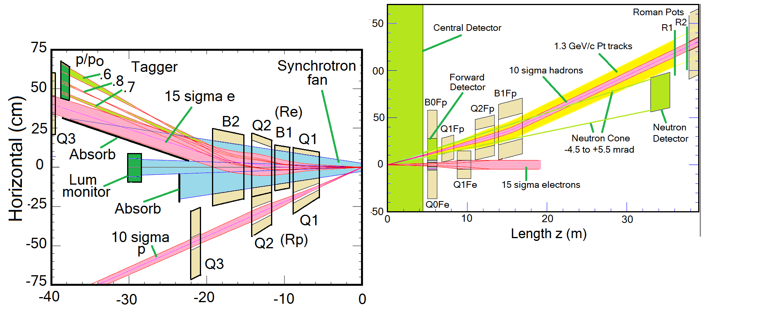
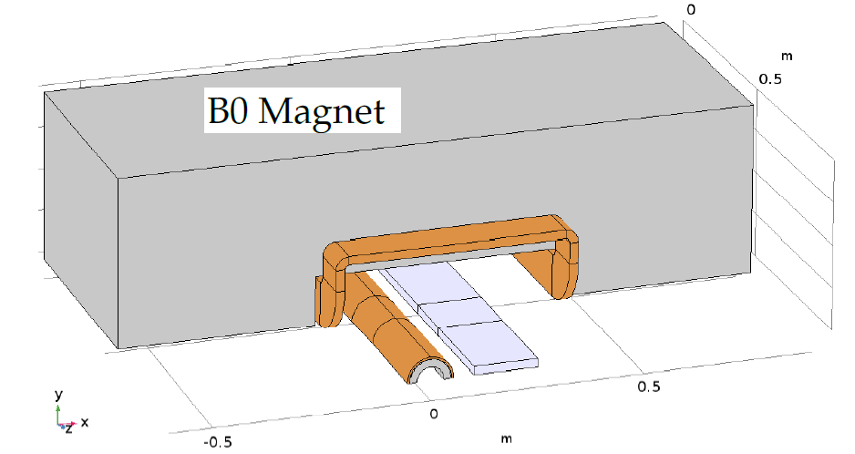
Design of IR Magnets

Slide 21
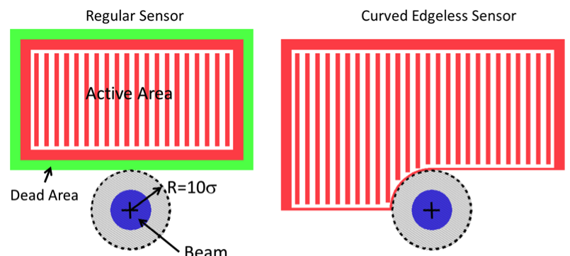
Operation in high Acceptance and Divergence Modes
Requirement:
Detect forward scattered protons with 0.18 GeV < p_{t} < 1.3 GeV in Roman Pots
→ 0.65 mrad < Θ < 5 mrad @ 275 GeV 1.8 mrad < Θ < 13 mrad @ 100 GeV
small p_{T}-acceptance limited by beam divergence and emittance
Roman Pot Si-Sensors
Can operate in two modes:
High acceptance
→ low beam divergence at lower luminosity (<2)
High divergence
→ lower acceptance at low p_{t} at higher luminosity
For 275 GeV Protons (√s=141 GeV)
 | Strong hadron cooling |  | Without hadron cooling
 | HA | HD | HA | HD
RMS Δθ_{H}, (μrad) | 65 | 117 | 65 | 150
RMS Δθ_{V}, (μrad) | 379 | 371 | 380 | 380
Luminosity 10³³ cm⁻²s⁻¹ | 0.89 | 1.45 | 0.33 | 0.67
HA
HD
Can optimize balance between divergence and luminosity further

Slide 22
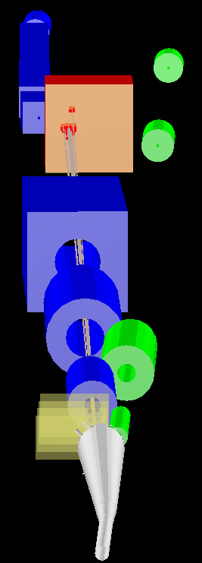
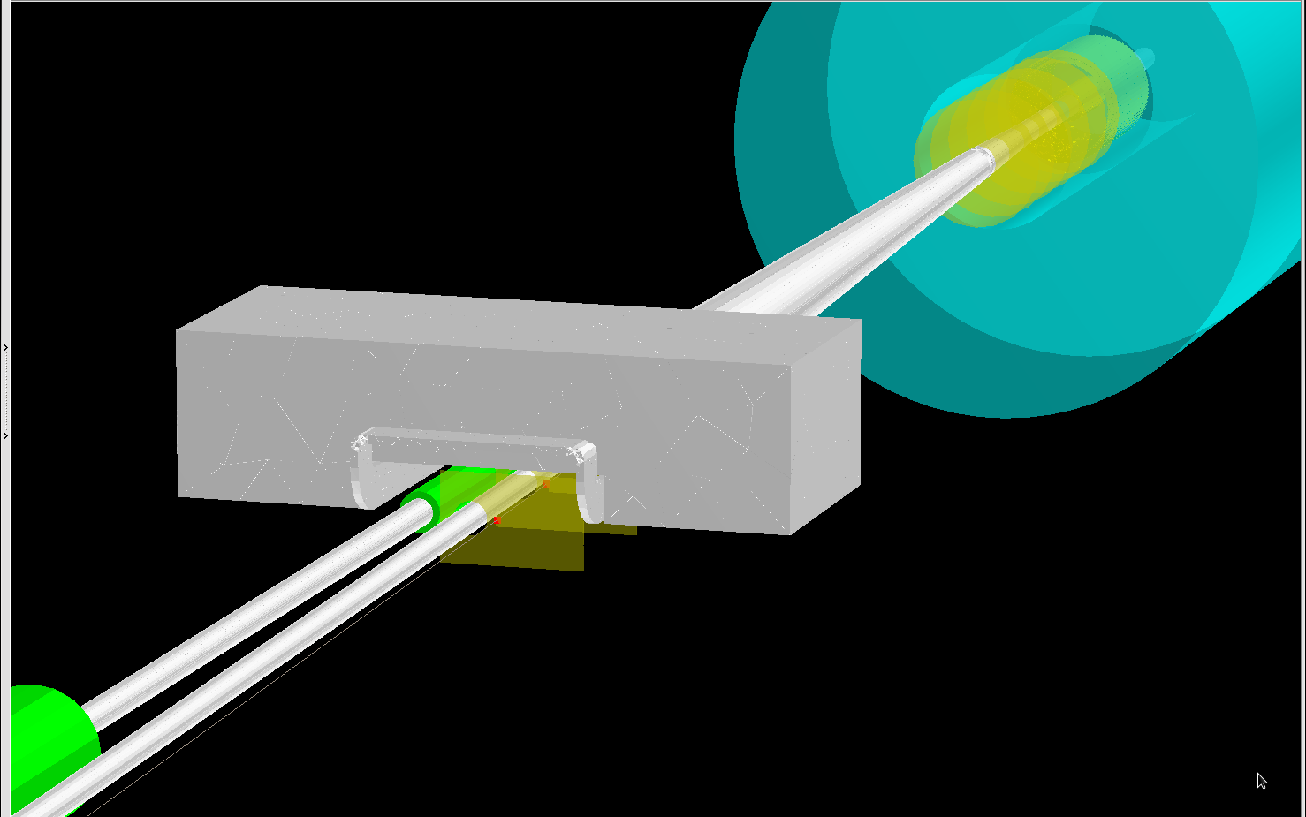
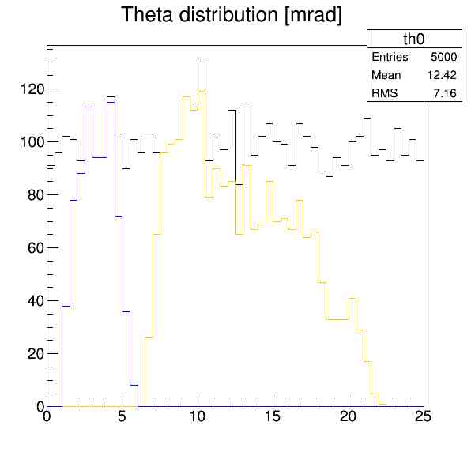
IR Simulations in GEANT
Outgoing hadron
direction
B0-magnet
Acceptance for forward
scattered protons from
exclusive reactions
Simulation for high divergence
case
Generation flat in theta
Gap between RP and B0
acceptance will be further
optimized

Slide 23
Requirements: Beam Background at IR
electron beam:
Synchrotron radiation
  Backscattering
  Photo desorption
  → degradation of vacuum
Beam gas interactions
  Off momentum electrons
Higher order mode losses
  Local heating at injection and ramp (short bunches)
  degradation of vacuum
background due to de-excitation of beam if bunches are replaced
proton beam:
Low beam lifetime during
injection and ramping
Beam gas interactions, large
hadronic cross section
  Secondary interactions with
  aperture limitations, i.e. with
  magnets, beam pipe, masks
Requirement:
Keep beam backgrounds as low as possible
→ Careful design of interaction region, beam-pipe masks and photon beam dump
→ Excellent vacuum system

Slide 24
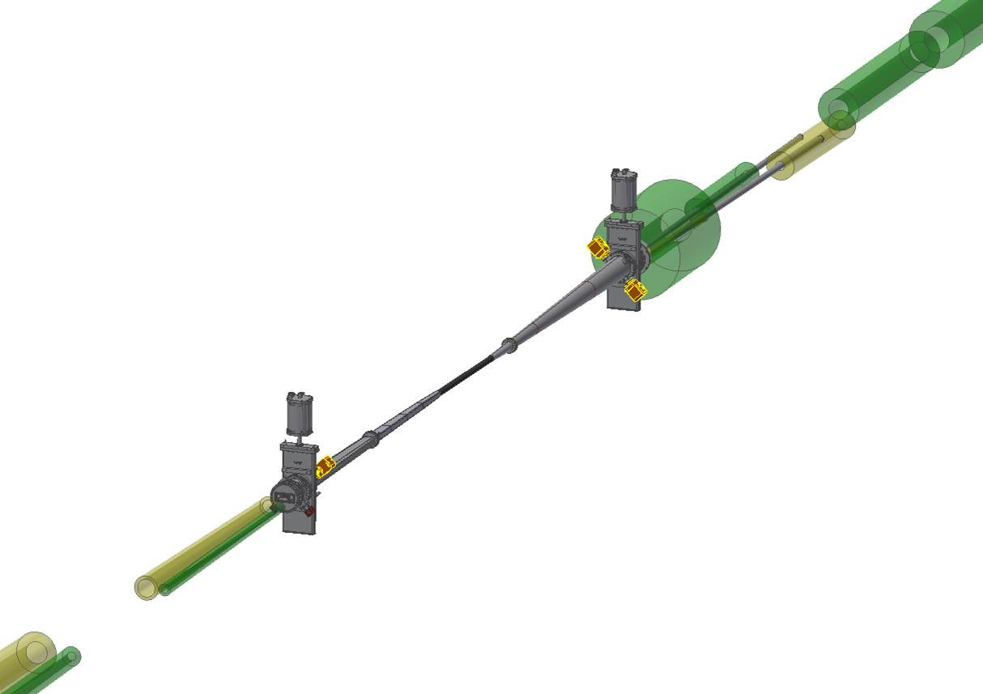
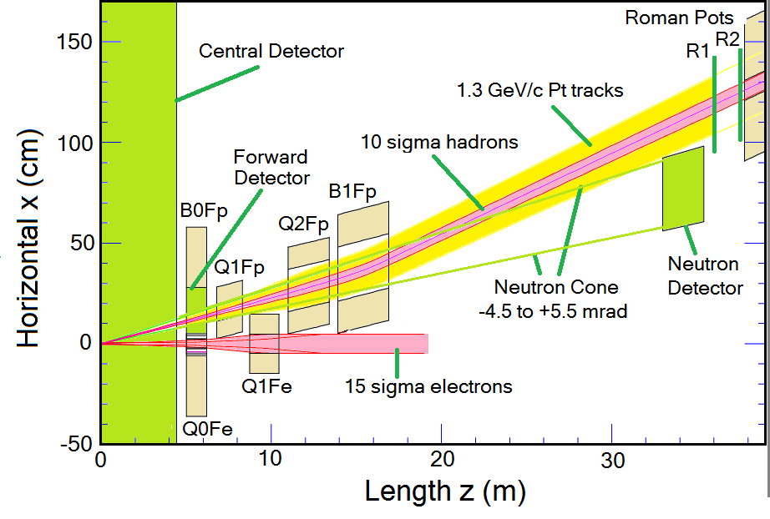
IR Vacuum Design
Requirements & Solutions:
Obey geometrical requirements from physics requirements and beam envelops at injection and flat top
Accommodate 13σ of the SR fan
Low base and dynamic pressure in IR
  → Integrate NEG pumping
  → tight space constrains → permanent back-out system
Limit number of sharp transition
  Limit contribution to overall Impedance budget
  Impedance assessment has started
  22 kW power deposition in the IR is a challenge for cooling. Design underway
Lengths of warm-cold vacuum transitions taken into account in lattice design
Low mass beam pipe material at center part
  Beryllium with a radius at center 31 mm
    consistent with μ-vertex detector
Current Layout:
Entire IR setup modeled in SynRad
→ to carefully check impact of SR on IR
vacuum design
→ SR from electron focusing quadrupoles
Q0EF and Q1EF

Slide 25
Available Experimental Infrastructure
RHIC Tunnel layout:
Six experimental halls
→ Four halls potentially available for detectors
→ All halls have different layout
12o’clock
2o’clock
6o’clock
8o’clock
No experimental hall,
Just a concrete slab
and a tunnel-like
structure
Very little
Infrastructure
Only if other halls are
To small
17m x 8m x 4.5m
asymmetric detector
hall; existing
Infrastructure
60 m long stub
Tunnel for forward
Spectrometer
Not consistent with
det . At IP-8
28m x 12m x 8.5m
Large detector hall
with existing
Infrastructure
16m x 32m x 12m
Large detector hall
with existing
Infrastructure
18.5m x 15m x 14.5m

Slide 26
Operation with 2 Experiments
Note:
2 collisions per turn double the beam-beam parameter
Simulations show detrimental beam-beam effects
  →That would require reducing the bunch intensities by factor 2
  → Would reduce luminosities per detector by factor 4
With a dedicated fill pattern and a slight longitudinal offset of one Detector, half the bunches collide in one IP, the other half in the other detector
With this scheme total luminosity of the two detectors combined remains constant

Slide 27
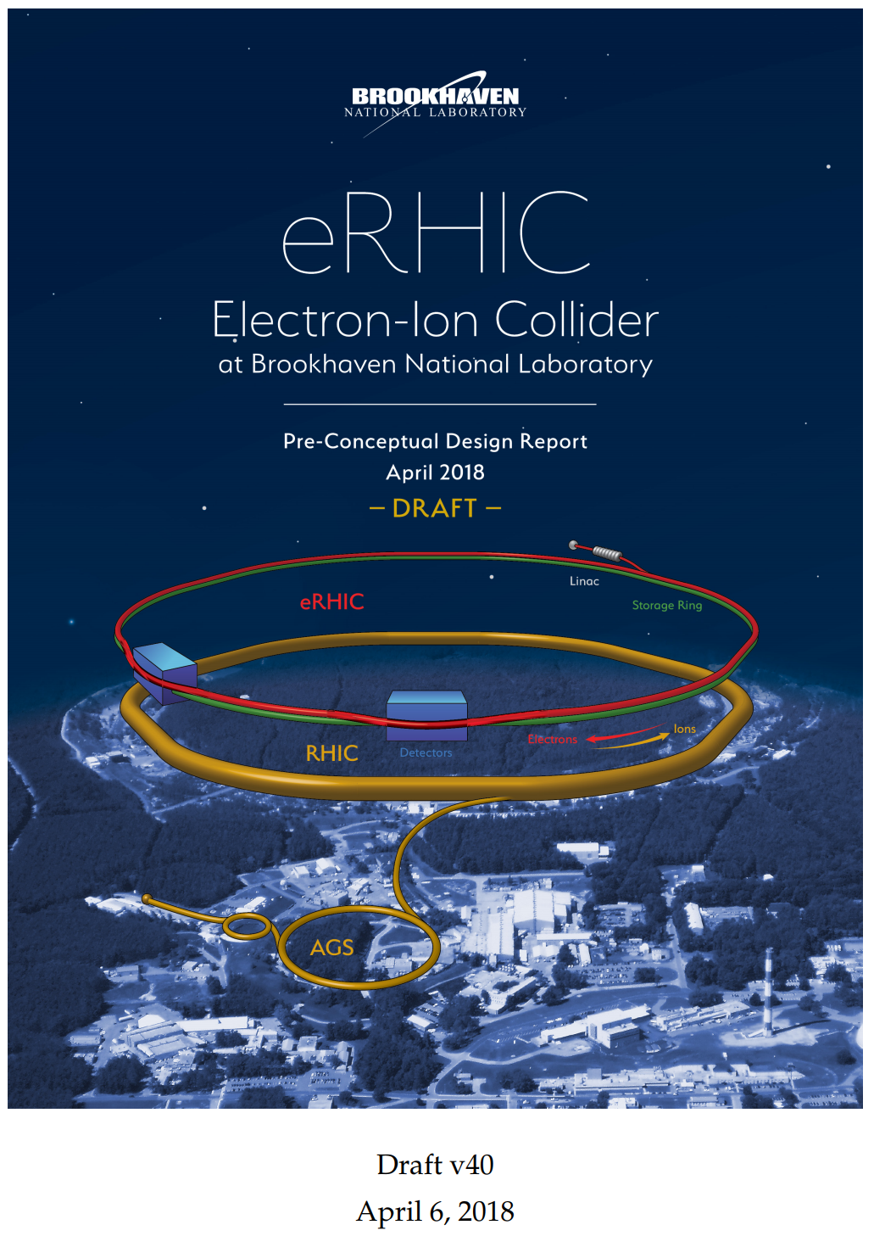
Summary
Coming soon
eRHIC pre-conceptual design integrates all EIC science driven requirements on IR and machine operations well
  Luminosity
  Center of mass energy reach √s=20 – 140 GeV
  High beam polarizations for hadrons and electrons
    Polarized p, D, He-3
  High acceptance for forward scattered particles
  Element free region for detector
  Wide range of nuclear beams D to U
Baseline design aims to 10³⁴ luminosity applying cooling requirement. To mitigate risks related with cooling technology eRHIC operation without cooling with ~3*10³³ luminosity is also considered.
Still a large amount of work ahead to arrive at a Conceptual Design,

Slide 28


Slide 29
Electron Injector Synchrotron
5-18 GeV spin polarized electrons are required for injection into the storage ring.
A comprehensive study resulted in the choice of a spin-transparent rapid cycling synchrotron in the RHIC tunnel
High lattice quasi-symmetry (achieved by straight sections designed as unity transformations) suppress systematic depolarizing resonance during the ramp
A 200 ms ramp is sufficiently fast to cross resonances without loss of polarization
Systemic tracking calculation result in stringent orbit control need, orbits should not deviate by more than 0.5 mm from ideal orbit. While this is a demanding requirement, it is believed but feasible using state of the art controls and correction tools.
Magnetic Stray-field from the injector experienced by the storage ring have been calculated as negligible
Electric interference is under study (the power circuit store the magnetic energy to reduce impact on the grid)
Bypass around the detectors are accomplished without distorting the quasi symmetry

Slide 30
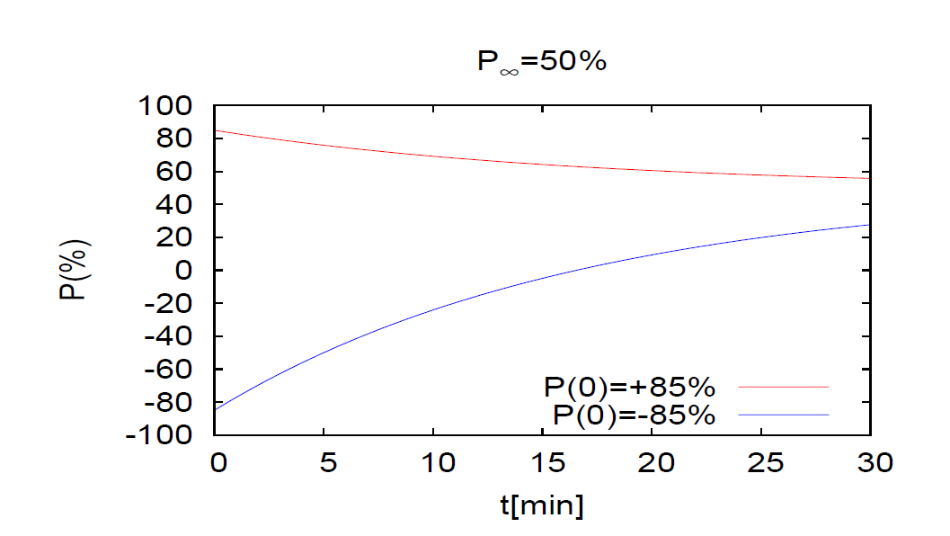
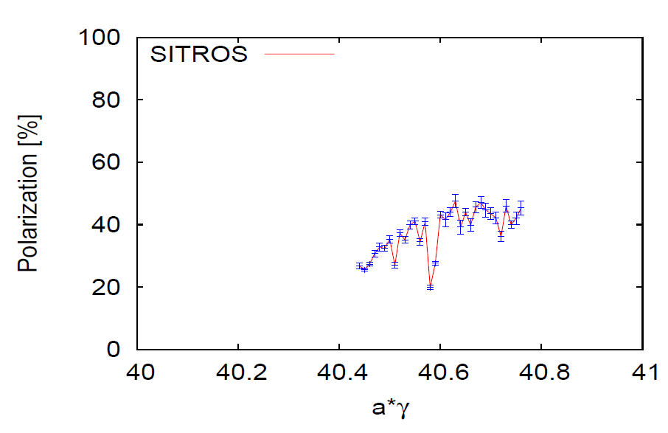
Electron Storage Ring Polarization
Need to store bunches with 85% initial polarization with spin parallel ↑ ↑ and spin antiparallel ↑↓ to guide field in the arc.
Need to replace bunches with parallel spin ↑ ↑ with a rate of up to 1/(5 minutes) because of Sokolov-Ternov Depolarization (defines the injection chain)
Equilibrium polarization P∞ = 50% in eRHIC sufficient to maintain polarization with <P> = 63% (spin ↑↓➔ 80%)
Higher vertical tune better (BB feasibility to be checked))
Spin matching between rotators essential (spin matching confirmed with alternative software, is ok)
Polarization with BB not yet done (HERA polarization suffered only indirectly from BB: non-colliding bunches pushed to unfavorable tunes by fixing the tunes for colliding ones (e⁻ - p)
Detector solenoid: influence not checked, important for p↑
Conclusion:
Polarization ok so far,
more improvements expected by harmonic bumps, BBA, etc
↑ 50% reachable
Polarization with realistic machine errors

Slide 31
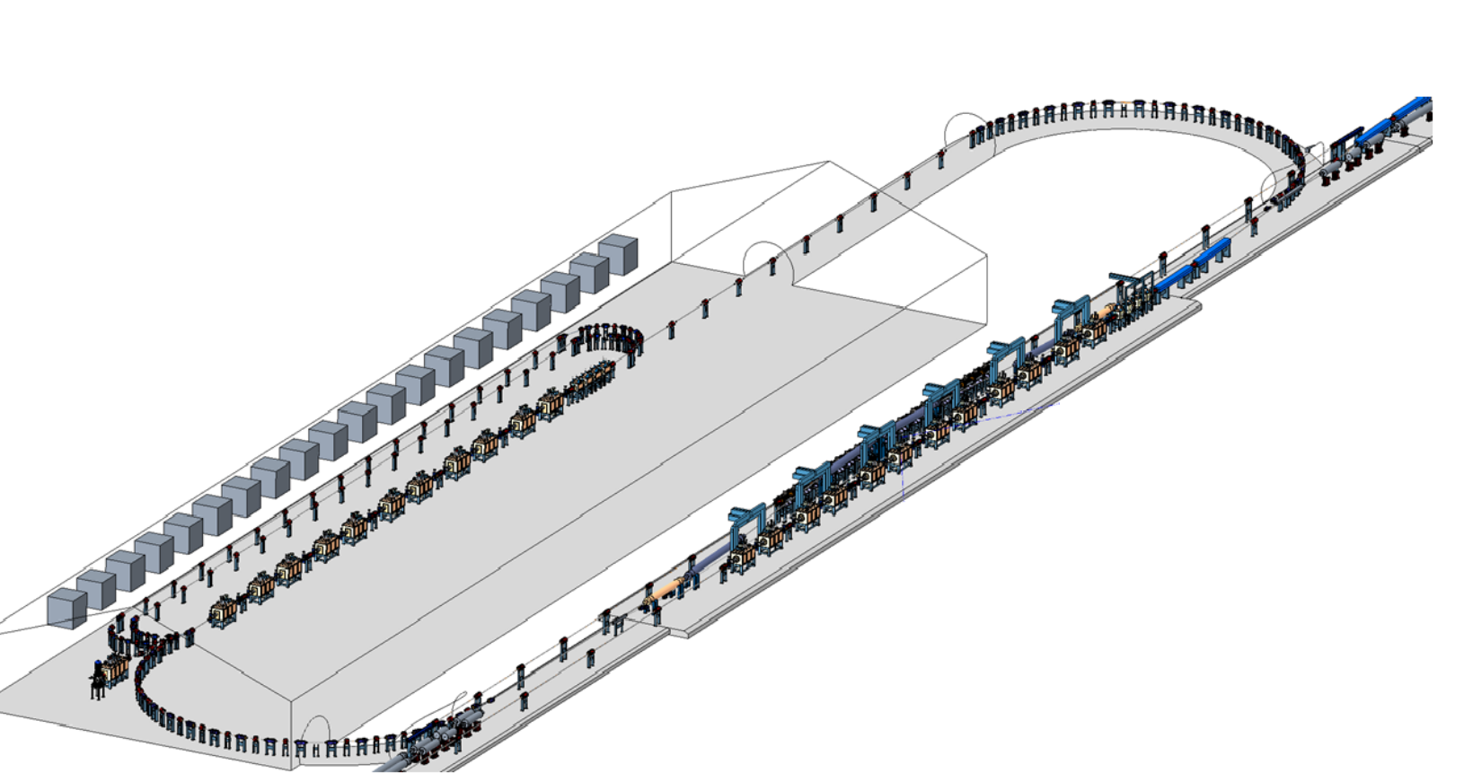
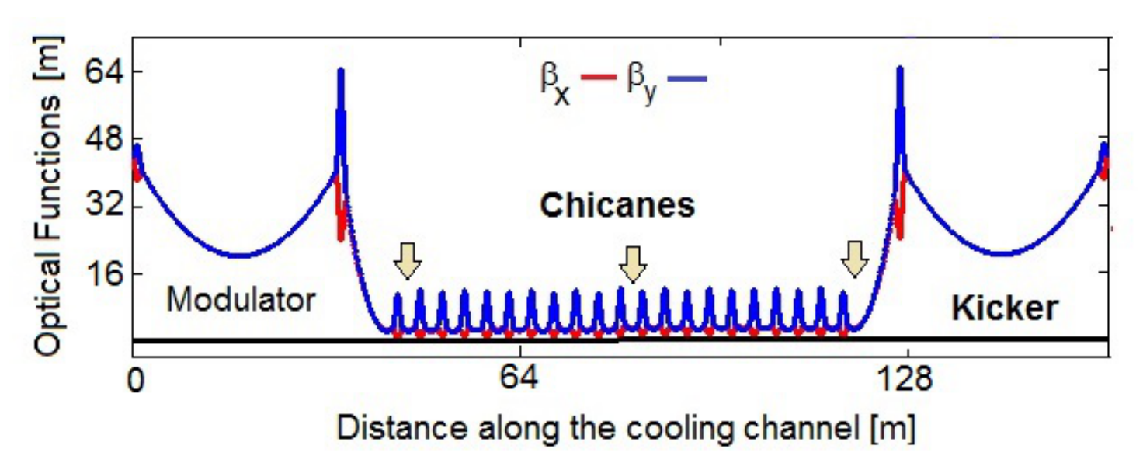
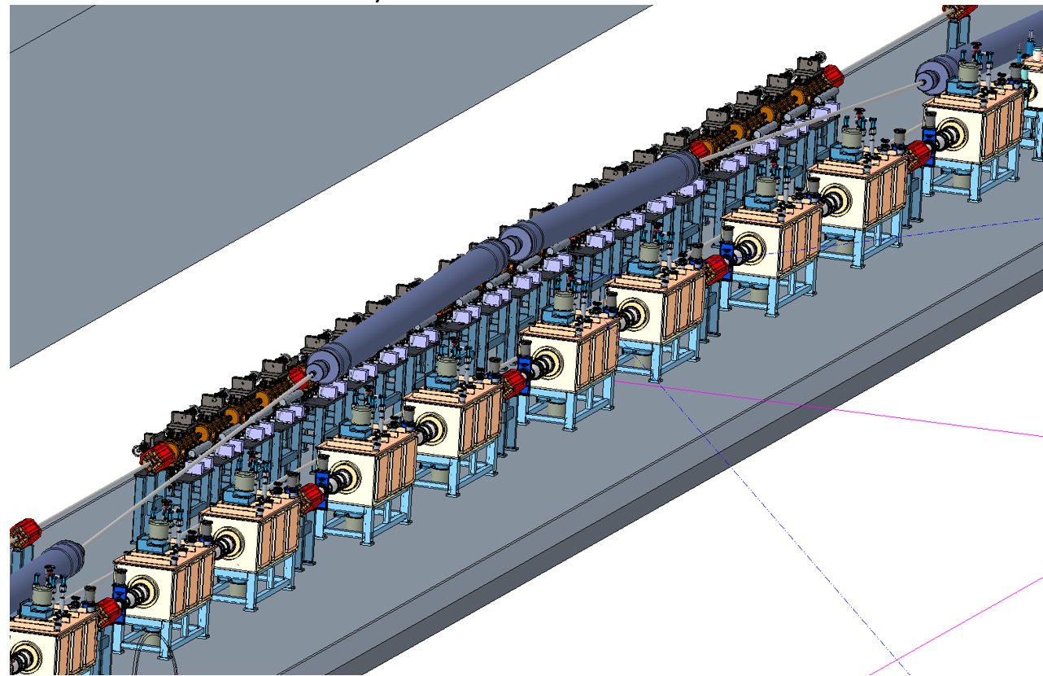
Strong Hadron Cooling
Challenges:
100 mA CW electron source is beyond state of the art
Hadron Chicane to compensate for electron delay in the micro-bunching chicanes is a considerable effort (need several blue ring s.c. RHIC magnets)
Unexplored:
Short bunches might boost the cooling rate, reduce the electron current and reduce number of amplifications.
To Do:
3-D model
Simulation including space charge and drifts
Optimization of parameters for short bunches

Slide 32
Lessons from HERA II upgrade
HERA performed an upgrade to increase luminosity by a factor of 5
  Mainly by squeezing the beam more at the IP by redesign of the IR
The upgrade increased backgrounds dramatically → Several month shutdown to implement improvements
Main culprits:
  no careful simulations prior to the upgrade
  Proton beam-gas interactions most severe background
    Needed an extremely good vacuum to mitigate this
  Synchrotron radiation background
    Background to detectors
    Excess heating of beam pipe
      Can damage flanges, etc.
      Can heat beam pipe, decreasing vacuum
  Electron beam-gas

Slide 33
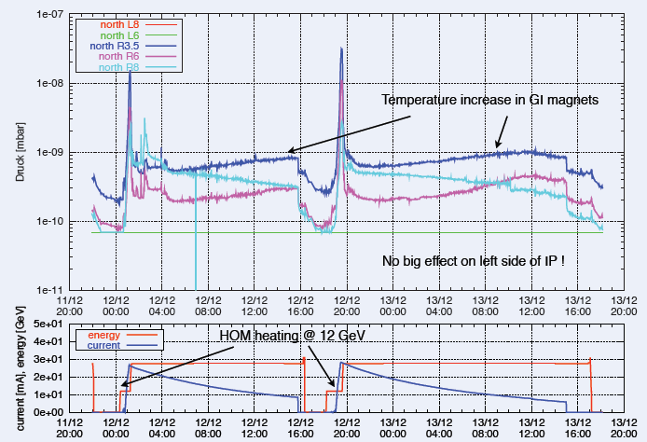
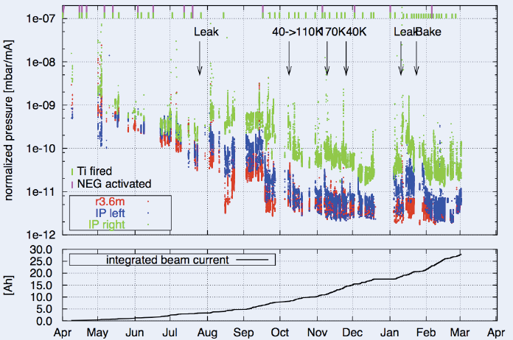
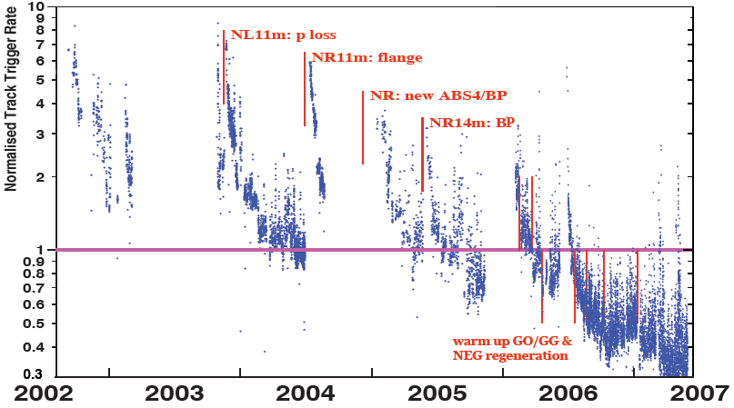
Lessons from HERA II upgrade
Dynamic pressure increase due
to thermal and photo desorption
Pressure vs. integrated electron
current 2002 - 03
Proton Beam Gas Background
Two time constants for vacuum conditioning
Short term after leaks 20 – 30 days
Long term 600 days

Slide 34
Beam-gas interactions
First and foremost, need an excellent vacuum
Some estimations
Assumptions of the vacuum and layout from other facilities (HERA, LHC)
Vacuum pressure | 10⁻⁹ mbar
Beampipe temperature | Room temperature
Average atomic weight of gas | Hydrogen (H²)
Molecular density (for 10 m pipe) | 2.65 x 10¹⁰ molecules/cm²
Luminosity (Ring-Ring) | 10.05 x 10³³ cm⁻²s⁻¹
Bunch intensity (R-R) (e/p) | 15.1 / 6.0 x 10¹⁰
Beam Current (R-R) (e/p) | 2.5 / 1 A
Bunch spacing (Ring-Ring) | 8.7 ns → 1320 bunches
ElectronxProton beam energy | 10 GeV x 275 GeV
Ring-Ring :
DIS-event rate: 600 kHz
Beam-gas event rate: 9818 kHz in 10m
Need to analyze the effect of the following assumptions:
What is the realistic beam pipe temperature and how does it change around the IR?
What is the gas density profile
and detector acceptance for BG-events?
How does the different SR load influence the vacuum

Slide 35
Some relevant cross sections and rates
DIS cross section is significantly smaller than for background processes
Need reliable methods for reducing or rejecting background
Cross sections:
process | 5 x 50 GeV e+p collision | 20 x 250 GeV e+p collision
DIS | 0.030 mb | 0.060 mb
Proton beam on rest proton | 38.4 mb | 40.7 mb
Proton beam on rest Argon(40) | 680 mb | 710 mb
Elastic scattering | 161 mb (Eγ > 0.1 GeV) | 284 mb (Eγ > 0.1 GeV)
Lumi ~ 4.1 x 10³³ cm⁻²s⁻¹
100 ns bunch spacing
Lumi ~ 3 x 10³³ cm⁻²s⁻¹
2 ns bunch spacing
Rates
process | 5 x 50 GeV Linac-ring | 20 x 250 GeV Linac-ring | 5 x 50 GeV Ring-ring | 20 X 250 GeV Ring-ring
DIS | 123 kHz | 246 kHz | 88.8 kHz | 177.6 kHz
Elastic scattering | 660 MHz | 1164 MHz | 477 MHz | 841 MHz

Slide 36
Deep Inelastic Scattering
DIS:
As a probe, electron beams
provide unmatched precision of
the electromagnetic interaction
Direct, model independent
determination of parton
kinematics of physics
processes
s: center-of-mass energy squared
Q²: resolution power
x: the fraction of the nucleon’s momentum
carried by the struck quark (0<x<1)
y: inelasticity

Slide 37
Requirements: Polarization and Luminosity Measurements
Need high beam polarization → statistical uncertainty of spin asymmetries
→ electron beam polarization: 0.8 hadron beam polarization: 0.7
Dominant systematics for double spin asymmetries:
Luminosity Measurement → Relative Luminosity
R needs to be controlled better then A_{LL}~10⁻⁴ at low x → RHIC: 2.-4.x10⁻⁴ @ 500 GeV
need to run many different spin patterns to balance L⁺⁺, L⁻⁻, L⁺⁻, L⁻⁺
reduce any time dependences
→ RHIC is a perfect example: every bunch can have a different spin orientation
Spin patterns combinations of:
1: +-+--+-++-+- 2: -+-++-+--+-+ 3: ++--++--++-- 4: --++--++--++
→ flexible spin orientation bunch-by-bunch for both lepton and hadron beam
Need also an excellent Luminosity measurement
→ coupling of polarization and luminosity measurement
→ Need overall systematics ≤ 2% (arXiv:1206.6014)
relative
luminosity

Slide 38
IR Requirements from Physics
Exclusive Reactions in ep/eA:
Exclusivity criteria:
  eA: large rapidity coverage → rapidity gap events
    HCal for 1<η<4.5
  ep: reconstruction of all particles in event
    wide coverage in t (=p_{t}²) → Roman pots
eA: large acceptance for neutrons from nucleus break-up
  Zero Degree Calorimeter
    veto nucleus breakup
    determine impact parameter of collision
→ Poses stringent requirements on IR design
γ, ρ, Φ, J/Ψ, Jets
t=p_{t}²
γ, ρ, Φ, J/Ψ, Jet
scattered
electron
not seen in main detector
scattered
proton
Proton
Beam
Note:
the kinematics of the scattered
proton is the same for all
diffractive processes
and known from HERA

Slide 39
Scattered Proton Kinematics
scattered protons
Remember:
Detector -4 to 4 in η
35 mrad from beam line
so not seen in main detector
need different detection technology
p_{T} of proton critical for physics
p_{T} = p’ sin(Θ)
p’_{L} > 97% of p_{Beam}
ZEUS Coll, JHEP 06 (2009) 074
Note:
high energy colliders (HERA, Tevatron, LHC, RHIC) use Roman Pots to detect
these proton
Θ < 10 mrad
  impact on large p_{T}-acceptance
small p_{T}-acceptance limited by
beam divergence and emmitance
→ rule of thumb keep 10σ between RP and beam
non-diffractive events
⟻
X_{L}=p’_{L}/p_{Beam}

Slide 40
Impact of reduced scattered proton acceptance
Measurement
Physics Obsevable
Plots from
EIC WP:
Requirement:
∫L_{int}=10fb⁻¹
0.18 < p_{t} (GeV) < 1.3
0.03 < |t| (GeV²)< 1.6
Fourier
Transform
Plots with
reduced
lower
p_{t}-acceptance
∫L_{int}=10fb⁻¹
0.44 < |p_{t}| (GeV) < 1.3
∫L_{int}=10fb⁻¹
0.18 < |p_{t}| (GeV) < 0.8
Plots with
reduced
high
p_{t}-acceptance

Slide 41
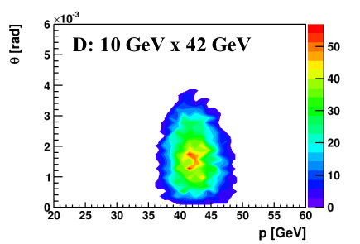
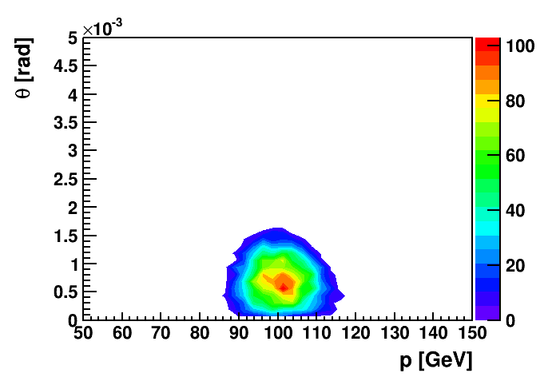
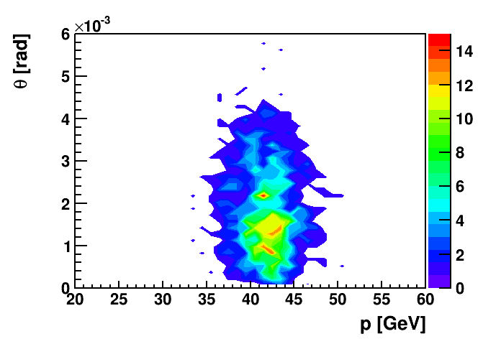
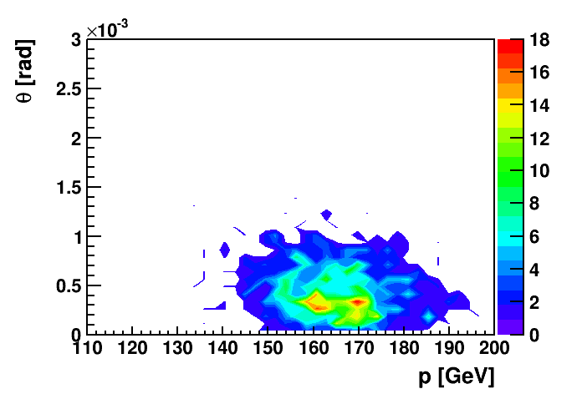
Spectator Proton Detection
To unravel the full (un)polarized flavor structure of nucleons → “neutron target”
effective neutron targets: (un)polarized Deuterium and He-3
Need to tag scattering occurred on neutron
  spectator proton(s) need to be detected
Deuterium spectator protons:
D: 10 GeV x 100 GeV
He-3 spectator protons:
Requirements:
need to be detected close to
IR due to different rigidity
and in high dispersion RPs
He-3: 10 GeV x 42 GeV
He-3: 10 GeV x 166 GeV

Slide 42
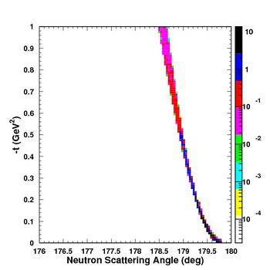
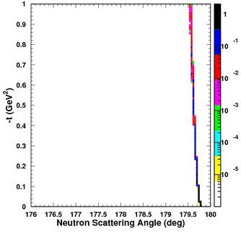
Forward scattered neutrons
Extremely important for many EIC physics topics:
ep:
diffractive reactions with charge exchange ep→ e’+π+n
5 GeV x 50 GeV
20 GeV x 250 GeV
p_{T}²
p_{T}²
Similar scattering angle (5 to 22 mrad) as function of hadron beam energy
as forward scattered protons
ZDC needs to have a larger transverse size as currently in RHIC
to contain all energy
→ precision reconstruction of Energy and angle → p_{T}

Slide 43
Forward scattered neutrons
Diffractive physics in eA
Measure spatial gluon distribution in nuclei
Reaction:
→ Momentum transfer t = |pAu-pAu′|²
e + Au → e′ + Au′ + J/ψ, φ, ρ
Au
suppress
by detecting
break-up
neutrons
Requirement:
Need at +/- 4 mrad beam element free
cone before the zero degree calorimeter
to detect the breakup neutrons
No nuclear dependence for heavy A
there neutrons are also critical to
reconstruct collisions geometry
L. Zheng, ECA, J-H. Lee arXiv:1407.8055
  precision neutron energy
  reconstruction → transv. size of ZDC
Physics requires forward
scattered nucleus needs to
stay intact
Veto breakup through
neutron detection
Notes:
spin-dependent gluon distribution

Slide 44
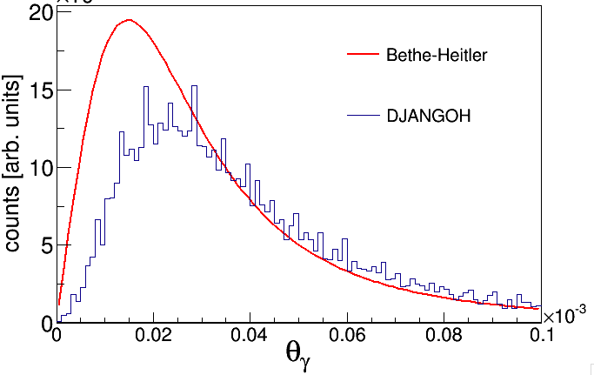
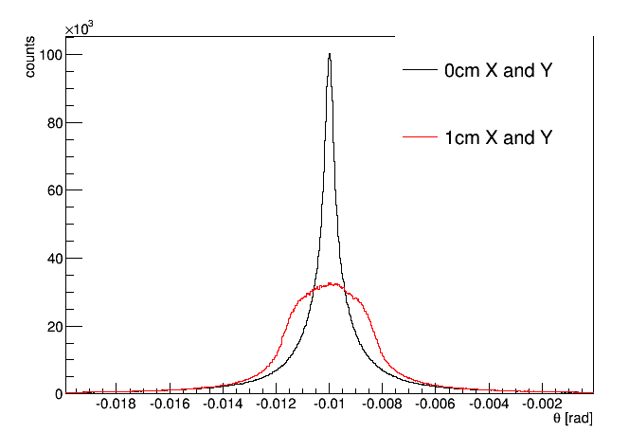
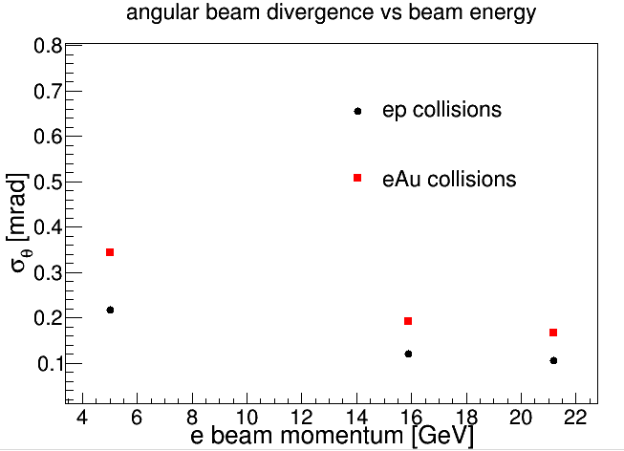
Luminosity Measurement: The Detector
The expected angular distribution of Bremsstrahlung photons
  Bethe-Heitler calculation
  typical angle emission less than 0.03 mrad
  though there is a fairly long tail to the distribution
    → what is the beam divergence contribution
  0.1 mrad for 20 GeV x 250 GeV
  σ_{θ} = angular beam divergence
  ε = (normalized) emittance
  = lorentz factor
  β* = beam optics parameter at IP
considering the added effect if the IP
moves a bit and is off center
both curves include crossing angle and angular
beam divergence and a flat z vertex spread of +/- 2.5cm
→ black has all events at (0,0) (x,y) vertex
→ red has events with (x,y) vertex distributed
flat with +/- 0.5 cm
Large contribution:
critical to be considered in the design

