Slide 1
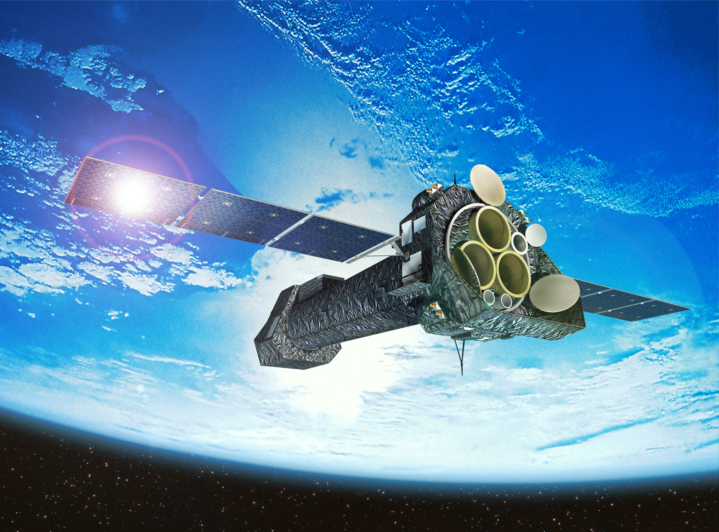
An empirical method for improving the XMM-Newton/EPIC-pn RMF and ARFs
Konrad Dennerl - Max Planck Institute for Extraterrestrial Physics – Garching - Germany

Slide 2
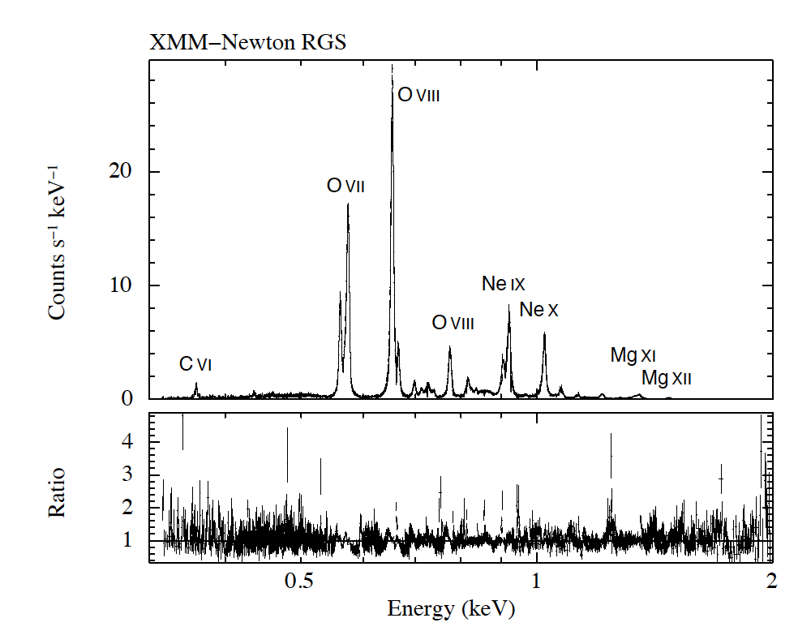
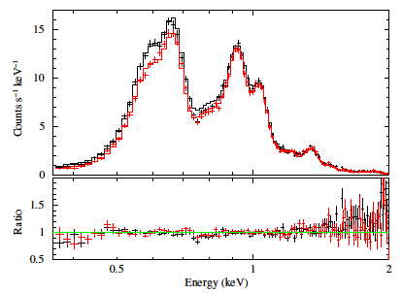
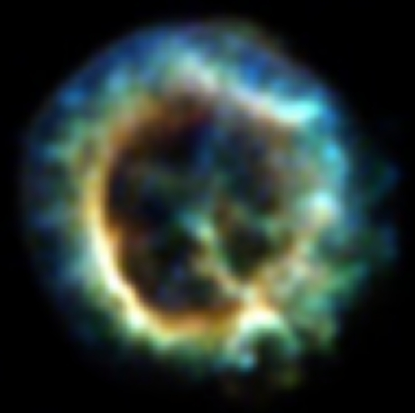
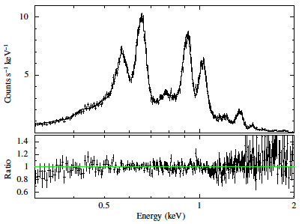
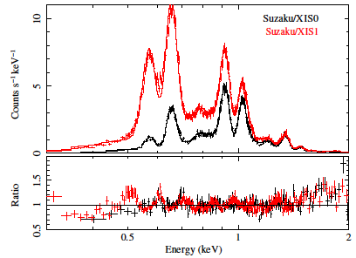
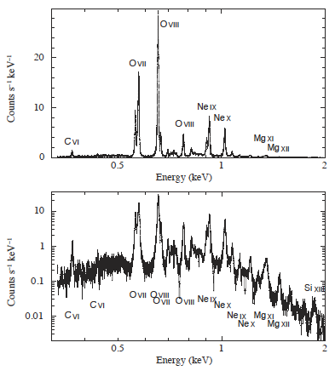
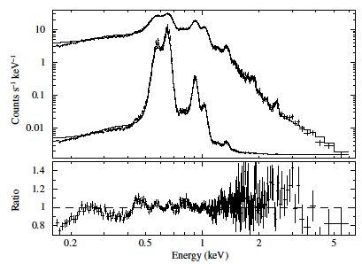
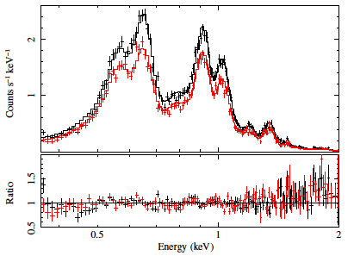
Plucinsky et al. 2017 (A&A 597)
± 20%
XMM RGS
Chandra ACIS-S3
XMM MOS1
Suzaku XIS
XMM PN
Swift XRT

Slide 3
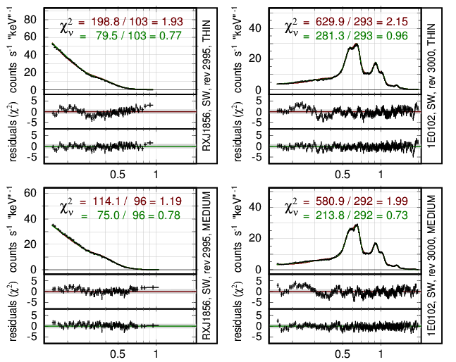
Warning: ARF adjustments alone may be dangerous !
Example: XMM/EPIC-pn, simultaneous fit to RXJ 1856 and 1E0102 in three filters each,
using the same model spectrum for each source, with no normalization between the filters
RXJ 1856
1E 0102
The apparent excess in residuals below 0.4 keV could be „repaired“ by increasing the ARF at low energies ..
Work on the RMF refinement, however, suggests to
increase the redistribution and to decrease the ARF at low energies !

Slide 4
General properties of the ARF and RMF
ARF: „Ancillary Response File“, RMF: „Redistribution Matrix File“
EPIC pn:
2067 vector elements
2067 x 4096 = 8 446 432 matrix elements
RMF @ EPIC pn: 4096 adu bins from 0.0 to 20.5 ‚keV‘ („EBOUNDS“) 2067 eV bins from 50 eV to 16 keV
EPIC pn RMF: 8.5 million matrix elements → HUGE parameter space! EPIC pn ARFs: 3 x 2067 elements → comparatively trivial
how to improve ?
→ find appropriate RMF parameterization and try to optimize it..

Slide 5
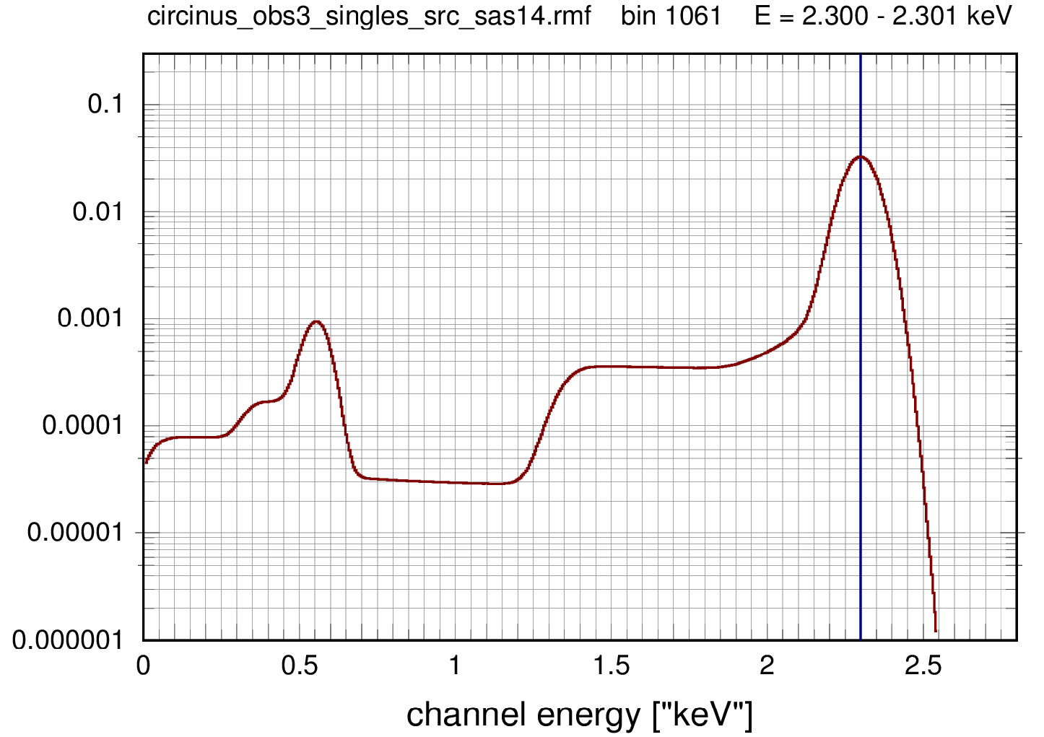
Model Parameters for the EPIC pn RMF

Slide 6
Model Parameters for the EPIC pn RMF
sigma
gamma,
vtherm
ecor
sh_sig_r
sh_sig_l
sh_rnorm
sh_esep
shlf_rnorm

Slide 7
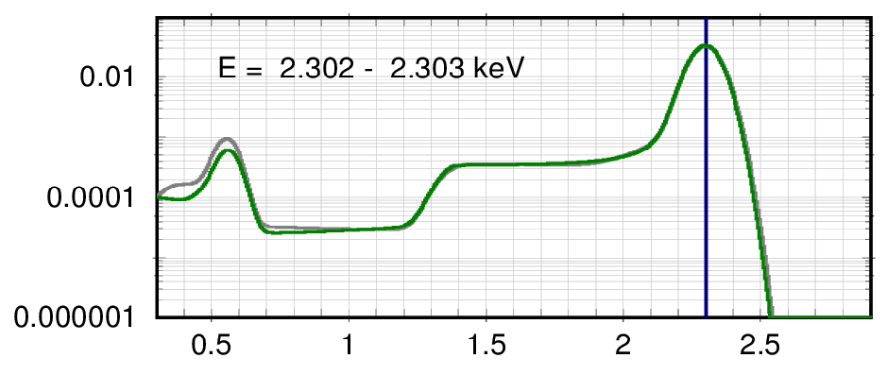
Comparison: original and recomputed RMF @ 2.3 keV
original RMF
recomputed RMF

Slide 8
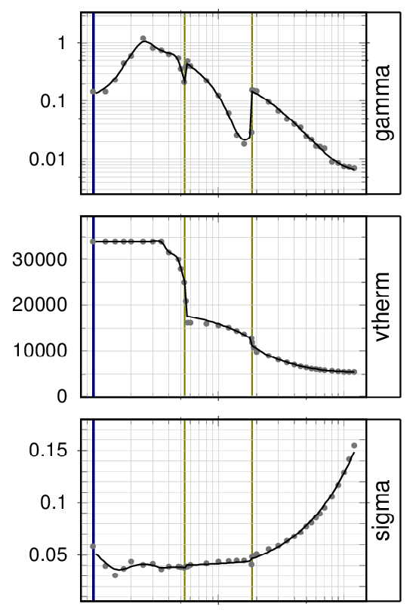
Modeling the EPIC pn RMF at individual energies
sigma
gamma,
vtherm
ecor
sh_sig_r
sh_sig_l
sh_rnorm
sh_esep
shlf_rnorm

Slide 9
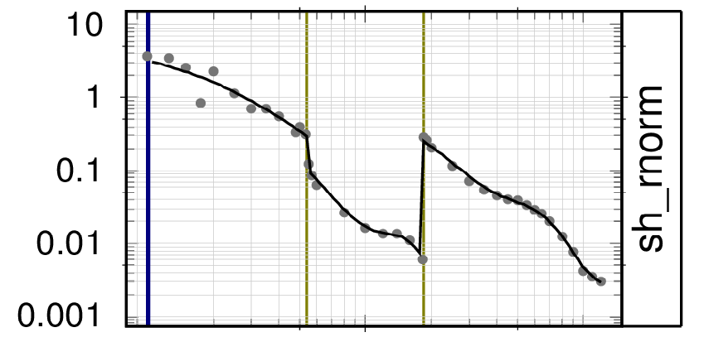
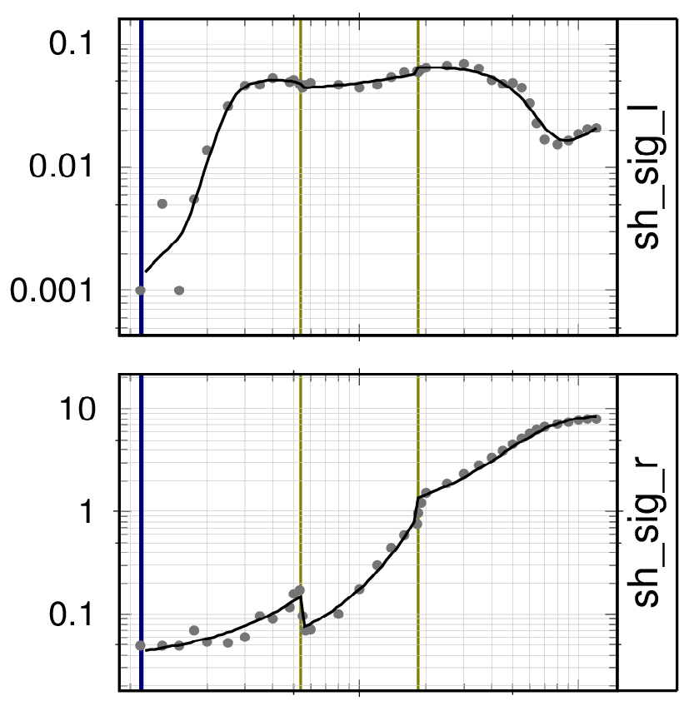
Modeling the EPIC pn RMF at individual energies
sigma
gamma,
vtherm
ecor
sh_sig_r
sh_sig_l
sh_rnorm
sh_esep
shlf_rnorm

Slide 10
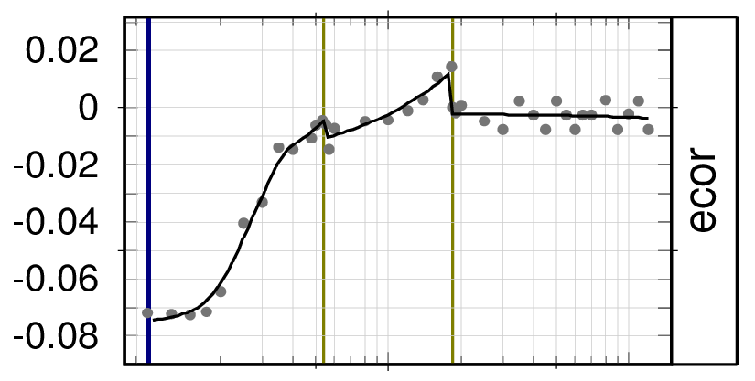
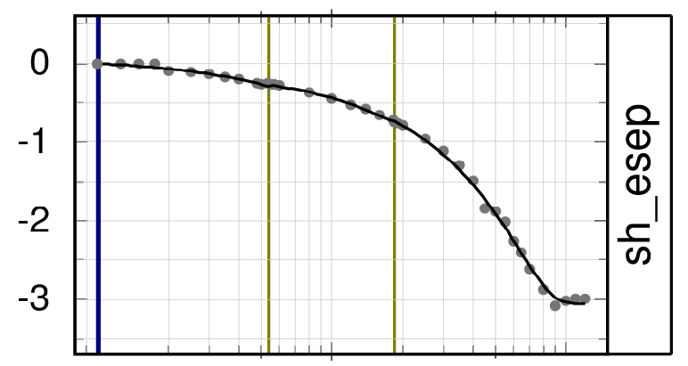
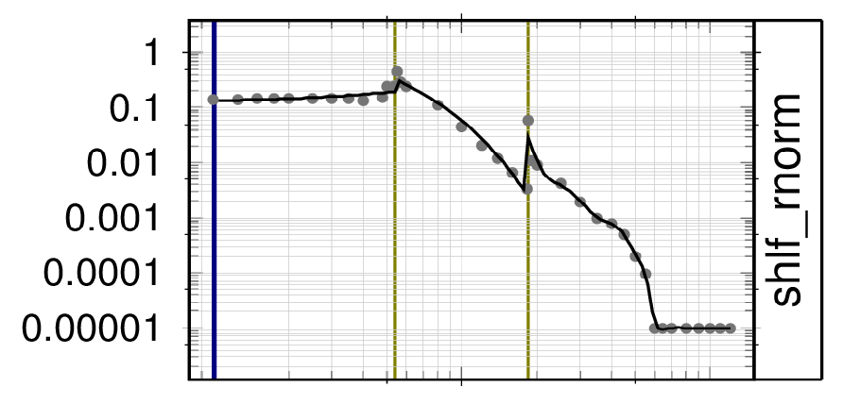
Modeling the EPIC pn RMF at individual energies
sigma
gamma,
vtherm
ecor
sh_sig_r
sh_sig_l
sh_rnorm
sh_esep
shlf_rnorm

Slide 11
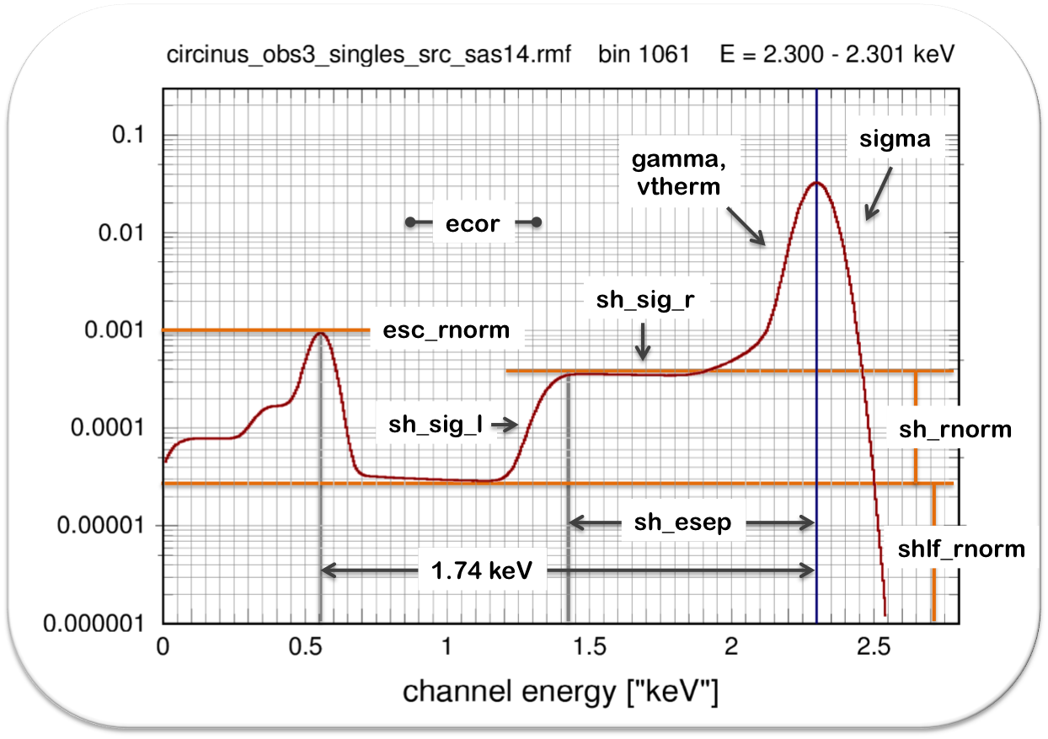
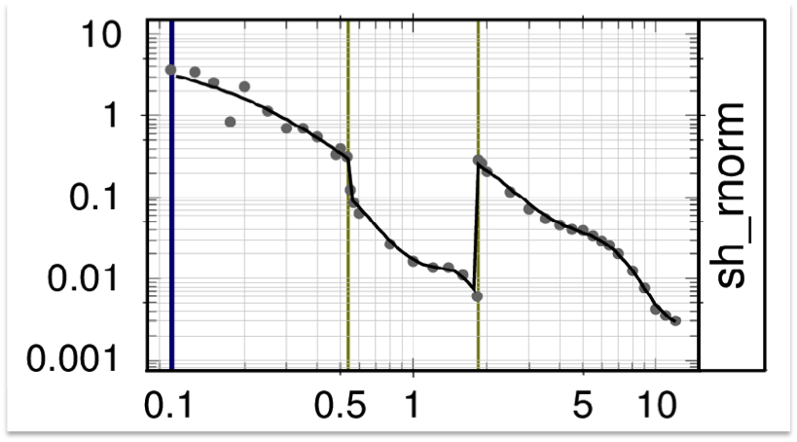
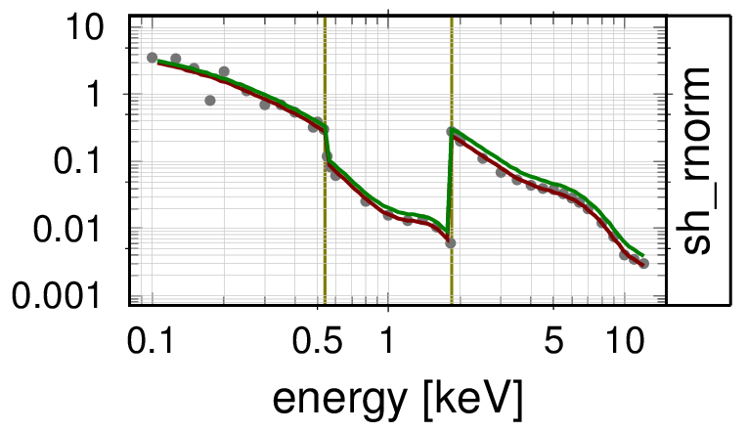
RMF refinement method
(ARF refinement comparatively trivial)
SF
1) Compose the RMF of (19) shaping functions SF
which are determined by shaping parameters SP:
main peak: gamma, vtherm, sigma
shoulder: sh_rnorm, sh_sigl, sh_sigr, sh_esep
shelf: shlf_rnorm, shlf_slope
escape peak: another 9 parameters
and determine deformation functions DF to model the energy dependence of each shaping parameter,
and to reproduce an existing RMF
DF
2) Apply correction functions CF to the deformation functions DF, recompute the RMF,
use this RMF for (simultaneously) fitting X-ray spectra with spectral model functions MF (using plausible spectral model parameters MP), and compute the goodness of the fit.
Vary the correction parameters CP (and the correction functions CF) in order to maximize the goodness of the fit.
CF
DF

Slide 12
RMF refinement method
Challenge: how to keep an overview (in total ~1000 parameters!)
19 shaping functions SF with a total of 19 shaping parameter SP;
the energy dependence of each SP is determined by a deformation function DF
the 19 DFs are computed from a total of 555 deformation parameters DP, which were derived by simultaneously fitting 39 EPIC-pn „RMF samples“ with 117 free and 438 fixed/tied parameters
19 correction functions CF, each determined by up to 21 adjustable CPs, yielding a total of 399 correction parameters CPs
spectral fits:
1E 0102: 208 model parameters MP₁, with 4 of them free + gain offset
RXJ 1856: 3 model parameters MP₂, with 1-3 of them free + gain offset
in addition for the 3 ARFs: (thick, medium, thin):
3 x 2 adjustable parameters for C-K and O-K absorption
up to 21 adjustable parameters for correcting the fraction of singles
up to 19 x 21 + 6 = 405 adjustable correction parameters in total
necessity to fix/tie/couple a subset of the correction parameters
necessity to constrain the correction functions
necessity to control the spectral fit results
very useful: concise graphical overview

Slide 13
Status @ IACHEC-2018
RXJ 1856
1E 0102
Chandra LETG
n_{H} == 7.25 x 10¹⁹ cm⁻² kT == 62.4 eV norm == 1.58 x 10⁵
thick medium thin

Slide 14
Status @ IACHEC-2018
RXJ 1856
1E 0102
ARF correction
Chandra LETG
n_{H} == 7.25 x 10¹⁹ cm⁻² kT == 62.4 eV norm == 1.58 x 10⁵
correction for threshold induced sensitivity drop
0.10 – 0.28 keV free | 0.28 – 1.74 keV free | 1.74 – 16.0 keV fixed
filter dependent ARF correction | correction for carbon thickness | correction for oxygen thickness
thin | = 0 (fixed) | free
medium | = 0 (fixed) | = O_cor(thin)
thick | = 0 (fixed) | = O_cor(thin)
thick medium thin
good fits (!)

Slide 15
Status @ IACHEC-2018
RXJ 1856
1E 0102
Chandra LETG
n_{H} == 7.25 x 10¹⁹ cm⁻² kT == 62.4 eV norm == 1.58 x 10⁵
With slight modifications of the RMF and ARF it is possible to fit simultaneously
RXJ1856, with exactly same spectral model
EPIC pn data in all three filters
Chandra LETG data
1E0102, with exactly same spectral model
EPIC pn data in all three filters
thick medium thin

Slide 16
Modelling temporal changes
software upgrade:
treat temporal dependencies as new fit parameters, individually for each shaping component
utilize parallel processing (→ ≈ 10-100 times faster!)
major restructuring of the program (also opportunity to clean the code)
≈ 14 000 lines of code, ~100 programs/modules/subroutines 852 RMF + ARF shaping parameters
also: various possibilities for monitoring, checks and documentation, e.g. highly compressed summary plots

Slide 17
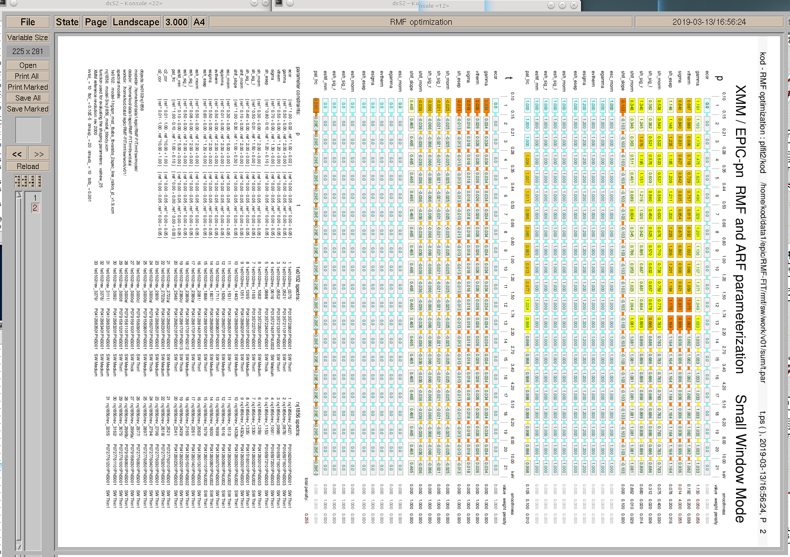
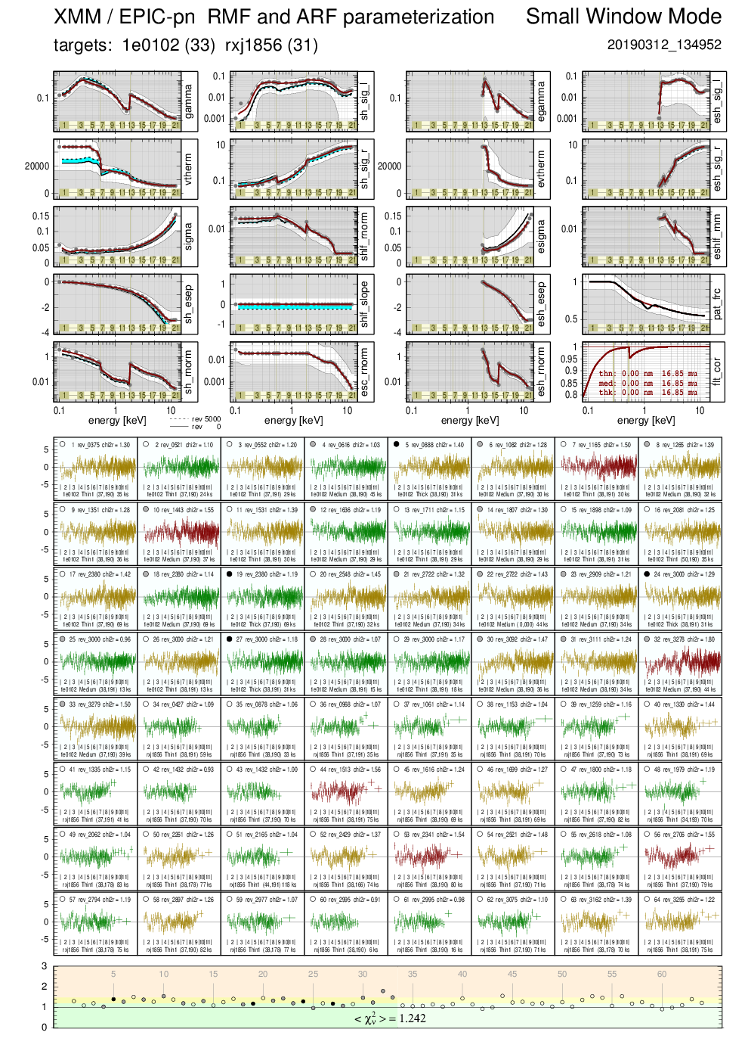
Modelling temporal RMF changes: sample output

Slide 18
19 RMF shaping functions
with 21 parameters each
→ 399 RMF parameters
21 parameters for correcting the energy dependence of
the fraction of singles
2 correction functions for the filter transmission (O and C thickness) for
each filter → 6 parameters
→ 27 ARF parameters
426 parameters
(linear) temporal dependence of each parameter
➔ 852 parameters
parameters can be fixed, coupled, tied, constrained,
and determined for a
given smoothness of the shaping function

Slide 19
Modelling temporal RMF changes: sample output

Slide 20
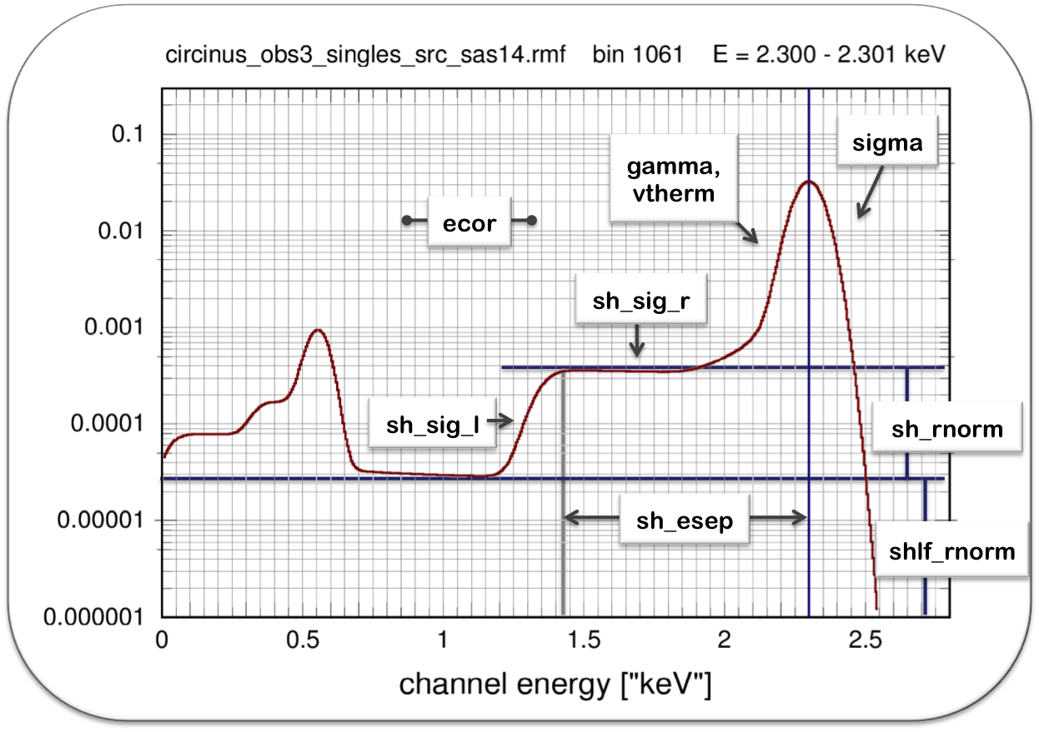
Modelling temporal RMF changes: shaping functions
ARF parameters
RMF parameters

Slide 21
Modelling temporal RMF changes: shaping functions

Slide 22
Modelling temporal RMF changes: sample output

Slide 23
Modelling temporal RMF changes: residuals
red: reduced χ² > 1.5
yellow: 1.2 ≤ reduced χ² ≤ 1.5
green: reduced χ² < 1.2

Slide 24
Modelling temporal RMF changes: sample output

Slide 26
Modelling temporal changes: data and models used
Data:
1E 0102:
33 observations from rev 0375 to rev 3279
13 x thin, 16 x medium, 4 x thick filter
SW mode only, and only singles
total exposure: 1.14 Ms
processed by Frank Haberl
with xmmsas_20170330_1731-17.0.0
using rmfgen-2.5.1, arfgen-1.93.1
RX J1856:
31 observations from rev 0427 to rev 3255
all with thin filter
SW mode only, and only singles
total exposure: 2.05 Ms
processed by Frank Haberl
with xmmsas_20160201_1833-15.0.0
using rmfgen-2.2.1, arfgen-1.92
in total: 3.2 Ms (!), time span: 15.9 years
Models:
1E 0102:
IACHEC model with only 1 free parameter:
global normalization
+ gain fit (offset)
RX J1856:
TBabs * bbodyrad
with all parameters from Chandra
(no free parameter!)
nH == 7.25 e-19 cm-2
kT == 62.4 eV
norm == 1.58 e5
+ gain fit (offset)

Slide 27
Residuals obtained with xmmsas RMF
spectral models:
1E 0102
IACHEC model
with only 1 free parameter:
global normalization
+ gain fit (offset)
RX J1856
TBabs * bbodyrad
with all parameters from Chandra
(no free parameter!)
nH == 7.25 10⁻¹⁹ cm⁻²
kT == 62.4 eV
norm == 1.58 10⁵
+ gain fit (offset)
average reduced χ² = 10.409

Slide 28
Residuals obtained with parameterized RMF
spectral models:
1E 0102
IACHEC model
with only 1 free parameter:
global normalization
+ gain fit (offset)
RX J1856
TBabs * bbodyrad
with all parameters from Chandra
(no free parameter!)
nH == 7.25 10⁻¹⁹ cm⁻²
kT == 62.4 eV
norm == 1.58 10⁵
+ gain fit (offset)
average reduced χ² = 1.310

Slide 29
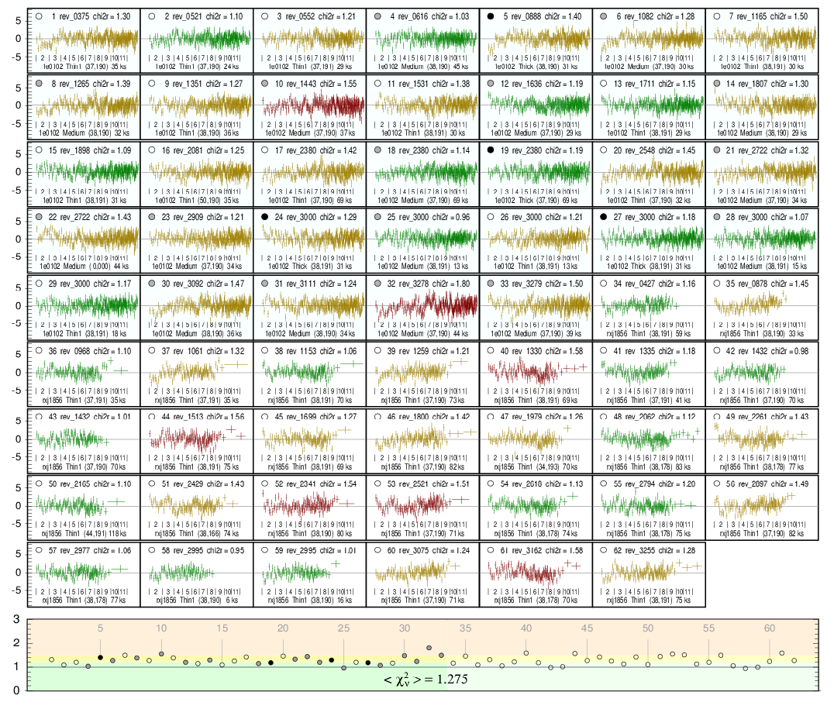
Residuals obtained with parameterized RMF
spectral models:
1E 0102
IACHEC model
with only 1 free parameter:
global normalization
+ gain fit (offset)
RX J1856
TBabs * bbodyrad
with all parameters from Chandra
(no free parameter!)
nH == 7.25 10⁻¹⁹ cm⁻²
kT == 62.4 eV
norm == 1.58 10⁵
+ gain fit (offset)
average reduced χ² = 1.275

Slide 30
Residuals obtained with parameterized RMF
spectral models:
RX J1856:
no need for a second component,
parameters identical to that derived from Chandra
1E 0102:
IACHEC model works well
1E 0102
IACHEC model
with only 1 free parameter:
global normalization
+ gain fit (offset)
no obvious filter dependence
no obvious positional dependence
no obvious long-term trend
1E 0102: no renormalization between individual filters necessary
RX J1856:
no renormalization between individual positions necessary (vignetting correction ok )
RX J1856
TBabs * bbodyrad
with all parameters from Chandra
(no free parameter!)
nH == 7.25 10⁻¹⁹ cm⁻²
kT == 62.4 eV
norm == 1.58 10⁵
+ gain fit (offset)
1E 0102
RXJ1856
average reduced χ² = 1.275

Slide 31
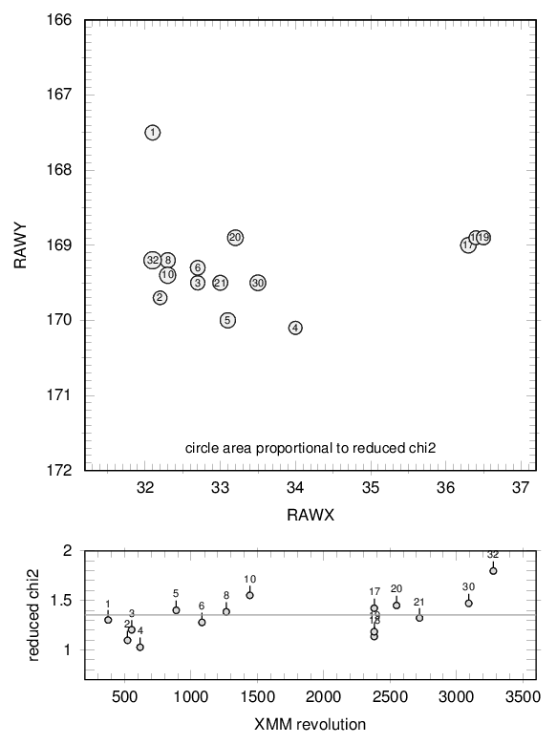
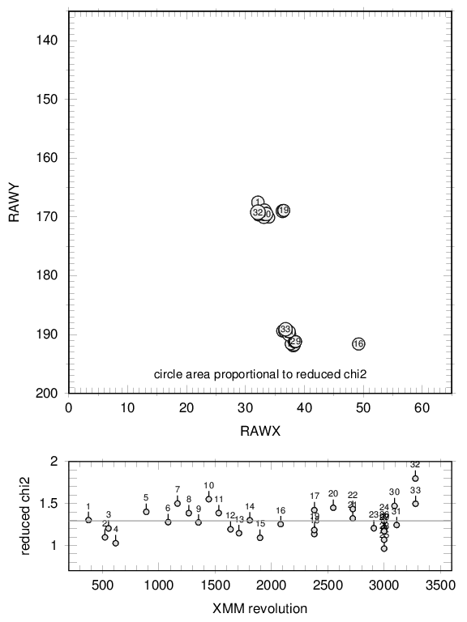
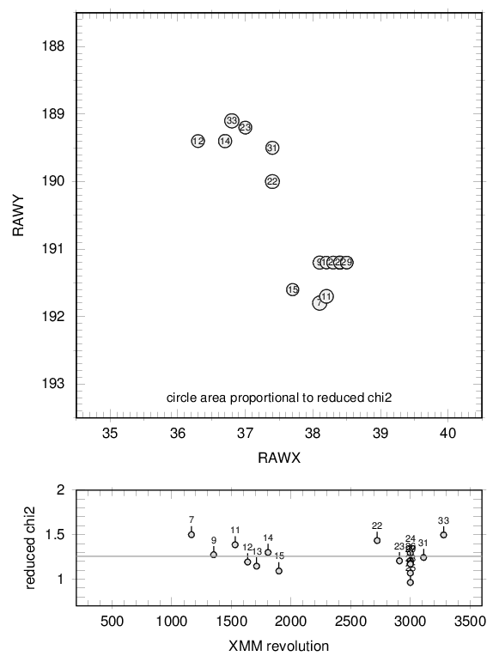
1E 0102: Fit quality over position and time
SW field of view
→ no obvious dependence on position or time

Slide 32
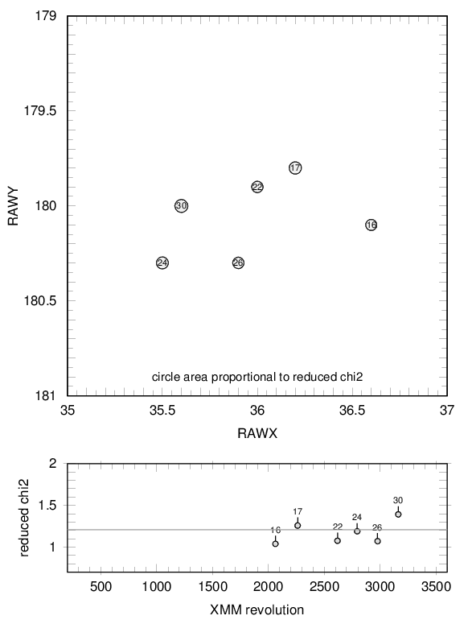
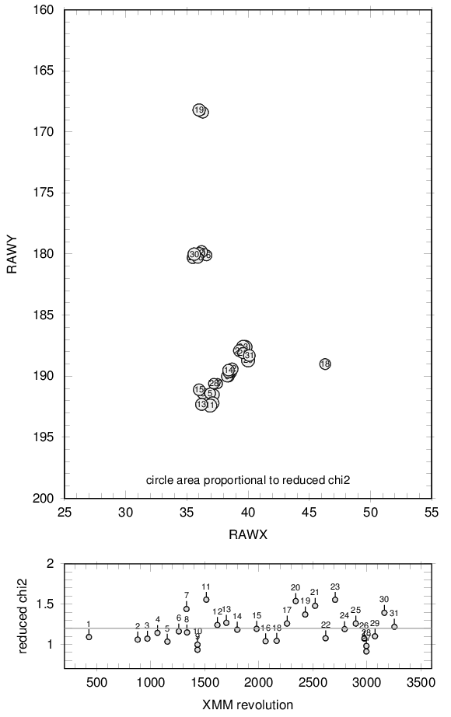
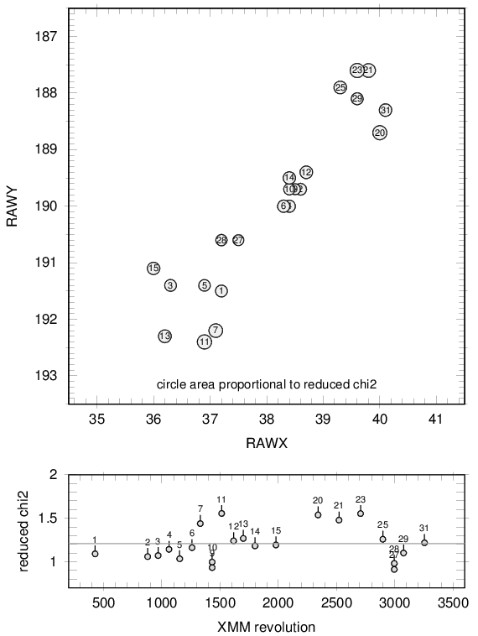
RX J1856: Fit quality over position and time
→ no obvious dependence on position, no obvious long-term trend

Slide 33
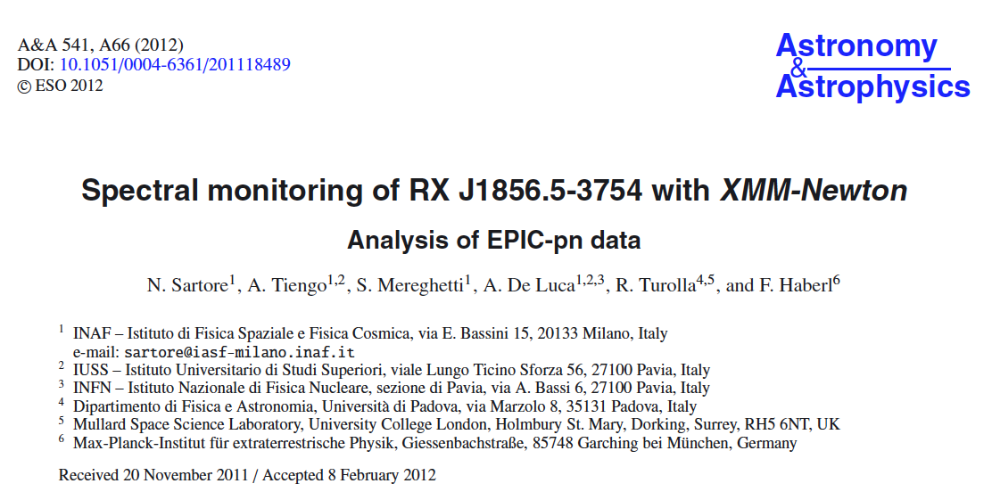
Previous spectral studies of RX J1856

Slide 34
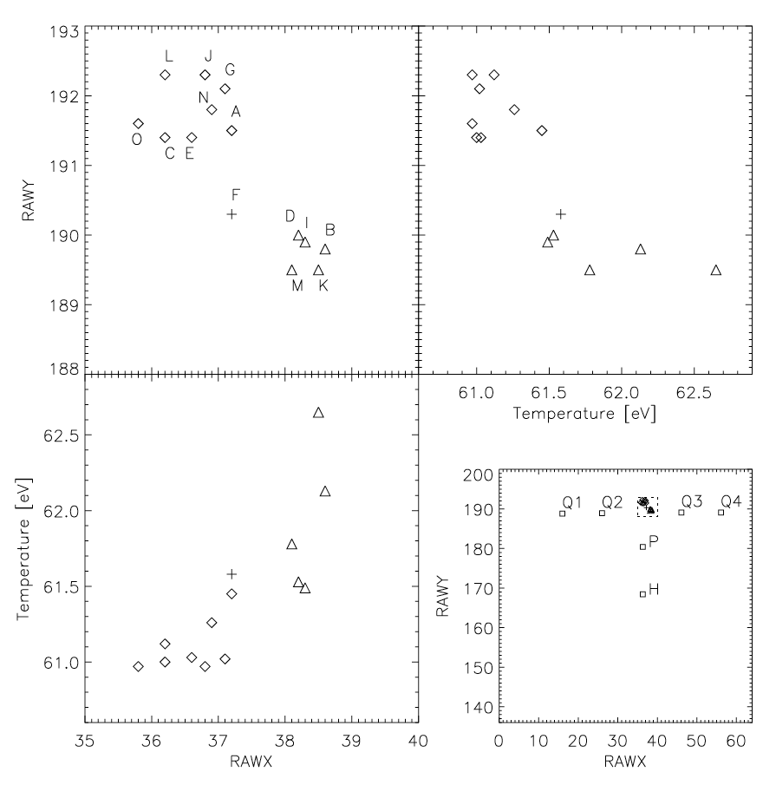
Previous spectral studies of RX J1856
Chandra LETG
Chandra LETG
Sartore et al. 2012, Fig. 3

Slide 35
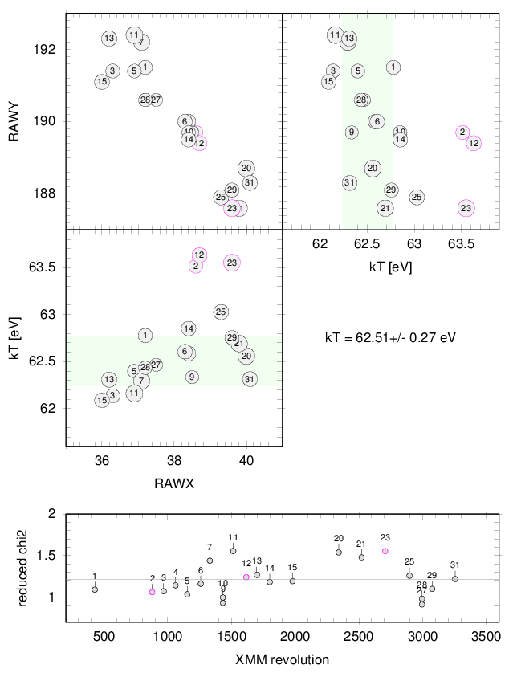
RX J1856: spectral fit results from new RMF
Chandra LETG
kT consistent with Chandra LETG
deviation in 3 observations (but no long-term trend and no positional trend)
Chandra: kT = (62.4 +/- 0.4) eV
→ kT = 62.51 +/- 0.27 keV
(excluding 2,12,23)

Slide 36
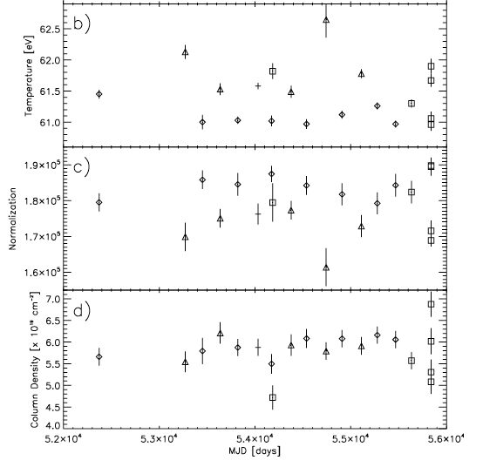
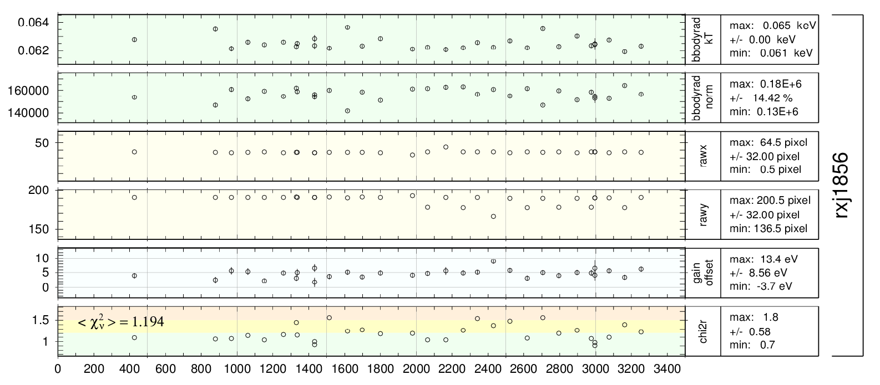
RX J1856: new RMF highlights sporadic spectral changes
single BB fits (phabs * bbodyrad)
to singles within 0.15 – 1.2 „keV“
with n_{H} fixed to 5.84×10¹⁹ cm^{-2,}
using SAS v11.0: χ_{ν}² = 1.37
large scatter
Sartore et al. 2012, Fig. 2
evidence for sporadic spectral changes
χ_{ν}² = 1.19

Slide 37
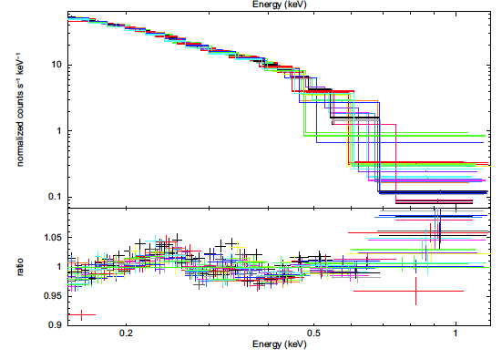
Previous spectral studies of RX J1856
2
TBabs * bbodyrad
with all parameters from Chandra
(no free parameter!)
nH == 7.25 10⁻¹⁹ cm⁻²
kT == 62.4 eV
norm == 1.58 10⁵
+ gain fit (offset)
→ necessity to adopt significantly different parameters
and/or to introduce a second component
common single BB fit (phabs * bbodyrad)
to singles within 0.15 – 1.2 ‚keV‘
with all parameters free, using SAS v11.0 + gain fit
→ n_{H} = (5.84 ± 0.04)×10¹⁹ cm⁻²
→ kT = 61.30 ± 0.04 eV
Sartore et al. 2012, Fig. 2
Sartore et al. 2012, Fig. 5
RX J1856: major discrepancies to Chandra results with xmmsas RMF

Slide 38
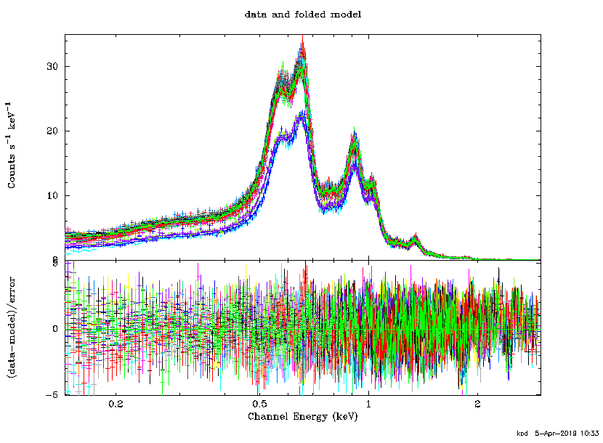
1E 0102: Combined fit of 33 EPIC-pn spectra, r = 30“
E = 0.15 – 3.0 keV, extraction radius: 30 arcsec, small window mode, singles only
each spectrum fit with time dependent parameterized RMF
reduced chi2 = 1.382, chi2 = 15 482, 11 206 PHA bins, 11 201 degrees of freedom

Slide 39
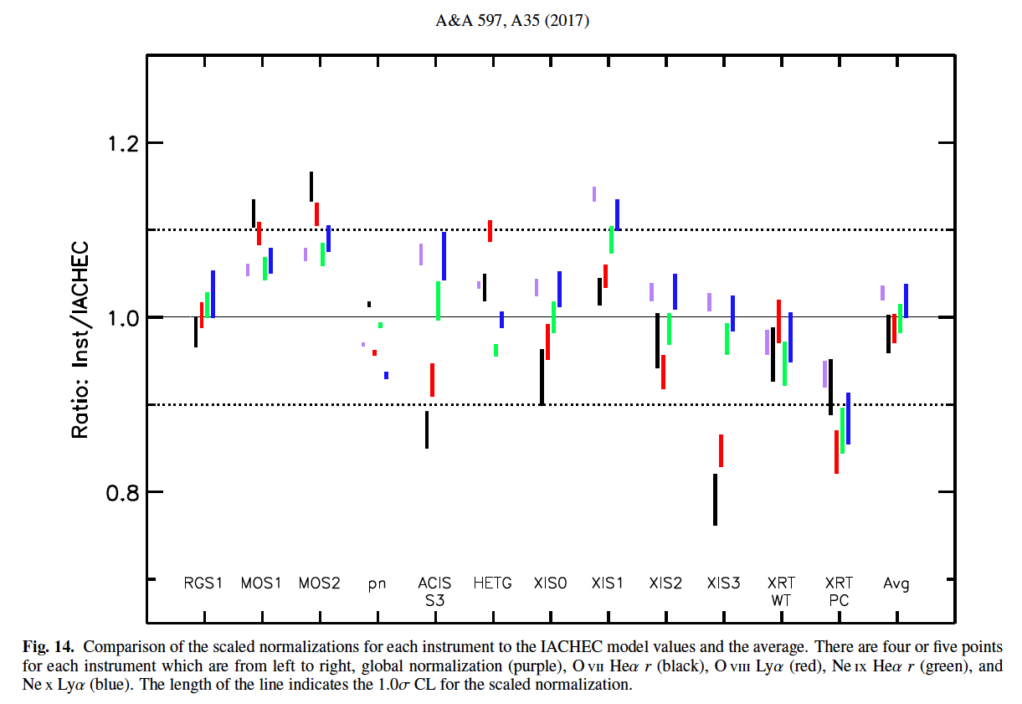
1E 0102: IACHEC model & XMM-Newton / EPIC-pn

Slide 40
1E 0102: IACHEC model & XMM-Newton / EPIC-pn
new

Slide 41
What has changed in the RMF ?
0.04
E = 1.0 keV
rev 2000
SW
singles
0.02
SAS RMF
parameterized RMF
0.0
channel energy [„keV“]

Slide 42
What has changed in the RMF ?
E = 1.0 keV
SW
singles
parameterized RMF
SAS RMF
channel energy [„keV“]

Slide 43
Temporal trend in the parameterized RMF
par. RMF for rev 0
0.04
par. RMF for rev 5000
E = 1.0 keV
rev 0 - 5000
SW
singles
0.02
0.0
channel energy [„keV“]

Slide 44
Composition of the parameterized RMF
sh_esep
E = 1.0 keV
SW
singles
sh_rnorm
sigma
shlf_rnorm shlf_slope
sh_sig_l sh_sig_r
gamma vtherm
channel energy [„keV“]

Slide 45
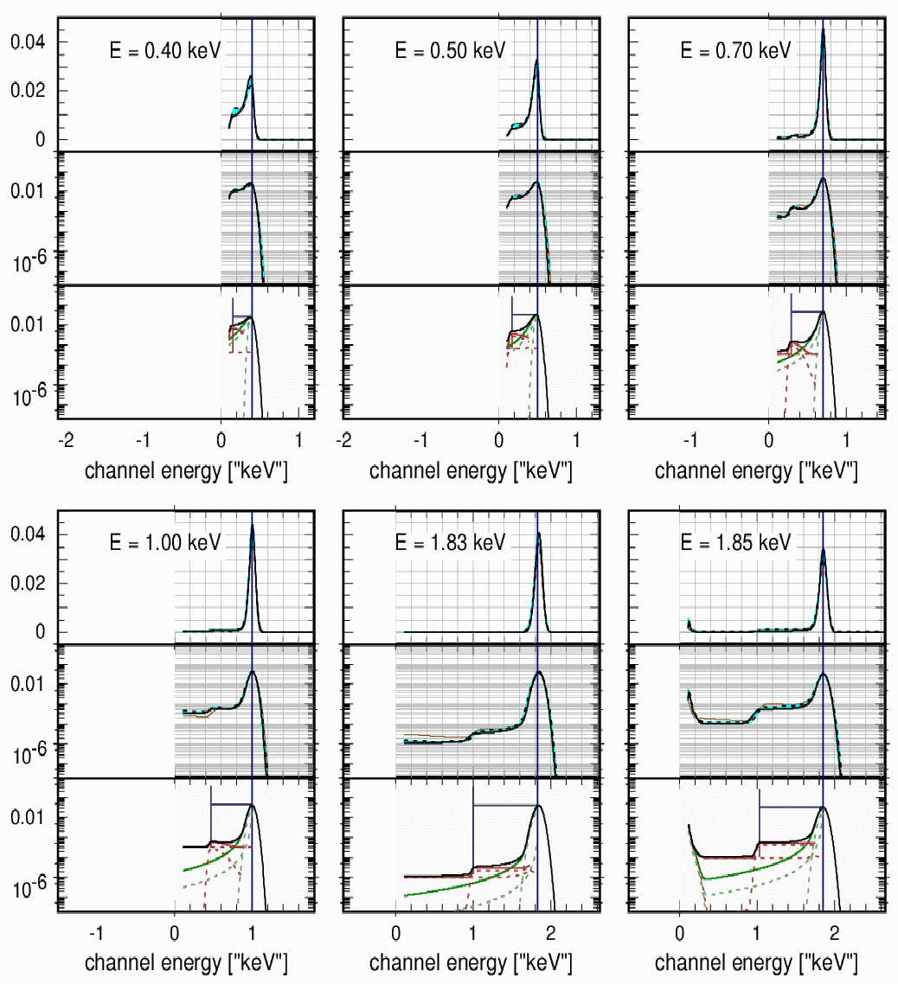
Parameterized RMF from 0.40 – 1.85 keV

Slide 46
Current status
With the current RMF and ARF adjustments it is now possible to fit simultaneously the spectra of RXJ1856 and 1E0102 obtained with all three EPIC pn filters in all revolutions in SW mode without any renormalization between the filters, and using the unmodified Chandra LETG spectral parameters for RXJ 1856. The ARF adjustment requires only a slight increase of the oxygen thickness (with the same value for all filters).
Current restrictions:
only soft (< 2 keV) spectra used (to avoid complications with photon escape)
only SW mode spectra analysed (excellent photon statistics, negligible pile-up)
only single pixel events used (to avoid complications with split charges(
Extensions needed:
full spectral range
other readout modes: FF, eFF, LW, TI, BU
double pixel events

Slide 47
Scientific by-product of the RMF parameterization:
Spectral monitoring of RX J1856.5-3754 with XMM-Newton / EPIC-pn
discrepancy with Chandra LETG solved
no necessity to introduce a second black body
no obvious long-term trend
evidence for sporadic spectral changes

Slide 48
EPIC-pn RMF and ARF Improvement: Modelling temporal changes
Konrad Dennerl - Max Planck Institute for extraterrestrial Physics – Garching - Germany

