Slide 1
Closing address
Takahiro Iwata
Yamagata University
Thanks to speakers, chairpersons and participants

Slide 2
LOC of PacSPIN2019
T. Iwata (Co‐Chair, Yamagata U.)
T. Matsuda (Co‐Chair, U. Miyazaki)
T.‐A. Shibata (Co‐Chair, Tokyo Tech/Nihon U.)
N. Doshita (Yamagata U.)
Y. Goto (RIKEN)
Y. Hatta (BNL)
Y. Koike (Niigata U.)
S. Kumano (KEK)
Y. Maeda (U. Miyazaki)
Y. Miyachi (Yamagata U.)
K. Nagai (Academia Sinica)
I. Nakagawa (RIKEN)
K. Nakano (Tokyo Tech)
G. Nukazuka (Yamagata U.)
S. Sasaki (Tohoku U.)
S. Sawada (KEK)
R. Seidl (RIKEN)
K. Tanaka (Juntendo U.)
Thanks to the members of LOC

Slide 3
Students
Shota Kuroiwa (U.Miyazaki, MC1)
Shuhei Kiyotake(U.Miyazaki, MC1)
Koutaro Nonaka(U.Miyazaki, MC2)
Daisuke Miura(Yamagata U.,DC1)
Secretary
Mami Miidera (Yamagata U)
ANA Holiday Inn Resort Miyazaki Sumio Yano
Kiyoto Mizutani
Miyazaki Convention & Visitors Bureau Kenji Tamura
Thanks to them

Slide 4
History of PacSPIN
1st 1996 Kobe University (23 years ago), Toshiyuki Morii
2nd 1999 RIKEN, Koichi Yazaki
3rd 2001 Peking University, Bo-Qiang Ma
4th 2003 University of Washington, Xiang-Dong Ji
5th 2005 Tokyo Tech, Toshi-Aki Shibata
6th 2007 Vancouver, Andy Miller
7th 2009 Yamagata University, Takahiro Iwata
8th 2011 Cairns, Anthony W. Thomas
9th 2013 Shandong University, Zuo-Tang Liang
10th 2015 Academia Sinica, Hai-Yang Cheng, Wen-Chen Chang
11th 2019 Miyazaki T. Iwata, T. Matsuda, T.-A. Shibata

Slide 5
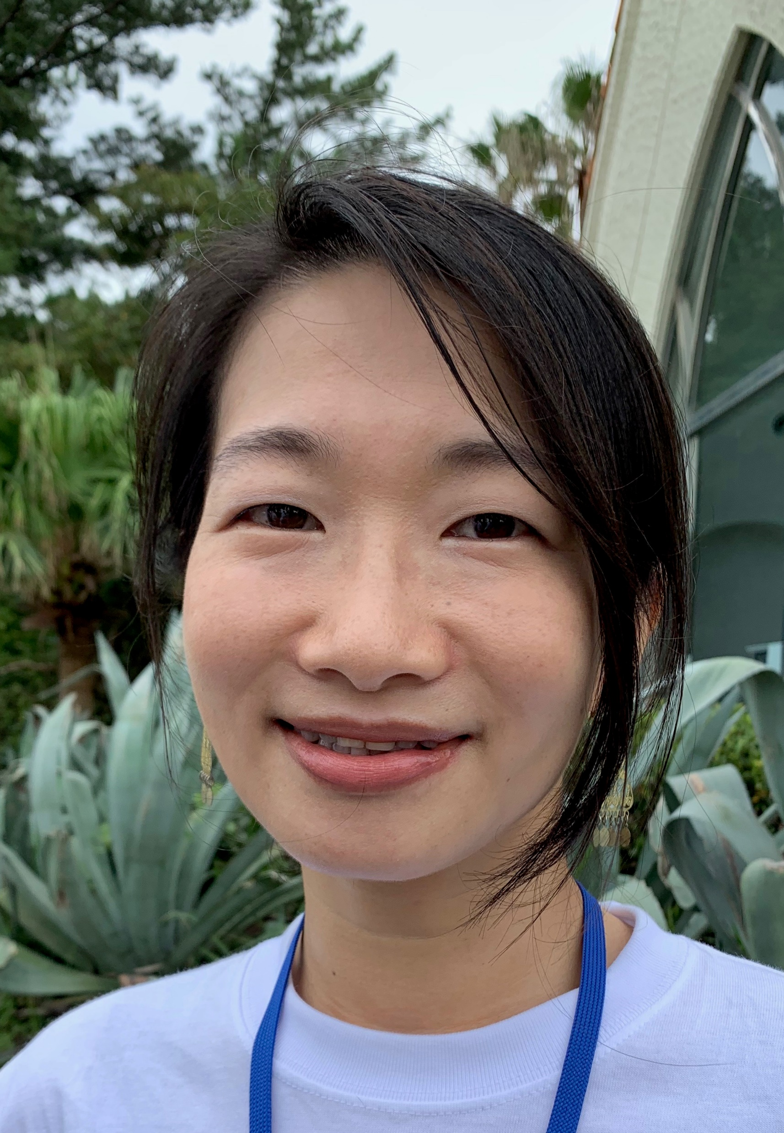
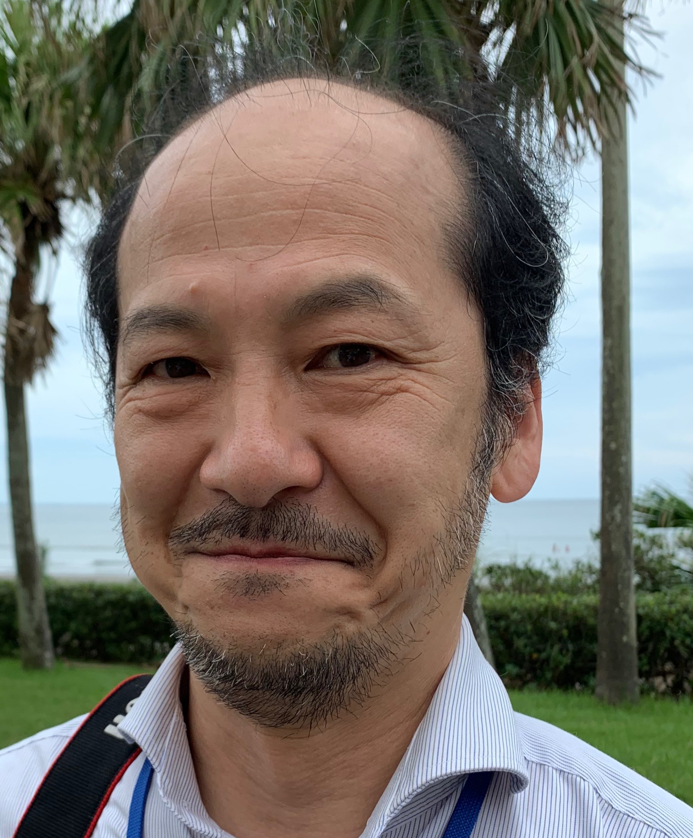
Special thanks to
Tatsuro Matsuda Yukie Maeda

Slide 6
Good-bye

