Slide 1
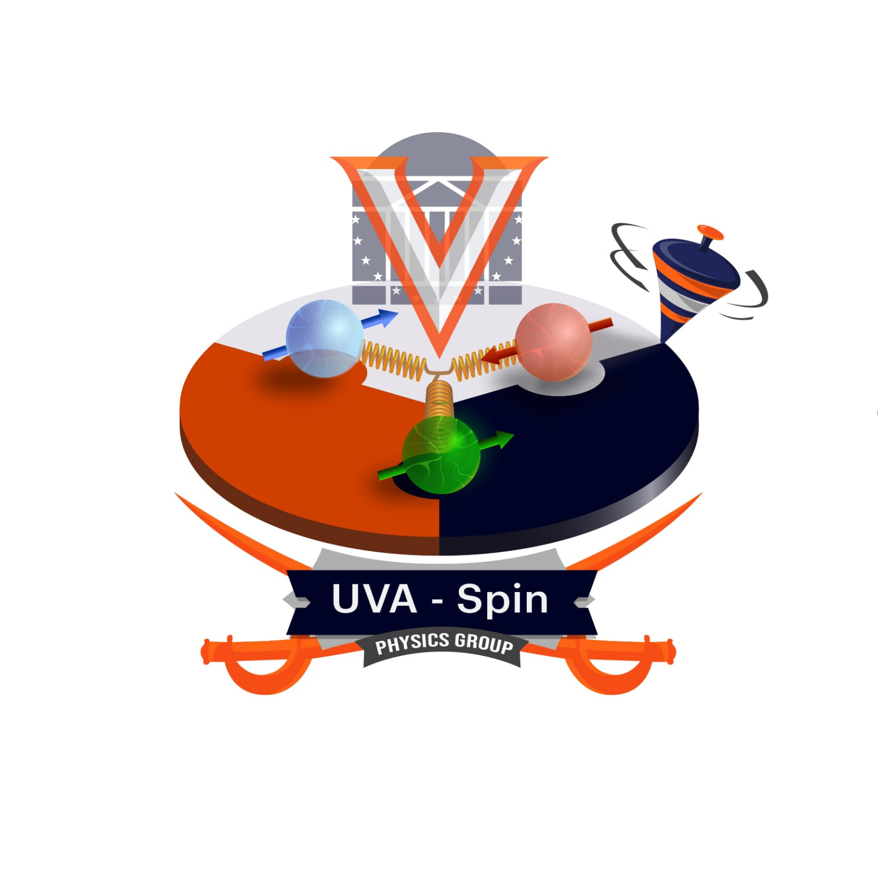
Machine Learning in LabVIEW to target NMR signals
Devin Seay, Ishara Fernando, Connor McClain, Dustin Keller

Slide 2
Background
NMR Measurements w/ Q-Meter
Deuteron lineshape and simulations
Why Artificial Neural Networks (ANN)?
Preliminary results
Observations & Outlook

Slide 3
What is Nuclear Magnetic Resonance (NMR)?
Nuclear Magnetic Resonance, or NMR, is the physical phenomenon that occurs when a constant magnetic field is applied to nuclei at resonance which is perturbed by a weak oscillating magnetic field, which causes the nuclei to respond by producing an electromagnetic signal with a frequency characteristic of the magnetic field of the nuclei.
In the case of this project, we are using NMR to study the inner structure of the Deterium atom.

Slide 4
NMR Measurements with Q-Meter
In the process of Dynamics Nuclear Polarization (DNP), extremely low temperatures, and high magnetic fields and microwaves are used to transfer the spin polarization from electrons to nuclei.
Using a non-destructive continuous wave phase-sensitive detector (ex., a Q-meter), is required to make accurate measurements of polarization in scattering experiments

Slide 5
NMR Measurements with Q-Meter
Q-meter couples to the magnetic susceptibility of target material (Solid Ammonia)
Signal passes through λ/2 length cable (358.0 cm for 5T), so the continuous wave NMR signal has a tuning range of λ/2 to 7λ/2
With a frequency range of 3-300 MHz
The signal is phase sensitive
Constant current supplied, to keep non-destructive polarization measurements

Slide 6
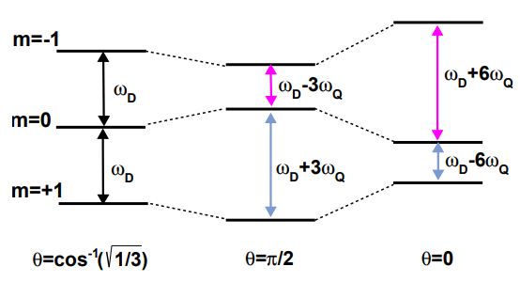
Benefits of using Dynamics Nuclear Polarization (DNP)
Normally forbidden electron transitions can be excited by microwave irradiation
This leads to an extreme increase in polarization and clarity of a lineshape

Slide 7
Deuteron lineshape and simulations
Deuteron's polarization proportional to the integral over the frequency domain of the signal of the NMR measurements
For any signal, the polarization can be calculated rather simply via a Riemann sum, which can be used for both vector and tensor polarization
As the deuteron's signal is about an order of a magnitude smaller than that of a proton, the thermal equilibrium signal is rather challenging to measure with the normal scale of signal-to-noise, which adds error that propagates to the polarized targets.

Slide 8
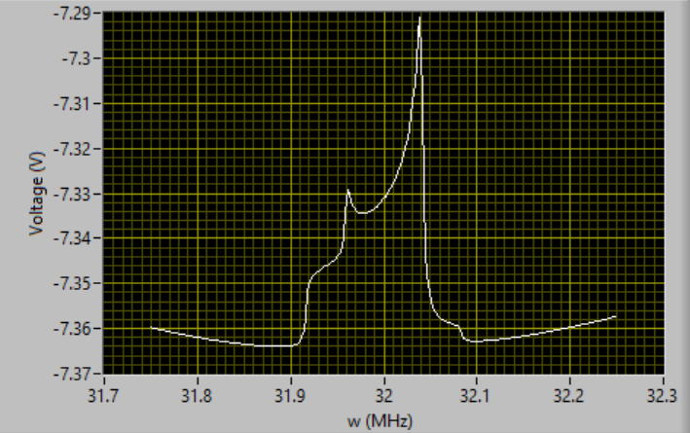
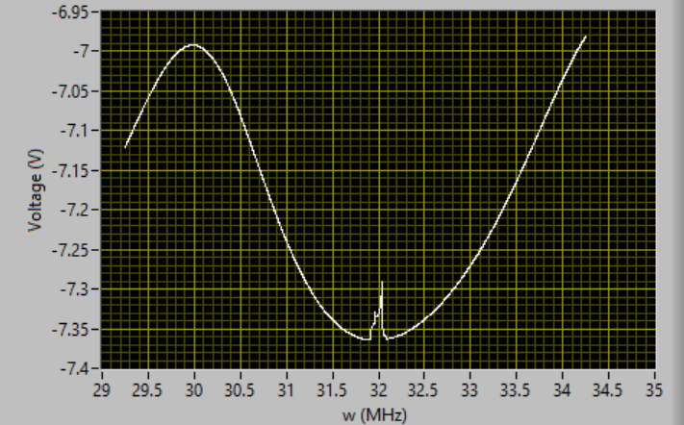
Deuteron Line-shape and Q-curve
Deuteron line-shape
Q-Curve

Slide 9
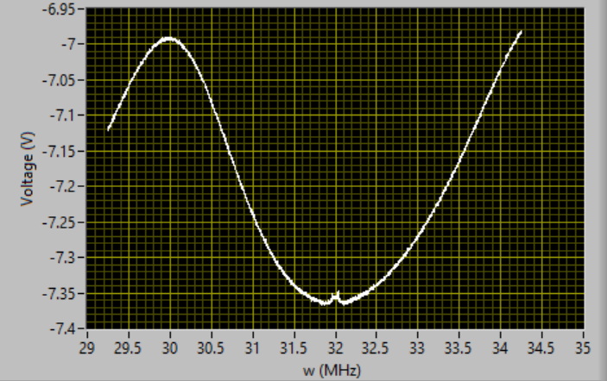
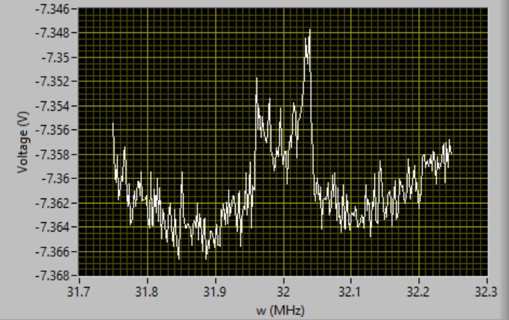
Deuteron Signals
The Deuteron Signal measured from the Q-meter scanning over a frequency range
Signal when scanning around the resonant freqeuency
The Deuteron Signal measured from the Q-meter scanning over a frequency range, with simulated Gaussian noise
Signal when scanning around the resonant frequency, with simulated Gaussian noise

Slide 10
Why Artificial Neural Networks (ANN)?

Slide 11
What is ANN?
Neural networks learn (or are trained) by processing examples, each of which contains a known "input" and "result," forming probability-weighted associations between the two, which are stored within the data structure of the net itself.
The training of a neural network from a given example is usually conducted by determining the difference between the processed output of the network (often a prediction) and a target output. This difference is the error.
The network then adjusts its weighted associations according to a learning rule and using this error value. Successive adjustments will cause the neural network to produce output which is increasingly similar to the target output.

Slide 12
Benefits of ANN
Compared to the Riemann sum method to calculated polarization, ANN techniques are much more accuarate in comparison which reduced measurement errors from 7% to 2%.
There is a least one hidden layer with a non-linear activation, therefore we can approximate the unknown behavior via ANN
Even with added Gaussian noise to make the deuteron signal less discernable, ANN can be trained to filter out the noise and measure the true polarization of a signal by noise that is 10x stronger than that of a signal
Causes of error: Background noise and noise periodicity, λ/2 cable length that signal passes through, Q-curve shape and centering, Inductance-Capacitance (LC) Relations, Radiofrequency (RF) reflections and interference modes (especially within cable), Slight variations in temperature.

Slide 13
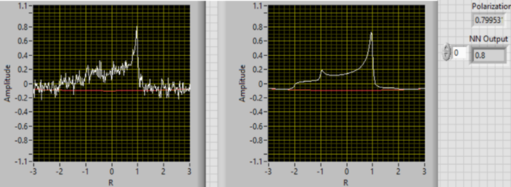
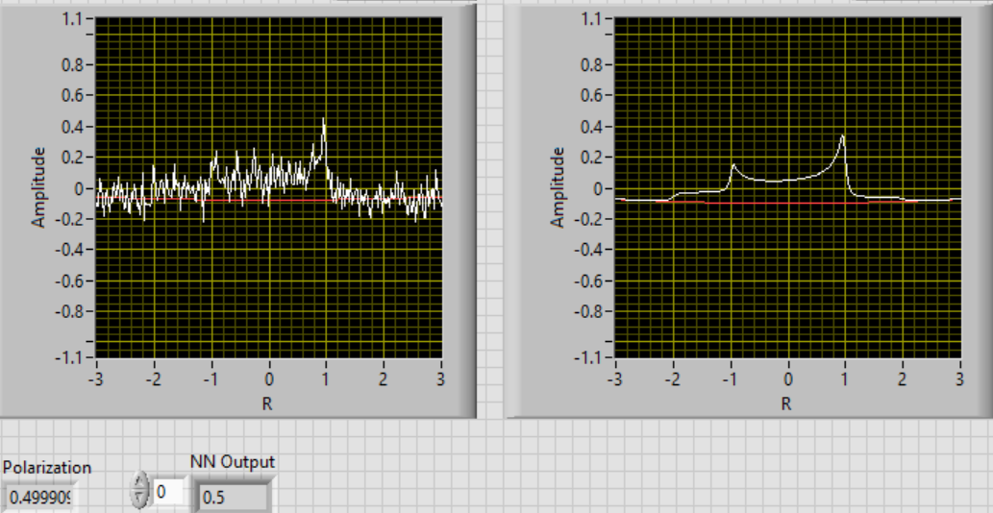
Preliminary Results
Deuteron signal with simulated noise (left) and anticipated ANN filtered noise (right)
Simulated P: 79.9%
ANN Estimate: 80.0%
Simulated P: 49.9%
ANN Estimate: 50.0%

Slide 14
Prospective Outlook and Future Plans
ANN can allow for the efficient filtering of background noise from deuteron signal (could also be applied to any NMR signal)
The adaptability of the ANN allows for changes in baseline and scanning range of an NMR to quickly and easily be considered
Can also train the ANN to adapt to changes in parameters which are outside the operational parameters of the physical systems
For the future: optimize the ANN to train to detect noisy signals caused by internal interference within a λ/2 length cable and filter out noise

Slide 15
Thank you!
This work was supported by DOE contract DE-FG02-96ER40950

