Slide 1

SPIN2016
SPIN2021 The 24th International Spin Symposium
October 18-22, 2021 at Matsue, Japan
Status of Polarized Solid Targets in European High Energy Scattering Experiments
G. Reicherz
Notes:
In Europe are running three polarized solid state targets in single and double polarized scattering experiments. In Bonn at ELSA and in Mainz at MAMI are two targets located. Both are so called frozen spin targets, which are dynamically polarized and during data taking the material is cooled down to 50 mK and lower, where the spins are frozen what means the relaxation time is increased to few hundred up to several thousand hours, depending on temperature and applied magnetic field. The biggest polarized target in the world is the COMPASS target, running in the north area at CERN. This target can run in frozen spin and in continuous wave mode depending on the physical question of the scattering experiment.
This talk presents the status of the three experiments with a focus on the targets.

Slide 2
Content
Introduction
COMPASS
A2-MAMI
CB-Elsa
Summary

Slide 3
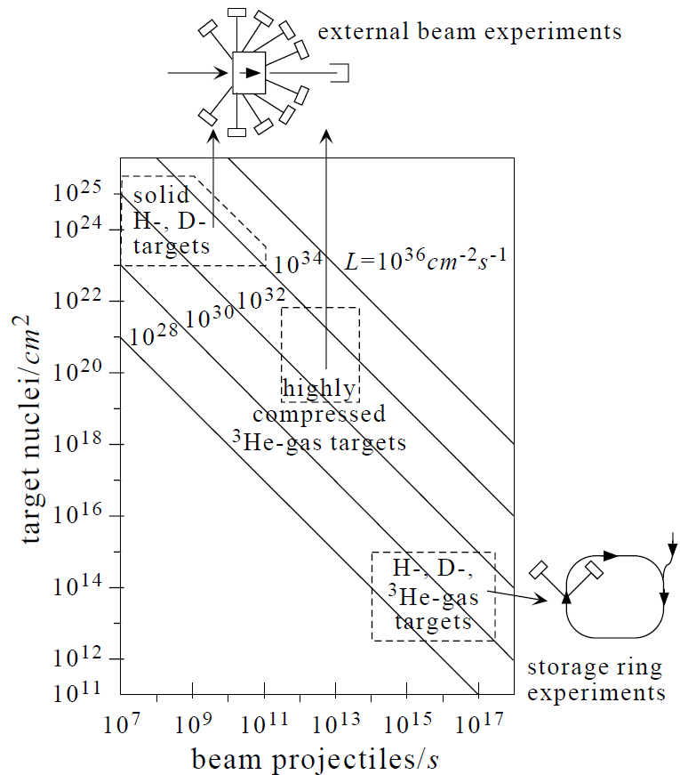
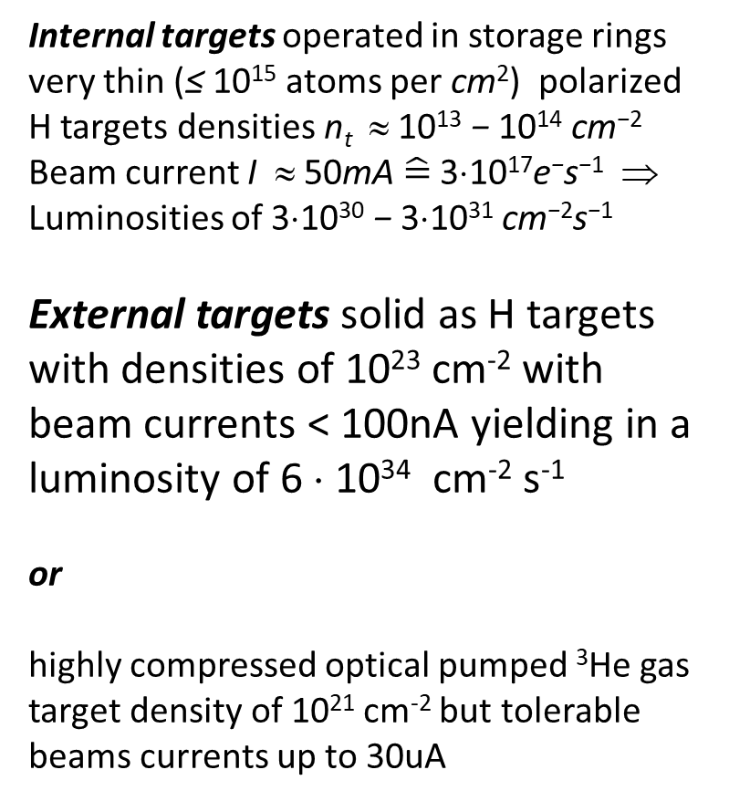
Introduction
Internal targets operated in storage rings very thin (≤ 10¹⁵ atoms per cm²) polarized H targets densities n_{t} ≈ 10¹³ − 10¹⁴ cm⁻²
Beam current I ≈ 50mA $\hat{=}$ 3⋅10¹⁷e⁻s⁻¹ ⇒
Luminosities of 3⋅10³⁰ − 3⋅10³¹ cm⁻²s⁻¹
External targets solid as H targets with densities of 10²³ cm⁻² with
beam currents < 100nA yielding in a luminosity of 6 ⋅ 10³⁴ cm⁻² s⁻¹
or
highly compressed optical pumped ³He gas target density of 10²¹ cm⁻² but tolerable beams currents up to 30uA

Slide 4
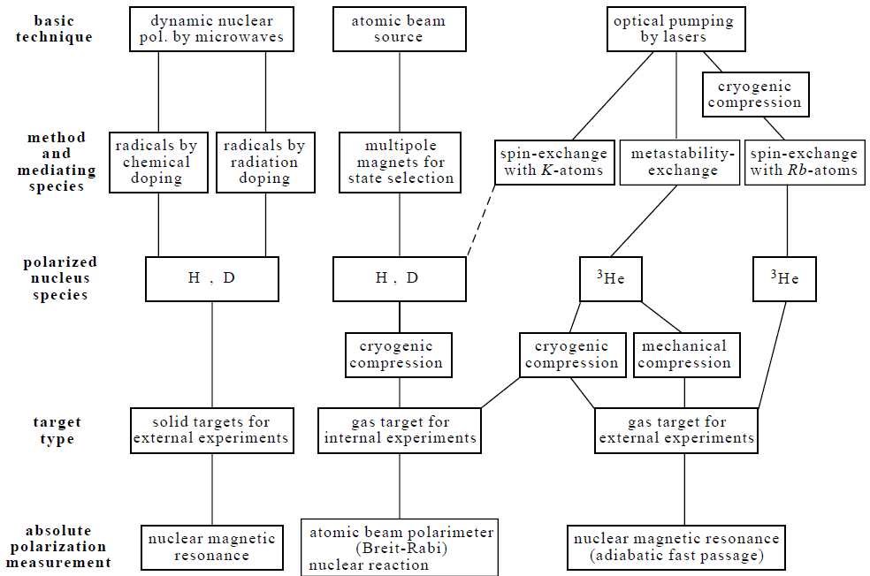
Target: polarization techniques
Notes:
Specifics of the different polarized target techniques. Dashed line --- : Up to now
laser driven sources using spin-exchange with K atoms are not routinely used for H-and D
target operation in particle physics experiments.

Slide 5
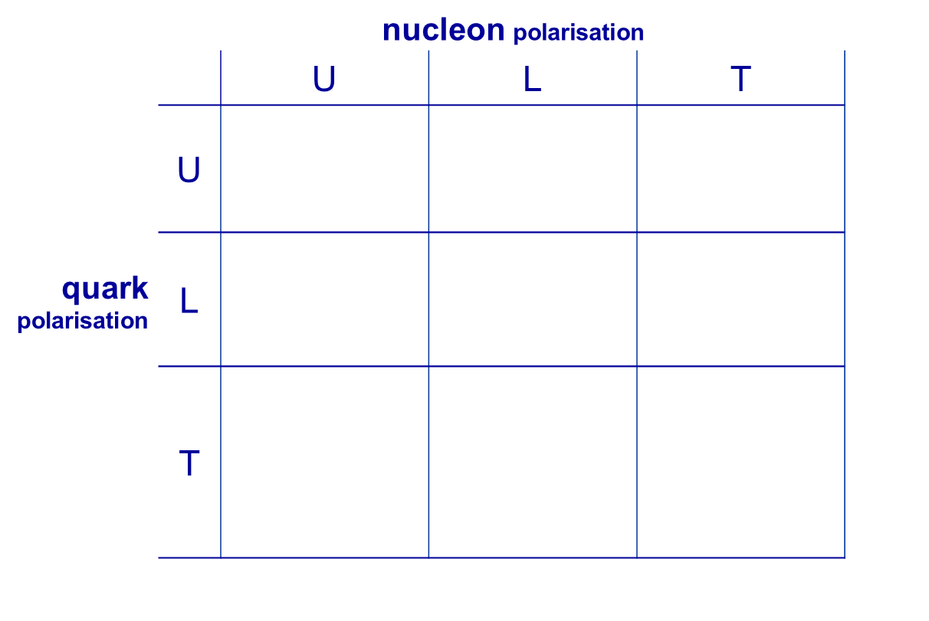
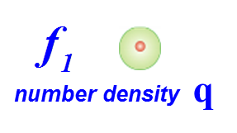
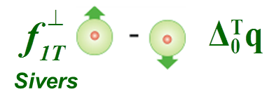
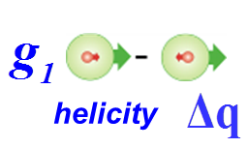

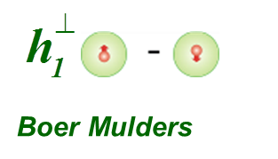

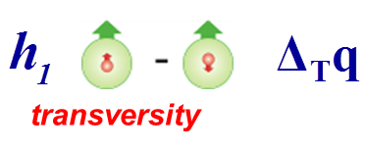

Introduction COMPASS CERN
Structure of the nucleon
8 intrinsic transverse momentum dependent PDFs
Asymmetries with different angular dependences on hadron and
spin azimuthal angles, Φh and Φs
nucleon polarization
quark
polarization
SIDIS gives access to all of them
Notes:
taking into account the quark intrinsic transverse momentum k_{T} ,
at leading order other 6 TMD PDFs are needed for a full description
of the nucleon structure

Slide 6
COMPASS II
approved by CERN Research Board in 2010
• Polarized Drell-Yan measurement
TMD PDFs
• GPD measurement
Transverse imaging
• Pion and Kaon polarizability
Chiral perturbation theory
π-- beam with polarized proton target
μ+ μ- beam with liquid hydrogen target
π--, K- (μ-) beam with nucleus target
With a upgraded COMPASS spectrometer
2014 Test beam Drell-Yan process with π beam and T polarized proton target
2015 Drell-Yan process with π beam and T polarized proton target
2016 DVCS / SIDIS with μ beam and unpolarized proton target
2017 DVCS / SIDIS with μ beam and unpolarized proton target
2018 Drell-Yan process with π beam and T polarized proton target
Notes:
TMD transverse momentum distribution
GPD General Parton Distribution

Slide 7
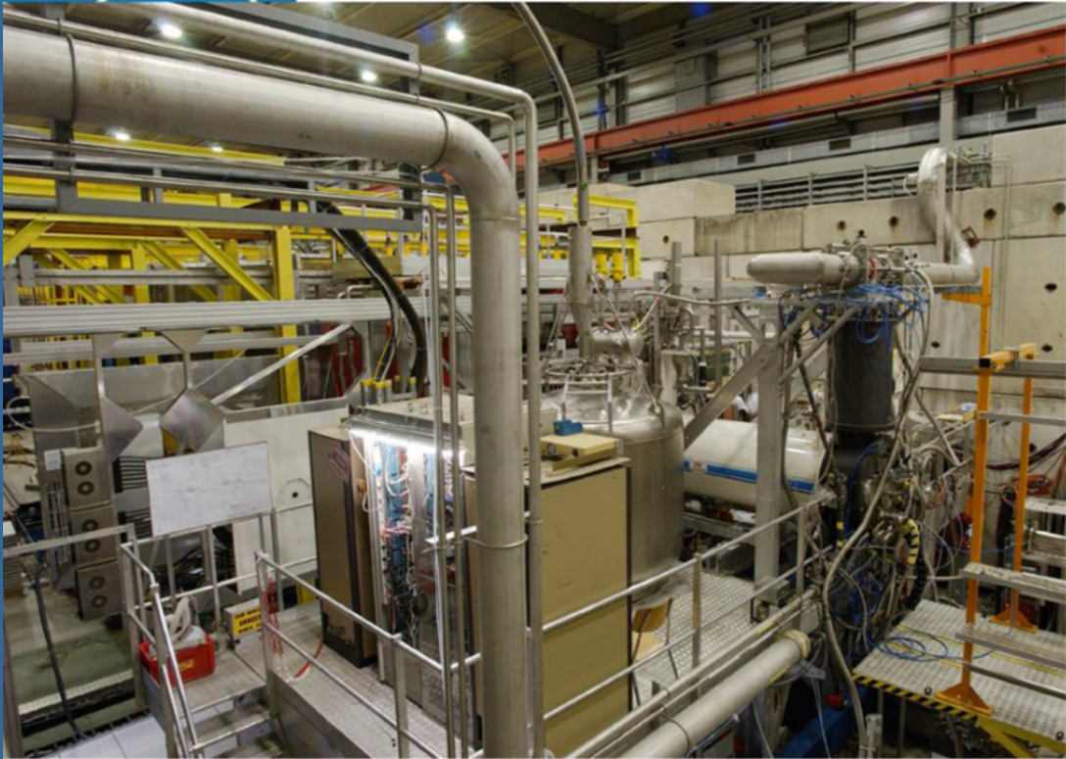
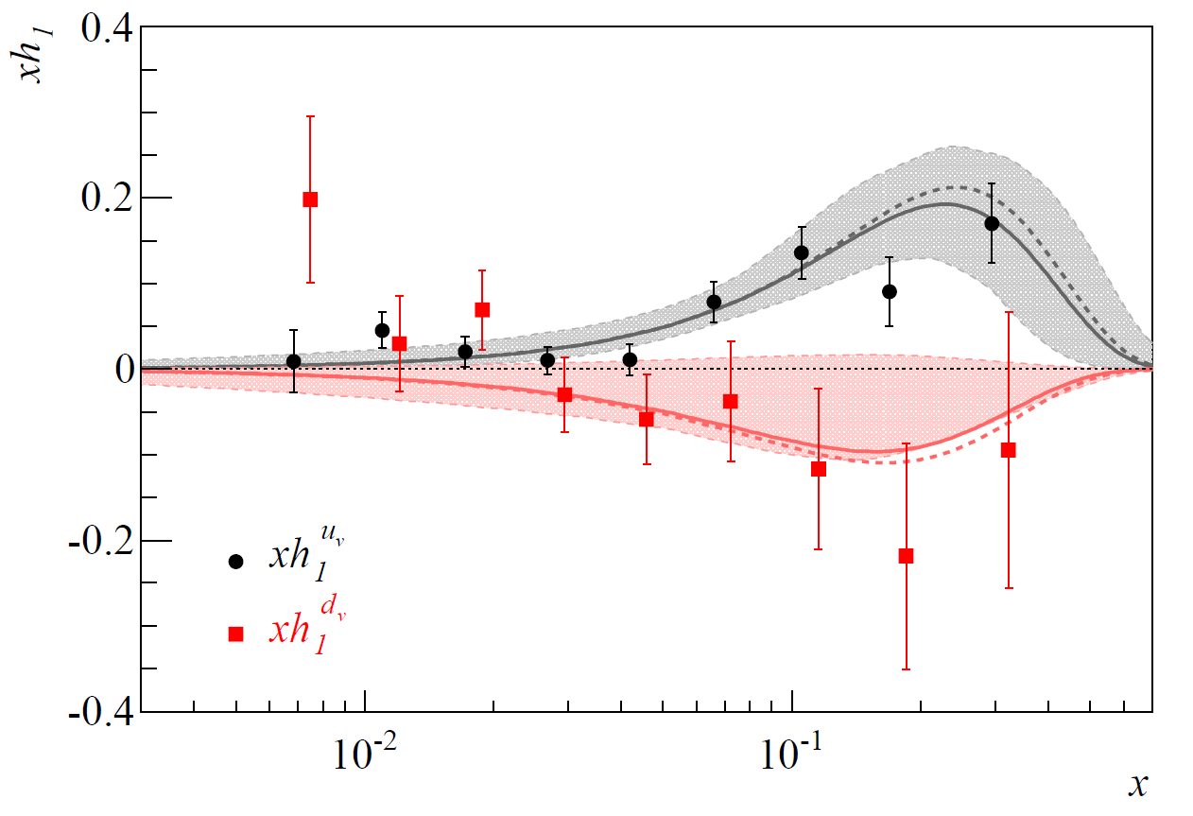
SIDIS – transversely polarized Deuteron Target
Transversity/Sivers PDF extraction
TMD PDFs and Transversity h₁(x) are flavor dependent
Flavour separation -> data on both proton and deuteron
transversely polarized targets
Proton data set is factor 4 compared to deuteron
(see error bars for transversity h₁(x) in the plot below)
It’s logical to increase the deuteron data set (so far the
only data sets available are COMPASS (⁶LiD) and
CLAS (³He) target
A new measurement of SIDIS on
transversely polarized deuteron
in 2021 and next year is planed.
A. Martin, F.B., V. Barone PRD91 (2015) 014034

Slide 8
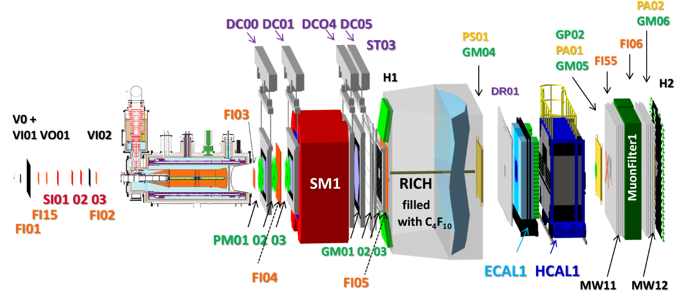
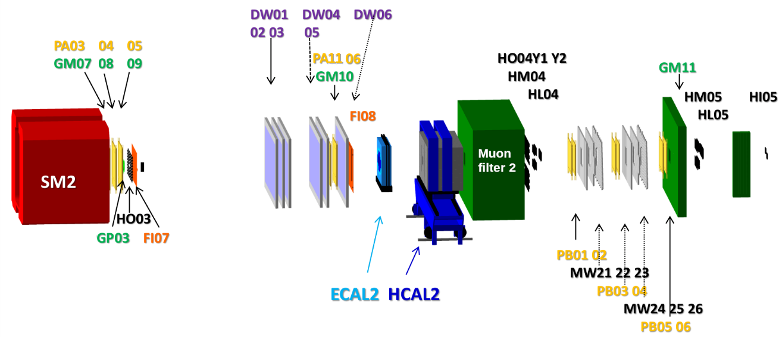
COMPASS setup in 2021
Similar setup to 2010, i. e. polarized target, large-angle spectrometer (LAS) tracking detectors.
The list of detectors is about the same as in 2018 plus the silicon beam telescope.
Notes:
Same setup like in 2015 increasing of the statistics

Slide 9
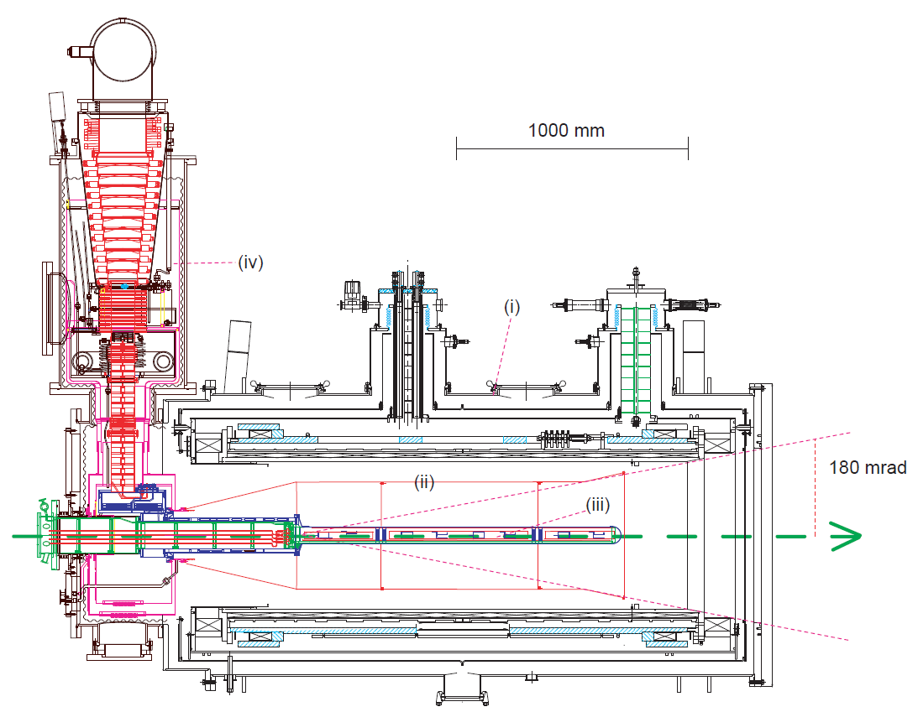
COMPASS Polarized Target 2021
SIDIS of muons off transversely
polarized ⁶LiD target
• 2.5 T solenoid + 0.6 T dipole
• 50 mK dilution refrigerator
• 30+60+30 cm long 3 cells
• LiD as deuteron target
• DNP by microwave of 70 GHz
• 10 NMR coils
• Frozen spin mode at 50mK

Slide 10
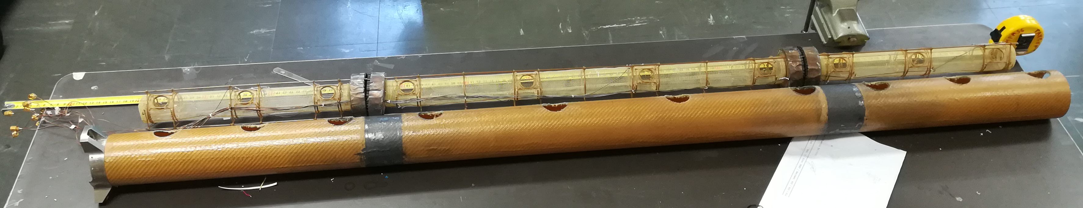
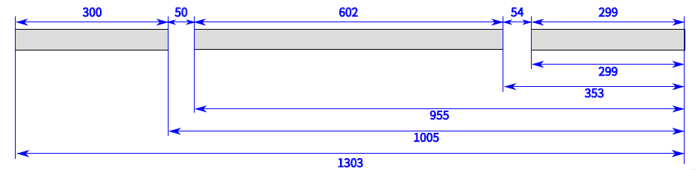
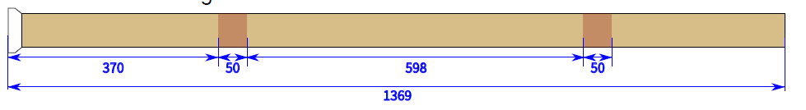
3 target cells and 10 NMR coils
Kevlar tube

Slide 11
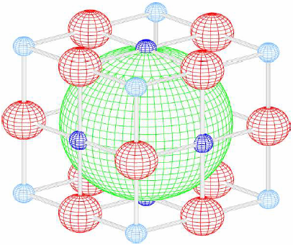
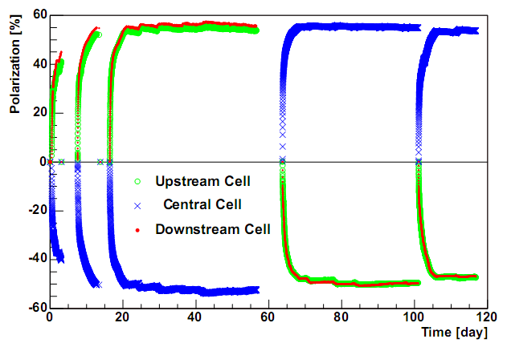
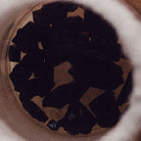
2021 Target material ⁶LiD
Preparation by irradiation with electrons
(E_{e}= 20 MeV, T=190K)
f = 4/8 = 0.5 (⁶Li: α + D)
COMPASS 2006
P+ = +56%
P- = -52%
Notes:
Produced in Bochum in 2000 and radiated in Bonn at 20MeV Linac e-

Slide 12
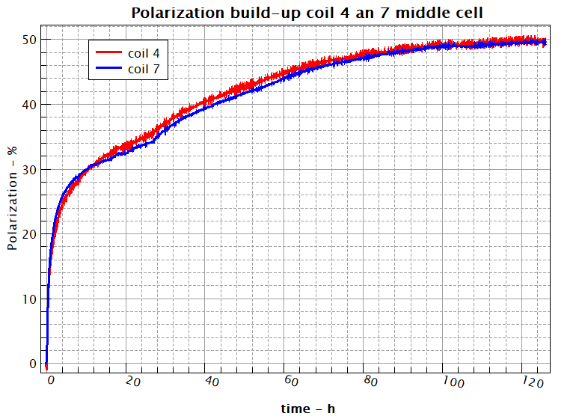
2021 Target results
Polarization buil-up for coils 4 and 7
in the middle cell
50% polarization was reached
Bolometric EPR lines for different
polarization values

Slide 13
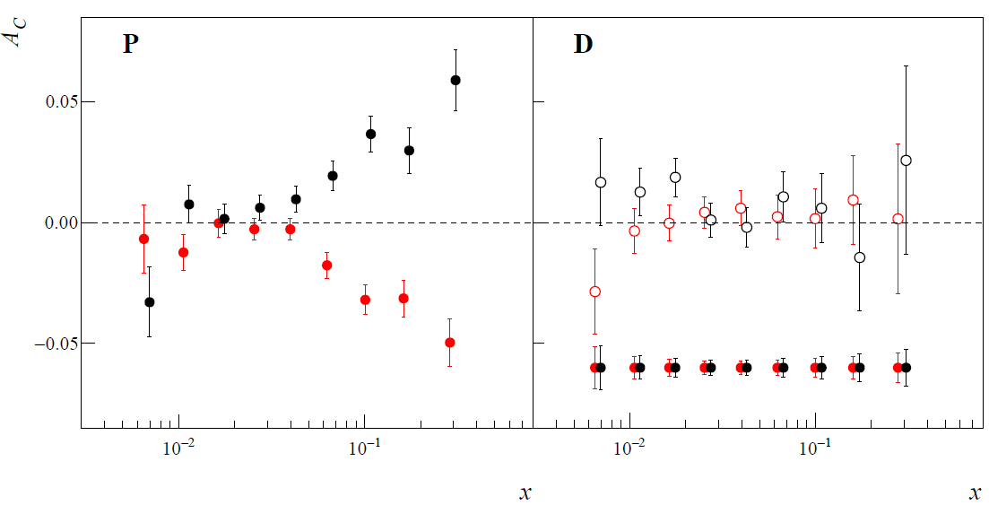
Measurement in 2022
Structure of the nucleon
SIDIS results on transversely polarized targets measured by COMPASS
h+ and h- (PID) TSA on d COMPASS
gluon Sivers, J/Ψ, Λ on p and d COMPASS
h+h- (PID) TSA on d COMPASS
d: statistically limited
one year of running with
transversely polarized
deuteron in the same
conditions as in 2010
decreased the statistical
errors
Notes:
taking into account the quark intrinsic transverse momentum k_{T} ,
at leading order other 6 TMD PDFs are needed for a full description
of the nucleon structure

Slide 14

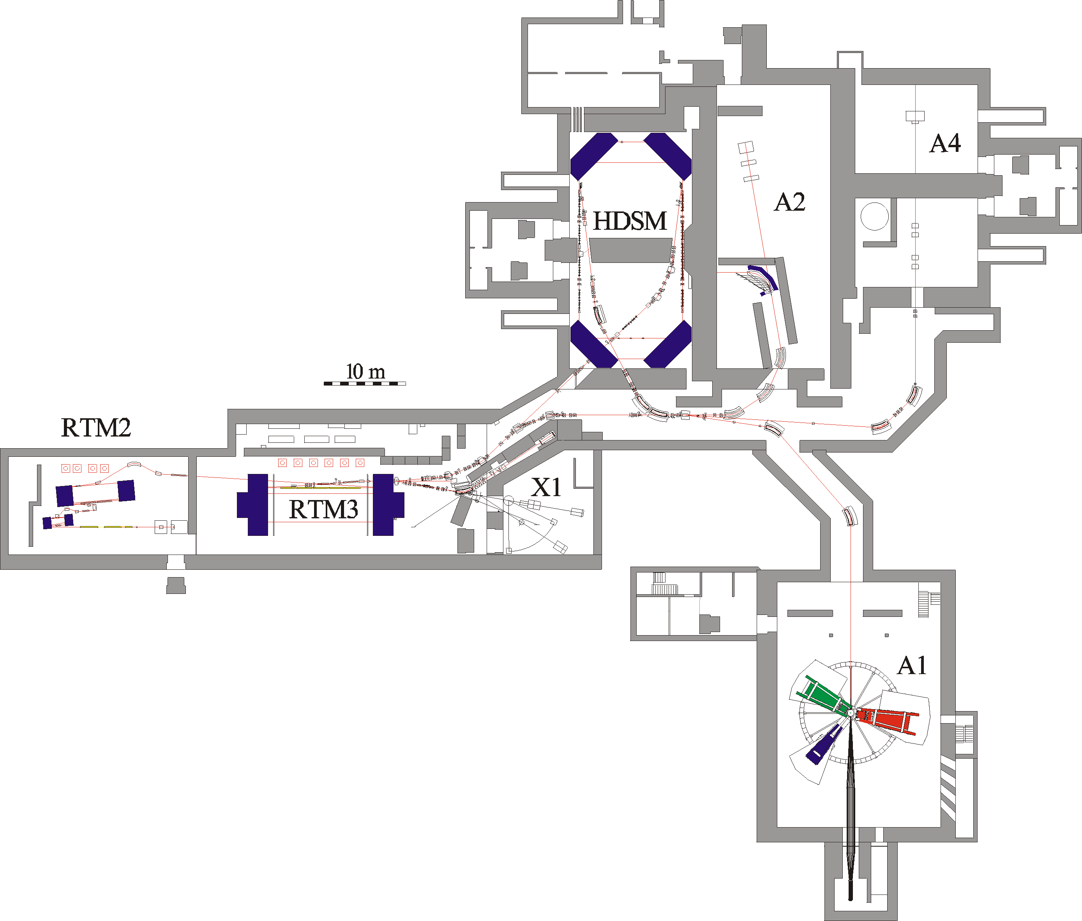
Status and plans for experiments with polarized target at MAMI
Parameter
1604MeV, σ_{E}=0.100MeV
max. 40μA polarized
ε_{h}=9 nm rad, ε_{v}=0.5 nm rad
~6500h/year
The Mainz Microtron MAMI

Slide 15

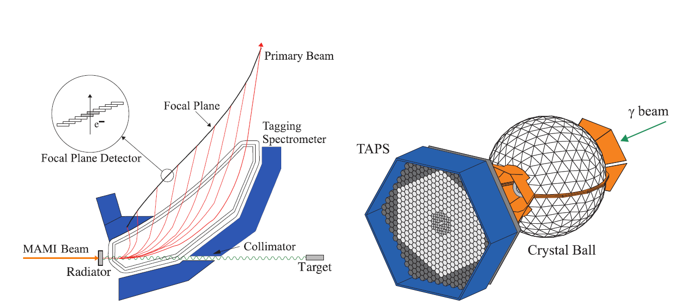
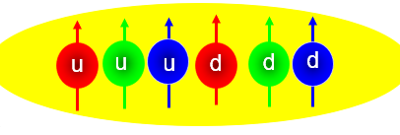
A2 Tagging system and Crystal Ball – TAPS detector
Next Experiments with PT starting in 2022:
Deuteron Photodisintegration of d*(2380) ? Hexaquark
Baryon Spectroscopy on polarized protons
Spin Polarizabilities with active polarized targets

Slide 16
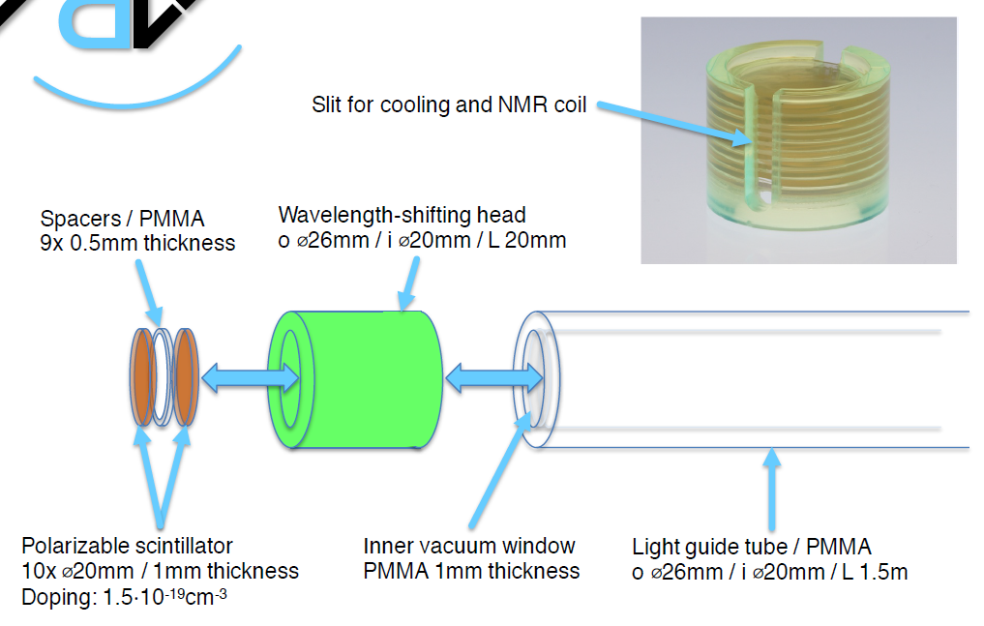
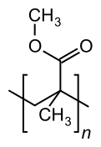
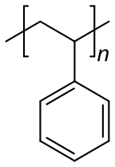
Active Polarized Target
Notes:
Polymethylmethacrylat (Kurzzeichen PMMA, auch Acrylglas) ist ein transparenter thermoplastischer Kunststoff.

Slide 17
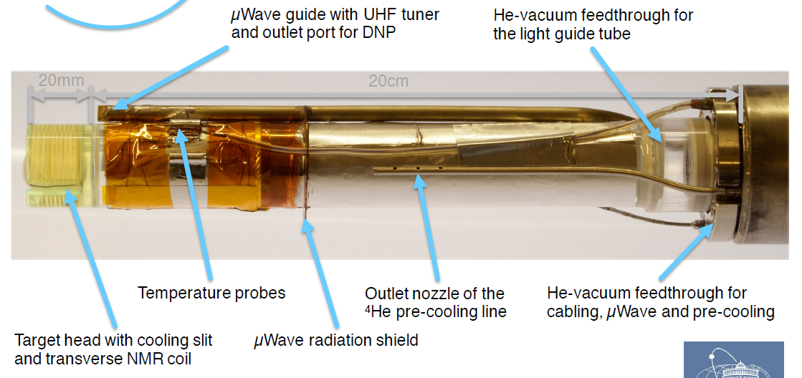
Active Polarized Target (First prototype 2016)
The active polarized proton target was in operation in our 4π detector system in 2016.

Slide 18


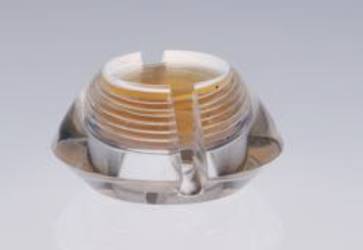
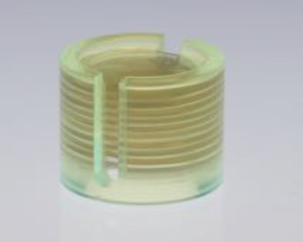
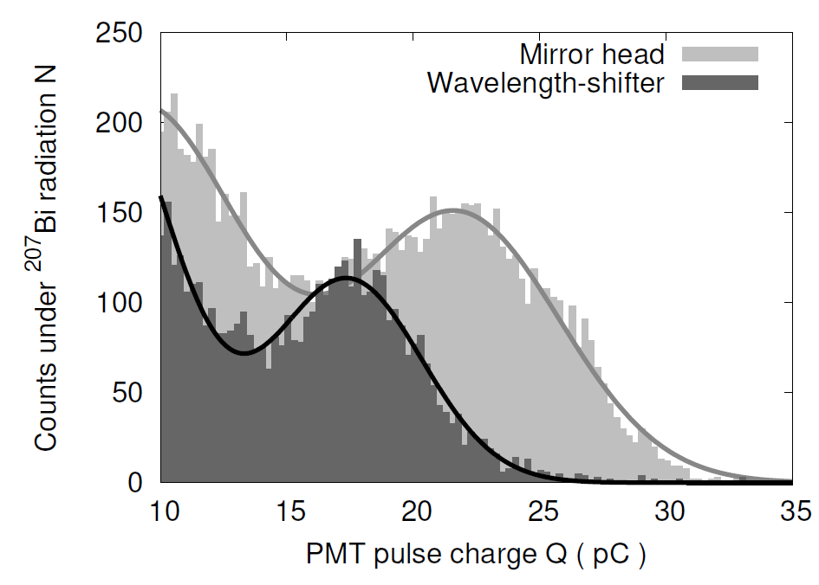
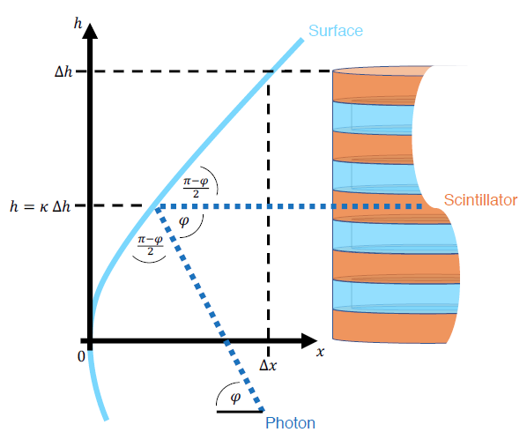
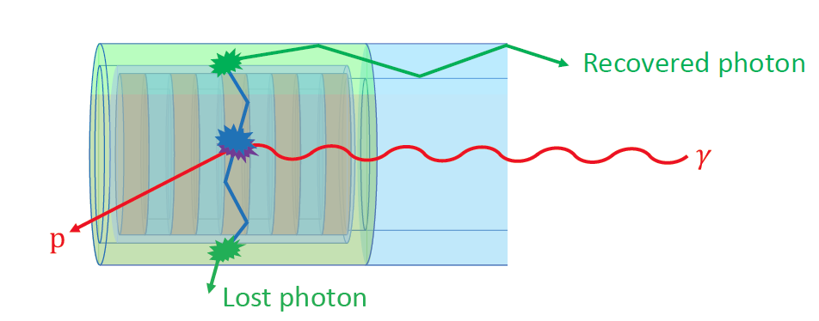
Active Polarized Target (Improved Insert 2021)
The detailed analysis in the framework of Maik Biroth gave a lot of new ideas for a better construction.
Detailed analysis, calculations and comparison of concepts for target heads for better light collection
eg. mirror head target
vs.
wave length shifter concept
The mirror head shows a superior light collection efficiency.
Problem: Mechanical stability.

Slide 19
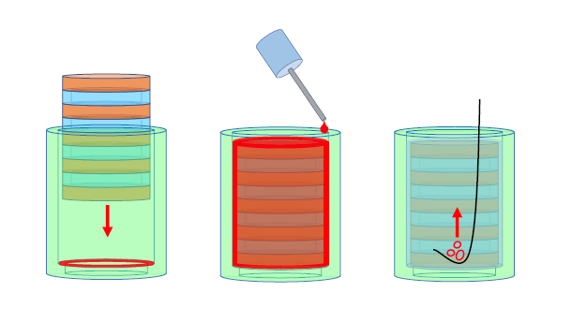
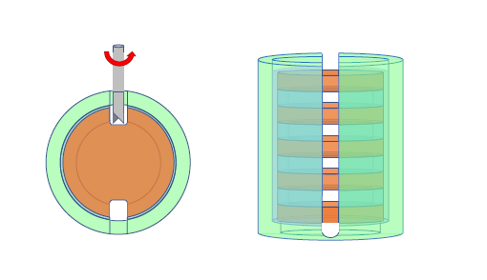
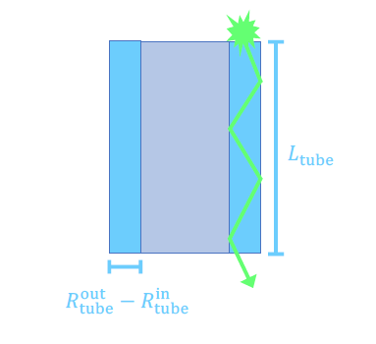
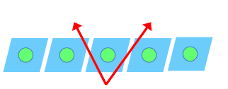
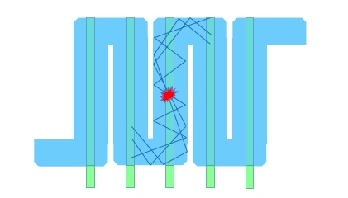
Active Polarized Target (Improved Insert 2021)
The production process of the
active polarized target stacks has been optimized.
The machining procedure for post production
for NMR and cryogenic cooling slits was further developed.
The coupling of the electronic readout to the light guide
components is well under control and documented.
R&D for polarized active szintillator target for threshold production and Compton is continued. Analysis of first data proofs light output.
New active target insert with better light transport system realized by fibers is under construction.
Scintillating target container with Butanol as option.

Slide 20
A2 - Publications
M. Biroth, P. Achenbach, E. Downie, and A. Thomas, “Silicon photomultiplier
properties at cryogenic temperatures,” Nucl. Instrum. Methods
Phys. Res. A, vol. 787, pp. 68–71, Jul. 2015.
P. Achenbach, M. Biroth, E. Downie, and A. Thomas, “On the operation
of silicon photomultipliers at temperatures of 1–4 kelvin,” Nucl. Instrum.
Methods Phys. Res. A, vol. 824, pp. 74–75, Jul. 2016.
M. Biroth, P. Achenbach, E. Downie, and A. Thomas, “A low-noise
and fast pre-amplifier and readout system for SiPMs,” Nucl. Instrum.
Methods Phys. Res. A, vol. 787, pp. 185–188, Jul. 2015.

Slide 21
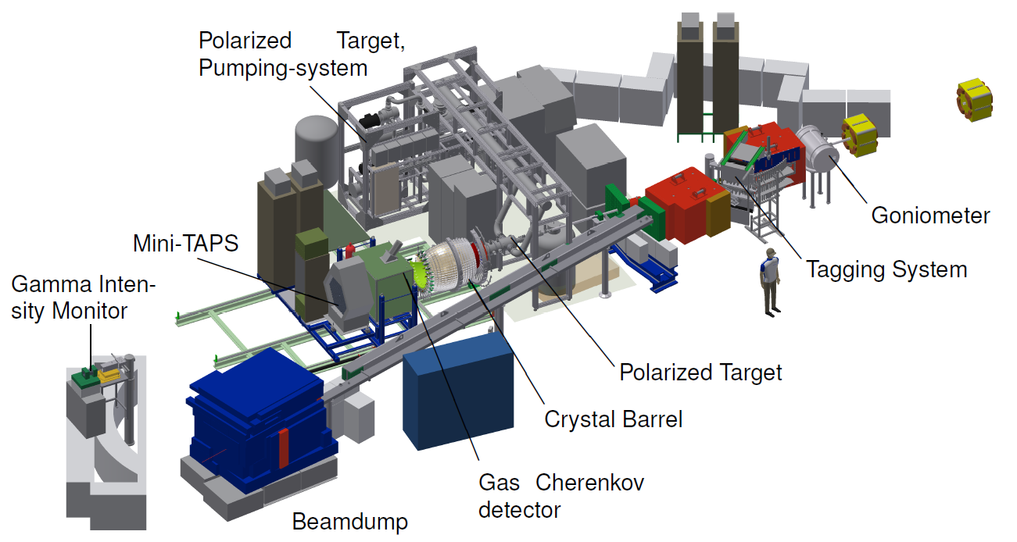
CBELSA/TAPS
Notes:
Das Two-Arm-Photon-Spektrometer TAPS [Nov91] [Str96] ist ein elektro-magnetisches Kalorimeter, das in der derzeitigen Ausbaustufe aus bis zu 9*64 Barium-Fluorid-Kristallen(BaF2) besteht. Zusätzlich ist vor jedem BaF2-Kristall ein Plastikszintillator angebracht, der als Veto-System für geladene Reaktionsprodukte fungiert. Das Detektorsystem wurde 1987 von der euro-päischen TAPS-Kollaboration 1 geplant und in den daraufolgenden Jahren aufgebaut und genutzt.

Slide 22
Baryon Spectroscopy
Aim: Better understanding of QCD and the structure of hadrons:
How does QCD give rise to hadrons?
Which hadrons – bound states of QCD – do exist?
-> Baryon spectroscopy
Quark models:
Many more resonance
expected than observed
Certain configurations
completely missing:
  Wrong degrees of freedom
  in quark model?
  Experimentally not found yet?
Fully relativistic quark model
U. Löring, B. Metsch, H. Petry, Eur. Phys. J. A10 (2001) 395

Slide 23
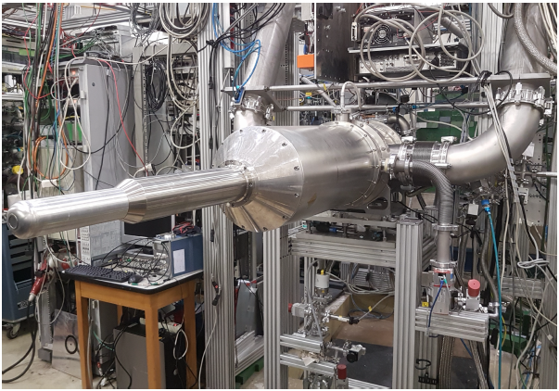
CBELSA/TAPS – Polarized Target
Work in 2017
I Merging the Dubna/Mainz and
Bonn Systems.
T_{min} < 30mK
γ p → π N
two periods with Butanol
and one with D-Butanol
Frozen spin with a holding field 0.6T
Generated by very thin magnet mount
on inner warming shield →↑
Dubna: Y. Usov, N. Borisov, I. Gorodnov et al. Mainz: A. Thomas et al. Bochum: G. Reicherz.
Bonn: S. Goertz, H. Dutz, S. Runkel et al

Slide 24
Data taking 2021
H-Butanol May 2018
D-Butanol October 2018
Next run at CB-ELSA will start on
Oct 27th with D-Butanol!
H-Butanol June 2021

Slide 25
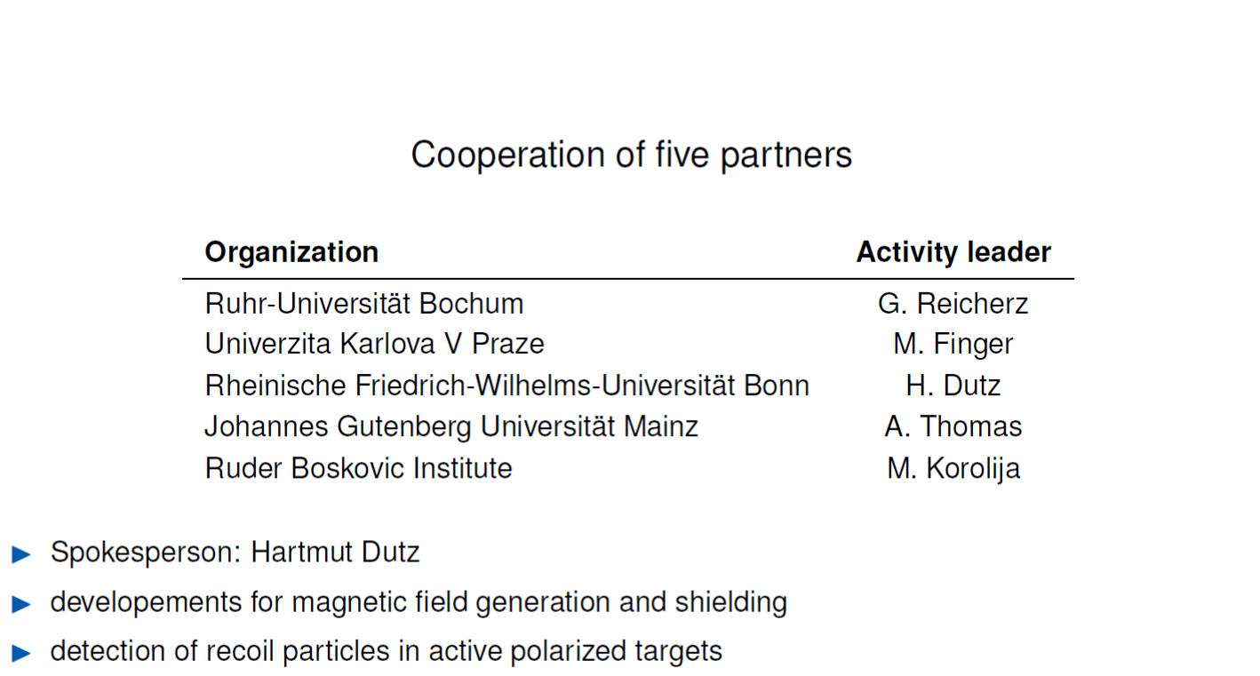
CryPTA: Cryogenic Polarized Target Applications
Notes:
STRONG-2020 “The strong interaction at the frontier of knowledge: fundamental research and applications” has received funding from the European Union’s Horizon 2020 research and innovation programme under grant agreement Nº 824093.
Production of polarized nucleon targets (at the prototype level) using solid state materials combined with superconducting high-field magnets and the Dynamic Nuclear Polarization method.

Slide 26
Summary
COMPASS runs the largest polarized solid target in the world
to investigate the structure of the nuclei.
In Mainz and Bonn are running frozen spin targets in double polarized
scattering experiments to determine the baryon spectroscopy
The recent activities leads to 4π continues mode target concept for real photon
double polarization experiments at ELSA and MAMI
and the development of a polarized active szintillator target for threshold production
and Compton is continued.

