Slide 1
First-of-a-kind autopsy of the Large Hadron Collider external beam dump
8th High Power Targetry Workshop (HPTW2023)
AP.BERNARDES on behalf of the LHC beam dump block autopsy team
Acknowledgements: M.Calviani, D.Grenier, S.De Man, E.Grenier-Boley, D.Pazem, C.Tromel, A.Infantino, L.R.Buonocore, E.Romagnoli, C.Veiga Almagro, S. Di Giovannantonio, R.Mouret, G.Dumont, O.Deschamps…

Slide 2
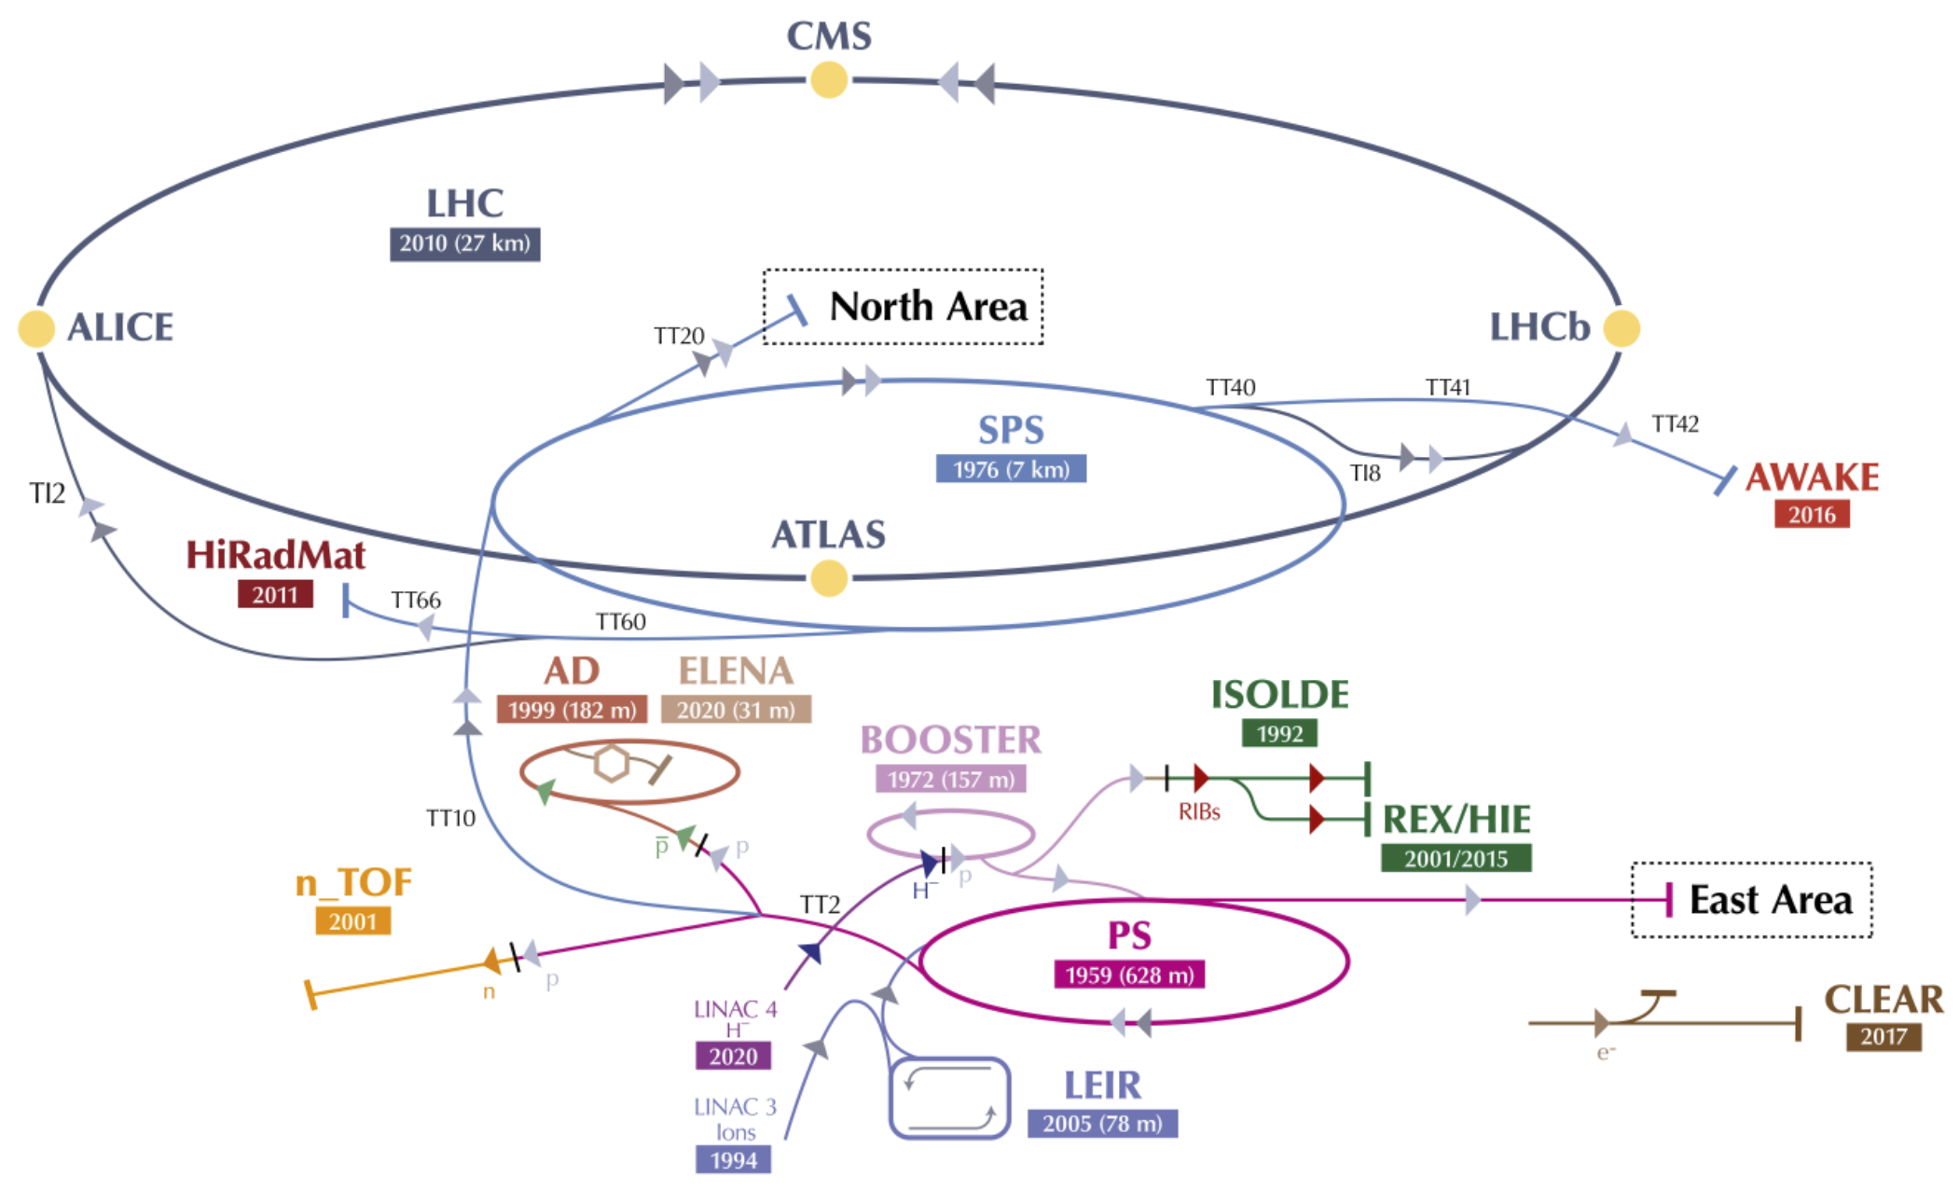
CERN’s accelerator complex and LHC beam dump
Point 6 – location of LHC Beam Dumping System (LBDS)
TDE = “Target Dump External”, a conventional name to refer to machine external dumps

Slide 3
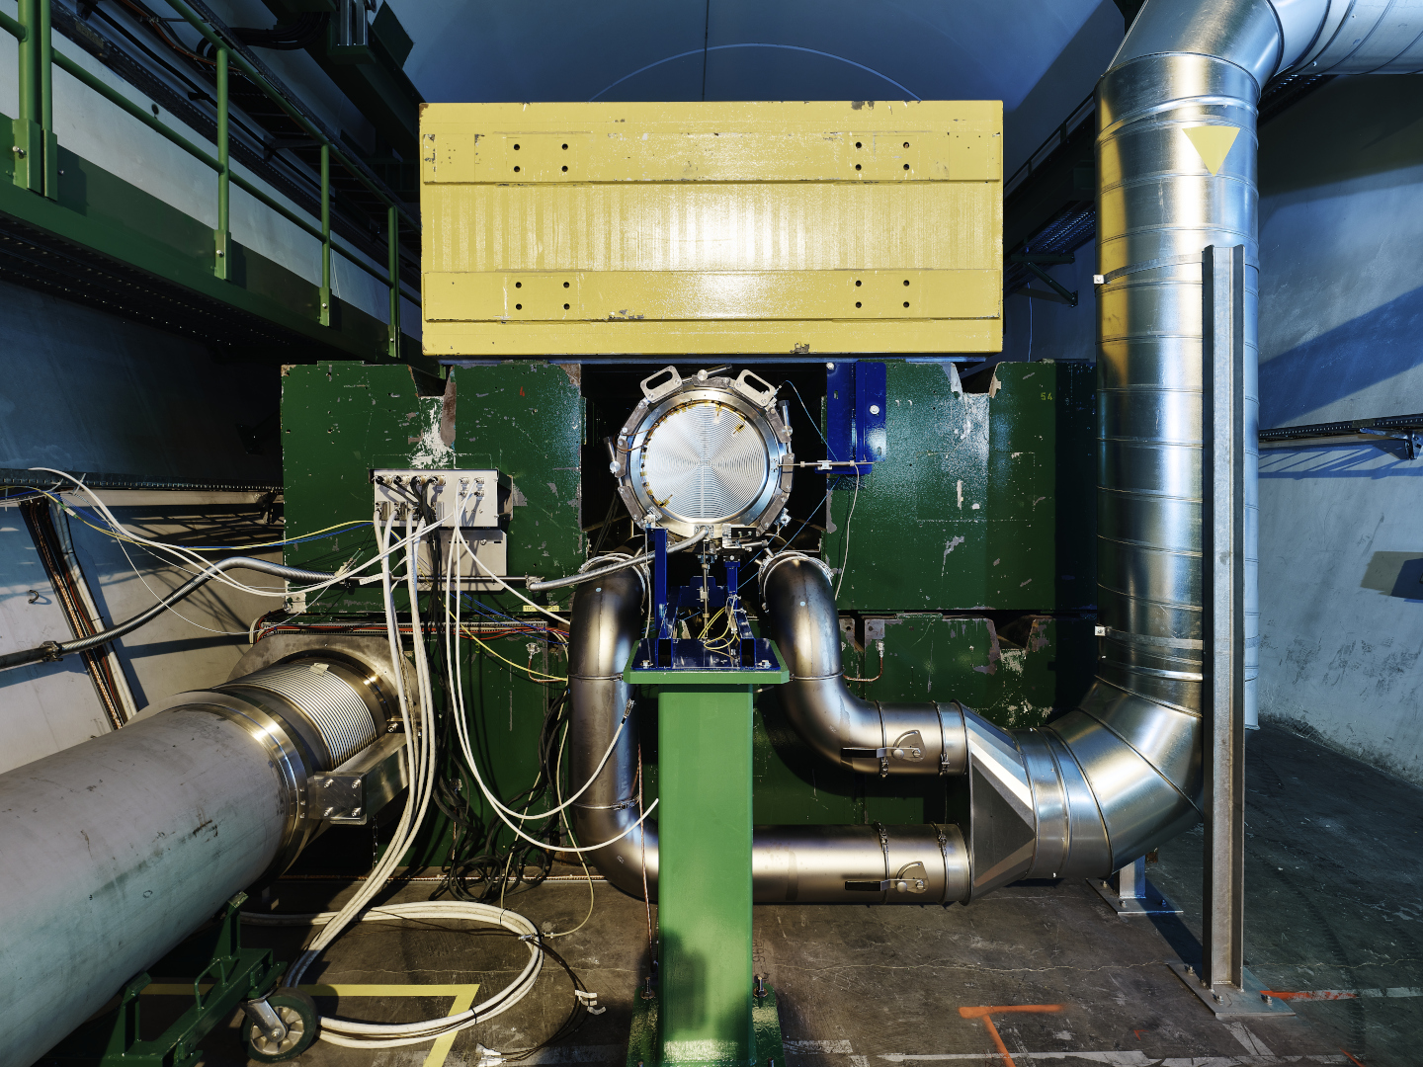
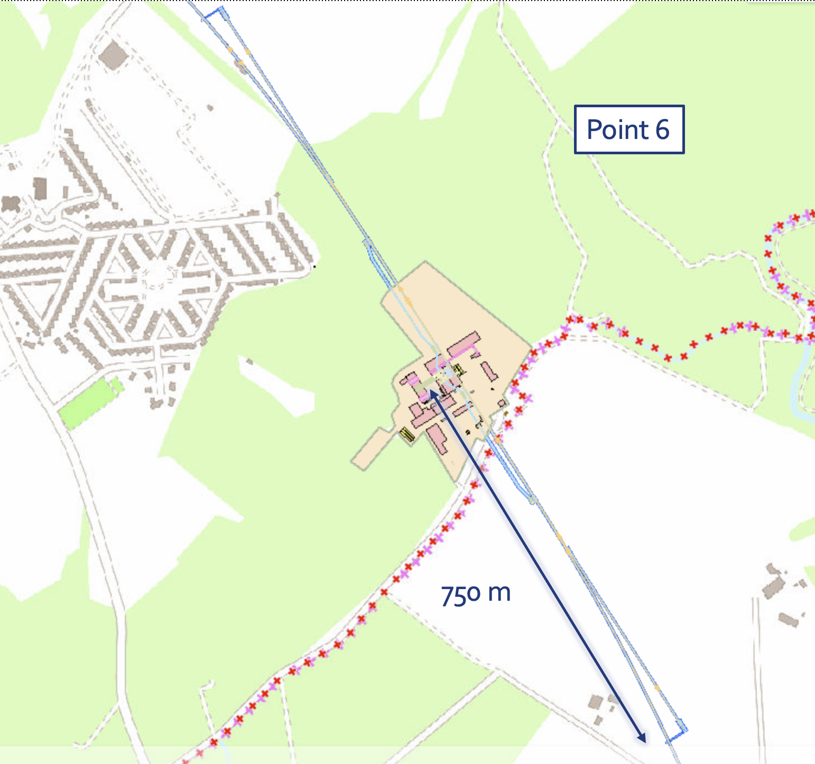
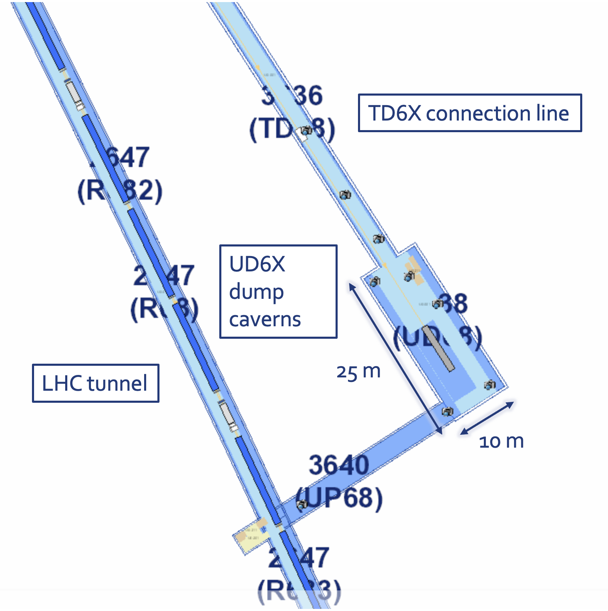

Slide 4
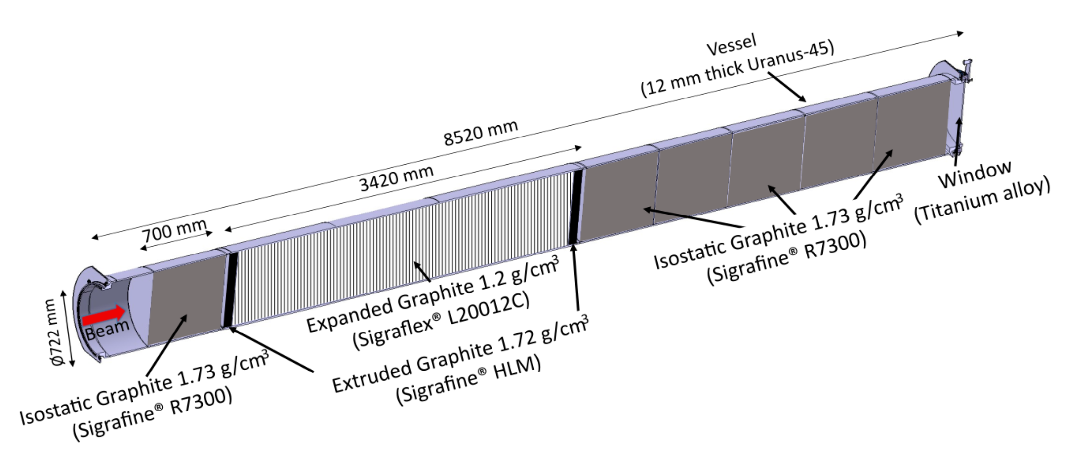
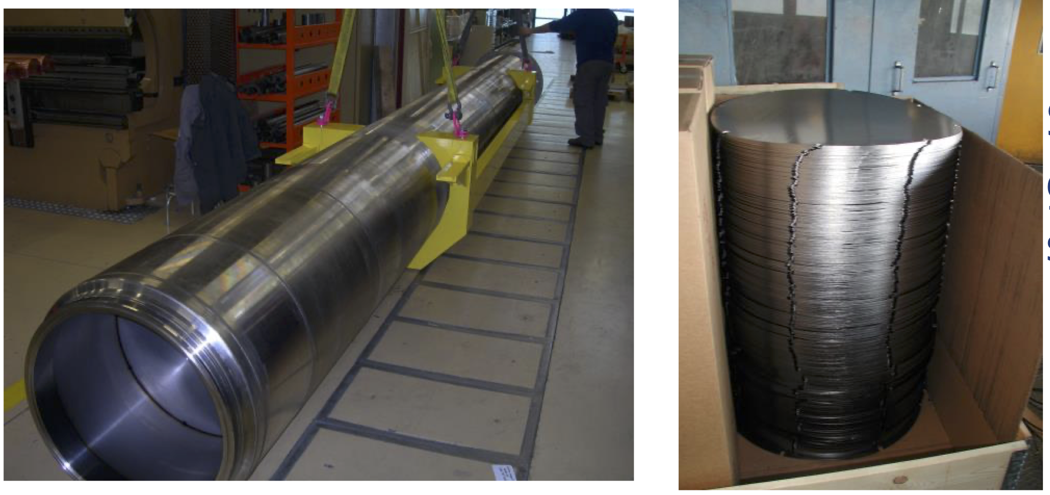
Introduction
The LHC TDE (Target Dump External) is a beam dump constituted by a graphite (low and high density) absorber of roughly 8.5 m length and 700 mm diameter – no active cooling
It is installed inside a 12 mm thick tube of 318LN duplex stainless-steel (1.4462) alloy and filled with nitrogen gas slightly above atmospheric pressure
HD HLM LD HLM HD
See M.Calviani talk
2 Dumps
(UD62 and UD68)

Slide 5
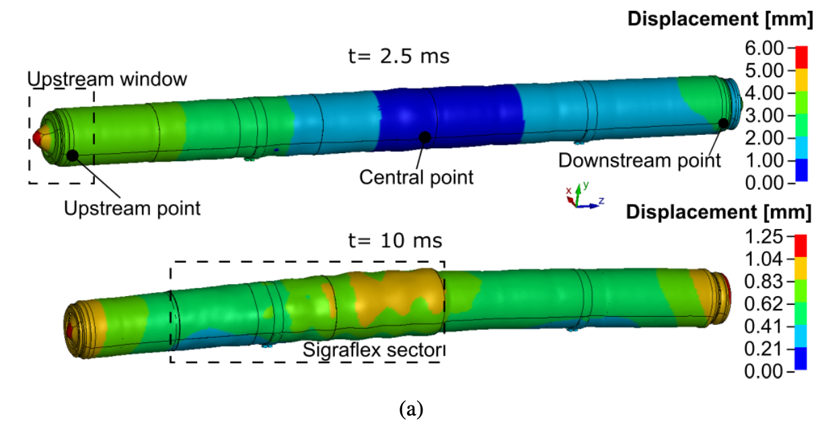
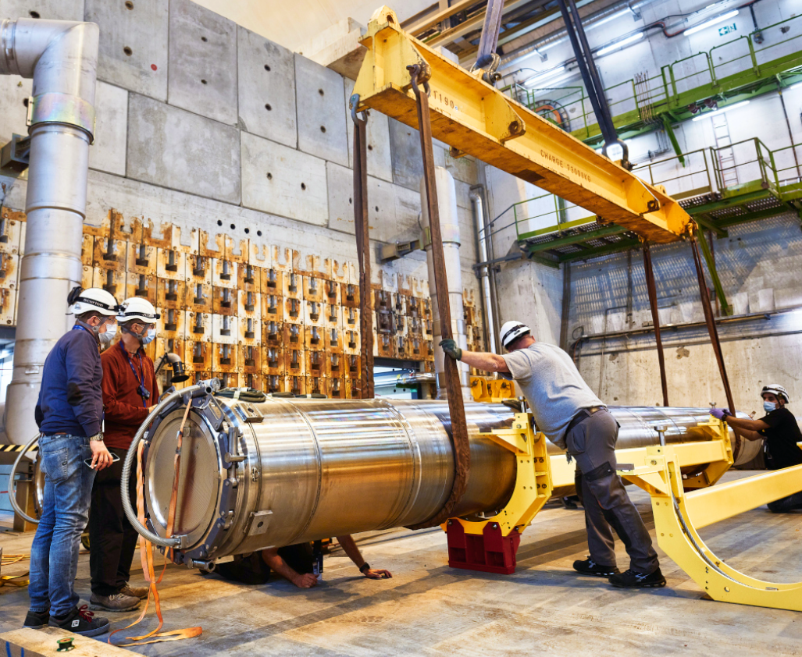
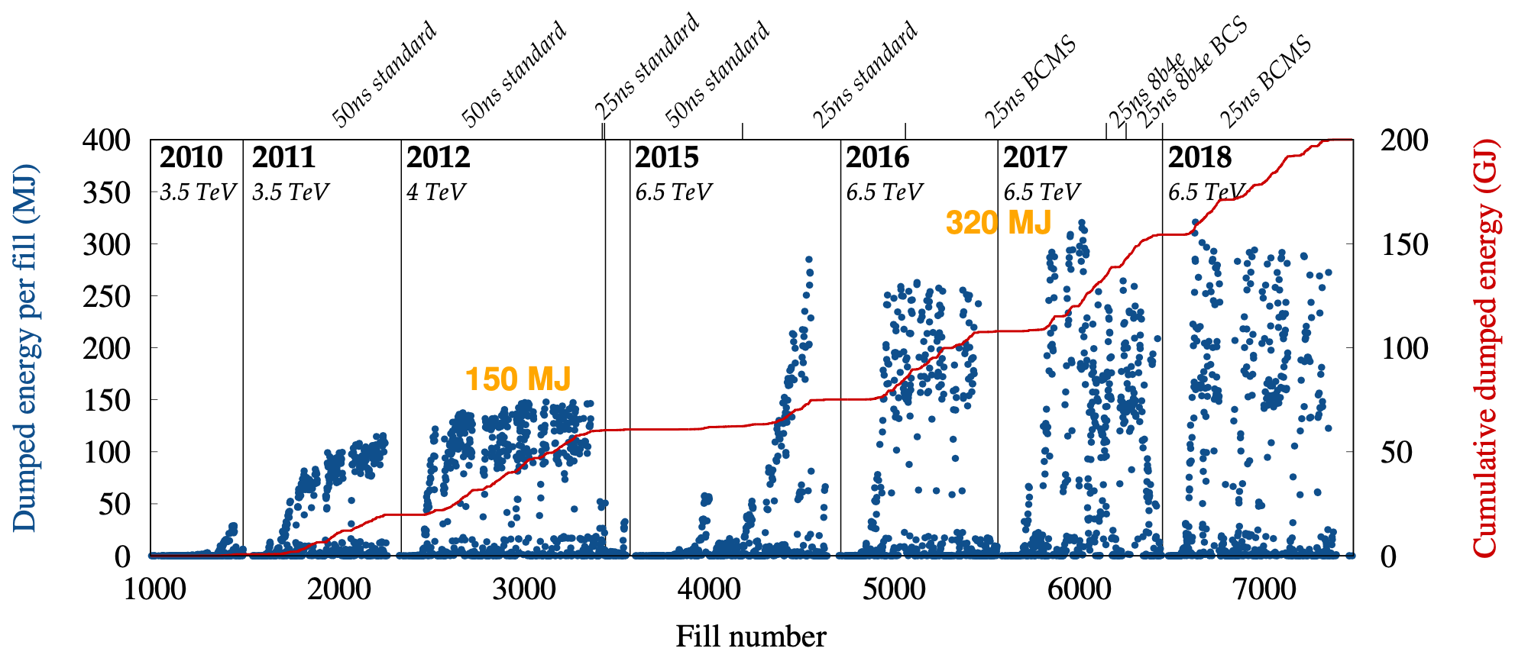
Introduction
Mechanical and thermal stress induce large vibration effects than cannot be removed
Dump windows upgrade during Long Shut-Down (LS2)
LHC original dumps (Run1+Run2)
Nitrogen leaks
LS2
See M.Calviani talk
Vibration effects mitigation (N₂ leaks) & windows upgrade implemented in run3 LHC dump
LS1
LS2
Run1
Run2

Slide 6
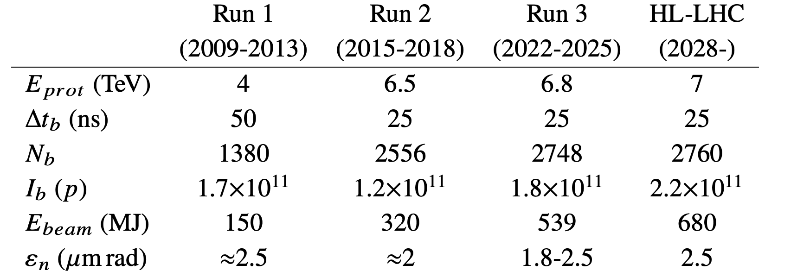
Introduction
Nitrogen leaks
LHC dump autopsy
(old design)
LHC TDE dump Autopsy was needed:
To clarify if LHC beam limitation should be defined for Run3 (539 MJ) (2022-2026)
To confirm raw material selection for LHC spare dumps (Delivery date end 2023)
Autopsy feed-back to be used for future HL-LHC dumps (680 MJ) – Run 4 (2029)
LHC dump exchange (improved design)
LHC spare dump production

Slide 7
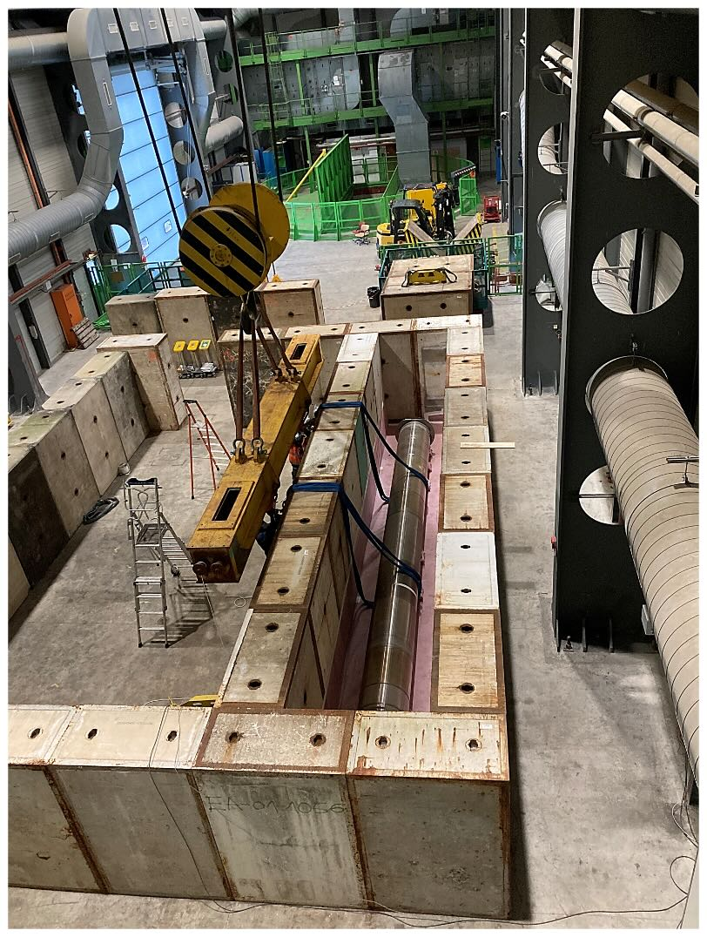
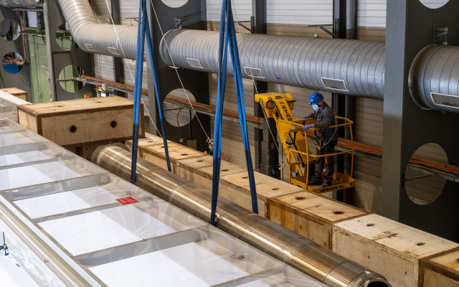
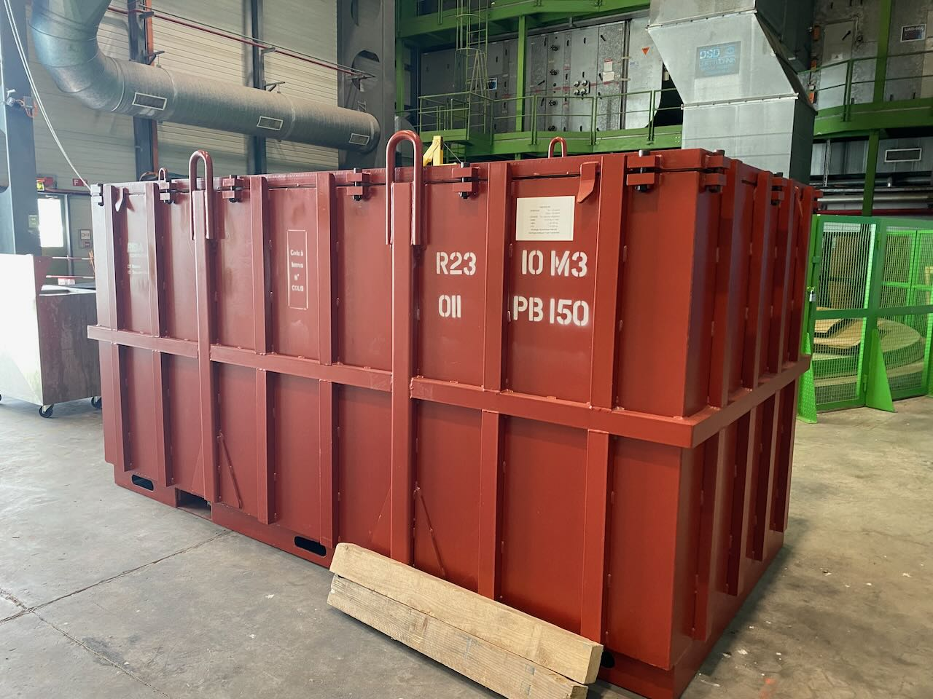
Introduction
LHC TDE dump autopsy and radioactive waste packaging opportunity:
Having to be cut for the autopsy, it was the opportunity to cut it for the radioactive waste packaging and to perform the RW characterization.
Volume reduction offer a very good optimization measure in matter of cost and open a pathway for long term disposal outside CERN
While RW packaging is already implemented for TFA waste (Very Low-Level Waste), it was the first time for FMA waste (Intermediate & Low-Level Waste)
TDE dump stored in storage bunker
TDE dump removed from storage bunker
3.3 m
8.5 m
Waste packaging for TDE dump

Slide 8
Introduction
The hardness of 318LN steel has been underestimated and the cutting method was inadequate
No rehearsal on 318LN performed before
Hands-on cutting far too slow for acceptable exposure
First tentative Q4 2020 - Q1 2021: Autopsy test with blanket contrat
Activity stopped for ALARA reason and contract closed

Slide 9
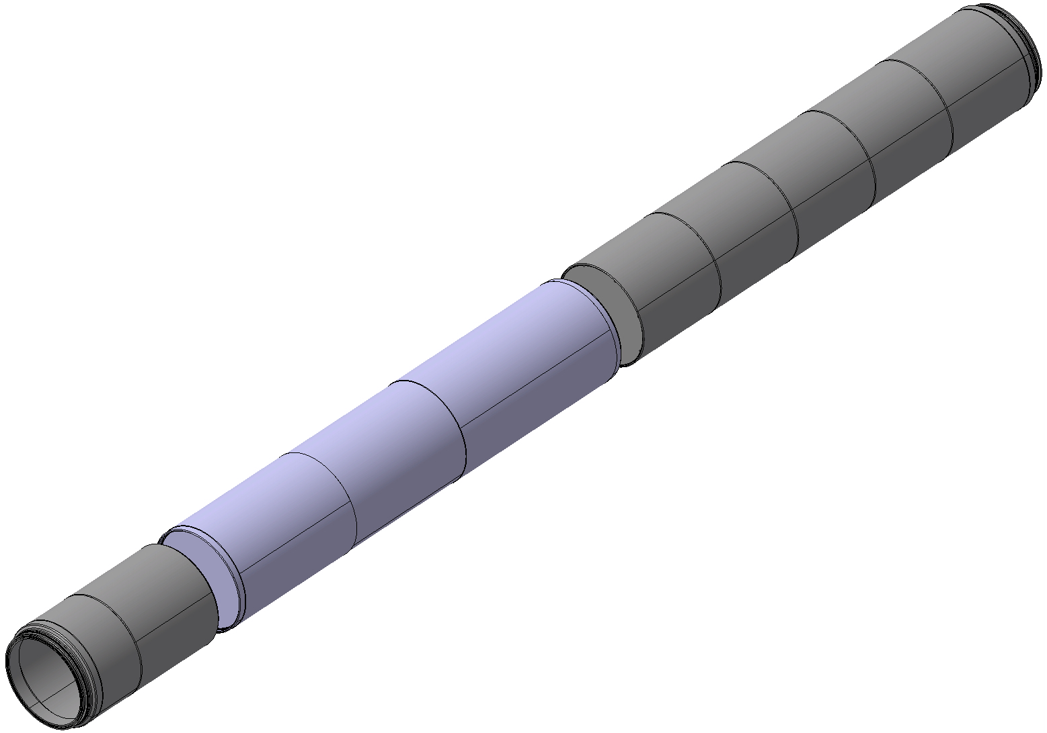
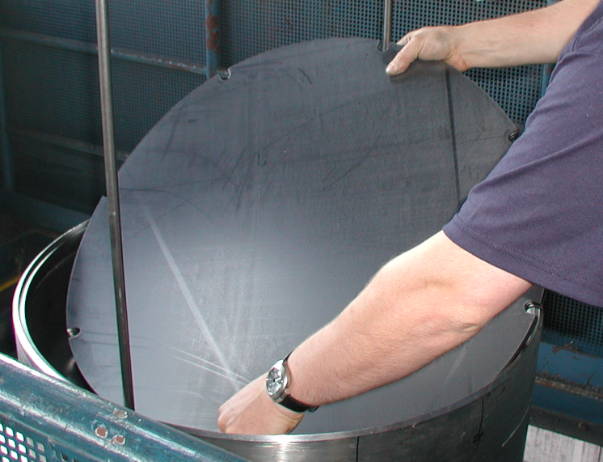
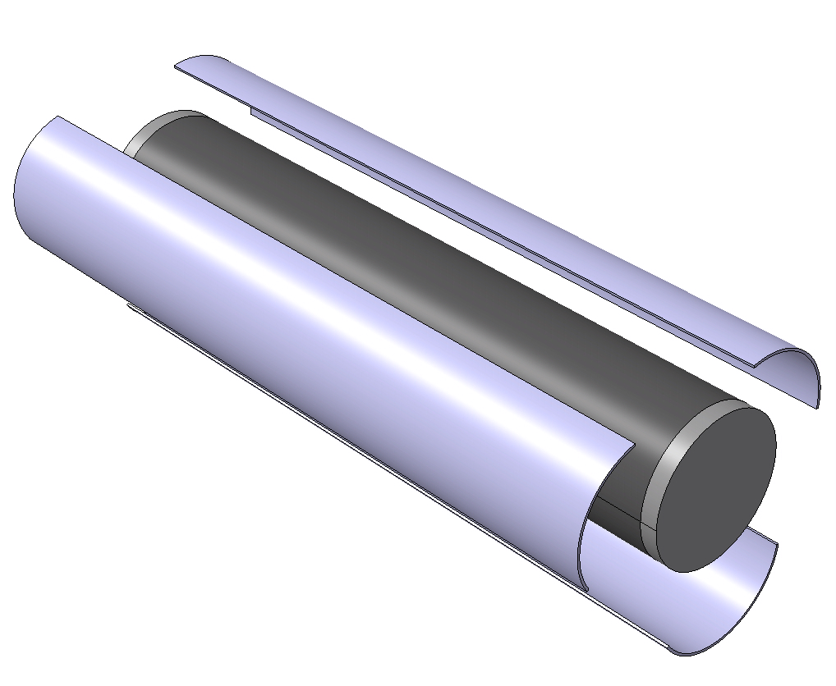
Autopsy sequencing
2 radial cuts to isolate the LDG part
HDG
LDG
HDG
3 longitudinal cuts to access to the sigraflex disks
Removal of sigraflex disks
ALARA LEVEL 2

Slide 10
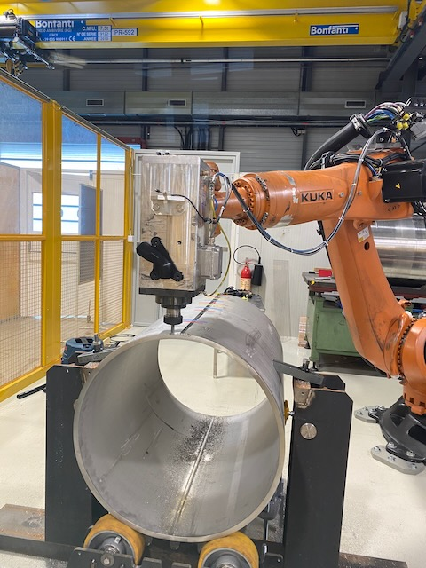
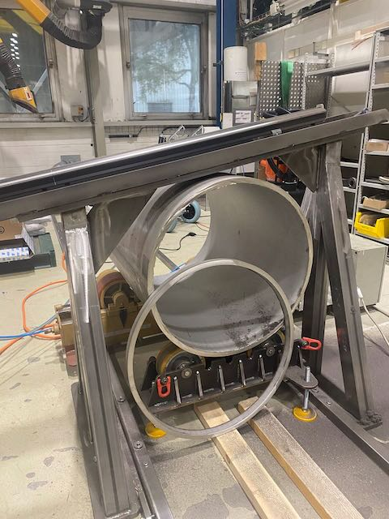
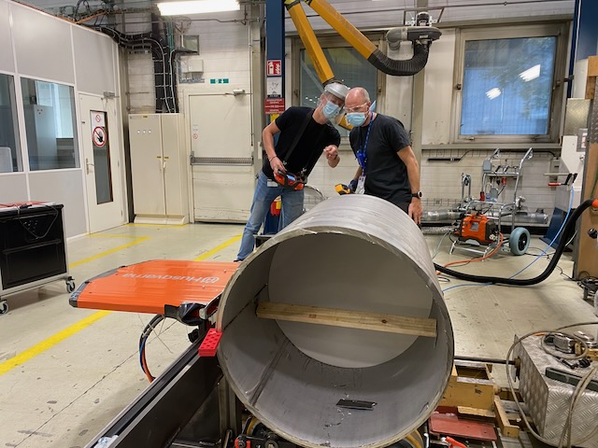
Getting ready for autopsy
Husqwarna saw main cutting methode SY-STI-TCD
Kuka robot back-up cutting methode BE-CEM

Slide 11
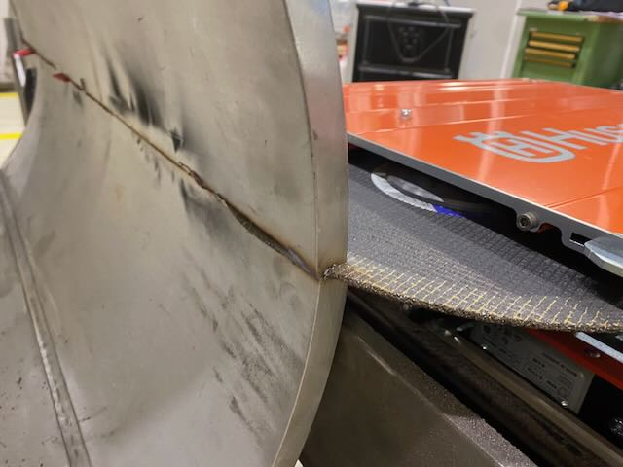
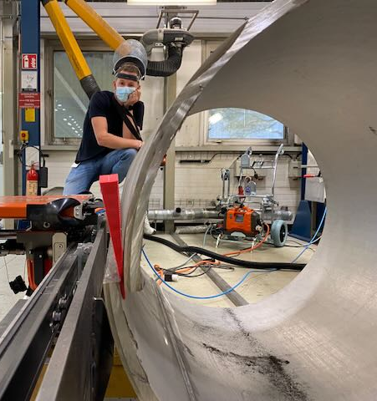
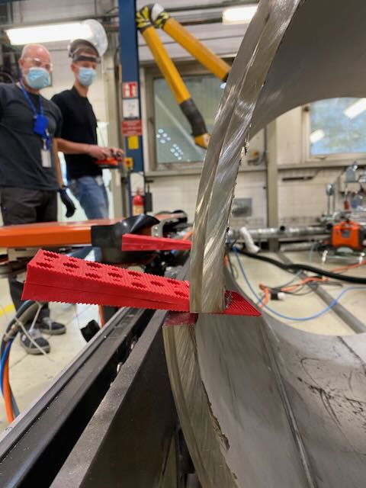
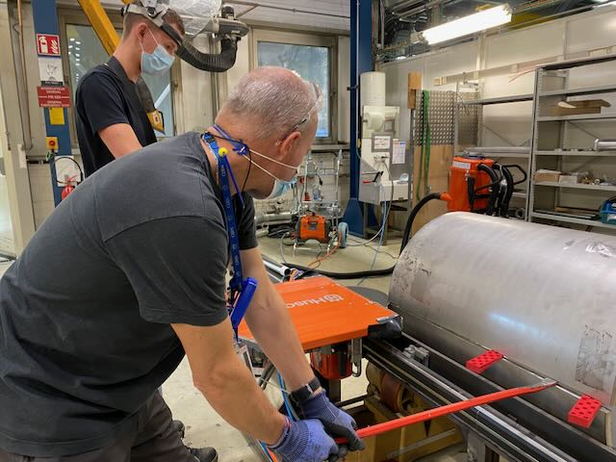
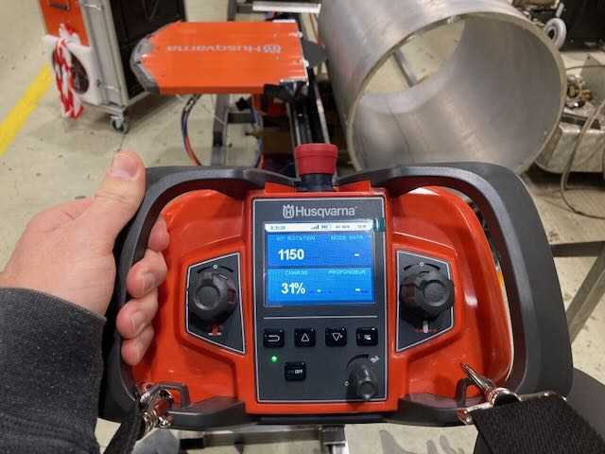
Getting ready for autopsy
Blade stucks
Random deformation of stainless steel envelop
Random loss of Wi-fi remote control saw connection

Slide 12
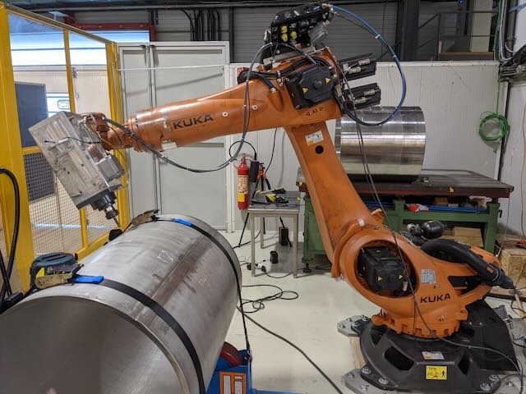
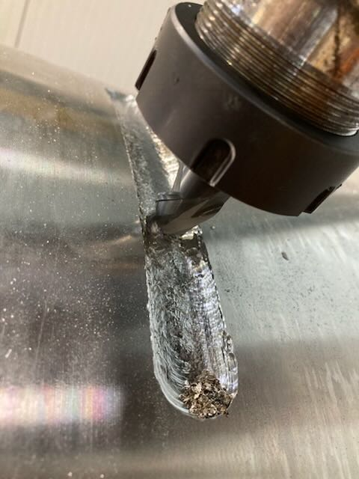
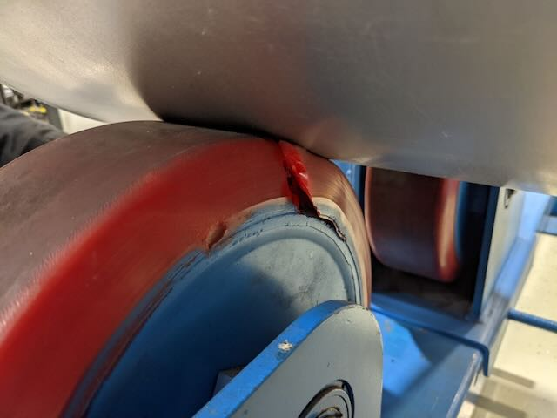
Getting ready for autopsy
Vibration issues
Broken milling tool
Broken wheels support
Saw methodologie was selected

Slide 13
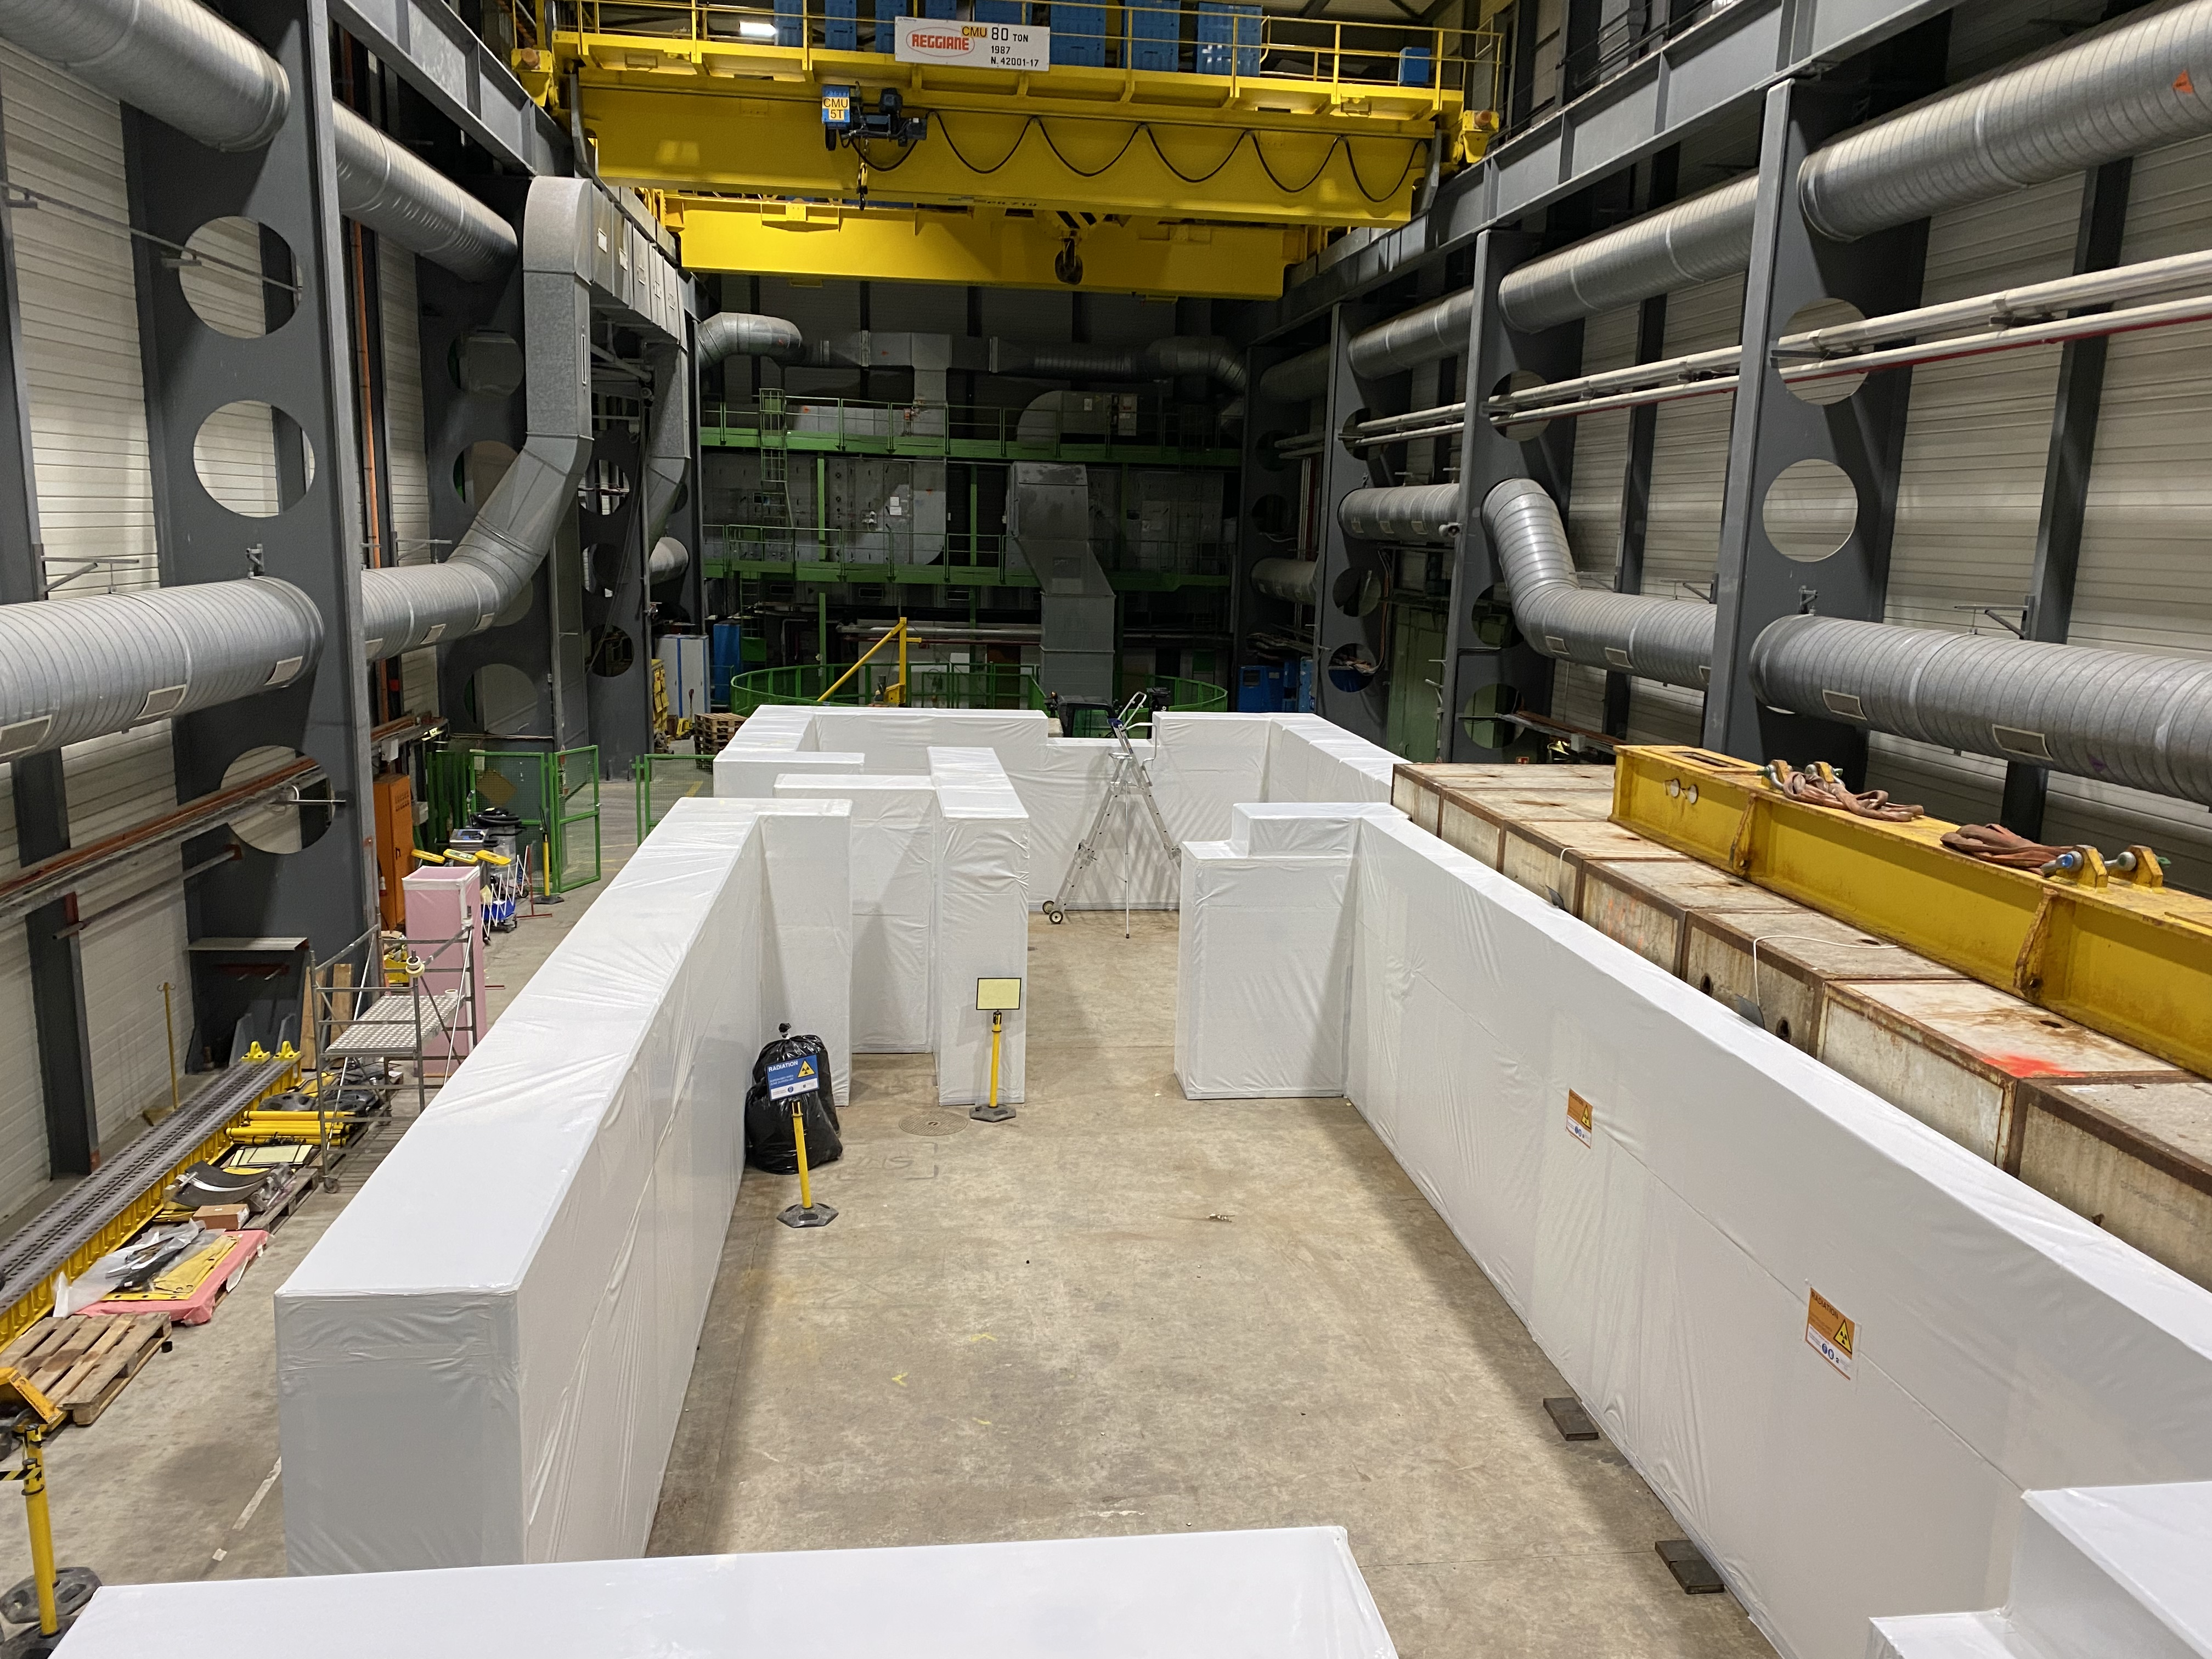
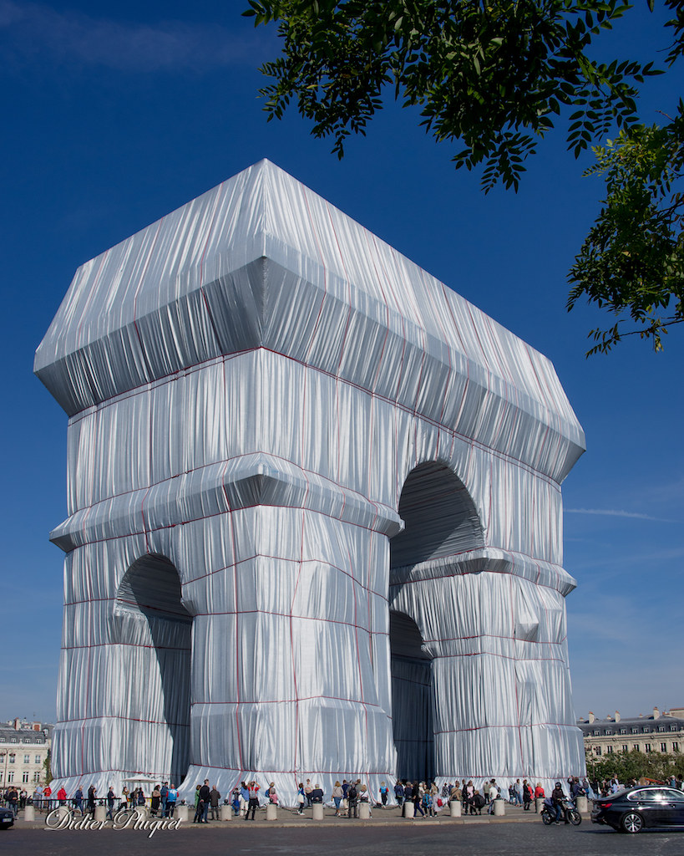
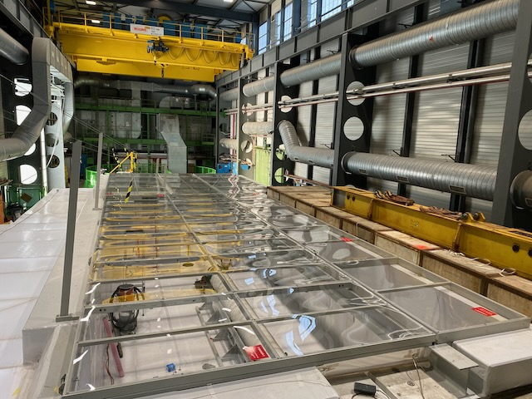
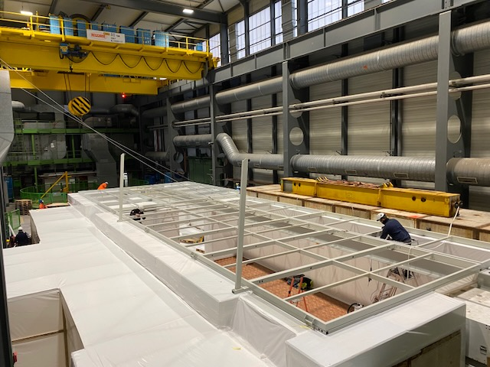
Airlock installation

Slide 14
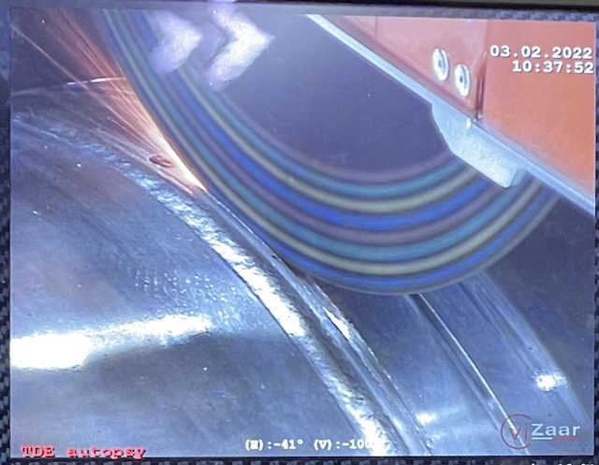
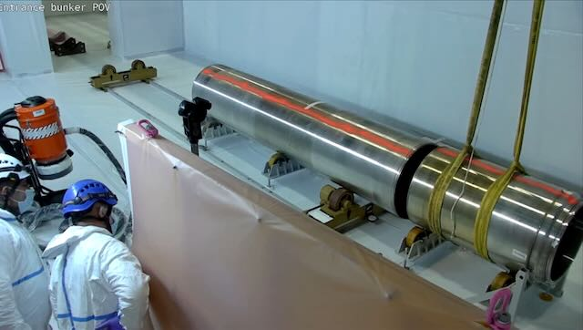
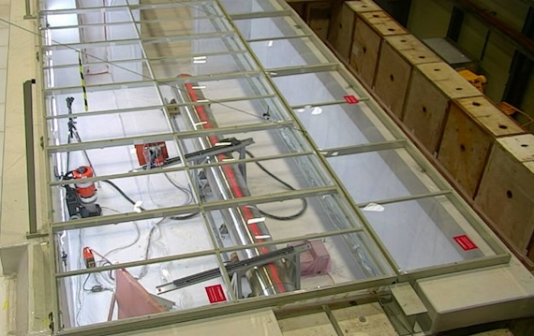
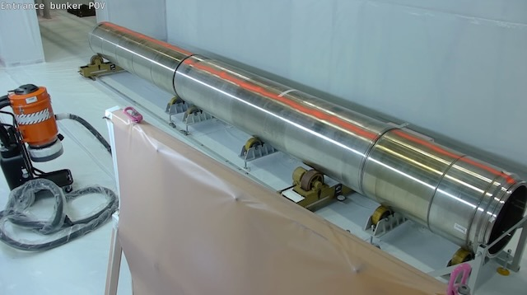
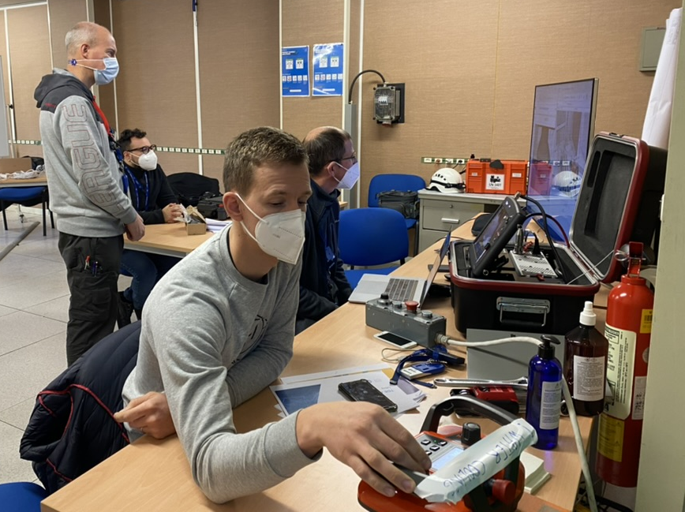
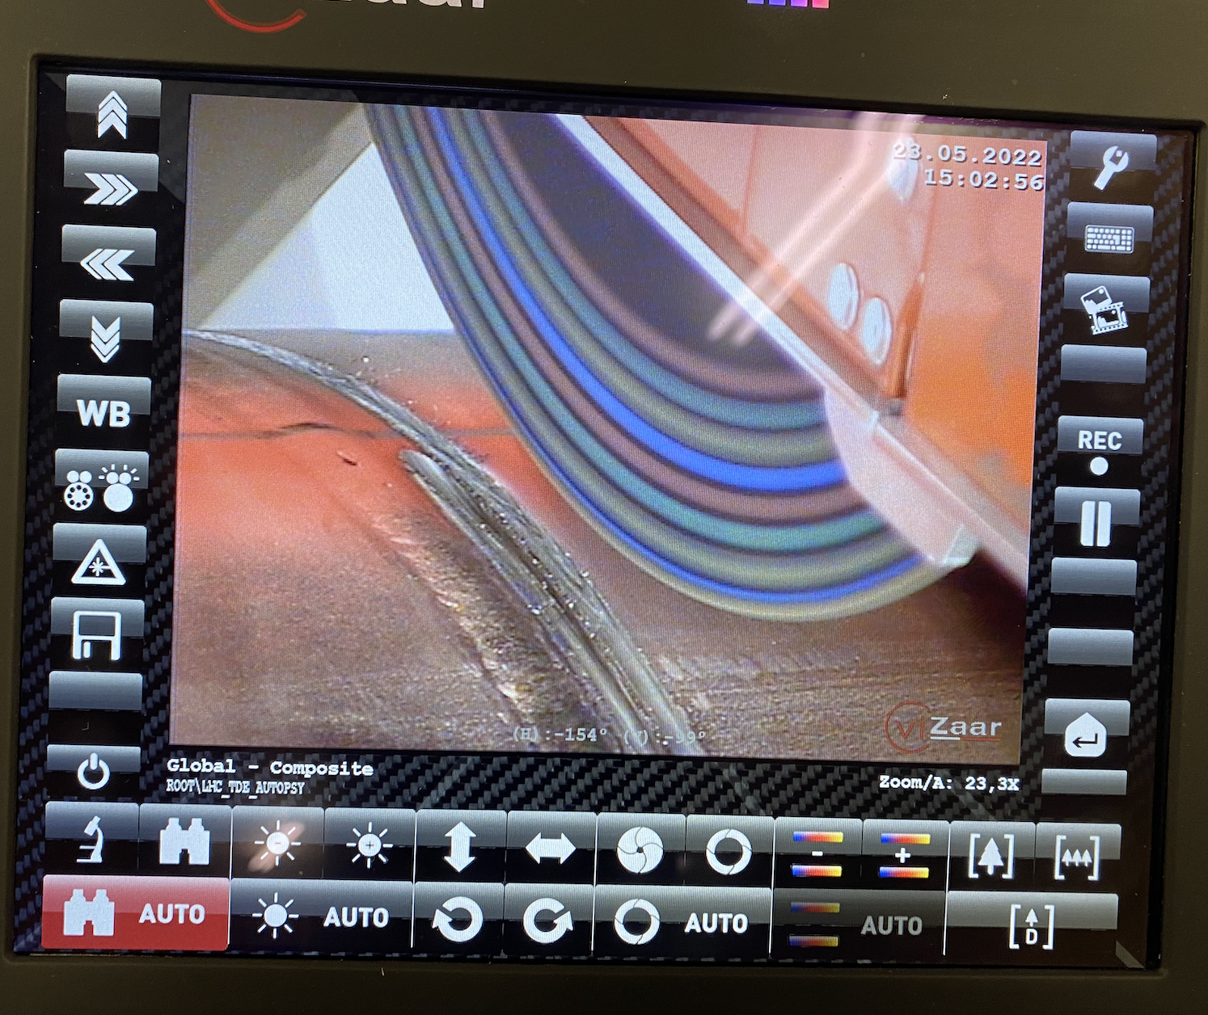
Radial Cuts
First radial cut
TDE dump installation in Airlock
End of the 2 radials cuts
The LDG is isolated from the HDG
Offset during vertical cut
HDG
End of second radial cut
LDG
HDG

Slide 15
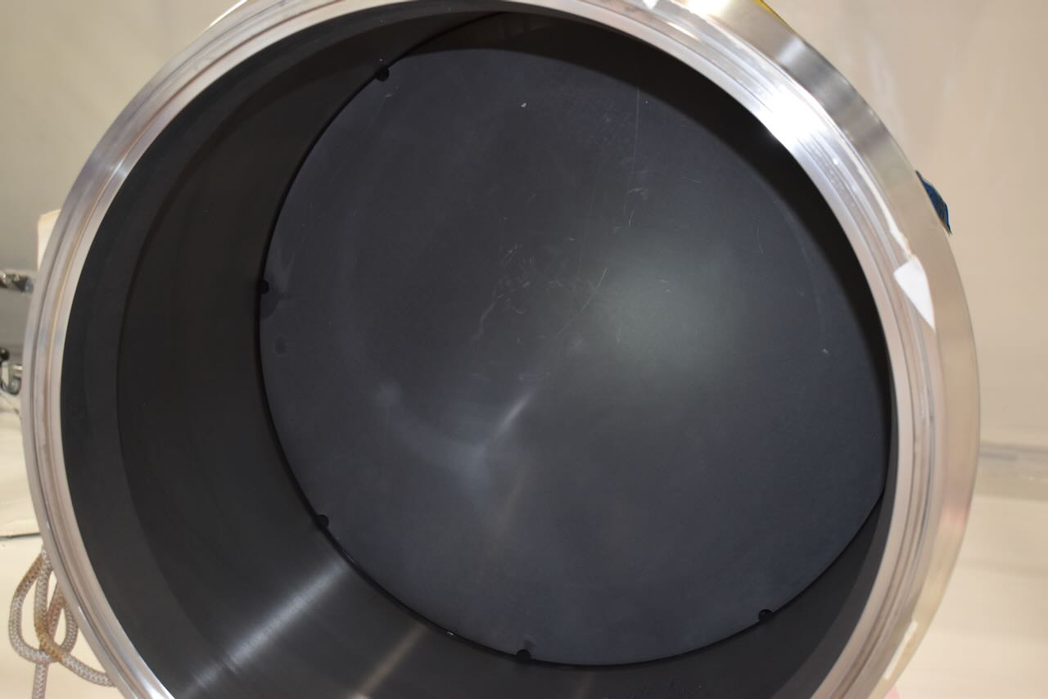
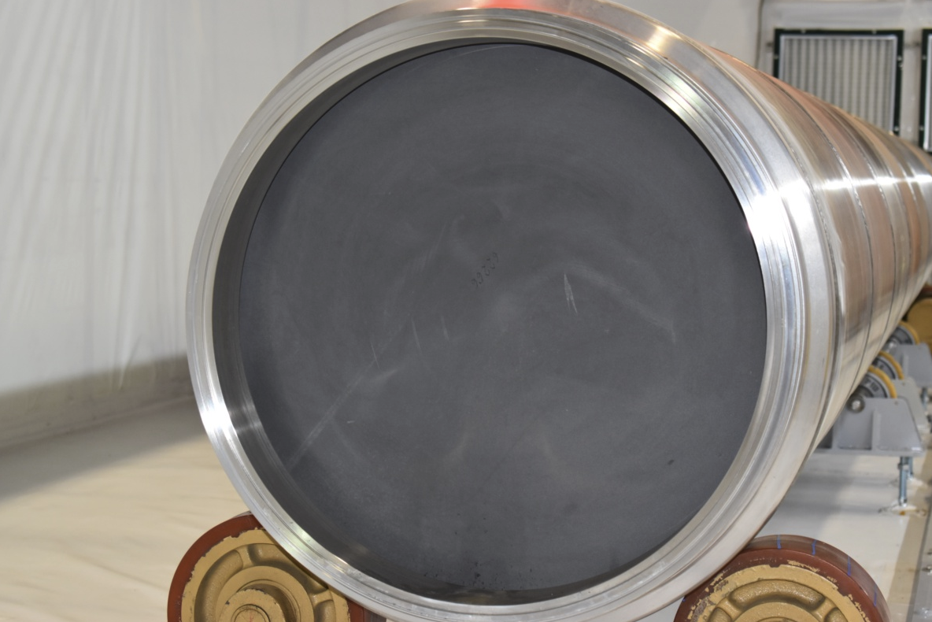
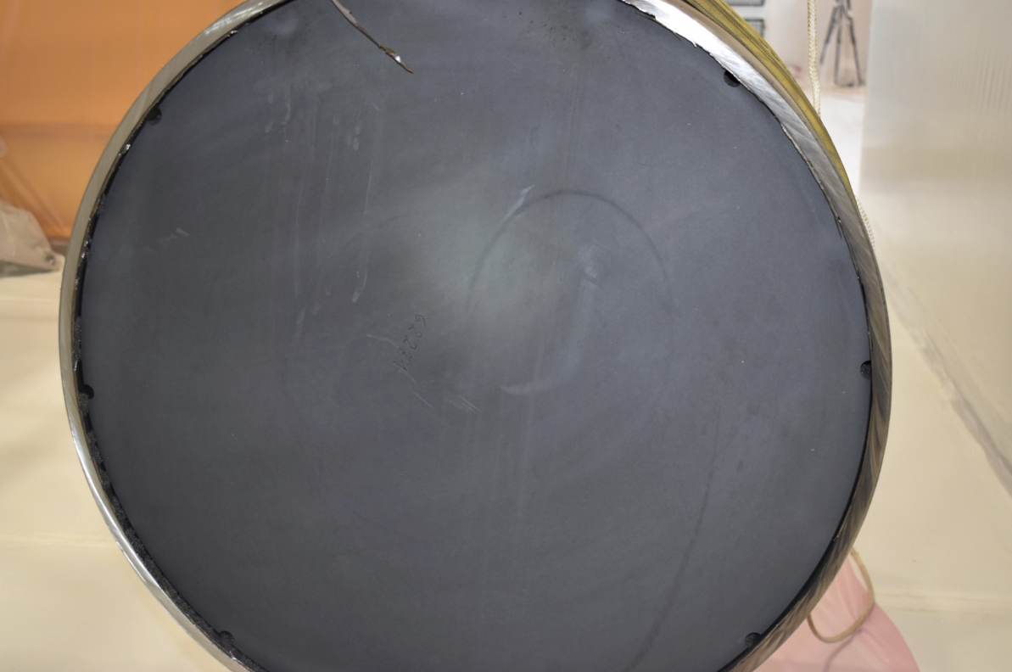
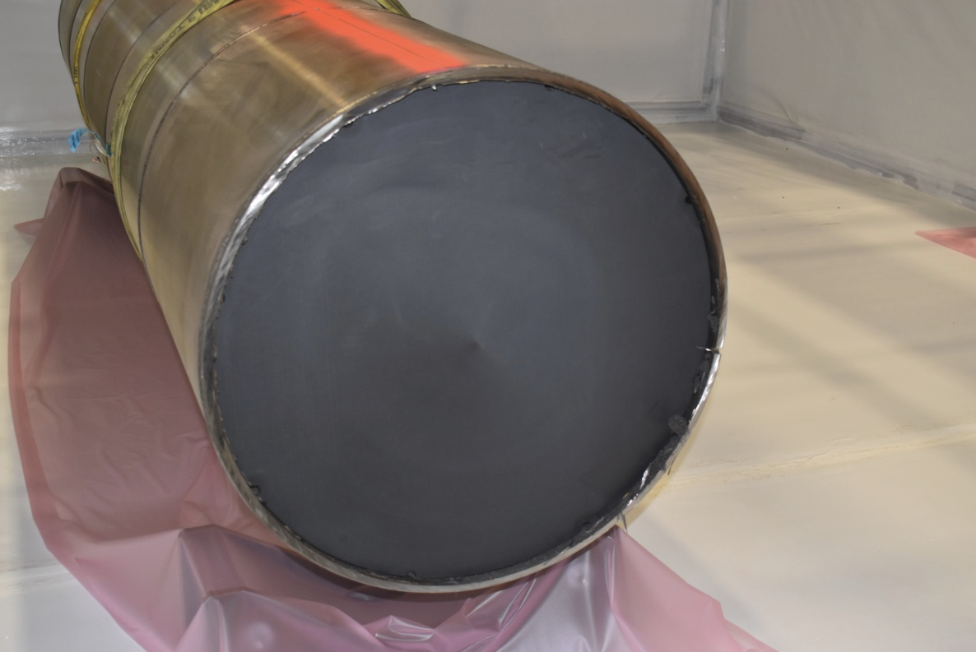
Results Summary – Autopsy (High Density)
HD1 upstrem
HD2 aval
HD2 amont
HD1 aval
HD2 downstream
HD1 amont
Removal of HDG extremities and visual inspection of the extruded graphite
HD1 downstream
HD2 upstrem
End of second radial cut
High Density graphite was confirmed as viable for the spare dumps

Slide 16
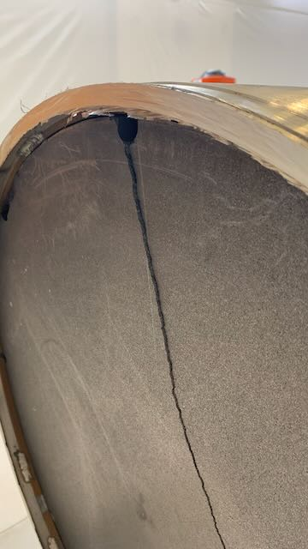
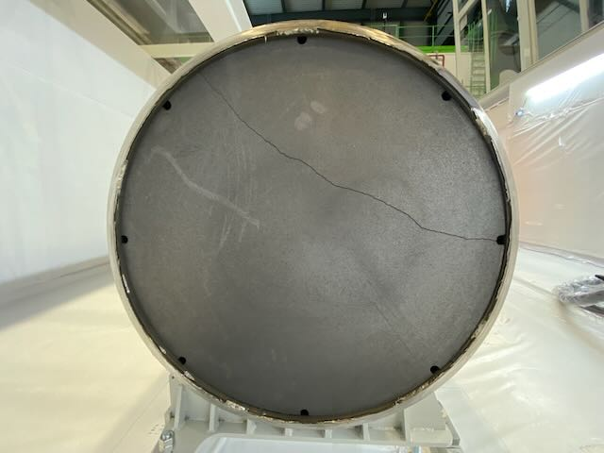
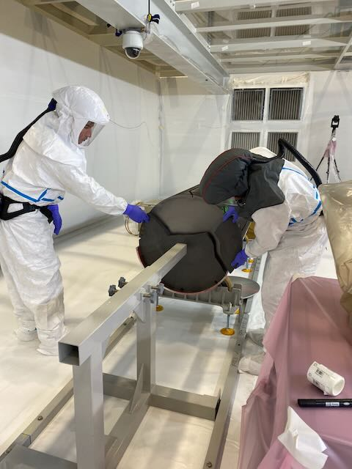
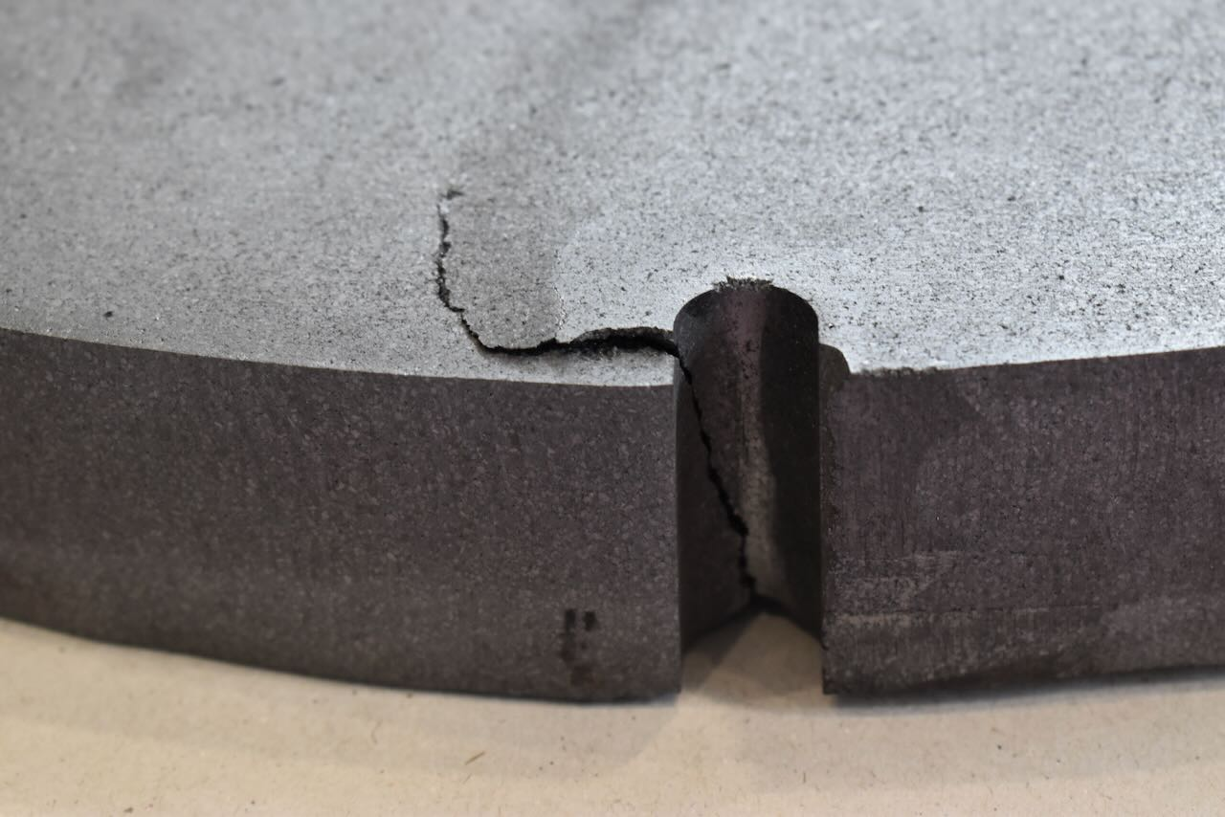
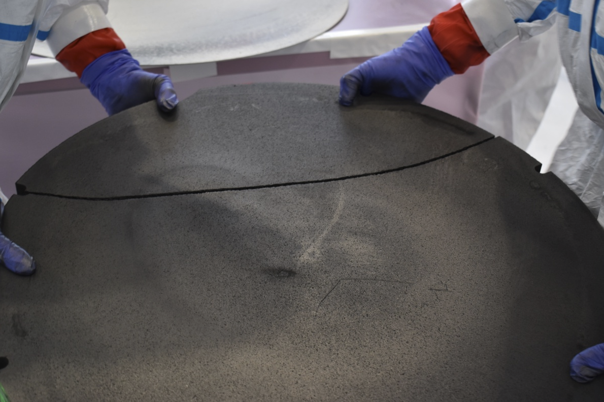
Results Summary – Autopsy (HLM- Extruded graphite)
HLM aval
HLM amont
HLM aval
HLM amont
HLM aval
HLM amont
Extruded Graphite were NOT OK for the spare dumps - 3DCC to be employed in future
Neverless Extructed graphite will likely keep their functionality throughout Run3 (compressed LD disks)

Slide 17
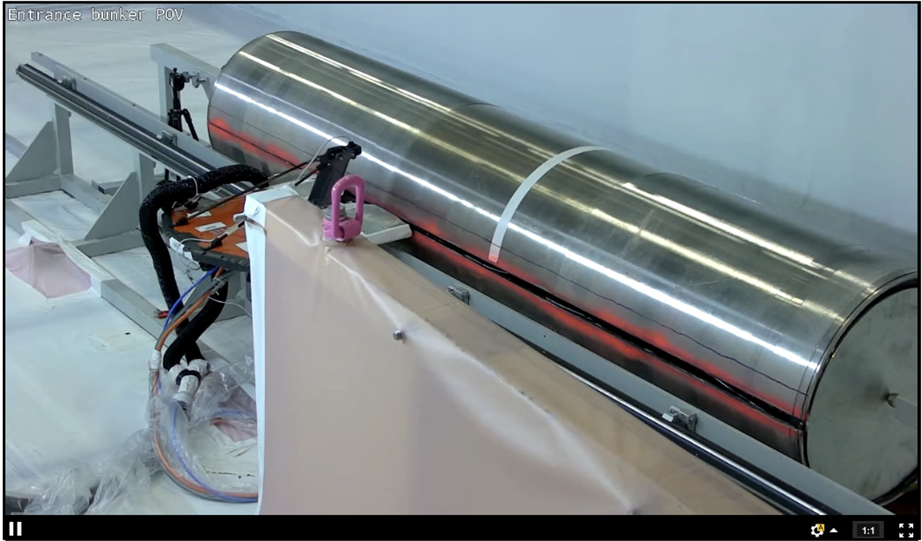
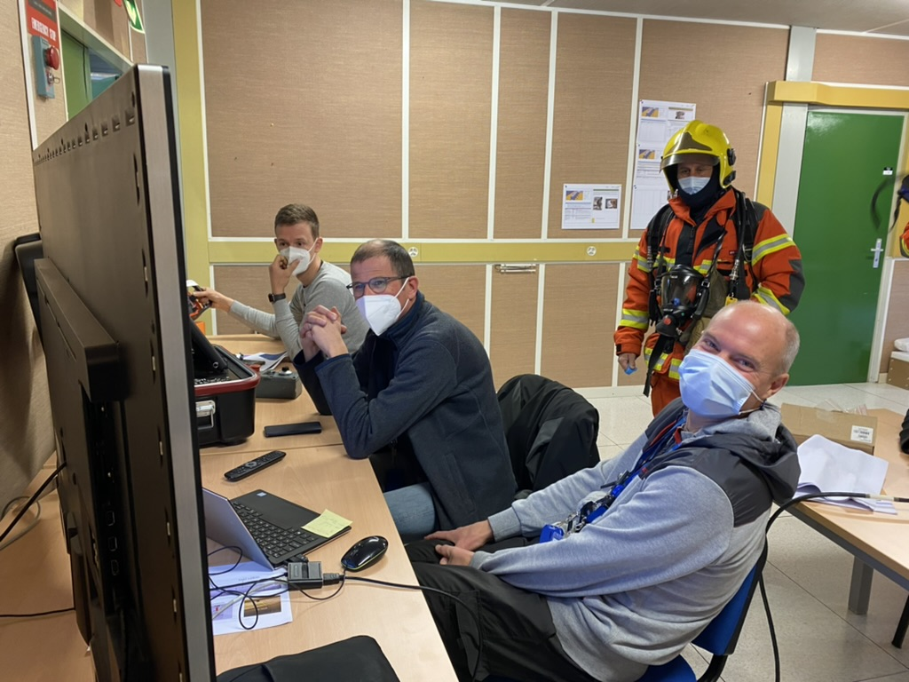
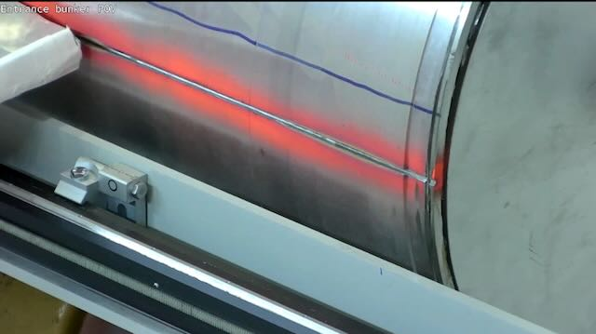
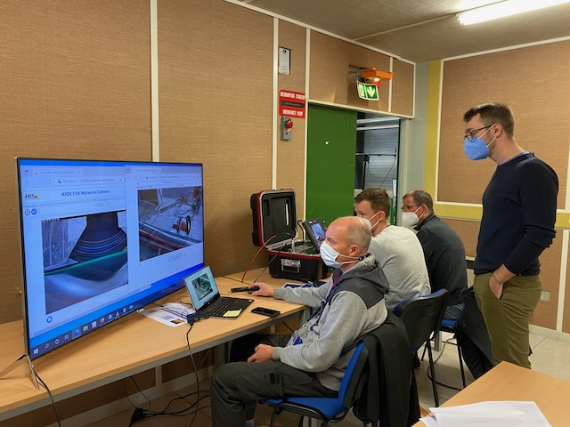
Longitudinal Cuts
First radial cut
TDE dump installation in Airlock
TDE dump installation in Airlock
End of second radial cut

Slide 18
Stainless steel removal
First radial cut
TDE dump installation in Airlock
TDE dump installation in Airlock
End of second radial cut

Slide 19
Sigraflex
First radial cut
Reverse Sigraflex on non activated aluminium 1/3 moon
Max dose rate :
25 μSv/h at contact

Slide 20
Sigraflex METRASCAN
First radial cut

Slide 21
Sigraflex autopsy
First radial cut
Acknowledgements HSE-RP: C.Tromel, M.El Drissi, T.Juhasz, S.El Drissi

Slide 22
Results Summary – Autopsy (Sigraflex)
Sigraflex
Sigraflex in very good state! Some exposed disks show some marks, to be further analysed (<1%)
Graphite oxidation or material ejection? No measurable swelling though
Sigraflex is confirmed for the spare dumps – Low Density 3DCC is discarded

Slide 23
Post Irradiation
Low Density graphite samples
Post irradiation of LD anf HD samples on going
High Density graphite samples

Slide 24
TDE dump waste packaging
First radial cut
HD Graphite and stainless steel blocks placed in a container for long term storage
318LN Stainless steel LG envelope were compressed

Slide 25
Conclusion
First-of-kind activity and No major technical issues - Extended rehearsals and technical review were the key of this success
Dump autopsy showed no major issue with core configuration during run 2 (320 MJ, 1.5 kJ/g) despite extruded graphite damaged
Dump autopsy increased our knowledge on material behaviour under real beam condition and allowed significant budget savings by confirming the performance of Sigraflex for run 3 spare dumps
Important lessons learnt for future similar endeavours. Autopsy is a key activity for the future. A dedicated place for autopsy could be a very important step.
Successful waste packaging for TDE68 dump. TDE62 RW packaging is on going. 4 more dumps to come!

Slide 26
Acknowledgements: S.De Man, D.Grenier, E.Grenier-Boley, L.Buonocore, S. Di Giovannantonio, E.Romagnoli, C.V.Almagro, M.Di Castro, D.Pazem, W.Bastien, O.Deschamps, S.Pelletier, O.Claude Matrat, D.Makrani, N.Solieri, S.El-Drissi, C.Tromel, R.Mouret, G.Dumont, S.Sgobba, A.Cherif, JP.Rigaud, B.Delille, R.Veness, M.Brice and much more…
Thank you for your attention !

