Slide 1
Recent spallation materials researches performed at PSI
Yong Dai, Peng Bi, Peng Song (PSI), Hossein Sina, Michael Wohlmuther (ESS)
HPTW2023, RIKEN, Japan 06.11.2023

Slide 2
Content
PIE of target material: Tungsten
PIE of proton beam window (PBW) materials: Inconel 718 & Al-6061

Slide 3
PIE of target material: Tungsten
Revision of irradiation
parameters based on
gamma measurements
Protons

Slide 4
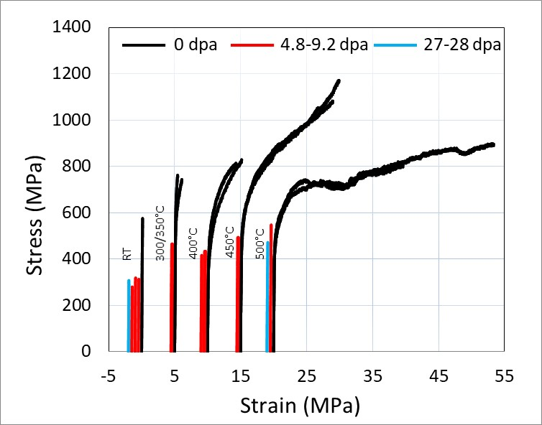
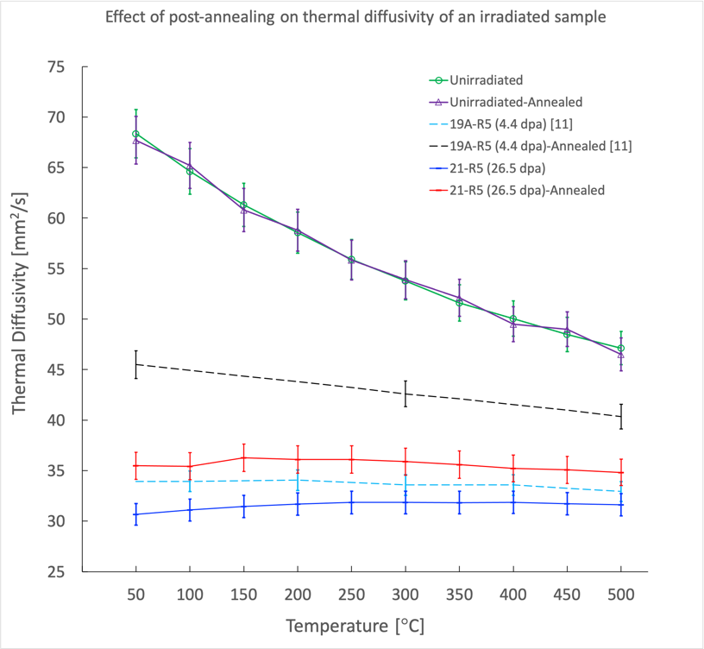
PIE of target material: Tungsten
3-point bend test
Thermal diffusivity measurement
Details in Sina Hossein’s talk on Thursday

Slide 5
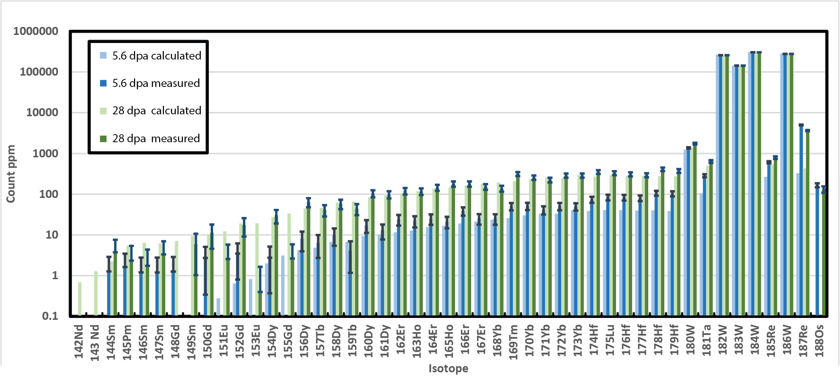
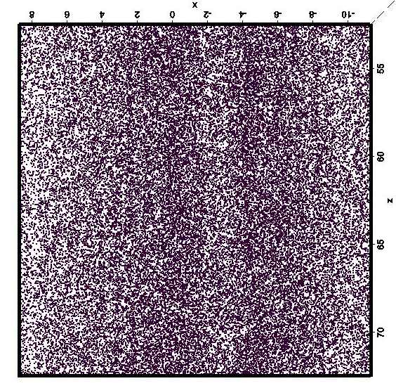
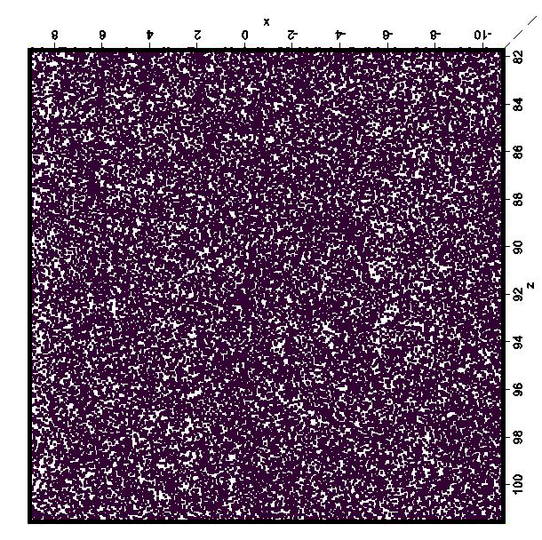
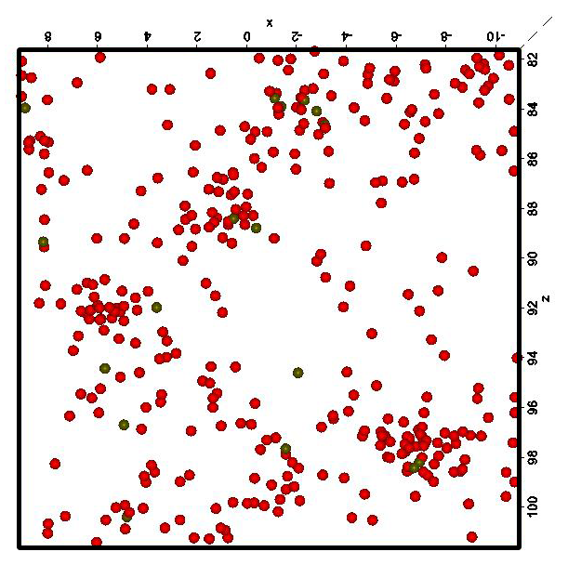
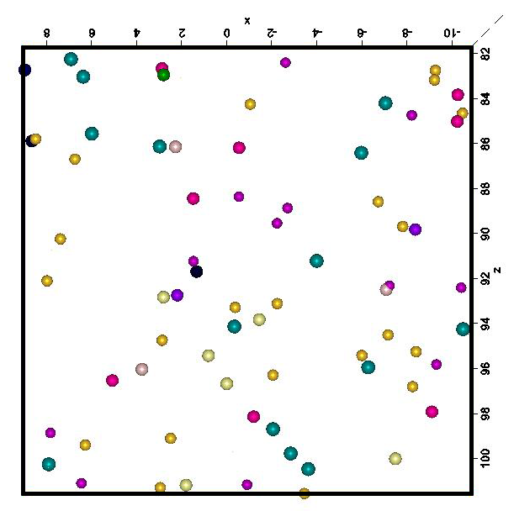
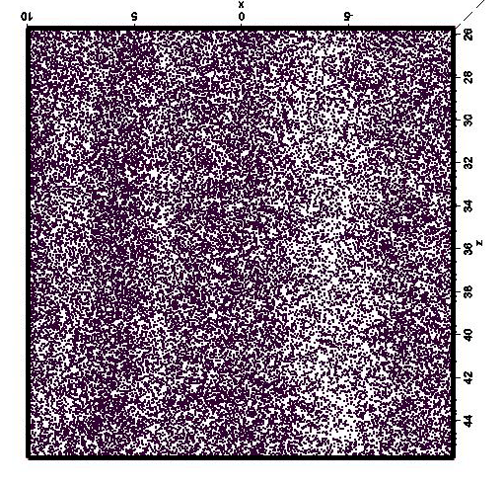
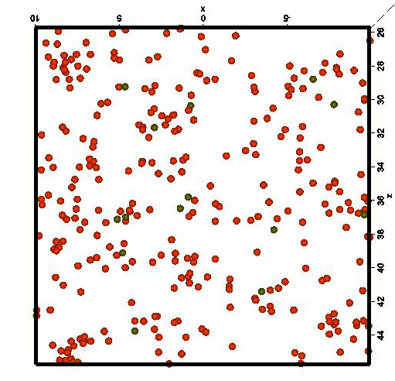
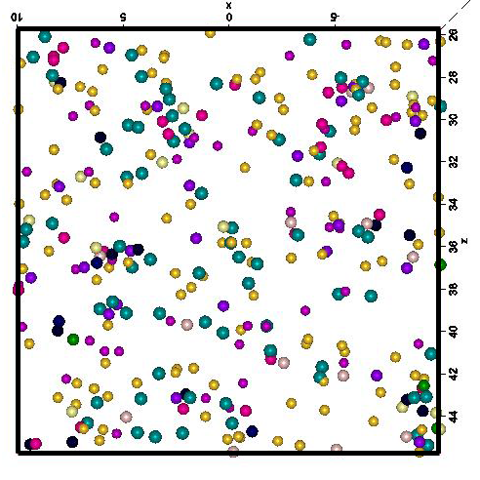
PIE of target material: Tungsten
Atom probe tomography (APT)
Clear clustering of Re in irradiated samples
Clustering of other Transmutants not clear, due to low concentration
As Received
20nm × 20nm × 5nm Slice
6.4 dpa
In neutron irradiation: mainly Re and Os (can be much higher! 1% at / dpa)
28 dpa

Slide 6
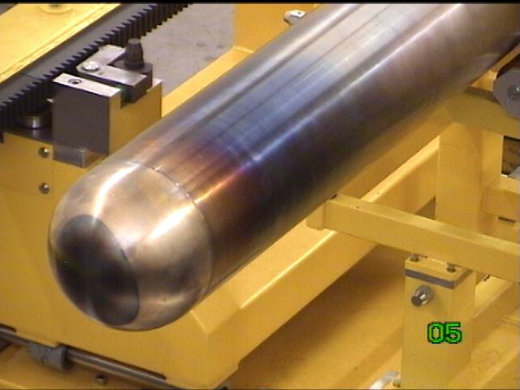
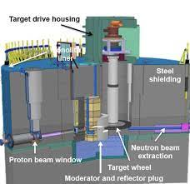
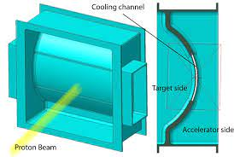
PBW materials
PBW of LANSCE: PH Inconel 718
PBW of SINQ: AlMg₃
2.3 mm wall thickness,
Max. dose 20 dpa
2.0 mm wall thickness,
Max. p-fluence: 8.6x10²⁵ p/m²
Max. dose 8.5 dpa
James, JNM 296 (2001) 139
PBW of SNS: SA Inconel 718
PBW of ESS: Al-6061-T6
1.8/2.0 mm wall thickness,
Max. dose 20 dpa
McClintock, Acta Mater. 231 (2022) 117889

Slide 7
PIE of PBW material: Inconel 718
PH Inconel 718 irradiated at LANSCE
SA Inconel 718 irradiated at SNS
Irradiated with 800 MeV / 1 mA protons for 9 months during 1995 – 1997. A leak was detected after 6 months.
PBW-4 was operated for 2 years, with 940 MeV protons and 8674 MWh.
Max. 9.7 dpa, 110°C
Max. 3.0 x 10²⁵ p/m², ~10 dpa, <400°C
5- 9.7 dpa
3- 5 dpa
McClintock, Acta Mater. 231 (2022) 117889
James, JNM 296 (2001) 139

Slide 8
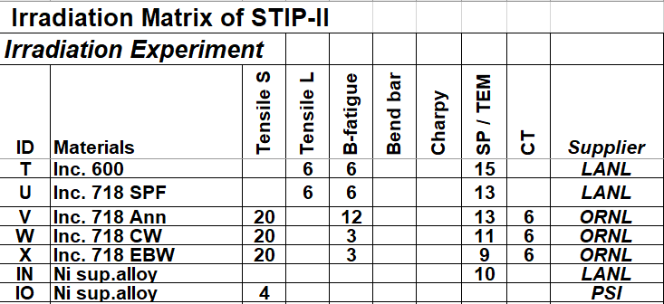
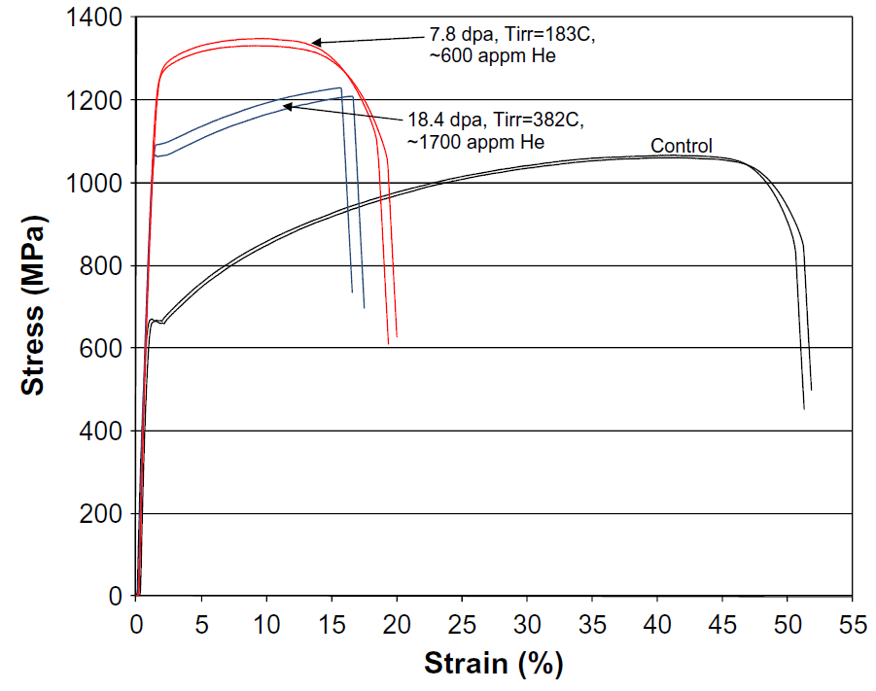
PIE of PBW material: Inconel 718
SINQ Target Irradiation Program – STIP
Inconel 718 irradiated in STIP-II
Inc. 718 SPF
protons
Maloy, JNM 417 (2011) 1005.

Slide 9
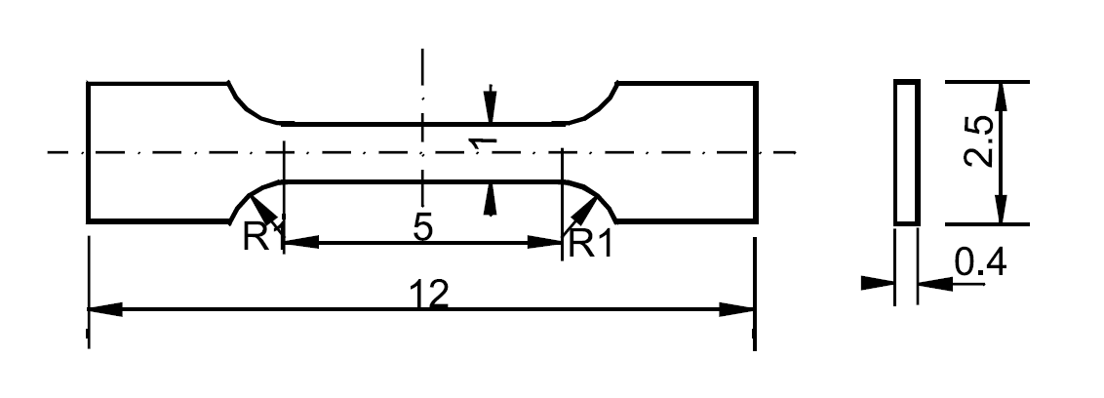
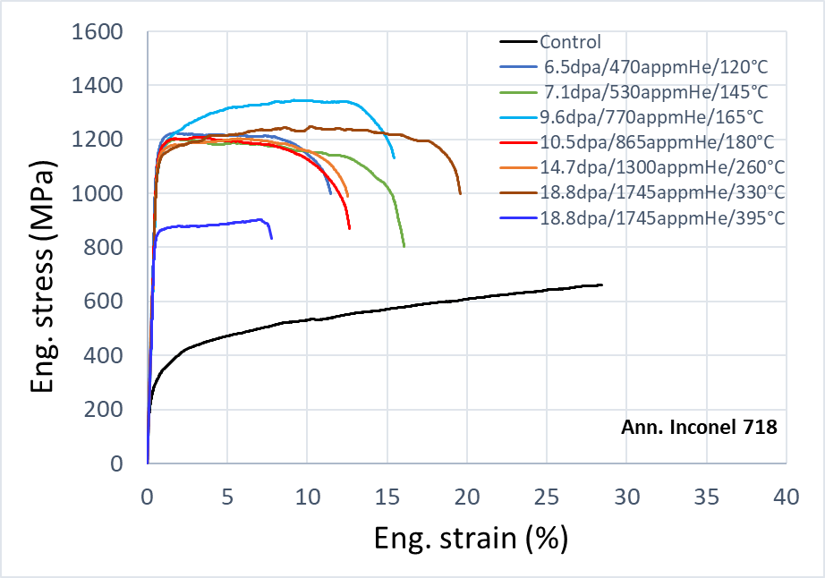
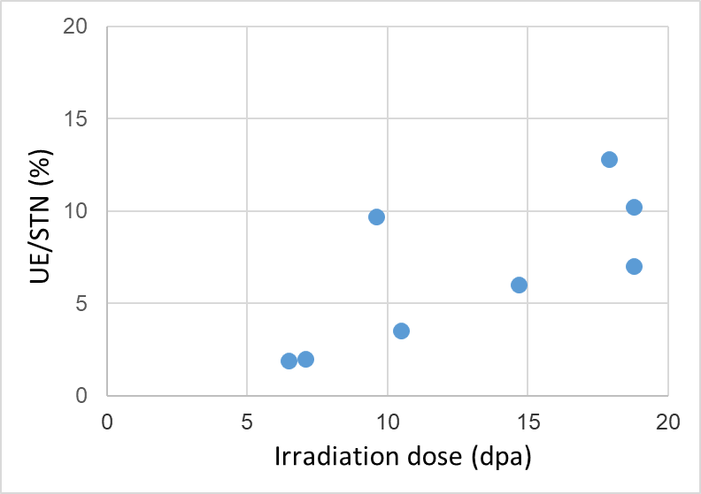
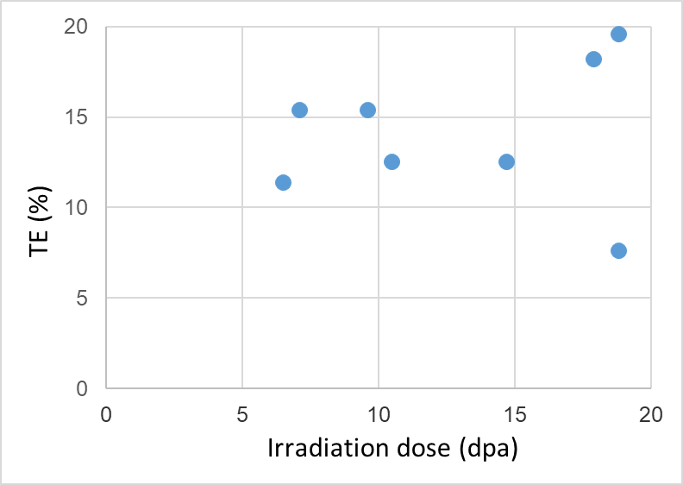
PIE of PBW material: Inconel 718
Inconel 718 irradiated in STIP-II
McClintock’s data range

Slide 10
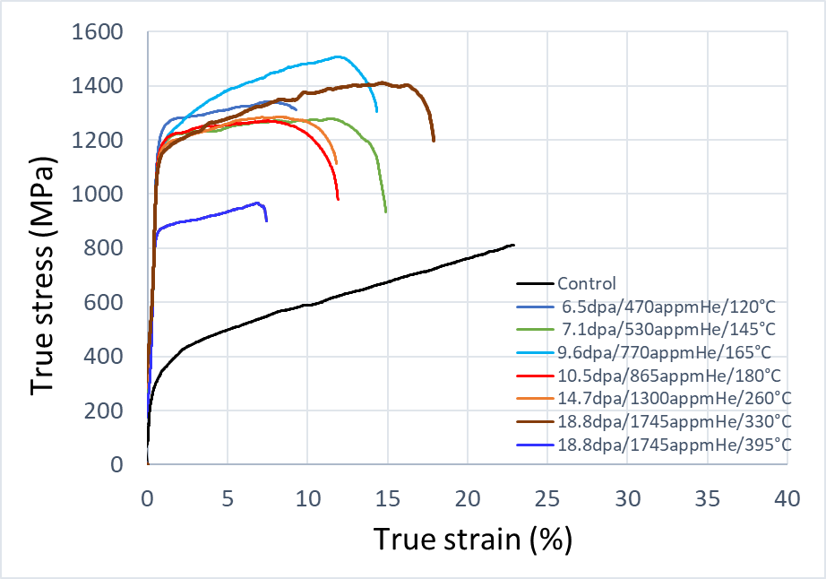
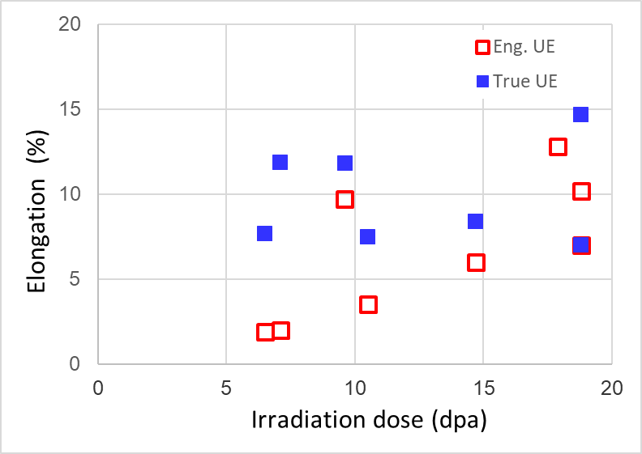
PIE of PBW material: Inconel 718
Inconel 718 irradiated in STIP-II

Slide 11
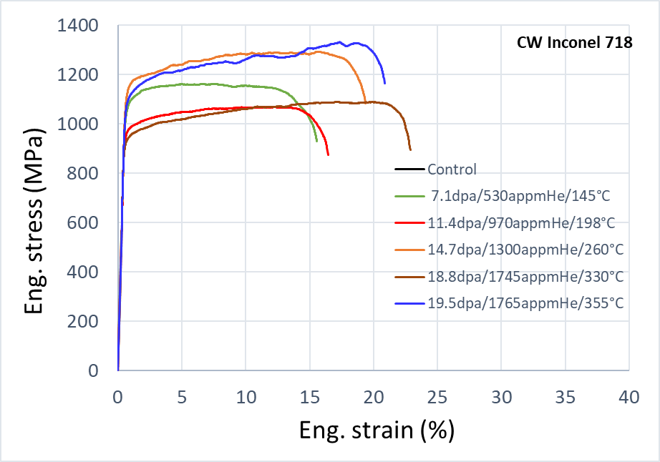
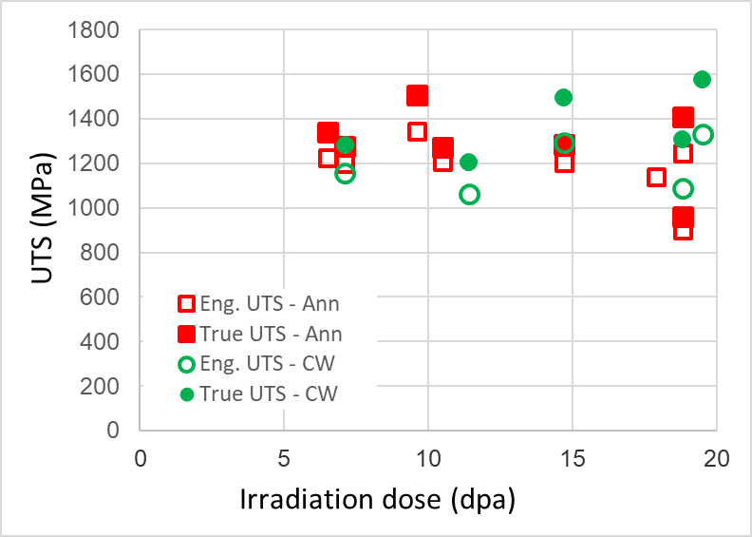
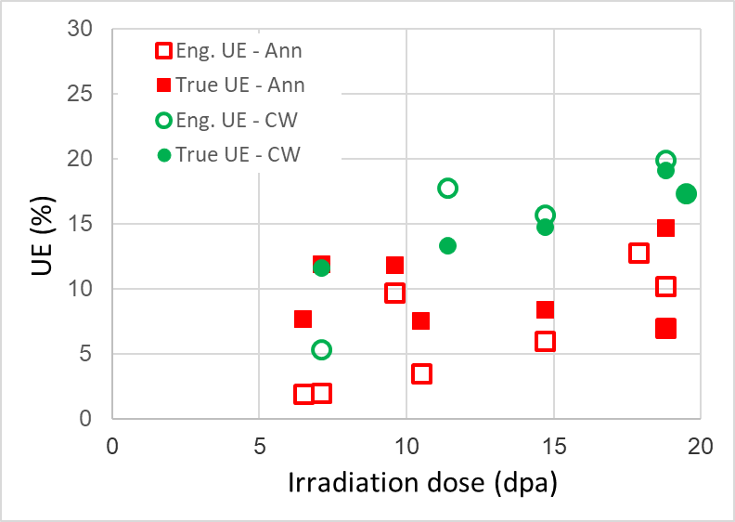
PIE of PBW material: Inconel 718
Inconel 718 irradiated in STIP-II
Chen, JNM 343 (2005) 236
HV0.2_{CW}= 459
HV0.2_{Ann}=220

Slide 12
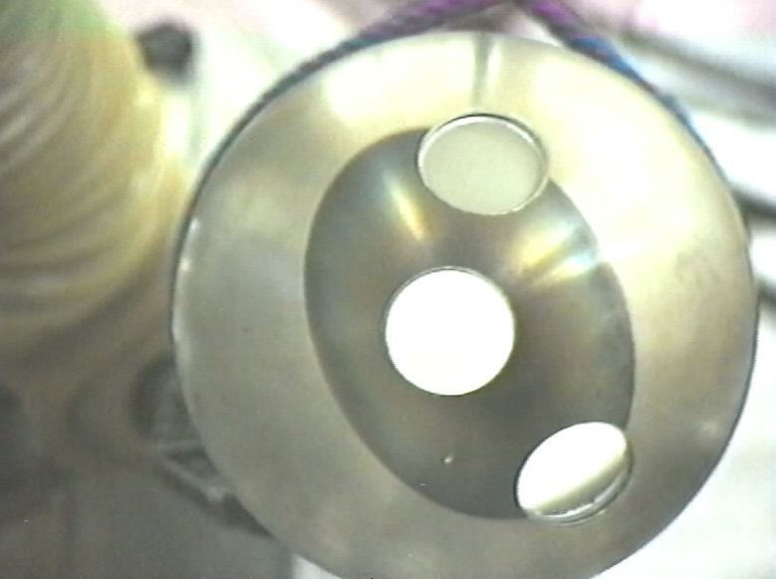
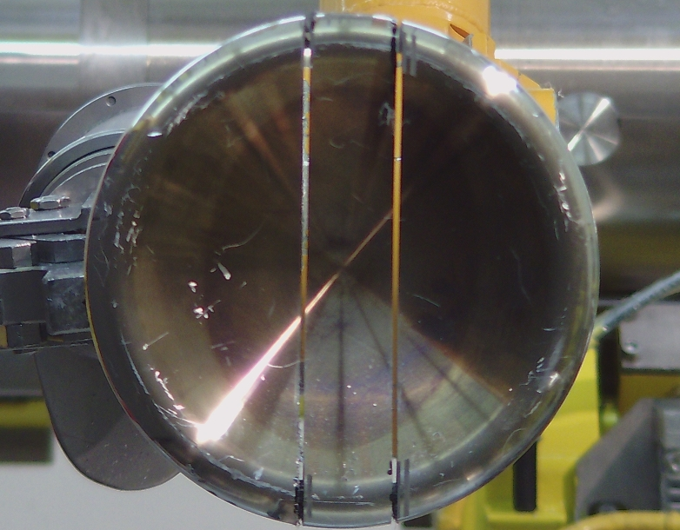
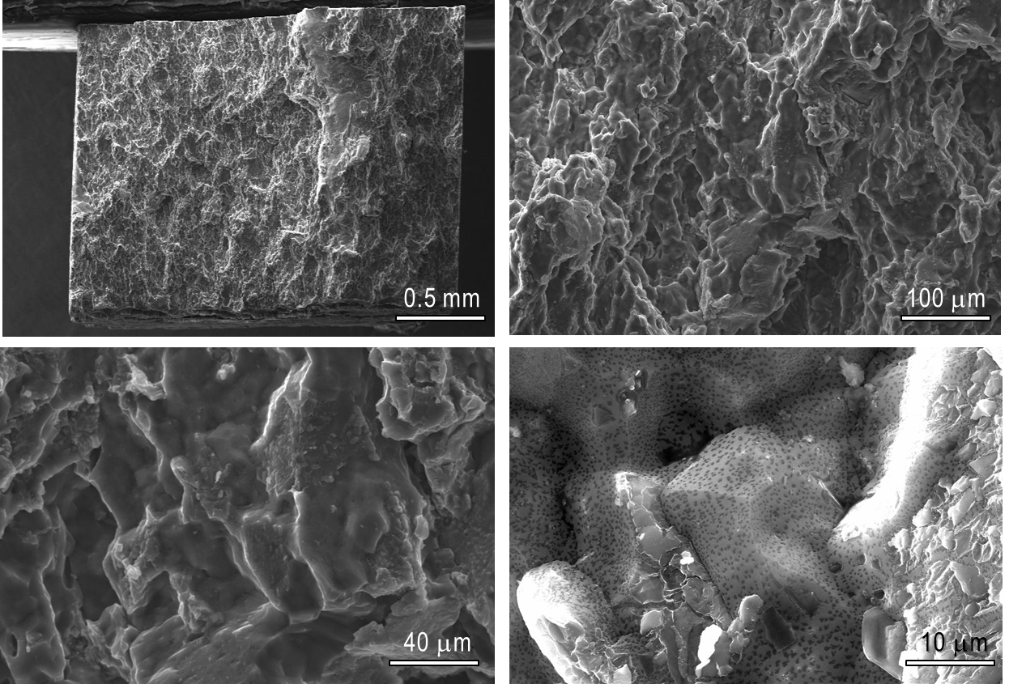
Al-alloys for PBW applications
Al-alloy: AlMg₃
SINQ Target-3 (1998-99), 6.8 Ah P⁺
SINQ Target-4 (2000-01), 10.03 Ah P⁺
SINQ Target-9 (2011-12), 13.13Ah P⁺
Proton fluence: 8.5x10²⁵ /m²
8.8 dpa / 2400 appm He / 4800 appm H

Slide 13
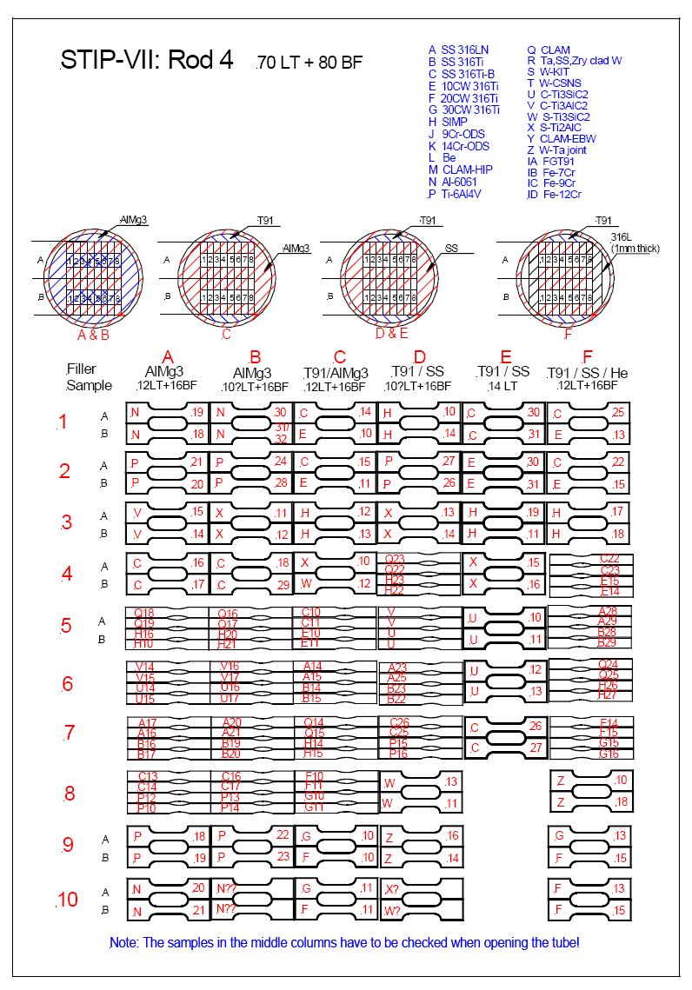
Al-alloys for PBW applications
Al-alloy: Al 6061-T6
Irradiation in STIP-7 (Target-10, 2013-14)
n-flu. | 9.5x10²⁵/m²
p-flu. | 1.6x10²⁵/m²
Dose | 10.1 dpa
He | 455 appm
H | 1095 appm
T_{irr} | 62°C
R4
to be finalized
to be published

Slide 14
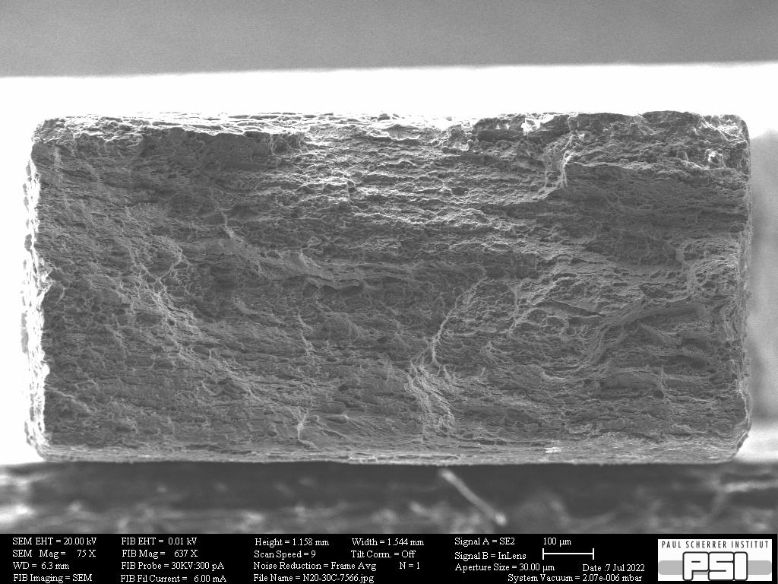
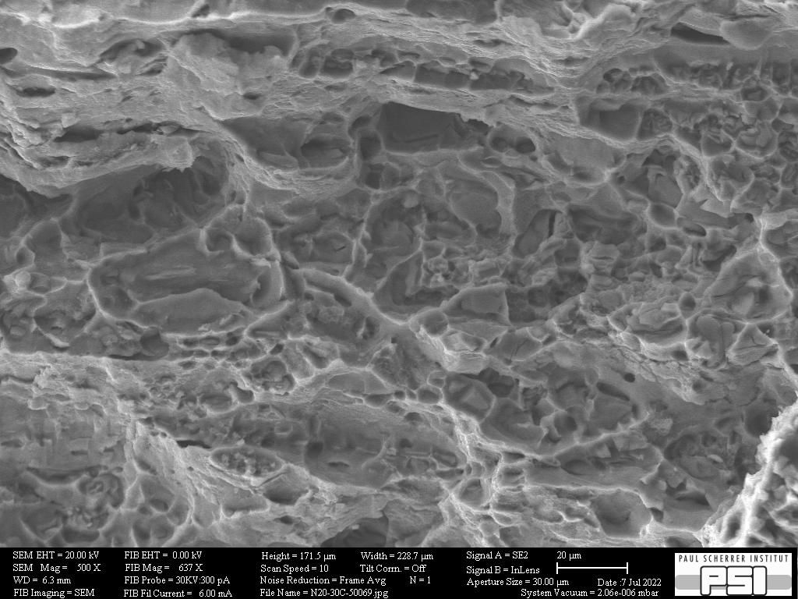
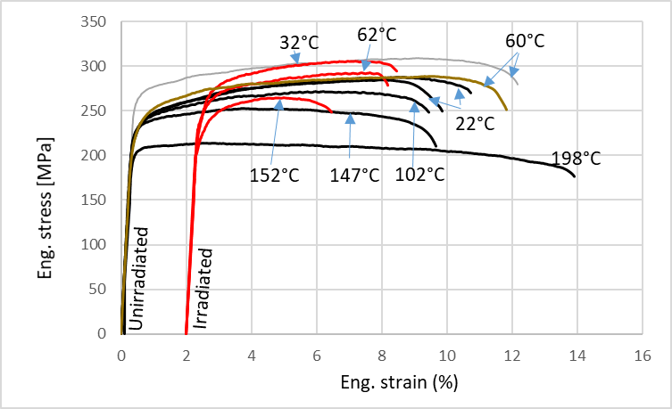
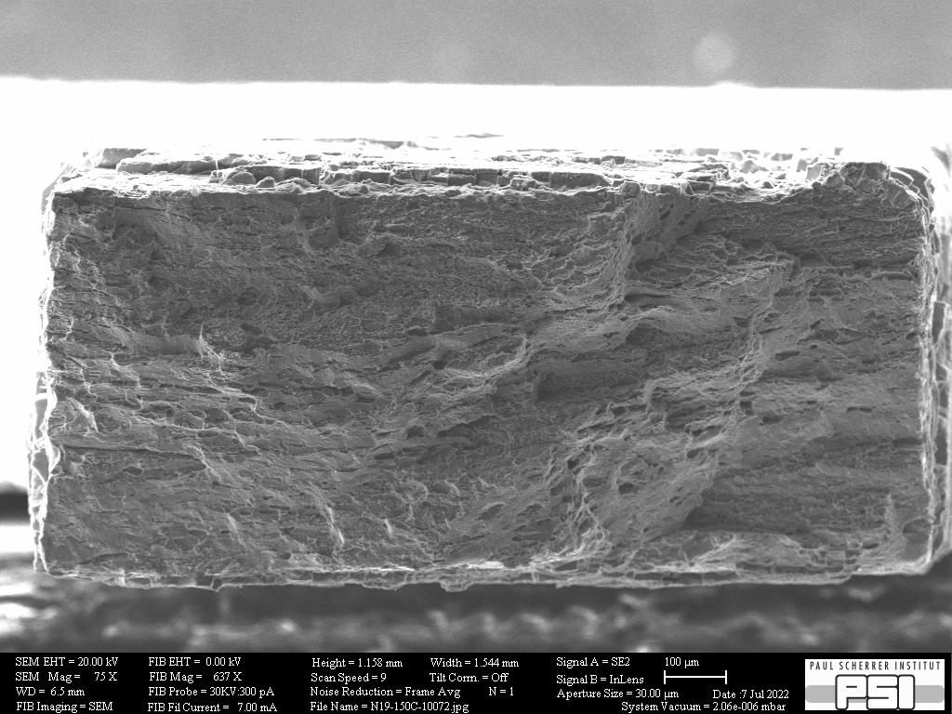
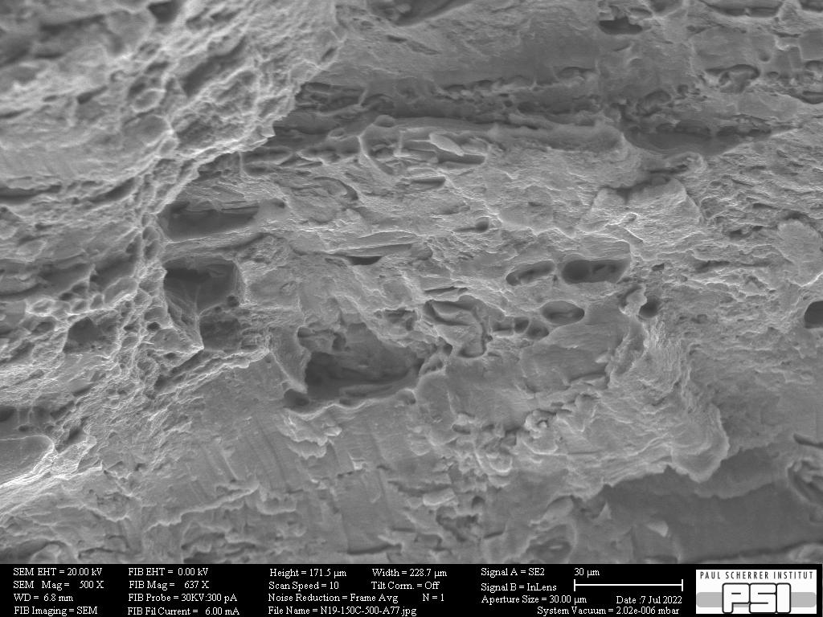
PIE of PBW material: Al 6061
Al-alloy: Al 6061-T6
Tt=32°C
Tt=152°C
Microstructural results in Peng Song’s talk on Thursday

Slide 15
Thank you!

