Slide 1
Capabilities of the FLUKA particle transport code for the design of high-power targetry systems
C. Ahdida, F. Salvat Pujol and V. Vlachoudis on behalf of the FLUKA.CERN Collaboration

Slide 2
Introduction to FLUKA

Slide 3
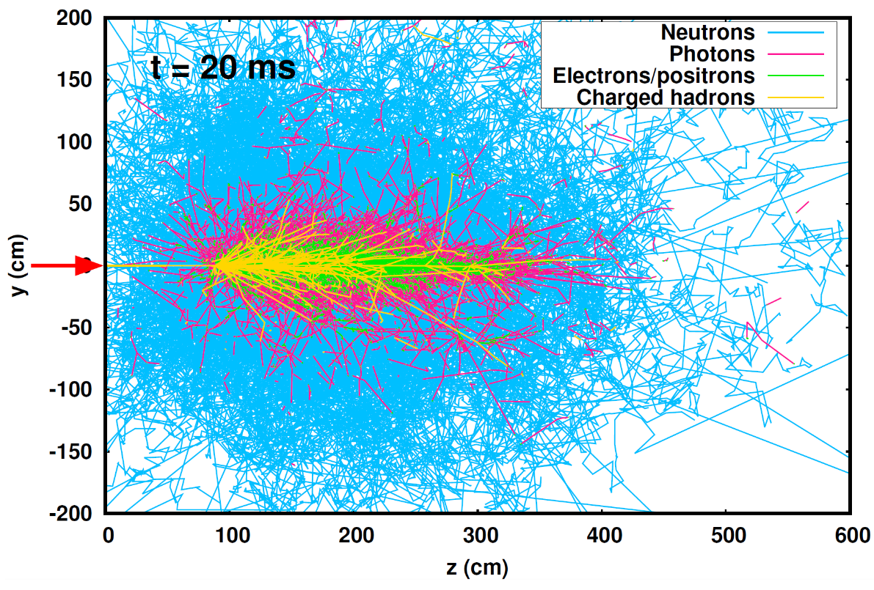
Particle shower simulation
Radiation shower set up by a single 450 GeV/c proton in Al

Slide 4
FLUKA
General-purpose code for the Monte-Carlo simulation of radiation transport
Maintained by the FLUKA.CERN Collaboration
Worldwide community of ~3000 active users
Mature simulation code: development started in the 1960s
Coupled hadronic/electromagnetic particle shower simulation
Over 60 particle species tracked, including γ, e±, μ±, 𝜏±, 𝜈, hadrons, ions
Energy range:
– up to 10 PeV
– down to 100 eV for γ, 1 keV for e±/p, 10⁻¹⁴ GeV for n
Not a simulation toolkit: most reasonable physics models adopted on behalf of our users
Very few simulation parameters: transport/production thresholds, toggling exotic/time-consuming processes, etc
Combinatorial geometry package for arbitrarily complex geometries
Tracking in magnetic fields (and electric fields in vacuum)
Built-in variance reduction / biasing techniques
Built-in scoring capabilities for a broad variety of radiometric quantities

Slide 5
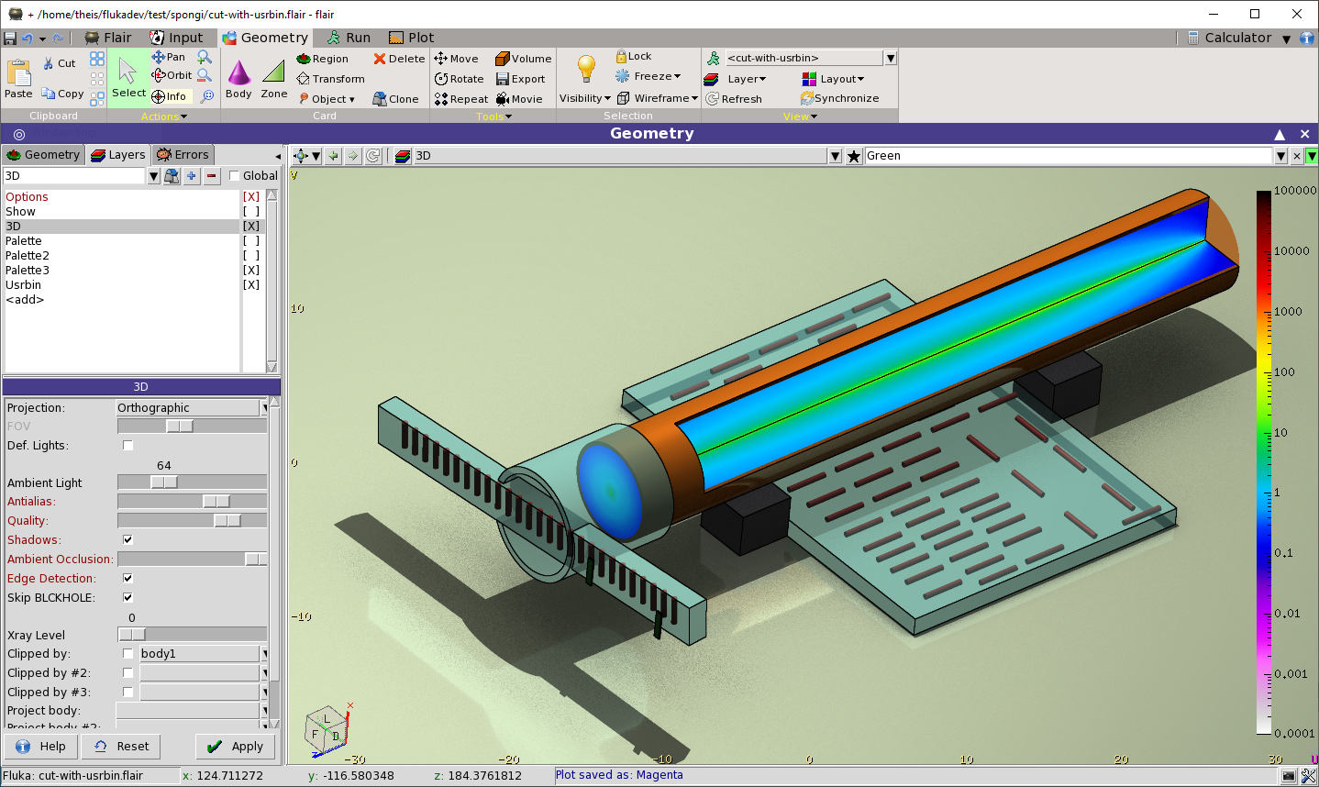
FLUKA’s graphical user interface: Flair
Assists users in all simulation stages:
Input setup
Geometry definition, visualization & debugging
Running (distributed)
Processing output
Visualizing results
https://flair.cern
Broad range of applications of FLUKA/Flair!
Constant evolution (e.g. planning RP interventions, animated movies)
E.g. energy deposition (GeV/cm³ in a test target at CERN’s H4IRRAD w/ 280 GeV/c mixed hadron beam)

Slide 6
FLUKA features for high-power targetry design
Energy (dose) deposition
Secondary particle production
Radiation damage estimates
DPA
H and He production
Radiation to electronics
Prompt radiation and activation
Prompt and delayed in a single run
Radionuclide inventories
Ambient doses (up-to-date fluence-to-dose conversion coefficients from ICRP116 and ICRU95)
Provides input for thermomechanical finite element analyses (ANSYS)

Slide 7
Displacement damage observables in FLUKA

Slide 8
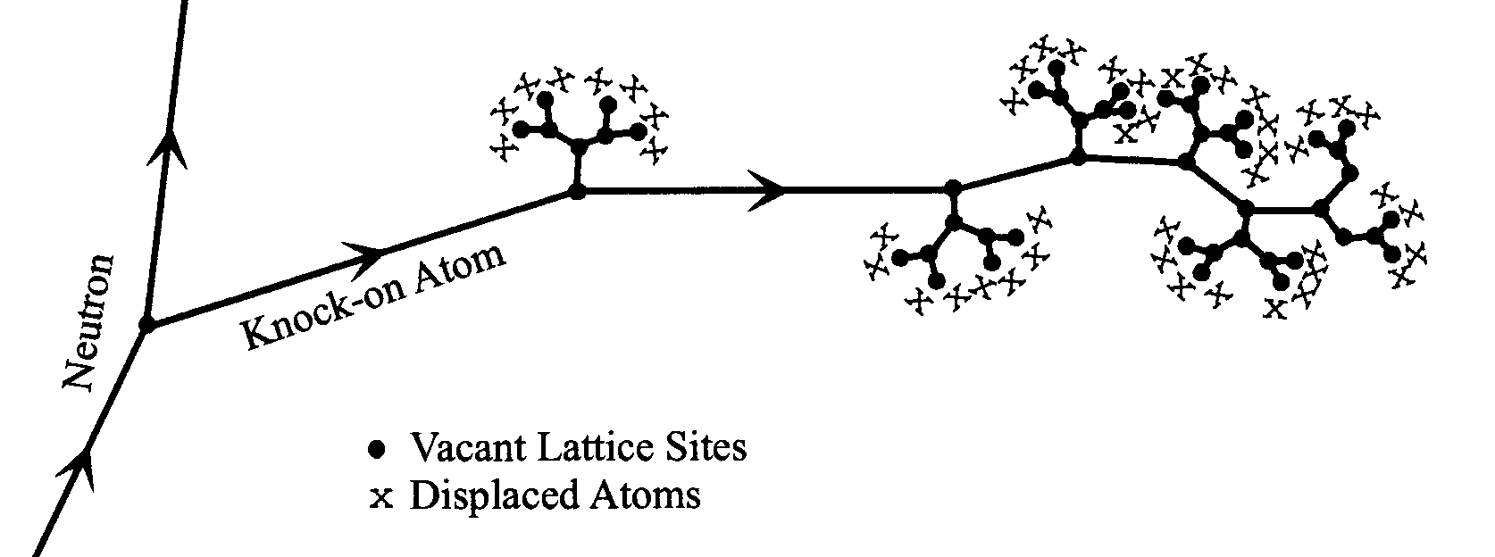
DPA
The unit that is commonly used to link the “radiation damage effects” with “macroscopic structural damage” is the displacement per atoms
It is a “measure” of the amount of radiation damage in irradiated materials
3 DPA means each atom in the material has been displaced from its site within the structural lattice an average of 3 times
A quantity directly linked to the Non Ionizing Energy Losses (NIEL) but restricted in energy
DPA is a strong function of projectile type, energy and charge as well as material properties and can be induced by all particles in the cascade
However, DPA for the moment is a “mathematical” quantity that cannot be directly measured experimentally

Slide 9
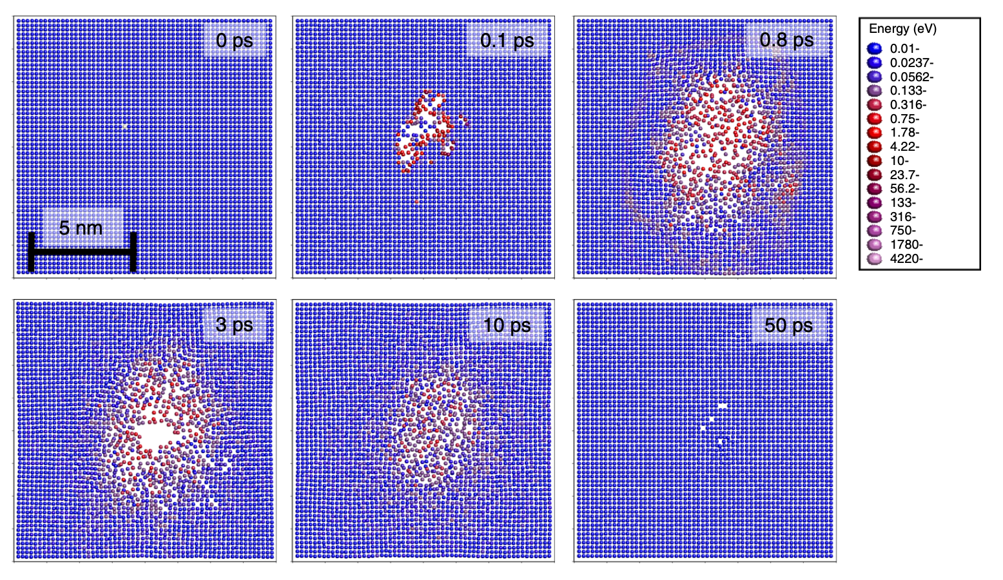
DPA in FLUKA
DPA-NRT
ARC-DPA
N_{d} – number of atomic displacements
T_{d} – damage energy
E_{d} – average threshold displacement energy
DPA-NRT and ARC-DPA
For all particle species
User-defined material constants b_{arcdpa}, c_{arcdpa}
During transport: restricted above the damage threshold
During ranging out (below 1 keV): unrestricted, relying on Lindhard partition function
Time-dependent evolution of displace-ment cascade based on molecular dynamics simulations
Nordlund et al., Improving atomic displacement and replacement calculations with physically realistic damage Models, Nature Commun., 9:1084 (2018)

Slide 10
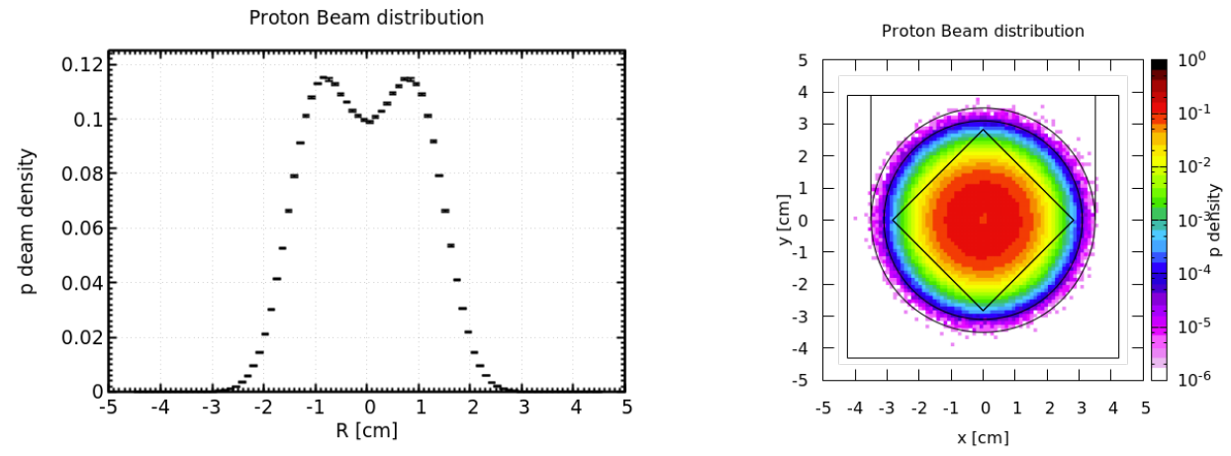
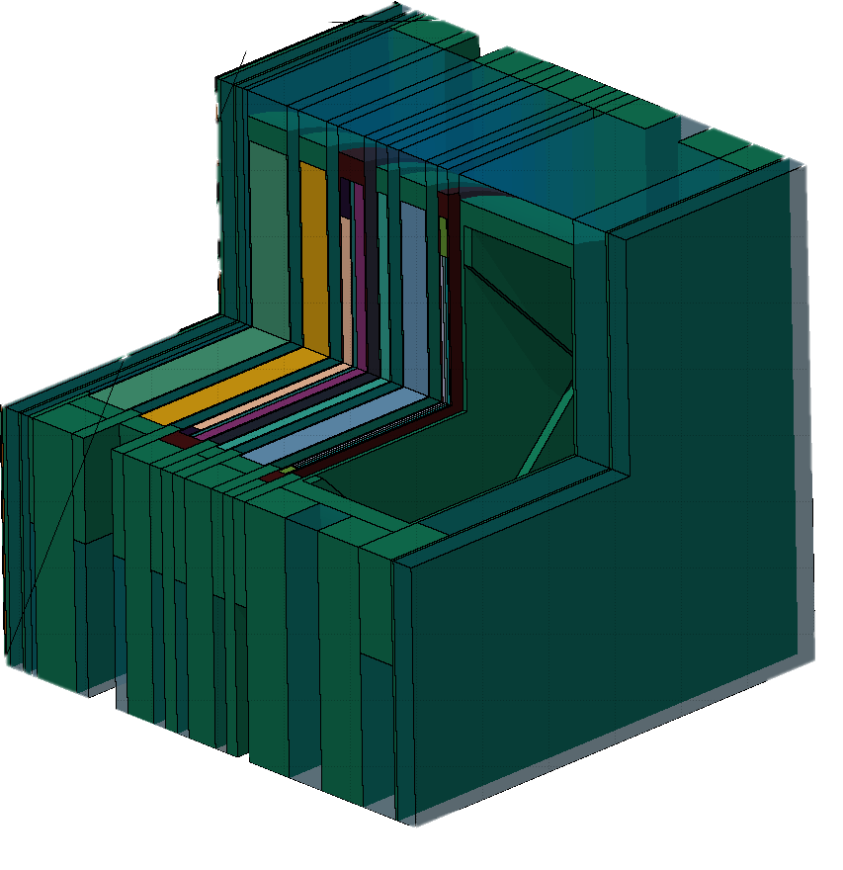
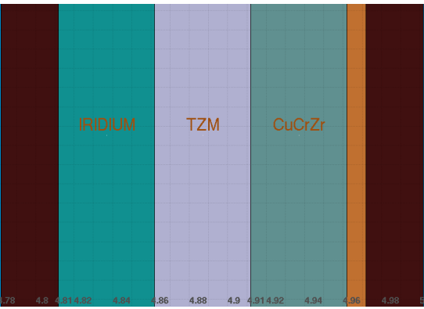
BLIP tests
Joao Espadanal, Vasilis Vlachoudis
Beam distributions
SS304 container with different capsules of material samples was irradiated at BLIP
Beam parameters:
Proton E = 181 MeV
σ_{x,y} = 5.1 mm
1.03 · 10²¹ POT for High-Z I capsule
High-Z I capsule contained iridium, TZM and CuCrZr
High-Z I capsule
SS316
Panagraphite
SS316
TZM: (%) 99.273 Mo; 0.55 Ti, 0.12 Zr; 0.03 C; 0.01 Fe; 0.01 Si; 0.002 Ni; 0.002 N; 0.003 O
CuCrZr: (%) 98.76 Cu; 1.0 Cr; 0.15 Zr; 0.04 Fe; 0.05 Si

Slide 11
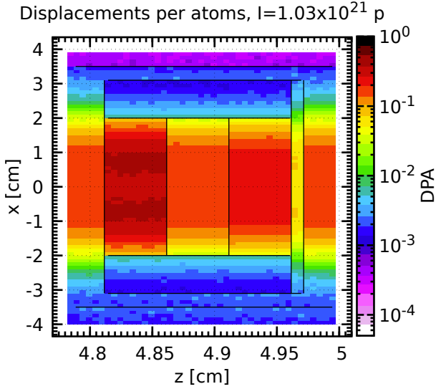
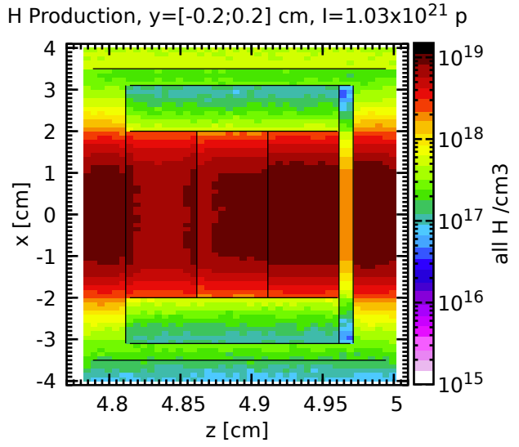
BLIP – Gas production per DPA
DPA (ARC-DPA)
H production
1.03 · 10²¹ POT
DPA is not the full picture for material damages
Other quantities should be considered, for instance the gas (H, He) production
In the BLIP example low energy protons are implanted in the material
If a large quantity of gas is produced and the material is not able to dissolve it in the inner structure, bubbles are created and cracks may appear
This may have a more important net effect than DPA itself → a factor of even 1000
SS316
Ir
TZM
CuCrZr
SS316
SS316
Ir
TZM
CuCrZr
Panagraphite
SS316
Panagraphite
max
0.4
0.2
0.2
0.2
0.1
H appm/DPA (ARC-DPA)
SS316
Ir
TZM
CuCrZr
SS316
SS316
Panagraphite
Ir
TZM
CuCrZr
SS316
Panagraphite
0.2
Joao Espadanal, Vasilis Vlachoudis

Slide 12
Application: radiation damage in the Muon Collider arc

Slide 13
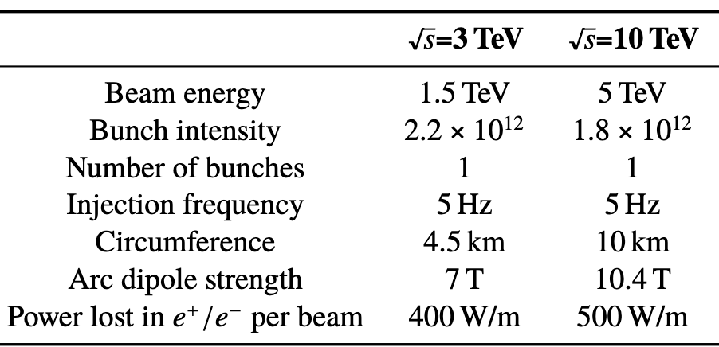
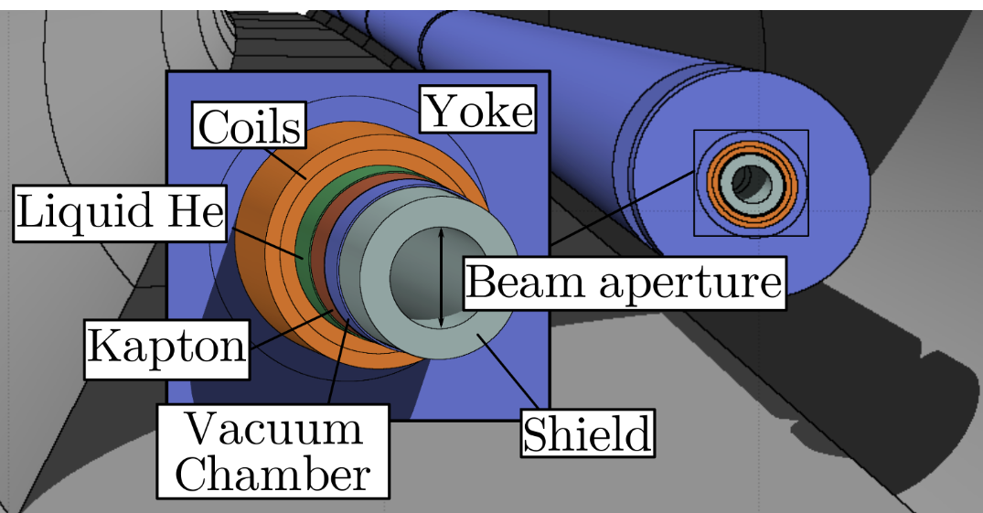
Muon collider: shielding study for dipole arc magnets
Calzolari et al., IPAC2022 doi:10.18429/JACoW-IPAC2022-WEPOST001
Parameters
IMCC aims to address key design questions for a multi-TeV muon collider
Multi-TeV muons still have a relatively short mean lifetime in the lab frame (0.1 s for √𝑠=10 ) and rapidly decay
The decay e-/e⁺ carry on average ~1/3 of the E_{µ} creating a dissipated power of several 100 W/m
Significant challenge for the collider design due to the instantaneous heat deposition and cumulative radiation damage
To sustain the radiation load, superconducting magnets need to be protected with a continuous absorber to
prevent beam-induced quenches
reduce the thermal load to the cryogenic system
avoid magnet failures due to the cumulative dose in insulators and atomic displacements in superconductors
Geometry
Similar power dissipated by decay e⁻/e⁺ due to diff. ring circumference
3 cm-thick W
Generic study with string of conventional dipole magnets (6 m long) and 20 cm long drift regions in between

Slide 14
Power, dose and DPA in superconducting coils
Calzolari et al., IPAC2022 doi:10.18429/JACoW-IPAC2022-WEPOST001
Short-term effects
Long-term effects
Peak power deposition in the coils
Maximum at around 1.2 and 1.5 mW/cm³ for 3 and 10 TeV, respectively
One order of magnitude smaller than the typical 15-20 mW/cm³ quench limit for the bending dipoles of the LHC
No problem in terms of magnet quenches
Dose over 10 y reaching 27 and 37 MGy is above customary limit
Additional shielding
More recent studies are within limits
DPA values reaching 10⁻⁴ over 10 years
Nb₃Sn samples degrade above 10⁻³ DPA
Similar DPA in inner triplet magnets for HL-LHC after 3000 fb⁻¹
DPA expected to be fine

Slide 15
Application: neutron attenuation benchmark

Slide 16
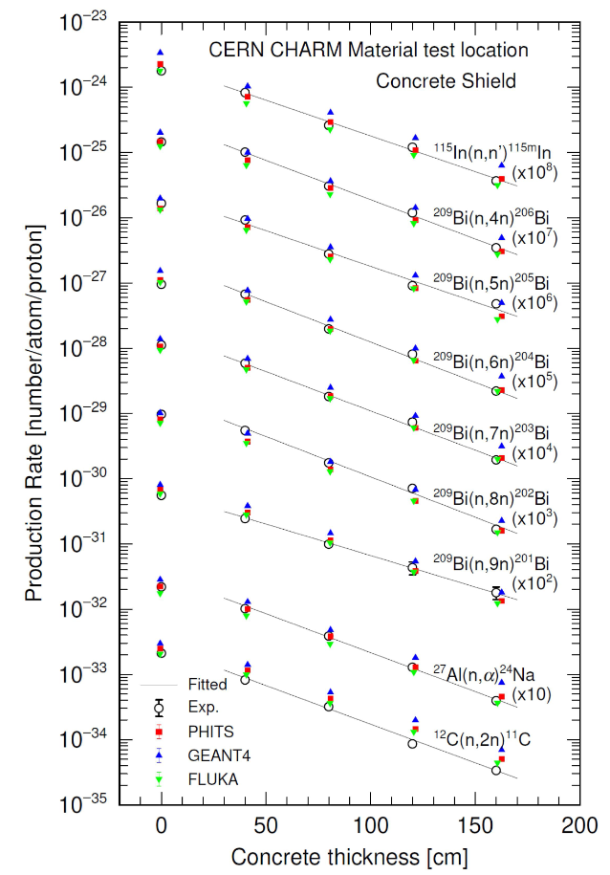
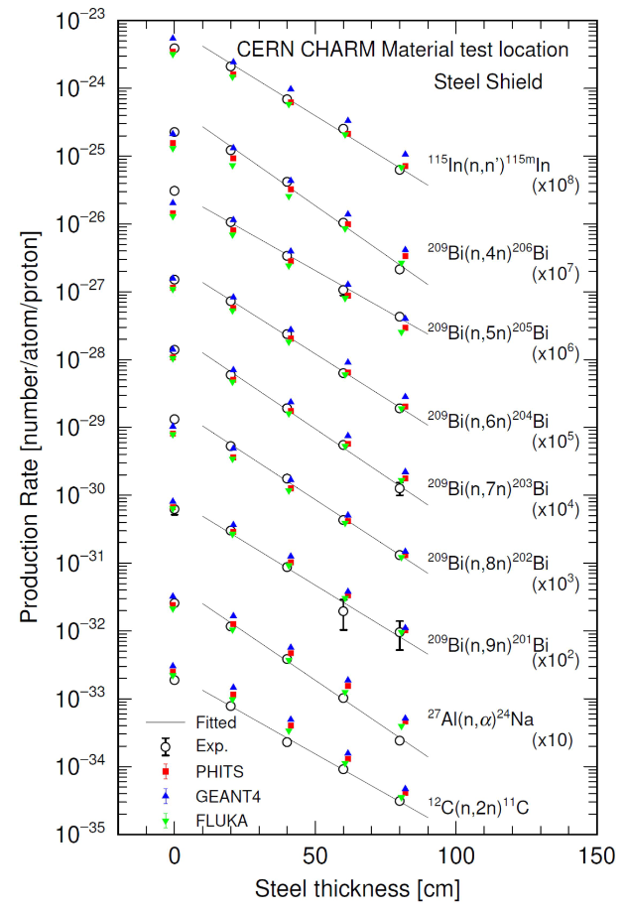
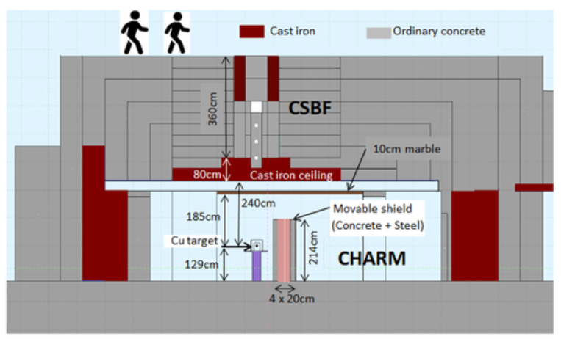
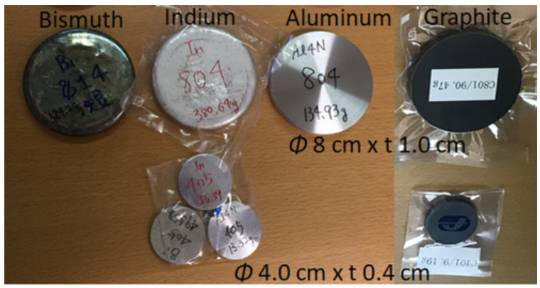
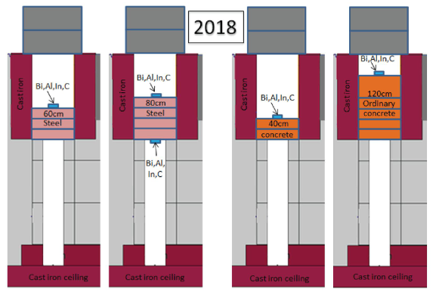
Neutron attenuation benchmark
Nakao et al., Measurement and simulations of high-energy neutrons through a various thickness of concrete and steel shields using activation detectors at CHARM and CSBF, Journal of Nuclear Science and Technology
CERN Shielding Benchmark Facility (CSBF)
A benchmark facility for testing different shielding material and thicknesses in comparisons of measurements and MC simulations
Attenuation profiles of radionuclides production rates
Material samples (Bi, In, Al, C) were placed behind concrete and steel shielding of different thicknesses
Neutrons transmitted through the various shield settings were estimated by observing activation reactions
5x10¹¹ p/pulse 24 GeV/c
50 cm thick Cu, Al targets
Benchmarks are essential for providing adequate data for accelerators

Slide 17
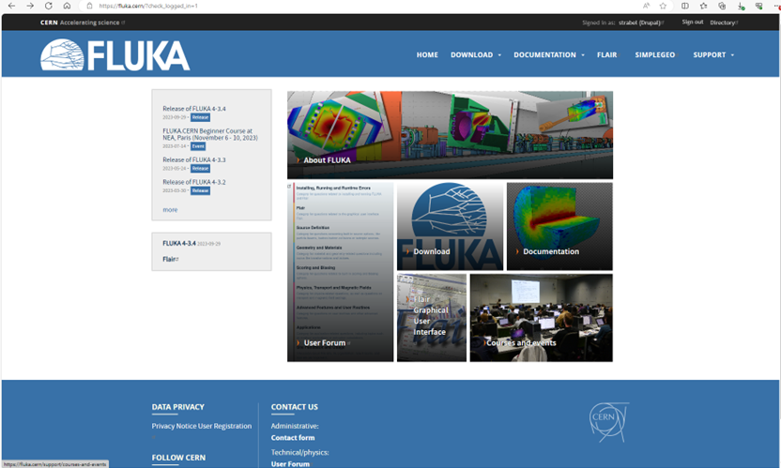
FLUKA courses
Next FLUKA Beginner’s course will take place in April 2024 in Madrid
Stay tuned for any course announcements (FLUKA webpage & forum)

Slide 18
Thank you very much for your attention!

