Slide 1
Second Target Station (STS) Preliminary Design Status
Mike Strong
Group Leader, Interface Systems
STS Target Systems
November 6, 2023

Slide 2
Outline
ORNL capability in neutron sciences and STS mission need
Preliminary Key Performance Parameters (PKPPs)
Project Critical Decision (CD) timeline and schedule overview
Challenge of design in the era of high inflation
Summary

Slide 3
ORNL operates two advanced neutron scattering user facilities

Slide 4
STS Mission Need Statement identified capability gaps that could only be met with a high intensity, cold neutron source
Capabilities more than an order of magnitude beyond the SNS First Target Station “will close mission capability gaps in nanoscience, biomaterials, energy storage media, structural materials and magnetic systems”
A high intensity, cold neutron source is needed to
  Answer more difficult questions requiring higher precision measurements or measurements in complex sample environments with correspondingly smaller samples
  Perform rapid, parametric studies or time-resolved studies to allow structural measurements as fast as a few seconds or less for materials far from equilibrium (faster with pump-probe methods)
  Study systems exhibiting greater complexity(e.g., complex chemical systems in soft matter or macromolecular functionality in biology)

Slide 5
STS top-level requirements derive from our Mission Need Statement
Sustains US leadership
in neutron sciences
Build a Second Target Station at the Spallation Neutron Source facility that:
Enables simultaneous measurement across broad ranges of length scales
Produces high-intensity neutron beams
to enable science
with smaller samples, samples under more extreme conditions, & in situ or in operando (materials in action)
Provides capabilities well beyond the existing target station, with more than 10× gain
Supports
≈20-24 neutron instruments
Optimizes production of cold (long-wavelength) neutrons

Slide 6
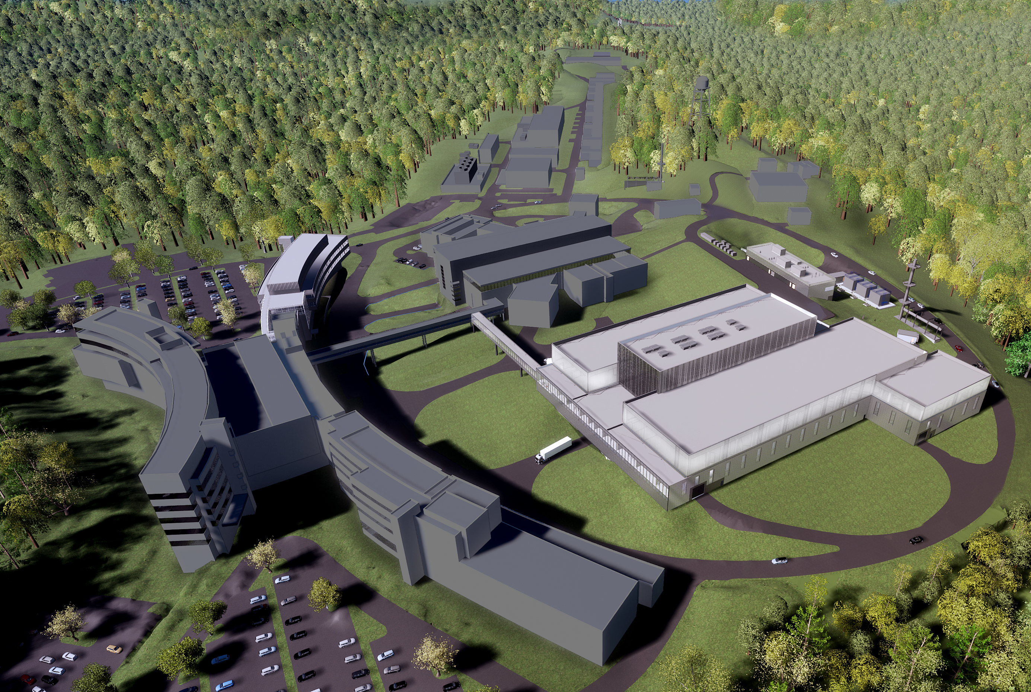
SNS upgrades will accelerate scientific progress and deliver wholly new capabilities
Proton Power Upgrade (PPU) project: Double the power of the existing accelerator structure
First Target Station (FTS) is optimized for thermal neutrons
Increases the brightness of beams of pulsed neutrons
Provides new science capabilities for atomic resolution and fast dynamics
Provides a platform
for STS
Complete 2025-2028
Second Target Station (STS) project: Build
the second target station with initial suite of beam lines
Optimized for cold neutrons
World-leading peak brightness
Provide new science capabilities for measurements across broader ranges of temporal and length scales, real-time, and smaller samples
Complete 2036-2040
Notes:
SNS was planned from its outset to be upgraded to operate at higher power and to share this power with a second target station.
The Proton Power Upgrade, or PPU, project, which is a totally separate project from STS, will double the power of the SNS accelerator.
PPU is well underway and they are already assembling cryomodules and building infrastructure
I should also mention that the First Target Station is optimized for thermal neutrons and with the PPU power increase it will be among the brightest sources of thermal neutrons in the world
The STS Project, which is outlined in yellow on this artists concept of the SNS site, is the subject of this review. STS will be optimized for cold neutrons, in-line with its Mission Need.
In fact, as I will show in a later slide, STS will achieve the highest brightness of cold neutrons in the world, which will provide scientists the capability to make measurements across a broader range of length and time scales and to examine smaller samples

Slide 7
Preliminary design scope supports case for achieving world-leading capability
Accelerator
Target
Instruments
Transport protons to STS operating at 15Hz
Independent operation of First Target Station (FTS) and STS
Conventional Facilities
Solid rotating water cooled tungsten target
2 high brightness, supercritical H₂ moderators
Integrated Controls
Provide capability for ≈20 to 24 beam line instruments
8 instruments included in STS
5 new buildings
40 m, 50 m, and 90 m instrument halls
Control systems and computing infrastructure
Data acquisition
for neutron scattering instruments
Notes:
I will say just a few words about the STS scope. The STS team has developed a rather detailed conceptual design, cost, and schedule for this stage of the project. The Conceptual Design Report - the cover is shown here - is available on our web site in 2 volumes.
You will hear much more in the subsequent talks, but I have just listed here the main elements of the scope for each area of the facility, corresponding to our level 2 WBS elements.
So the Accelerator extracts the beam from the existing High Energy Beam Transport line at SNS and transports the beam to the second target station. It, along with the integrated controls, also provides the capability to operate the FTS or STS independently.
The spallation source is a rotating tungsten disc with high brightness supercritical moderators above and below the Target
There will be 22 beam lines available at the facility, with five beam lines built within the project
Conventional Facilities provides 9 new buildings on the SNS site with 350,000 gross square feet, including three Instrument Halls meant to house the end stations for three different length categories for beam lines – 40 m, 50 m, and 90 m
Integrated Controls provides the control system and computing infrastructure for the entire STS and performs the Data Acquisition for the neutron scattering instruments

Slide 8
Preliminary Key Performance Parameters (PKPPs)
Key Performance Parameter | Objectives
Demonstrate independent control of the proton beam on the two target stations | Operate beam to FTS at 45 pulses/s, with no beam to STS Operate beam to STS at 15 Hz, no beam to FTS Operate with beam to both target stations; 45 pulses/s at FTS and 15 Hz at STS
Demonstrate proton beam on STS at 15 Hz | 700 kW beam power
Measure STS neutron brightness | peak brightness of 2 x 10¹⁴n/cm²/sr/Å/s at 5 Å
Beamlines transitioned to operations | ≥ 8 beamlines successfully passed the integrated functional testing per the Transition to Operations (TTOP acceptance criteria

Slide 9
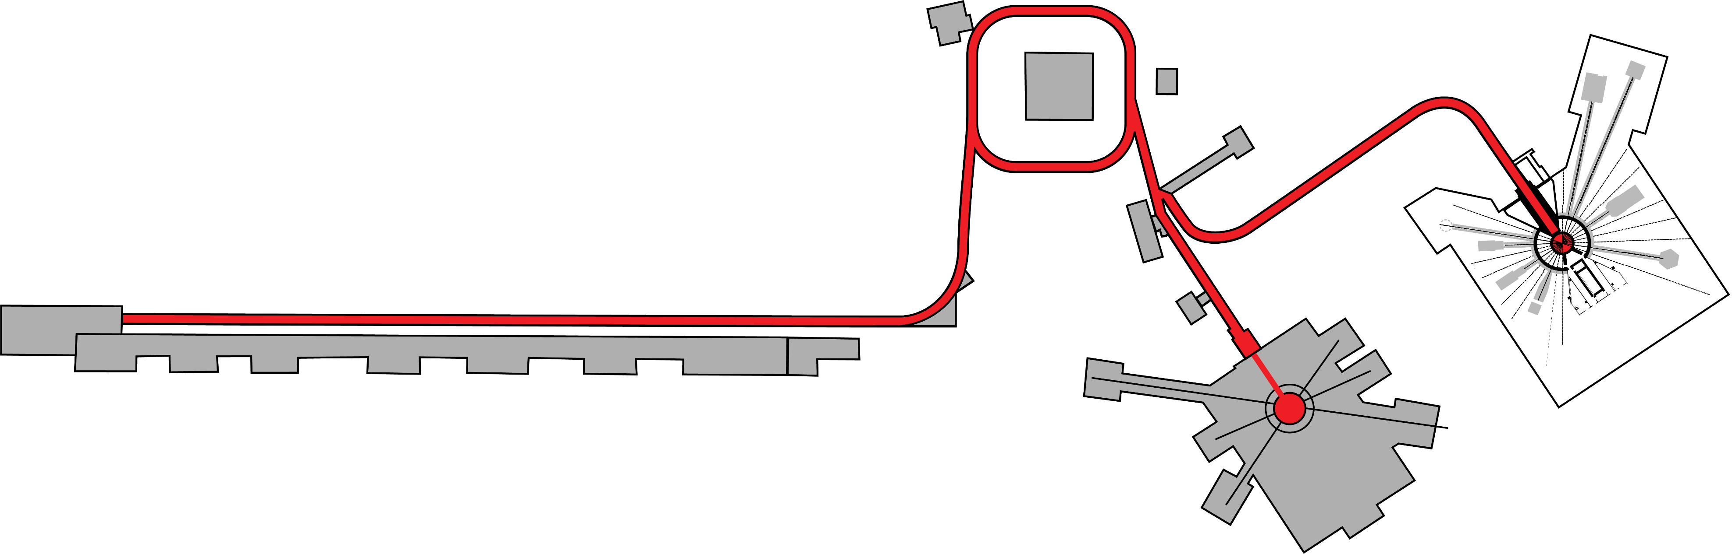
STS will make optimal use of the PPU-upgraded SNS accelerator capability
1 out of 4 proton pulses
15 Hz
700 kW
Accumulator Ring
60 Hz accelerator
46.7 kJ/proton pulse
2.8 MW capable
Ion Source
Linac
Second Target Station (STS)
Short pulses at 15 Hz enables simultaneous measurement across broad wavelength range (Δλ =13.2 Å at 20 m
from source)
Complementarity with FTS – uses all available accelerator capability provided by PPU
Flexibility will be provided to operate both FTS and STS
at the same time or separately if either is shutdown
First Target Station (FTS)
3 out of 4 proton pulses
45 pulses/sec
2 MW
*animation courtesy of Matt Stone
Notes:
Both the first and second target station make use of the same accelerator infrastructure of the SNS. Negatively ionized hydrogen atoms are accelerated along the linear accelerator up to about 90% of the speed of light. The particles pass through a foil which strips them of their electrons, leaving just a positively charged proton. The protons are injected into a storage ring and further accelerated and bunched together into pulses. These pulses then are sent to the liquid mercury target of the first target station to produce neutrons. The second target station will use the same accelerator, but operate at a rate of 15 Hz. So one in four of the first target stations pulses will be sent to the second target station. To compensate for this loss of neutrons at the first target station, the linear accelerator is currently going through a power upgrade to operate at up to 2 MW peak power compared to the current 1.4 MW.
Both of these target stations can operate independently If the first target station is under a maintenance outage, the second target station can continue to operate.

Slide 10
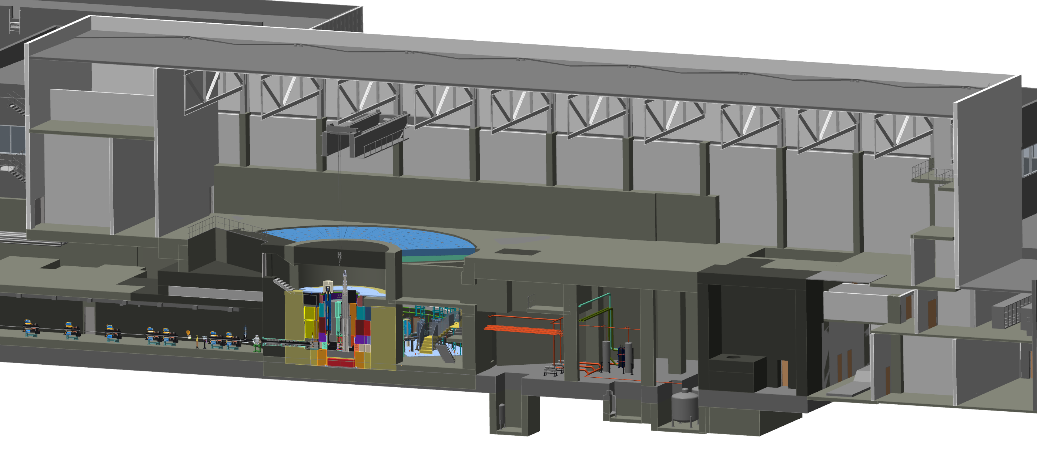
STS Target & Instrument Building Design

Slide 11
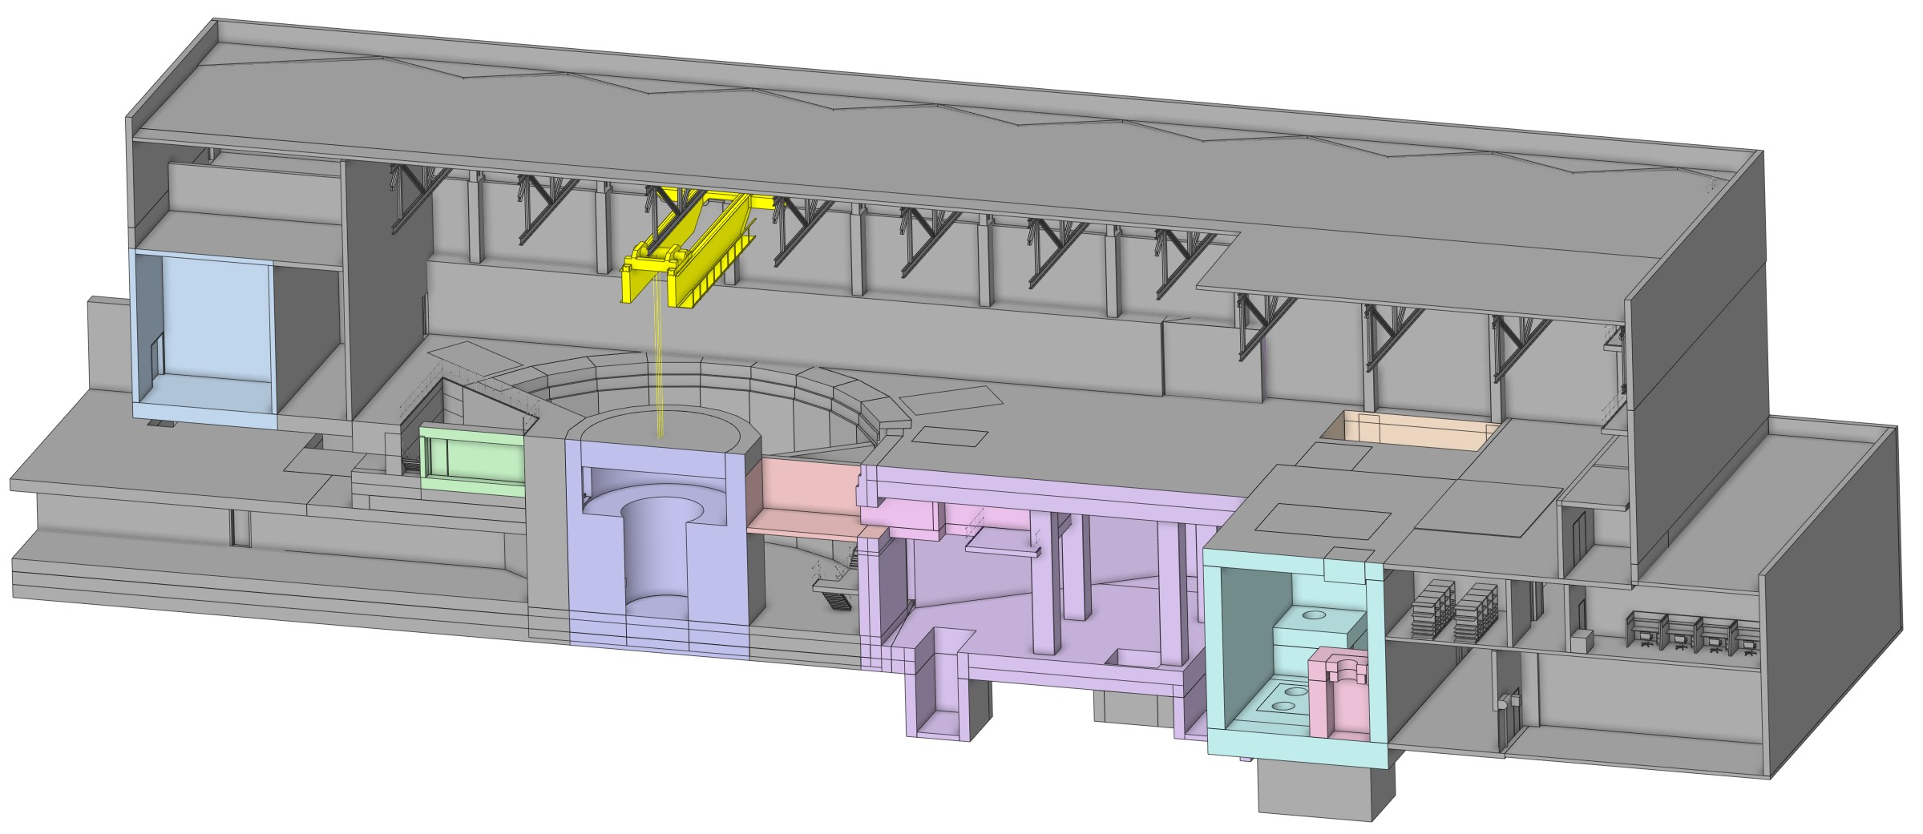
Target Systems visual scope
Cryogenics Moderator Systems (CMS)
Process System for moderator supercritical hydrogen.
Refrigeration Cryoplant, Helium Compressors and Coldbox
Monolith / Core Vessel
Vessel holding shielding around Moderator & Reflector Assembly, Target Wheel, Target Viewing Periscope, Proton Beam Window
Process Systems
Hot Process Vault with process systems for cooling water and core vessel atmosphere,
GLS and delay cavities
Service Cell
Processing Cell for drying and cooling of components that have reached end of life and processing of these for disposal into shipping casks

Slide 12
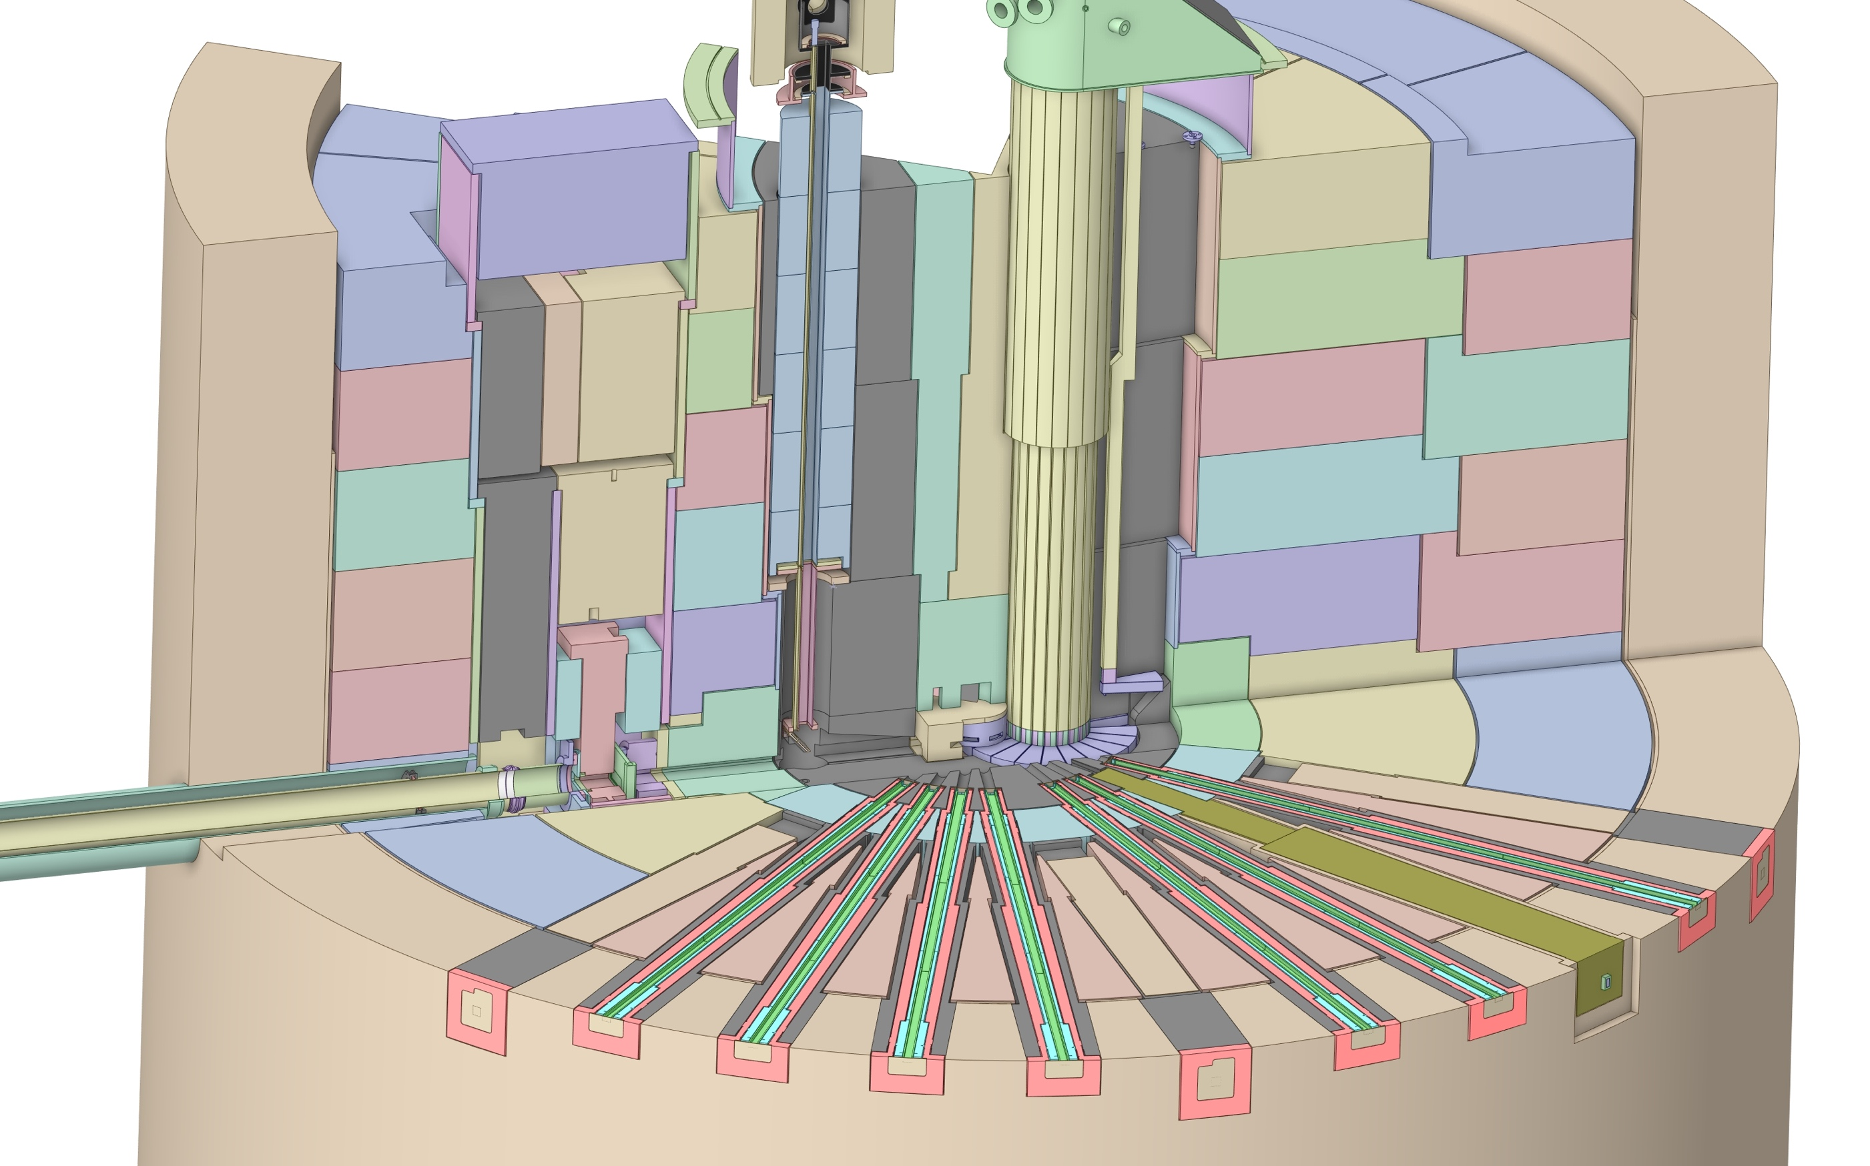
Monolith visual scope
Target Viewing Periscope
Core Vessel shielding
Moderator Reflector Assembly
Core Vessel
Target assembly, drive, shaft segments
Proton beam window
Bulk steel shielding,
(Ø5.9 m)
Target disk (Ø1.2 m)
Nozzle Extension
Proton beam tube assembly
Instrument Optics Insert

Slide 13
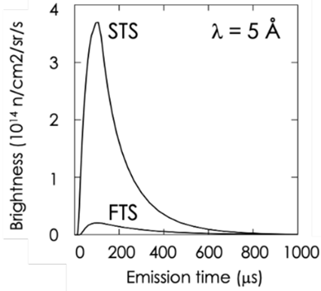
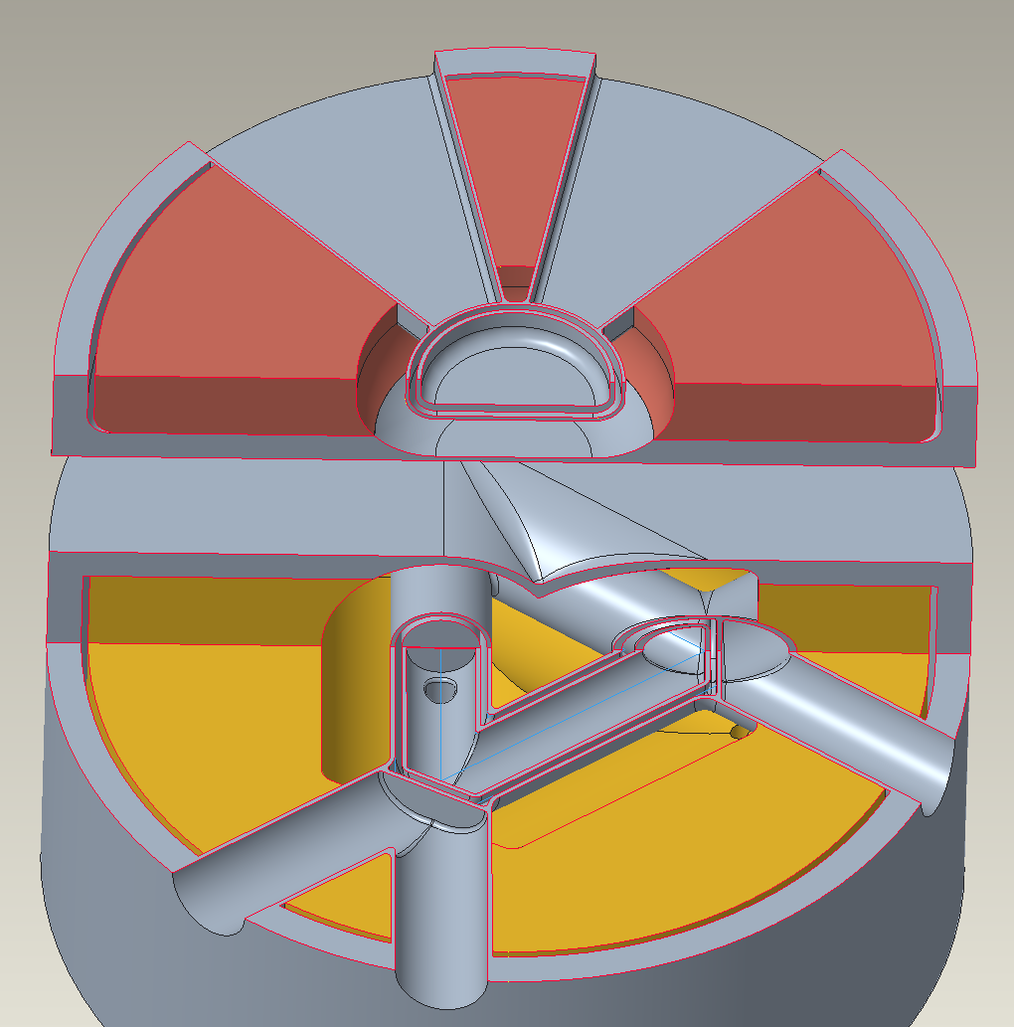
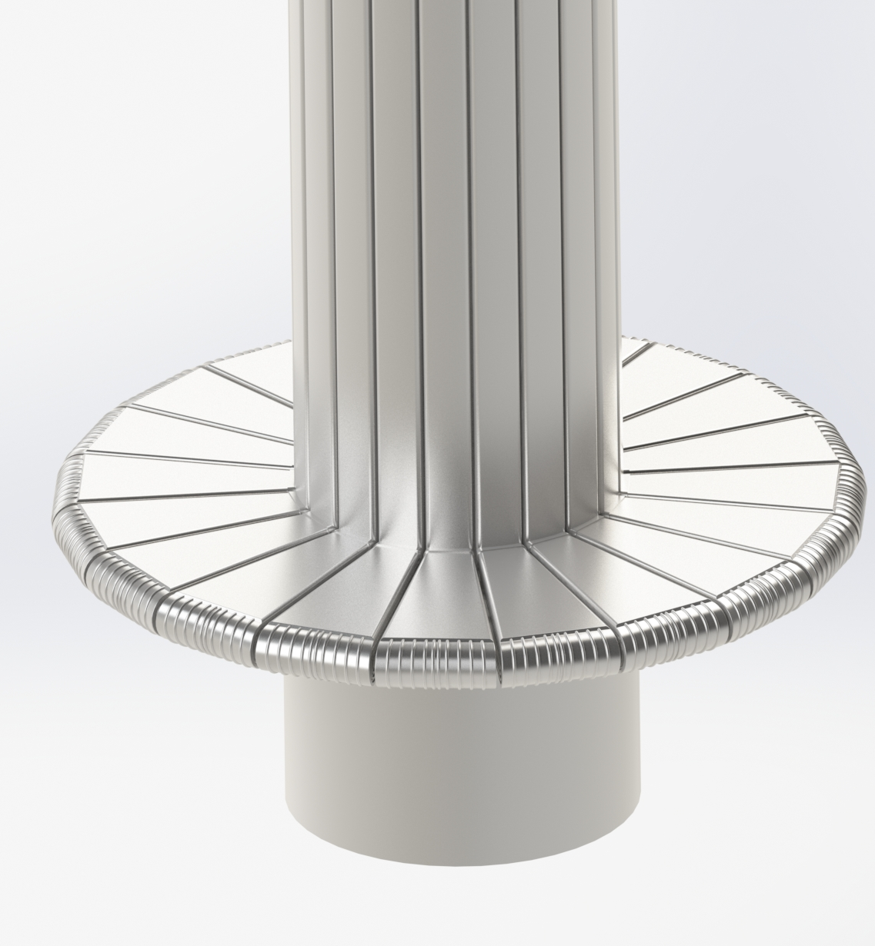
STS Target Systems – providing the world’s brightest neutron source – core parameters
Target:
  Proton beam size on target: 60-90 cm²
  Target Type: solid, rotating, water cooled
  Spallation material: tungsten
  Shroud material: Inconel, copper and tantalum as interlayers
Moderators:
  Number: 2
  Material: liquid hydrogen
  Upper: cylinder
  Lower: tube
  Reflector: beryllium
Cylinder Moderator
Proton Beam
Target Slot
Tube Moderator

Slide 14
Moderators successfully completed prototyping

Slide 15
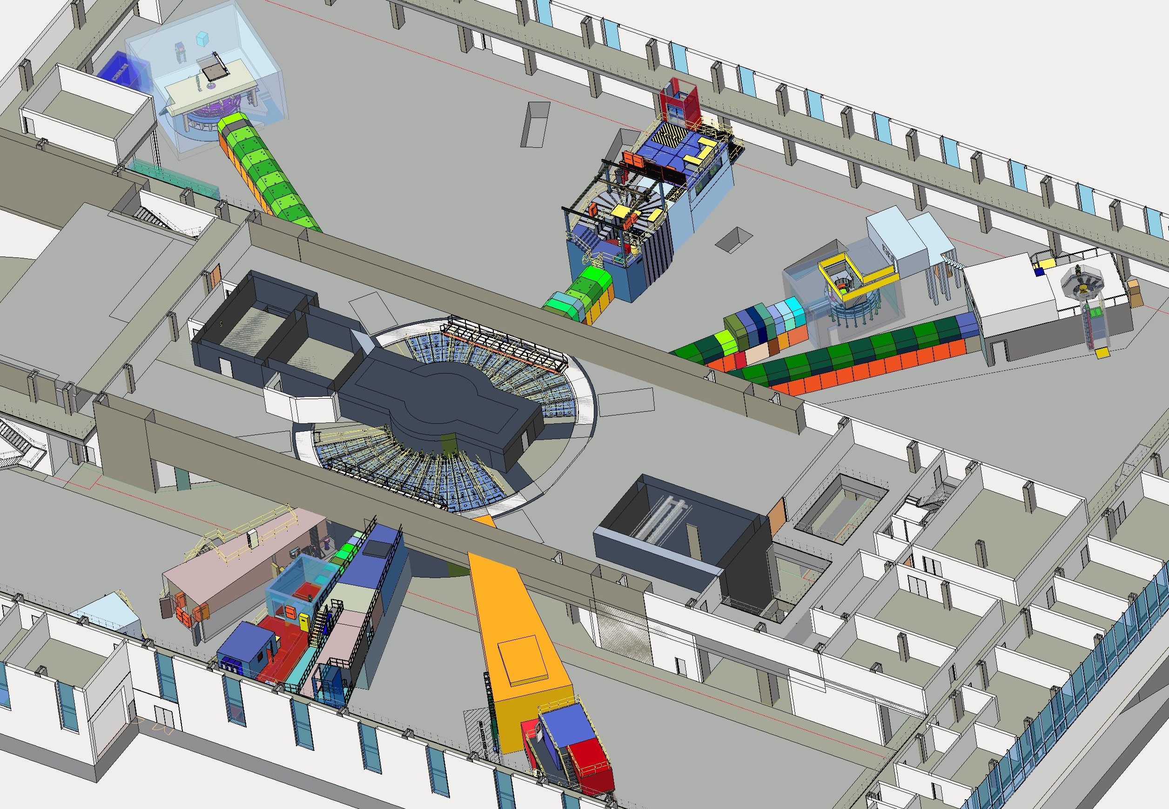
Bright source at 15 Hz/700 kW in a facility that supports ≈20-24 instruments fulfills mission need and doubles users at SNS
Instrument performance gains of 100 or more make STS a next generation source enabling new science capabilities
Time-resolved measurements to observe materials in action – as they are made, as they
perform, as they fail,
and as underlying
chemical or physical
processes unfold
High brightness beams
to measure small
samples of newly
discovered or
synthesized materials
Simultaneous structure
measurement of
hierarchical materials
from Å to microns
High brightness and broad perspective (bandwidth) to reveal complex behavior in materials in extreme environmental conditions
λ = 5 Å
short-pulse
SNS-STS
ESS
(5 MW)
J-PARC
SNS-FTS (2 MW)
ESS
(2 MW)
SNS-FTS
ISIS TS2
CSNS
long-pulse
HFIR
ISIS TS1
LUJAN
FRM-II
ILL
NIST
SONATE (est.)
PSI
steady-state
STS Project will construct 8 initial instruments
ORPHEE
USA
Planned
Asia
Existing
Europe

Slide 16
Preliminary Design Definition for the STS
The Preliminary Design phase exists between the conceptual design and final design phases
The conceptual design phase adds enough detail and analysis to understand the feasibility, basic scope and order of magnitude cost
The preliminary design phase builds upon the conceptual design to reduce risk and increase confidence that the design is sufficiently viable as to proceed to final design
Requirements are defined in the preliminary design phase
S01020500-PIN10000 Preliminary Design Definition
Approve mission need
Approve alternative selection and cost range
Approve performance baseline
Approve start of construction
Approve project completion
Conceptual Design Phase
Preliminary Design Phase
Final Design Phase
Procurement / fabrication / installation
operations
CD-0
CD-1
CD-2
CD-3
CD-4
Figure 1 from S01020500-PCD10001 Second Target Station (STS) Project Design Development Procedure

Slide 17
STS Schedule Overview and CD Timeline

Slide 18
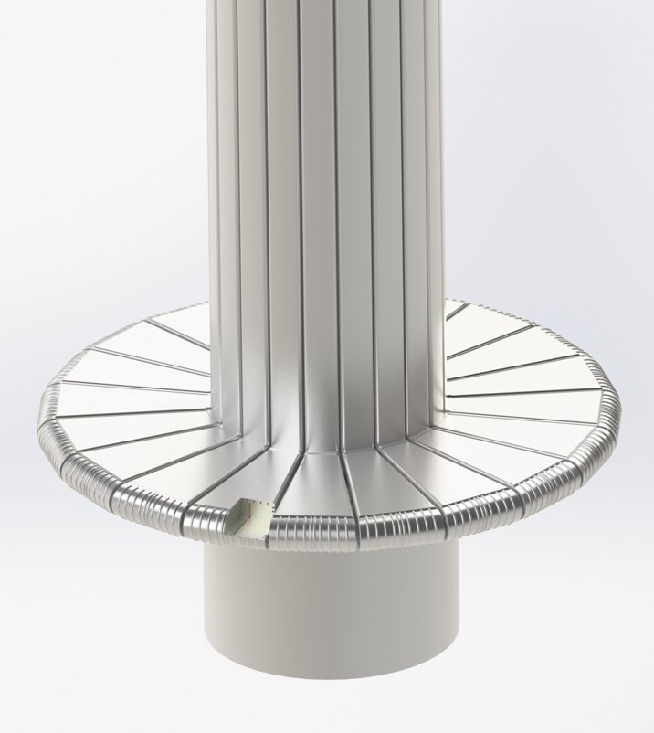
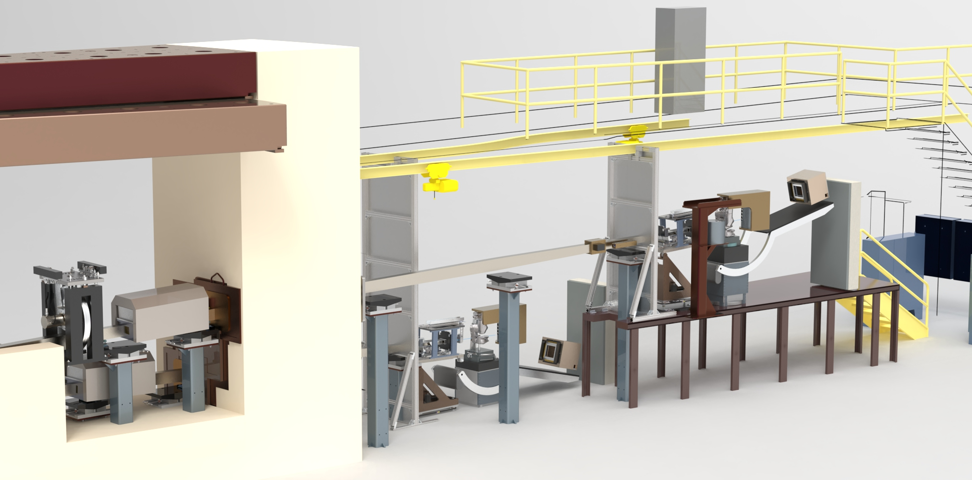
Progress in STS technical designs since Conceptual Design
Segment
Target Concept
Selected
New proton transport lattice
MRA/Inst. Sys. Interface Sheet issued
RTST & CSB design begins
Preliminary neutronic heating, structural & CFD analysis completed
TS/AS beam parameter IS Rev 2 issued
T & I bldg. design begins
2021 IPR
Preliminary Moderator Optimization Complete
Lasagna
Target Concept
Selected
PDR proton beam optics planned
Segmented Target
2021
2022
2023
8 STS Project Neutron Instruments selected
Site plan established
Two beam flavors workshop report issued
Requirements documents issued for all 8 instruments
Second critical device workshop for FTS target cart out of position
PDR Timing System, Run Permit System, & Linac LLRF controls
PDR for CHESS, PIONEER, & QIKR optics scheduled
Independent Control
700 kW proton beam power
Peak Brightness
≥ 8 neutron instruments
Technical review of initial designs for 4 instruments complete
ICDs & ICSs with AS & SNS issued
QIKR Instrument

Slide 19
Design in the era of high inflation
Double-digit inflation in FY2021 and FY2021
After approval of Conceptual Design, cost estimates grew almost 20%
Challenge: Reduce the project’s Total Project Cost (TPC) without impacting PKPPs
Significant scope optimization has been implemented and more are underway
  Cryogenic moderator system simplification
  Reduction of Target Process Systems water loops
  Monolith shielding composition changes

Slide 20
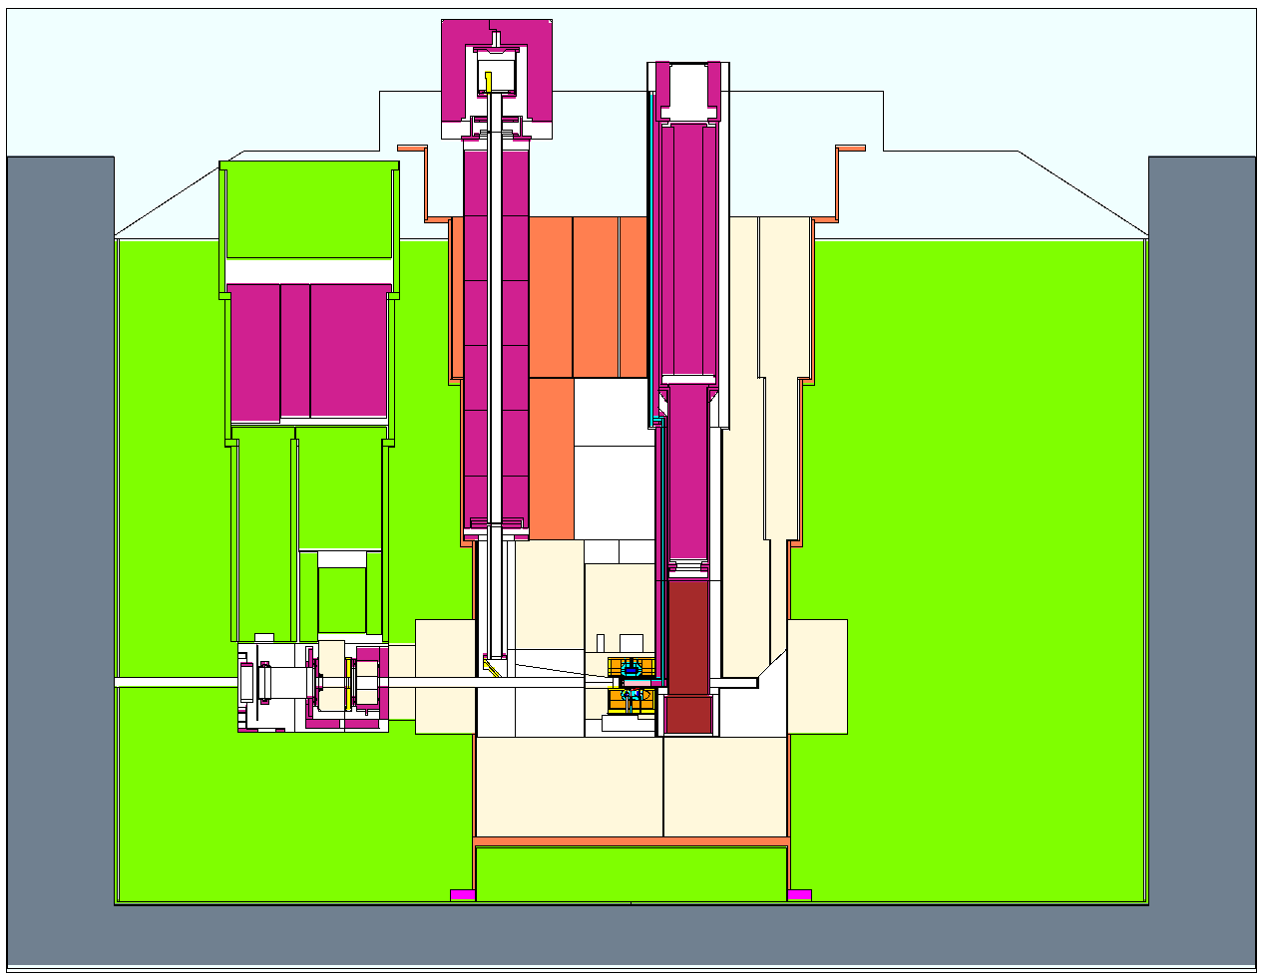
Shielding optimization – Target Monolith
During conceptual design, the surface of the Target Monolith was assumed to be a generally
accessible area, so shielded to 0.25 mrem/hr
  Shielding was similar to First Target Station with
  an inner core of steel and outer cylinder of
  high-density concrete (~230 cubic yards)
Current STS design includes a bunker which
eliminates access to the Target Monolith surface
during operations and a bunker wall that
provides some additional shielding
Optimization proceeded in two steps via
neutronics calculations:
  1. Verified that high-density concrete outer cylinder can be
  replaced with regular density concrete
  2. Maintaining a fixed outer radius, explored moving the
  boundary from between the steel and concrete inward (effectively replacing steel with concrete)
Concrete
Steel
Neutronics Model of the Target Monolith

Slide 21
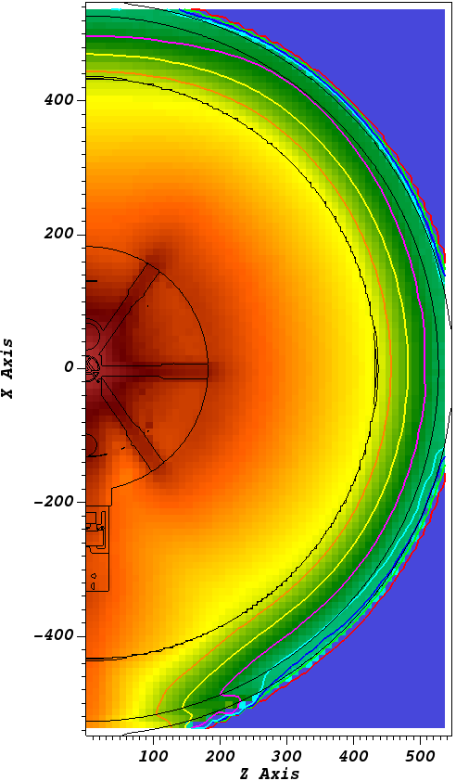
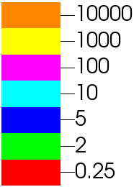
Neutronics calculations show that high-density concrete can be replaced with regular density concrete
Shielding Type | Cost (FY22 $’s)
Regular concrete | $1733/cubic yard
High-density concrete | $7300/cubic yard
Carbon steel (rough machined) | ~$1.80/lb (~$23,700/cubic yard)
Monolith Surface (<100 mrem/hr)
Replacing high-density concrete with regular concrete is a potential cost savings in as-spent dollars
Further work has demonstrated feasibility of replacing much of the internal steel shielding with high-density concrete for a further cost savings
mrem/h
Neutronics calculation with regular density concrete

Slide 22

Summary
STS will provide researchers with new capabilities addressing the science gaps identified in the Mission Need Statement
Optimal use of a PPU-upgraded SNS accelerator combined with advances in target and moderator technologies will make STS the leading peak brightness source for cold neutrons
Preliminary design has progressed with excellent progress in all technical areas
  STS technical systems have made excellent progress towards a design baseline decision in FY26
  The project has identified many scope optimizations that do not affect our preliminary-KPPs

Slide 23
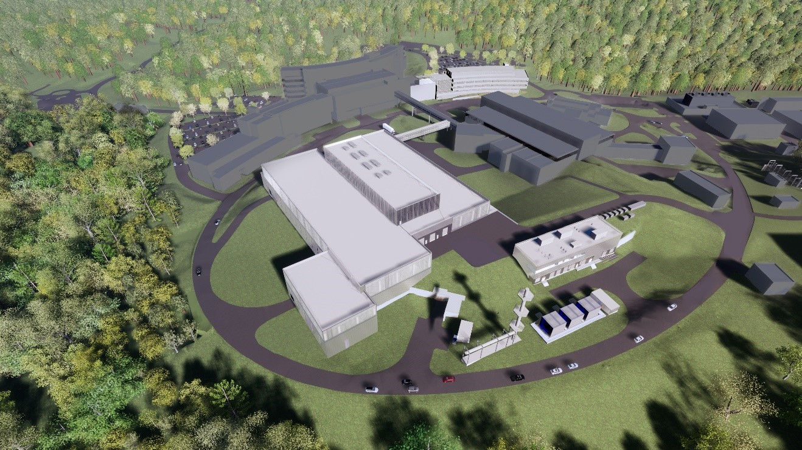
Discussion
Questions?

Slide 24
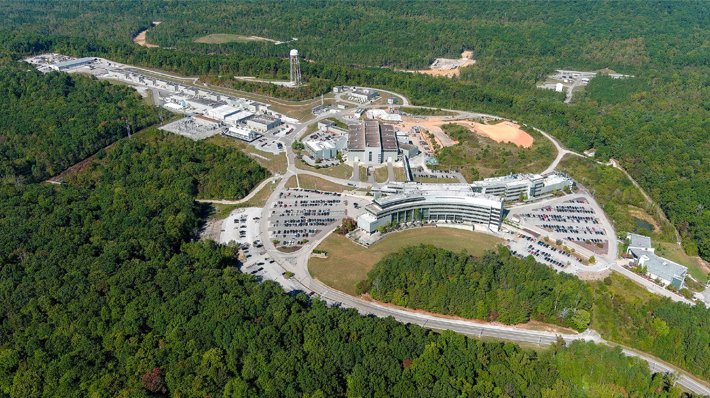
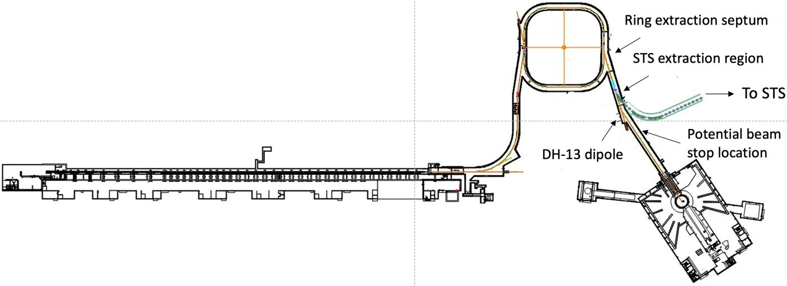
PPU Project is making excellent progress with the construction of the STS RTST stub (1)

Slide 25
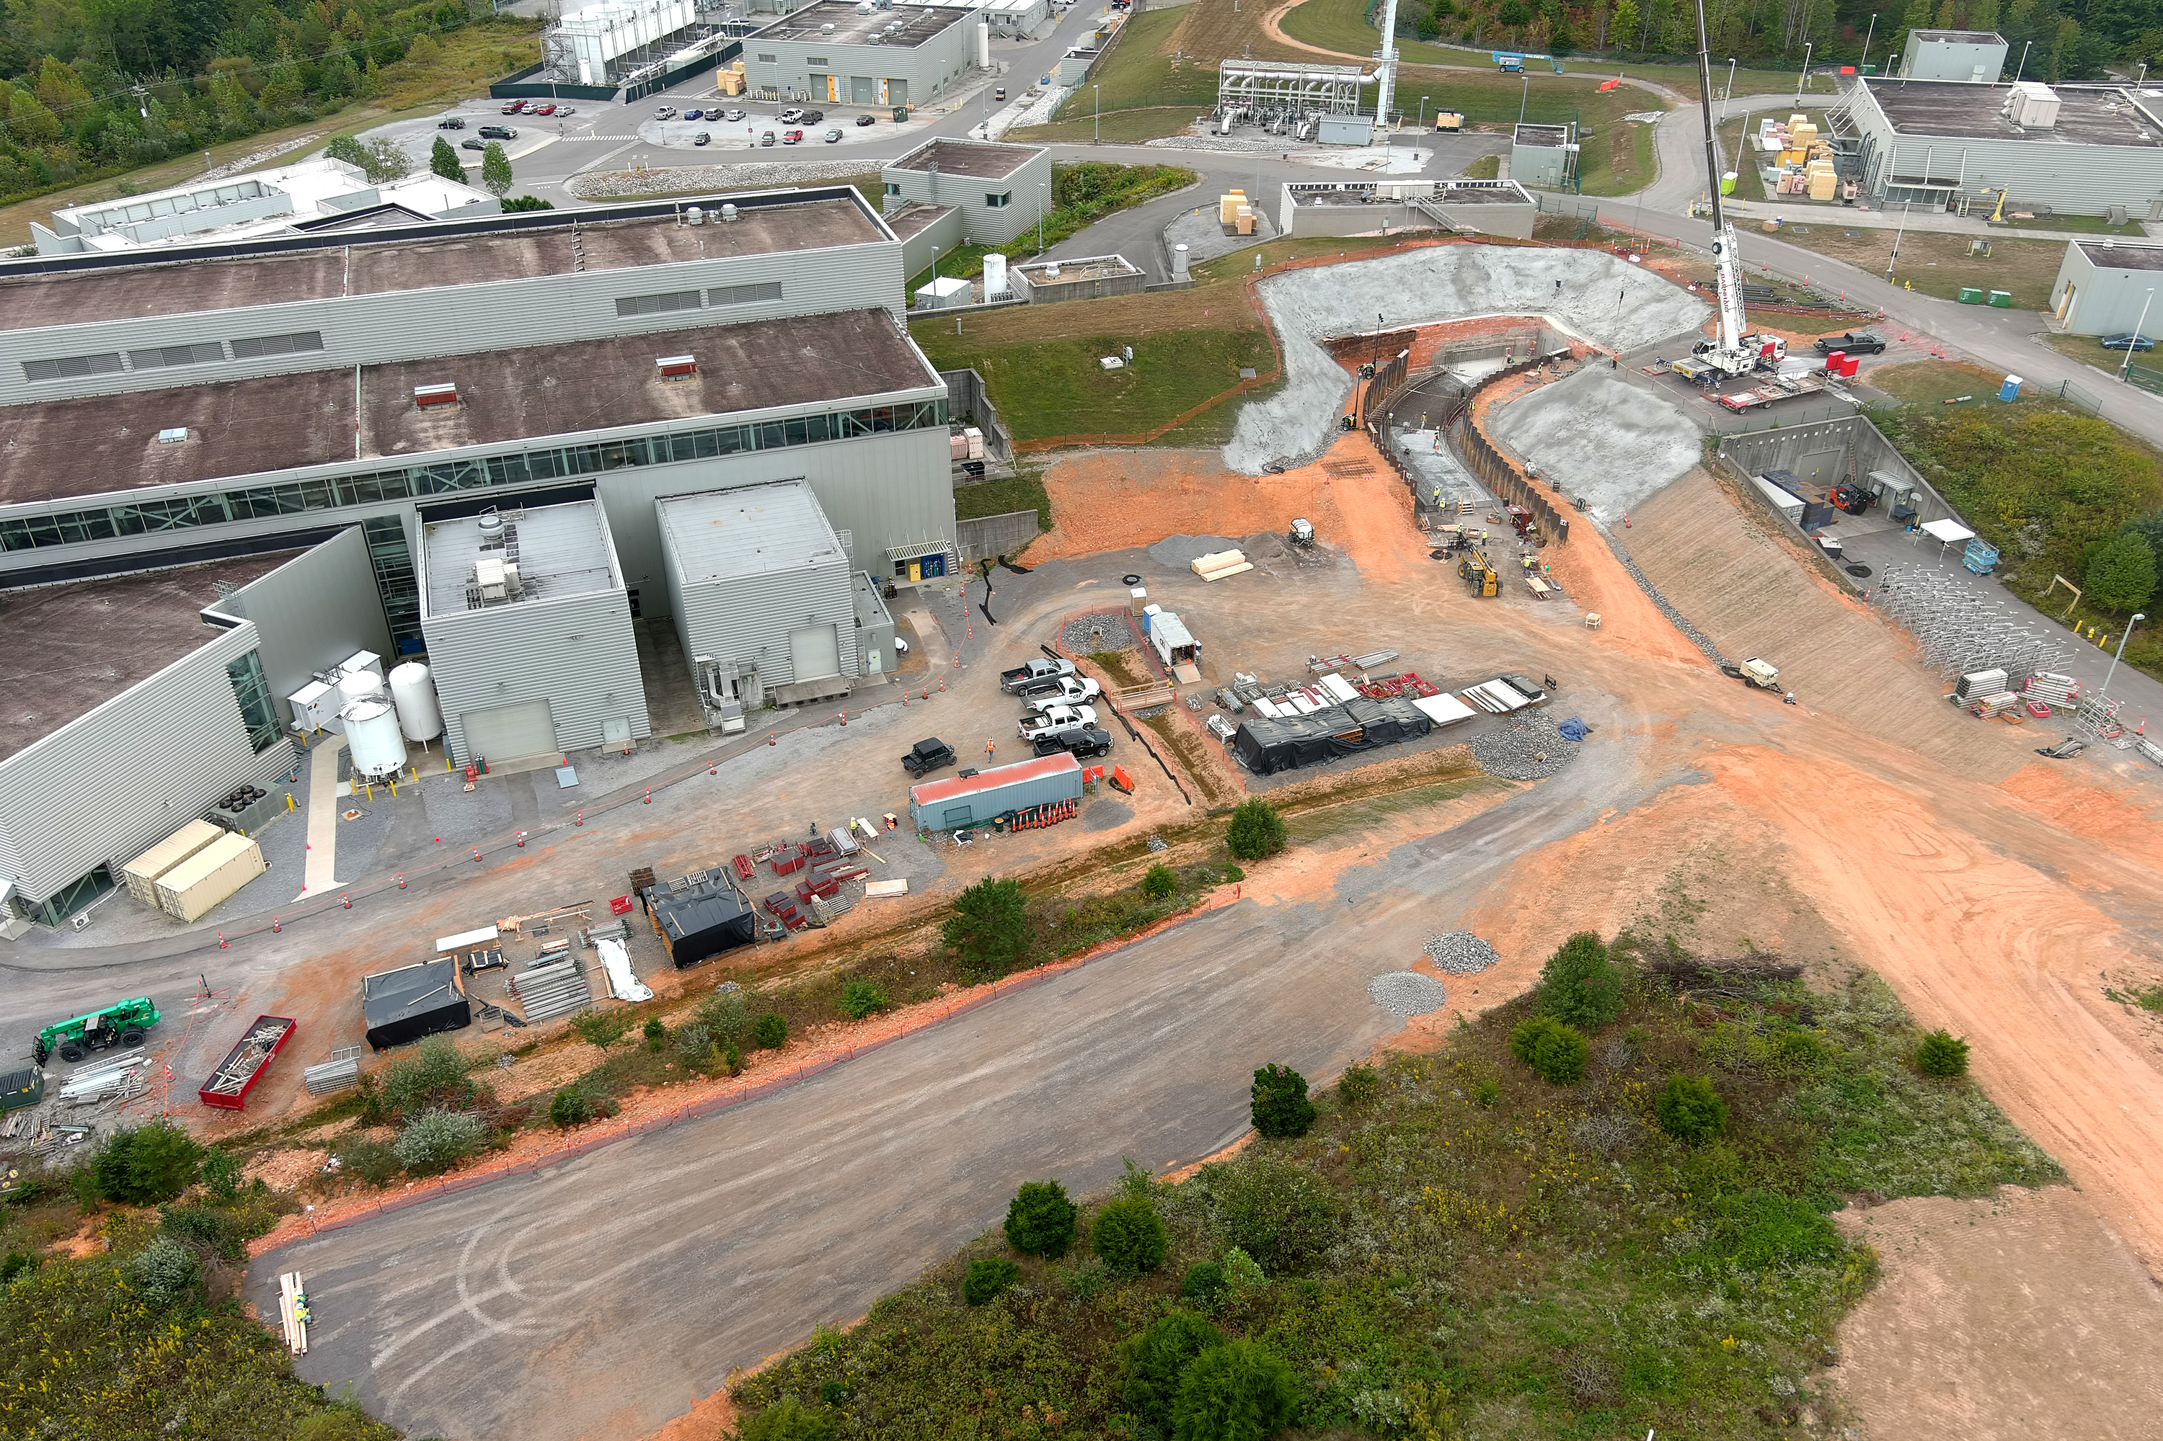
PPU Project is making excellent progress with the construction of the STS RTST stub (2)

