Slide 1
ORNL Second Target Station Vessel Systems Preliminary Design Update
Chris Anton
Cam Eiland
Min-Tsung Kao
Thomas McManamy
Joseph Tipton Jr.
Michael Strong
11/6/2023

Slide 2
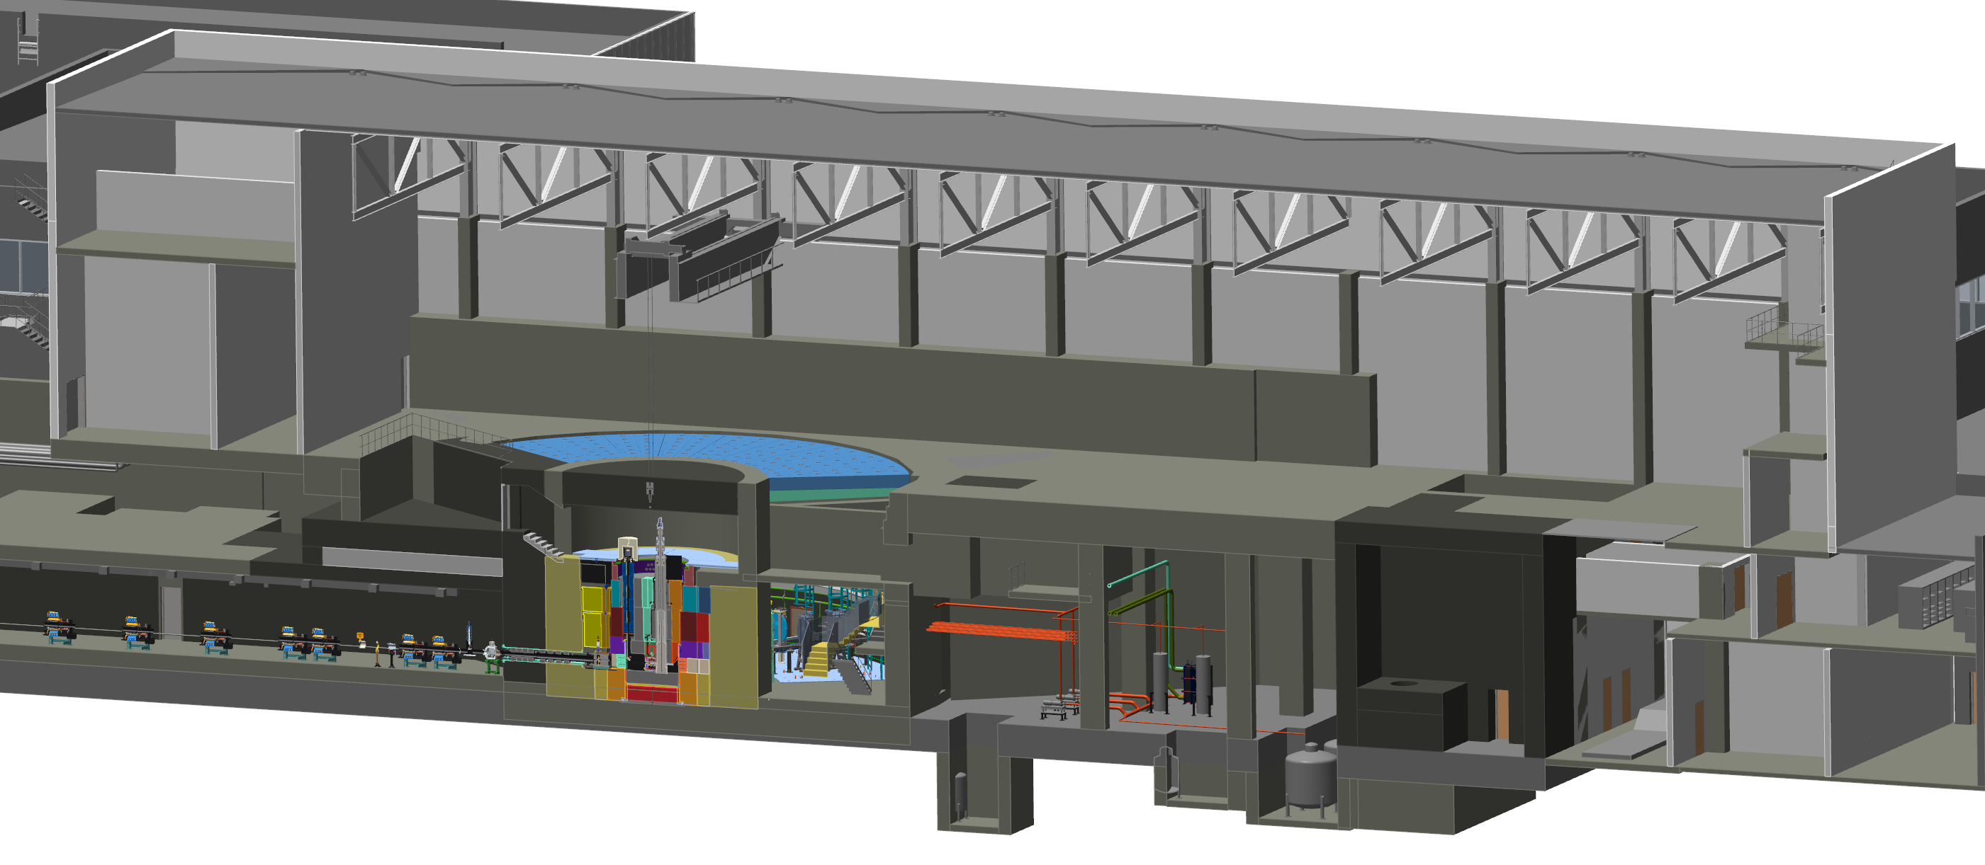
Target Systems Overview
Target Viewing
Periscope
Target Subsystems:
S.03.01 Management & System Integration
S.03.02 Target Assembly
S.03.03 Cryogenic Moderator System
S.03.04 Moderator Reflector Assembly
S.03.05 Accelerator Interface Components
S.03.06 Vessel Systems
S.03.07 Target Station Shielding
S.03.08 Installation of Target Monolith Systems
S.03.09 Target Process Systems
S.03.10 Remote Handling Systems
S.03.11 Target Vacuum Systems
Core Vessel
Core Vessel Shielding
Target Station
Shielding
Moderator Reflector
Assembly
Monolith Concrete
Proton Beam
Window
Proton Beam
Tube Assembly
Target Assembly

Slide 3
Vessel Systems Introduction
Requirements Highlights:
Maintain a sealed environment of rough vacuum or sub-atmospheric helium
50+ year lifetime
Accommodate 99.9% of proton beam profile striking the target
Allow alignment of the MRA to the neutron beamlines to appropriate tolerances
Allows alignment of the Target and Target Viewing Periscope to the Proton Beam
Incorporate liquid cooling in key areas to maintain proper component alignment
Allow for remote handling operations for all removable components within the Core Vessel
Accommodate safe drainage of liquid leaks from internal components

Slide 4
Vessel Systems Introduction
Ø 3745 mm
Primary Components:
Core Vessel
316LSS Construction
1’’ thick shell sections, 2’’ thick rings
Approximate weight = 44 metric tonnes
Core Vessel Lid
Hatches for MRA removal, target segment removal and utility line access
Supports weight of target assembly
Supports weight of TVP top shielding
Nozzle Extensions
316LSS construction
Welded design
Carry Core Vessel environment through the Nozzle Extensions
Approximate weight = 422 kg each
Qty 18 total
1x large nozzle to support QIKR instrument
Ø 3295 mm
Ø 3095 mm
6399 mm
Ø 2895 mm
Ø 3500 mm
610 mm
Ø 2692 mm
Ø 3048 mm
254 mm
305 mm
555 mm
3778 mm

Slide 5
Core Vessel Construction
Core Vessel Lid
Shell Sections
1’’ thick 316LSS rolled and welded shells
Ports cut in the flat (alignment not stringent)
Flanges
2’’ thick 316LSS turned flanges to provide steps in sidewalls
2’’ thick top flange
4’’ thick bottom flange
3’’ thick base plate
Beltline Section
Welded plate construction on east and west ends
Forged and welded construction on north and south ends
Liquid cooling throughout beltline
Expected to be the most challenging aspect of Core Vessel manufacturing
Core Vessel Lid
Must provide support and alignment of Target assembly
Removable hatches for target segment removal, MRA removal and utility line access
Utility nozzles
(water, electrical)
Rolled and
welded shells
Field weld
during install
Beltline
Bottom Plate
Mounting Skirt

Slide 6
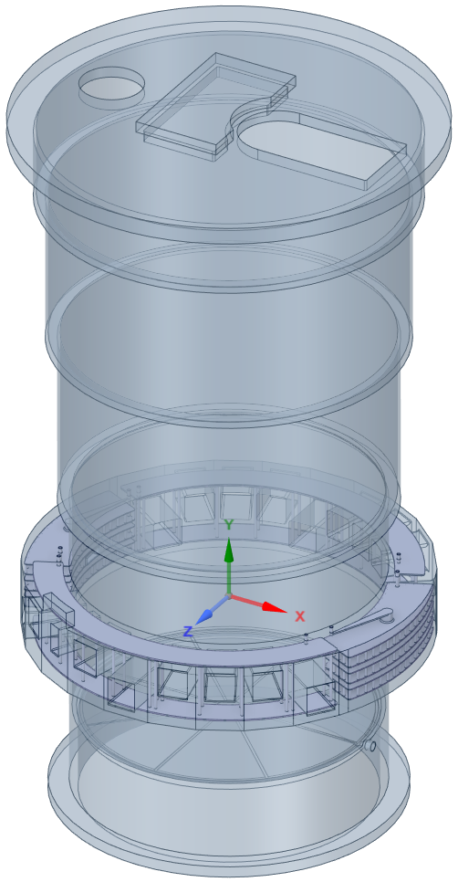
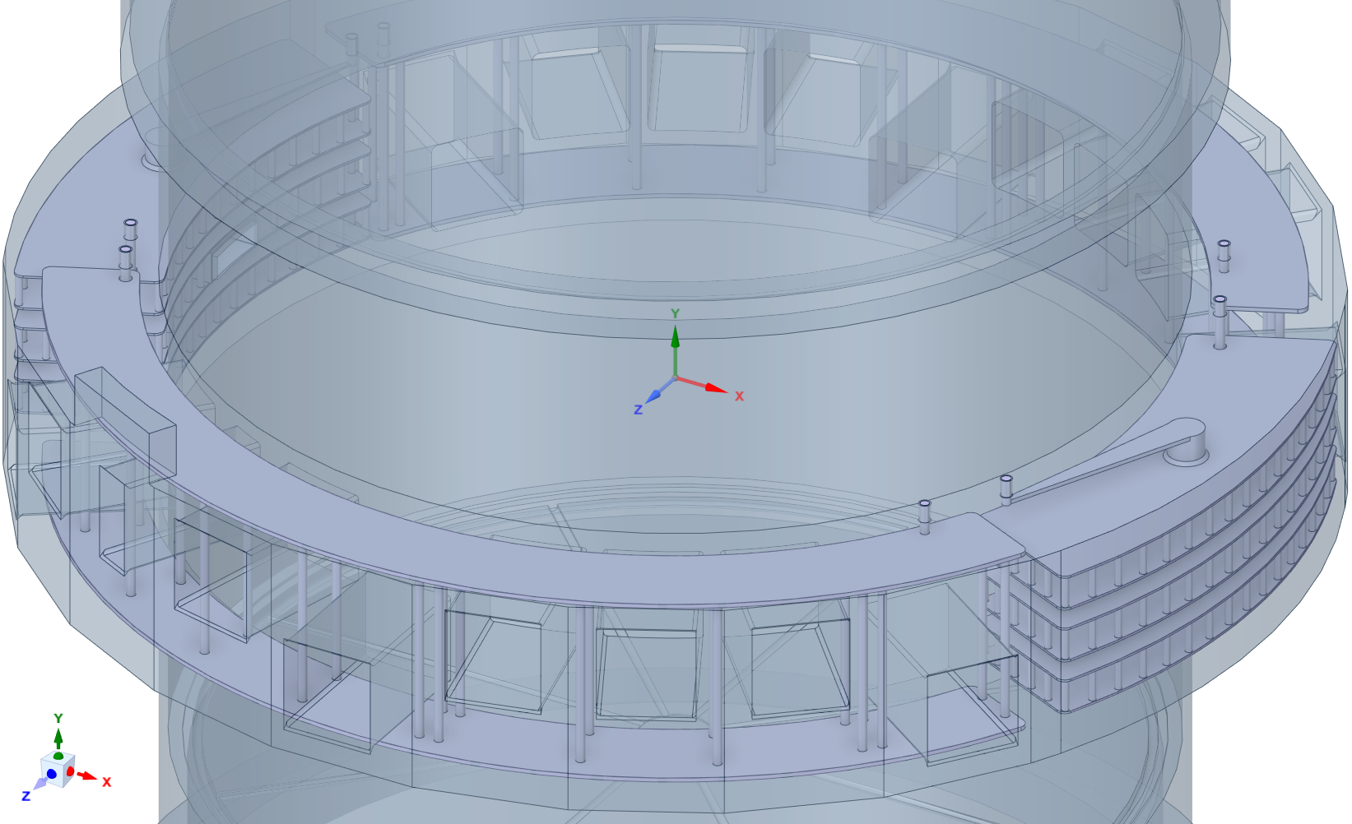
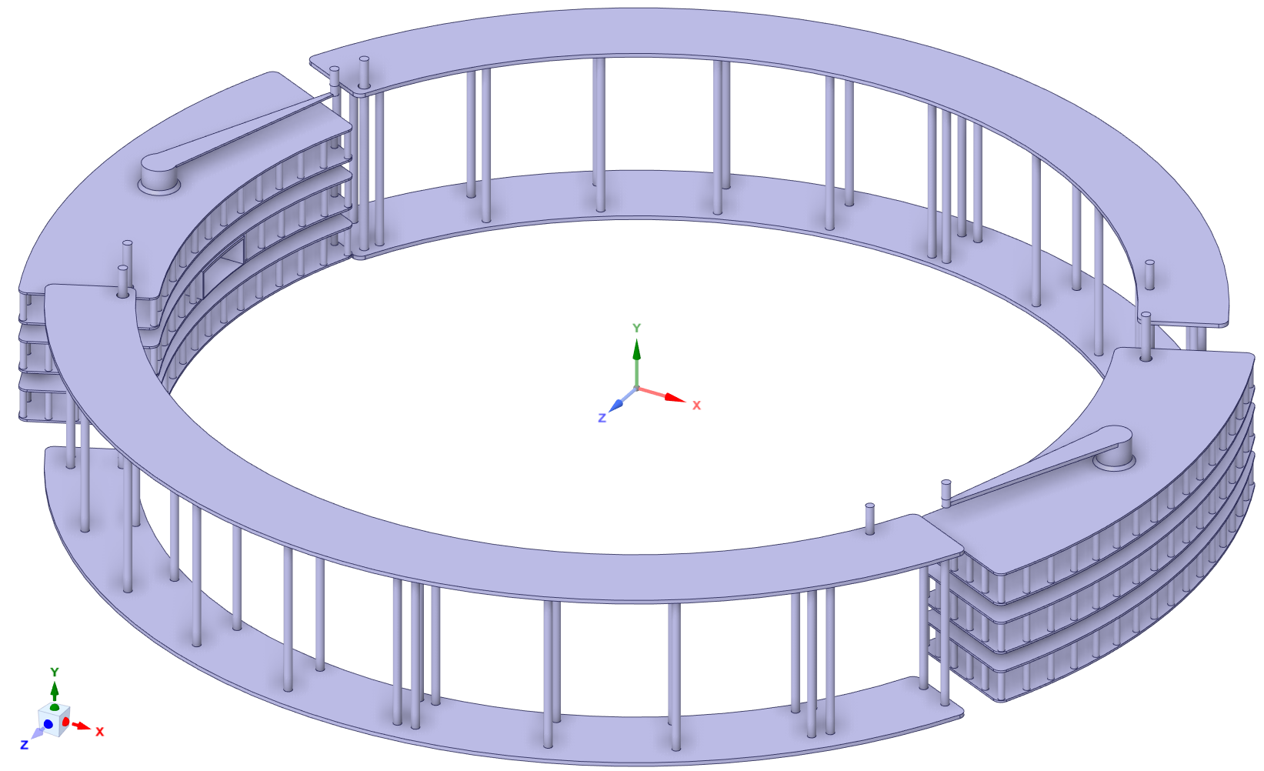
Core Vessel Thermal Analysis
Loop_1
Loop_4
cooled
Water
Loop_2
Loop_3

Slide 7
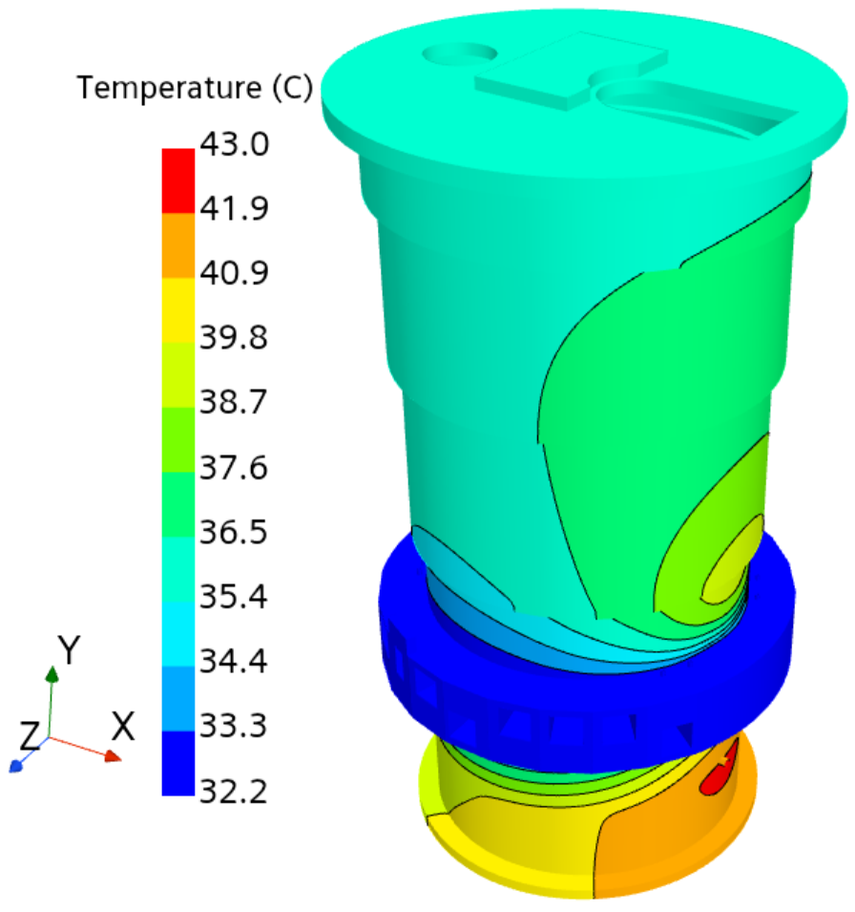
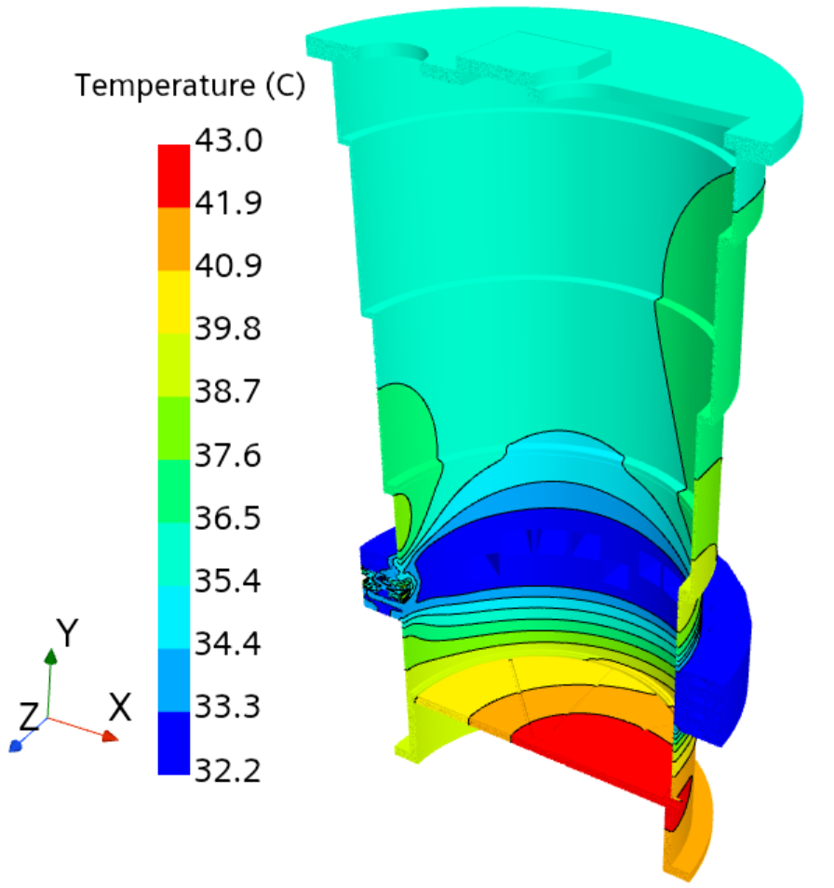
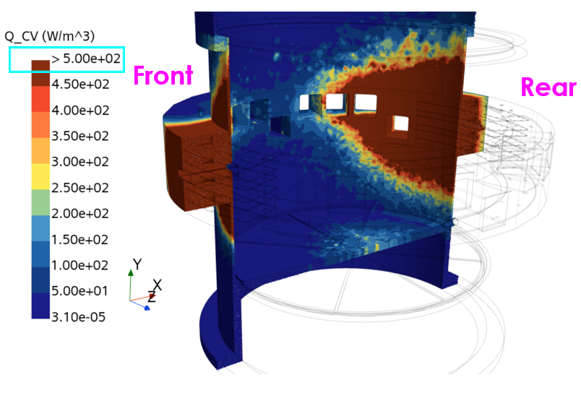
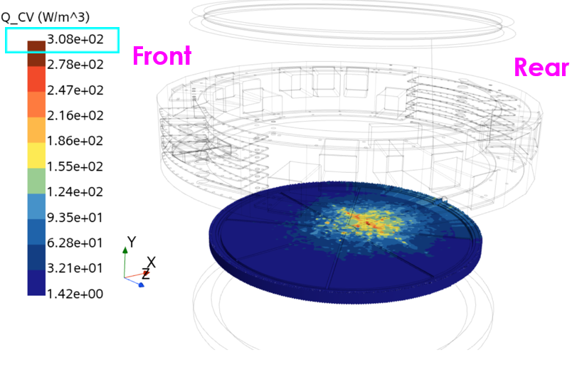
Core Vessel Thermal Analysis
Peak: 43°C
Heat Source
No cooling channel in this plate

Slide 8
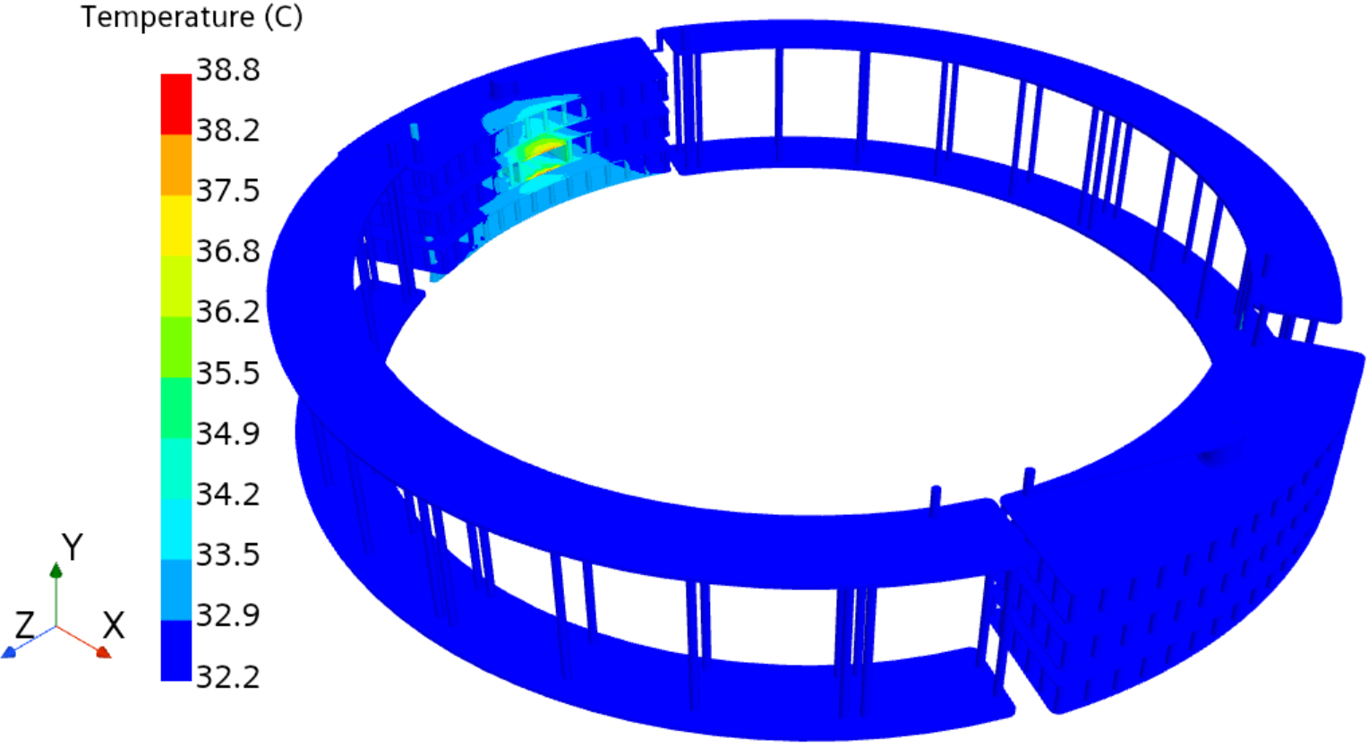
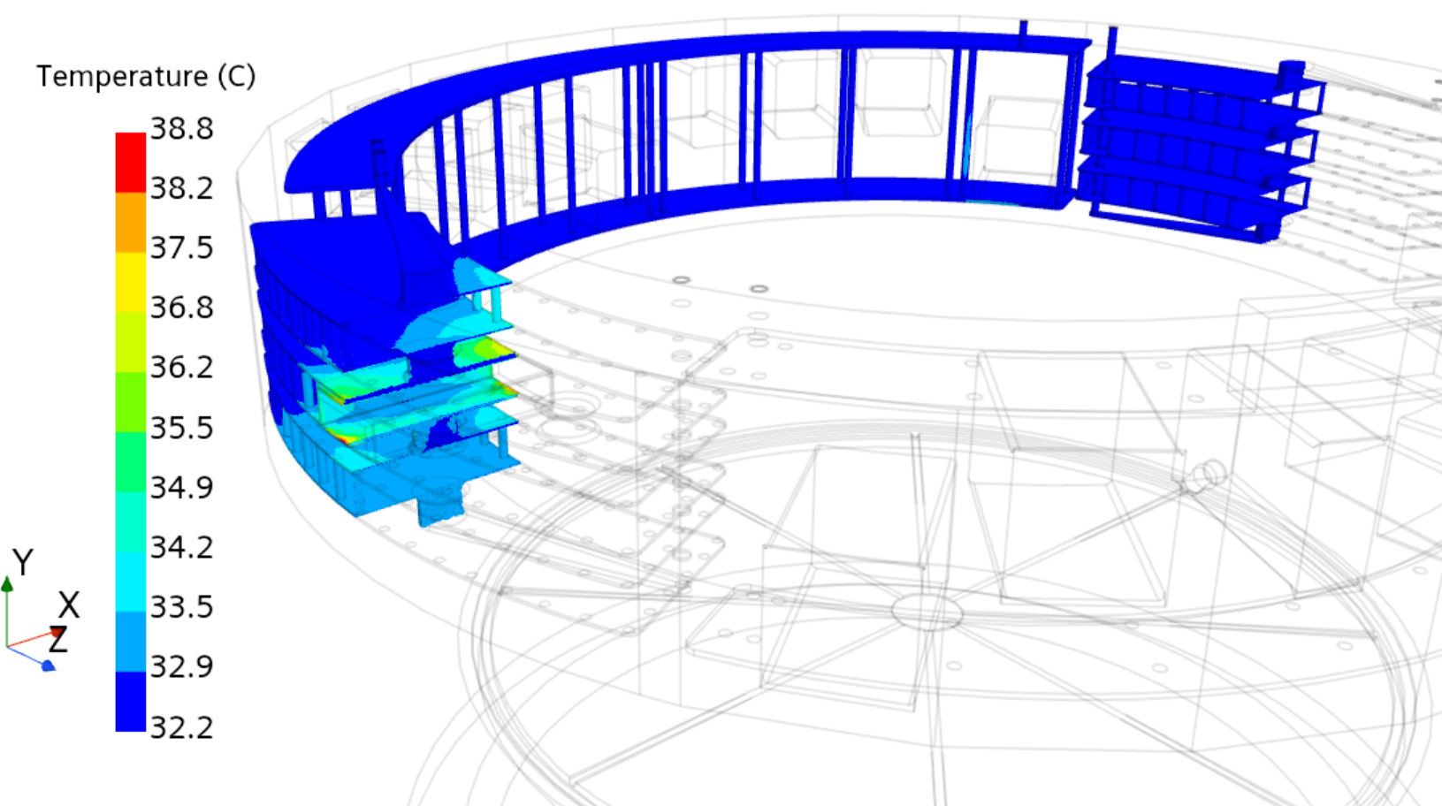
Core Vessel Thermal Analysis
Peak: 38.8°C

Slide 9
Core Vessel Shielding
Bottom 3 layers are water cooled 316L stainless steel construction
1 meter above and below the proton beam center
The MRA is supported off of the bottom block, requiring good control of thermal expansion
Top two rows and MRA removable shielding (blue blocks) are uncooled nickel coated carbon steel
The target segment removable shield block (orange) is a hybrid design, with the bottom section liquid cooled stainless steel and the top section uncooled carbon steel
Uncooled
Shield Blocks
Water Cooled
Shield Blocks

Slide 10
Core Vessel Shielding – Removable Shielding
MRA Removable
Shield Blocks
Target Removable
Shield Block

Slide 11
Core Vessel Shielding – Moderator Utility Routing
Galleries cut in permanent shield stack to protect pipes during shielding installation and removal
Single 400 mm jog in hydrogen line
Double 200 mm jogs in water lines
Cooled shield block water lines routed along the OD of the vessel shielding

Slide 12
Core Vessel Shielding – Thermal Analysis Highlights

Slide 13
Core Vessel Shielding – Thermal Analysis

Slide 14
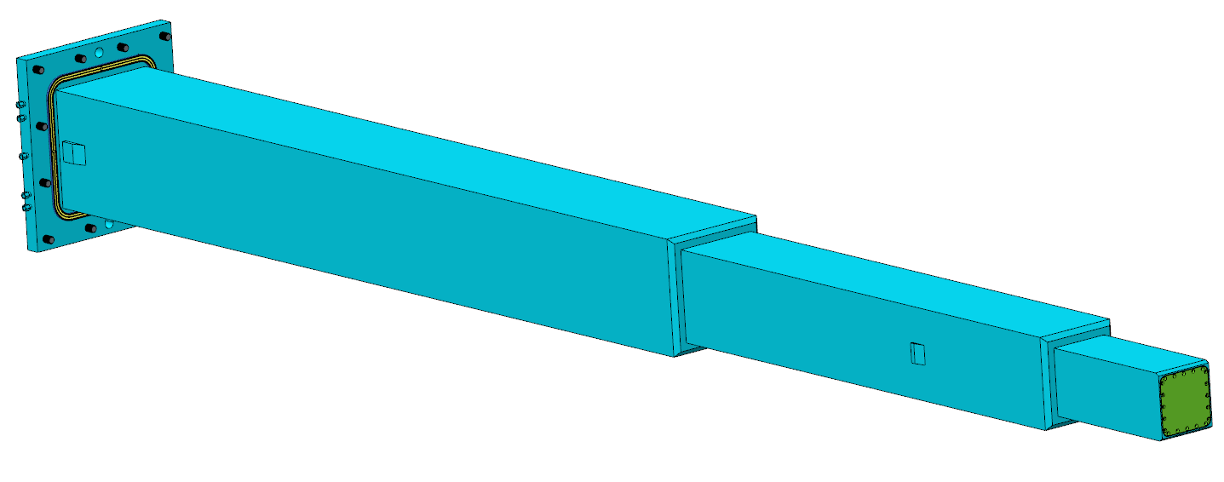
Nozzle Extension Summary
Nozzle Extension / Core Vessel Seal
Basic Functions:
Provide defined insertion path for Monolith Inserts
Provide precise alignment landing pads for Monolith Inserts at the instrument end of the Nozzle Extensions
Contain the core vessel environment to the seal up to the large rear face of the Monolith Inserts, and therefor must be leak tight (most designs)
Precisely mate to the Core Vessel beltline in order to facilitate accurate alignment of the Monolith Inserts
Installed radially from the Instrument bunker prior to installing Vessel Station Shielding
Life of the facility components
Maintenance Shutter
Nozzle Extension
Guide Module
Guide Module
Monolith Insert
Monolith Insert
CD-1 Nozzle Design
Insert Seal Surface
Downstream Beam Window
Insert with shield plug
Insert Utility Connections
Upstream Beam Window

Slide 15
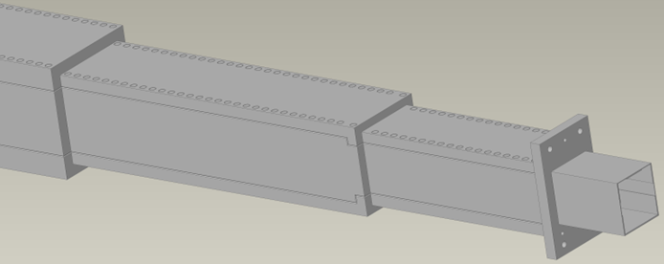
Nozzle Extension Design
2022 Nozzle Extension Design:
Bolted and welded construction
Precision machined plates provide a highly controlled interior profile
High vendor cost estimates prompted a redesign of the nozzle
Old Design
Current Nozzle Extension Design:
Commercially available square profile tubes with welded center and rear flanges
Significant cost savings over 2022 design
Reduced front flange accommodates recent changes to Target Station Shielding
New Design

Slide 16
Nozzle Extension Mounting
Vacuum seal weld near ID of beltline
Mounting brackets at beltline support nozzle extension and protect seal welds from mechanical loading
Landing pads bolted to inside region of the CV beltline to provide alignment for Monolith Inserts (guide optics)
Landing pads will be custom made after CV fabrication, installation and survey to ensure optimal positioning of Monolith Inserts
Seal Welds
~10’’ x 10’’
Monolith Insert Landing Pads

Slide 17
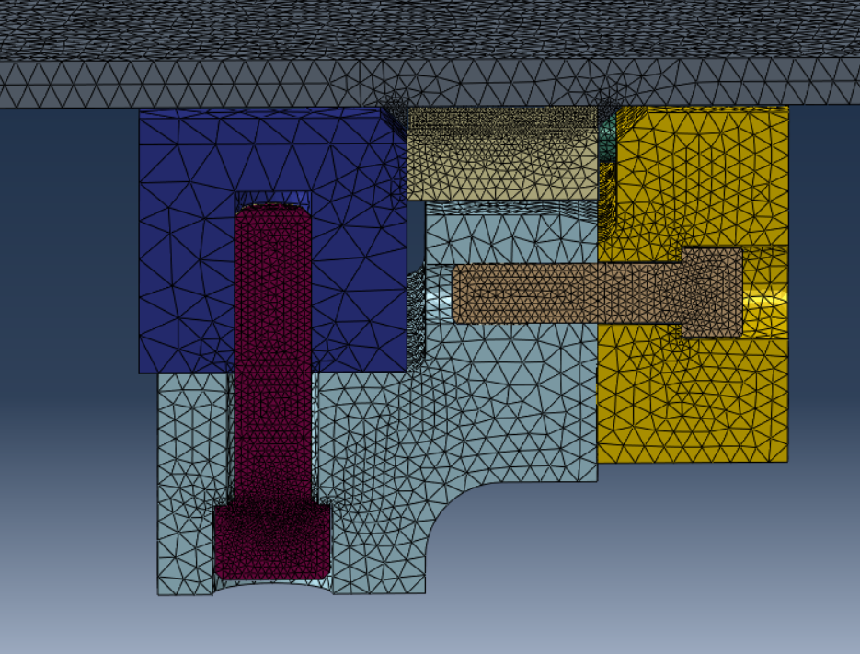
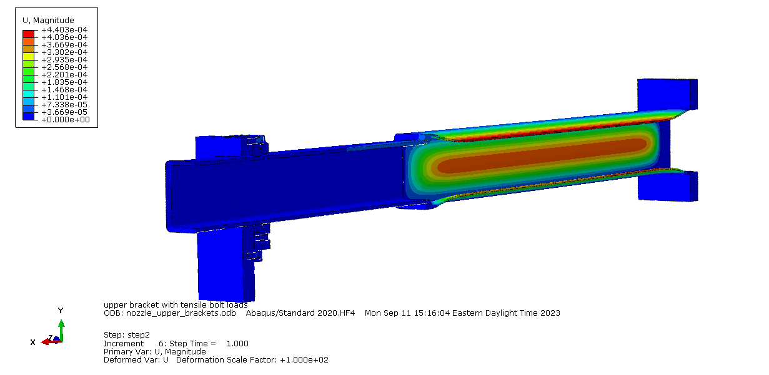
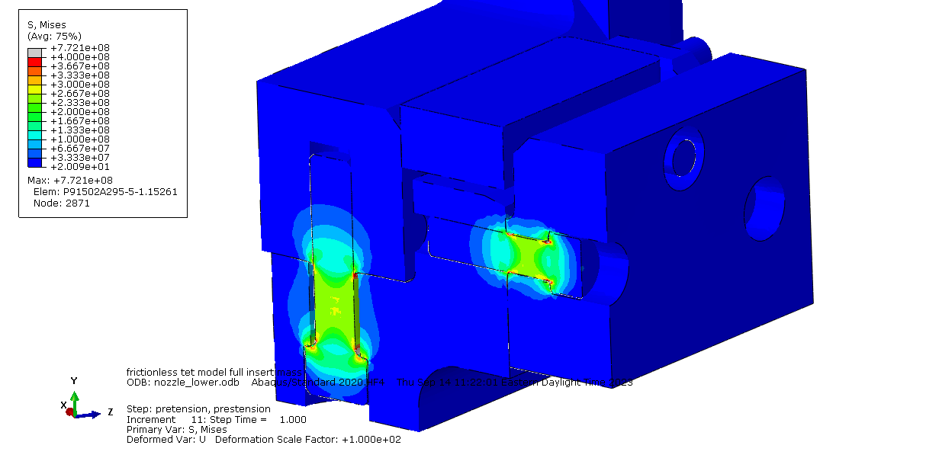
Nozzle Extension Analysis Highlights
S Mises
Close view

Slide 18
Target Station Shielding
Primary Components
Bulk Shielding – Carbon Steel
Bulk Shielding Liner – Carbon Steel
Pipe Pans – Carbon Steel
Monolith Ports – Carbon Steel
Recent TSS Updates:
Steel diameter reduced to from 8500 mm to 5700 mm per Neutronics analysis
Monolith ports provide penetrations through the concrete for the nozzle extensions
Monolith ports will be installed prior to the concrete pour

