Slide 1
Design of Rotating Tungsten Target with Segmented Modules for Replacement
Design & analysis
Aaron Jacques, Joseph Tipton Jr., Tom McManamy, Justin Mach Jr. Yongjoong Lee, Joel Montross, Min-Tsung Kao, Daniel Lyngh, Thomas Muth, Lukas Zavorka, Kristel Ghoos
November 6, 2023

Slide 2
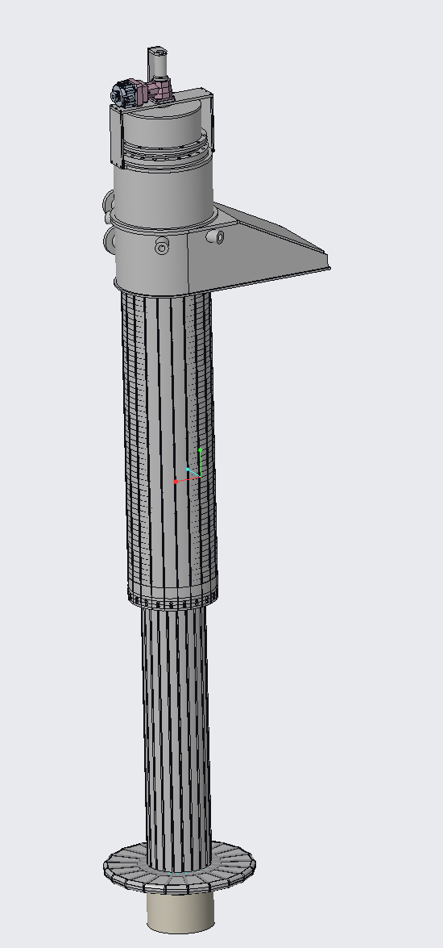
Key Parameters
Beam
  1.3GeV, 700kW, 15Hz, 2.2x10¹⁴ protons/pulse over 1µs
Water cooled
Survive 10 years (1.3x10⁸ pulses)
  FOS at end life >1
95% availability
  Fast replacement
  Tolerance against tungsten cracking

Slide 3
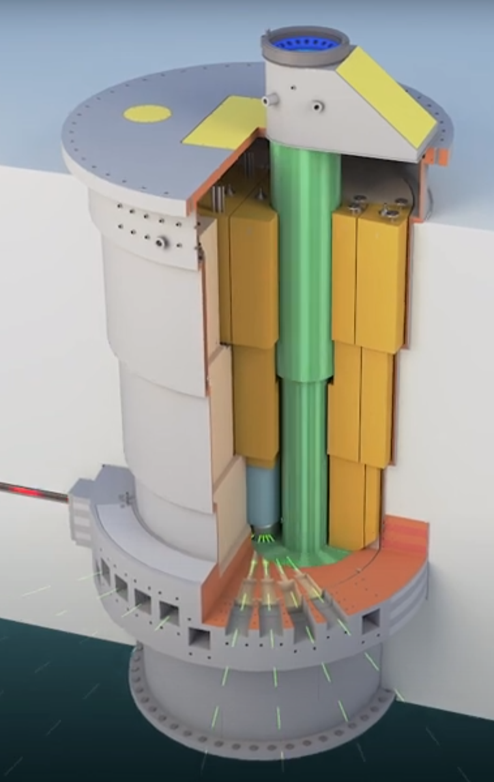
Segmented Architecture

Slide 4
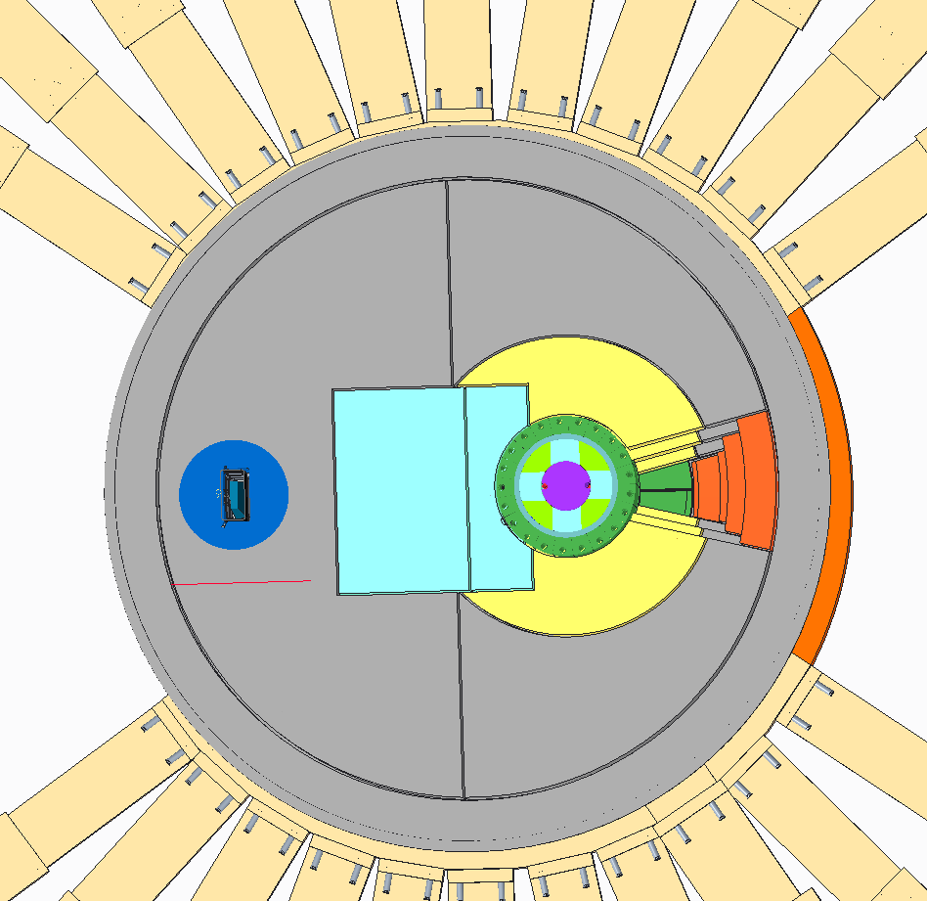
Segmented Target
Target shaft
MRA access plugs
Goal of 95% availability
  Requirement implies 10 days of unscheduled downtime permitted
  Approach: requirement can be met if failures can be handled within permitted downtime (10 days)
Remove & replace segment through vertical “plug”
Target removal opening
Beam
TVP
Shielding
Estimated target replacement:
10 days

Slide 5
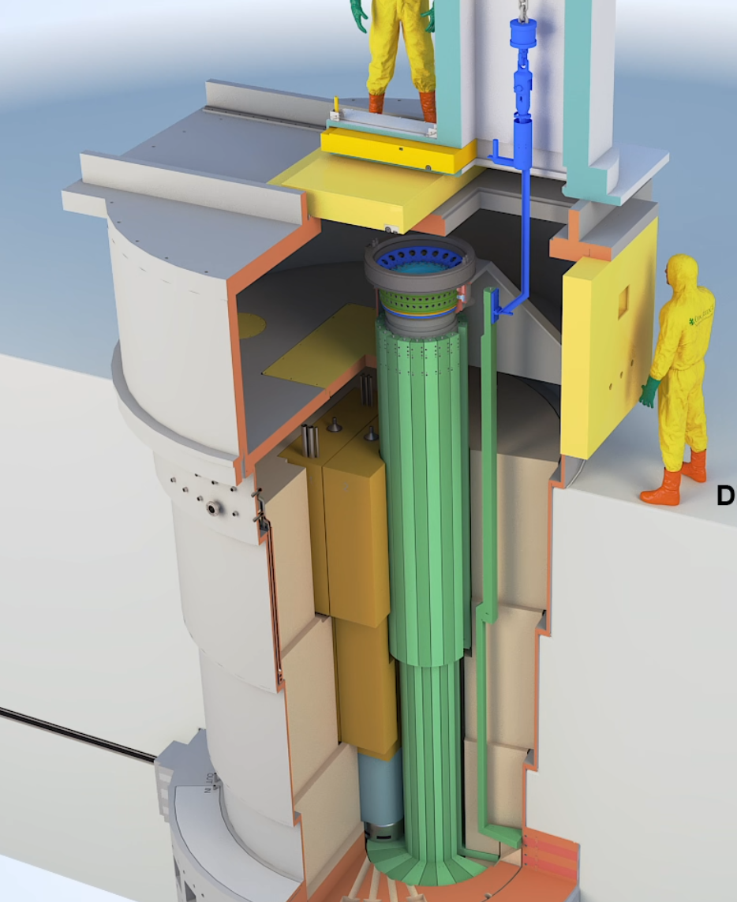
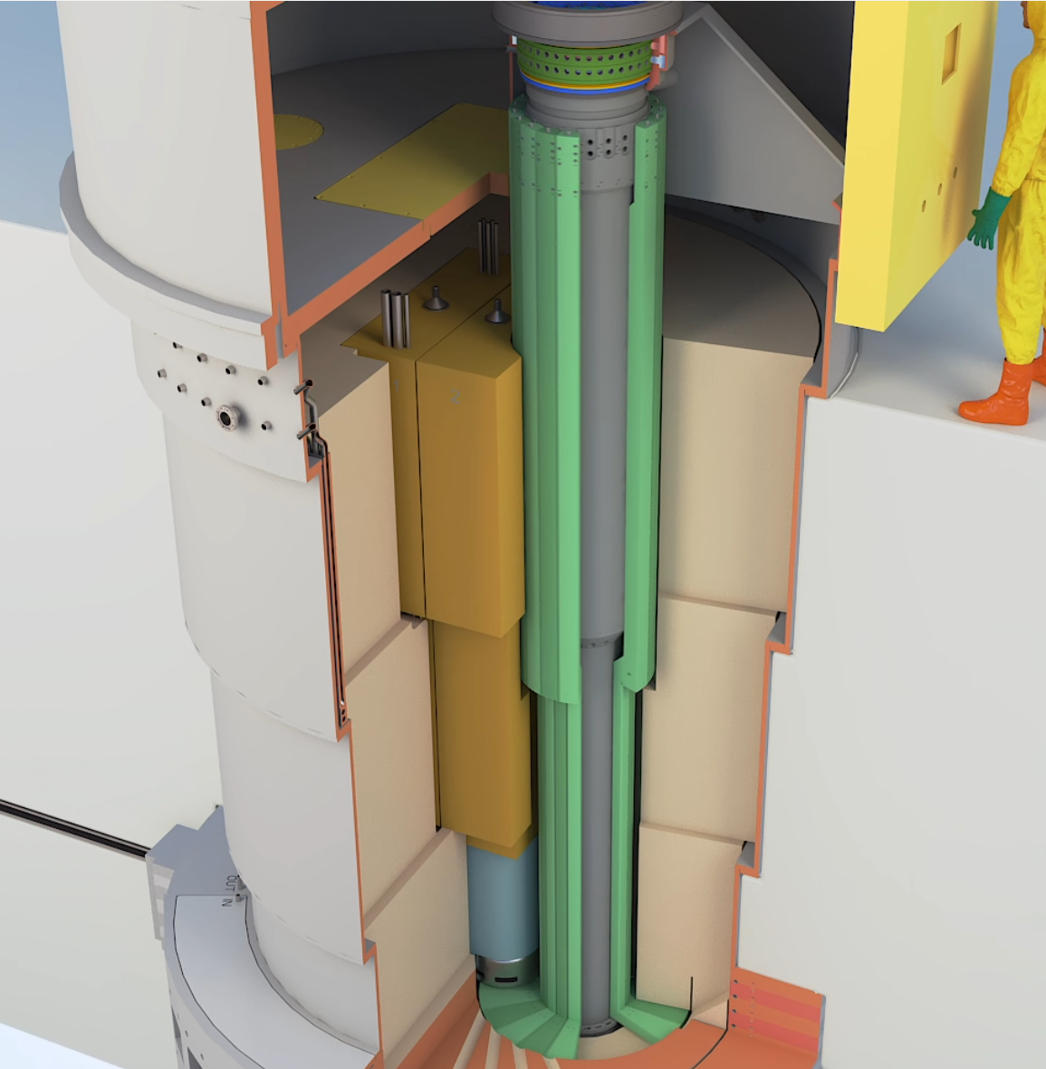
Target & Moderator removal
Drive System
Crane attachment
Removable shield
Shaft (life of facility)
3 segments removed & rotated for MRA access
Access door & window
Core vessel
Removable MRA shield blocks
MRA
Segment
Removable shield blocks (not shown)

Slide 6
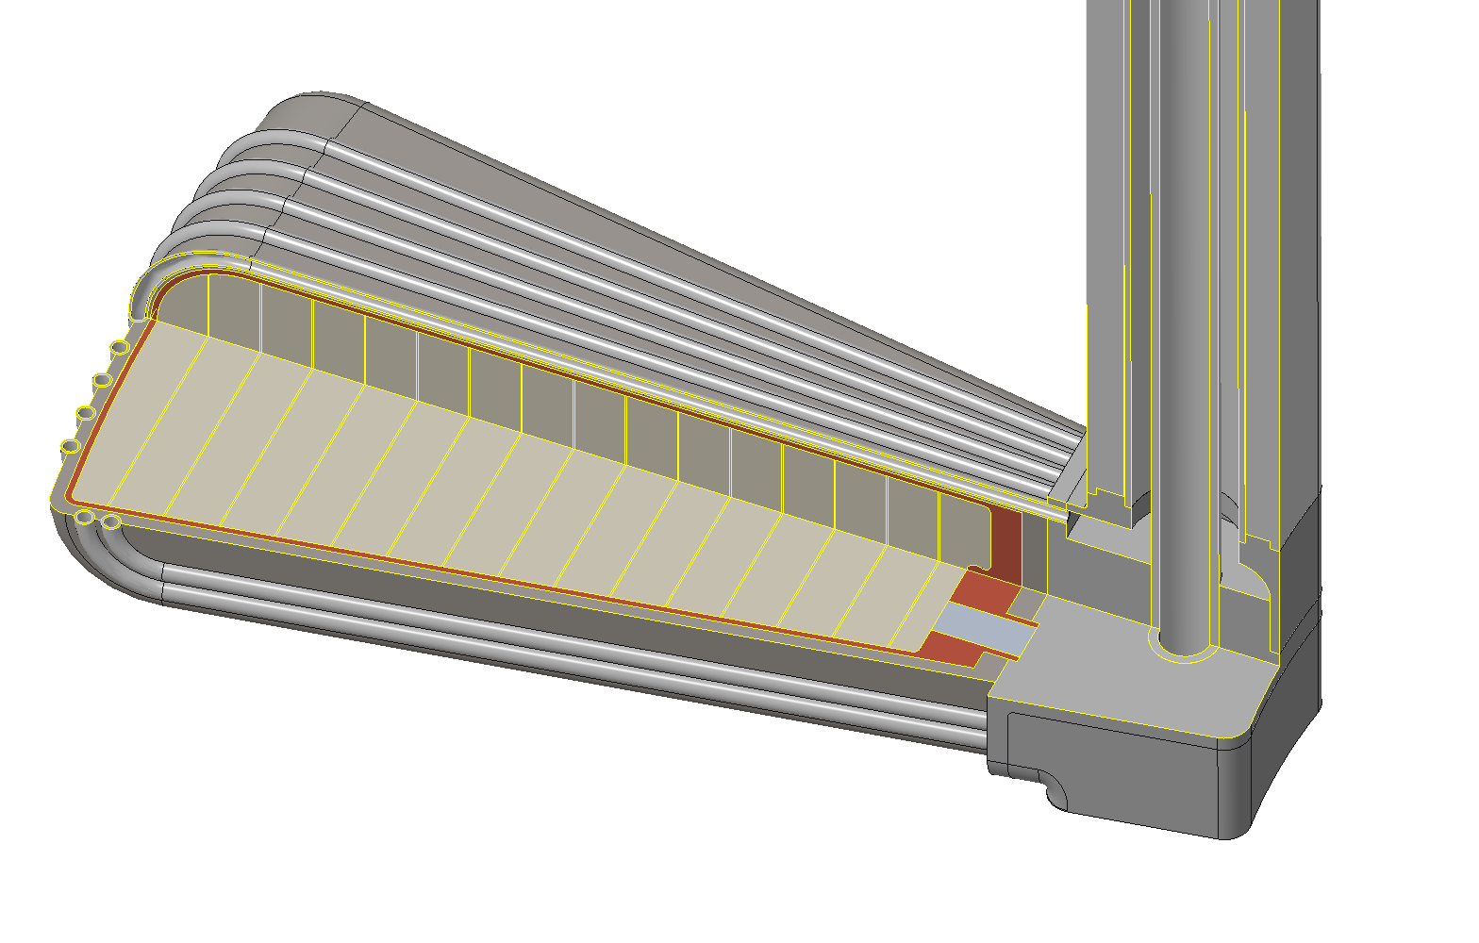
Target Block Design

Slide 7
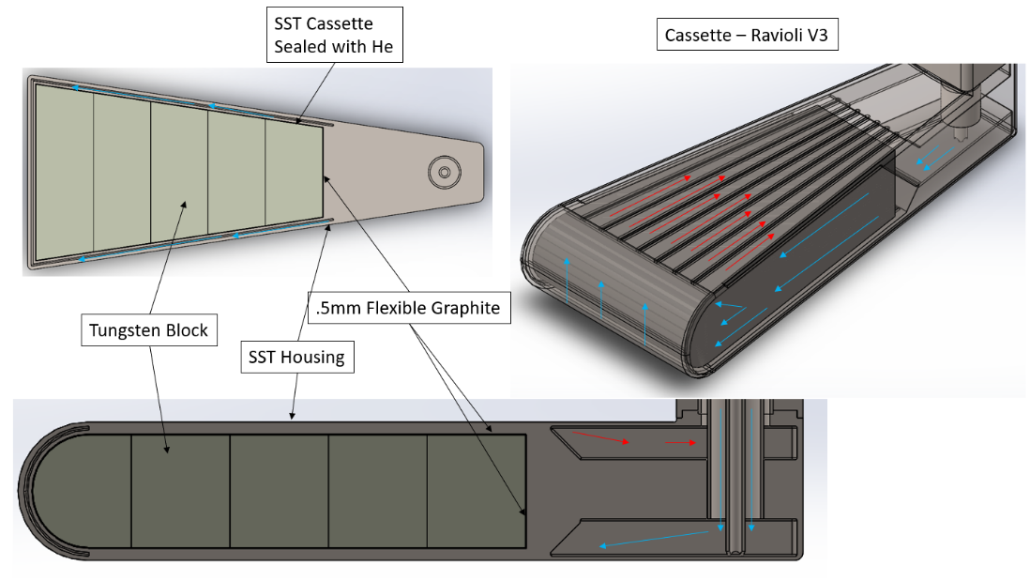
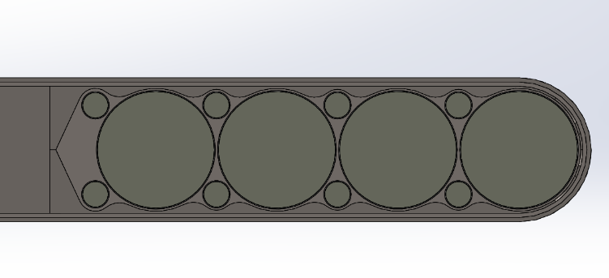
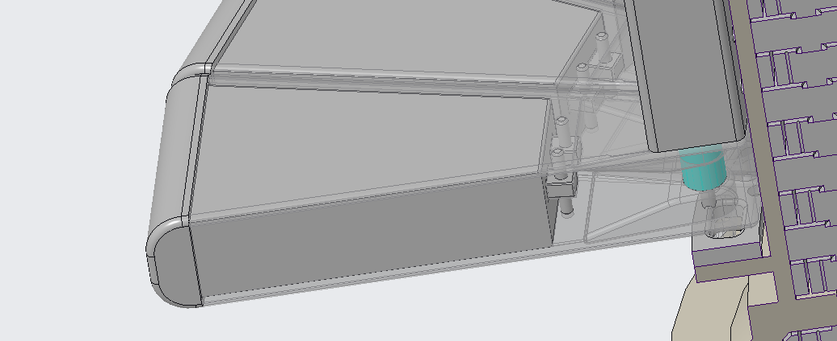
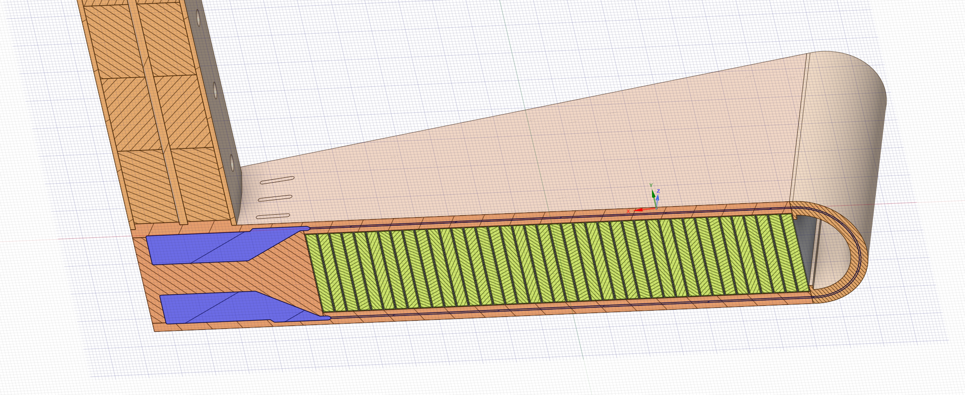
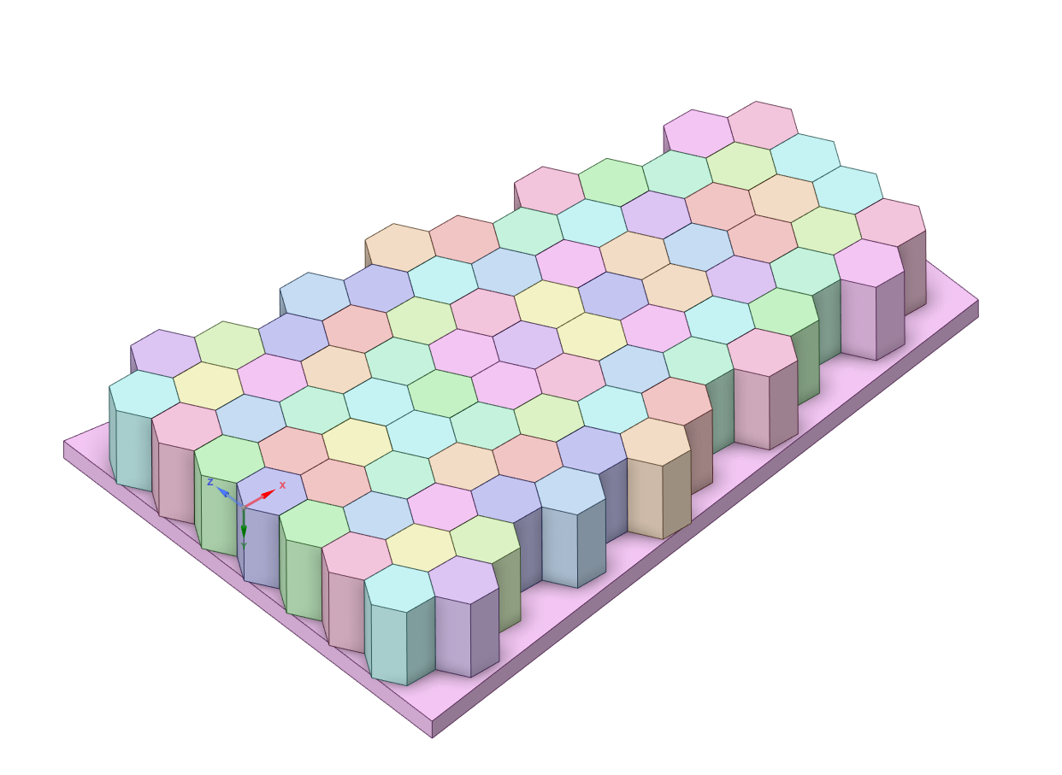
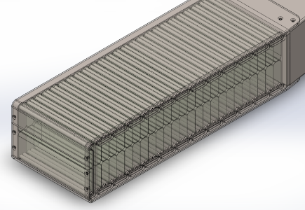
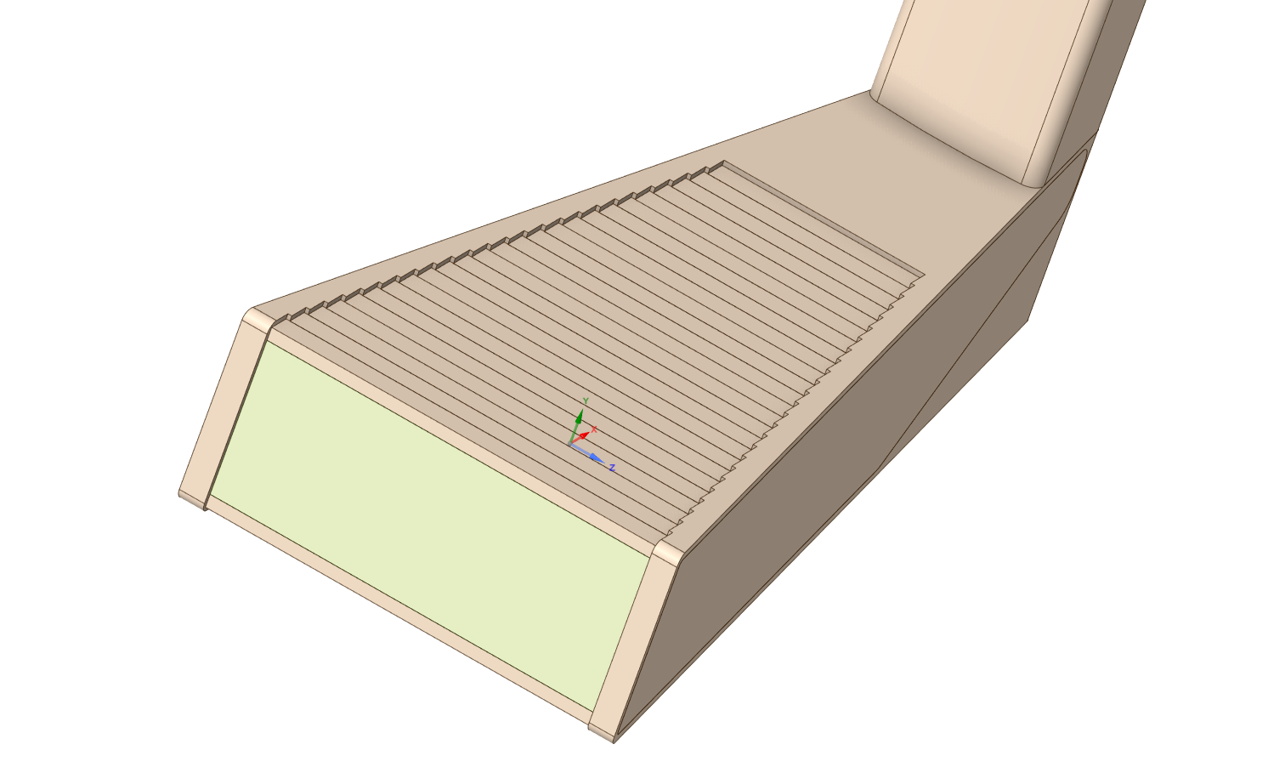
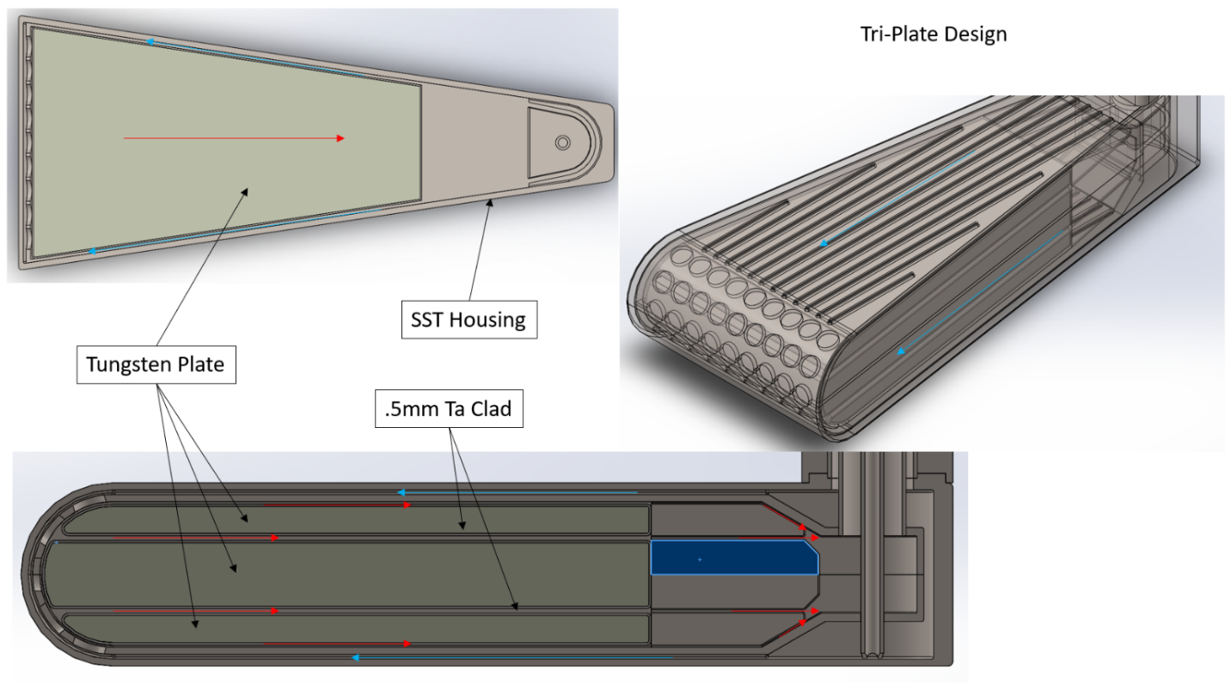
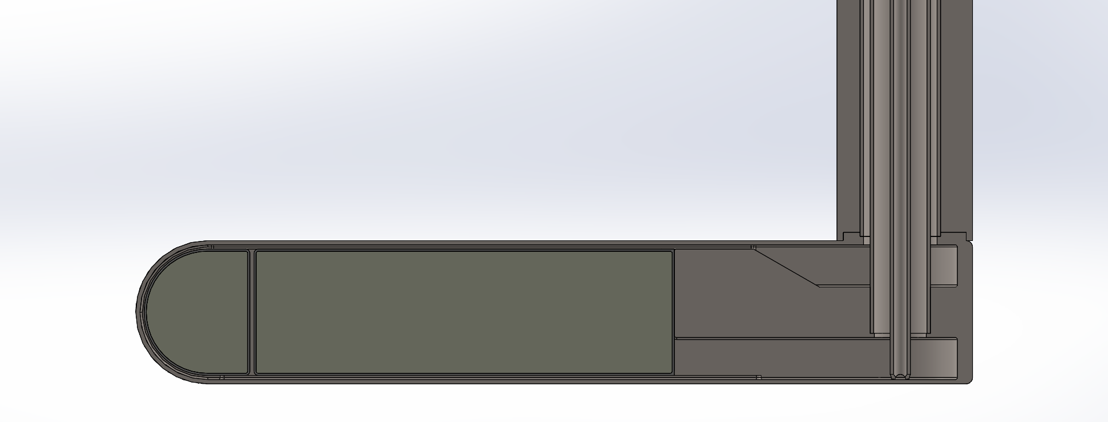
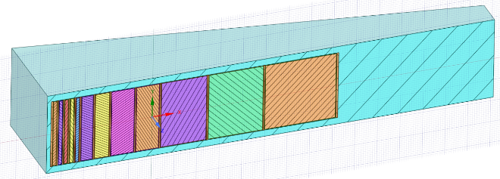
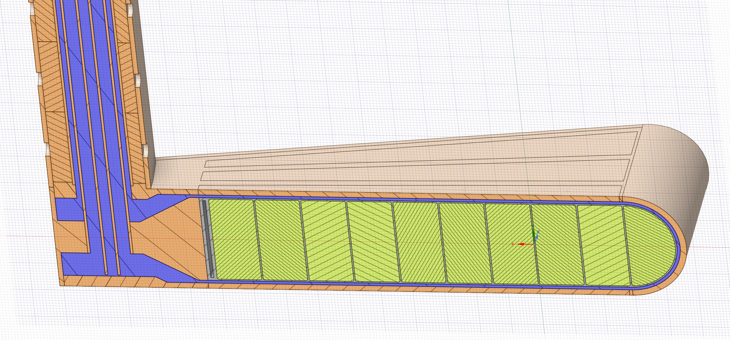
Many concepts explored in a very short amount of time

Slide 8
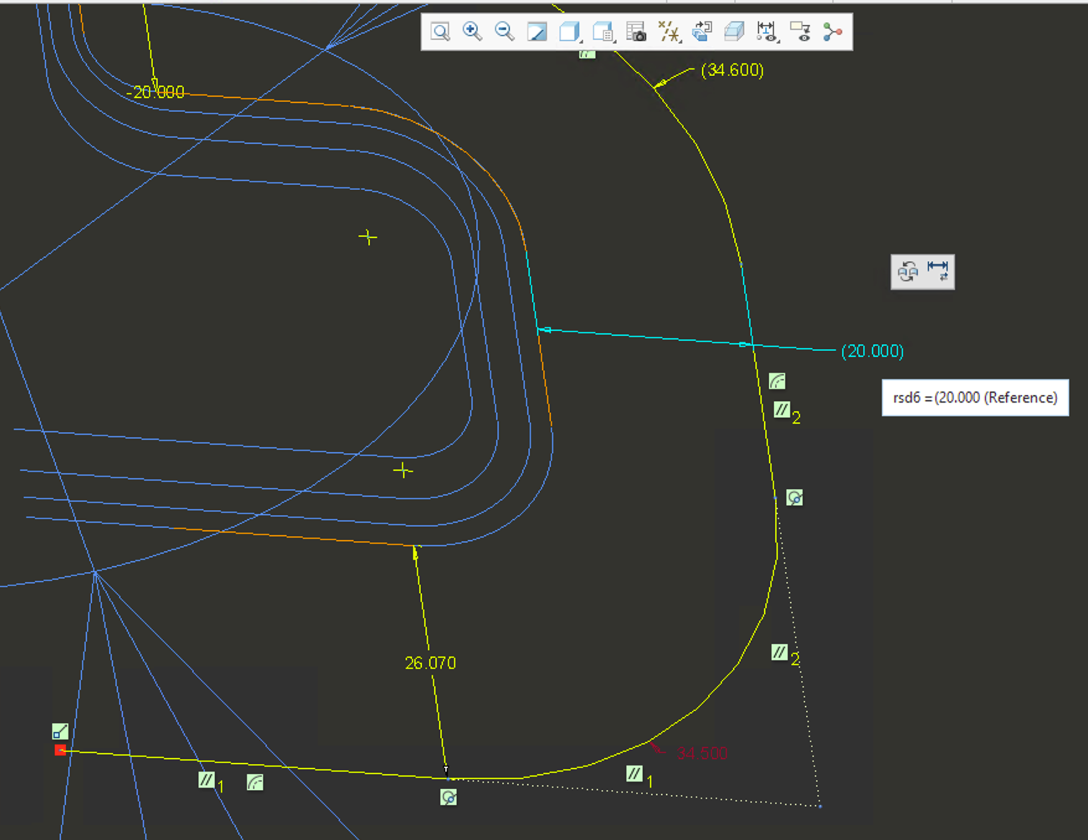
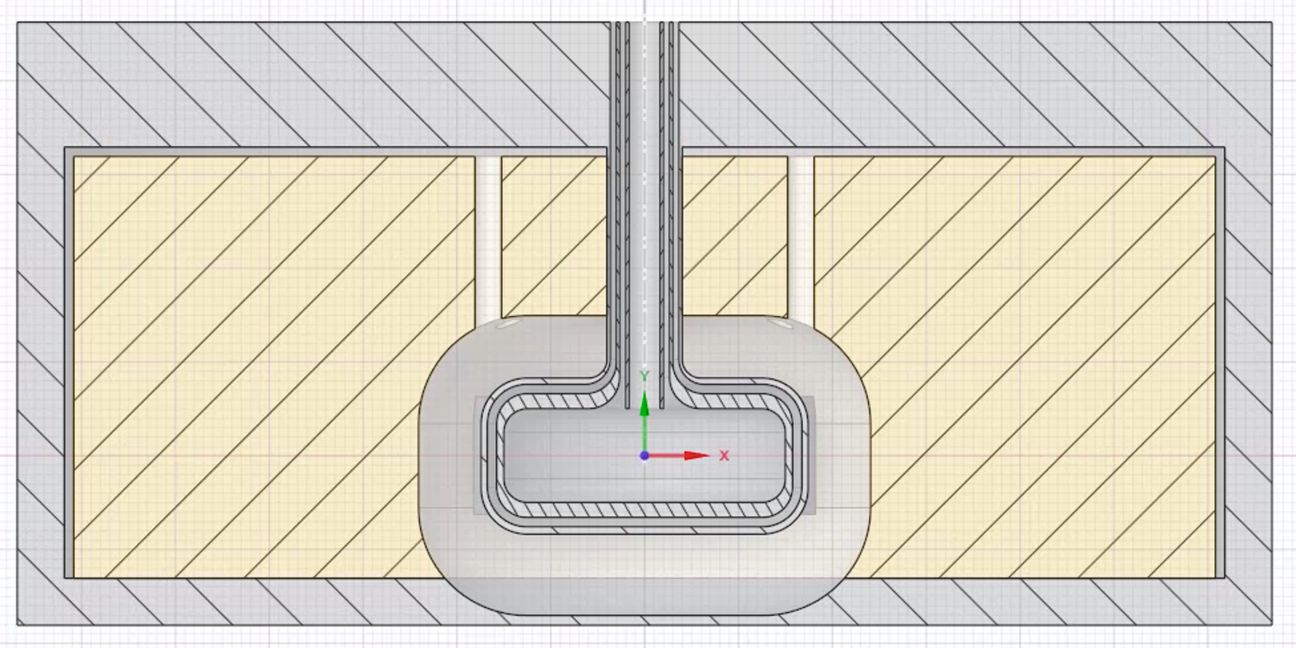
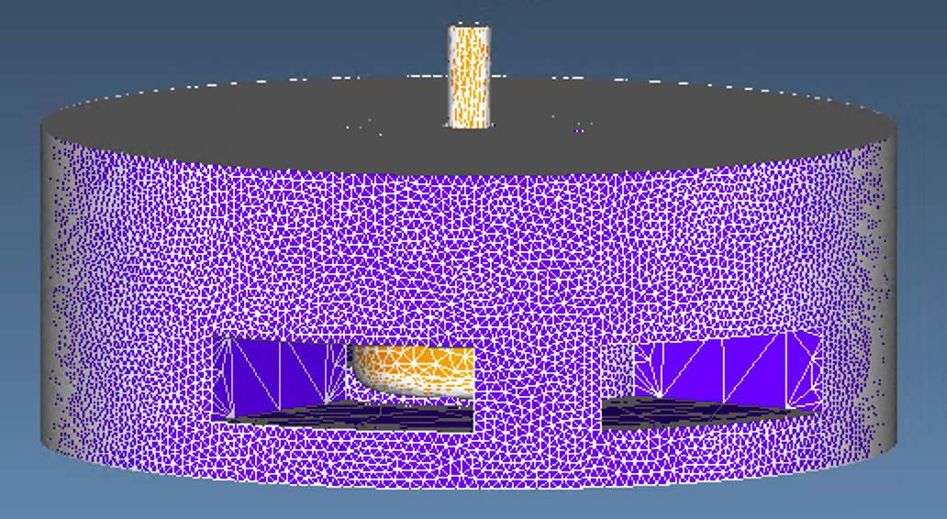
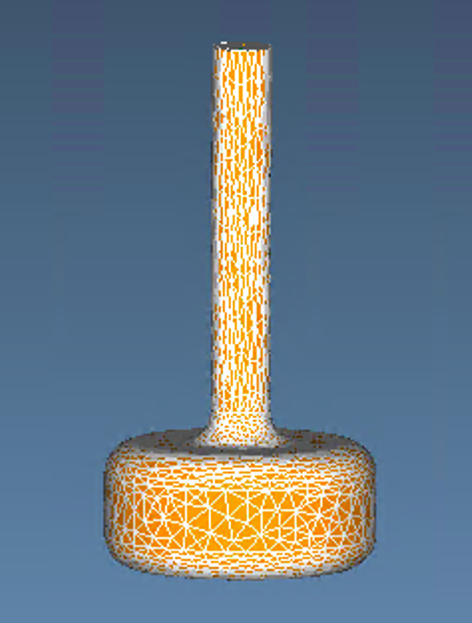
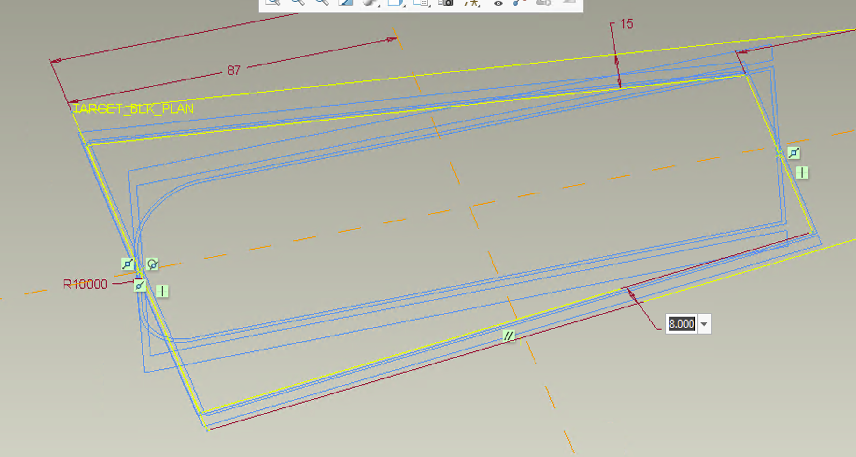
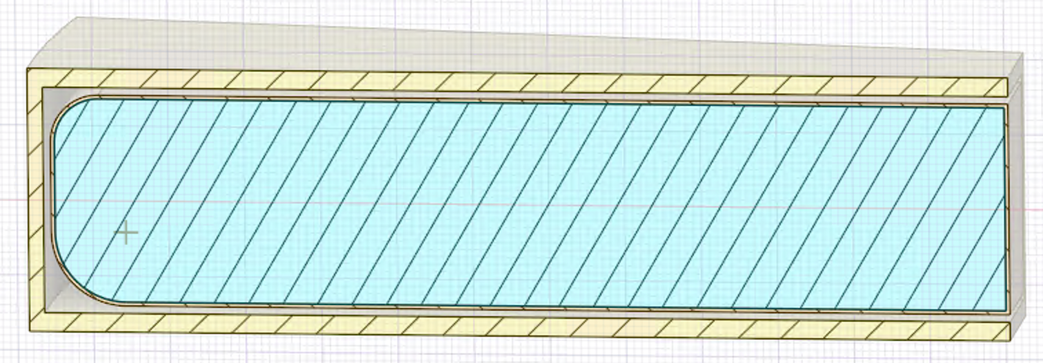
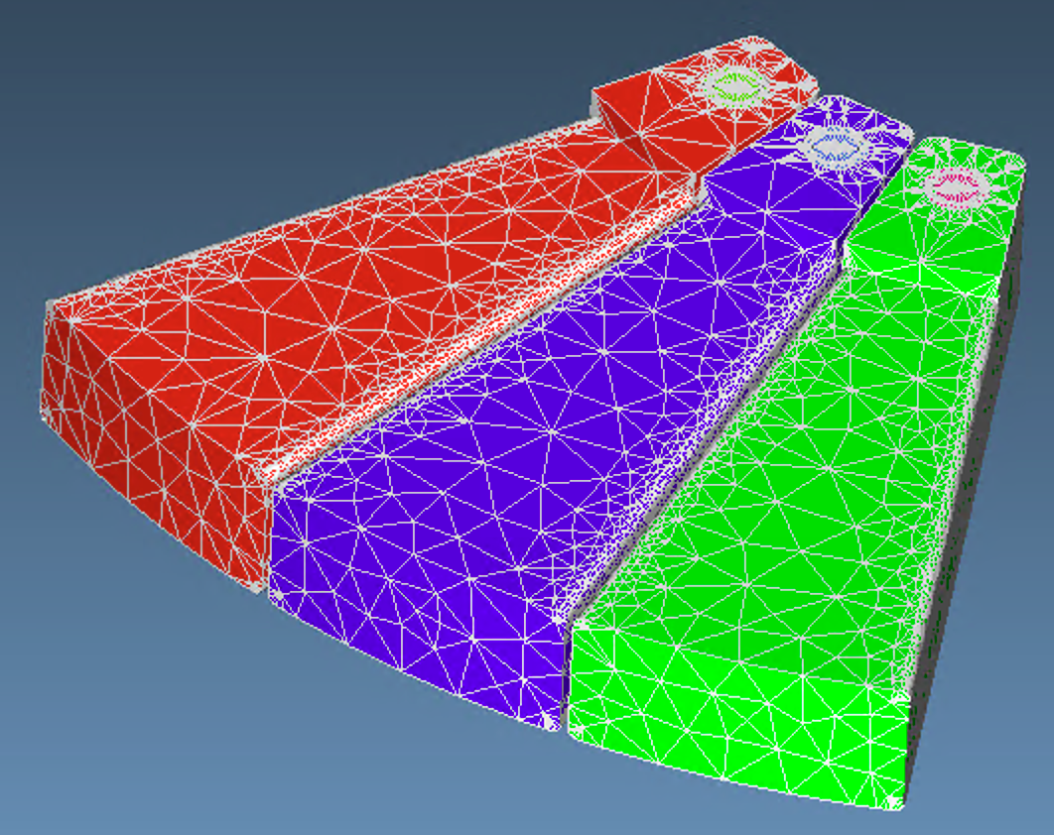
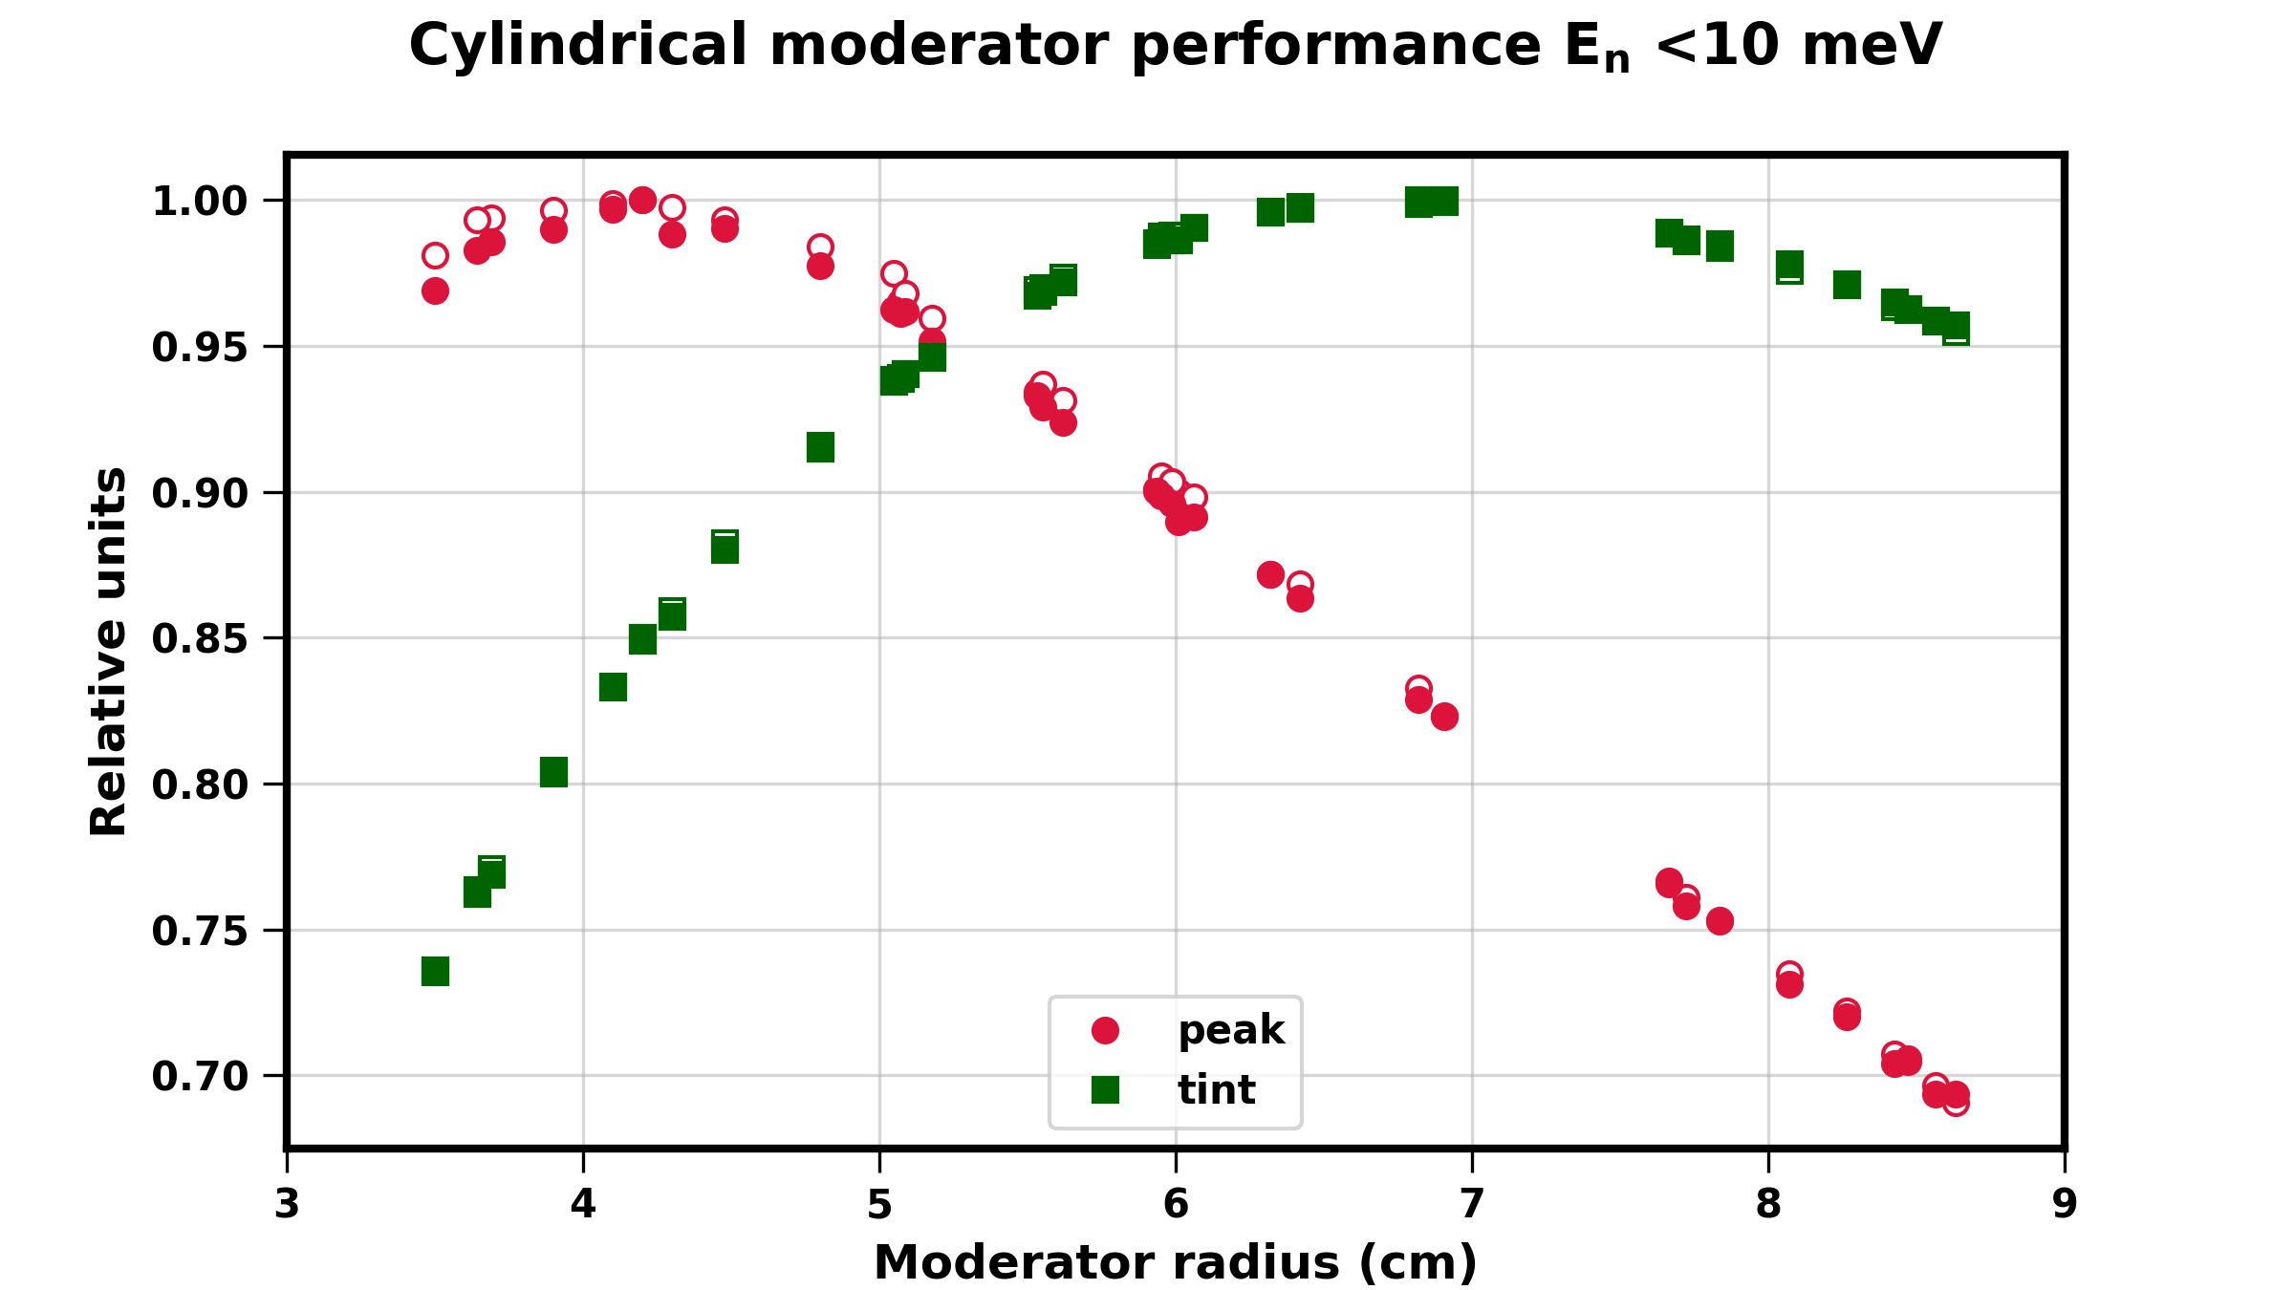
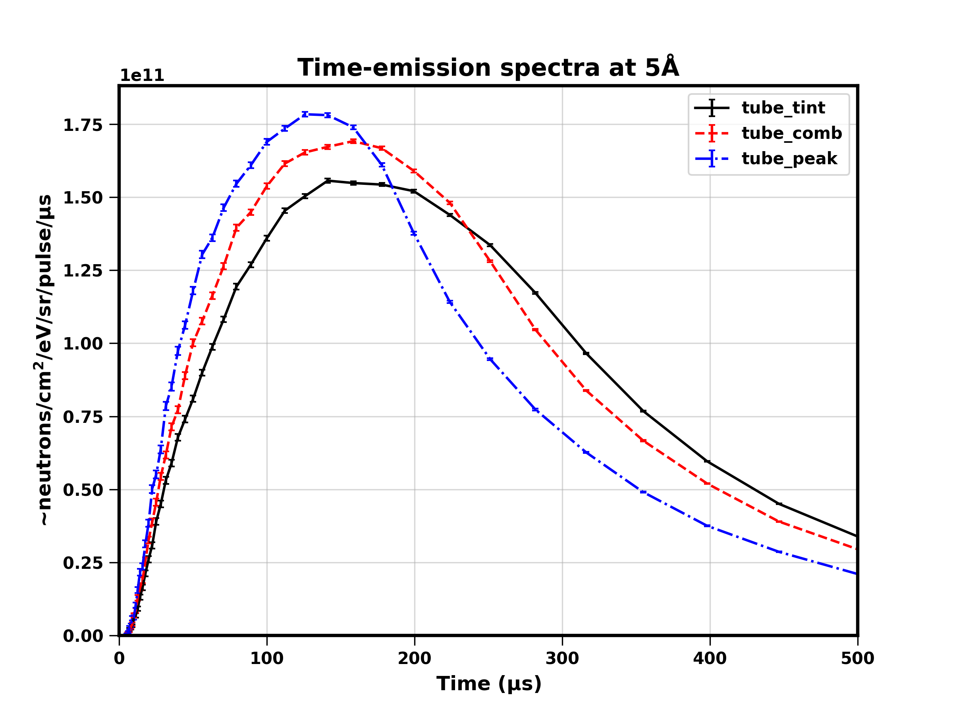
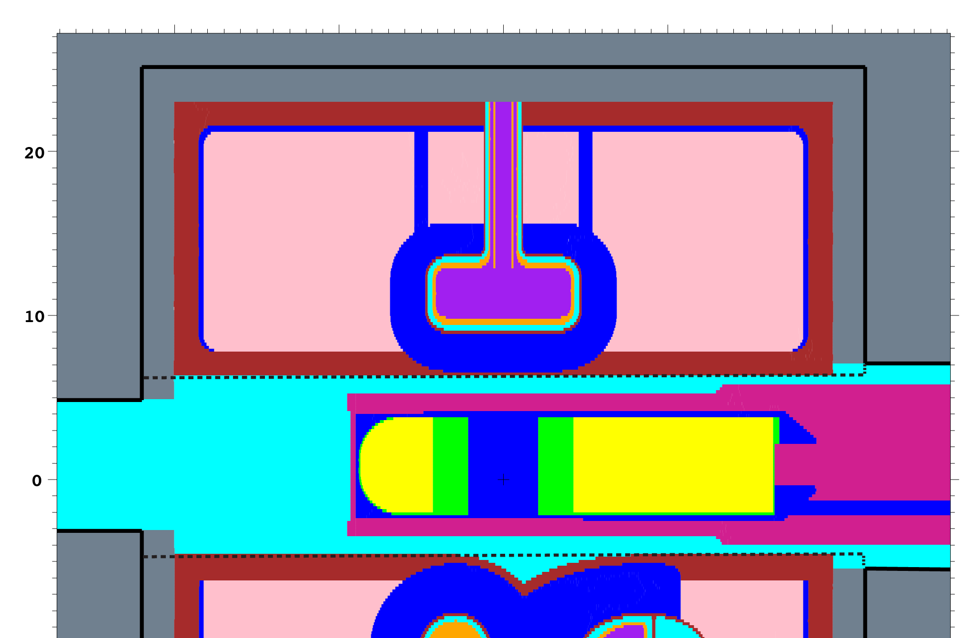
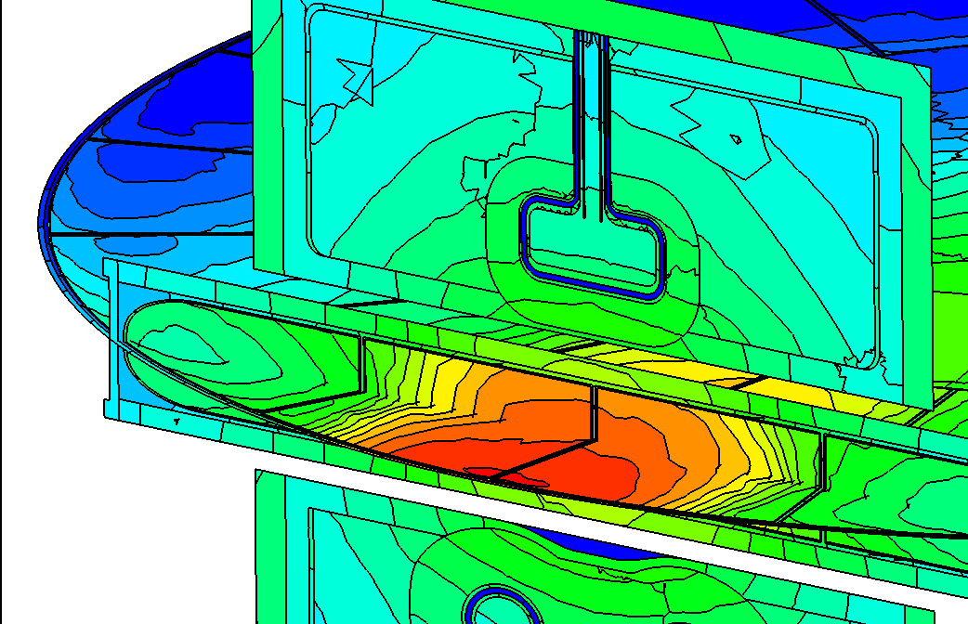
Advanced Automated Rapid OptimizatioN
Unstructured Mesh (UM) generation with Attila4MC
Parametrization with CREO
Filling volumes with SpaceClaim
Hybrid UM/CSG MCNP model
DAKOTA
Optimization
Structural analysis
Neutronics analysis
MCNP
Credit: Lukas Zavorka

Slide 9
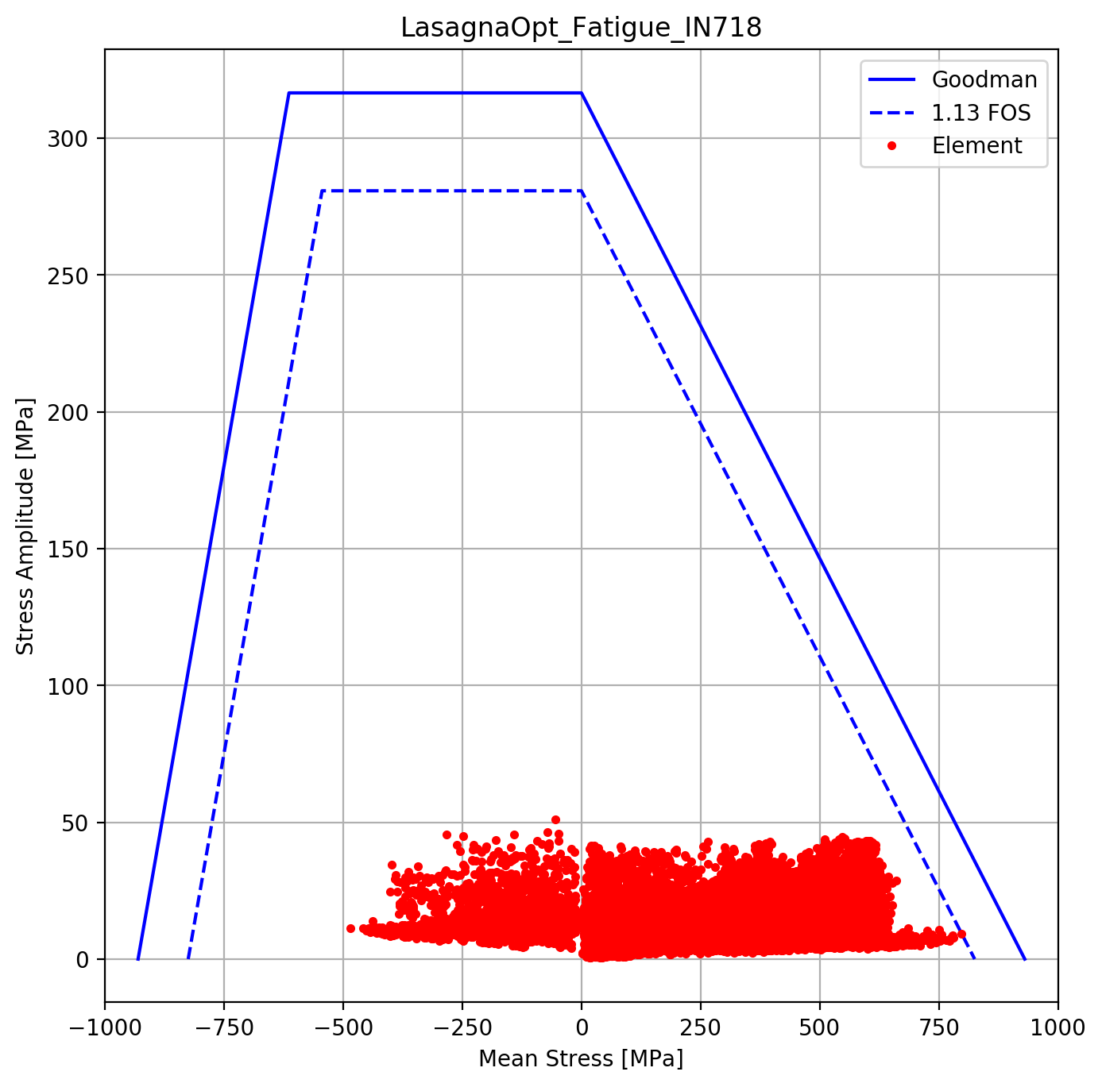
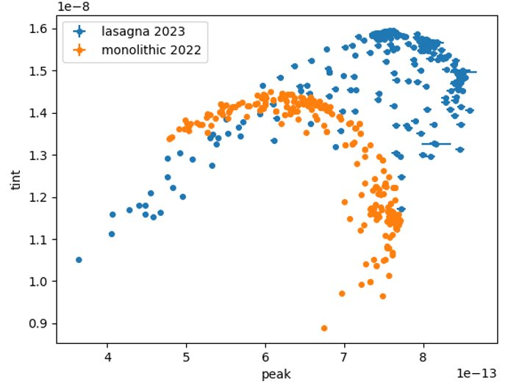
Selected Target Block Design
Increase fatigue performance
Improved Neutronic performance
Bonded construction
Robust outer water boundary
Compliant thermal interface
FOS=1.13 @ 1.3e8
IN 718 SA
10% increase
78mm
Copper
Tungsten
Tantalum
580mm

Slide 10
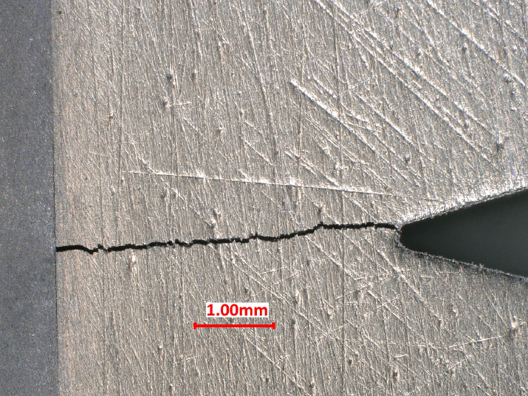
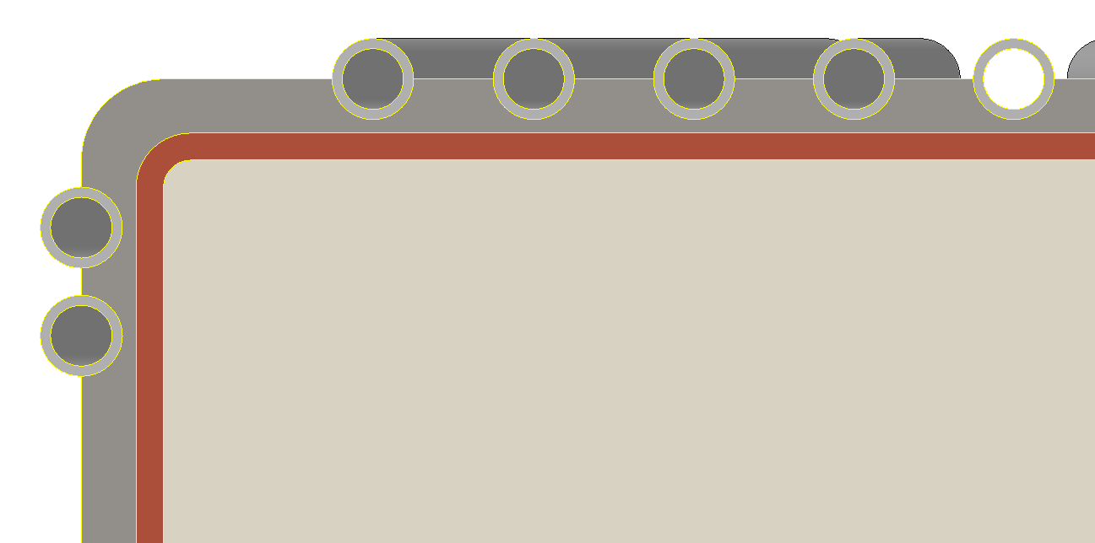
Fault tolerant failure modes were chosen
1
3
 | Description | Probability (of effect) | Effect
1 | Crack in W propagates, causing internal water leak (undected) | Unlikely | W in water (Detected only in water activity)
2 | Housing cracks (fatigue or other) | Unlikely | Shutdown - Leak
3 | W crack, debonds interface | Likely | Increased temp, maintain operation
4 | Debond, overstress, leak | Unlikely | Cu in water (Detect in water activity)
5 | Copper swells, causing external crack, leak | In-progress | Shutdown - Leak
6 | Copper swells, internal crack & leak | In progress | W in water (Detected only in water activity)
W
STS R&D specimens (Nov/Dec 2022
Clad Debond
Ta
Crack propagation
5
2
1
Failure modes are external, visible & do not contaminate water loop
3
4
6

Slide 11
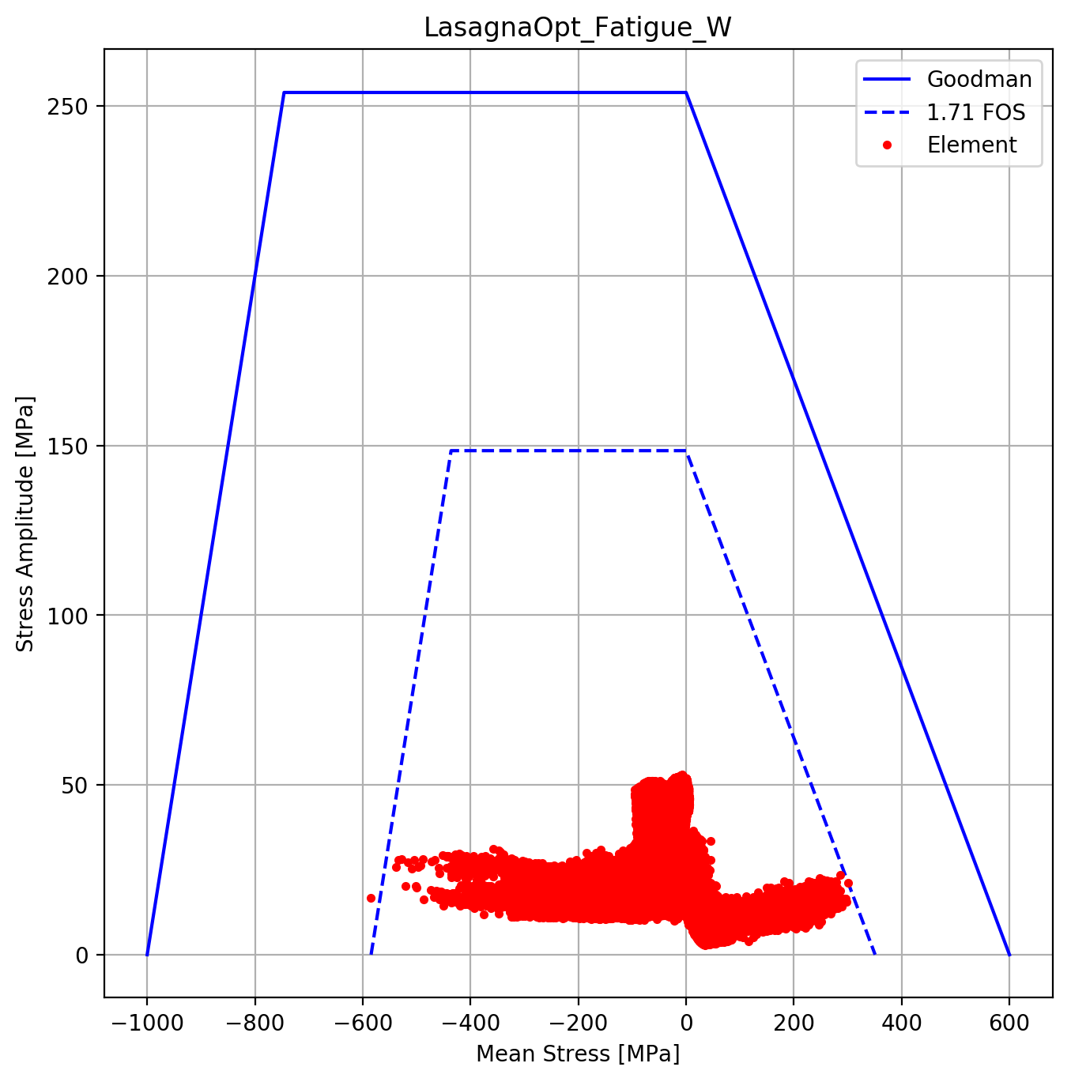
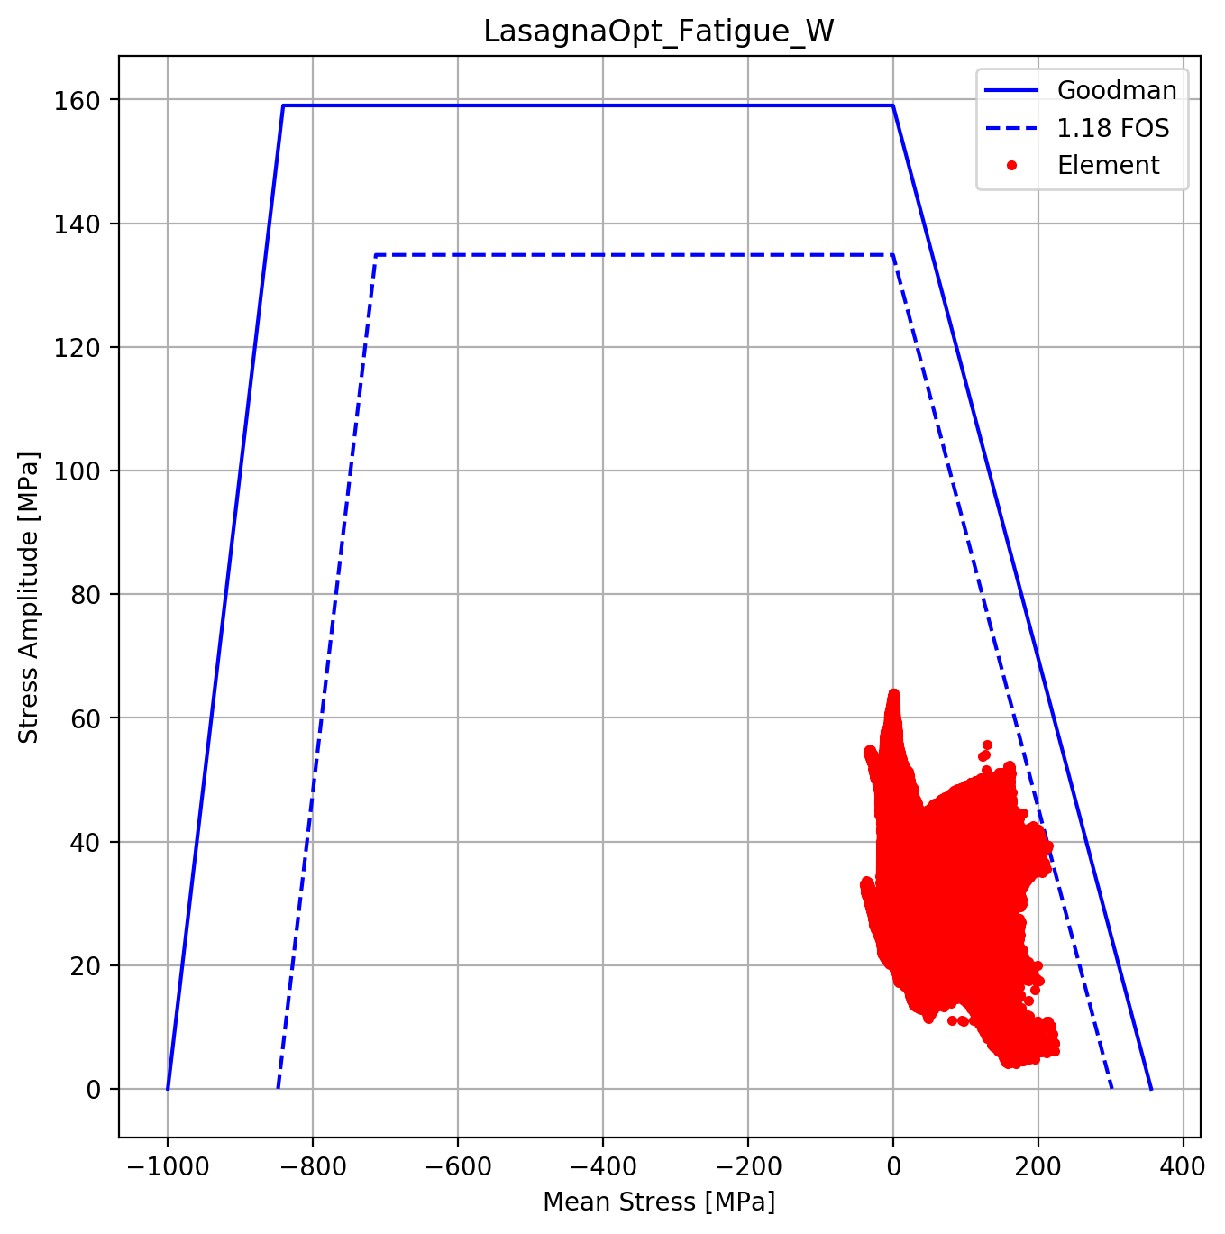
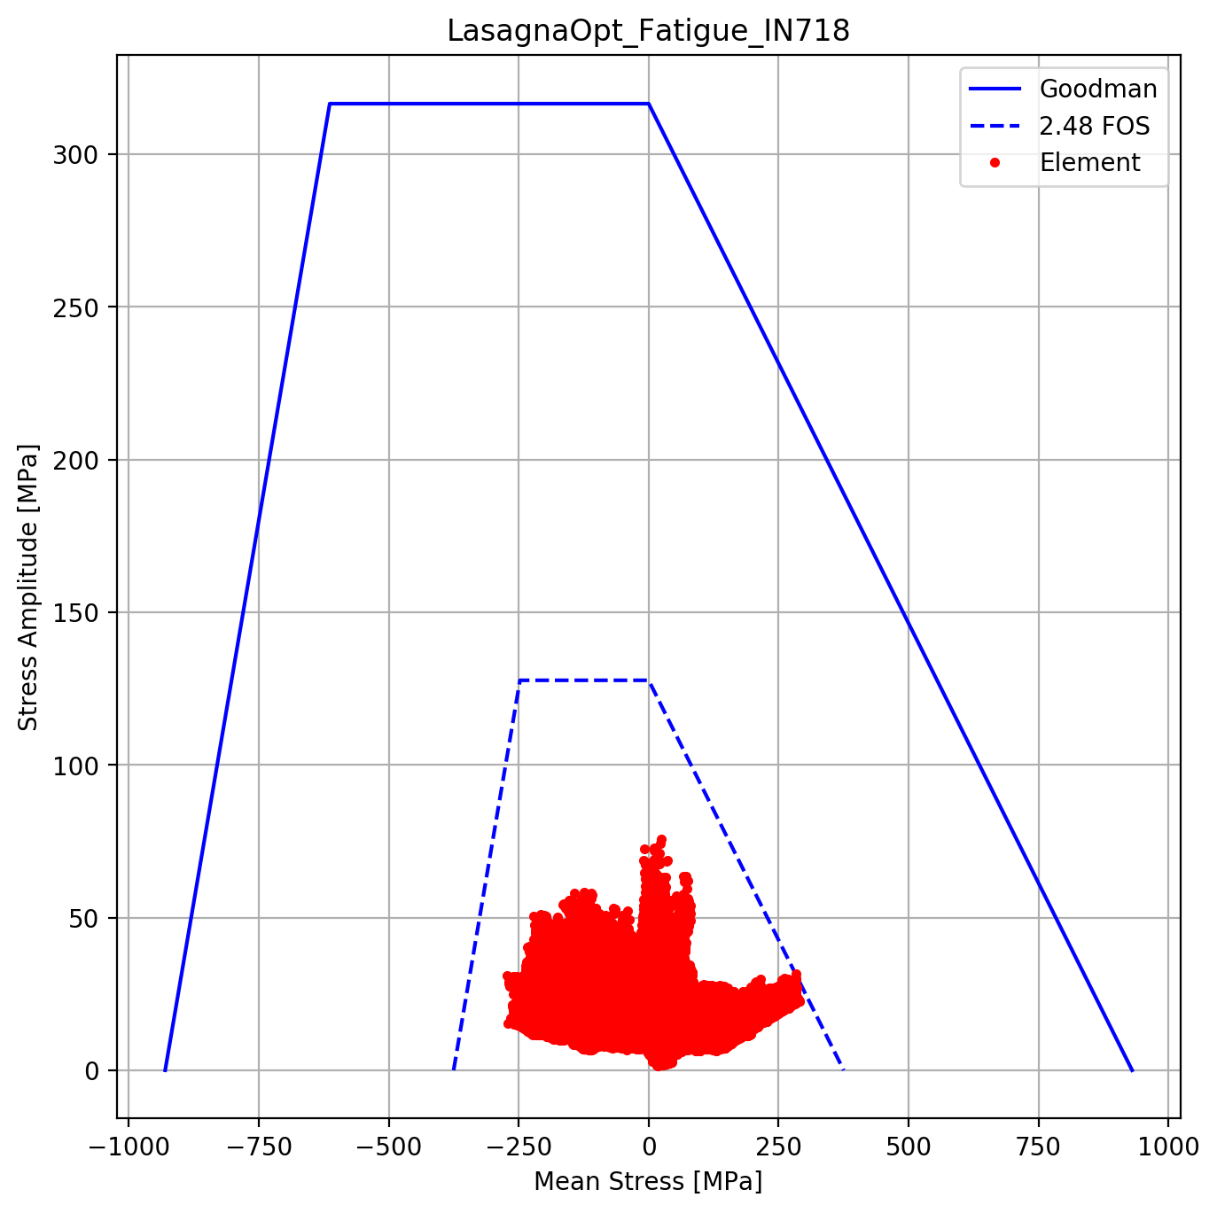
Fatigue Analysis
Beginning of Life
Unirradiated thermoelastic-plastic properties
Fabrication cooldown from 800°C to RT
Beam pulse applied at RT
10 years of pulses at this condition
 | IN718SA | W
BOL | 1.1 | 1.7
EOL | 2.5 | 1.2
End of Life
Irradiated thermoelastic-plastic properties
Residual stresses fully relieved at RT
Beam pulse applied on top of steady-state heating
Copper swelling as function of temperature & DPA
10 years of pulses at this condition

Slide 12
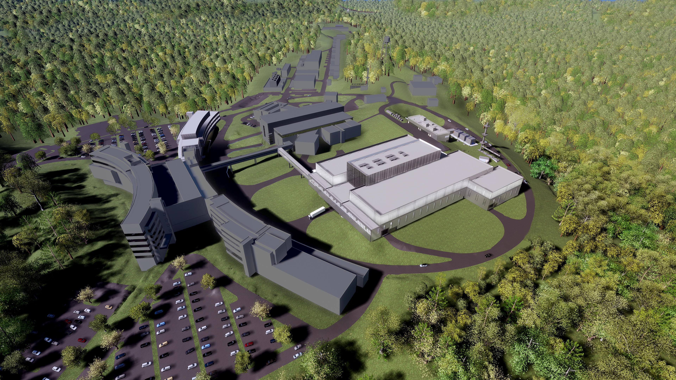
Questions
STS website: https://neutrons.ornl.gov/sts
(overview video)

