Slide 1
RaDIATE Collaboration Overview and Achievements in the Last Few Years on Materials
Frederique Pellemoine, on behalf of the RaDIATE Collaboration
8th HPTW – November 6-10, 2023 - RIKEN, Japan
7 November 2023

Slide 2
Outline
Introduction
High Power Targetry Context
Common challenges in beam intercepting devices
RaDIATE Collaboration
Common interest
RaDIATE program and approach
Current research approach and results
In-beam studies
Develop alternative methods
Novel materials development
Develop modeling
Summary

Slide 3
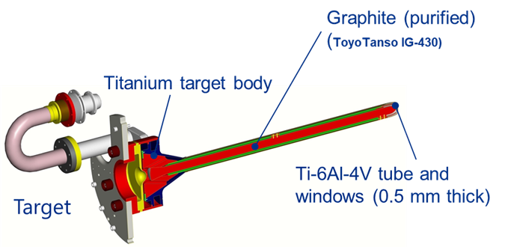
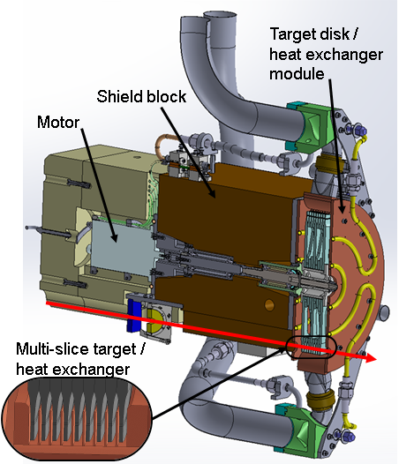
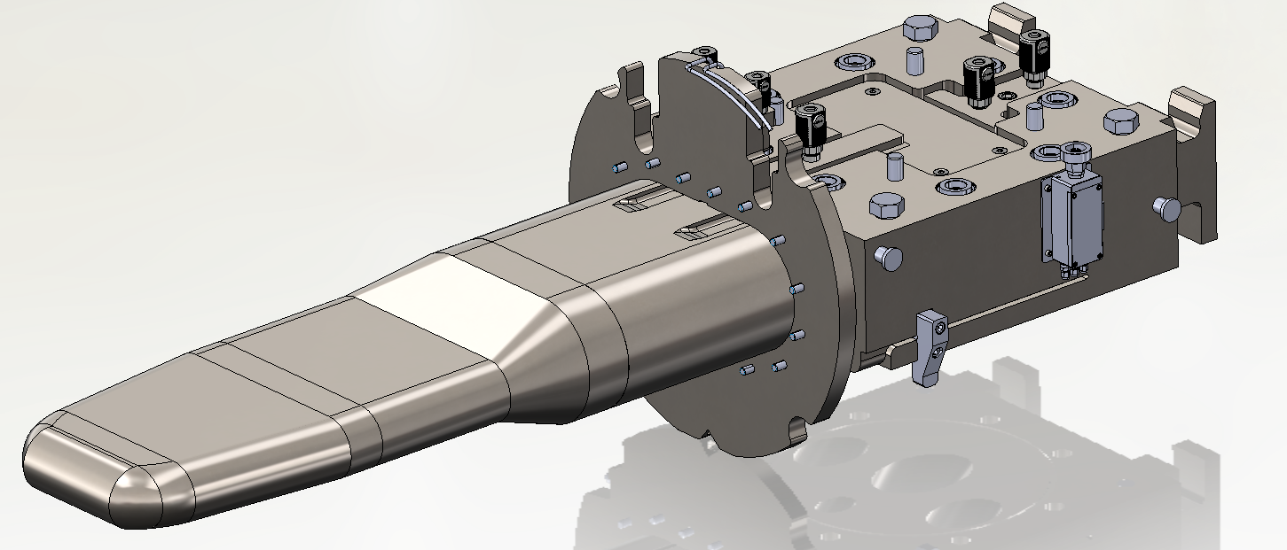
High Power Targetry Context
Beam Intercepting Devices (BIDs) are continuously bombarded by high-energy high-intensity particle beams
Primary beam and target containment windows
Secondary particle-production targets (eg. neutrino targets)
Collimators, Absorbers
Few target examples
Neutrino production at Fermilab National Accelerator Laboratory
graphite target
~ 1MW of 120 GeV pulsed proton beam
Future up to 2.4 MW
Rare Isotope production at Facility for Rare Isotope beam (MSU-FRIB)
graphite rotating target
400 kW of heavy ion beams (from O to U) at a minimum of 200 MeV/u
Neutron production at Oak Ridge National Laboratory (Spallation Neutron Source)
Liquid mercury target
1.4 to 2 MW of 1.3 GeV pulsed proton beam

Slide 4
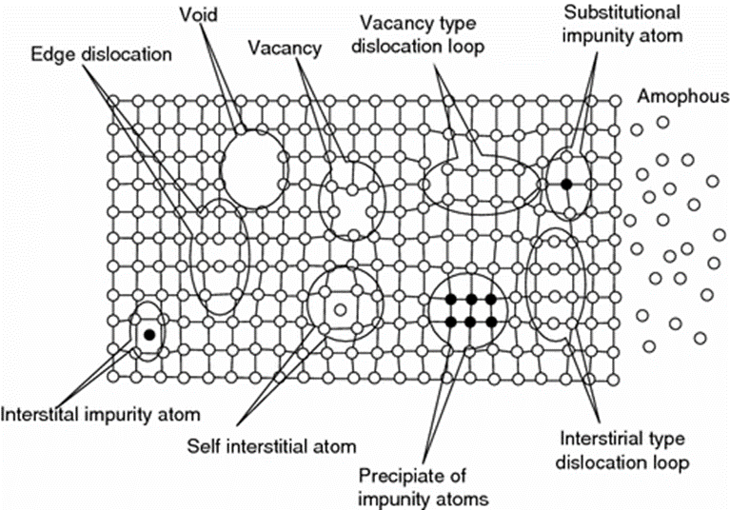
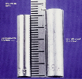
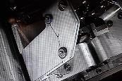
Challenges associated with BIDs
Radiation Damage: Displacements in crystal lattice expressed as Displacements Per Atom (DPA)
Hardening and embrittlement
Creep and swelling
Fracture toughness reduction
Thermal/electrical conductivity reduction
Coefficient of thermal expansion
Modulus of elasticity
Transmutation products (H, He gas production can cause void formation and embrittlement)
Thermal Shock: Sudden energy deposition from pulsed beam
Fast expansion of the material surrounded by cooler material generates localized area of compressive stress
1 MW target: ~250 K in 10 µs pulse (2.5 x 107 K/s)
Stress waves move through the material at sonic velocities. Plastic deformation, cracking and fatigue failure can occur
Thermal Fatigue: Cycling loading environment
Cycling loading progressively damage material’s microstructure such that it can ultimately fail at stress levels that are actually lower than its failure strength
D.L. Porter and F. A. Garner, J. Nuclear Materials, 159, p. 114 (1988)
Iridium (left) and Sigraflex (right) targets tested at CERN’s HiRadMat facility
Horn stripline fatigue failure (FNAL)

Slide 5
R a D I A T E Collaboration
Radiation Damage In Accelerator Target Environments
RaDIATE collaboration created in 2012, with Fermilab as the leading institution. The collaboration has grown up to 20 institutions over the years.
First MoU was signed with 5 institutions 10 years ago!
Objective:
Harness existing expertise in nuclear materials and accelerator targets
Generate new and useful materials data for application within the accelerator and fission/fusion communities
Activities include:
Analysis of materials taken from existing beamline as well as new irradiations of candidate target materials at low and high energy beam facilities
In-beam thermal shock experiments
Contact:
Frederique Pellemoine, fpellemo@fnal.gov
Web: radiate.fnal.gov
Notes:
To address these material challenges, the HPT community formed the RaDIATE collaboration in 2012, with Fermilab as the leading institution. The goal was to bring experts from the accelerator and fission/fusion communities together to generate new data for accelerator materials. The collaboration has grown up to 14 institutions over the years.

Slide 6
R a D I A T E Collaboration
Radiation Damage In Accelerator Target Environments
Facility/Accelerator
Irradiation station
Post Irradiation Examination

Slide 7
R a D I A T E Collaboration
Radiation Damage In Accelerator Target Environments

Slide 8
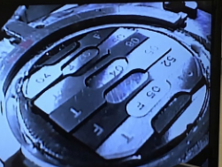
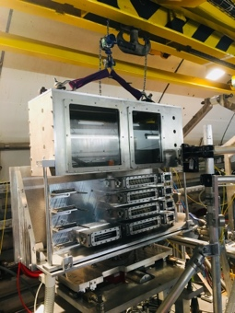
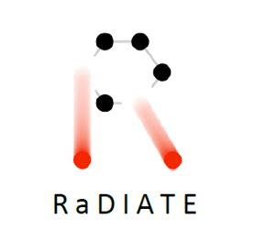
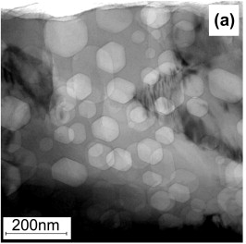
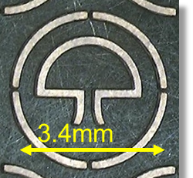
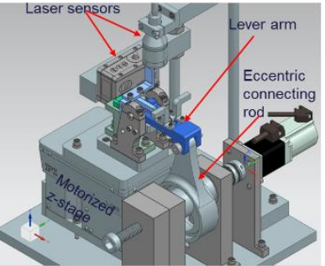
High-Power Targetry R&D Approach
In-Beam Studies
Evaluate in-beam performance of candidate materials
Irradiated Material Studies: high energy proton irradiation at BNL-BLIP
Thermal shock testing: HiRadMat facility at CERN
Novel Target Materials
New materials with enhanced thermal shock and radiation damage resistance
High-Entropy Alloys
Nanofibers
Composite materials
Heat treatment
Alternative Methods
Emulate high energy proton irradiations for accelerated and cost-effective material screening
Low Energy Ion: for assessing radiation damage effects
Electron beam for thermal shock and fatigue testing
Novel Testing Methods (fatigue studies)
Develop Modeling
Prediction of fundamental response of various materials to irradiation and thermal shock
Helium gas bubbles formation and segregation
Radiation damage effects
Heat transfer mechanism in nanofiber media

Slide 9
High-Power Targetry R&D Approaches
F. Boix Pamies – talk 42 - Monday
In-Beam Studies
Evaluate in-beam performance of candidate materials
Irradiated Material Studies
From failed/used devices
From high energy proton irradiation at BNL-BLIP
Post-Irradiation Examination
Thermal shock testing
HiRadMat facility at CERN
D. Kim - poster 17 - Tuesday
E. Wakai - talk 100 - Tuesday
A. Casella - poster 20 - Tuesday
D. McClintock - talk 95 - Thursday
S. Meigo - talk 100 - Tuesday
2017-2018
2015 2018 2022
High-energy proton irradiation
Post-Irradiation Examination
In-beam thermal shock

Slide 10
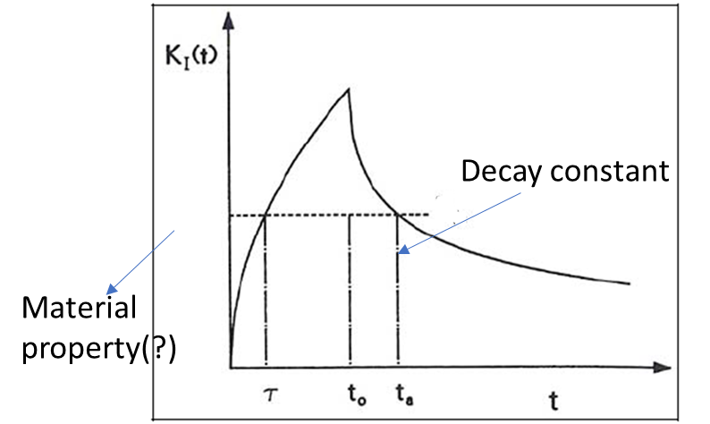
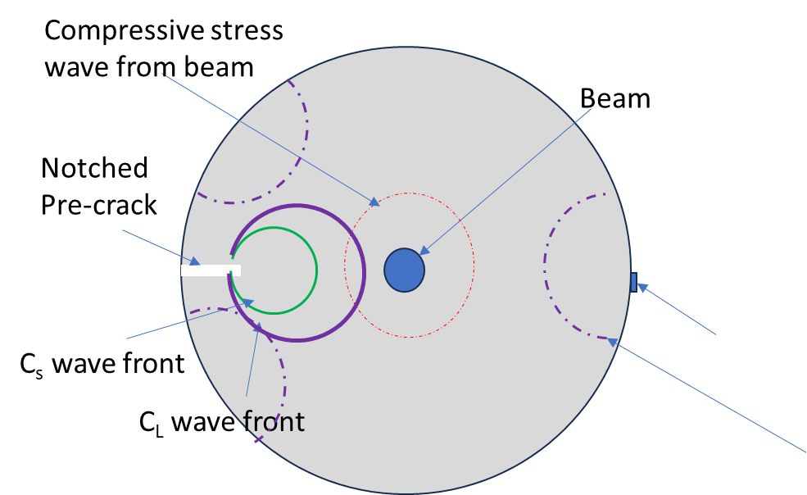
Future HiRadMat Experiment
Previous HiRadMat experiment (2015, 2018 and 2022)
Understand and compare single-shot thermal shock response and limits between non-irradiated and previously irradiated material specimens from BNL BLIP
Explore various materials: different grades of conventional materials, novel materials
Directly measure beam-induced dynamic effects to validate simulation codes
Preparing a proposal for beam in 2025
Use beam induced stress wave to estimate dynamic fracture toughness of target materials
Static stress intensity factor
Stress wave Dynamic loading
Stress field around crack tip is not in equilibrium and inertia effects can not be neglected
Crack may propagate instantly depending on magnitude of stress wave and rate at which it is applied
LDV /gage location to detect change in crack growth

Slide 11
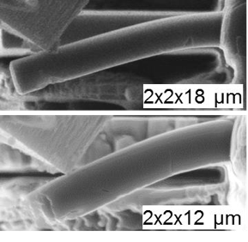
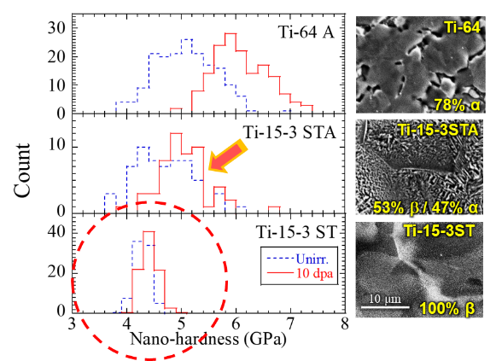
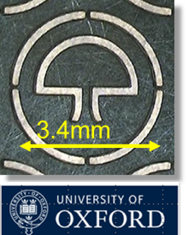
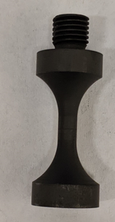
High-Power Targetry R&D Approaches
E. Wakai - talk 100 - Tuesday
R. Cowan - poster 20 - Tuesday
S. Bidhar - talk 66 - Wednesday
Alternative Methods
Emulate high energy proton irradiations for accelerated and cost-effective material screening
To thermal shock
Electron/laser beam for thermal shock and fatigue testing
To Radiation damage
Low Energy Ion: for assessing radiation damage effects
To High-Cycle Fatigue Testing
Novel Testing Methods (fatigue studies)

Slide 12
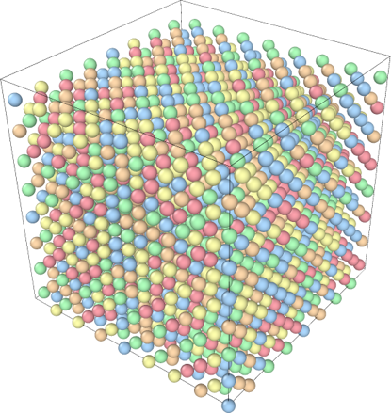
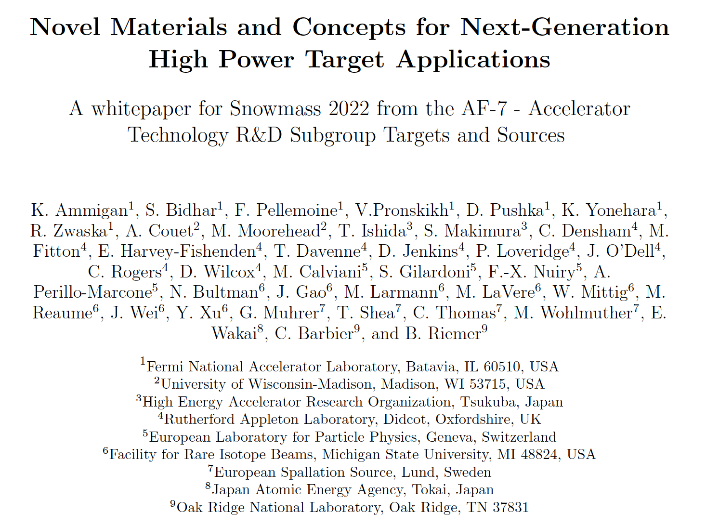
High-Power Targetry R&D Approaches
Looking beyond conventional materials
Novel Target Materials
New materials with enhanced thermal shock and radiation damage resistance
High-Entropy Alloys
Nanofibers
SiC-coated graphite and SiC-SiC composites
Dual-Phase titanium alloys
Toughened Fine-Grained Recrystallized (TFGR) Tungsten
Advanced graphitic materials
Novel materials to enable next-generation multi-MW accelerator facilities
K. Ammigan - talk 36 - Tuesday
A. Burleigh - poster 18 - Tuesday
https://arxiv.org/abs/2203.08357
S. Makimura - poster 21 - Tuesday
HEP High Power Targetry Roadmap Workshop – Targets and Sources (April 11-12, 2023)
https://indico.fnal.gov/event/59123/
E. Wakai - talk 100 - Tuesday

Slide 13
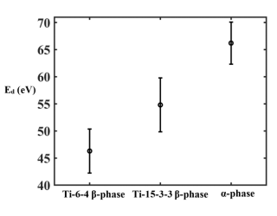
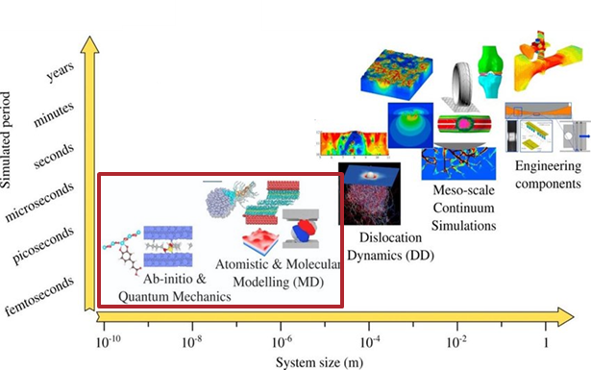
High-Power Targetry R&D Approaches
A Roy et al., J. Nuclear Materials 586 (2023) 154695
S. Meigo - talk 22 - Monday
H. Matsuda, JNST 57 1141 (2020)
S. Meigo, EPJ Web of conf 239 06006 (2020)
G. Arora - talk 47 - Tuesday
D. Senor - invited talk 97 - Monday
Develop Modeling
Prediction of fundamental response of various materials to irradiation
Helium gas bubbles formation and segregation
Radiation damage
dpa
in Ti-alloys
In HEAs
Heat transfer mechanism in nanofiber media

Slide 14
R&D Related to RaDIATE Collaboration
Neutrino Production
Muon Production – US
Rare Isotope Production
Neutron Production
Cooling System
Muon Production – Japan
Q. Peterson - talk 96 - Thursday
Y. Fukao - talk 112 - Monday
P. Hurh - talk 52 - Thursday
S. Makimura - talk 45 - Wednesday
S. Matoba - talk 114 - Thursday
K. Yonehara – talk 133 - Tuesday
N. Kawamura - poster 14 - Tuesday
Z. Liu - talk 64 - Wednesday
H. Sunagawa - poster 15 - Tuesday
J. Song - talk 28 - Friday
T. Sakamoto - poster 21 - Tuesday
S. Makimura - poster 22 - Tuesday
J. Maestre - talk 35 - Tuesday
Y. Nagasawa - poster 23 - Tuesday
M. Ooi - poster 24 - Tuesday
N. Kamei - talk 99 - Tuesday

Slide 15
Summary
Future high-power beams present critical target facility challenges
Understanding material behavior under intense multi-MW beams
Materials R&D is essential to help design robust targetry components and maximize primary beam power on target and secondary particle production
Globally coordinated R&D activities through the RaDIATE Collaboration are producing useful results
In-Beam irradiation for prototypic irradiation to closely replicate material behavior in accelerator target facilities
Develop alternative irradiation facilities, material testing and characterization methods to have effective (cost and time) support to R&D program
Look beyond the conventional materials and explore novel material
Develop advanced modeling to better understand and predict fundamental response of various materials to irradiation

Slide 16
Thank you for your attention
radiate.fnal.gov

Slide 17
Backup Slides

Slide 18
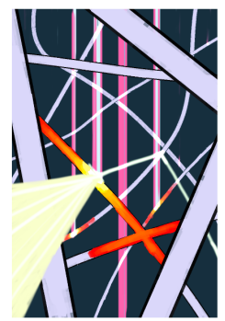
Analysis and Mitigation of Thermal Issues in a Nanofiber Target
W. Azstalos and Prof. Y. Torun (IIT)
Need better understanding of mass and heat transport mechanism in nanofiber media
Very complex heat and mass transfer
Conduction along fiber axis and crossings
Convection through He flow
Radiation reflects off nearby fibers, additional heating at certain λ’s
Need of nanoscale radiation model (λ-r)
Complex fluid flow
Low packing density
Beam
High packing density
Approach:
Use Porous Media Models to handle all three modes of heat transfer:
Conduction: introduce effective k(T) for nanofiber mat due to Bhattacharyya and Daryabeigi
Convection: use Darcy’s Law to simulate fluid flow, include energy equation in simulations
Radiation: Mie Theory to solve scattering off infinite cylinder exactly, feed into model due to Lee
Low packing density samples survived
Holes, cracks in higher density samples

Slide 19
High Power Targetry Challenges
Heat removal
Thermal shock
Thermal Shock and Radiation Damage were always identified as the most cross-cutting challenges of high-power target facilities but need to consider target thermal fatigue as fatigue stress cycle amplitude will be x2 at 2.4 MW
Physics performance
Radiation damage
Operational safety
Storage and disposal
Notes:
High power targetry community identified thermal shock and radiation damage as the most cross-cutting challenges facing HPT.

Slide 20
Use Alternative to Understand Radiation Damage
Modeling
HEP
HE protons
NE
neutrons
Irradiation stations
LE HI
LE p
e-
PIE Facilities
Notes:
We see synergy between the two communities where we can share techniques, facilities, expertise
Need experimental data to validate numerical models…

Slide 21
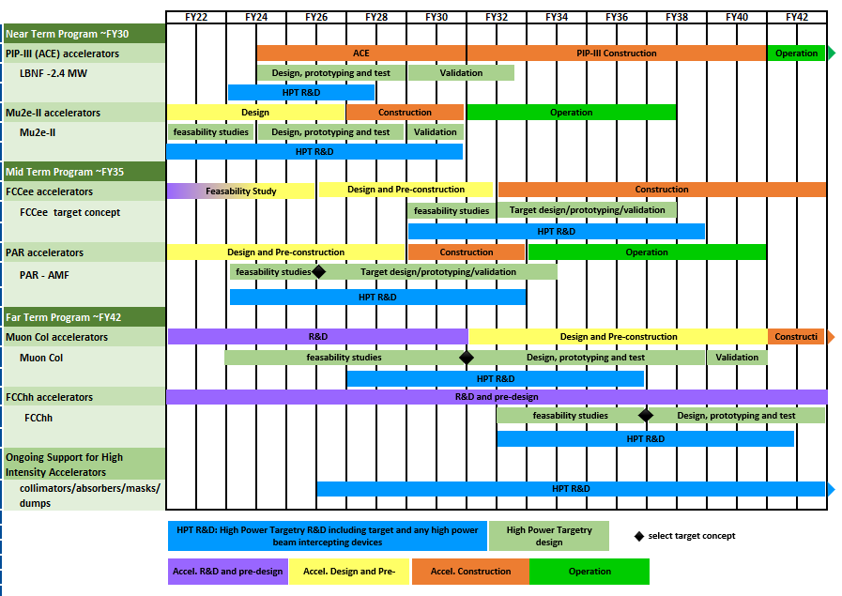
High Power Targetry R&D Roadmap
HPT R&D is aligned with timeline of HEP Accelerators
HEP HPT R&D Workshop – April 11-12 2023

