Slide 1
Novel Materials R&D for Next-Generation Accelerator Target Facilities
Kavin Ammigan
8th High Power Targetry Workshop
6-10 November, 2023

Slide 2
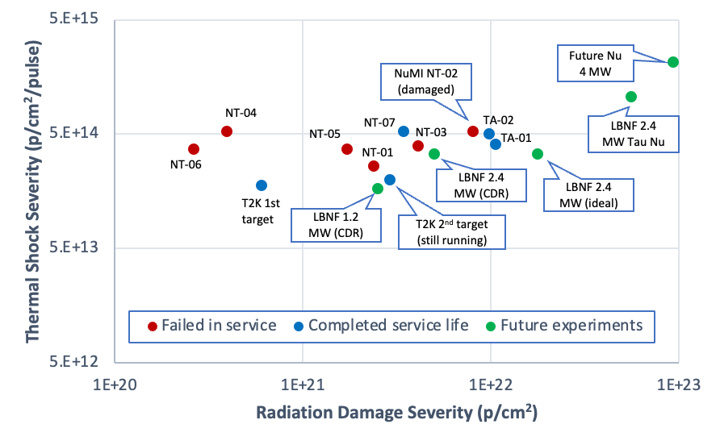
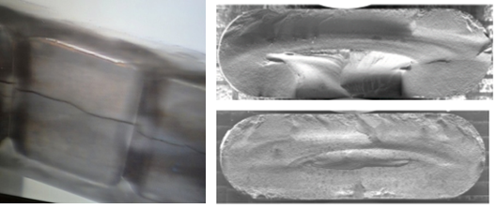
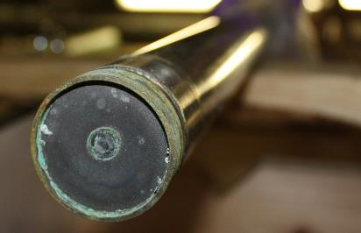
Motivation for Novel Targetry Materials
Advance the state-of-the-art in targetry materials for future multi-MW accelerators
  Enable the physics benefits of next-generation multi-MW accelerator target facilities
  Improve performance, reliability and operation lifetimes of beam-intercepting devices
Neutrino HPT R&D Materials Exploratory Map
~10x increase in accumulated proton fluence and power density
LBNF/DUNE 2.4 MW
Mu2e-II
Future Muon Collider and Neutrino Factory (4 MW+)
MINOS NT-02 target failure: radiation-induced swelling (FNAL)
Primary Be window embrittlement (FNAL)

Slide 3
Looking Beyond Conventional Materials
Exploit the inherent properties of High-Entropy Alloys (HEAs) and Nanofiber materials, two promising novel classes of materials for accelerator target applications
Radiation Damage
Nanocrystalline materials: fine grains with high-density grain boundaries
  GBs serve as defect sinks to absorb and annihilate irradiation-induced defects
Phase stability
  Prevents irradiation-induced grain coarsening and void swelling
Other inherent irradiation resistance properties
Thermal Shock
Reduce stress magnitude, stress wave velocity and fatigue life
Low density
Low elastic modulus
Low coefficient of thermal expansion
High specific heat
Inherent ability to absorb and dampen stress waves
HEAs for beam window applications
Nanofibers for particle production targets

Slide 4
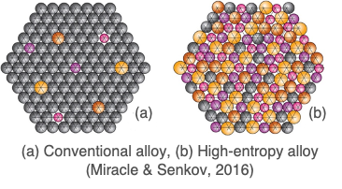
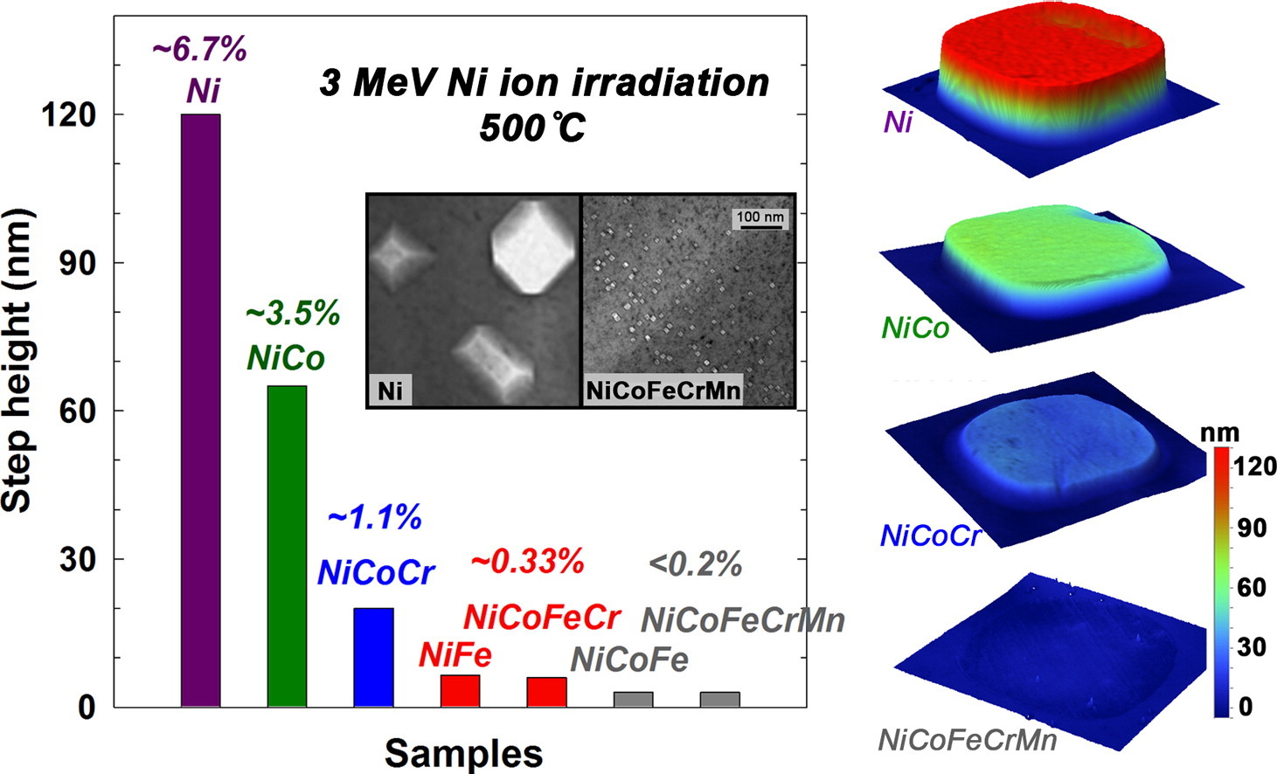
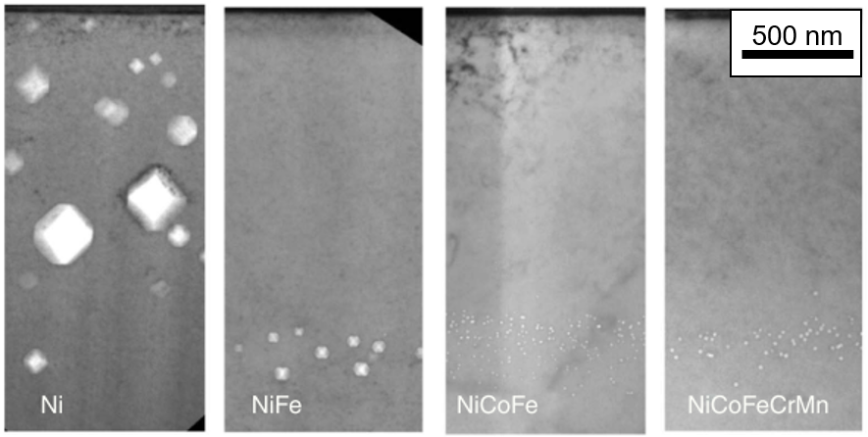
High-Entropy Alloys
HEAs are alloys with multiple principal elements
Equi-atomic or near equi-atomic composition
Usually defined as being primarily a solid-solution matrix
Distorted lattice
Large composition space to explore new materials
Promising properties observed
High-temperature strength
High specific strength
Improved fatigue and fracture properties
Corrosion and oxidation resistance
Enhanced radiation tolerance
  Greater phonon scattering, sluggish diffusion of atoms/defects, broad migration energies, and more…
Void swelling shown to be less pronounced in more compositionally complex alloys upon heavy-ion irradiation (3-MeV Ni⁺ ions to 5 x 10¹⁶ cm-² at 773 K), Lu et al., Nature Com., 2016
Swelling of increasingly complex alloys under ion irradiation, Jin et al., Scripta Materialia 119 (2016)

Slide 5
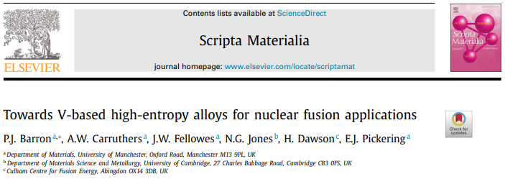
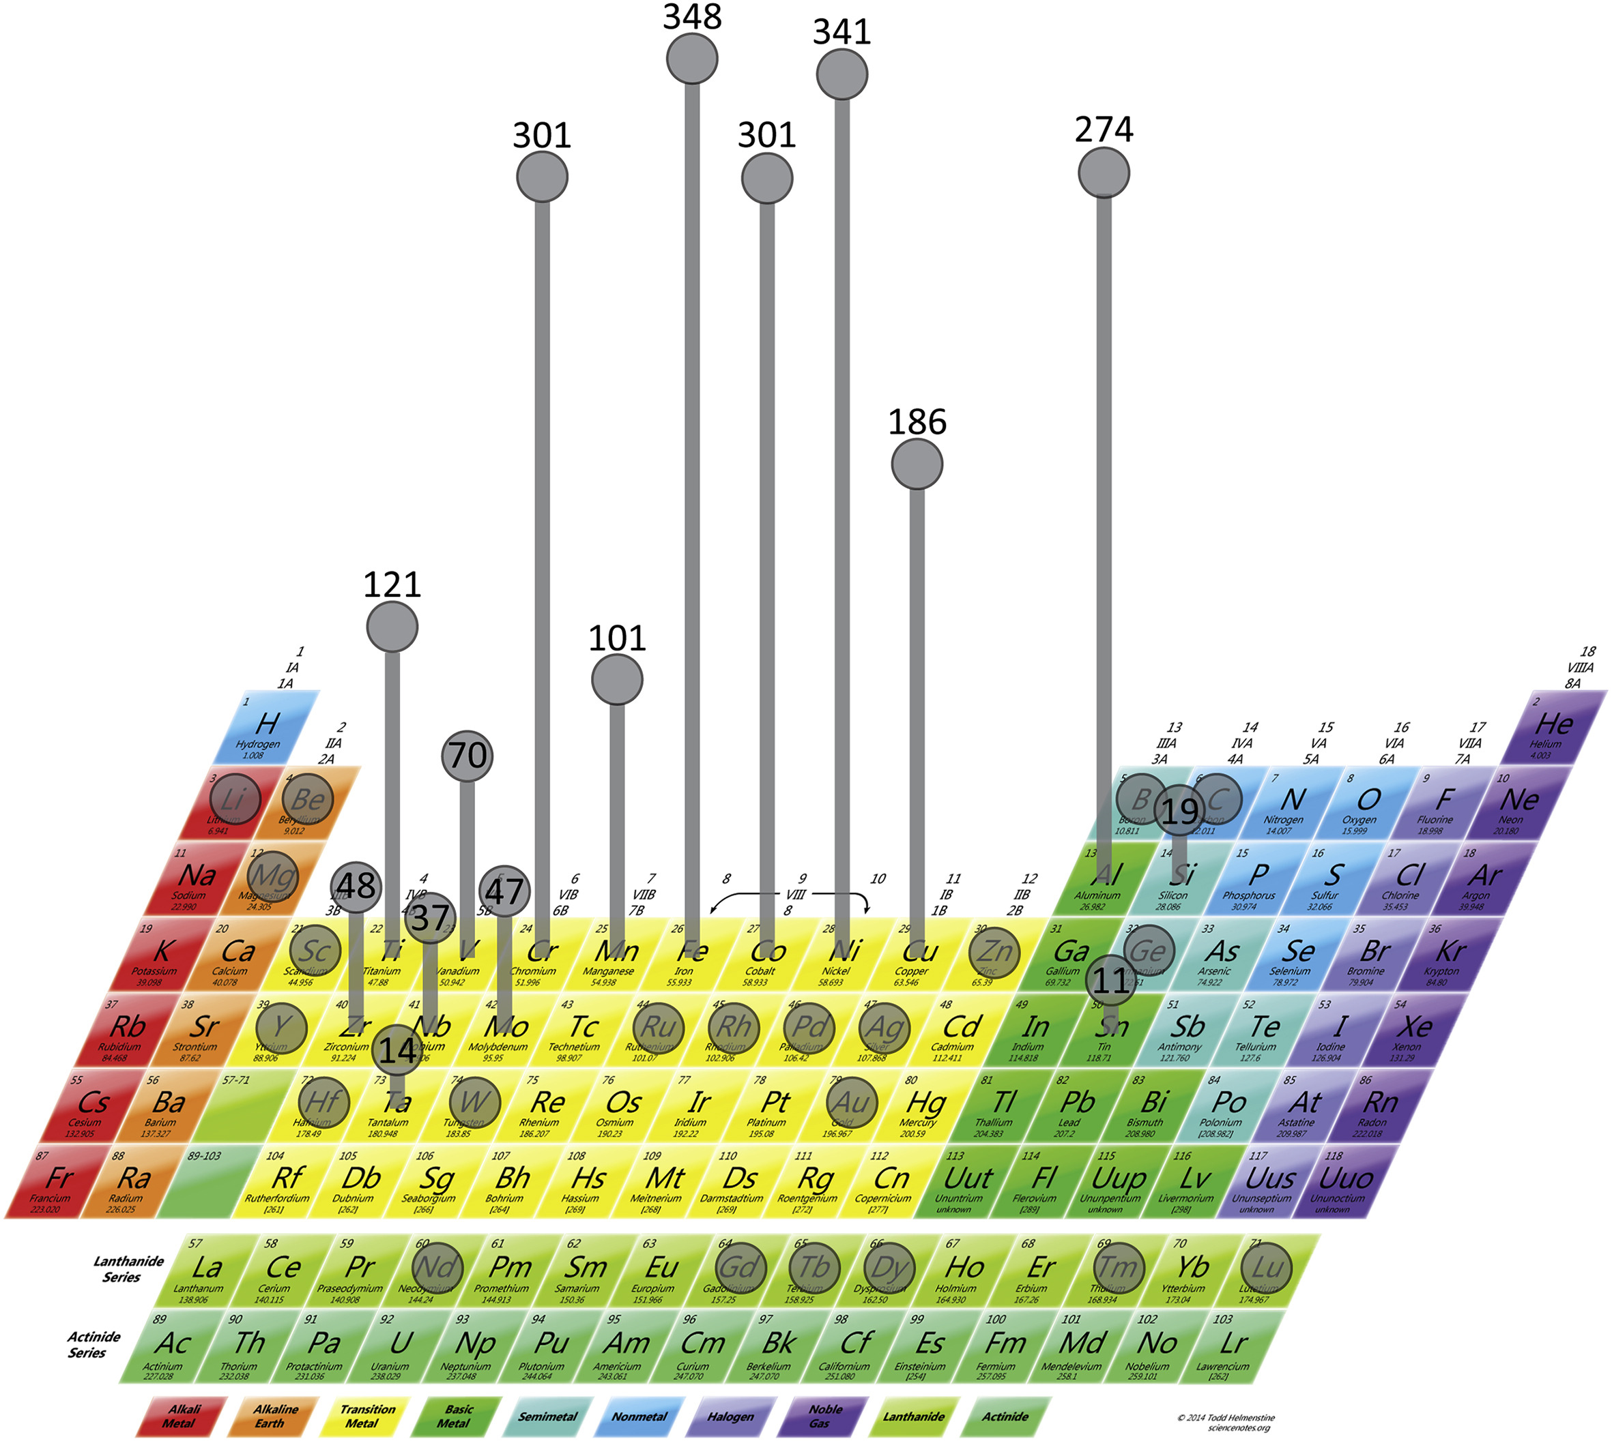
HEAs for Accelerator Beam Windows
Elemental selection considerations
Light-weight elements (low density)
  Reduced interaction with protons
  Minimize energy loss and multiple scattering
Primarily a single-phase alloy
  Better ductility and manufacturability
Minimal activation
  Safer/easier to handle and dispose after use
Equimolar Cr-Mn-V shown to be single-phase BCC
Ti additions reduce concentration of interstitial impurities by forming Ti-(C,O,N)
Concerns Ti concentrations above ~8% will promote Laves phase formation
Fe forms intermetallic compounds near the equimolar ratio with Cr, Ti, V
Most commonly used elements in HEAs from literature (Miracle, 2017)
Common alloys: CoCrFeMnNi (Cantor alloy), Al_{x}CoCrFeNi, Al_{x}CoCrCuFeNi

Slide 6
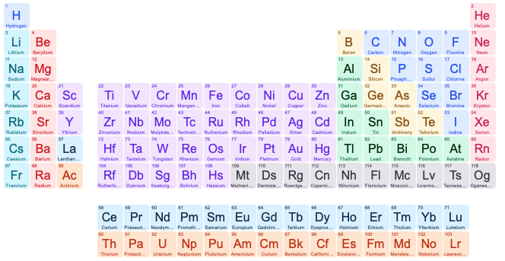
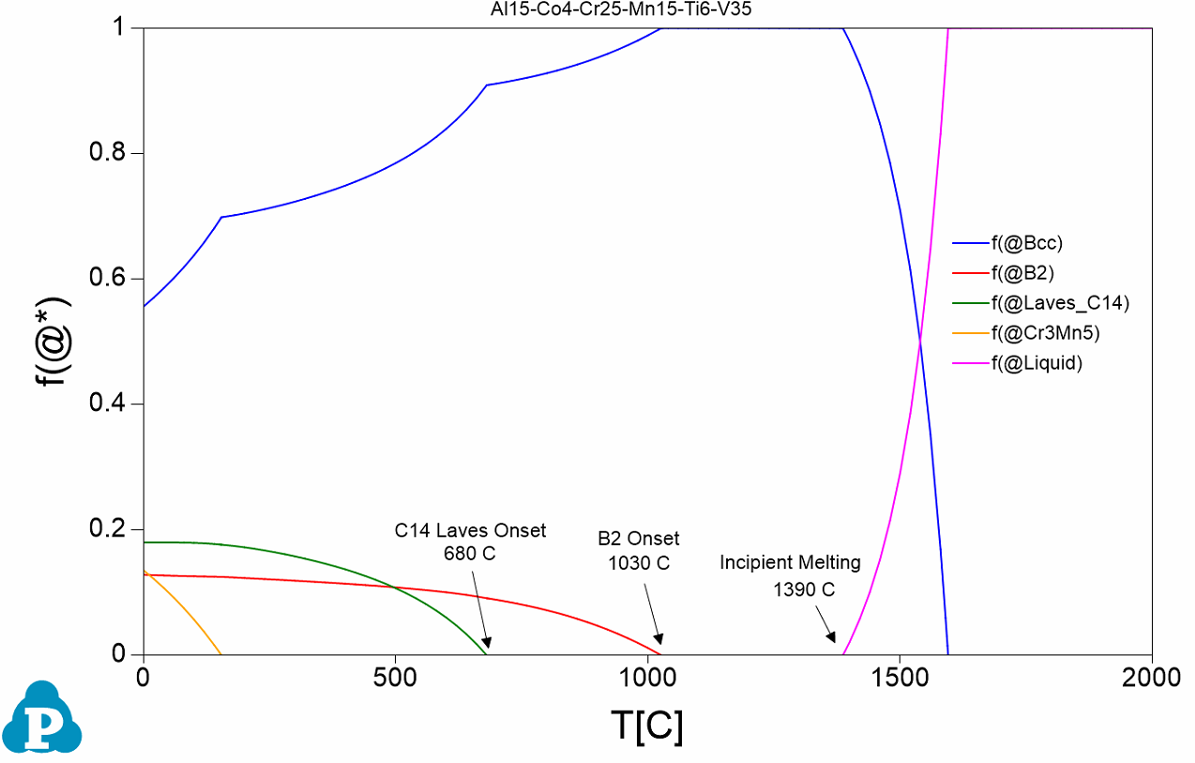
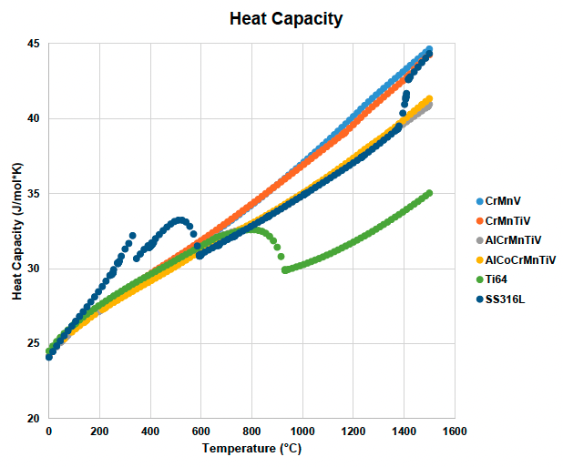
HEA Design Approach
CALPHAD simulations to understand the thermodynamics and phase diagrams of the multicomponent alloy systems
CrMnV
Equimolar BCC single phase
CrMnTiV
Impurity getter
Goals
Broaden BCC phase field range
Reduce Laves phase formation temperature
Lower density
Add semi-coherent precipitates (B2 phase)
AlCrMnTiV
BCC phase stabilizer
AlCoCrMnTiV
Semi-coherent secondary phase

Slide 7

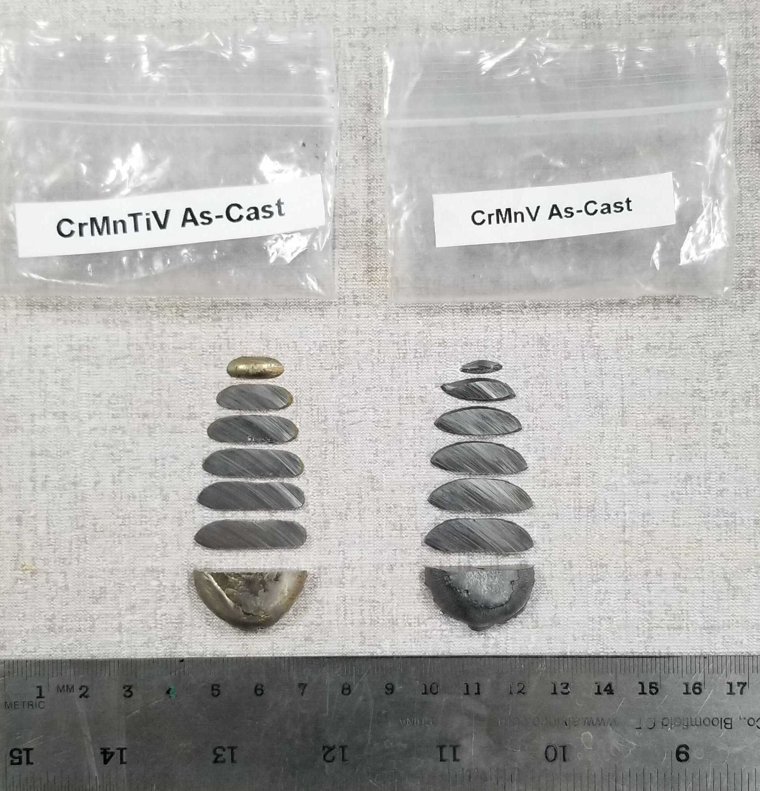
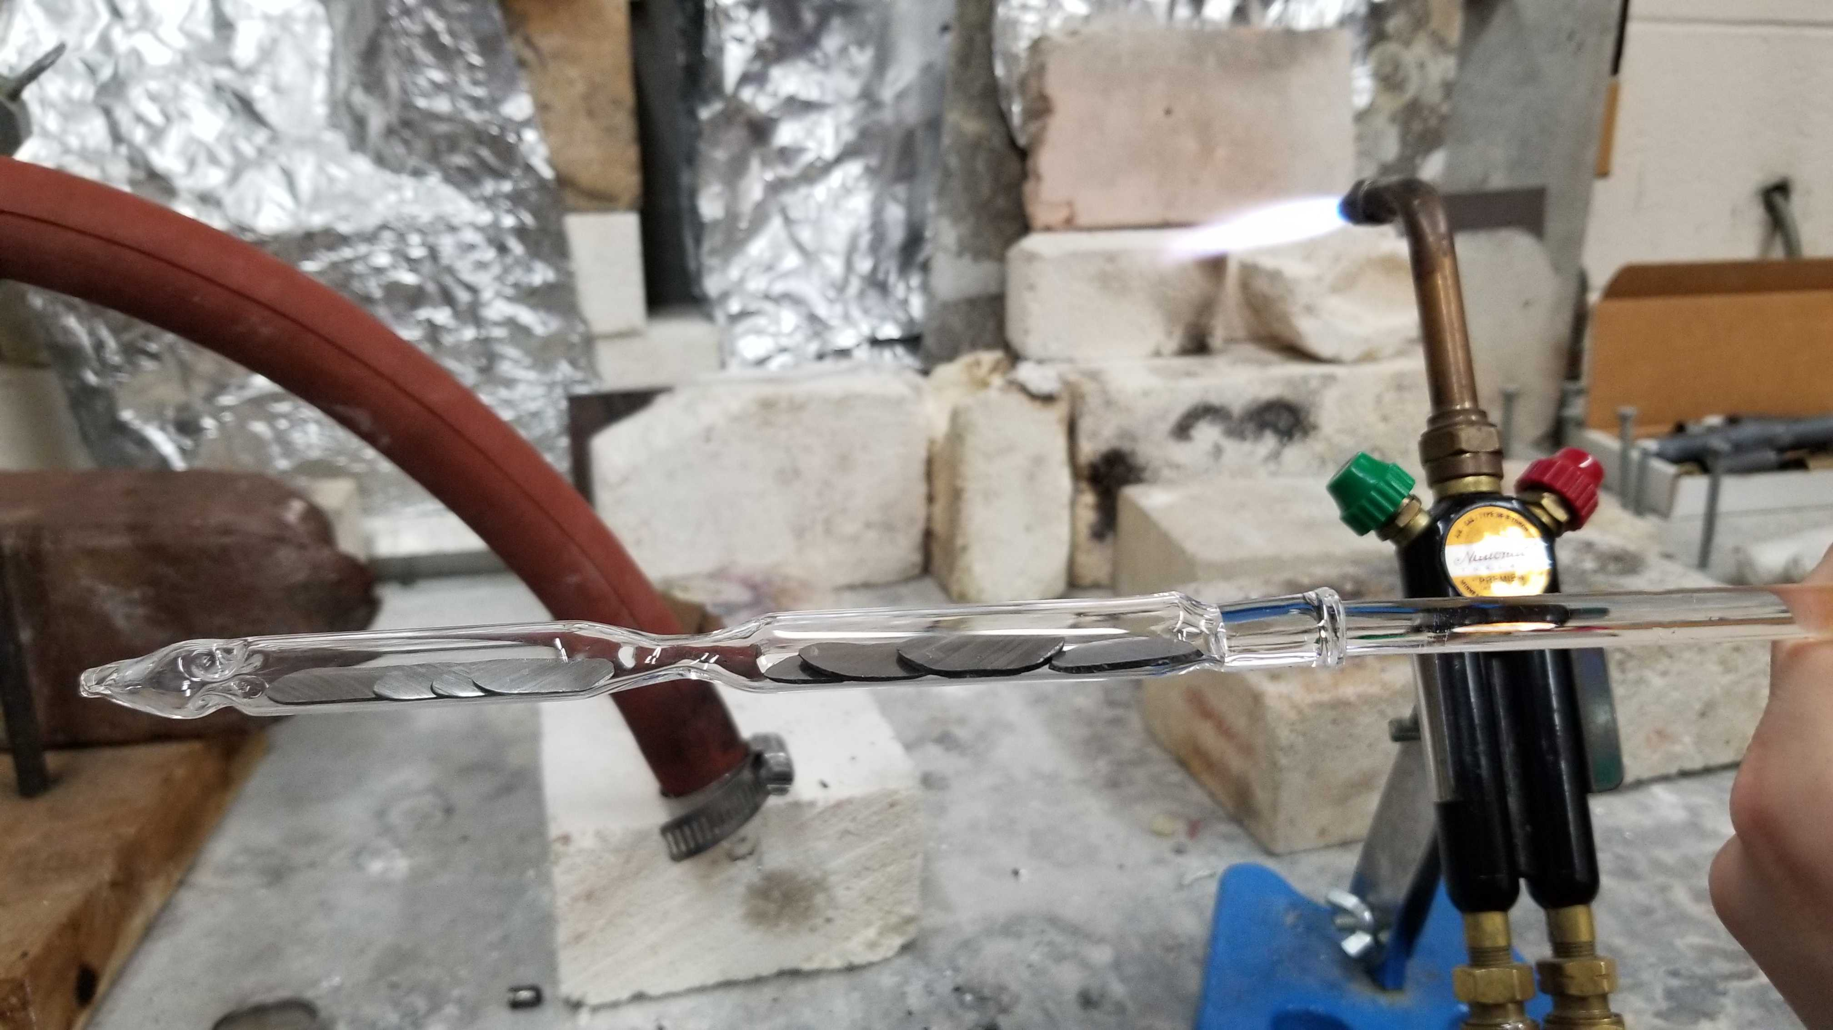
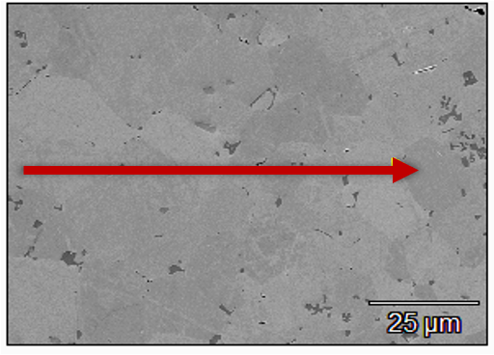
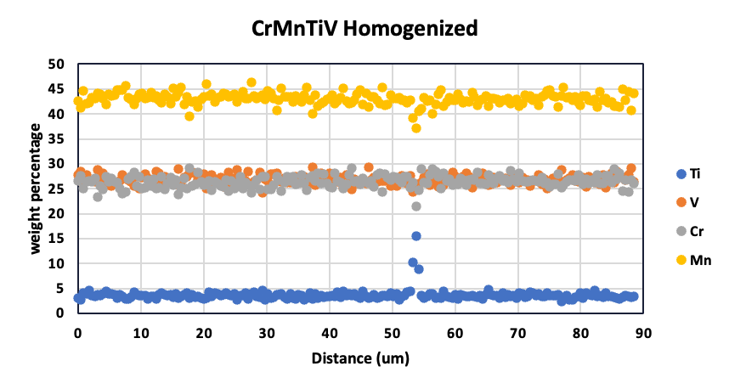
Preliminary HEA Synthesis
4 HEA compositions
Cr₃₃Mn₃₃V₃₃
Cr₃₁Mn₃₁Ti₇V₃₁
Al₁₅Cr₂₀Mn₂₀Ti₁₀V₃₅
Al₁₅Co₄Cr₂₅Mn₁₅Ti₆V₃₅
Sectioned arc-melted ingots (UW-Madison)
HEA samples sealed in quartz under vacuum before heat treatment (UW-Madison)
Homogenized HEAs achieved target composition within 1at%
XRD confirmed BCC phase
A. Couet, M. Moorehead et al.
UW-Madison

Slide 8
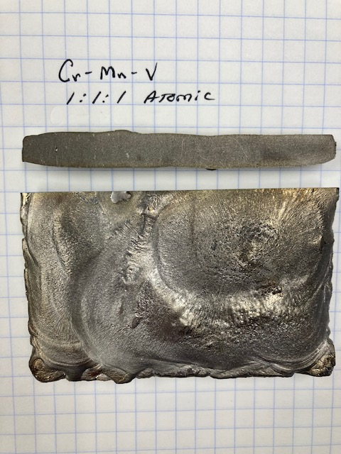
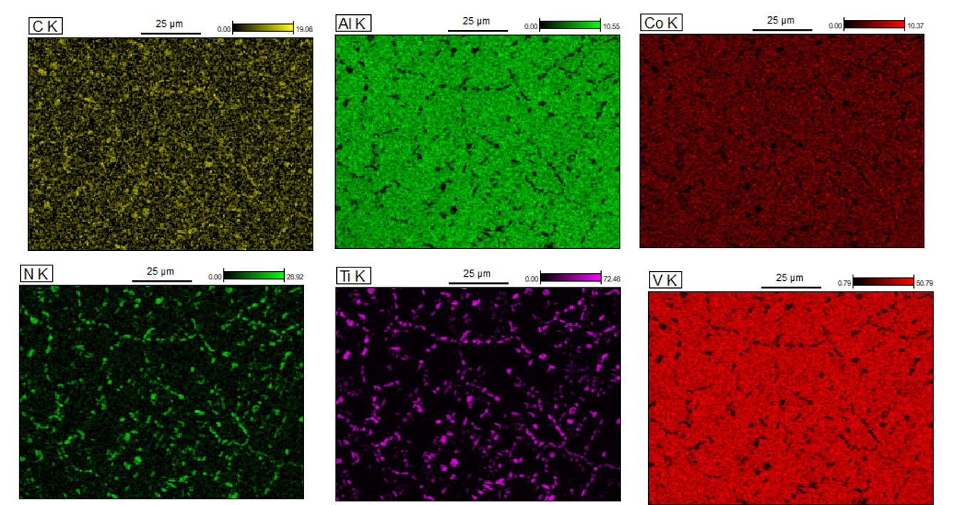
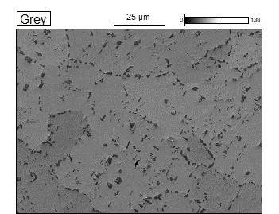
HEA Plate Fabrication & Characterization
Procured plates from external vendor (Sophisticated Alloys Inc.)
  100 mm x 100 mm x 2 mm
  HIPed at 1200 ºC for 4 hr
  Homogenized at 1200 ºC for 48 hr
Microstructural characterization ongoing (SEM, EBSD, EDX, TEM, XRD)
SEM/EDX of Al₁₅Co₄Cr₂₅Mn₁₅Ti₆V₃₅
Ti(C-N)

Slide 9

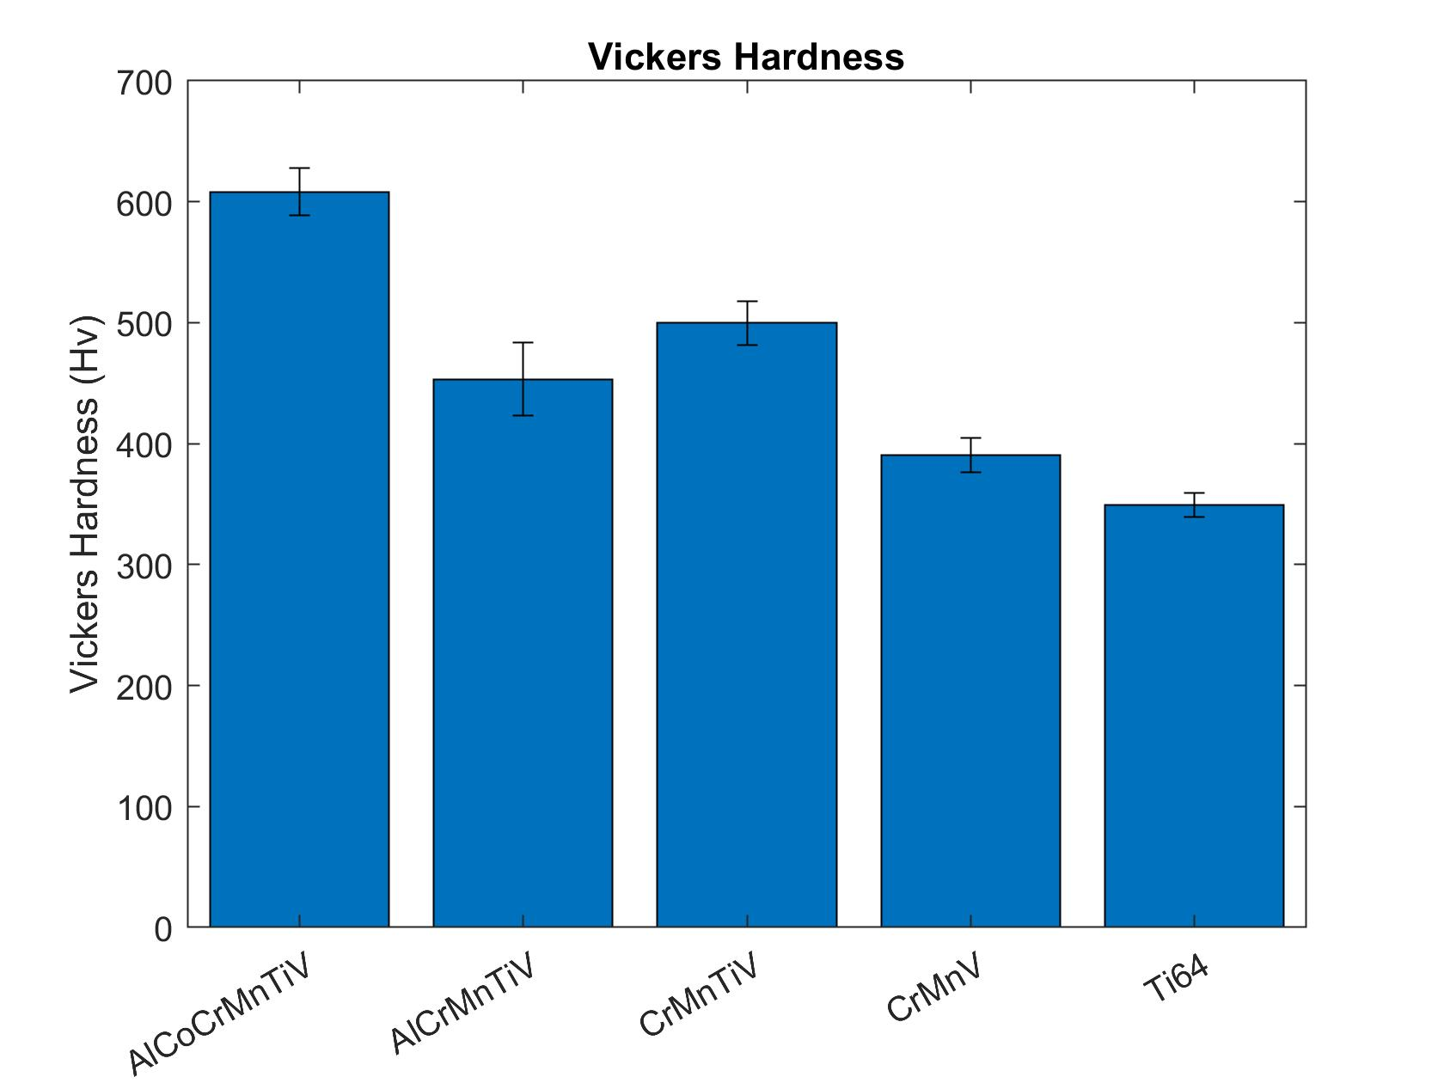
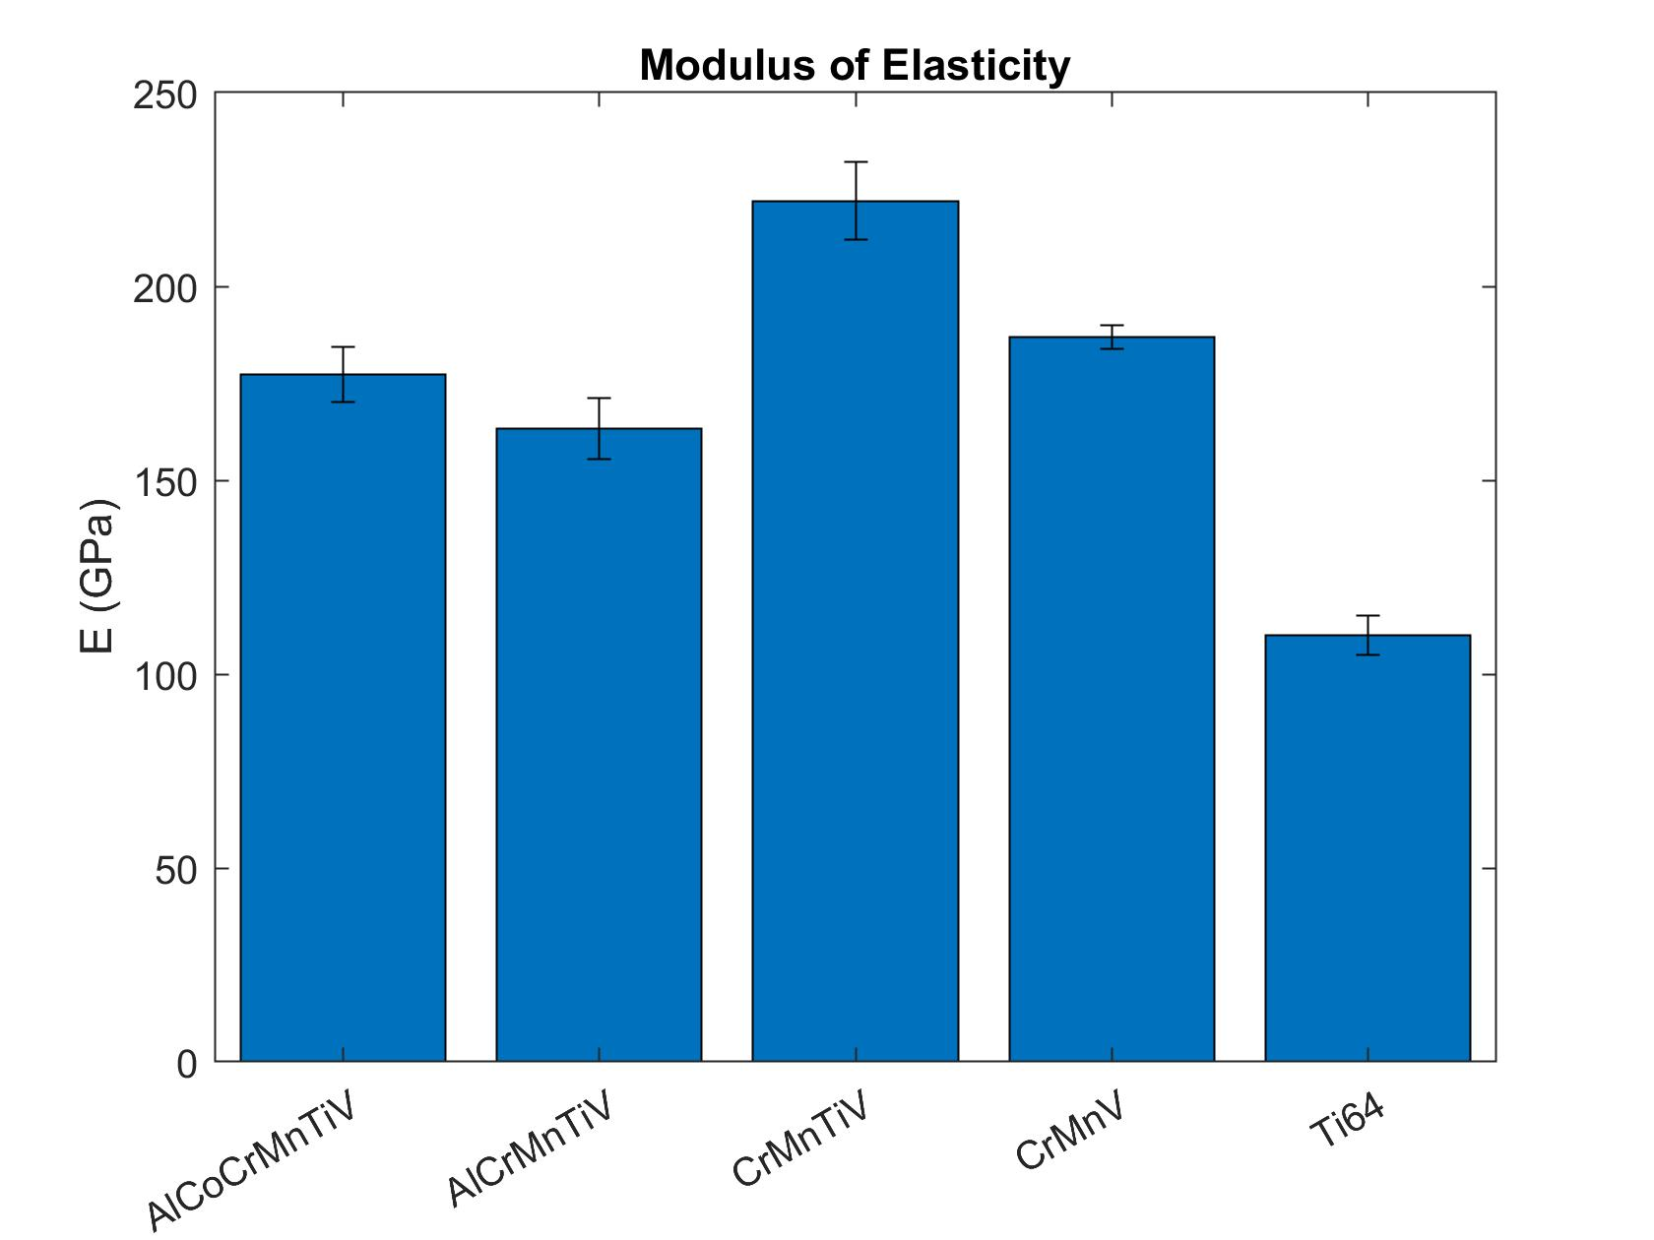
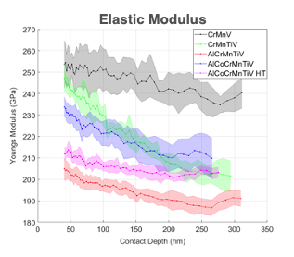
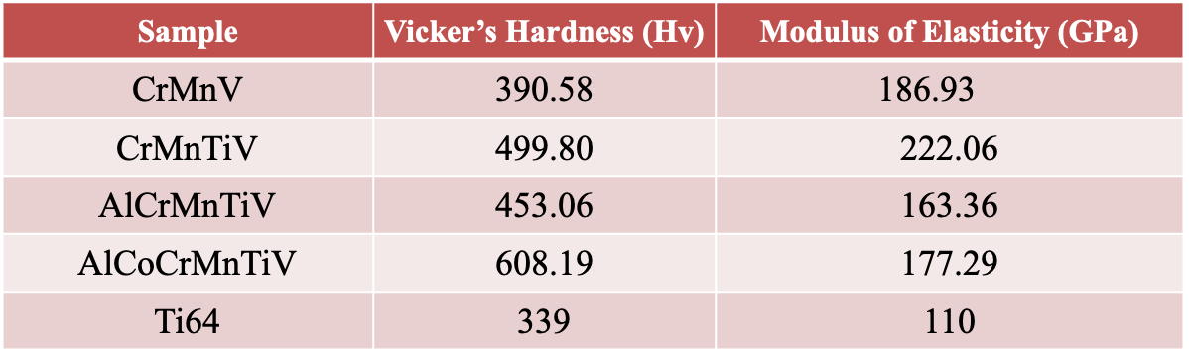
Hardness Measurements
Lower density of Ti-(C,N)
No observable cracks at corners of indents
Continuous stiffness measurements from nanoindentation work ongoing
Relatively higher hardness than Ti but show promising signs of ductility
Modulus greater than Ti, but lower than Beryllium (303 GPa)
N. Crnkovich, UW-Madison

Slide 10
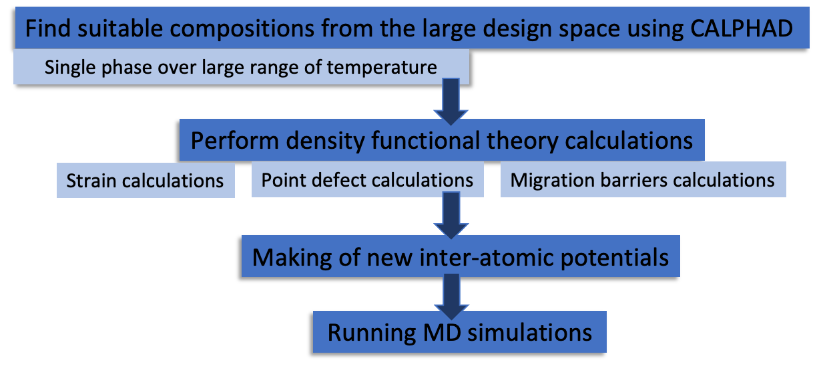
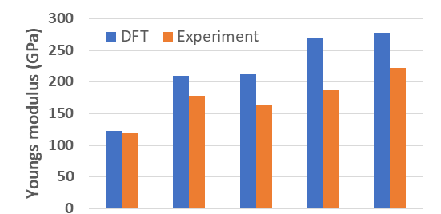

Density Functional Theory (DFT) calculations
Comparison of Young’s Modulus from DFT calculations with measurements
Building new inter-atomic potentials to study radiation damage effects in HEAs and guide compositions
Ti-6Al-4V
Cr₃₃Mn₃₃V₃₃
Cr₃₁Mn₃₁Ti₇V₃₁
Al₁₅Cr₂₀Mn₂₀Ti₁₀V₃₅
Al₁₅Co₄Cr₂₅Mn₁₅Ti₆V₃₅
G. Arora’s talk
DFT (G. Arora, FNAL)
Measurements (N. Crnkovich, UW-Madison)

Slide 11

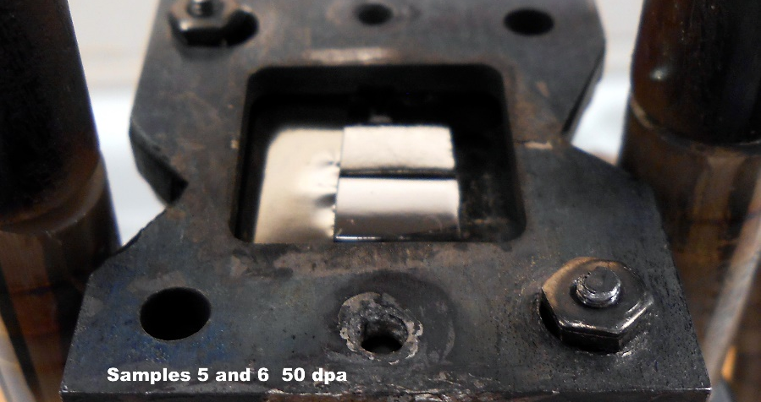
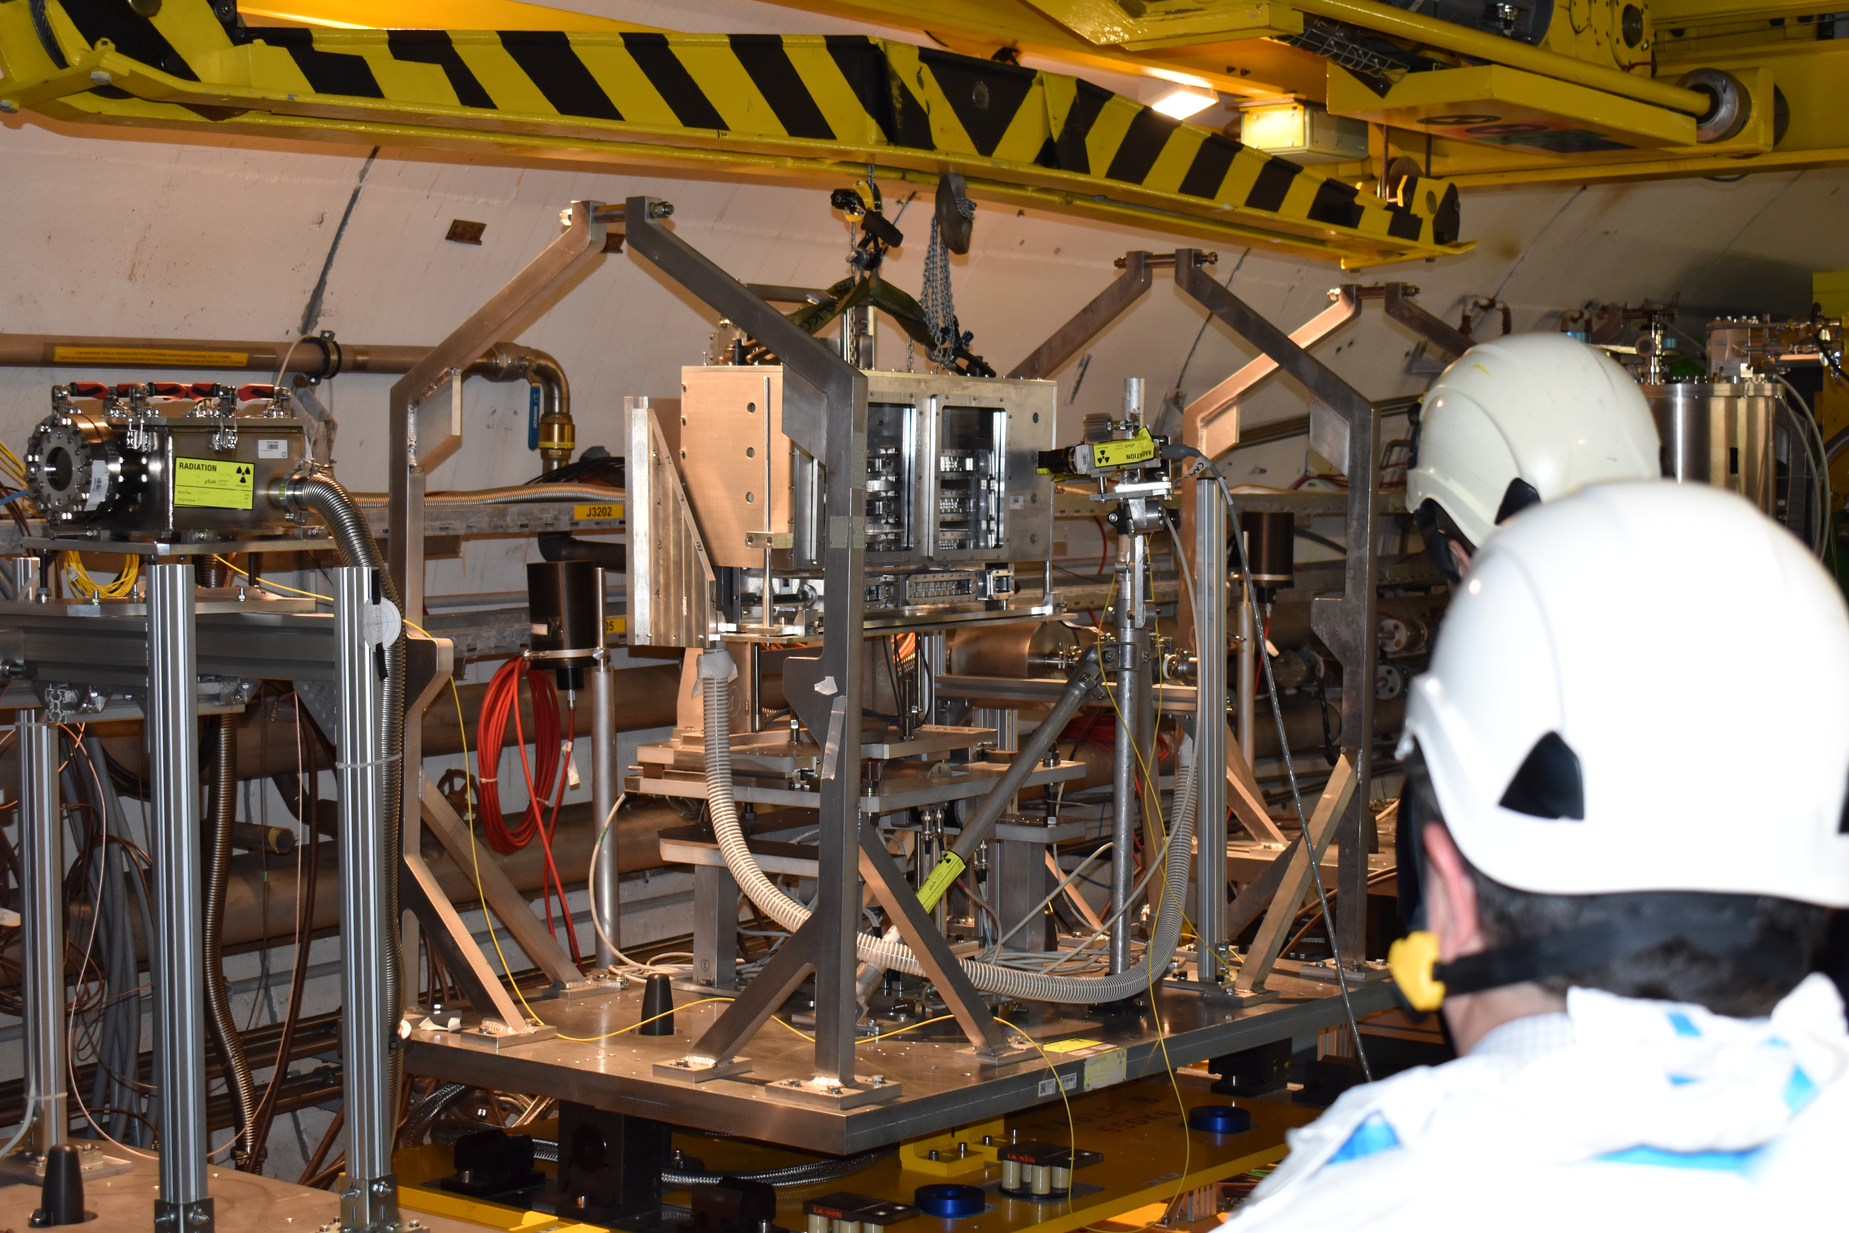
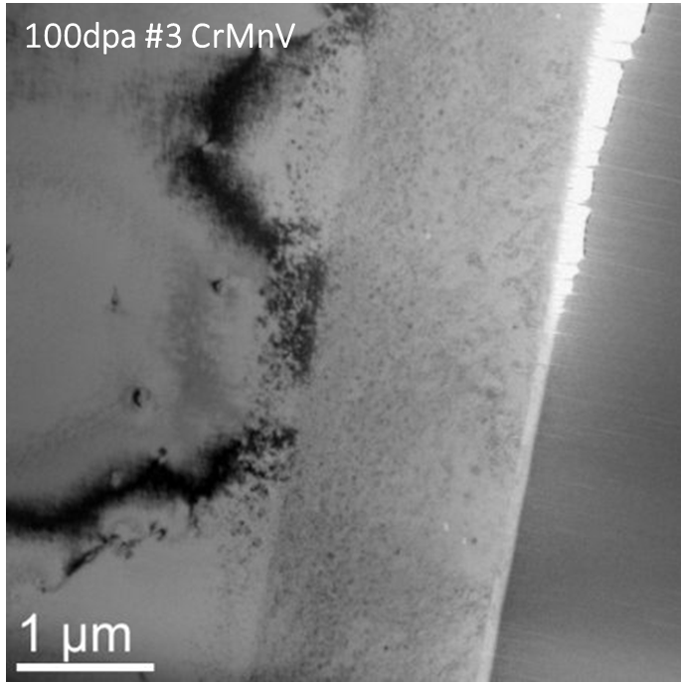
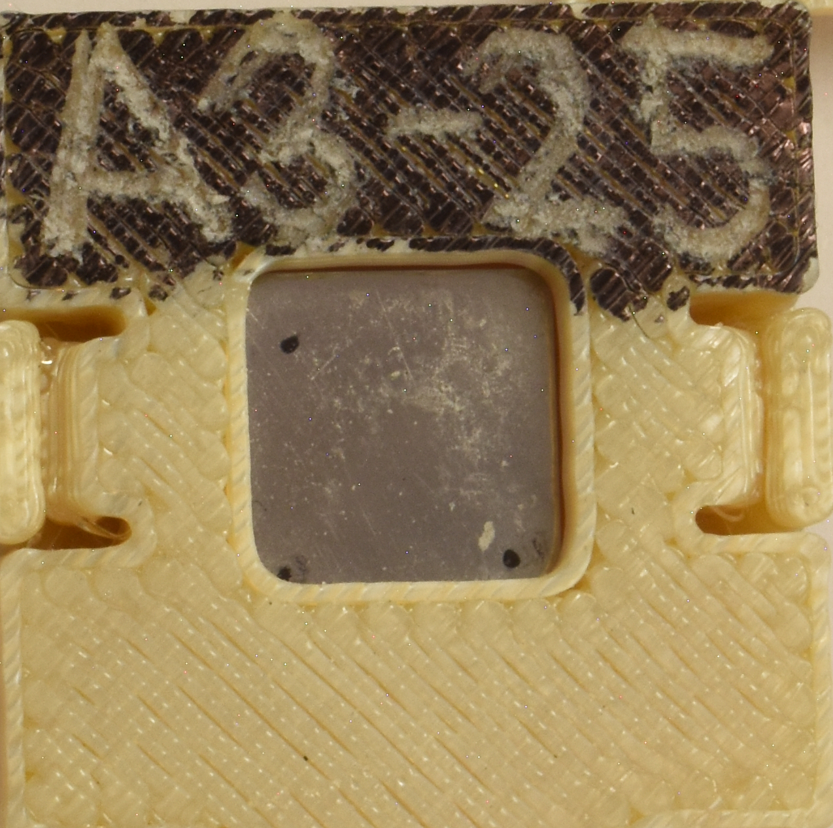
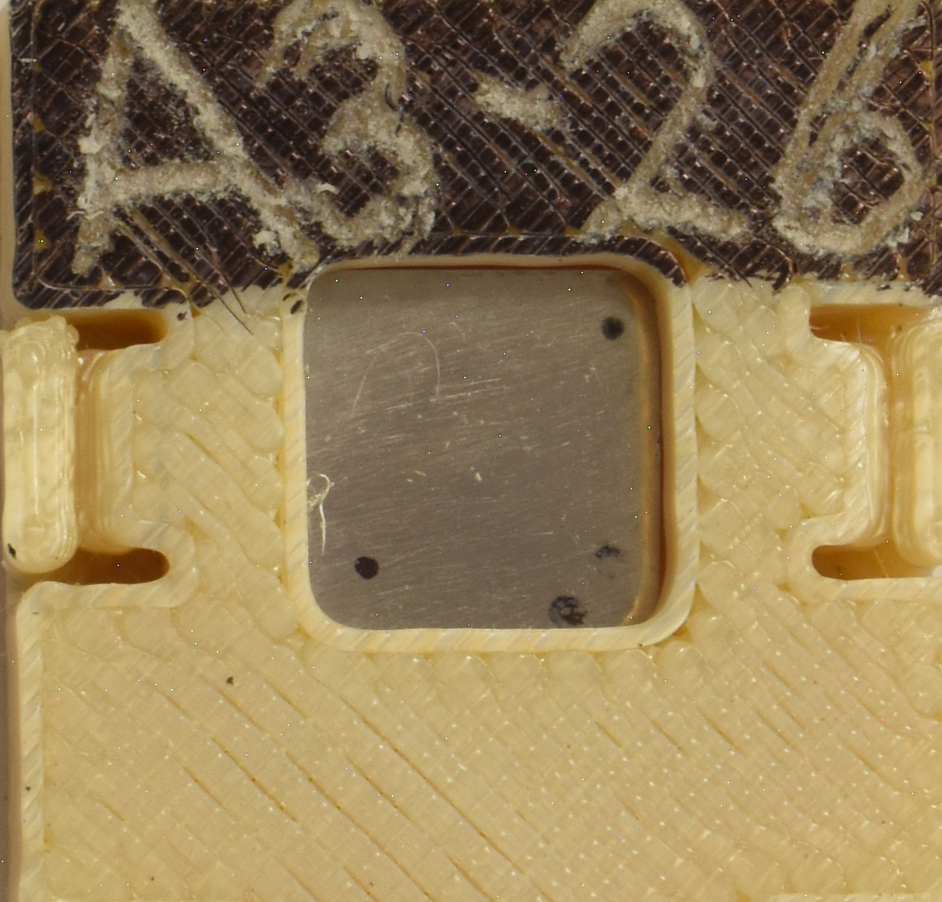
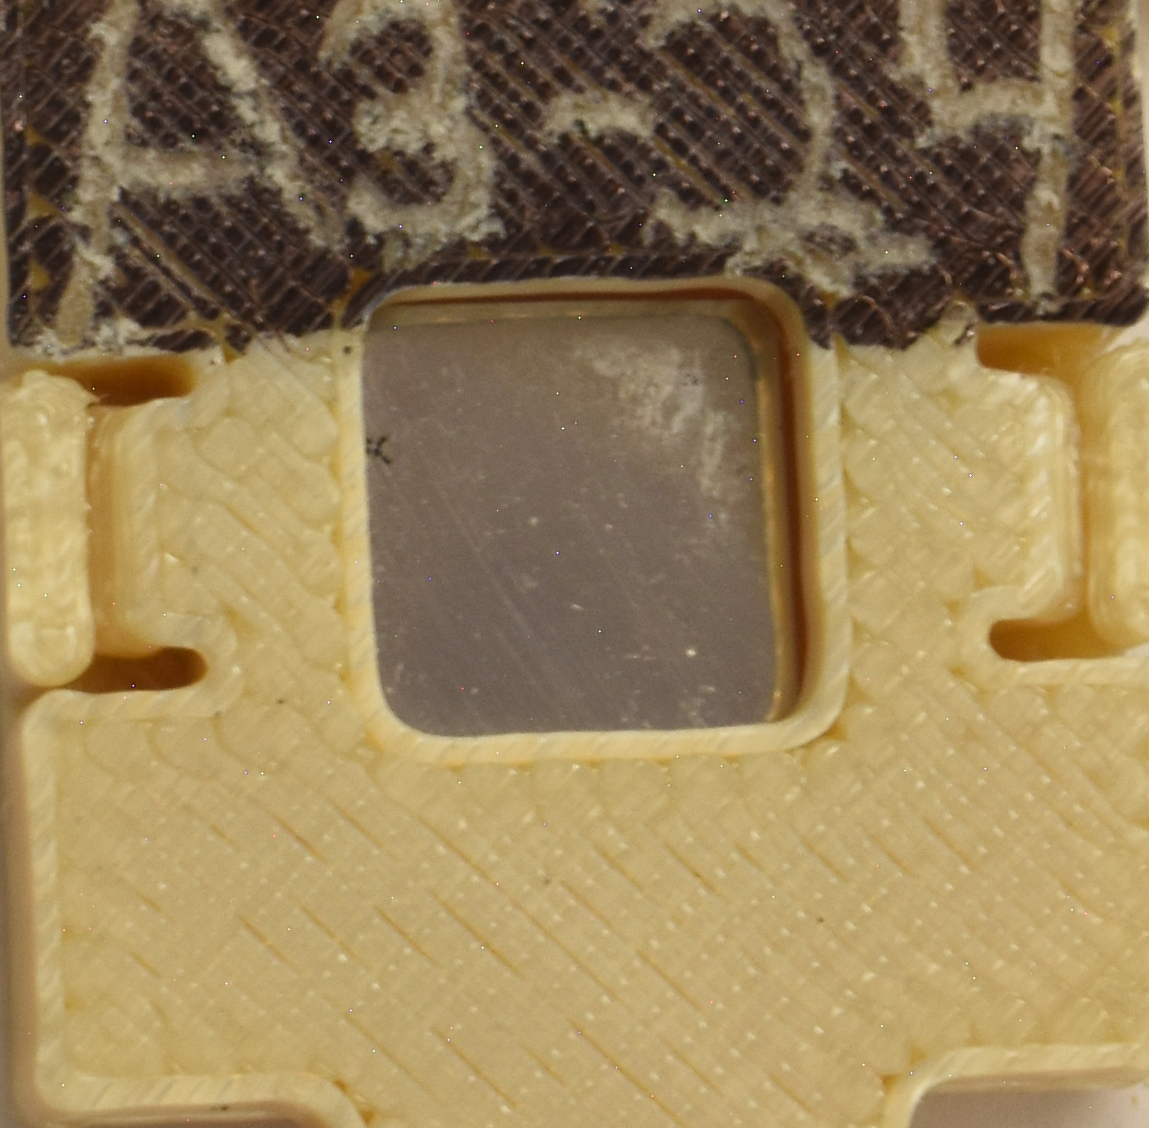
Initial In-Beam Tests
V²⁺ ion irradiation 50/100 DPA at 500 ºC at Wisconsin Ion Beam Laboratory
Thermal shock test at CERN’s HiRadMat facility (2022)
HEA samples included in HRMT-60 RaDIATE experiment
Exposed to single-shot 7 × 10¹² proton beam (𝜎 ~0.25 mm)
Two HEAs samples prepared for irradiation
PIE starting…
What are the dominant irradiation effects?
Effects visible at low DPA?
PIE at UKAEA-MRF starting soon
HEA samples images after beam pulse
TEM BF image of the irradiated cross-section

Slide 12
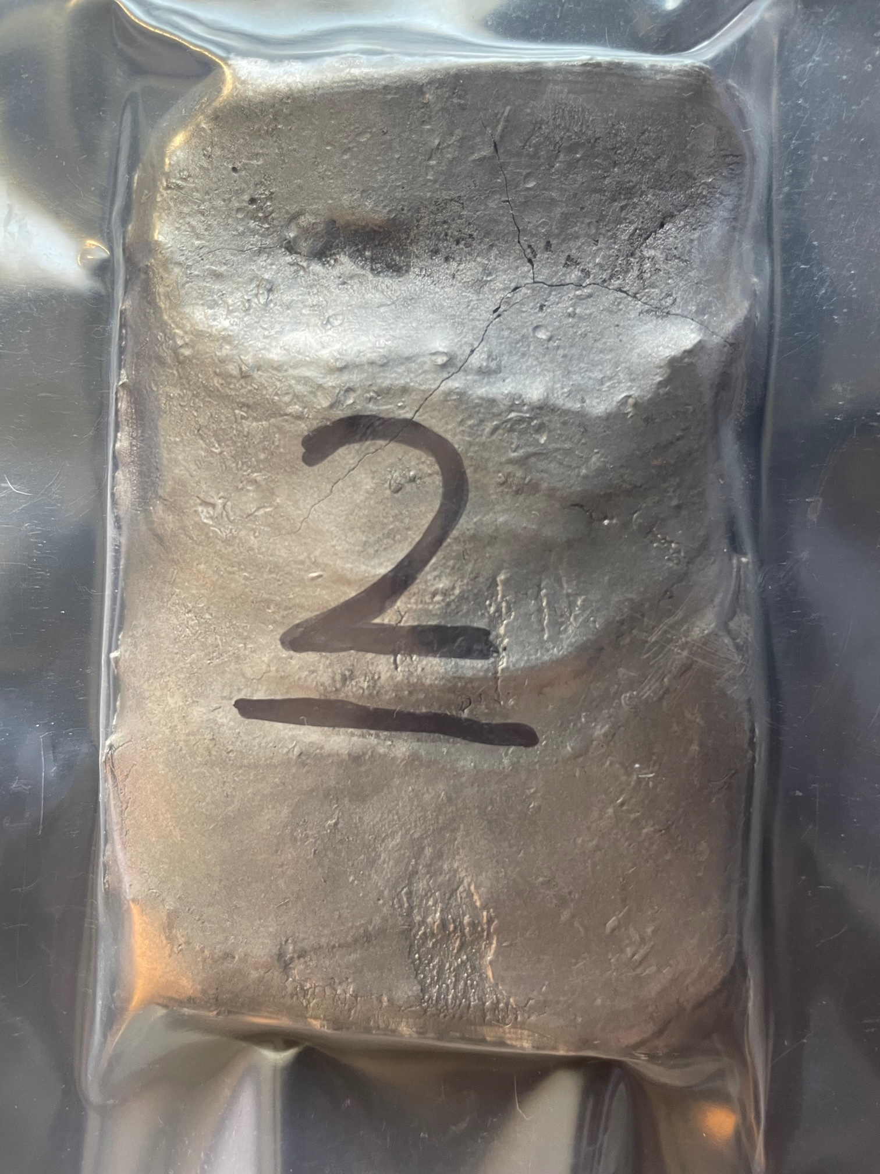
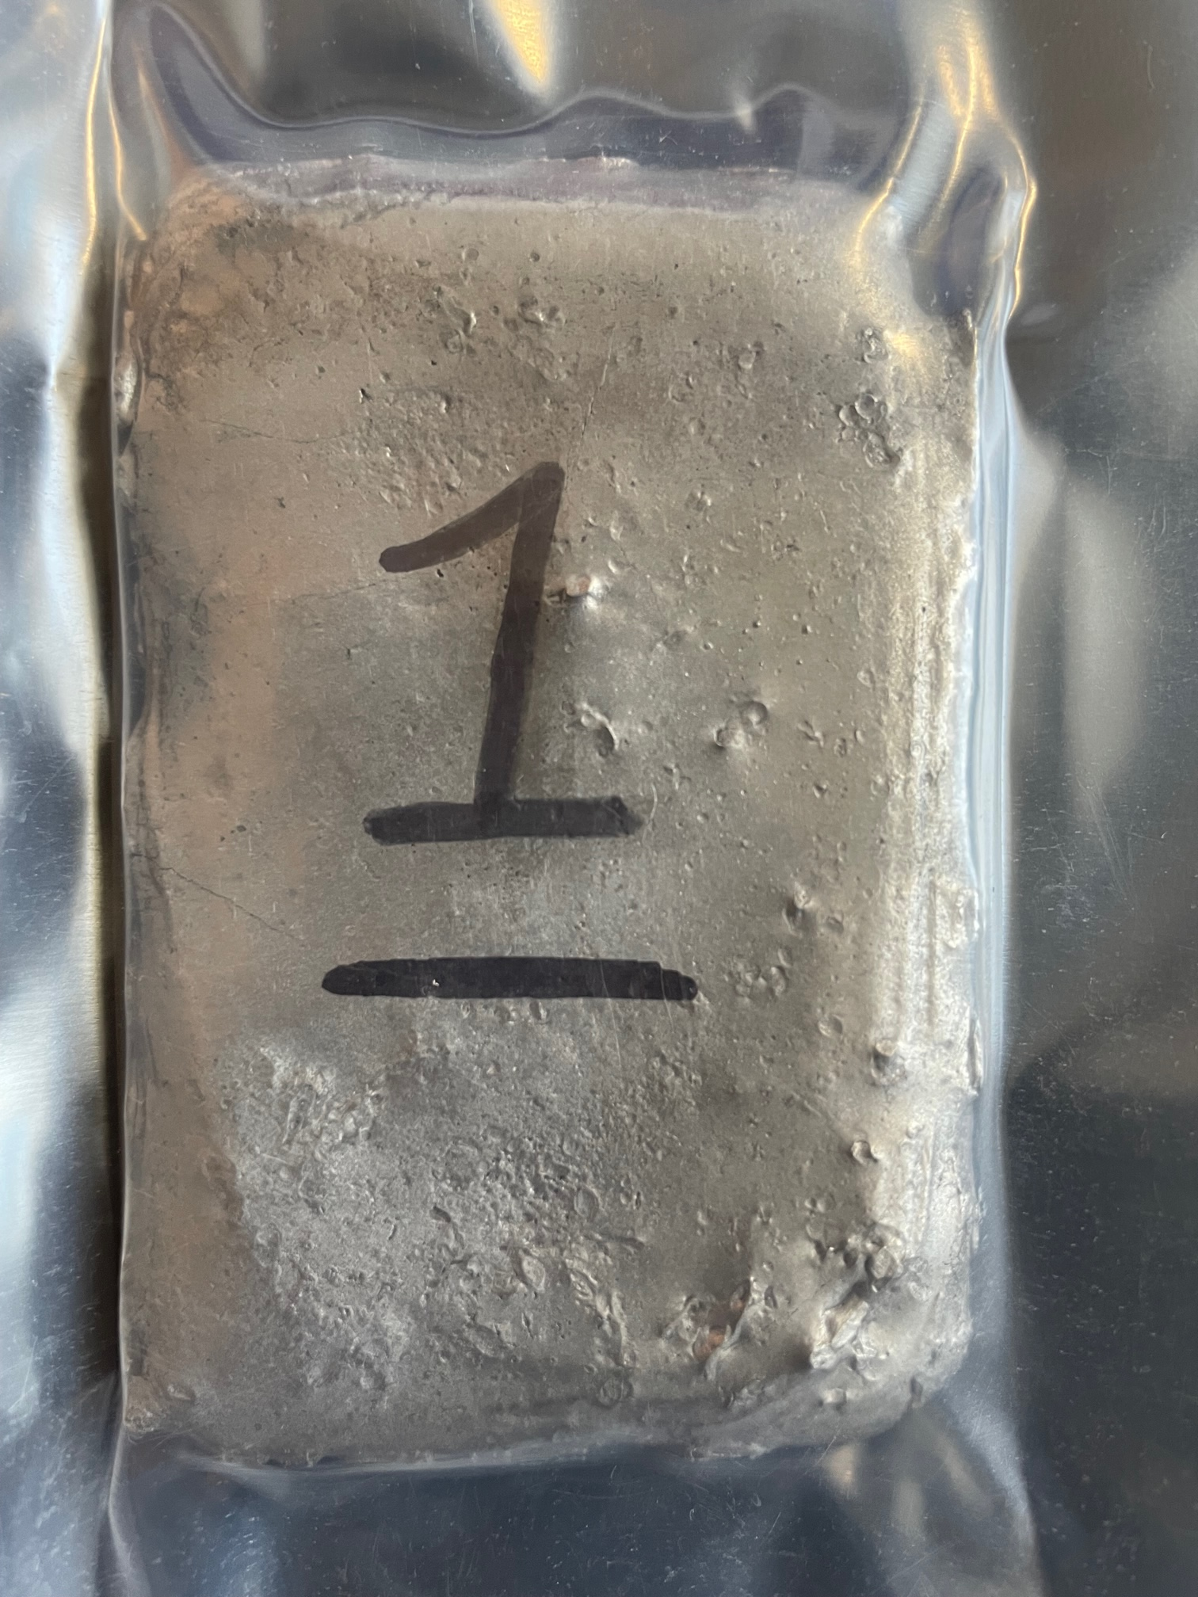
HEA Design Refinement & 2nd Gen. HEAs Synthesis
Systematic compositional space search using high-throughput CALPHAD simulations
  > 8,500 compositions (N. Crnkovich, UW-Madison)
  > 120,000 compositions (G. Arora, FNAL)
To optimize BCC/B2 phase regions, onset of embrittling secondary phases, properties
Al₁₀Co₄Cr₂₅Mn₂₆Ti₁V₃₄
Al₁₀Co₄Cr₂₇Mn₂₁Ti₄V₃₄
Al₁₆Co₂Cr₂₅Mn₃₀Ti₁V₂₆
Al₁₆Co₄Cr₂₅Mn₃₀Ti₁V₂₄
Al₂₀Co₁Mn₂₇Ti₂V₅₀
Al₁₂Co₃Cr₆Mn₂₇Ti₂V₅₀
Al₁₈Mn₃₀Ti₂V₅₀
Al₂₀Co₂Mn₂₆Ti₂V₅₀
Effect of Ti concentration as an impurity getter
Effect of Co as B2 phase enhancer
8 new HEA plates have been fabricated and currently being sectioned for analysis
Effect of Al concentration and removing Cr
G. Arora’s talk
A. Burleigh’s poster
Effect of removing Co, with Al as the potential B2 phase enhancer

Slide 13
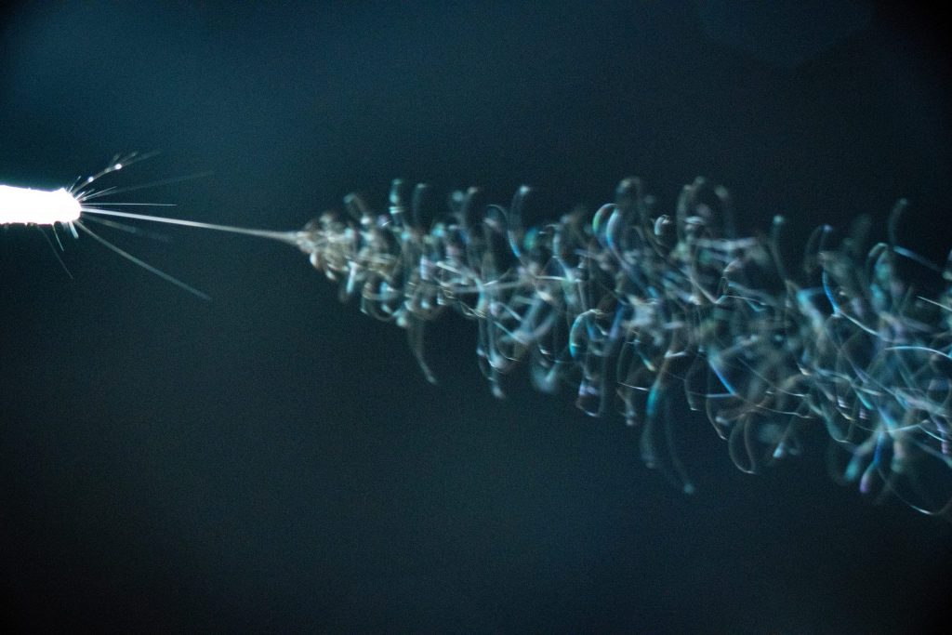
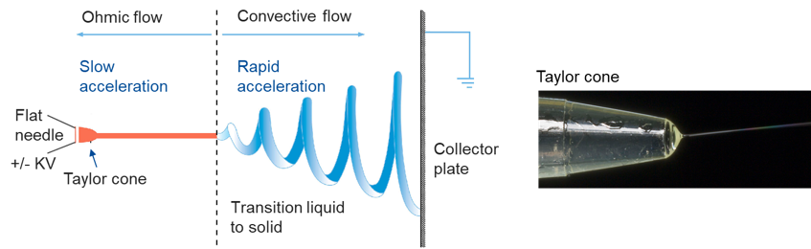
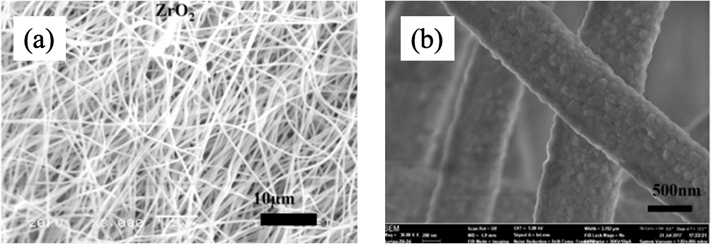
Electrospun Nanofiber Materials
Intrinsically tolerant to both thermal shock and radiation damage
Nanofiber continuum is discretized at the microscale but continuum at meso-scale
  Reduced temperature gradient limited to fiber axis
  Fiber discontinuity mitigates stress wave propagation
  High surface area and gaps allow for effective local heat removal with gas
Evidence of radiation damage resistance due to nanopolycrystalline structure of ceramic nanofibers
Bidhar et al., PRAB, 24, 2021
Photo: Reidar Hahn, FNAL
Electrospinning technique and Taylor cone.
SEM images of Zirconia nanofibers produced at Fermilab, (a) bulk nanofiber mat, (b) single nanofibers revealing polycrystalline grains (S. Bidhar)

Slide 14

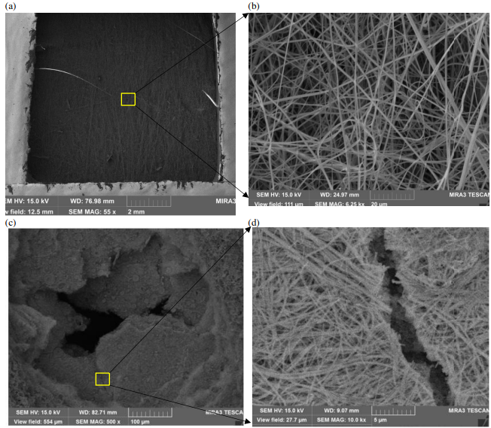
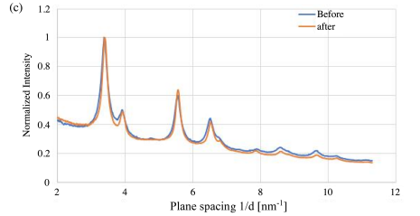
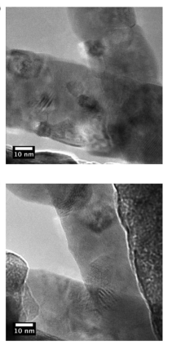
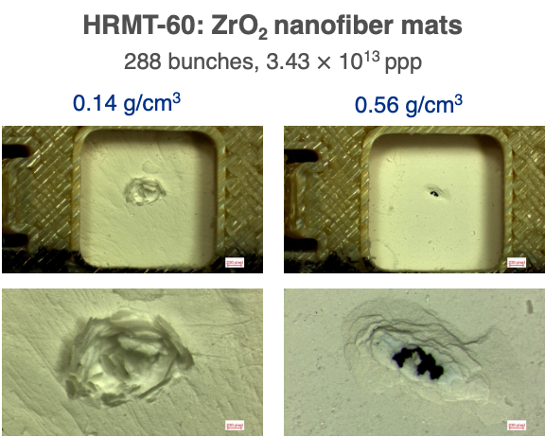
In-Beam Tests of Ceramic Nanofibers
Ion irradiation (in-situ TEM)
Thermal shock test (HRMT-43) - 2018
TEM before irradiation
Low packing density
TEM after irradiation
1 MeV Kr²⁺ ion
3.25 x 10¹⁵ ions/cm² → 5 dpa
No measurable change in lattice parameter
No defects formation
Evidence of radiation damage resistance
High packing density
440 GeV protons, σ: 0.25 mm, 1.21 x 10¹³ protons in 4 µs
Low packing density samples survived
Holes, crack in higher density samples
@ Argonne IVEM Tandem, S. Bidhar, PRAB (24), 2021

Slide 15

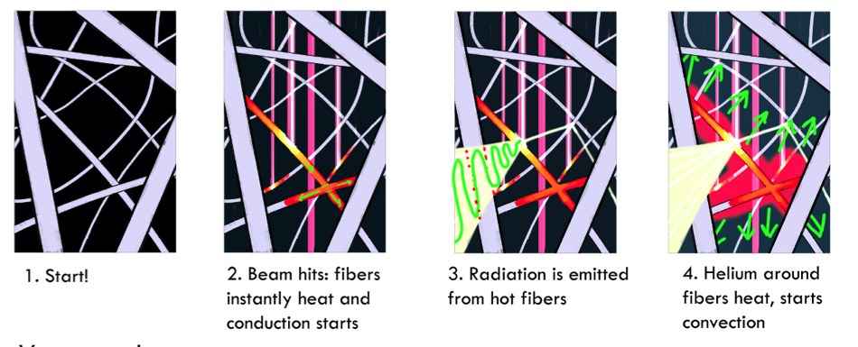
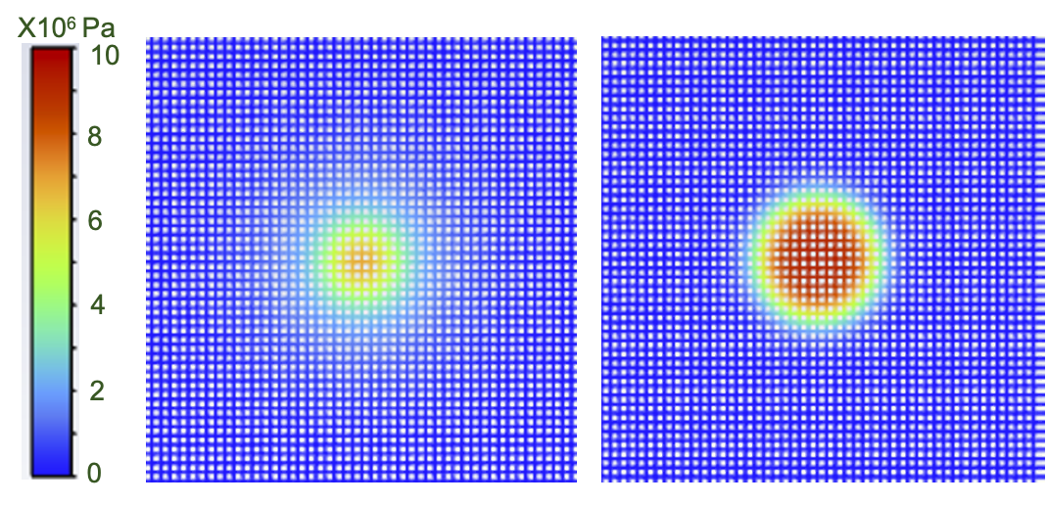
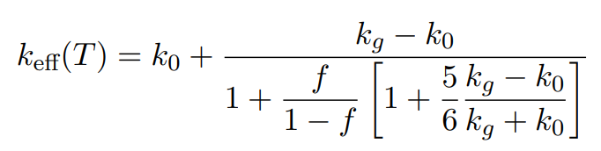
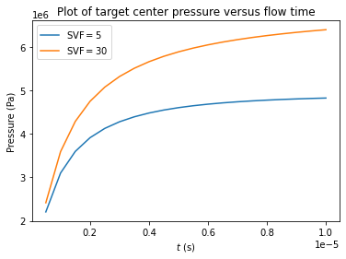
Multiphysics Simulations of HRMT-43 Nanofiber Mats
2D mesoscale simulation (ANSYS FLUENT)
Low packing density
High packing density
Bhattacharya model to evaluate effective thermal conductivity
Pressure distribution at end of beam heating
Rapid heating of target → Pressure shockwave for a higher packing density target
Higher packing density reduces airflow induced by beam heating (natural convection) which exerts higher pressure on fibers
3D- fiber level simulation in progress
MS & PhD work of Will Asztalos @IIT

Slide 16
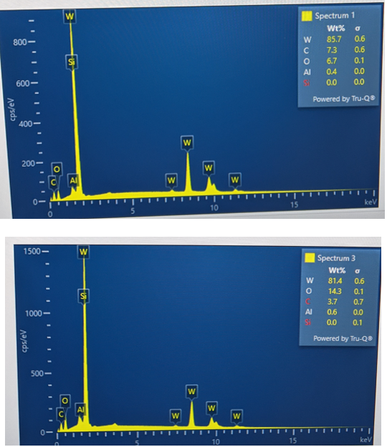
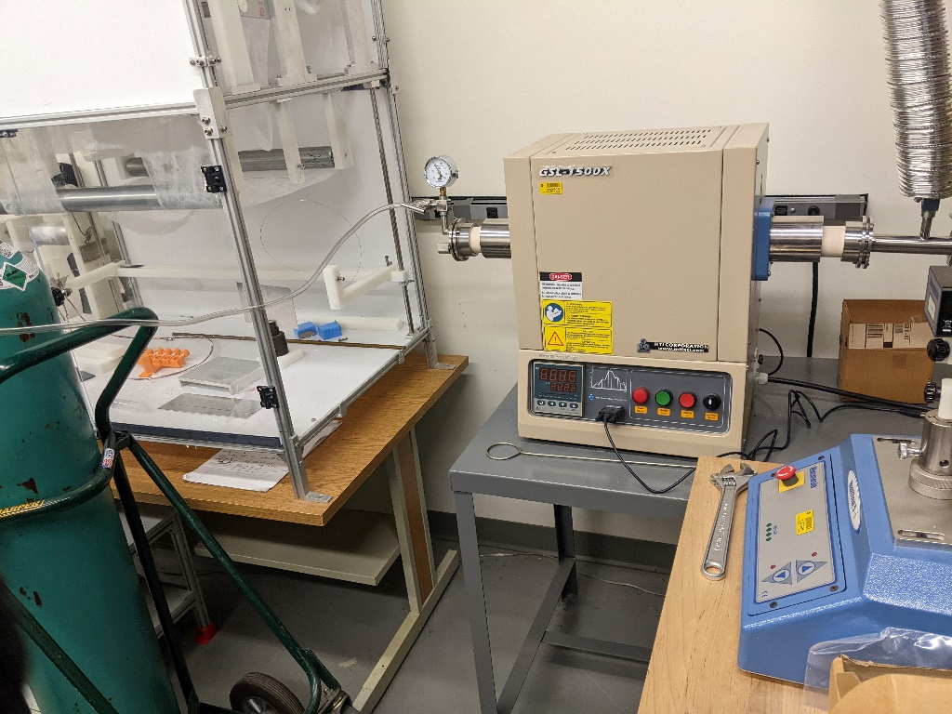
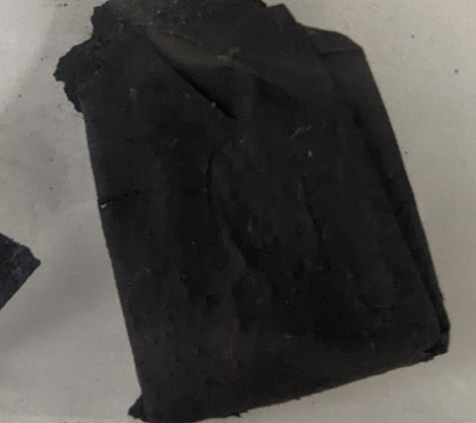
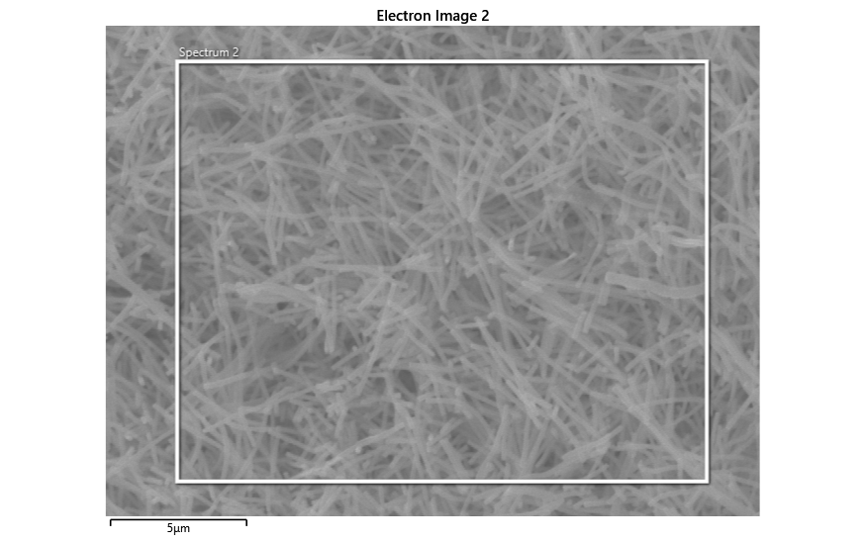
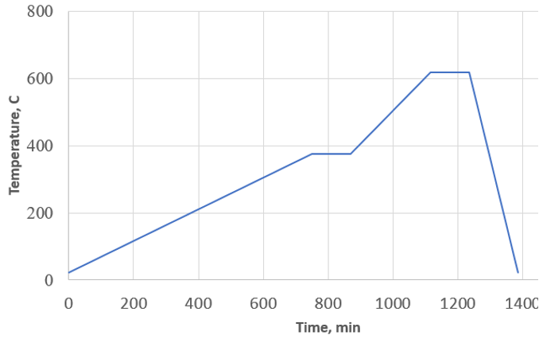
Extending Work to Pure Tungsten Nanofibers
High temperature furnace with N2 gas flow
W nanofiber mat after heat treatment
Heat treatment profile
SEM/EDS show presence of Oxygen (~8-14 wt%) and Carbon
Increasing temperature during heat treatment reduced oxide formation to 1.35 wt%
  Will now heat treat with forming gas 5%H2+95%N2 to further reduce oxide
XRD analysis ongoing to evaluate crystal parameters, phase and structure
Investigating techniques to strip carbon from surface of fibers

Slide 17
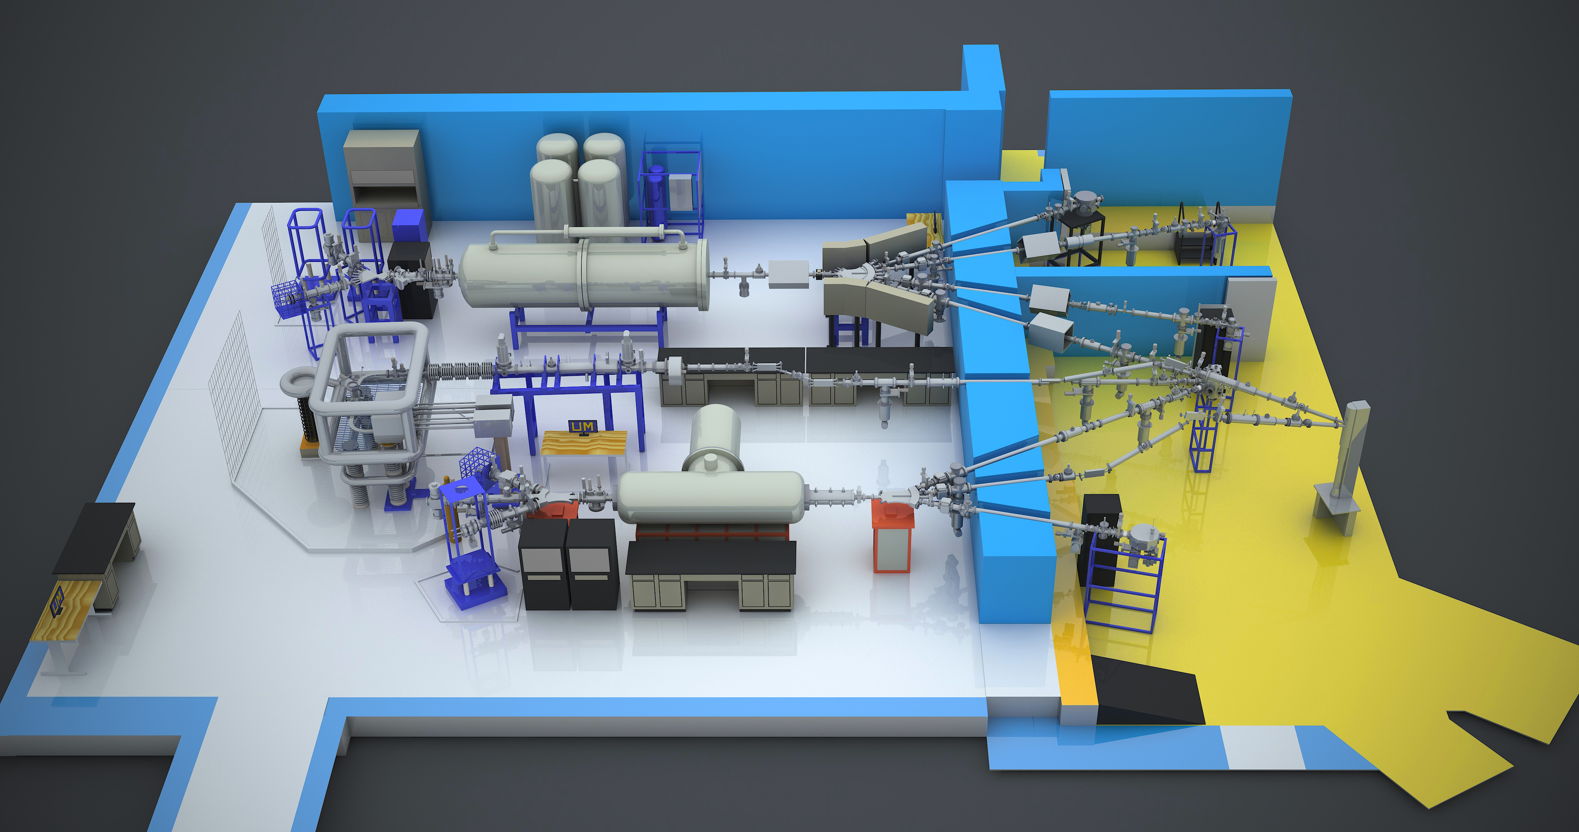
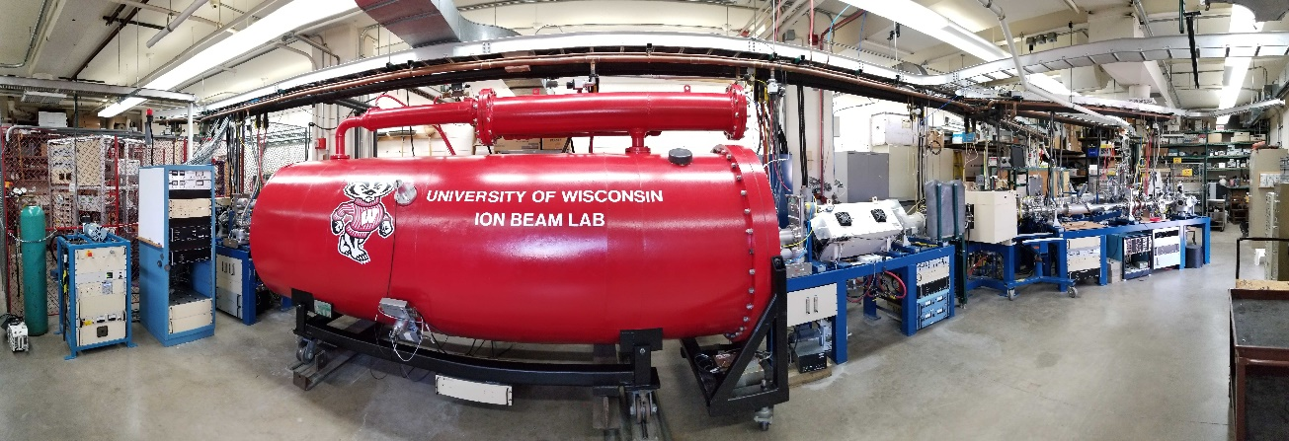


Materials Irradiation Screening
Accelerated and cost-effective methods for screening and down-selecting candidate materials
  Low-energy ion irradiations
  Electron beam for thermal shock/fatigue
Pre/Post-irradiation material characterization
  Characterize size and density of radiation-induced dislocation loops, point defect clusters, void swelling and segregation (XRD, SEM/EDS, FIB/TEM, ..)
  Bulk property testing
Michigan Ion Beam Laboratory (MIBL) with triple-beam irradiation capabilities
Wisconsin Ion Beam Laboratory (IBL)
A. Burleigh’s poster
S. Bidhar’s talk
A2D2 facility (FNAL)

Slide 18





Prototypic Irradiations and Evaluation
Final phase: prototypic beam irradiation with high-energy high-intensity proton beams before final validation/evaluation (FOMs) and selection of novel materials
  BLIP facility at BNL, Fermilab beamlines or other facilities
  CERN’s HiRadMat facility
CERN’s HiRadMat facility for single-shot thermal shock tests
D. Kim’s poster
A. Goillot’s talk
PNNL hot cells

Slide 19


Current Collaborations & Acknowledgements
Fermilab
K. Ammigan, G. Arora, S. Bidhar, A. Burleigh, F. Pellemoine
University of Wisconsin-Madison
A. Couet, N. Crnkovich, M. Moorehead, I. Szufarska
Illinois Institute of Technology
W. Asztalos, Y. Torun
The work was supported by Fermi National Accelerator Laboratory, managed and operated by Fermi Research Alliance, LLC under Contract No. DE-AC02-07CH11359 with the U.S. DOE. This material is based upon work supported by the U.S. Department of Energy, Office of Science, Office of High Energy Physics under an Early Career Research Program award to KA. This project has received funding from the European Union’s Horizon Europe Research and Innovation programme, under Grant Agreement No 101057511 (EURO-LABS)

Slide 20
Summary
Innovate and advance state-of-the-art in targetry materials to support next-generation multi-MW accelerator target facilities
  High-Entropy Alloys (beam windows)
  Nanofiber Materials (secondary particle-production targets)
Iterative material development process
  Optimization of composition, microstructure and properties
  Planning several experiments (irradiations and material characterizations)
  Complementary DFT & MD modeling of radiation damage effects in HEAs
Potential benefit/impact
  Enable Fermilab’s multi-MW neutrino physics program (LBNF/DUNE 2.4 MW)
  Expand Fermilab’s accelerator R&D capabilities in HPT
  Benefits to international HEP and non-HEP programs

Slide 21
Novel Materials R&D for Next-Generation Accelerator Target Facilities
Kavin Ammigan
8th High Power Targetry Workshop, Japan
6-10 November 2023

