Slide 1
Computational Exploration of High Entropy Alloys as Promising Materials for Future Beam Windows
Gaurav Arora
8th High Power Targetry Workshop
November 2023
FERMILAB-SLIDES-23-365-AD

Slide 2
What we already know!
Major accelerator facilities have had to limit their beam powers because of the survivability of their targets and windows, rather than as a limitation of the accelerators themselves
More power
More challenges
More radiation damage
Increased thermal shock and thermal fatigue
Ammigan, Kavin, and Frederique Pellemoine.FERMILAB-CONF-22-107-AD. Fermi National Accelerator Lab.(FNAL), Batavia, IL (United States), 2022.
Notes:
Because more power would bring more radiation damage
Cycling loading progressively damage material’s microstructure such that it can ultimately fail at stress levels that are actually lower than its failure strength

Slide 3
Overarching goal
Develop materials capable of withstanding higher levels of beam power for extended operational lifespans
How to achieve?
Using simulation techniques along with experiment for developing new materials

Slide 4
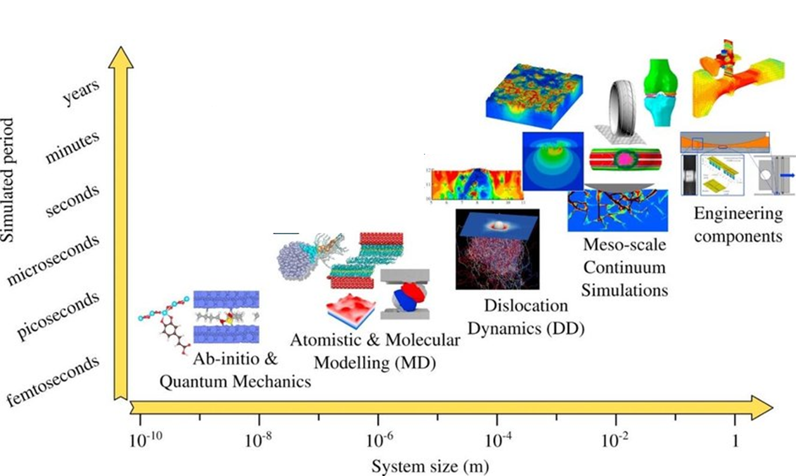
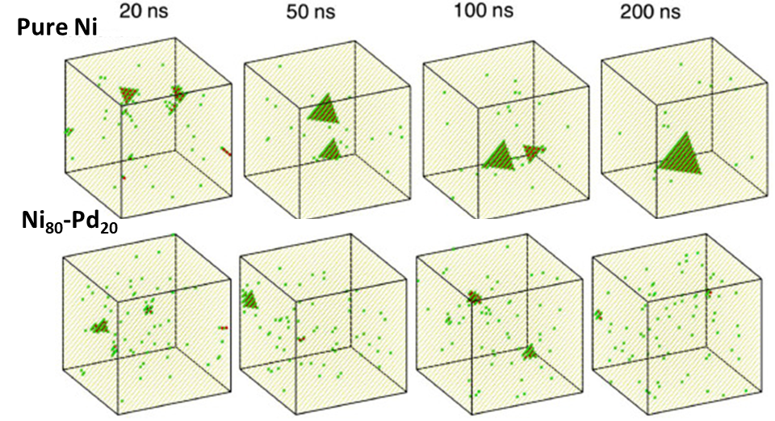
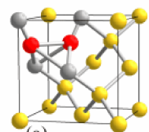
Types of simulations: Time vs. system size
Density functional theory (DFT): Defect formation energies, band gap, etc.
Molecular dynamics (MD): Radiation damage such as void formation, evolution of system with respect to temperature, etc.
Goel, Saurav, et al. Materials Today Chemistry 18 (2020): 100356
Arora, Gaurav, et al." Materialia 15 (2021): 100974
Notes:
David senor PNNL
Give example of formation energy of defect.

Slide 5
Overview of density functional theory (DFT)
Basic definition
DFT is a quantum mechanical modeling method used to study the electronic structure and properties of materials.
It provides insights into the behavior of atoms and molecules at the atomic scale.
Advantage of DFT
Wide applicability: DFT can be applied to range of materials to study electronic structures, charge density, magnetic and more.
Does not require any input from the experiment as it uses fundamental equations to solve the problem
Insight into chemical and physical processes: Offers deep understanding of the chemical reactions, electronic transitions and physical phenomena at atomic level.
Complement experimental results.
  Allows the extraction of additional information such as atomic structures, reaction pathways.
DFT serves as powerful tool for screening and analyzing electronic properties of the materials before they are even synthesized

Slide 6
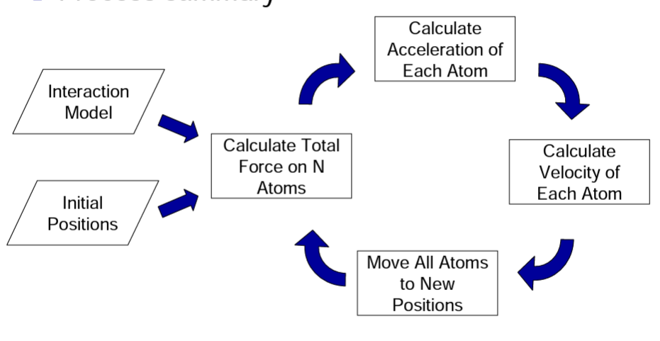
Overview of molecular dynamic (MD)
Basic definition
Based on classical physics and is used to describe positions, velocities, and orientations of molecules over time.
Energy/forces are calculated using Newton’s law of motion.
Advantages
System can be simulated using different conditions, for example at very high temperature and pressure.
Visualize the evolution of system with time.
Millions of atoms can be modeled.
MD serves as powerful tool for studying microscopic properties of materials
https://www.compchems.com/molecular-dynamics-md/#advantages-and-disadvantages
https://nanohub.org/resources/7573/download/Martini_L1_Introduction.pdf
Notes:
Energy/force tolerance
Talk about that its an iterative process

Slide 7
Summary of DFT and MD
DFT
Work on the principle of quantum physics
Highly accurate
Computationally expensive
Limited to ~300 atoms
Software: VASP, Q-espresso, etc.
MD
Work on the principle of Newton laws
As accurate as interatomic potentials
Computationally cheap
Million of atoms can be modeled
Software: LAMMPS
Interatomic potentials
Mathematical function for calculating potential energy of the system with given positions of atoms.
Equations are fitted using data derived from DFT and/or experiments.
Not all the properties can be derived from just one form of inter-atomic potentials.
Accuracy of the simulations depends upon the accuracy of the interatomic potentials.
Development of accurate interatomic potentials is the key challenge in designing or studying defect properties of materials
Notes:
Now we have the techniques but I want to talk little bit about the materials on which we should these techniques to.

Slide 8
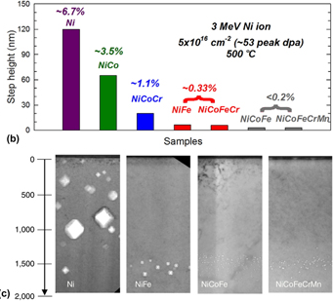
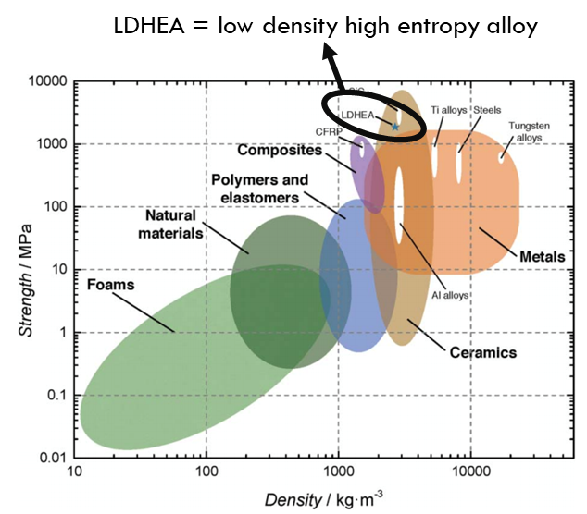
Exceptional properties of High entropy alloys (HEAs)
Radiation tolerant property of HEAs
High strength along with high ductility
High strength while maintaining low density
HEAs offer a new route for exploring and designing next generation material for beam windows
Oh et al., Nat Comm. 10, 2090 (2019)
Youssef et al., Materials Research Letters, 95-99 (2015)
Jin et al., Scripta Materialia 119 (2016)

Slide 9
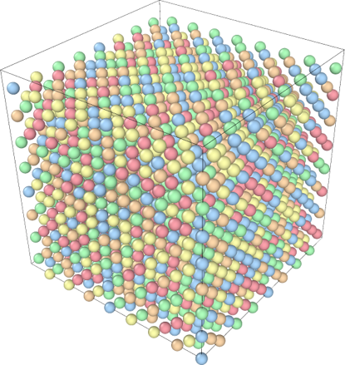
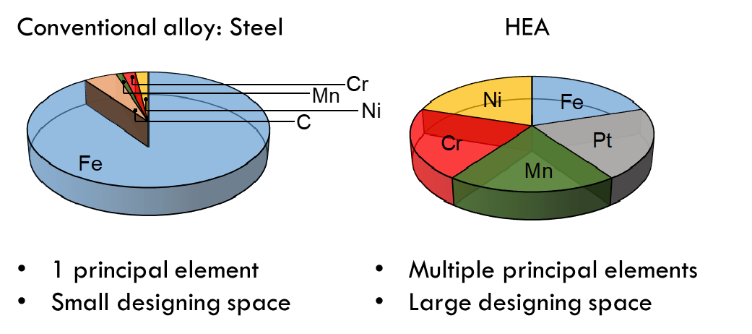
Overview of high entropy alloys (HEAs)
Multi-principal elemental alloys
Random solid solution
Equi-atomic or near equi-atomic composition
FCC, BCC or HCP crystal structures
Distorted lattice
Large number of HEAs can be designed by changing the chemistry and composition of principal elements.
Simulations provide an opportunity for exploration.
Yang, Tengfei, et al.Journal of Materials Research 33.19 (2018): 3077-3091.

Slide 10
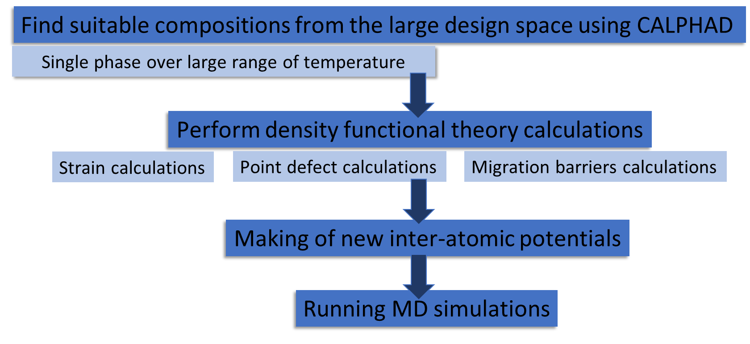
Design process for HEAs
CALPHAD stands for "Calculation of Phase Diagrams.“
Used for making phase diagrams.

Slide 11
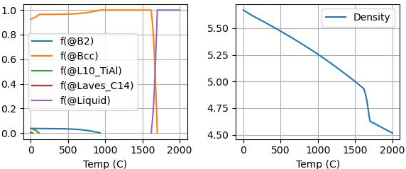
Exploring large design space using CALPHAD
Find suitable compositions from the large design space using CALPHAD
Single phase over large range of temperature
Cr-Mn-V base ternary alloy to avoid high activation elements
  - Single phase BCC crystals
Additional elements for improved strength
  Ti as impurity getter
  Al for lower density
  Co to from semi-coherent B2 phase for strengthening
Range of elements explored (~120,000 combinations were explored)
 | Al | Co | Ti | Cr | Mn | V
Min | 0 | 0 | 0 | 0 | 0 | 0
Max | 20 | 5 | 20 | 50 | 50 | 50
Step (at%) | 2 | 1 | 2 | 3 | 3 | Bal
Alloy compositions sorted by single-phase BCC/B2 temperature range
In collaboration with UM-Madison Materials Degradation under Corrosion and Radiation (MADCOR, Dr. Couet)

Slide 12
Selected HEAs for further exploration
Study the effect of Ti concentration
Al10-Co4-Cr25-Mn26-Ti1-V34
Al10-Co4-Cr27-Mn21-Ti4-V34
2. Study the effect of Co concentration
Al16-Co2-Cr25-Mn30-Ti1-V26
Al16-Co4-Cr25-Mn30-Ti1-V24
3. Study the effect of Al and removing Cr
Al20-Co1-Mn27-Ti2-V50
Al12-Co3-Cr6-Mn27-Ti2-V50
4. Study the effect of removing Co
Al18-Mn30-Ti2-V50
Al20-Co2-Mn26-Ti2-V50
In collaboration with UM-Madison Materials Degradation under Corrosion and Radiation (MADCOR, Dr. Couet)

Slide 13
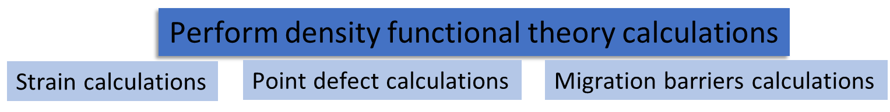
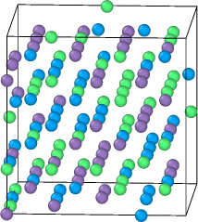
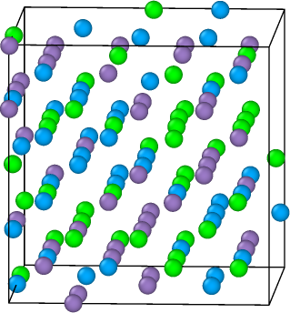
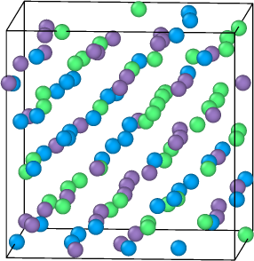
DFT simulations
To study the evolution of system following set of simulations are performed
Compressive and tensile strain
Shear strain
Vacancies and interstitial
Different temperature
Approximately 600 simulations are performed for each composition.
Forces and energies are extracted and fed into making of machine learning potential.

Slide 14
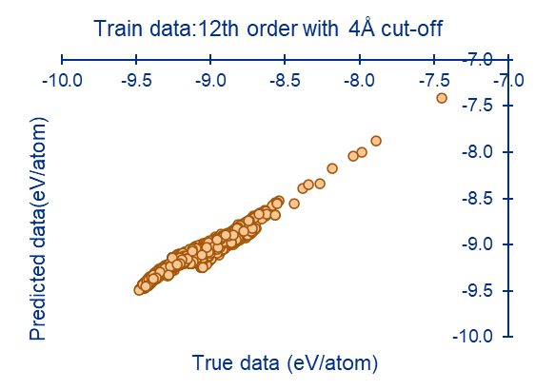
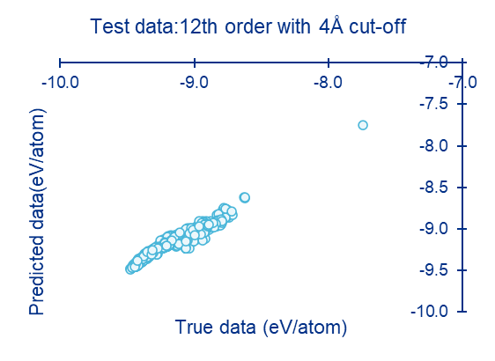
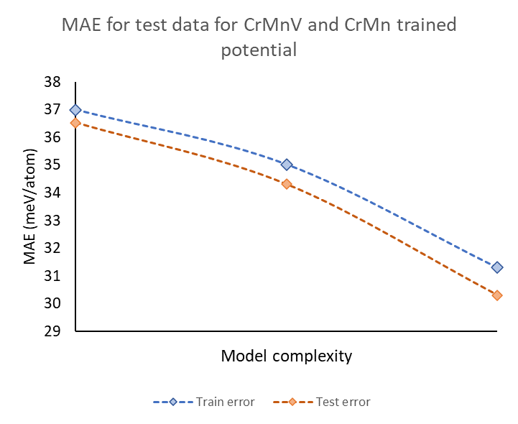
Preliminary results
Data was trained for CrMnV equimolar and CrMn binaries.
2878 training data points and 723 test data points.
R=0.97
R=0.97
Model can predict energies accurately
Increasing model complexity decreases the error

Slide 15
Conclusion and future work
HEAs needs to be explored further for designing new alloys.
Simulations could serve as powerful techniques for exploring the phase space.
Future work
Run more DFT simulations and expand the dataset for training machine learning potentials.
Use trained model for predicting behavior of material under extreme conditions.

Slide 16


Acknowledgement
HPT R&D group at Fermilab:
  Frederique Pellemoine
  Kavin Ammigan
  Sujit Bidhar
  Abraham Burleigh
University of Wisconsin-Madison
  Izabela Szlufarska
  Dane Morgan
  Adrien Couet
  Nicholas Crnkovich
Thank you!

