Slide 1





Upgrades, fabrication and quality assurance of 1.3MW HyperK target
8th High Power Targetry Workshop
Mike Fitton, Chris Densham
& Eric Harvey-Fishenden
7th November 2023
High Power Targets Group
Rutherford Appleton Laboratory
Notes:
The abstract pattern can be removed or repositioned if required. Be careful to ‘Send to Back’ so that it does not obscure any important information.

Slide 2
Overview
Target experience to date
Required upgrades for 1.3MW operation
Quality assurance of targets
Performance of ceramic isolators & metal seals under cyclic thermal fatigue
Future upgrades

Slide 3
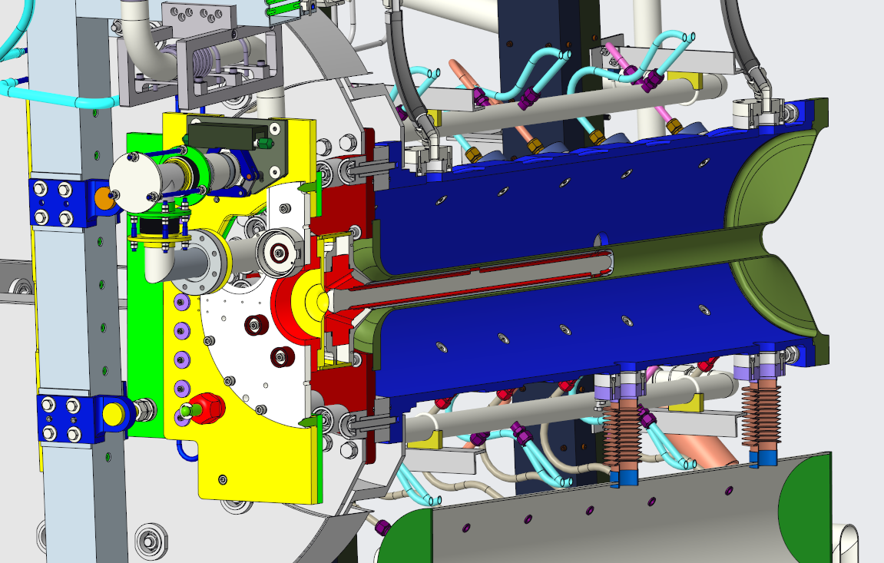
T2K target experience to date (2010-2023)
Helium cooled graphite rod, enclosed in grade 5 titanium
Target installed within 1st horn bore (3mm clearance)
Original design beam power: 750 kW
Beam power so far: ~540 kW (2.6 x10¹⁴ppp @ 2.48Hz)
Approx. 3% beam power deposited in target as heat
1st target & horn replaced after 4 years, 6.5e20 p.o.t.
2nd target & horn replaced after 8 years, 3.1e21 p.o.t.
3rd target installed and just started taking beam
No target failure experienced to date.
Only failure was of helium outlet pipe in 2016
  The pipe alone was remotely replaced
  Modifications have already been made
    Diffusion bond -> Brazed ceramic
    Pressure balanced bellows
    Alignment adjustment bellows
    Stress relieving
Target I
Target II
Target III

Slide 4
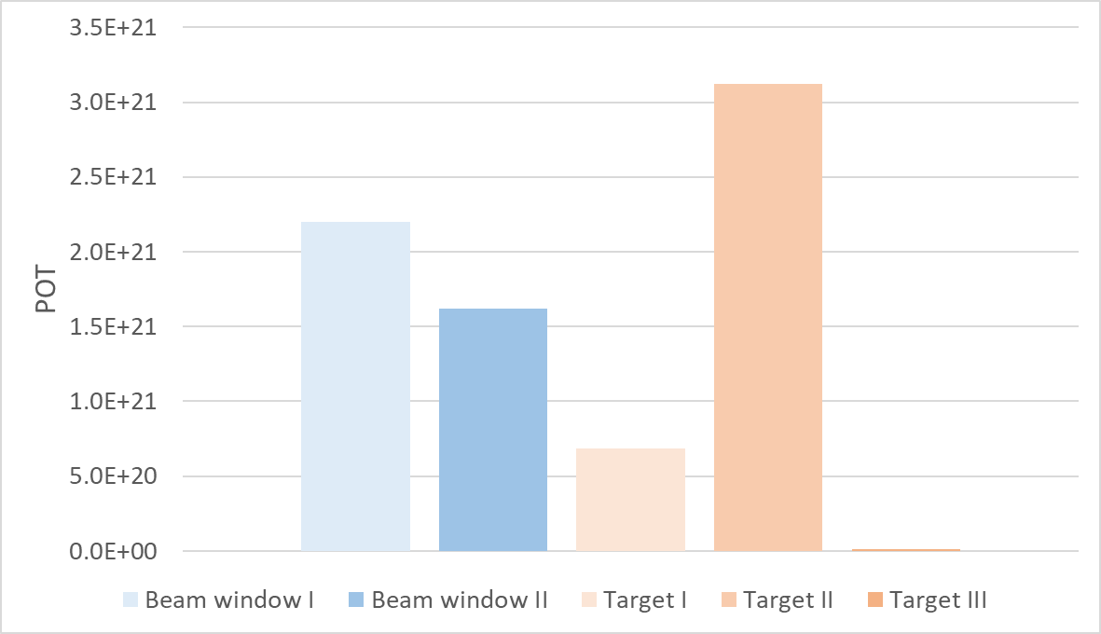
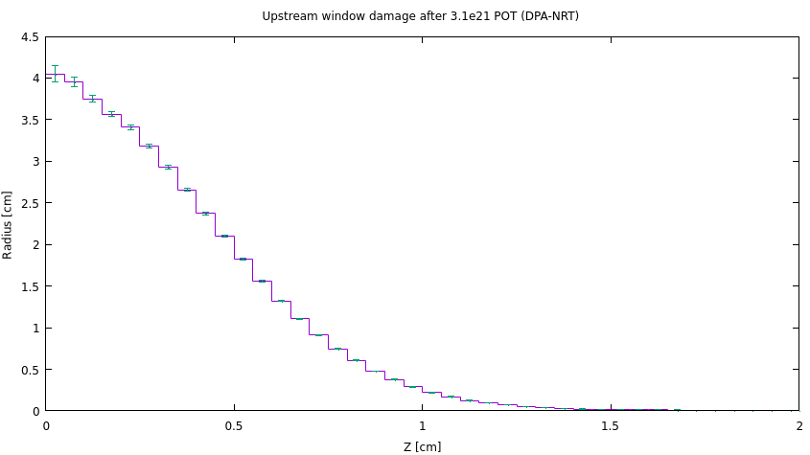
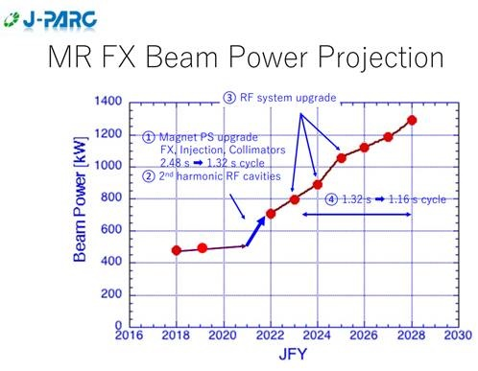
T2K Experience of target and beam window lifetime (POT and DPA)
How long will a Ti-6Al-4V target/window last?
    No titanium failures observed to date
    No indications of graphite failure
Target II has highest POT 3.1 x 10²¹ POT → 4 DPA-NRT
DPA higher than BLIP irradiated samples! → 0.95DPA-NRT
3.1x10²¹
1.6x10²¹
FLUKA estimate current target window @ 4DPA-NRT
Damage threshold = 40eV
Replaced before failure
Replaced before failure
Work underway to irradiate titanium alloys using 28MeV protons @ Birmingham university MC40 cyclotron
2.5-3 DPA-NRT damage of high cycle fatigue samples with ~30days irradiation.
See poster by Richard Cowan
“Testing high-DPA irradiated titanium alloys for high-cycle fatigue”
Replaced before failure
In service
In service
HK upgrade
Current upgrades to accelerator should result in a rapid increase in rep rate and beam power.
1.3MW beam around 2026
(3.2x10¹⁴ppp @ 1.16Hz) – 19% increase
In HK era we can expect around 3 x 10²¹ POT/yr
Ideally a target & beam window will not need to be replaced more than 1 time per year. More data needed!

Slide 5
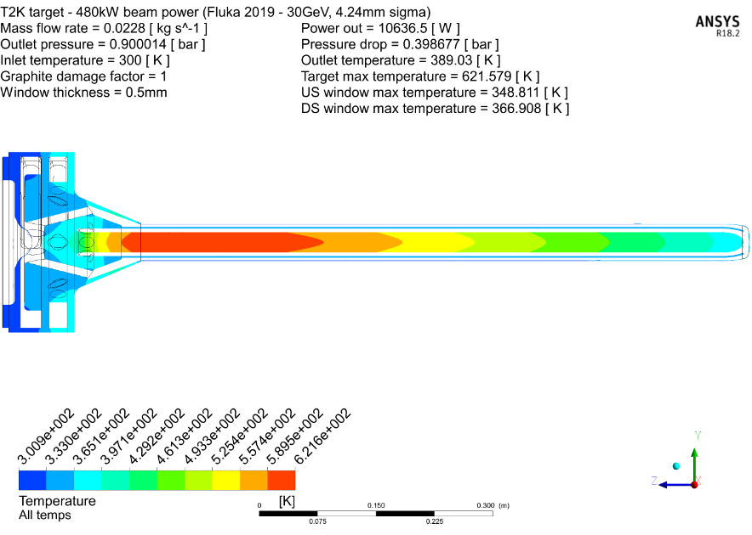
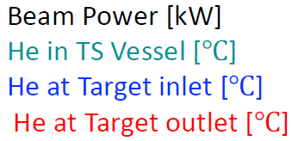
T2K target experience – Heat deposition verification (Operational data vs. FLUKA)
The best measure of heat load on the T2K target is the helium outlet temperature which is measured close to the target. Along with the measured flow rate, this enables us to calculate the power deposited by the beam. Original MonteCarlo simulations have been updated with FLUKA in 2019
480kW operational data, temp. rise of He = 73.4°C @ 22.9g/s → 8,716W
480kW FLUKA (2019), temp. rise of He = 89.0°C @ 22.9g/s → 10,636W (agreement within 20%)
Helium ΔT is large -> Errors should be small
Beam Power 480kW
Operational data 18th April 2018
He Outlet 102.5°C
Ansys + FLUKA (2019)
He dT 73.4°C
He Inlet 29°C
NOTE: Fast cooling rate ~60°C/min
Concern for ceramic isolators!

Slide 6
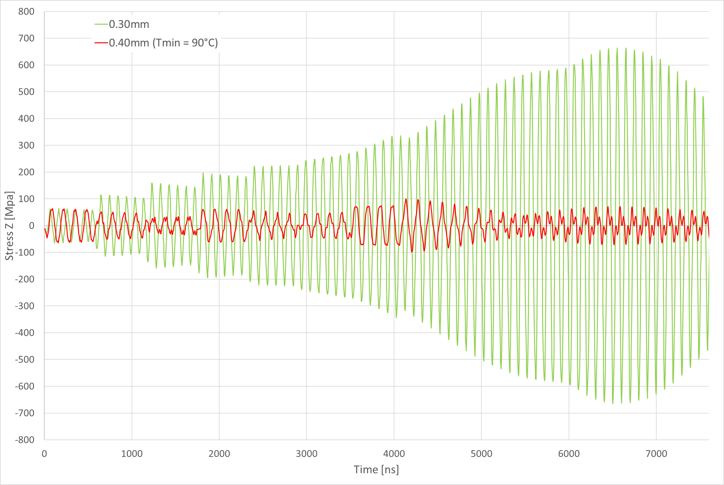
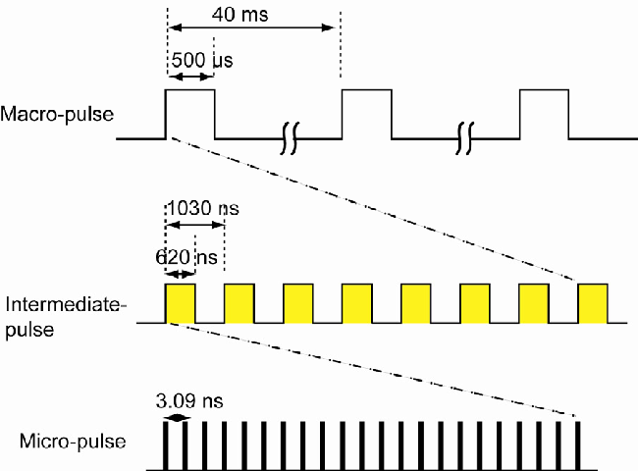
T2K target – Why did we select Ti-6Al-4V (Grade 5) titanium alloy?
Excellent thermal shock resistance
Low thermal expansion and closer match to graphite
Good availability -> “workhorse titanium alloy”
Much data and information available (except radiation damage)
Good machinability and welding experience
T2K Effect of window thickness on stress waves
Proton bunches
3.2x 10¹⁴ protons per pulse
4x10¹³ protons per bunch
Due to JPARC pulse structure stress wave resonance can be experienced. Thickness of target windows must be fine tuned!
In phase
Anti-phase
JPARC linac pulse structure
Figure of Merit for thermal shock resistance (normalised to 1J/g)
Best materials for thermal shock resistance are Ti-6Al-4V and Beryllium
Making target casing out of Beryllium would be difficult and costly

Slide 7
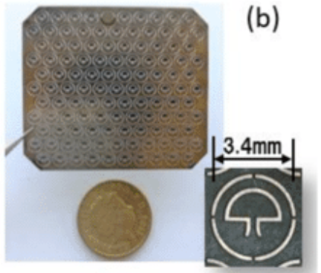
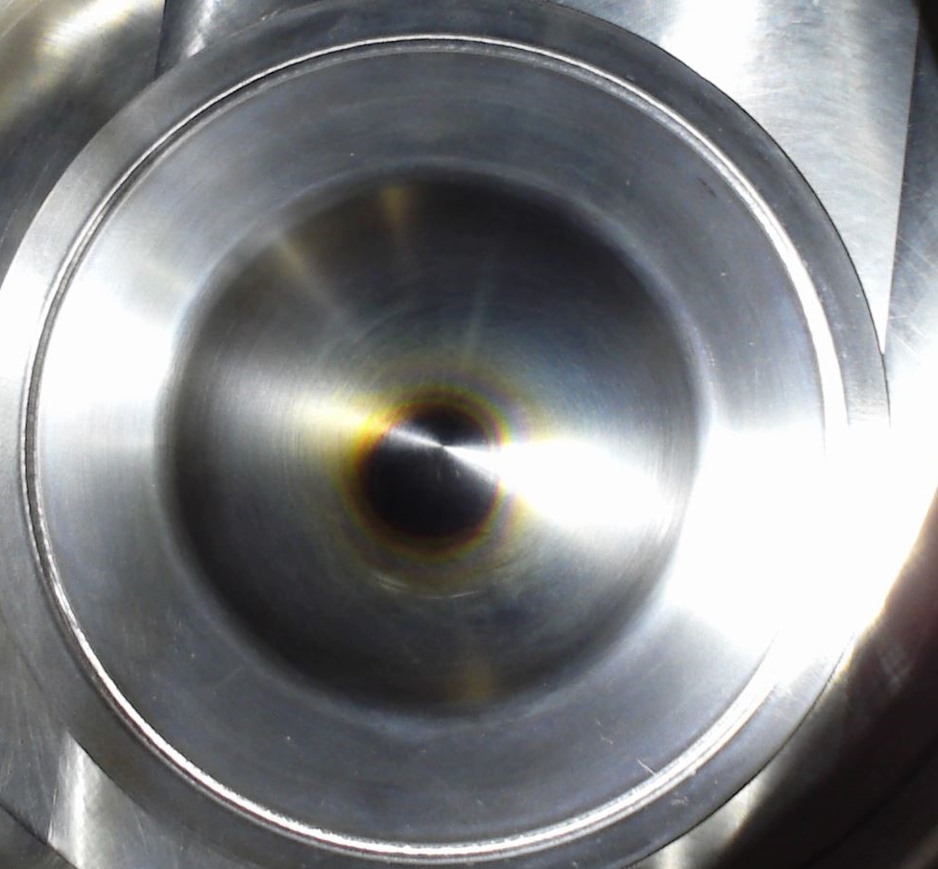
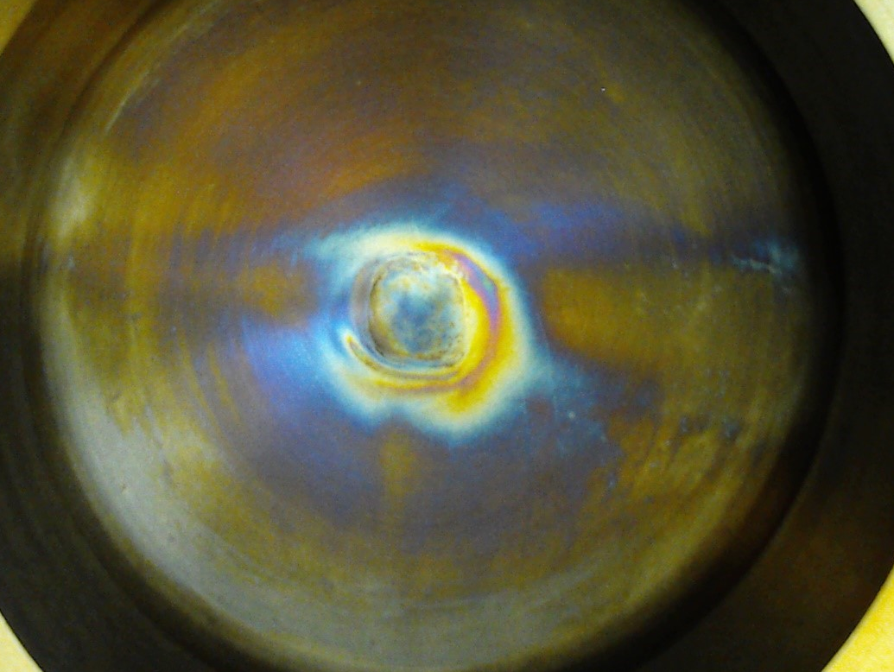
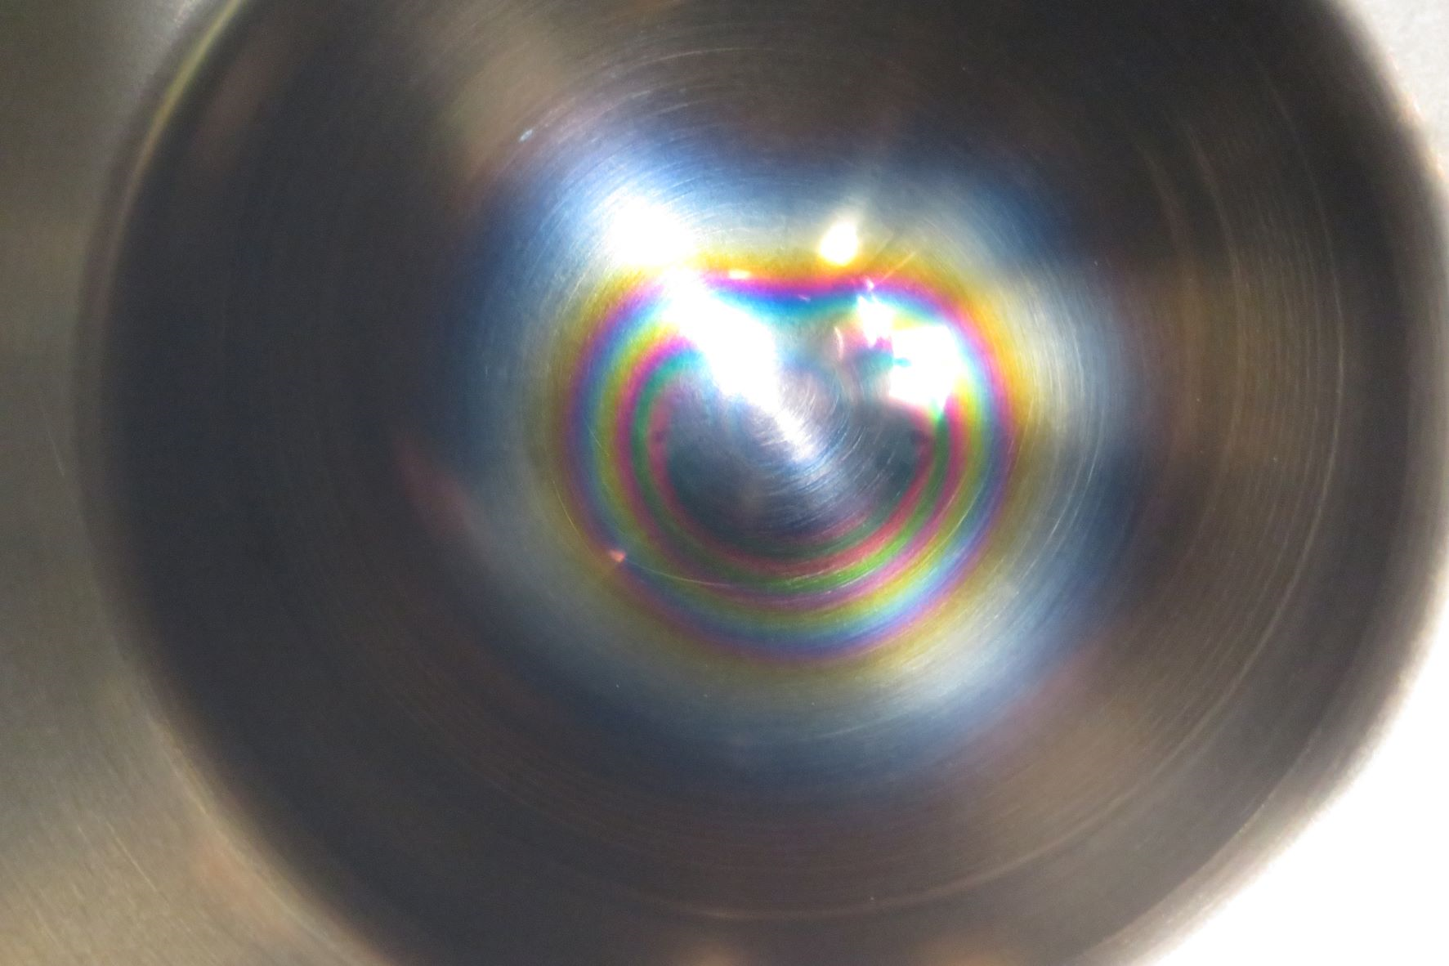
T2K target – Experience with Ti-6Al-4V titanium alloy
Good experience so far, with no failure of targets or beam windows
Stress relieving was required for thin walled structures to avoid distortion from residual stress
Still have questions about radiation damage and how long components can run before failure
  RaDIATE collaboration
  High cycle fatigue testing of BLIP irradiated Meso-scale cantilevers will hopefully start soon
Some corrosion concerns where environment is not well controlled (Poor vacuum, Humid helium)
  Some apparent corrosion or deposit on helium side (only photos, no chemical analysis)
  Vacuum side much cleaner but some colour bands observed
Beam window I (Vacuum side)
Suspected poor vacuum due to pump failure
Beam window I (Helium side)
High humidity, Water leaks
Beam window II (Vacuum side)
Better environment control but still some colour bands

Slide 8
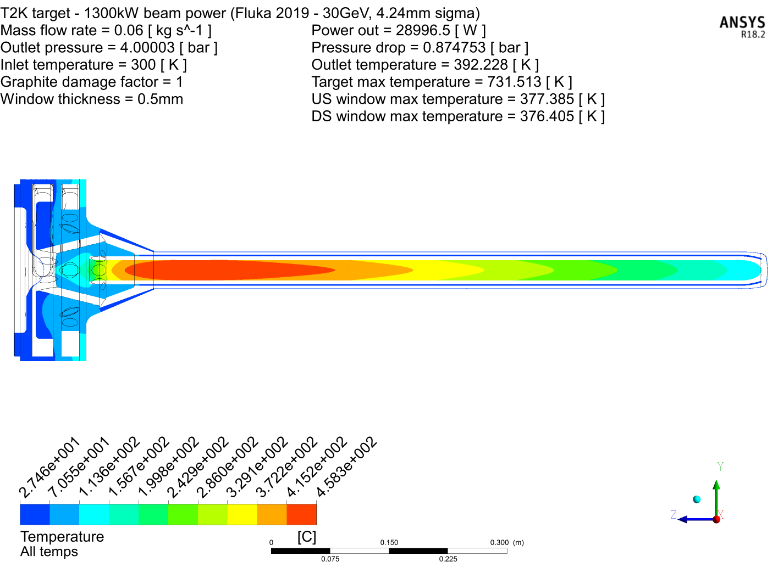
T2K (750kW) -> HyperK (1.3MW) - Target requirements for upgrade
Design beam power 0.75→1.3MW will increase the integrated heat load on the target (x 1.7 times)
Need more cooling but can’t just increase flowrate
  Pressure drop -> @ 60g/s would be 2bar!
  Helium velocity -> @ 60g/s approaching Mach 1!
Solution -> Increase operating pressure:
  Increases Helium density
  Allows higher mass flow rate without big increase in pressure drop or velocities
  Compressor will be smaller and lower power
60g/s @ 4.9bar (4barG outlet) – 1.3MW beam power (Heat load from FLUKA 2019)
120 °C
458 °C
104 °C
103 °C
To enable this, Target components must be:
Re-designed/optimised for operation at 5 bar (Working pressure)
With outlet pressure @4 barG the pressure drop of the system is comparable to the 750kW design (32g/s @1.6bar/0.9barG outlet) = 0.73bar

Slide 9
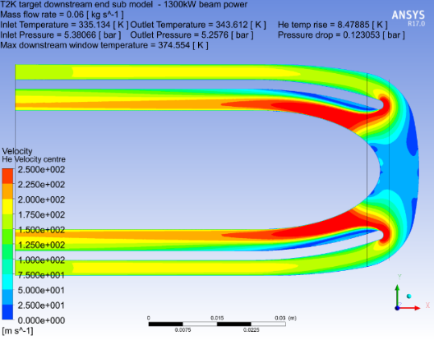
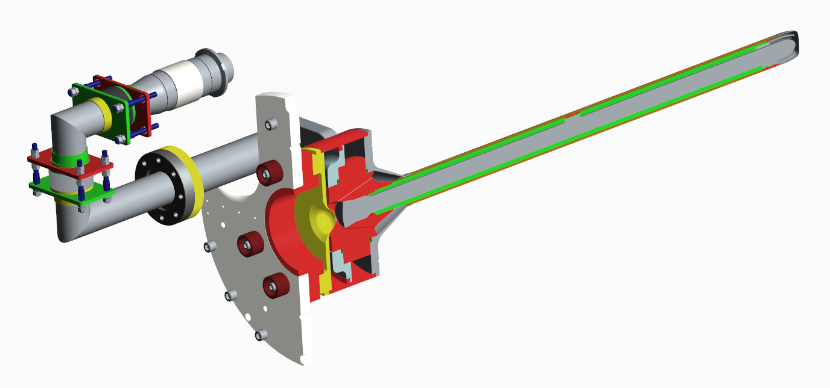
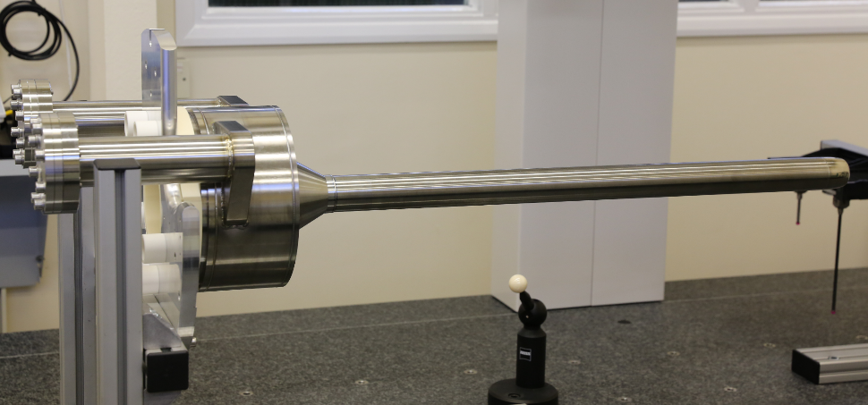
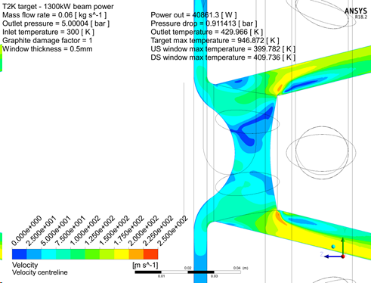
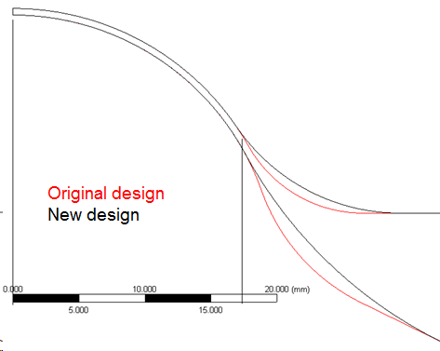
Required Target upgrades for operation at higher pressure
1.3MW design
Thrust force 1.4kN @ 5bar (per pipe)
Need to remove to prevent target deflections from 2.8kN force
Redesign target pipes for 5 bar operation. Increase pressure rating and remove thrust force
Full penetration EB weld at downstream target window
Outercover welds increased to full penetration (~5mm)
Re-optimise downstream target window to reduce pressure stress & maintain good cooling
Increased beam power → Increased chance of target failure Enhanced QA testing and traceability required
Re-optimise upstream target window to reduce pressure stress & maintain good cooling

Slide 10
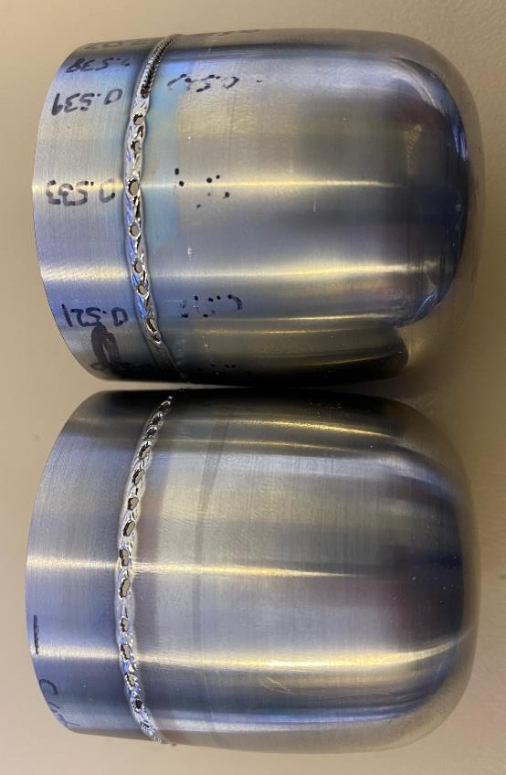
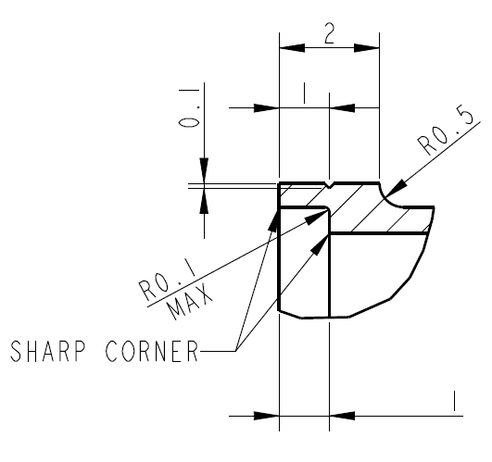
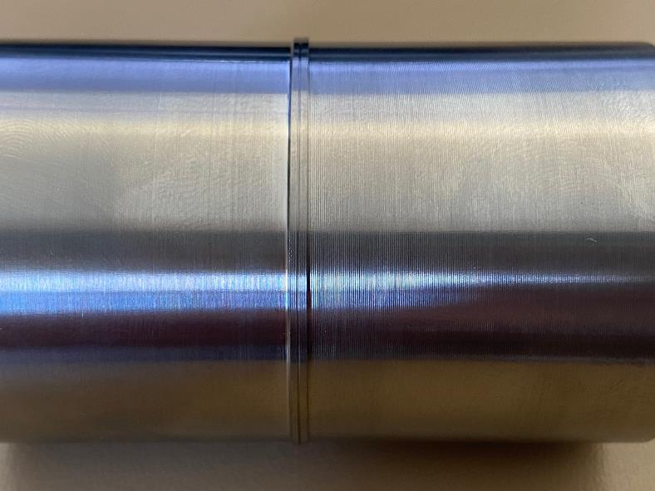
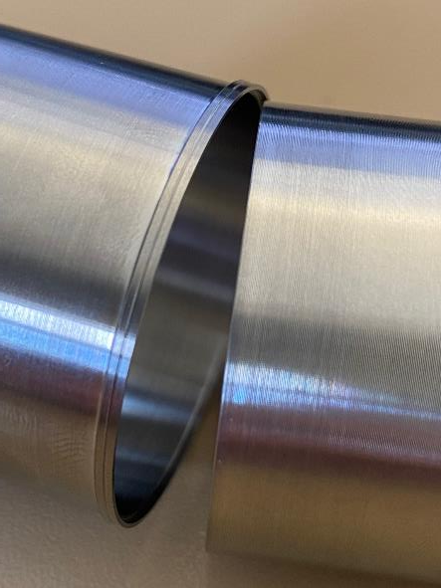
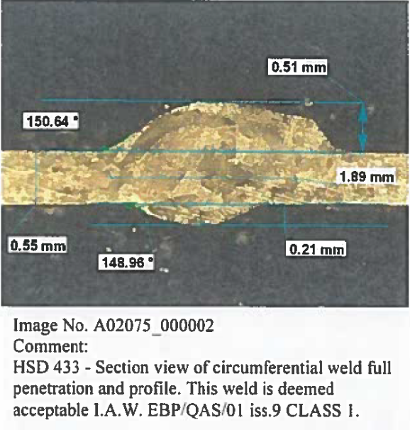
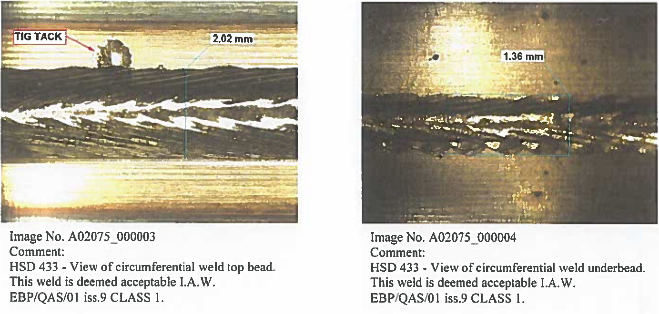
1.3MW prototype target production – Downstream window full penetration EB weld
One of the most challenging stages of the target manufacturing is the full penetration welding of the downstream window. Parts are only 0.5mm thick and we have experienced many failures.
Our latest design uses an external socket to locally the increased wall thickness.
EB
Part has scribe line to aim the EB weld
Cross section
Top bead
Under bead
Weld is much more forgiving, but still challenging. More development in progress
Fit-up of parts cannot be checked easily

Slide 11
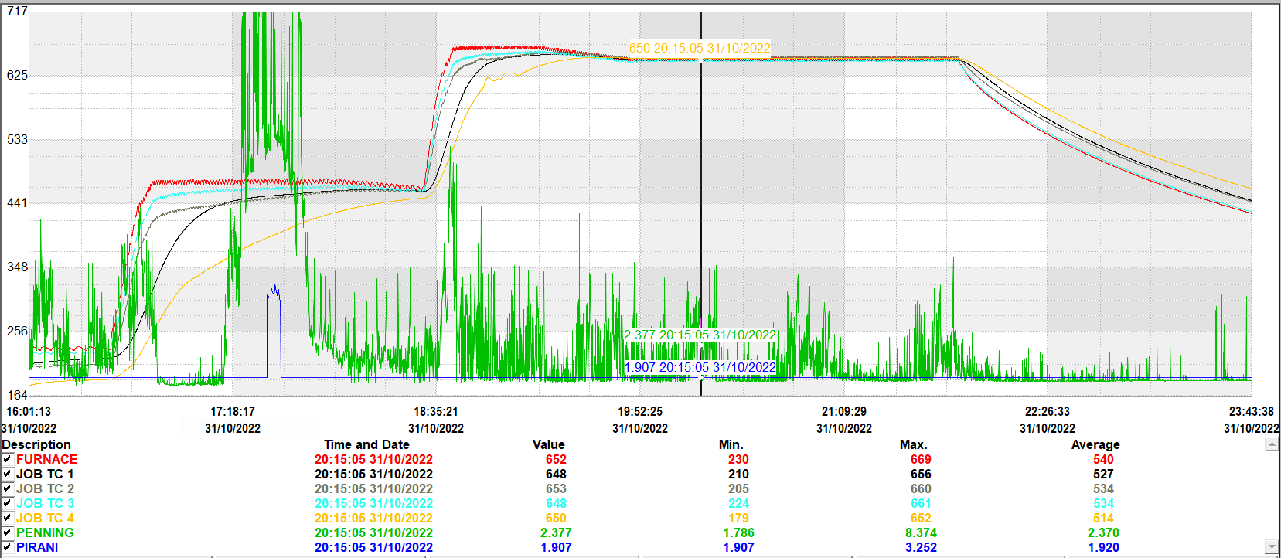
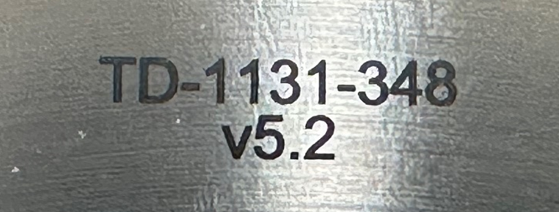
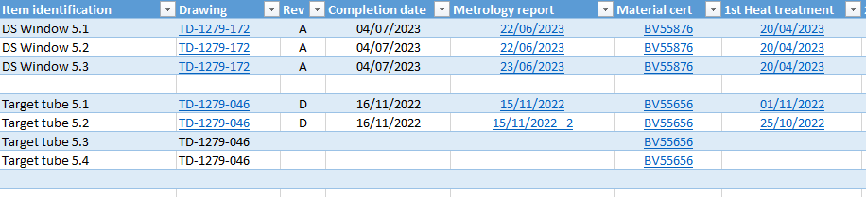
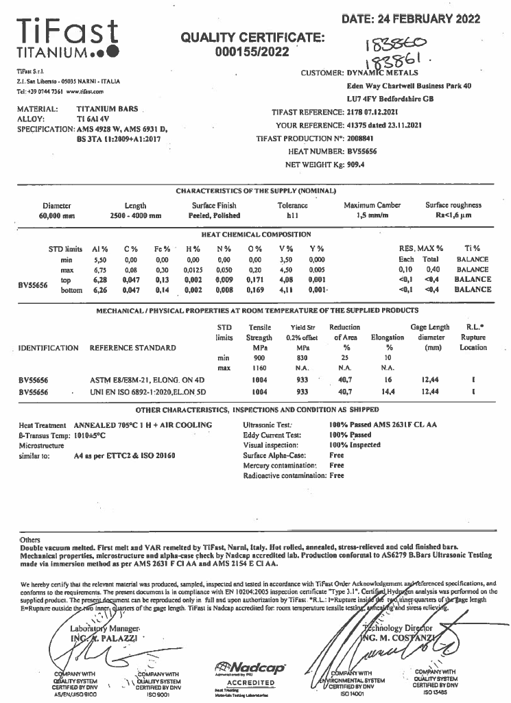
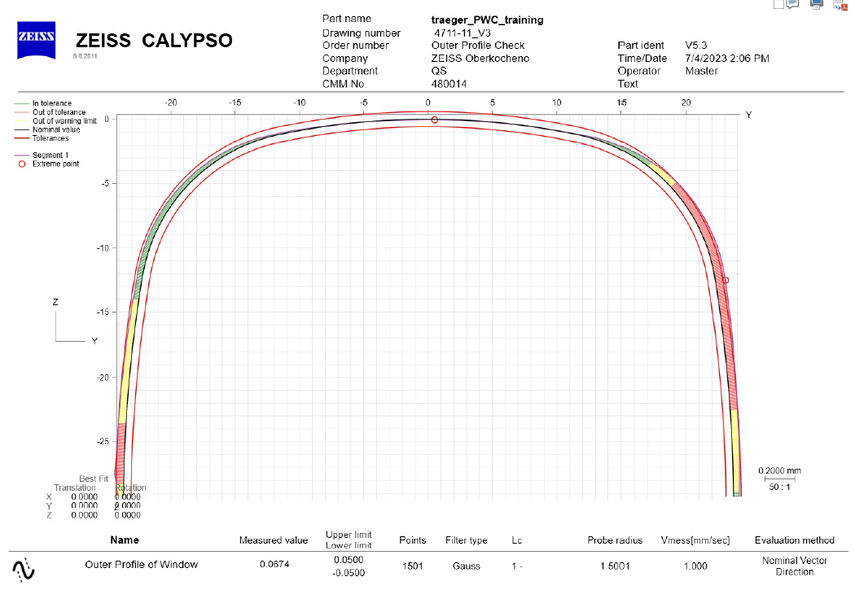
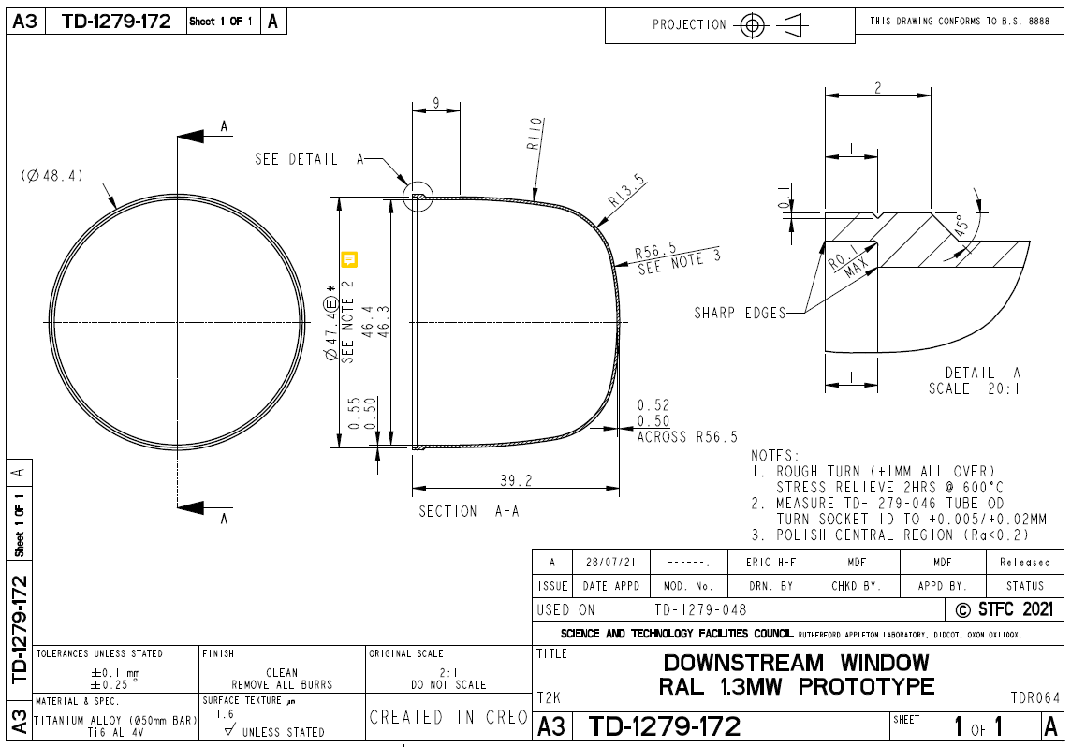
Quality assurance – Full component traceability
All QA reports/certificates are recorded in a spreadsheet and hyperlinked to reports
Easy to find record for each component and identifies any missing information
Furnace data from heat treatments
All components laser marked for identification
Material CERTs
Metrology data reports

Slide 12
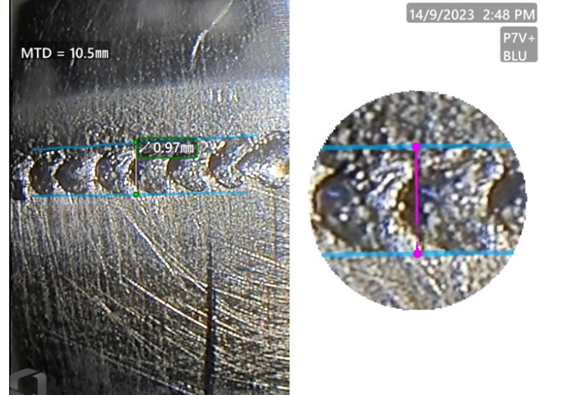
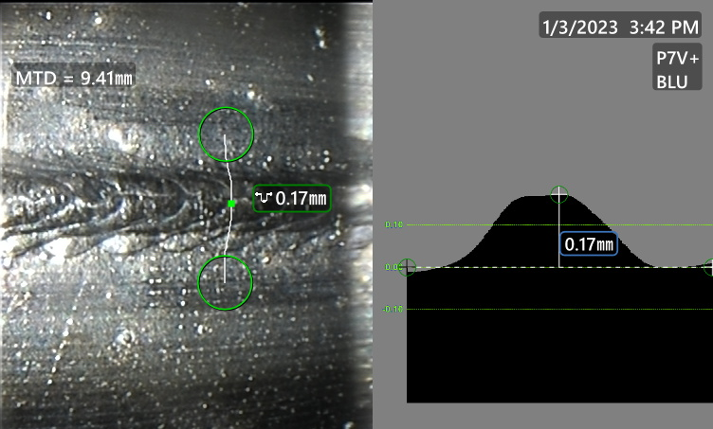
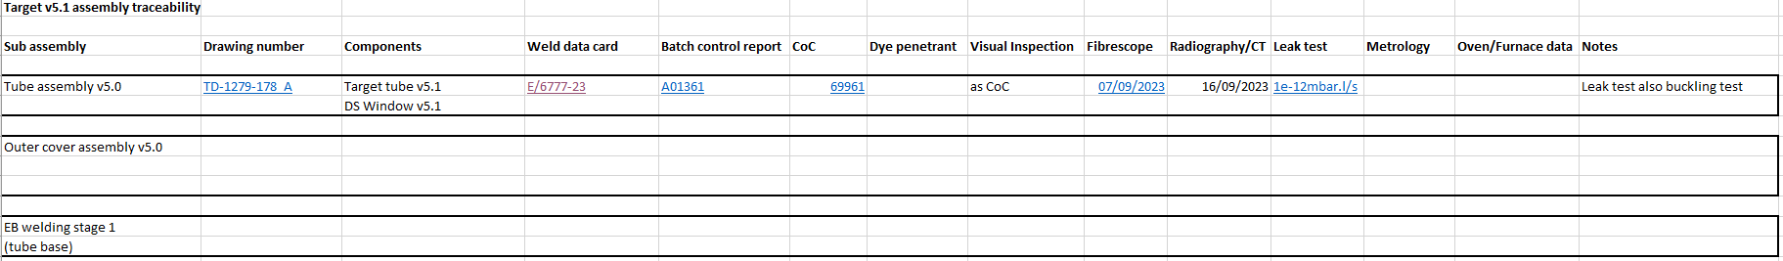
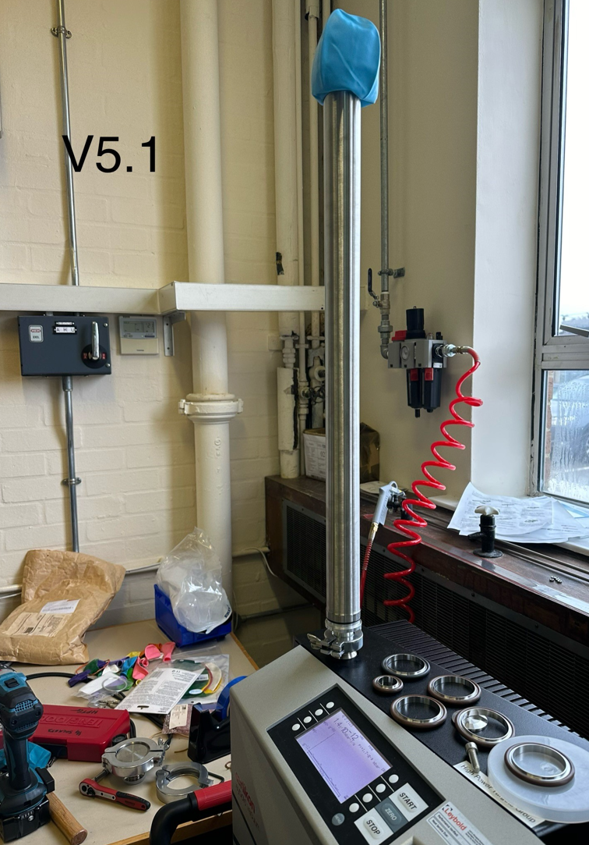
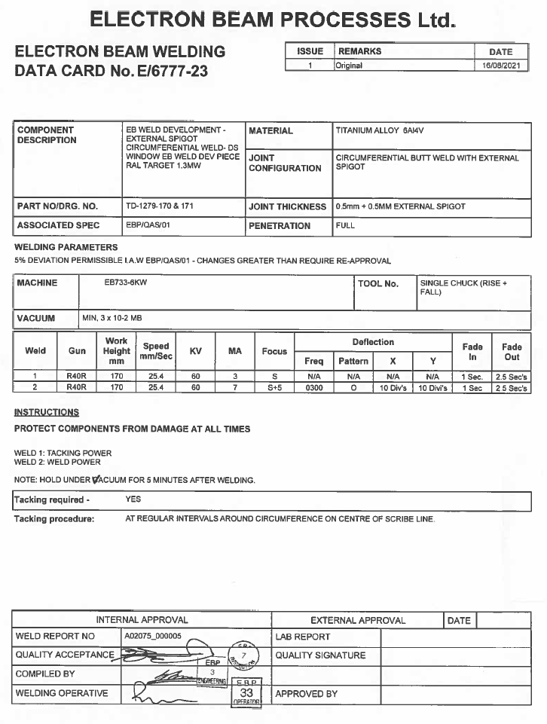
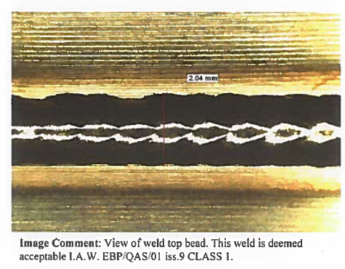
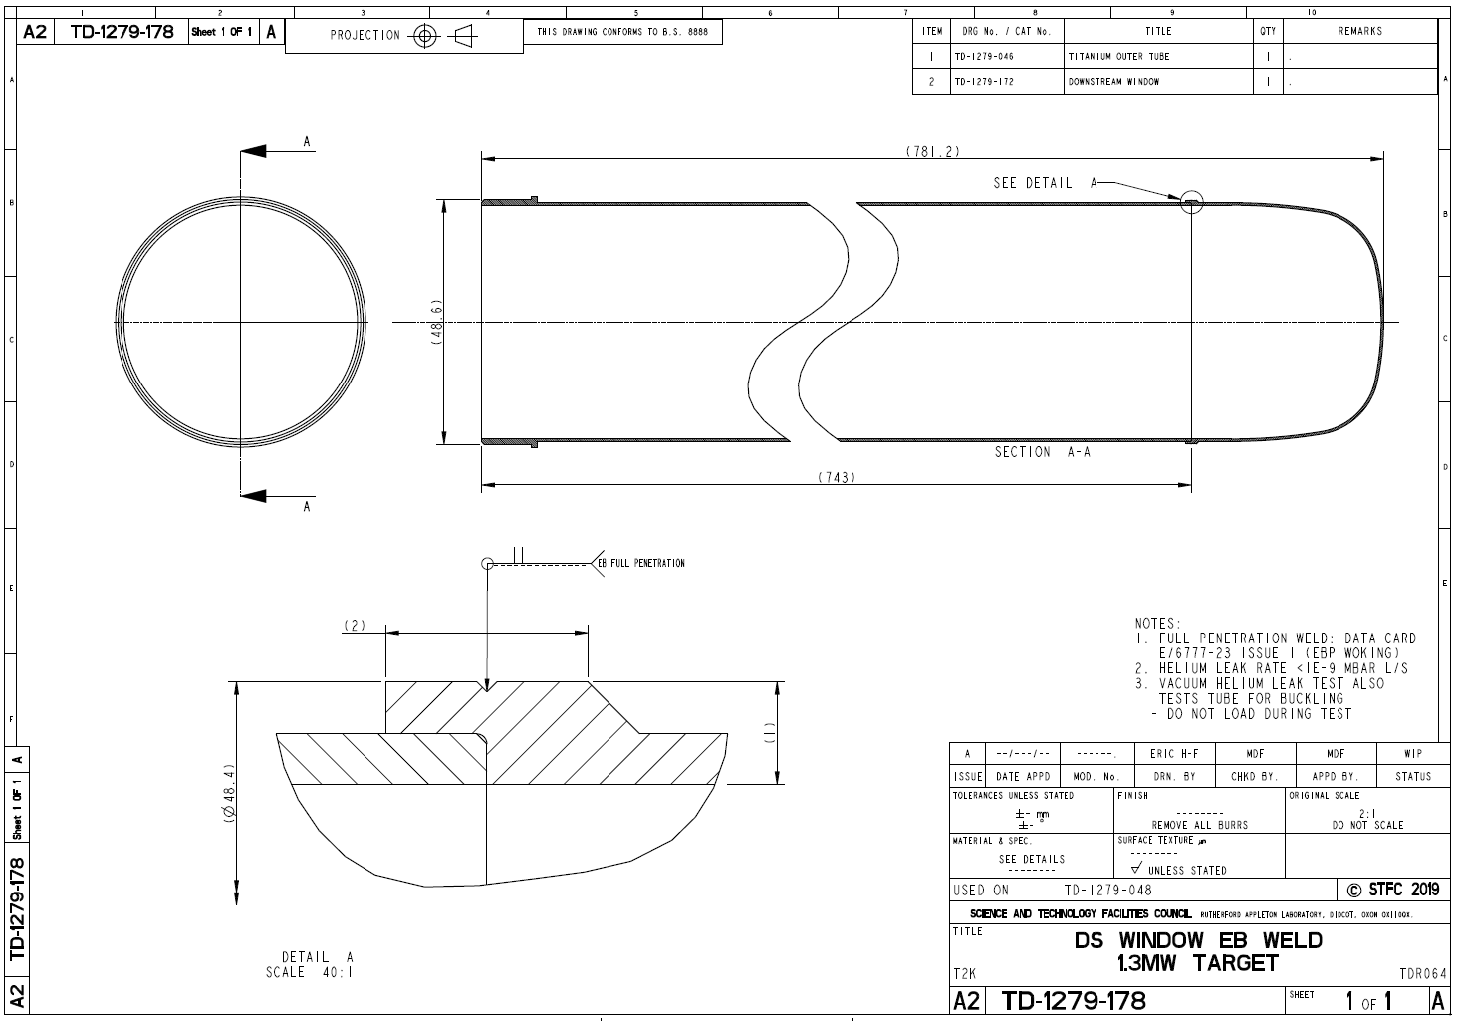
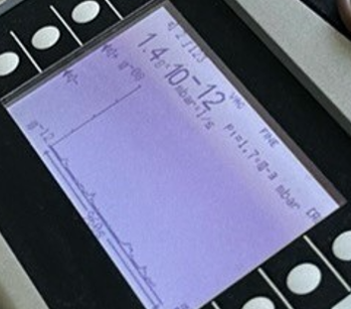
Quality assurance – Assembly traceability
Actual components used in each assembly are recorded
Weld procedures and QA recorded for each step of the assembly
Due to fully welded construction we must check each joint before its incorporated into the next assembly.
CT shown later

Slide 13
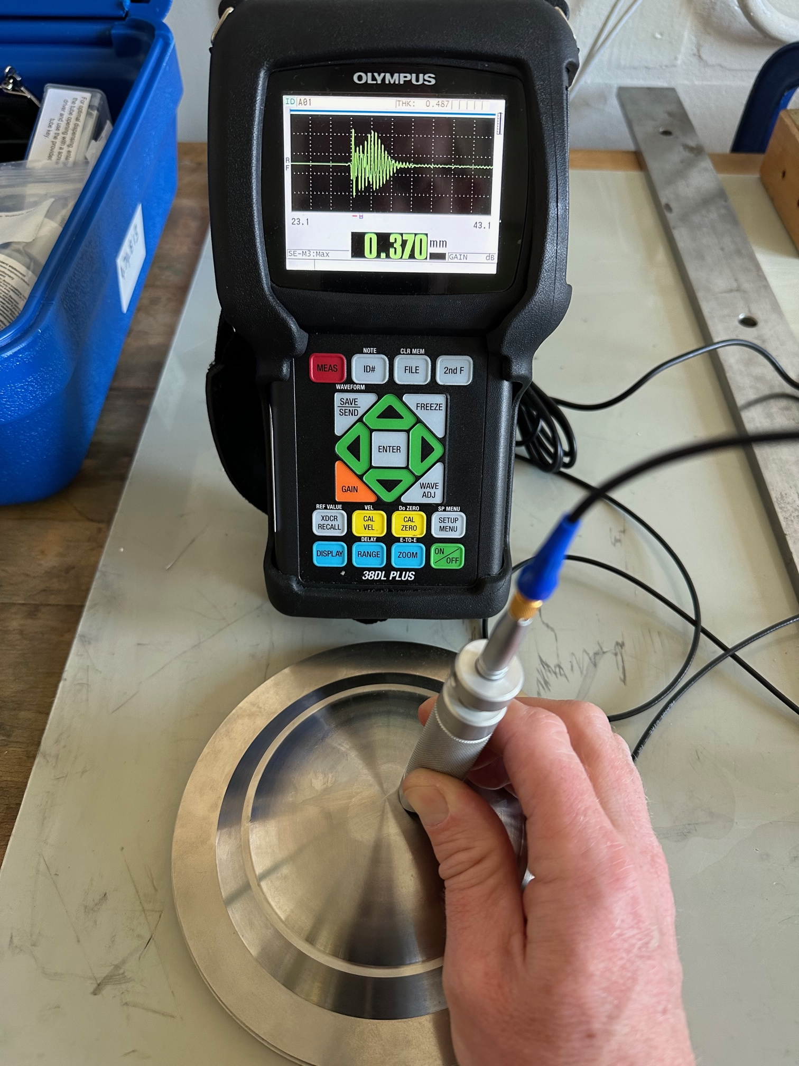
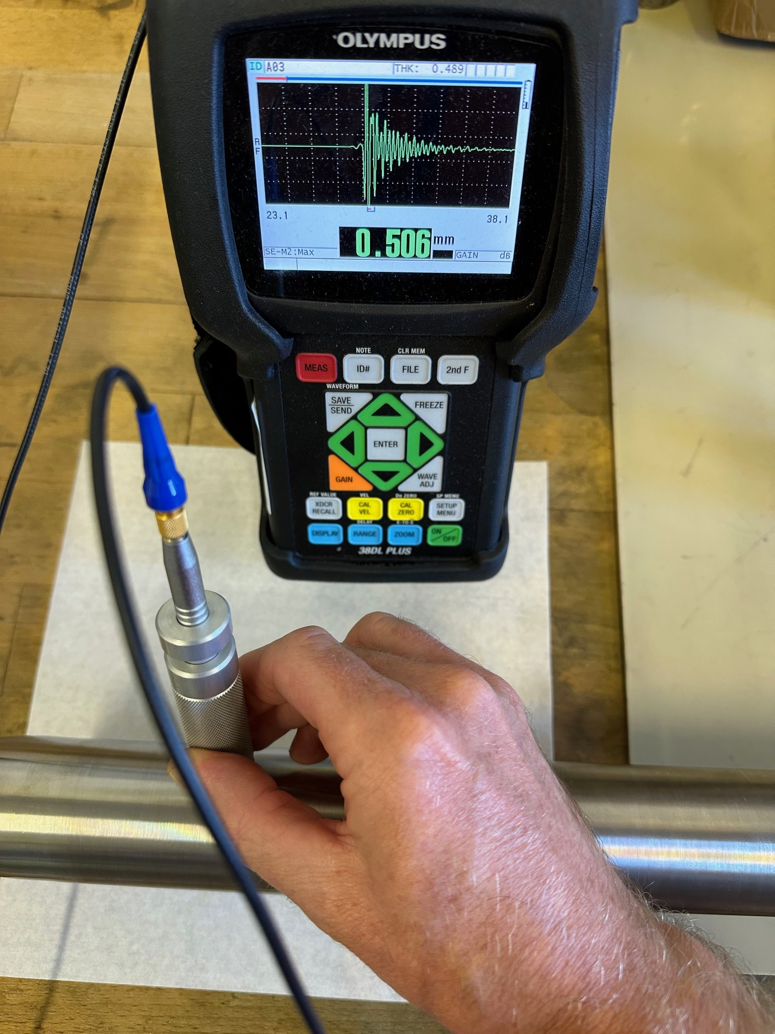
Quality assurance – Ultrasonic inspection
Olympus 38DL PLUS Ultrasonic thickness gauge
15MHz transducer with delay line
2mm tip with V-notch holder for alignment
Wide range -> 0.08-635mm thickness
High Resolution software –> 0.001mm
Useful for:
Checking wall thickness of target tubes
  Measuring wall thickness in centre of tubes is difficult/impossible with conventional metrology techniques
  Can be used to monitor wall thickness whilst machining on mandrel
Checking thickness of beam windows
Verifying speed of sound and Young’s modulus of materials
Beam window thickness
Target tube thickness (~800mm long)

Slide 14
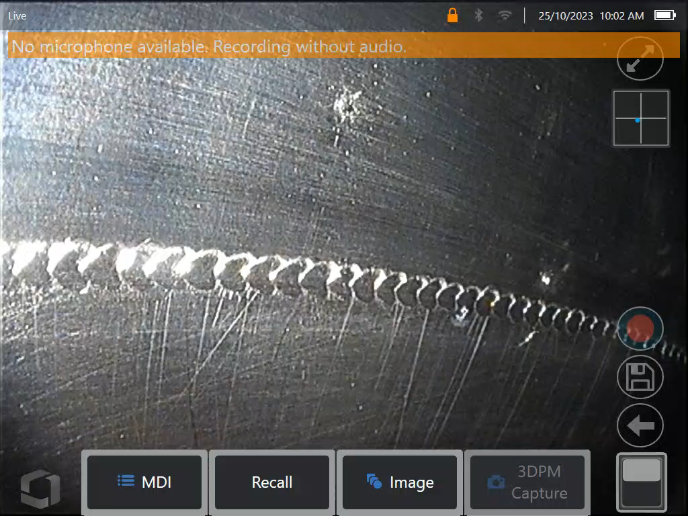
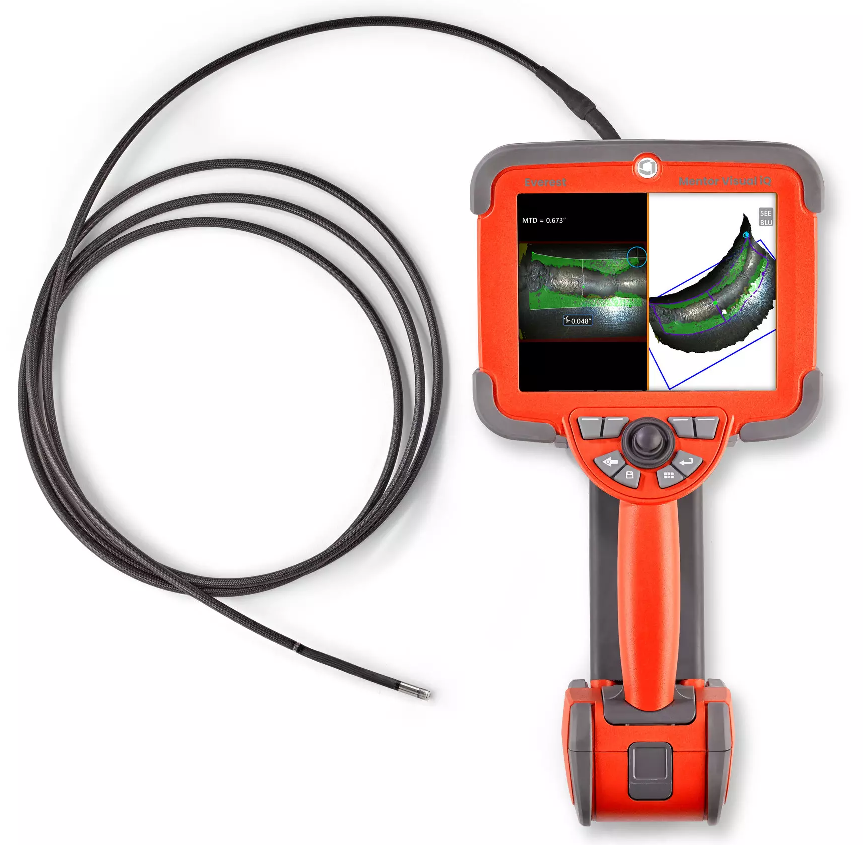
Target QA – Videoscope inspection
Internal target visual inspections using Waygate Technologies (GE) Mentor iQ videoscope.
2 meter long, 4mm diameter probe
Forward and side view tips
3D stereo measurement capabilities (~10-20micron)
We use this for a number of tasks, such as
Checking fit-up of welds on the inside
  External lock lip design make fit-up check difficult
QA inspection of welds on the inside
Measurement of weld underbead
Checking graphite for damage after welding/transport
Checking for internal ”weld splatter” from EB
https://youtu.be/WFWzjGef2PM

Slide 15
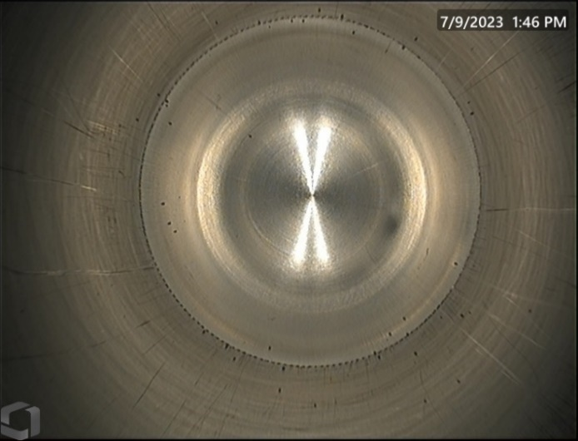
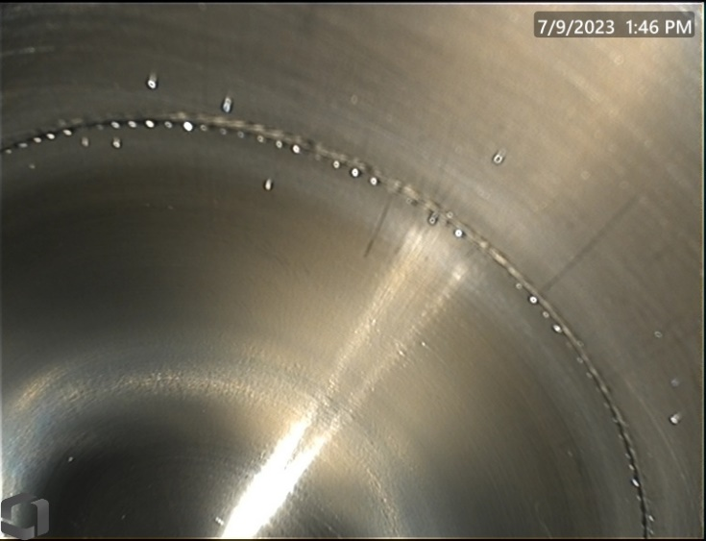
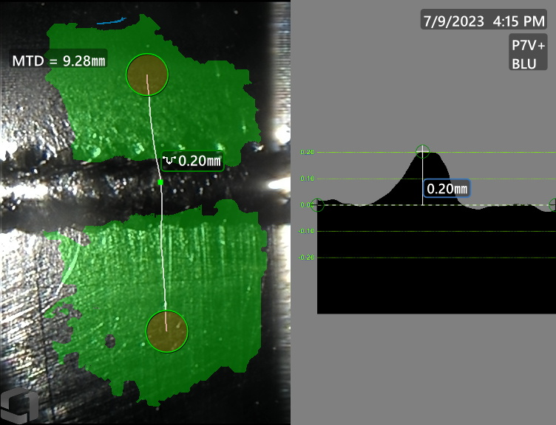
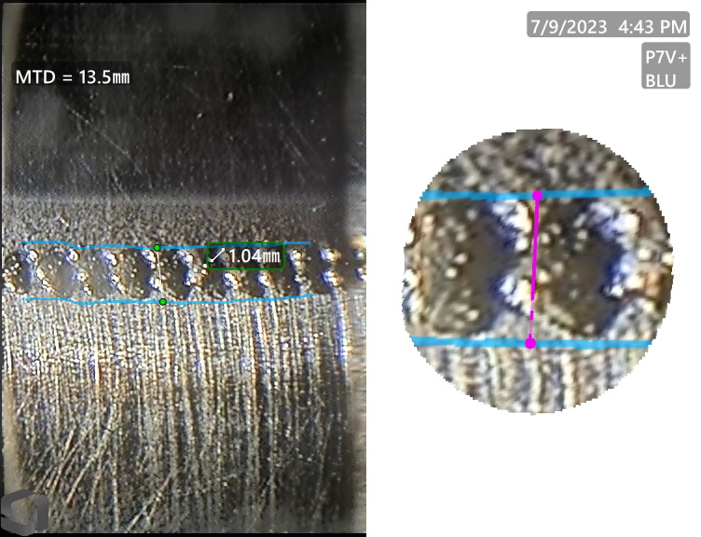
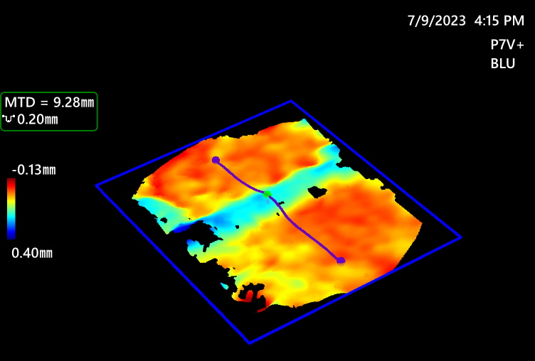
Target QA – Videoscope analysis of HyperK target tubes (v5)
Downstream window weld inspection and stereo measurement
Images showing weld splatter.
Most of this was cleaned up post inspection.
A few were well fused to the wall and remain.
Most important to remove loose material!
Measurement of under-bead width and depth profile
Can confirm if concave or convex

Slide 16
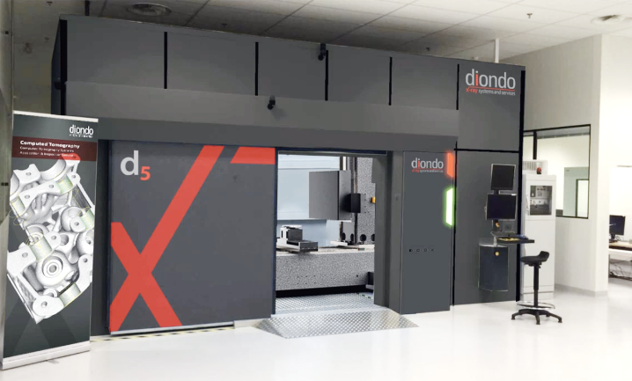
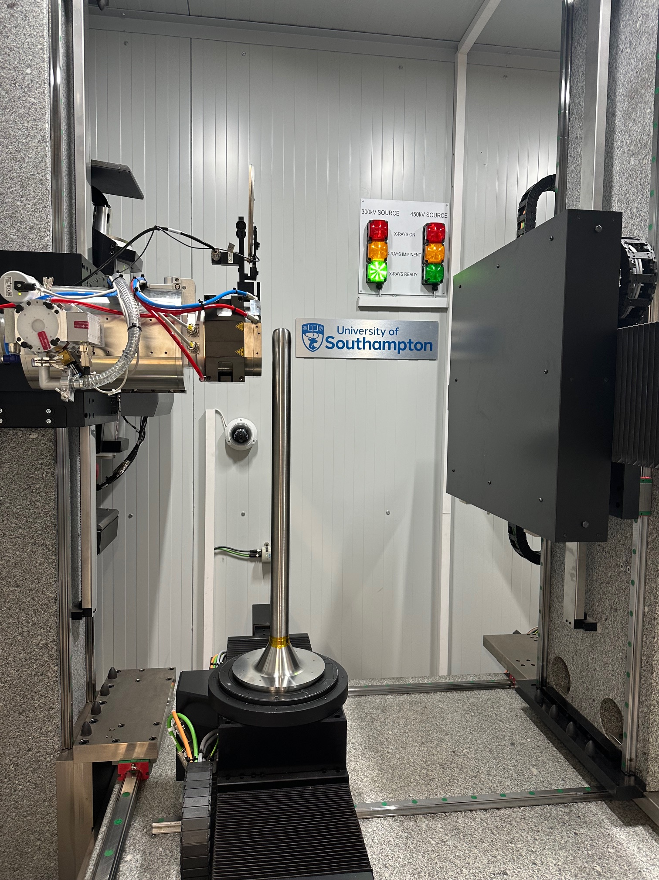


Target QA – CT Scanning (μ-VIS at the University of Southampton)
CT scanning is probably the best and most revealing QA technique for thin welds
Downstream window of the HyperK 1st operational target was scanned using the new Diondo d5 CT scanner.
300 kV & 450 kV X-Ray sources
Scan field-of-view in excess of 1 m (Ø) x 1.5 m

Slide 17
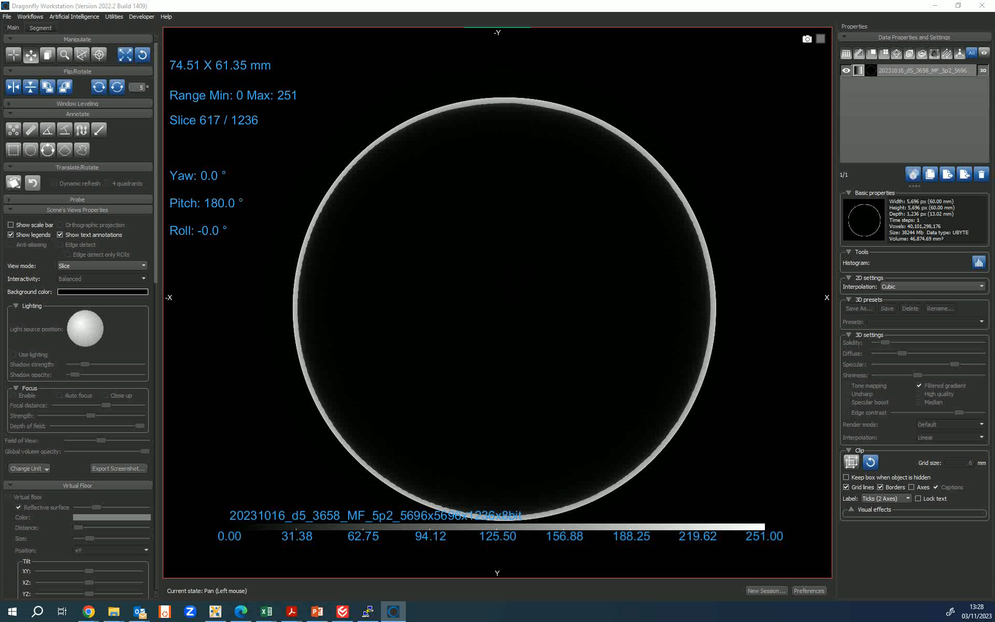

Target QA – CT Scanning (μ-VIS at the University of Southampton)
Resolution of detector is 3000x3000 pixels and 2 horizontal scan locations (5695 x 5695 x 1236 pixels)
Full scan consists of 6000 radiographs through 360° rotation -> Radiographs reconstructed into CT data
200kV X ray energy at 120uA
Final CT resolution = 10.53 x 10.53 x 10.53 microns
File size 252Gb -> 38Gb downscaled to 8-bit grayscale
What can we see from radiographs?
Inclusion or weld “splatter”?
Example radiograph
1 Large void visible
Not much else - Difficult to detect small defects in radiograph.
Thickness variation due to topbead and underbead of weld is greater than defect size.
https://youtu.be/tsuQ2m0u6to

Slide 18





Target QA – CT reconstruction -> Much better contrast and detail + 3D information
3D Visualisation of underbead
Can differentiate weld splatter from inclusions
Much small defects visible than radiographs (20-30um)
3D viewing of pores/inclusions

Slide 19




Target QA – CT Scanning – Analysis of first 1.3MW operational target tube (v5)
Analysis of pores using Dragonfly
Pores are identified by density and segmented as new region of interest. The details of voids (position, size, sphericity, etc) can be output to csv for analysis
Fail
Pass
ASME BPVC Section VIII (Pressure Vessels, Division 2), Part 7
Maximum size of isolated pore is 1/3t = 1/3 x 0.5mm = 0.166mm
Maximum size of random pore is 1/4t = 1/3 x 0.5mm = 0.125mm
NOTES
ASME code only has criteria for indications with wall thicknesses over 3mm
25mm between indications seems challenging for 47mmφ x 0.5mm wall
ASME Code only requires radiographs, in which only the largest pore is identifiable
QA Result: FAIL

Slide 20
Quality assurance – Full target metrology (Zeiss CMM)
Downstream end of target v4 within 97µm of theoretical position.
Line
Plane
0.064mm
0.073mm
Point
Target is mounted horizontally on a support frame and a Coordinate Measuring Machine (CMM) is used to probe target features at key locations. Gravity sag is included!
Fully constrained coordinate system constructed from “functional” datums –> Support plate contact area (plane), alignment hole centre (point) to alignment slot centre (line).

Slide 21





Offline testing - Thermal fatigue testing of ceramic isolators and metal seals
Test section heated by 600W heater tape
Cooled by internal forced convection with air
Heating/cooling PID controlled
Max test temperatures ~200°C
(limited by instrumentation)
70°/min cooling rate achieved at ceramic outer surface
Blower (600m^3/hr)
Ceramic test section
Acoustic baffles (inlet and exhaust) for 24hr running
PID control system
Test section with tape heater
Ceramic or metal seal here
Instrumentation -> PT100’s bonded to ceramic isolator
Temperature of cooling air fixed at room temperature.
Cooling rates can be controlled by changing the dT -> Max temp of ceramic isolator
Notes:
PLEASE DELETE/REPLACE PHOTO CREDIT IF CHANGING THE IMAGE.

Slide 22
Offline testing – Thermal fatigue cycling of Helium ceramic isolator results
Testing of original the original diffusion bonded and proposed brazed isolators has been completed
Brazed ceramic isolator is still ok after 4th phase of testing (19,548 cycles) 4years @ cooling rate more severe than 1.3MW
    1 year of operation is estimated to be about 5000 beam trips
 | Temp Range (°C) | Max cooling rate* (°C/min) | Max heating rate (°C/min) | Cycles complete | Failure detected**
485kW @ 23g/s (Operational data + ansys) | 33-100 | 25 | 23
1.2MW @ 32g/s (CFX - Ansys) | 30-167 | 61
1.3MW @ 60g/s (CFX - Ansys) | 30-101 | 53
Testing phase 1 (complete) | 40-140 | 50 | 35-40 | 5120 | No
Testing phase 2 (complete) | 40-160 | 55 | 35-40 | 5200 | No
Testing phase 3 (complete) | 40-180 | 60 | 35-40 | 5160 | No
Testing phase 4 (complete) | 40-200 | 70 | 35-40 | 19,548 | No
← Beam data
← Expected operating conditions
Brazed isolator
Testing has given good confidence that the brazed isolator can withstand the thermal cycling from beam trips & looks good for higher power operation
Diffusion bonded ceramic failed between 450-770 cycles (leak tested at ~1E-5mbar l/s) and would not pump down on the leak detector after 1090 cycles at 40-140°C
Brazed isolator is preferred technology for thermal fatigue resistance
* Measured or calculated at ceramic surface (e.g. position of PT100)
** Failure detected by helium leak test

Slide 23

Offline testing – Metal seal thermal fatigue – Aluminium Helicoflex HN100
304 Stainless
Ti-6Al-4V
No detectable leak after 6000 cycles to 160°C
This geometry was a proposal to replace a welded joint

Slide 24


Offline testing – Metal seal thermal fatigue – Conflat DN63CF (4.50" OD) gaskets (40-200°C)
CF flange between target and pipes.
Material transition from Ti-6-4 to Stainless

Slide 25




Future upgrades – 1 3MW Production Target Design Changes (V5)
Incorporates all the high-pressure upgrades of the prototype, but with modification to the inlet/outlet pipe joint:
V4 Prototype
V5 Production
CNC controlled planetary EB weld reduces risk of scrapping target
Weld access here is very difficult
Difficult/risky titanium hand TIG welds – CT scans show Tungsten inclusions
Tungsten inclusions in radiograph
We gave the welder a difficult task!
EB welding parameters have been developed successfully and are ready for production parts

Slide 26


Future upgrades – Possibility to use higher density graphite -> Improved physics performance
Current graphite
IG-15 & IG-45 looks like a good candidates
4.2% Higher density – Increased pion yield
Strength about the same
Same high thermal conductivity
Block sizes are better for target rod – Could actually be slightly longer!
Candidate graphite

Slide 27




Future upgrades – Energy deposition effect of higher density graphite
Increasing the Density from 1.82->1.9 (4.2%) increases the integrated heat load by 5.2%
Average and peak energy densities are higher everywhere except:
Upstream window -> No change
Downstream window -> Lower peak energy deposition
Target core
Graphite inner tube
Downstream window
Titanium outer tube
FLUKA simulation
30GeV

Slide 28

Questions?

Slide 29


Target pipe development
Target Pipe Evolution
Leak tested with total leak rate <1E-12mbar l/s
Pressure tested to 7.5bar with acceptable deflections
0.08mm
Pressure balanced pipe design:
All bellows rated for 5 bar WP and 8 bar test
Balancing bellows cancels out thrust force
0.12mm
Time→
1.5x Working pressure
7.5 bar
Active bellows
Balancing bellows
Adjustment bellows
2.8kg
Tri-axis load cell under remote connector measures force during pressure test.
1.4kN Thrust force almost eliminated!
Electrically isolated helium pipes are challenging to design and manufacture

Slide 30

1.3MW prototype target production – Target tube straightness
Runout checks are made before and after welding the tube assembly to the target head.
This weld is critical to the straightness of the target assembly.
Measurement of total runout captures tube straightness, roundness and concentricity.
After welding
Max total runout = 0.518mm
Straightness is approx. 0.259mm
At this stage the assembly can be rotated so that the end of the target points up. This will compensate for the gravity deflection and reduce shimming requirements later.
Runout
Before welding = 0.313mm
After welding = 0.518mm
Runout
Before welding = 0.159mm
After welding = 0.379mm
Base level = 0.006mm
Base runout = 0.004mm

Slide 31



Target QA – CT Scanning (μ-VIS at the University of Southampton)
Other areas of interest
Target / tube spacers
Reslice
Gap measured from CT = 63um
Fasteners and cross flow holes in graphite

