Slide 1
Positron source and target in KEK
2023/11/7
Y. Enomoto

Slide 2
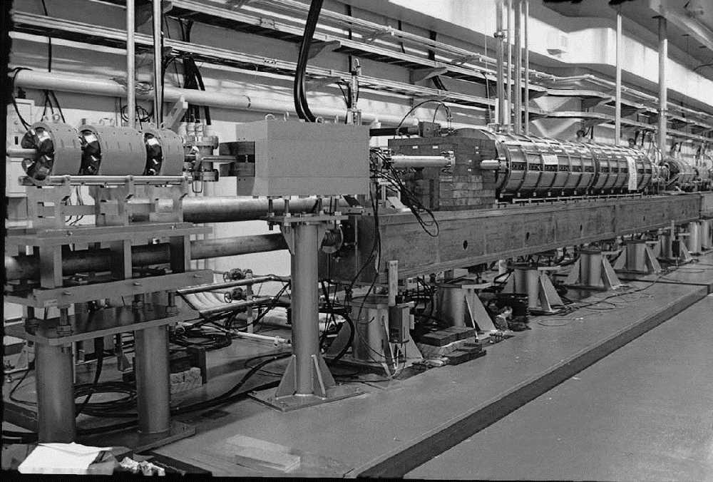
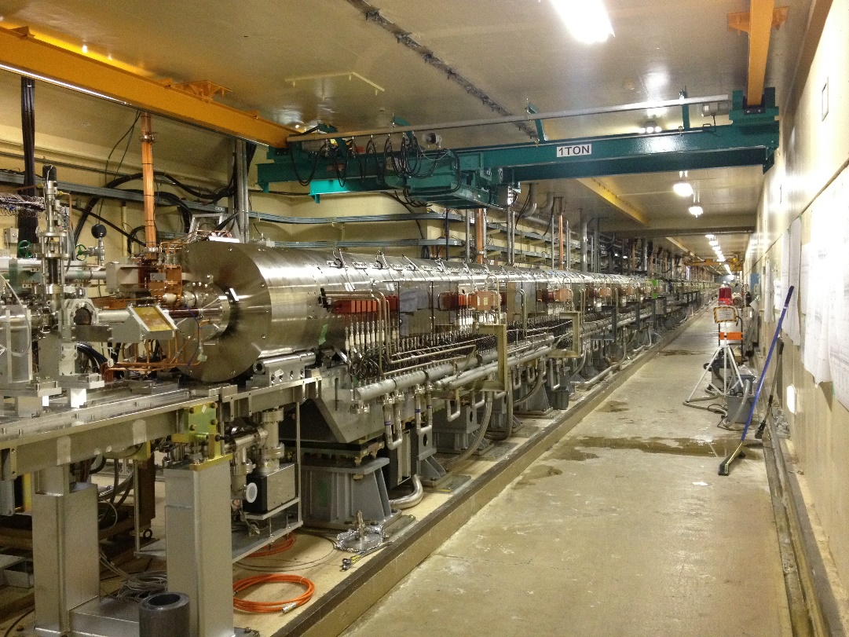
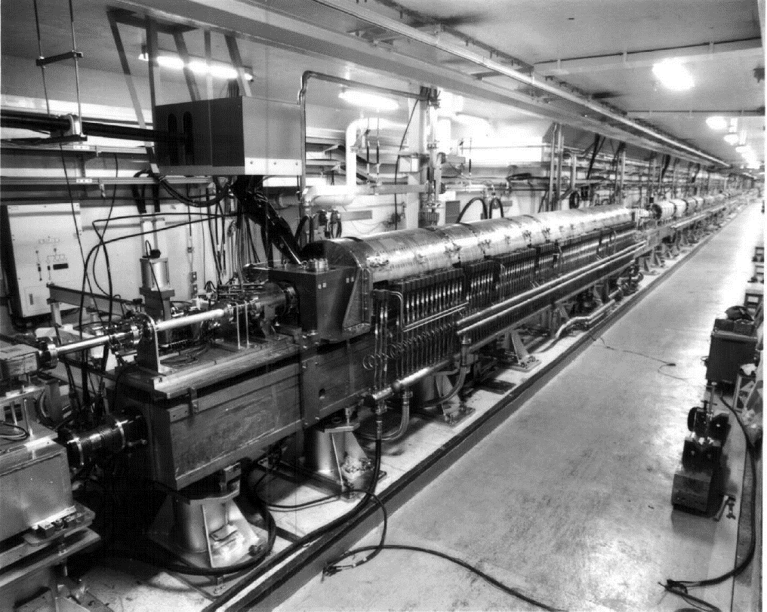
KEK and positron
From TRISTAN to ILC
  KEK LINAC has keep providing positron beam to e⁺e⁻ collider experiment since 1980s.
  Positron source for SuperKEKB is world’s most intense positron source in operation.
  We play an important role to develop future positron source for ILC.
TRISTAN
SuperKEKB
KEKB

Slide 3
Comparison of high-power targets in Japan
 | e⁺ | e⁺ | μ | n | Neutrinos | Hadrons | RIBF
Institute | KEK (SuperKEKB) | ILC (e-driven) | J-PARC | J-PARC | J-PARC | J-PARC | RIKEN
Primary particle | e⁻ | e⁻ | p | p | p | p | C~U
Target material | W | W | C | Hg | C | Au | Be, W
Energy [GeV] | 3 | 3 | 3.5 | 3 | 30 | 30 | 0.345/u
Charge/pulse [nC] | 10 ✕ 2 | 3.7 ✕ 66 | 13300 | 13300 | 52900 | 16470 | CW
Repetition [Hz] | 50 | 100 / 300 | 25 | 25 | 0.47 | 0.19 | CW (1puA)
Beam Power [kW] | 3 | 74 | 1000 | 1000 | 750 | 95 | 82
Beam size σ_{x} ✕ σ_{y} [mm] | 0.5 ✕ 0.5 | 2 ✕ 2 | 3.5 ✕ 3.5 | 37 ✕ 17 | 4.2 ✕ 4.2 | 2.5 ✕ 1.0 | 0.42 ✕ 0.42
Thickness [mm] | 14 | 16 | 20 | 2000 | 909 | 66 (6 ✕ 11) | ~mm
Deposited power [kW] | 0.5 | 18.8 | 3.1 | 480 | 20 | 7.4 | 18
PEDD [J/g] | 27.5 | 33.6 | 20 | 1.1 | 190 | Slow extraction | CW
Cooling | Water | Water | Radiation | Water | He | Water | Water
structure | Fixed | Rotating | Rotating | Liquid | Fixed | Fixed | Rotating
■■ beam power
■ deposited power
Power (kW)
SKEKB
ILC
μ
n
H
ν
RIBF
SKEKB
ILC
μ
n
H
ν
RIBF

Slide 4
Particle sources and positron source
secondary particle source
Primary particle source
Neutron source
Muon source
Neutrino source
Accelerator
Electron source
Ion source
High quality beam for acceleration
Stand alone test is possible
No radiational, thermal requirement
Positron source source
Low beam quality is acceptable
Need high power primary beam
Severe radiational, thermal requirement
Positron source is installed in the middle of accelerator
Collection and acceleration of secondary particles
need high power primary beam for full test
  Usually impossible before construction

Slide 5
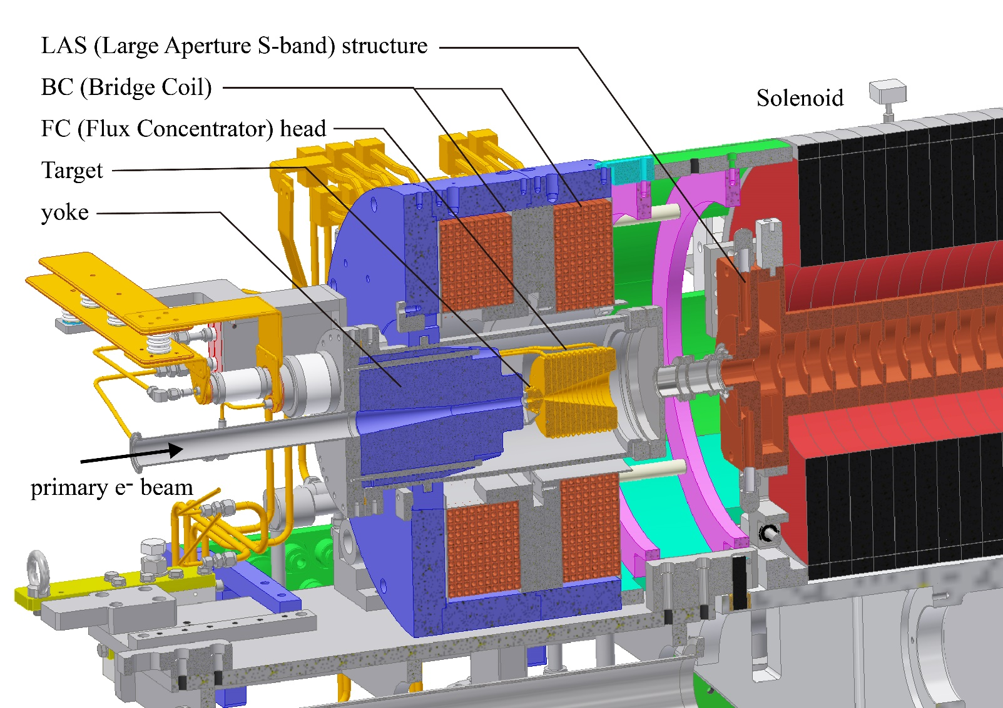
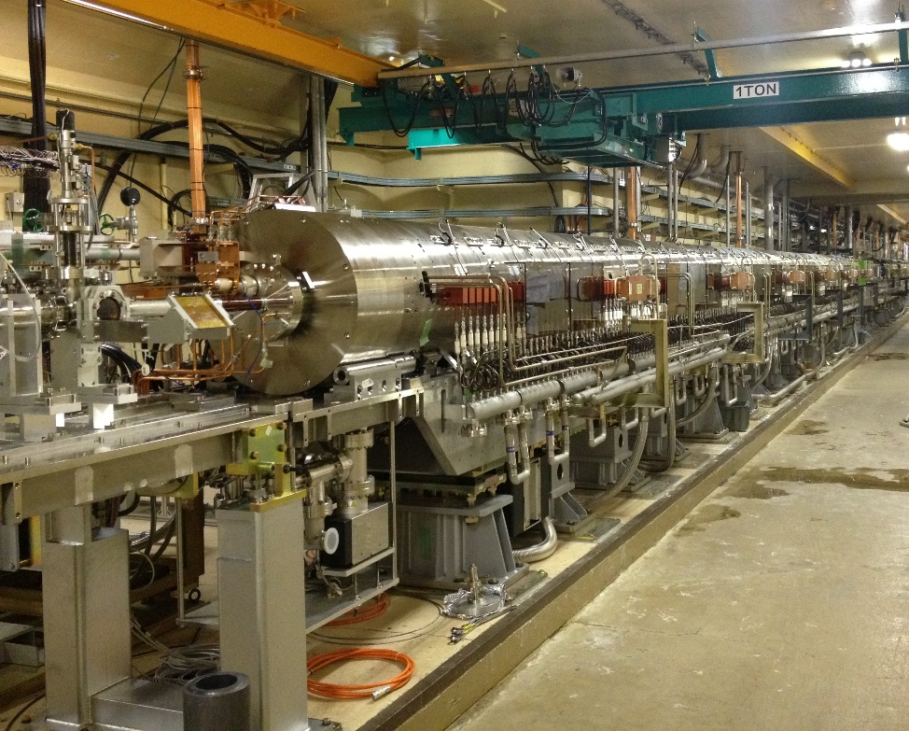
Positron source for SuperKEKB
Originally developed by SLAC
Almost all the other positron sources follows this design
Surrounded by solenoid → limited space
Need UHV （<10⁻⁶ Pa）
FC = pulsed coil (20 kV, 12 kA) installed close to target (2mm)

Slide 6
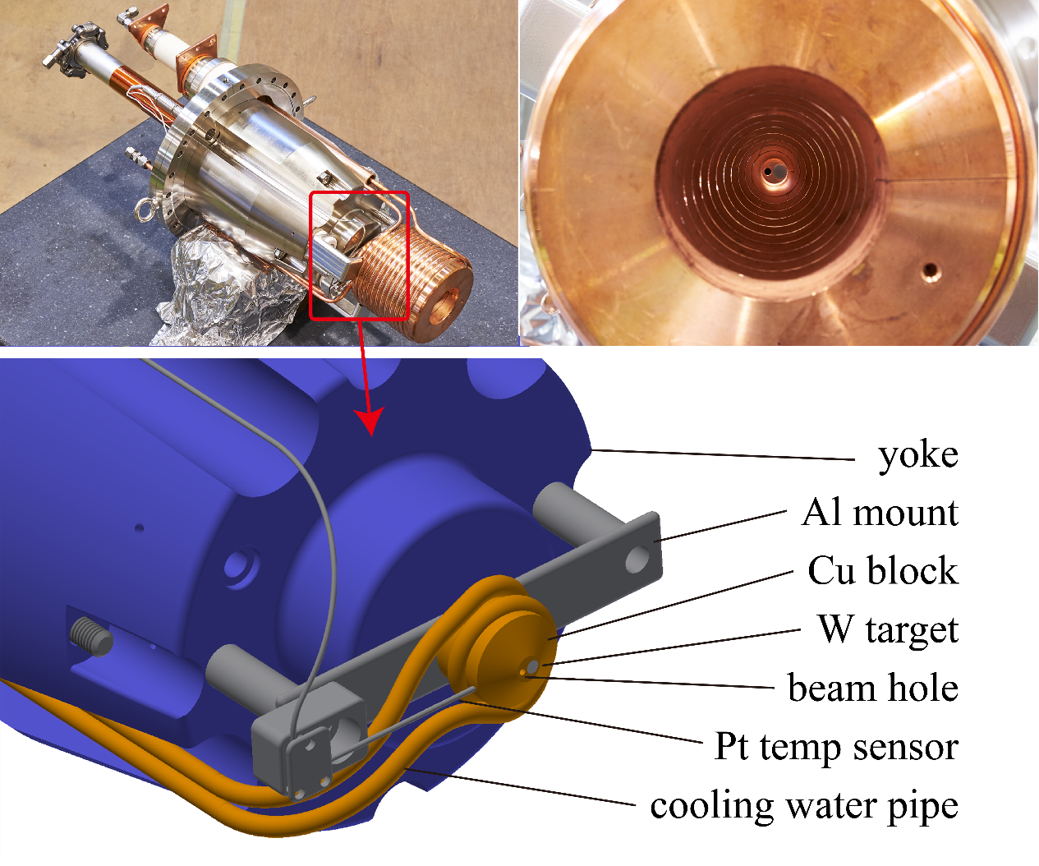
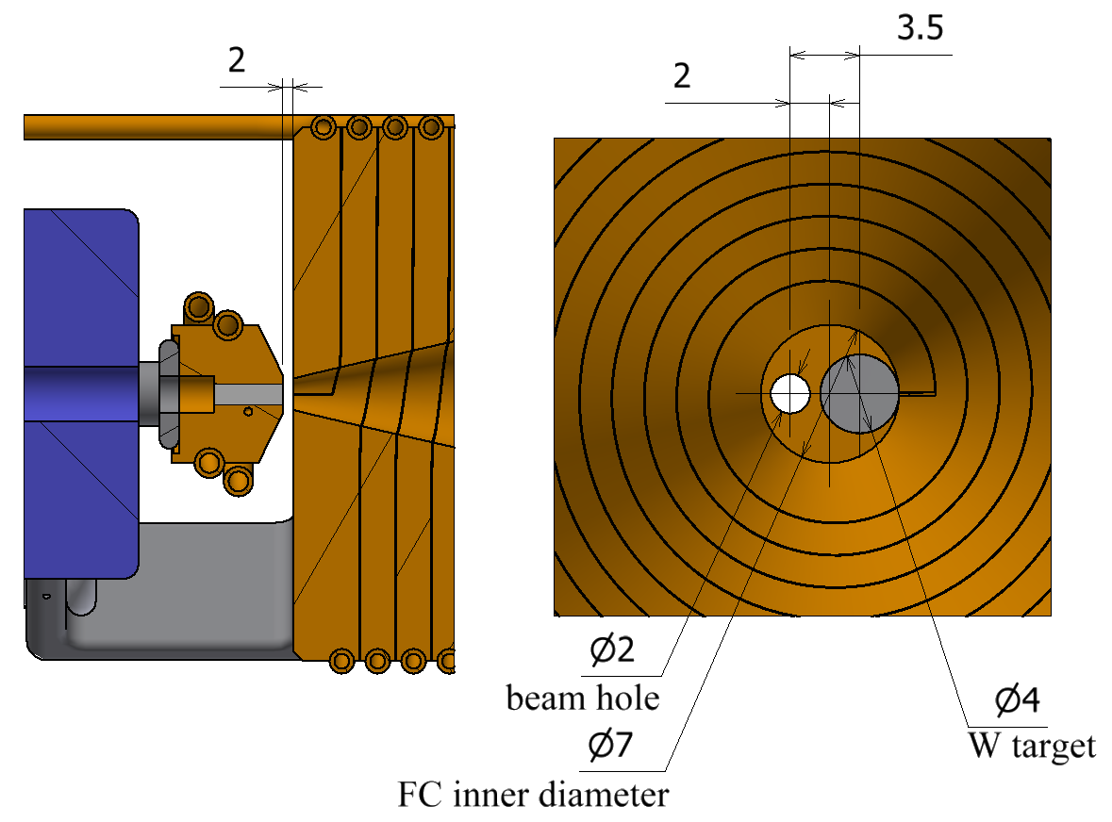
SuperKEKB target
W（Φ4 ✕ L14）、HIP to Cu block for cooling
Hole for electron
Beam power 3 kW (3 GeV ✕ 10 nC ✕ 2 bunch ✕ 50 Hz)
Deposition ~ 0.7 kW
PEDD : 27.5 J/g

Slide 7
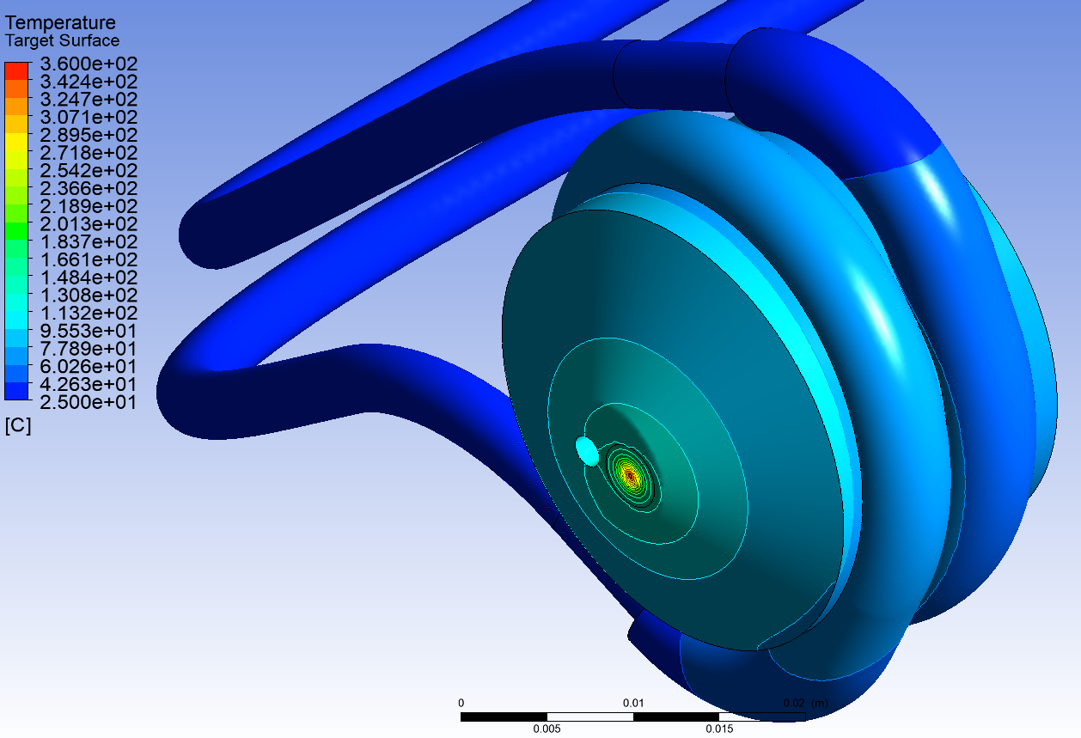
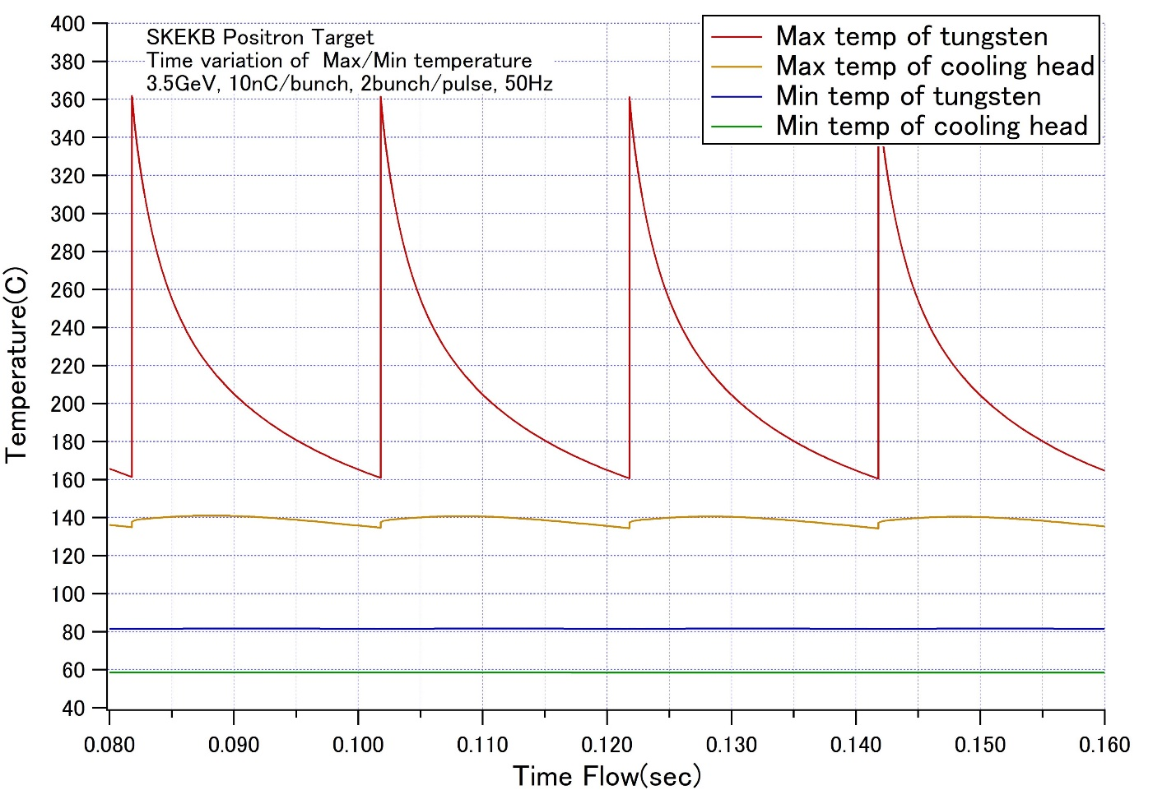
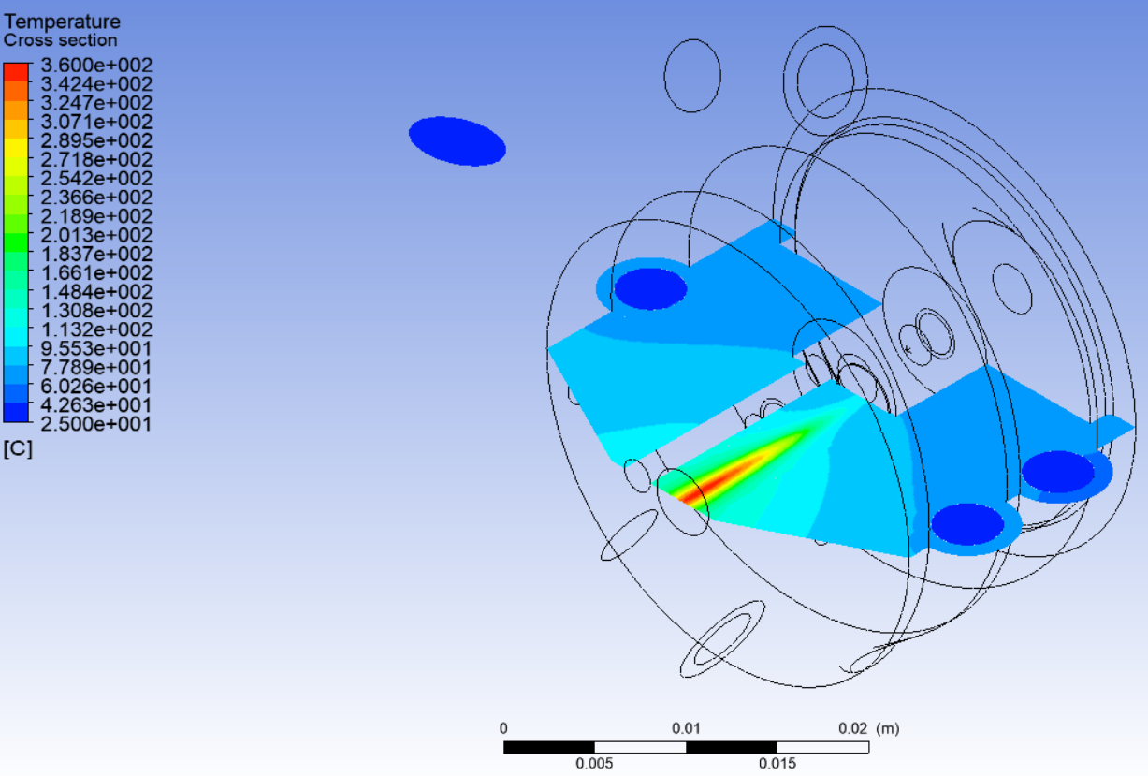
temperature
Y. Morikawa
20 ms
Pulsed heating every 20 ms by beam
Amplitude ~ 200℃

Slide 8
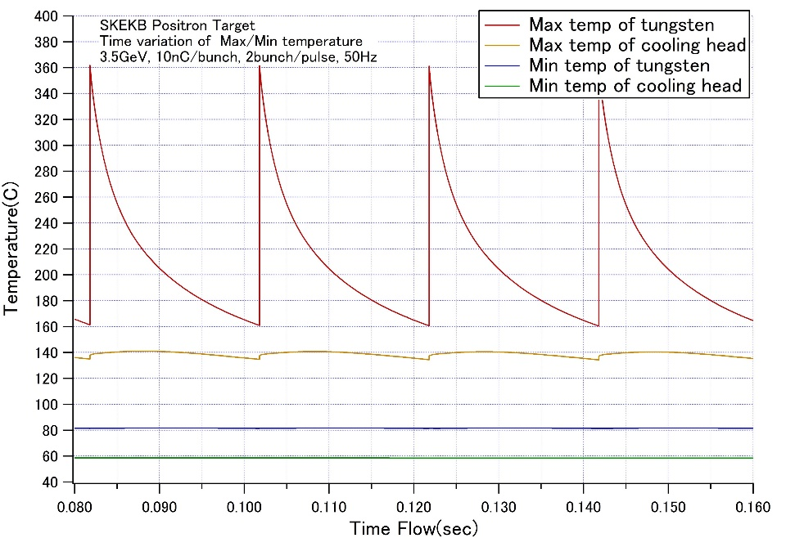
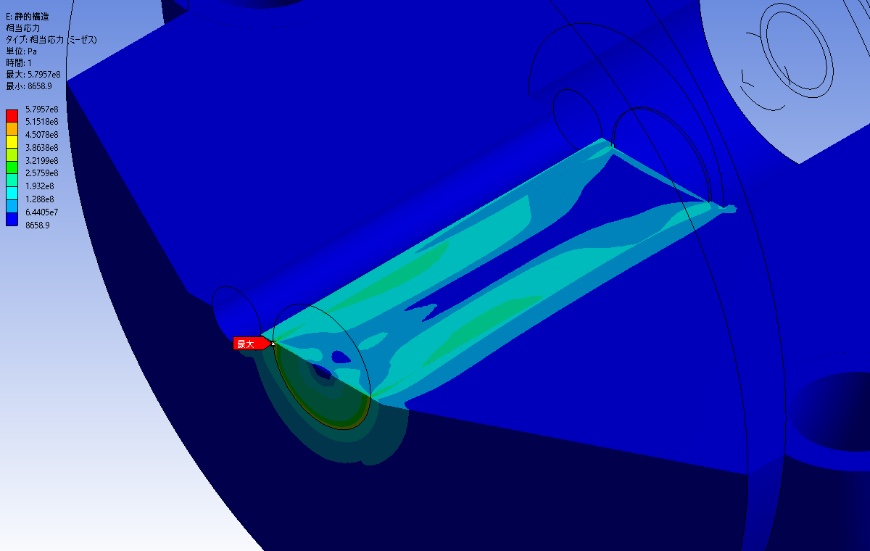
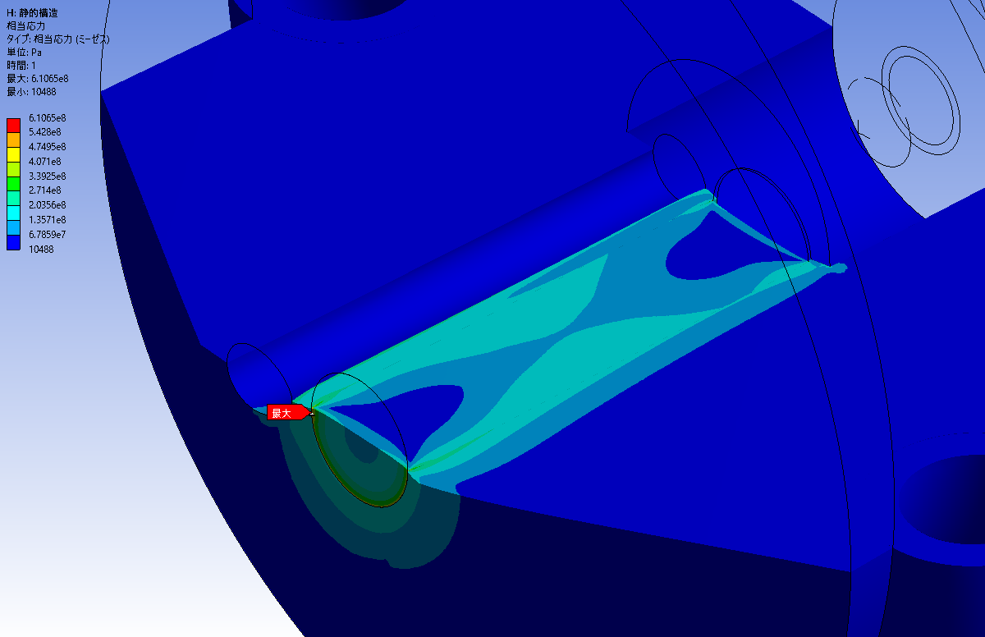
stress
Y. Morikawa
Thermal stress by pulsed beam
High at Cu-W contact surface
Care must be taken to fatigue
50 Hz = 4 ✕ 10⁶ /day
Beam heat peak
(140 MPa)
Beam heat peak
(30 MPa)
Caused by difference of thermal expansion coefficient and edge geometry (580MPa)
Caused by difference of thermal expansion coefficient and edge geometry (610MPa)

Slide 9

Withstanding heat load
Melting point
  Unavoidable Limit
Single pulse destruction
  Thermal stress exceed material yield strength
  Short pulse beam → instantaneous temperature rise
Embrittlement by recrystallization
  W-Re alloy shows better value
    Difficult to obtain large size
  Advanced W alloys are one of research field
    JPS Conf. Proc. 28, 031002 (2020)
Fatigue
  limit by repetitive thermal load by pulsed beam
~3700 K
(456 J/g)
Melting point
~2160 K
(250 J/g)*
Single pulse
destruction
~1500 K
(161 J/g)
embrittlement by
recrystallization
~870 K
(77 J/g)
fatigue
Value in （） varies design of target.
Here target of SuperKEKB is assumed for reference.
*thermal stress reach 1 GPa

Slide 10
From SuperKEKB to ILC
Based on SuperKEKB
Big jump from SuperKEKB
3 x SLC in beam power (74 kW)
4 x SuperKEKB in capture efficiency
●past
▲present
◆future
ILC e-driven
CLIC
High efficiency
SuperKEKB
FCCee
BEPC
DAFNE
VEPP-5
CEPC
KEKB
SLC
ILC undulator
High power

Slide 11
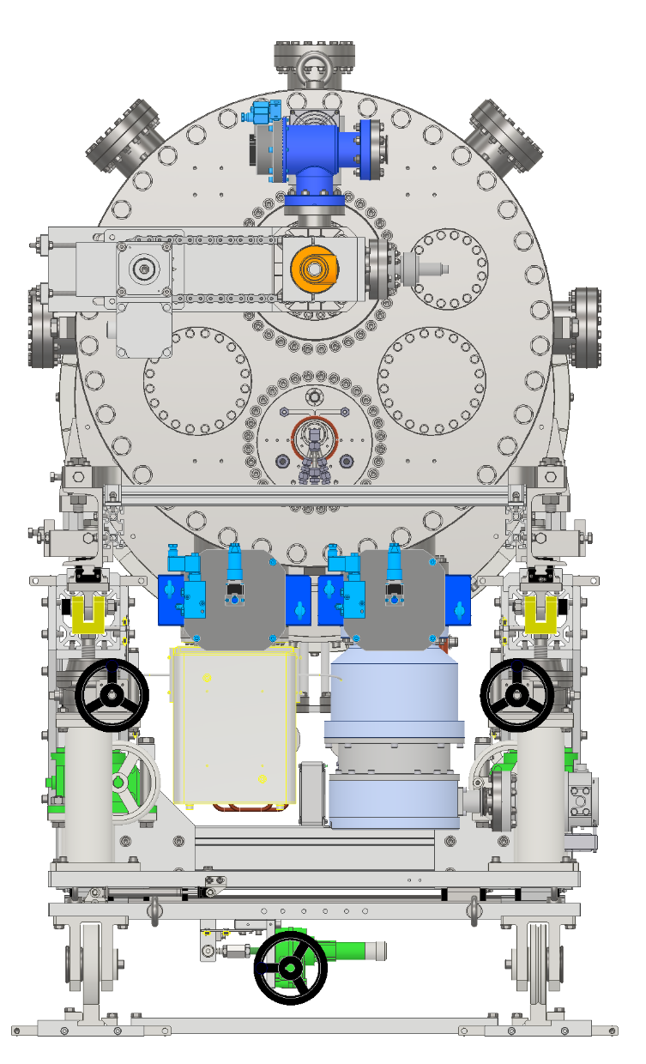
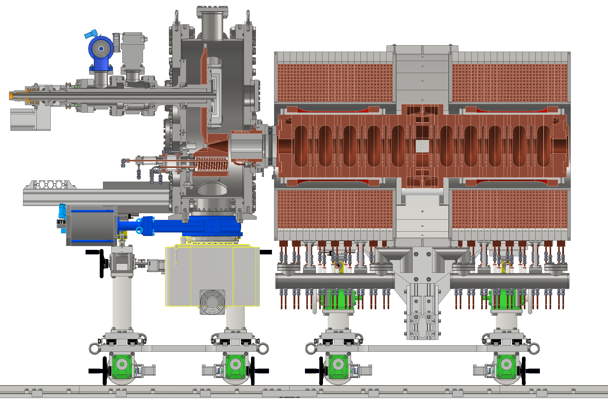
Latest 3D model for ILC positron source
Rotating target
RF cavity
solenoid
Flux concentrator

Slide 12
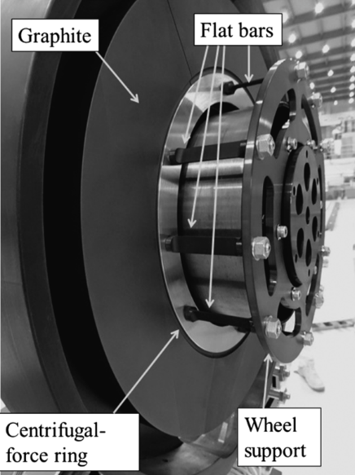
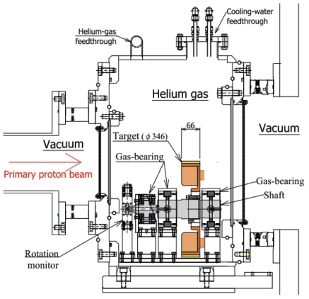
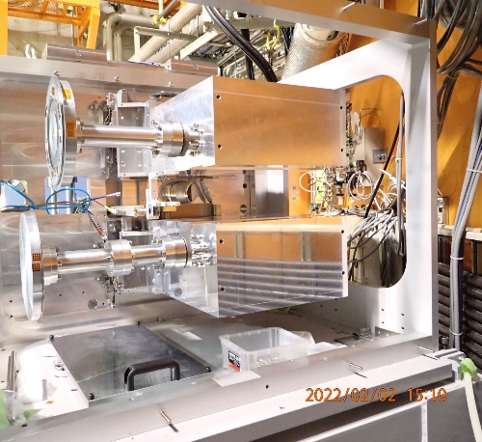
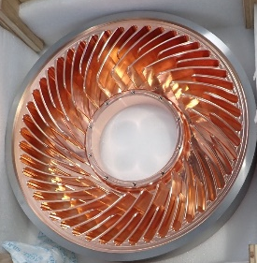
Rotating target in Japan
 | e⁺ | μ | Hadrons | RIBF
Institute | ILC (e-driven) | J-PARC | J-PARC | RIKEN
Primary particle | e⁻ | p | p | C~U
Target material | W | C | Au or W | Be, W
Repetition [Hz] | 100 / 300 | 25 | 0.19 | CW (1puA)
Beam Power [kW] | 74 | 1000 | 150 | 82 (design)
Deposited power [kW] | 18.8 | 3.1 | 11 | 18 (design)
PEDD [J/g] | 33.6 | 20 | Slow extraction | CW
status | Prototype | In operation | Prototype | In operation
Cooling | Water | Radiation | He | Water
Thanks to
J-PARC Muon: Matoba, Makimura
J-PARC hadron: Sawada, Takahashi, Watanabe
RIKEN RIBF: Yoshida, Yanagisawa

Slide 13
To do
Water cooled UHV compatible rotating mechanism
Robust W-Cu connection
RF cavity after the target
  ~a few 10 kW heat load from shower
Flux concentrator compatible with rotating target
Exchange mechanism of highly activated materials in accelerator tunnel
  Not in special target area
  Deep underground (~100 m) and limited space
Grant from MEXT
FY2023 ~ FY2027
Development started 2022/Q4

Slide 14
5 years-plan
FY |  | 2022 |  | 2023 |  |  |  | 2024 |  |  |  | 2025 |  |  |  | 2026 |  |  |  | 2027
year |  |  | 2023 |  |  |  | 2024 |  |  |  | 2025 |  |  |  | 2026 |  |  |  | 2027
Quarter |  | Q4 | Q1 | Q2 | Q3 | Q4 | Q1 | Q2 | Q3 | Q4 | Q1 | Q2 | Q3 | Q4 | Q1 | Q2 | Q3 | Q4 | Q1 | Q2 | Q3 | Q4 | Q1
Test bench
High power test bench
W-Cu connection
Target unit | 1st unit
 | 2nd unit
 | 3rd unit
FC base | 1st unit
 | 2nd unit
magnet | Solenoid + ST
 | Power supply
Chamber, vacuum, support
Acc. Structure | Dummy
 | 1st unit
 | 2nd unit
FC power supply
RF power supply
Design
Manufacuring
test

Slide 15
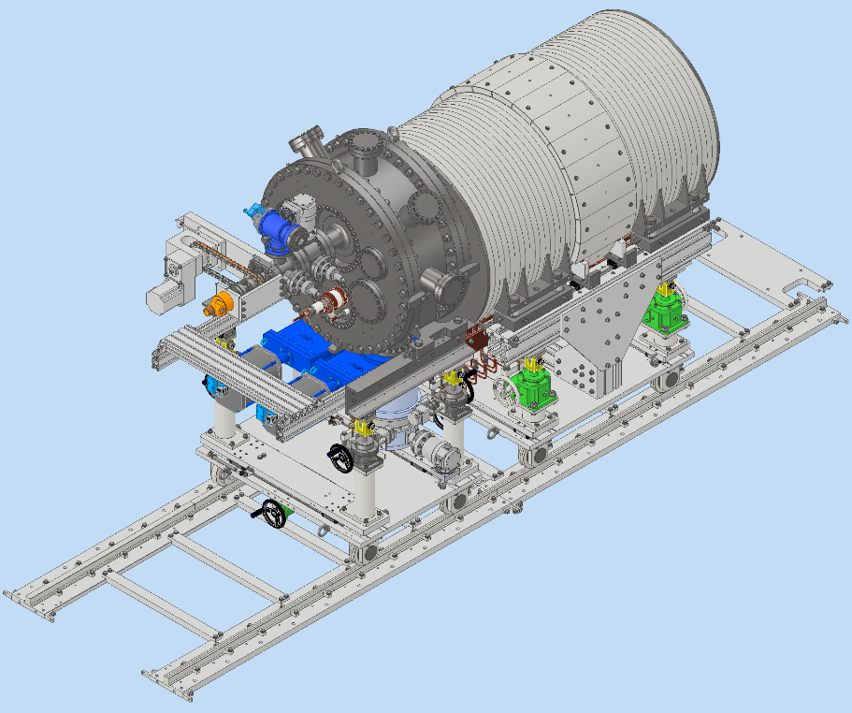
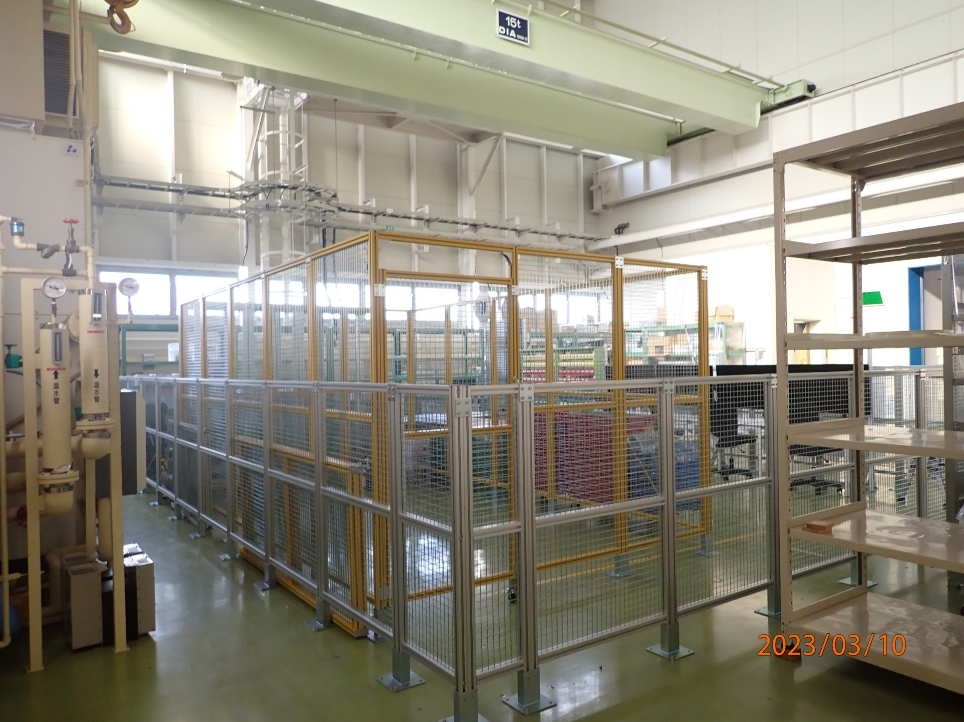
Test bench for ILC positron source

Slide 16
Summary
Say hello to the high-power target community from positron group
Different requirement and limitation from proton machine
  Most of the technologies are still useful for us
Requirements of the ILC, linear collider, are very high
We started development for ILC recently
  Details about rotating target → next talk

Slide 18
Bunch structure
M. Kuriki, OHO seminar 2021
Create positron for 66 ms
Store them in the DR for 199.3 ms
Extract them to main linac for 0.7 ms
20 pulse / train
66 bunch / pulse
1320 bunch / train
Repetition 5 Hz
FC must keep field variation below the requirement to keep bunch-by-bunch charge variation
Minimum current pulse width is about 500 ns
66
…….
train
3.3 ms✕20 = 66 ms
pulse

