Slide 1
LBNF Hadron Absorber – Design Status & Assembly Planning
Jonathan Williams – FNAL Target Systems Department
High Power Targetry Workshop
7 November 2023

Slide 2
Outline
LBNF Overview
System Requirements
Design Overview
Assembly & Installation Planning

Slide 3
LBNF Overview

Slide 4
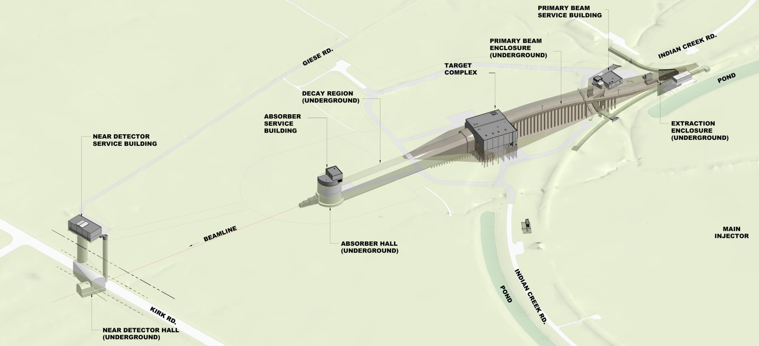
Long-Baseline Neutrino Facility
Make the neutrino beam for DUNE
Protons on a graphite target > focus pions > decay to neutrinos
What happens to the protons? Everything else?

Slide 5
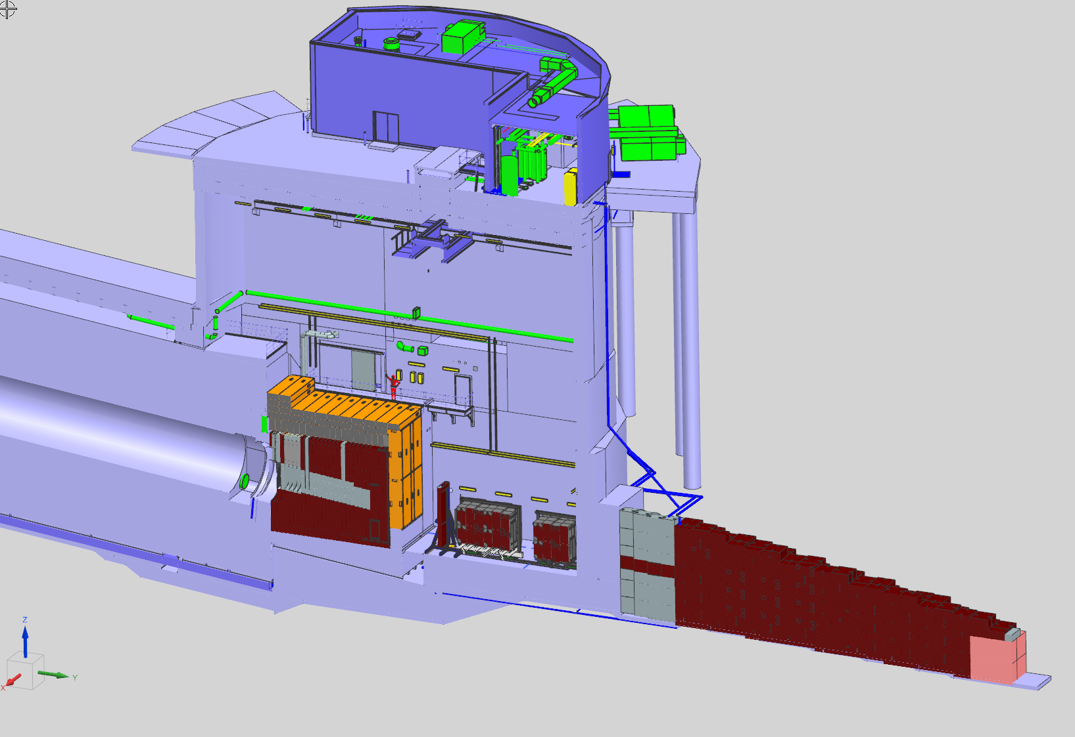
LBNF-30: Absorber Complex
Service Building
Access Hatch
Beamline
Decay Pipe
Hadron Absorber
Muon Monitors
& Shielding
Muon Kern

Slide 6
Absorber Requirements
Intercept primary proton beam
2.4 MW @ 120 GeV: 1.2s cycle time, 1.5E+14 protons per pulse
2 full-power accident pulses, assuming no hit on target or baffle
Beam permit interlock
Active detection, limit accident pulses to 2
Serviceability & Accident Resiliency
30-year design life, allow for future upgrades/replacements in core (plus morgue space)
Structural Integrity
Interface with decay pipe
Radiological Safety
Interventions and Operations - ALARA

Slide 7
Design Overview

Slide 8
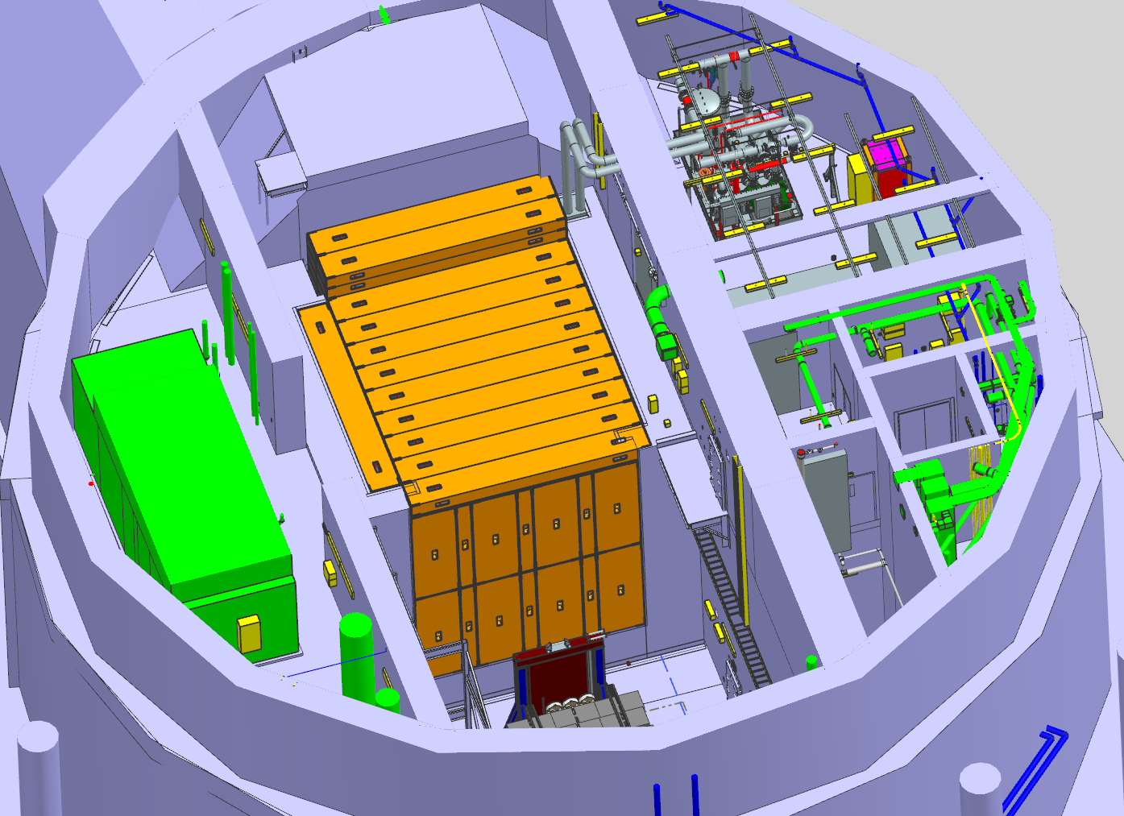
Concrete Blocks
48x “G”-blocks, 24ft x 3ft x 1.5ft (7.32 m x 0.91m x 0.46m)
Includes 10x heavy mix concrete at top upstream end (extra boron)
“T”-shaped blocks for downstream face
Provide labyrinthing
G-Blocks make an air seal over pile
Air supply for cooling
Isolate absorber/morgue air volume from Hall
Need to redo caulking after interventions

Slide 9
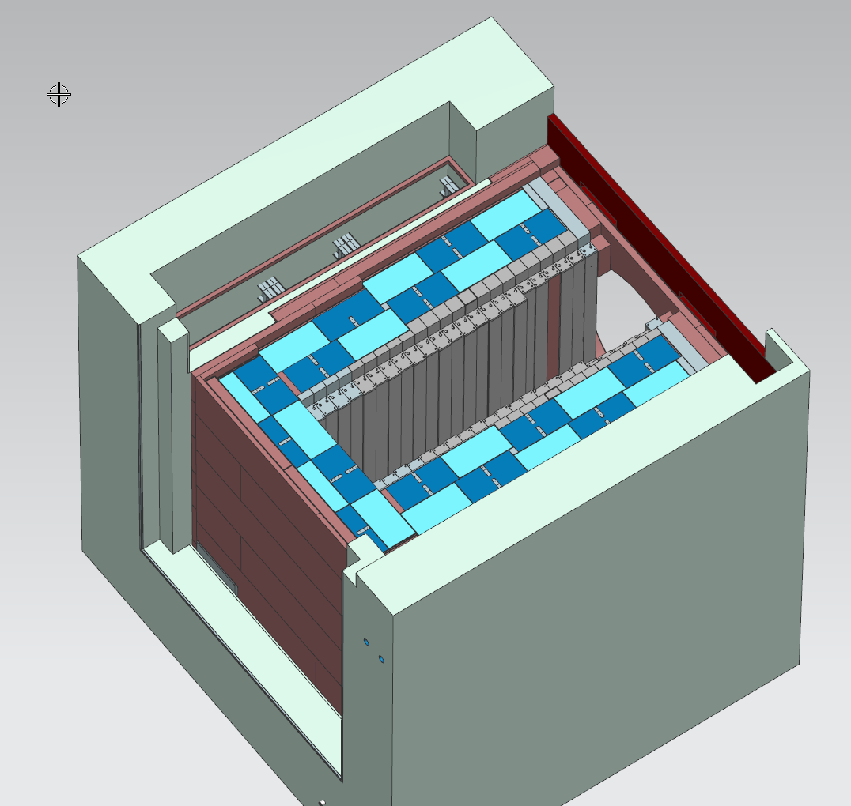
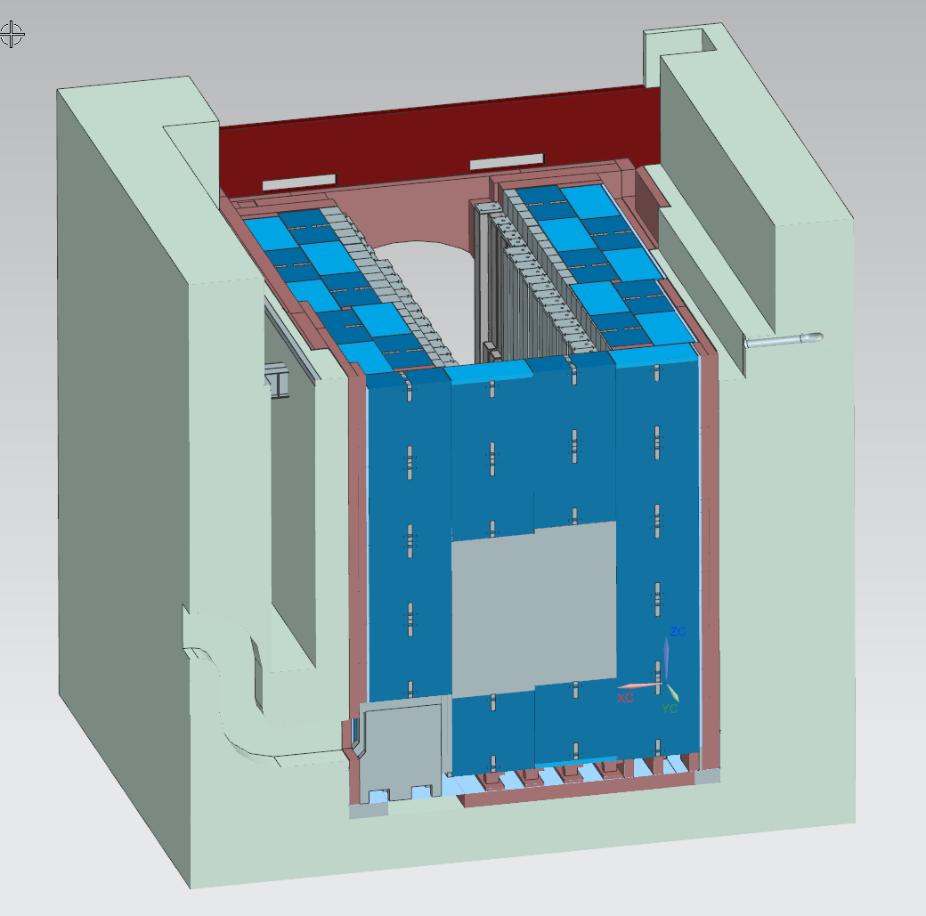
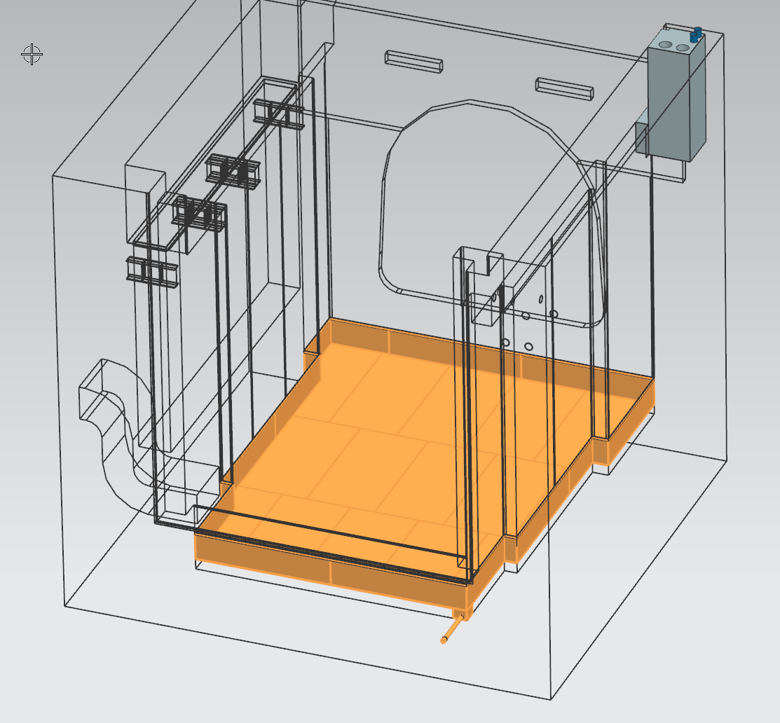
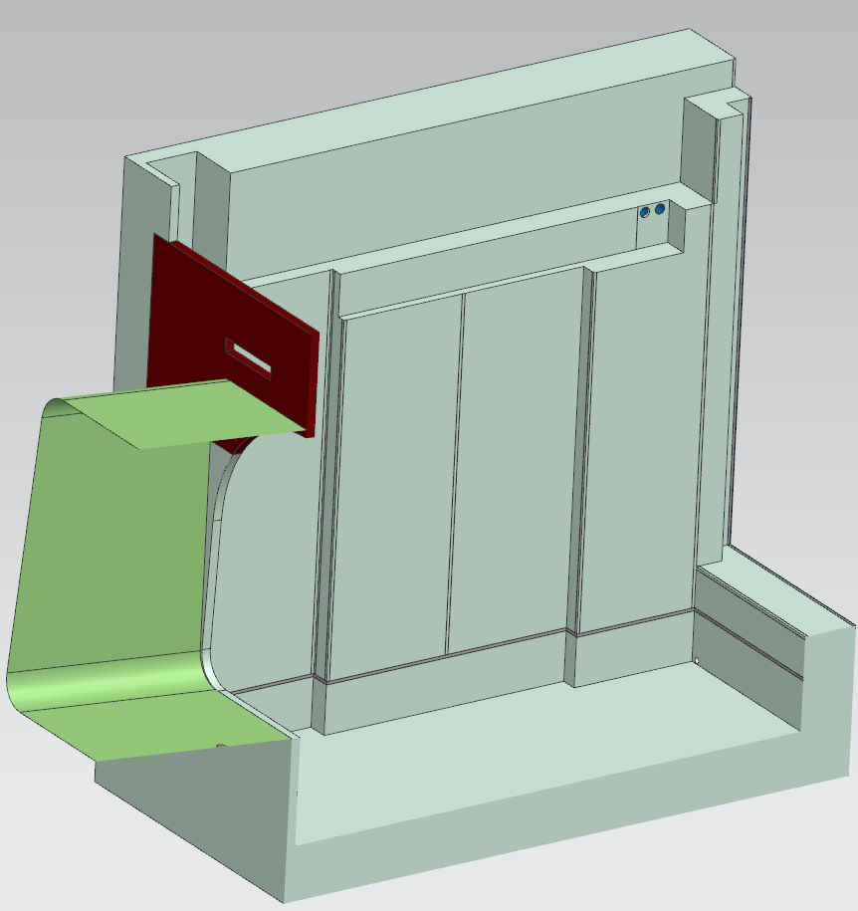
Bunker & RAW Pan
Bunker
Morgue: 4 core modules, 2 hadron monitors (HADES)
Air inlet & exhaust
Water supply manifold
Stainless steel pan (1/4” thick) to catch water leaks from core
Leveling during assembly is crucial
Embeds in wall to attach sides of pan

Slide 10
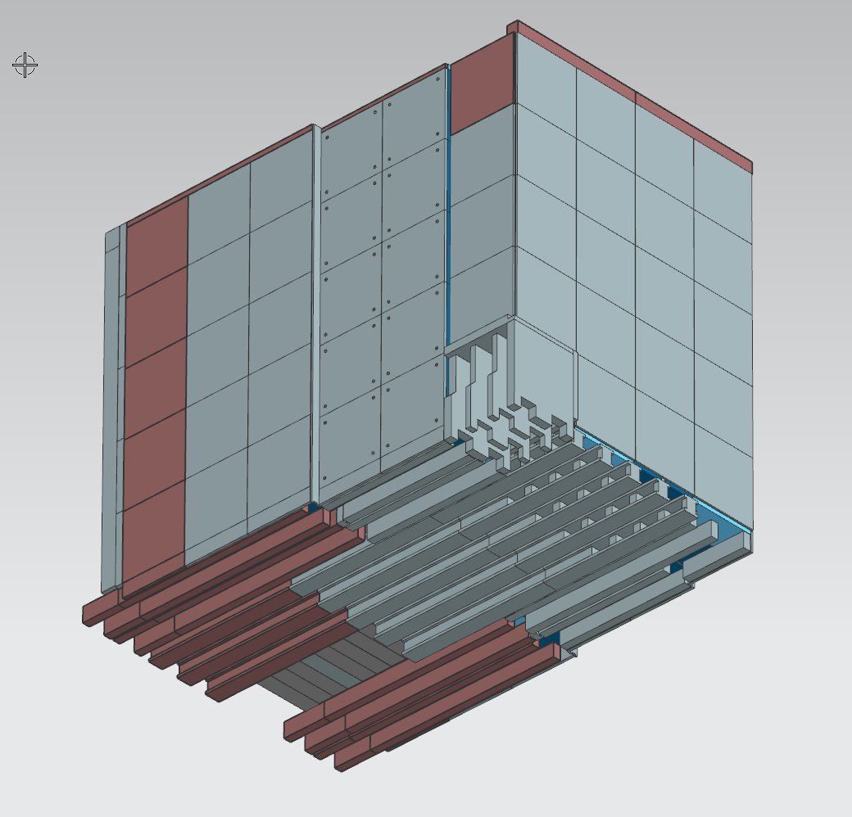
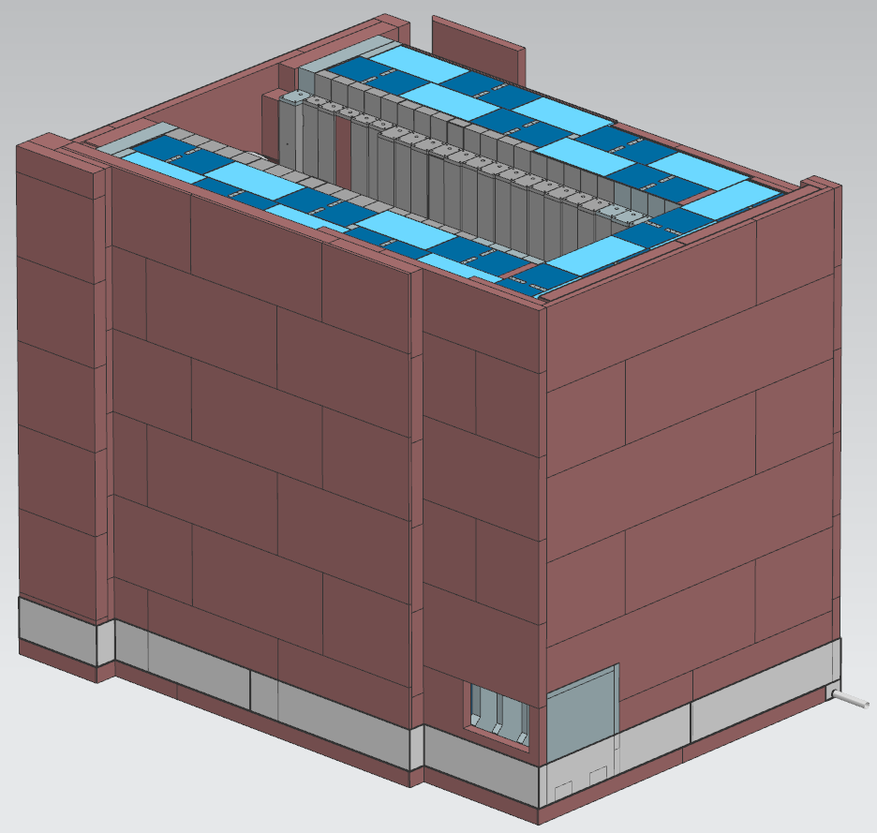
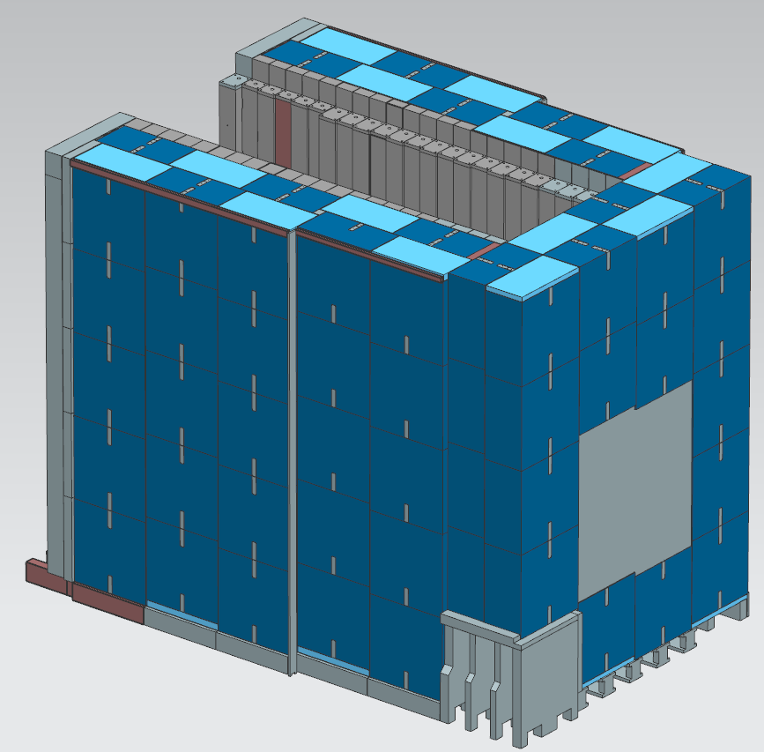
Outer Steel Shielding
1.2 million pounds Continuous-Cast Salvage Steel (CCSS)
130 Duratek S2 Shield Blocks (Blue Blocks), 20,000 lbs each (2.6M total)
Blue Blocks are air-cooled

Slide 11
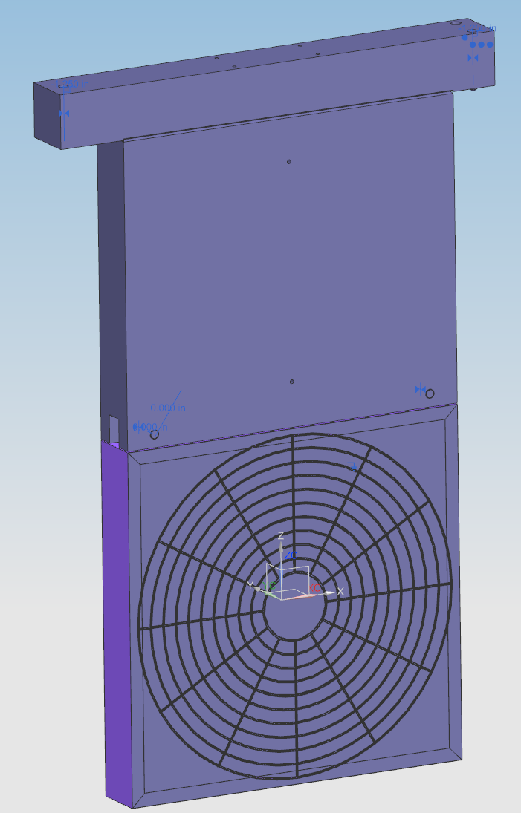
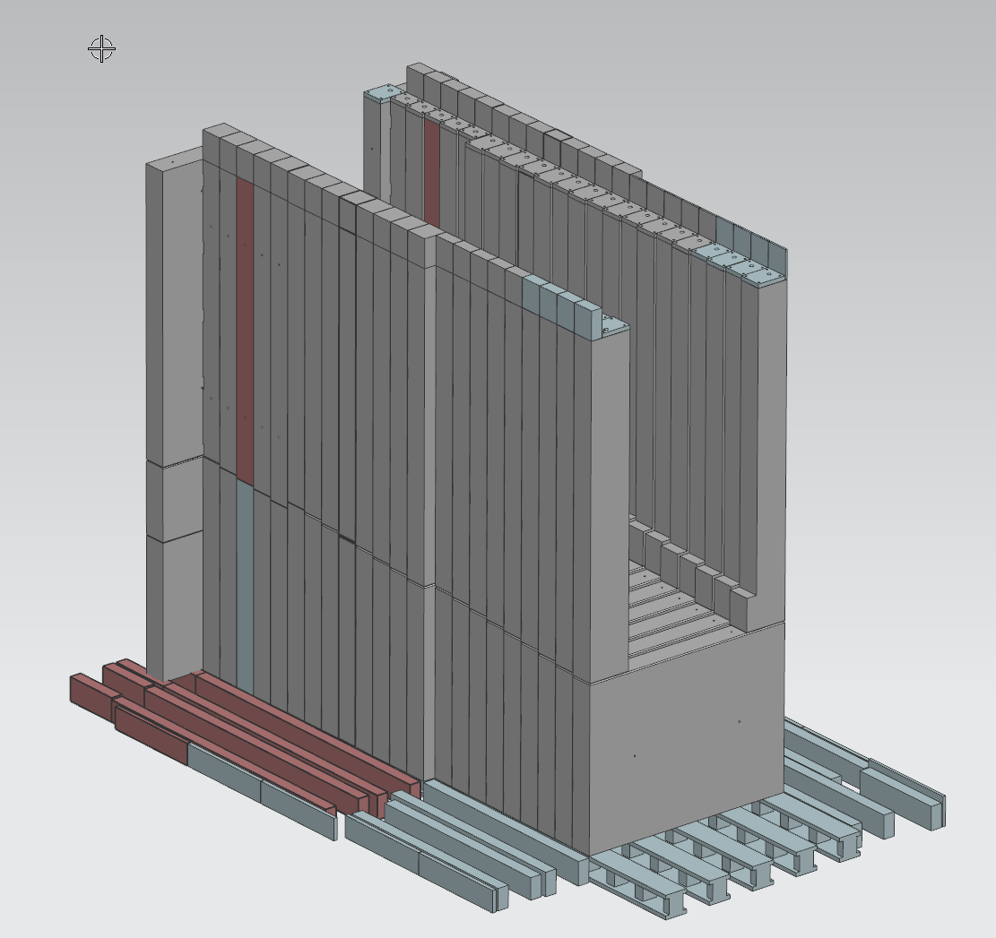
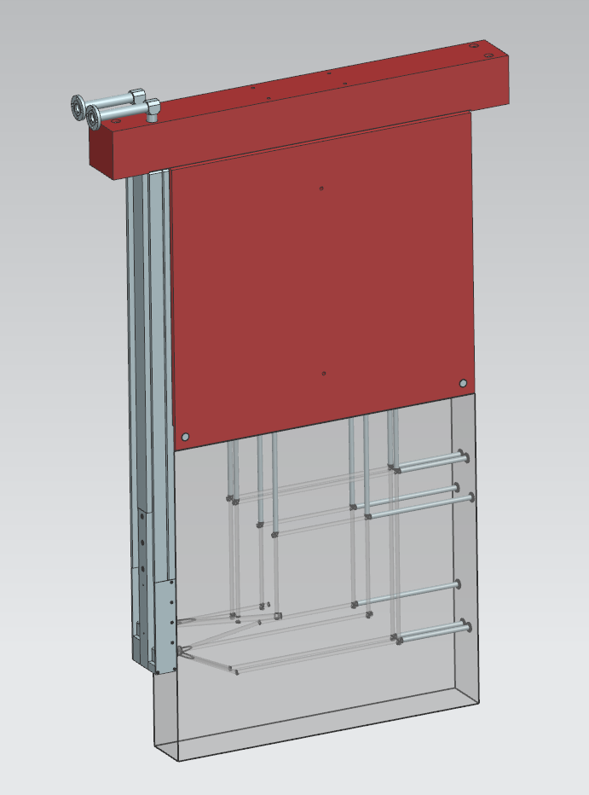
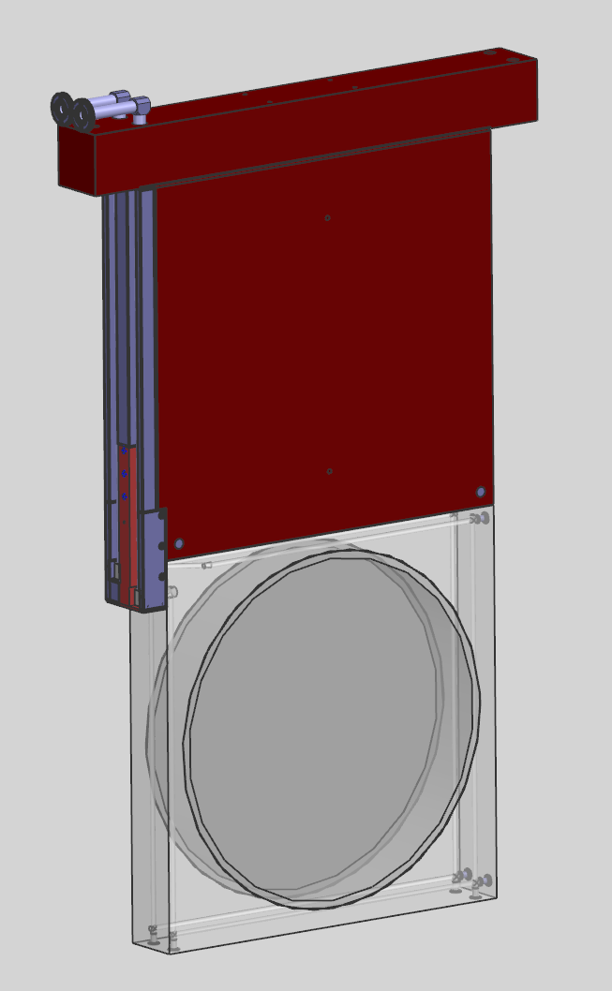
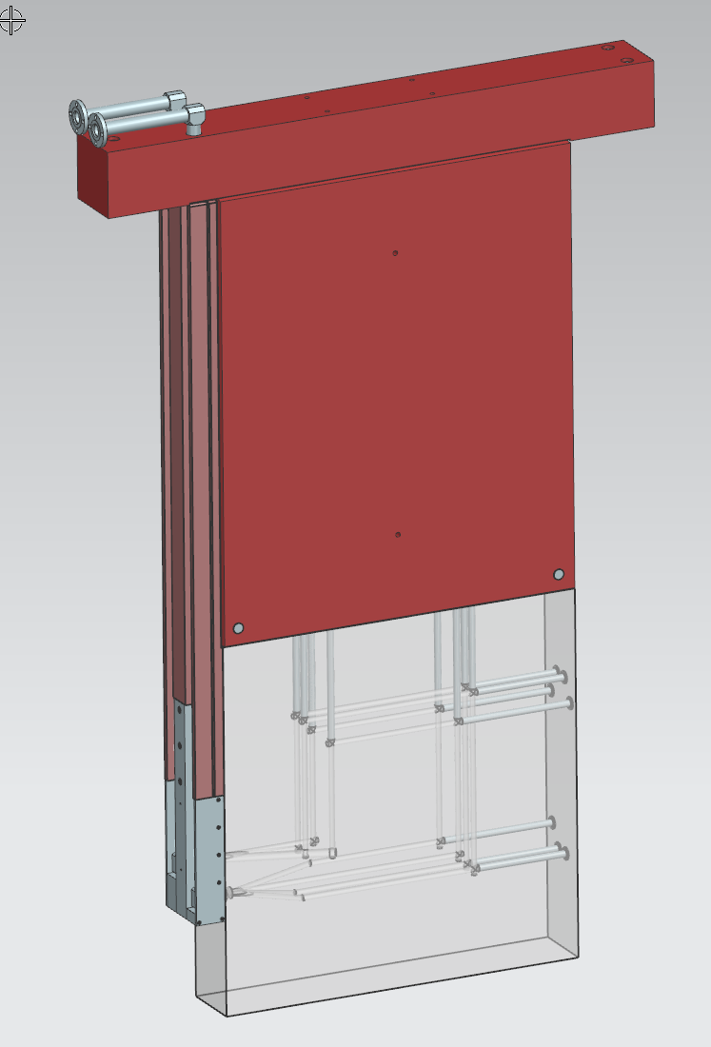
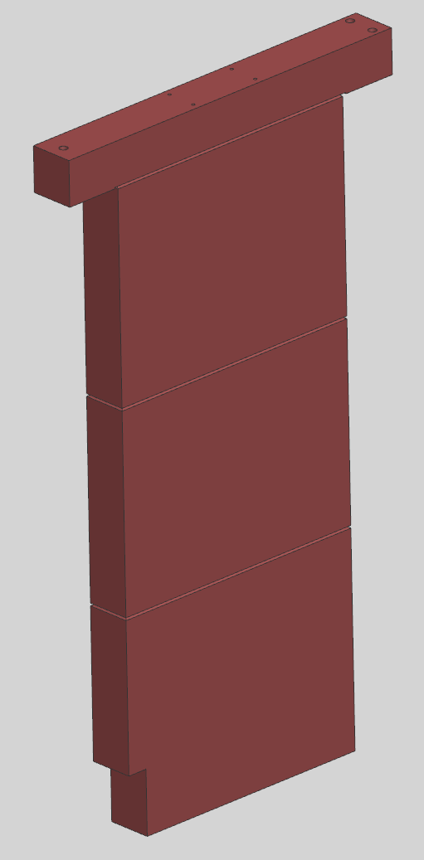
Core Modules & Supports
HADES (left)
Pre-Spoiler Air Box (right)
Steel T-Block (air-cooled)
Absorber based on NuMI target shield pile
Aluminum core blocks (water-cooled)
Staggering along beam direction – wide/narrow blocks
Module Supports
Spoiler
Mask
Al Core
Steel Core

Slide 12
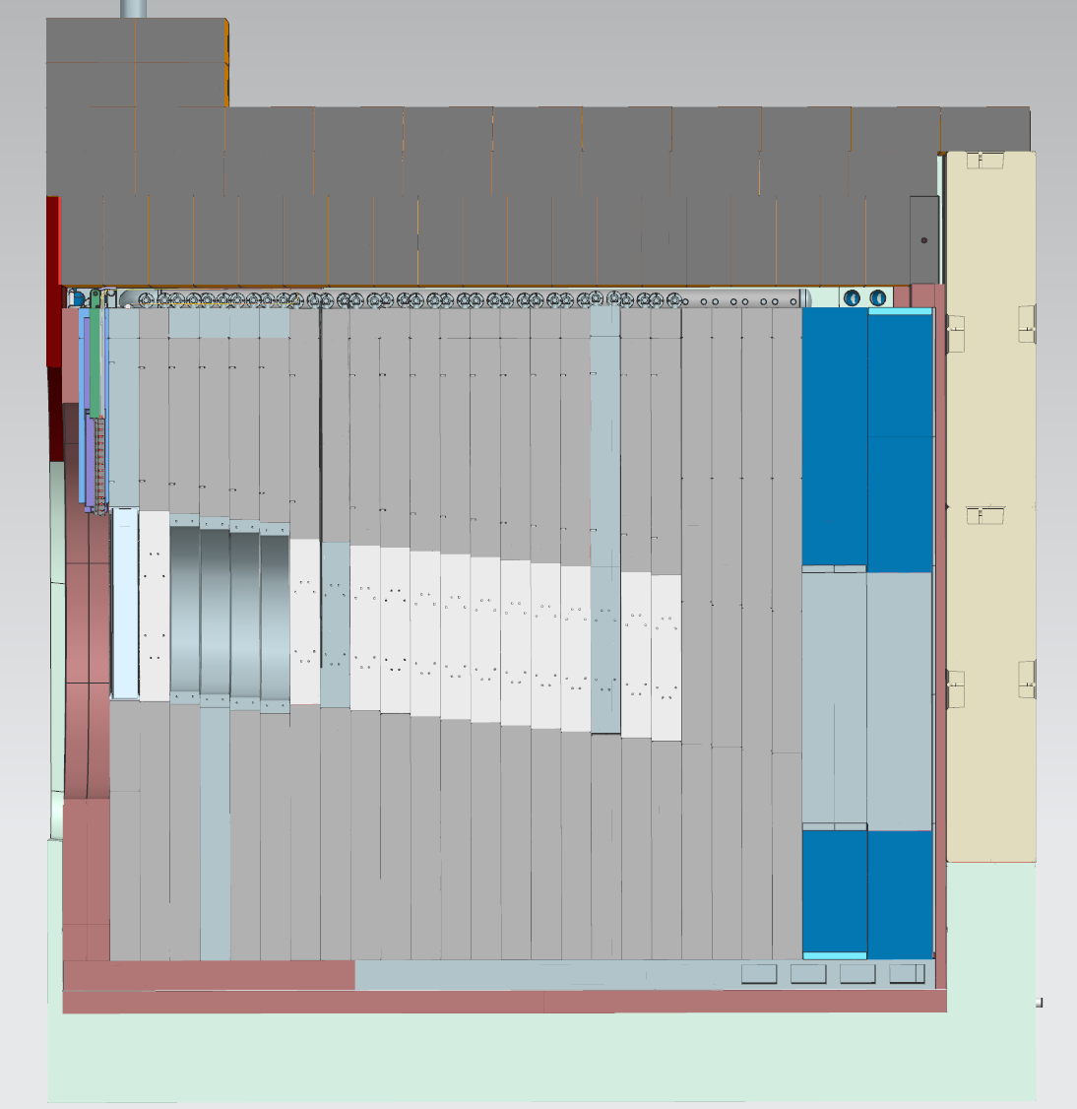
Core Modules & Supports
Spacer plates between supports maintain air gap
Leveling screws on modules
Bring in modules after chase is complete
Take time to align/level each module to ensure spacing

Slide 13
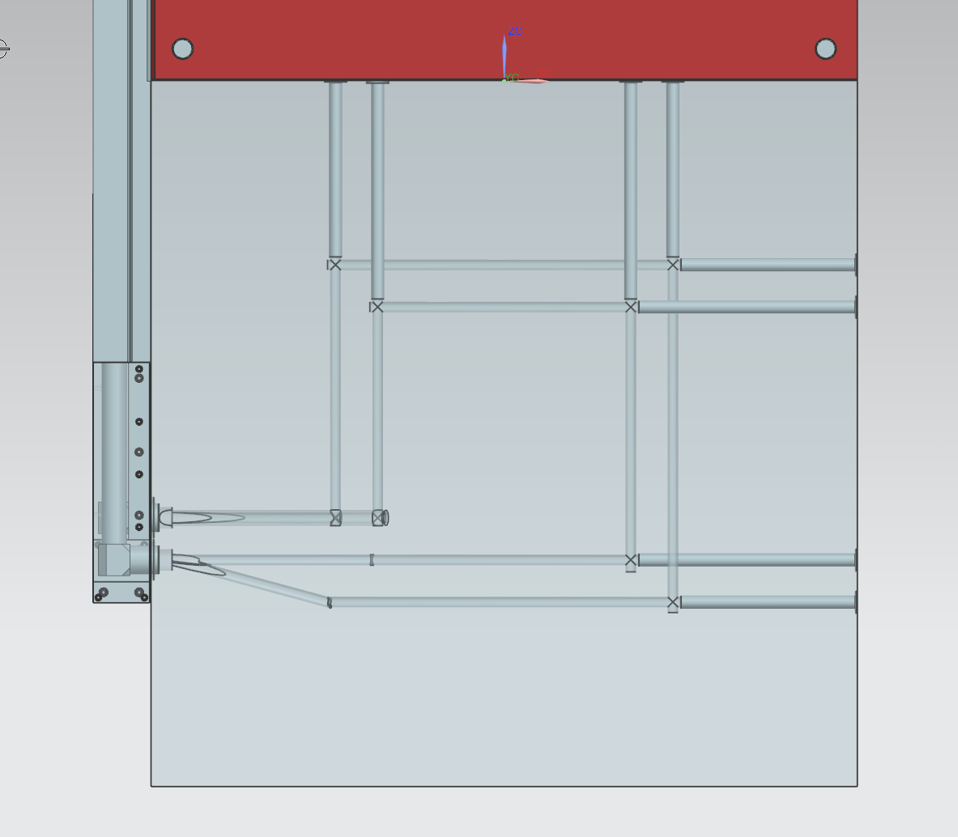
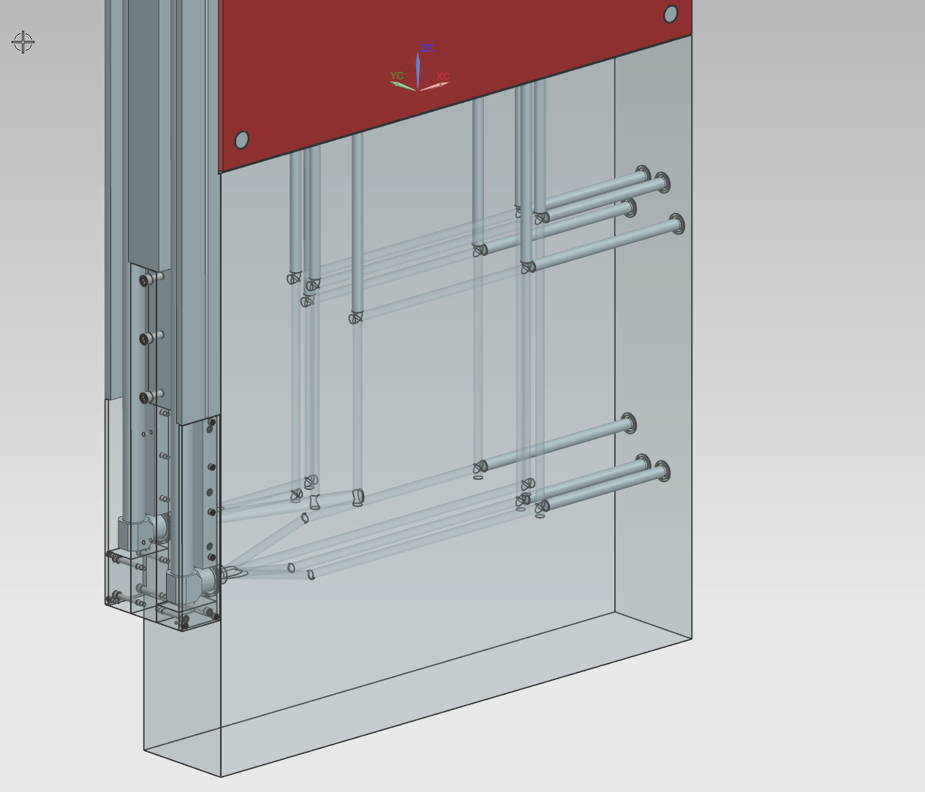
Core Blocks

Slide 14
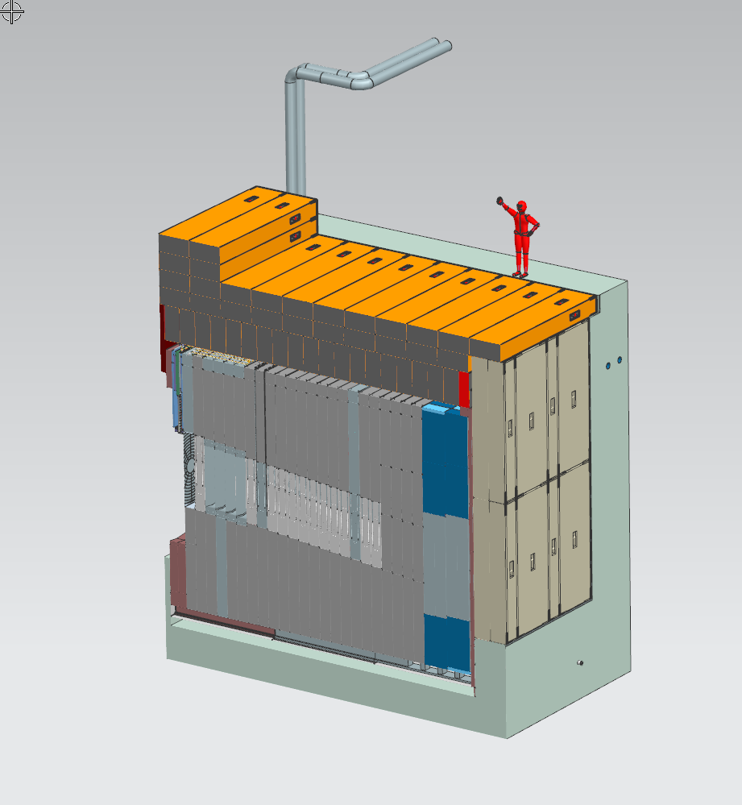
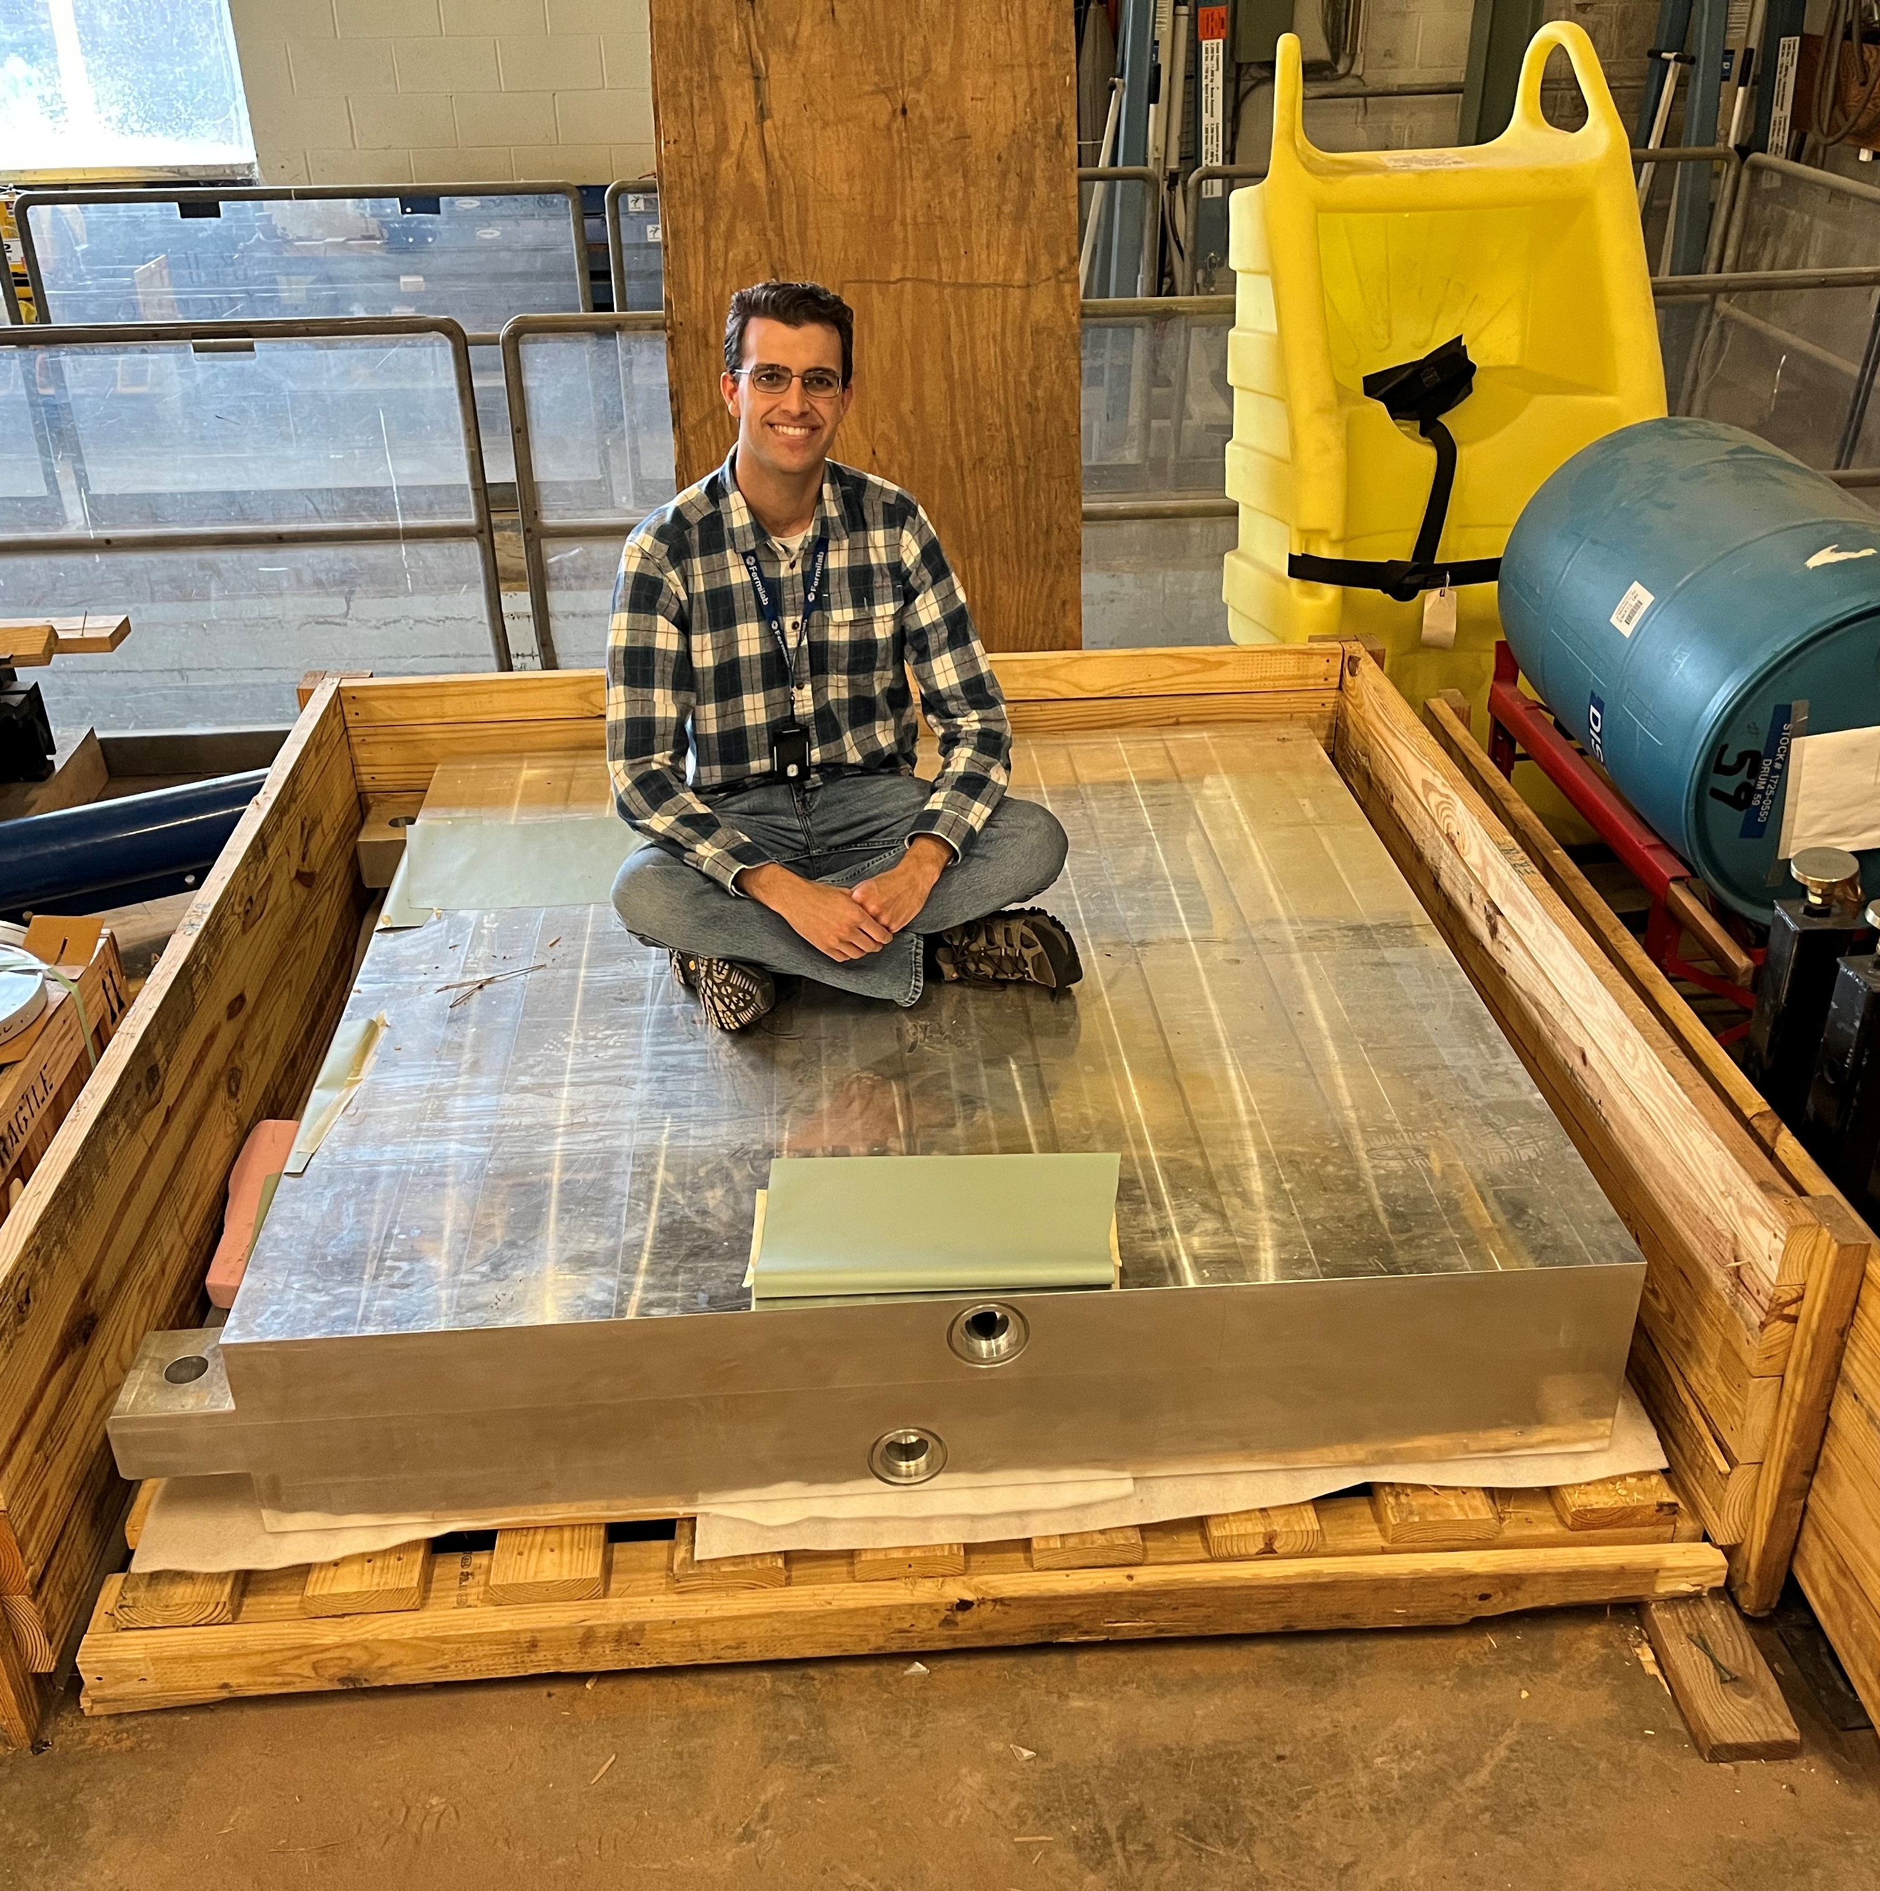
Core Blocks
Prototype Core Block – Engineer for scale

Slide 15
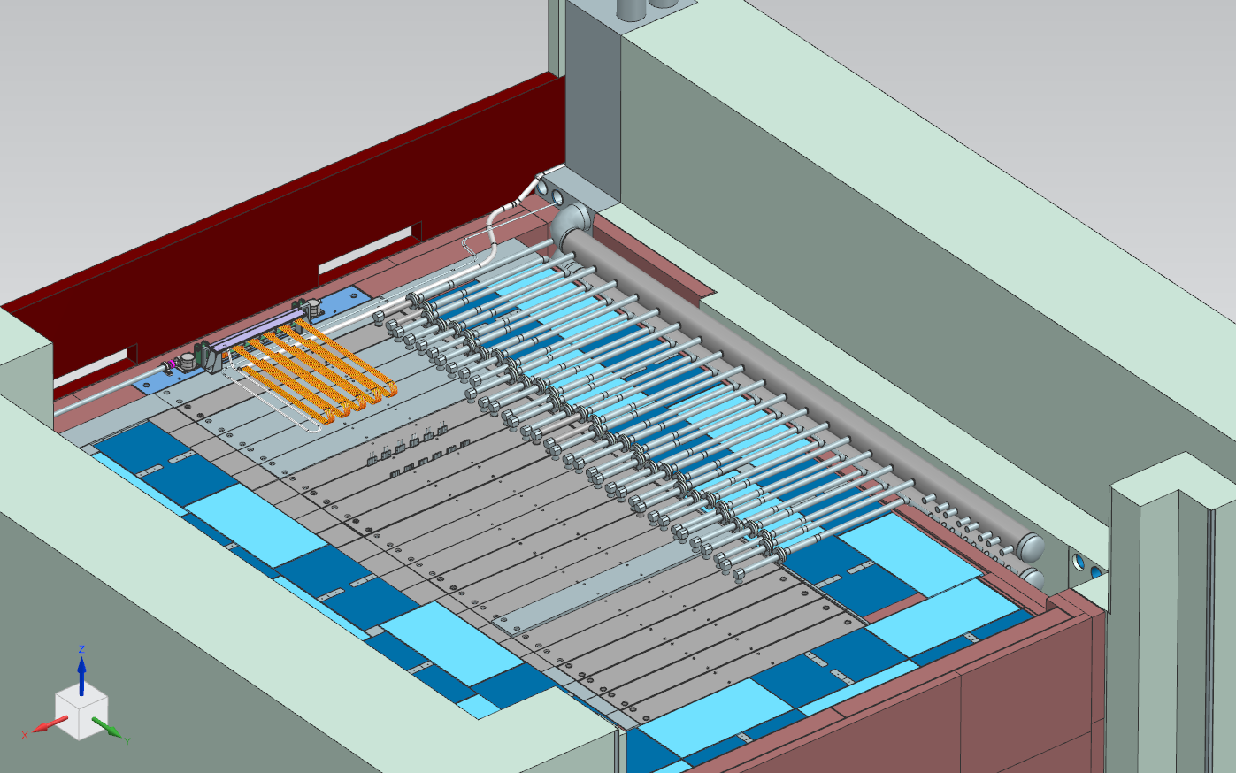
Core and Shielding – Active Cooling
1310 gpm water @ 80 F (27 C), 5-7 ft/s in passages, 80 gpm core, 40 gpm mask (229 kW @ 2.4 MW)
25,000 CFM air, 32” water column, 5 mm gap, 15m/s velocity (244 kW @ 2.4 MW)
Water manifold has leftover blank ports

Slide 16
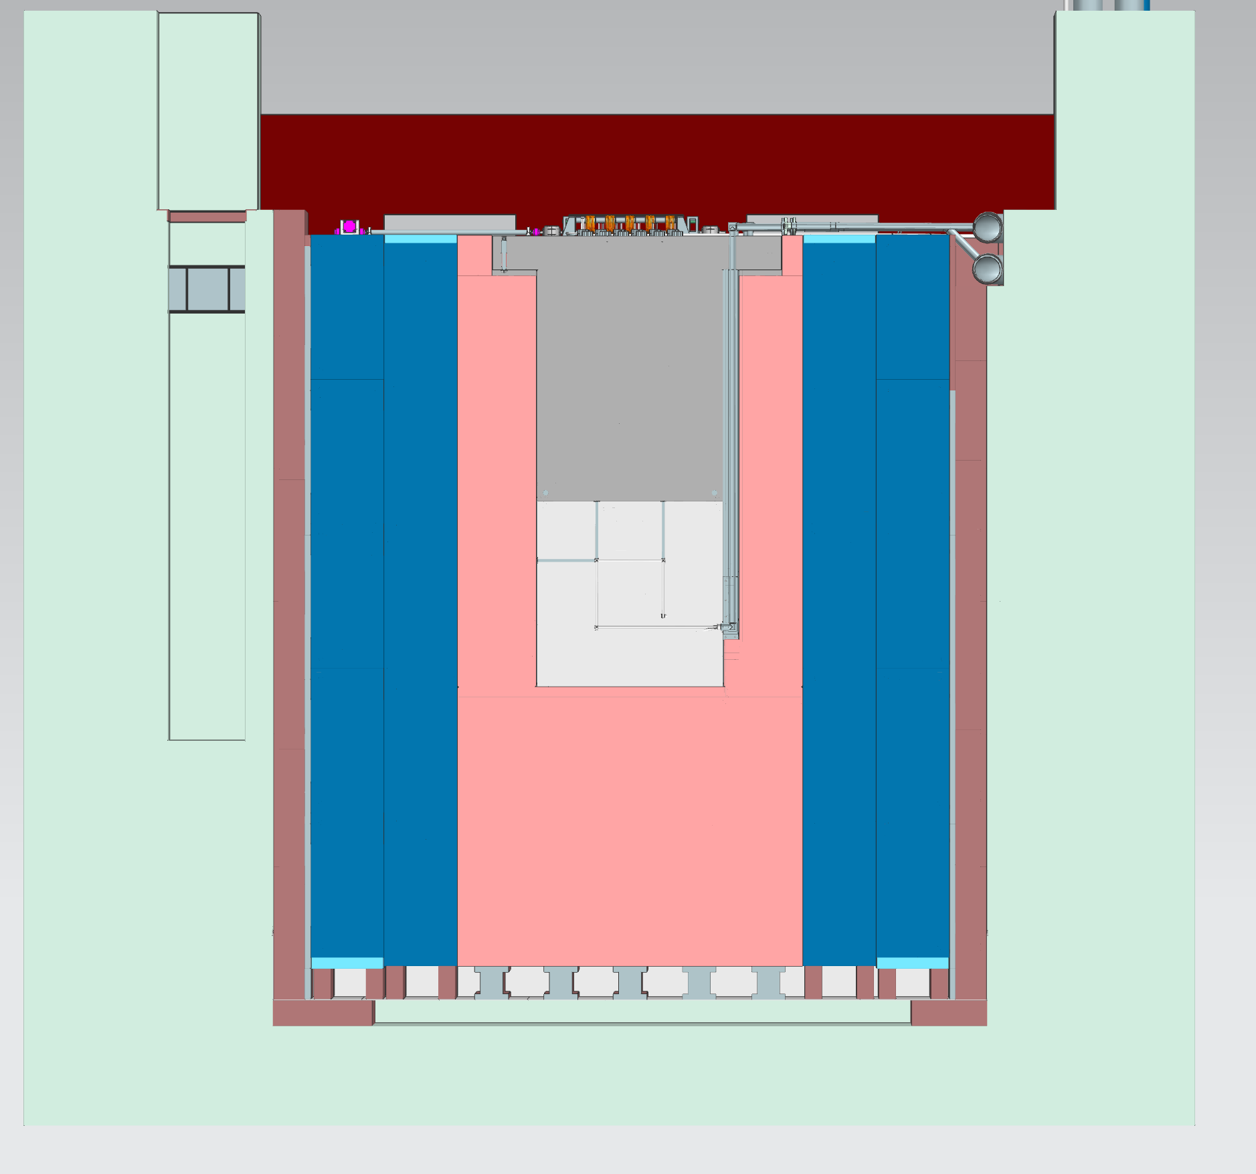
On-Axis View

Slide 17
Assembly & Installation Planning

Slide 18
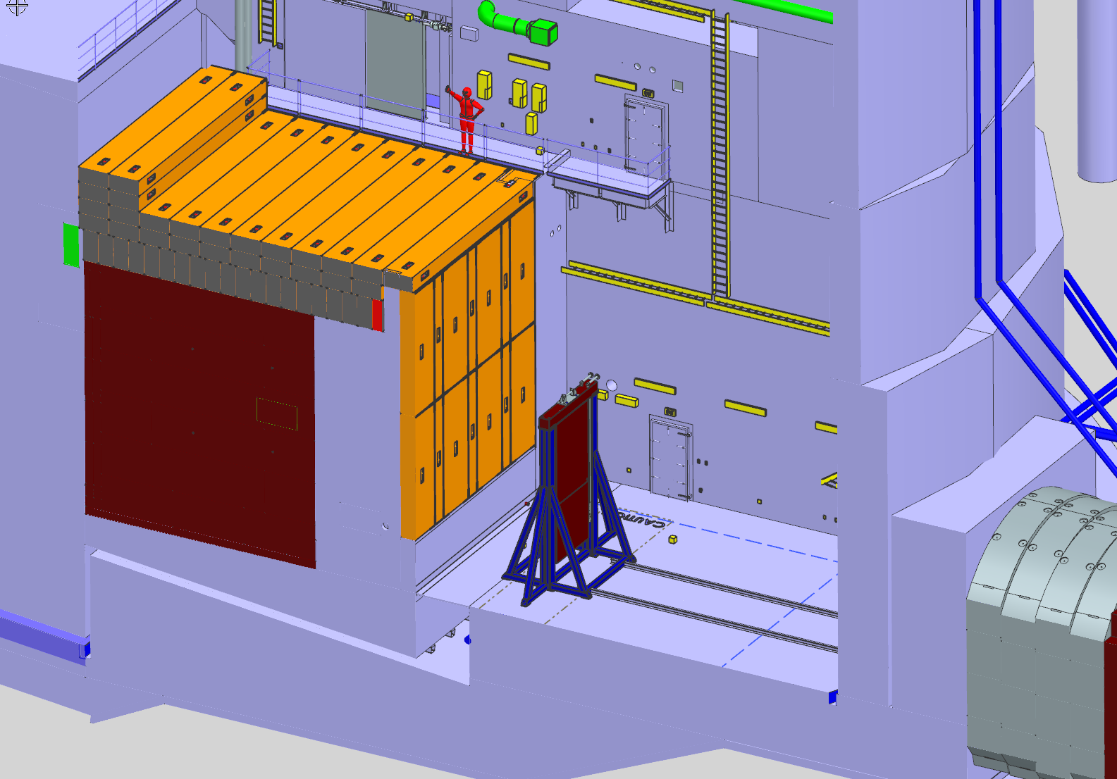
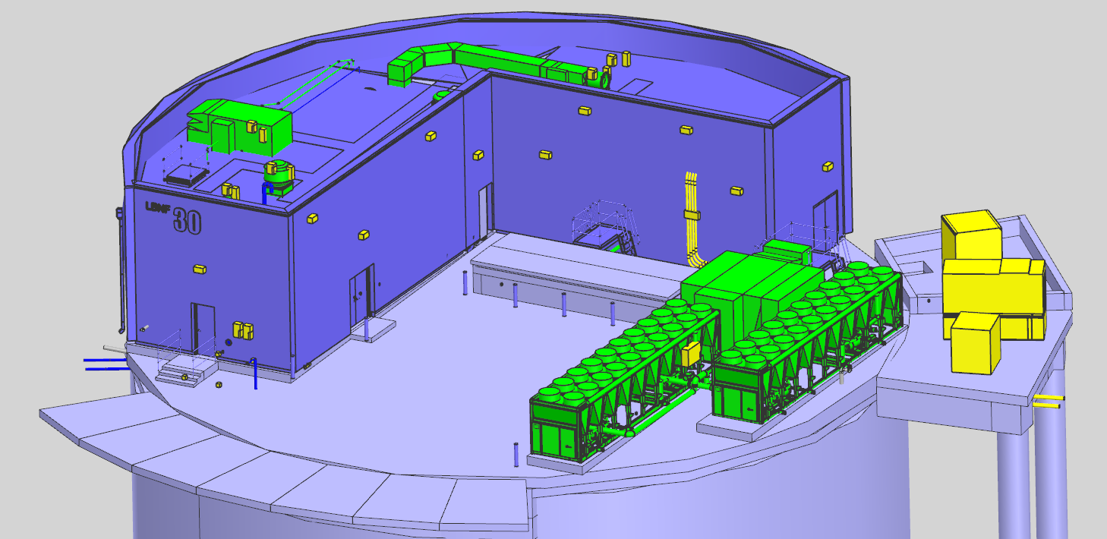
Ship in a Bottle
Open-air access hatch
All components lowered via external crane
Installation bottleneck
Limited space downstairs for storage
Just-in-time delivery
Hard to install components in parallel
Receiving Stand

Slide 19
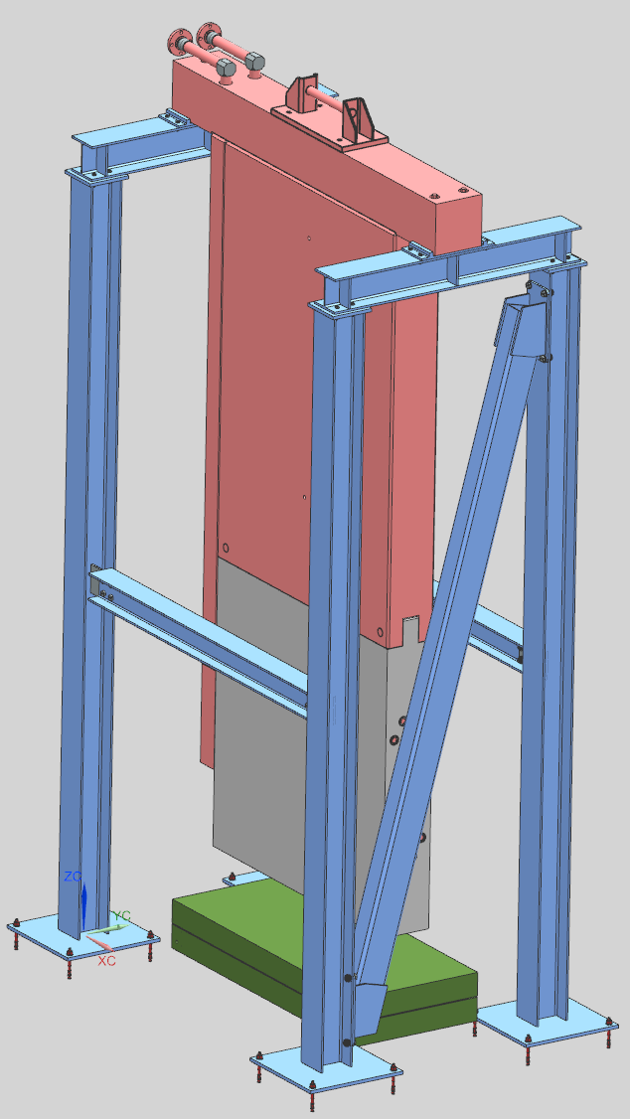
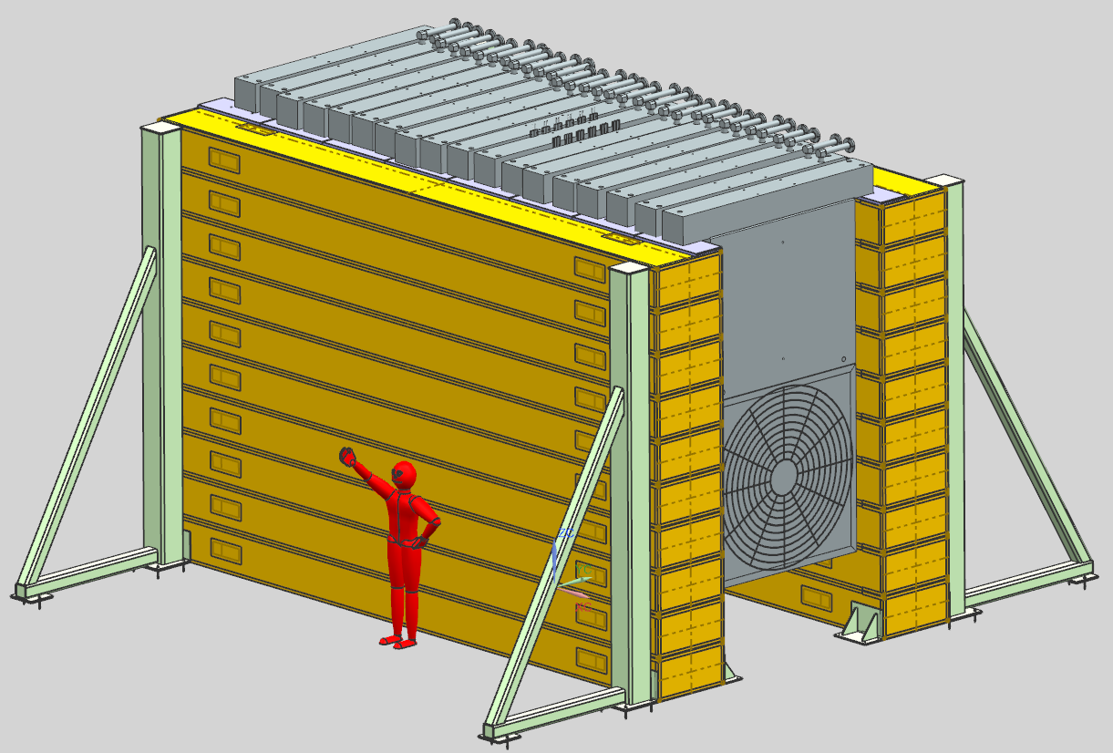
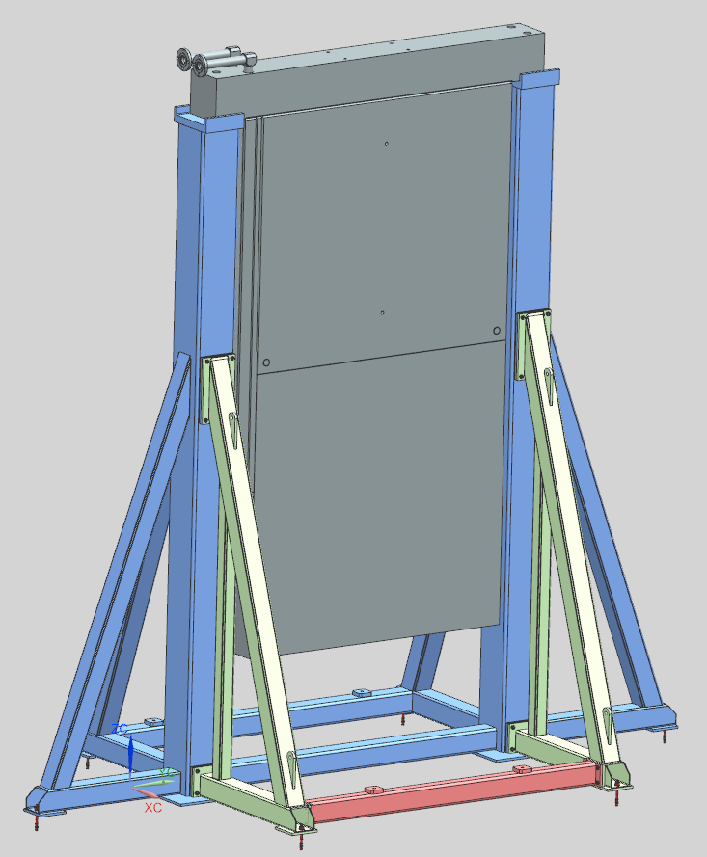
Core Module Assembly
Core module water loops are gundrilled, with welded-on supply lines
Assemble vertically: 1G position for aluminum welds
Store vertically, then transport to Absorber Hall
Assembly Stand
Storage Stand (20x G-Blocks, reuse for Absorber)
Down-Shaft Receiving Stand

Slide 20
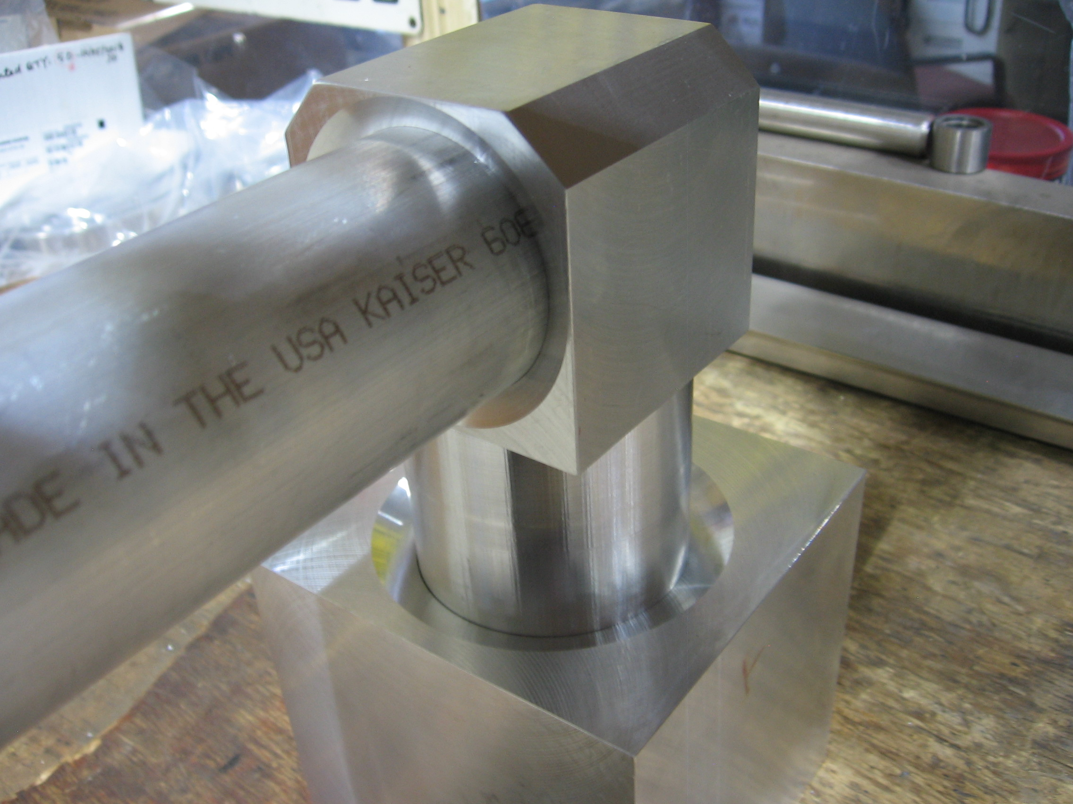
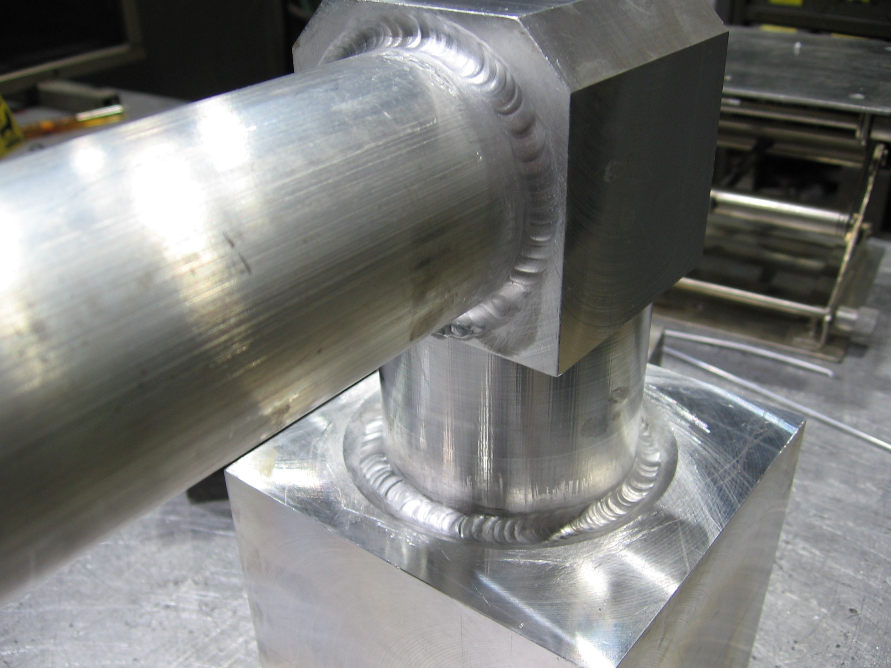
Water Line Welding
Need rigorous qualification of aluminum welds
Can’t radiograph core module/elbow welds
Planning more weld tests with destructive inspections

Slide 21
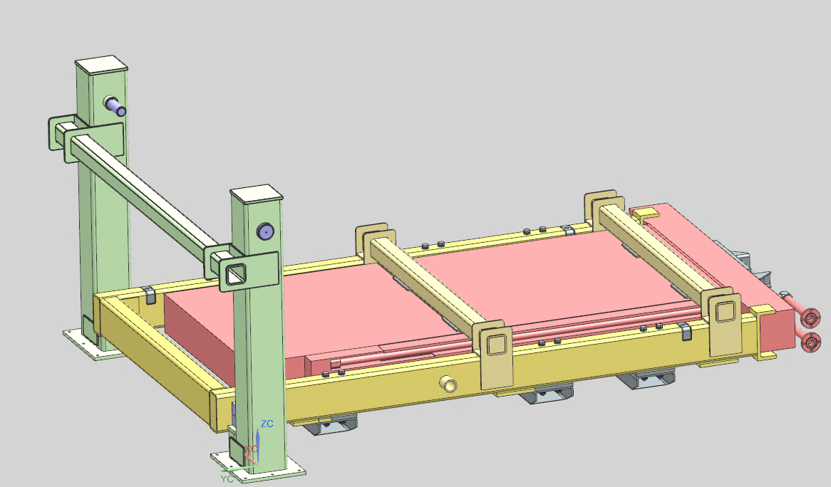
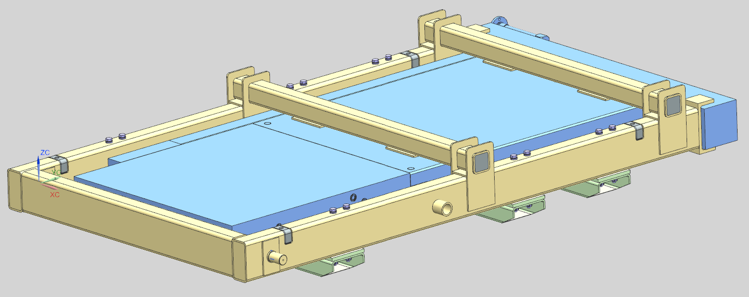
Module Transport
Rotating strongback/transport cradle
Rotation fixture at hatch and storage location, transport flat by trailer
Rotation Stand & Transport Frame

Slide 22
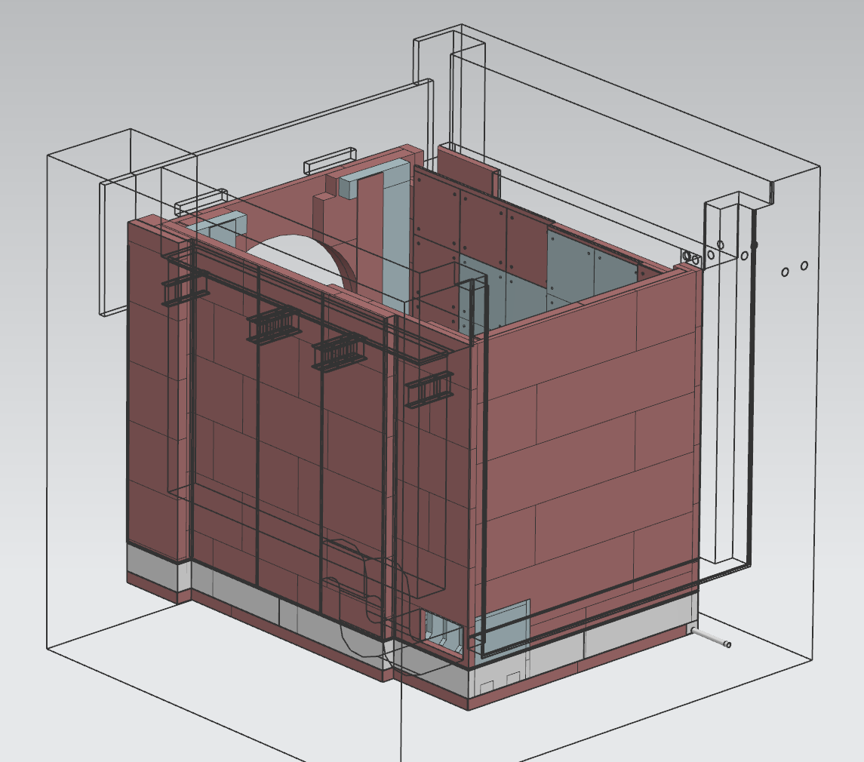
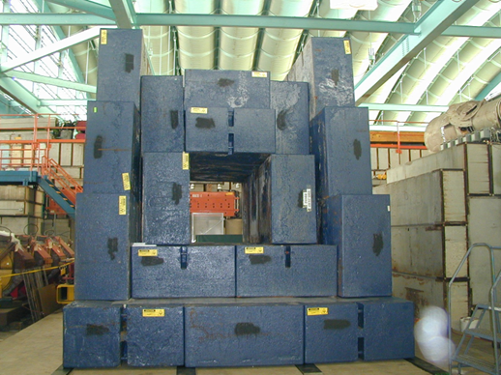
Outer Shielding Installation
Upstream and downstream walls require welding
HADES supported by upstream wall
Examining “loose” stacking of CCSS slabs on sides
Restrained by core supports, blue blocks, and the bunker wall
Assembly model
Catalogue parts by size - Bunker walls are hard limit, everything has to fit
Blue block dimensions are (+.25”/-.75”)
CCSS slabs will likely have camber
Filler plates to close off any gaps from undersize parts

Slide 23
Installation Overview
*Plans have changed!

Slide 24
Design & Documentation – What’s Left?
Final Design Review scheduled for February/March
Final design of core modules recently completed
Installation sequence – step-by-step drawings (layer by layer)
Groundwork for assembly model with serialized components
Bunker design is set in stone concrete
Procurement process has begun for construction contract

Slide 25
Questions?

Slide 26
Backup

Slide 27
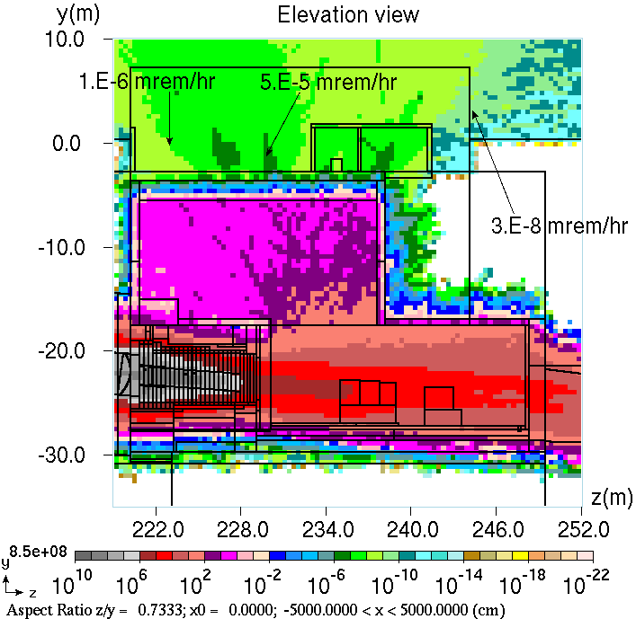
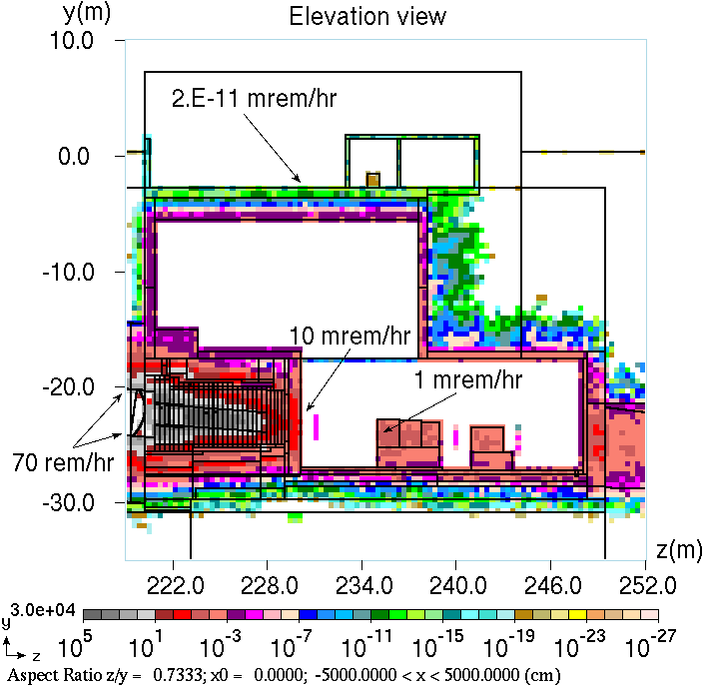
Radiation Modeling
FNAL MARS group has been extensively modeling the Absorber
Recent changes to air supply duct, modeling residual dose in air
Beam on (2.4 MW) prompt dose
Beam off (110 d irr., 4 hr cooling) contact residual dose
Scale is mSv/hr
DUNE-DocDB-17021-v5

Slide 28
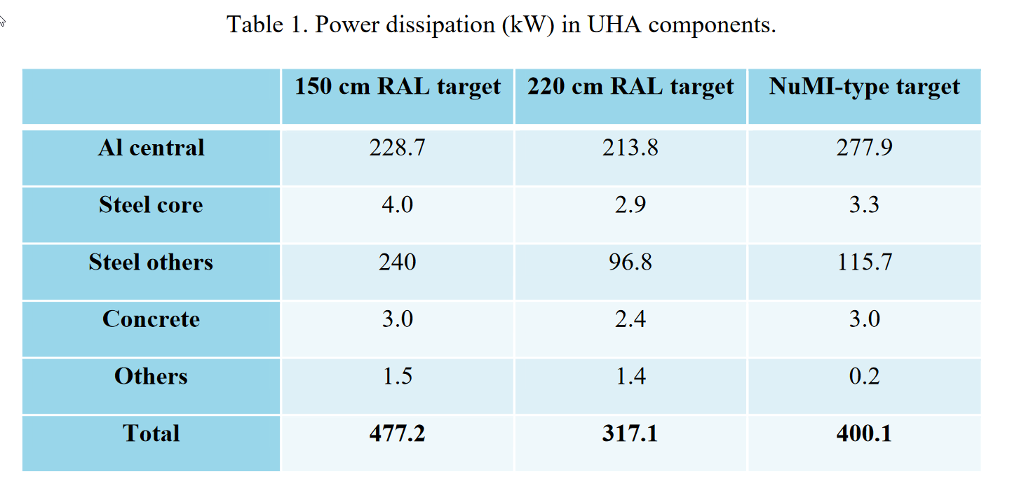
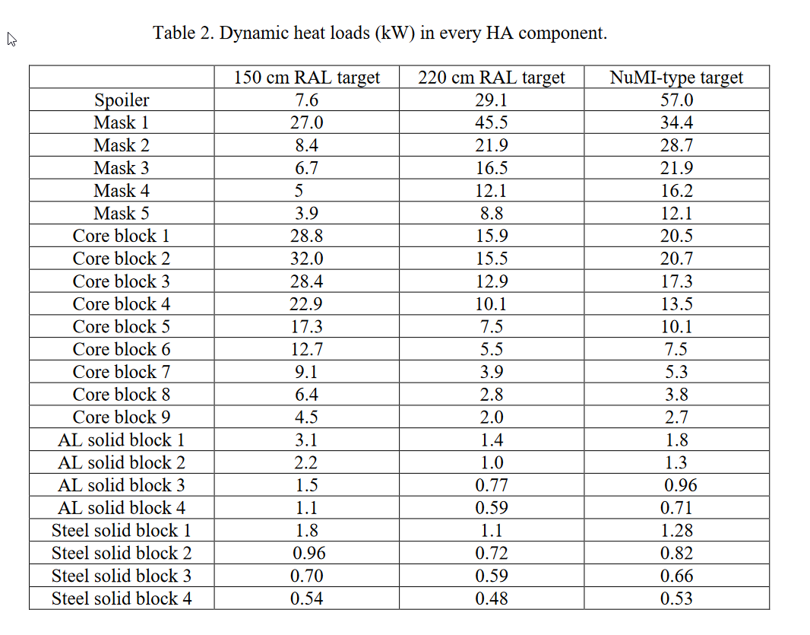
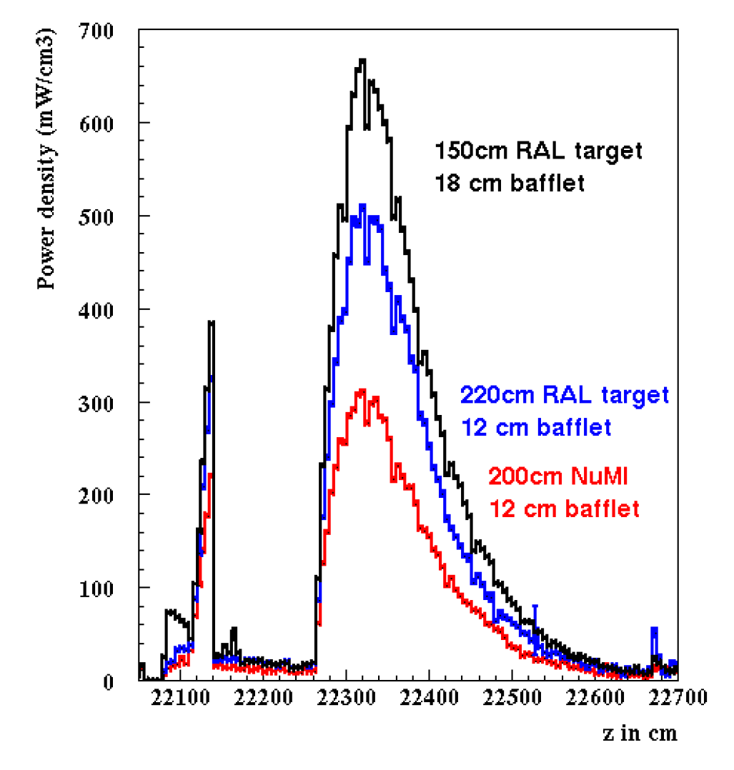
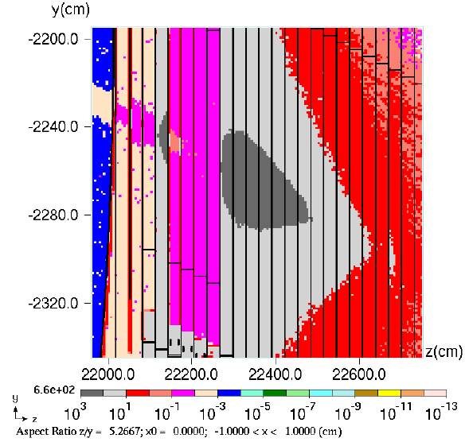
Heat Deposition
*Data for 2.4 MW operation
DUNE-DocDB-17064, S. Striganov
mW/cm³

Slide 29
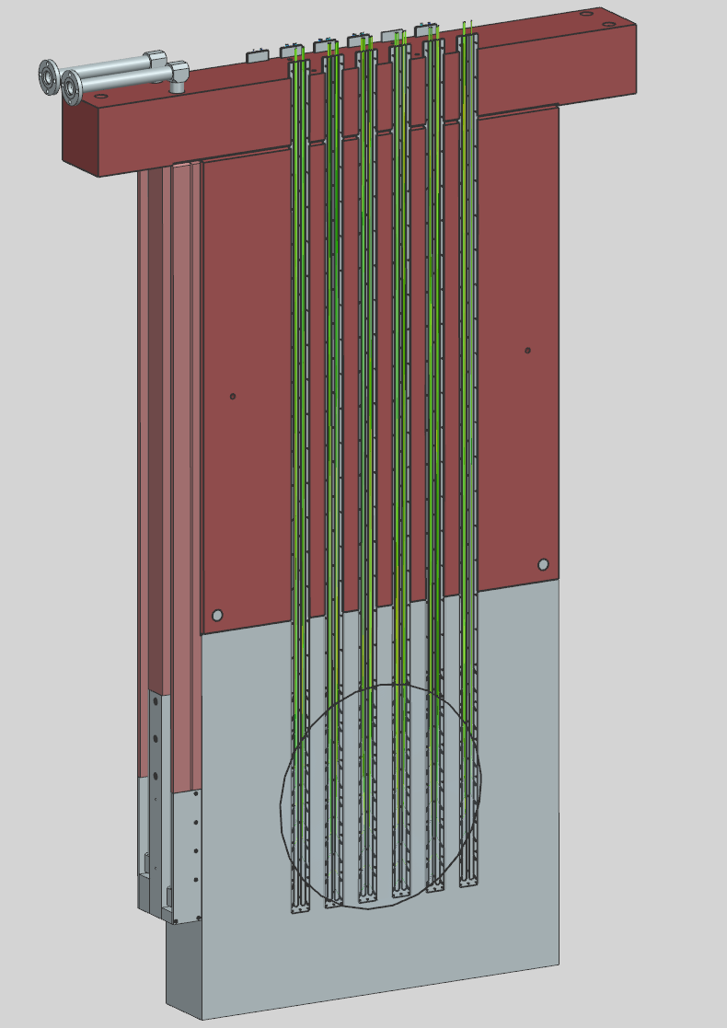
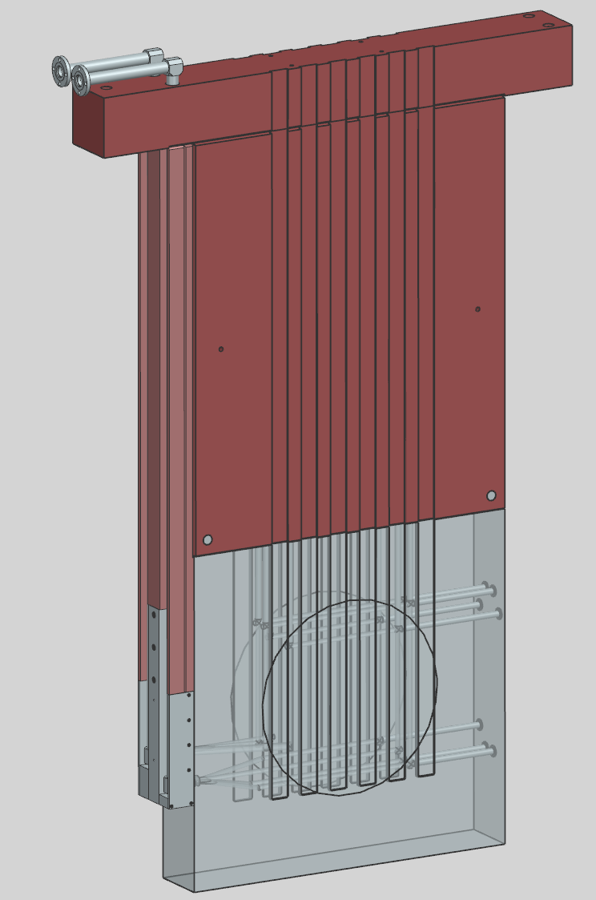
Challenges & Some Solutions
Future-proof active cooling systems - design for 2.4 MW
Maintain all temperatures within material limits – 100 C fatigue limit for 6061-T6 core blocks, 230 F for anti-corrosion paint on steel
Absorb secondary particles and radiation
Steel backstop, muon kern downstream
How to detect bad beam quickly?
224 thermocouples (in beam) in core module 2
Scaled-up NuMI system (4 TCs)
dT/pulse limit: <1 degree normal, 16-90 deg for accidents
Water line could be hit by beam: modeling work
Thermocouple Core Module

Slide 30
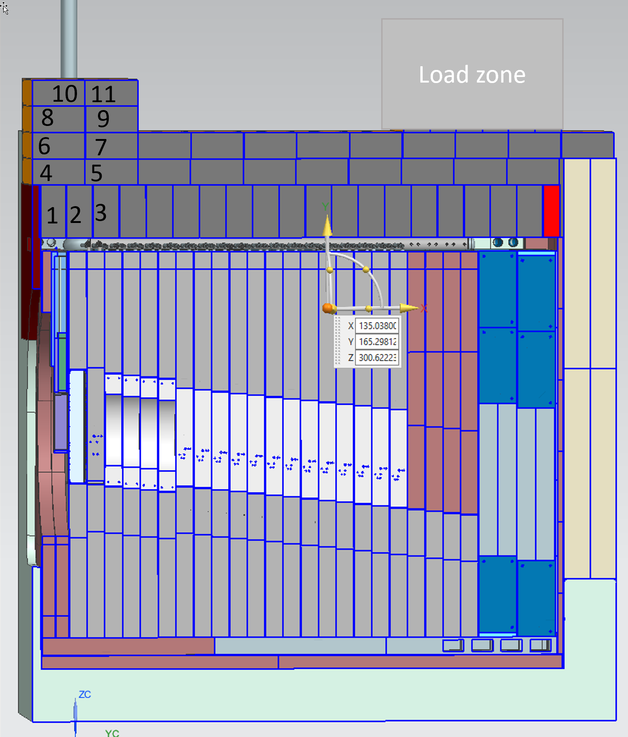
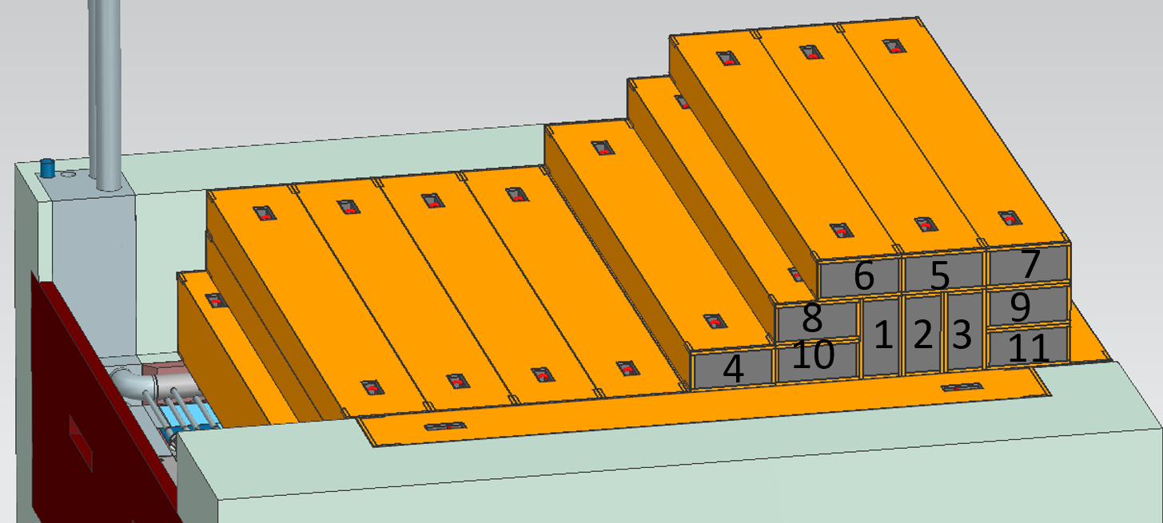
Challenges & Some Solutions
How to minimize worker dose?
Remote crane operations, minimize touch labor on top of absorber
(water line connections & wiring only)
Conceptual stacking layout for HADES access
Graphics: V. Sidorov

Slide 31
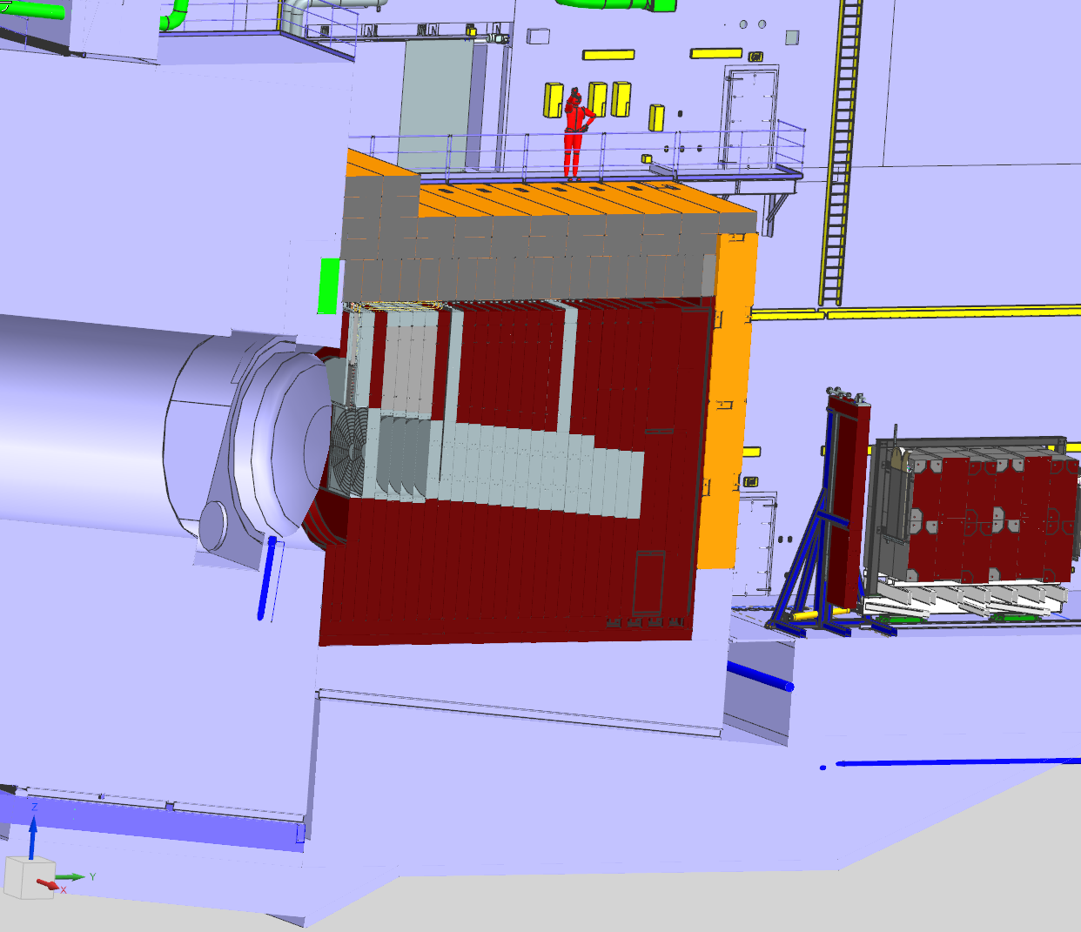
Challenges & Some Solutions
Thermal Expansion of Decay Pipe
200m length – lots of steel and concrete to expand with beam heating
6” (~15 cm) expansion allowance
Low clearance between downstream decay pipe window & HADES
Expansion coefficient for poured concrete ~ 10 µm/m*C °
200m, 10 C° = 1 cm linear expansion
Decay Pipe
Concrete Shielding
LBNF-30
Foundation
6” gap

Slide 32
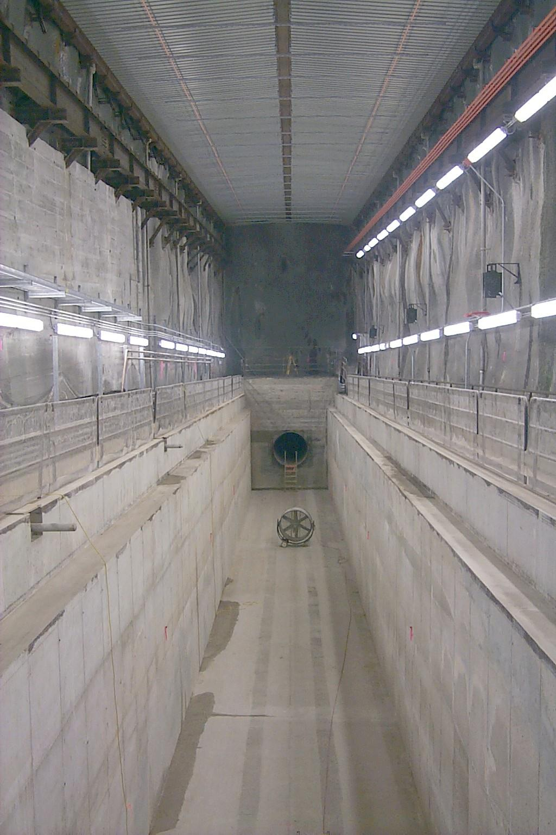
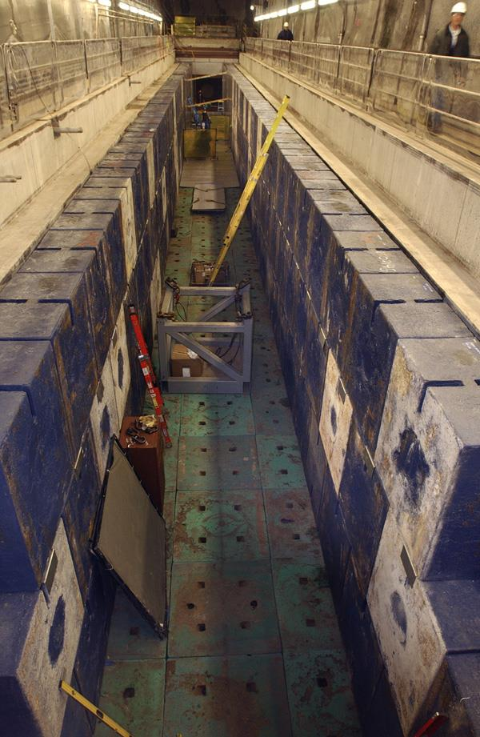
NuMI Target Shield Pile
3-high on-edge Blue Block stack
LBNF Absorber has 5-high stacks
Blue blocks modeled oversize, shimmed to fit and level
NuMI Target Shield Pile Installation
NuMI Target Shield Pile Mockup

Slide 33
HADES Retractive System

