Slide 1









LBNF Target Design
Dan Wilcox
Rutherford Appleton Laboratory, UK
For UK team in collaboration with Fermilab LBNF Targetry Project Team, UK Universities, and Culham MRF
8th High Power Targetry Workshop
November 7th 2023

Slide 2
Overview
UK project overview
Target challenges
Prototype target design
  Engineering analysis
  Prototype manufacturing
  Irradiated material studies
Future plans and deliverables

Slide 3
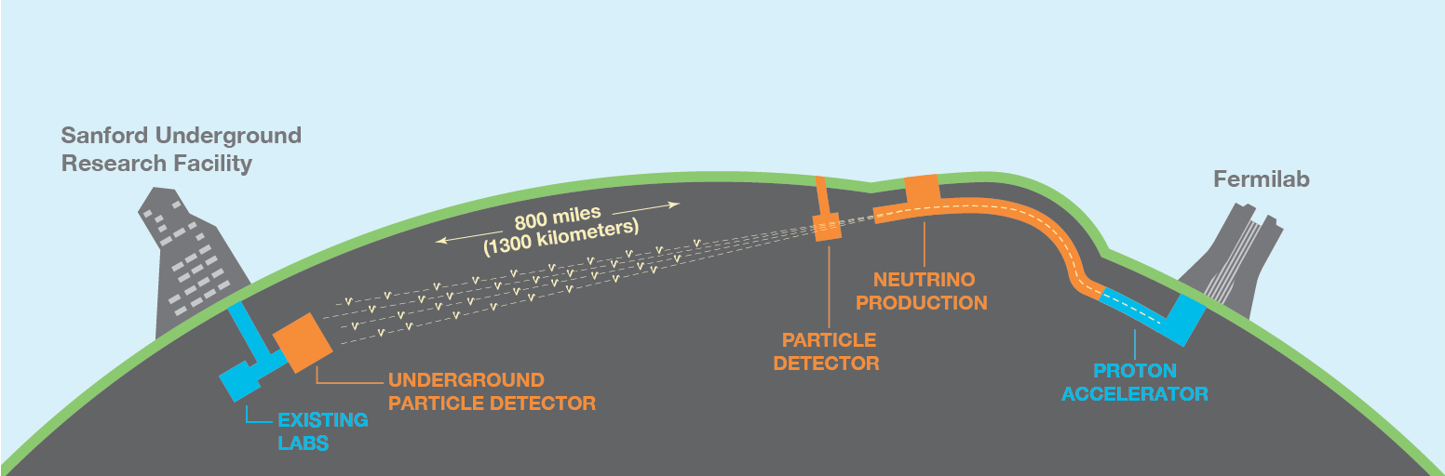
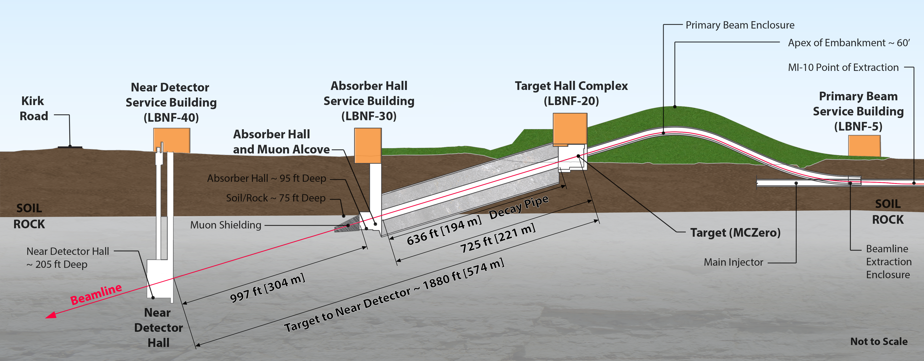
LBNF and DUNE
See talk by Patrick Hurh on Thursday 9th
Physics highlights:
World’s most intense neutrino beam
Longest distance to detector
May indicate why the Universe is made of matter
Target absorbs protons, produces pions
Accelerated Protons In
Neutrinos
Out
Pions decay to muons and neutrinos

Slide 4
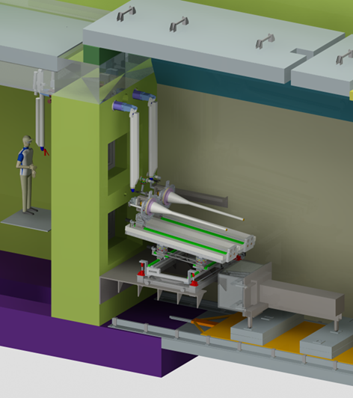
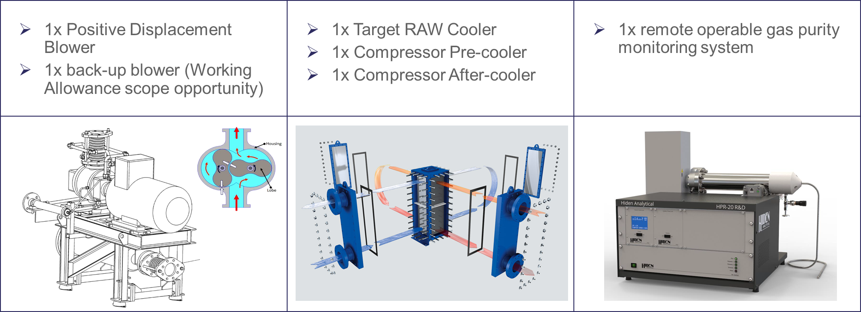


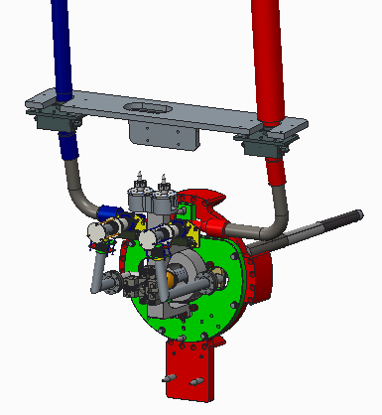
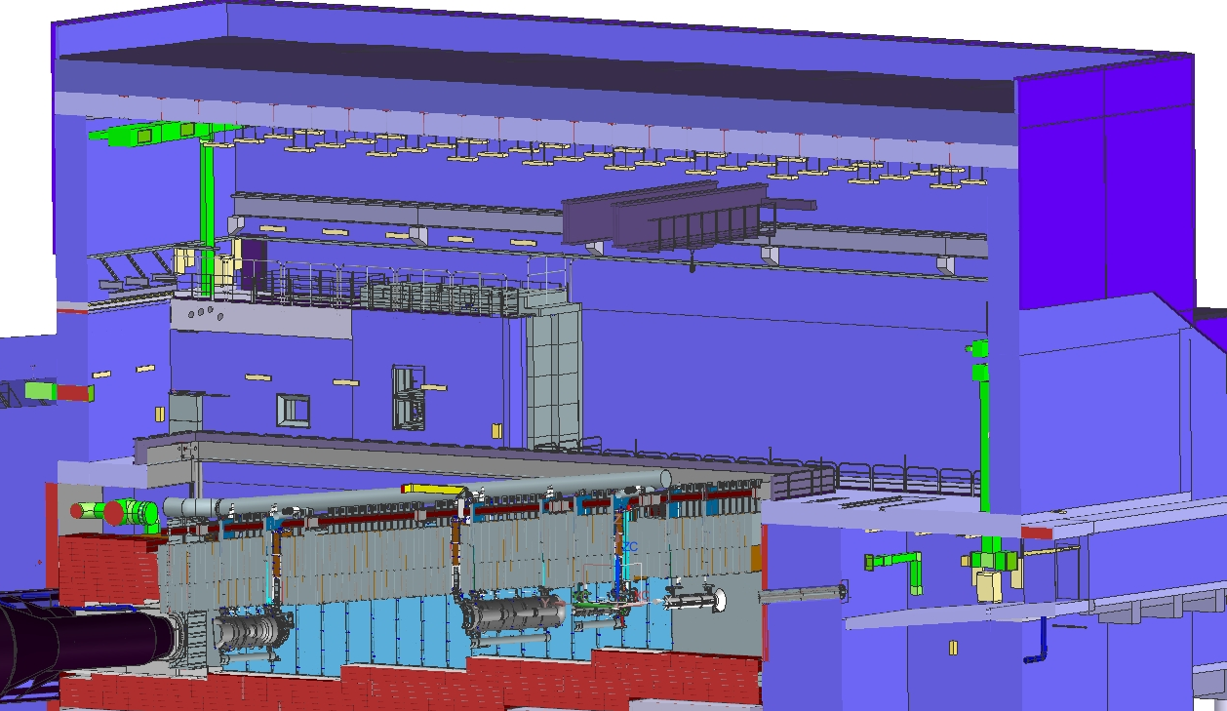
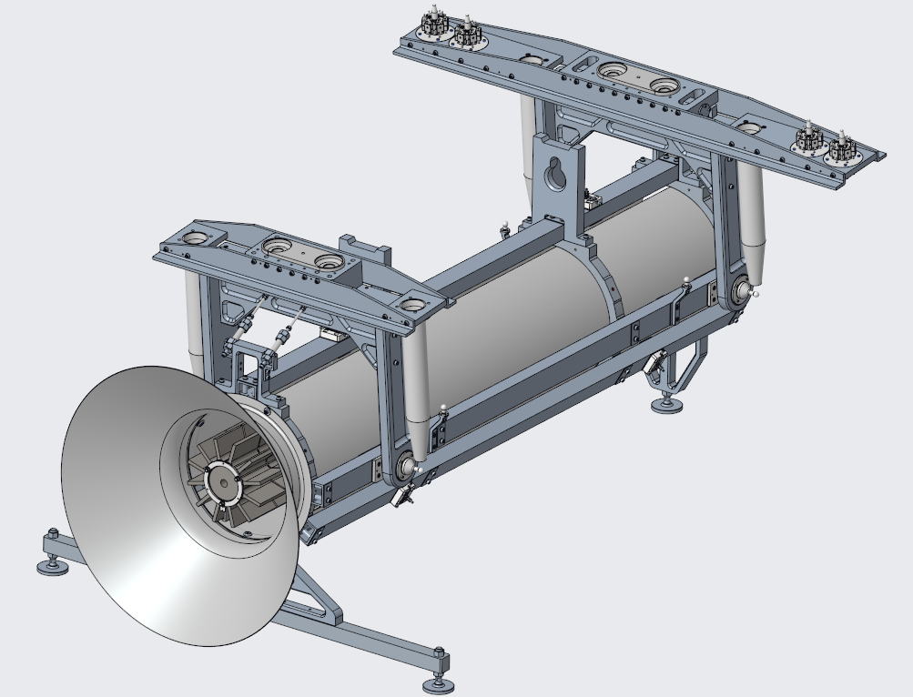


Scope of UK Targetry Contribution
1x Target Exchange System:
Various Helium Plant Components inc. Blower and Coolers:
1x Instrumented Baffle:
Protons
Targets and Connecting Pipework:
1x Prototype Target
1x Production Target

Slide 5
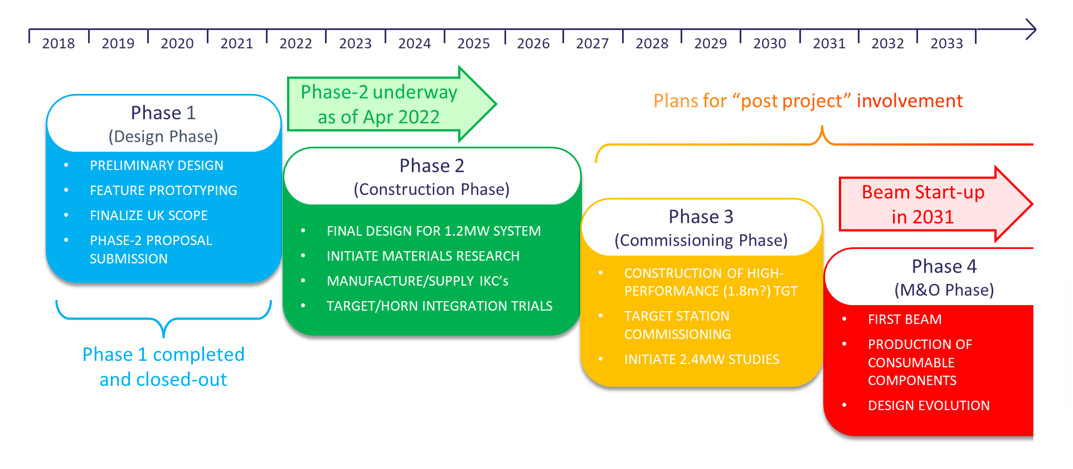
UK Project Timeline

Slide 6
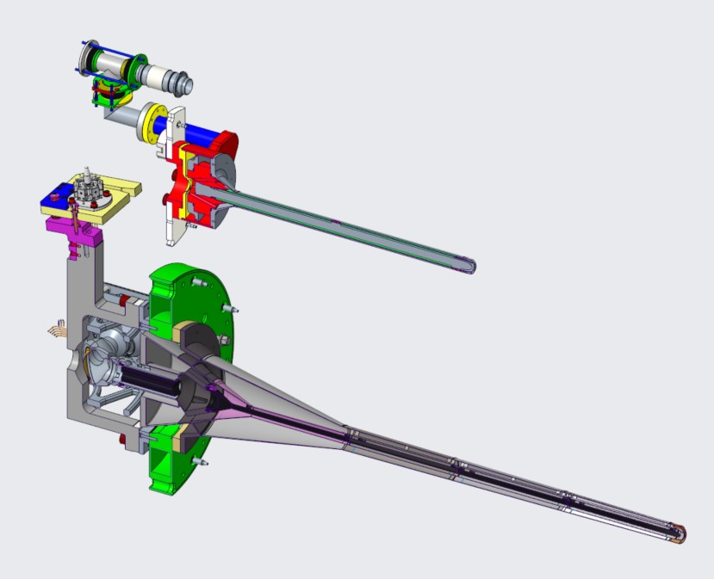
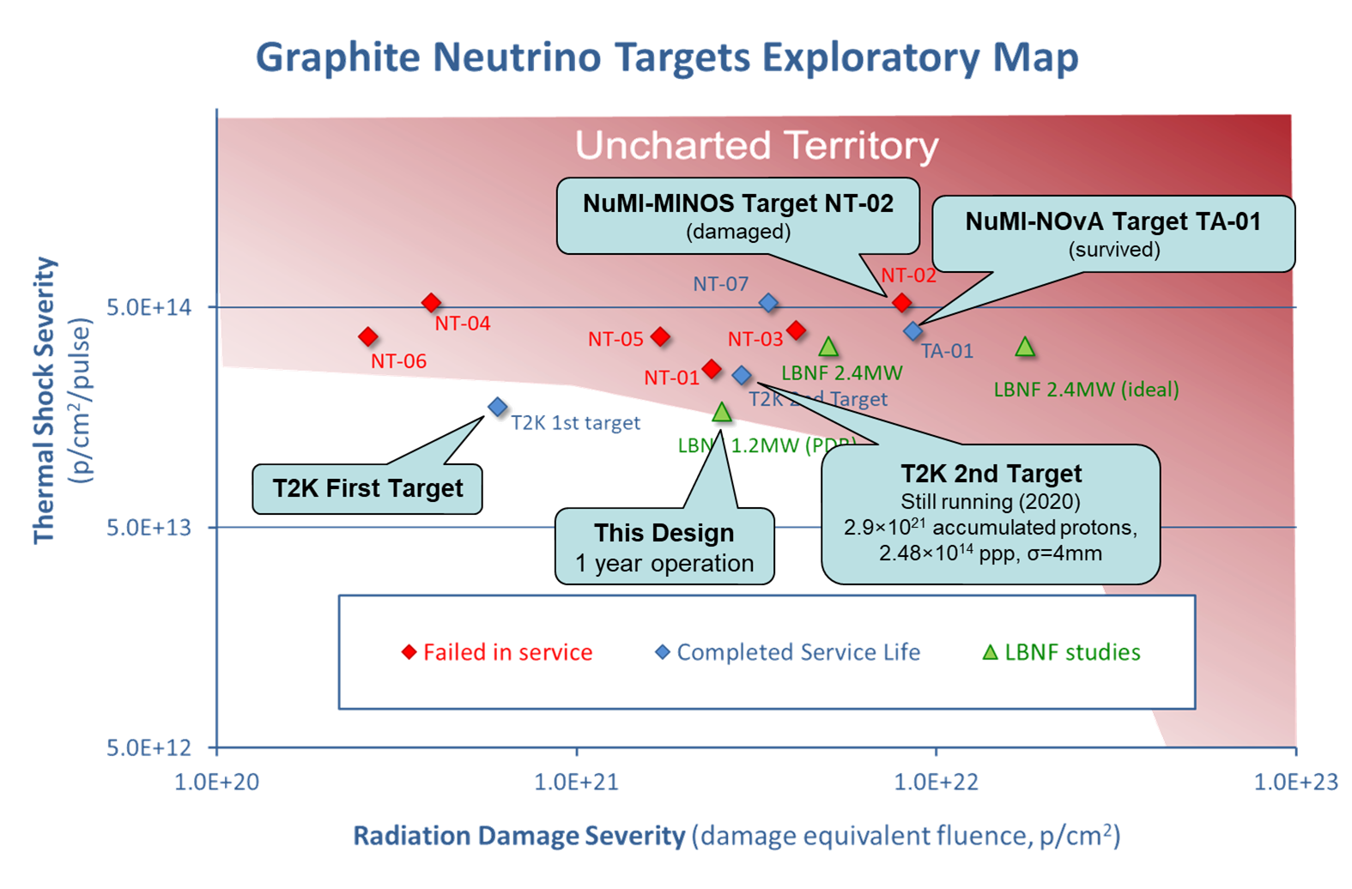
Comparison with T2K
Parameter | LBNF Design (1 Year Design Life) | T2K Experience (Target 2 History)
Beam Power (MW) | 1.2 | 0.51
Proton Energy (GeV) | 120 | 30
Beam Current (μA) | 10 | 17
Beam Sigma (mm) | 2.7 | 4
Radiation Damage Severity (p/cm^2) | 2.5E+21 | 3.1E+21
Thermal Shock Severity (p/cm^2/pulse) | 1.7E+14 | 2.6E+14
Higher beam power and smaller beam spot, but lower current = lower proton fluence and thermal shock than T2K
Longer target will require optimised design of cantilever support
To scale. Core length = 0.9m T2K, 1.5m LBNF
T2K
LBNF
c/o Patrick Hurh (Fermilab)

Slide 7
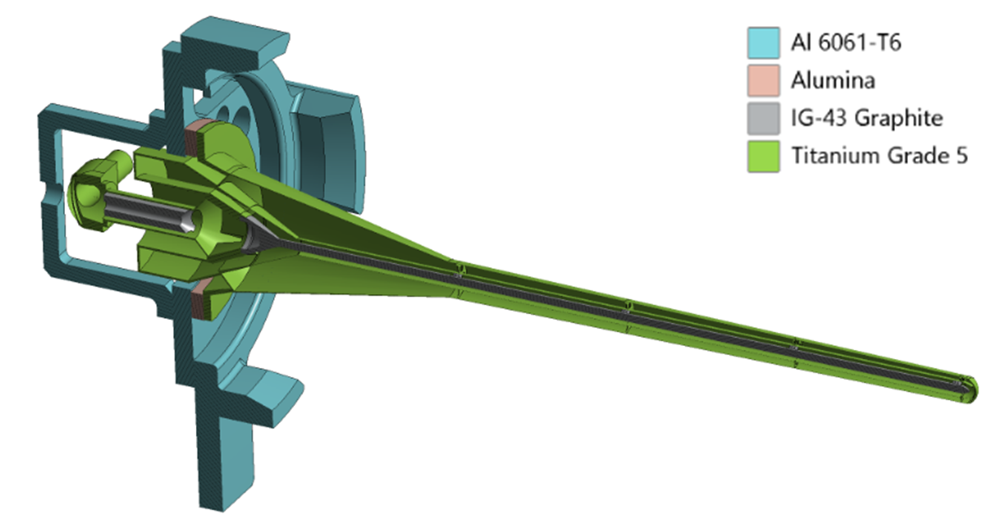
Target Engineering Challenges
Vibrations transmitted from horn to target mount
Support structure must align the target very accurately relative to the horn and proton beam
Target core temperature jumps by 140°C in 10ms, once every 1.2s – thermal shock and fatigue
Protons
Vessel wall must be thin to prevent pion reabsorption, but strong to contain pressure and support cantilever
Proton beam causes very high heat deposition and radiation damage (several DPA/yr along beam centreline)
1.5m long cantilever – must not touch the inside of the horn
Materials must be strong and perform well at high temperature:
Nuclear-grade graphite core
Titanium alloy outer container

Slide 8
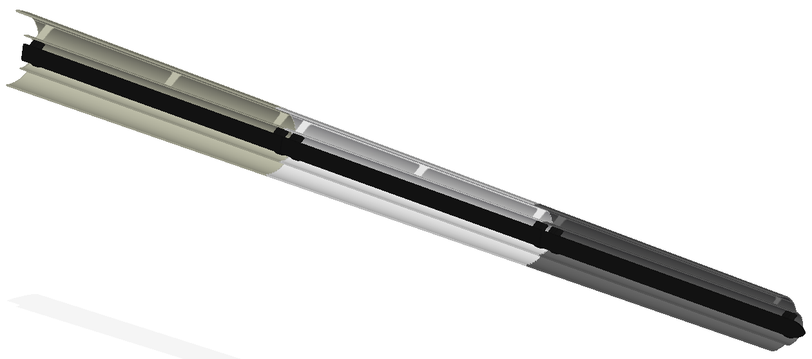
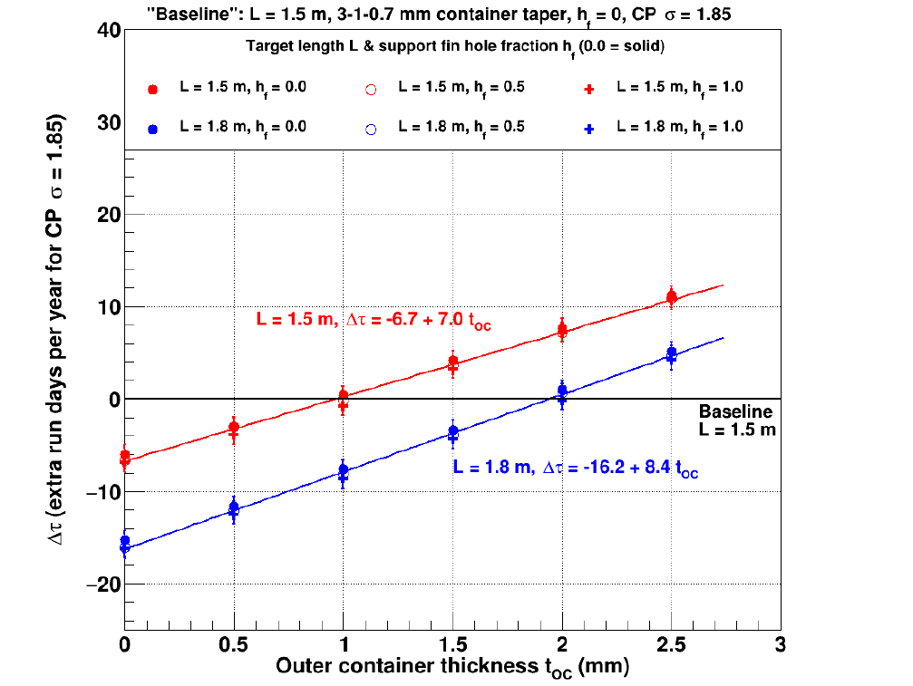
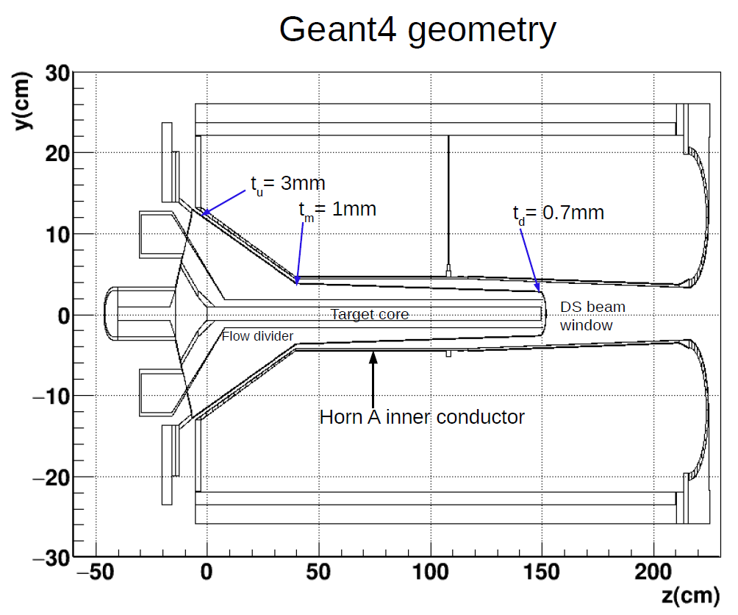
Physics Optimisation of Engineering Features
Size of Support Fins
Vessel Wall Thickness
Small effect of varying support fins
Total
Target Length
Prototype Target
Larger effect of increasing target length
Very large effect of changing vessel thickness
c/o John Back (Warwick University)

Slide 9
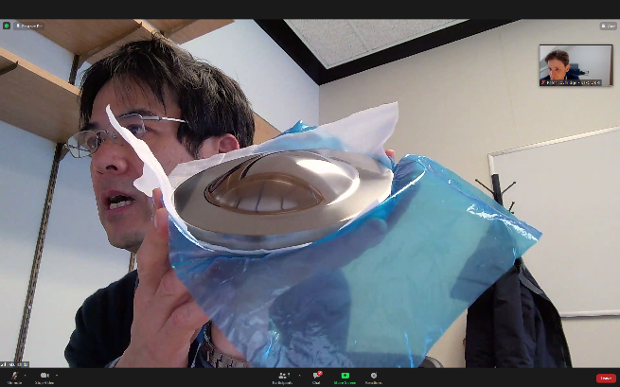
Prototype Target Titanium Grade Selection
 | Grade 2 (CP Ti) | Grade 9 (Ti-3Al-2.5V) | Grade 5 (Ti-6Al-4V) | Ti 15-3 (Ti-15V-3Cr-3Al-3Sn)
Prior Operating Experience | None | None | Used in T2K target | Non-pressure use at T2K
Pressure Code Approval | Listed in ASME | Code route exists | Code route exists | No previous code use
Structural Safety Factor | Lowest | Higher than grade 2 | Higher than grade 9 | Even higher than grade 5
Radiation Damage Tolerance | No data available | Better than grade 5? | Good data and T2K use | Looks best, but needs R+D
Ease of Manufacture | Successful prototype | Difficult to machine | Successful prototype | Welding not yet tested
Ease of Procurement | Widely available | Less widely available | Widely available | Limited availability
Note that it must also be possible to weld the selected vessel and window grades together
Ti 15-3 window prototype c/o
T. Ishida

Slide 10
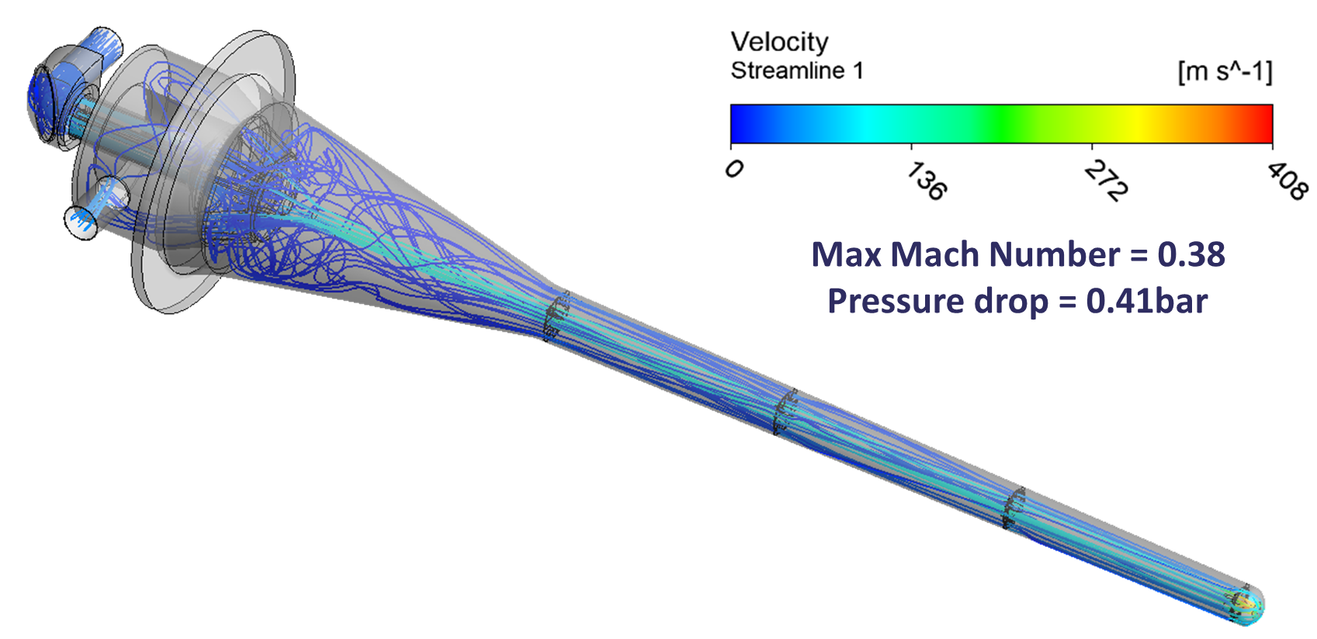
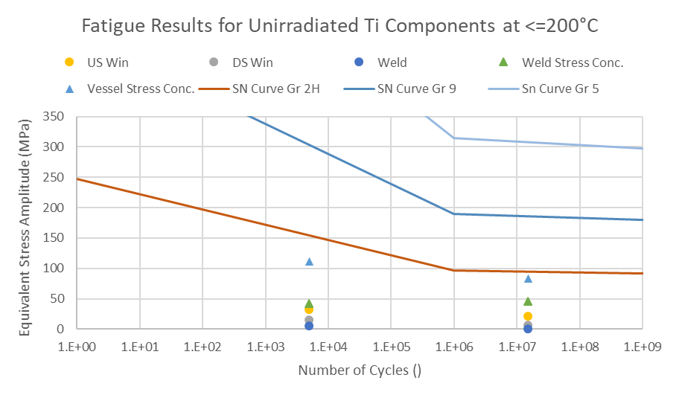
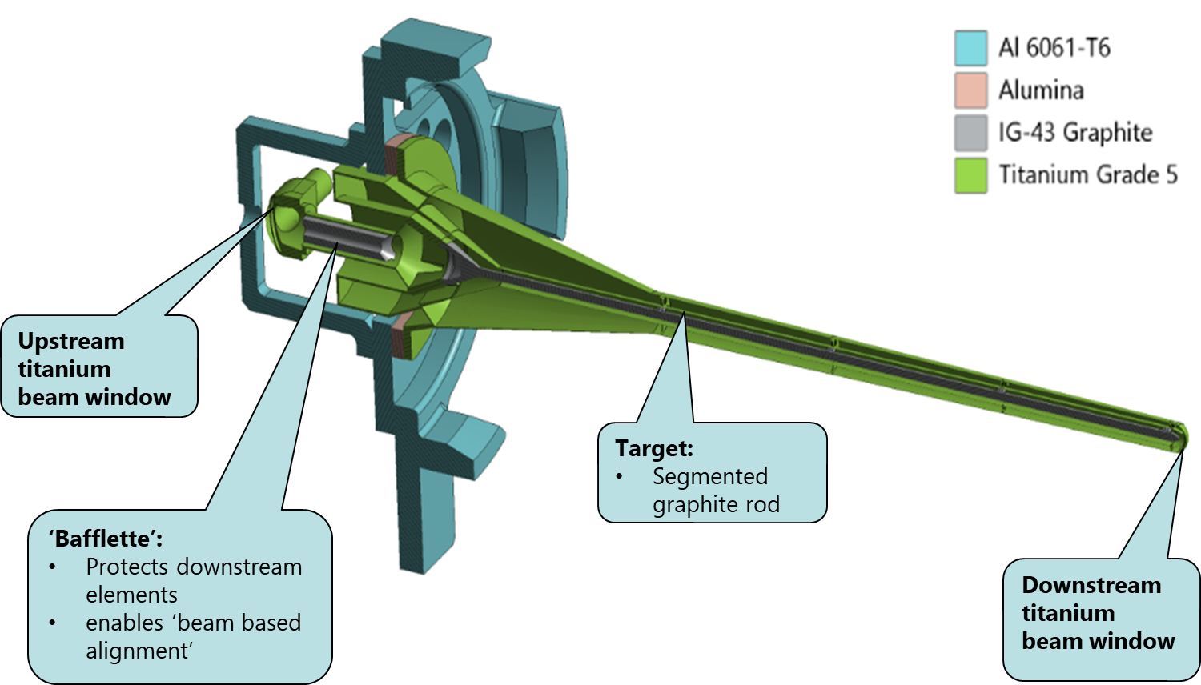
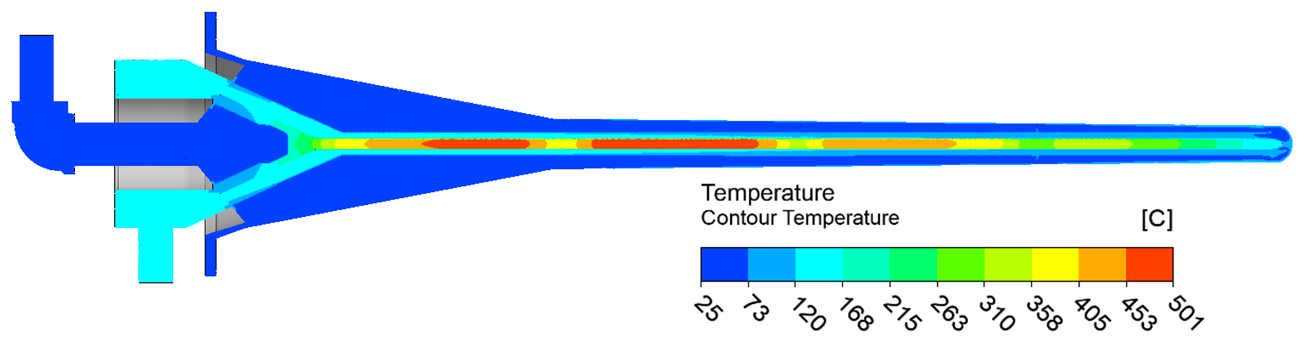
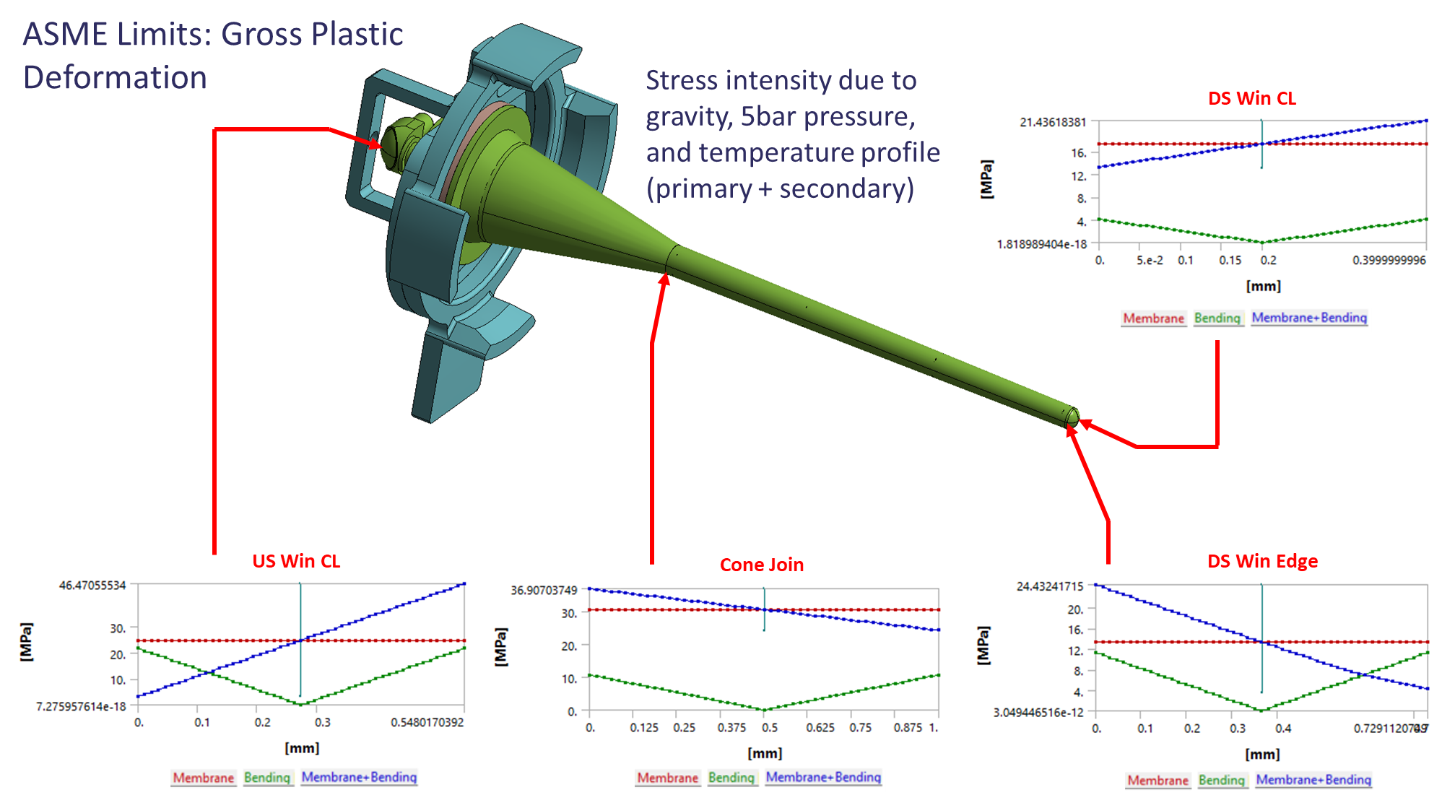
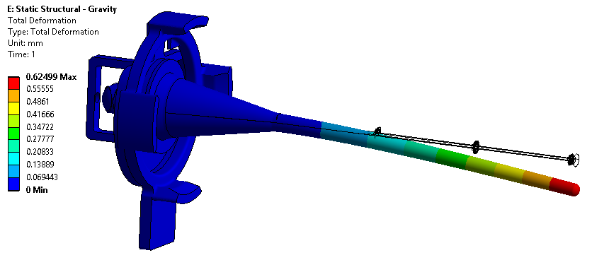
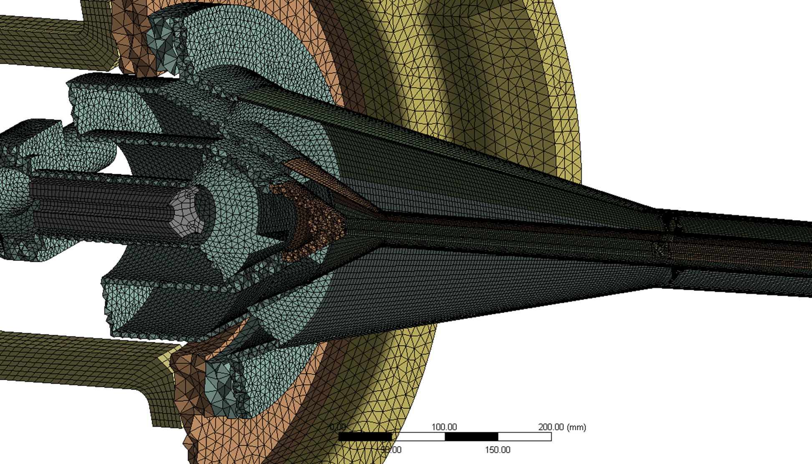
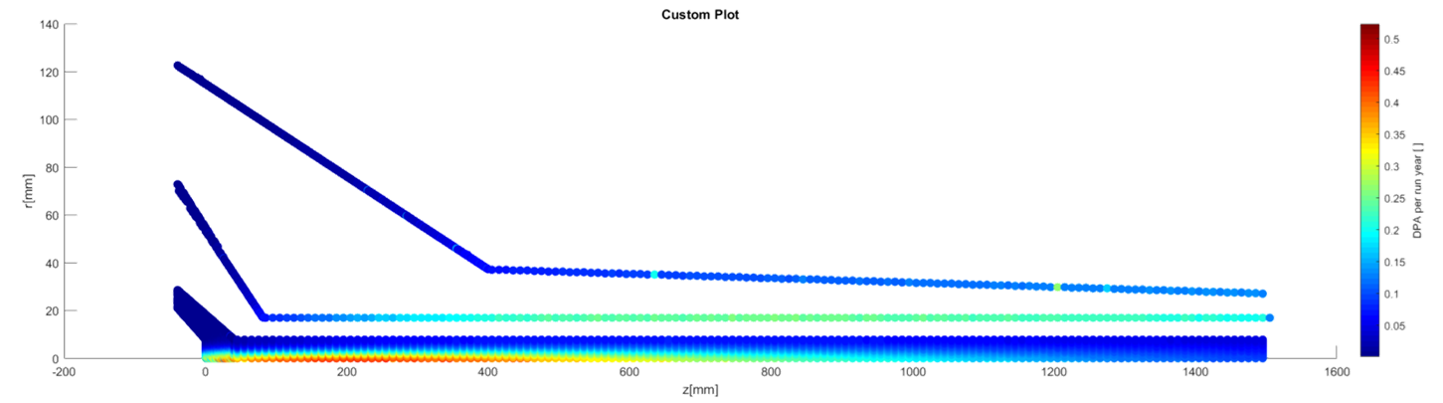

Detailed Target Analysis
Fluid:
Fatigue:
Geometry:
Thermal:
Stress Categorisation:
Structural:
Mesh:
Radiation Dose:
Pressure Code Approval
(FESHM and ASME BPVC)

Slide 11
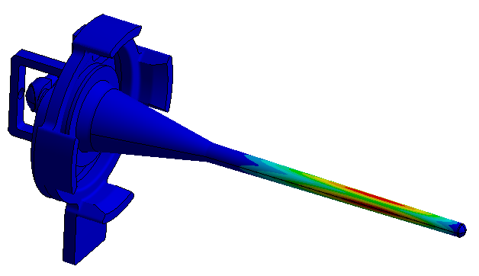
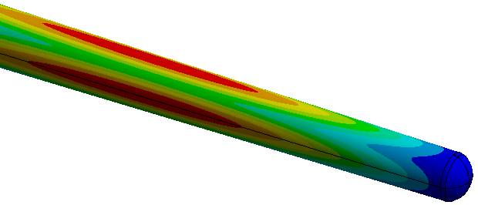
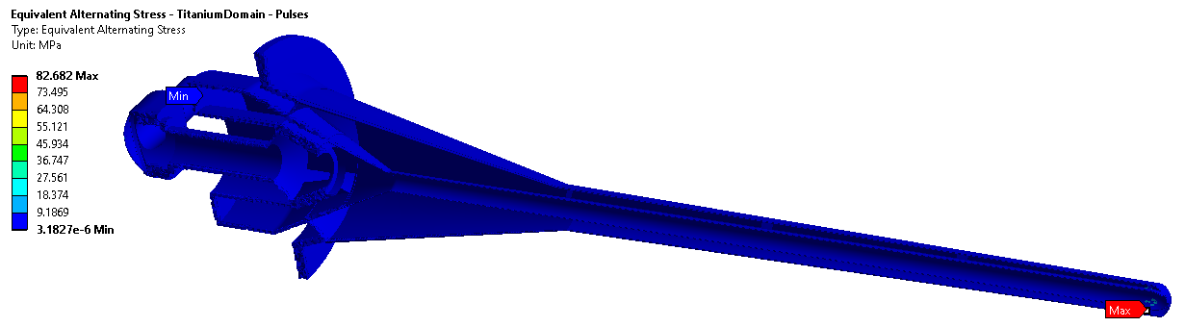
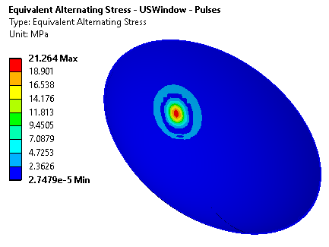
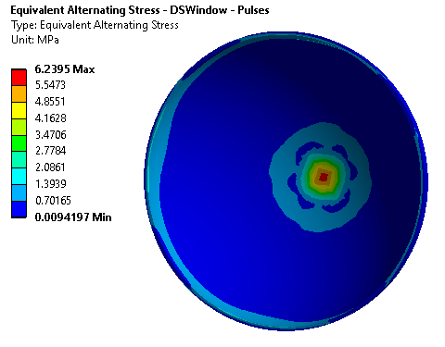
ASME BPVC Required Analyses
Plastic Collapse
  Stress categorisation and/or plasticity analysis
Buckling analysis
Fatigue
First buckling mode with no internal support structures
Goodman equivalent stress amplitude in vessel and windows

Slide 12
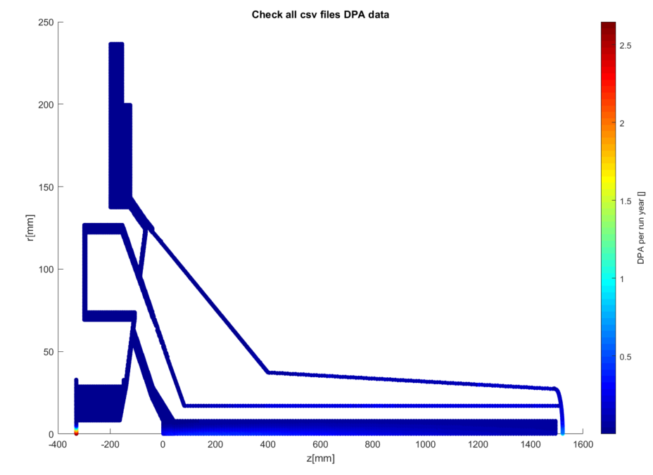
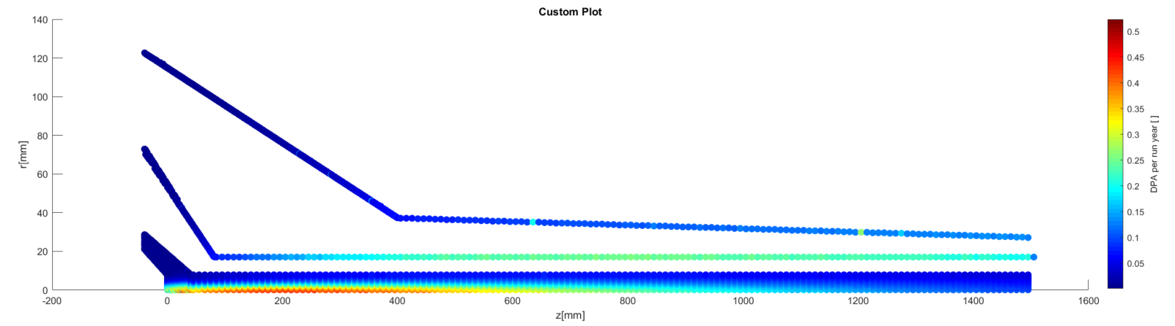
Radiation Dose with Nominal Beam, 1.2MW
DPA is highest in the windows (2.5/yr) and target (0.5/yr)
Peak DPA in any other component is 0.26/yr, in the flow divider tube
Some titanium irradiation data available for up to 0.24 DPA

Slide 13
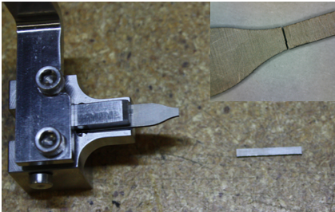
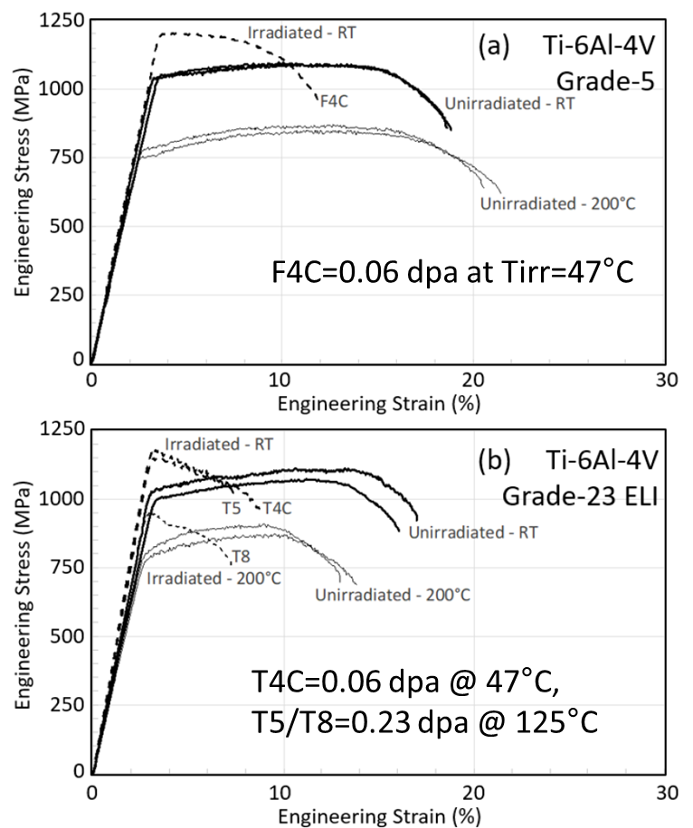
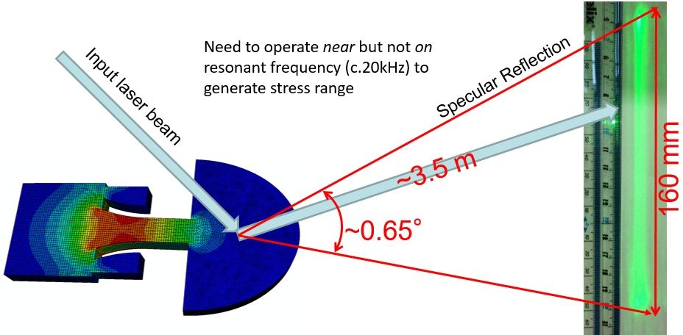
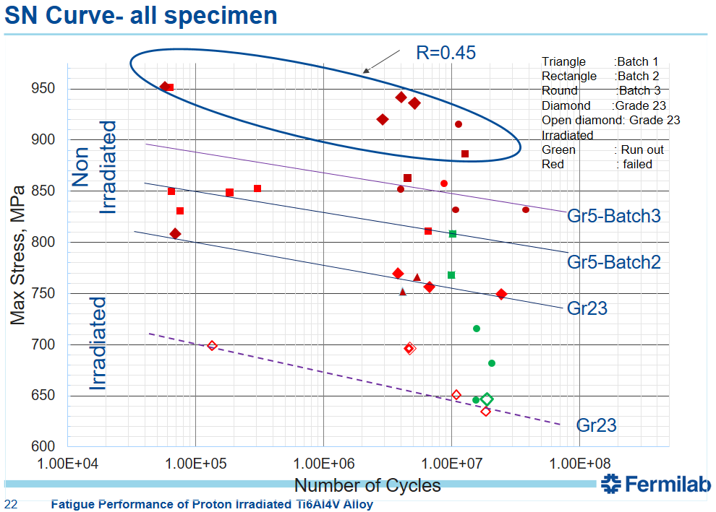
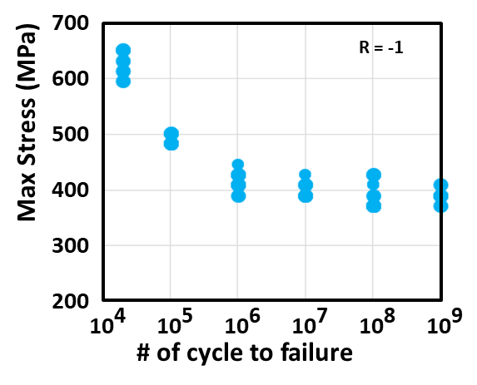
Irradiated Titanium Data Summary – Grades 5 and 23
Macro-scale Fatigue
Gr5/23
Meso-scale Fatigue
Gr23 A&STA, Gr2, 15-3Ti
Tensile Testing
Gr5/23, Gr9
Dose at neck region
0.06~0.24 DPA
Irradiation temp
50C~125C
Meso-scale S-N Curve of unirradiated Ti-6Al-4V
R=0.2-0.28
“Fatigue Performance of Proton Irradiated Ti6Al4V Alloy”, Sujit Bidhar, 6th RaDIATE Collaboration Meeting, Dec 10, 2019
V. Kuksenko, RaDIATE2017
“Tensile behavior of dual-phase titanium alloys under high-intensity proton beam exposure…”, T. Ishida et al., Journal of Nuclear Materials, 2020

Slide 14
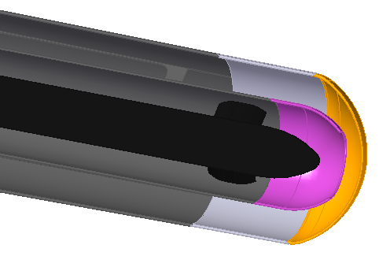
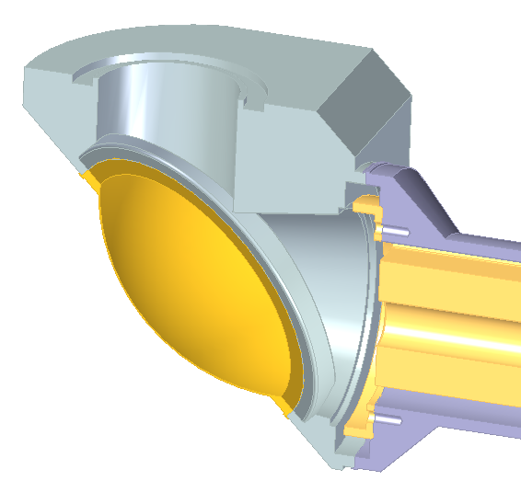
Radiation and Fatigue in Titanium
Windows have the highest radiation damage and fatigue of any Titanium component
Extrapolated Endurance Limit for >1E9 Cycles (MPa) | SE (MPa)
Titanium Grade 5 | 360
Derated for 150°C | 315
Derated for 150°C and 0.24DPA | 240
Upstream Window
t_{min} = 0.3mm
Dose = 2.5dpa/yr
T_{steady} = 115°C
T_{max} = 150°C peak
ΔT = 70°C/pulse
Δσ_{Eq} = 21MPa/pulse
Downstream Window
t_{min} = 0.4mm
Dose = 0.7dpa/yr
T_{steady} = 150°C
T_{max} = 175°C peak
ΔT = 55°C/pulse
Δσ_{Eq} = 6MPa/pulse
Expected number of beam pulse cycles = 1.5E7 per year

Slide 15
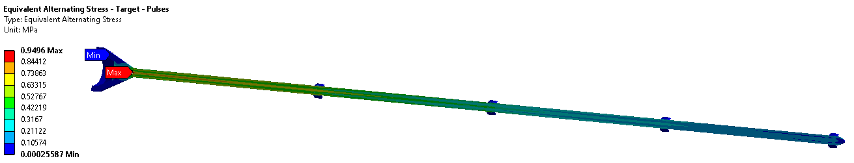
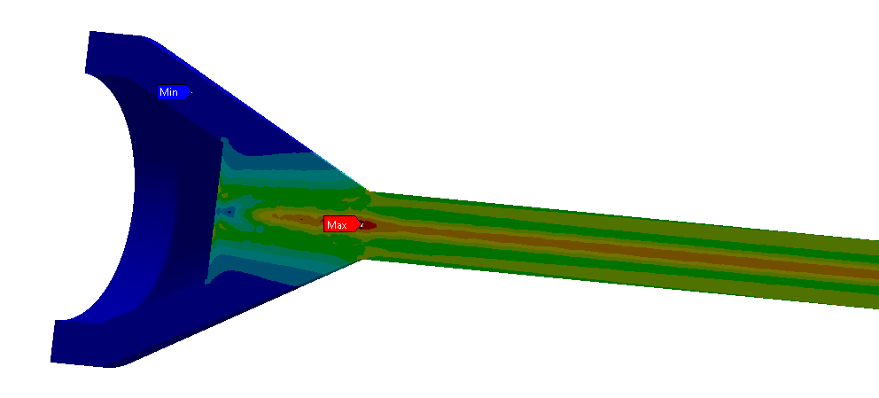
Radiation and Fatigue in Graphite
First two target segments have highest radiation damage and fatigue of any Graphite component
 | IG-43 Graphite
UTS at room temp (MPa) | 37
Estimated endurance limit (MPa) | 18.5
Equivalent stress amp. (MPa) | 0.95

Slide 16
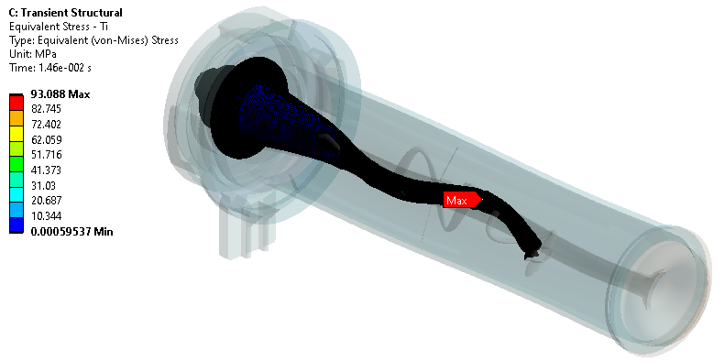
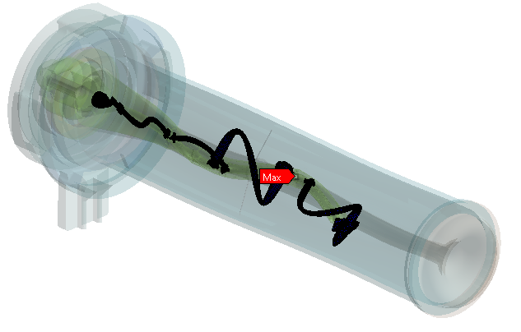
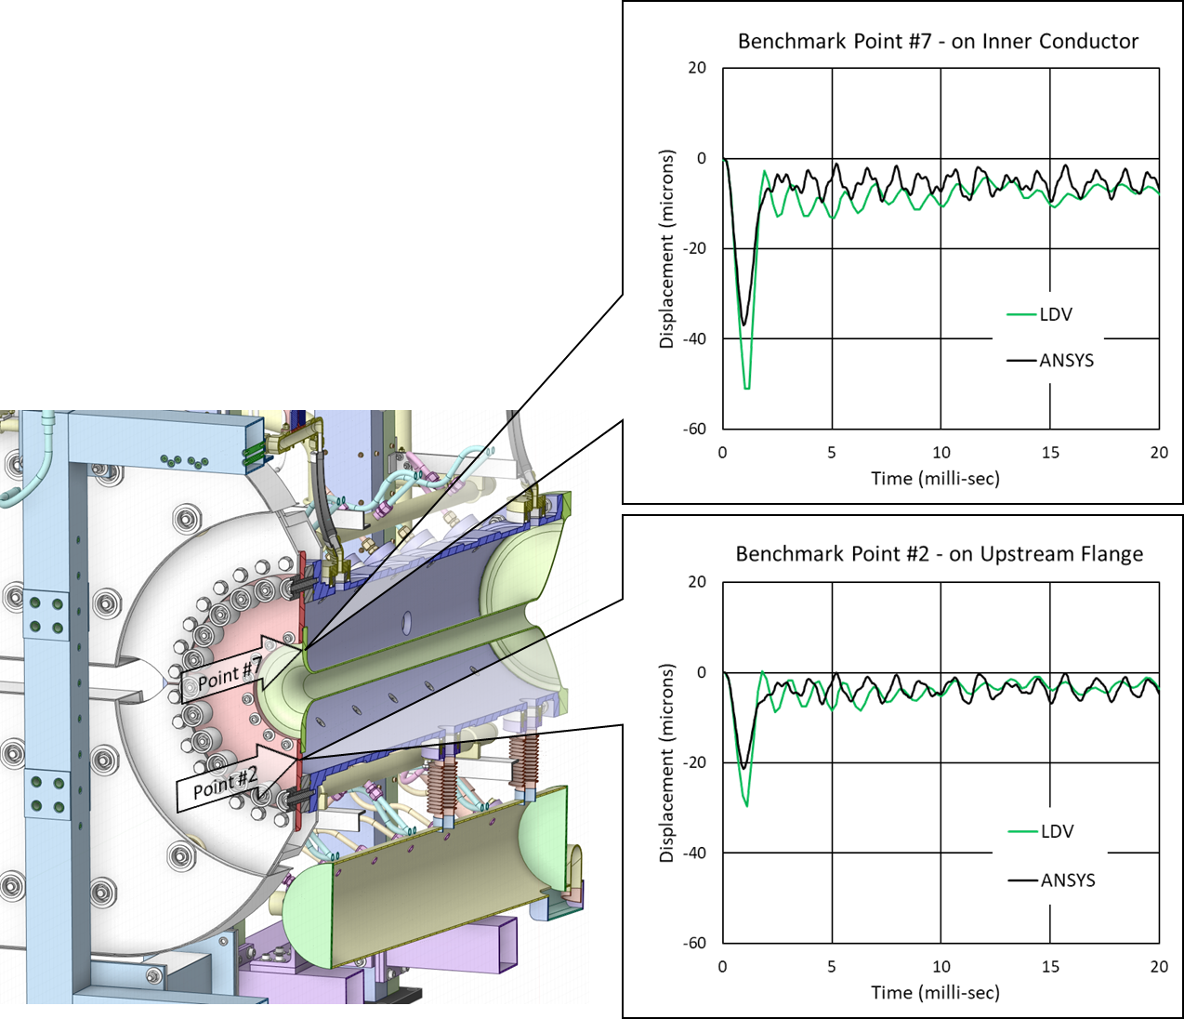
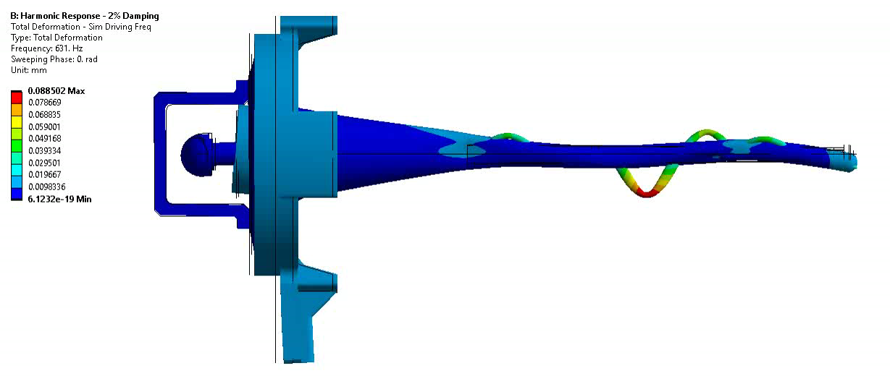
Horn-Induced Vibrations
Identified risk of vibrations from the magnetic horn being transmitted to the target
  Physical testing not possible for several years; must rely on simulation expertise
Combined simulation of horn and target:
Benchmark against T2K Horn measurements:
c/o T. Sekiguchi (KEK)
Axial vibrations transmitted
from horn to target mount
(Peak applied acceleration ≈20g)
*Deformation not to scale

Slide 17
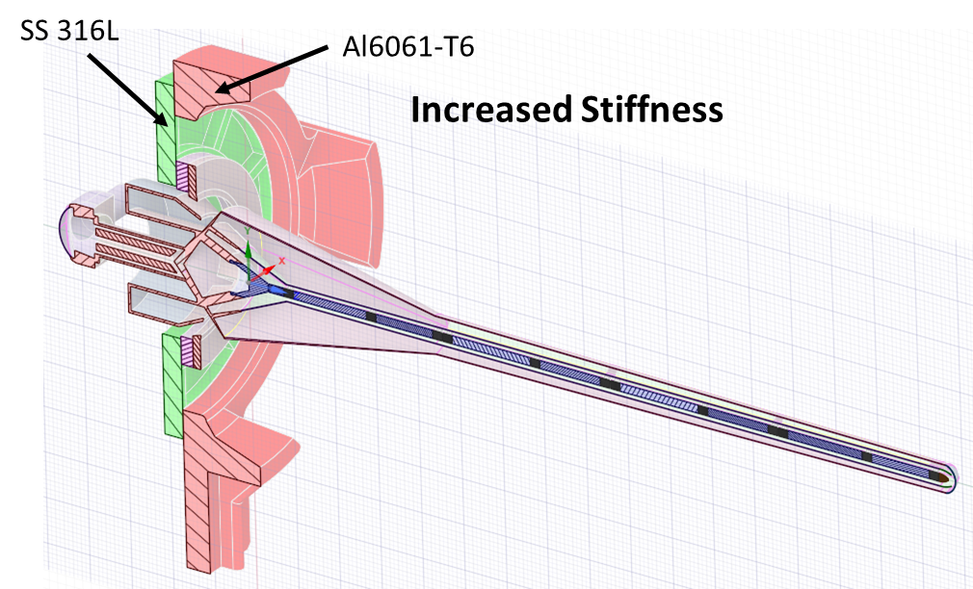
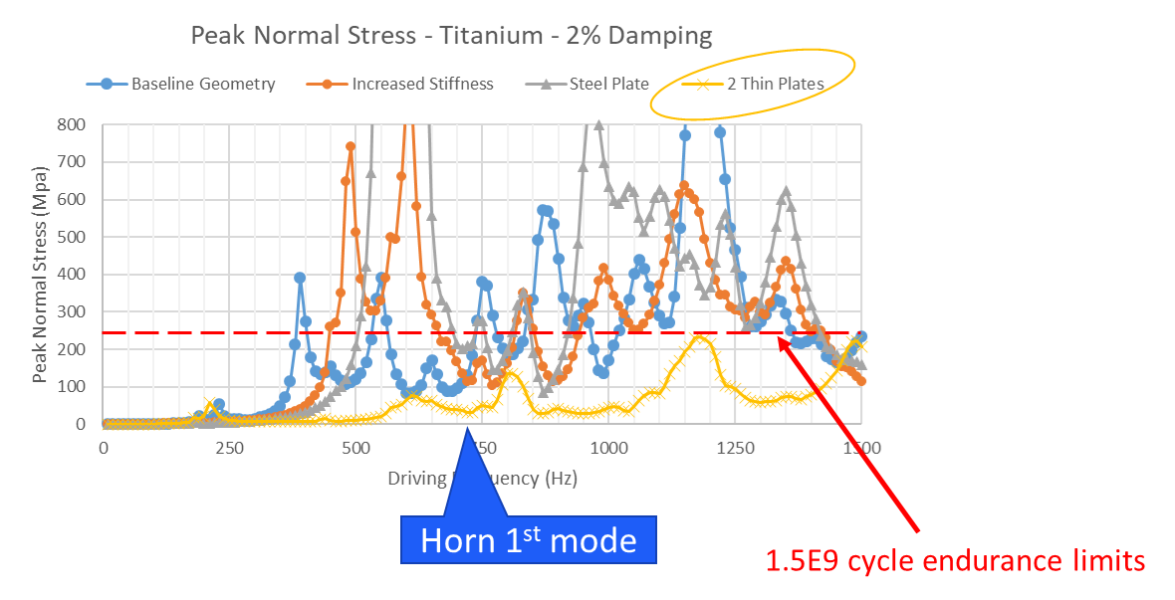
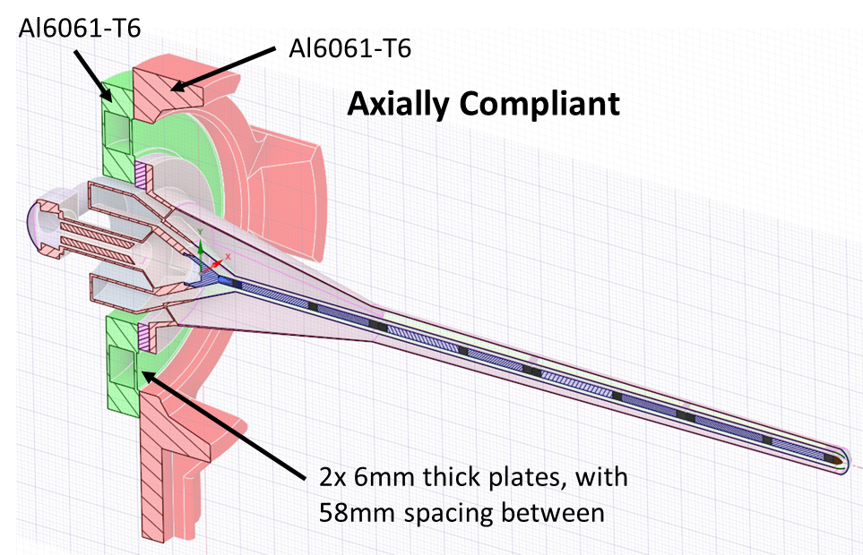
Horn-Induced Vibrations
Alternative geometries developed and tested in simulation
  Proposed solution works well over a broad frequency range, and is easy to modify if future testing does find issues

Slide 18
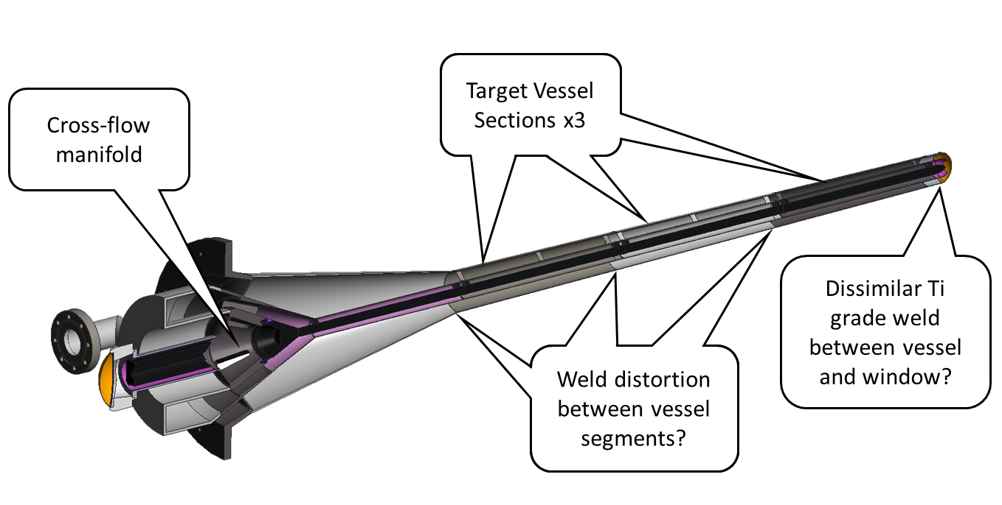
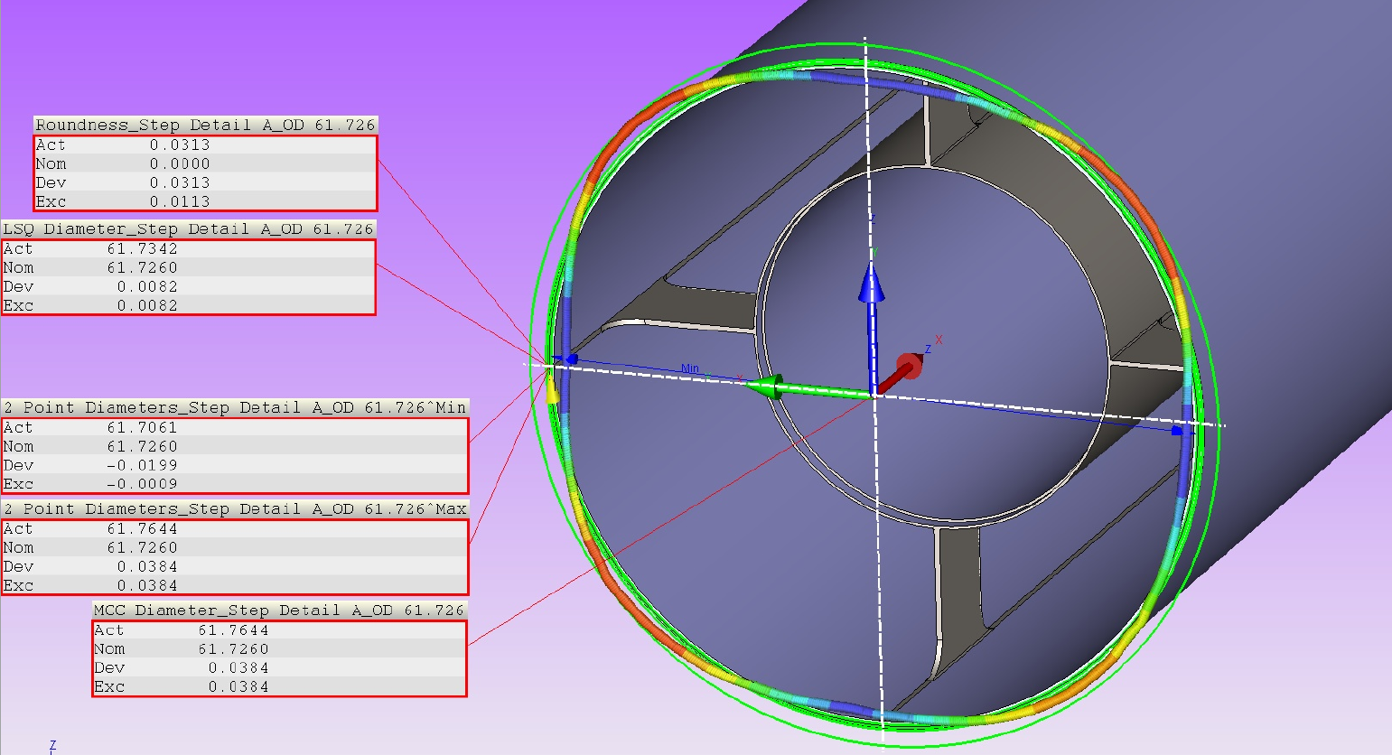
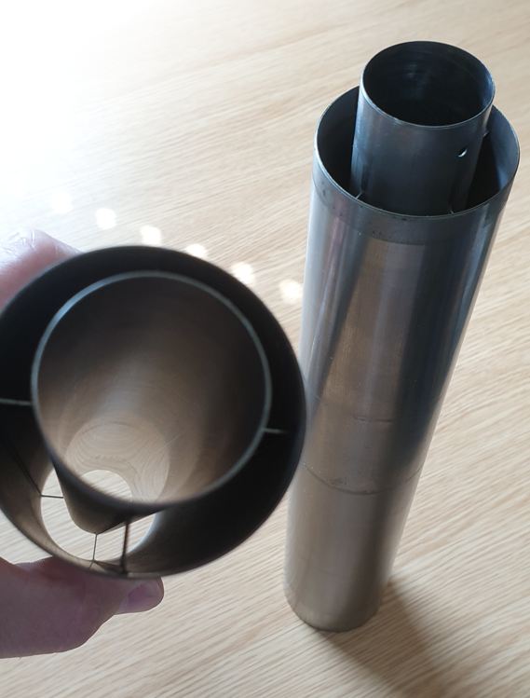
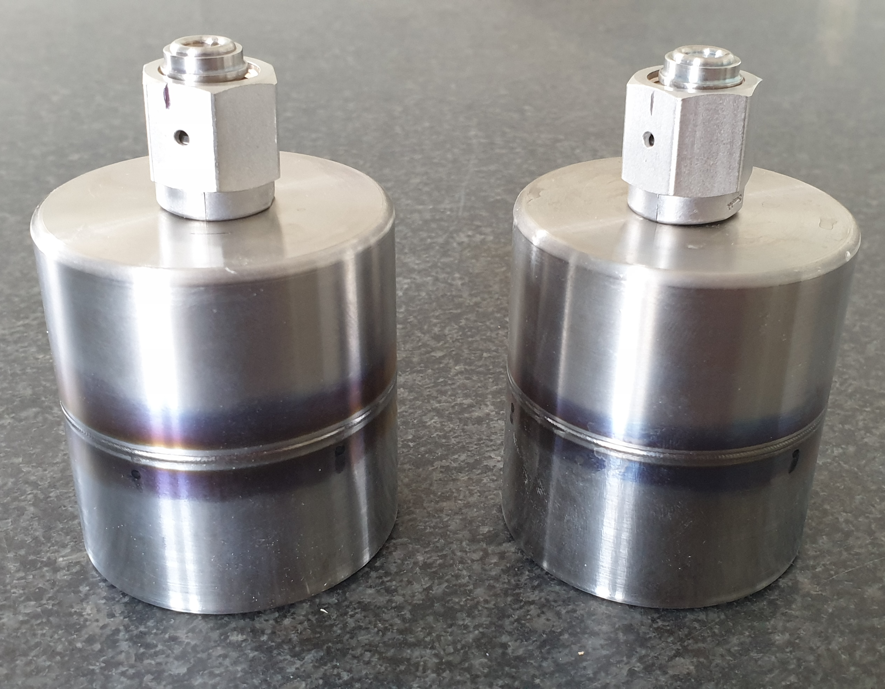



Feature Prototyping Highlights

Slide 19





Production challenges identified at PDR
Quotes received

Slide 20








Ongoing Prototyping Efforts
Full length target core segment prototype completed:
Target core mounting design development:

Slide 21























Target Weldment Order of Fabrication
TD-1268-643
Bafflette can
TD-1268-211
cross-flow
TD-1268-622
exhaust mf.
TD-1268-414
funnel
TD-1268-415
Cone
TD-1268-680
Vessel section A
TD-1268-681
Vessel section B
TD-1268-682
Vessel section C
TD-1268-586
DS flow guide
TD-1268-702
DS window
Weld 1
Weld 7
Weld 8
Weld 3
Weld 9
TD-1268-658-XX
US window
TD-1268-657
USW housing
Weld 4
Weld 10
Weld 2
Weld 5
Weld 6
Weld 11

Slide 22











Irradiated Material Collaborations
Titanium
Highest dose to beam windows:
Titanium irradiation at BLIP:
Future Ti irradiations also planned at Birmingham University
Graphite
Cracked graphite targets seen at NuMI-MINOS and other facilities:
- Active sample on its way to Bristol University
- Neutron diffraction experiment at ISIS (ENGIN-X) approved
Meso-fatigue specimens have been shipped to Culham MRF:
Fatigue test in hot cell, using a method developed at Oxford University*:
*See poster by Richard Cowan

Slide 23
Conclusions
Phase 1 (Design) complete and closed out. Phase 2 (Construction) fully funded
Design and analysis of prototype target completed, initial manufacturing now underway
Focus will now be on:
  Completing construction of working prototype target
  Irradiated material studies to inform design of future targets
  Refine design, then construct 1st production target

Slide 24




Slide 25
Backup Slides

Slide 26




Main Baffle Design
Prototype
core
segments
Graphite core segment stack

Slide 27


Baffle Protection Against Off-Axis Beams
FLUKA simulations by John Back of Warwick University
  Radial offset of 17.25mm to directly hit target flowguide
A direct hit through the main baffle produces less heating than the shower from the target during normal operation
Normal Operation
Off-Axis, Impinging on Flowguide
Case | Peak heat in flowguide | Delta T per Pulse
 | W/m^3 | C
Normal Operation | 5.54E+07 | 26.8
Off-Axis | 1.06E+07 | 5.1

Slide 28


Target Exchange System (TXS)
Rail system for remote exchange of targets in hot cell
Based on a similar system successfully deployed at T2K

Slide 29



TXS Testing at RAL
“Red plate”
Very accurate alignment required to avoid damage to target or horn
Mock-up to test procedures and alignment mechanism built at RAL
“Green plate”
Dummy target mass
Compliance mechanism
Insertion rail

Slide 30




Helium Plant Deliverables
v
  1x Positive Displacement Blower
  1x back-up blower (Working Allowance scope opportunity)
  1x Target RAW Cooler
  1x Compressor Pre-cooler
  1x Compressor After-cooler
  1x remote operable gas purity monitoring system
Custom machine:
identified two potential
European Suppliers
e.g. Kelvion:
Welded Plate and Frame
Heat exchanger
e.g. Hiden:
HPR-20 benchtop
mass spectrometer
x 1(/2)
x 3
x 1

